Slide 1
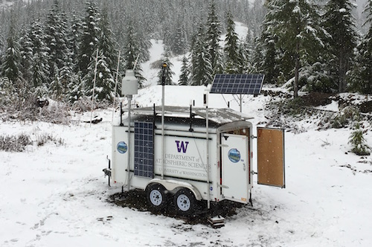
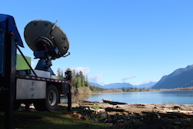
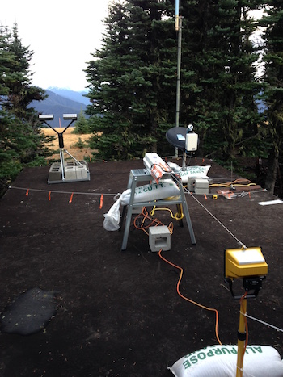
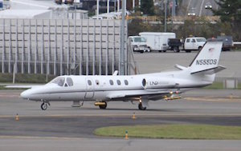
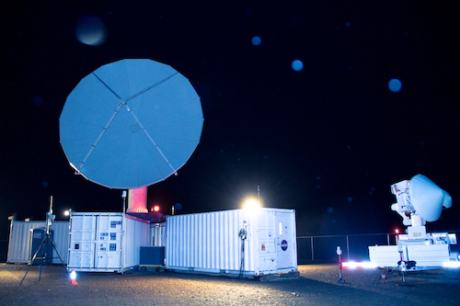

OLYMPEX breakout session
6:00pm Tuesday Evening, 25 Oct 2016
Lynn McMurdie, Walt Petersen, Bob Houze
Joe Zagrodnik, Jessica Lundquist, Ryan Currier, Tom Schuldt, Ali Tokay
PMM Houston, Breakout Session, 25 October 2016

Slide 2
OLYMPEX breakout session
Schedule:
Lynn – What we observed, ground instrument status
Angela – Radar Status
Stacy – NPOL
Bob – aircraft status (with Jay, Simone, Joe)
Walt – Plans for March 2017 Workshop

Slide 3
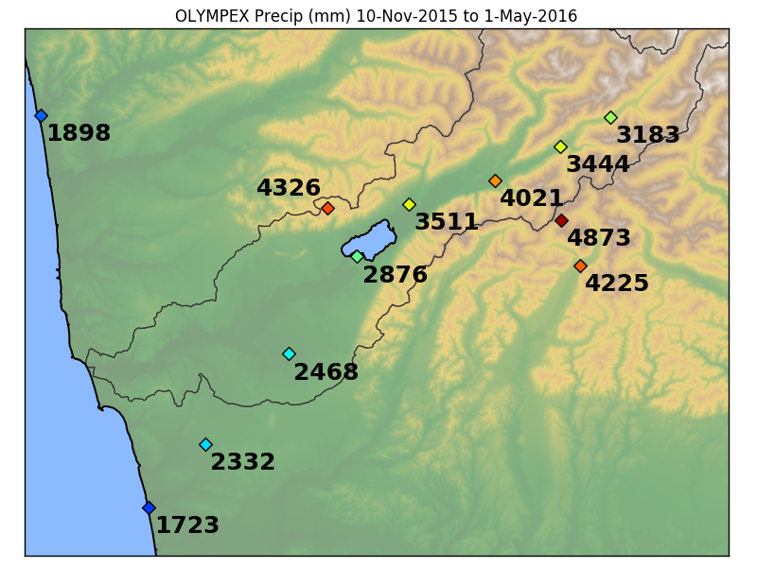
What we observed – A lot of Precipitation during ground network deployment

Slide 4
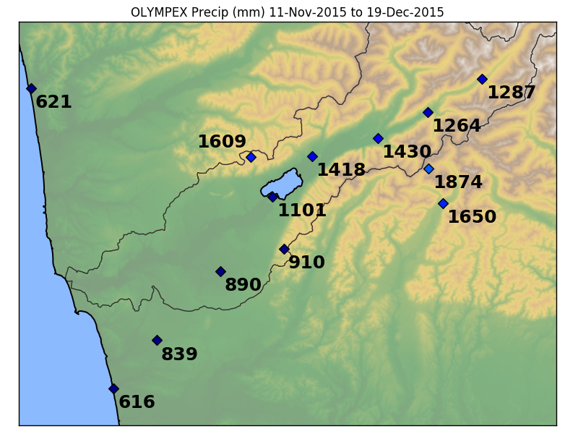
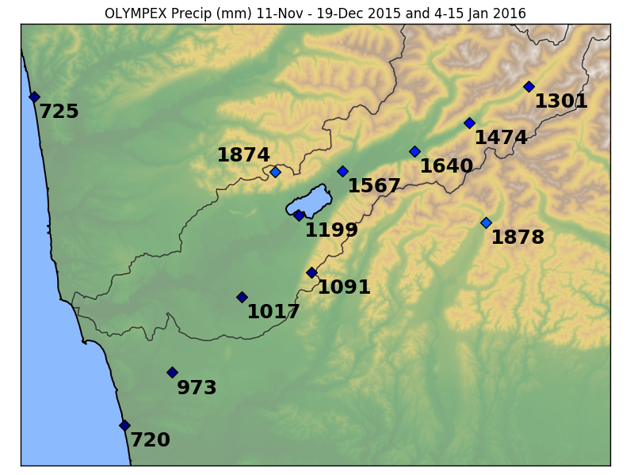
What we observed – A lot of Precipitation during radar and aircraft deployment
During aircraft deployment: 30/38 days measured precipitation
During radar deployment: 36/50 days measured precipitation

Slide 5
Variety of storm systems

Slide 6
OLYMPEX Scorecard
Dates | Synopsis | Flights | Sector
Nov 12 | Very warm AR storm. GPM | DC-8, UND | Prefrontal, warm
Nov 13 | Same storm, NCFR | DC-8, UND | Warm, cold front
Nov 14 | Frontal wave, Chehalis, GPM | DC-8, UND | Warm, frontal wave
Nov 18 | Weak postfrontal, midclouds | DC-8, ER-2, UND | Post-, pre-frontal
Nov 23 | Weak CF, low melting level | DC-8, ER-2, UND | Prefrontal, frontal
Nov 24 | Postfrontal, cold air outbreak | DC-8, ER-2, UND | Post-front, orographic
Nov 25 | Calibration | DC-8 | Clear air
Dec 1 | Weak storm, strat., orographic | DC-8, ER-2, UND | Prefront, warm, waves
Dec 3 | Complex storm, oro. GPM | DC-8, ER-2, UND | Prefront, warm, waves
Dec 4 | Postfrontal | DC-8, ER-2-UND | Postfrontal
Dec 5 | Warm advection, prefrontal | DC-8, ER-2, UND | Prefrontal, warm
Dec 8 | Warm AR storm, flooding, GPM | DC-8, ER-2 | Prefront, warm, waves

Slide 7
OLYMPEX Scorecard cont.
Dates | Synopsis | Flights | Sector
Dec 10 | Occluded front, postfrontal | DC-8, ER-2, UND | Postfrontal
Dec 12 | Occluded front, warm sector | DC-8, ER-2, UND | Occluded front, warm
Dec 13 | Postfrontal showers | DC-8,ER-2, UND | Postfrontal
Dec 18 | Complex storm, Chehalis flood | DC-8, UND | Pre-frontal, frontal
Dec 19 | Postfrontal, GPM | DC-8, UND | Postfrontal
Summary
About 12 different synoptic systems sampled
Prefrontal and warm sector flights = 8
Frontal passages = 2, waves = 4
Postfrontal flights = 6
Much more of everything sampled by radar and ground network

Slide 8
Ground Instrument Status
Rain Gauges
  Dual tipping buckets (Iowa Gauges)(9 Quinault, 10 Chehalis), Single tipping gauges (5 Quinault, 2 Hurricane)
  Pluvios (3)
  UW network (5)
Disdrometers
  Parsivel (14)
  2DVD (4)
MRRs (4)
Snow Camera (~14 sites)
  Camera data
  Snow survey data
  ASO lidar flight

Slide 9
Raingauges
Raingauge data uploaded to DAAC (see later slide)
Rainmaps- Daily precip totals 00 Z – 00 Z
  full domain completed
  Quinault zoomed in region – in progress
To get rainmaps, go to: http://olympex.atmos.washington.edu/

Slide 10
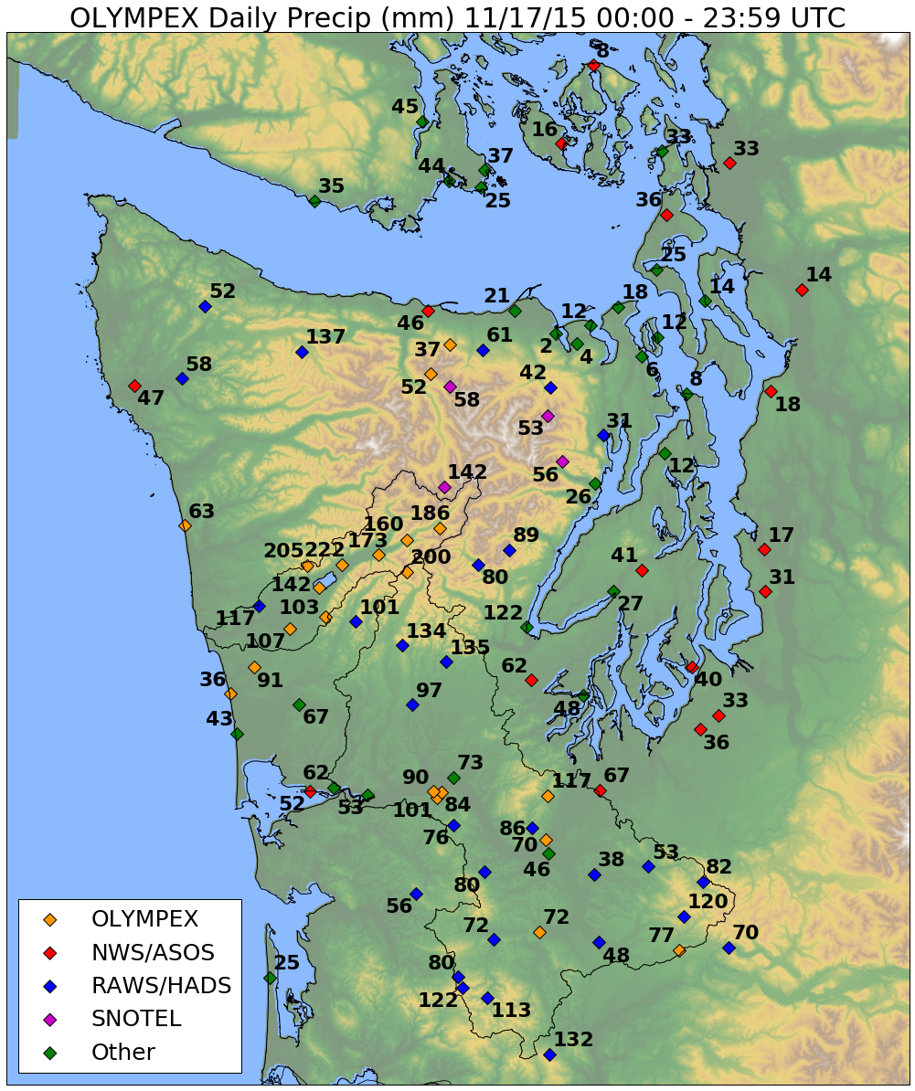
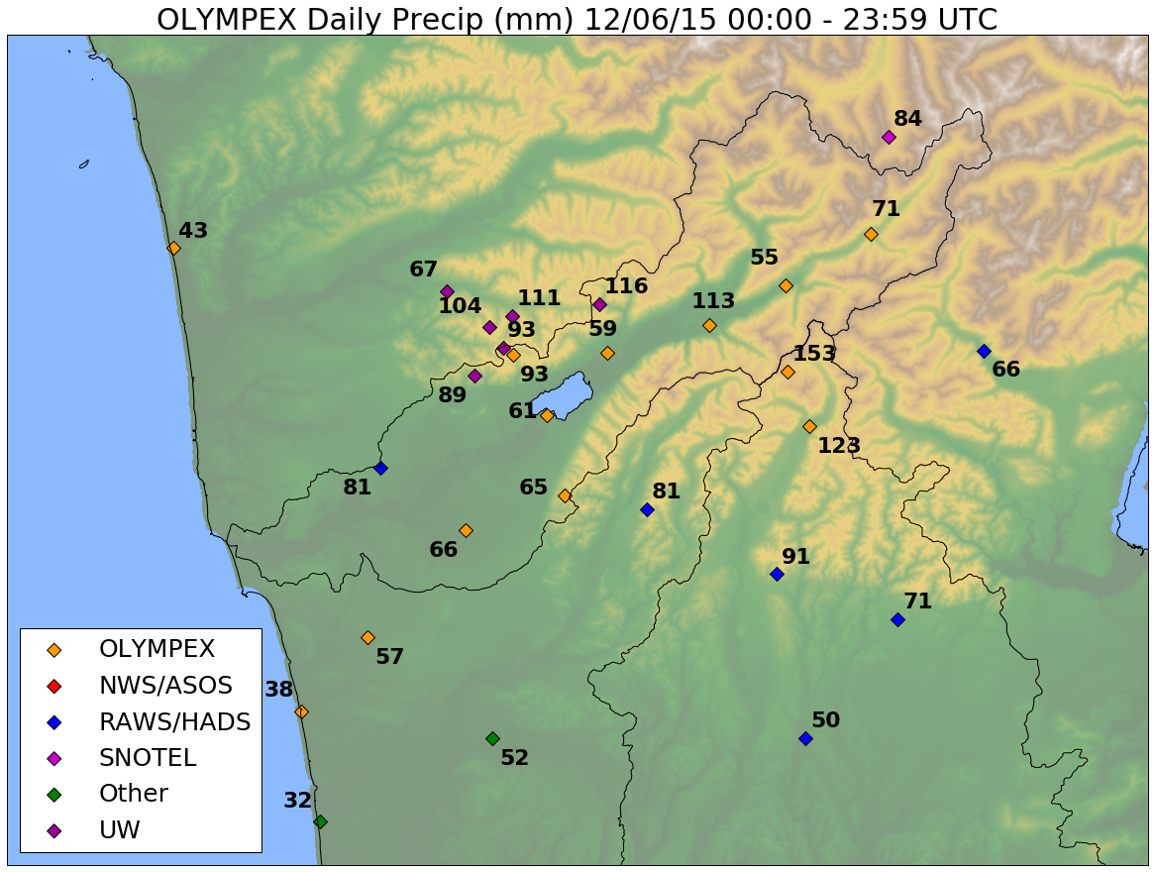
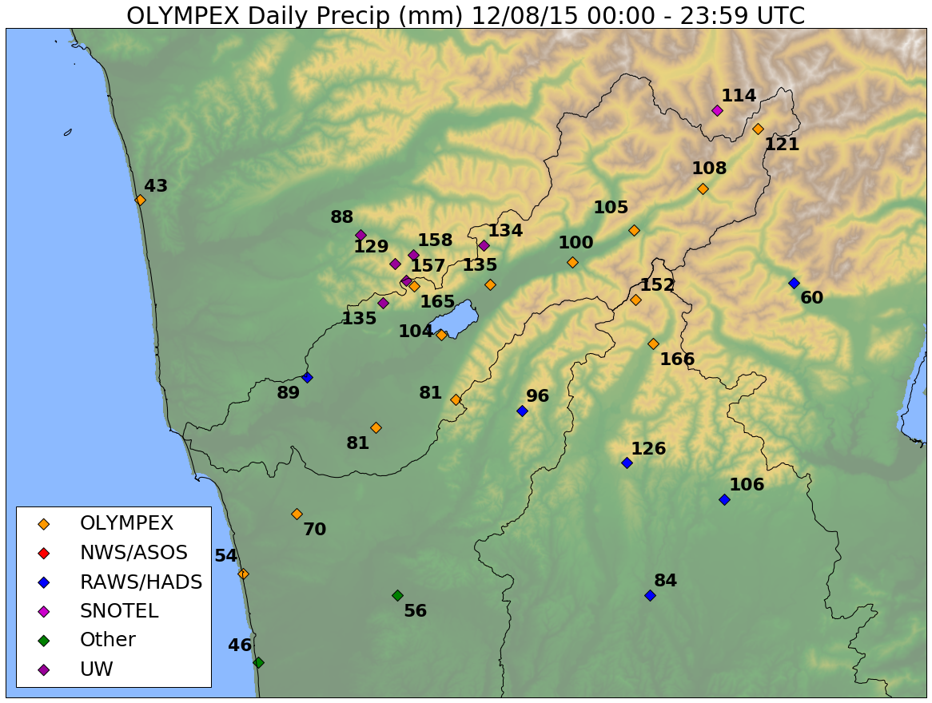
Example Rainmaps
QC’d available now, entire Peninsula + western WA
Available soon, Quinault, UW gauges

Slide 11
Ground Network Status
Have spread sheet of timeline of instrument status for every disdrometer, Pluvio, rain gauge and MRR
Available online at: http://olympex.atmos.washington.edu/
Almost complete
Need to add UW gauges
Check date

Slide 12
Screen grab of spreadsheet
Time →

Slide 13
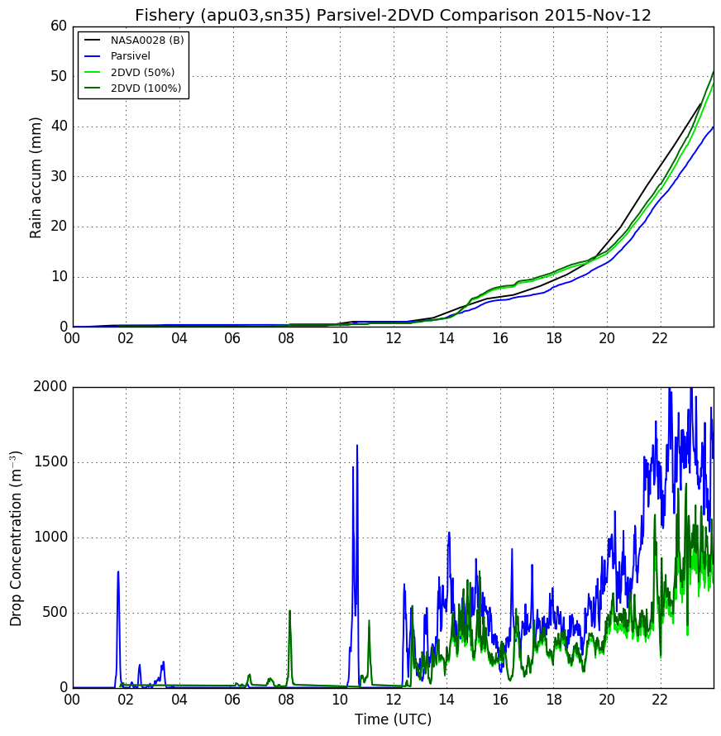
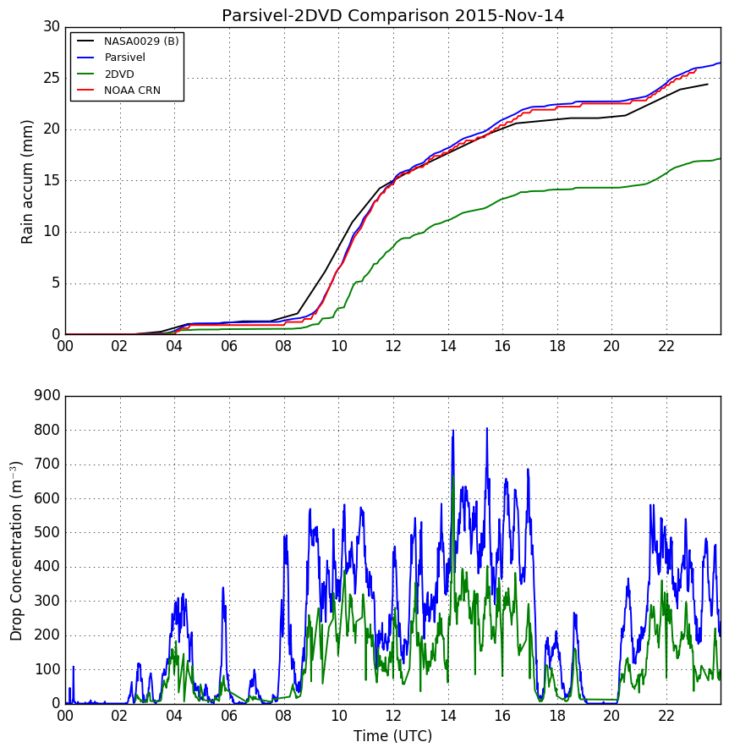
2DVD vs Parsivel Disdrometers
Concern that 2DVD had trouble keeping up with high drop density that occurs frequently on the Peninsula

Slide 14
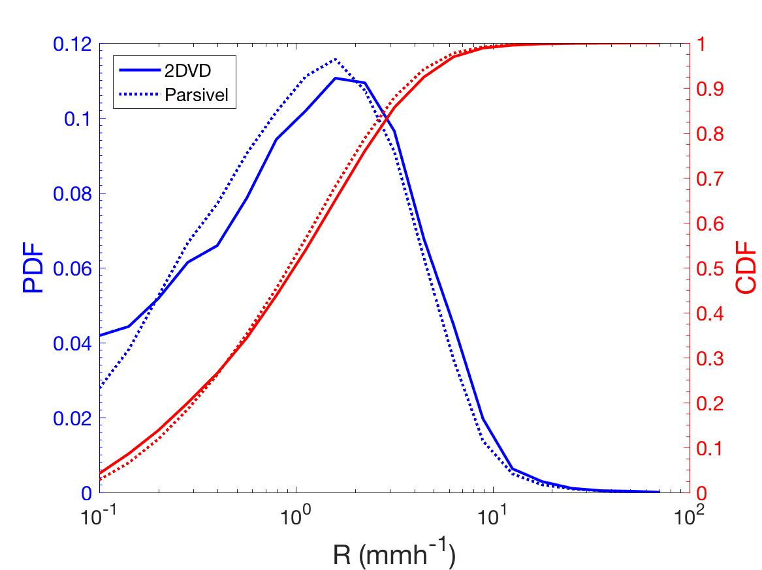
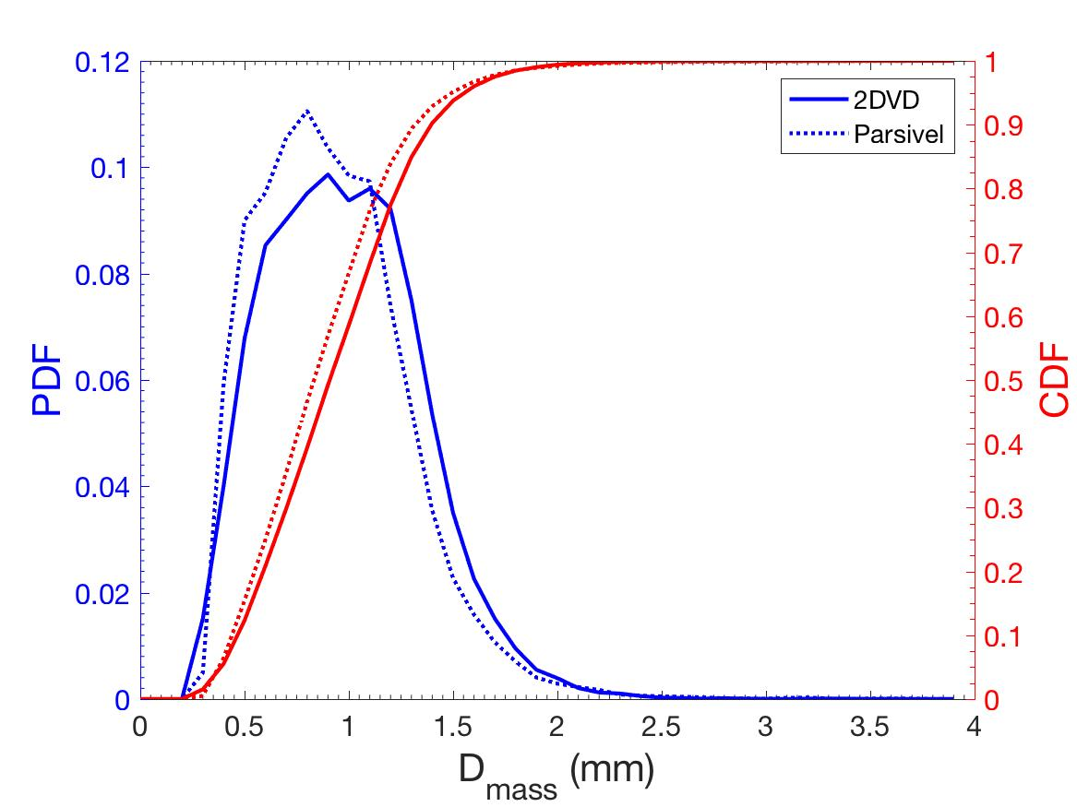
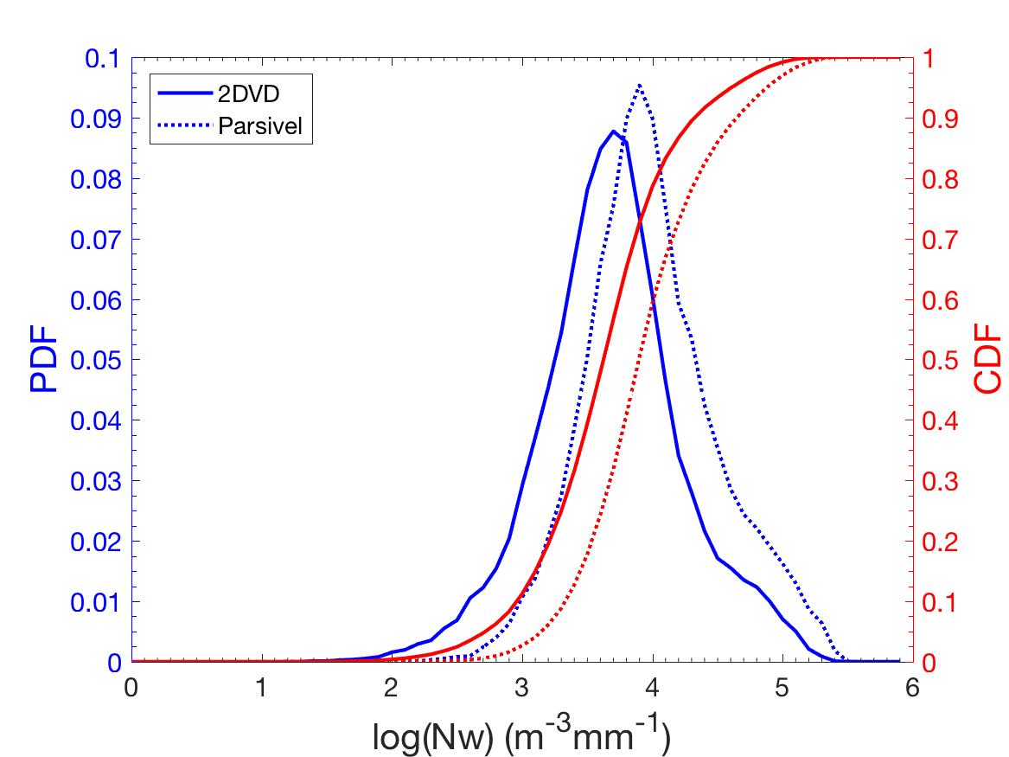
Probability and Cumulative Distributions - OLYMPEX
(2DVD vs Parsivel²)
 | R (mmh⁻¹) |  | D_{mass} (mm) |  | Nw (m⁻³mm⁻¹)
 | Mean | Median | Mean | Median | Mean | Median
2DVD | 2.01 | 1.03 | 1.03 | 1.01 | 12008.9 | 5326.2
APU | 2.10 | 1.25 | 0.97 | 0.93 | 22416.1 | 9891.2

Slide 15
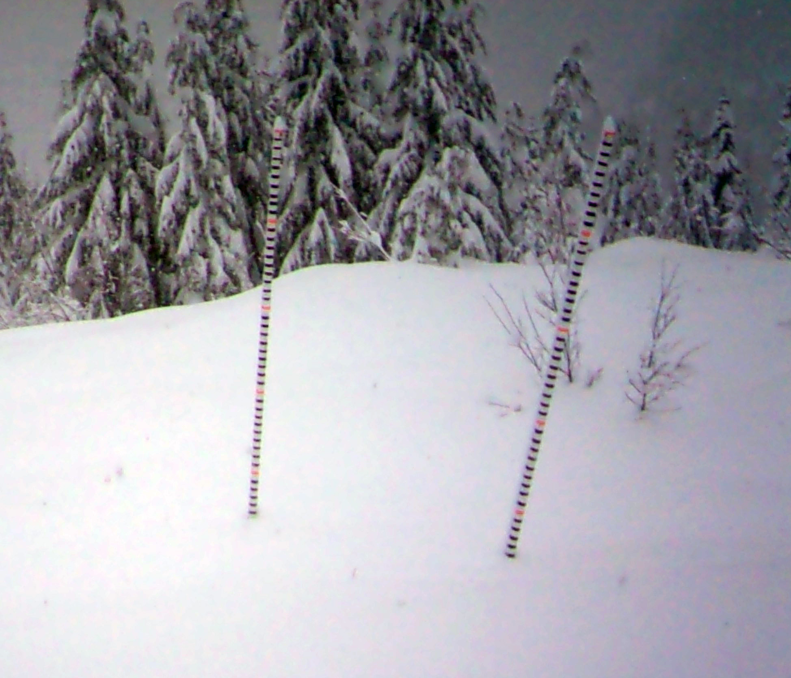
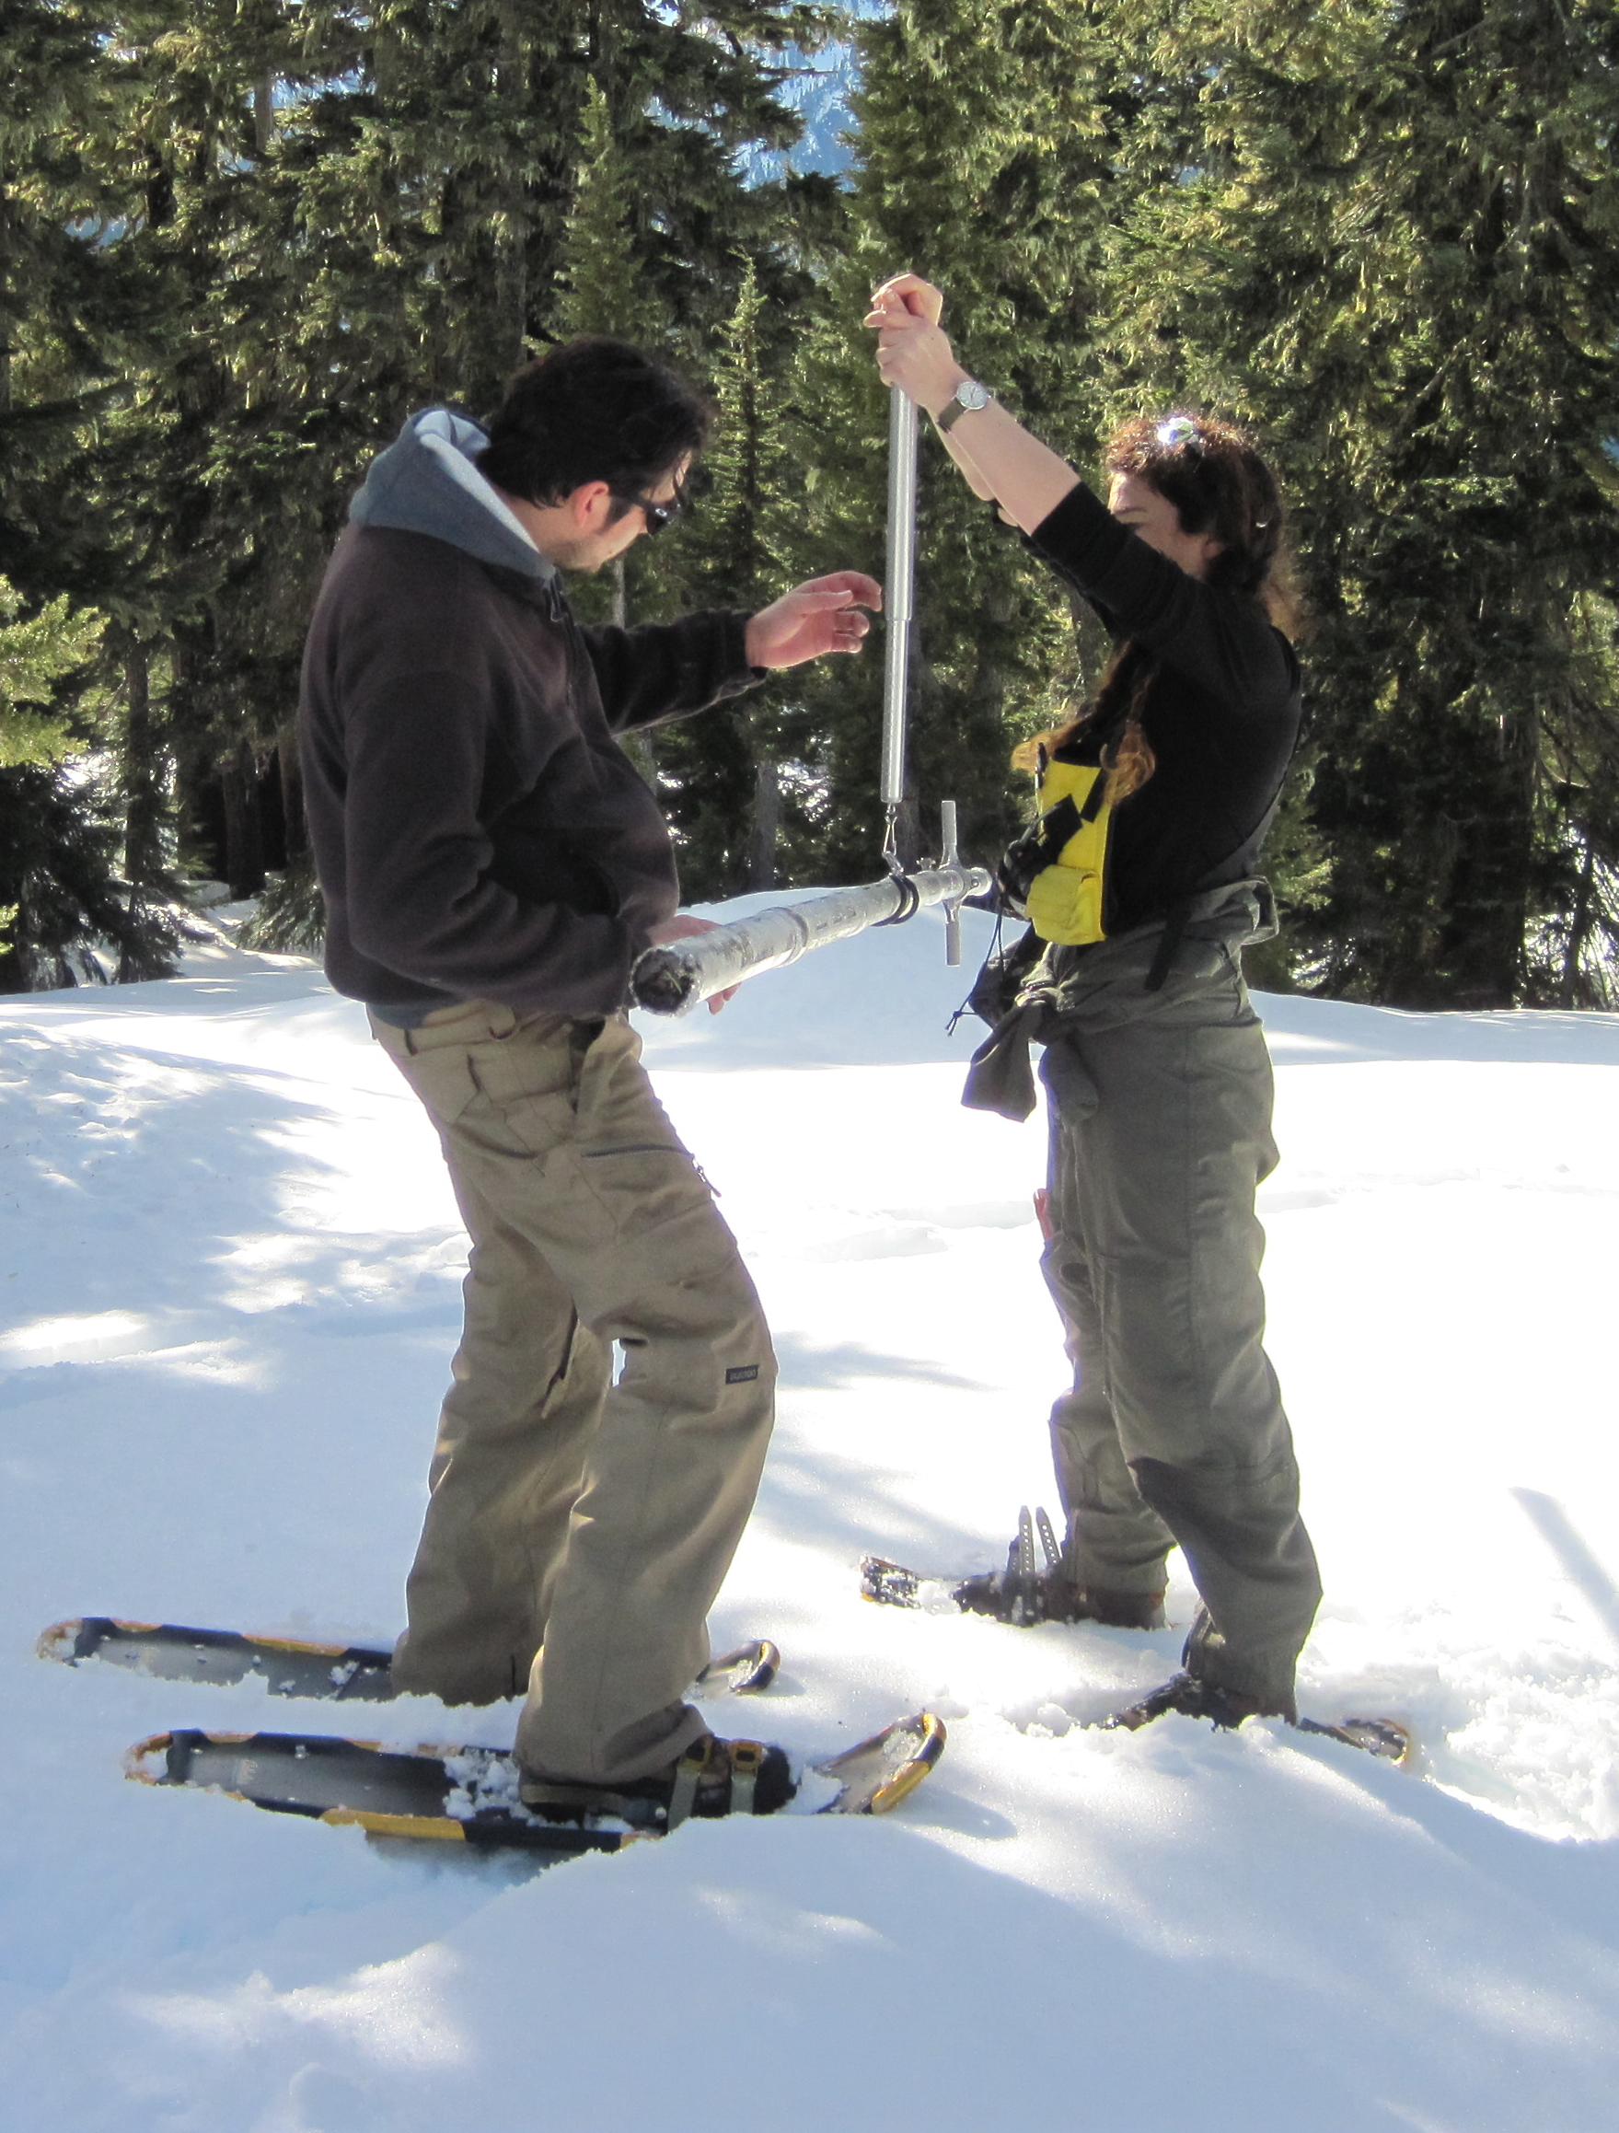
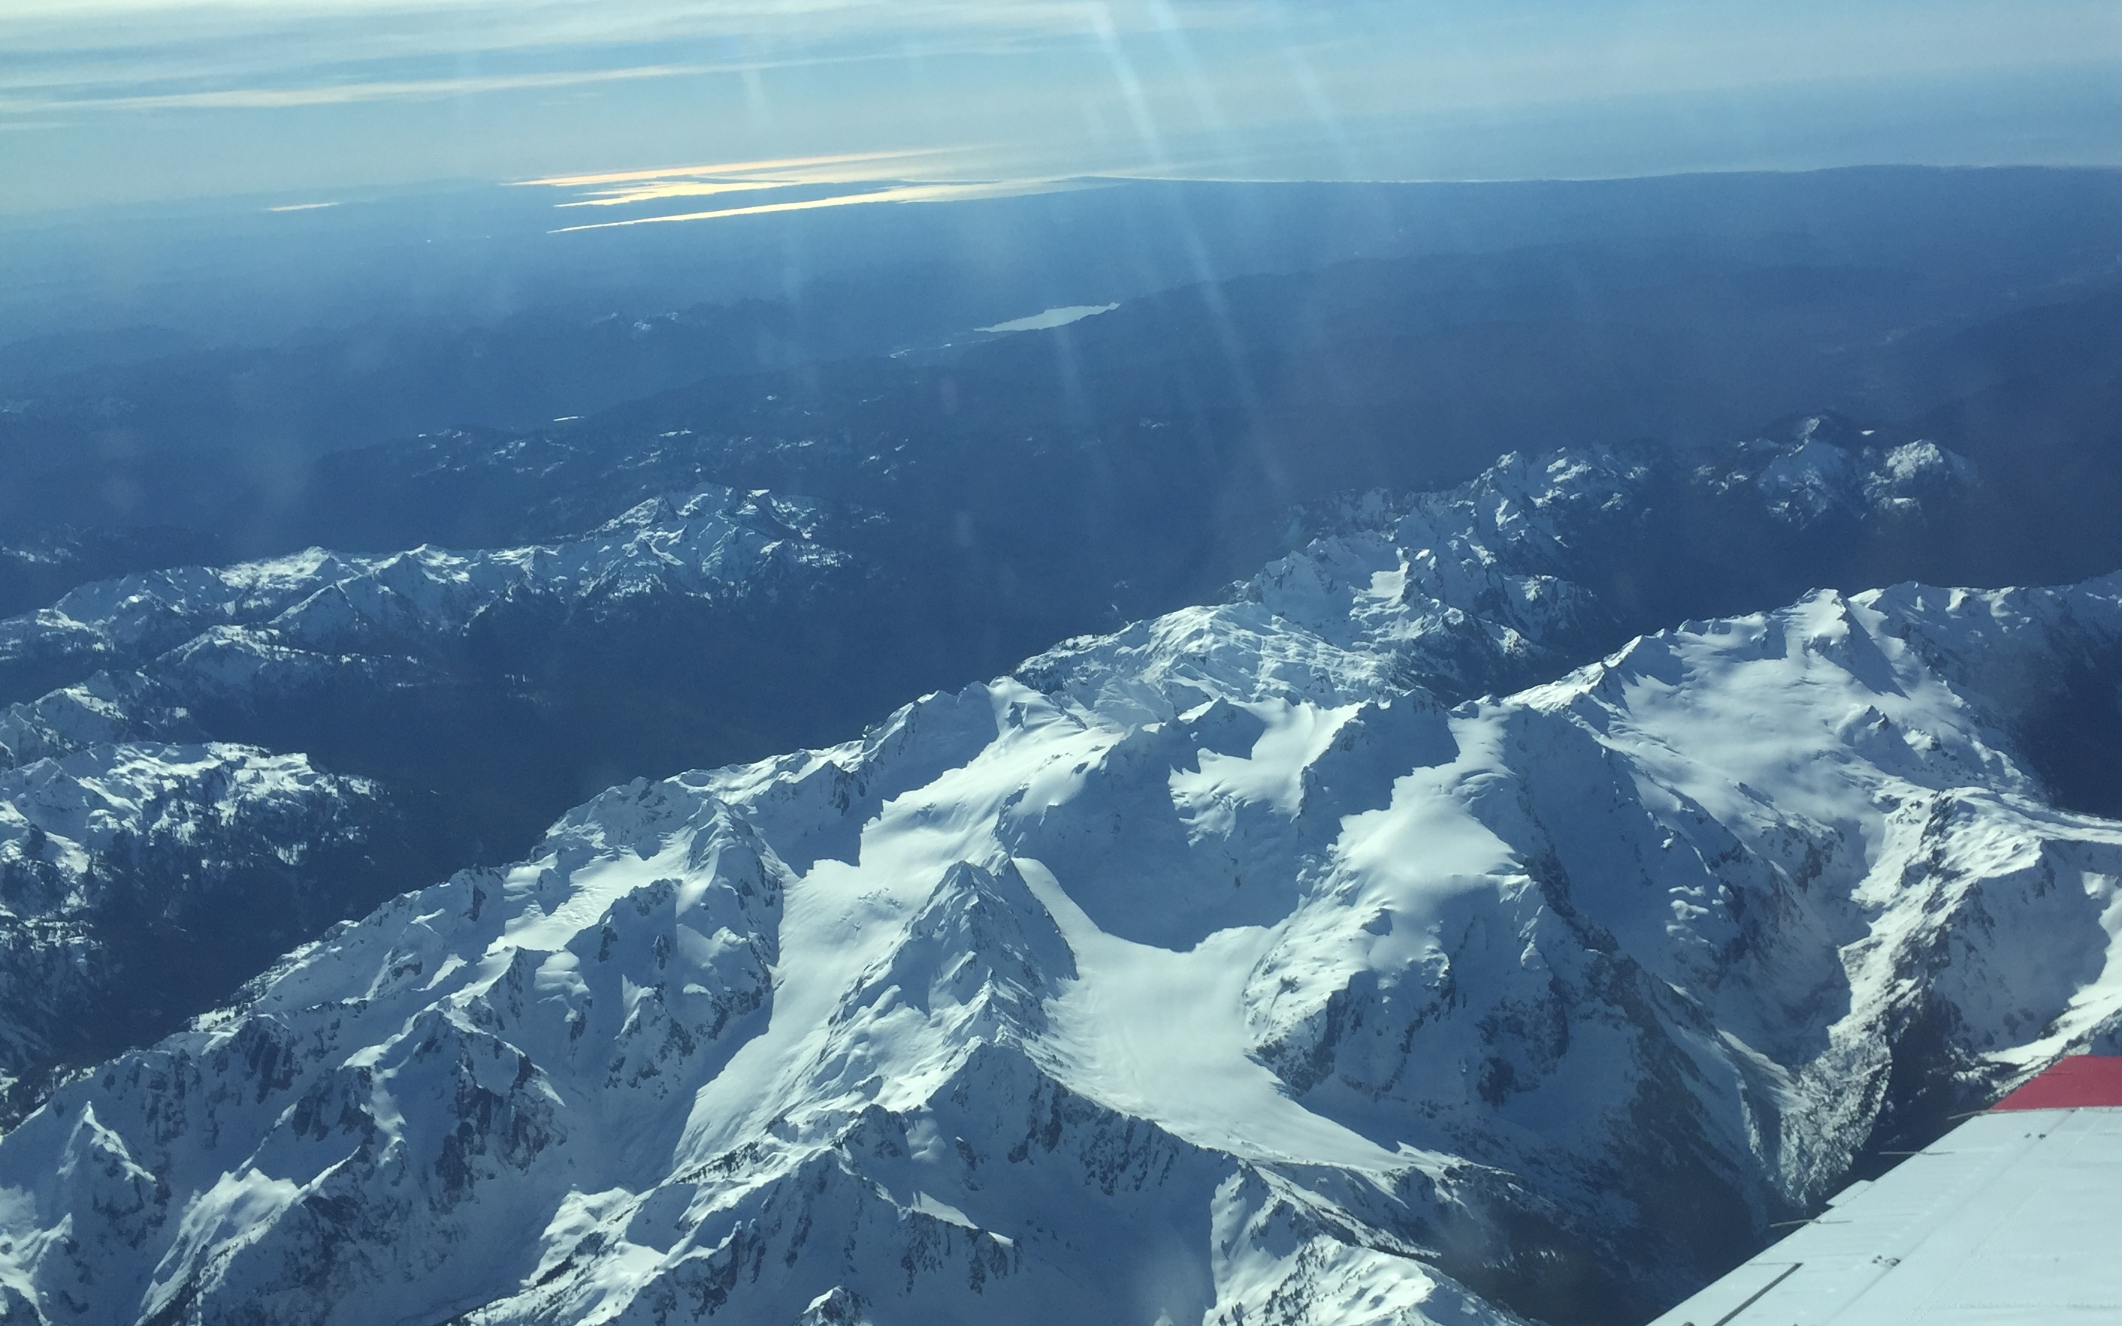
Snowpack Analysis Status
Snow Cameras
  ~14 sites with multiple cameras and poles
  Problems with snow creep, snow loading, etc. bending the poles
Lidar Flights and Snowpack Surveys
  Early February (mid snowpack) and Late March (peak snowpack)
  Measured snowdepth (remotely, Lidar, directly, surveys) and density

Slide 16
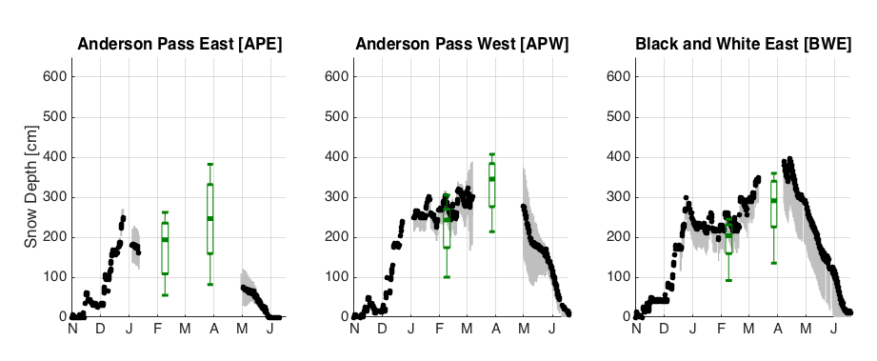
Snowpack Analysis Status
Examples of comparison of snow cameras to Lidar snow depth
  Black – camera estimates
  Gray – uncertainty due to bent poles, etc
  Green – Lidar estimates

Slide 17
OLYMPEX data status DAAC
Radar | Ground | Aircraft | Soundings
NPOL | 2DVD | DC-8 CoSMIR | NPOL
D3R | APU | DC-8 APR-3 | EC UVictoria
DOW | NASA Gauge - Dual | AVAPS - soundings | NWS – KUIL, KSLE, CYZT
EC-XBand | NASA Gauge - Single | MASC
 | UW Gauges (in progress) | ER-2 AMPR
 | MRR | ER-2 CPL
 | Snow Camera (in progress) | ER-2 other
 |  | UND-microphysics
 |  | ASO
GHRC Portal - https://fcportal.nsstc.nasa.gov/olympex/home 15 datasets available
Green – available, Yellow - Pending

Slide 18
ER-2 instruments
eMAS
CPL
AMPR
HIWRAP
CRS
EXRAD
AirMSPI

Slide 19
OLYMPEX DATA WORKSHOP
When: March 21-23, 2017 (Tues-Thu)
Where: UW Activities Center (same location as planning meetings)
Probable attendance ~40-50, good range of instrument PI’s and science expertise
Organizing Committee
  Suggestion: Lynn, Bob, Walt, Simone

Slide 20
  STRAWMAN WORKSHOP AGENDA TOPICS
Basic status (brief presentations on status and preliminary science) of
  A/C
  Radar
  Ground data and sounding
  Modeling
Identification of continued directions
  Relation to GPM needs-
    Case priorities
    Statistical studies
    Propose/develop new integrated datasets
  Fundamental understanding studies
  Common software needs
  Necessary and useful collaborations

