Slide 1
Citation Data on 5 December 2015 in OLYMPEX
Robert A. Houze, Jr. Megan Chaplin
Andrea Neumann
Mike Poellot
PMM Science Team Meeting, Houston, 25 October 2016
Supported by NASA grants NNX16AD75G, NNX15AL38

Slide 2
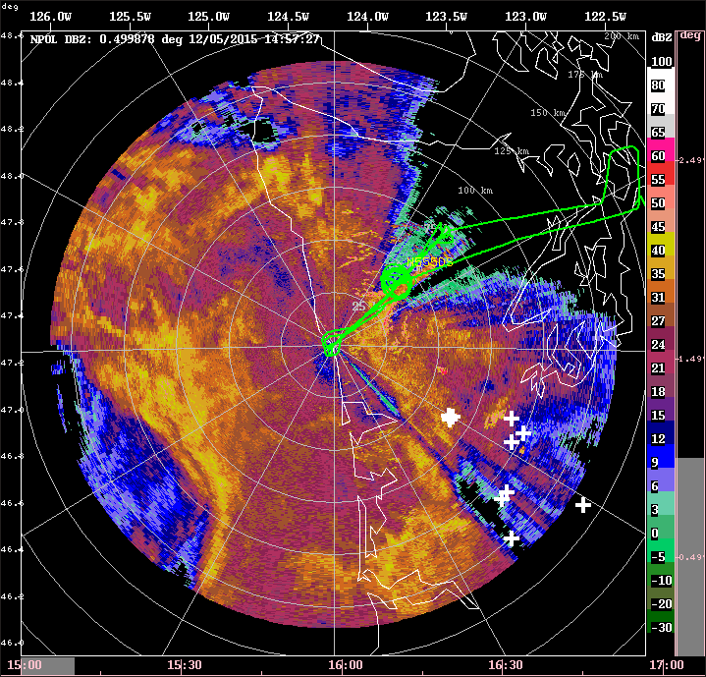
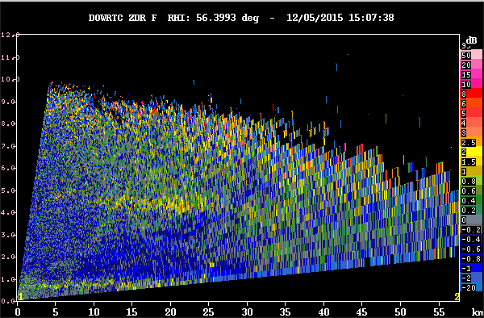
05 December 2015
Secondary maximum at 4.5 km
Differential reflectivity looking up valley from DOW (56°), at 15:07 UTC
Citation track (green) over NPOL reflectivity (dBZ) at 1500 UTC

Slide 3
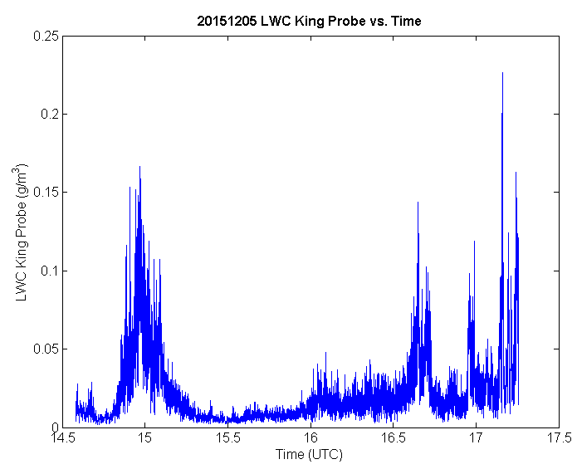
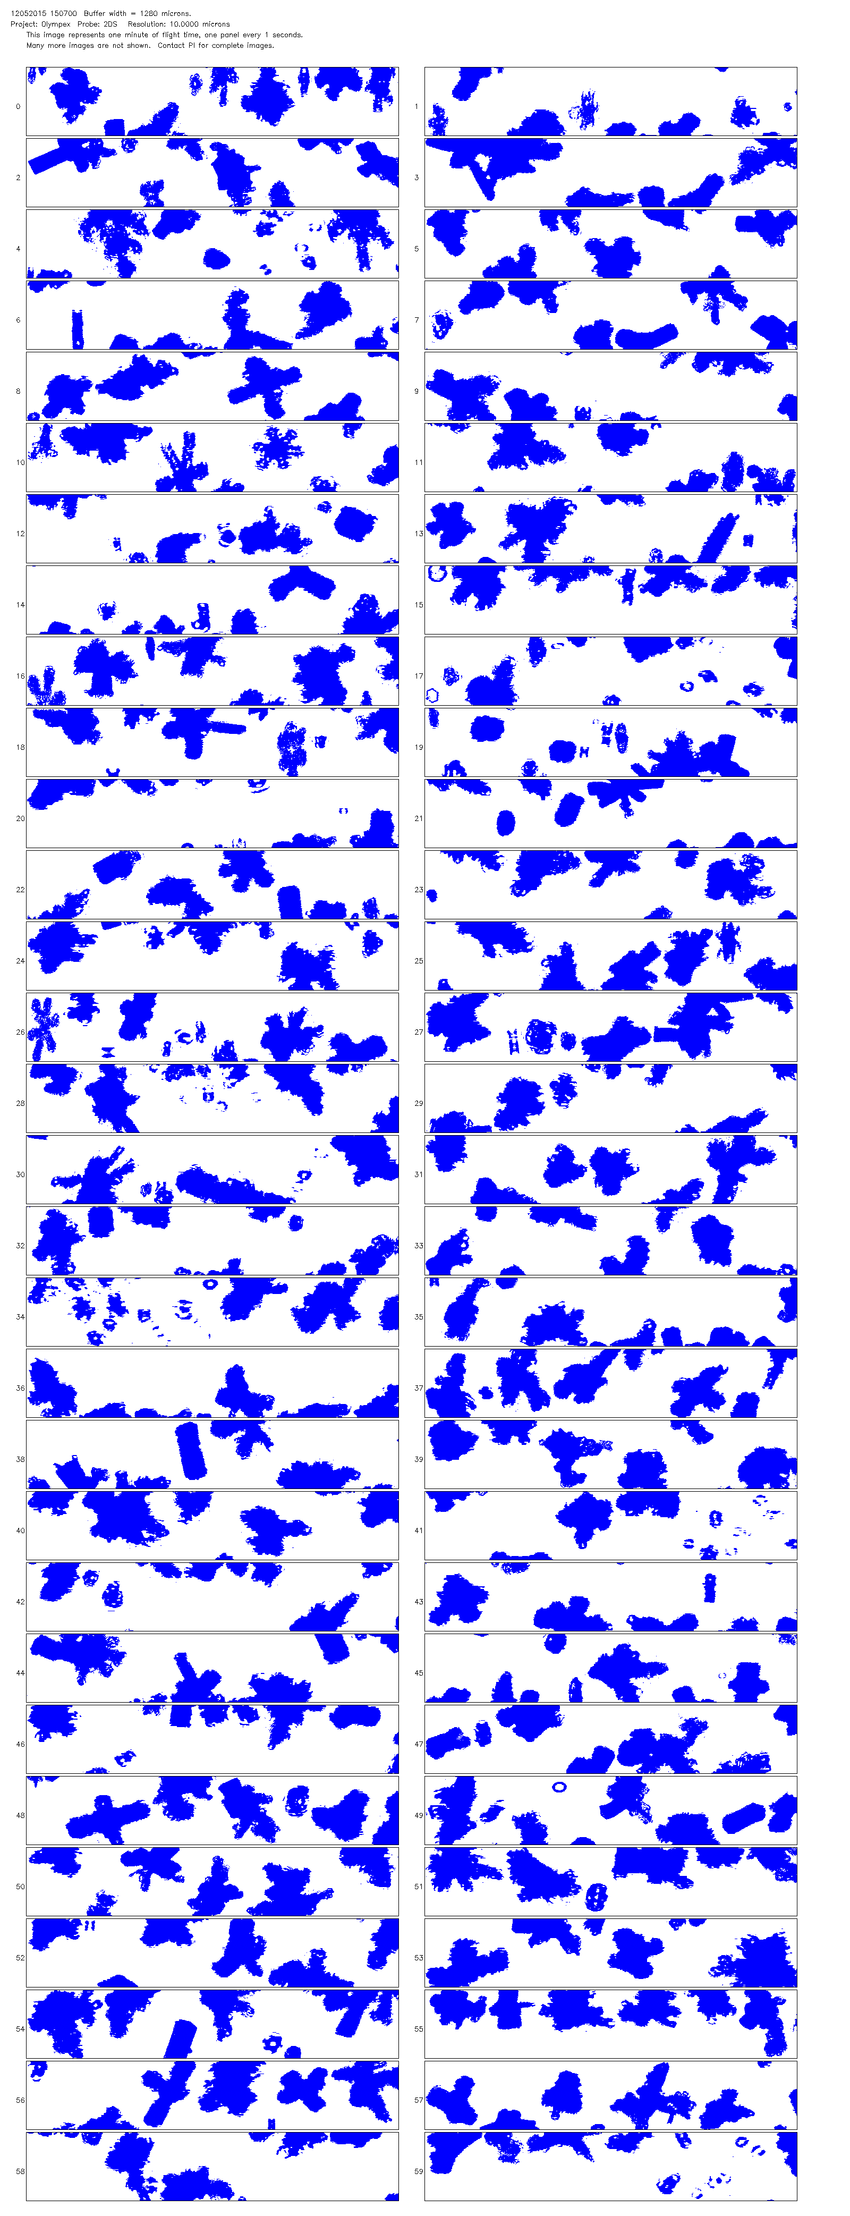
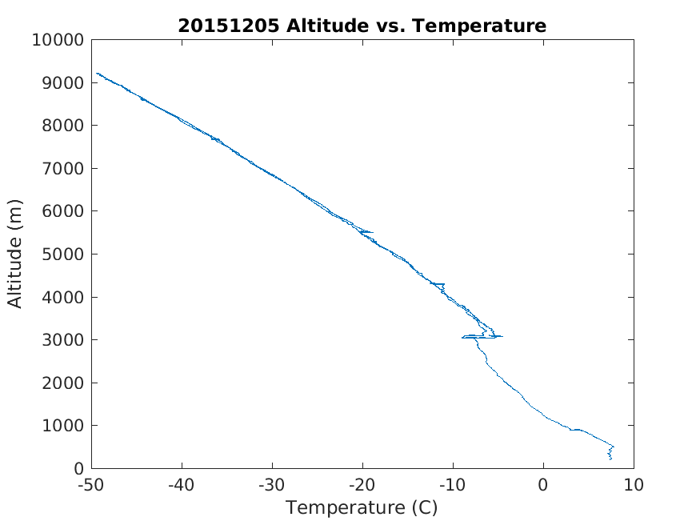
Increased liquid water content
Dendrites, aggregates, plates in 2DS-H probe imagery
-15°C at 4.5 km

