Slide 1
Development of shallow, precipitating clouds during MC3E
Angela Rowe and Robert Houze, Jr*
University of Washington, *PNNL
PNNL
Richland, WA
27 September 2016

Slide 2
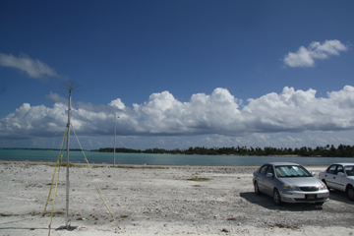
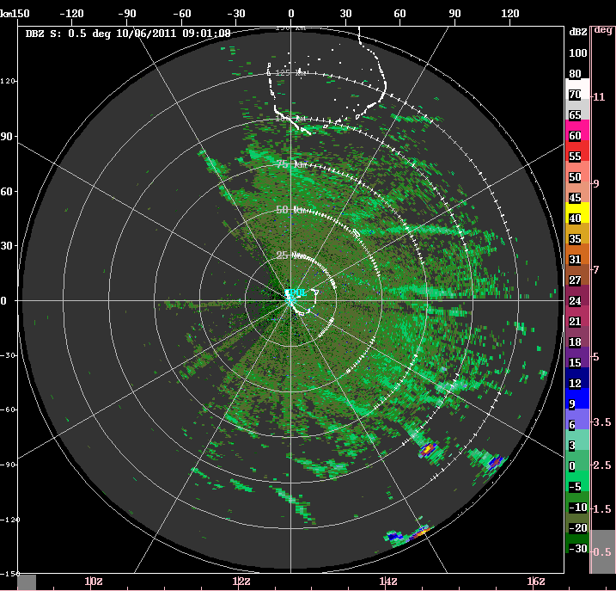
AMIE/DYNAMO Early suppressed
Photo: Bob Houze
1) Cloud lines oriented parallel to wind direction and (initially) to low-level shear
2) Shallow precipitating clouds produce cold pools during afternoon
Rowe and Houze (2015)

Slide 3
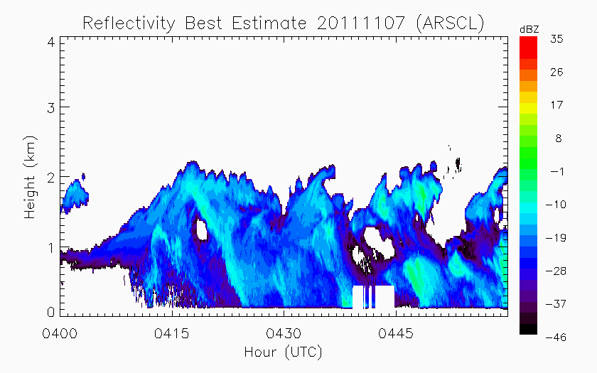
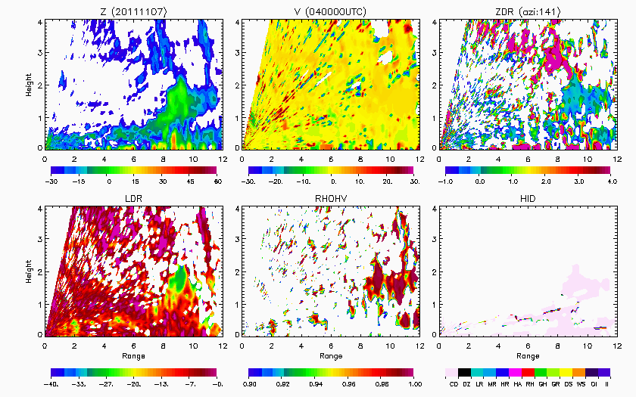
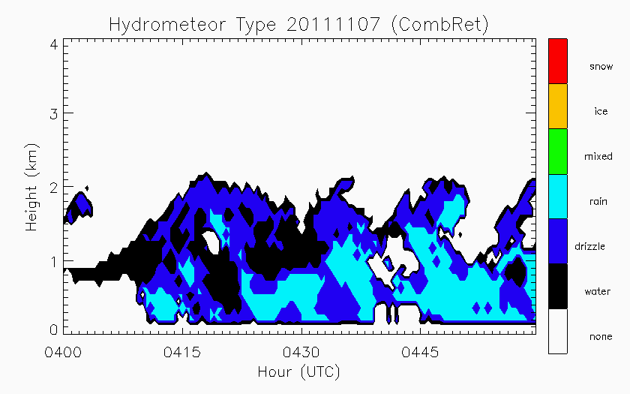
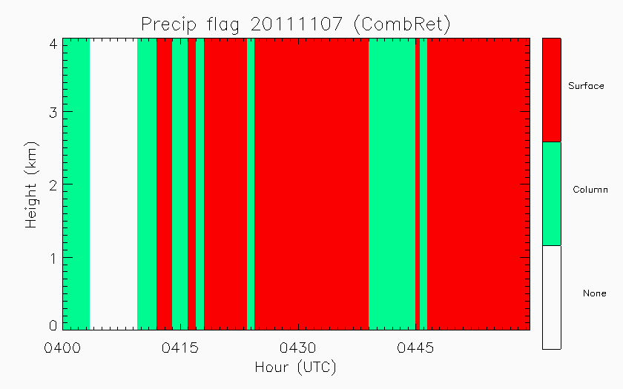
Nonprecipitating echo
Water/drizzle
Cloud droplets
KAZR-ARSCL: Active Remote Sensing of CLouds
COMBRET: Combined Remote Sensor Retrieval Algorithm (radar + lidar)

Slide 4
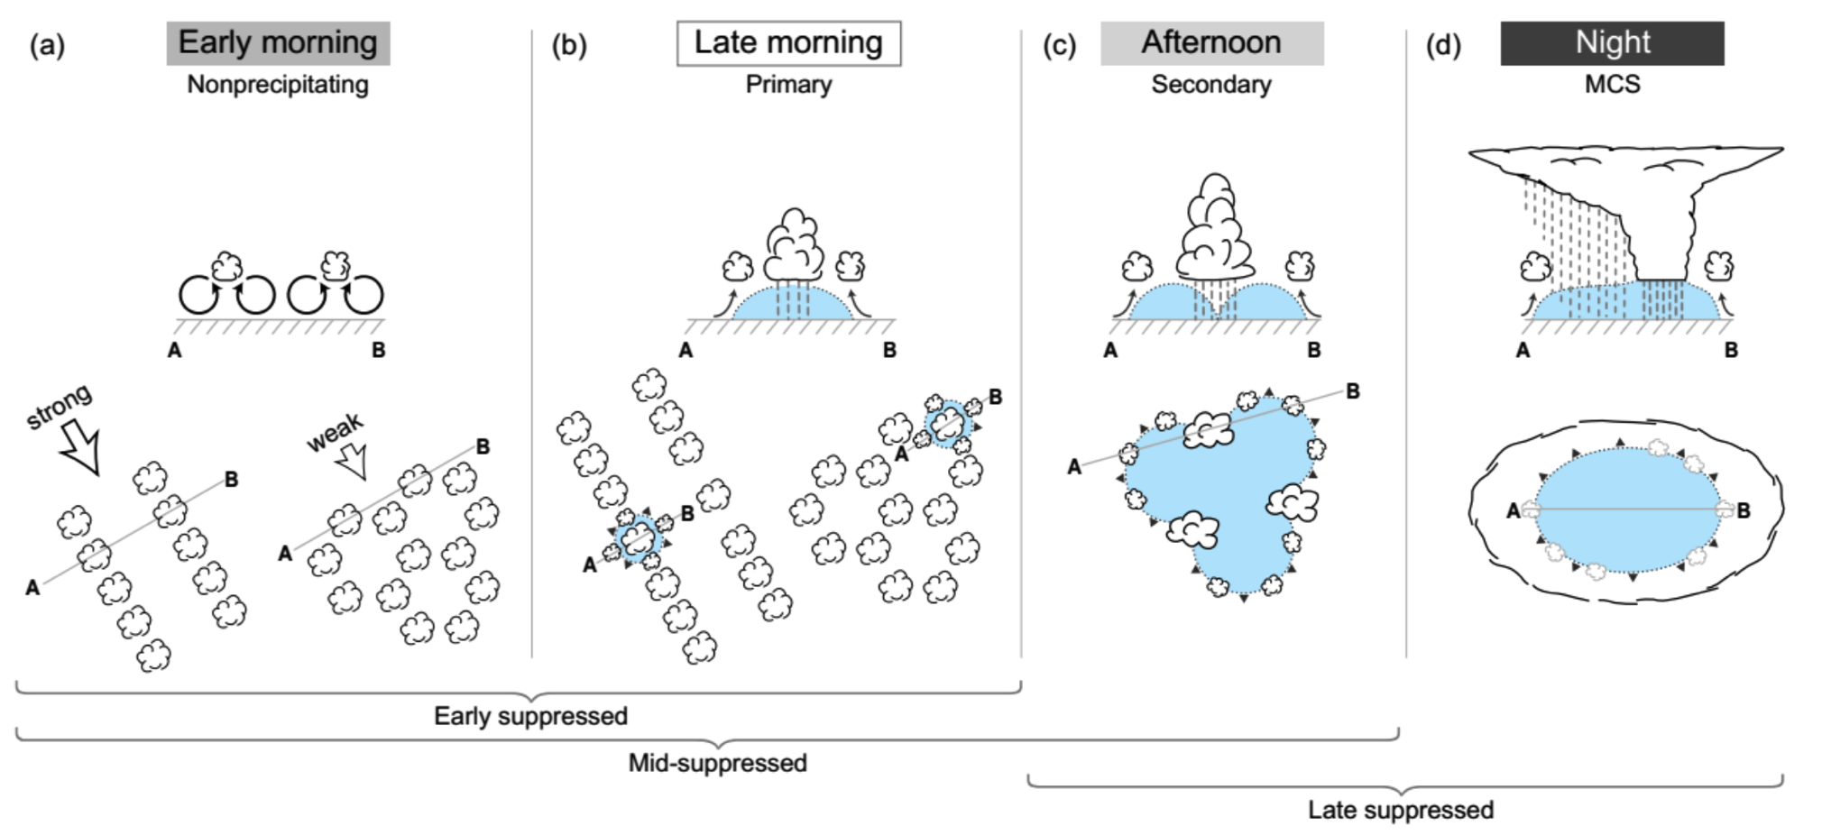
Transition to active periods
Rowe and Houze (2015)

Slide 5
Shallow-to-deep transition
Mechanisms from CRM/LES studies:
  Free-tropospheric humidity: buoyancy of entraining cumulus (Derbyshire et al. 2004; Kuang and Bretherton 2006)
  Subdomain variability such as boundary layer cold pools: promote further convective initiation (Tompkins 2001; Chaboureau et al. 2004; Khairoutdinov and Randall 2006)
  Atmospheric instability at cloud level: during transition from shallow to deep (Houston and Niyogi 2007; Wu et al. 2009)
Association between boundary layer inhomogeneity and deep convection from observations of strong convection associated with squall lines (Wakimoto 1982), land-sea breezes (Kingsmill 1995), and MCSs (Engerer and Stensrud 2008)

Slide 6
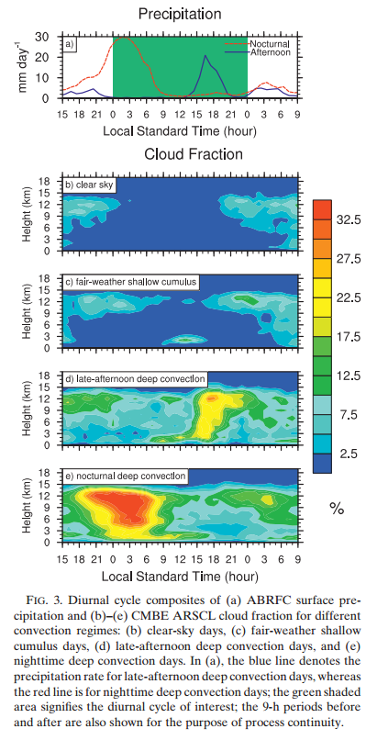
SGP – Zhang and Klein (2010)
Data: rainfall (ABRFC), cloud fraction (ARSCL), water vapor (soundings, microwave radiometer), SH and LH fluxes (BAEBBR product), surface met obs (SMOS, Mesonet), large-scale winds (NCEP)
May-Aug 1997-2007
Diurnal cycle
  Overnight max associated with eastward-propagating convective systems (e.g., Carbone et al. 2002)
  Afternoon/evening max might be response to local surface heating (Jiang et al. 2006)

Slide 7
SGP – Zhang and Klein (2010)
Late afternoon deep convection days: precipitation starts early afternoon, peaks at 1630 LST, diminishes after 2100 LST
  Low clouds precede deep convective clouds
Nighttime deep convection days: Begins preceding afternoon, peaks at 0200 LST, lasts until early morning
  High clouds precede deep convective clouds
Fair-weather shallow cumulus days: Low cloud fraction maximizes at 1.8 km from 1200 to 1400 LST (1700-1900 UTC in summer)

Slide 8
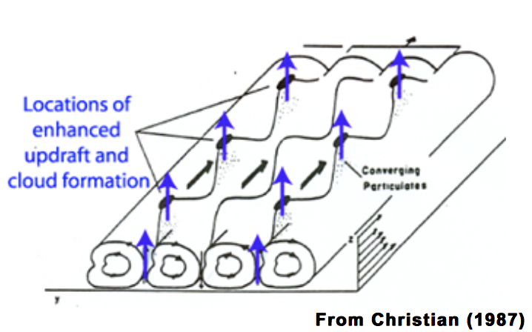
SGP – Zhang and Klein (2010, 2013)
Observations consistent with a role of lower-tropospheric (2-4 km) humidity and boundary layer inhomogeneity in the shallow-to-deep transition (support for LES-based transition theories)
  Inhomogeneity before and after precipitation
Need for analyzing individual events using radars
Ability of boundary layer air parcels to reach LFC
  Highest values of moisture in BL
  Mesoscale fluctuations in BL wind
Horizontal Convective Boundary layer rolls

Slide 9
SGP Shallow cumulus– Zhang and Klein (2013)
Connection to land surface
  Vegetation cover, soil moisture, surface roughness, soil type, terrain slope, elevation (Chen and Avissar 1994; Rabin and Martin 1996)
Relationship with nocturnal (Vilà-Guerau de Arellano 2007) and early-morning T and moisture conditions (Findell and Eltahir 2003)
Build upon Berg and Kassianov (2008) process to select fair-weather shallow cu days (May – Aug, 1997-2009) – Selection criteria based on precipitation rate, ARSCL and TSI clouds, cloud tops/bases (MMCR, MPL, ceilometer), fair-weather conditions from satellite
Cloud base height correlated with surface RH (locally generated cu)
Higher BL RH and weaker stability above make air parcel less susceptible to become negatively buoyant
Use results to test large-scale parameterizations using single-column models, LES (relative importance of different environmental conditions in controlling different shallow cu types and affecting transition from shallow-to-deep over land)

Slide 10
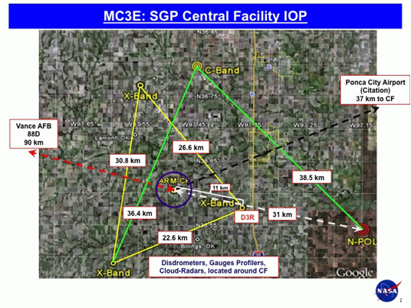
MC3E
April-June 2011
Convective systems and their environments
Cloud radars, wind profilers, lidars, disdrometers, aircraft, radiometers, surface obs, soundings,…
Dual-pol radar network
  3 X-SAPRs
  C-SAPR
  NPOL (S-band)
  NEXRAD

Slide 11
MC3E (Jensen et al. 2015)
22 – 28 April: high-level moisture, periods of moderate CAPE, low rain rates from widespread shallow stratiform rain
29 April – 7 May: Dry conditions, no precipitation, little CAPE
8 – 12 May: Period of high CAPE, low-level moisture return on 10th, significant precipitation on 11th
13 – 18 May: Another dry period
19 May – 24 May: Second period of high CAPE, significant precipitation events, deep active period
Rest: No significant precipitation

Slide 12
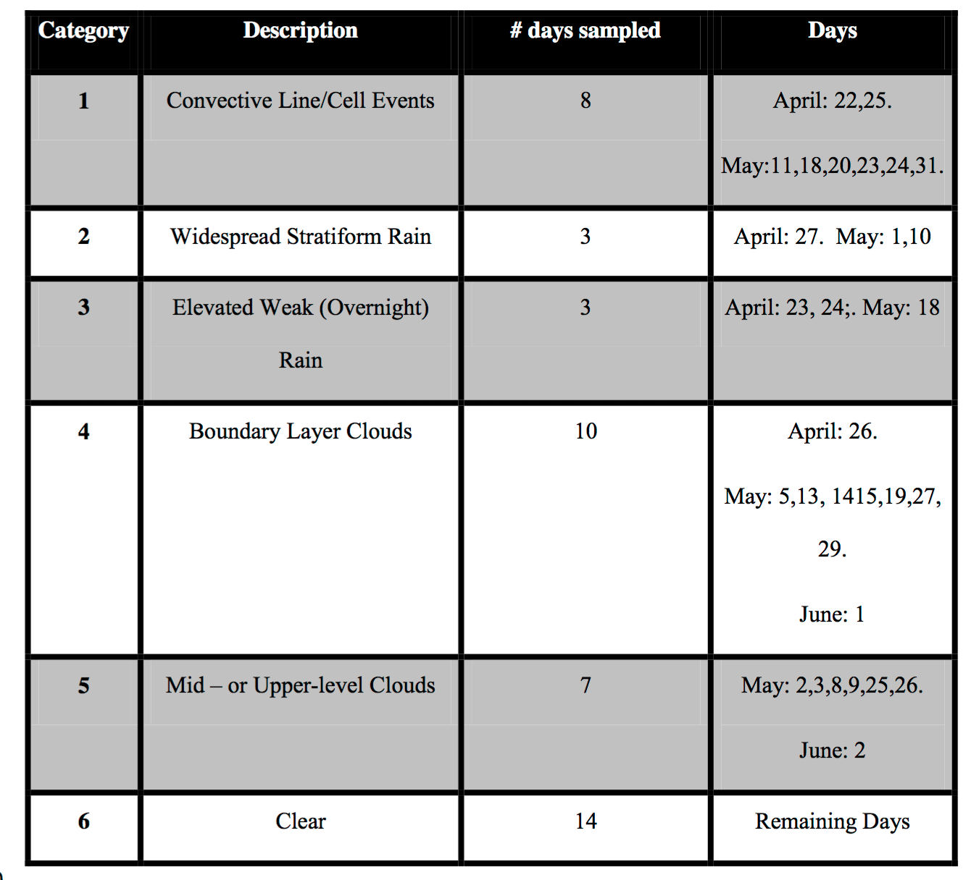

Slide 13
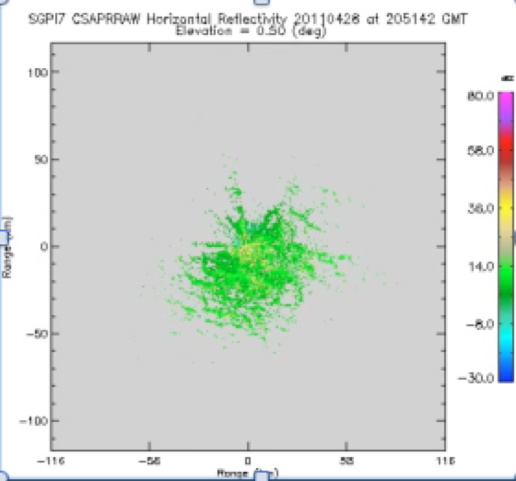
MC3E (28 April - Clear) - CSAPR
1800 UTC
Late afternoon/early evening horizontal convective boundary layer rolls
Clouds?

Slide 14
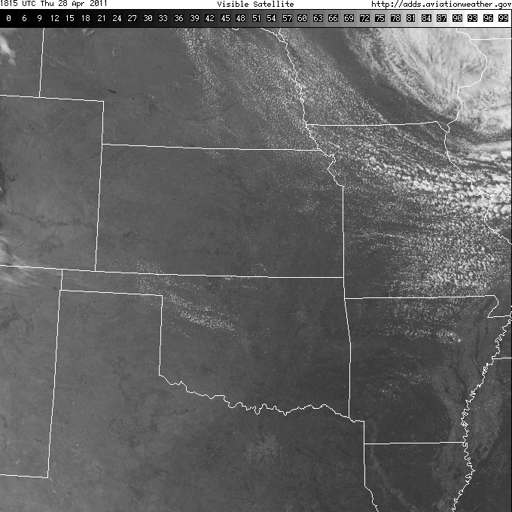
1815 UTC
MC3E (28 April)

Slide 15
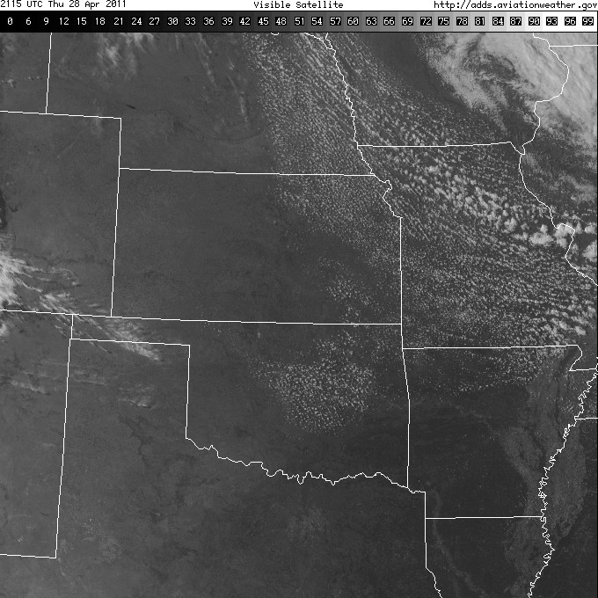
2115 UTC
MC3E (28 April)

Slide 16
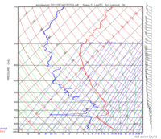
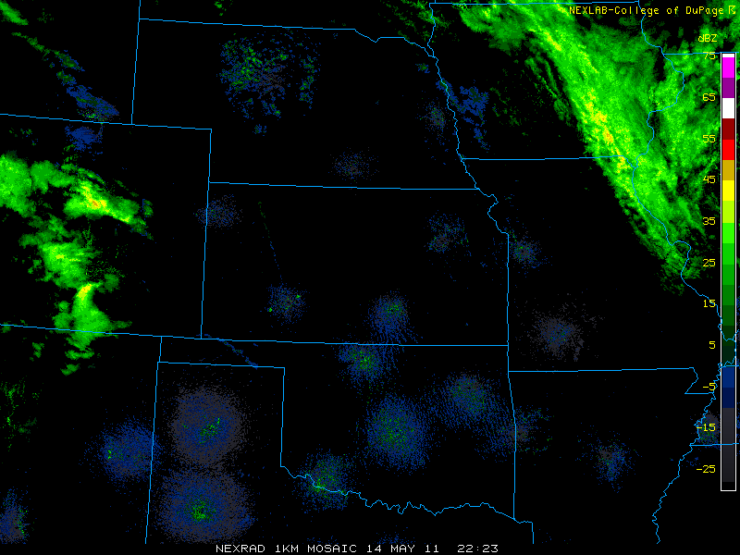
MC3E (14-15 May)
Mid/upper clouds
14 May: A few low clouds are hanging around this morning, but they will clear off by midday. Skies will remain clear this afternoon.
15 May Forecast: High level moisture will bring high clouds (primarily above 18K ft), especially in the afternoon. No precipitation in the forecast area.

Slide 17
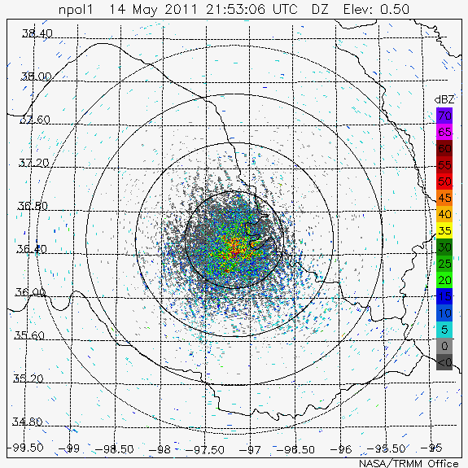
MC3E (14 May) - NPOL

Slide 18
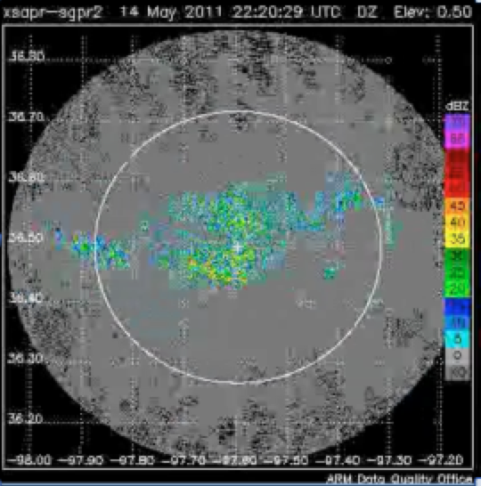
MC3E (14 May) - XSAPR

Slide 19
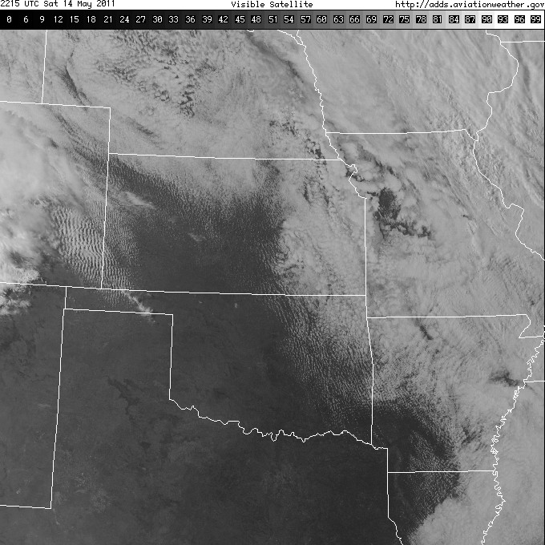
MC3E (14 May)

Slide 20
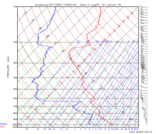
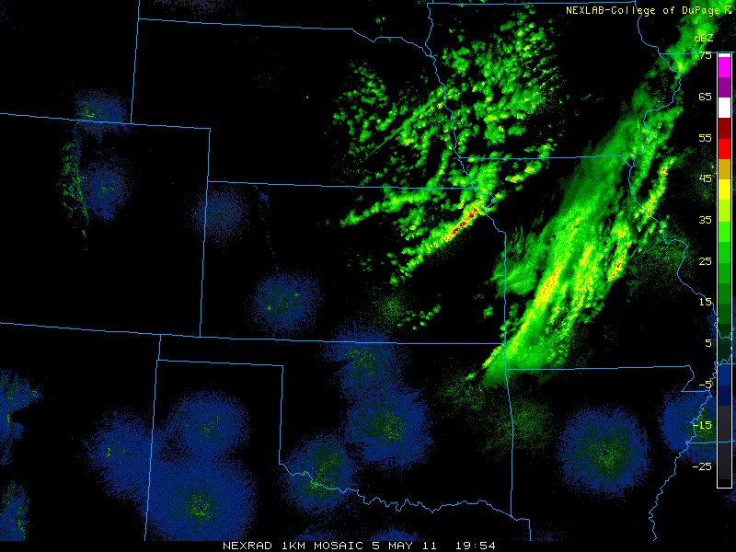
MC3E (5 May) - BL clouds
A weak cold front passed through north central OK this afternoon, with a deck of mid-level cloud this morning. Fair weather cumulus over the region this afternoon (bases near 2 km 70/40F (20/5C)), with storms/showers staying far off over eastern Kansas and NE OK.

Slide 21
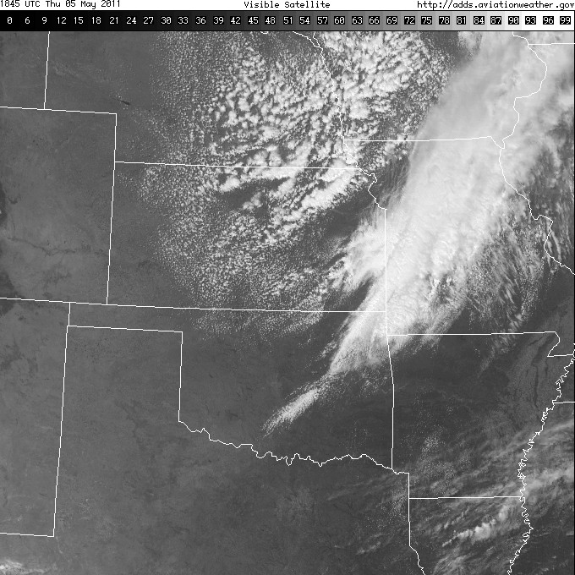
MC3E (5 May)

Slide 22
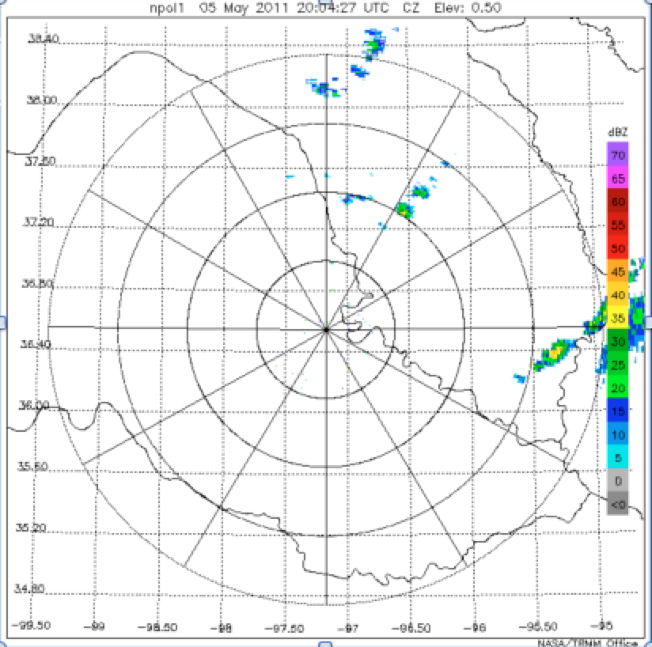
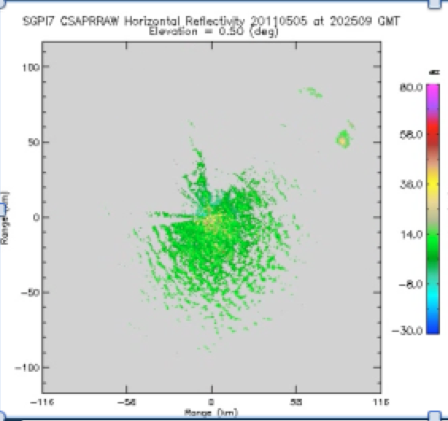
MC3E (May 5) – NPOL/ CSAPR

Slide 23
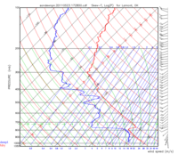
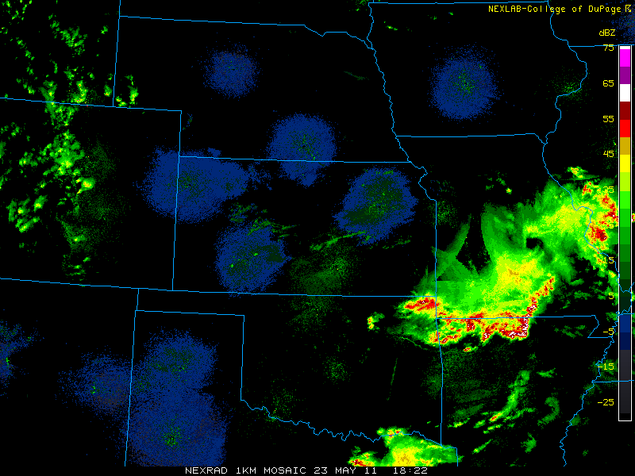
MC3E (23 May - Conv)
23 May: A surface low pressure system currently sitting near the panhandle with surface boundaries will be the focal point for convection later this afternoon. A dryline near the Texas/OK border could also see some initiation, with storms progressing eastward. Likely to form along the surface fronts and outflow boundaries forming this morning.

Slide 24
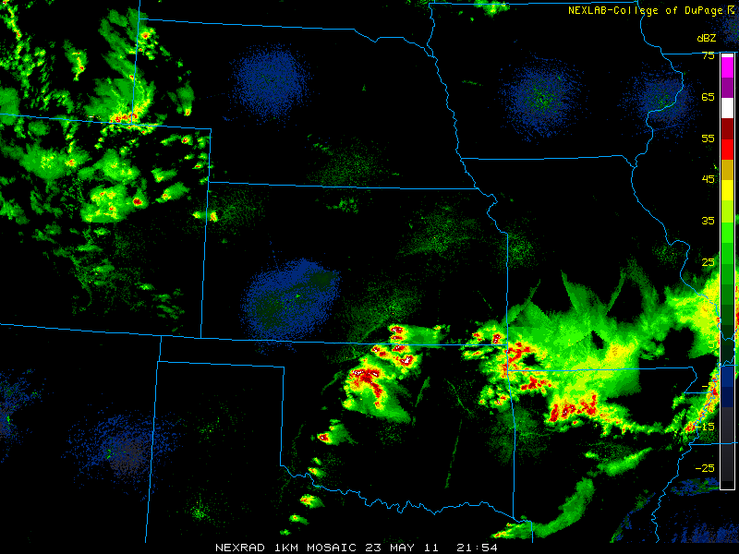
MC3E (23-24 May)

Slide 25
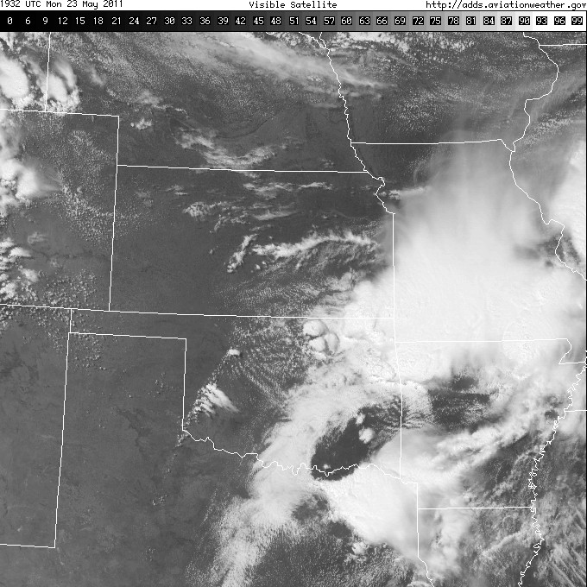
MC3E (23-24 May)

Slide 26
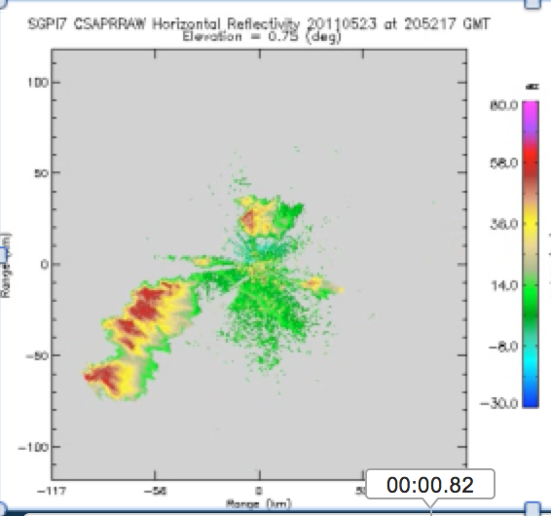
MC3E (23 May) - CSAPR

Slide 27
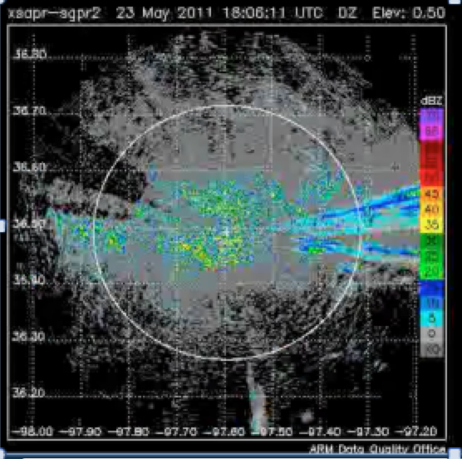
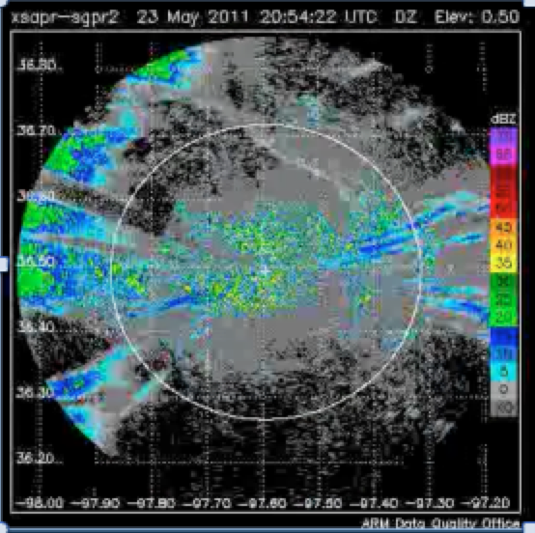
MC3E (23 May) - XSAPR

Slide 28
Analysis
Type 1: Boundary layer rolls, no convective initiation
Type 2: Boundary layer rolls, convective initiation
Type 3: Large-scale system, initiation on convective outflow
Questions (observations)
  Is a pre-existing boundary layer organization (overturning circulation in cumulus fields) necessary for convective initiation in domain?
  Can we see that boundary layer structure on days when larger scale systems moving in?
  How do the environmental conditions differ between the cases?

Slide 29
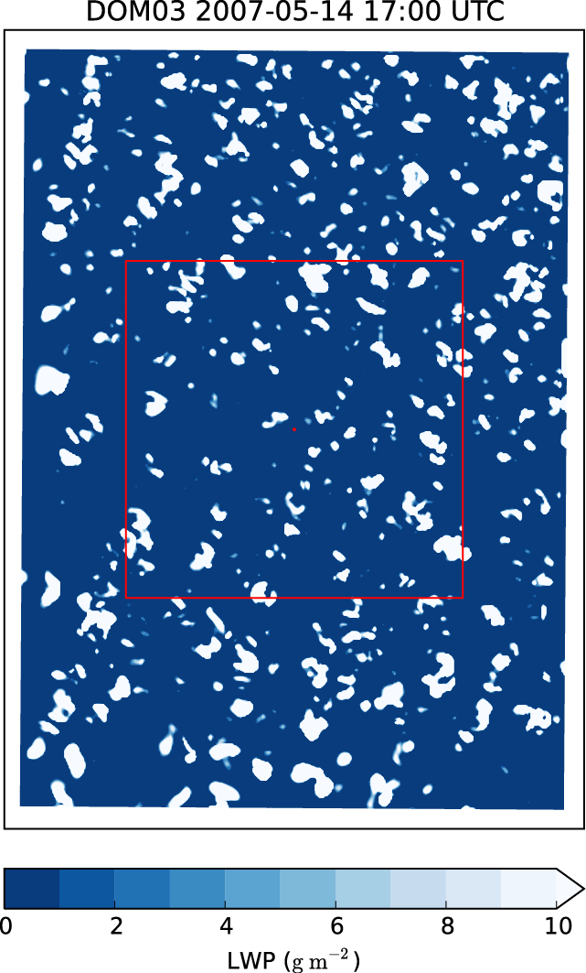
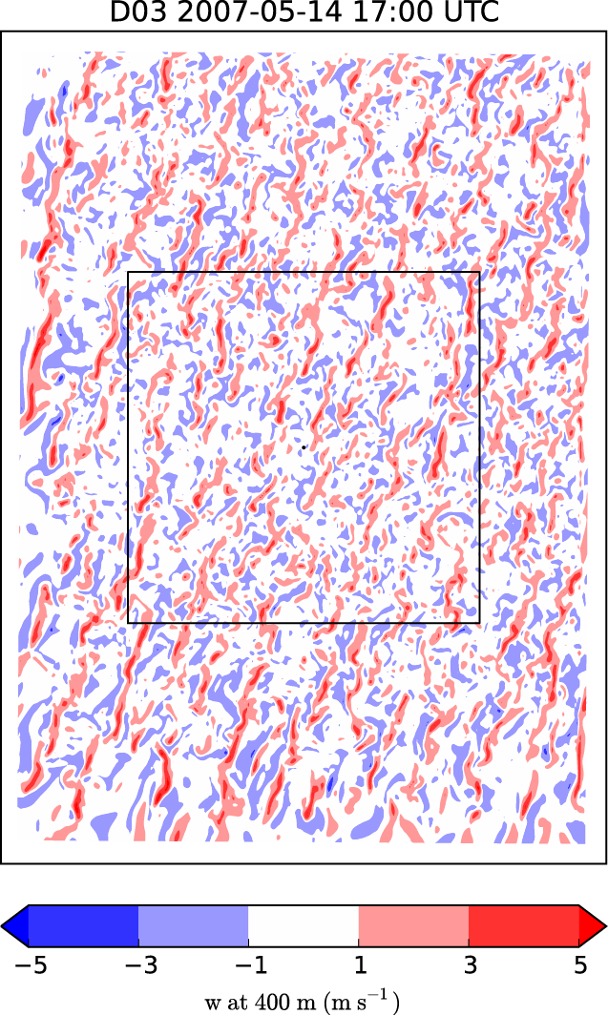
LES (Heng Xiao) – Strong winds, strong buoyancy production in cloud layer
20 km
SGP

Slide 30
Approach – LES (Heng Xiao)
Previous LES nested runs
  Profiles/forcing SCM data
  Change inhomogeneity of surface (patches of higher SH and/or LH fluxes)
  Impact of land-surface model on shallow clouds
Previous cases over SGP: 20070514, 20070512, 20070516
Evaluating average cloud fraction and LWP in 30-km box
Open cell vs. rolls w.r.t. low-level wind direction/speeds
  Strong winds: wind effect dominates any secondary circulations from land surface
  Weak winds: greater moist patches and more boundary layer roll organization
  Low-level shear (lowest 100 m) most impactful for controlling presence and depth of rolls

Slide 31
Approach – LES (Heng Xiao)
What would happen with convective initiation if no system came through?
Is it the upstream systems that initiate the convection or is there some pre-existing boundary layer roll feature required?
How do the boundary layers differ in these scenarios?
  Likely that total BL moisture plays a more important role than moisture inhomogeneities
  Look at deep-layer residual layers of moisture vs. PBL moisture
  How does convection develop the day after widespread convection? (moisture vs. heating effects)
Idealized LES framework
  Nested domain: difficult to remove outside influence of convection/outflow

Slide 32
Data
Shallow clouds
  VIS satellite imagery
  XSAPR, CSAPR (rolls)
  KAZR, SACR
  Ceilometer, Total Sky Imager, MPL (MPLCMASK)
  ARSCL, WACRARSCL (cloud fraction, base, height, vvel)
Broader context (precipitating systems)
  NEXRAD, NPOL
  Satellite
  ARBFC: gridded rainfall
Environment
  BL winds: Doppler Lidar, profilers
  Low-level T and RH: AERIs (lowest 3 km)
  Vertical columns water vapor: Raman Lidar
  LWP/Column WV: Microwave radiometer
  Large-scale T, RH, wind: Radiosondes (MERGESONDE)
  Surface fluxes: Energery Balance Bowen Ratio Station (EBBR)
  Surface obs: Oklahoma Mesonet

Slide 33
SFA Structure
1) Aerosol
2) Land
3) Cloud Lifecycle
Connecting land (2) with cloud lifecycle (3) through the boundary layer
Disturbed boundary layer transition to shallow clouds
Nonprecipitating to precipitating shallow clouds
Building on to shallow-to-deep convective transition

Slide 34
Summary
Combination of observations from MC3E and idealized LES approach for evaluating boundary layer processes and large-scale environmental conditions associated with shallow cumulus
In weakly forced environments, shallow cumulus initiated and organized along horizontal convective boundary layer rolls (weak winds)
On cases with mesoscale forcing, high instability, and deep moisture, ability of precipitating convection to initiate and grow from outflow boundaries
Need to test relative importance of boundary forcings in convective initiation/growth

Slide 35
Thank you
Comments? Questions? Suggestions?

