Slide 1

Atmospheric Rivers observed during the Olympic Mountains Experiment (OLYMPEX)
L. McMurdie, R. Houze, J. Zagrodnik, W. Petersen, M. Schwaller
International Atmospheric Rivers Conference, San Diego, CA, 9 August 2016

Slide 2
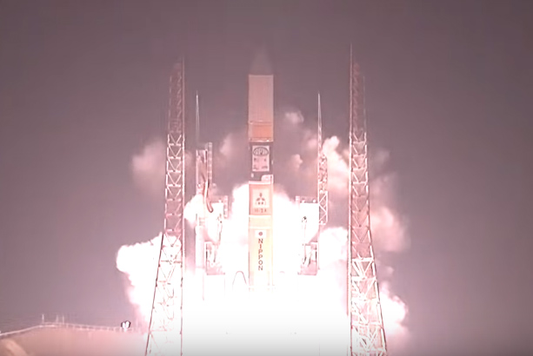
Goals of OLYMPEX
Validate GPM satellite radar and passive microwave instruments measurements of precipitation
GPM Satellite launch 28 Feb 2014

Slide 3
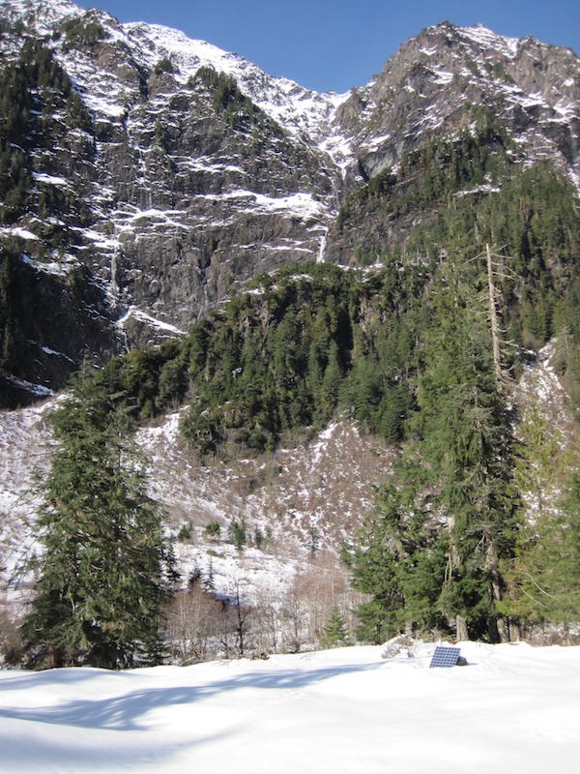
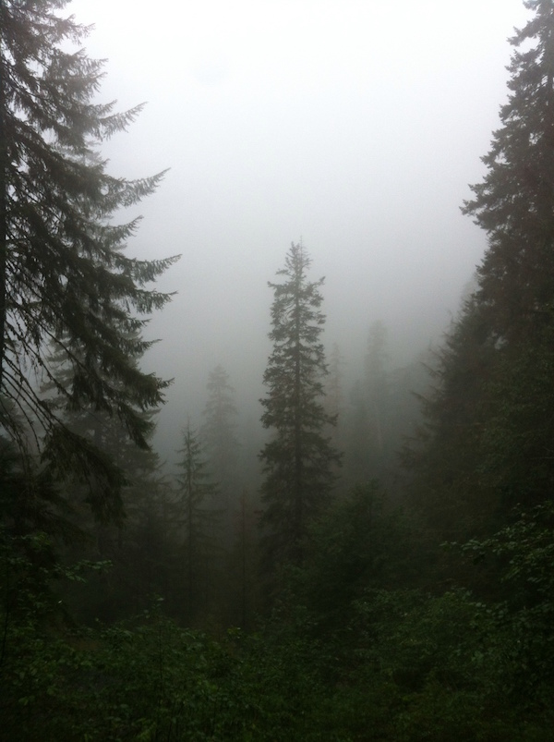
Goals of OLYMPEX
Determine the orographic effects on precipitation processes

Slide 4
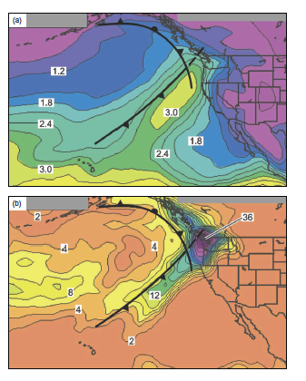
What are the mechanisms of enhancement of Atmospheric Rivers and other frontal precipitation over coastal mountains?
Composite
PW (cm)
Results addressing this question can inform the PMP (Larry Schick’s talk)
Composite
Rain (mm)
Neiman et al. 2008

Slide 5
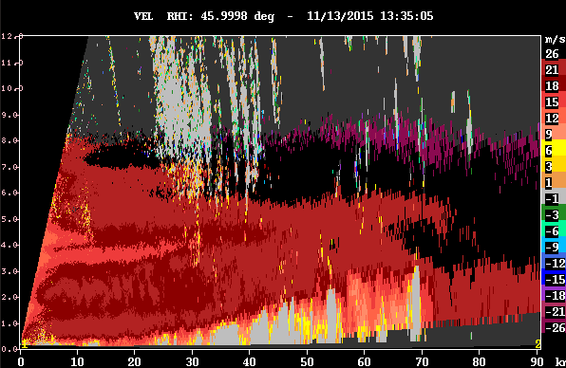
Layer lifting of low-level warm moist jet?
Radial
Velocity

Slide 6
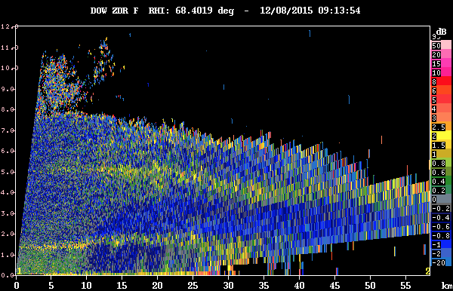
Enhancement of ice-phase processes?
Enhanced aggregation?
ZDR

Slide 7
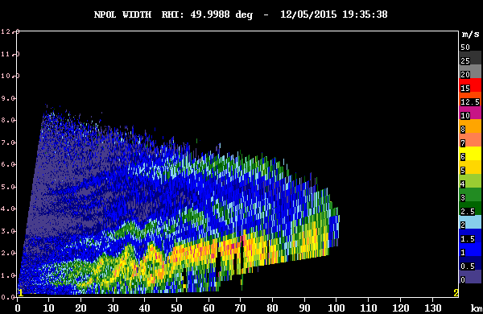
Cellularity in the upslope flow?
KH waves
Spectrum width
(shear)

Slide 8
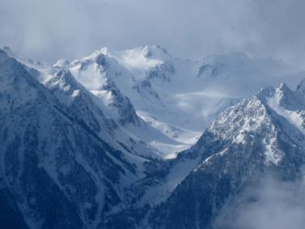
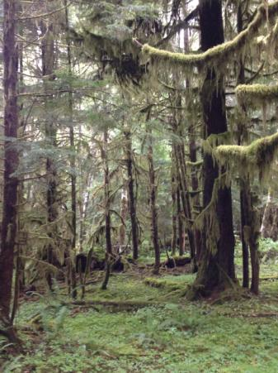
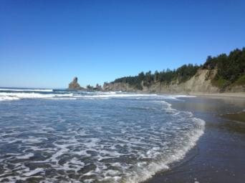
The Olympic Peninsula
High Terrain
Valley
Rain Forest
Ocean

Slide 9
The OLYMPEX Strategy
Aircraft
ER2 & DC8—over the top
Citation—through the clouds
Surface
Particle sizes and fallspeeds
Rain and snow amounts
Snow cameras
Upper air
Supplemental soundings in events
Windward and leeside stations
Radars for 3D structure
RHI sectors at 4 different wavelengths
Dual polarization
Doppler

Slide 10
RHI sectors

Slide 11
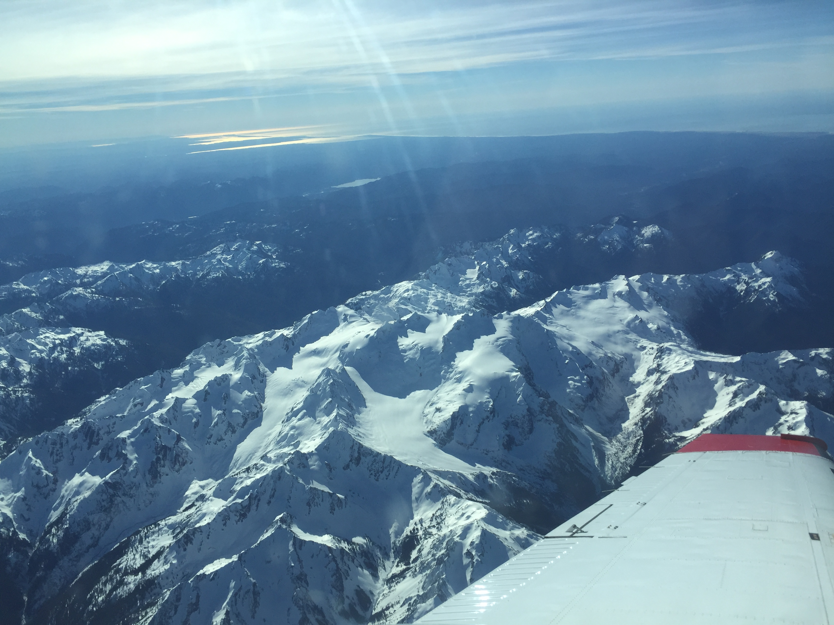
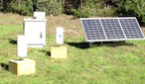
Timeline of Operations
Testing
Ground sites collecting data – Gauges, Parsivel, MRR’s and snow measurements
Oct 2014
Spring 2015
Oct 2015
Nov 2015
Dec 2015
Jan 2016
Feb 2016
May 2016
Ground Sites
Rain gauges, disdrometers, MRR’s
Snow Measurements
Trailer, Hurricane Ridge, Snow Poles, Snow Survey, Lidar Flights

Slide 12
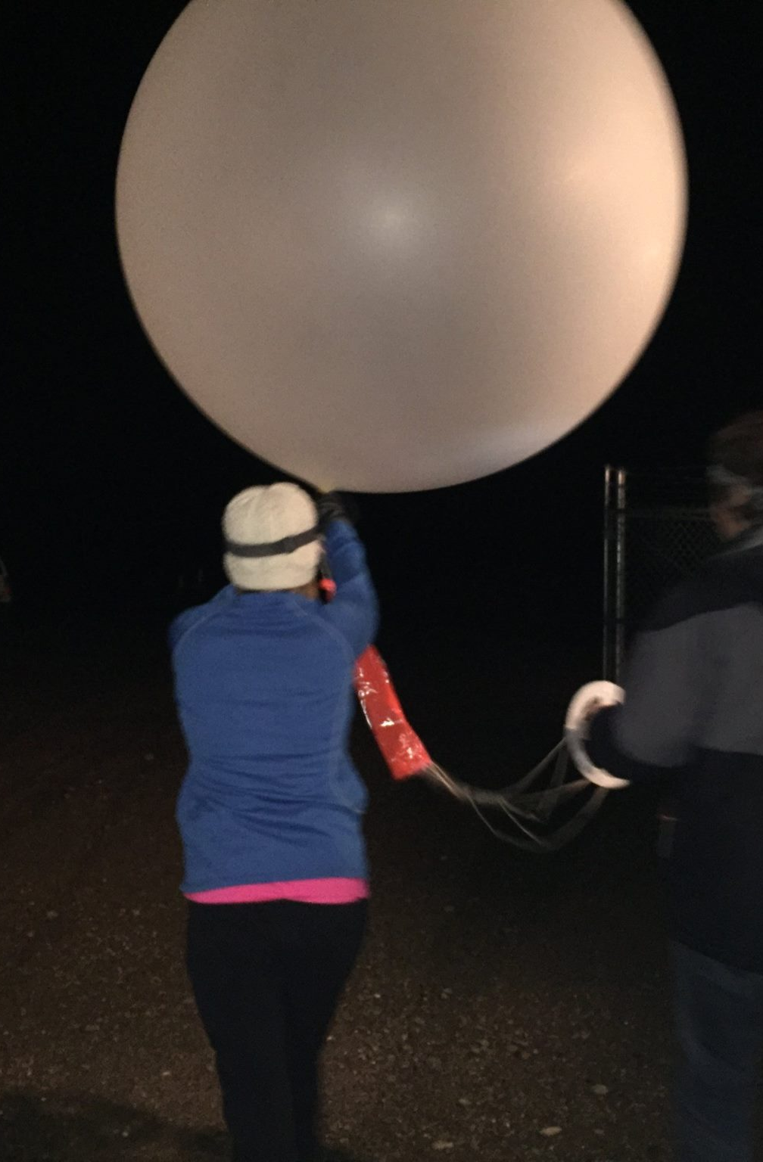
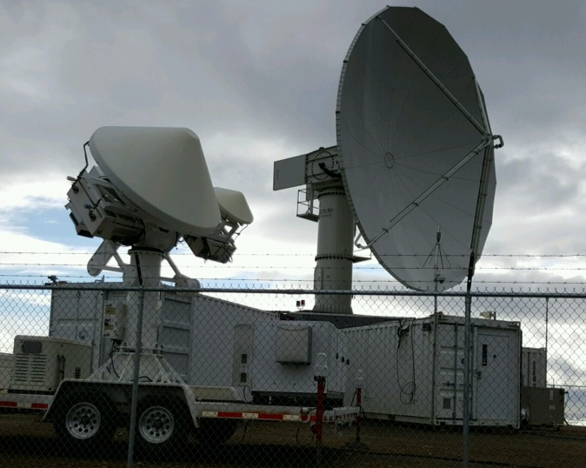
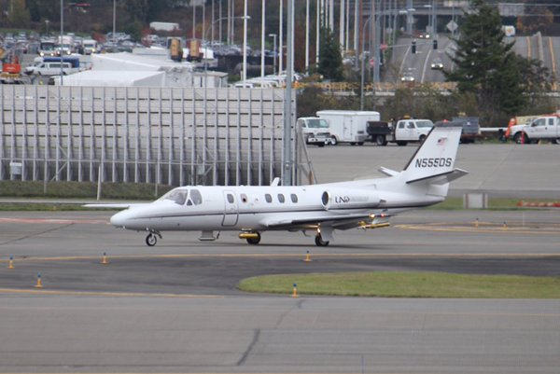
Timeline of Operations
Aircraft
Aircraft
Soundings
Soundings
EC X-band Operations
NPOL and DOW Operations
NPOL,DOW
Testing
Ground sites collecting data – Raingauges and Parsivel and MRR’s
Oct 2014
Spring 2015
Oct 2015
Nov 2015
Dec 2015
Jan 2016
Feb 2016
May 2016
Aircraft
Radars
Soundings
Radars
Soundings

Slide 13

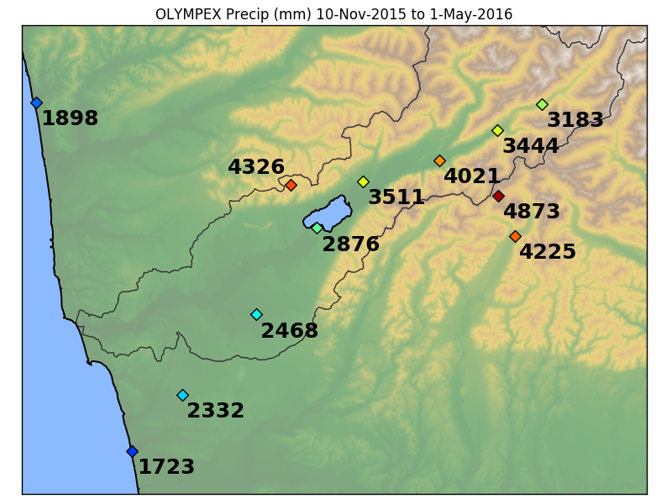
What did we observe?
Elevation 190mft
Elevation 115m
Elevation 540m
Elevation 1020m and 280m
Elevation 0m
The OLYMPEX Season Totals
2015-2016 Season Totals
A lot of precipitation

Slide 14
Our criteria for
Atmospheric River events
High Melting level (> 2 km)
High Precipitable water (>25mm)
Strong cross-barrier flow (>40 kts at 925 hPa)
Long period of precipitation/ orographic enhancement of precipitation (in our cases)
Notes:
Melting level > climo for moist onshore flow = 1.4 km
The above sets the stage for precipitation, but have criteria of long period of precip to show that there is a mechanism for lift to produce precipitation

Slide 15
At least 6 Atmospheric River Events during OLYMPEX
12 – 13 November – First day of full operations
16 – 17 November – no aircraft flights – strong cross winds
3 – 4 December
8 – 9 December
21 – 22 January 2016 –observed by ground network only
14 – 16 February 2016 – observed by ground network only

Slide 16
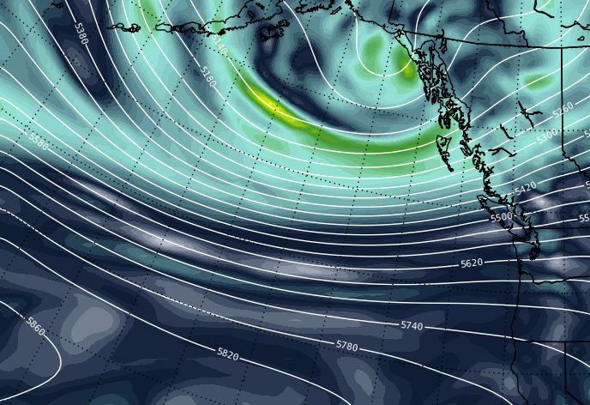
WSW Flow
Strong Jet across Pacific
0600 UTC 13 November
500 hPa Heights and Vorticity

Slide 17
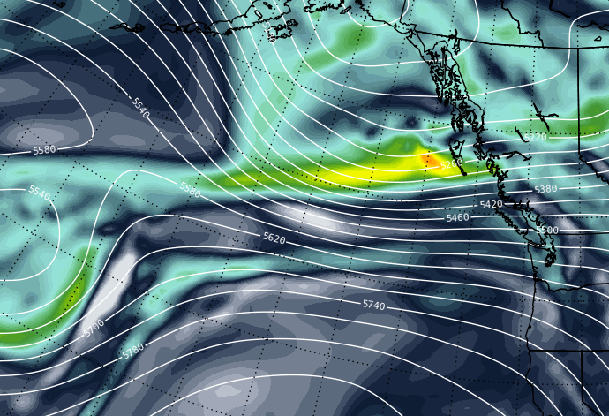
WSW Flow
Even stronger Jet across Pacific
1200 UTC 17 November
500 hPa Heights and Vorticity

Slide 18
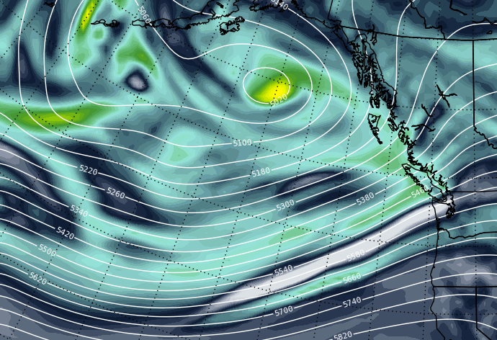
SW Flow
Strong Jet across Pacific
1800 UTC 8 December
500 hPa Heights and Vorticity
All 3 cases had strong ~(south)westerly jet aimed straight towards Olympic Peninsula

Slide 19
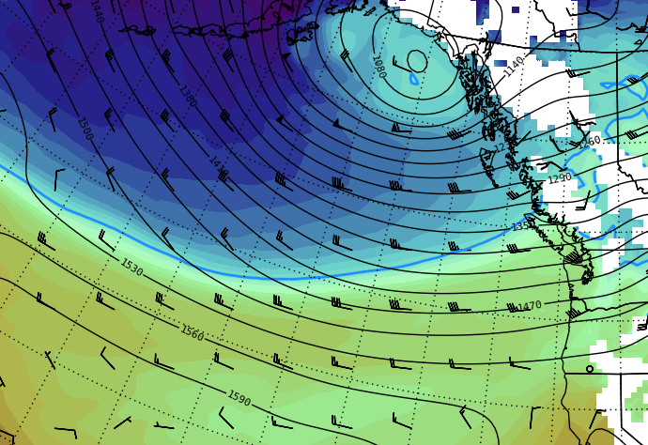
Strong onshore flow at 850hPa. Very warm airmass
0600 UTC 13 November
850 hPa Heights and Temperature

Slide 20
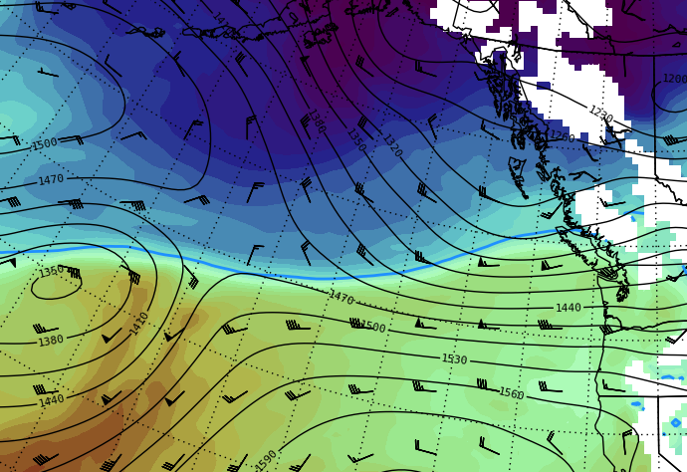
Strong onshore flow at 850hPa. Very warm airmass
1200 UTC 17 November
850 hPa Heights and Temperature

Slide 21
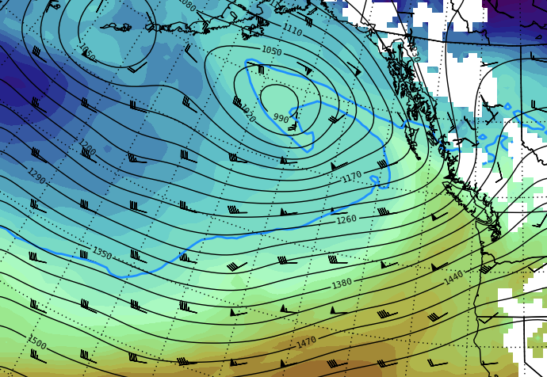
SW Flow
Strong Jet across Pacific
1800 UTC 8 December
850 hPa Heights and Temperature
All 3 cases had warm, strong low level flow. Nov 13 and 17 events had NCFR passage at end of event

Slide 22
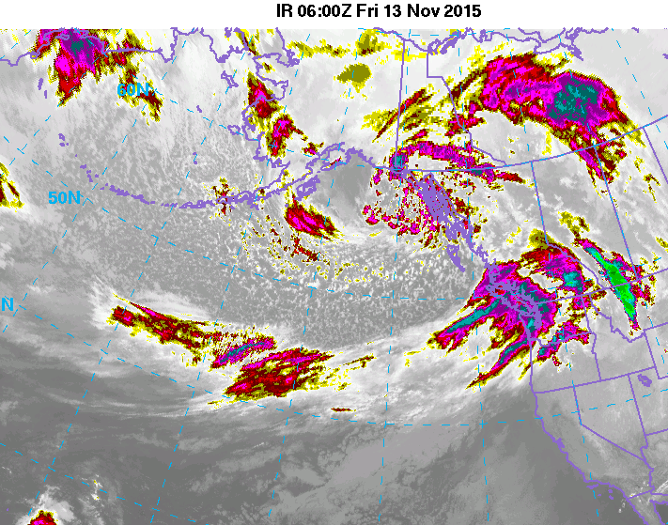
12 – 13 November Atmospheric River

Slide 23
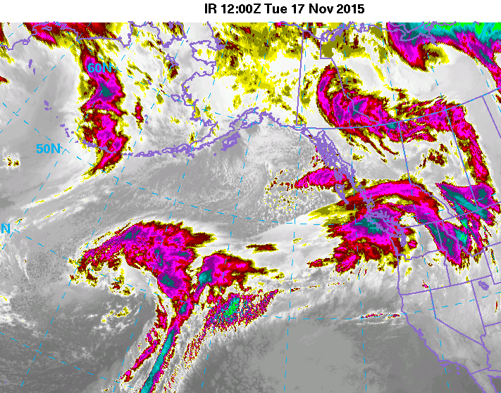
16 – 17 November Atmospheric River

Slide 24
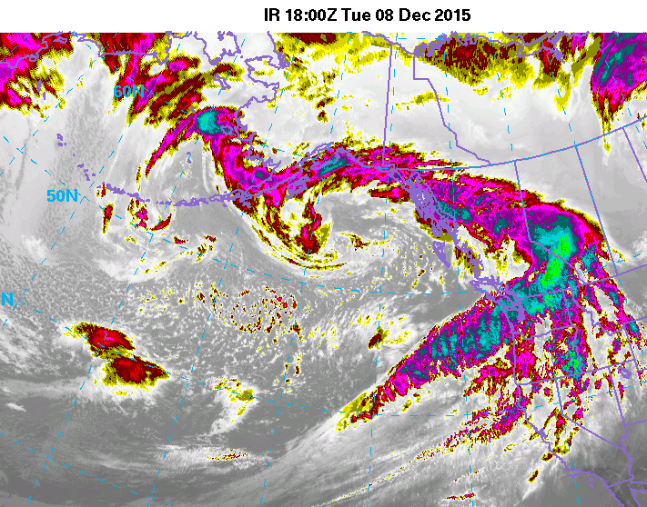
8 – 9 December Atmospheric River

Slide 25
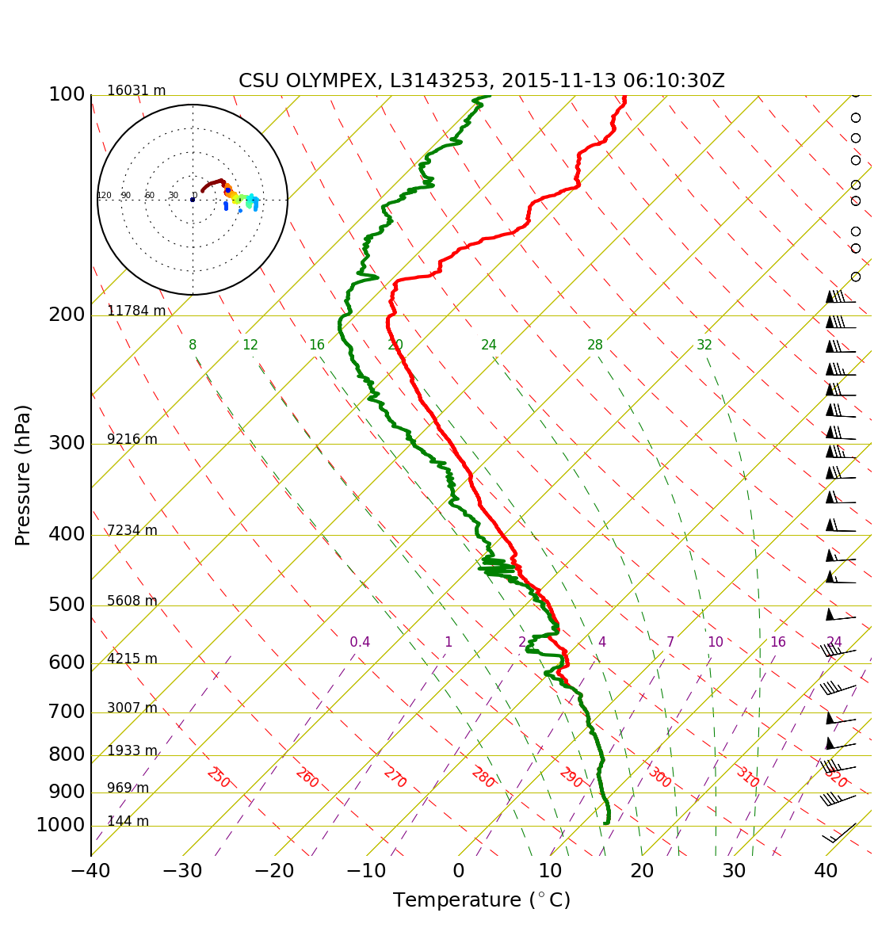
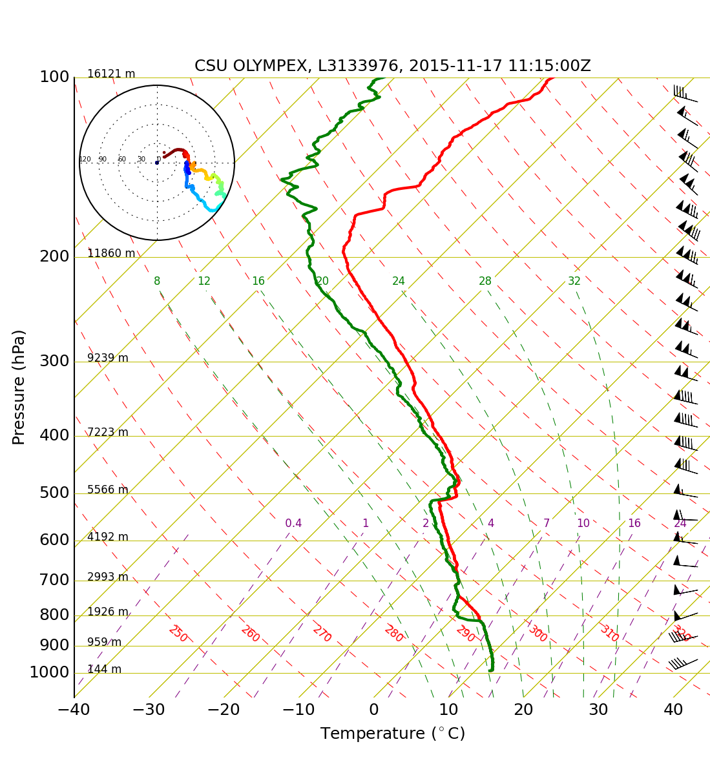
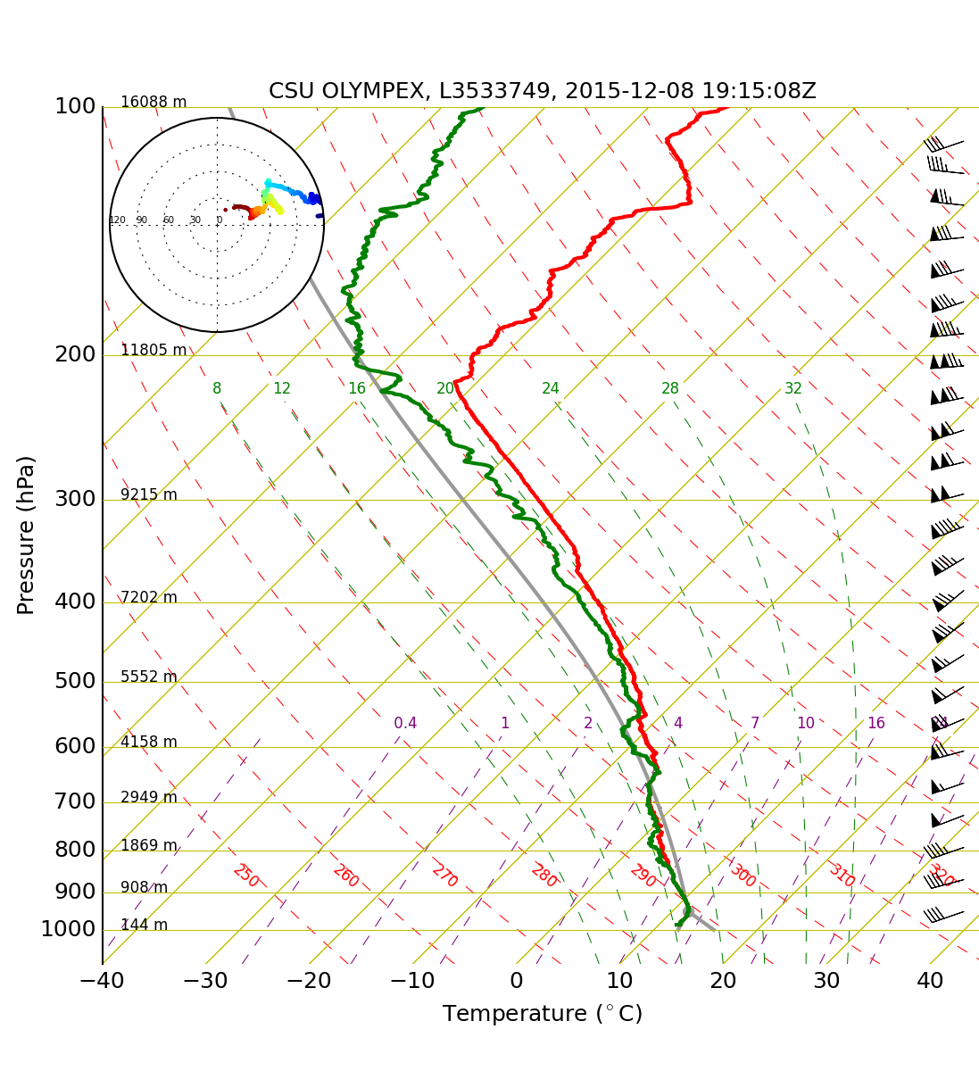
0600 UTC 13 Nov
PW = 29.3 mm
0°C = 2680 m
1200 UTC 17 Nov
PW = 27.1 mm
0°C = 2276 m
1800 UTC 8 Dec
PW = 28.8 mm
0°C = 2488 m
All 3 cases had high melting levels and large precipitable water and strong 40kt jet at 925 hPa with little turning

Slide 26
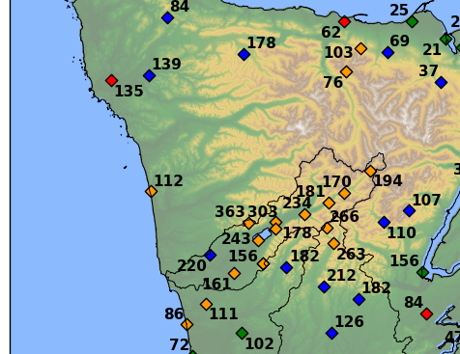
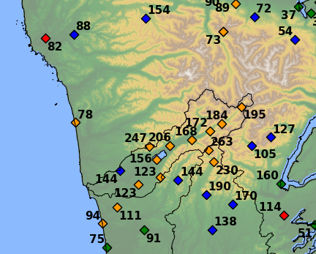

Season Totals
12-13 November
Max in interior
Factor of 2.5 enhancement
Factor of 4 – 5 enhancement
8-9 December
16-17 November
Max over initial slopes

Slide 27
Hydrological Impacts

Slide 28
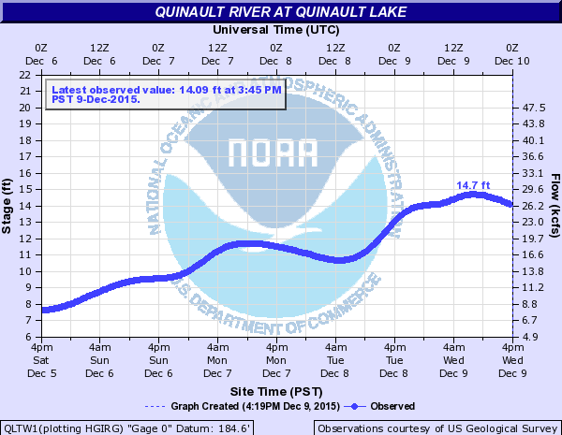
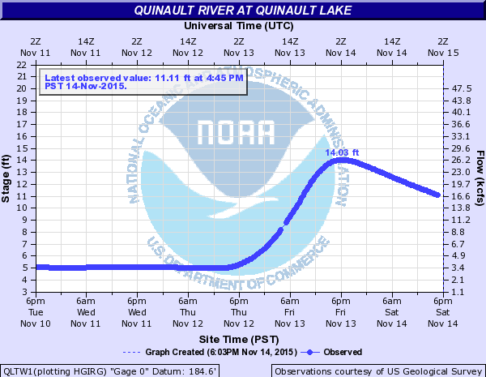
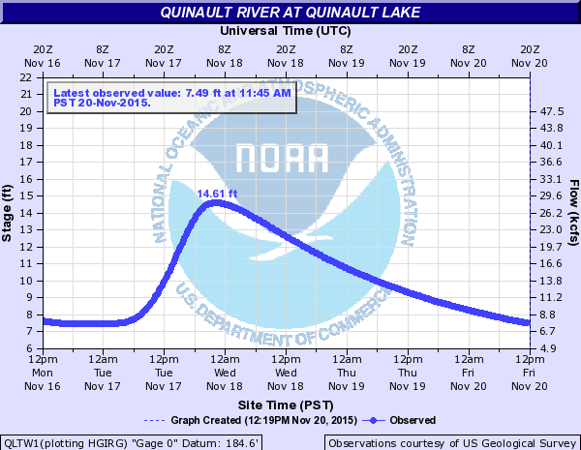
Dec 8-9
Nov 12-13
Nov 16-17

Slide 29
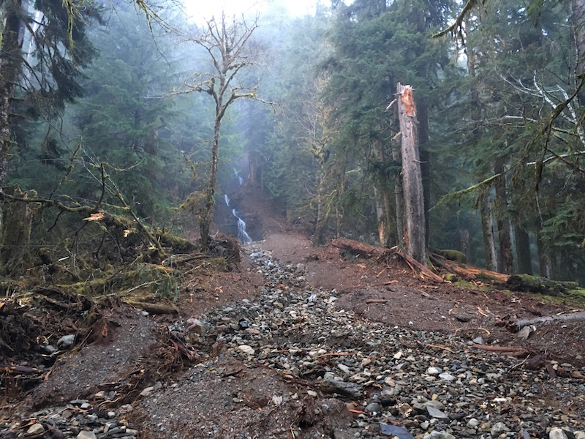
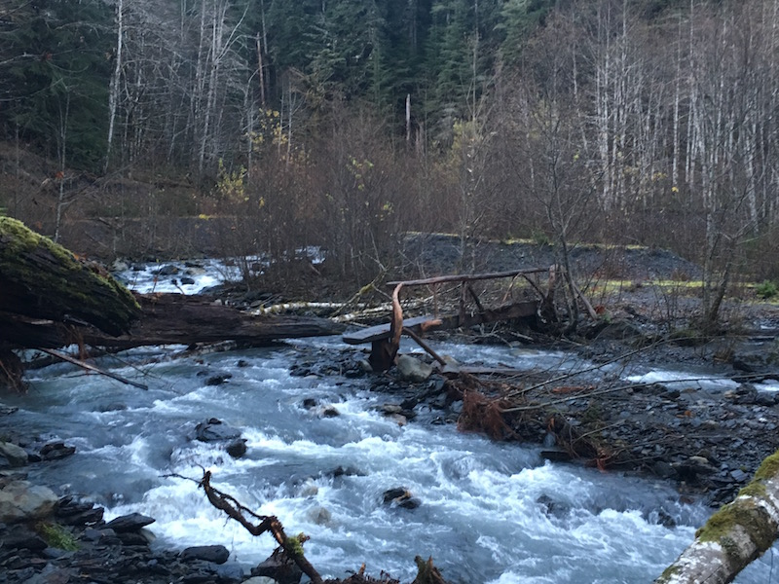
16 – 17 November Atmospheric River

Slide 30
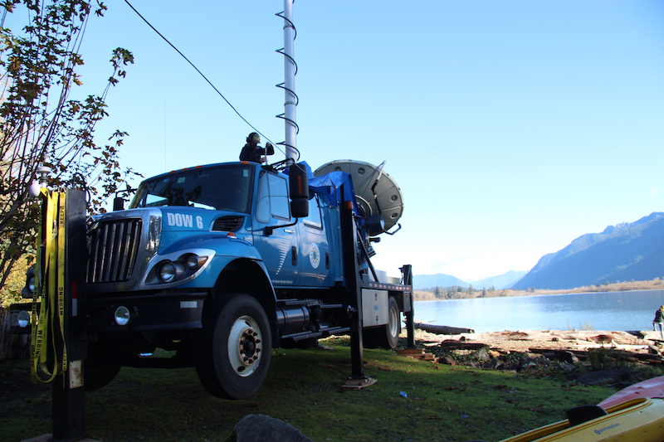
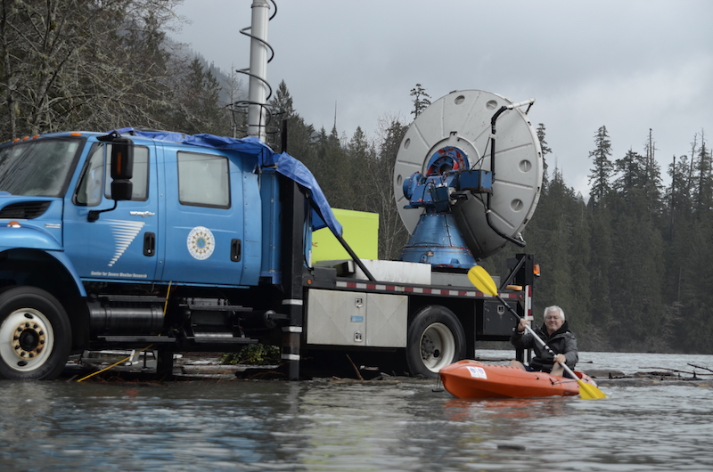
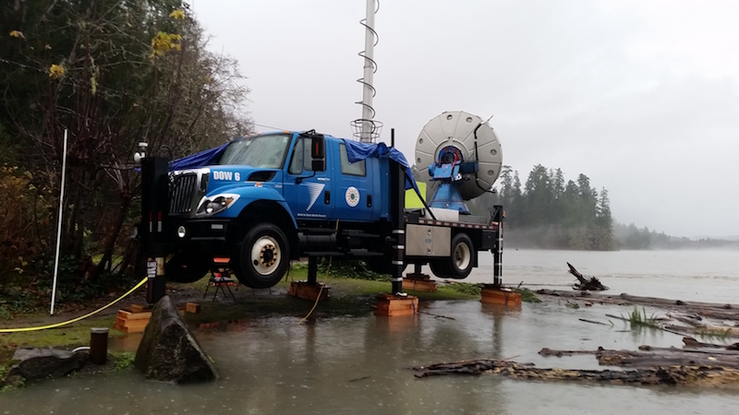
The Doppler on Wheels (DOW)
Water

Slide 31
Common Features of these 3 Events (warm sector period)
Strong, moist WSW flow towards the Olympic Mountains with high melting levels
Precipitation patterns differ from seasonal climatology including stronger than average orographic enhancement
Large hydrologic impact
Next talk: What is role of warm rain and ice-processes in contributing to orographic enhancement?

Slide 32
Now for some preliminary results from Joe…

Slide 33
Acknowledgments
Work supported by:
NASA grants NNX15AL38G and NNX16AK05G

