Slide 1
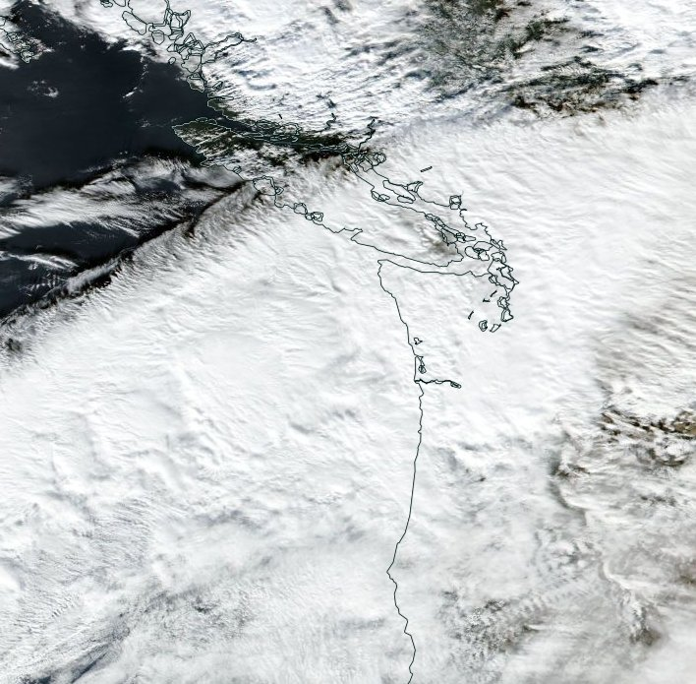
Airborne Doppler radar observations of mid-latitude storms during OLYMPEX
Jennifer DeHart and Robert Houze
17th Conference on Mountain Meteorology
6.28.16
NASA grants: NNX15AN52H, NNX13AG71G, NNX15AL38G, NNX16AD75G
NSF grant: AGS-1503155

Slide 2
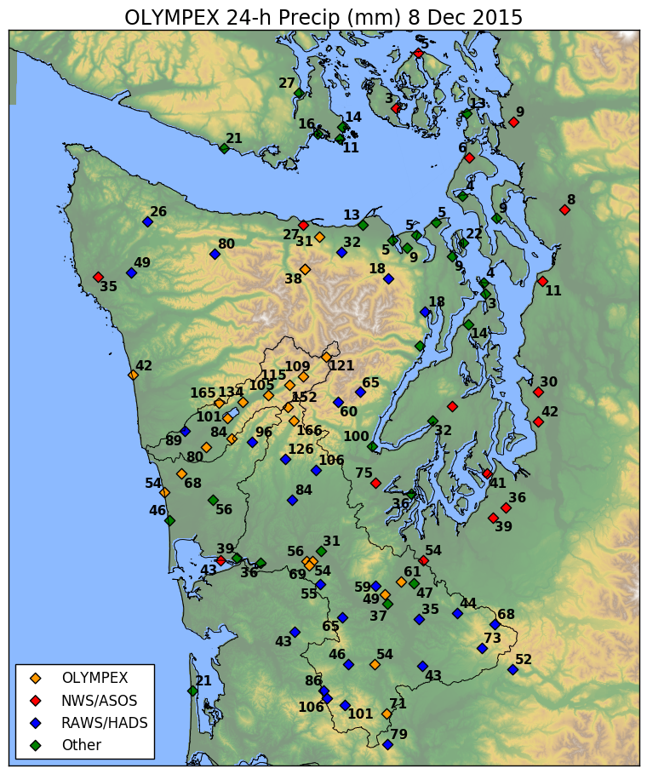
December 8th
Strong precipitation enhancement on windward slopes to the SW
Goal: examine how precipitation structure varies around the Olympics

Slide 3
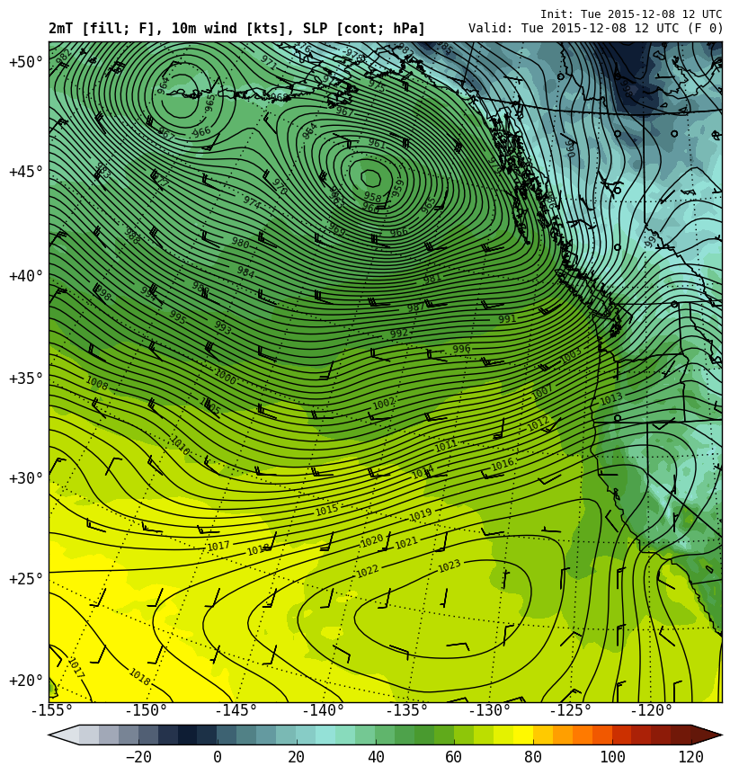
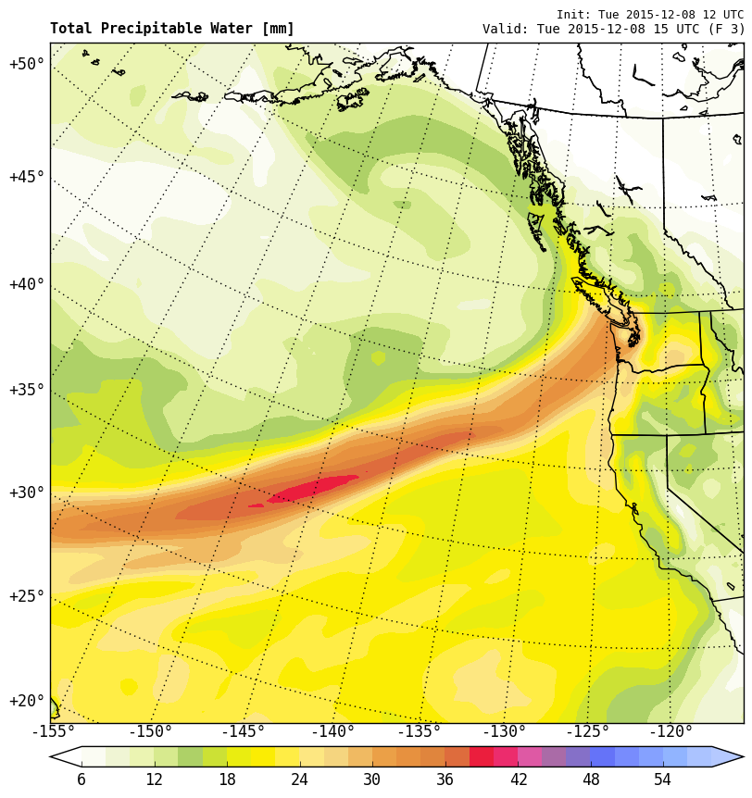
UW WRF – 36 km
Surface + TPW – 12/8

Slide 4
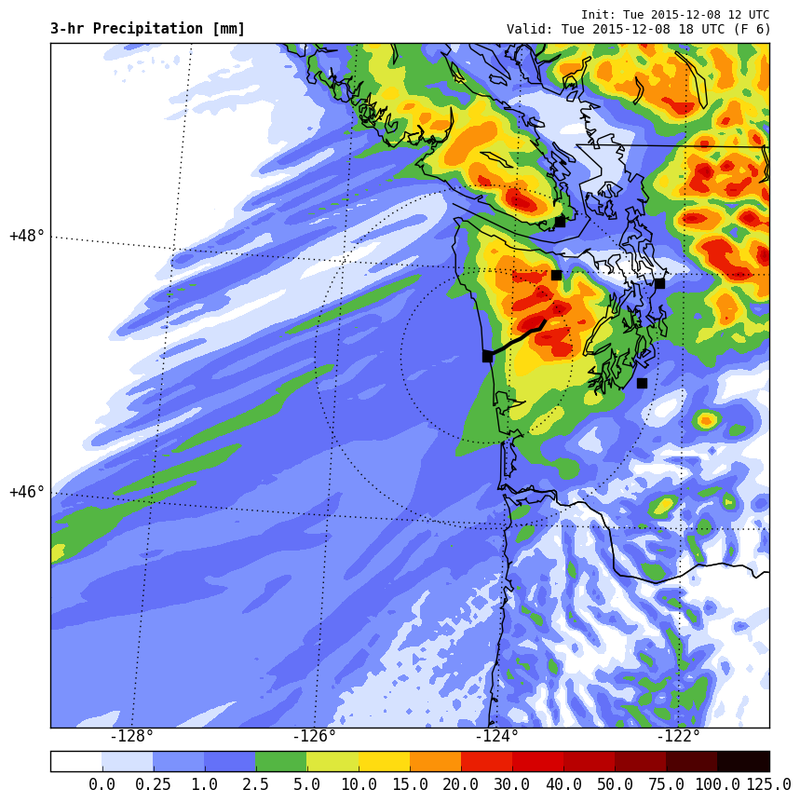
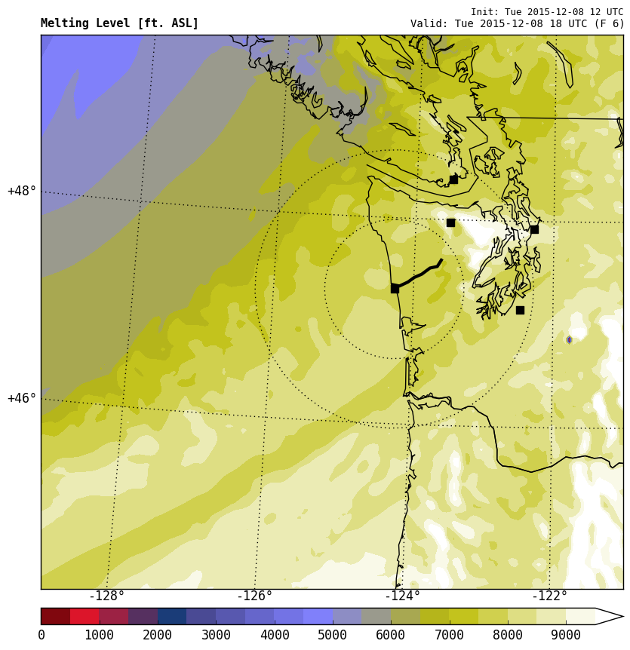
UW WRF – 4 km
3 hr precip + melting level hgt – 18 UTC 12/8

Slide 5
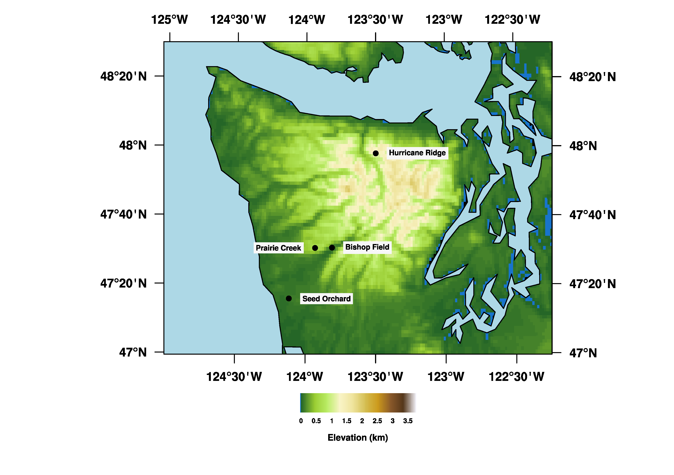
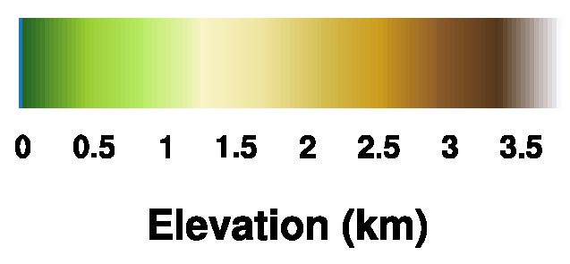

Slide 6
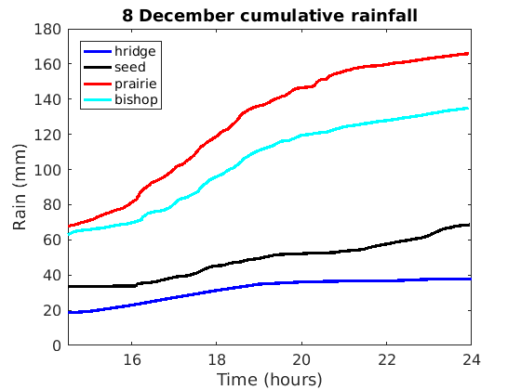
Prairie Creek 24 hour total: ~165 mm / 6.5 in
UW OLYMPEX gauges (Hurricane Ridge from NW Avalanche Center)

Slide 7
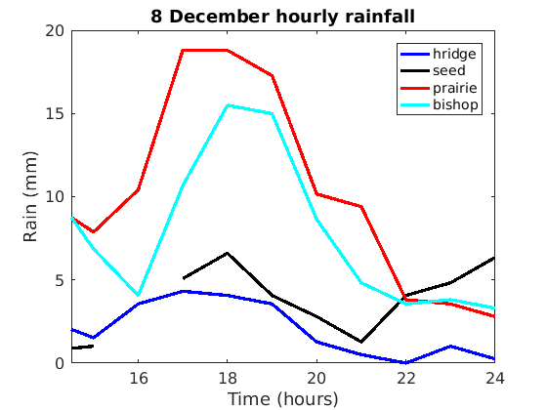
Hourly rainfall at windward locations (Prairie Creek / Bishop Field) double low elevation site (Seed Orchard) and lee site (Hurricane Ridge) through 2200 UTC 8 Dec

Slide 8
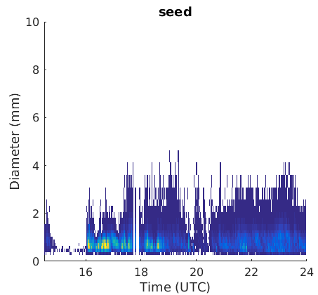
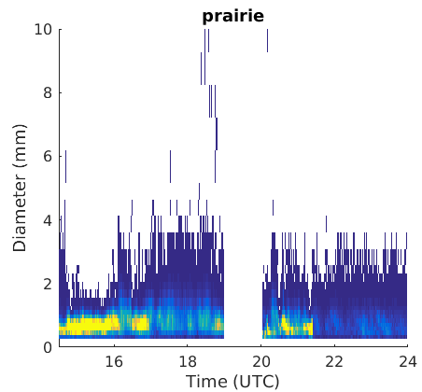
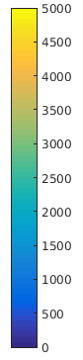
Flight legs
Weak precipitation (1430-1600 UTC)
Strong precipitation (1600 – 1830 UTC)

Slide 9
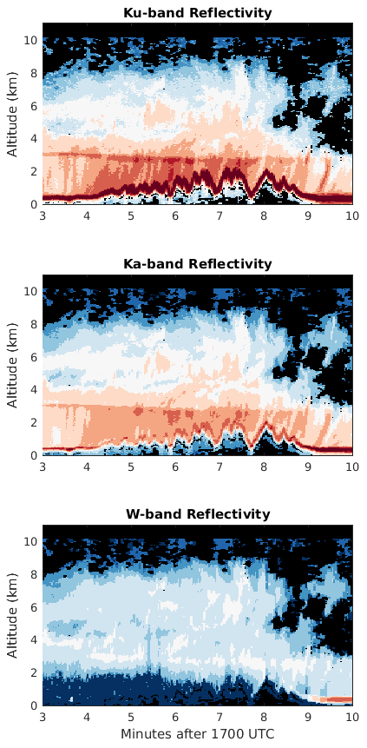
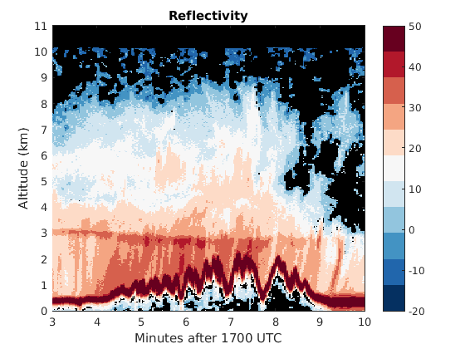
APR-3
NASA DC-8 equipped with the Advanced Precipitation Radar 3
  Ku / Ka / W band
  Cross-track scanning strategy
  High vertical resolution
  Documents structure around the Olympics (windward, lee, ocean and high terrain)

Slide 10


Slide 11
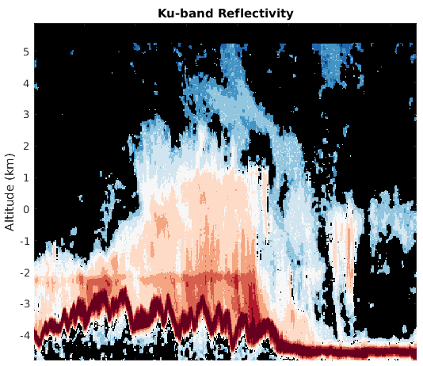
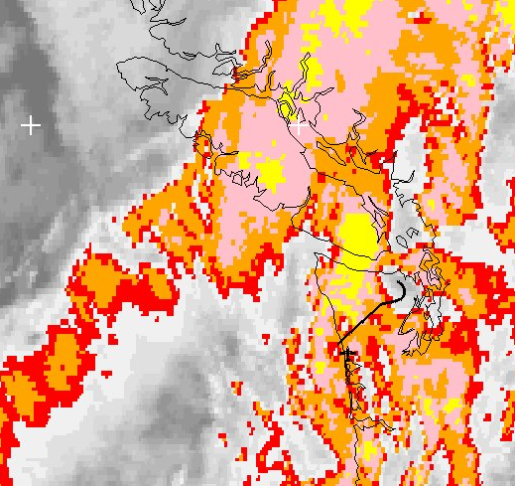
Windward
Radar echo limited to immediate vicinity of terrain
Max enhancement found near initial windward slopes
Highest terrain does not see maximum enhancement
Echo top height decreases in lee
Precipitation removed from most intense cloud band

Slide 12
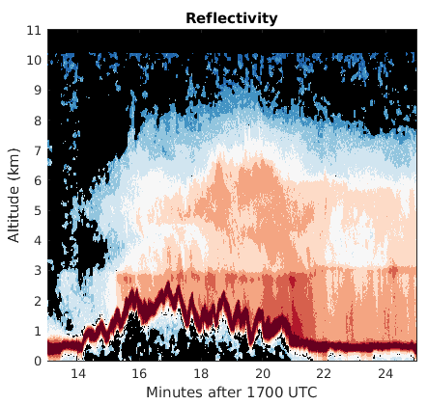
Northern leg
Southern leg
Windward
Windward
Some similarities with earlier leg
Except radar echo now exists upstream
APR-3 also documents changing melting level height

Slide 13
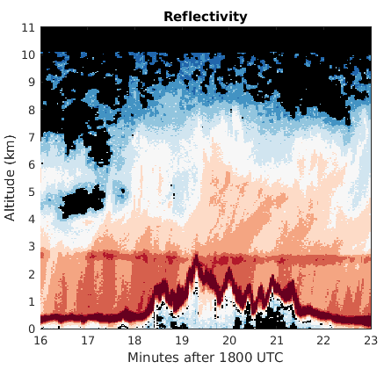
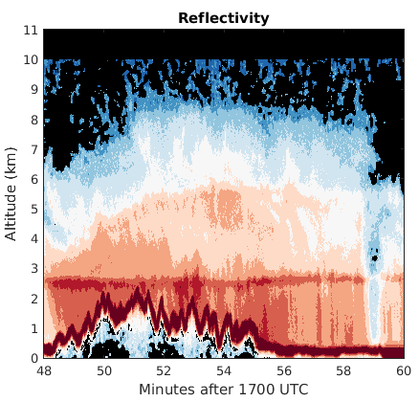
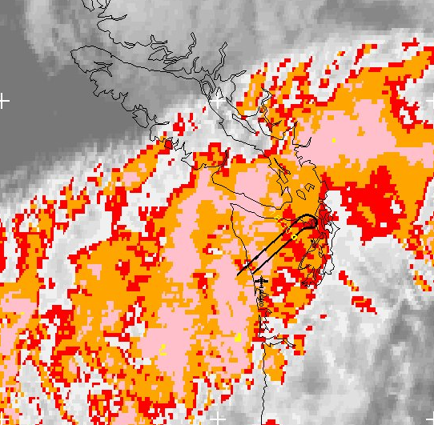
Northern leg
Southern leg
Windward
Windward
Less than an hour later, leeside reflectivity filled in
Reflectivity profiles in lee vary over short distances
Reduction in reflectivity towards surface in southern leg, perhaps indicating evaporation of hydrometeors

Slide 14
Summary
APR-3 complements stationary ground radars by providing data around the Olympic peninsula, especially over high terrain
Maximum reflectivity present over first ridge
  Reflectivity intensity over the highest terrain no greater than in the initial ascent
Synoptic pattern exerts a strong influence on the precipitation structure around terrain

