Slide 1

The Olympic Mountains Experiment (OLYMPEX)
R. Houze, L. McMurdie, W. Petersen, M. Schwaller, & many others
17th Conference on Mountain Meteorology, Burlington, VT, 28 June 2016
Supported by NASA grants: NNX12AL54G, NNX14AO64GNNX15AL38G, NNX16AD75G; NSF grant NNX16AD75G

Slide 2
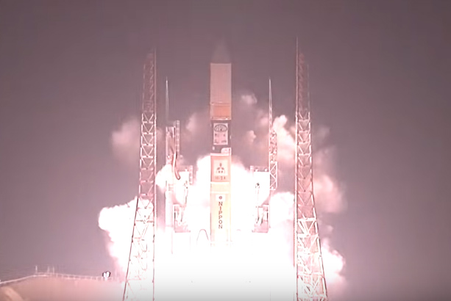
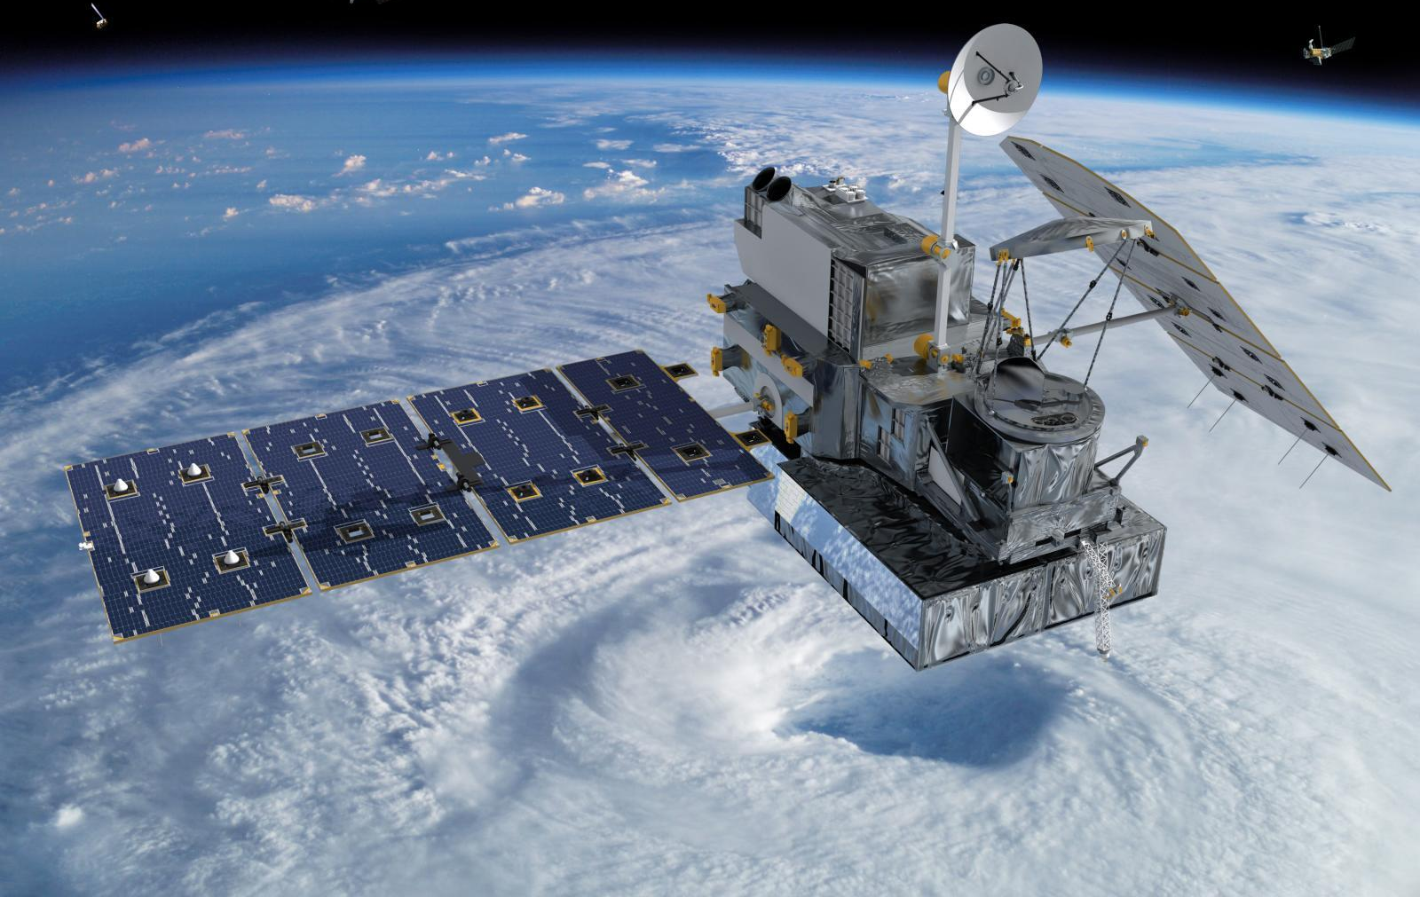

The GPM Satellite
Satellite Validation in the Pacific Northwest
27 Feb 2014

Slide 3
GPM Orbit

Slide 4
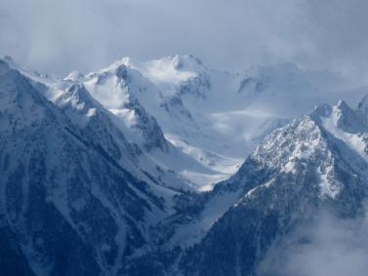
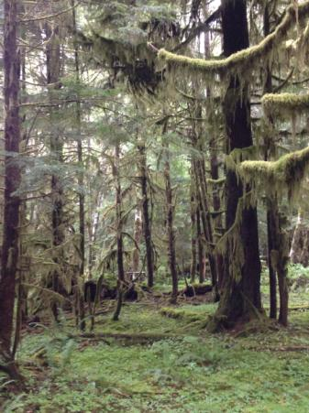
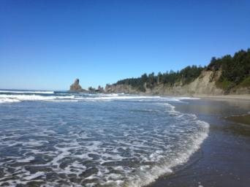
The Olympic Peninsula
High Terrain
Valley
Rain Forest
Ocean

Slide 5
Goals of OLYMPEX
Validate satellite radar and passive microwave instruments
Determine the orographic effects on precipitation processes

Slide 6
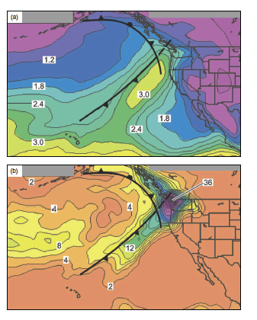
What are the mechanisms of enhancement of Atmospheric Rivers and other frontal precipitation over coastal mountains?
Composite
PW (cm)
Composite
Rain (mm)
Neiman et al. 2008

Slide 7
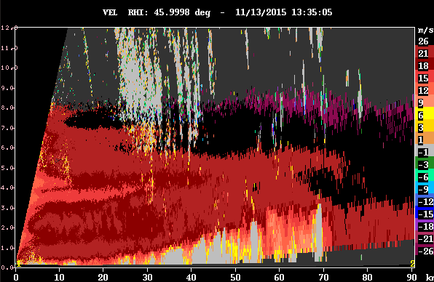
Layer lifting of low-level warm moist jet
Radial Velocity

Slide 8
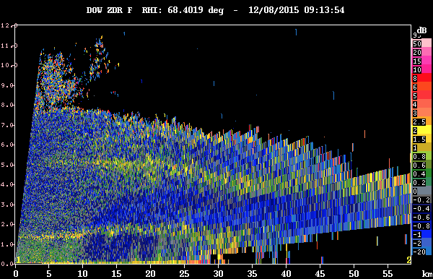
Enhancement of ice-phase processes
Enhanced aggregation?
ZDR

Slide 9
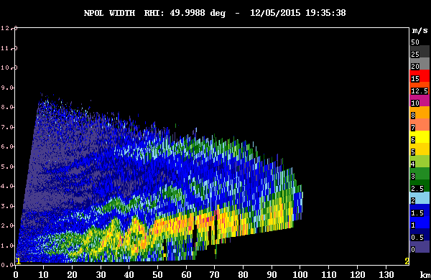
Cellularity in the upslope flow?
KH waves
Spectrum width
(shear)

Slide 10
Instruments on GPM

Slide 11
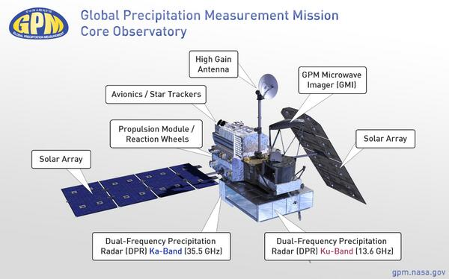
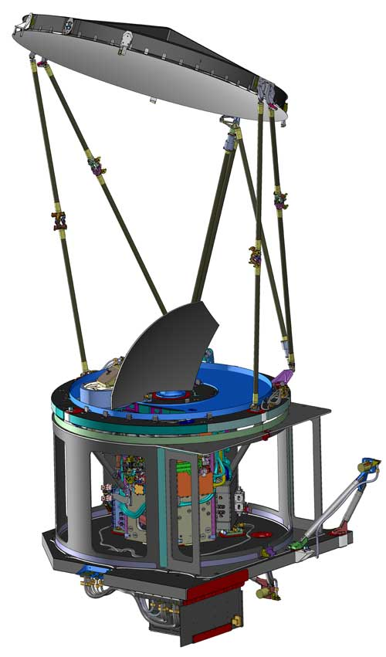
GMI
DPR
GPM Microwave Imager (GMI) – Passive instrument
Can measure wide range of precipitation intensities including falling snow
Dual Precipitation Radar(DPR) – Active instrument
Measures 3-D structure of precipitation

Slide 12
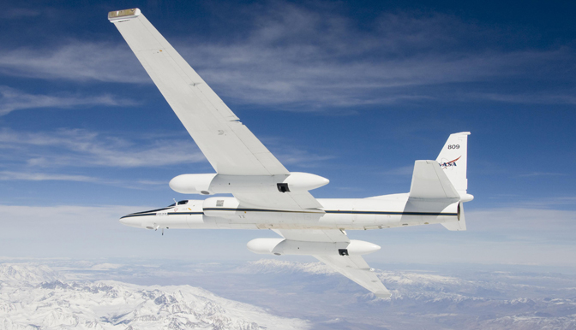
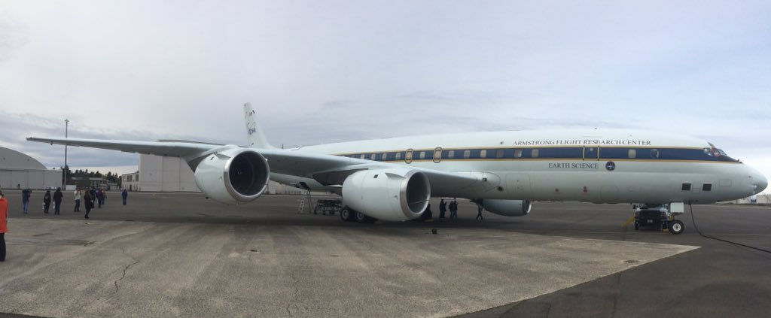
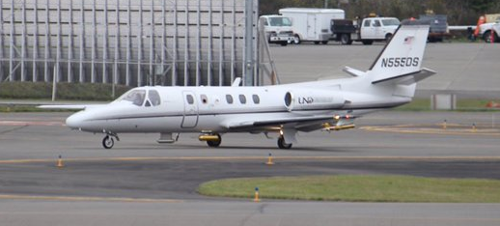
OLYMPEX Aircraft
DC-8
ER-2
RADARS, AMPR
DC-8
APR3, COSMIR
Cloud Physics
UND Citation

Slide 13
The OLYMPEX Strategy
Aircraft
ER2 & DC8—over the top
Citation—through the clouds
Surface
Particle sizes and fallspeeds
Rain and snow amounts
Snow cameras
Upper air
Supplemental soundings in events
Windward and leeside stations
Radars for 3D structure
RHI sectors at 4 different wavelengths
Dual polarization
Doppler

Slide 14
RHI sectors

Slide 15
Ground Sites

Slide 16
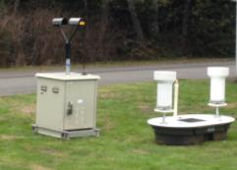
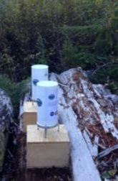
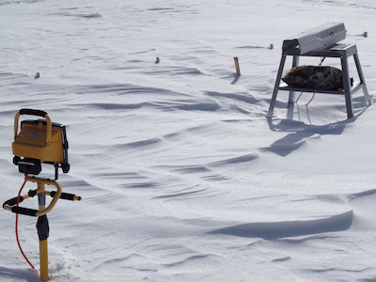
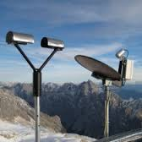
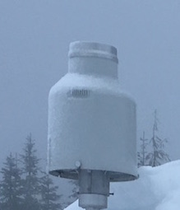
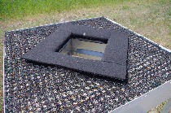
Ground Instruments
Tipping Buckets
Tipping Bucket
PIP
Parsivel
Parsivel
Pluvio
2DVD
Micro Rain Radar

Slide 17
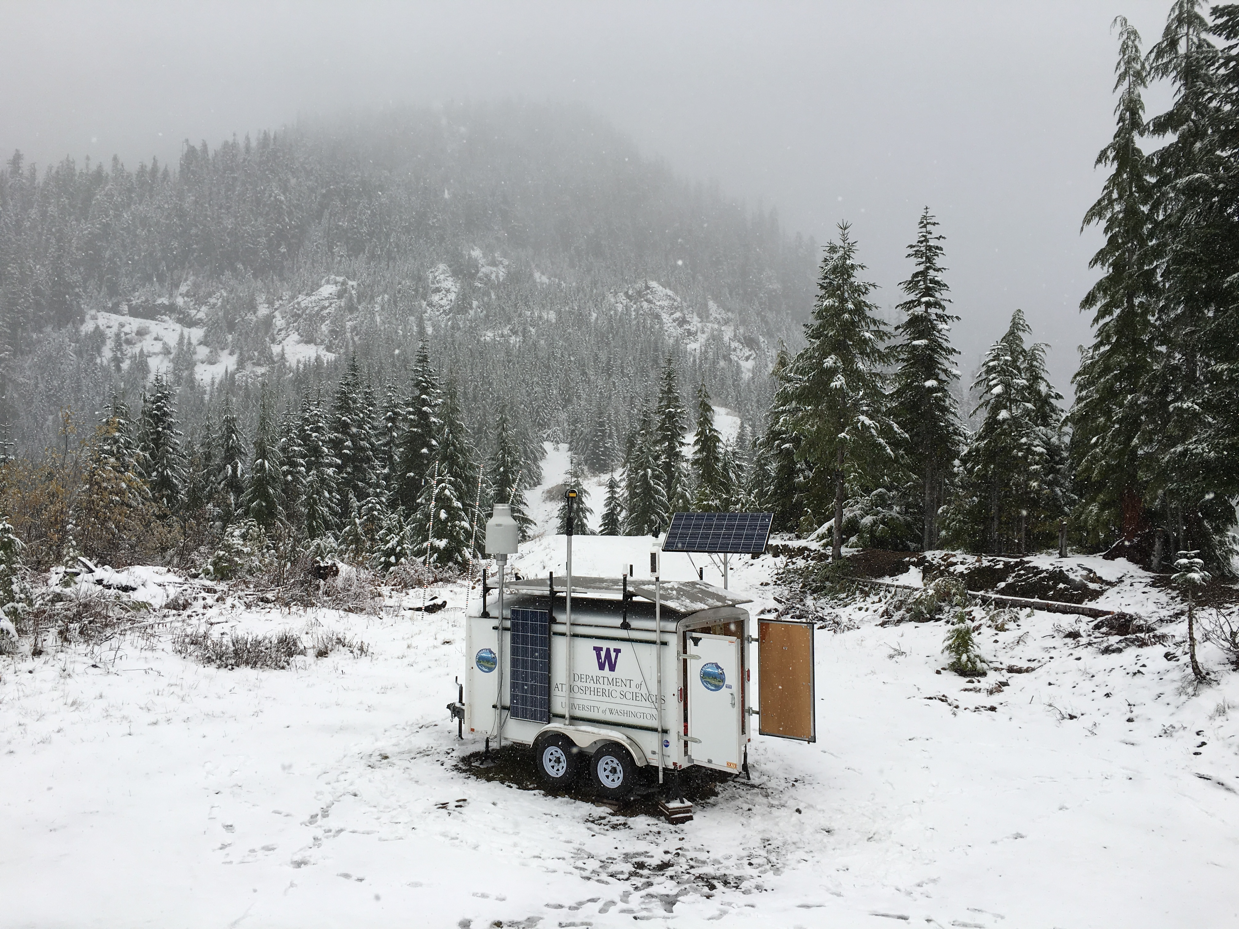
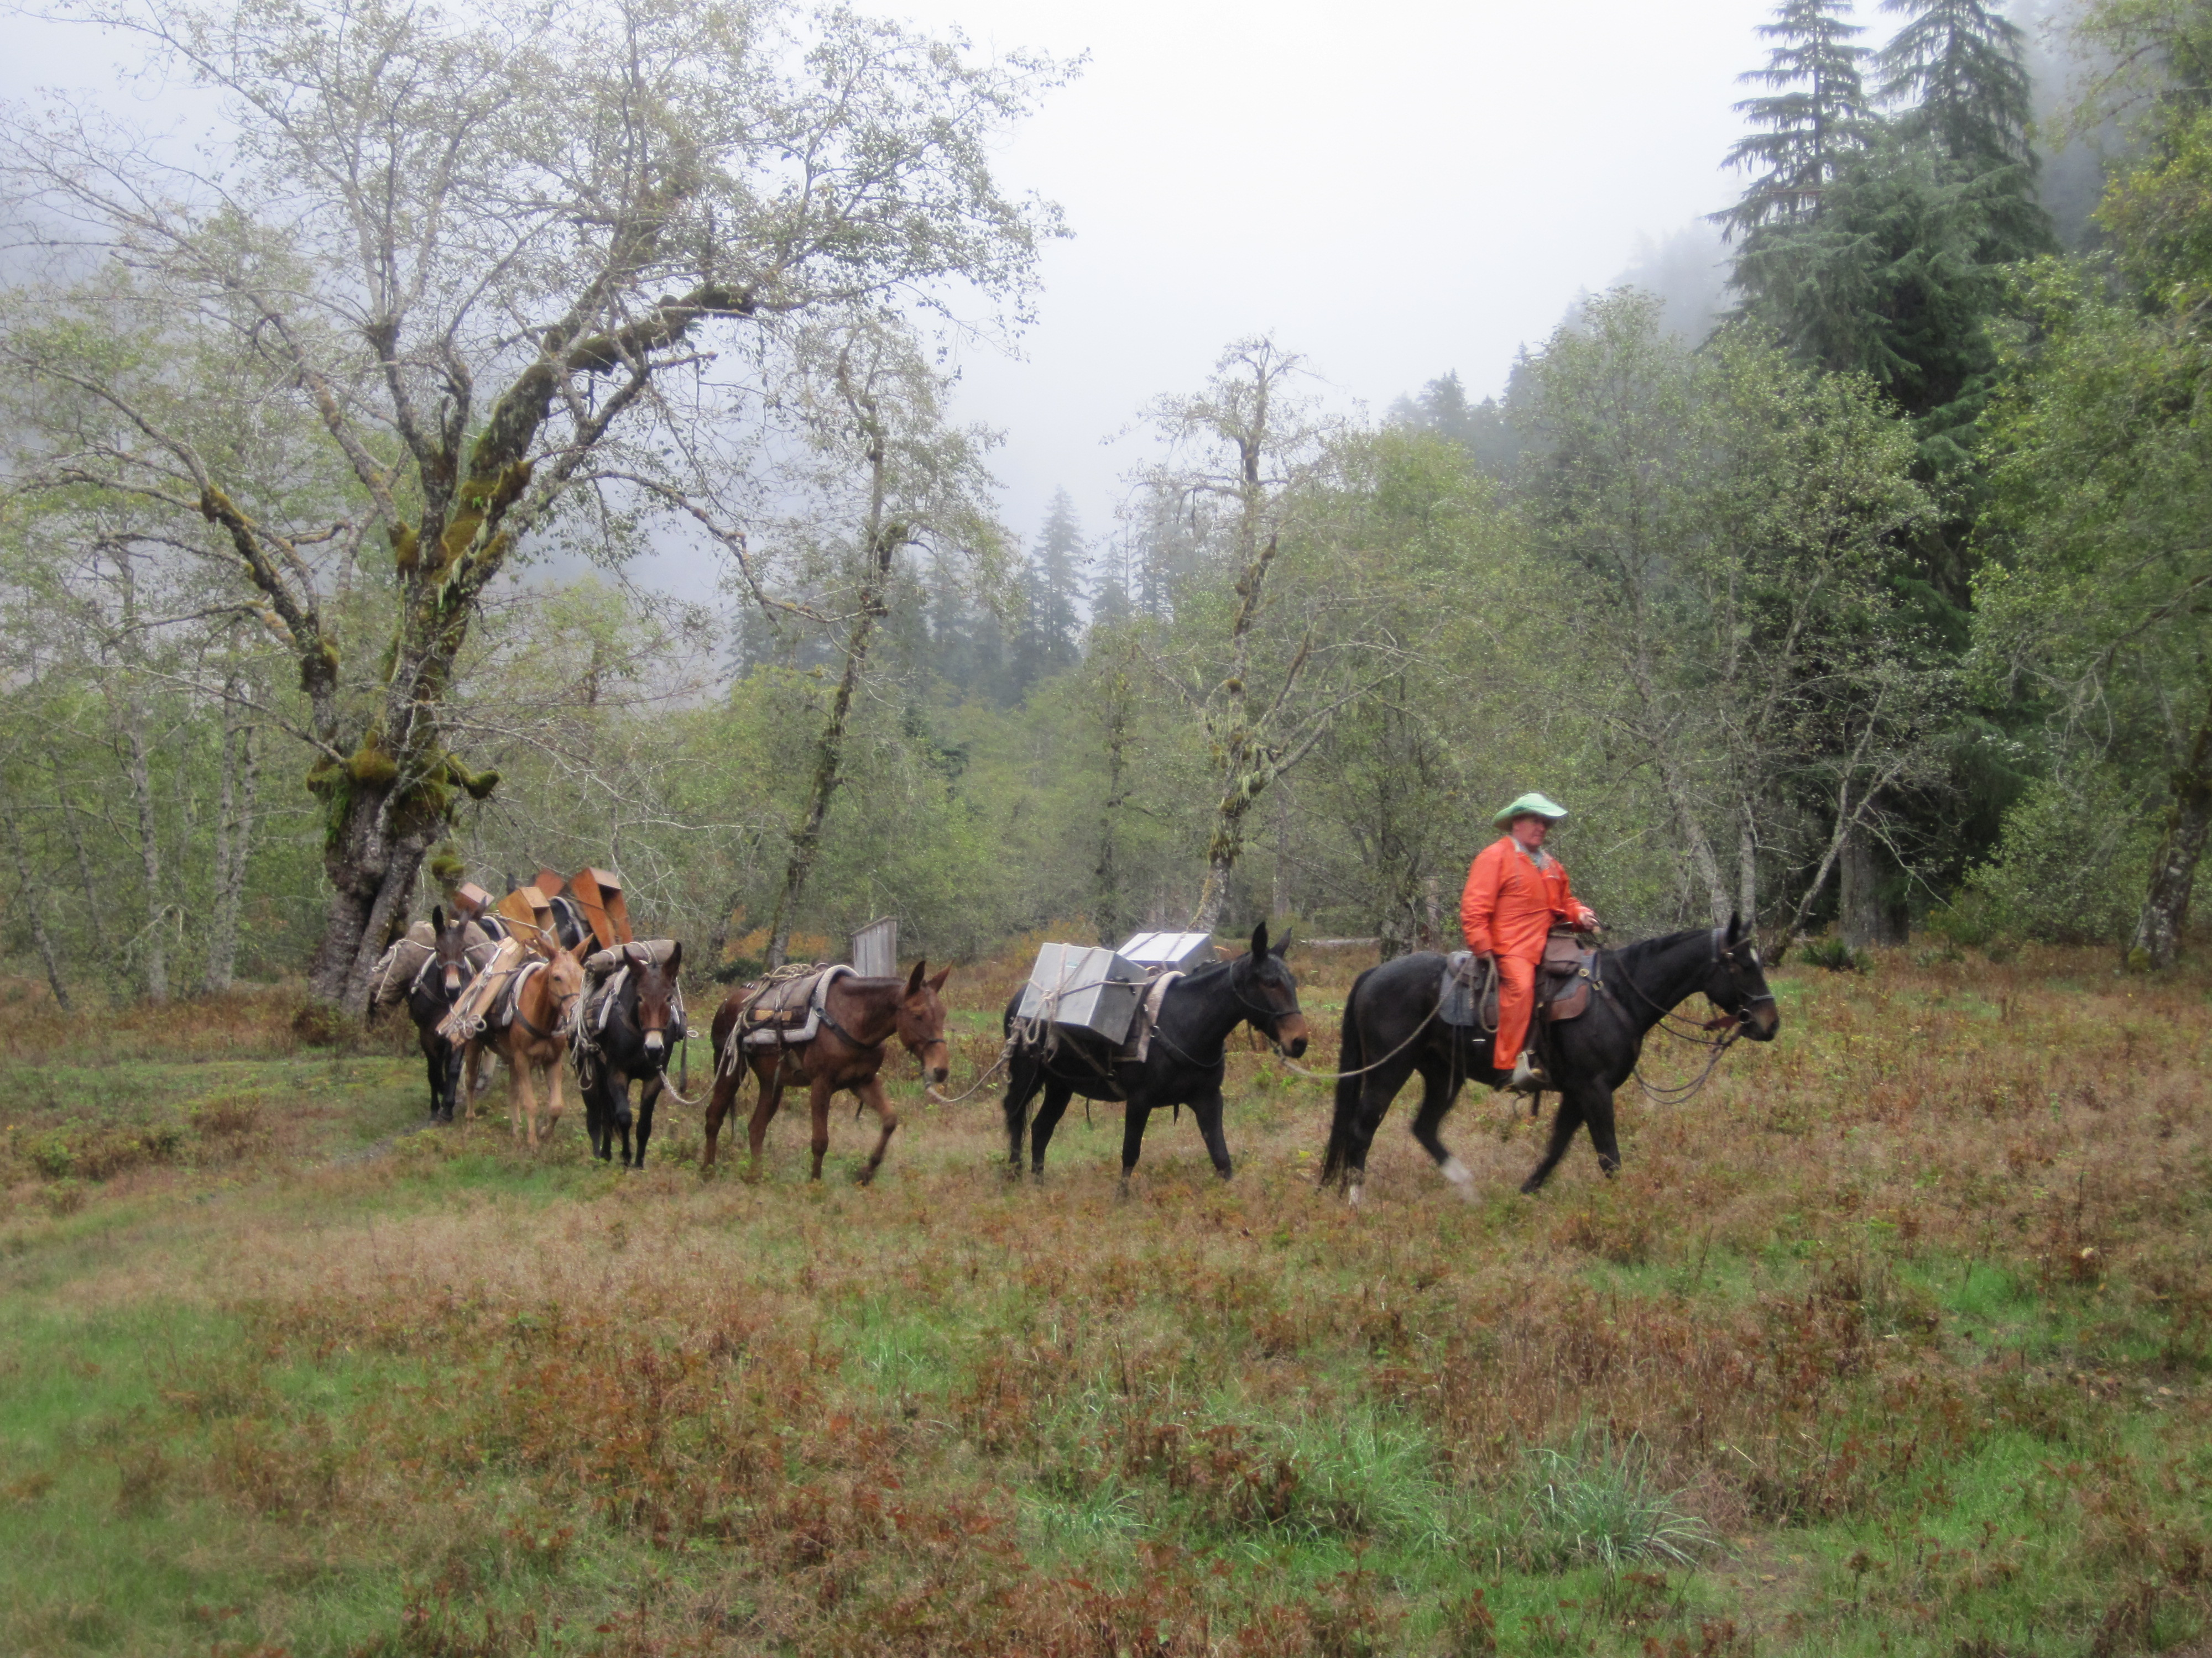
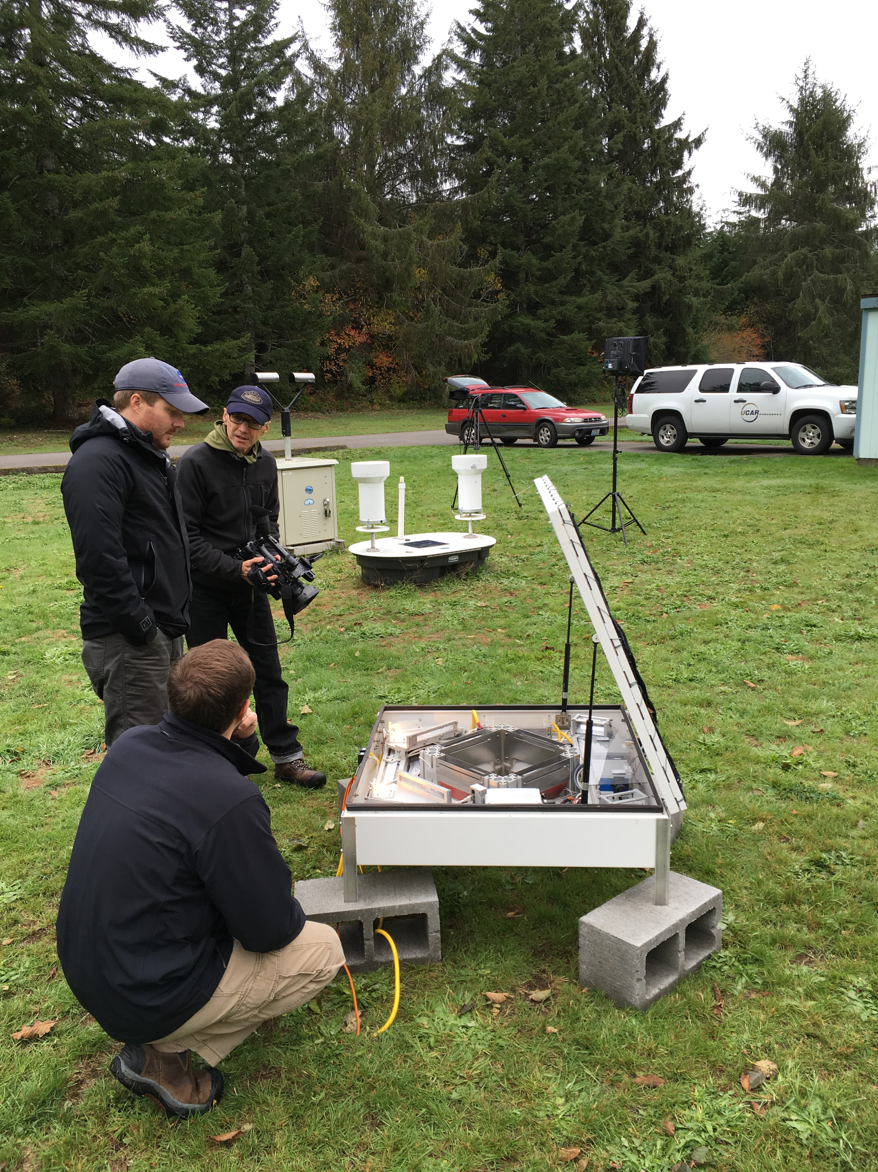
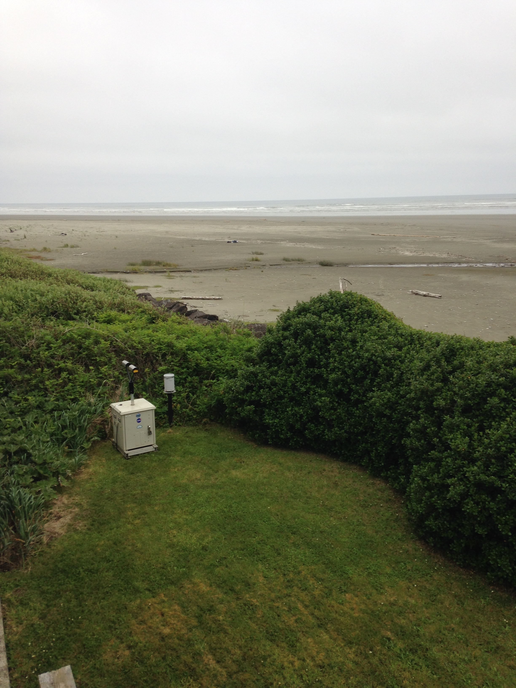
Ground Instrument Locations
3000 feet
To the Upper Quinault
Lower valley
On the beach

Slide 18
Leeside strategy: Hurricane Ridge & EC radar

Slide 19
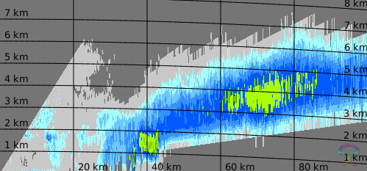
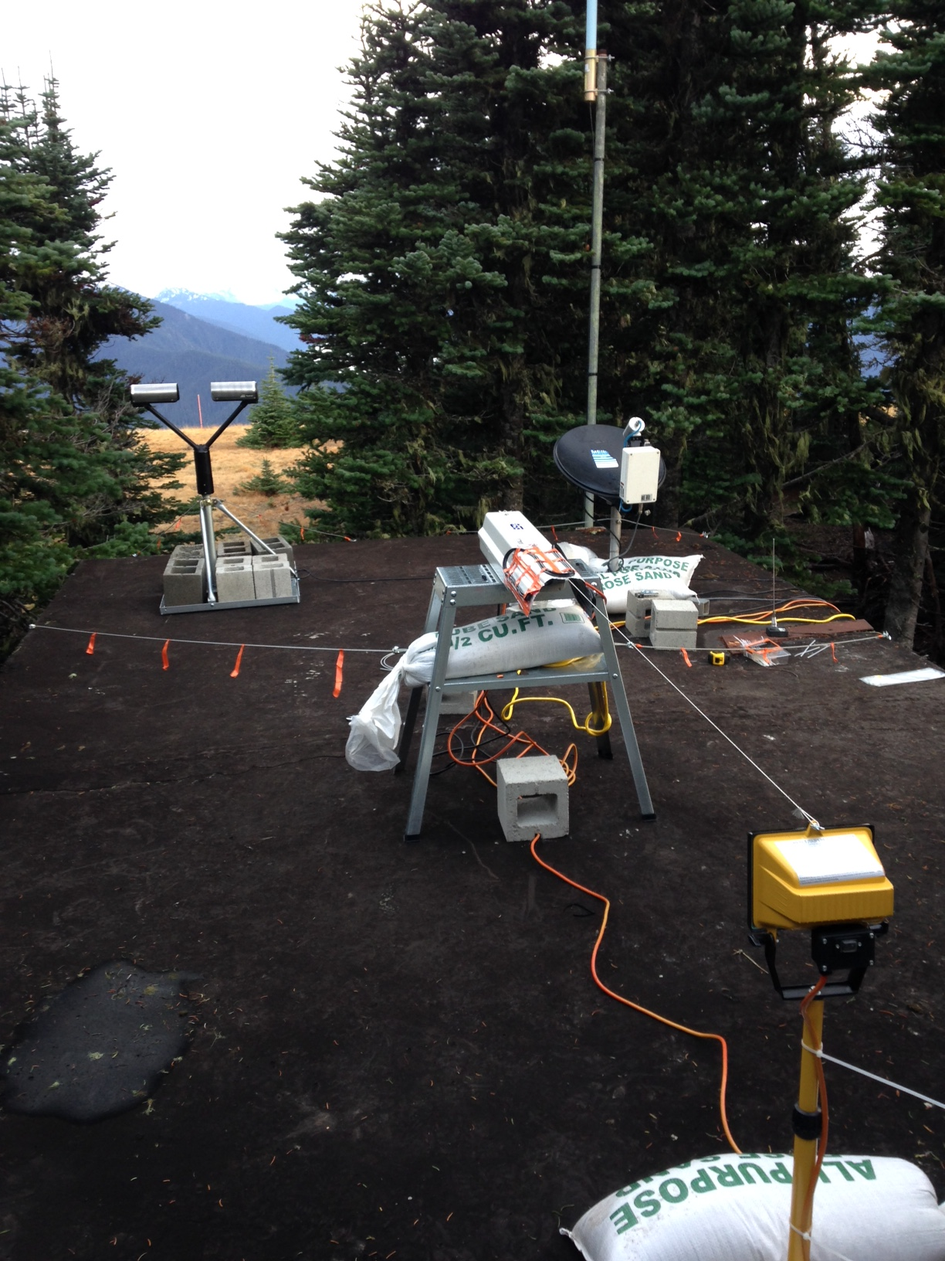
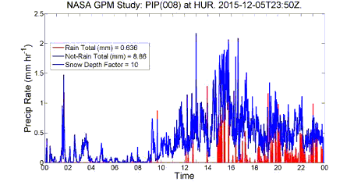
Hurricane Ridge
2125 UTC 5 Dec
EC X-band
Elevation 5000 feet
MRR
Hurricane Ridge
Parsivel
PIP
PIP

Slide 20
Aircraft Coordination

Slide 21
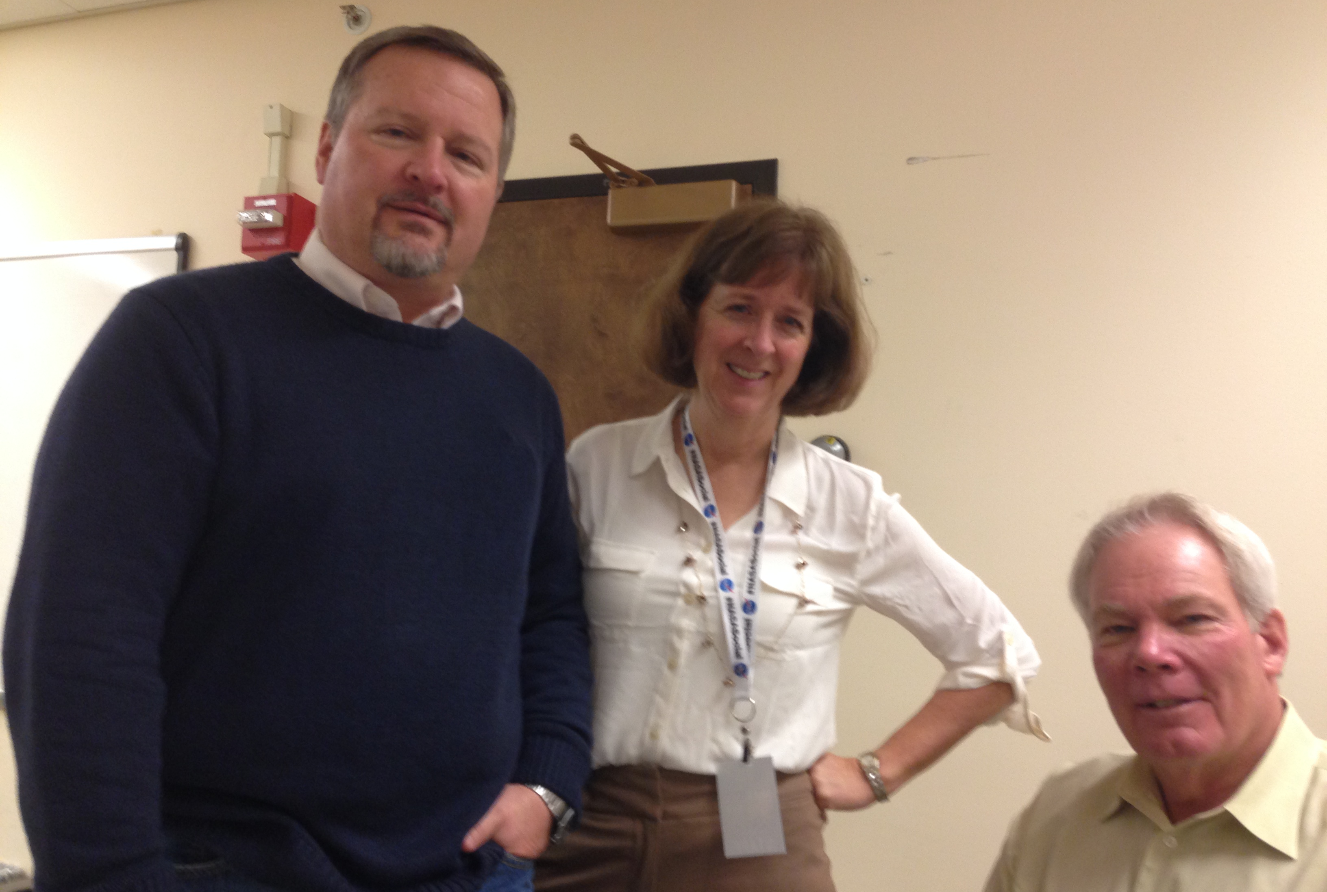
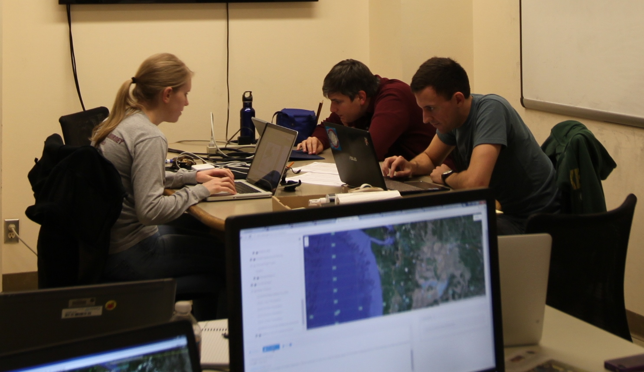
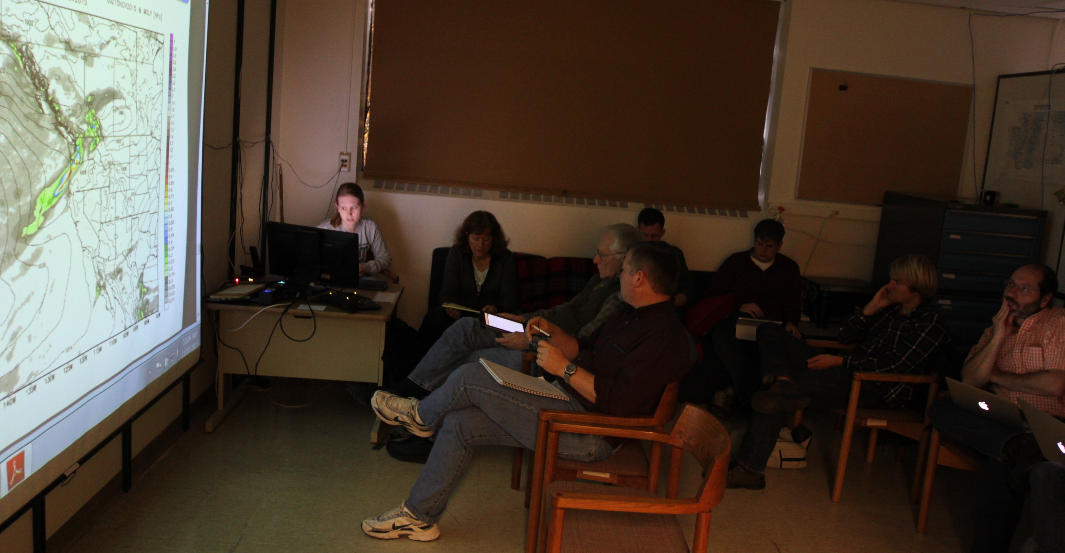
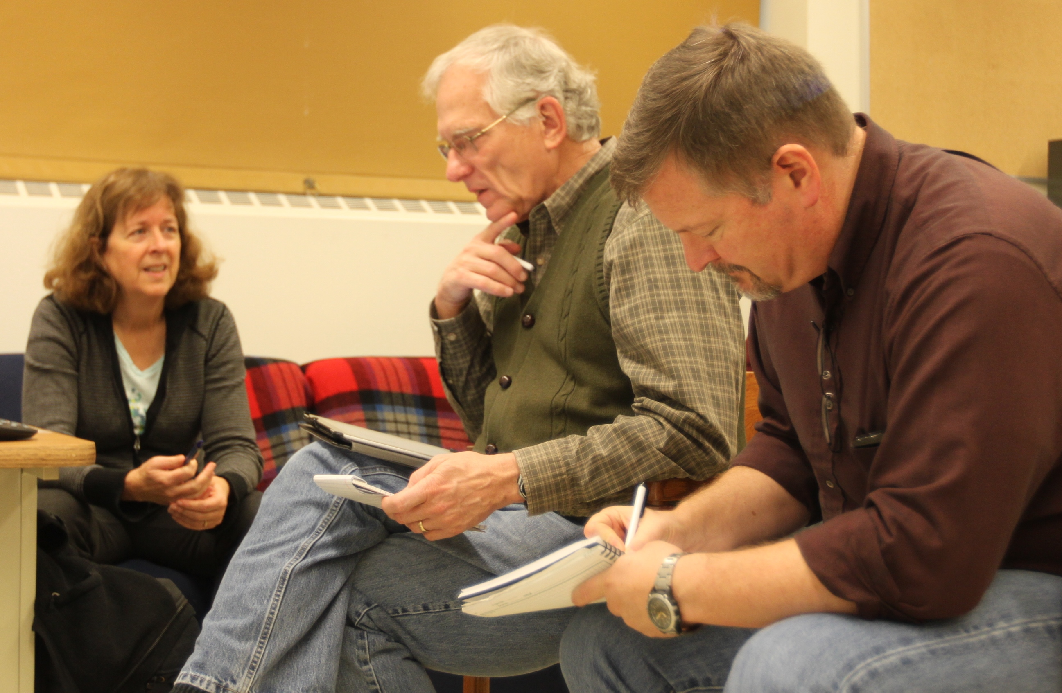
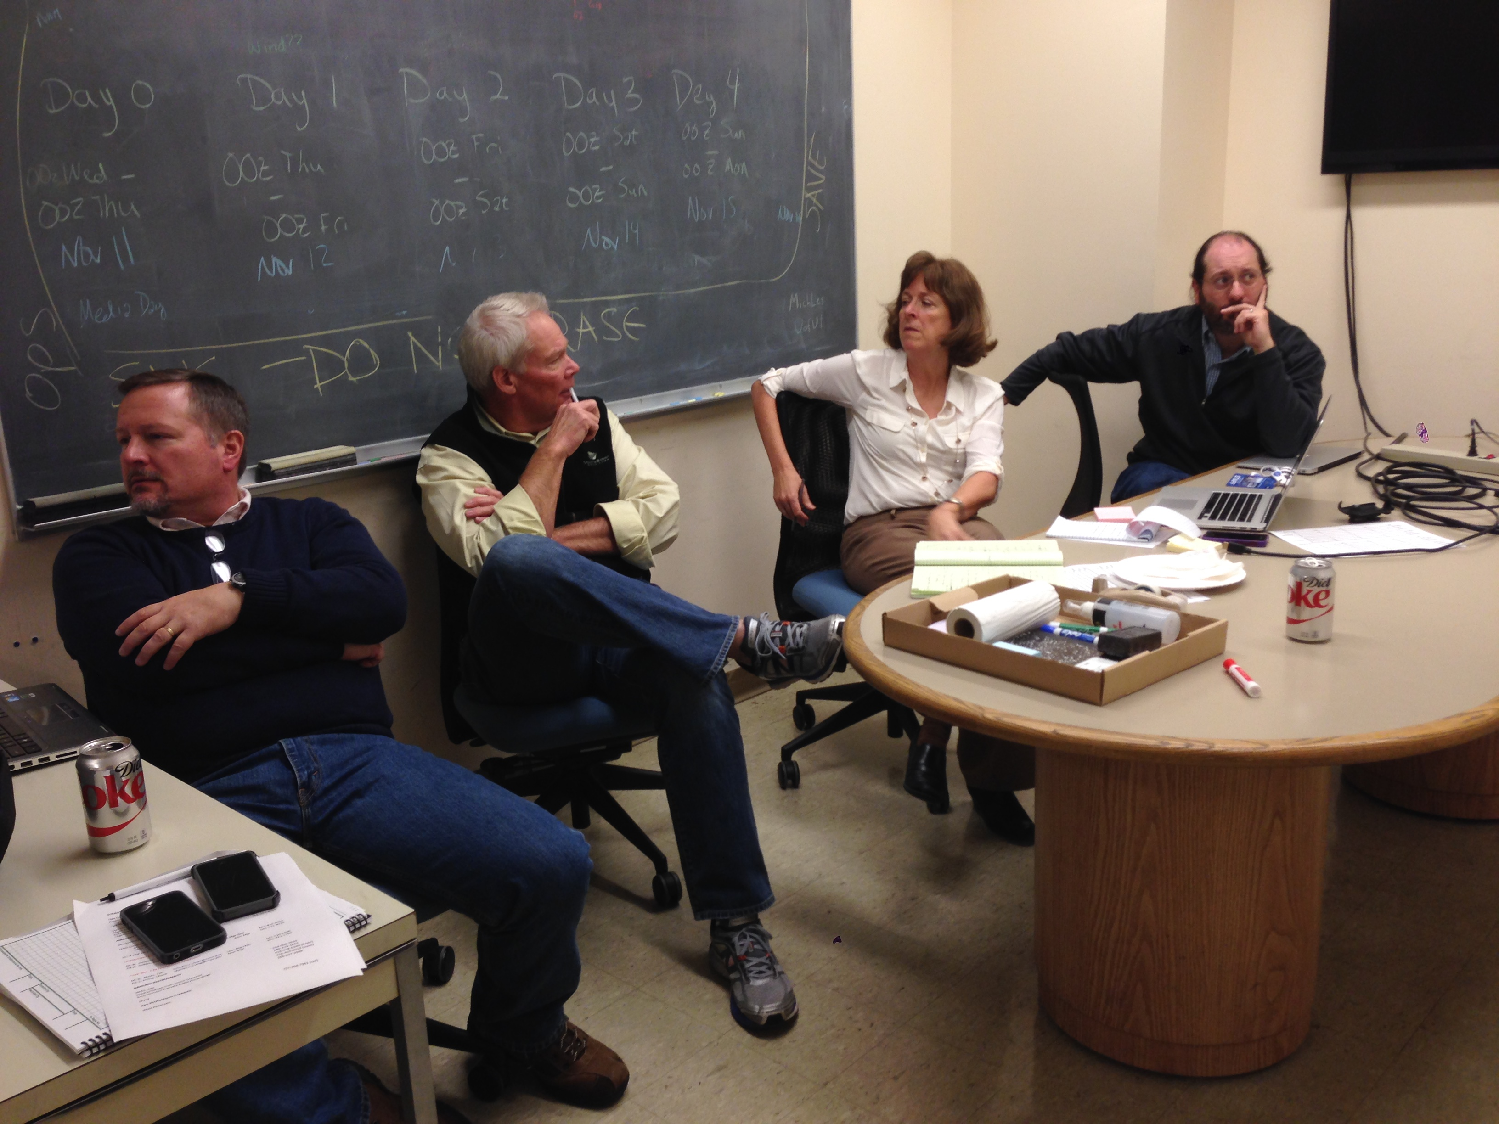
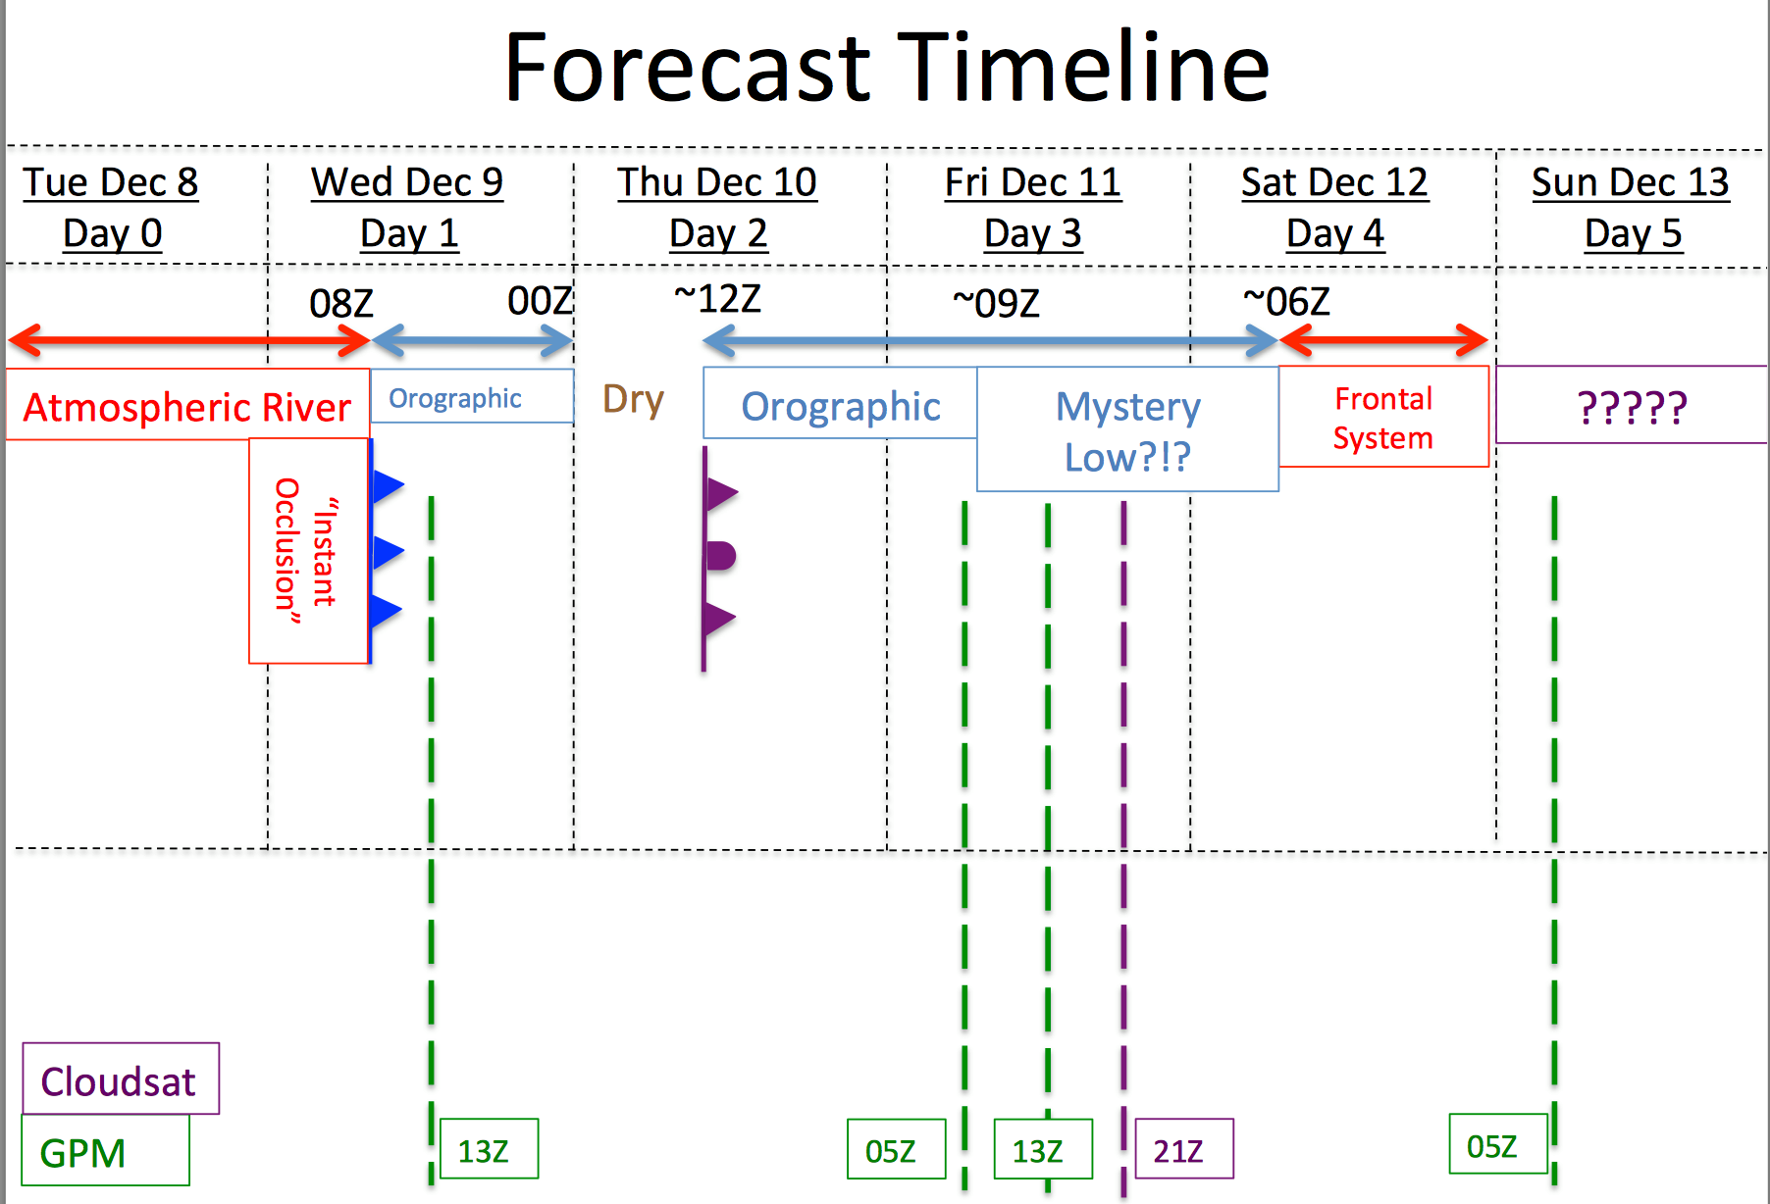
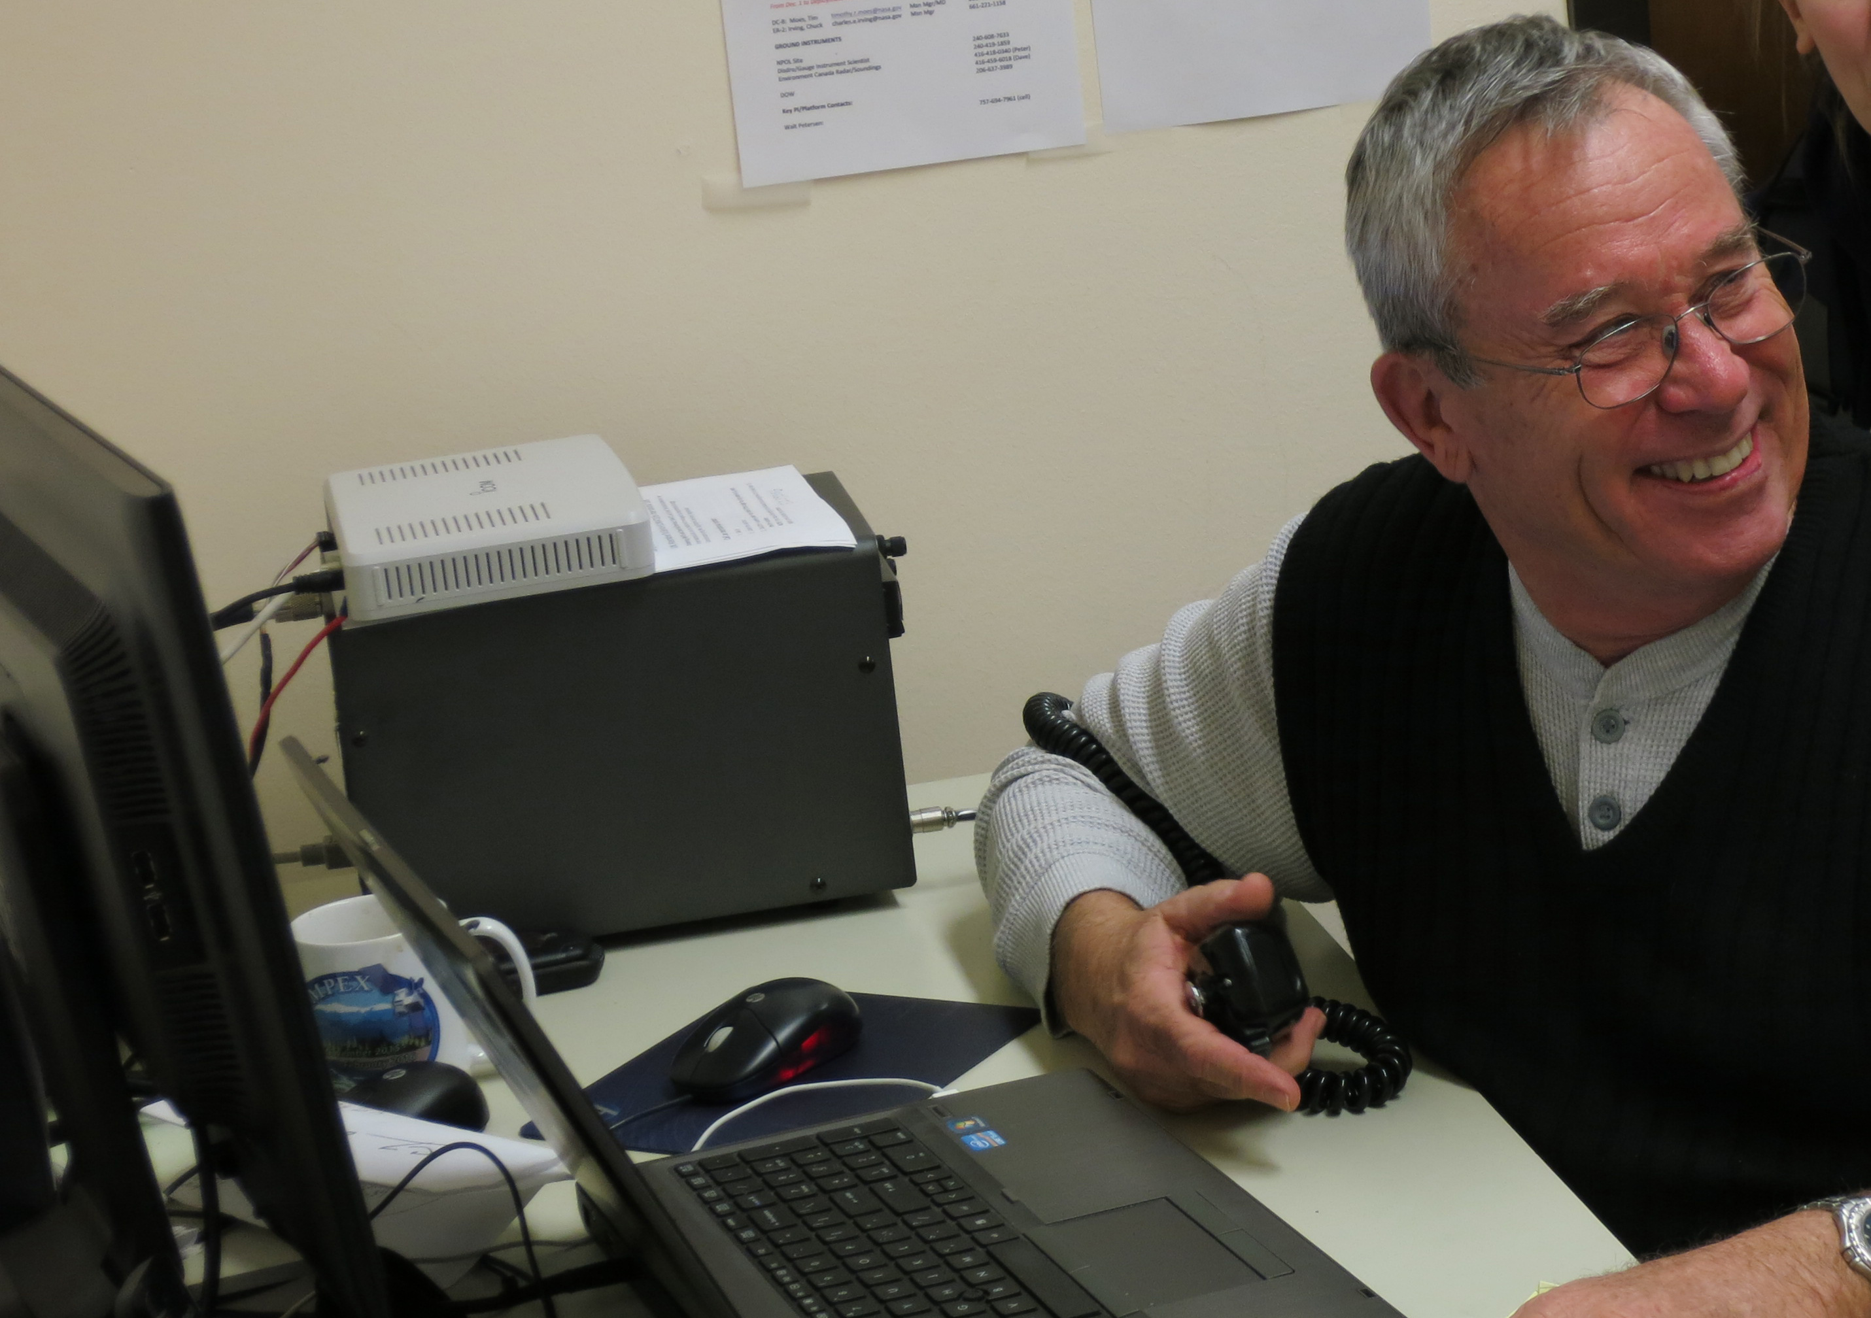
Operations Center at the UW

Slide 22
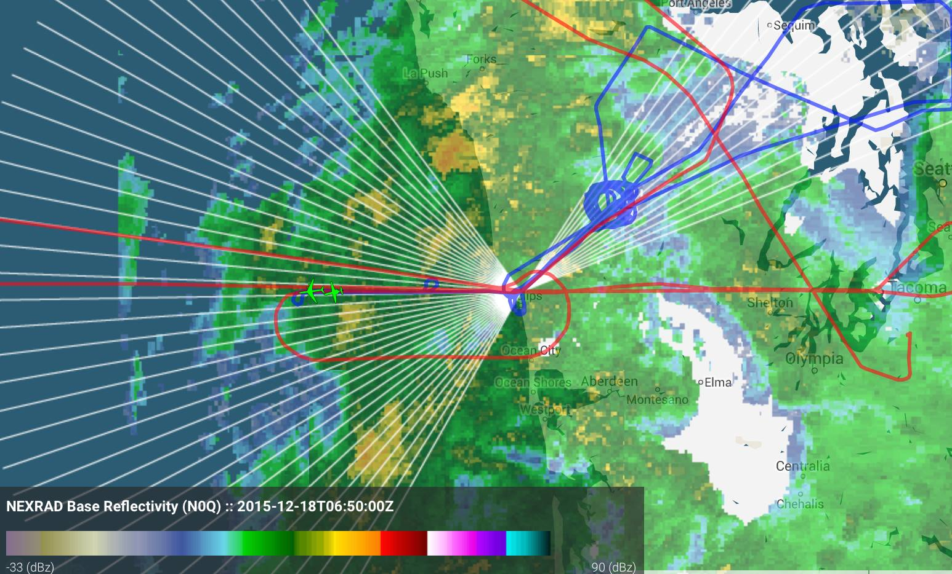
An Example of Coordination
NPOL RHIs
CITATION
DC8

Slide 23
Snow Cameras

Slide 24
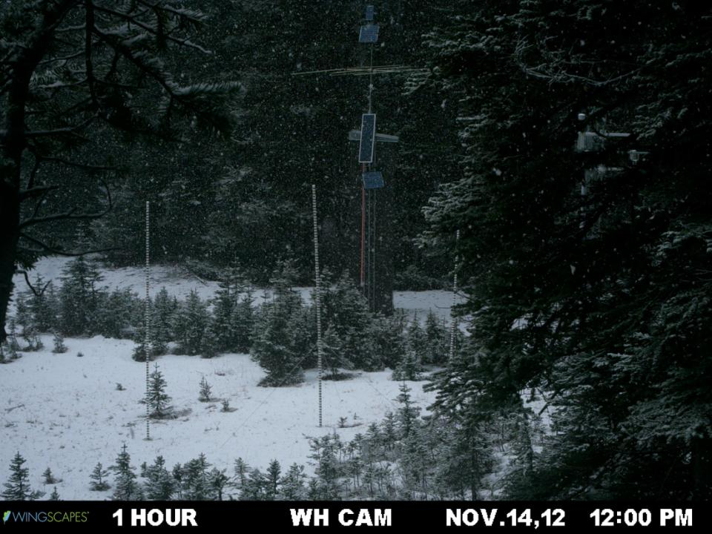
Snow Cameras

Slide 25
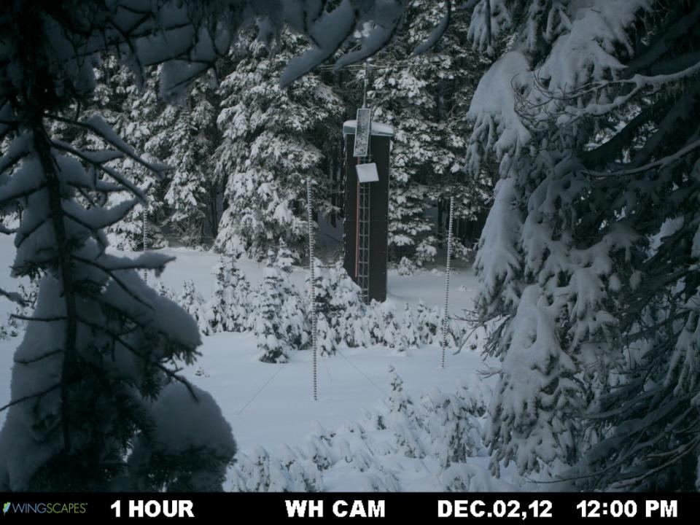
Snow Cameras

Slide 26
Now for some preliminary results…

Slide 28
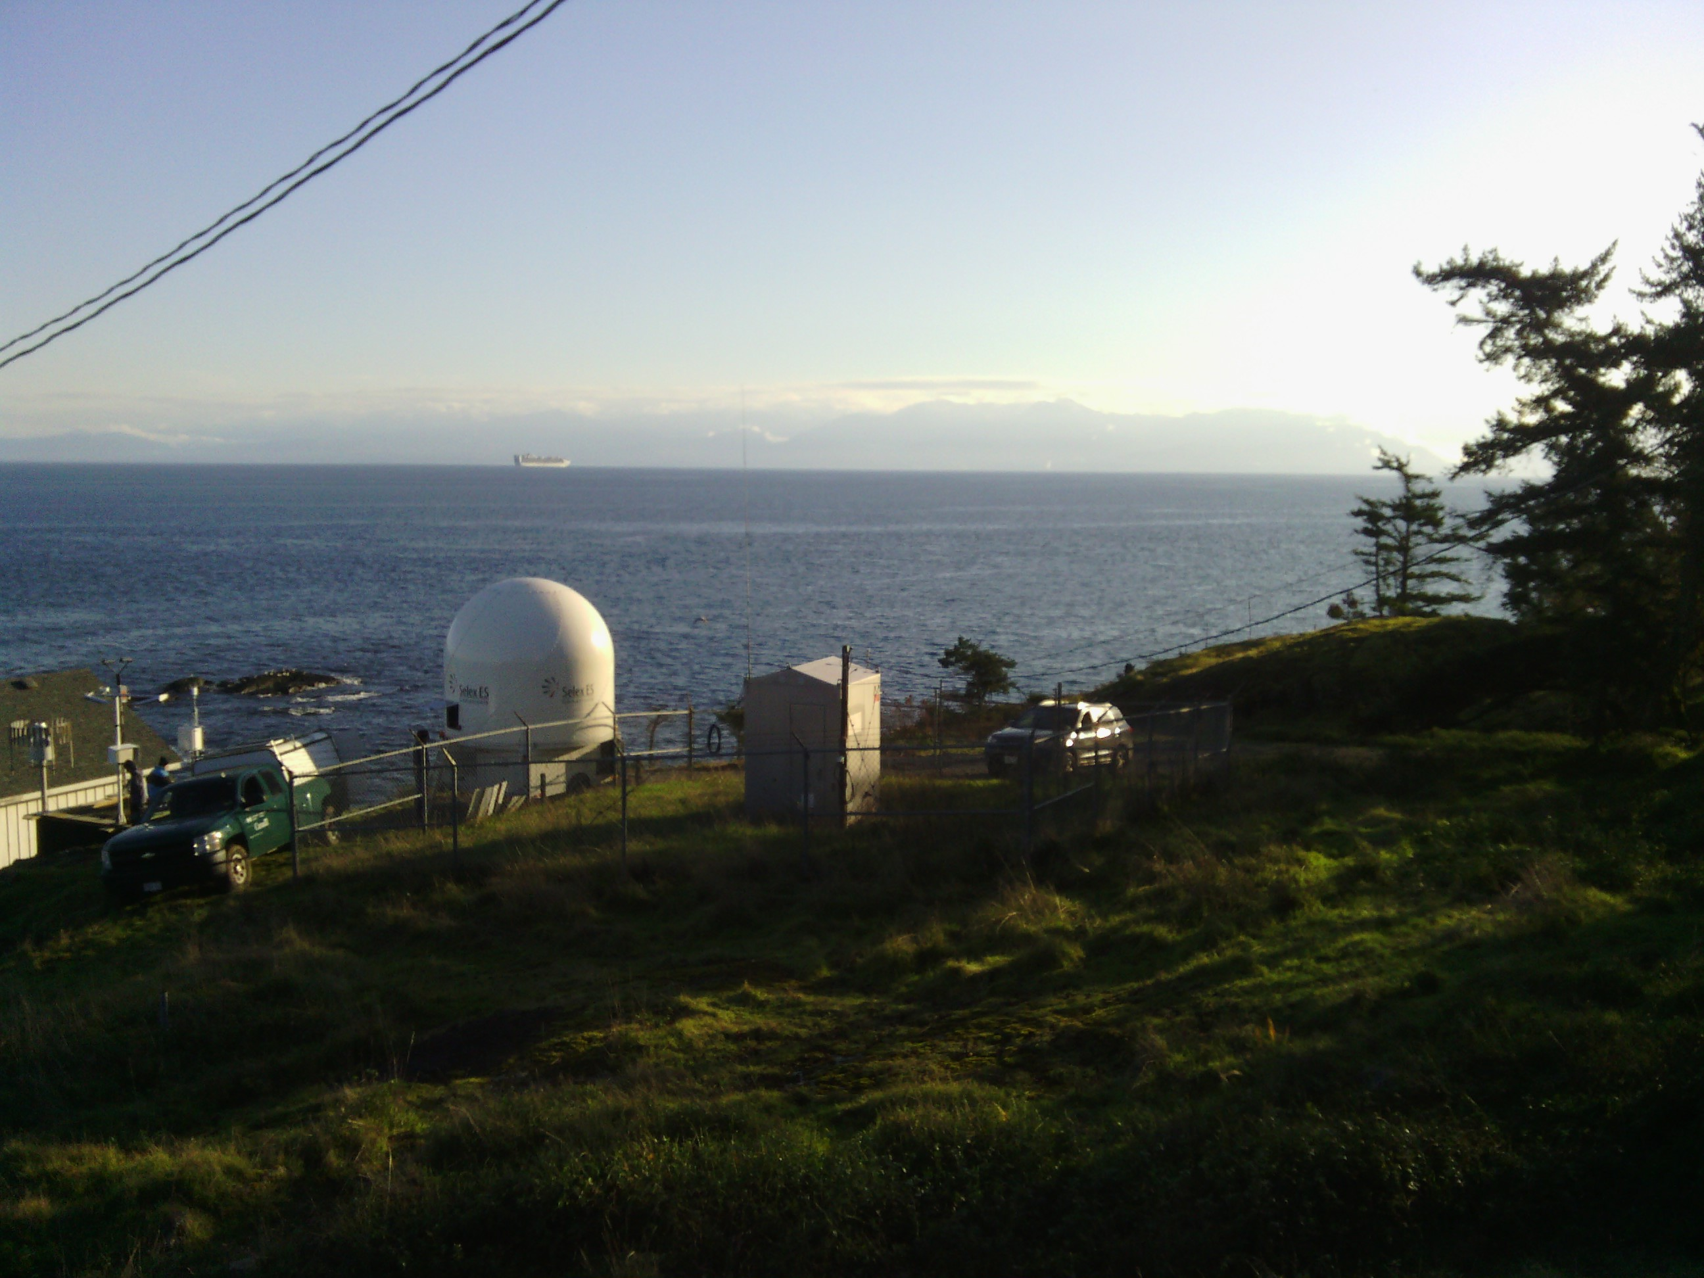
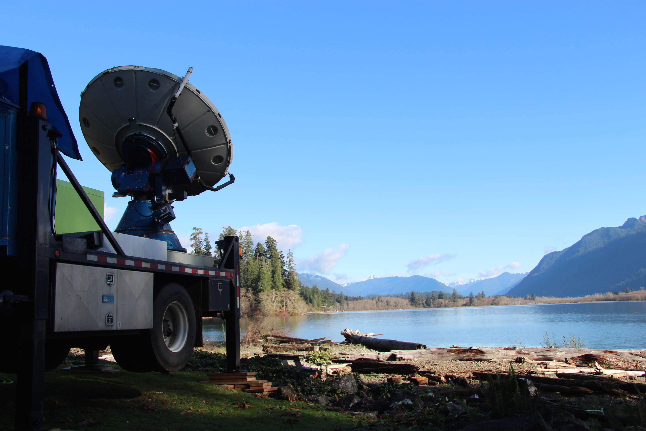
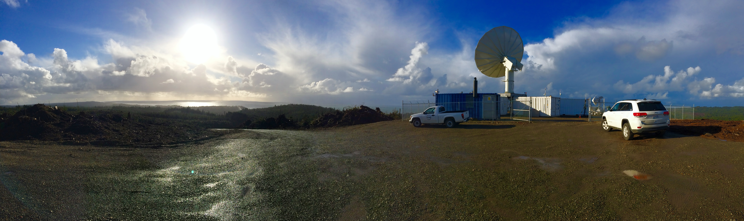
The RHI radars
EC X band
DOW
NPOL

Slide 30
The OLYMPEX Strategy
Aircraft
ER2 & DC8—over the top
Citation—through the clouds
Surface
Particle sizes and fallspeeds
Rain and snow amounts
Snow cameras
Upper air
Supplemental soundings in events
Windward and leeside stations
Radars for 3D structure
RHI sectors at 4 different wavelengths
Dual polarization
Doppler

