Slide 1
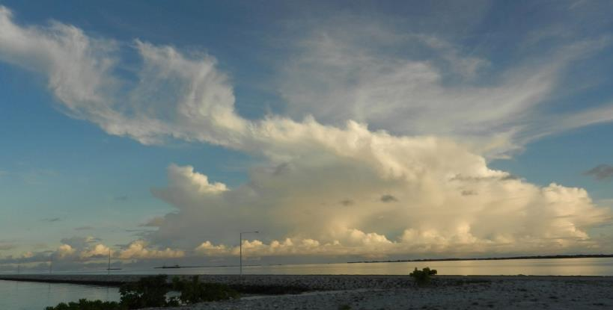
The Microphysical Structure of Mesoscale Convective Systems
Hannah C. Barnes
Ph. D. Defense
31st May 2016
University of Washington, Seattle, WA
Funded by NSF grants AGS-13555567 & AGS-1059611 and DOE grant DE-SC0008452 / ER-65460
Notes:
I will be presenting results from my observational and modeling work that describes how microphysical processes are spatially organized in mesoscale convective systems. However, before we get to my results I want to take a few minutes to make sure we all understand what exactly I study and why it matters.

Slide 2
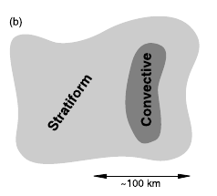
What is a Mesoscale Convective System? (MCS)
Contiguous precipitation over 100 km
Y
X
Idealized Map of Radar Reflectivity
Houze 1997, 1989, 2004
Notes:
So the first step in this process is to understand what is a mesoscale convective system, or what I will refer to as an MCS.
Definition: For my purposes broadly defined as contiguous precipitation covering 100 km in any one direction
MCSs composed of two fundamental components called the convective region and stratiform region.
These two regions are shown in this Figure which is an idealized horizontal map of radar reflectivity looking down at an MCS. The darker colors represent higher radar reflectivity and more intense precipitation. You can see the convective region is smaller and has higher radar reflectivity and thus more intense precipitation. The stratiform region is much larger but has weaker reflectivity signifiying less intense precipitation.
Radar reflectivity can also distinguish these regions when a vertical cross section is taken through the storm.
So if I take a cross section along this through an idealized MCS I get this reflectivity structure. The convective region is characterized by cores of high reflectivity reaching high altitudes. The stratirom region is distguishable by they band of high radar reflectivity right at the melting level. This is called the brightband.

Slide 3
The Structure of MCSs:
40+ Years of Radar Meteorology and Field Experiments
DYNAMO / AMIE (2011-12)
Hydrometeors
Microphysics
GATE (1974)
Convective / stratiform
Latent and radiative heating
TOGA COARE (1993)
Airflow
Ganache and Houze, 1982; Houze and Rappaport, 1984; Houze 1982
Kingsmill and Houze, 1999a
Barnes and Houze, 2014; 2016
Shortwave
Radiation
Stratiform Region
Convective Region
Longwave
Radiation
Convective Updraft
Midlevel Inflow
Y
A
B
z
X
Idealized Cross Section of Radar Reflectivity
x
Notes:
As I mentioned a few minutes ago I study the spatial pattern of microphysical processes in MCSs. And the primary observational tool I use to do that is radar data. By using radar data to study these storms it puts me in a really unqiue opportunity to contribute and expand upon a 40 year tradition of using radar data to understand the structure of tropical oceanic MCss.
This tradition started with GATE in 1974. The more I learn about this campaign the more I am in awe of it. It really set the stage for all subsequent research into MCSs. Using only radar reflectivity studies from GATE established the basic convective/stratiform structure of MCSs, determined that the stratiform region is characterized by broad ascent along and broad descent near the surface, and determined the distribution of longwave and shortwave radiation in these storms.
The next advancement in our understanding of the structure of MCSs came 20 years later in TOGA COARE. One of the most important studies that came out of this field campaign was Kingmill and Houze (1999), which established that air in the convective region steeply rises as a layer out of the boundary layer and the stratiform region is characterized by what is called a midlevel inflow. This layer of air starts in the rear of the storm and gradually descends towards the center of the storm using radial velocity data from radars. These kinematic structures confirmed previous modeling studies including Moncrieff 1992, but showed that these airflow patterns were inherently three dimensional.
Now, my research, which uses dual-polarimetric radar data from another major field campaign called DYNAMO/AMIE to show how hydrometeores and microphysical processes fit into these conceptual models.

Slide 4


What are Hydrometeors and Microphysical Processes?
Hydrometeors: Frozen, liquid, and vapor particles
Microphysical Processes: Describe how hydrometeors interact with each other in a cloud
Deposition:
Frozen collecting vapor
Aggregation:
Frozen collecting frozen
Riming:
Frozen collecting water
Melting:
Frozen melting
Notes:
So when I say hydrometeors and microphysical processes what do I mean. Well, hydrometeors is really just a fancy term for all the frozen, liquid, and vapor particles in a cloud.
Microphysical processes describe how hydrometeors interact with each other.
In my work I focus on ice microphysical processes. The four that I will be discussing today included:

Slide 5
Why is the Microphysical Structure Important?
Microphysical processes impact storm structure and global circulation
Theorized but direct observations and validation limited
Houze, 1989
Notes:
Understanding the spatial structure of microphysical processes is important for several reasons. For example, microphysical processes are associated with latent heat and I mentioned earlier that latent heat from MCS impacts the global circulation.
The structure of microphysical processes has been theorized for decades. This is a conceptual model presented by Houze (1989) in which the convective region is characterized by the generation of new hydrometeors and riming and the stratiform region is characterized by a layered pattern of deposition, aggregation, melting, and evaporation.
Now while ideas about the microphysical structure of MCSs has been theorized for decases, direct observation and validation of these ideas has been difficult.

Slide 6
Microphysical Structure of MCSs
Observation and validation difficult
Observation / Validation Method | Aircraft Observations | Dual-polarimetric radar | Numerical Simulations
Advantages | In situ | Large spatial coverage Increased temporal coverage | Complete spatial coverage Complete temporal coverage
Disadvantages | Spatially limited Temporally limited | Theory & observation based Difficult to validate Limited by radar quality | Theory based Difficult to validate Parameterizations Different schemes
Notes:
One way to obtain data about the microphysical processes in convection is using air craft observations. These are good since you get direct observations within the storm, however your data coverage is limited to the exact location of the plane. If you want to validate the holistic conceptual model presented in Houze 1989, this limited data will not work.
In recent years, we have obtained two new ways to investigate the microphysical structure of MCSs. These include polarimetric radar data and numerical simulations.
Both of these provide data that covers larger spatial areas and longer temporal periods. However, they also have their draw backs. Both are difficult to validate and are based on some extent on theory. Also radar data is limited by the quality of the radar and numerical simulations use parameterizations which often differ drastically.
Despite these draw backs dual-polarimetric radar data and numerical simulatiosn provide the best opportunity to understand the complete spatial pattern of microphysical processes within convection. This brings up the question of whether the microphysical structure of

Slide 7
Microphysical Structure of MCSs
Observation and validation difficult
Observation / Validation Method | Aircraft Observations | Dual-polarimetric radar | Numerical Simulations
Advantages | In situ | Large spatial coverage Increased temporal coverage | Complete spatial coverage Complete temporal coverage
Disadvantages | Spatially limited Temporally limited | Theory & observation based Difficult to validate Limited by radar quality | Theory based Difficult to validate Parameterizations Different schemes
Objective: Is microphysical structures in dual-polarimetric radar data and WRF consistent with each other and previous theories?
Notes:
One way to obtain data about the microphysical processes in convection is using air craft observations. These are good since you get direct observations within the storm, however your data coverage is limited to the exact location of the plane. If you want to validate the holistic conceptual model presented in Houze 1989, this limited data will not work.
In recent years, we have obtained two new ways to investigate the microphysical structure of MCSs. These include polarimetric radar data and numerical simulations.
Both of these provide data that covers larger spatial areas and longer temporal periods. However, they also have their draw backs. Both are difficult to validate and are based on some extent on theory. Also radar data is limited by the quality of the radar and numerical simulations use parameterizations which often differ drastically.
Despite these draw backs dual-polarimetric radar data and numerical simulatiosn provide the best opportunity to understand the complete spatial pattern of microphysical processes within convection. This brings up the question of whether the microphysical structure of

Slide 8

Outline
Spatial organization of hydrometeors / ice processes around midlevel inflow
Part 1: Radial Velocity and Dual - Polarimetric Radar Composite Analysis
  Systematic hydrometeor organization around midlevel inflow
  Frozen hydrometeors ~ Ice microphysical processes
Part 2: WRF Simulations
  Force squall by assimilating radial velocity
Part 3: Spatial Comparison
  Broad pattern similar
  Details differ
Notes:
Rest of my time is going to be spent answering that question. In order to do that this presentation is broken into three parts.
The first will briefly discuss my observational work uses radial velocity data to indentify MCSs with a midlevel inflow and then that spatially composites dual-polarization radar data around those midlevel inflows to show that hydrometeors in MCSs are systematically organized around these inflow layers. I will also introduce the idea that the frozen hydrometeors I categorize represent microphysical processes. This is an incredibly important step since that interpretation allows me to move forward and directly investigate whethere WRF simulations have a similar spatial pattern.
I will spend a few moments describing my WRF simulations which assimilated radial velocity data to ensure that my simulated storms have a midlevel inflow layer similar to observations.
And finally, I will compare the radar observations and simulations and show that each have a broad layered pattern to their ice microphysical processes but details in the spatial patterns differ.

Slide 9

  Part 1:
  Radial Velocity and Dual – Polarimetric Radar Composite Analysis
  Systematic hydrometeor organization around midlevel inflow
  Frozen hydrometeors ~ Ice microphysical processes
Barnes and Houze, 2014
Notes:
Alright so lets get started with my observational work.

Slide 10

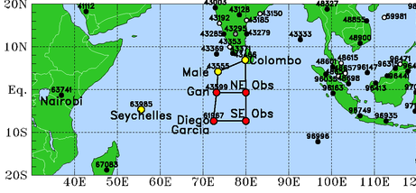
Why does DYNAMO / AMIE show Microphysical Structure?
NCAR S-PolKa Radar
Oct 2011 – Jan 2012
Addu Atoll, Maldives
S - Band
Single Doppler
Dual - polarimetric
Notes:
The data I use for this portion of my research is data obtained during a field project called DYNAMO or AMIE (depending on your funding agency). This project took place in the winter of 2011-2012 in the middle of the Indian Ocean. The tool I will specifically be using is NCAR’s S-PolKa radar, which was located on this tiny island called Addi Atoll in the Maldives. This radar is an S-band Doppler radar that has dual-polarimetric capabilities.
And what is really important about this radar, and what allows me to add to 40 years of research into the structure of MCSs, is its dual-polarimetric capabilities.

Slide 11
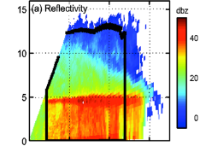
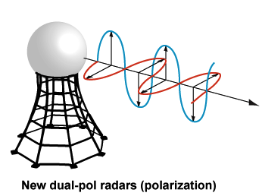
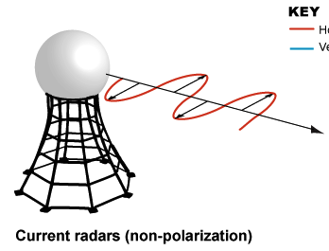
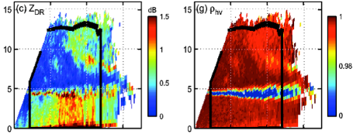
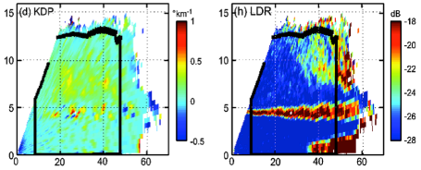
Dual - Polarimetric Radar
Reflectivity
Emit and receive horizontal and vertical pulses
Variables
  Differential Reflectivity (Z_{DR})
    Shape, phase
  Specific Differential Phase (K_{DP})
    Water content
  Correlation Coefficient (ρ_{HV})
    Phase, diversity
  Linear Depolarization Ratio (LDR)
    Phase, orientation, diversity
18 November 2011
0150 UTC
Height (km)
Differential Reflectivity
Correlation Coefficient
Height (km)
Dual-Polarized Radars
Non-Dual-Polarized Radars
Specific Differential Phase
Linear Depolarization Ratio
Distance from S-PolKa (km)
Notes:
DYNAMO/AMIE was one of the first times that a dual-polarimetric radar was deployed in a oceanic, tropical environment.
Dual-polarimetric radars are special since they emit and receive horizontal and vertical pulses. By comparing these pulses we can obtain four additional radar variables that describe characteristics of the particles sampled by the radar. These characteristics include information about the shape, whether the particles are frozen or liquid, their orientation, and whether all the particles being sampled are the same or different.
The bottom four panels in the figure on the right show an example of these dual-polarimetric radar variables. You can see that these additional variables give a lot of extra information but you can see that the data is very complex.
Radar meteorologists are tradition to intreprete this data, but it is time consuming. We have nearly 3 months of DYNAMO/AMIE data and manual analyses of all the data is just not an option.

Slide 12
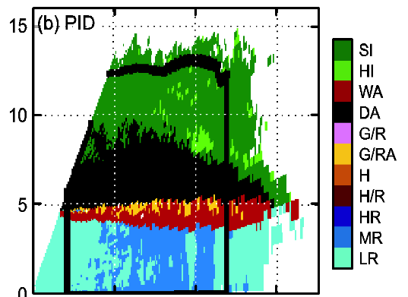
NCAR Particle Identification Algorithm (PID)
Algorithm
Categories
Mimics radar expert
Identifies most likely dominant hydrometeor
Based on theory, observations, experience
Rain
Heavy Rain
Moderate Rain
Light Rain
Graupel/Rimed Aggregates
Wet Aggregates
Dry Aggregates
Small Ice Crystals
Horizontally-Oriented Ice
Particle ID
Mixed Phase
Height (km)
Frozen
Distance from S-PolKa (km)
0150 UTC 18 November 2011
Vivekananda et al., 1999
Notes:
To address this situation NCAR developed what is referred to as a PID.
This algorithm mimics a radar expert and uses a combination of the dual-polarimetric radar data and a temperature profile from a rawinsonde to determine what is the dominant hydrometeor within each radar sample volume.
An example of this data is shown at the bottom where the different colors present different types of hydrometeors. In this work I use 8 categories of hydrometeors classified by the PID. This includes ….
Now the PID has its limitations. It only tells you the domiant hydrometeor type even though several different types of hydrometeors are likely present. This dominant hydrometeor type may also be biased to particles that are the largest or densest particle, even if this particle is not the most prevenlant. Additionally, the PID is based on completx theory and difificult to validate. Despite these draw backs the DYNAMO/AMIE PID has been deemed accurate by a study by Martini et al in 2015 and by several members of the Houze group.
Thus, I go forward and use this PID data to investigate how hydrometeors are organized in tropical oceanic MCSs

Slide 13
Compositing Methodology
Notes:
The way that I do this is by developing an innovative spatial compositing methodology that composites PID data around the midlevel inflow observed in 37 different MCSs during DYNAMO/AMIE.

Slide 14
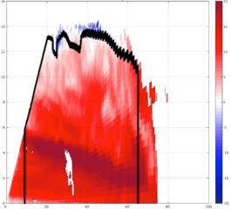
Methodology: Case Selection
Subjectively identify RHIs
  Radial velocity
  Midlevel inflow
  One per storm
37 midlevel inflows analyzed
Reflectivity PPI
Radial Velocity RHI
Distance from S-PolKa (km)
100
Height (km)
16
20
14
15
50
12
10
10
5
0
8
0
Distance from S-PolKa (km)
6
-5
-50
4
-10
2
-15
-100
-100
-50
0
50
100
0
-20
0
20
40
60
80
100
Distance from S-PolKa (km)
1900 UTC 23 December 2011
Notes:
This compositing methodology has three parts.
The first is to indentify MCSs with a midlevel inflow. This was done manually. Cross sections of radial velocity from MCSs were analyzed and cases with a midlevel inflow were identified. For example, here is a MCS on 23 December. The left shows a horizontal map of reflectivity, like what you would see on television. The right is a cross section of the radial velocity through the storm along this black line. This descending region of dark red colors represents the midlevel inflow.
In order to avoid biasing my resolts toward any one storm I only analyze one cross section from each storm. The cross section I select is the one with the most well defined midlevel inflow.
Using this technique I identified 37 midlevel inflow cases.

Slide 15

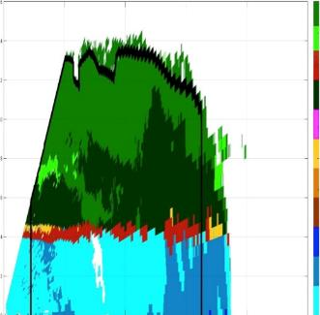
Methodology: Compositing
1.) Map kinematics and hydrometeors using radial velocity and PID
2.) Composite around layer lifting model
1900 UTC 23 Dec 2011
Generic Midlevel Inflow
Particle ID
Radial Velocity
m/s
16
20
SIC
HIC
14
15
WA
12
10
Height (km)
DA
10
G/R
5
8
G/RA
0
H
6
-5
H/R
4
HR
-10
MR
2
-15
Z Scale Factor
X Scale Factor
LR
0
40
60
80
100
-20
0
20
Distance from S-Polka (km)
Notes:
Once I had my cases I actually did the compositing ….

Slide 16
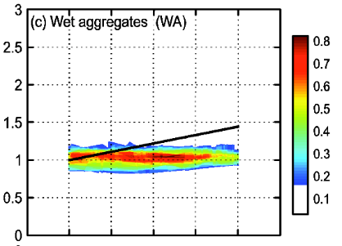
Methodology: Composite Results
Wet Aggregates
Normalized Height
Normalized Range
Notes:
Once I do this for all 37 of my cases I get a composite that looks like this. The x-axis is a normalized hozitonal distance. The y axis is a normalized height axis. The thick black line approximates the location of the midlevel inflow. The colors show where wet aggregates were most often observed.
This was repeated for all eight of the PID categories I consider

Slide 17
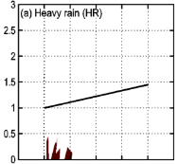
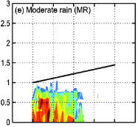
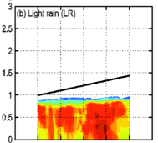
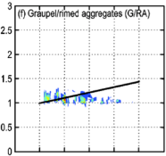
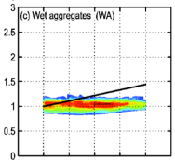
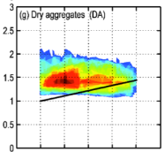
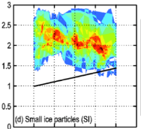
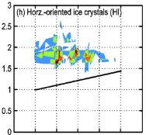
Midlevel Inflow Composites
Heavy Rain
Moderate Rain
Light Rain
Graupel /
Rimed Aggregates
Normalized Height
Normalized Range
Wet Aggregates
Dry Aggregates
Small Ice Crystals
Horz. Oriented Ice
Notes:
Which results in this set of composites. The colorbar differs in each panle, but in each the red colors represent areas where that hydrometeor was most often observed. There is a lot here but I want to highlight a few things
What is quite amazing is that even though I considered 37 different MCSs the composites indicate that the spatial hydrometeor pattern within the midlevel inflow region is very systematic. This enables us to develop a conceptual model for how hydrometeors are organized relative to the midlevel inflow.

Slide 18
Radar Analysis Conclusions
Conceptual Model of Hydrometeor Type within Midlevel Inflow
Small Ice Crystals
Deposition
Horz.-Oriented Ice
-20˚C
Aggregation
-20˚C
Dry Aggregates
Riming
0˚C
Graupel / Rimed Aggregates
Melting
0˚C
Wet Aggregates
Light Rain
Are ice processes layered in WRF?
Z
Z
X
X
Moderate Rain
Heavy Rain
Frozen hydrometeor categories indicate microphysical process
  Small Ice Crystals = Deposition
  Dry Aggregates = Aggregation + Deposition
  Graupel / Rimed Aggregates = Riming + Deposition
  Wet Aggregates = Melting
Barnes and Houze, 2014
Notes:
Notice by framing the location of the hydrometeors relative to the midlevel inflow, our results ditrectly build upon results from the previous 40 years that used radar data to investigate the structure of MCSs.
Up to now I have been talking about all of my observational work in terms of hydrometeors. The reason for that is PIDs are traditionally interpreted as an indication of the type of particle dominant in a given location. However, that is not the only interpretation of the PID. Given that the PID classifies particles based on their physical characteristics such as their phase, shape, and structural diversity, the PID categories can be interpreted as microphysical processes. This is particularly true for the frozen hydrometeors. Specifically, ….
This interpretation is important because it enables these observational results to be directly compared with model simulations since models also calculate these processes. The PID cannot be used to valid models when it is inpreted in the traditional hydrometeor sense since the definitions used to classify hydrometeors are fundamentally different in the PID and models.
So after interpreting the PID in terms of microphysical processes the natural question is :

Slide 19
  Part 2:
  WRF Simulations
  Must have midlevel inflow
  Assimilate radial velocity
Barnes and Houze, 2016 (in revision)
Notes:
To address this question I have conducted a series of WRF simulations. However, comparing the microphysical structure in simulations and obsrvations is tricky since the spatial pattern of microphysical processes is sensitive to the dynamical structure of the convection. Thus, to eequatiably compare observatiosn and models you need to have a simulation that has the same dybnamical structure as observations. To satisify this requirement I have assimilated radial velocity data into WRF in order to force simulations to have the same midlevel inflow structure as observations.

Slide 20
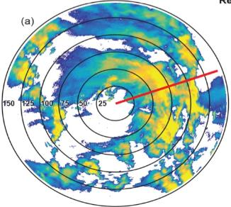
Reflectivity
S-PolKa Observations
23 December 2011 Squall Line
1930 UTC
Radial Velocity
ms⁻¹¹
Height (km)
Particle ID
Distance from S-PolKa (km)

Slide 21
WRF Data Assimilation
Penn State University EnKF / WRF
Simulation Time | 23 Dec 2011 1200 - 2000 UTC
Assimilation Time | Every 15 mins starting at 1800 UTC
Initialization | ERA - Interim
Vertical Levels | 39, Top at 26 km
Domains | 3 km, 1 km
Members | 50
Assimilate | S - PolKa radial velocity
Planetary Boundary Layer Parameterization | Bretherton and Park (UW)
Longwave Radiation Parameterization | RRTM
Shortwave Radiation Parameterization | Dudhia
Surface Layer Parameterization | MM5 Similarity
Microphysics Parameterization | Milbrandt – Yau Morrison WDM6
Group production terms by process
  All processes
  Provides rate (kg kg⁻¹ s⁻¹)
Composite members containing midlevel inflow
Notes:
I used the Penn State University EnKF version of WRF to conduct my simulations. I have all the details of the simulations listed here, but I will highlight a few things. I will be showing results of a squall line that occurred on 23 December. The model spun for 6 hours and then radial velocity was assimilated every 15 minutes after that. There are 50 members in my ensemble and I have two nested domains which are shown on the right. I will only present results for the inner domain. I ran three sets of simulations which only differed in terms of their microphysical parameterization. The parameterizations I tested included.
If you are familiar with WRF you know that the standard output does not included microphysical processes. However, within each scheme there are dozen of variables that describe the microphysical processes acting on the hydrometeors within the model. Thus, to get fields of microphysical processes. I went into WRF and output these hydrometeor interaction variables. This in no way changes how WRF runs, it just adds additional output.
Usually when you work with an ensemble you often work with the ensemble mean. However that does not work in my case. Instead I need to create composites of the ensemble members.

Slide 22
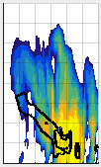
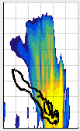
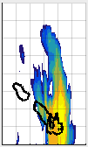
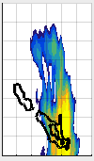
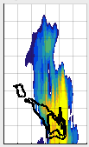
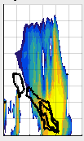
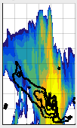
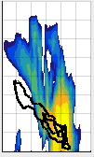

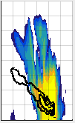
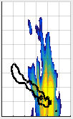
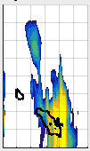
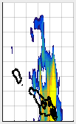
Why Spatial Compositing is Necessary?
16
12
WDM6
Shading = Reflectivity
Contours =
Horz. Wind Speed > 18 m/s
8
4
0
16
12
Height (km)
8
dBZ
4
0
16
12
8
4
0
0
50
100
150
0
50
100
150
0
50
100
150
0
50
100
150
Distance from S-PolKa (km)
Magnitude and length of midlevel inflow varies in each member
Averaging smears microphysical pattern
Notes:
The reason composites are necessary is that each ensemble member has a slightly different midlevel inflow. What is shown here is a cross section of the squall line simulated in 12 ensemble members from my WDM6 simulations. The colors are radar reflectivity and the black contours show where the horizontal wind speeds are greater that 18 m/s. This contours approximate the location of the midlevel inflow in each simulation. You can see that each have a midlevel inflow, but it varies slighty in each scheme. This is required for the EnKF to function correctly, but is a serious problem for me since if I simply average them I would smear out the spatial pattern of the microphysical processes.

Slide 23
Compositing Methodology
Notes:
The solution to that problem is spatial compositing and I do this in a manner that is very similar to what I did previously.

Slide 24
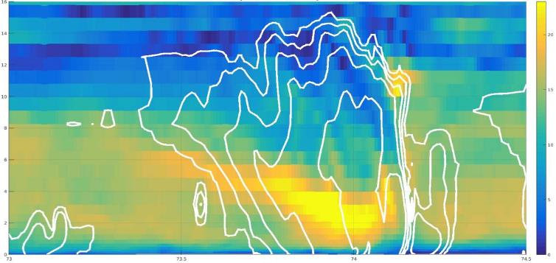
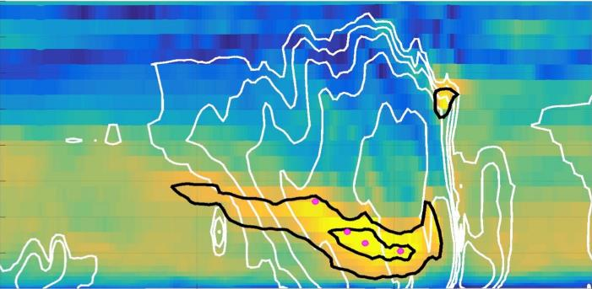

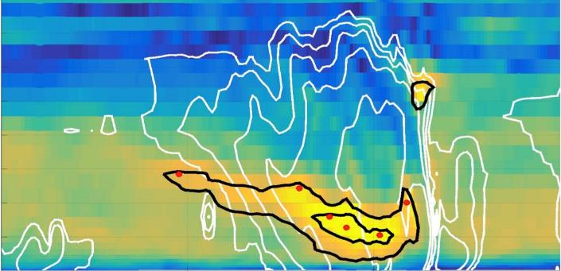
Midlevel Inflow Member Selection
16
Shading: Horz. Speed
White Contours: Reflectivity
Black Contours: Horz. Speed > 18 m/s
m/s
Shading: Horz. Speed
White Contours: Reflectivity
Black Contours: Horz. Speed > 18 m/s
Dots: Max Speed at level post tests
Shading: Horz. Speed
White Contours: Reflectivity
Black Contours: Horz. Speed > 18 m/s
Dots: Max Speed at level
Shading: Horz. Speed
White Contours: Reflectivity
14
20
14
12
12
10
15
10
Height (kn)
8
8
10
6
6
4
4
5
2
2
0
0
72
73.5
74
74.5
0
Longitude
Milbrandt-Yau: Member 17
1930 UTC 23 Dec 2011
Notes:
The first step is to identify cross sections that have a robust midlevel inflow. …

Slide 25
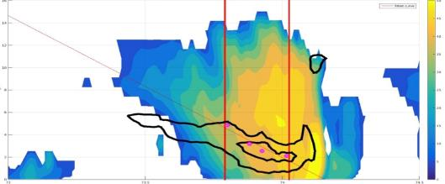
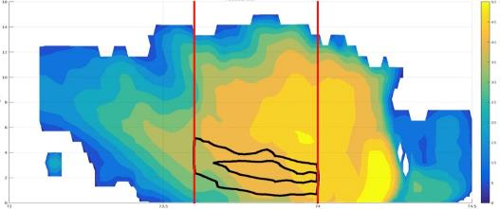
Midlevel Inflow Compositing
dBZ
16
Shading: Reflectivity
Black Contours: Horz. Speed > 18 m/s
Dots: Max speed at level post test
Red Lines: Analysis boundaries
50
14
45
12
40
35
Original
10
30
Height (km)
8
25
6
20
4
15
10
2
5
0
73
Longitude
74.5
0
73.5
74
dBZ
16
Shading: Reflectivity
Black Contours: Horz. Speed > 18 m/s
50
14
45
12
40
35
Scaled
10
30
Height (km)
8
25
6
20
4
15
10
2
5
0
73
Longitude
74.5
0
73.5
74
Milbrandt-Yau: Member 17
1930 UTC 23 Dec 2011
Notes:
Once I have my region of interest I then composite the cases. I do this my stretching or compressing the data so that its MLI is 0.4deg long. That is what is shown here for radar reflectivity, but same process for all the processes.
For all the simulation results I will be showing composites that were constructed at 1930 UTC an 23 December. At this point radial velocity had been assimilated in WRF seven times. I only analyzed one time step since I am not interested in the temporal evolution of the microphysics. From each ensemble member I analyzed 5 cross sections, however, each cross section was independently analyzed. This was done to increase my sample size. The results do not change depending on how many cross sections I consider.

Slide 26
Success of Assimilation Technique
Average S-PolKa Radial Velocity and Composite Horizontal Wind Speed
Observations
WRF Simulations
S-PolKa
Milbrandt - Yau
Morrison
WDM6
Height (km)
Height (km)
Distance from S-PolKa (km)
Normalized Zonal Distance
20
18
16
14
12
10
8
6
4
2
0
m s⁻¹
Notes:
Now, before I jump into the microphysical structure in these simulations. I first must prove that assimilation served its purpose and forced my simulations to have a midlevel infow that is similar to observations. One the left hand side I am showing S-PolKa radial velocity observations from the squall line I am similating. The panels on the right show the cross section of horizontal winds speeds from my three simulations in shading. The gold contours are the composite reflectivity. The dashed line is the approximate location of the midlevel inflow. You can see that assimilation has forced each simulation to have a midlevel inflow similar to observations.
With this proof that the assimilation served its purpose we will now start comparing ..

Slide 27
Part 3:
Spatial Comparison
Broad pattern similar
Details differ
Barnes and Houze, 2016 (in revision)
Notes:
With this intercomparison I focus on the spatial pattern. Does the WRF simulations have these ice microphysical processes at the same location as the PID results. We will see that the patterns are broadly similar but the parameterizations have some significant differences when you consider their detailed structure.

Slide 28

Deposition
Composite Frequency, Upward Motion, and Reflectivity
Milbrandt - Yau
Morrison
WDM6
Height (km)
Normalized Zonal Distance (km)
DYNAMO PID
Height (km)
Distance from S-PolKa (km)
Notes:
Start with deposition. The next four slides are going to structured the exact same way so I going to go through this slide in detail.
Each parameterization allows deposition to occur at some point anywhere above an altitude of 5 km and occurs most frequently where upward motion is statistically more common.
This is reasonable since the 0C level is located and expect the occur wherever upward motion in the cloud.
Consistent with PID.
Overall, spatial pattern of deposition appears accurate in simulations.

Slide 29
Aggregation
Composite Frequency, Temperature, and Reflectivity
Milbrandt - Yau
Morrison
WDM6
-40°C
-40°C
-40°C
-20°C
-20°C
-20°C
Height (km)
0°C
0°C
0°C
Normalized Zonal Distance (km)
DYNAMO PID
Height (km)
Distance from S-PolKa (km)
Notes:
Now we turn to aggregation. These plots are very similar to the previous slide. The only difference in the orange lines represent the 0., -20, and -40 temperature levels.
The spatial pattern of aggregation in the simulations are very similar. Aggregation is found in all simiulations everywhere between the 0C level and cloud top.
Aggregation in the PID is represented by dry aggregates, which are dark green here. You can see that aggregation never reaches cloud top in observations.
Additionally, previous laboratory studies indicate that aggregation does not occur below -20C.
Thus, it appears that each of these paramtereizations has too much aggregation.
This has serious implications for the accuracy of these simulations. For decades studies have found that simulations are often deficient in stratiform previpitation. This excessive aggregation may be a reason for this problem. If too much aggregation is occurring the particles are becoming too heavy and falling out too quickly.

Slide 30
Riming
Composite Frequency, Upward Motion, and Reflectivity
Milbrandt - Yau
Morrison
WDM6
Height (km)
Normalized Zonal Distance (km)
DYNAMO PID
Height (km)
Distance from S-PolKa (km)
Notes:
Now lets turn to riming. In these figures the orange lines once again show regions of upward motion.
You can see that there is a lot of variability among the schemes in terms of riming. However, in each scheme you can see that over 50% of the cross sections had riming reaching up to 10 km and is very common near the 5 km level. Riming in the PID is represented by this the yellow color. You can see that riming in the observations is very shallow and isolated. Thus, the parameterizations create riming that is too deep and too frequency. This may have important implications for the accuracy of simulations and help explain why previous studies have found that simulated oceanic convection have updrafts that are too strong and contain too much graupel.
Despite these biases this riming figures tell us something important. Notice that the peak riming frequencies do not correspond to the peak upward motion. While our assimilation technique creates a similar mesoscale circulation in each simulation, there are differences in the convective scale vertical motion. Thus, the variability in riming and its lack of correlation with the mesoscale upward motion suggests that riming in stratiform regions is influenced by convective scale vertical velocity pertubations, which is consistent with conclusions from previous studies.
One last thing. Notice that milbrandt differs significantly in that it has riming near the surface. This is incorrect. These simulations were conducted in oceanic tropical environments, frozen hydrometeors and ice processes should never occur near the surface. It is important to note however, the rate of these near surface riming processes is very low so it is likely not a huge issue, but it is still something to keep in mind.

Slide 31

Melting
Composite Frequency, Temperature, and Reflectivity
Milbrandt - Yau
Morrison
WDM6
Overall: Similar to first-order but details differ
-40°C
-40°C
-40°C
-20°C
-20°C
-20°C
Height (km)
0°C
0°C
0°C
Do differences impact simulation accuracy?
Normalized Zonal Distance (km)
DYNAMO PID
Height (km)
Distance from S-PolKa (km)
Notes:
Finally here is melting with the orange lines showing temperature contours.
Excluding Milbrandt, melting is the process most consistent with observations. In that Mor and WD have it occurring in a narrow band. Similar to riming, Milbrant has it extending to the surface

Slide 32
Impact of Microphysical Differences
Average S-PolKa Reflectivity and Composite Simulated Reflectivity
S-PolKa
Milbrandt - Yau
Morrison
WDM6
dBZ
45
40
35
Horizontal Map
30
Distance from S-PolKa (km)
Distance from S-PolKa (km)
25
20
15
10
Distance from S-PolKa (km)
Distance from S-PolKa (km)
5
dBZ
40
35
30
Height (km)
25
Vertical Cross Section
Height (km)
20
15
Normalized Zonal Distance (km)
10
Distance from S-PolKa (km)
5
Notes:
So we see that the spatial microphysical patterns in the PID and WRF simulations are similar to first order. However, significant differences exist in terms of the detail spatial patterns. The question arises, does this matter. This slide shows S-PolKa observations of radar reflectivity on the left and the corresponding simulated reflectivities on the right. Even though each simulation has a similar midlevel inflow and their broad microphysical pattern is similar, the reflectivity structure of this squall line drastically differs in each scheme and no scheme matchs S-PolKa. While the difference in the parameterization of these ice processes do not entirely account for these differences, since the schemes differ in more than just how processes are parameterization, differences in the parameterization of tehse processes must have some impact since they influence the entire dynamical structure of these storms by producing latent heat.

Slide 33
Conclusions
Continues 40+ years of tropical MCS research using radar
Ice microphysical processes have layered structure
  Observations and WRF broadly similar
    Results support previous microphysical conceptual models
  Convective-scale motions produce riming
  Details differ (esp. Aggregation and Riming)
    Factor into reflectivity differences
    Accuracy of simulations limited until improve
Small Ice Crystals
Horz.-Oriented Ice
Dry Aggregates
-20˚C
Graupel / Rimed Aggregates
Wet Aggregates
0˚C
Light Rain
Z
X
Moderate Rain
Heavy Rain
Conceptual Model of Hydrometeor Type within Midlevel Inflow

Slide 34

Acknowledgements

Slide 35














Bob
Greg
Cliff
Daehyun
Gerard
626
Mesoscale Group
Grads 2010
Aunt Ellen
Aunt Arlene
Uncle Jerry
Katie
Grandpa
Mom and Dad

Slide 36
Conclusions
Continues 40+ years of tropical MCS research using radar
Ice microphysical processes have layered structure
  Observations and WRF broadly similar
    Results support previous microphysical conceptual models
  Convective-scale motions produce riming
  Details differ (esp. Aggregation and Riming)
    Factor into reflectivity differences
    Accuracy of simulations limited until improve
Small Ice Crystals
Horz.-Oriented Ice
Dry Aggregates
-20˚C
Graupel / Rimed Aggregates
Wet Aggregates
0˚C
Light Rain
Z
X
Moderate Rain
Heavy Rain
Conceptual Model of Hydrometeor Type within Midlevel Inflow

