Slide 1
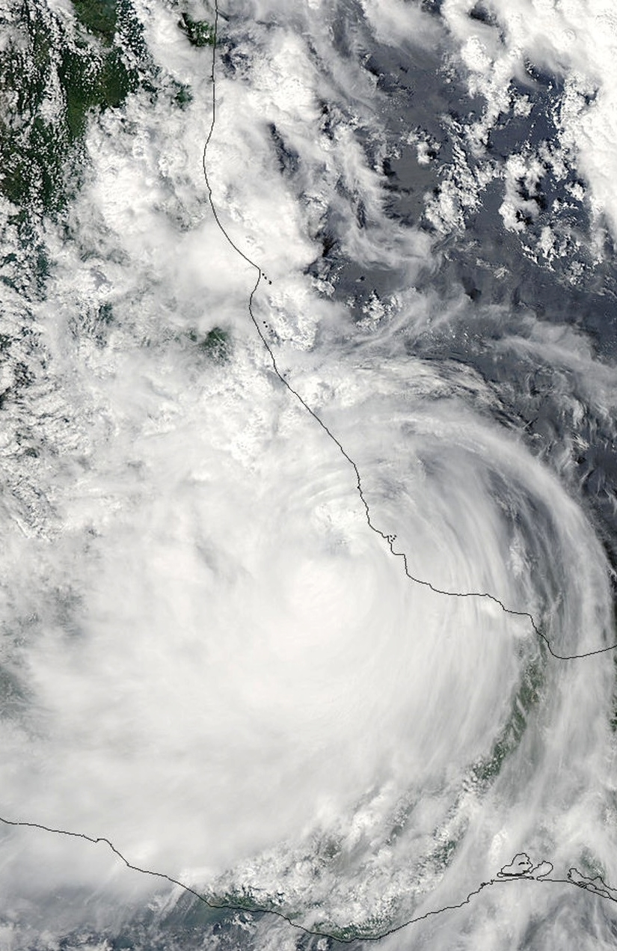
Characterizing the Structure of Hurricane Karl (2010):
Doppler Radar and WRF
Jennifer DeHart and Robert Houze
32nd Conference on Hurricanes and Tropical Meteorology
4.20.16
NASA grants: NNX13AG71G / NNX12AJ82G
NSF grant: AGS-1503155

Slide 2
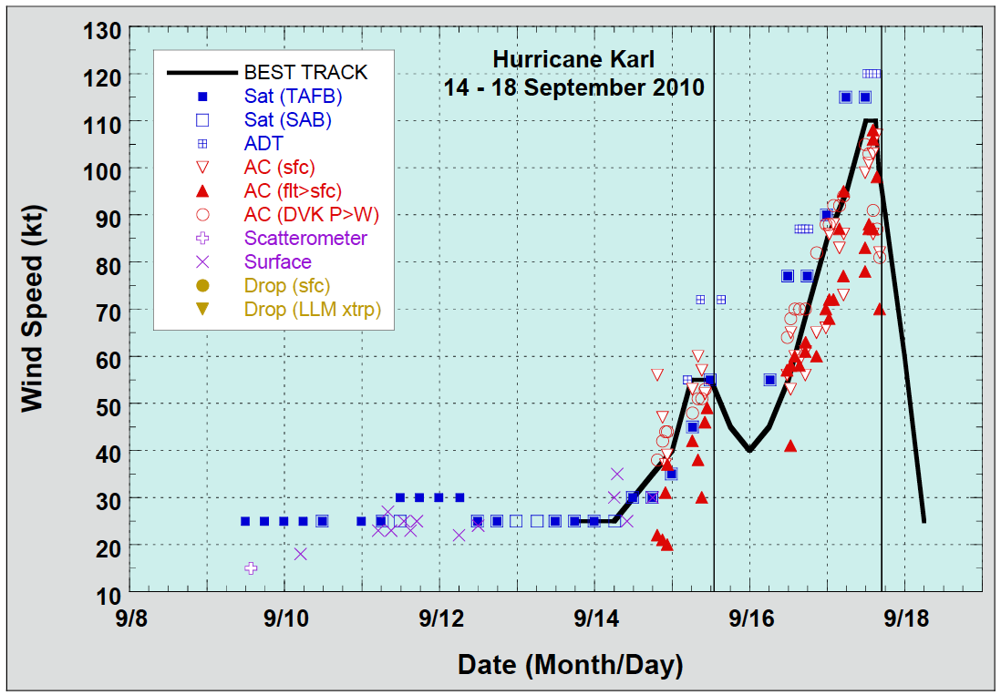
Karl Best Track and Flights
Flight
Image: NHC
Notes:
Karl’s best track in terms of wind speed, reaching Category 3. Can see initial landfall on Yucatan peninsula and intensification after reemerging over the warm ocean water. NASA’s GRIP campaign flew several flights into Karl, but today I’ll be focusing on the flight during Karl’s second landfall.
Transition: While Karl was one of many hurricanes during a busy 2010 season, it’s remembered in Mexico for the mudslides caused by the rain.

Slide 3
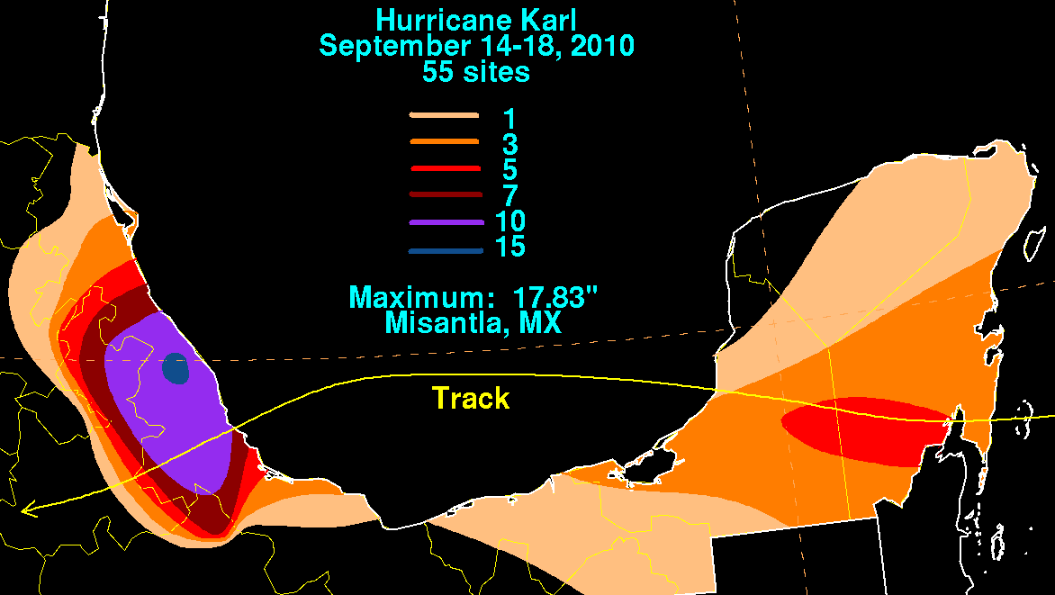
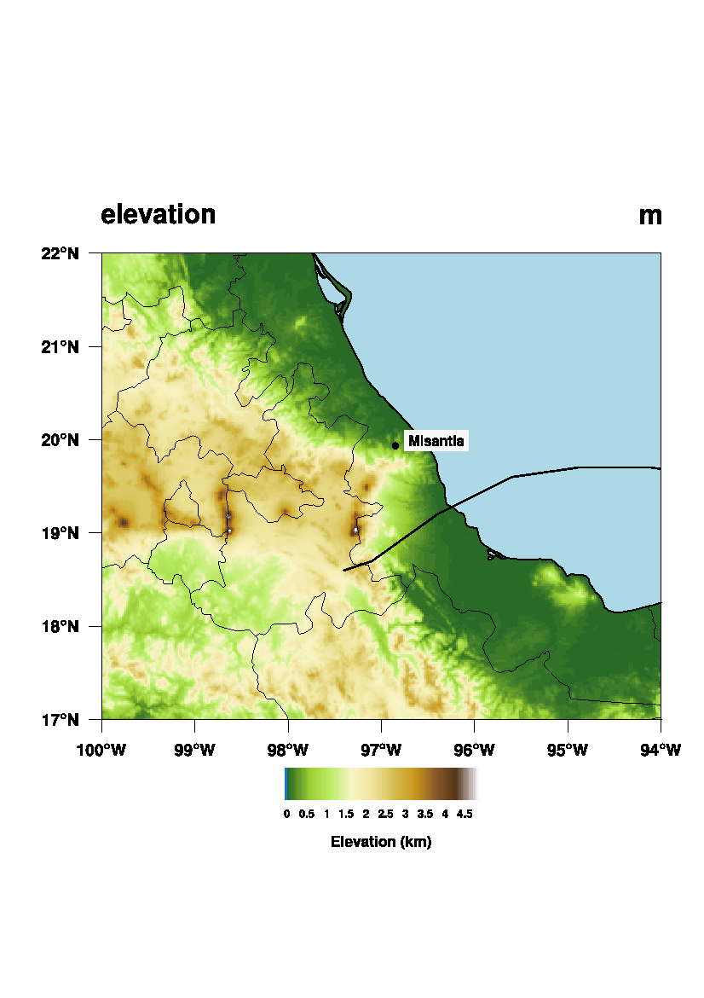
Rainfall and Mexican Terrain
Intense rainfall collocated with eastern edge of Mexican terrain
Maximum rainfall measured near Misantla
Image: David Roth, NOAA
Notes:
Coming on the heels of a very wet summer in Mexico, Karl dumped an additional 10 inches (250 mm) over already saturated soil. Flooding and mudslides were the biggest destruction. Plots of rainfall from David Roth at NOAA and mexican topography. Large swath of rainfall within Veracruz, with the total amount maximizing north of the triangular feature jutting out towards the gulf.
Transition: Looks like orographic enhancement clearly played a role, but I’d like to investigate exactly what Karl’s structure was as it made landfall.

Slide 4
Science Questions
What do airborne radar measurements indicate about the nature of the precipitation during landfall over the mountainous terrain of Mexico?
What can WRF simulations tell us about the underlying processes?

Slide 5

NASA GRIP
DC 8 Flight Track – 09/17/2010
Aug. / Sept. 2010
Key instrument: APR-2 radar on DC8
  -10 km flight level
  -Ku / Ka band
  -high resolution
  -downward pointing
  -cross-track scan
Notes:
I’ll be trying to answer those questions with data collected during NASA’s GRIP campaign during the summer of 2010. Featured planes with a number of instruments, but today I’ll be looking at data from the APR-2 radar on the DC-8. Specs. Track from the 17th is shown on the left.
Transition: First, let’s again look at the surface context

Slide 6
Upstream Sounding
Notes:
Upstream sounding from just a couple minutes before the radar swath showing a very moist, almost neutral environment – this supports the notion that enhanced reflectivity is due to rainwater collecting cloud droplets created by forced ascent.
Transition: can now look further to the south to compare the structure.

Slide 7
Karl Circulation at 19Z
Notes:
Here is the 19Z positioning (interpolated from the NHC best track) of Karl in reference to the cities mentioned before: leg around xalapa would experience a strong easterly component of the flow, which could easily ride up the topography. orizaba and cordoba on the other hand aren’t favorably situated to experience enhancement. observations from cordoba indicate wind with a northerly and even westerly component.
Transition: given paltry rainfall rates at each city during the time, this emphasizes another key point: background precipitation is important.

Slide 8
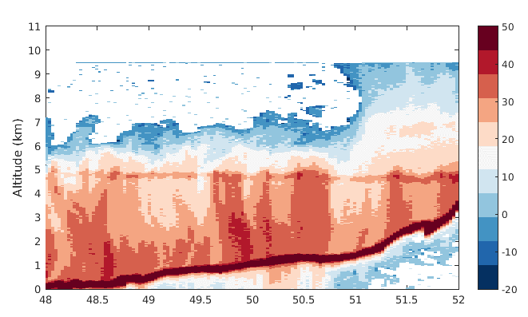
Upslope Segment
Minutes after 1800 Z
Low-level enhancement present in reflectivity data
Warm-rain process
Notes:
Here we have a vertical cross-section through the radar swath – this is the nadir most beam. Blue arrow denotes direction. First, there are some interesting structural features. Further east, the vertical extent of the echo is quite reduced – only extending up to 6 km. There’s a sudden jump in reflectivity height moving further west – likely due to where air mass originated. However, I want to focus on the low-level structure. Despite fairly average reflectivity intensities, there is a general increase in reflectivity moving down towards the surface. While it’s possible this could be due to larger rainfall particles settling, give the positioning relative to the terrain, likely that it’s enhancement due to terrain. Additionally, orographically enahnced precip often thought of as convection kicked off by forced ascent or low-level production of cloud water that’s caught by falling raindrops. Don’t currently have processed doppler velocity data, but the raw doppler velocity doesn’t show strong upward motion. Would think this would be cloud water.
Transition: what does thermodynamic environment look like?

Slide 9
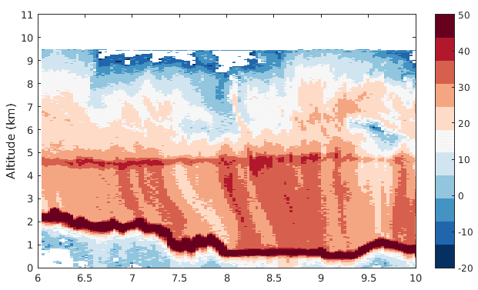
Downslope Segment
Minutes after 1900 Z
Low-level enhancement not present
Fall streaks from melting ice aggregates
Notes:
Another vertical cross-section near Orizaba and Cordoba and the overall structure is quite different. First, much higher vertical extent of the radar echo. Overall reflectivity intensity is the same, slightly stronger in the bright band. However, most notable difference is the low-level structure. There is no increase in reflectivity at low-levels, in fact looks more like the the particles are being moved by the wind.
Transition: Obviously, given positioning of the storm center, we would expect this.

Slide 10
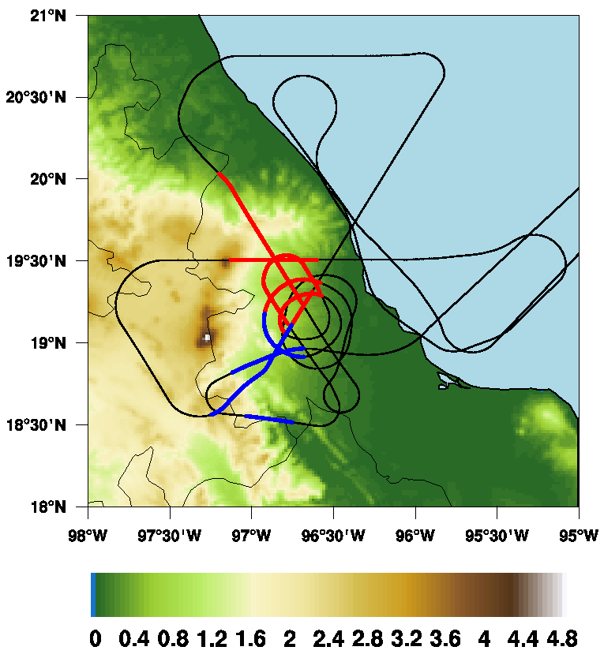
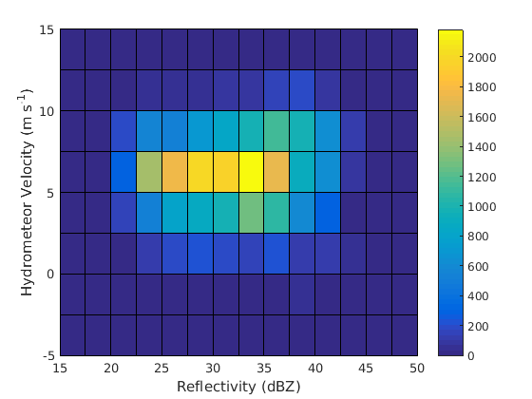
Upslope and Downslope Segments
Compare reflectivity and hydrometeor velocity distributions between upslope and downslope flight legs

Slide 11
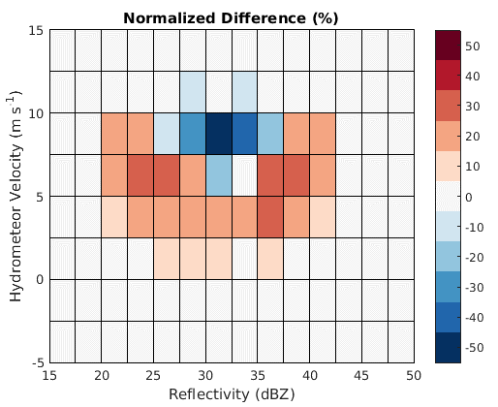
Anomaly frequency diagram
Upslope segments minus downslope segments
Beams affected by attenuation have been removed
Velocity distribution for upslope segments shifted towards weaker hydrometeor velocities
Larger particles fall quickly in downslope legs and upslope legs have weaker velocities – small particles

Slide 12
Terrain Modification Experiments

Slide 13
WRF Details
WRF 3.4.1
Initialized at 00Z on 9/15/2010
4 domains: 54, 18, 6, 2 km
  2, 6 km domains follow vortex
Microphysics: Goddard
Boundary Layer: MYJ
Levels: 70
Two runs: control and reduced terrain

Slide 14
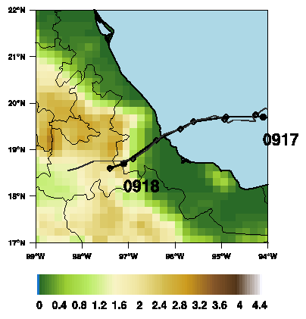
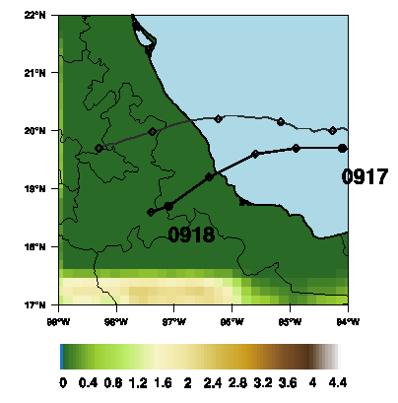
Observed and Simulated Tracks
Control run: traces observed track (storm motion too fast).
Flat terrain run: track shifts northward.

Slide 15
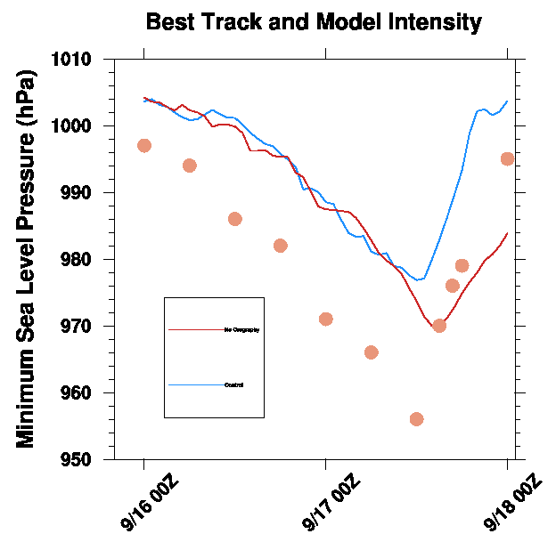
Modeled Intensity
Karl’s intensity is underestimated, but general trend is captured
Modified terrain run reaches deeper intensity and does not drop off as quickly
Control
Best Track
Modified Terrain

Slide 16
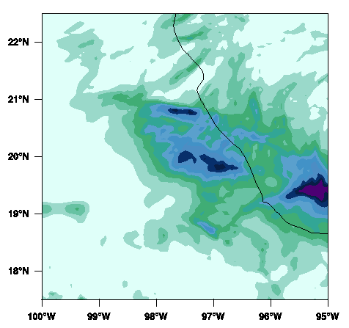
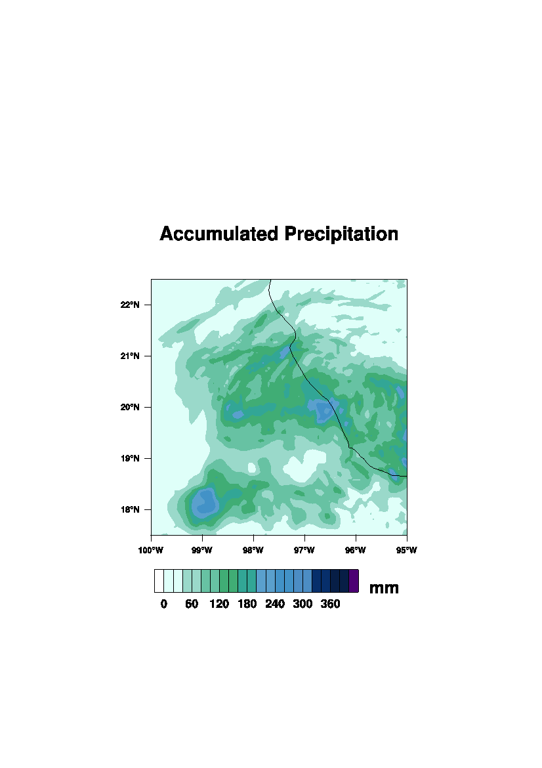
Accumulated Precipitation

Slide 17
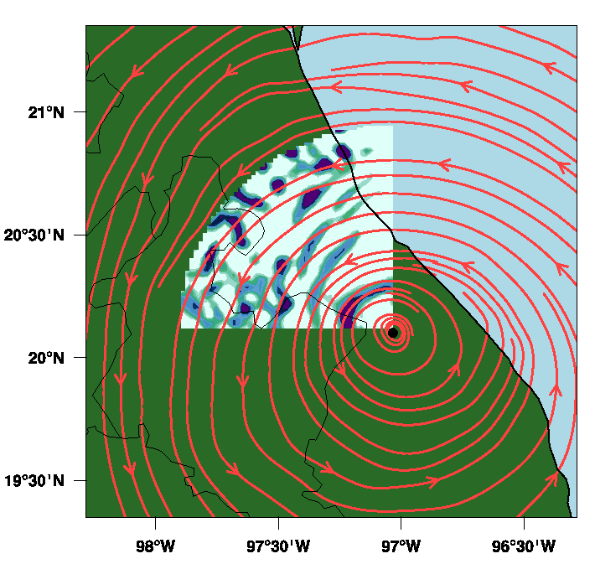
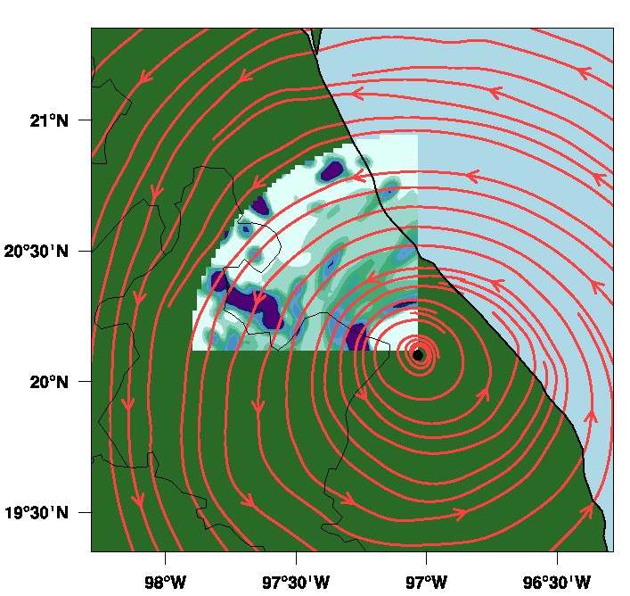
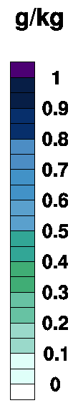
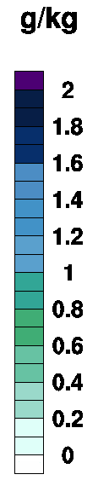
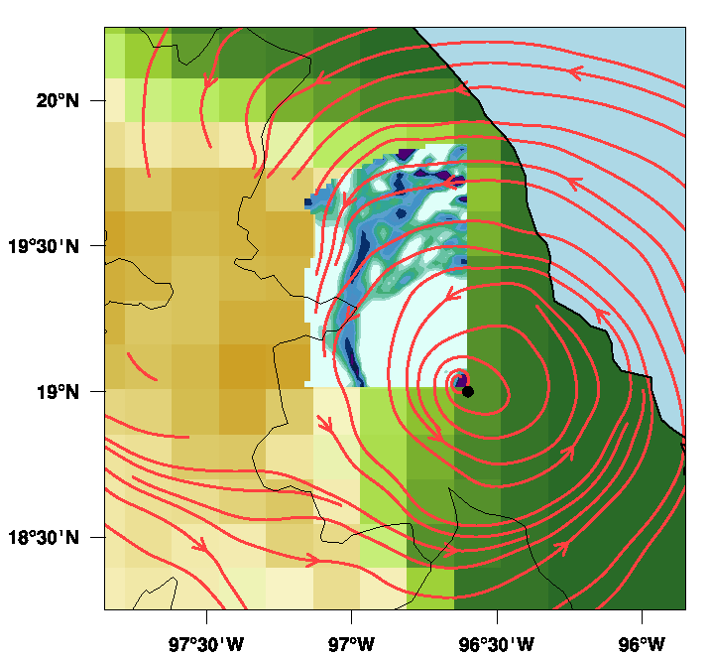
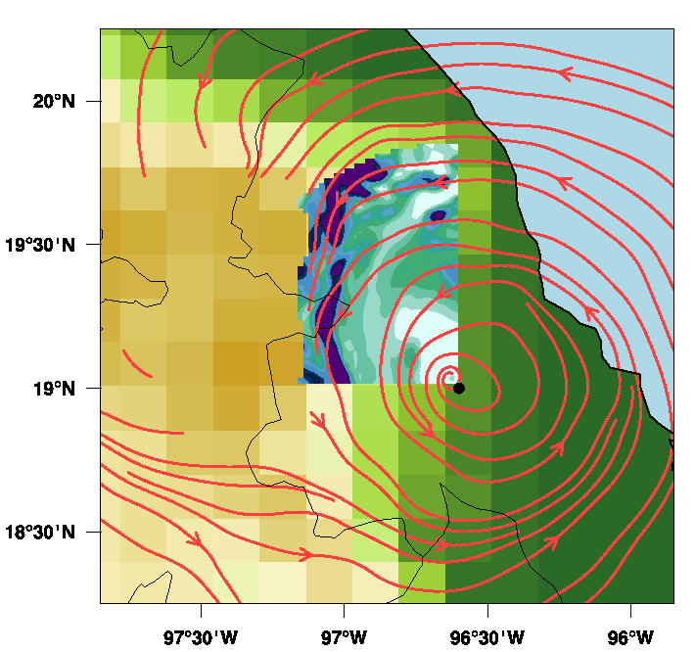
Cloud Water
Rain

Slide 18
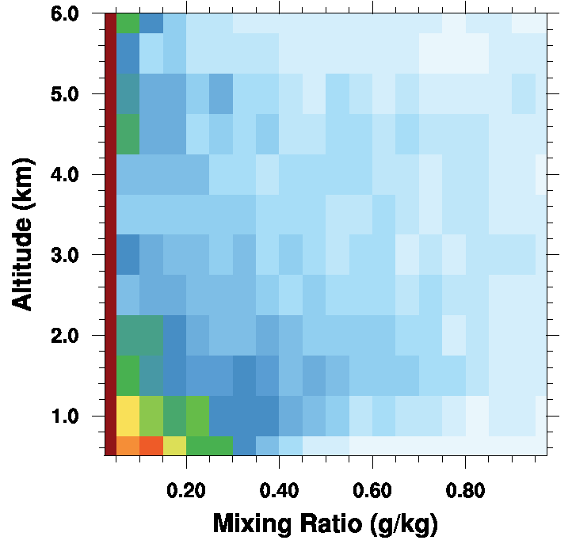
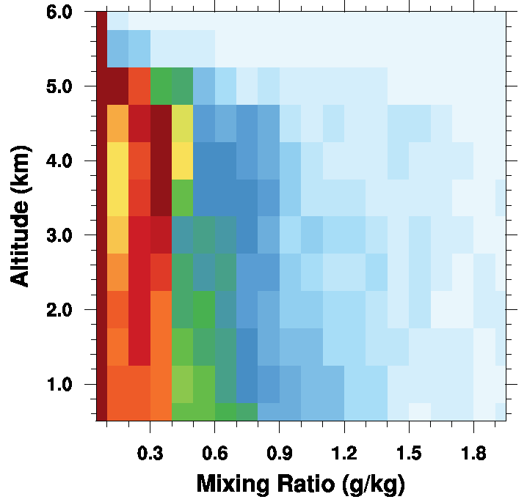
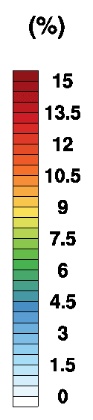
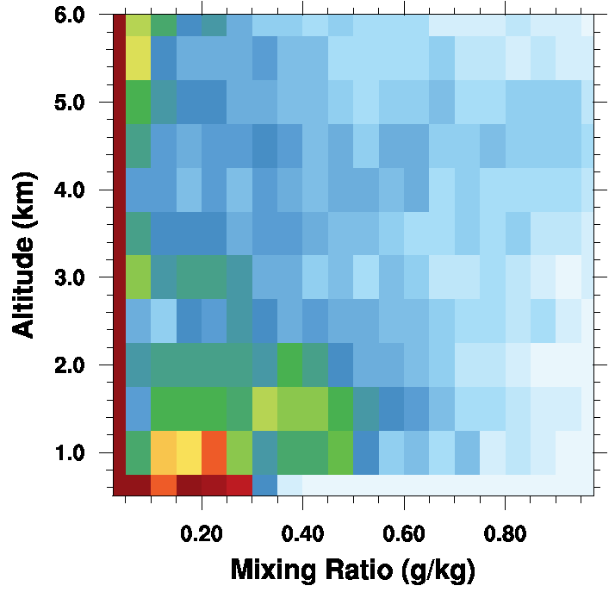
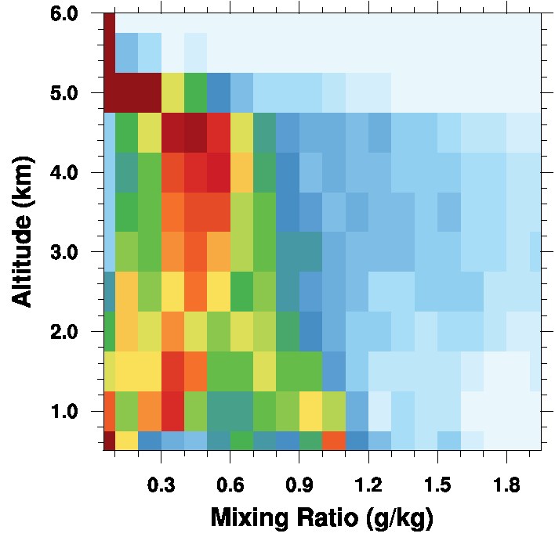
Flat Terrain
Cloud Water
Rain
Full Terrain

Slide 19
Conclusions
Upslope flow produces enhanced near-surface reflectivity in Karl
  cloud water collected by falling raindrops
  velocity distributions shift to weaker speeds – smaller drops falling slowly
WRF simulations consistent
  enhanced cloud water and rain trace line of Mexican terrain
  vertical distributions shift towards greater hydrometeor mixing ratios

