Slide 1
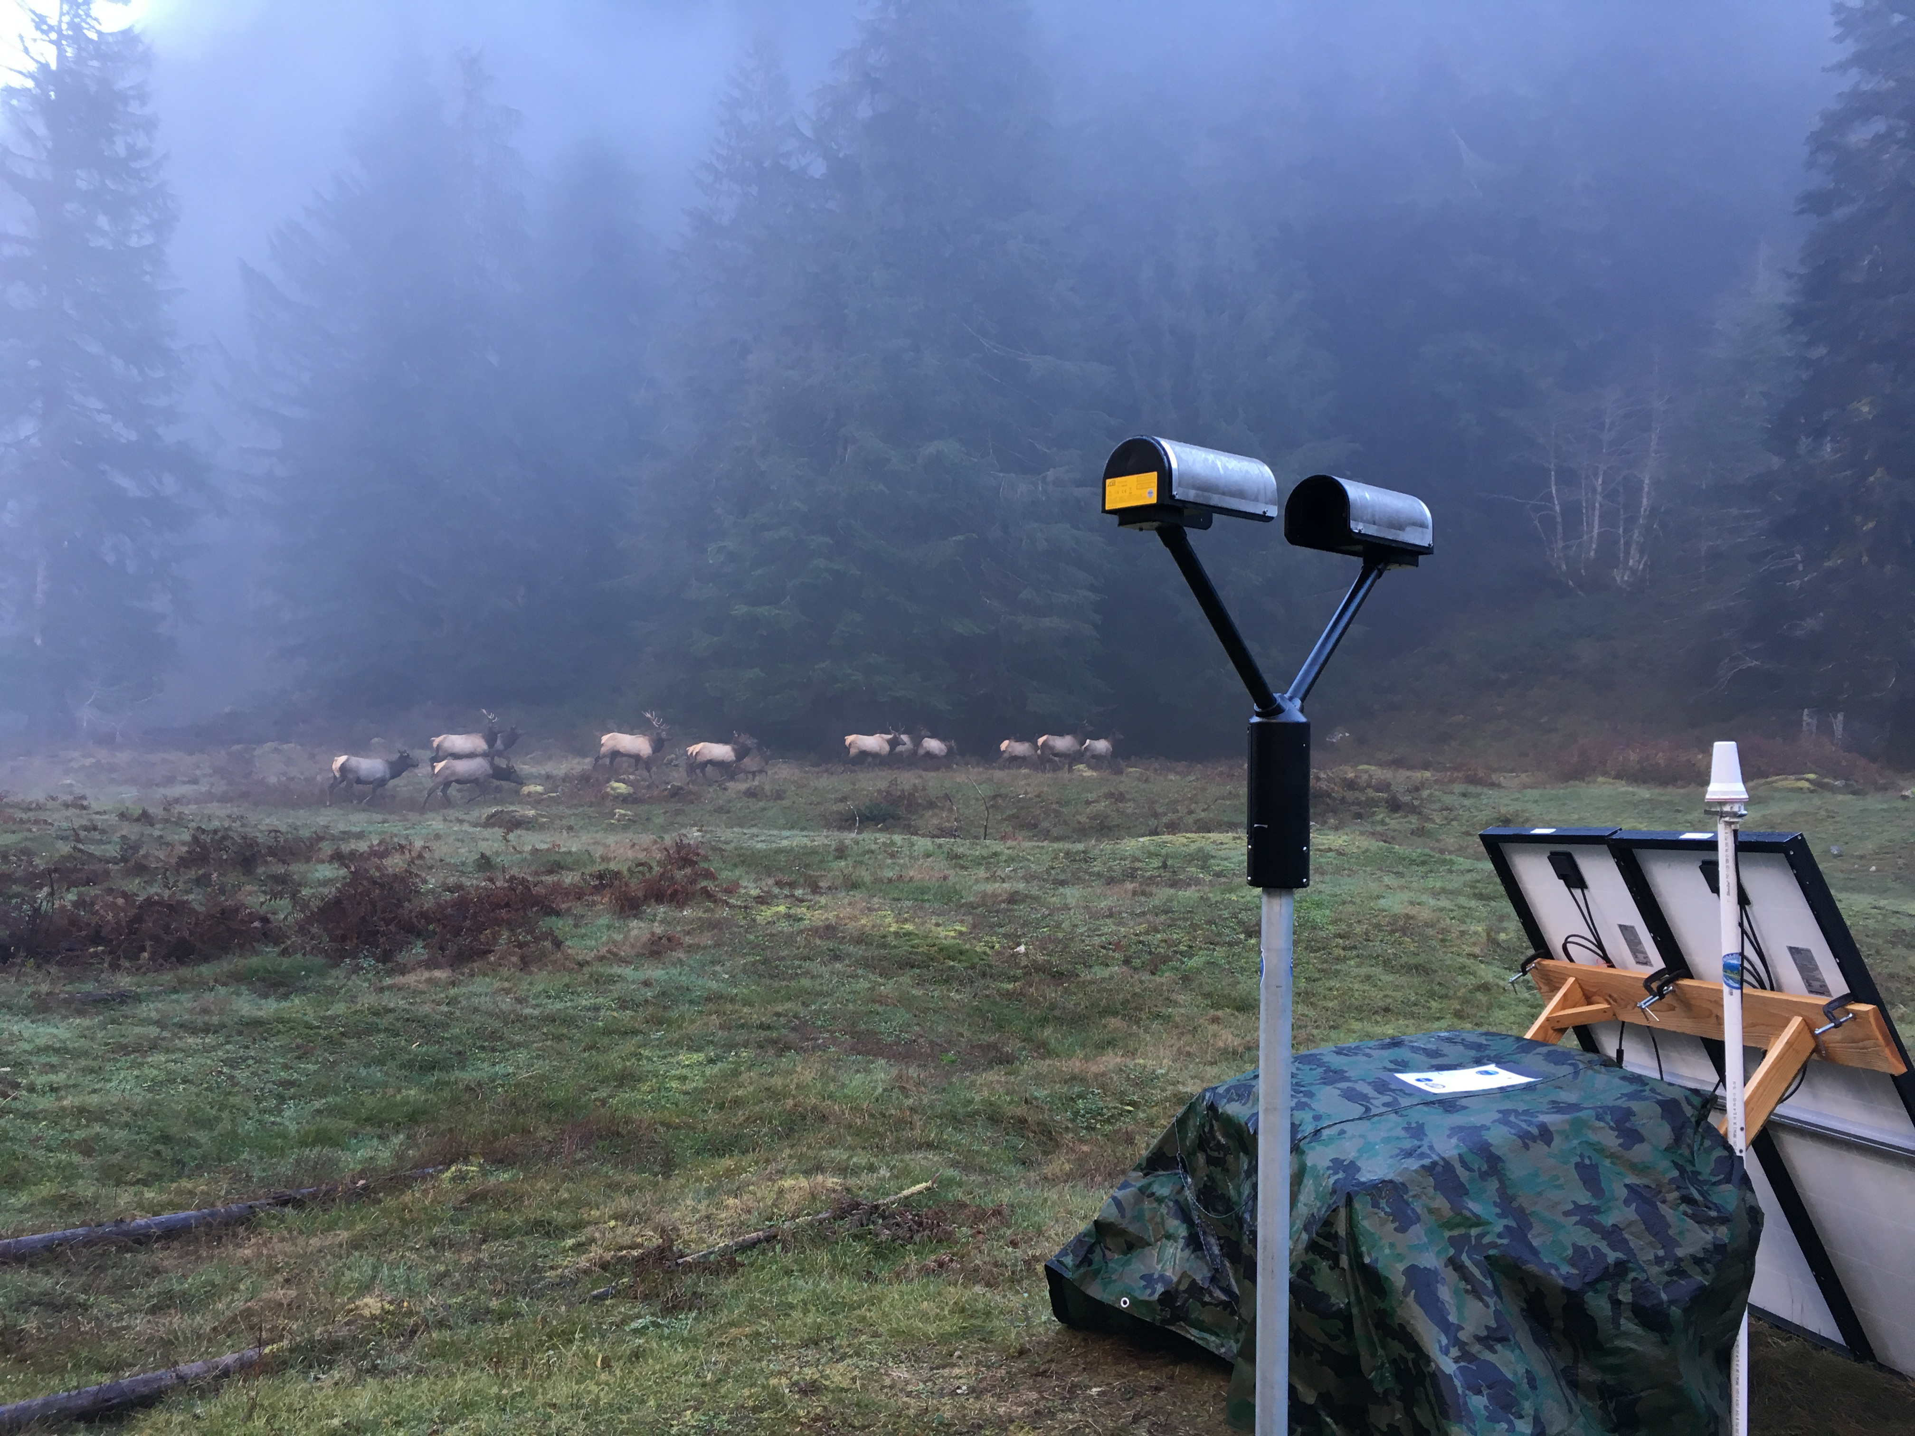
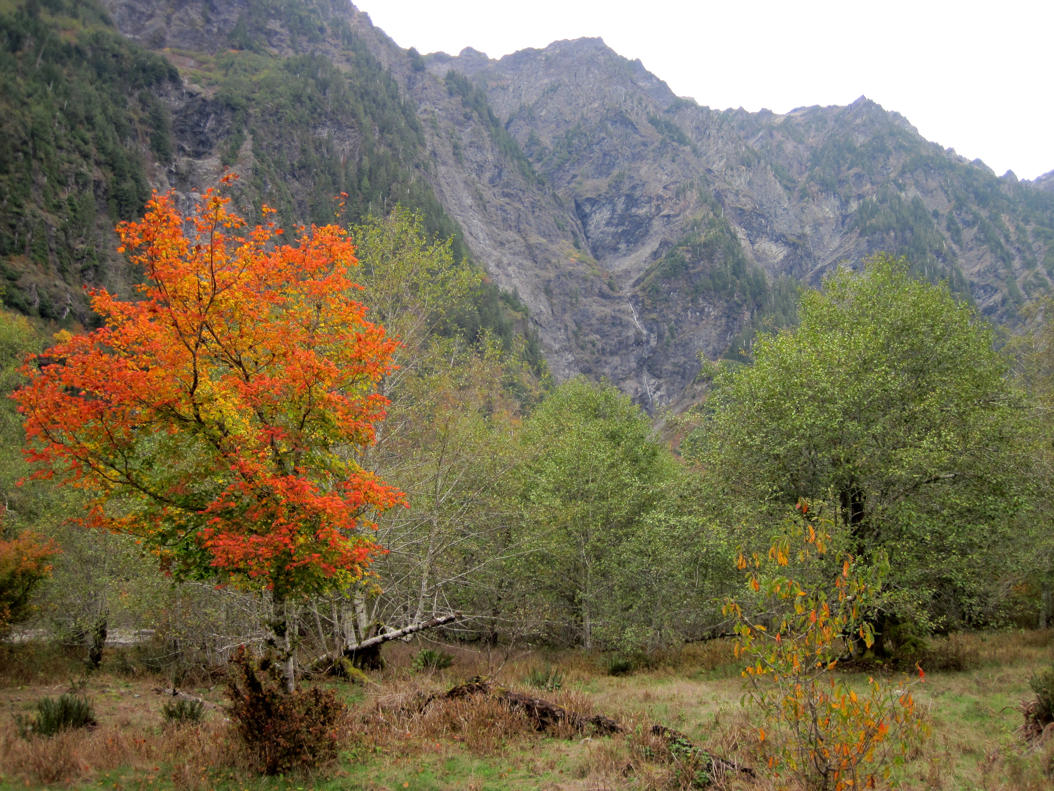
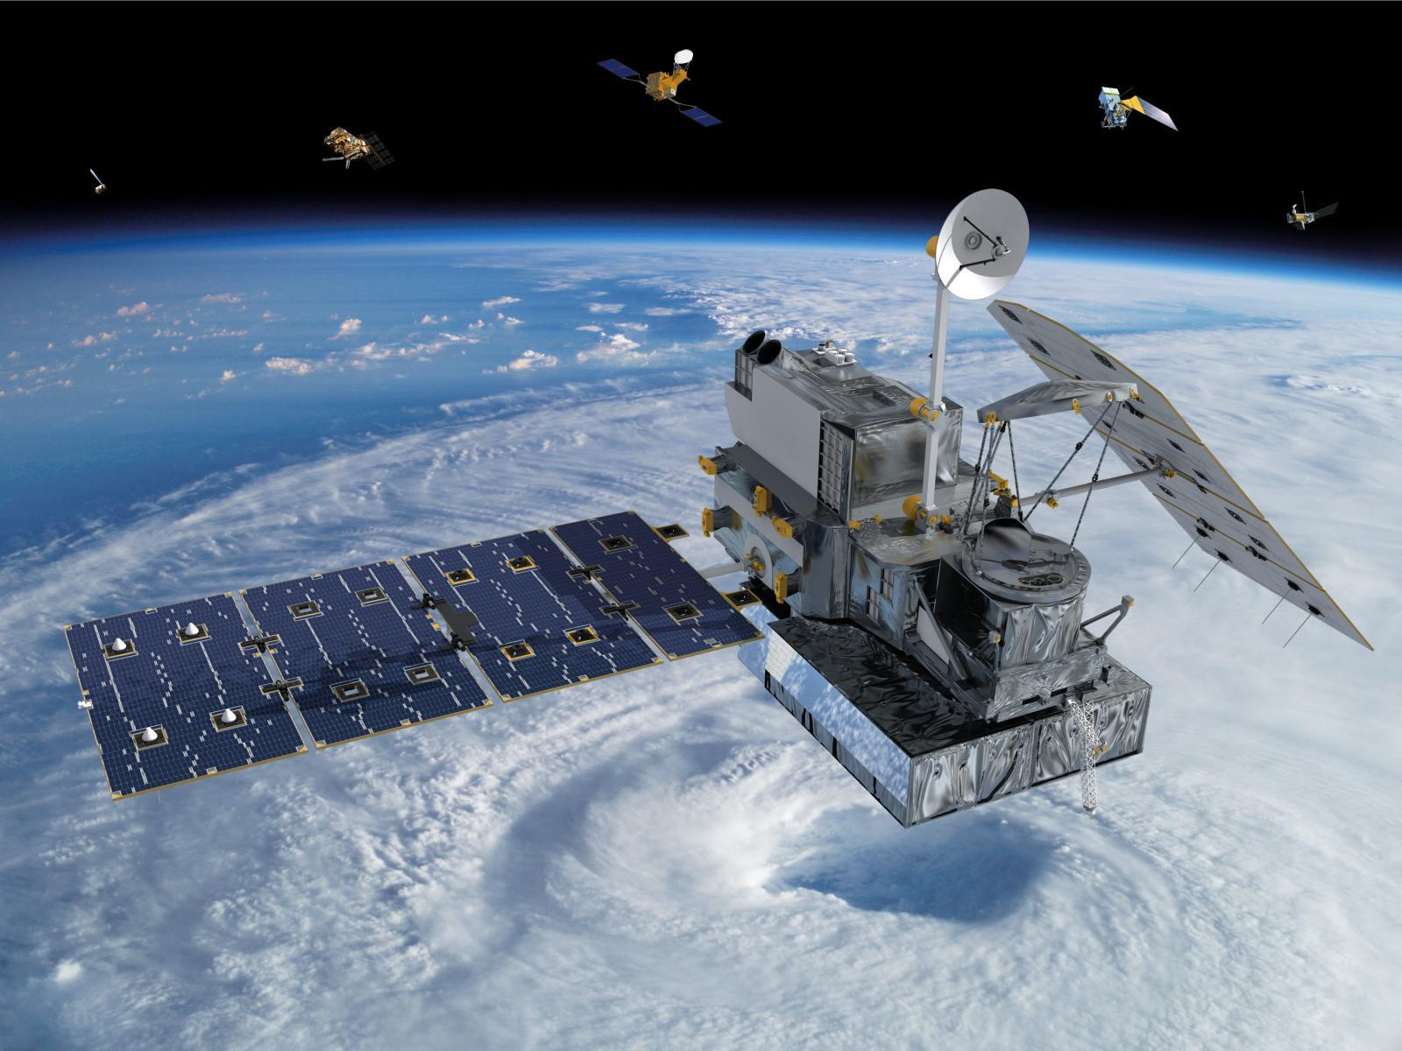
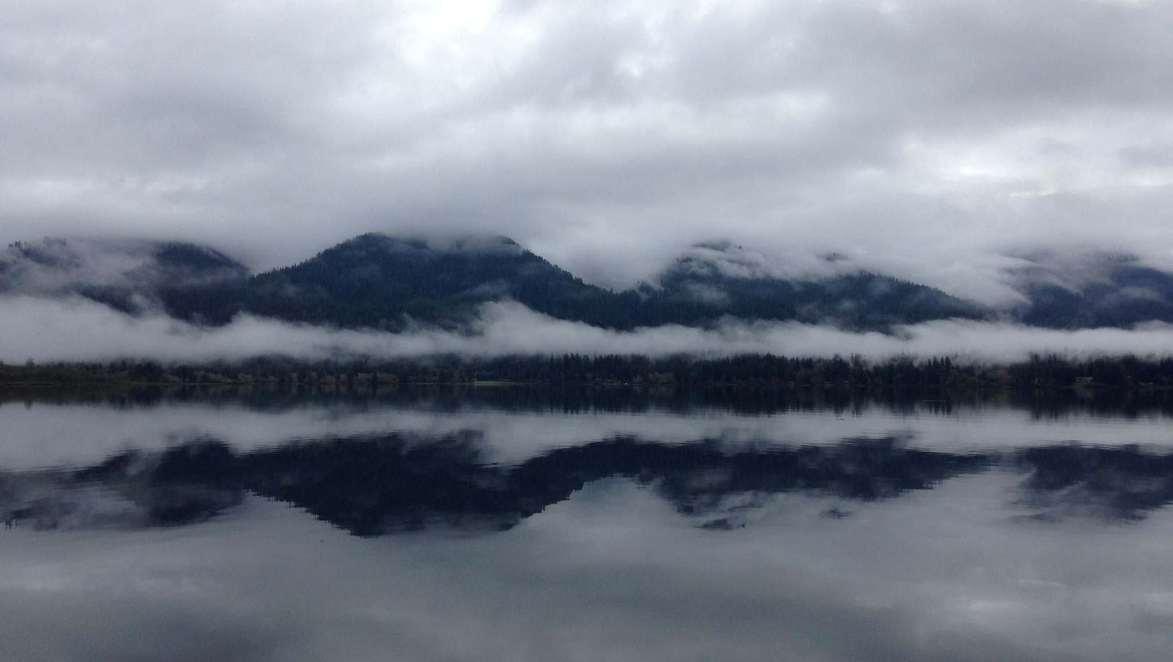
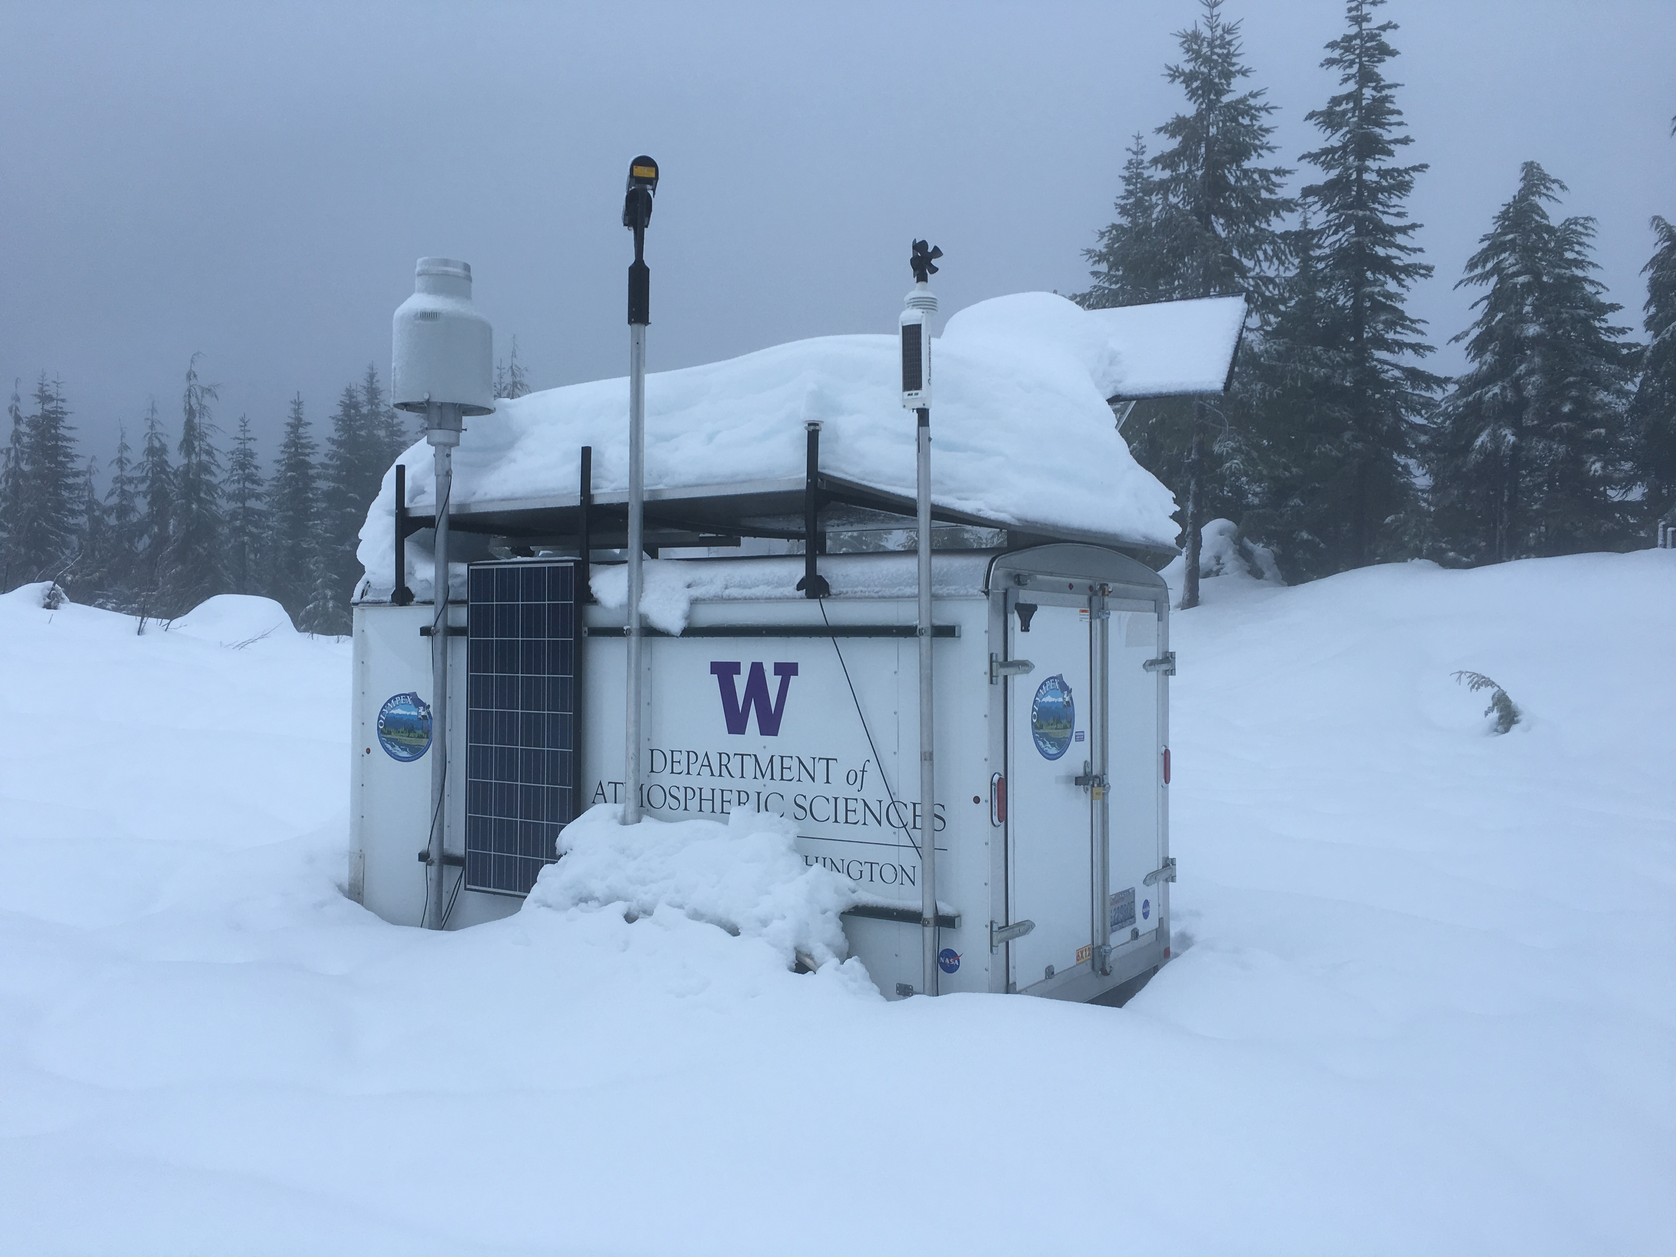
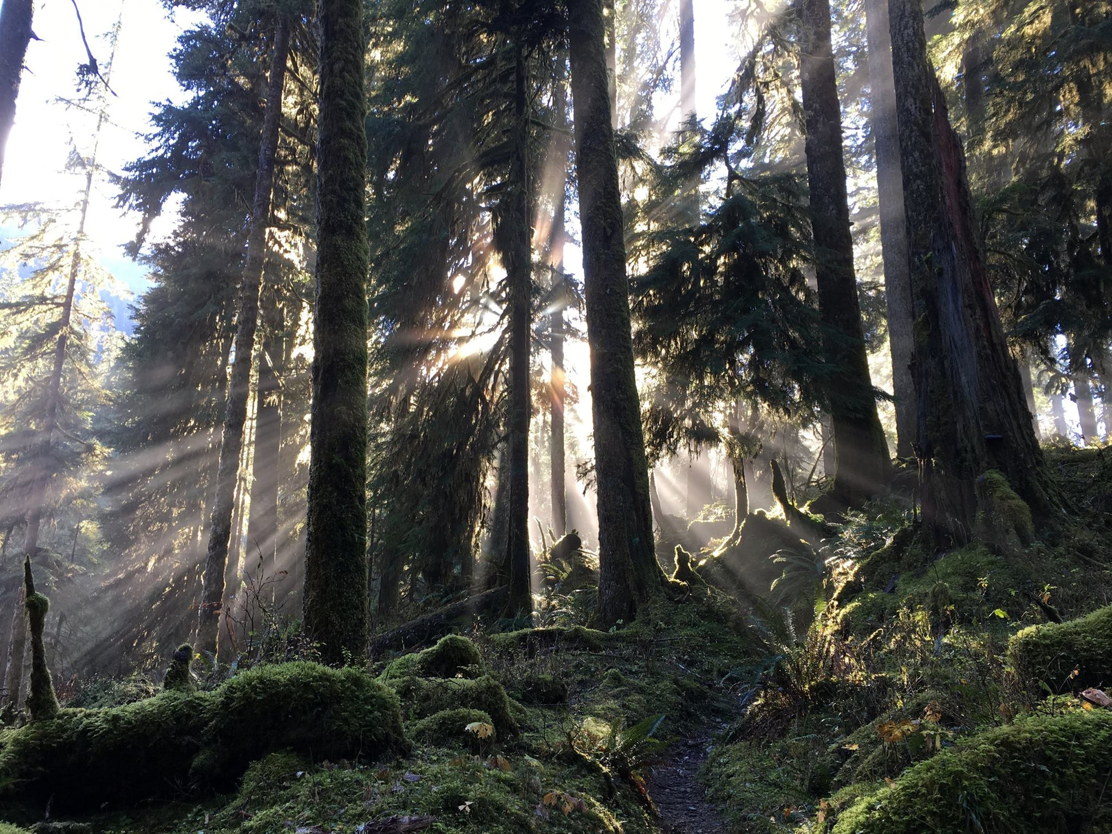
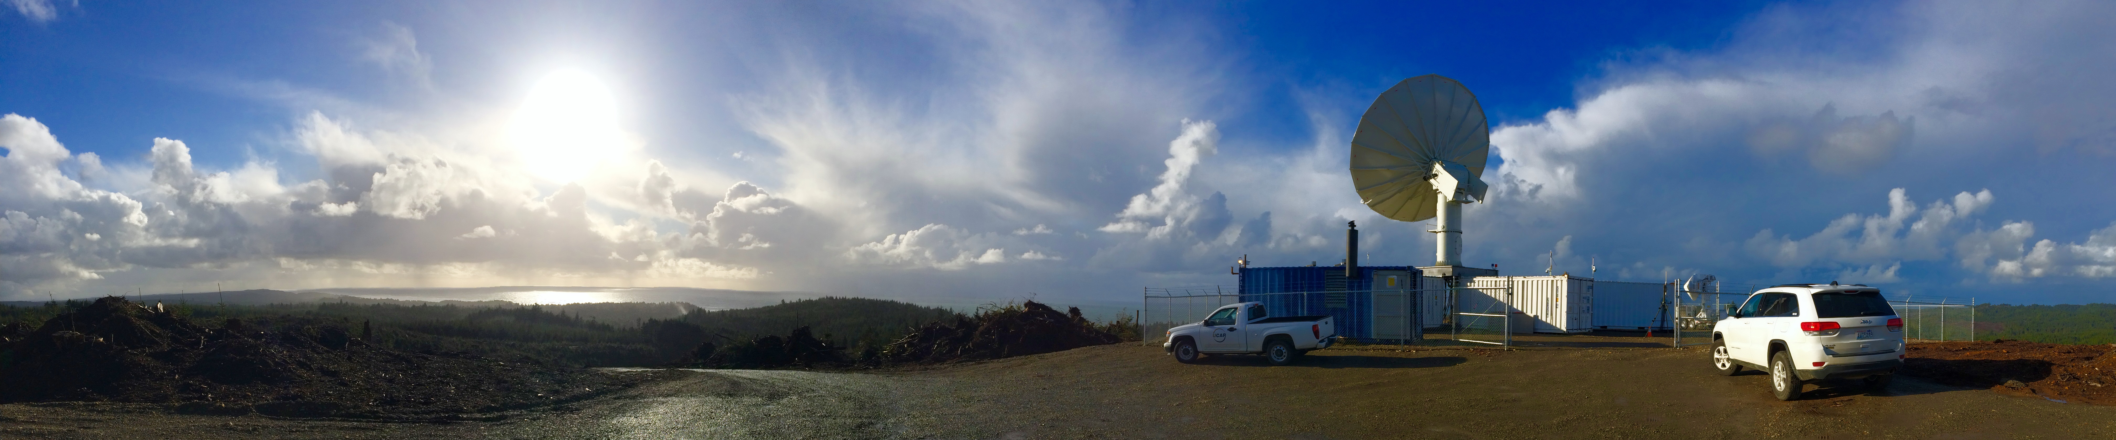
OLYMPEX
Measuring Rain and Snow on the Olympic Peninsula
Project Manager, Lynn McMurdie at Western Snow Conference, Seattle, 18 April 2016

Slide 2


OLYMPEX
“A NASA supported Global Precipitation Measurement (GPM) Satellite Ground Validation Field Campaign over the Olympic Peninsula to measure winter-time mid-latitude cyclones as they traverse from the ocean to the coast to high terrain to the leeside.”
~ whew~

Slide 3
OLYMPEX
“A NASA supported Global Precipitation Measurement (GPM) Satellite Ground Validation Field Campaign over the Olympic Peninsula to measure winter-time mid-latitude cyclones as they traverse from the ocean to the coast to high terrain to the leeside.”

Slide 4
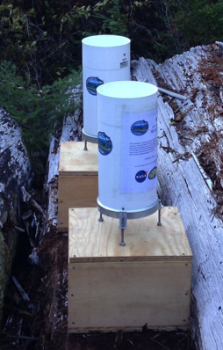
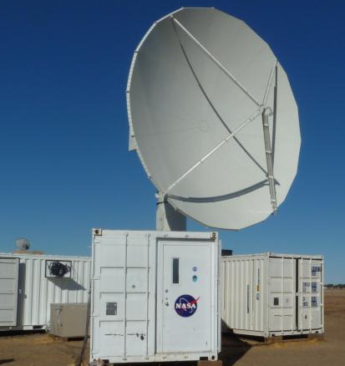
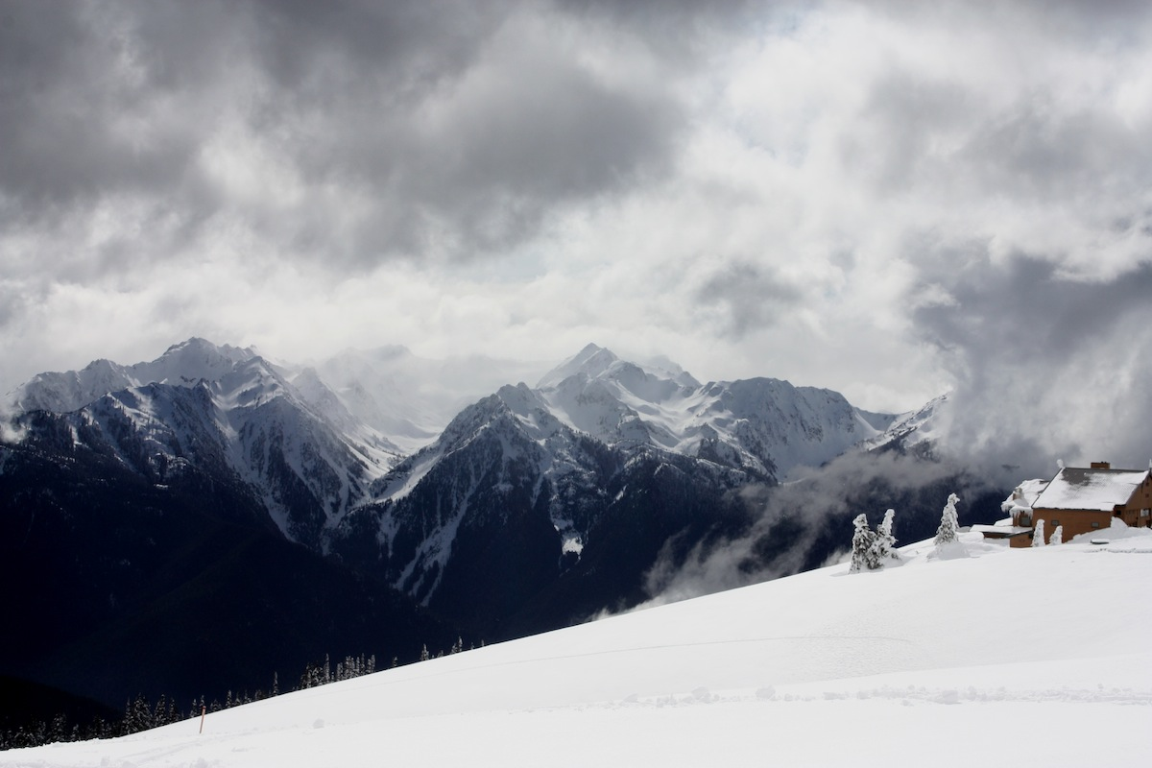
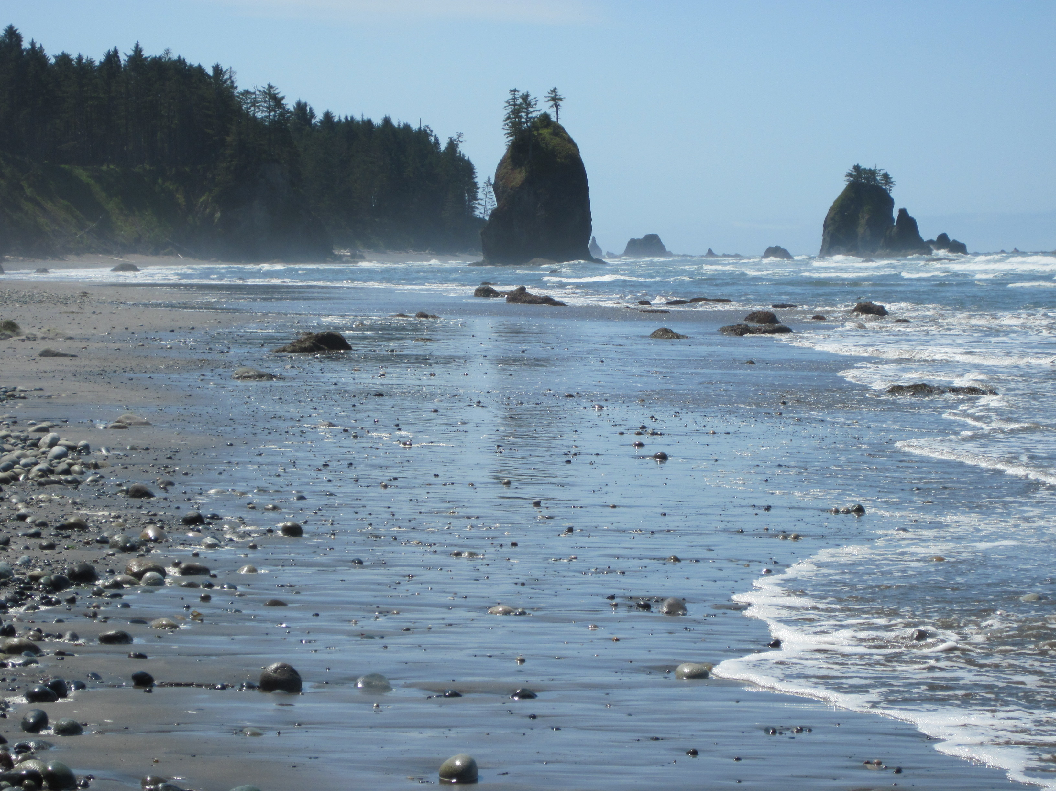
OLYMPEX How can we measure precipitation?
Hurricane Ridge
rain gauges weather radars.
Olympic National Park
How about over ocean? Over remote locations?
GPM Core Satellite
Measure precipitation from satellites

Slide 5
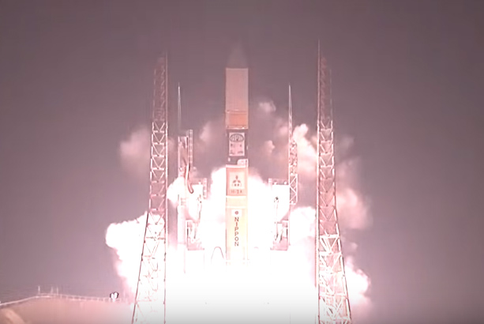
Global Precipitation Mission Measuring Precipitation from Space
GPM Core Satellite
27 February 2014
Polar Orbiting Satellite
Passive Instrument called GPM Microwave Imager (GMI)
Active Instrument called the Dual Precipitation Radar (DPR)

Slide 6
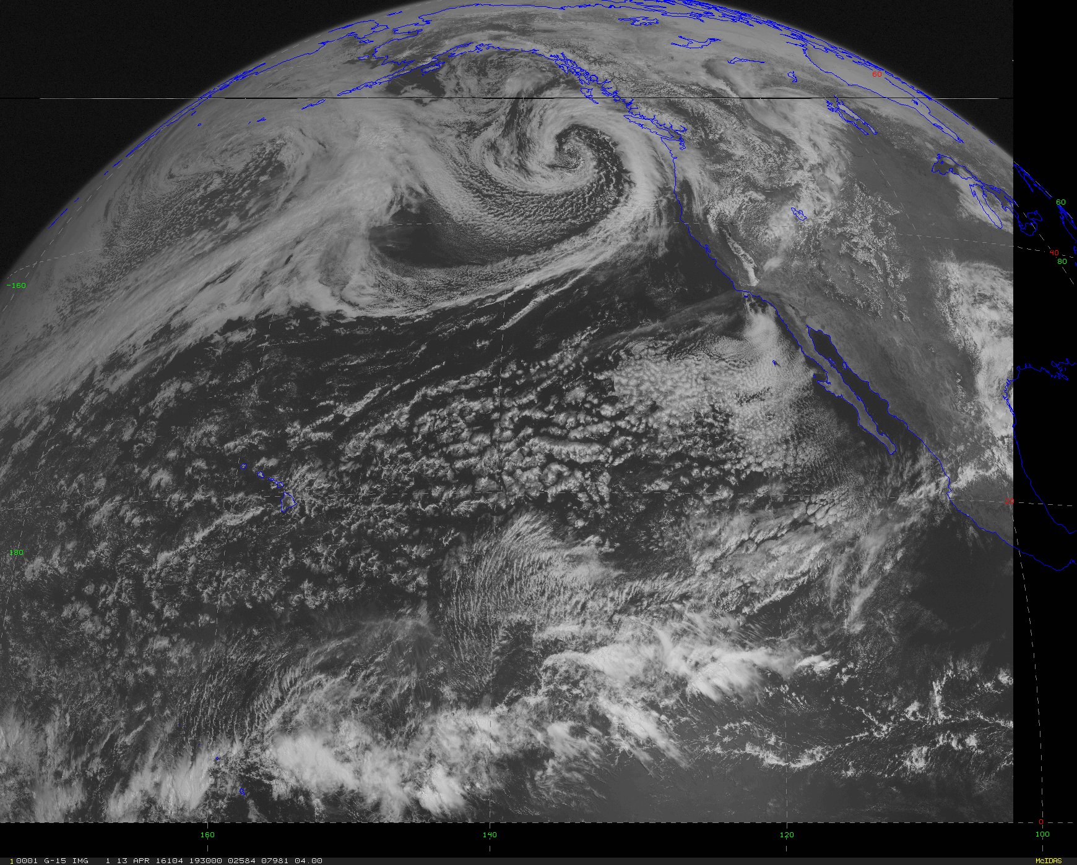
Types of Satellites: Geosynchronous
Visible picture of the clouds taken 13 April 2016
Satellite rotates at the same speed as the earth itself rotates
Appears to be stationary
35,000km above earth
10 Geosynchronous satellites positioned around the Earth
Takes pictures ‘visible’ or ‘infrared’ every 15 min
Often shown on TV weather shows, the Weather Channel, etc.

Slide 7
Types of Satellites: Polar Orbiting
Circle around the earth more or less from pole to pole.
GPM samples Antarctic circle to Arctic circle.
These satellites make one orbit every ~110 min (~13 orbits/day).
~800km above the earth.
Satellite observes the same location on earth ~ 2 times a day

Slide 8
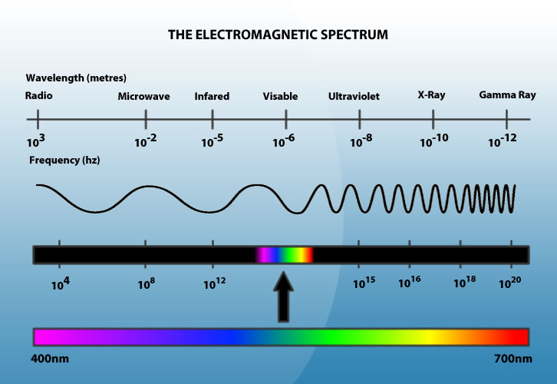
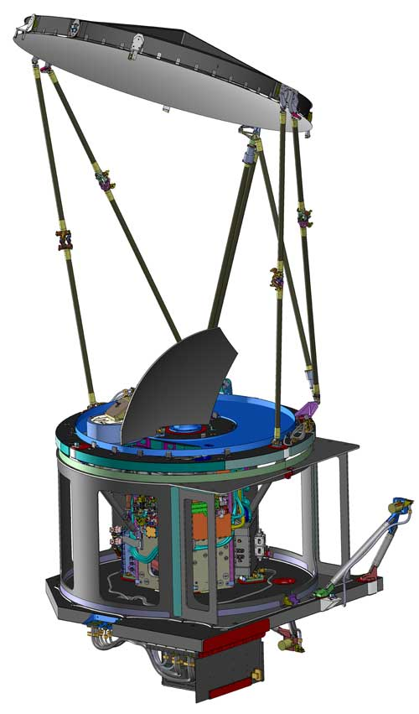
Types of Instruments: Passive
The GMI on GPM
Everything ‘radiates’ according to its temperature. Very hot things radiate at high frequencies (the sun at visible light). Cold things at lower frequencies (the earth, people at IR)
Raindrops and snowflakes also radiate at a variety of wavelengths including microwave.
The GMI measures radiation from the rain and snow at microwave wavelengths.
Algorithms translate the microwave radiation measured by GMI to things we want to measure like rain rate.
Notes:
NASA has a good video on passive/active measurements from space at http://gpm.nasa.gov/education/videos/water-falls-getting-big-picture

Slide 9
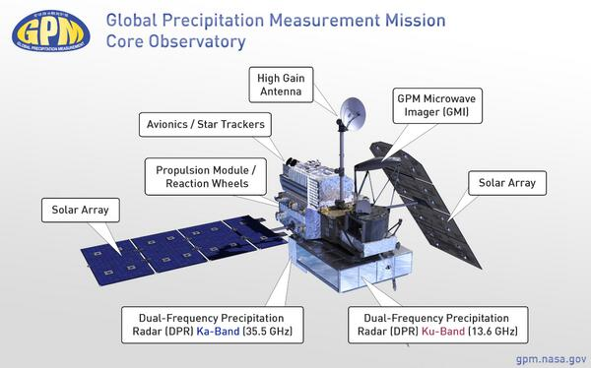
Types of Instruments: Active
The DPR on GPM
Sends out a beam of radiation and it is reflected back by the raindrops and snowflakes
Amount of reflected energy is measured at the instrument (weather radar).
The GPM has the first dual-frequency radar (DPR) in space.
The DPR is a Ku- and Ka-band dual radar.
This ‘reflectivity’ gives 3-D distribution of precipitation and rate rate on the surface.
Ground weather radars are usually in the S-band (10cm))

Slide 10
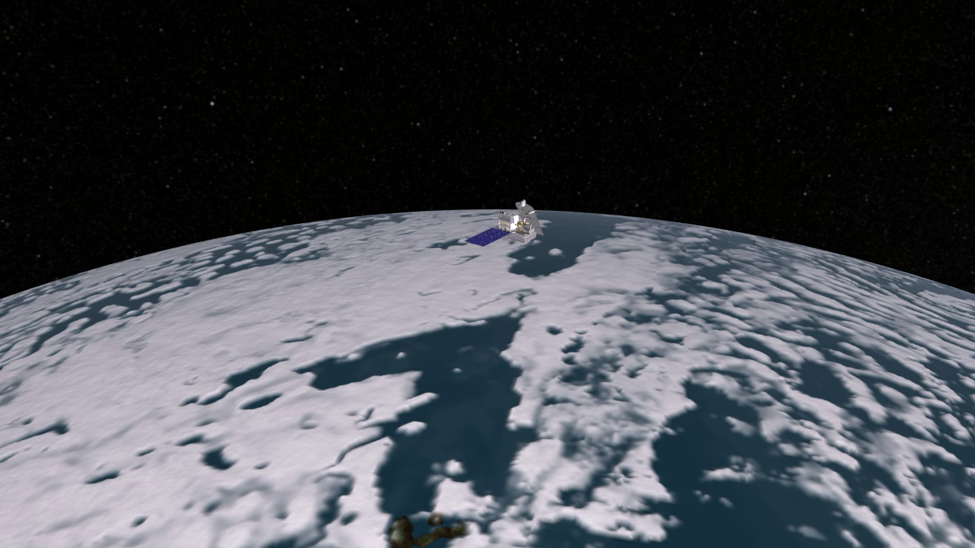

Slide 11
OLYMPEX
“A NASA supported Global Precipitation Measurement (GPM) Satellite Ground Validation Field Campaign over the Olympic Peninsula to measure winter-time mid-latitude cyclones as they traverse from the ocean to the coast to high terrain to the leeside.”

Slide 12
Midlatitude Cyclones

Slide 13
Midlatitude Cyclones

Slide 14
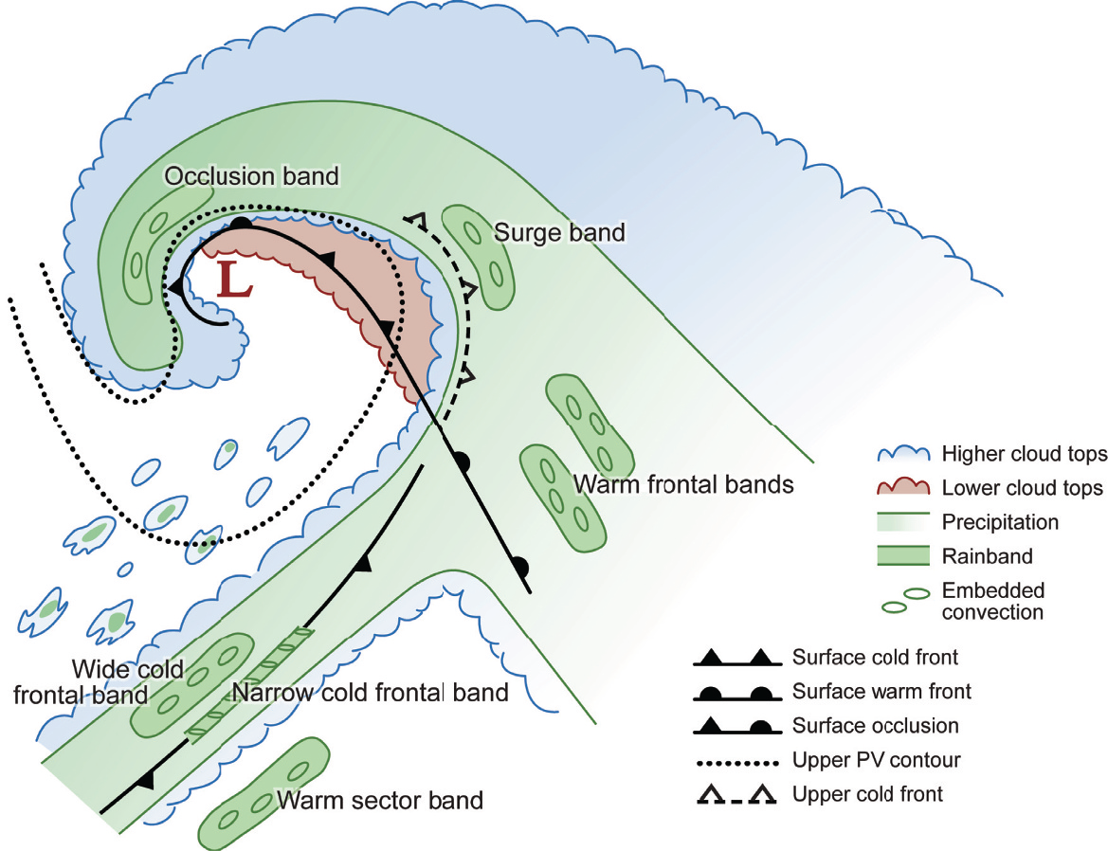
Midlatitude Cyclones
Graphic from Cloud Dynamics, 2nd Ed., by R. A. Houze, Jr., ©Academic Press-Elsevier, 2014
Prefrontal
Post Frontal
Frontal
Warm Sector

Slide 15
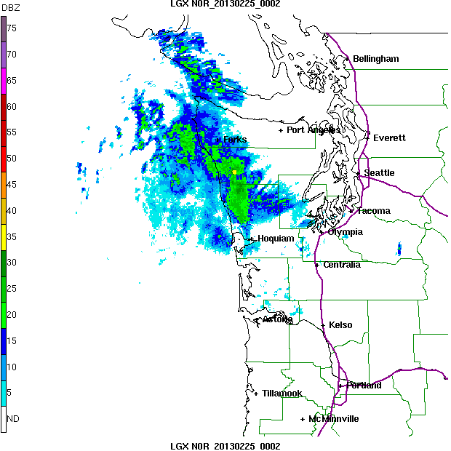
Typical Frontal Passage Olympic Peninsula gets wet in all sectors of storms!
Prefrontal
Frontal
Postfrontal
SW side of Olympics gets rain well ahead of front
SW side gets rain during front
SW side gets post-frontal showers
Notes:
This is the radar loop of the same storm

Slide 16
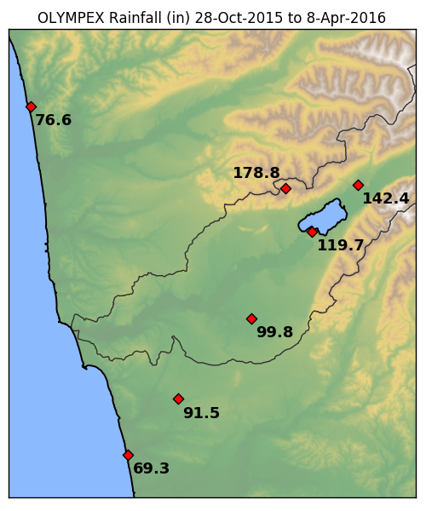
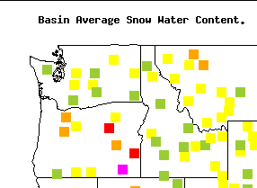
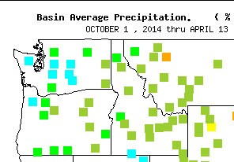
Precipitation Totals this Water Year so far
100%
75 - 90%
125 -150%

Slide 17
OLYMPEX
“A NASA supported Global Precipitation Measurement (GPM) Satellite Ground Validation Field Campaign over the Olympic Peninsula to measure winter-time mid-latitude cyclones as they traverse from the ocean to the coast to high terrain to the leeside.”
Need to make in situ measurements to validate what is measured from space
Need to test assumptions made by satellite algorithms

Slide 18
OLYMPEX
Olympic Peninsula is the place to go to measure precipitation!! But has challenges.

Slide 19
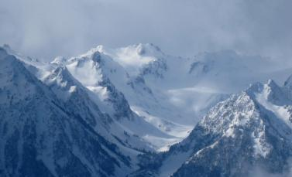
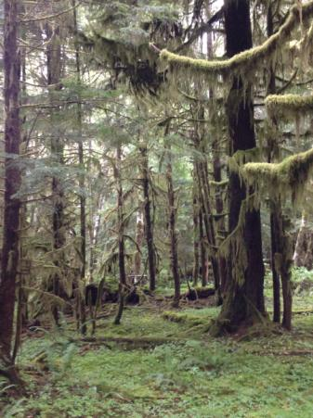
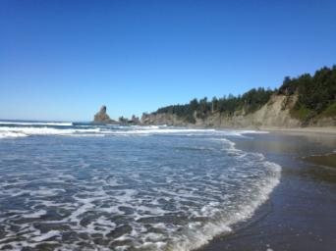
Observational Regions
High Terrain
m
Valley
Quinault
Rain Forest – Windward Side
Chehalis
Ocean

Slide 20
Timeline of Operations
Oct 2014
Spring 2015
Oct 2015
Nov 2015
Dec 2015
Jan 2016
Feb 2016
Now

Slide 21
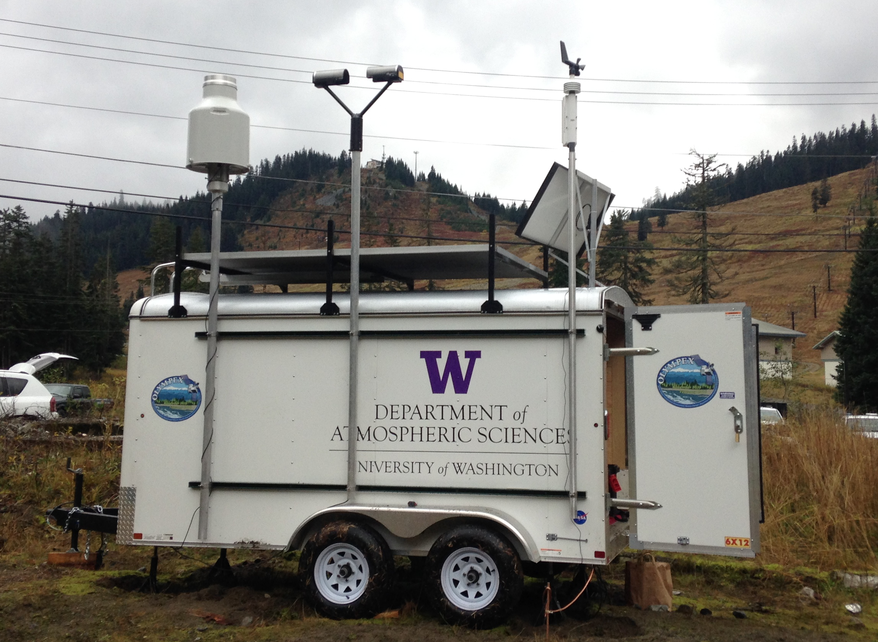
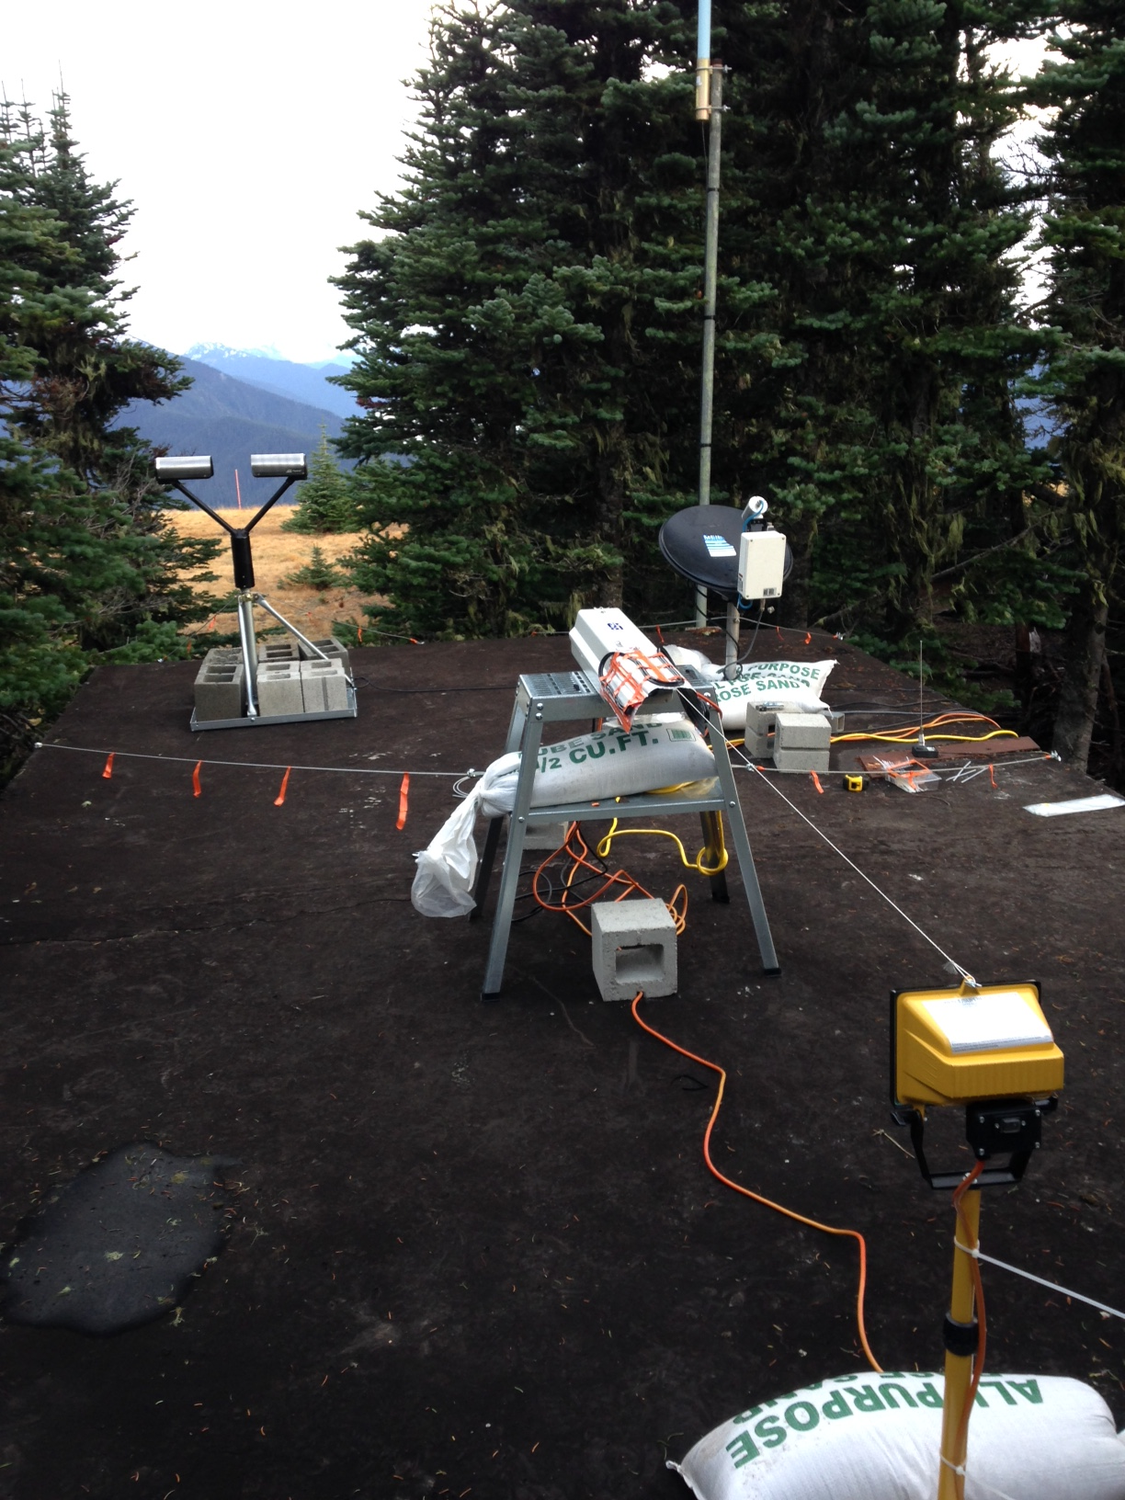
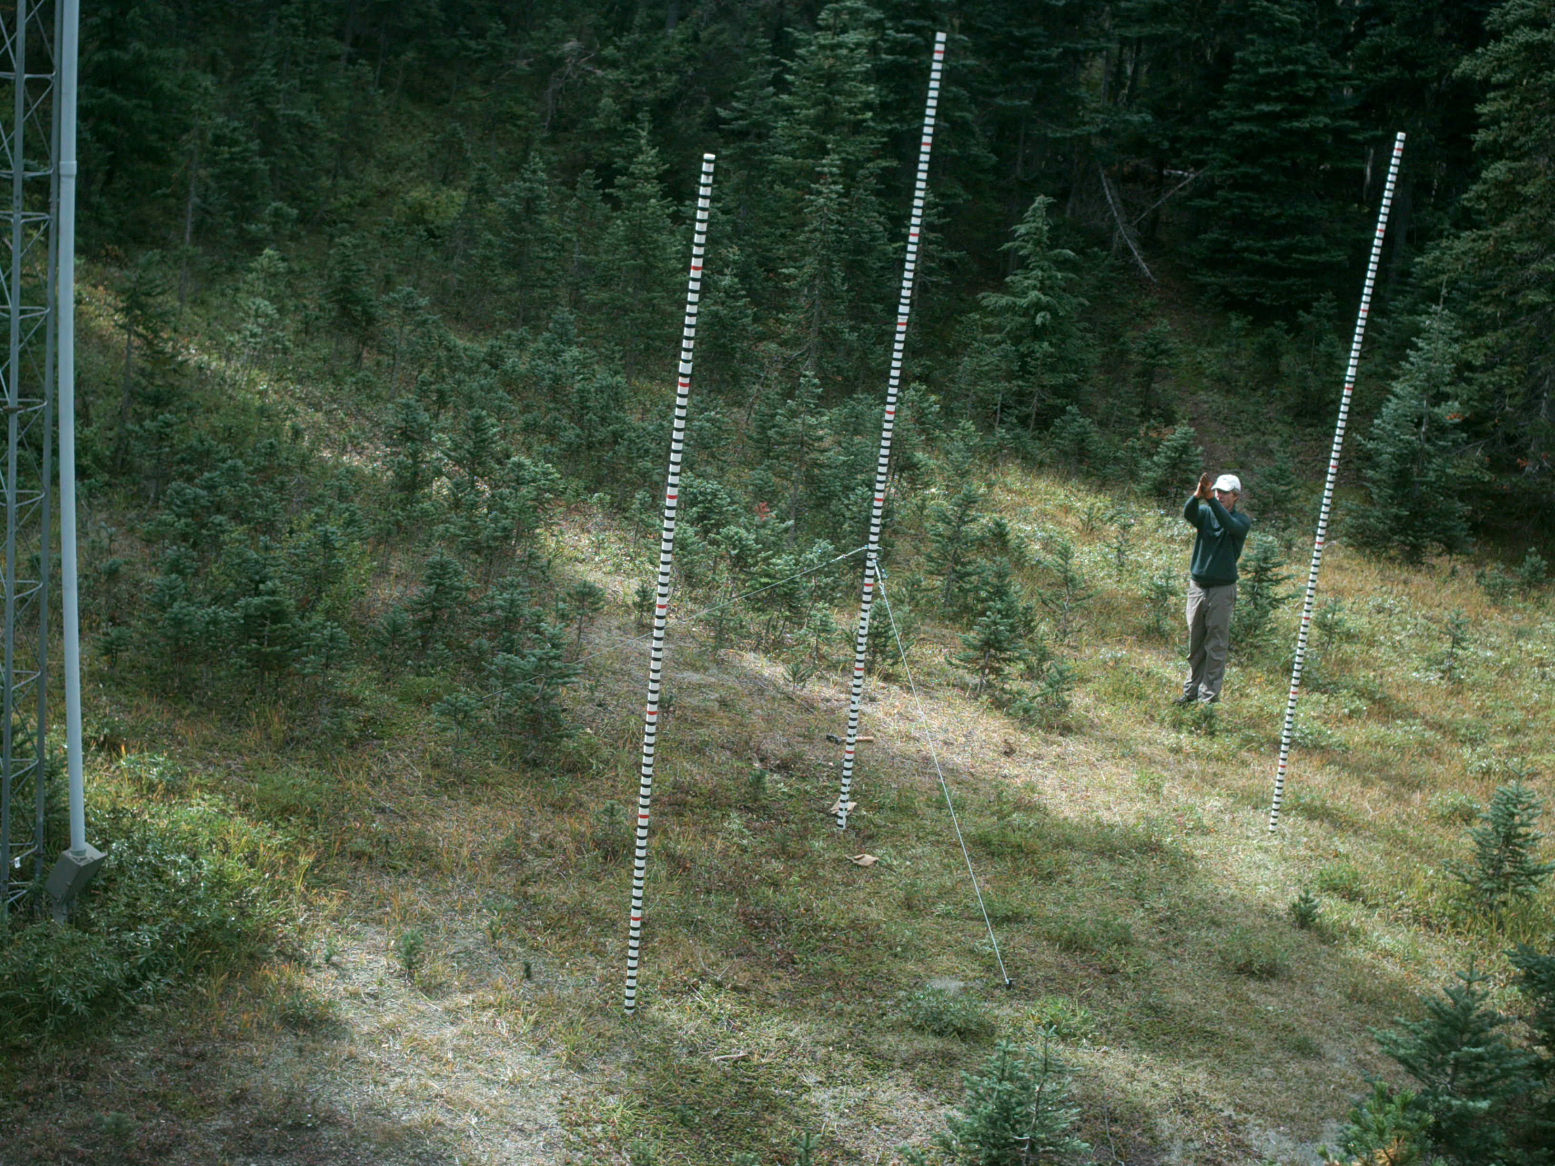
Timeline of Operations
Testing
Oct 2014
Spring 2015
Oct 2015
Nov 2015
Dec 2015
Jan 2016
Feb 2016
Now
Testing of Remote sites: Snow Poles, Trailer, Hurricane Ridge

Slide 22
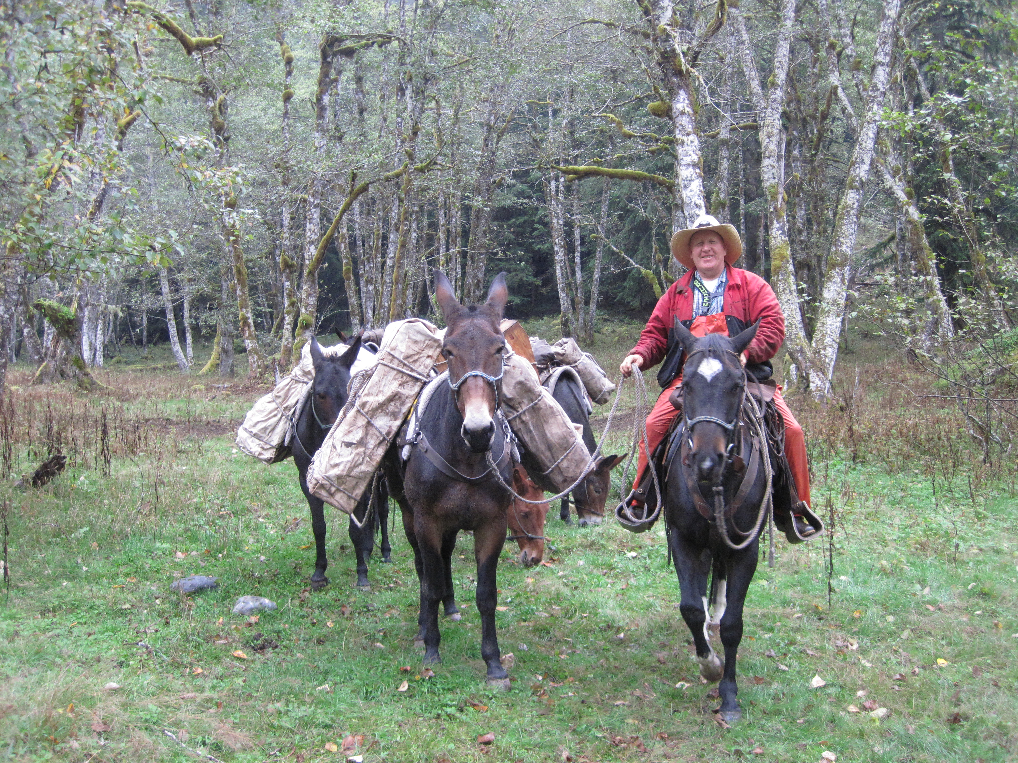
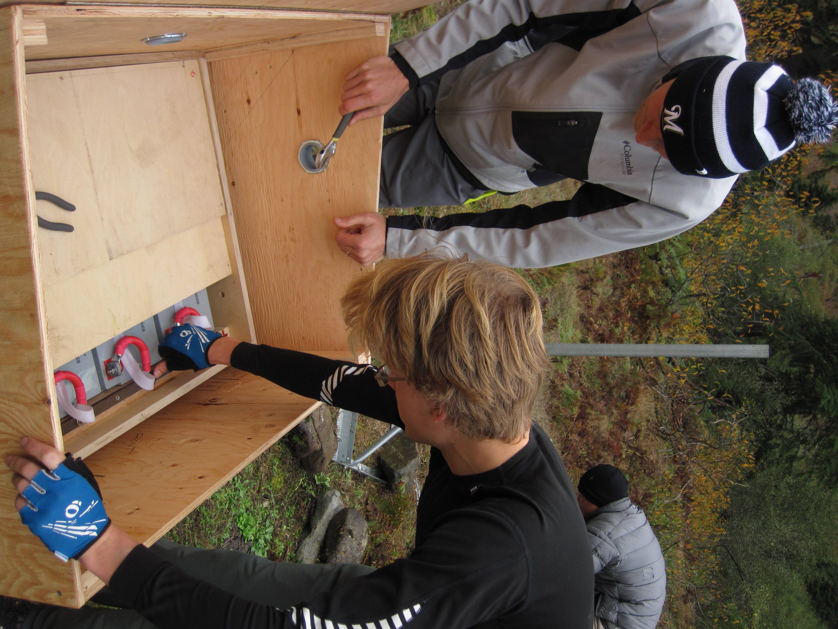
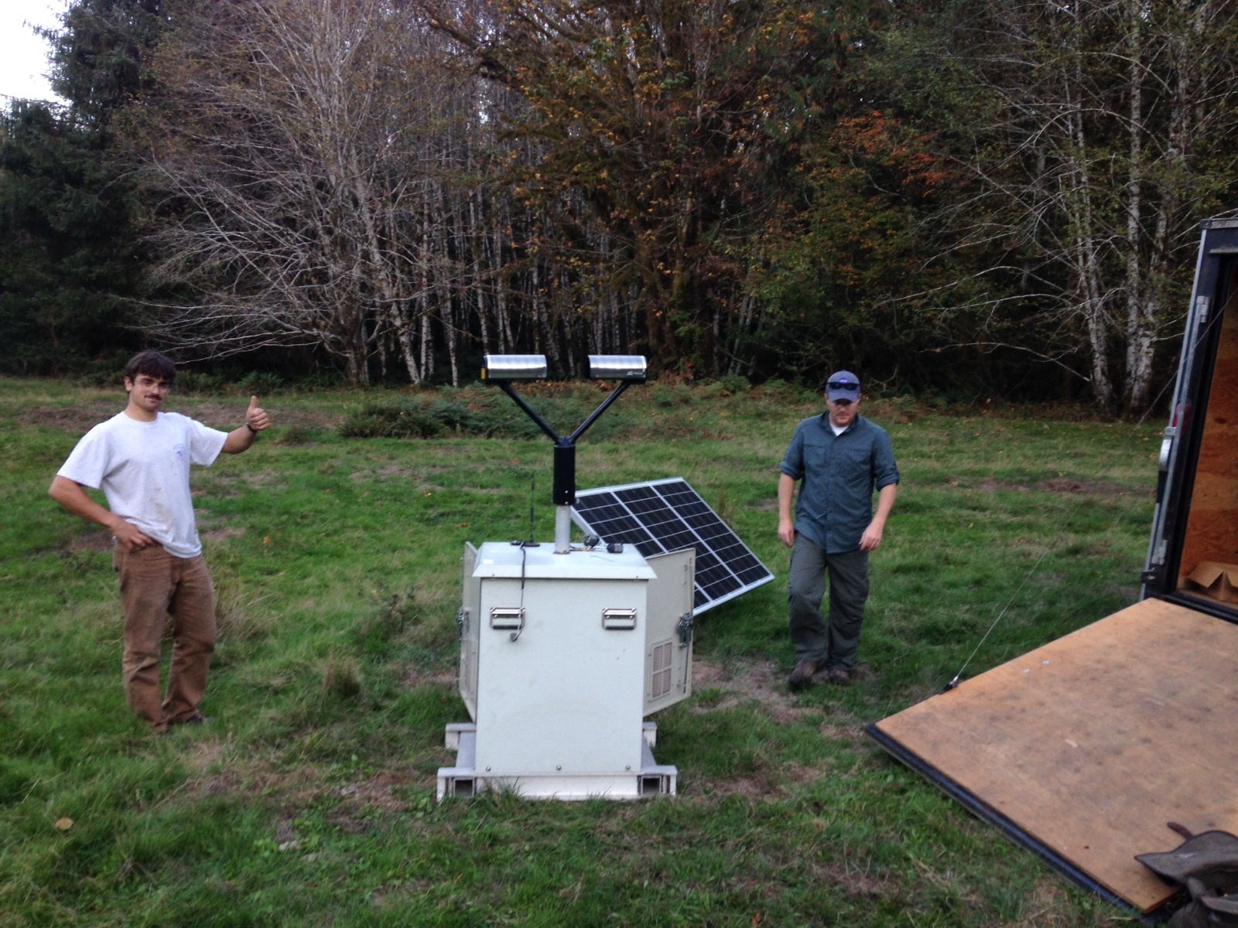
Timeline of Operations
Testing
Ground sites collecting data – Raingauges and Parsivel and MRR’s
Oct 2014
Spring 2015
Oct 2015
Nov 2015
Dec 2015
Jan 2016
Feb 2016
Now
Installation
Ground sites

Slide 23
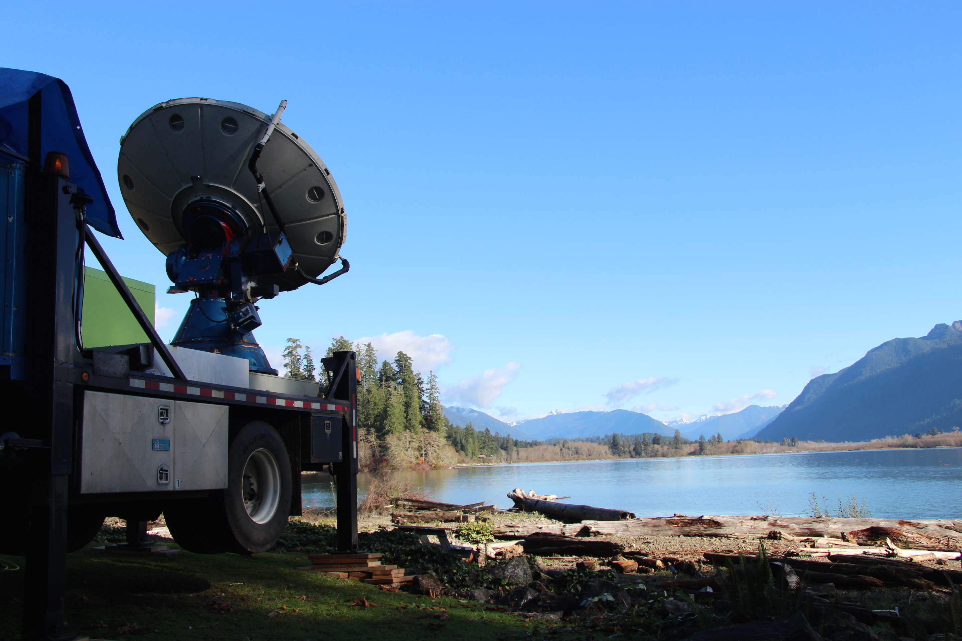
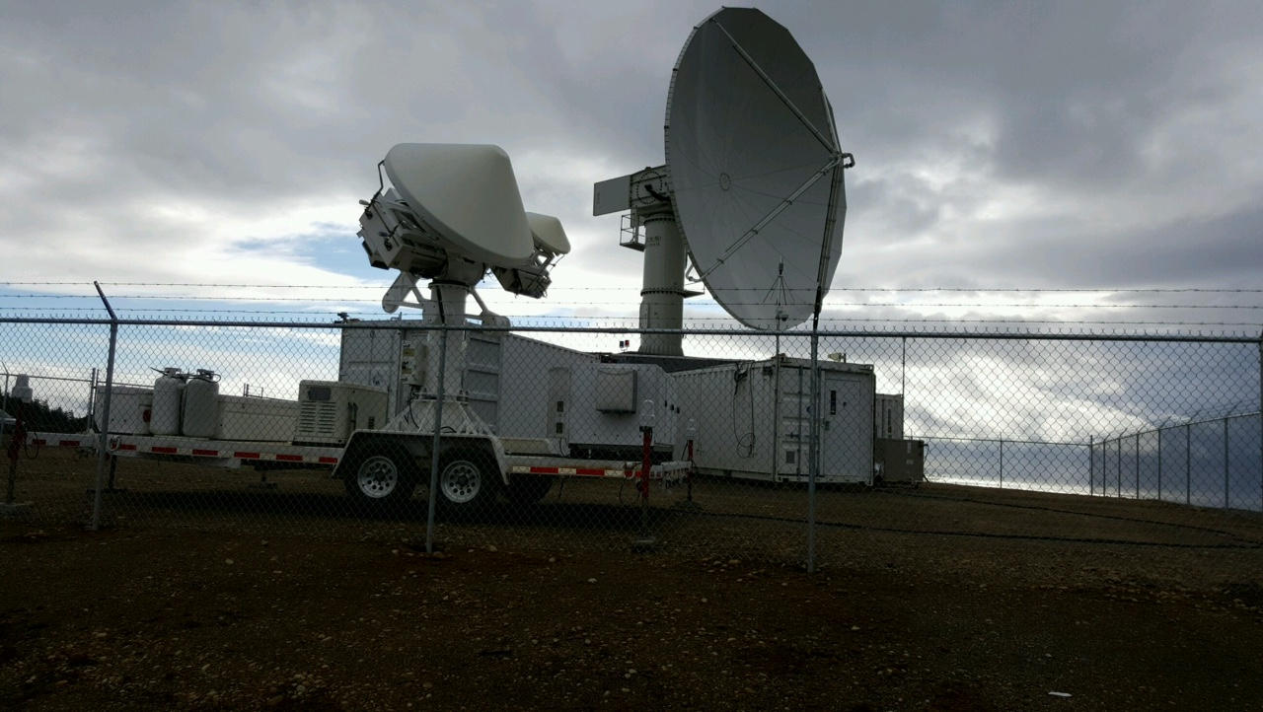
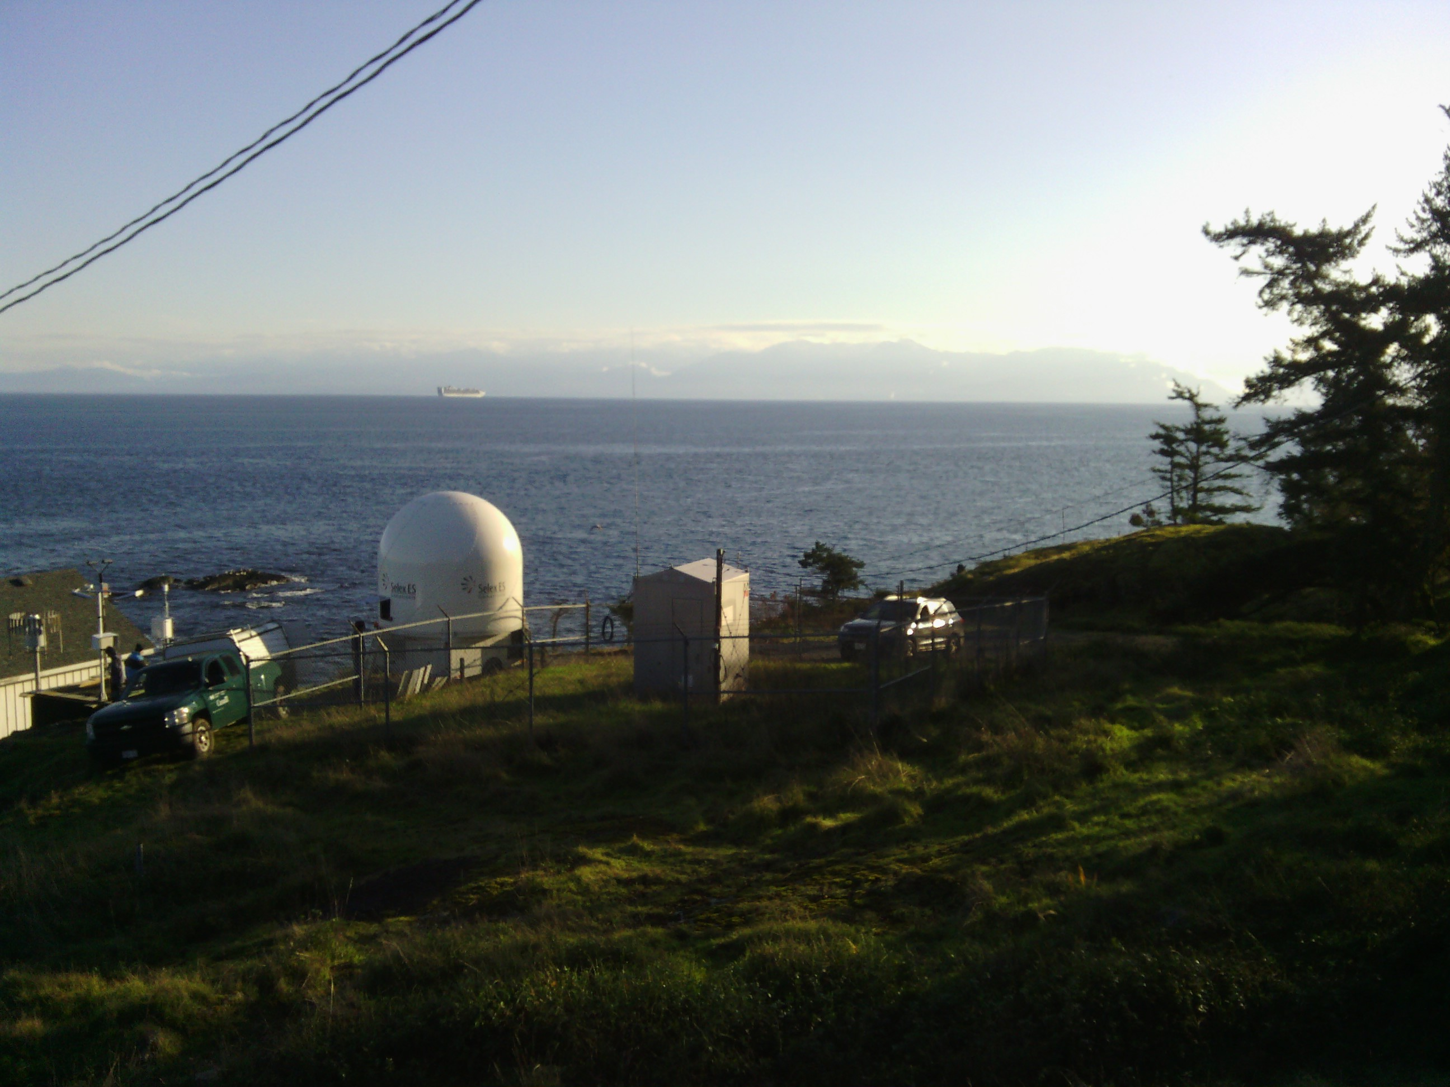
Timeline of Operations
EC X-band Operations
NPOL and DOW Operations
NPOL,DOW
Testing
Ground sites collecting data – Raingauges and Parsivel and MRR’s
Oct 2014
Spring 2015
Oct 2015
Nov 2015
Dec 2015
Jan 2016
Feb 2016
Now
Installation and Operations of Radars
NPOL, DOW, EC X-band

Slide 24
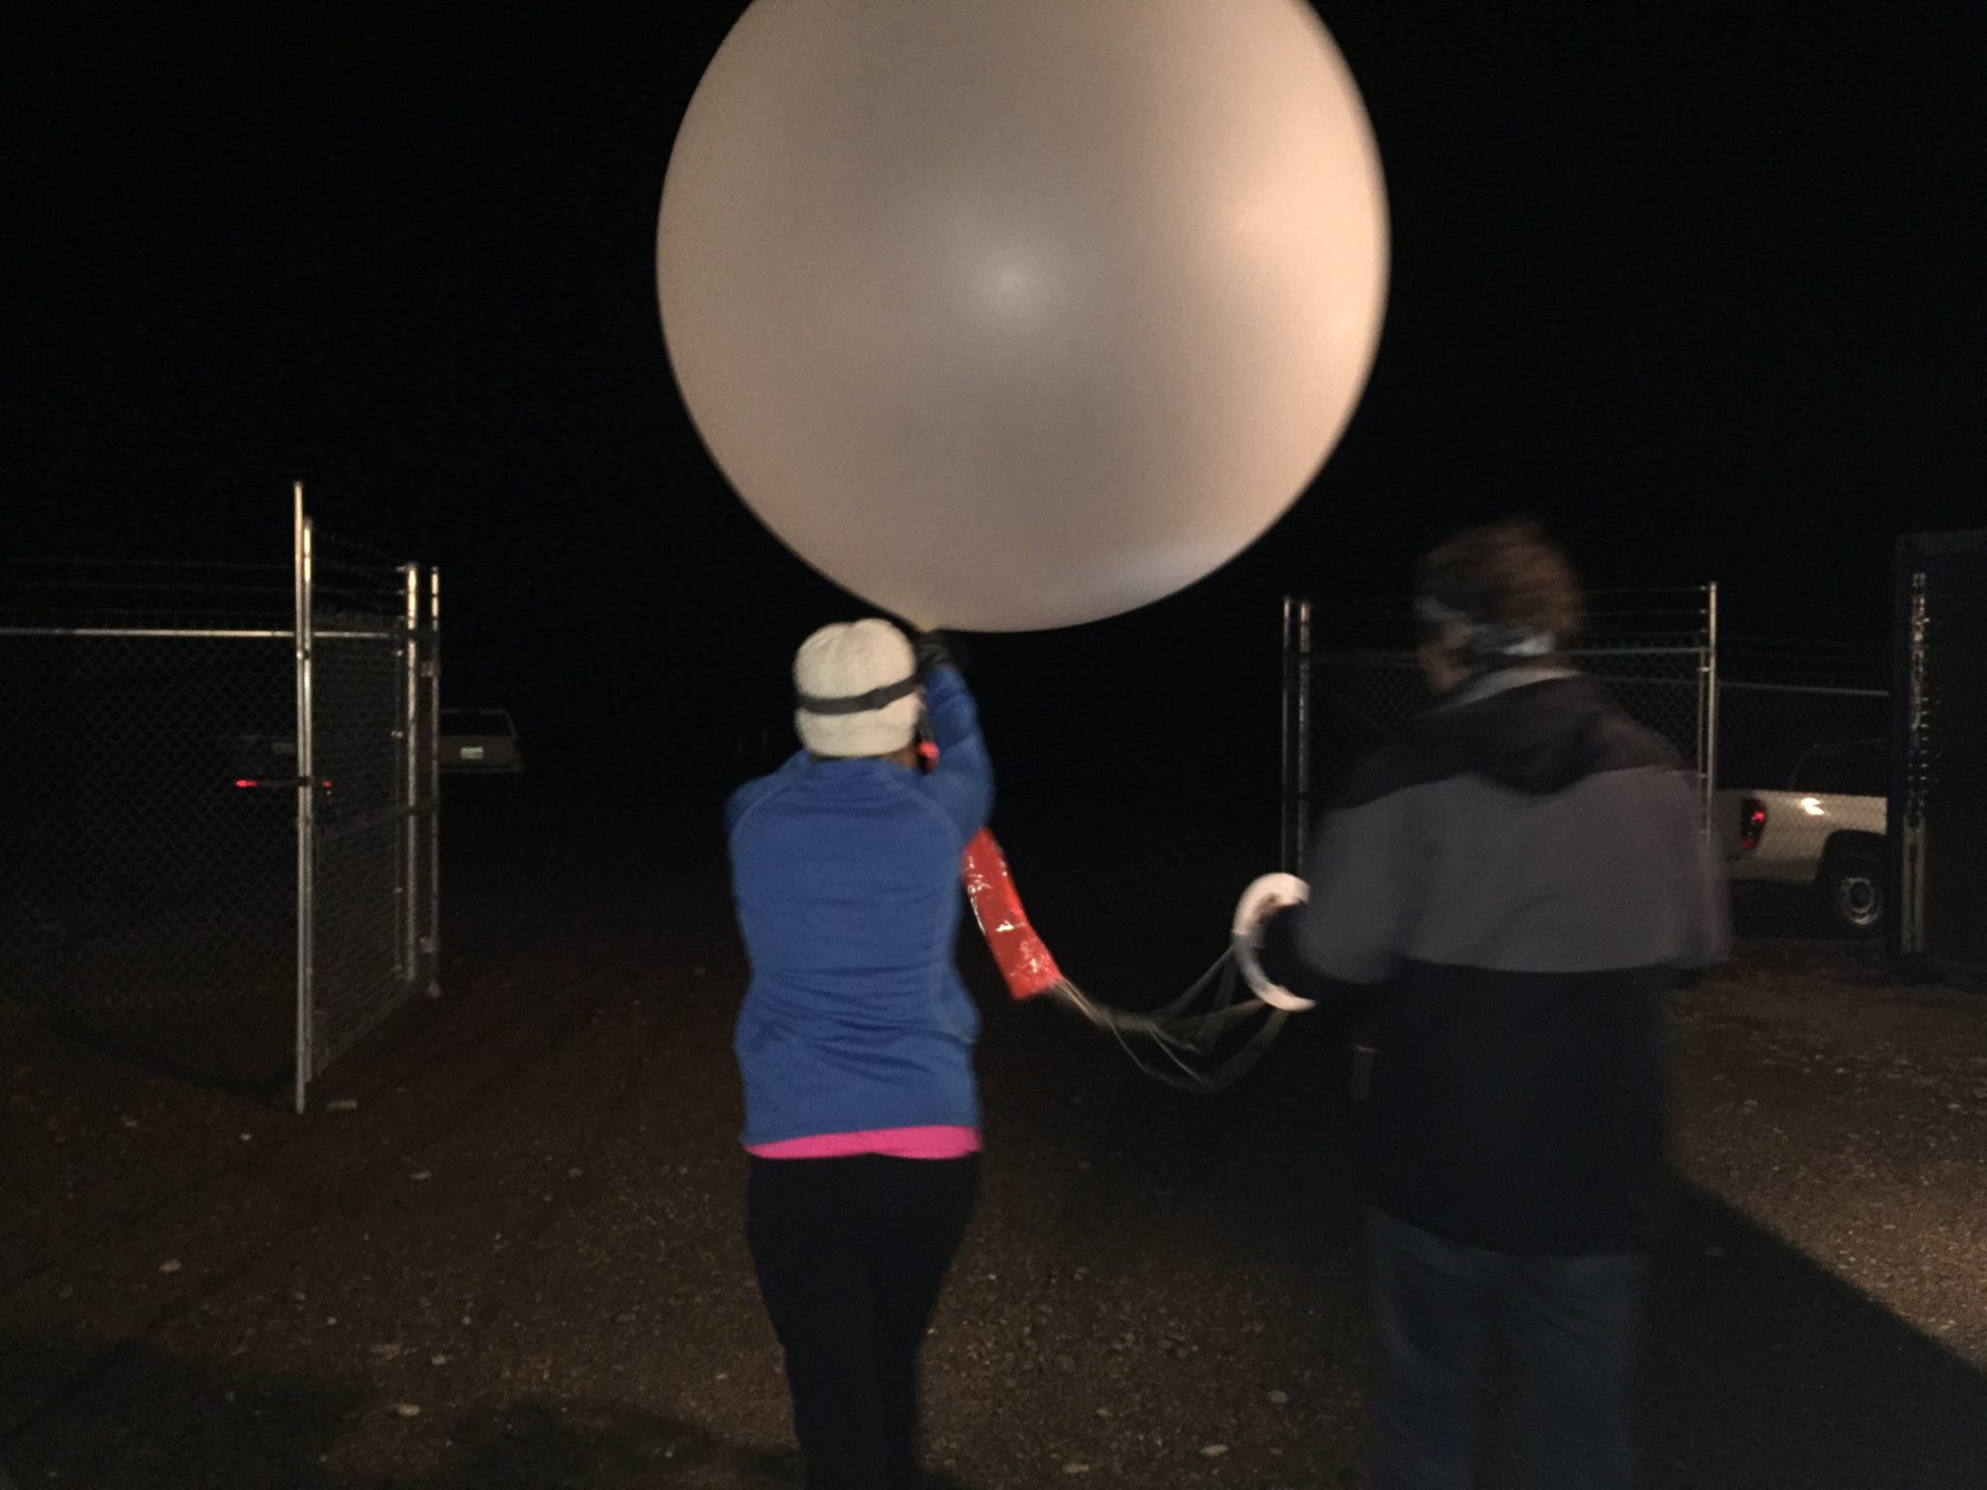
Timeline of Operations
Soundings
Soundings
EC X-band Operations
NPOL and DOW Operations
NPOL,DOW
Testing
Ground sites collecting data – Raingauges and Parsivel and MRR’s
Oct 2014
Spring 2015
Oct 2015
Nov 2015
Dec 2015
Jan 2016
Feb 2016
Now
Supplemental Soundings
NPOL and Victoria KUIL

Slide 25
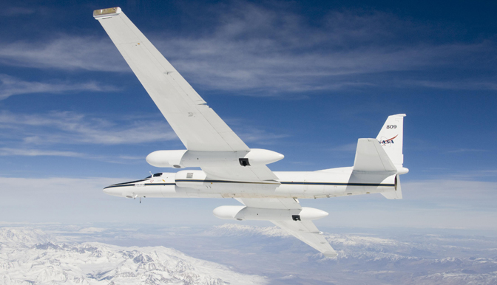
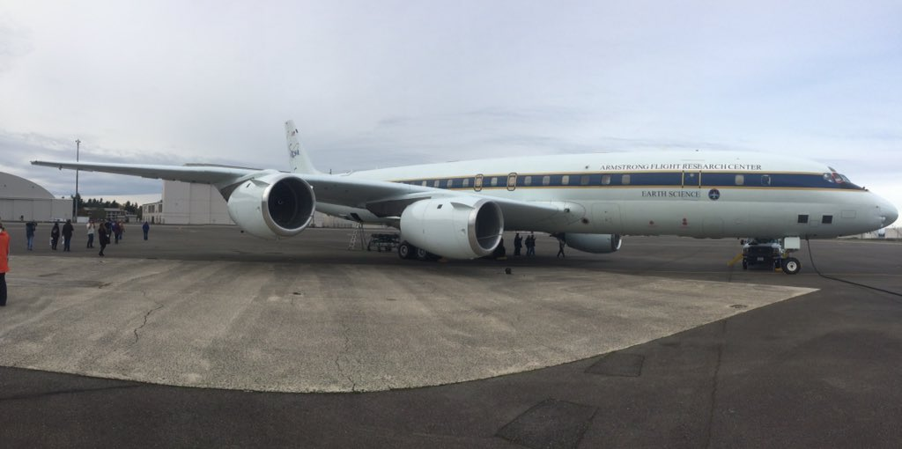
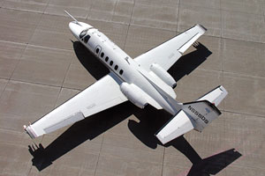
Timeline of Operations
ER-2
Aircraft
Soundings
Soundings
EC X-band Operations
NPOL and DOW Operations
NPOL,DOW
Testing
Ground sites collecting data – Raingauges and Parsivel and MRR’s
Oct 2014
Spring 2015
Oct 2015
Nov 2015
Dec 2015
Jan 2016
Feb 2016
Now
Aircraft
DC-8, Citation, ER-2
DC-8

Slide 26
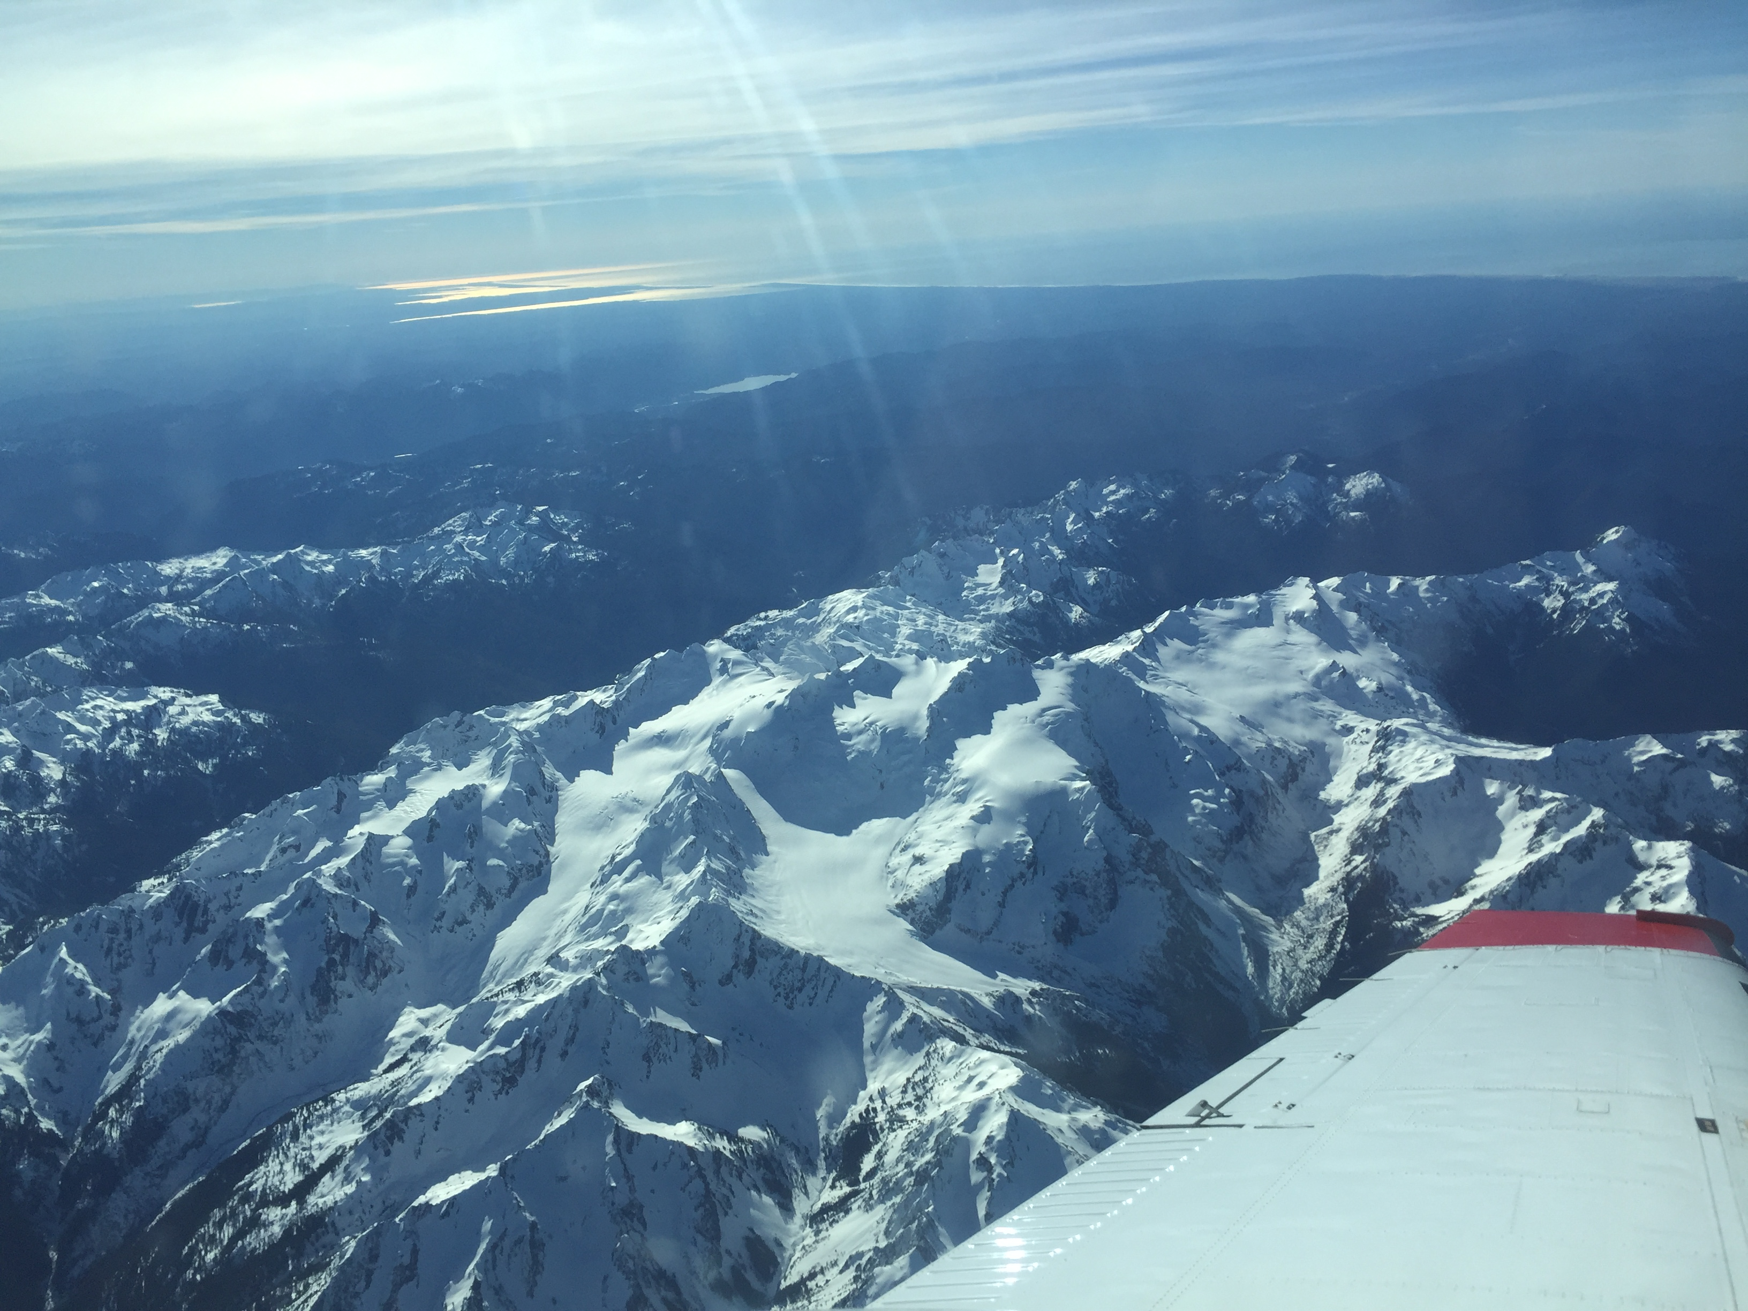
Timeline of Operations
Snow Measurements
Aircraft
Soundings
Soundings
EC X-band Operations
NPOL and DOW Operations
NPOL,DOW
Testing
Ground sites collecting data – Raingauges and Parsivel and MRR’s
Oct 2014
Spring 2015
Oct 2015
Nov 2015
Dec 2015
Jan 2016
Feb 2016
Now
Snow Measurements
Trailer, Hurricane Ridge, Snow Poles, Snow Survey, Lidar Flights

Slide 27
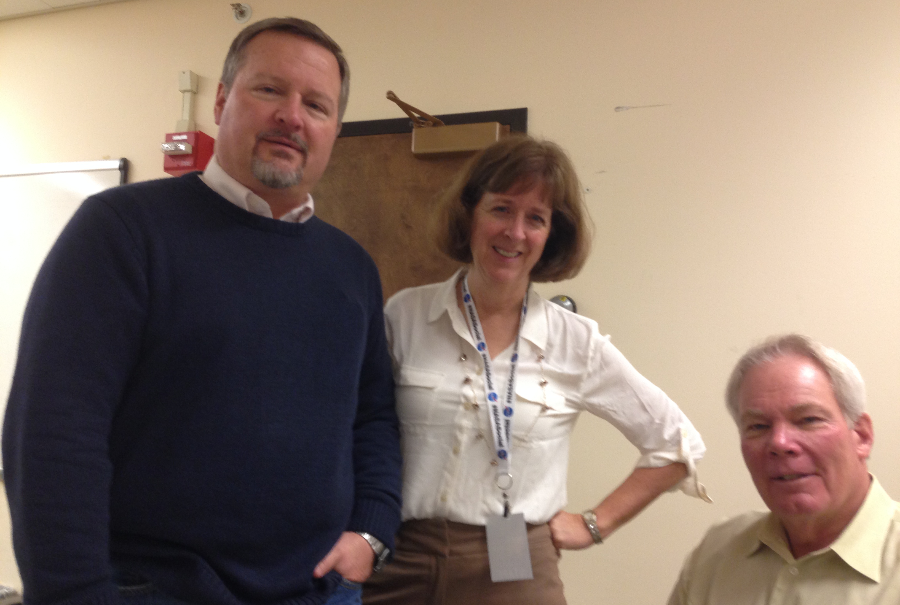
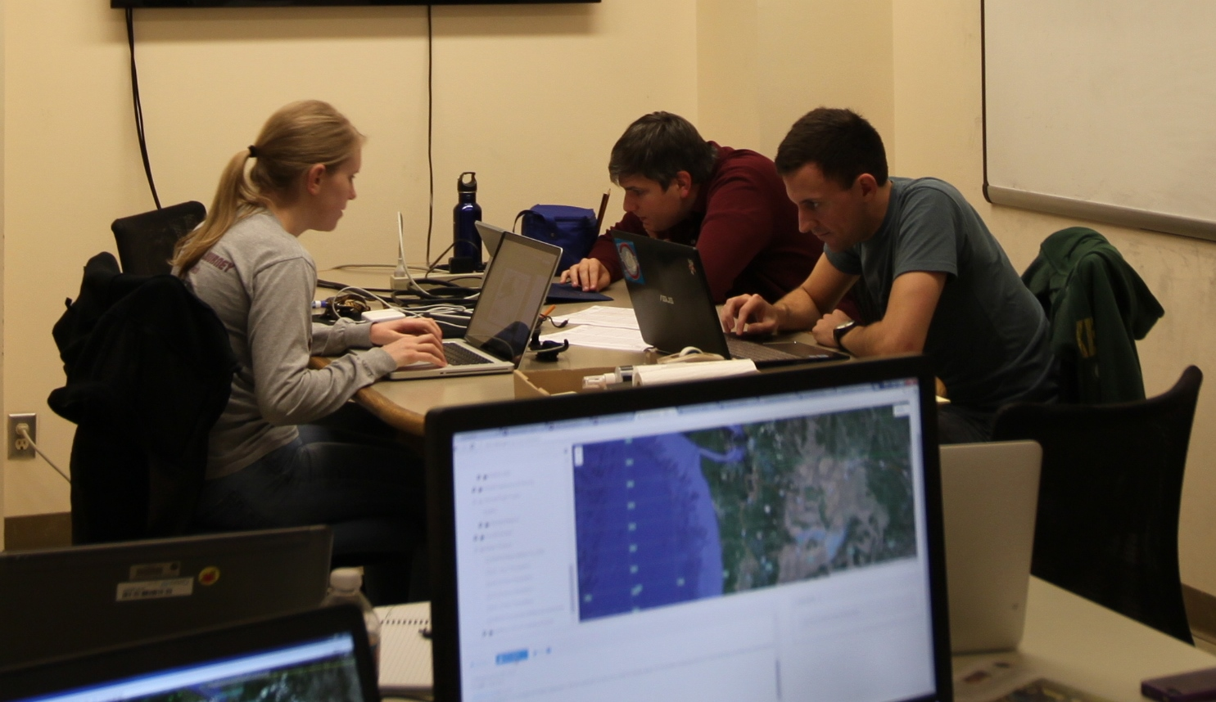
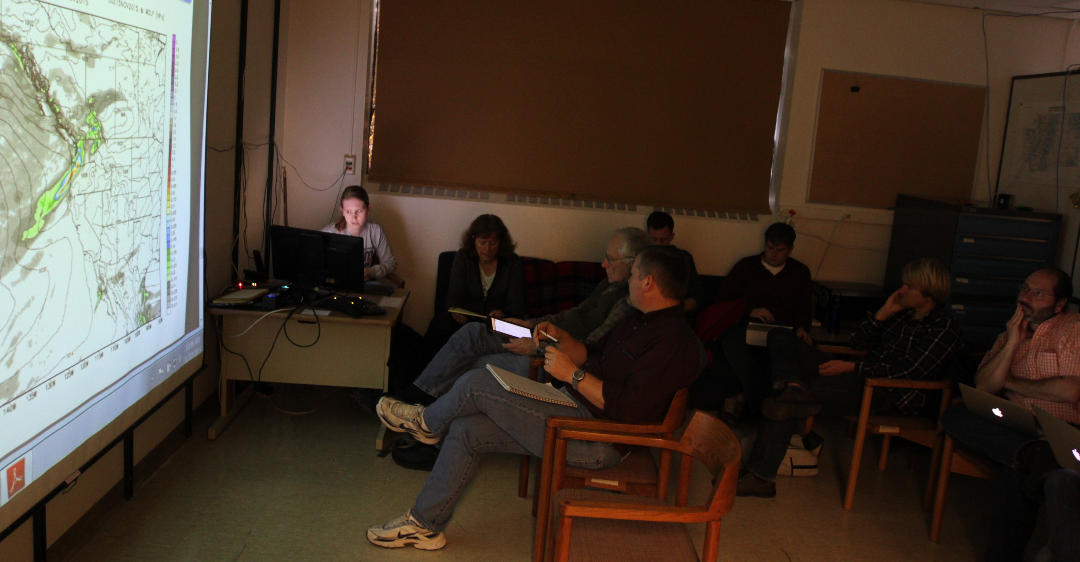
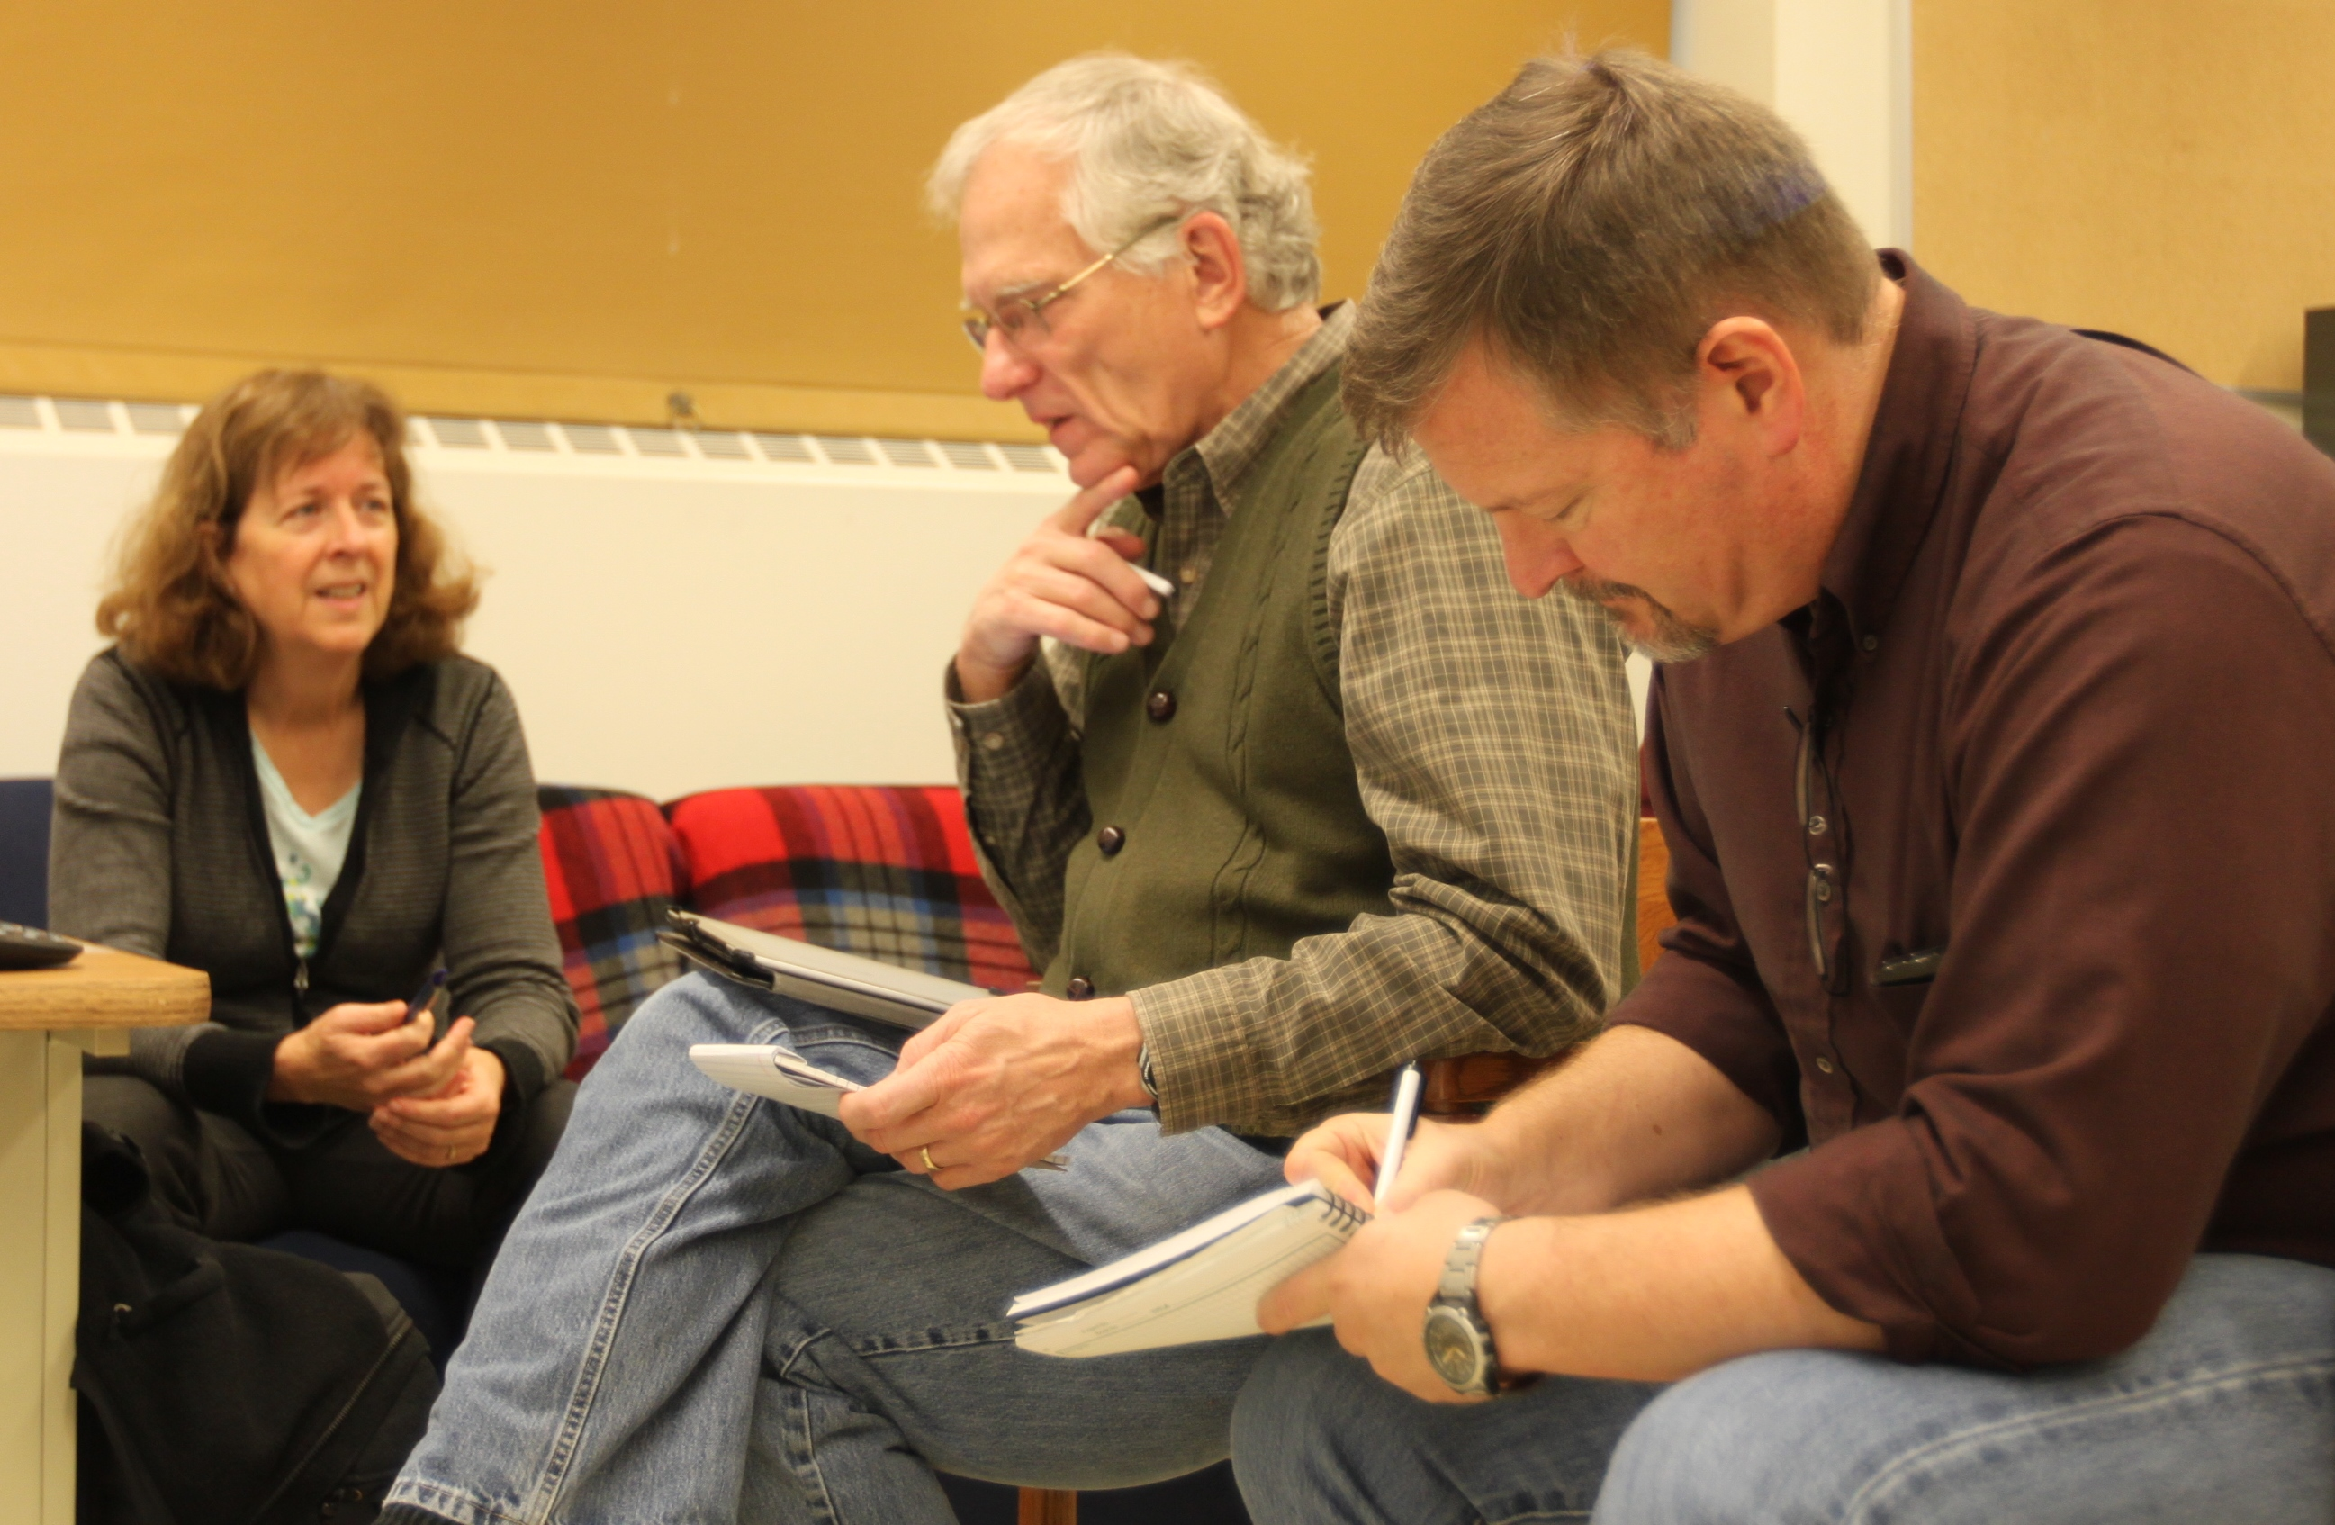
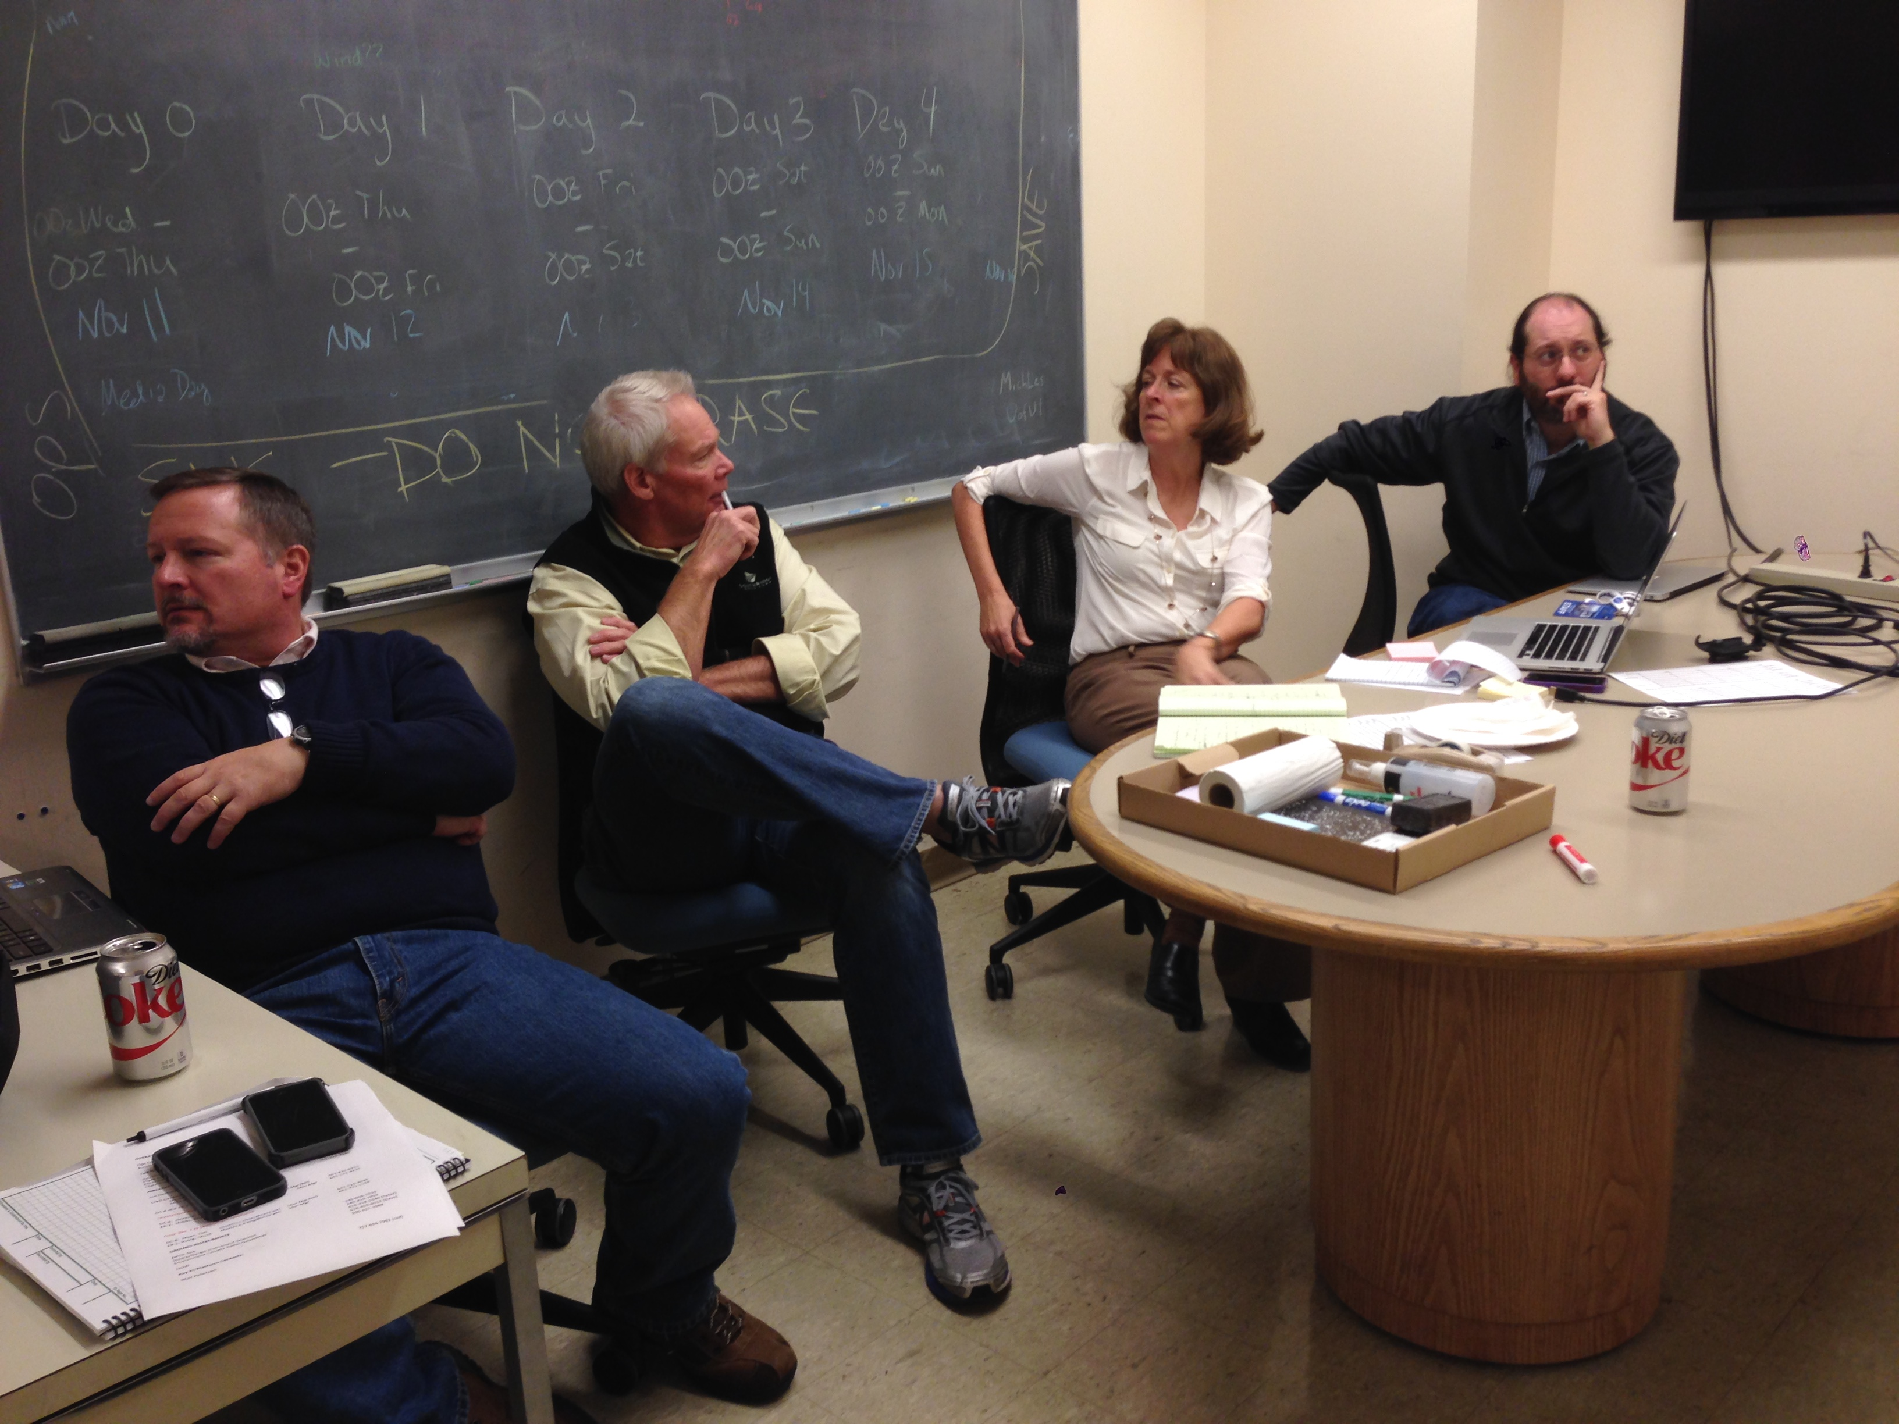
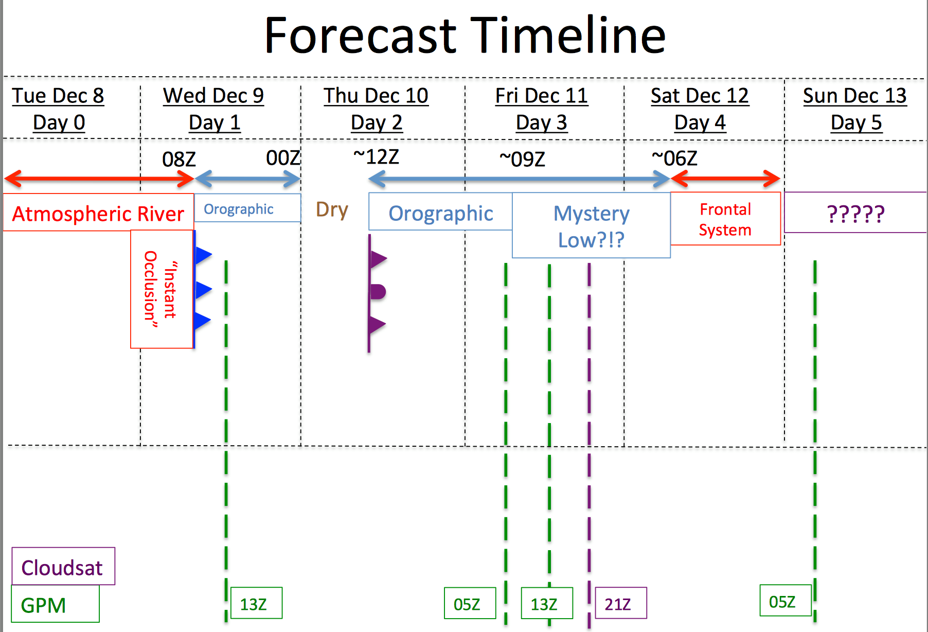
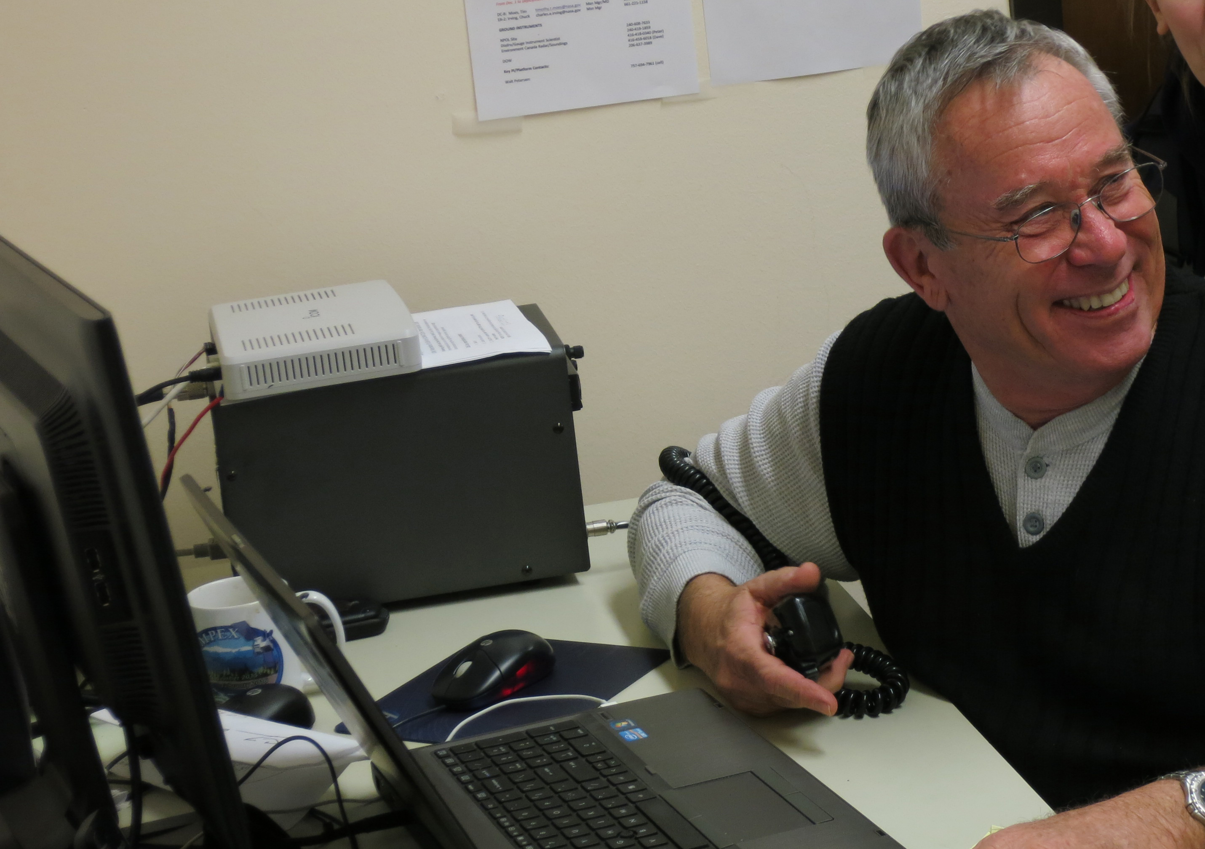
Operations Center at the UW

Slide 28
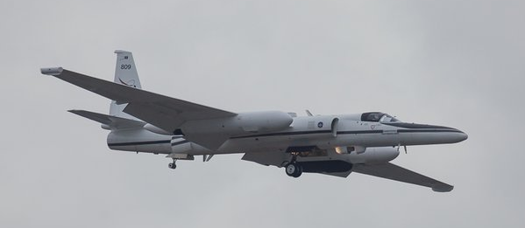
High-flying NASA Aircraft
ER-2 over McChord
DC-8 at McChord AFB
High altitude: DC-8 at 39K ft and ER-2 at 61K ft
Satellite-simulating instruments
Allowed direct comparison with radars and ground instruments

Slide 29
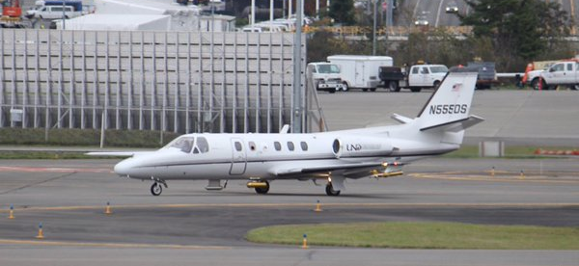
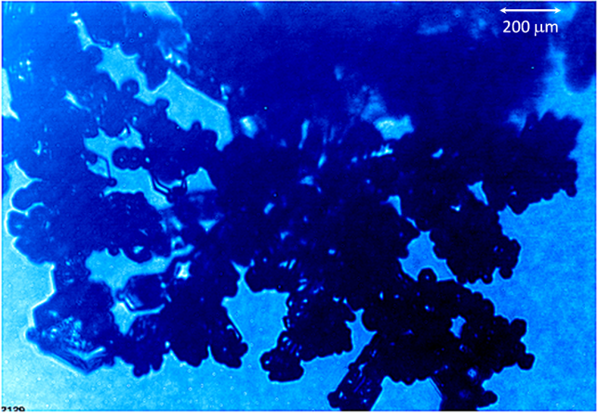
In-cloud aircraft
North Dakota Citation at Paine Field
Flew into/out of clouds
Sampled ice crystals & drops
Important for satellite validation

Slide 30
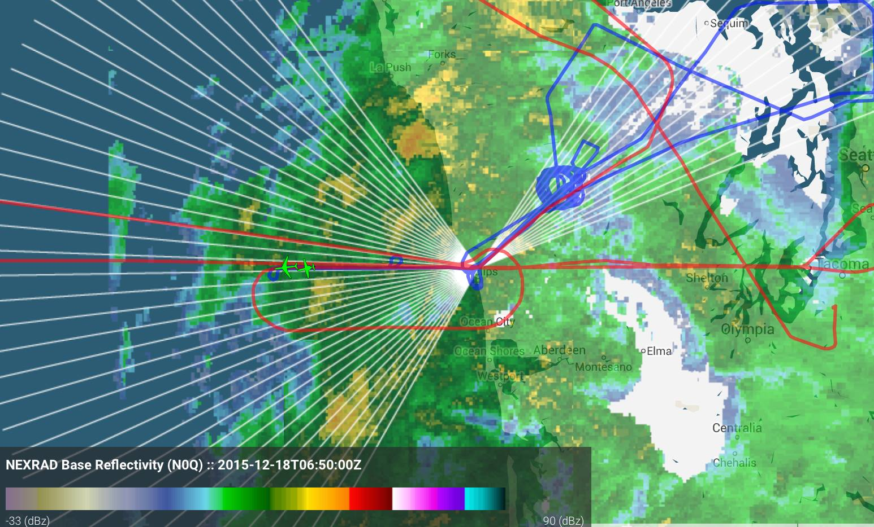
An Example of Coordination
NPOL RHIs
CITATION
DC8

Slide 31



OLYMPEX Conducts first ever 3-aircraft stack (DC-8, ER-2, UND Citation) directly under the GPM Core satellite track within ground-based polarimetric radar coverage
12/3/2015: A complex heavy precipitation event over the Olympic Mountains
Aircraft flight and GPM tracks overlaid on radar data
DC-8
NPOL Radar Reflectivity
UND
NPOL Differential Reflectivity
Branched crystal growth
Aggregation and riming
Snow melt to rain
UND Citation cloud particle imager (CPI) observation, 4 km altitude. Indications of rimed (supercooled liquid water), branched and aggregated snow.
NPOL Radar vertical cross-sections across GPM satellite/aircraft tracks indicating snow crystal growth and aggregation process to make rain below
UND CPI Image
Notes:
Notes- this is a complex orographically-enhanced stratiform situation with embedded light convective overturning- some riming (liquid water) present and upper level ice generating cells indicated by the ground radars. At the location of the UND Citation aircraft, the polarimetric data indicate a layer of branched crystal growth at around 13000-17000 feet and then rapid aggregation of that snow underneath that layer prior to melting to become rain. The Citation microphysics probes detected the rimed branched crystals. The story is consistent between the ground radars, airborne radars and the Citation microphysics data (always a plus).
ER-2 altitude 65,000 feet (~20 km)
DC-8 altitude 39,000 feet (~12 km)
Citation altitude 13,000 feet (in cloud/ice-precipitation); Large aggregated snow (up to 1.5 cm diameter) reported, icing and liquid water contents up to 0.6 g/m^3 reported.
Gauge observations report 100-200 mm (4 – 8 inches) of rain on southern Olympics, with 50-100 mm (2 – 4 inches) in vicinity of Quinault Valley.
Per S. Nesbitt, airborne 3 freq data indicate the same process; including the riming.

Slide 32
OLYMPEX
“A NASA supported Global Precipitation Measurement (GPM) Satellite Ground Validation Field Campaign over the Olympic Peninsula to measure winter-time mid-latitude cyclones as they traverse from the ocean to the coast to high terrain to the leeside.”
Need to make in situ measurements to validate what is measured from space
Need to test assumptions made by satellite algorithms

Slide 33

Satellite Precipitation Measurement Challenges
Melting level variations
1km increase
in melting level over 1 hour

Slide 34



Satellite Precipitation Measurement Challenges
Dropsize distribution variations

Slide 35



Satellite Precipitation Measurement Challenges
Precipitation regimes
Cold Front
Atmospheric River
Post Frontal Convection

Slide 36
Satellite Precipitation Measurement Challenges
Effects of terrain

Slide 37
We want to measure:
Different storms with different melting levels
Variation of raindrop sizes
Different storms intensities
Different storm sectors
Precipitation enhancement due to terrain
Accumulating snow pack
How did we do all that?

Slide 38


OLYMPEX
More Information:
http://olympex.atmos.washington.edu/
http://gpm.nasa.gov
http://www.nasa.gov/gpm
Facebook: https://www.facebook.com/OLYMPEX/
Twitter: uw_olympex
NASA Facebook/Twitter: NASA.Rain NASA_Rain

Slide 39
OLYMPEX
Work supported by: National Aeronautics and Space Administration Grants NNX14AO64G and NNX15AL38G and NSF grant AGS-1503155.

