Slide 1
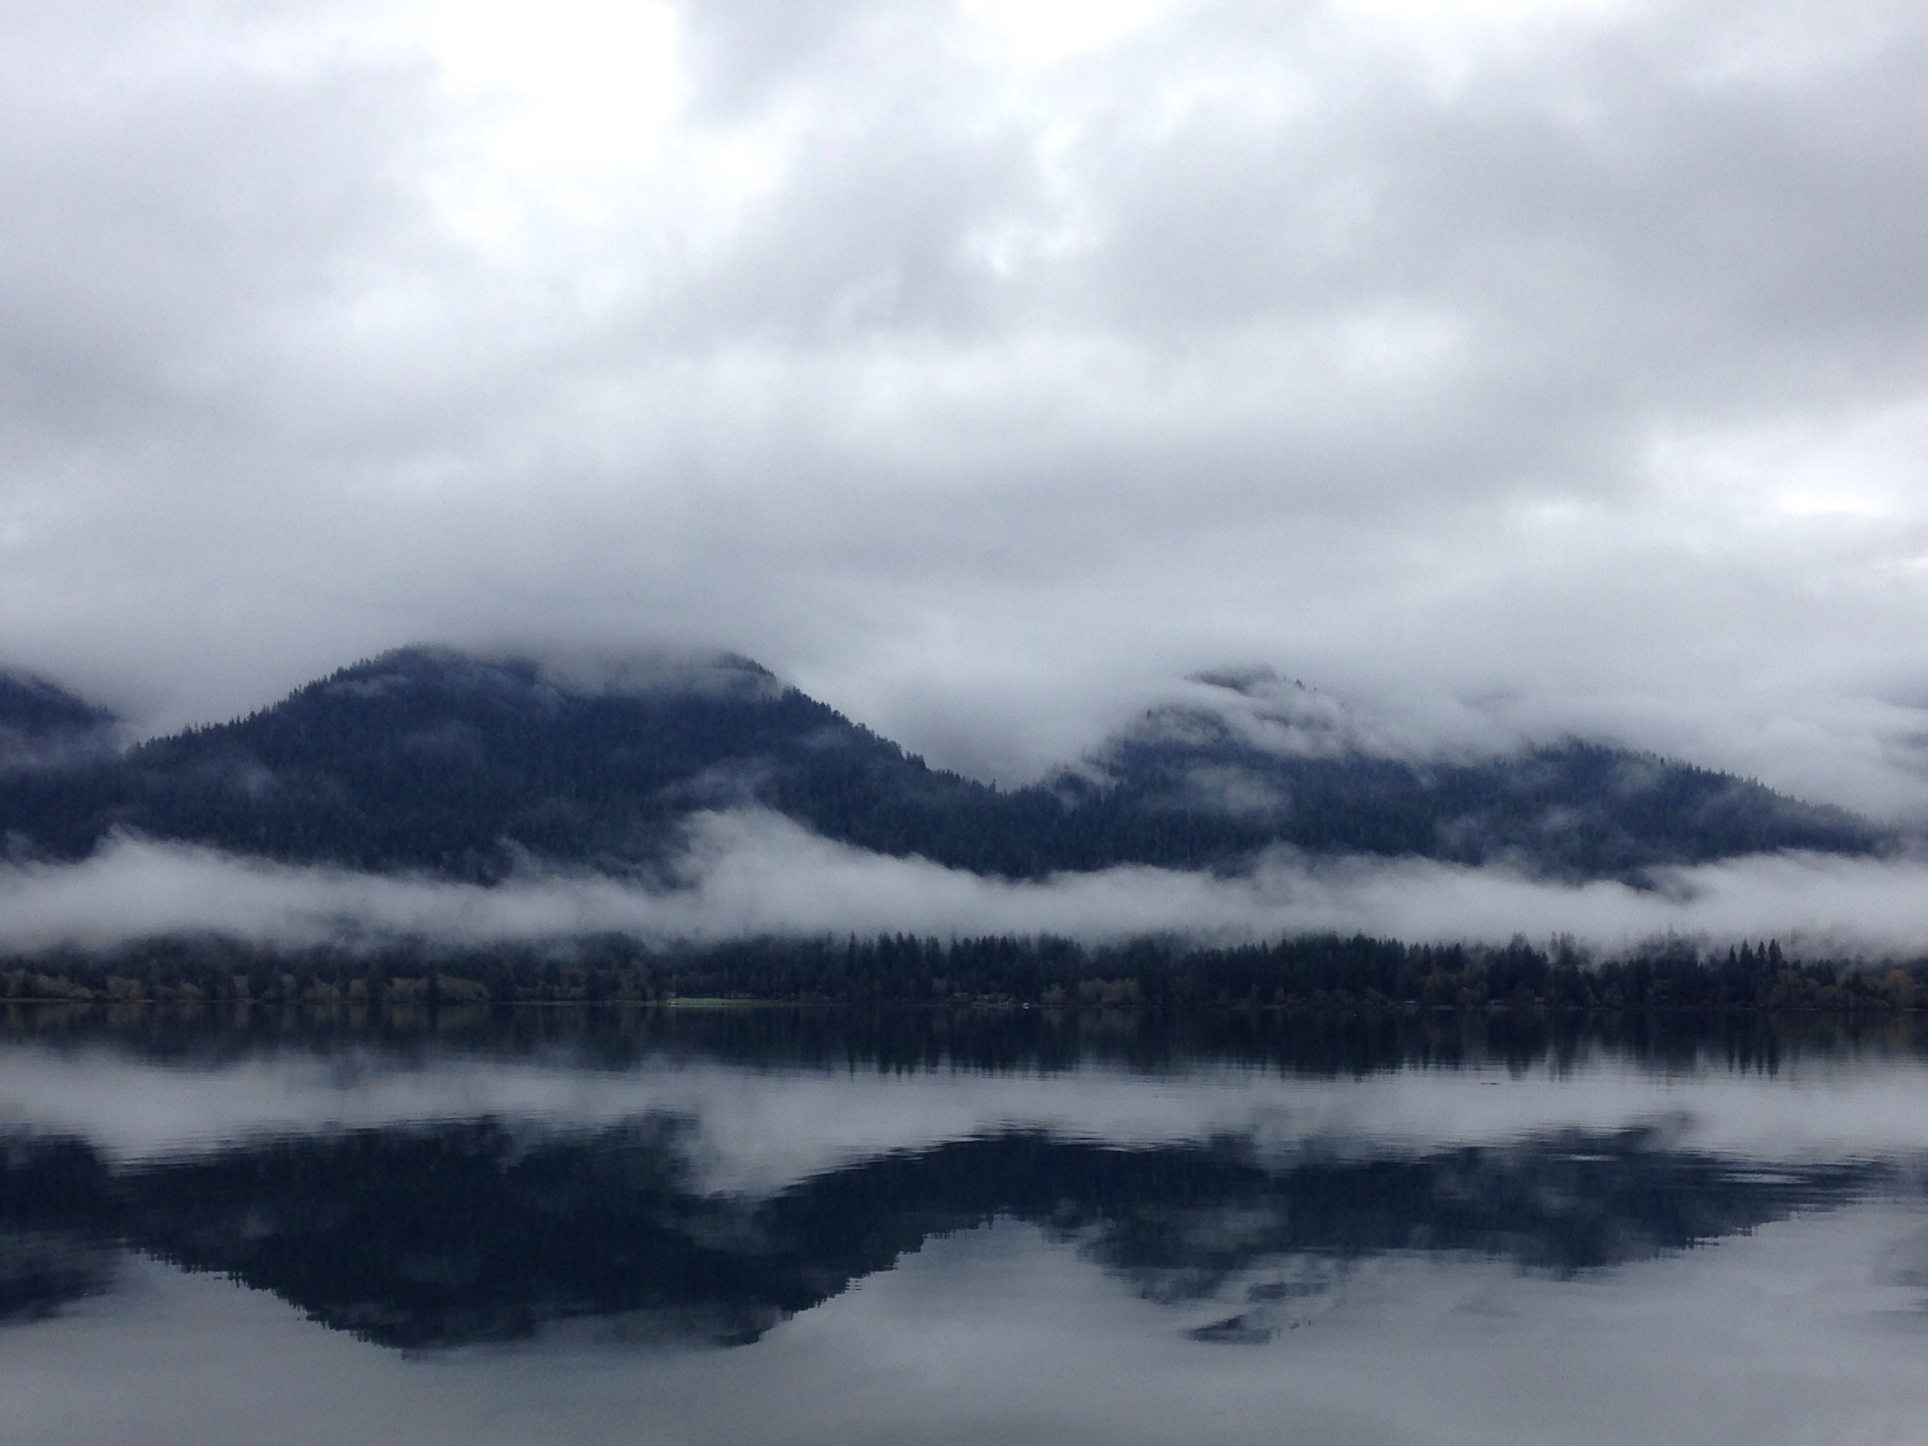
Synoptic and Orographic Control of Observed Drop Size Distributions (DSDs) during OLYMPEX
Joe Zagrodnik
ATM Physics/Chemistry Seminar, 11 April 2016
Contributors: Lynn McMurdie, Robert A. Houze
Thanks to: Matt Wingo, Bill Baccus, CJ Urnes, Hans Mohrmann, Patrick Gatlin, Ali Tokay, Dave Wolff
NASA grants: NNX13AG71G, NNX15AL38G, and NNX16AD75G NSF grants: AGS-1503155

Slide 2
OLYMPEX Overview
Notes:
Ocean-coast-high terrain, satellite validation
Key locations: Ground sites, NPOL, DOW (put interactive circles)

Slide 3
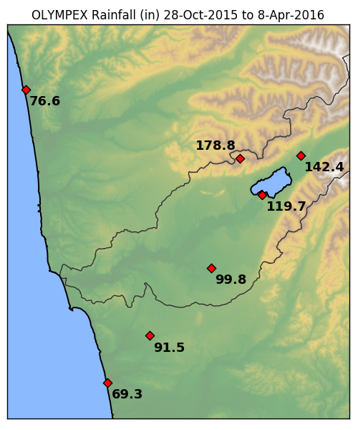
We observed lots of precipitation, especially inland:
Gradient of increased totals from coast to Lake Quinault
At least 178” (4500 mm) at Prairie Creek at only 1,700 ft elevation.
Mike Wallace’s Beach House observed 69.3” (1760 mm).
Many individual events had different precipitation distributions compared with this map.
Prairie Creek
Beach House
Notes:
Will show more sites in detailed cases later. Haven’t pulled data from inland sites in a while.

Slide 4
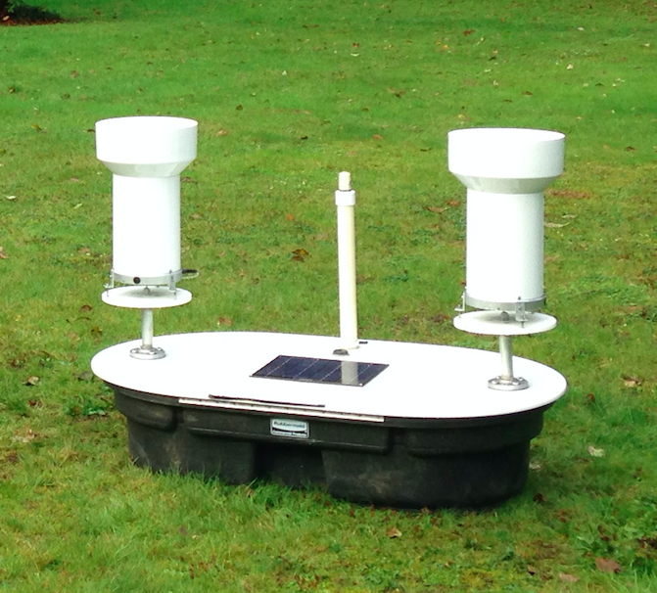
Dual Tipping Bucket Rain Gauge
Cell antenna
10 gauges in Quinault, 10 in Chehalis
Subject to usual limitations of tipping buckets (calibration, moving parts, freeze/thaw cycle)
Critical for comparing to disdrometer-estimated rain rates
12” diameter
Solar panel
GPS

Slide 5
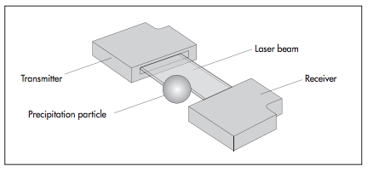
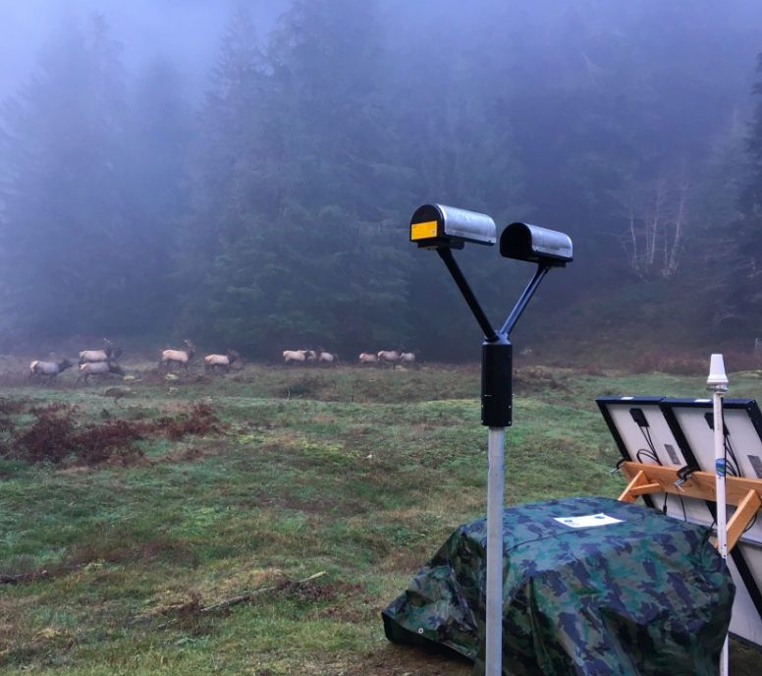
Parsivel² Disdrometer
Particles pass through sheet laser, fall speed inferred based on time in laser path
Assumptions:
Spheroidal raindrop shape
Drops falling straight down (no wind)
Only one drop in laser path at a time
Measurements are only 1D (bad for snow)
Some anomalous large drops
Runs on battery + solar power = huge plus for OLYMPEX
Deployed at 14 ground sites. Unprecedented dataset!!!
Sampling rate: 50 kHz
Sampling area: 54 cm²
Notes:
Transition: What

Slide 6
Goals of this presentation
Are there any coherent spatial patterns/regimes in the normalized OLYMPEX drop size distribution (DSD) data?
If so, which synoptic/orographic controls are most important?
Prefrontal/warm-sector/frontal/postfrontal
Location relative to terrain
Moisture, shear, flow direction?
Notes:
Use stratiform/convective tools→applied to orographic precipitation

Slide 7
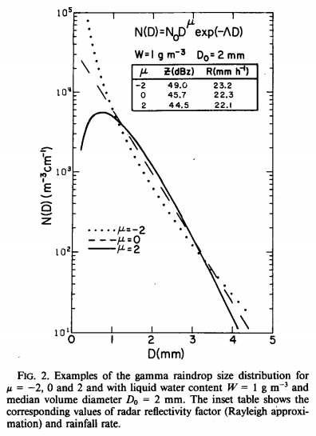
Drop Size Distribution Review
Marshall—Palmer DSD:
N₀ = Intercept (fixed constant)
Λ = Slope (depends on rain rate)
Gamma DSD (Ulbrich 1983):
μ = Shape parameter
Advantage: More realistic DSDs
Disadvantage: N₀ is not entirely physical
Notes:
Problem with Marshall-Palmer is that N0 is not a constant In nature
Problem with Gamma is that N0 depends on mu
Plot doesn’t show it, but the gamma distribution is also useful at high D
We would prefer to have two physically-based parameters to describe the DSD independent of the shape of the DSD.

Slide 8
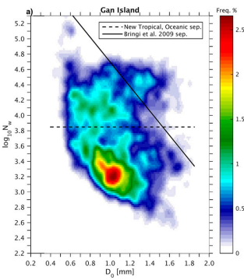

“Normalized” DSD
Tropical Marine Distribution:
Testud et al. (2001) derived a normalization procedure:
More drops
Convective
D₀ = Volume median diameter
N_{w} = “Normalized” intercept parameter
Why is this useful?
N_{w} is same as N₀ for an exponential DSD with same LWC and D₀.
No assumption about μ (shape).
DSDs with different rain rates can be compared directly.
(For future work) Dual-pol parameters Z_{DR} and K_{DP} are directly proportional to D₀ and LWC*D₀ respectively.
Stratiform
Larger drops
Thompson et al. (2015)
Notes:
-Nw is the intercept parameter of the exponential DSD with the same LWC and D0
-Nw is proportional to LWC (simply the 3rd moment of DSD—no ambiguity!
Why useful?
-We now have 3 independent parameters, Nw, D0, and mu, all of which are independent of each other
-Key point from figure: We can look for “regimes” of different DSDs from Nw and Do. Note the two separation lines!

Slide 9
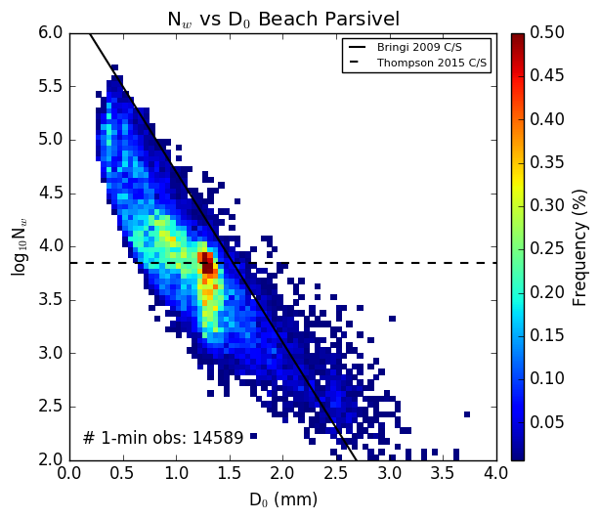
Wallace Beach House (lowest rain total)
Most DSDs cluster into one regime.
Plenty of outliers with either higher N_{w} + smaller D₀ or vice-versa.
N_{w} values are surprisingly high at times.
5-Nov-2015 to 17-Jan-2016
Each 1-min DSD must have > 100 drops
Notes:
About 13 days worth of “raining” data (after filtering out for only DSDs with at least 100 drops)

Slide 10
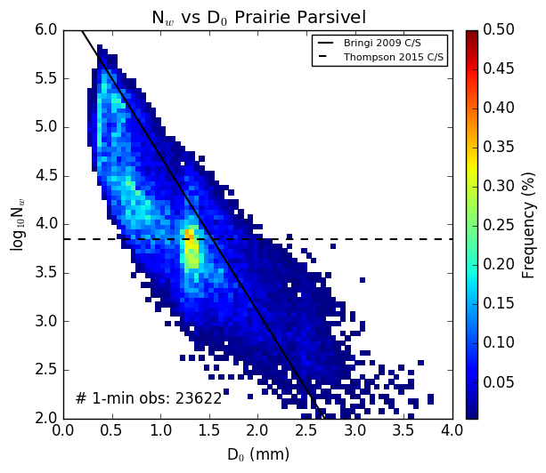
Prairie Creek (highest rain total)
More frequent rain.
Greater spread in values.
Higher N_{w} + smaller D₀ is more common than Beach
Many more points with both higher N_{w} and D₀ suggesting greater rain rates at times.
5-Nov-2015 to 17-Jan-2016
Each 1-min DSD must have > 100 drops
Elevation: 1700 ft (520 m)
Notes:
Most extreme difference

Slide 11
Case Studies
Nov 12-13, 2015 “Atmospheric river”
Dec 3, 2015 “Intense shortwave trough”
Notes:
Both cases warm with high moisture content. This is useful because it rains.

Slide 12
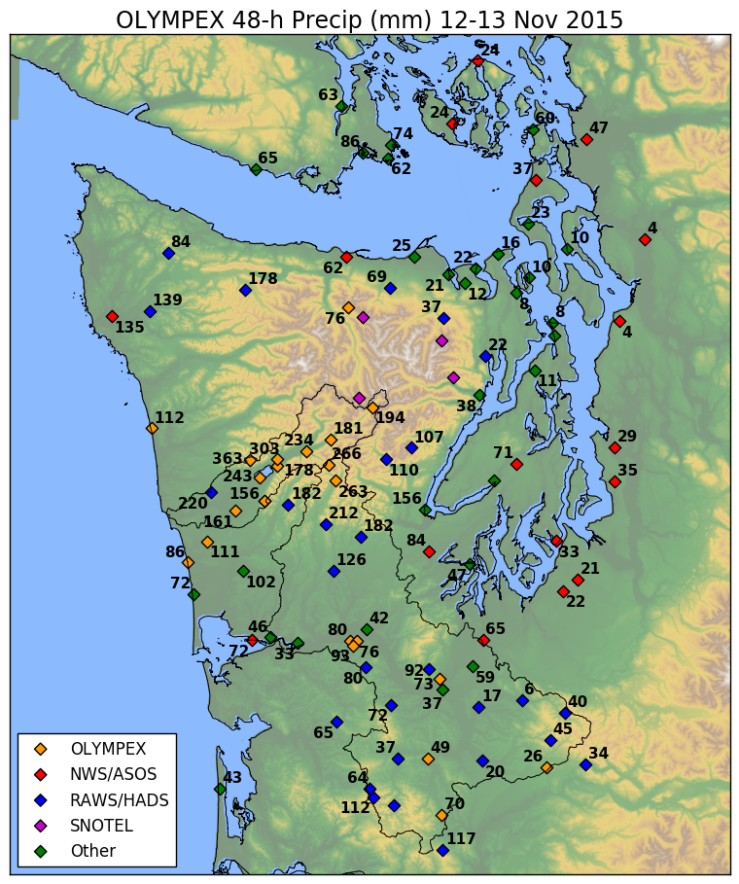
Nov 12-13: Widespread extreme rainfall totals
303 mm at CRN site just north of Lake Quinault
363 mm at 1,700 ft (Prairie Creek)
The famous rain shadow!
175-275 mm farther up Quinault Valley and in Wynoochee area
Gradient of increasing rainfall totals moving inland

Slide 13
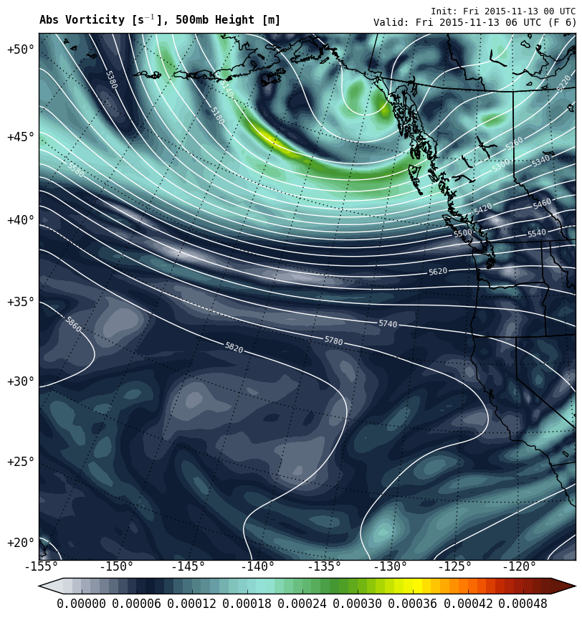
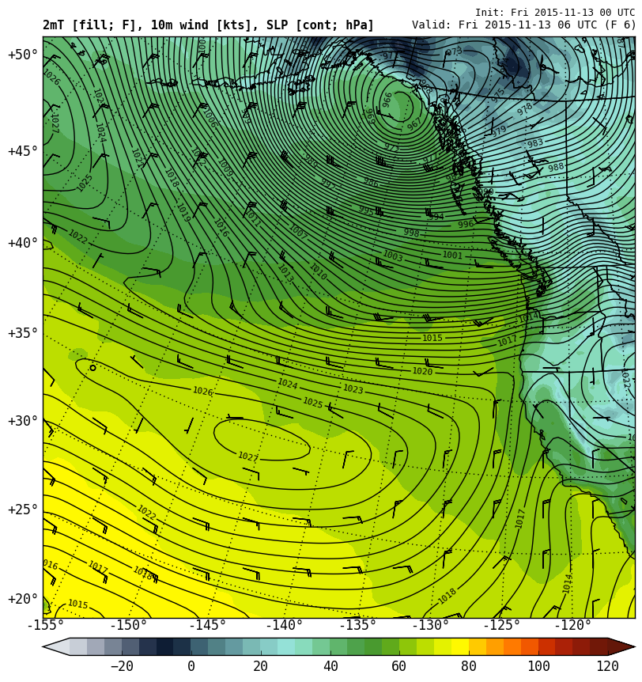
Nov 12-13 0600 UTC
500 hPa Height (lines), Vorticity (contours)
Surface Pressure (contours), Temp (colors)
L
H
“Westerly Atmospheric River”

Slide 14
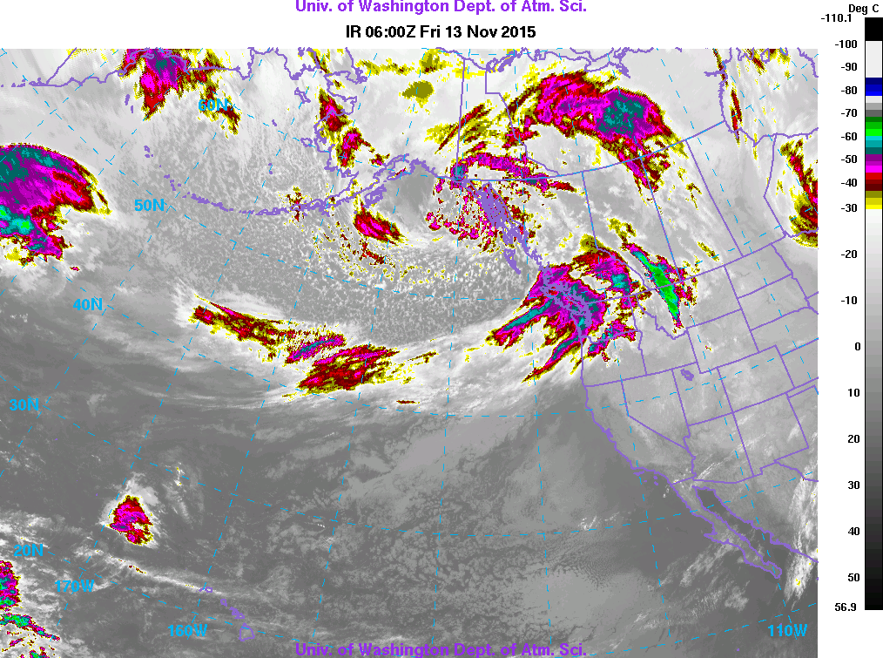
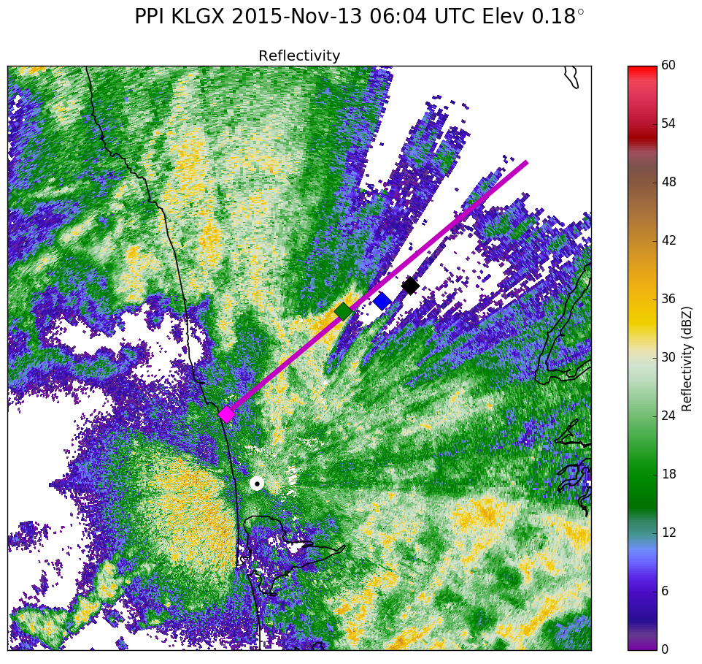

Slide 15
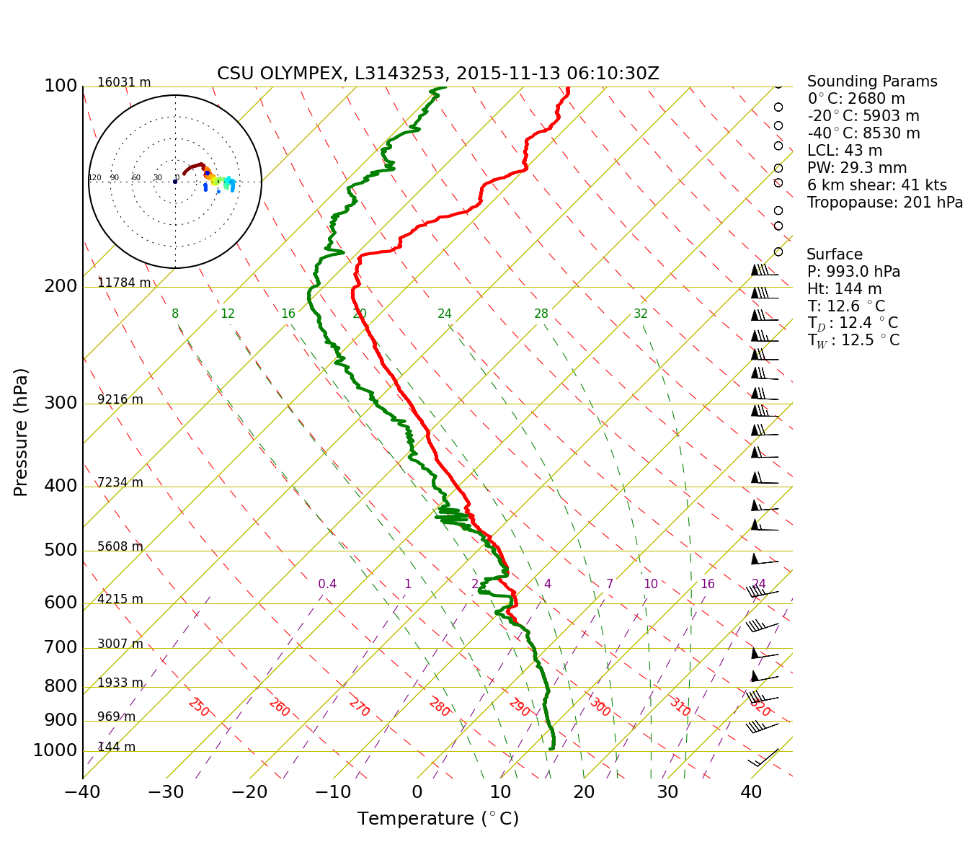
NPOL Sounding 0600 UTC 13-Nov
45 kt wind at 925 hPa

Slide 16
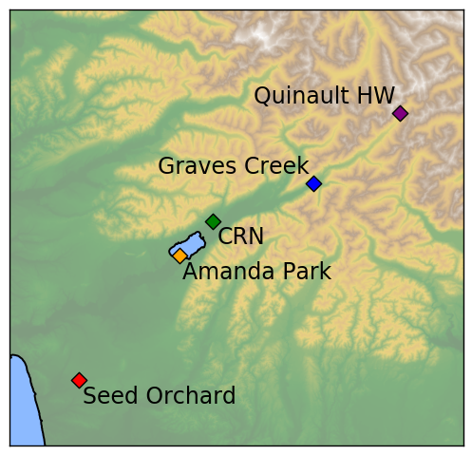
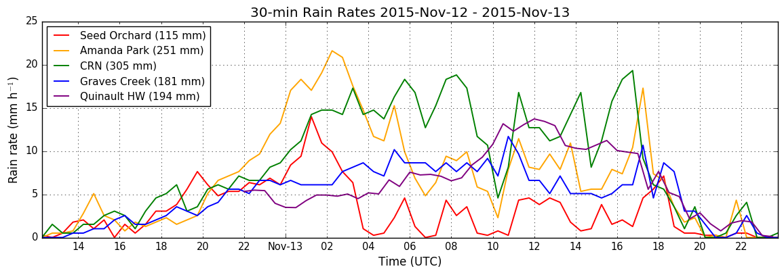
Nov 12-13 Rain rates
18 hour period of orographic enhancement
starting around 00 UTC 13-Nov
More rain at low-elevation CRN site compared with interior sites (Graves Creek, Quinault HW)

Slide 17
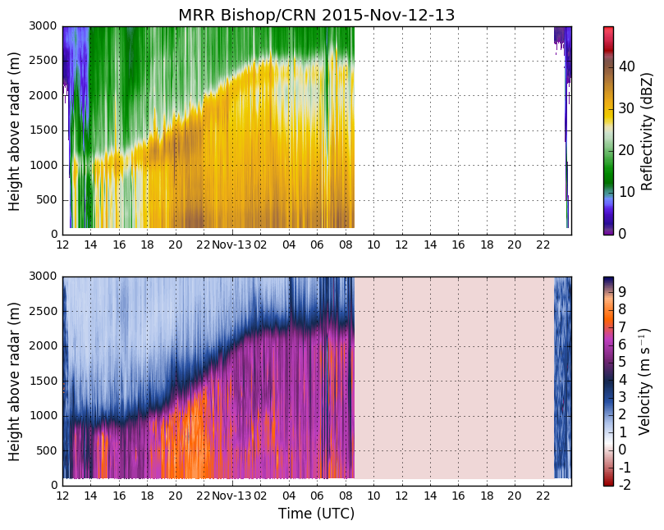
“Prefrontal”
“Warm Sector”
Weaker bright band
Near-surface dBZ remains constant
No data (power outage)
Big drops falling fast

Slide 18
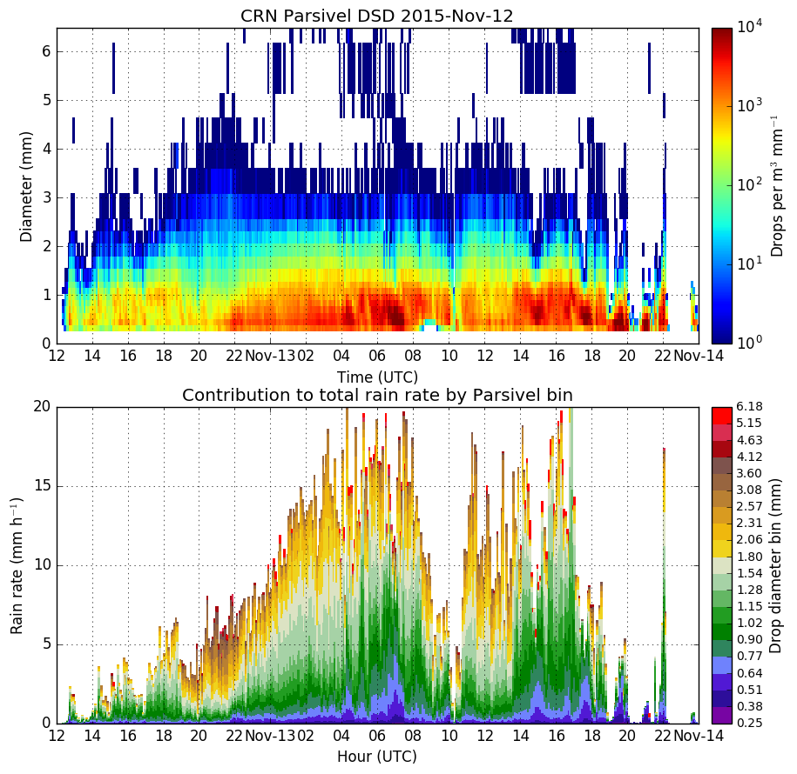
Max orographic enhancement
Orographic enhancement associated with large quantities of < 1.5 mm drops
These small-medium sized drops are responsible for the majority of the increase in rain rate
Notes:
Plotted on a log scale to emphasize contribution from larger drops

Slide 19
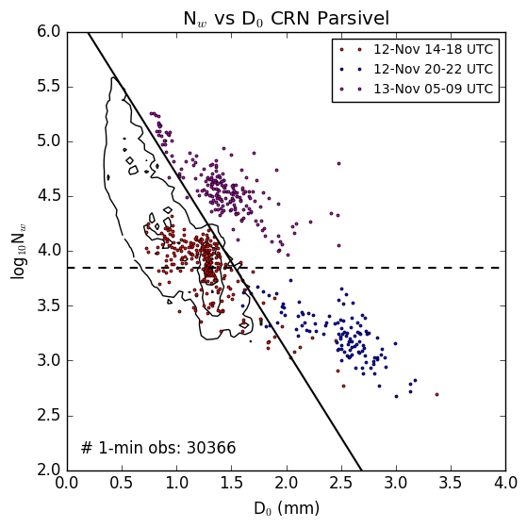
Normalized 1-min DSDs (CRN, selected times)
Red dots: Prefrontal stratiform
Blue dots: Intensified stratiform
(“Big drops falling fast”)
Purple dots: Warm sector (maximum orographic enhancement)
DSD regimes remain consistent for hours at a time, then transition depending on changes in the storm such as frontal passages.
Warm sector enhancement generally leads to an increase in N_{w}.
Both the blue and purple DSDs are outliers relative to the sample of 21 days worth of 1-min raining observations (> 100 drops/min).
Notes:
Outliers—mostly because of high rain rates
It was also uncommon to have large drops like the ones observed in the prefrontal sector

Slide 20
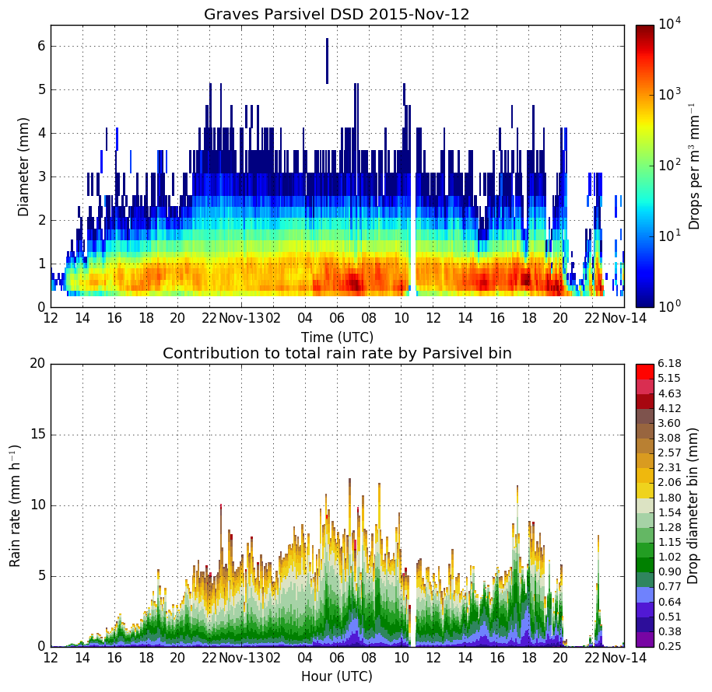
Max orographic enhancement
Looks similar, but considerably less drops in all size ranges
Increase in rain rate on 13-Nov is subdued
Notes:
Plotted on a log scale to emphasize contribution from larger drops

Slide 21
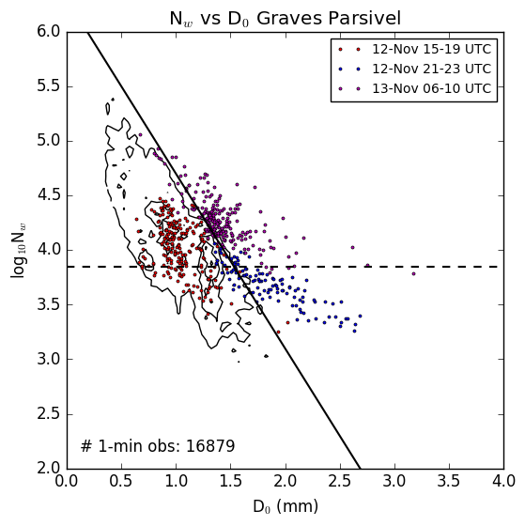
Normalized 1-min DSDs (Graves Creek, selected times)
Red dots: Prefrontal stratiform
Blue dots: Intensified stratiform
Purple dots: Warm sector (maximum orographic enhancement)
Times shifted forward 1-hr from CRN plot.
Same regime separation is observed as CRN site, just more subdued.
Stratiform regimes (red, blue) shifted toward smaller D₀ compared with CRN site (smaller drops).
Warm sector regime (purple) shifted toward lower N_{w} (less drops).
Notes:
Outliers—mostly because of high rain rates
It was also uncommon to have large drops like the ones observed in the prefrontal sector

Slide 22
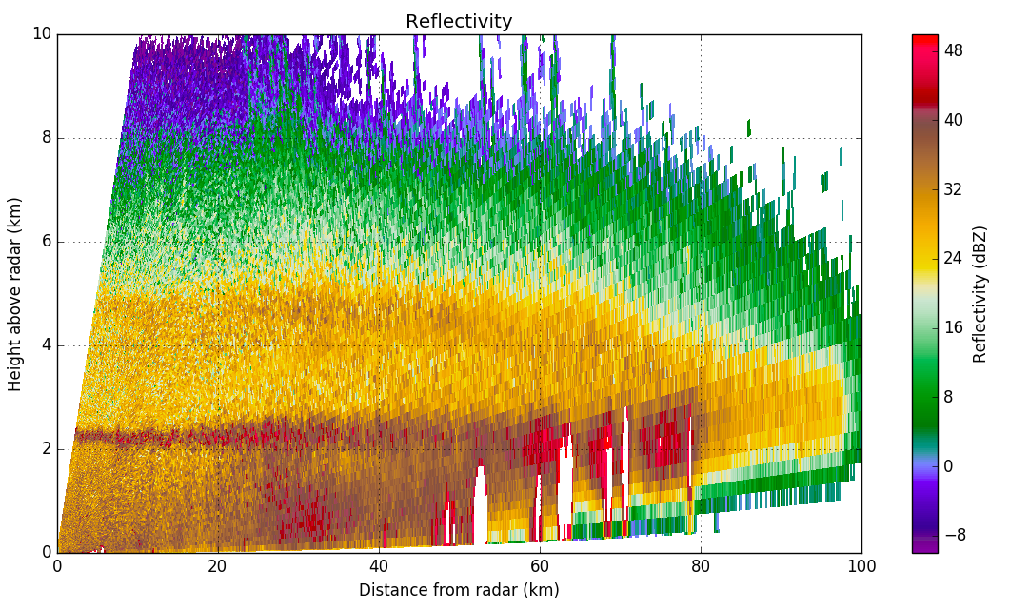
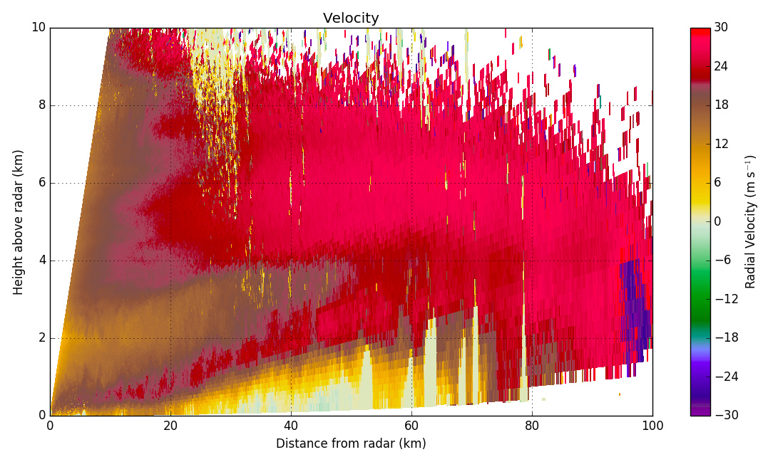
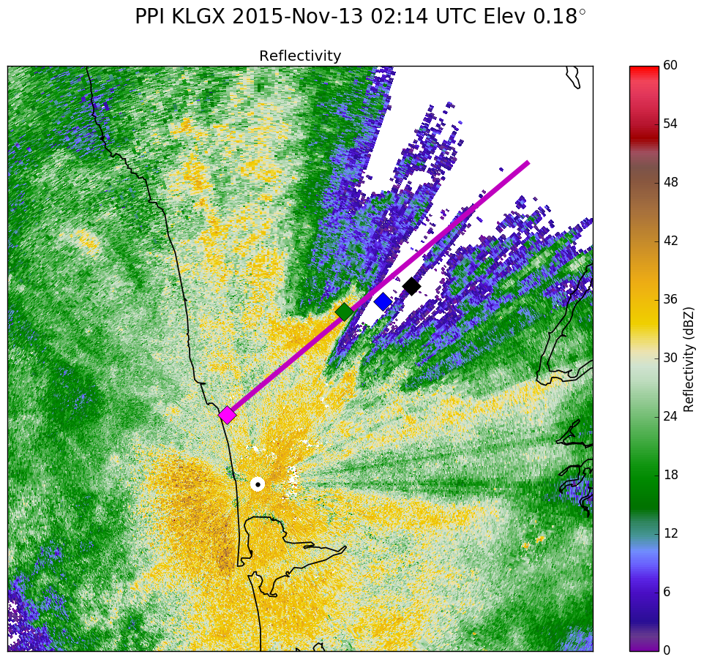
NPOL RHI 13-Nov 02:12 UTC
50° Azimuth
Reflectivity
Low-level jet is within 1 km of the surface near NPOL and starts lifting around 20 km from radar (white arrow)
Shear below jet is likely enhancing collision/coalescence, allowing drops to grow quickly and fall out.
Jet lifting decreases 50-60 km from radar.
NPOL
CRN
Graves
Quinault HW
Velocity
NPOL
Mountain
Notes:
During period of max orographic enhancement!!!

Slide 23
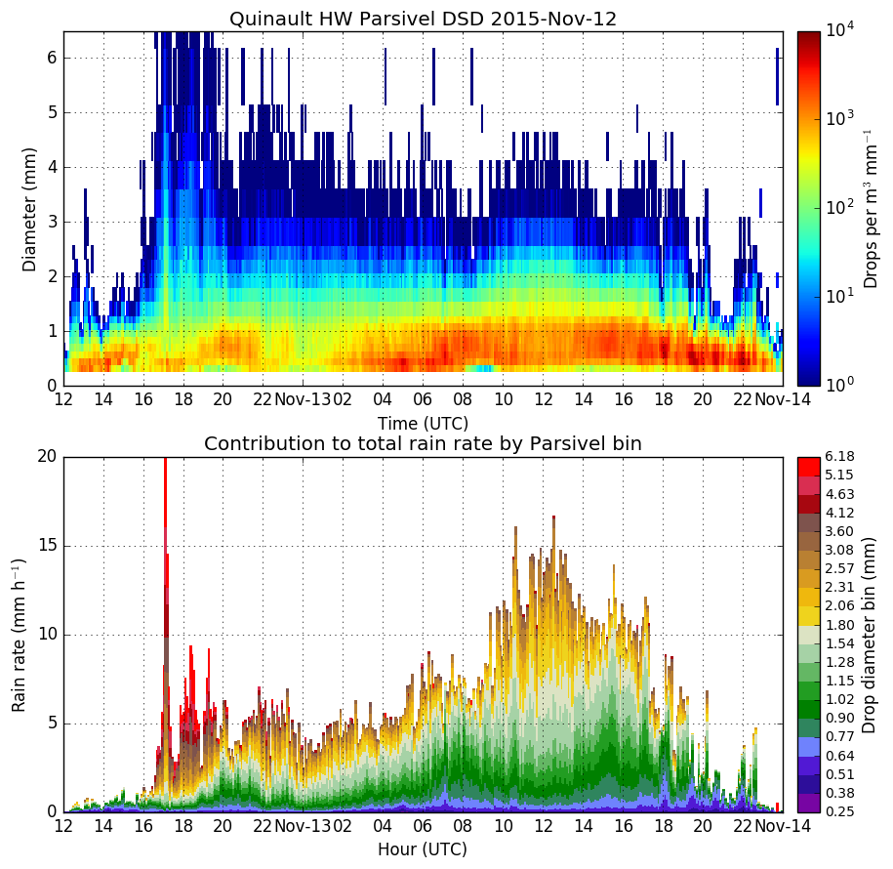
SNOW
Max orographic enhancement
DSD is nearly identical to Graves Creek prior to 09 UTC
10-13 UTC, medium-to-large sized drops account for the increase in rain rate!
Smaller drops dominate again after 14 UTC.
SNOW
Notes:
Plotted on a log scale to emphasize contribution from larger drops

Slide 24
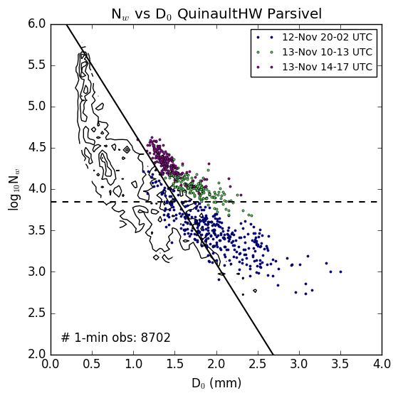
Normalized 1-min DSDs (Quinault HW, selected times)
Blue dots: Intensified stratiform, big drops
Green dots: Orographic enhancement with larger drops dominating
Purple dots: Orographic enhancement with smaller drops dominating
Early prefrontal period was snow so it can’t be compared.
Enhanced stratiform period lasts longer than other sites.
Around 13-Nov 14 UTC, the warm phase precipitation (purple dots) takes over. Rain rate decreased slightly (13 -> 10 mm/hr) during this transition.
Notes:
Outliers—mostly because of high rain rates
It was also uncommon to have large drops like the ones observed in the prefrontal sector

Slide 25
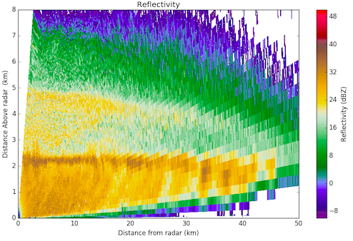
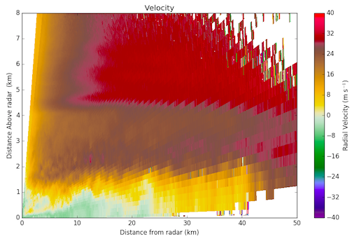
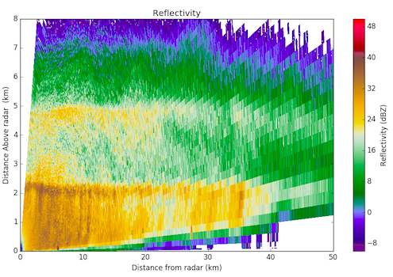
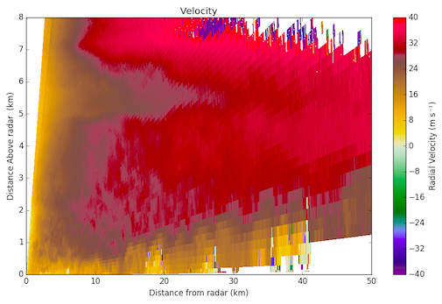
Mid-level jet
DOW RHI 13-Nov 02:04 UTC
65° Azimuth
Low-level jet
DOW
Graves
Quinault HW
DOW RHI 13-Nov 11:14 UTC
65° Azimuth
Deeper, stronger jet
Enhancement later in event at Quinault HW possibly related to evolution of low to mid level jet. Appreciable shear is observed between upper and lower layers.
Notes:
This is DOW!!!!!!!!!

Slide 26
Nov 12-13 Conclusions
Low-level jet lifting -> orographic enhancement
Shear enhances particle growth
Below bright band = warm processes (collision/coalescence), drops fall out quickly
Within/above bright band = cold processes (riming/aggregation), drops grow to larger sizes
These processes are evident in distinct DSD regimes and are consistent with radar + synoptic setup.
“Enchanced stratiform” period may be related to warm front passage.

Slide 27

Dec 03: Significant localized enhancement
Most totals around Lake Quinault recorded less than 25% as much rain as Nov 12-13 event
Huge totals at a few sites in interior Quinault Valley.
213 mm at 3,400 ft Wynoochee site (80% of Nov 12-13 event)
Little to no increase between coast and Lake Quinault
125-150 mm near Lake Cushman (more than Nov 12-13)

Slide 28
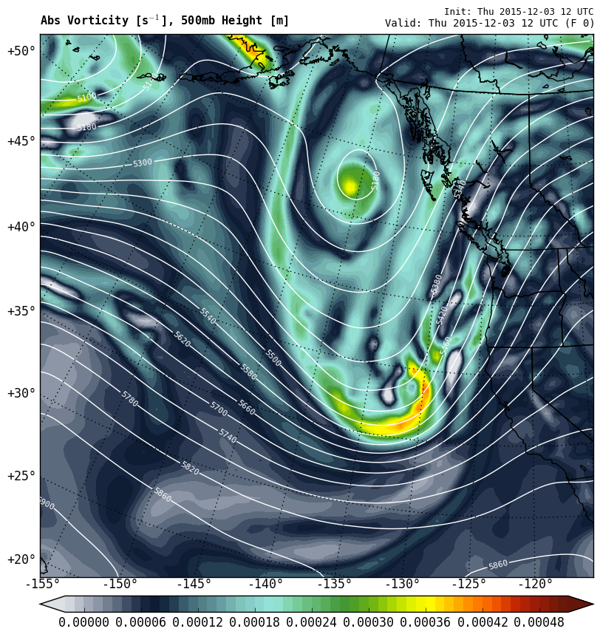
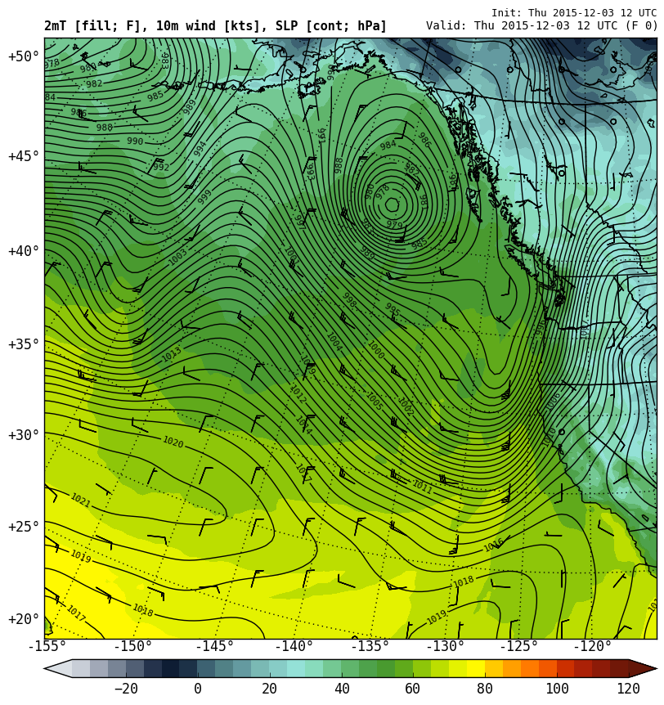
Dec 03 1200 UTC
500 hPa Height (lines), Vorticity (contours)
Surface Pressure (contours), Temp (colors)
L
H
East-west surface pressure gradient favors low-level easterlies.
South-southwesterly flow at mid-levels

Slide 29
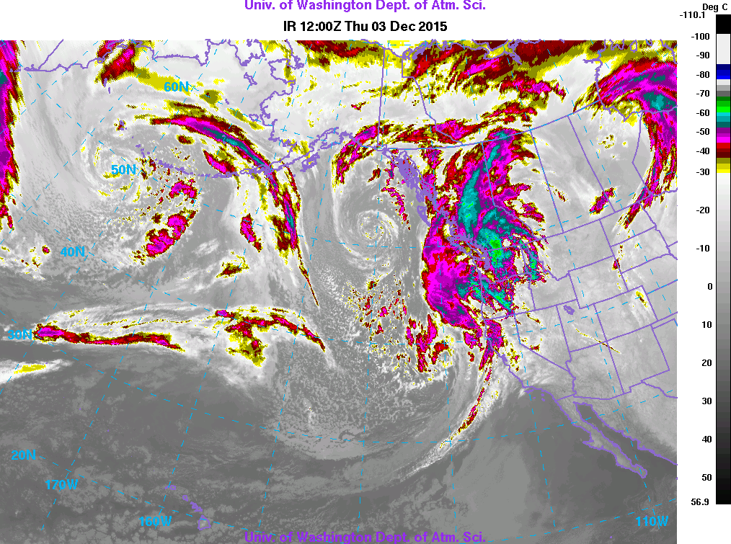
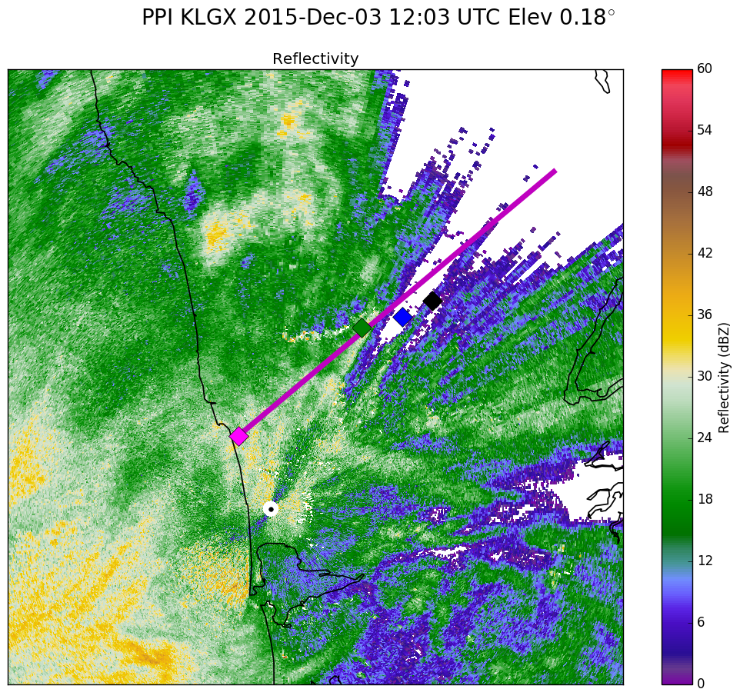

Slide 30
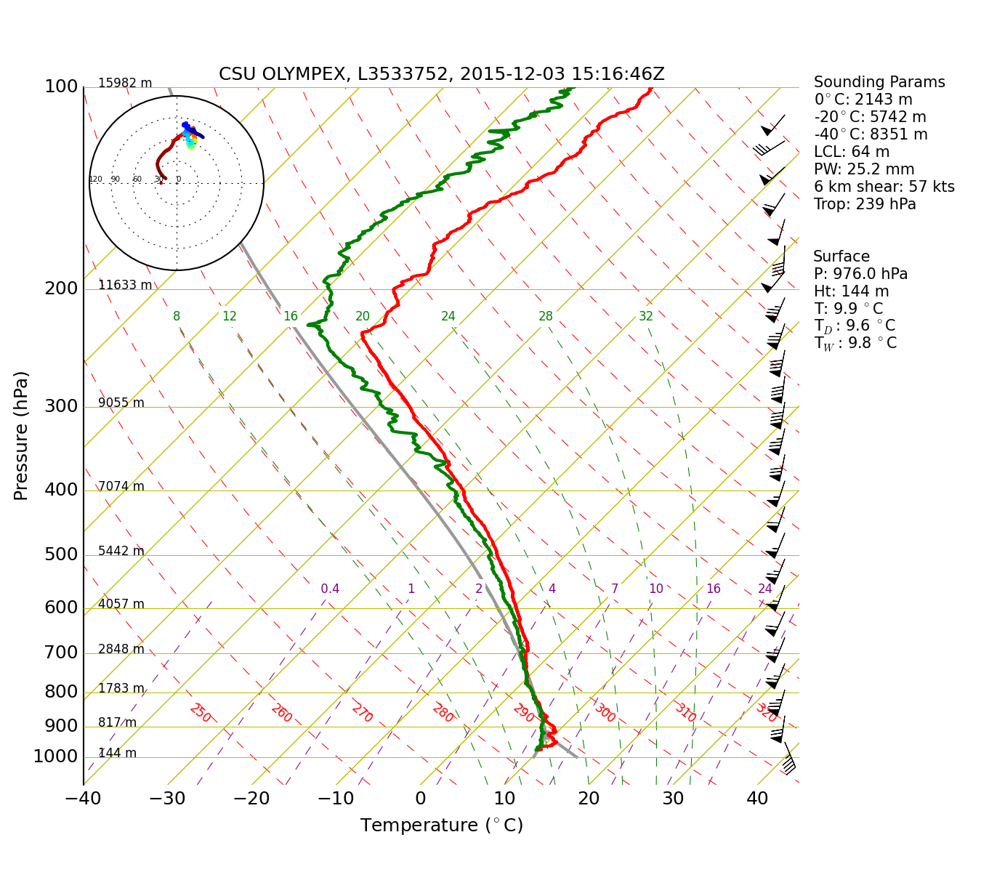
NPOL Sounding 1500 UTC 03-Dec
70 kt wind at 900 hPa
SE flow at surface

Slide 31
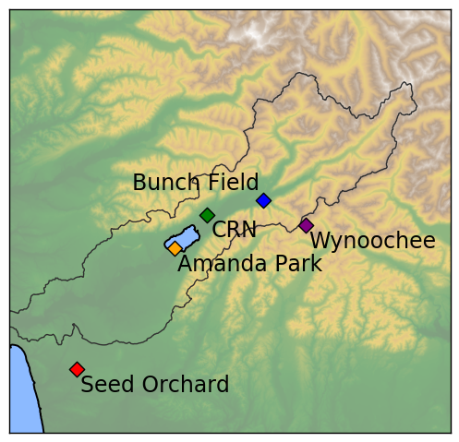
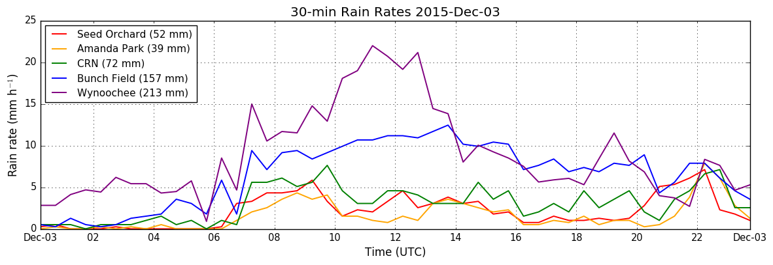
Dec 3 Rain Rates
10-14 UTC: Max orographic enhancement
Wynoochee and Bunch Field have highest rain rates by far

Slide 32
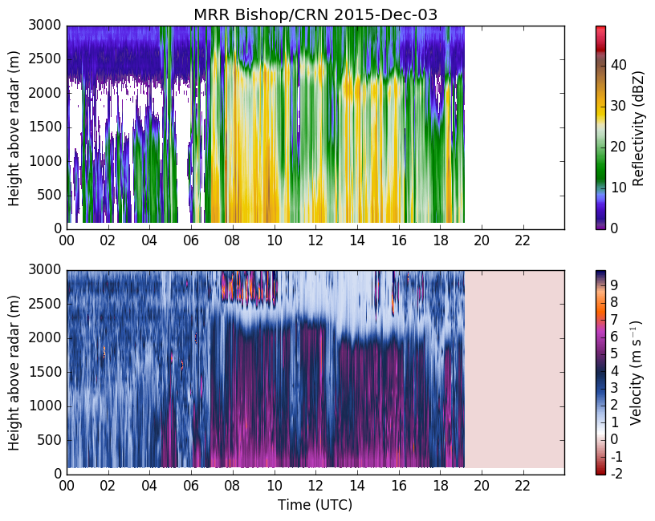
Light to moderate stratiform precipitation, some weak enhancement at low-levels
Another power outage!

Slide 33
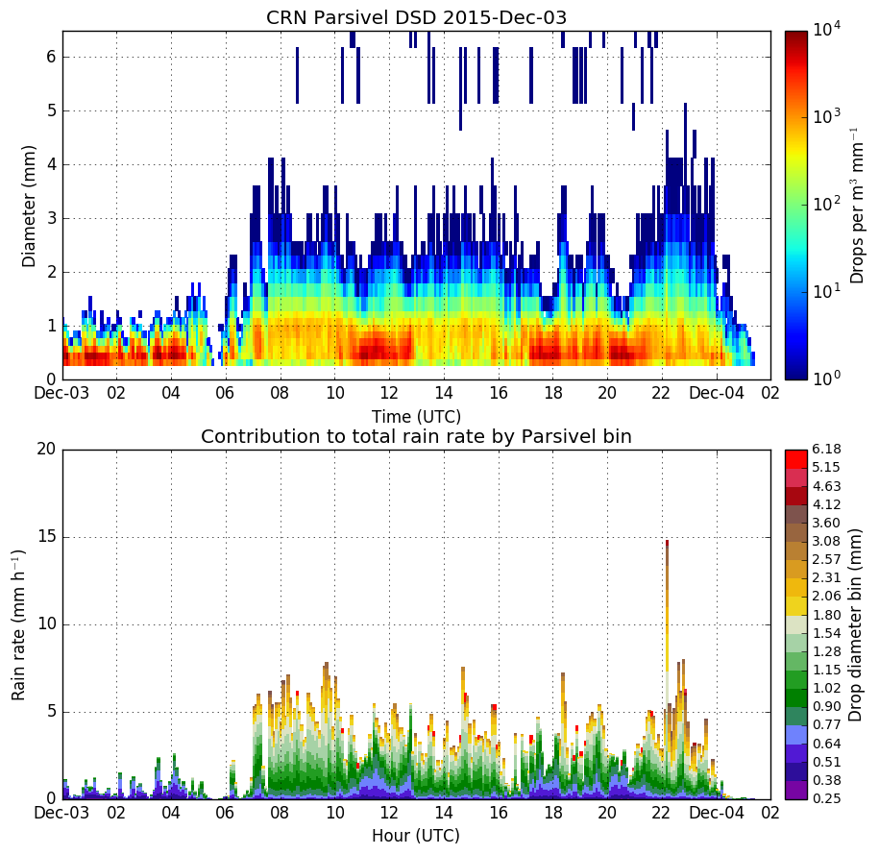
Overall smaller size and number compared with Nov 12-13
Not much contribution to rain rate from drops > 1.5 mm
Notes:
Plotted on a log scale to emphasize contribution from larger drops

Slide 34
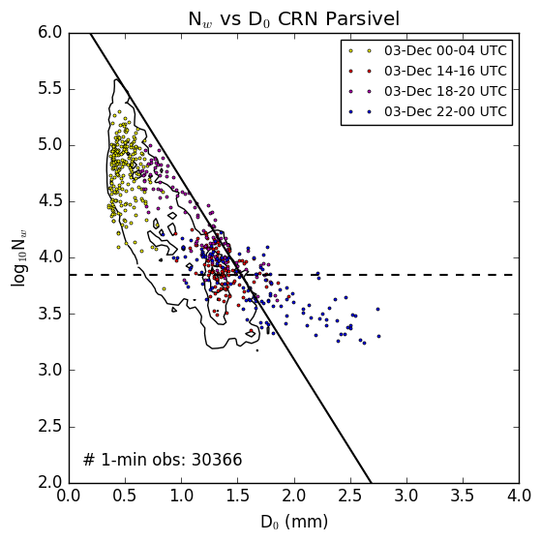
Normalized 1-min DSDs (CRN, selected times)
Yellow dots: Warm drizzle
Red dots: Weaker stratiform
Purple dots: Orographic enhancement with smaller drops dominating
Blue dots: Slightly-intensified stratiform
Drizzle and stratiform periods fit well with expected regimes from full-season sample.
Drops formed by warm processes are less numerous and smaller compared with Nov-13.
Cold front passage briefly increases drop size at end of event.
Notes:
Outliers—mostly because of high rain rates
It was also uncommon to have large drops like the ones observed in the prefrontal sector

Slide 35
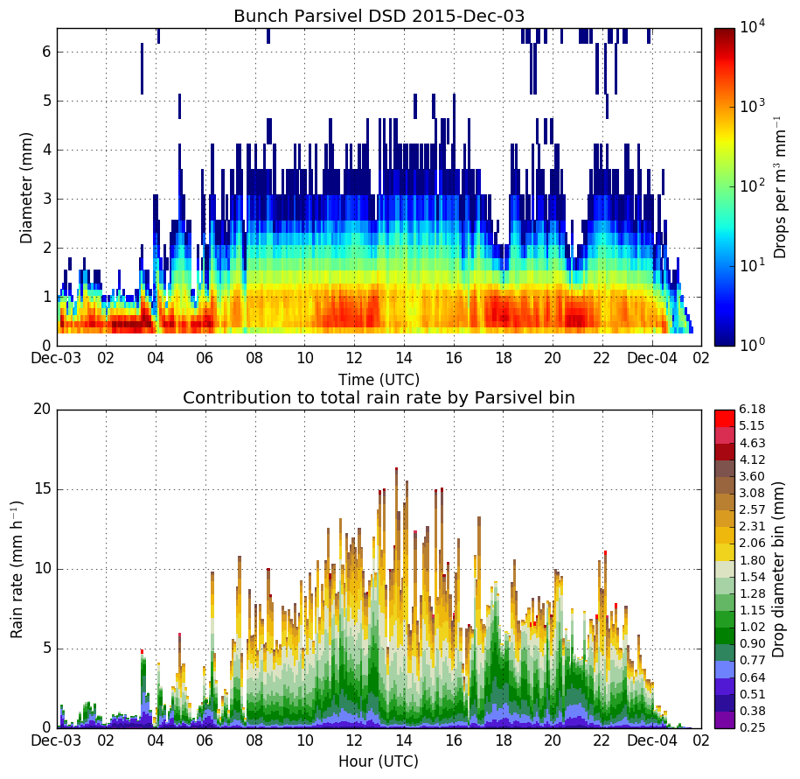
Only 9 km up valley from CRN!
Significant increase in larger drops > 0.9 mm compared with CRN.
Small drops increase also but not to extreme levels seen on Nov-13.
Notes:
Even more pronounced at Wynoochee

Slide 36
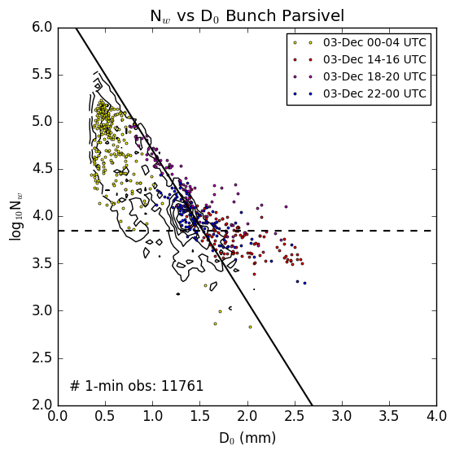
Normalized 1-min DSDs (Bunch Field, selected times)
Yellow dots: Warm drizzle
Red dots: Stratiform
Blue dots: Stratiform (near time of cold front passage)
Purple dots: Orographic enhancement with smaller drops dominating
Shift toward higher D₀ in stratiform (red) period.
Depending on the exact time, subtle shifts toward higher D₀ and/or N_{w} are both occurring during blue/purple periods.
Notes:
Outliers—mostly because of high rain rates
It was also uncommon to have large drops like the ones observed in the prefrontal sector

Slide 37
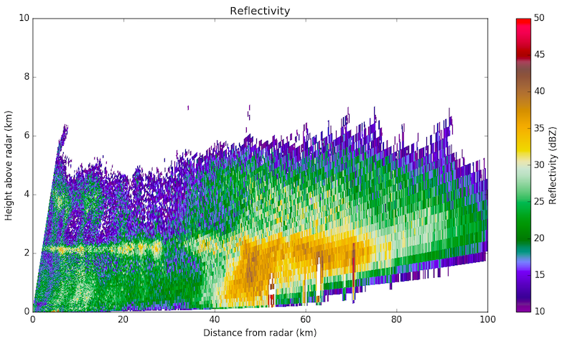
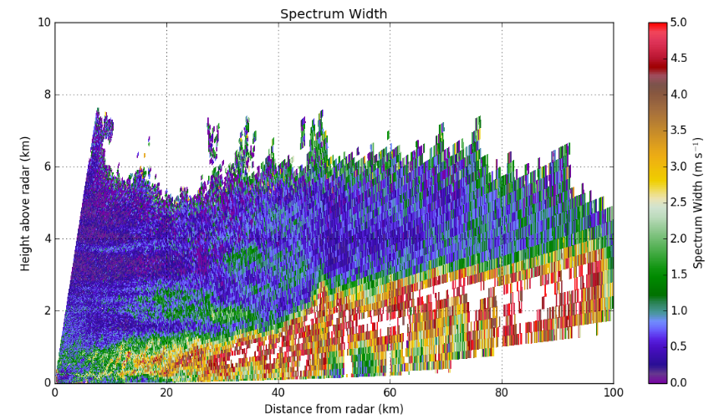
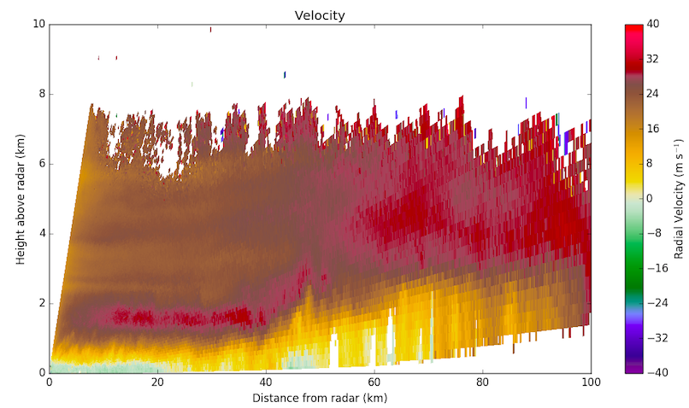
NPOL RHI 03-Dec 11:32 UTC
50° Azimuth
Reflectivity
80 kt SW low-level jet, 1.9 km above surface. All shear is below the jet max, veering toward alignment with 50° RHI.
Jet lifts abruptly when it reaches higher mountains 40-50 km from NPOL.
Lifting occurs downstream of the CRN site, accounting for less precipitation compared with sites farther inland.
NPOL
CRN
Bunch
Velocity

Slide 38
Dec-03 Conclusions
Jet begins higher and lifts farther inland -> changes location and type of orographic enhancement.
Enhancement at Bunch Field appears to be from both warm and cold processes.
A cold front passage resulted in a brief increase in larger drops.

Slide 39
Conclusions
Normalized DSDs provide an effective way of diagnosing the relative contribution of warm and cold orographic processes (and even when the two processes are blended).
The synoptic setup appears to be the key factor in determining what type of orographic enhancement will occur, especially the low-level jet position.
Future work: statistical distributions of vertical reflectivity and fall velocity to compare with DSD regimes.
Haven’t looked very closely at convective processes (e.g. postfrontal) or very cold events with lower melting levels.

Slide 40
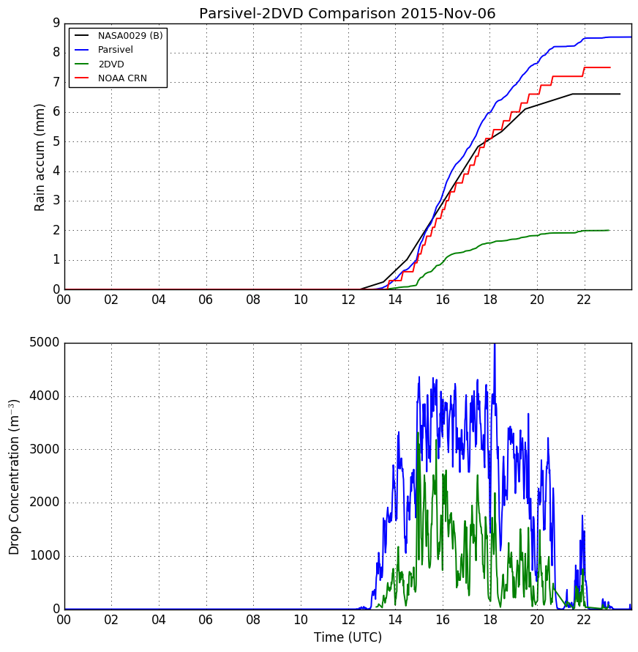
Problem with the 2DVD

