Slide 1
OLYMPEX
Pacific Northwest Weather Workshop, Seattle, 4 March 2016

Slide 2
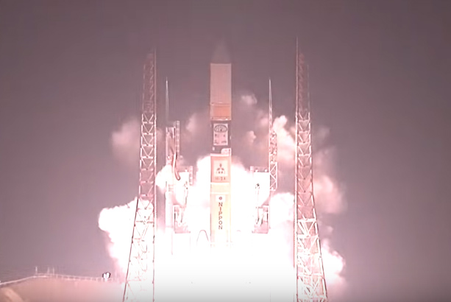
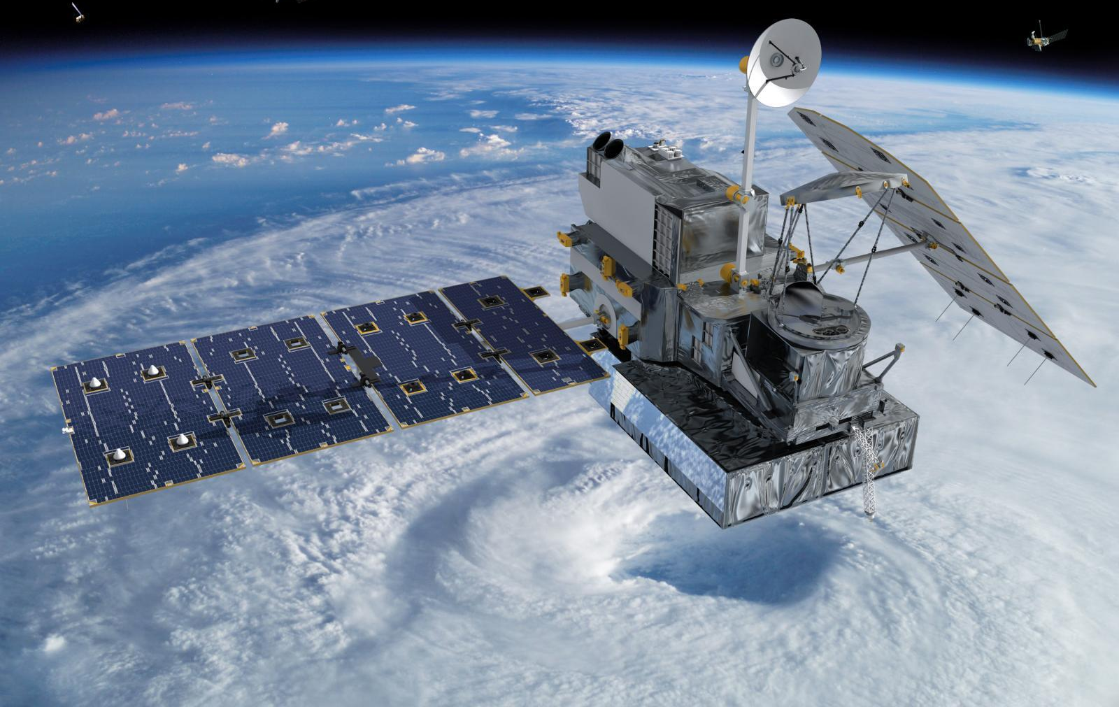

The GPM Satellite
Satellite Validation in the Pacific Northwest
27 Feb 2014
Pacific Northwest Weather Workshop, Seattle, 4 March 2016

Slide 3
GPM Orbit

Slide 4
The Olympic Peninsula was the Best Place to Validate the GPM Satellite!

Slide 5
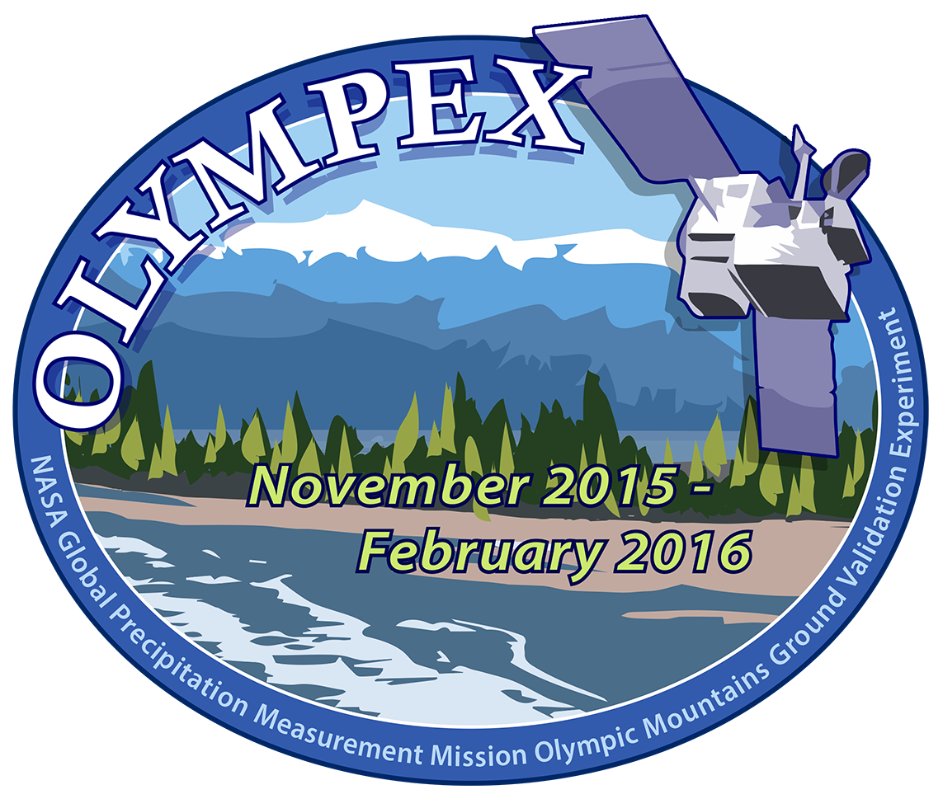

Slide 6
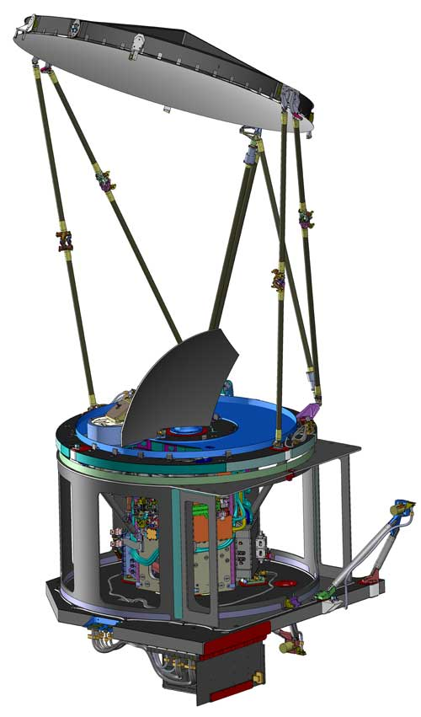
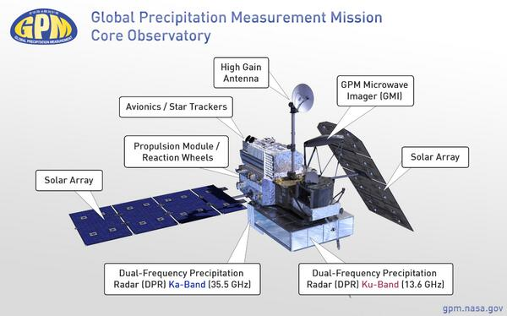
Instruments on GPM
GMI
GPM Microwave Imager (GMI) – Passive instrument
Can measure wide range of precipitation intensities including falling snow
Dual Precipitation Radar(DPR) – Active instrument
Measures 3-D structure of precipitation

Slide 7
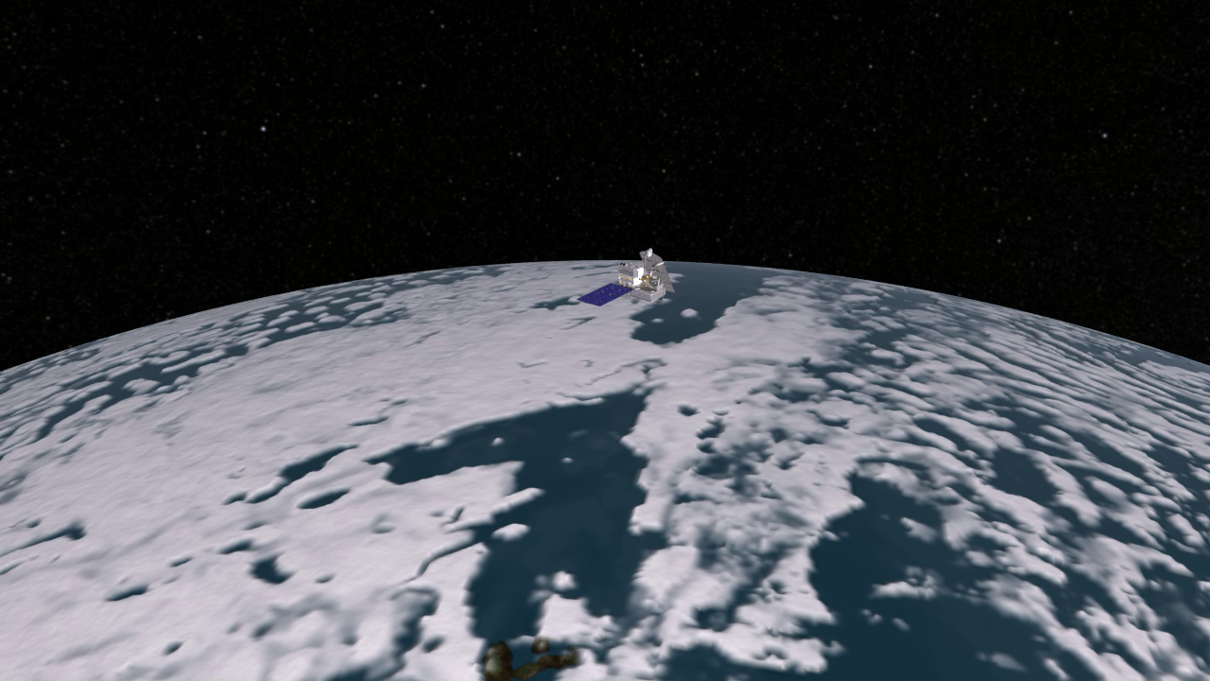

Slide 8
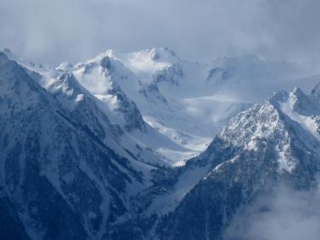
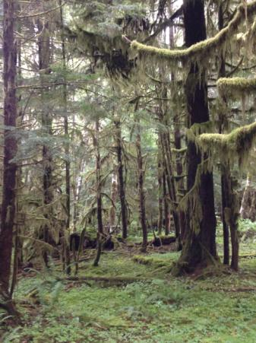
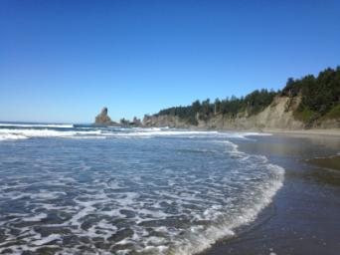
Observational Targets
High Terrain
Valley
Rain Forest
Ocean

Slide 9
The OLYMPEX Strategy
Aircraft
ER2 & DC8—over the top
Citation—through the clouds
Surface
Particle sizes and fallspeeds
Rain and snow amounts
Snow cameras
Upper air
Supplemental soundings in events
Windward and leeside stations
Radars for 3D structure
RHIs at 4 different wavelengths
Dual polarization
Doppler

Slide 10
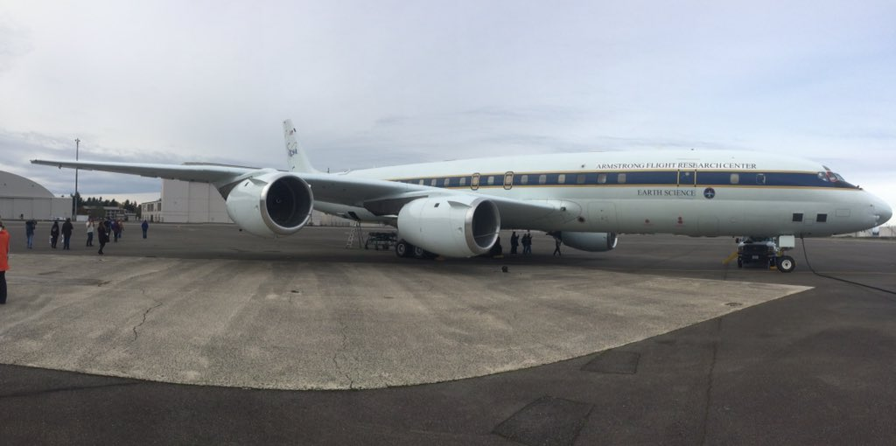
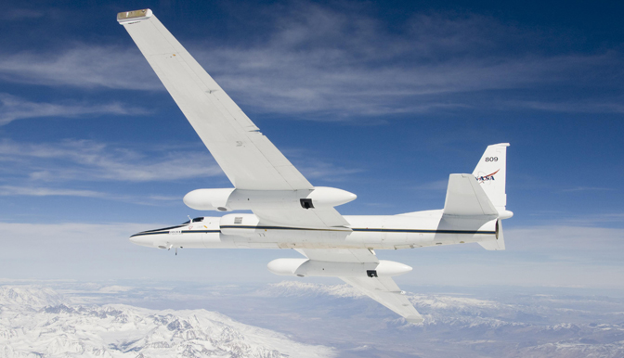
High-flying NASA Aircraft
ER-2
DC-8
High altitude
Satellite-simulating instruments
Allowed direct comparison with radars and ground instruments

Slide 11
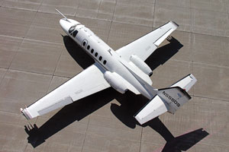
In-cloud aircraft
North Dakota Citation
Flew into/out of clouds
Sampled ice crystals & drops
Important for satellite validation

Slide 12
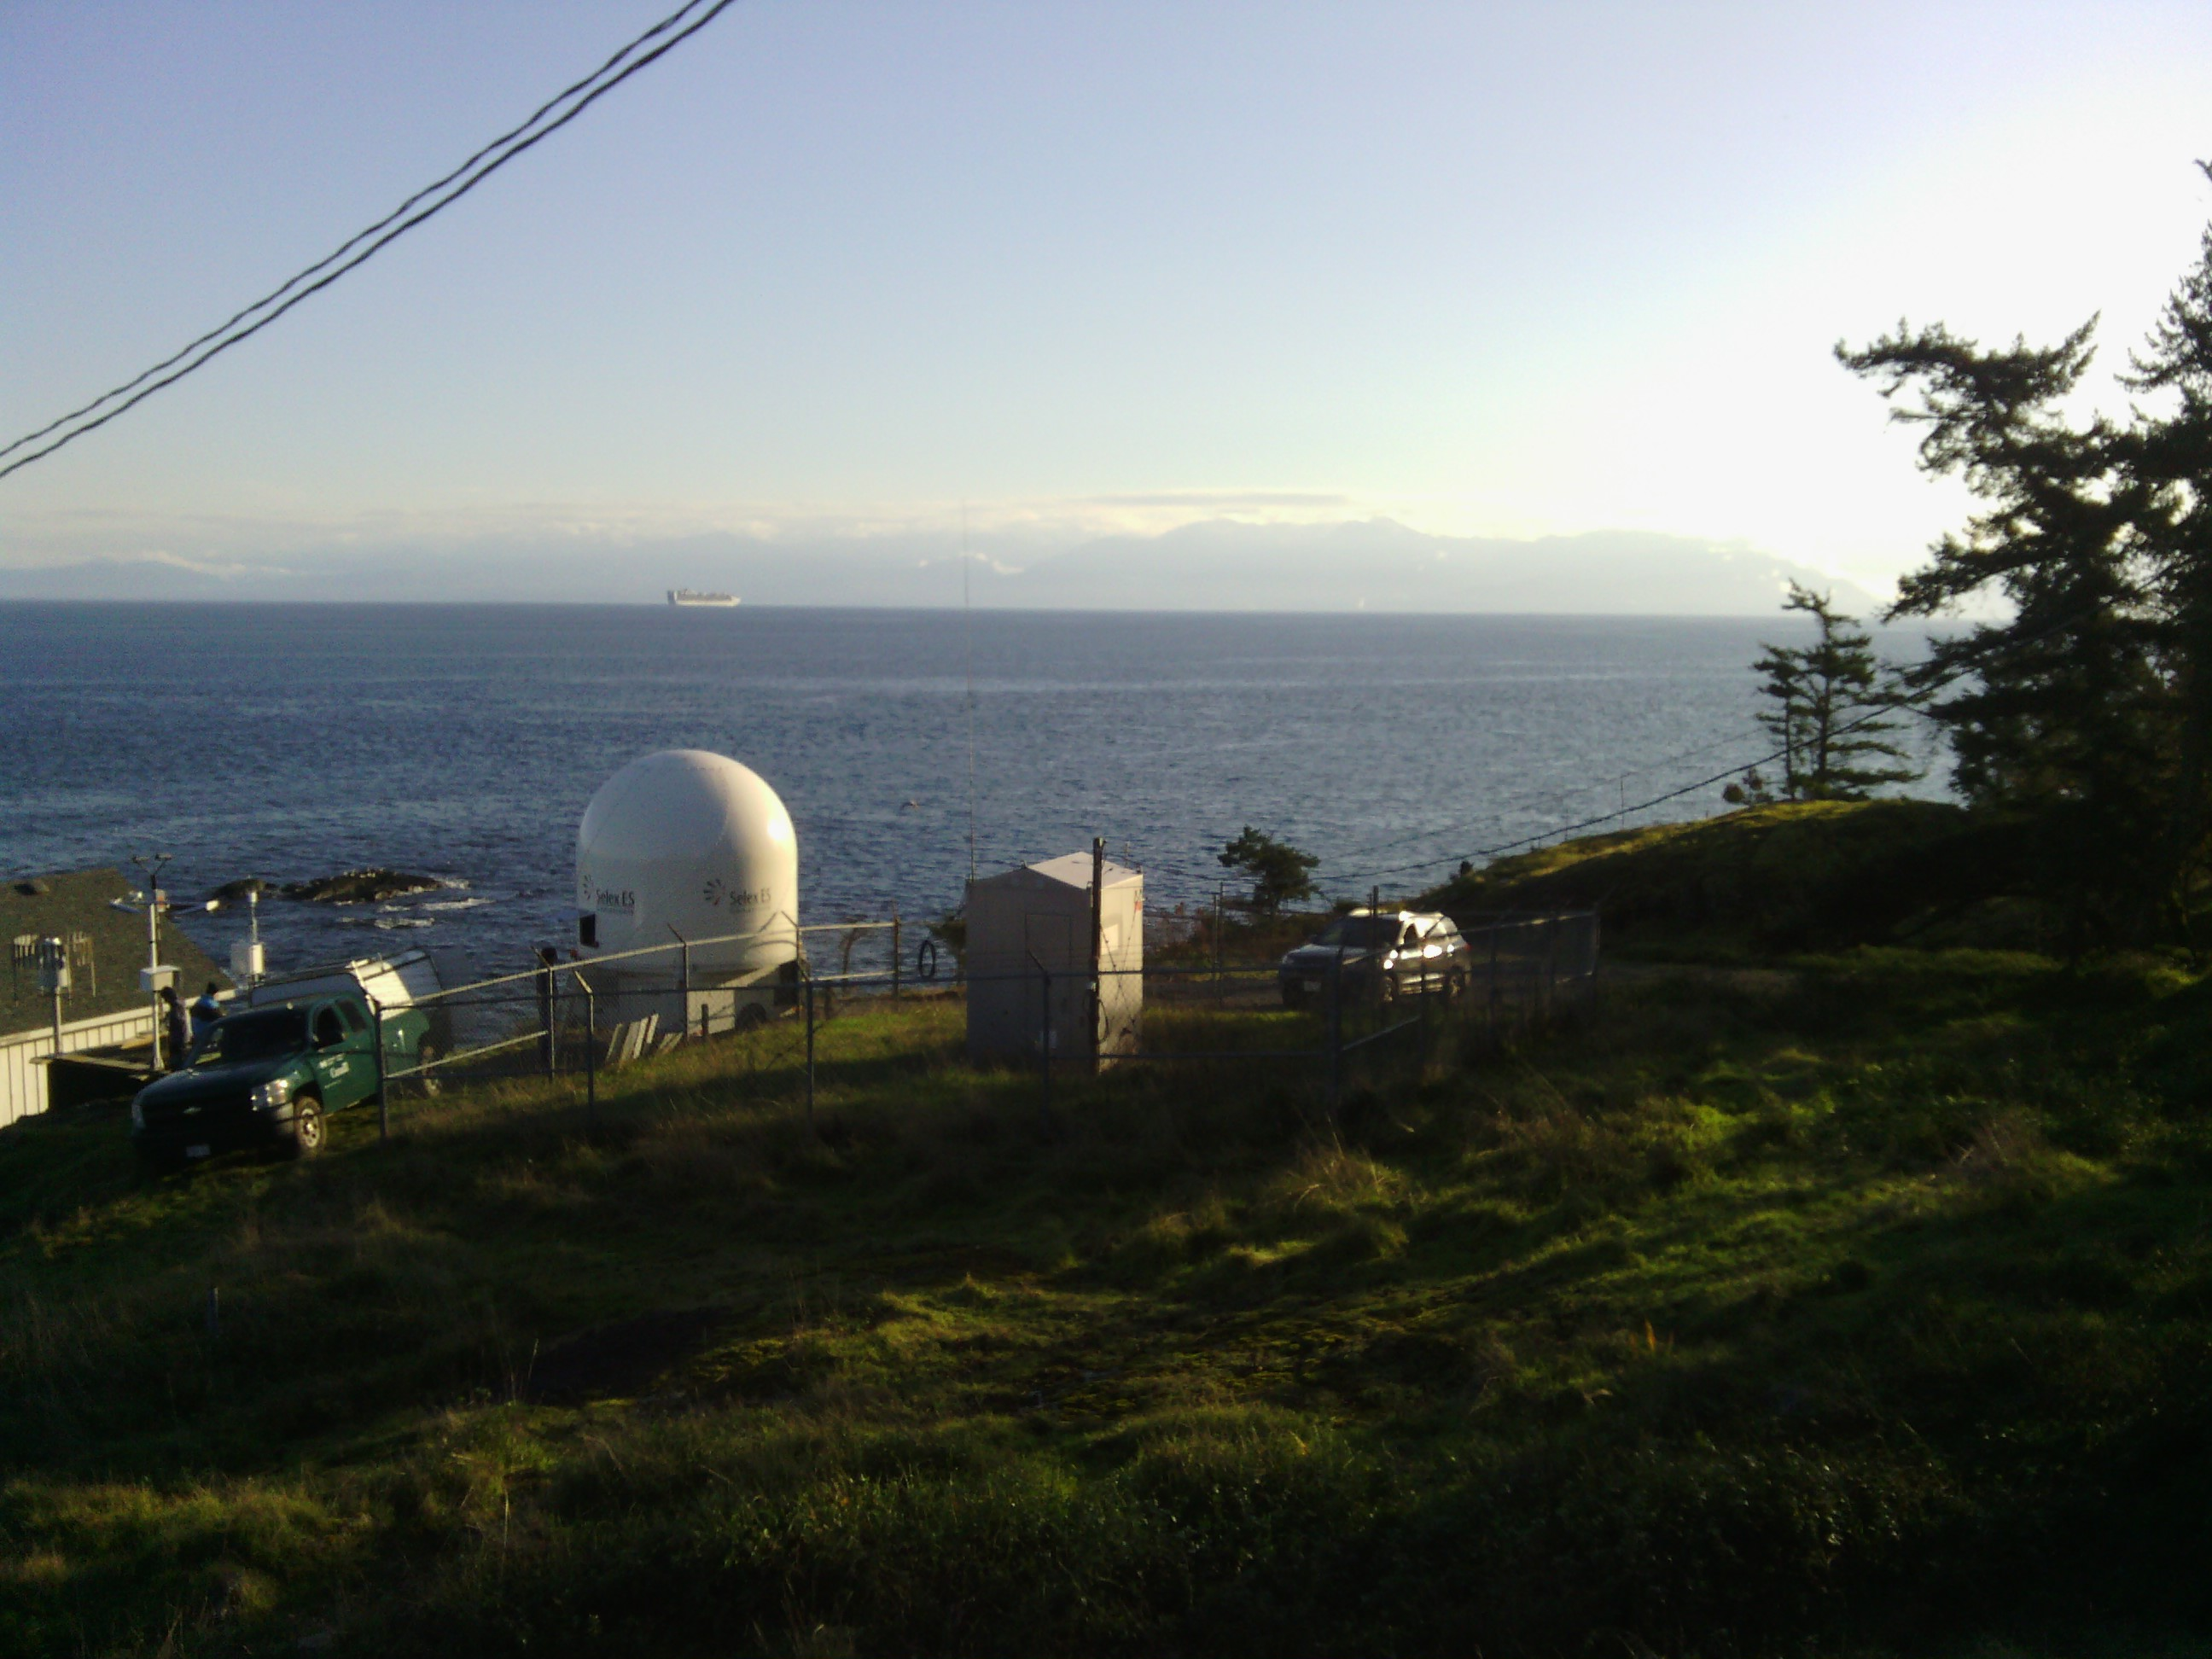
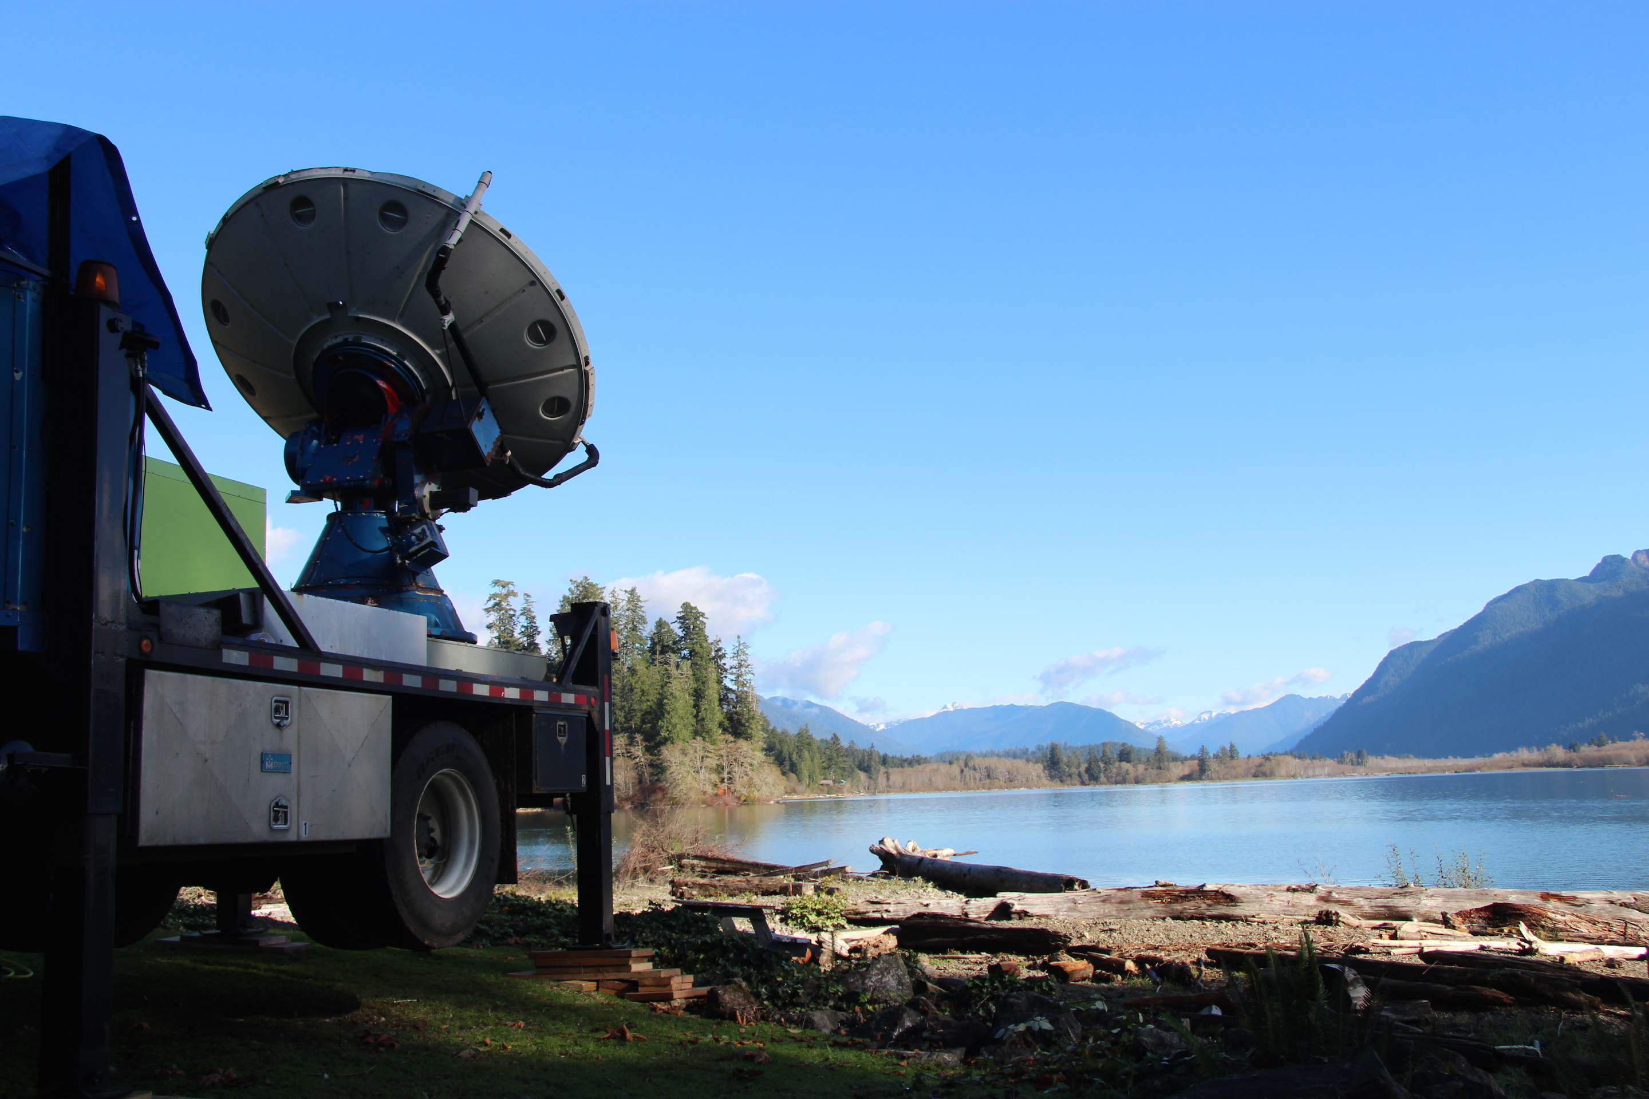
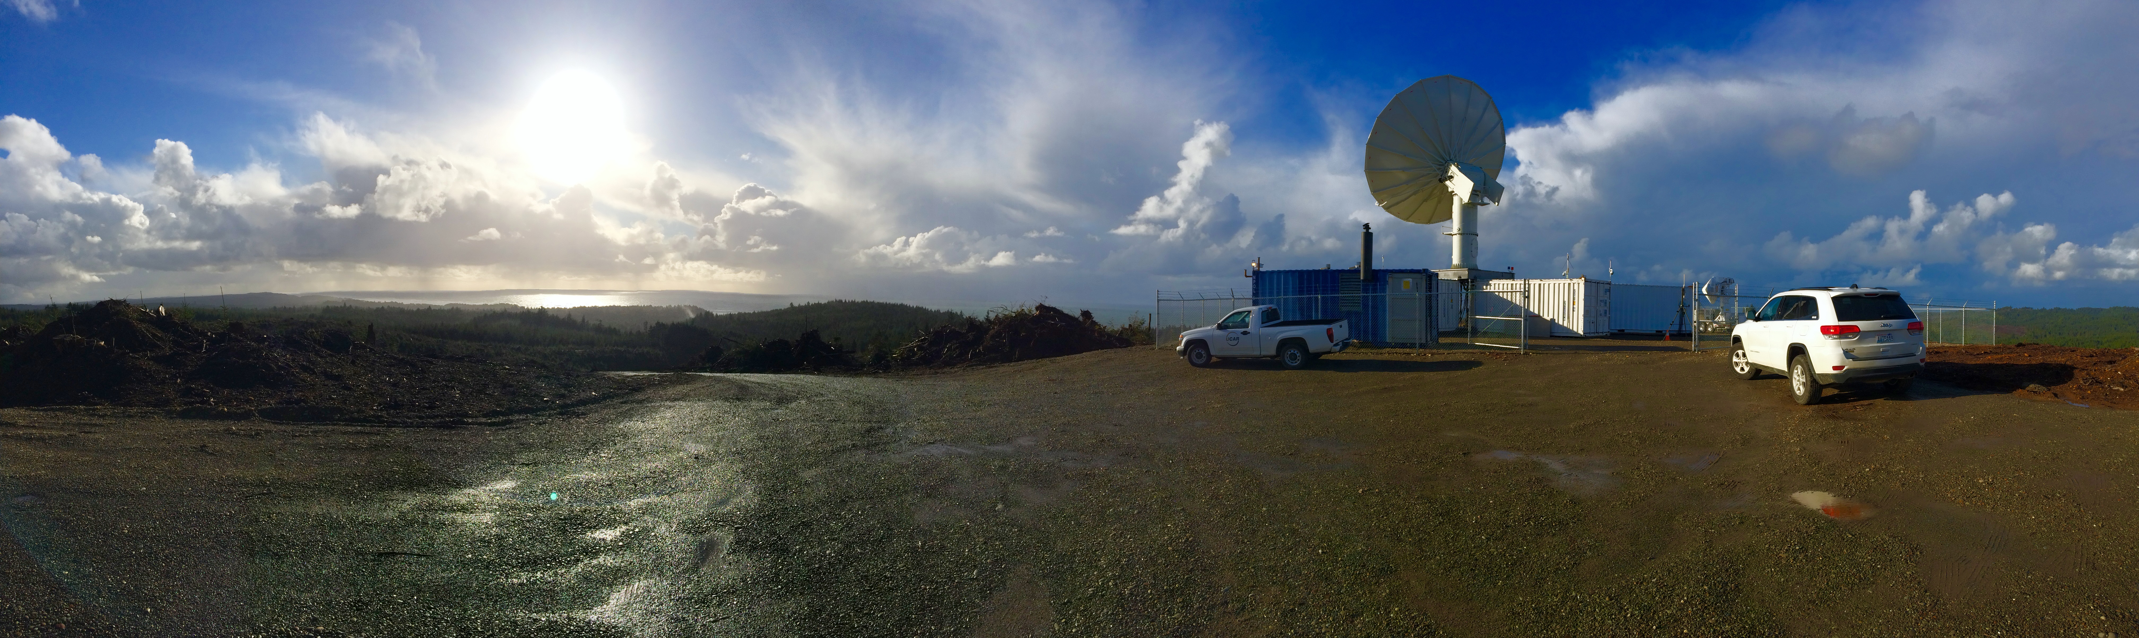
The RHI radars

Slide 13
Ground Sites

Slide 14
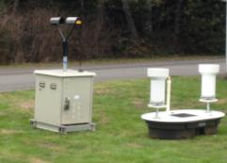
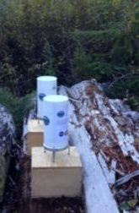
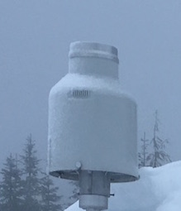
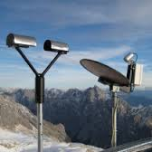
Ground Instruments
Tipping Buckets
Tipping Bucket
Parsivel
Pluvio
Parsivel
Micro Rain Radar

Slide 15
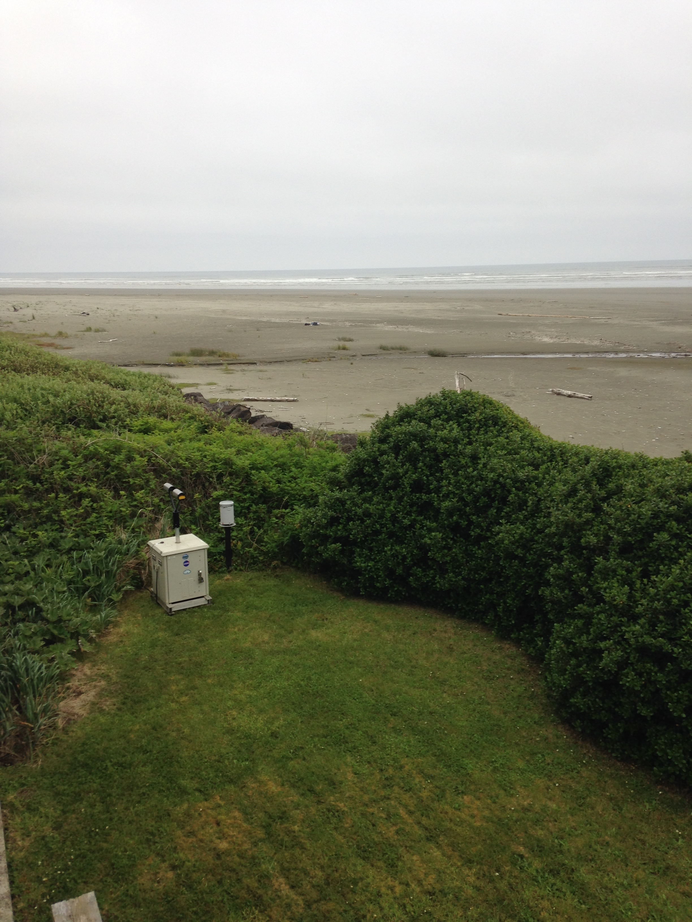
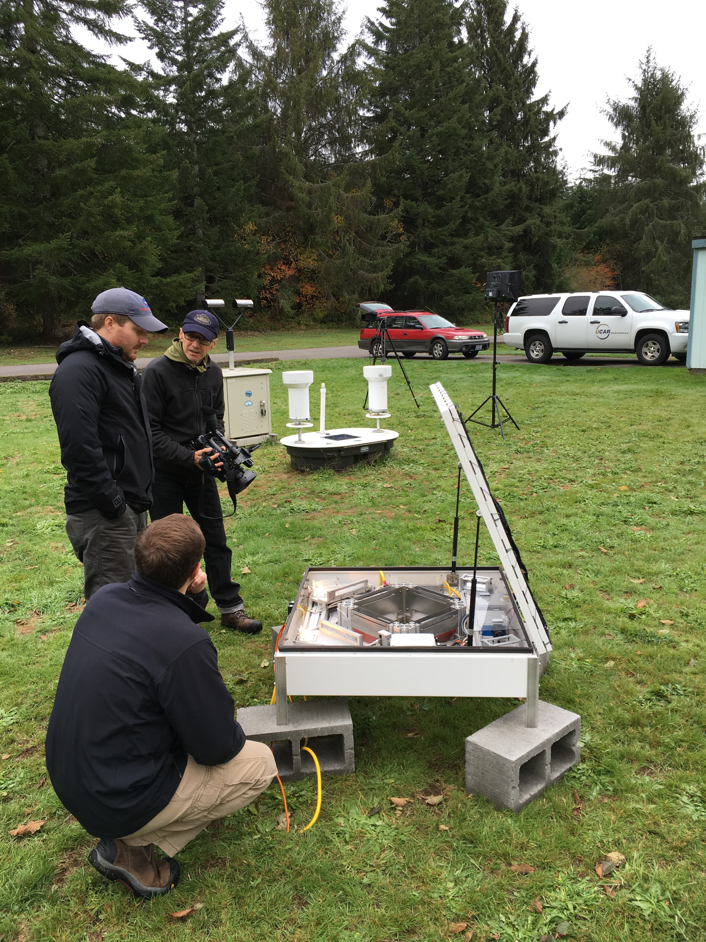
Ground Instruments
On the beach
Lower valley

Slide 16
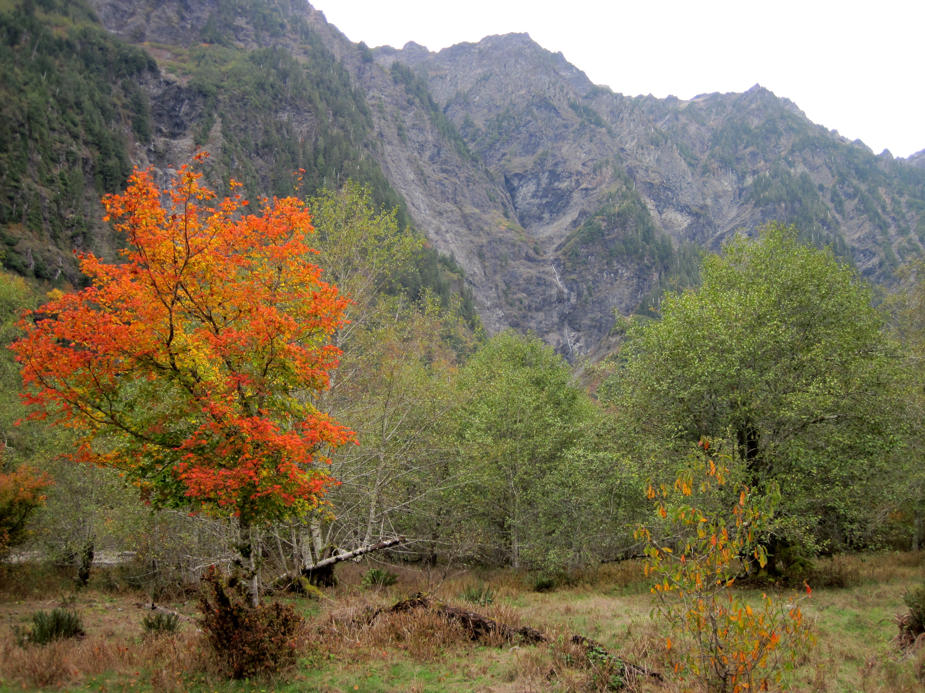
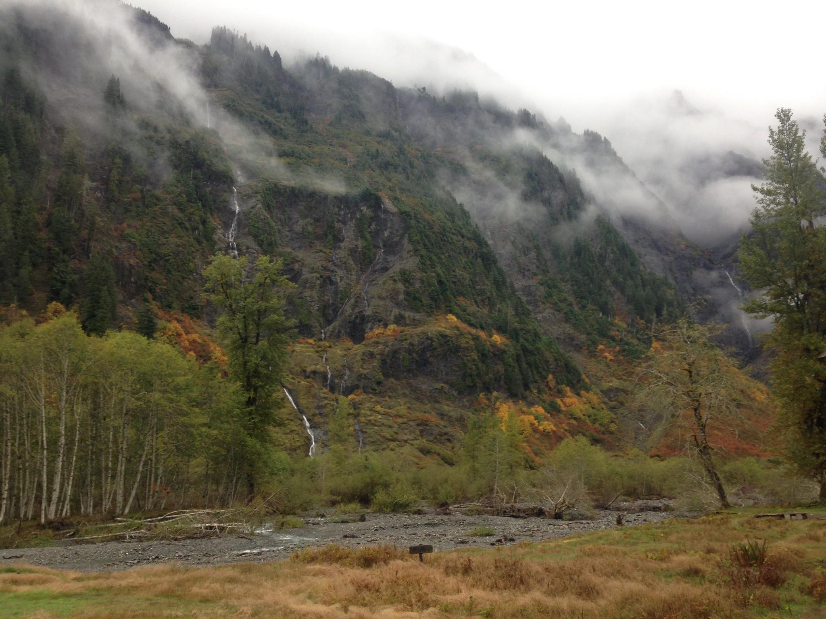
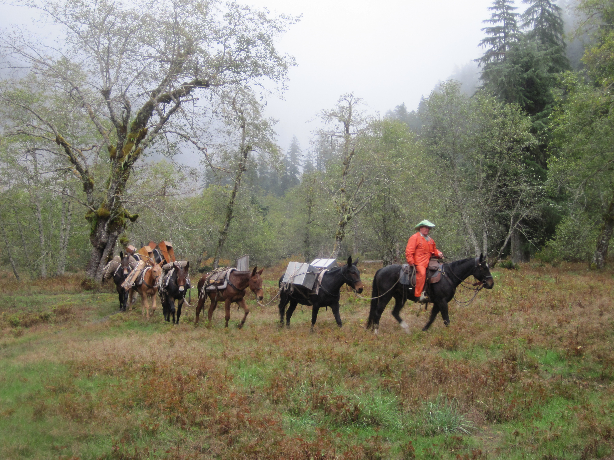
Ground Instruments
Inside the Quinault Valley
To the Upper Quinault

Slide 17
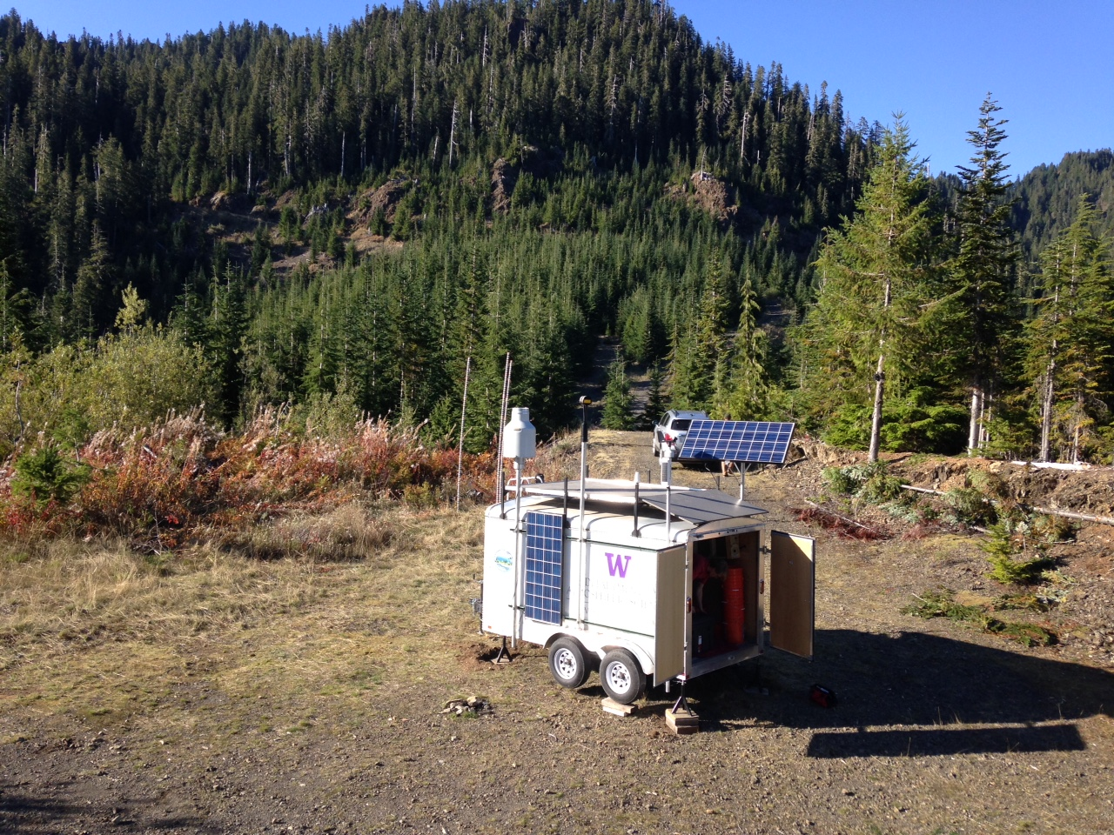
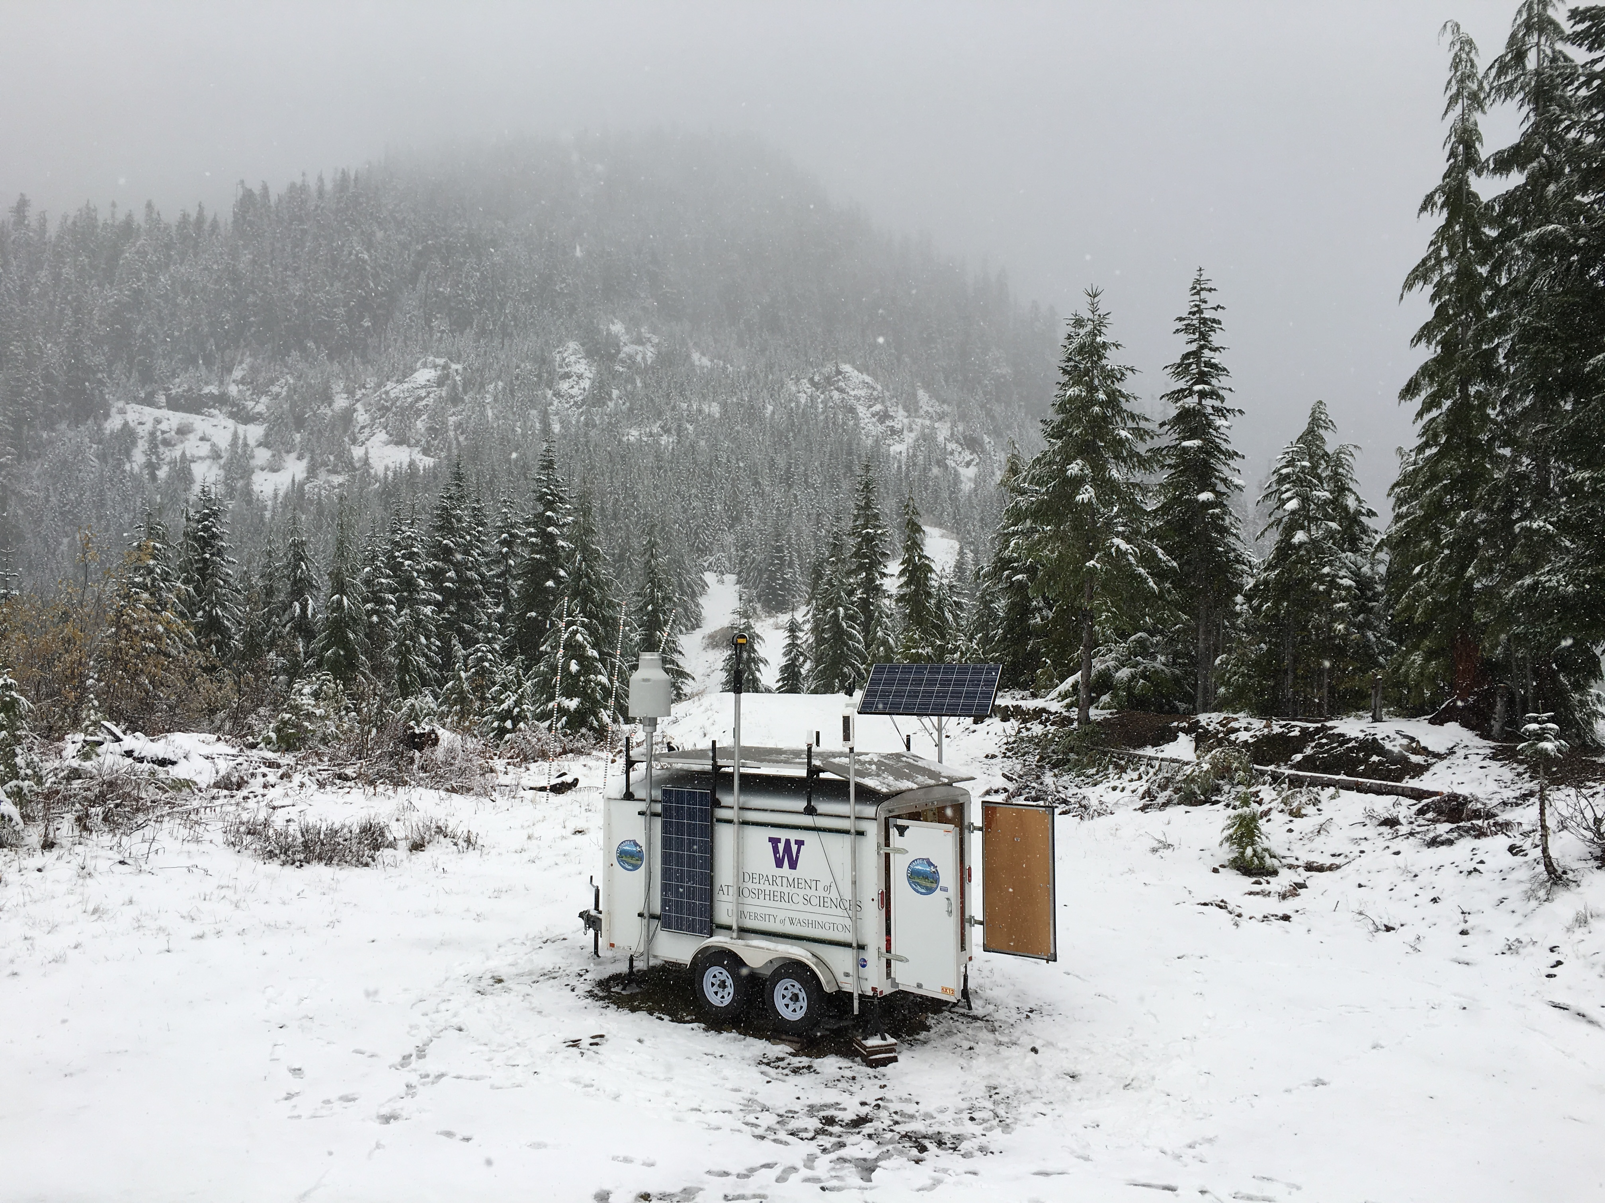
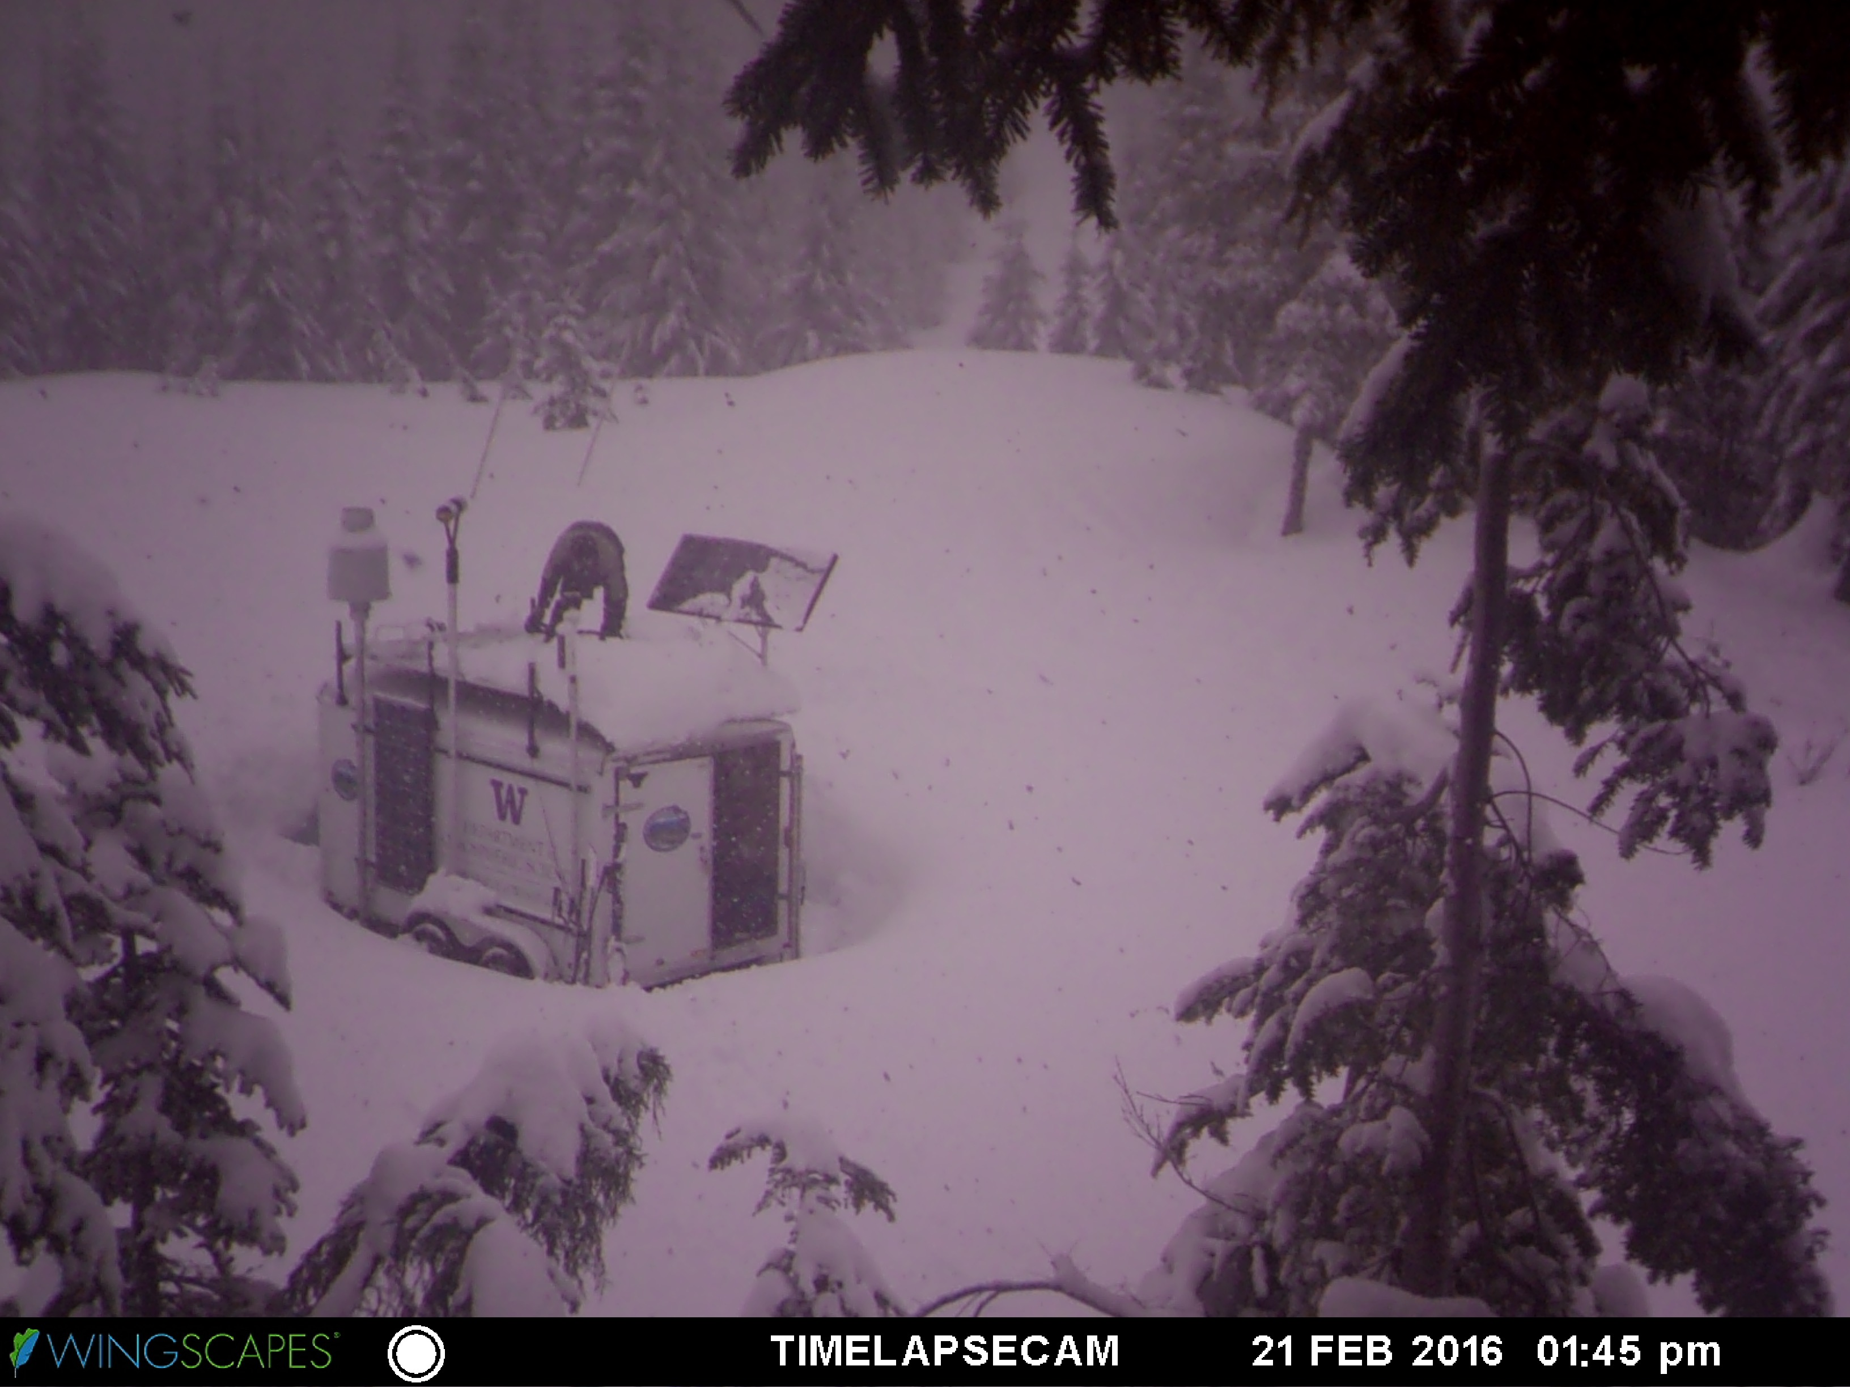
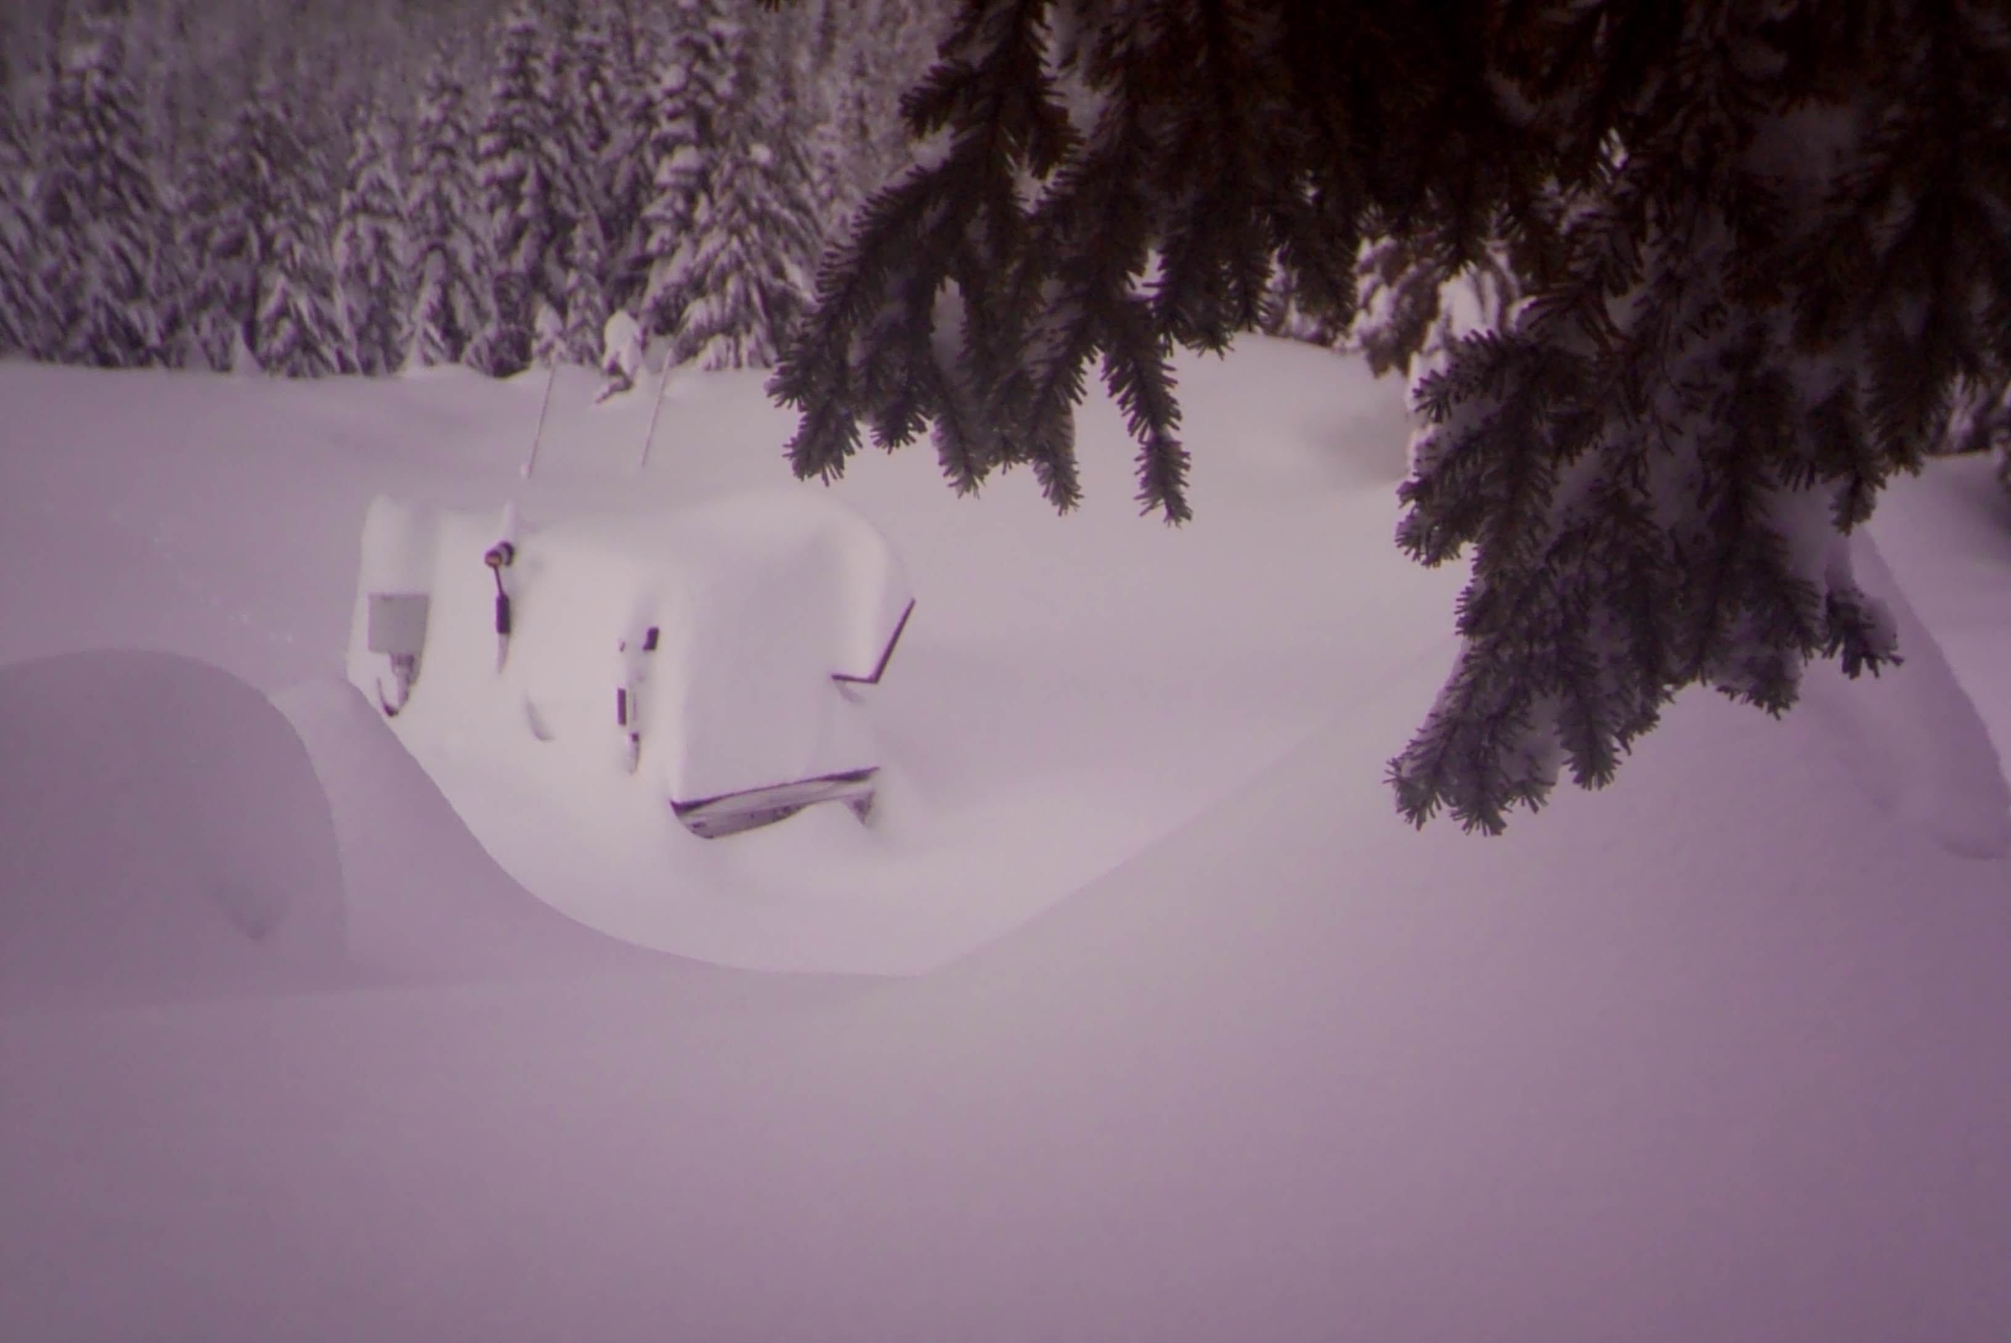
Ground Instruments
3000 feet

Slide 18
Snow Cameras

Slide 19
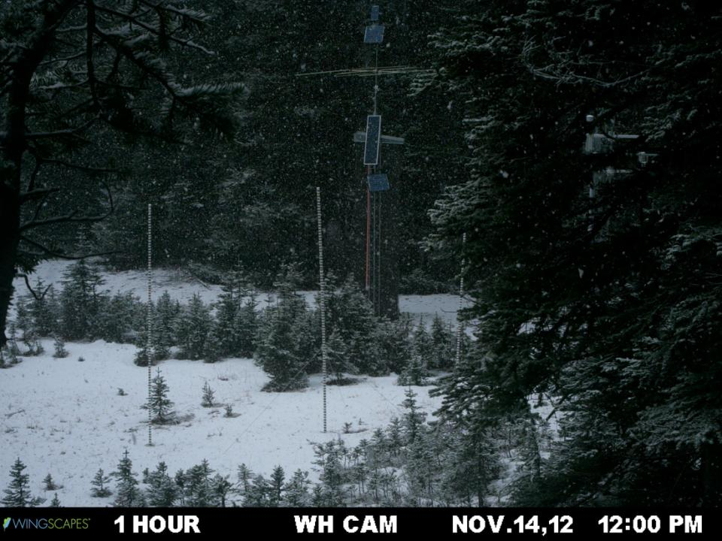
Snow Cameras

Slide 20
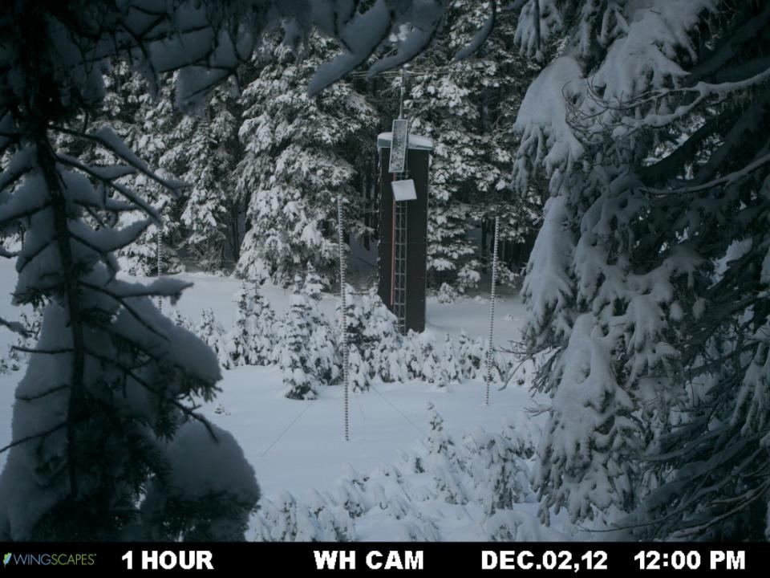
Snow Cameras

Slide 21
Leeside strategy: Hurricane Ridge & EC radar

Slide 22
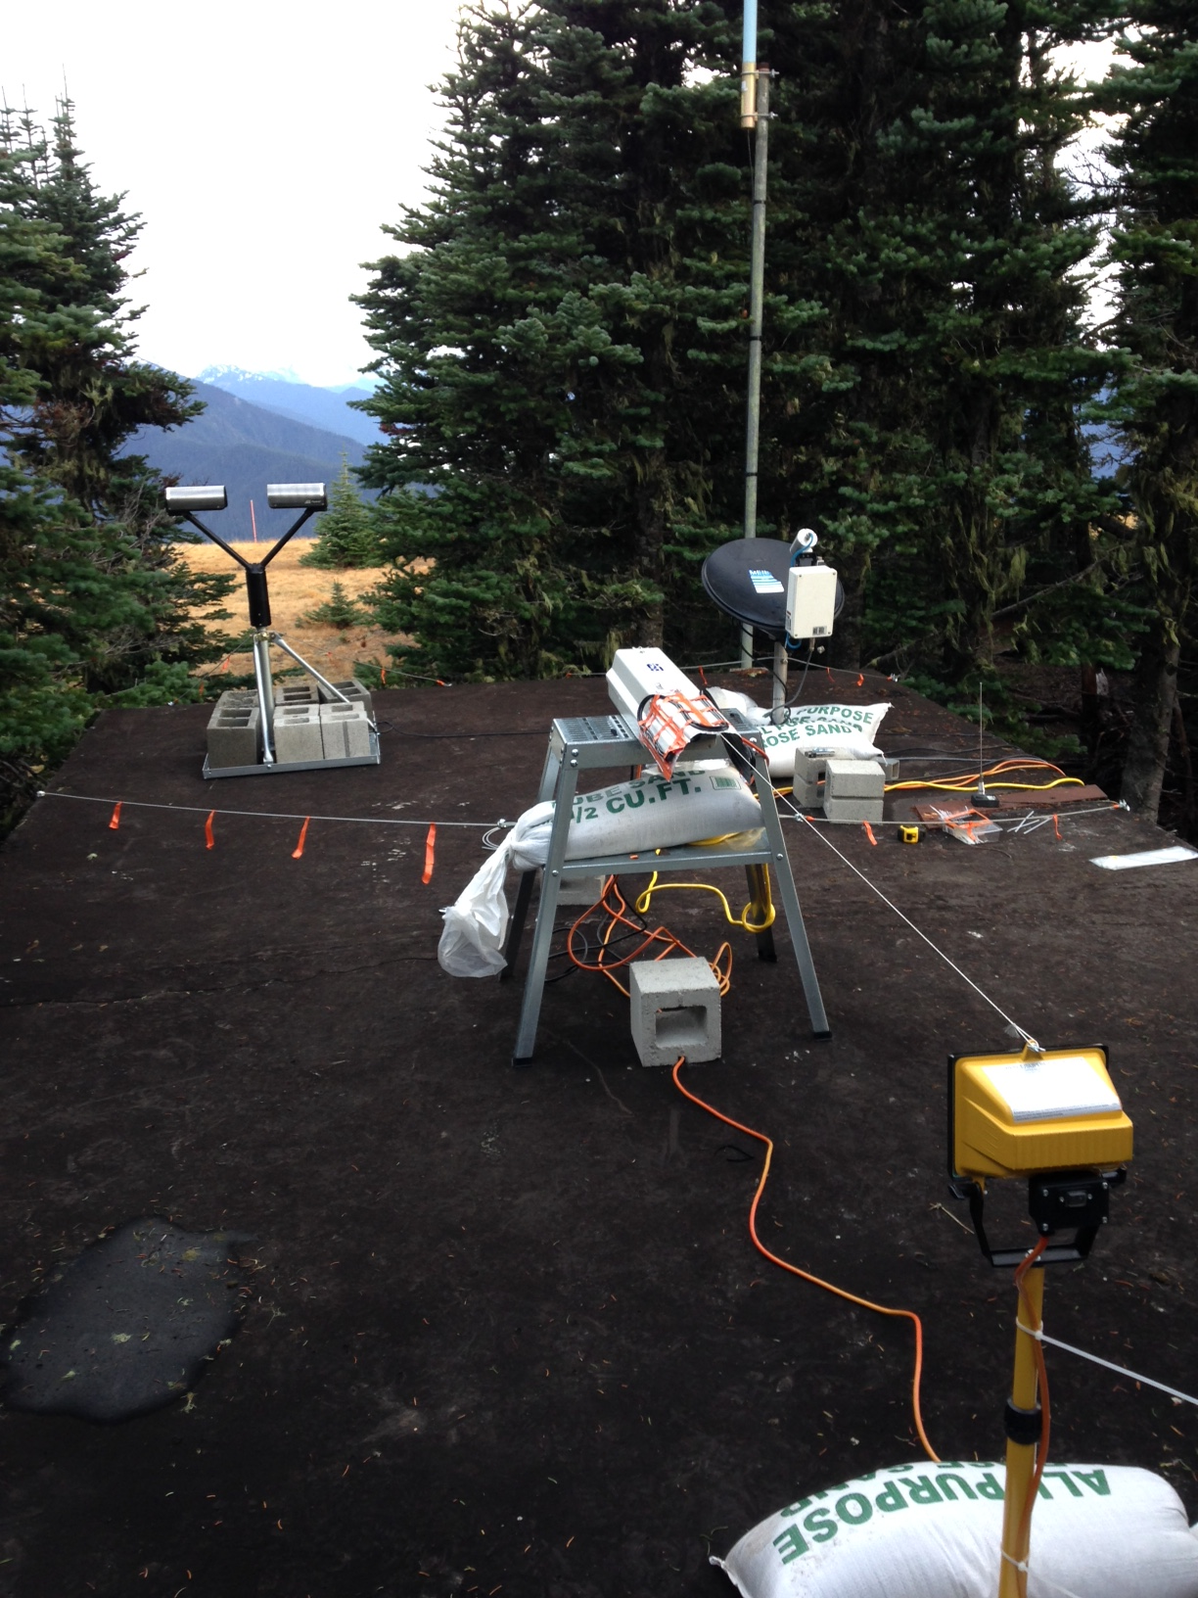
Hurricane Ridge
MRR
Leeside
Elevation >5000’
Parsivel
PIP

Slide 23
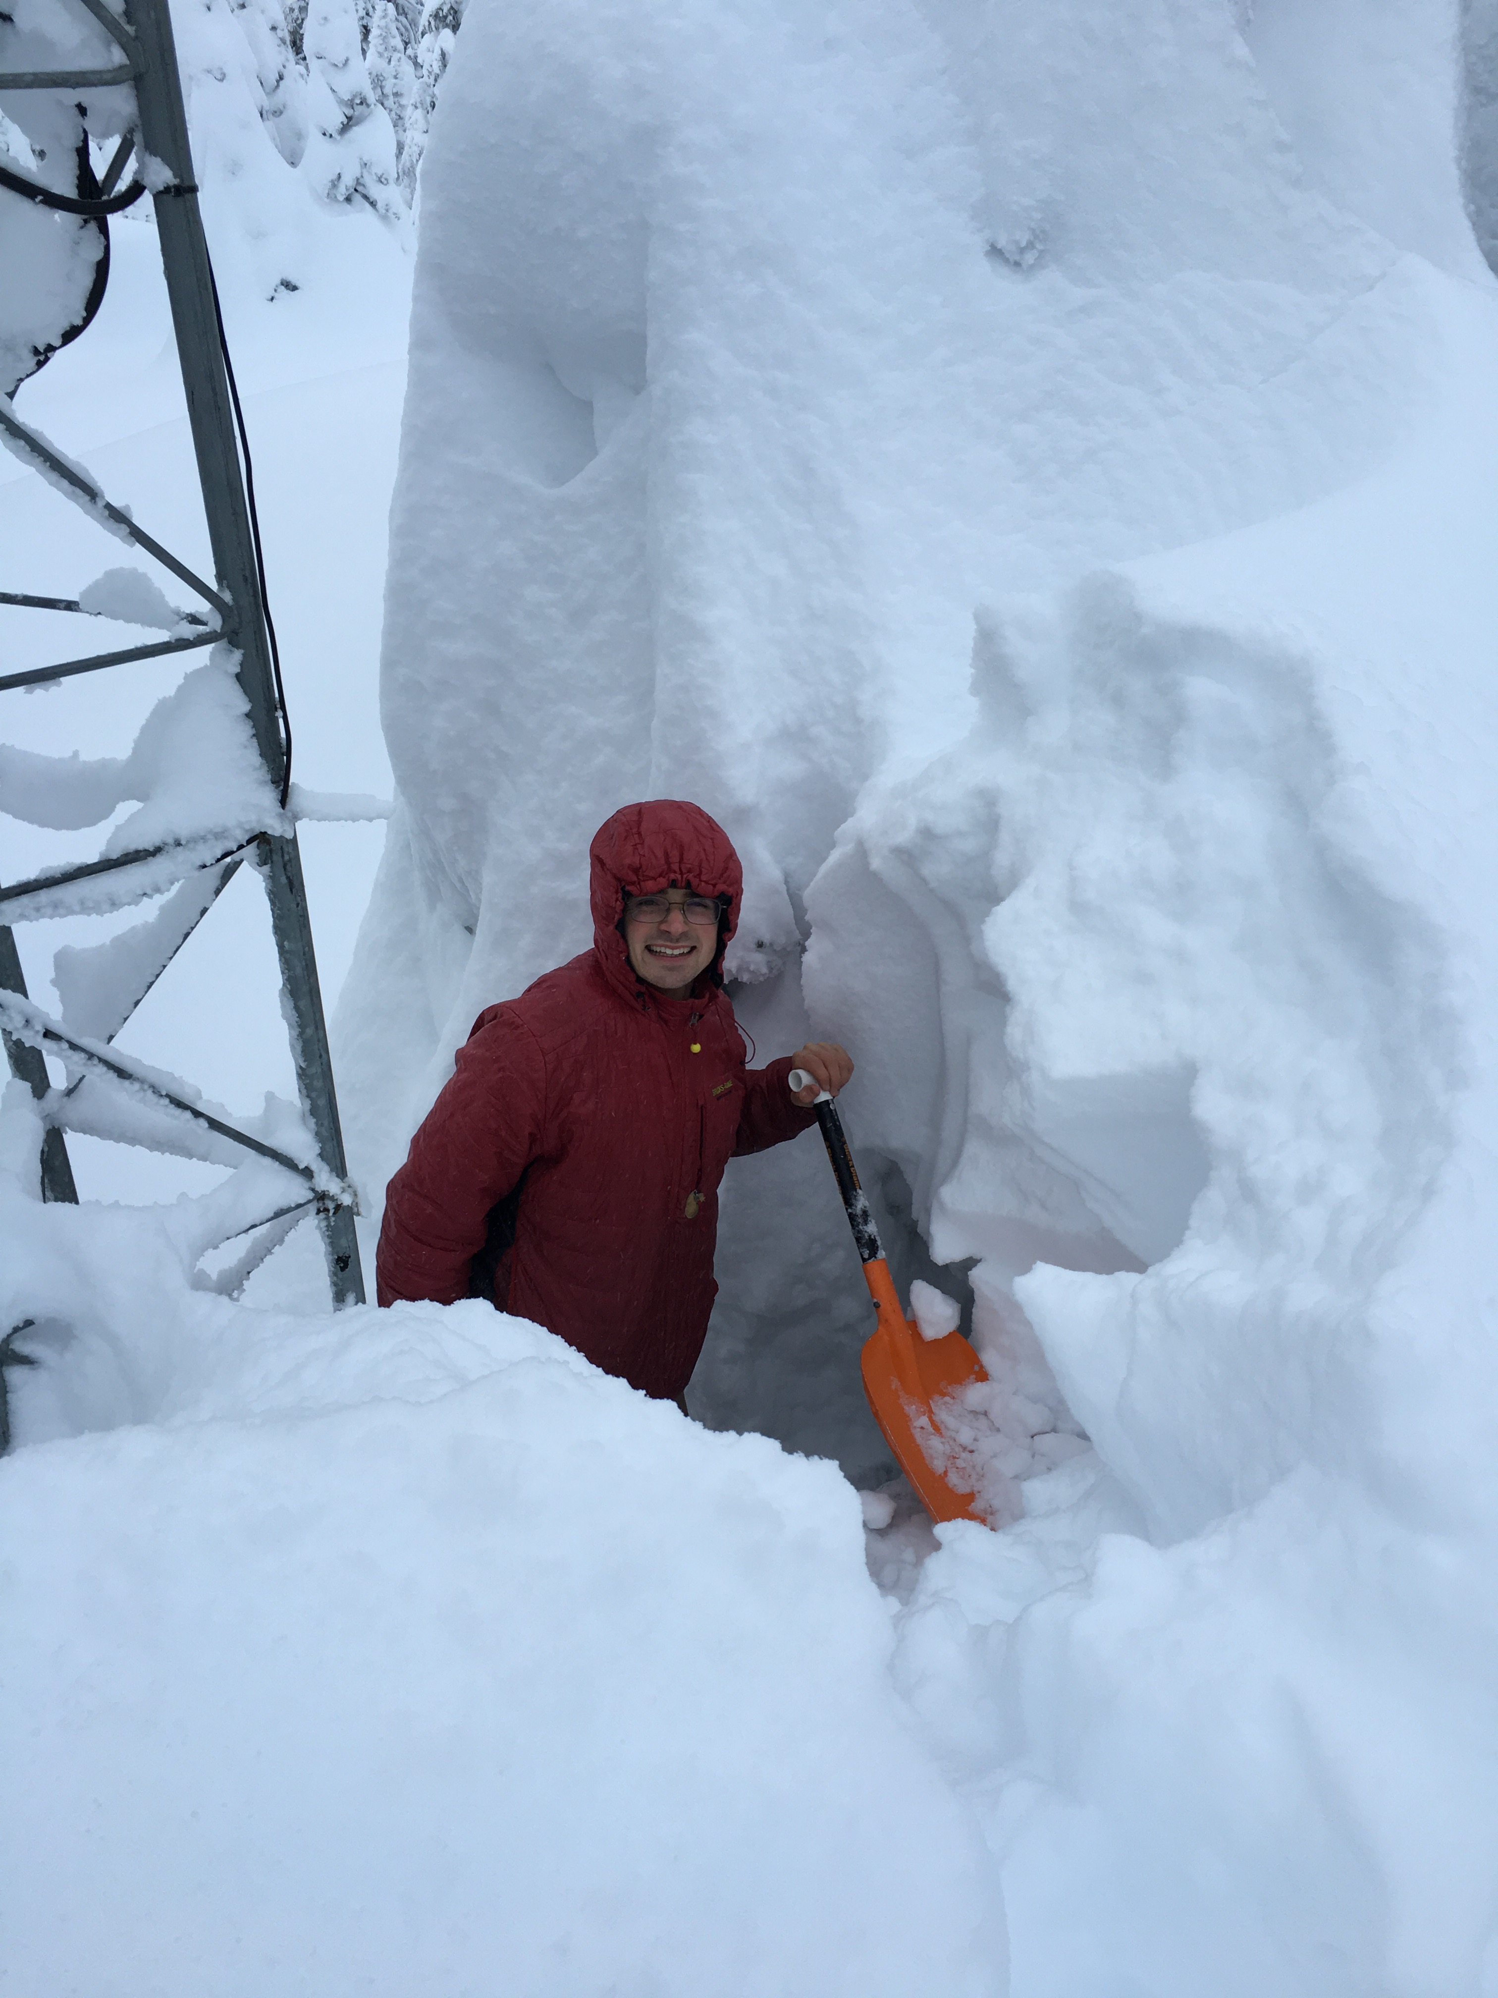
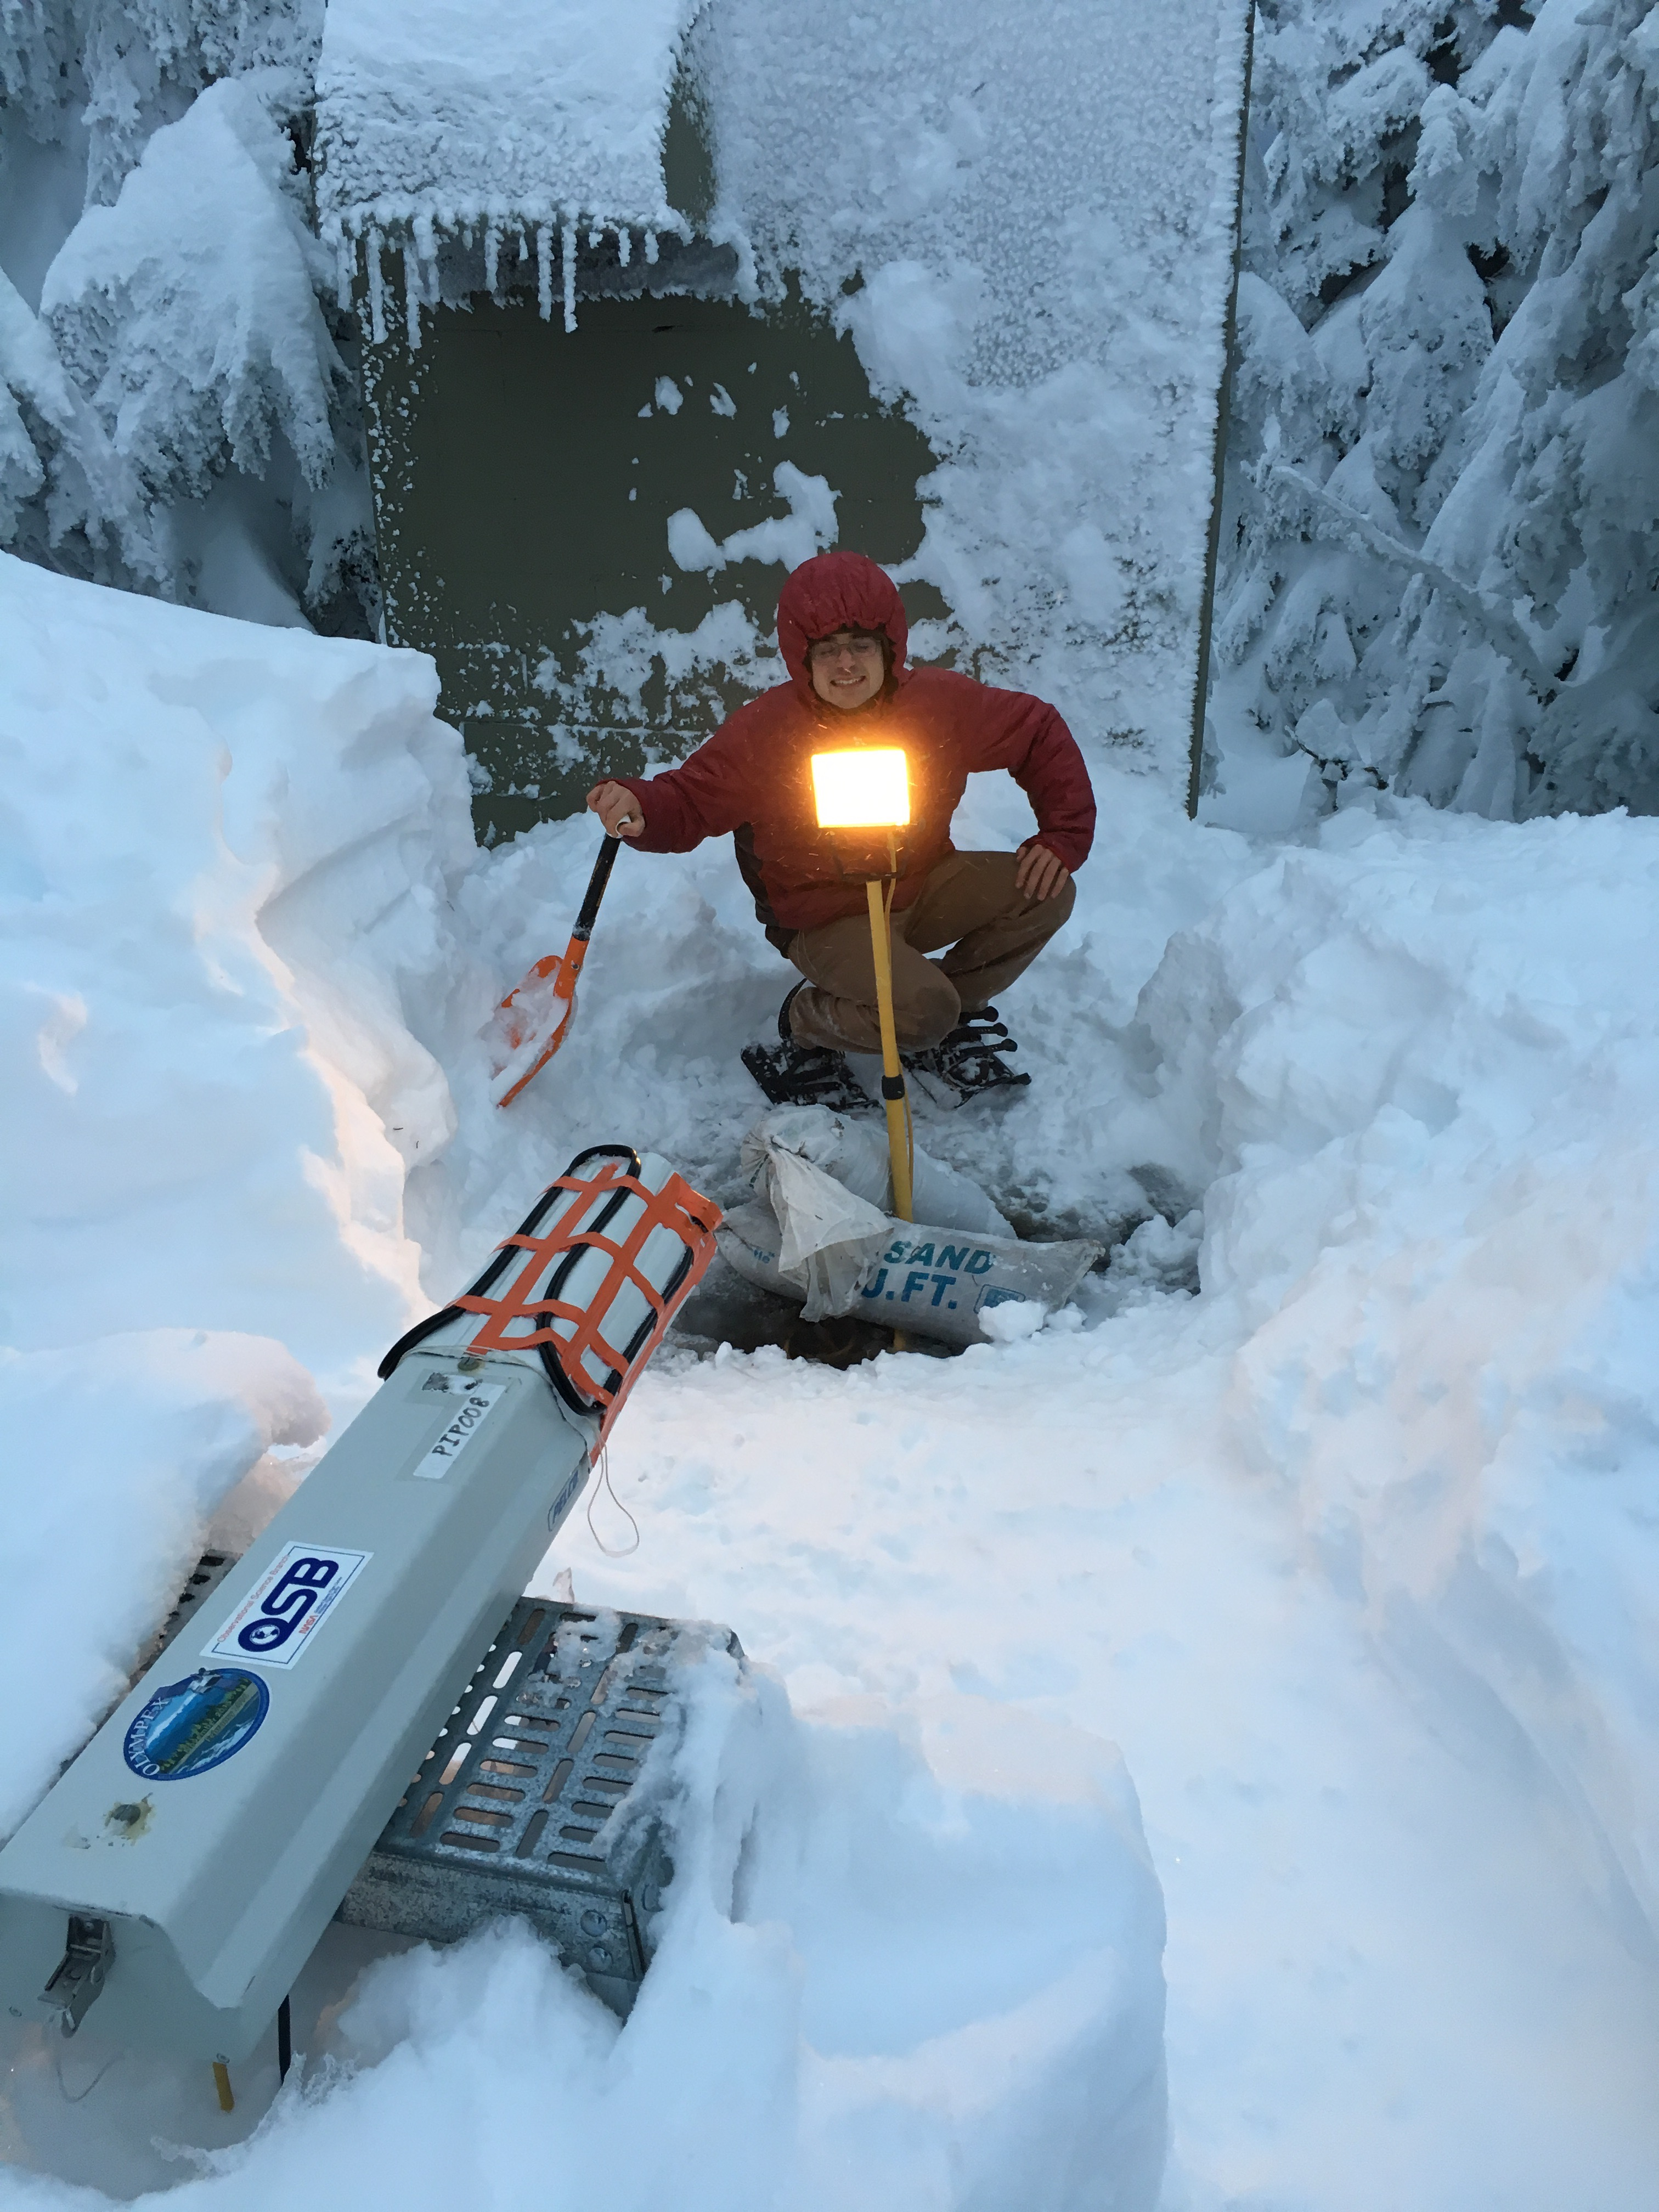
Hurricane Ridge

Slide 24
The Daily Challenge: Aircraft Coordination

Slide 25
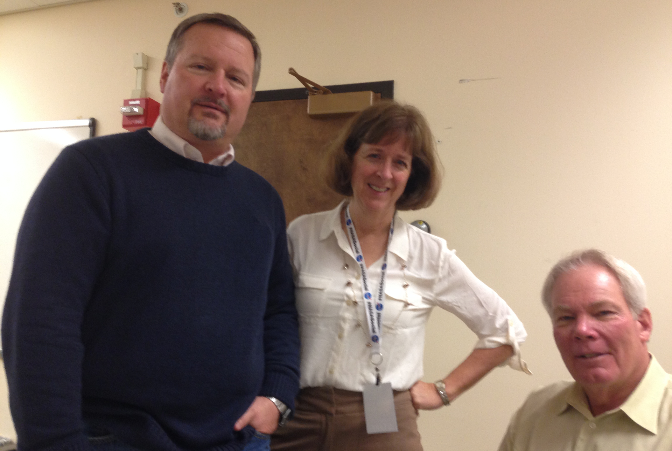
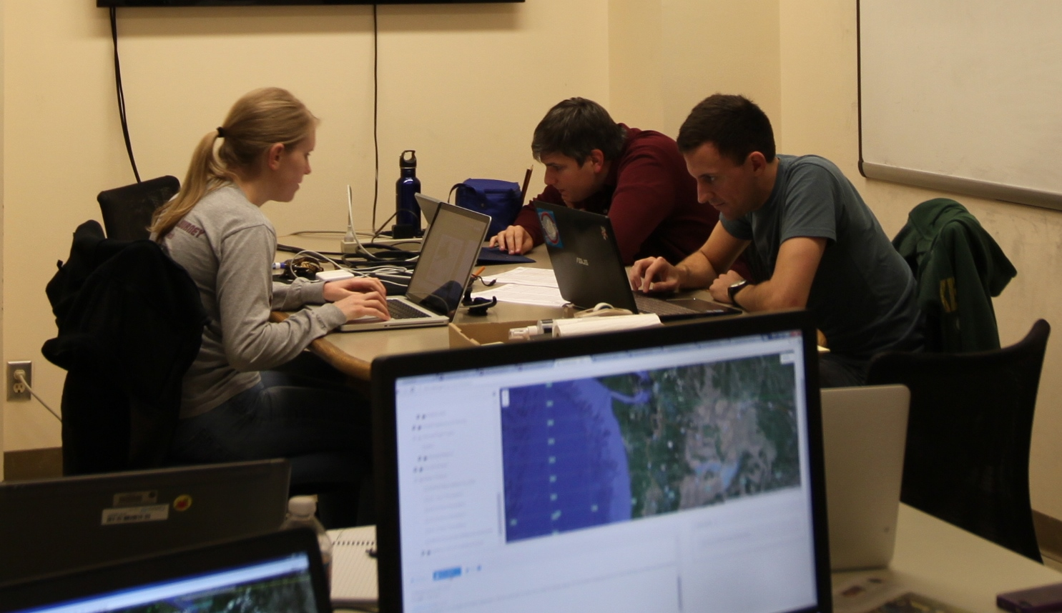
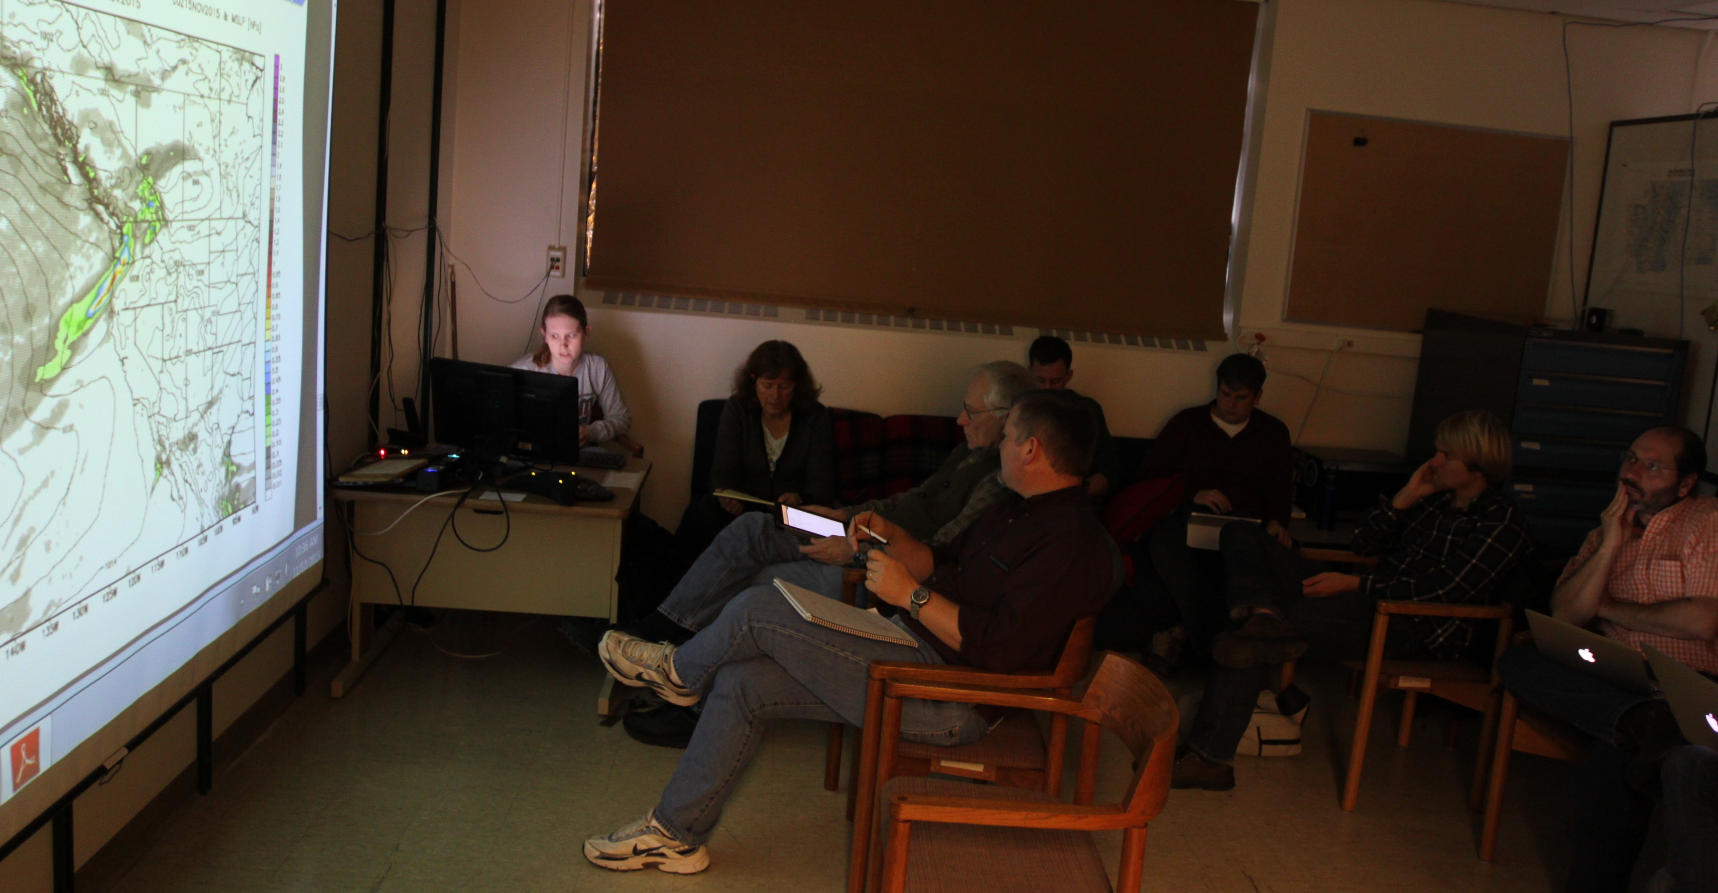
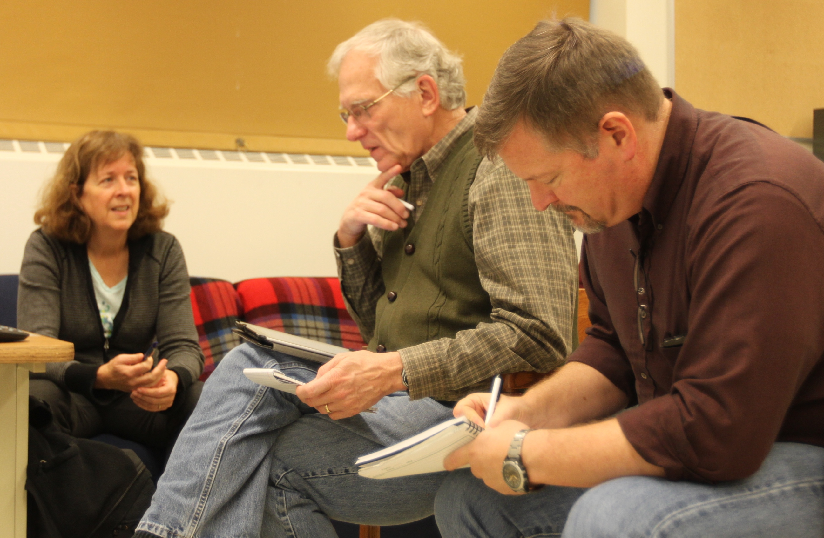
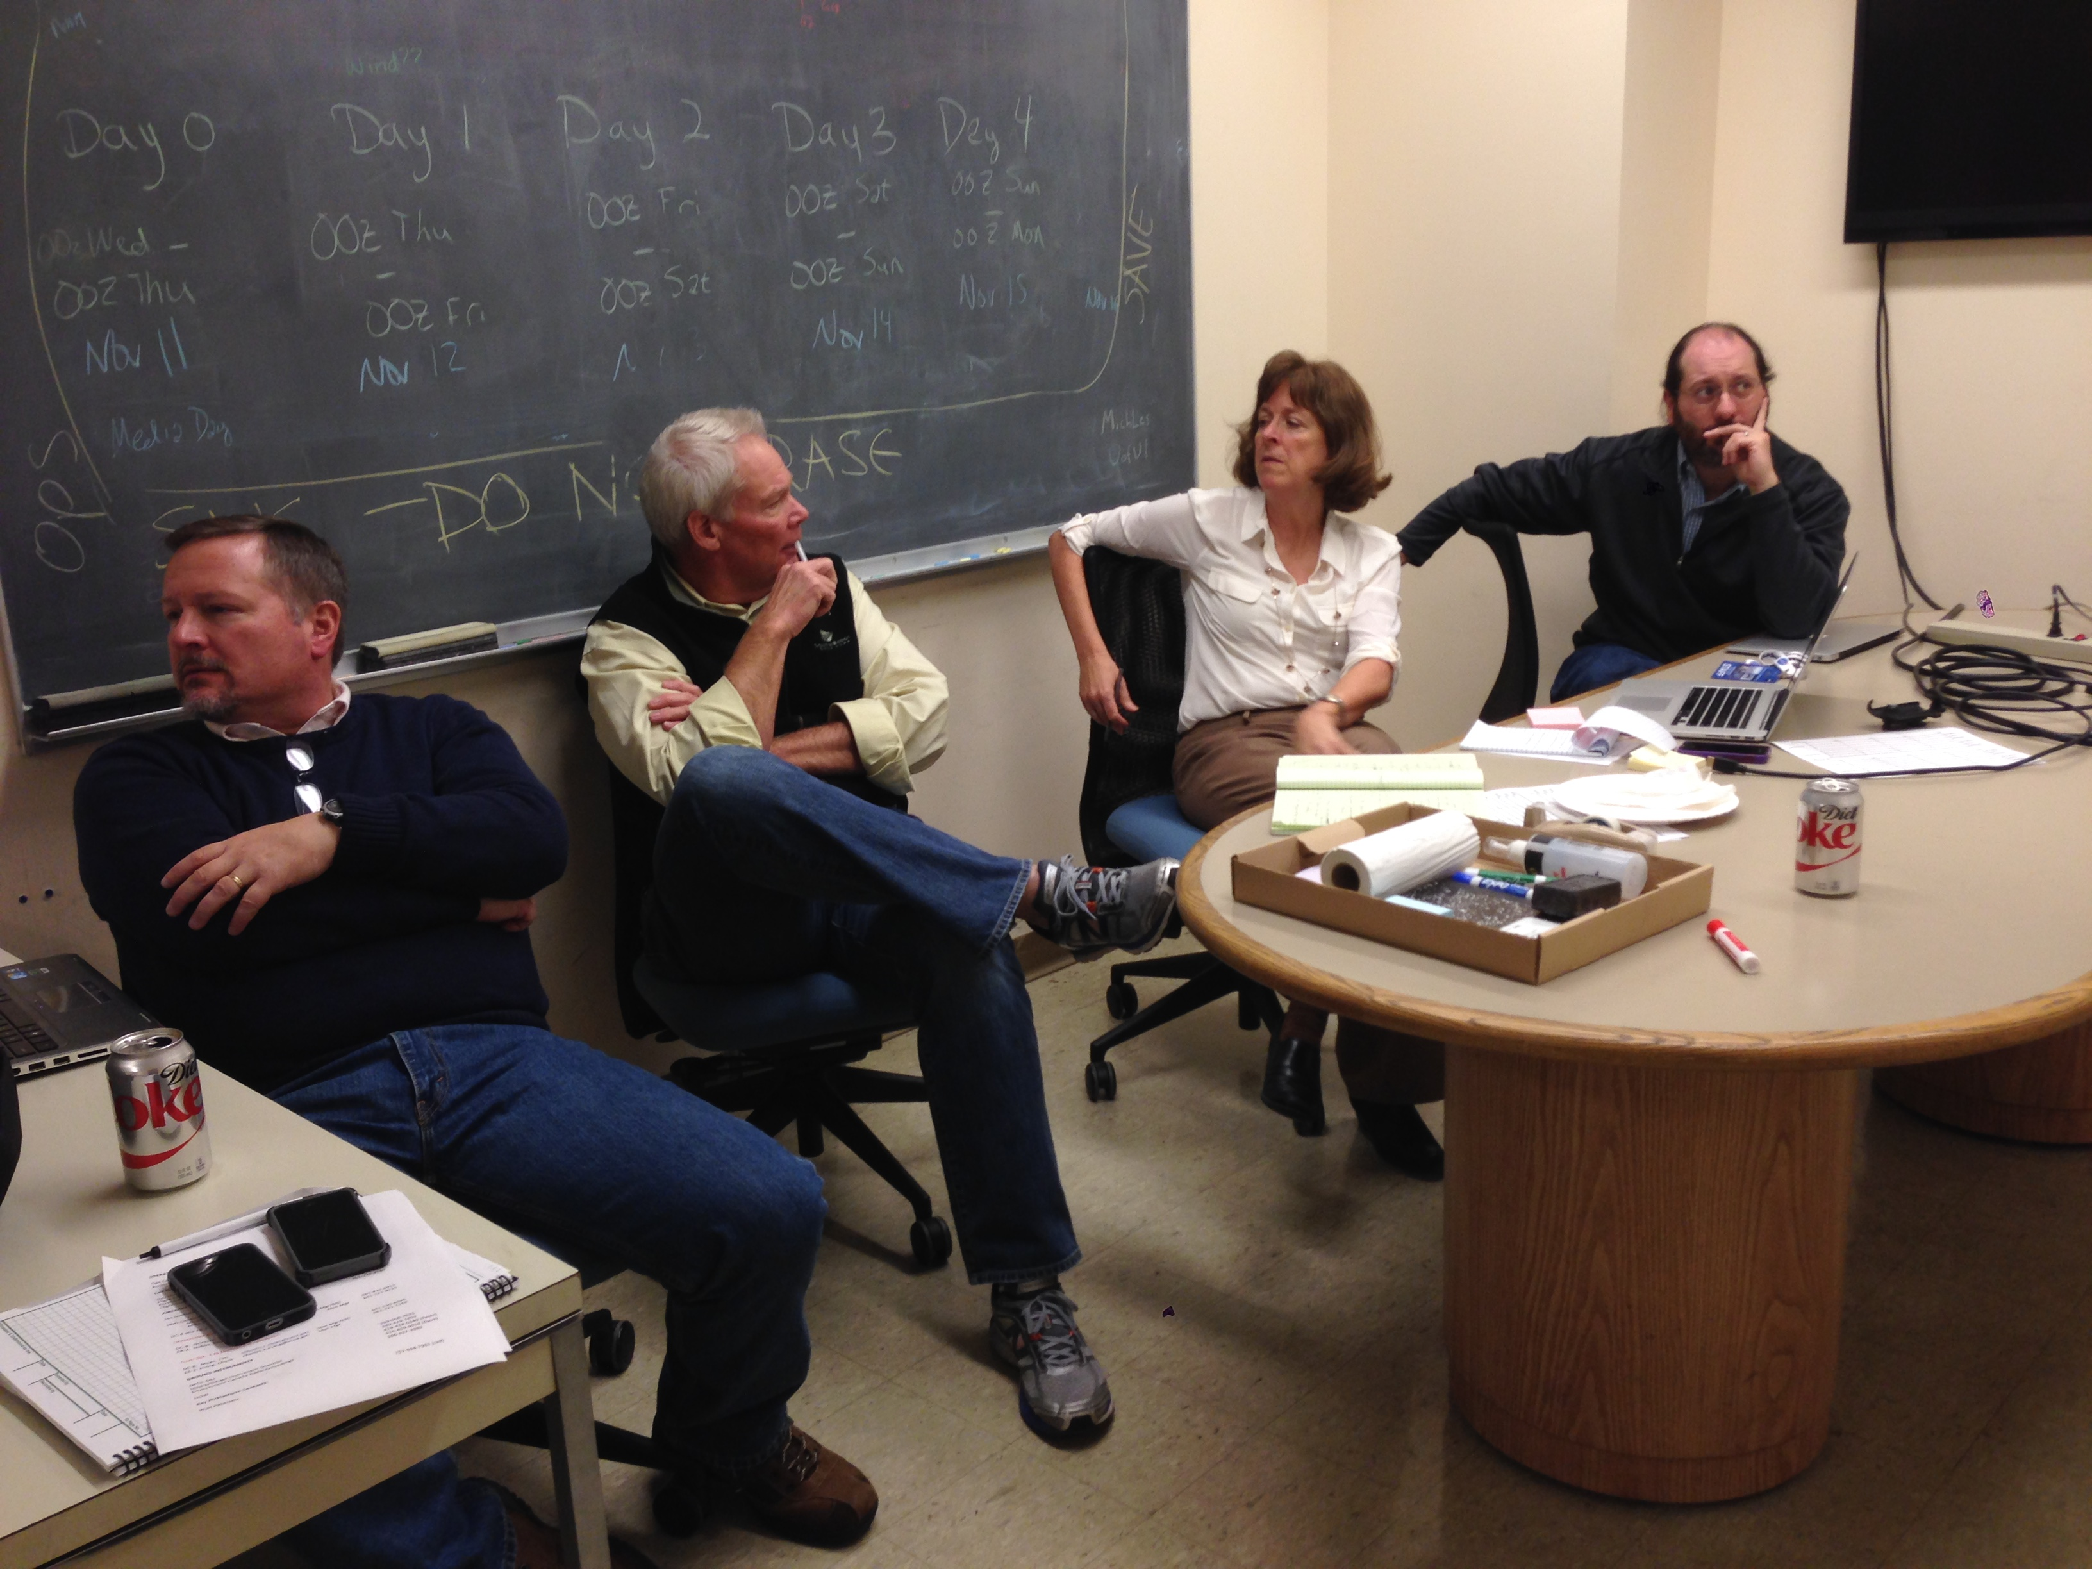
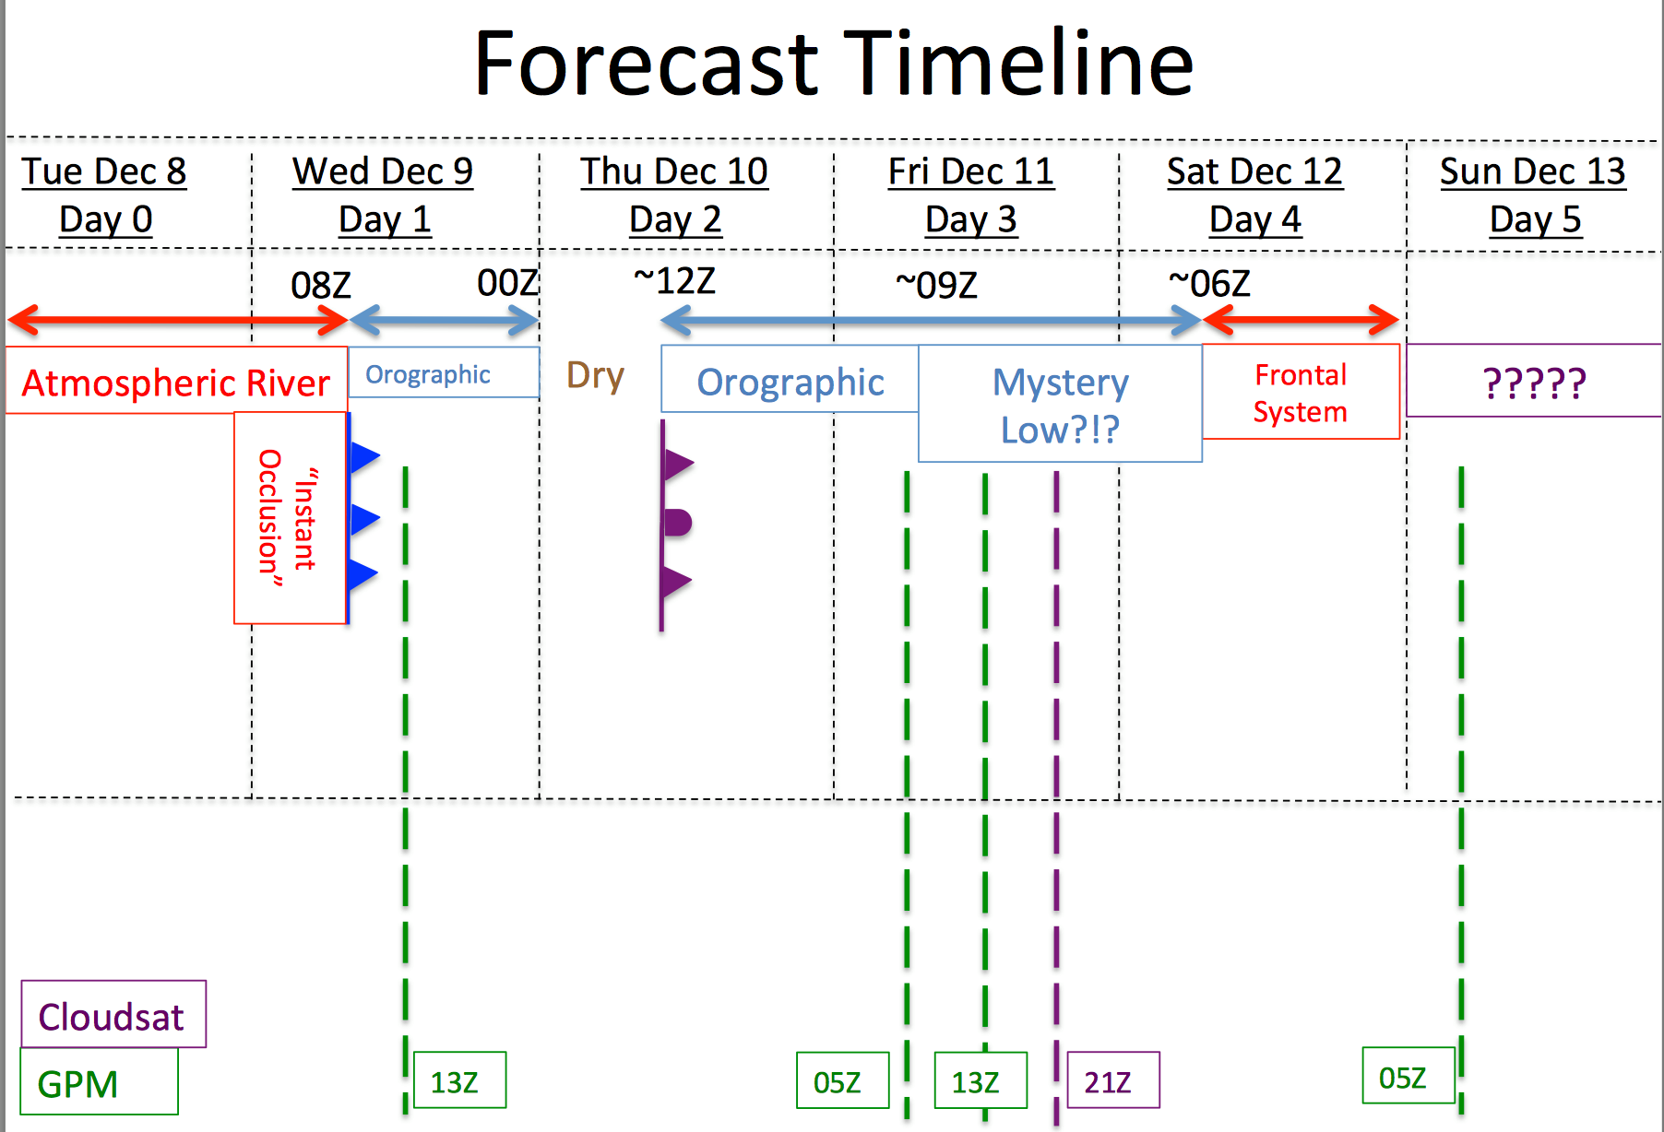
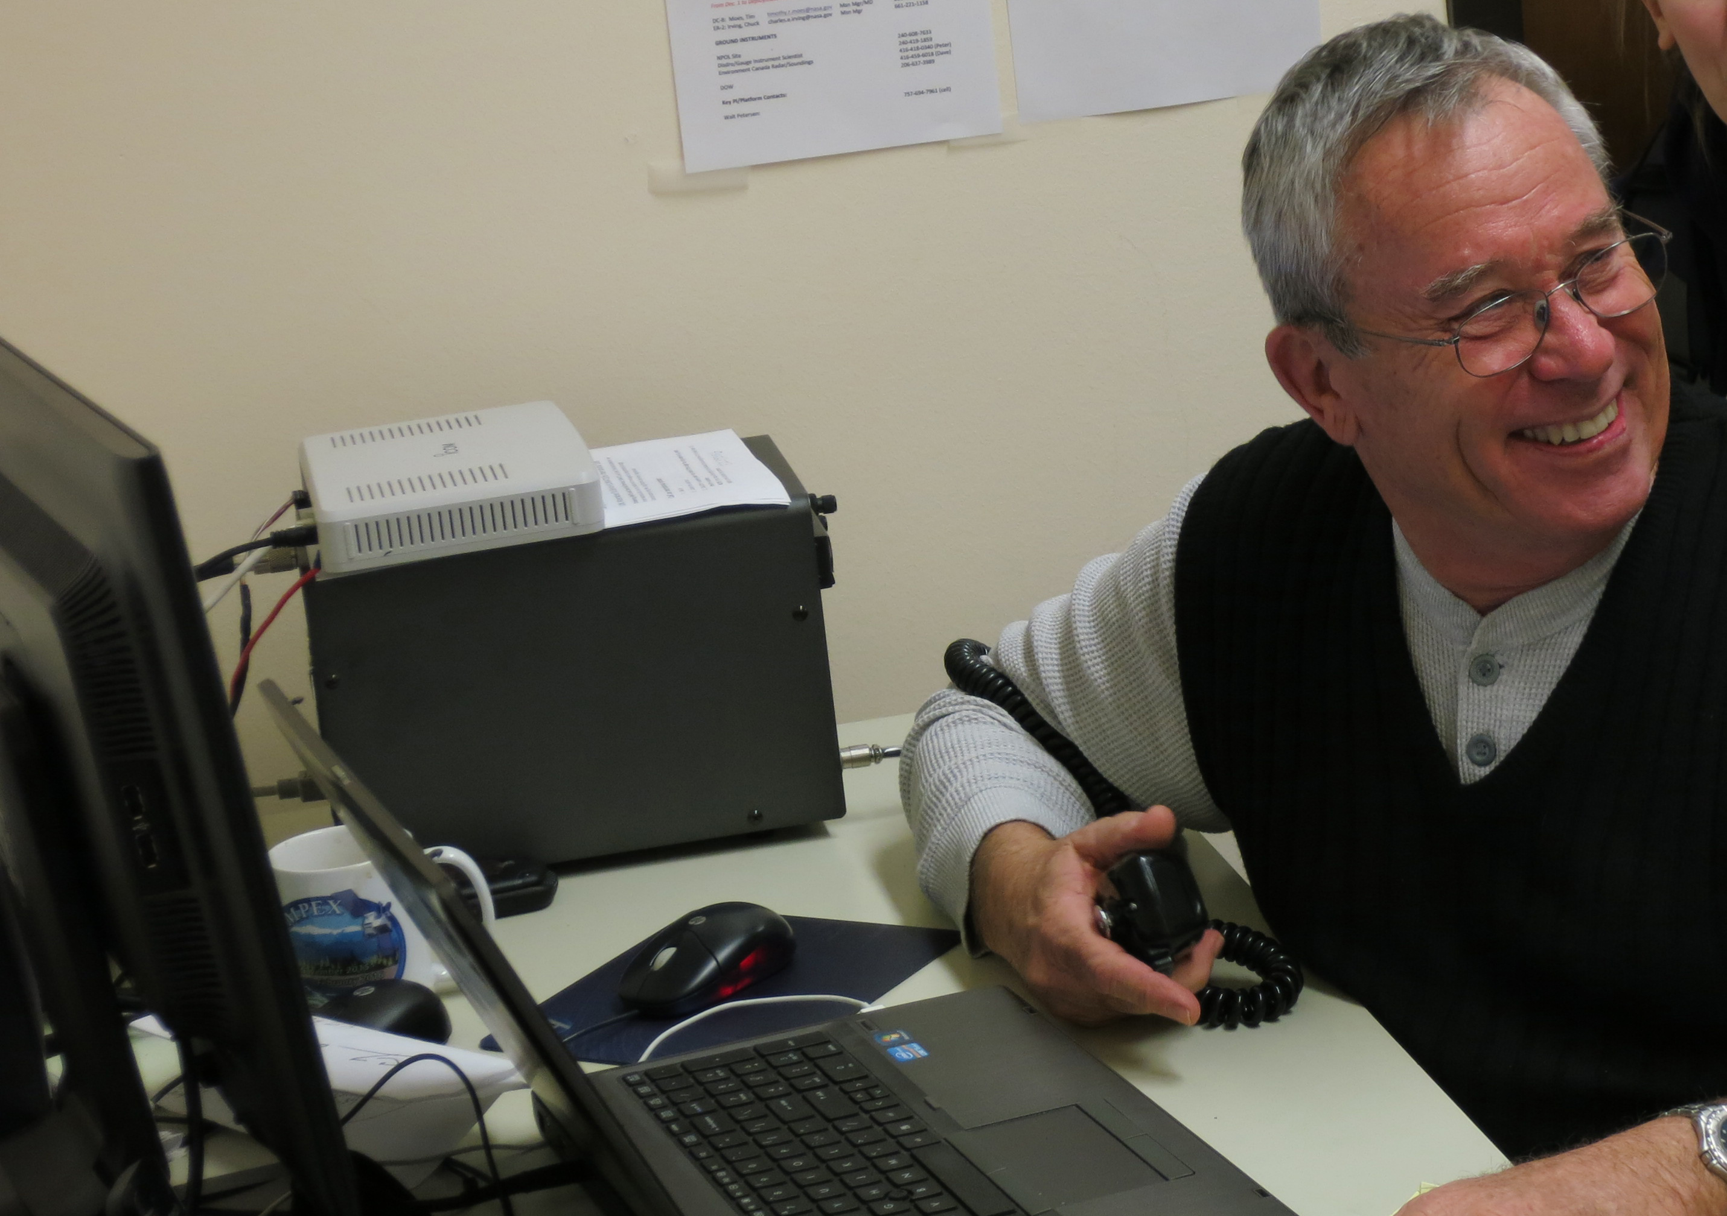
Operations Center at the UW

Slide 26
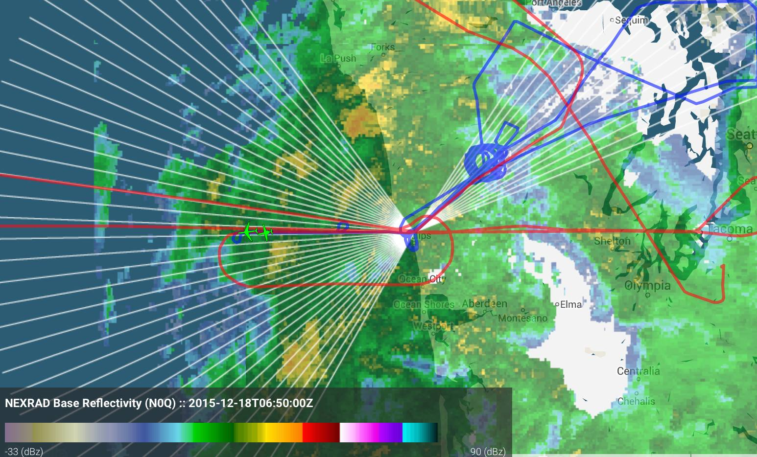
An Example of Coordination
NPOL RHIs
CITATION
DC8

Slide 27
Now for some preliminary results…

Slide 28
Acknowledgements:
This research is supported by NASA grants NNX13AG71G, NNX15AL38G, and NNX16AD75G
and NSF grant AGS-1503155

