Slide 1
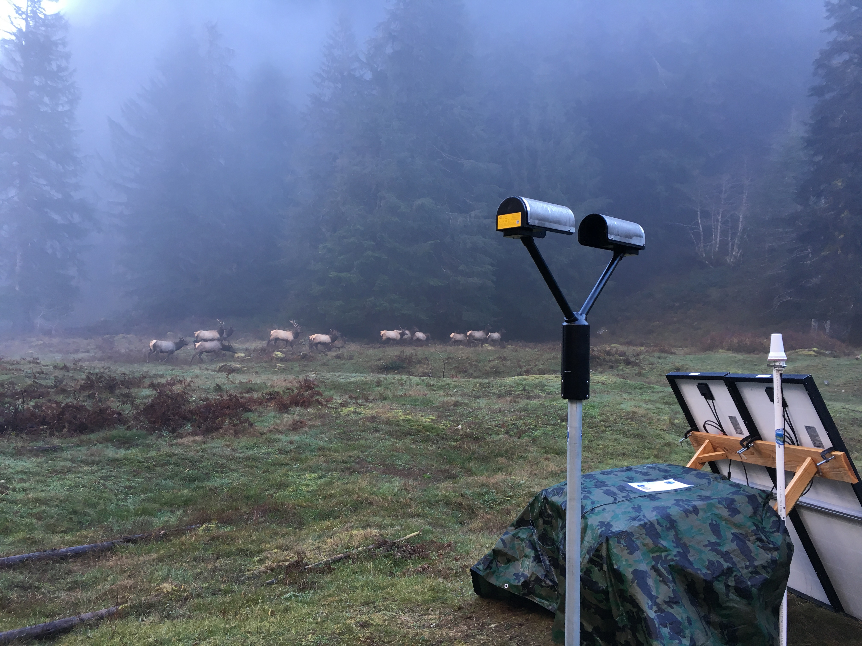




Variations in Raindrop Concentration and Size Distribution on the Olympic Peninsula during the Nov 12-13 Heavy Rain Event
Parsivel-2 Disdrometer at the Upper Quinault site in Olympic National Park
Joe Zagrodnik
Robert A. Houze, Lynn McMurdie
Pacific Northwest Weather Workshop 4 March 2016
NASA grants: NNX13AG71G, NNX15AL38G, and NNX16AD75G
NSF grants: AGS-1503155

Slide 2
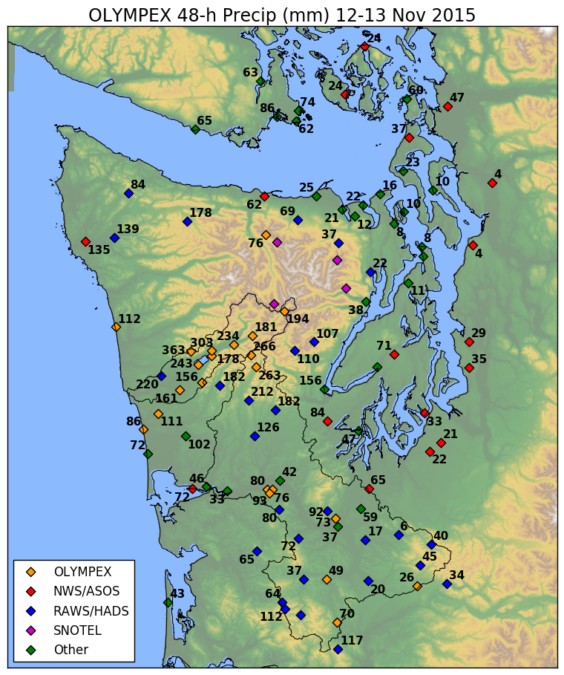
Nov 12-13: Widespread extreme rainfall totals
303 mm at CRN site just north of Lake Quinault
363 mm at 1,700 ft on ridge NW of lake
The famous rain shadow!
175-275 mm farther up Quinault Valley and in Wynoochee area
Gradient of increasing rainfall totals moving inland

Slide 3
Goal of this presentation
Explain the differences in rainfall distribution using the various measurements from OLYMPEX

Slide 4
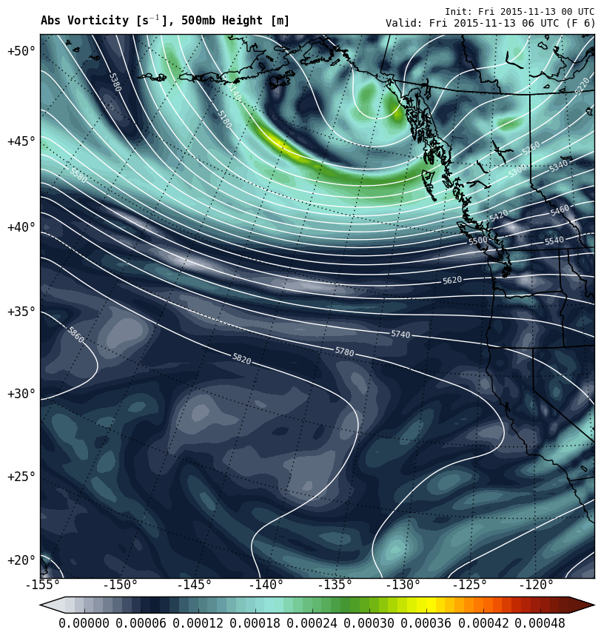
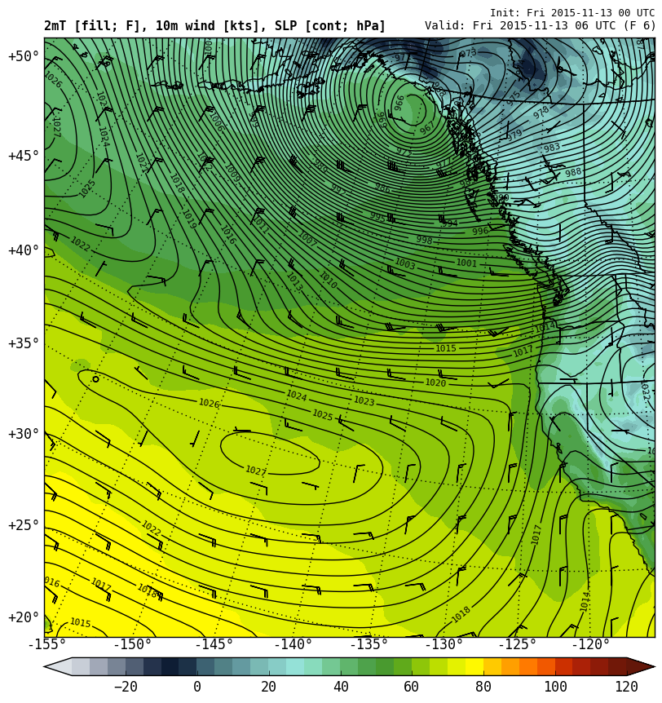
Nov 12-13 0600 UTC
500 hPa Height (lines), Vorticity (contours)
Surface Pressure (contours), Temp (colors)
L
H
“Westerly Atmospheric River”

Slide 5
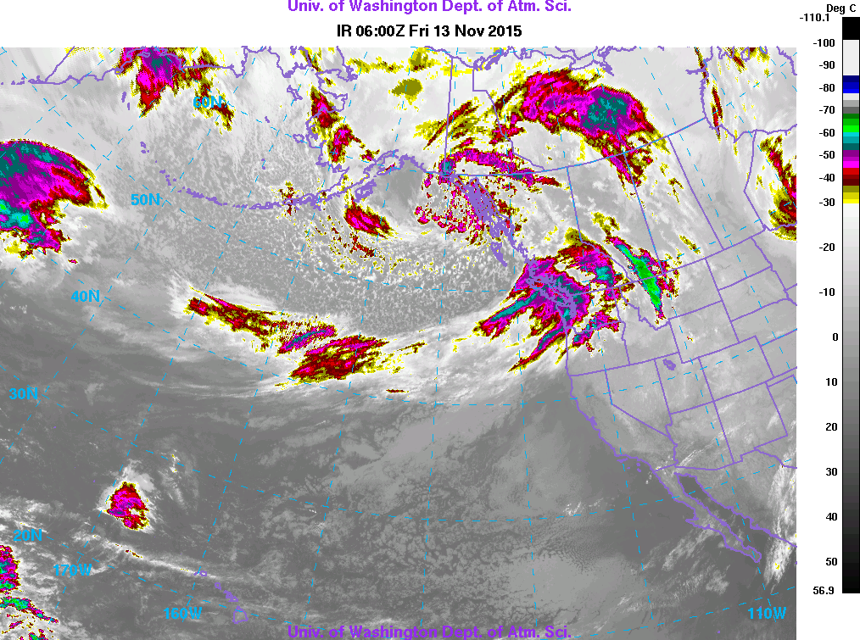
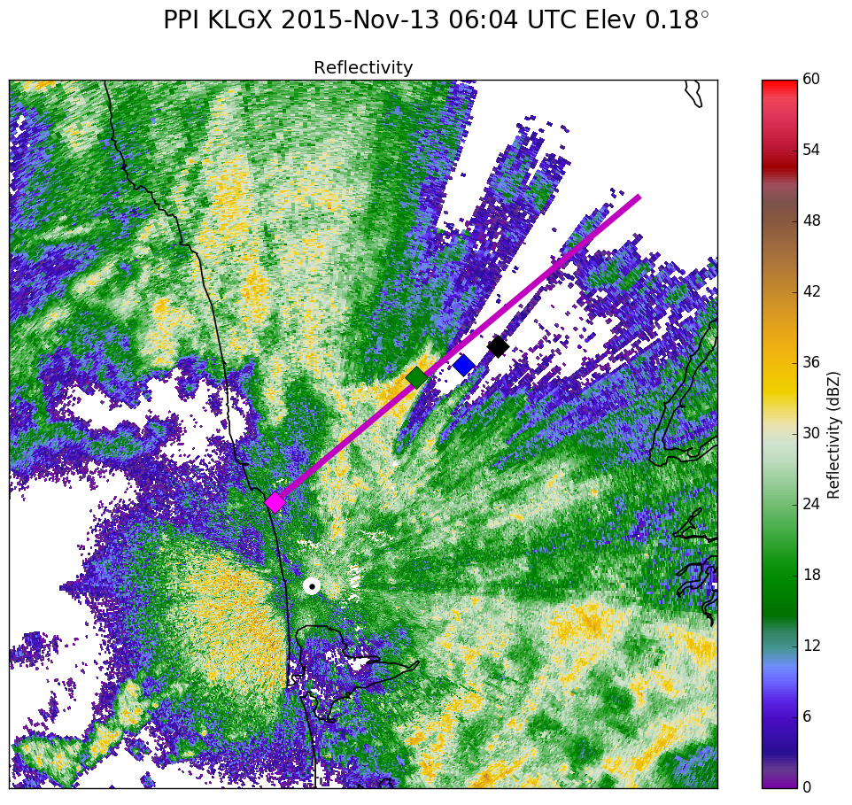

Slide 6
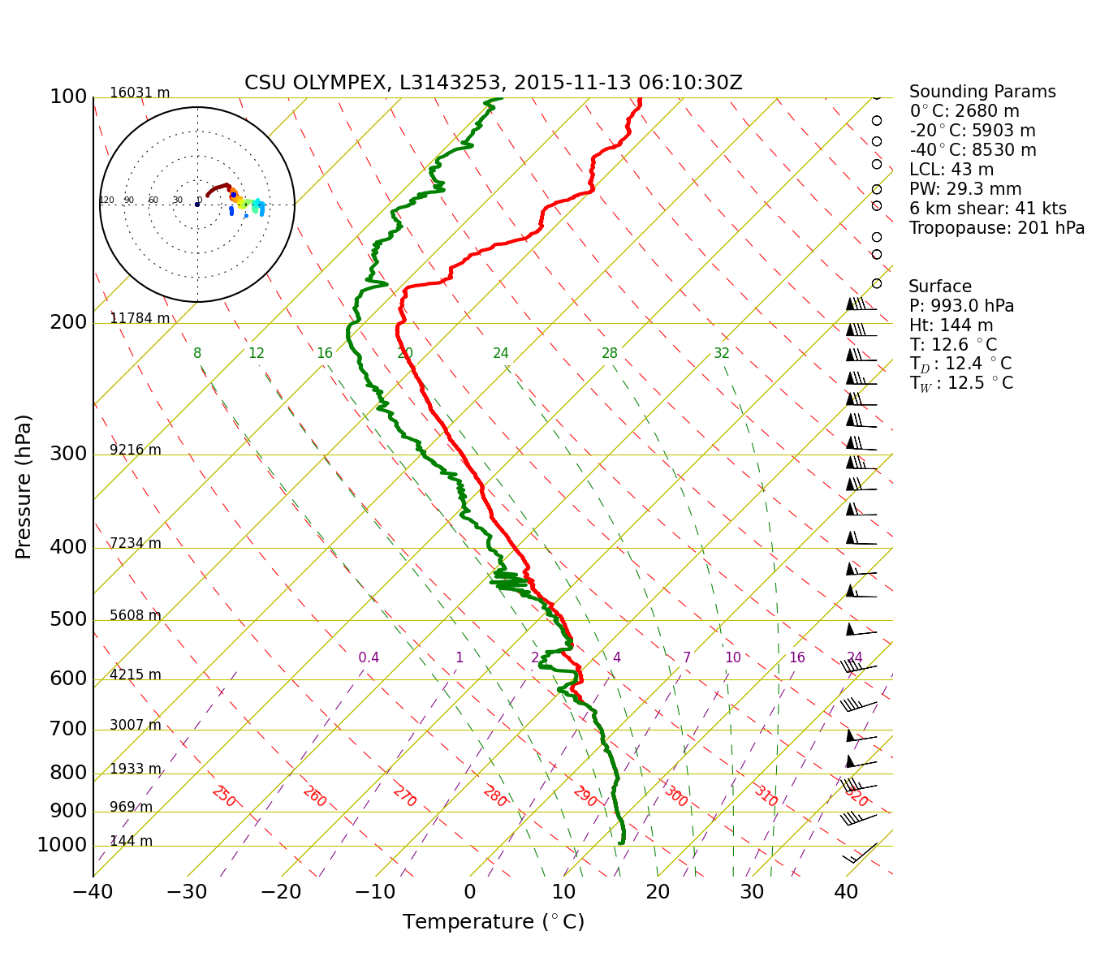
NPOL Sounding 0600 UTC 13-Nov
45 kt wind at 925 hPa

Slide 7
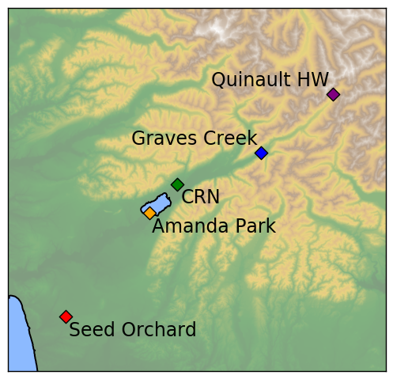
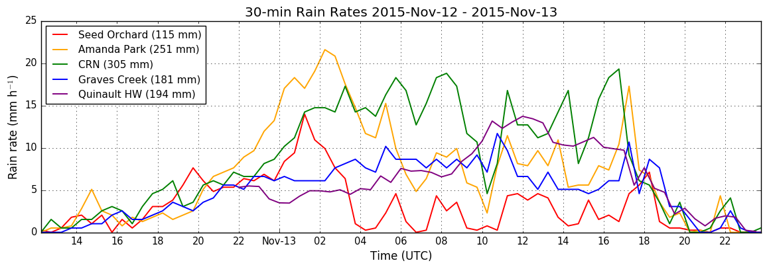
Nov 12-13
Rain rates
18 hour period of orographic enhancement
starting around 00 UTC 13-Nov
More rain at low-elevation CRN site compared with interior sites (Graves Creek, Quinault HW)

Slide 8
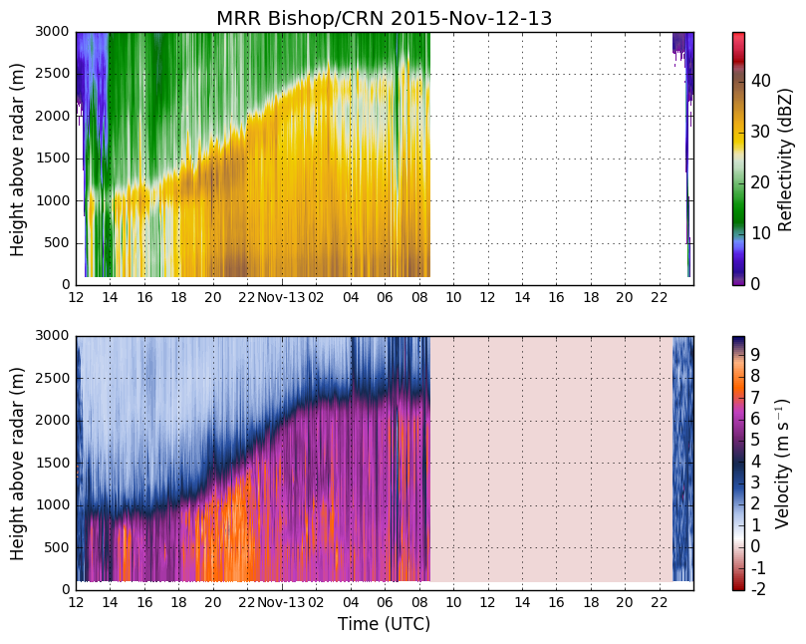
“Prefrontal”
“Warm Sector”
Weaker bright band
Near-surface dBZ remains constant
No data (power outage)
Big drops falling fast

Slide 9
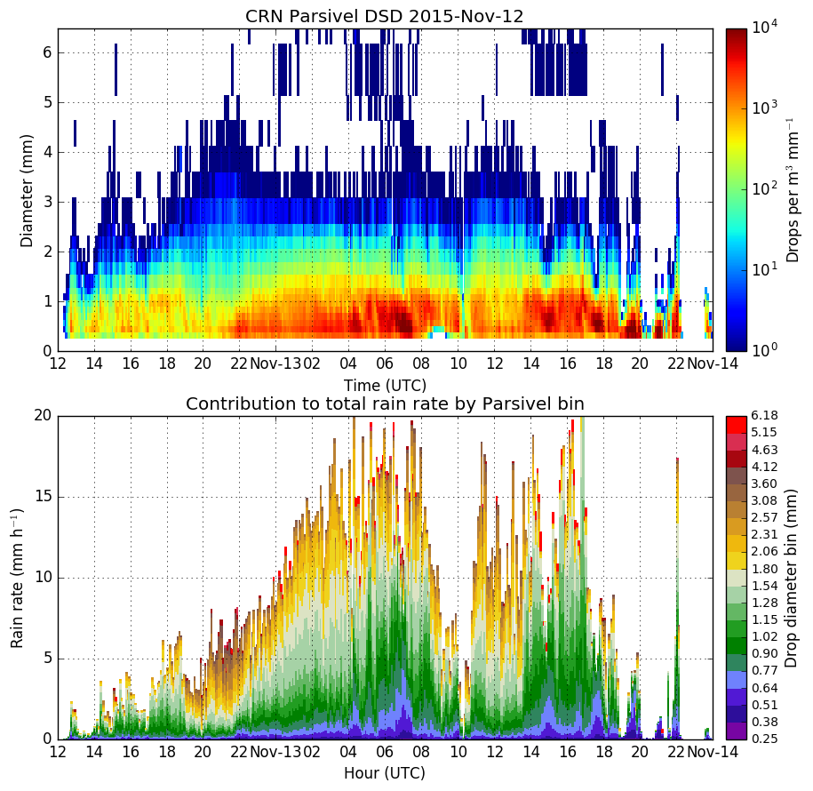
Max orographic enhancement
Orographic enhancement associated with large quantities of < 1.5 mm drops
These small-medium sized drops are responsible for the majority of the increase in rain rate
Notes:
Plotted on a log scale to emphasize contribution from larger drops

Slide 10
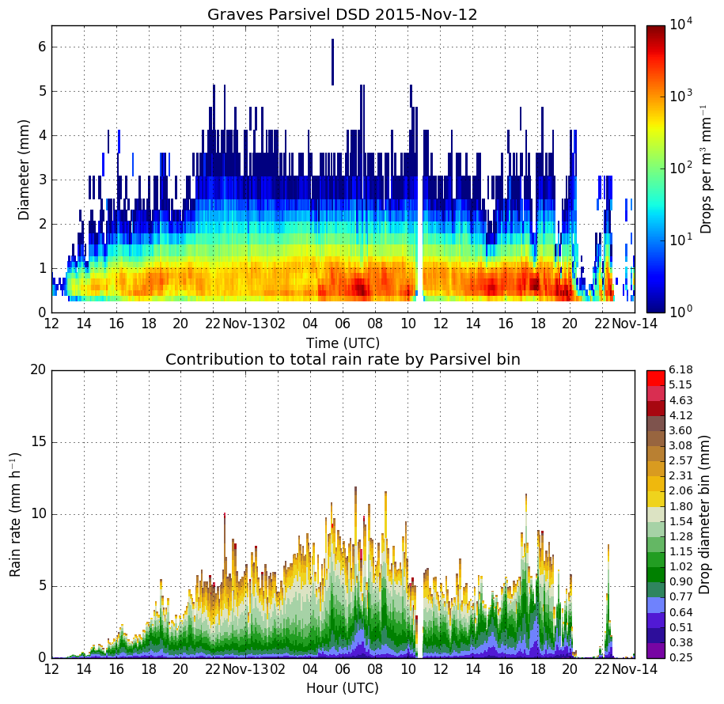
Max orographic enhancement
Looks similar, but considerably less drops in all size ranges
Increase in rain rate on 13-Nov is subdued
Notes:
Plotted on a log scale to emphasize contribution from larger drops

Slide 11
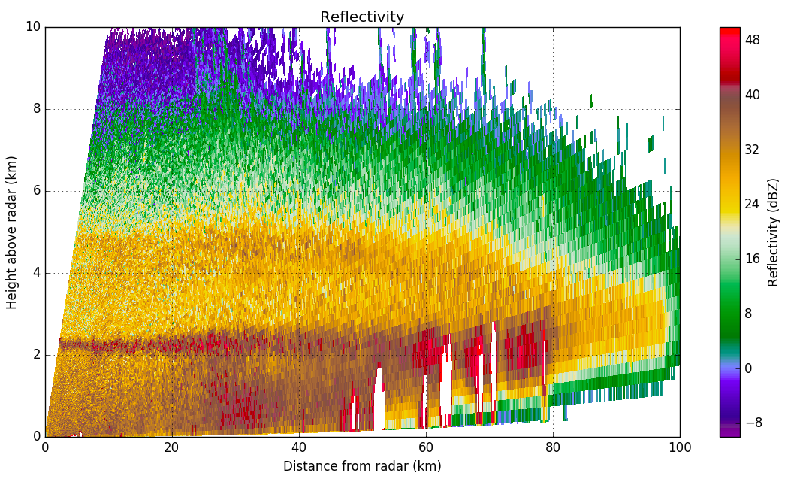
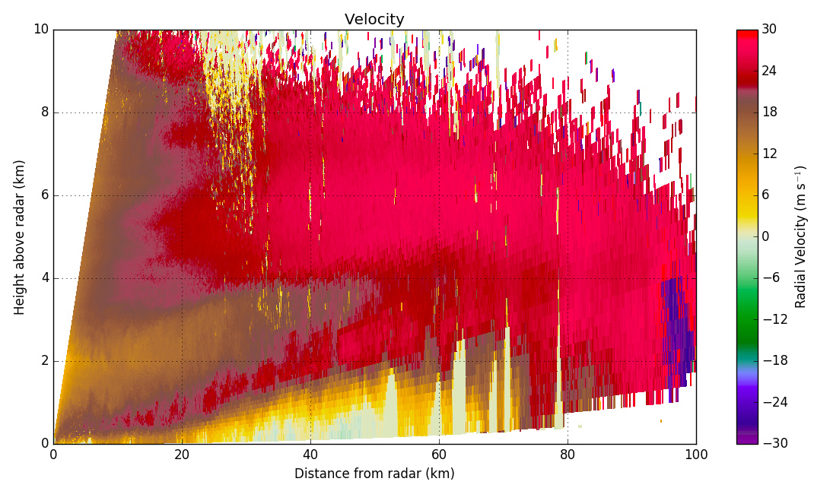
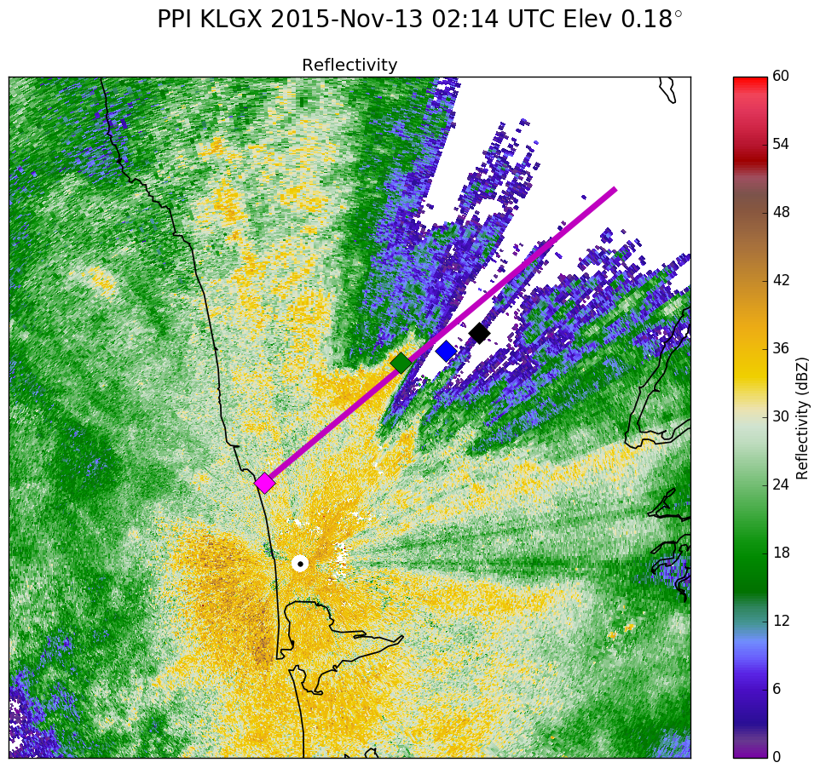
NPOL RHI 13-Nov 02:12 UTC
50° Azimuth
Reflectivity
Low-level jet is within 1 km of the surface near NPOL and starts lifting around 20 km from radar (white arrow)
Shear between lower and upper layer is likely enhancing collision/coalescence, allowing drops to grow quickly and fall out.
Jet lifting decreases 50-60 km from radar
NPOL
CRN
Graves
Quinault HW
Velocity
NPOL
Mountain

Slide 12
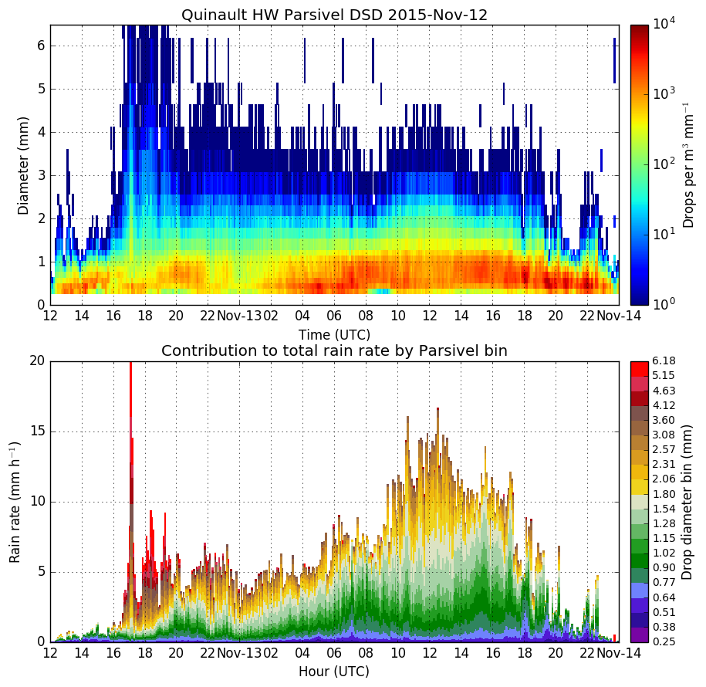
SNOW
Max orographic enhancement
DSD is nearly identical to Graves Creek prior to 09 UTC
After 09 UTC, medium-to-large sized drops account for the increase in rain rate!
SNOW
Notes:
Plotted on a log scale to emphasize contribution from larger drops

Slide 13
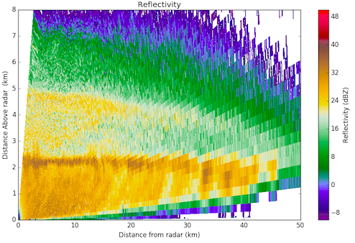
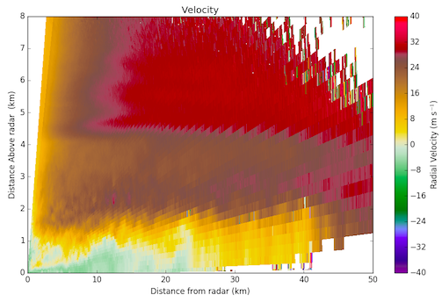
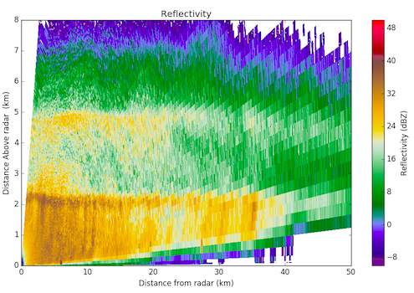
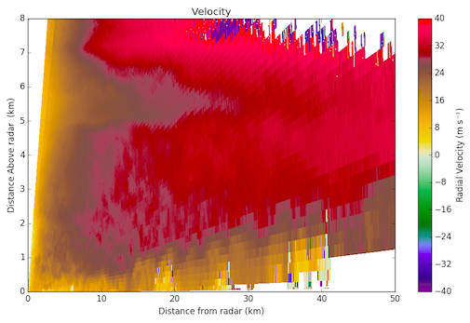
Mid-level jet
DOW RHI 13-Nov 02:04 UTC
65° Azimuth
Low-level jet
DOW
Graves
Quinault HW
DOW RHI 13-Nov 11:14 UTC
65° Azimuth
Deeper, stronger jet
Enhancement later in event at Quinault HW possibly related to evolution of low to mid level jet. Appreciable shear is observed between upper and lower layers.

Slide 14
Conclusions
Strong relationship between lifting of low-level jet and orographic enhancement.
Depth and extent of lower layer of easterly flow is important for determining location of lifting and max enhancement.
Jet lifting below bright band enhances drop formation/growth via warm processes. Drops form and fall out quickly in large numbers.
Role of shear-generated turbulence needs to be investigated further. May be enhancing particle growth both above and below the bright band.

