Slide 1
Microphysical processes during OLYMPEX: Insight from a research S-band polarimetric radar
Angela Rowe
University of Washington, Seattle, WA
Pacific Northwest Weather Workshop
Seattle, WA
4 March 2016

Slide 2
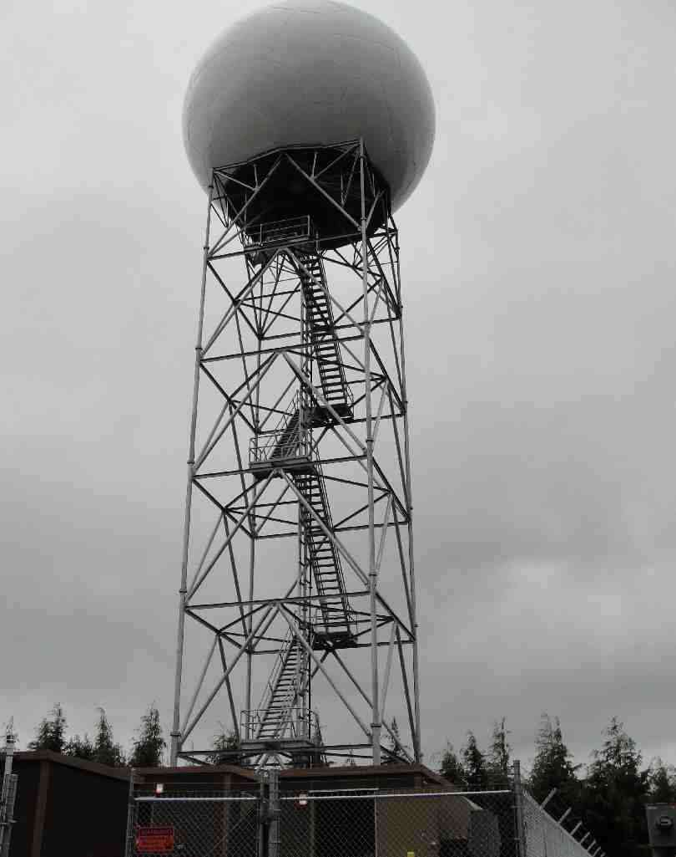
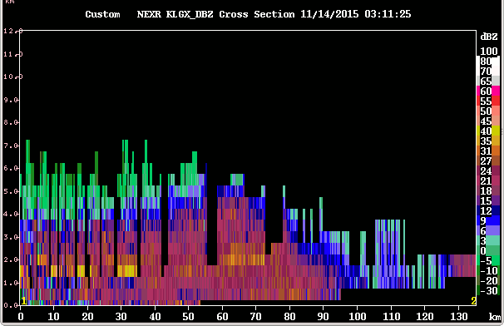
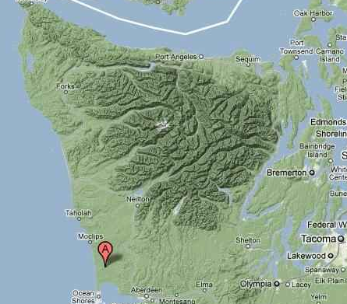
Full-volume scans every 5(?) minutes
Great for precipitation estimates
Not ideal for microphysical studies (high spatial resolution desired)
KLGX
Full-volume scans every 5 minutes
Great for precipitation estimates
Not ideal for microphysical studies (high vertical resolution)
Langley Hill
Notes:
-The radar is located on Langley Hill at an elevation of approximately 250 ft, roughly 3 miles east of the coastal town of Copalis Beach
- Info/photos from http://www.atmos.washington.edu/%7Ecliff/Langleyradar.html

Slide 3
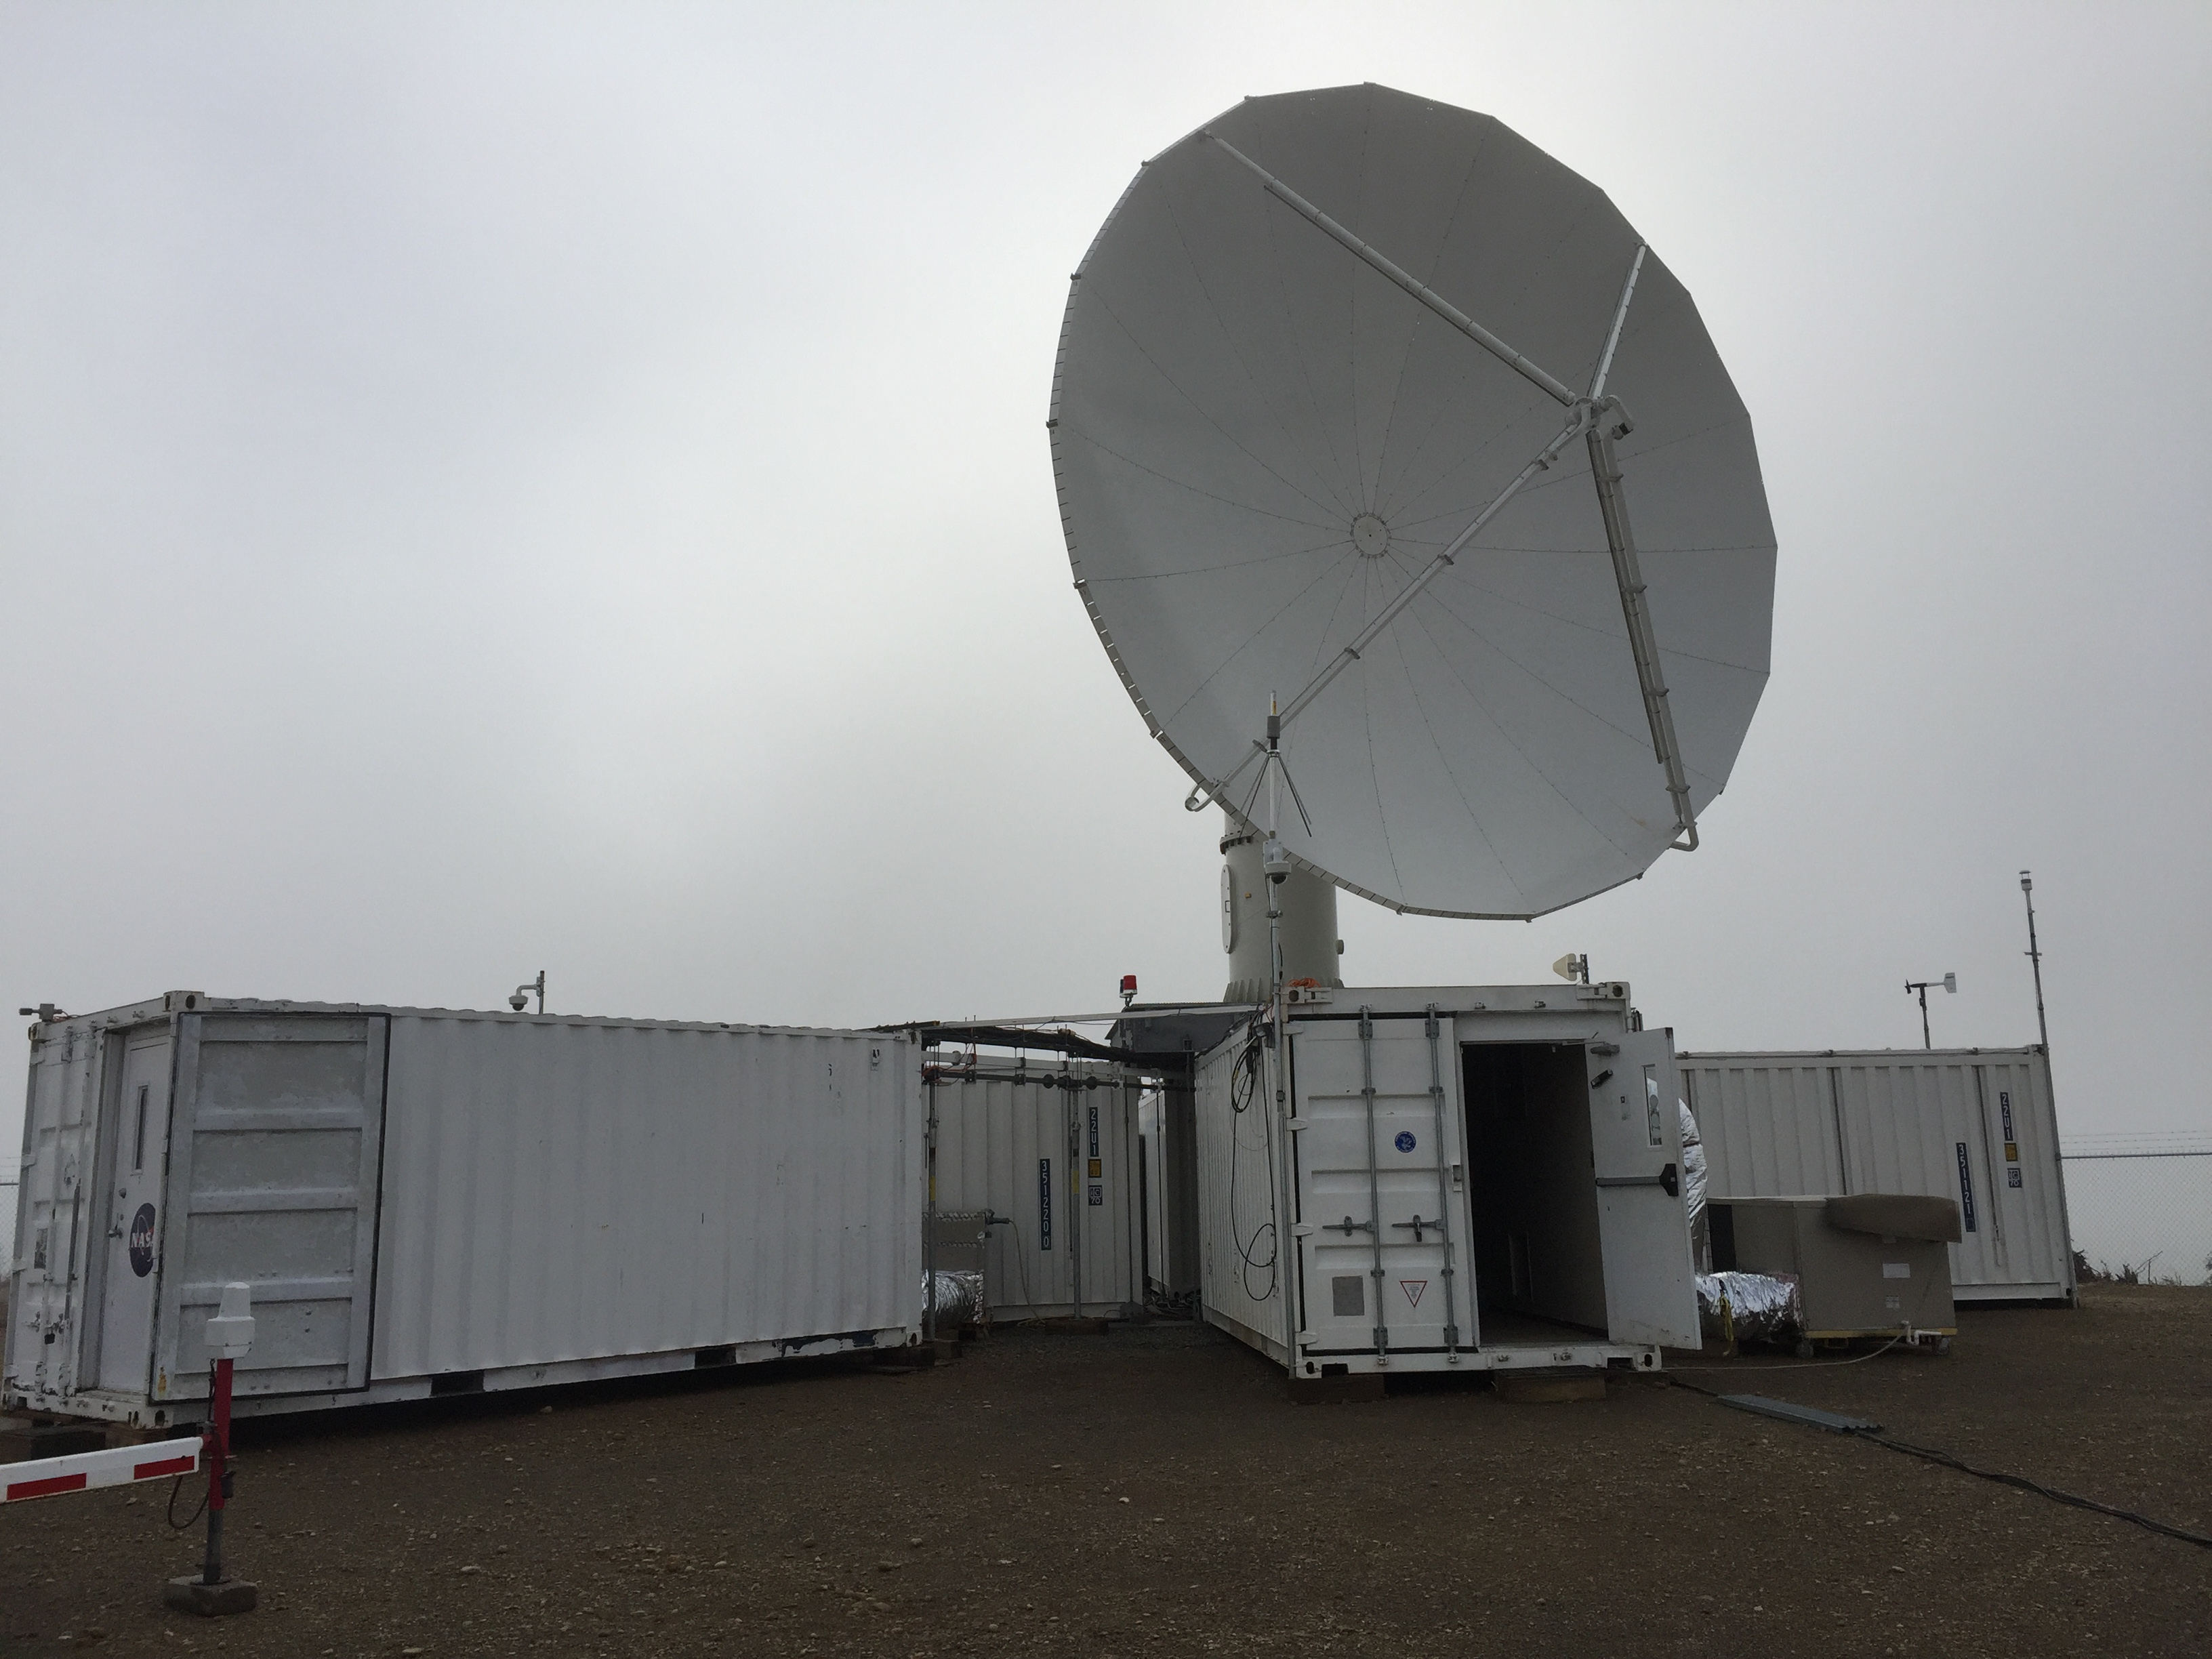
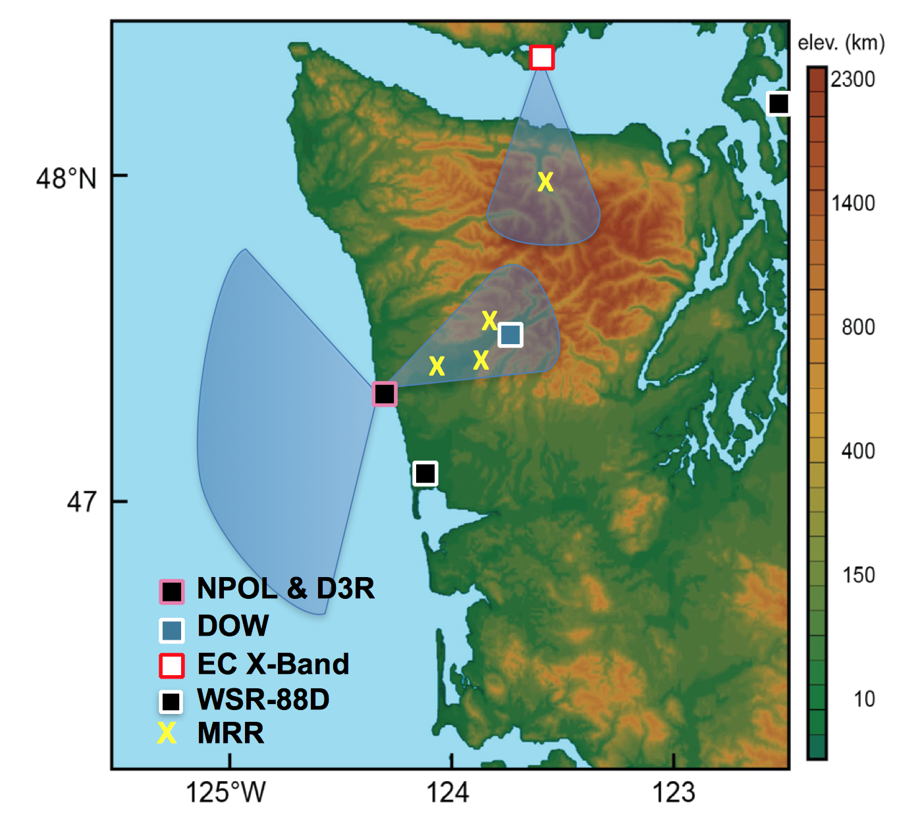
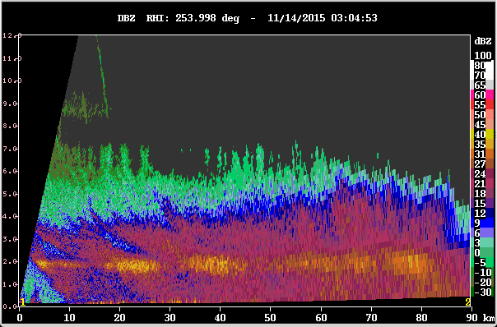
NPOL
40 RHIs, 3° spacing (12 min)
16 RHIs, 2° spacing (4 min)
Notes:
RHIs (0-45 deg elevation, 135 km range, 125 m beam spacing)
– Ocean: 40 azimuths, 3-degree spacing, ~12 min
- Valley: 16 azimuths, 2-degree spacing, ~ 4 min
Followed by 3 low-level PPIs then a birdbath once an hour
Total: ~19 min cycle

Slide 4
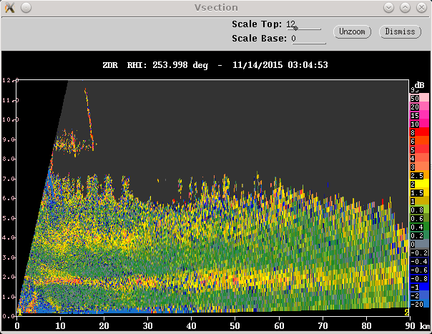
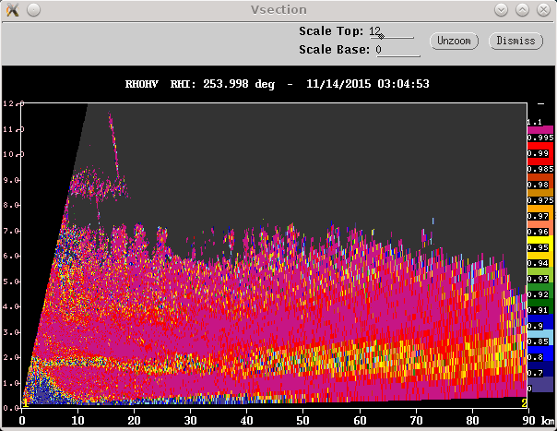
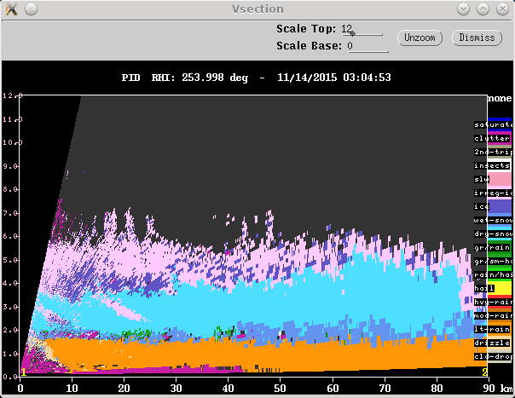
Brightband
14 Nov 2015
Reflectivity (Z): Intensity
Differential Reflectivity (Z_{DR}): Size/shape
Correlation Coefficient (ρ_{HV}): Similarity
Particle Identification (PID): T+variables

Slide 5
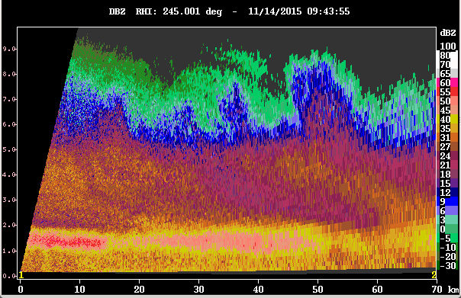
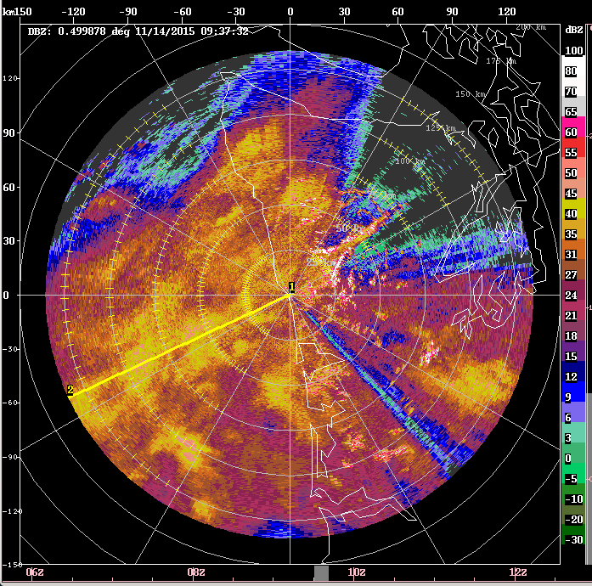
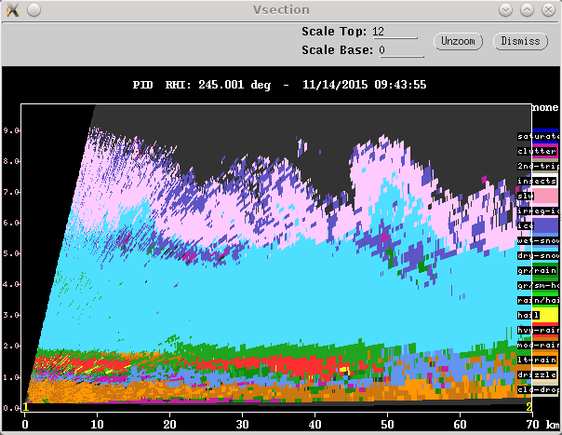
Brightband
14 Nov 2015
Z
60 dBZ!
PID

Slide 6
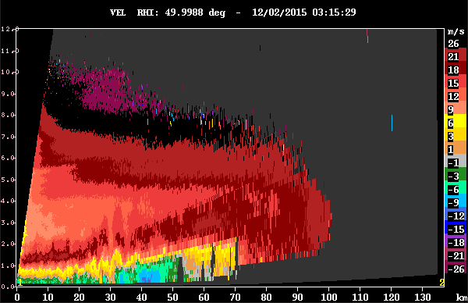
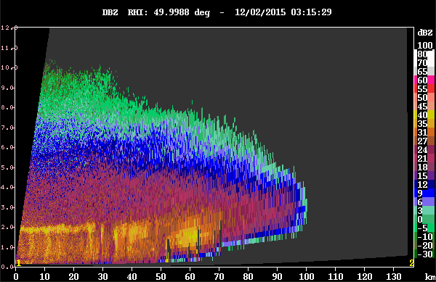
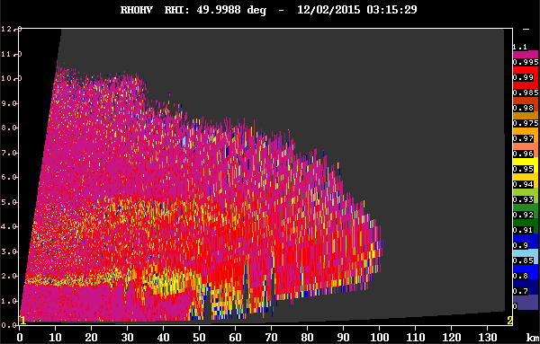
Role of terrain
2 Dec 2015
Radial velocity (V): Red – away, blue - toward
Z
Lifting air (upstream of mountains)
Precipitation enhancement
Dipping of brightband
- Latent cooling (melting)
- Melting distance
- Adiabatic cooling (forced ascent)
- Preexisting cold air
ρ_{HV}

Slide 7
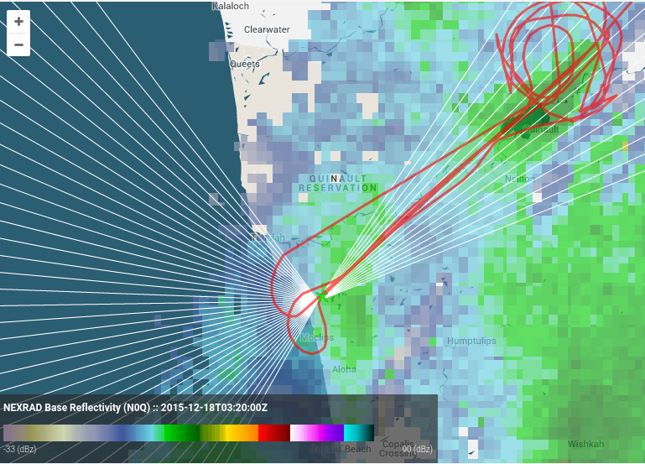
In-situ Aircraft Data

Slide 8
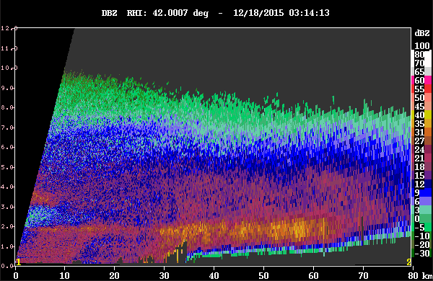
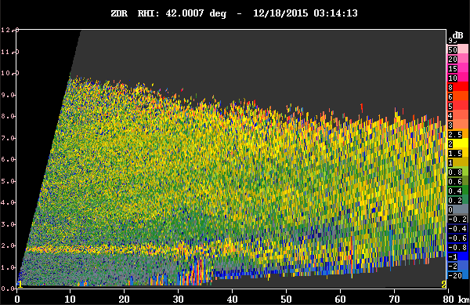
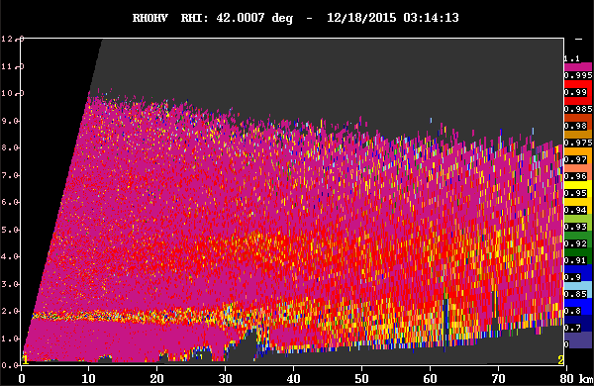
Microphysical processes
18 Dec 2015
Z
Z_{DR}
Citation: Flying at 14,000 FT (~ 4 km), noted plates, capped columns, and plate aggregates
→Dendritic growth zone, aggregation
ρ_{HV}
Notes:
This setup of widespread stratiform precipitation toward and over the mountains persisted throughout the 3-h duration of the Citation’s flight. Around 0315-0320 UTC, the Citation was flying along NPOL/DOW radials over the Quinault Valley and toward the radar. Flying at 14,000 ft (just over 4 km), the crew noted plates, capped columns, and plate aggregates, probably corresponding to the continued slight enhancement in ZDR/reduction in RHOHV at that level (~4 km) seen in Quinault RHIs around this time (Figure 2).

Slide 9
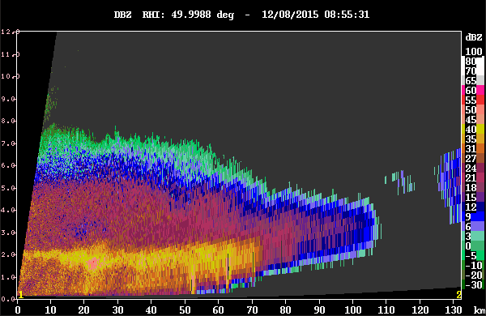
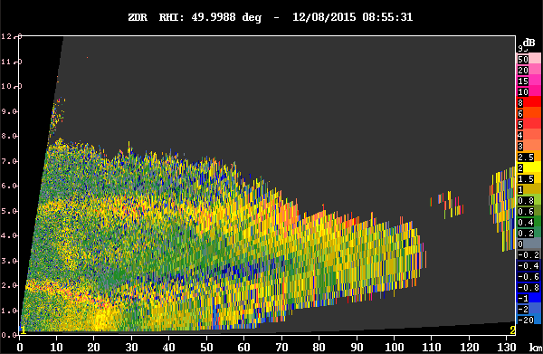
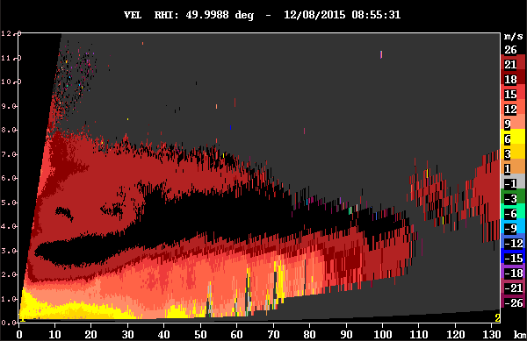
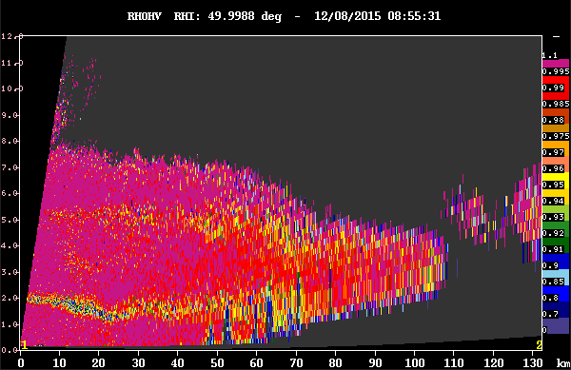
Dendritic growth zone
8 Dec 2015
Z
Z_{DR}
V
ρ_{HV}

Slide 10
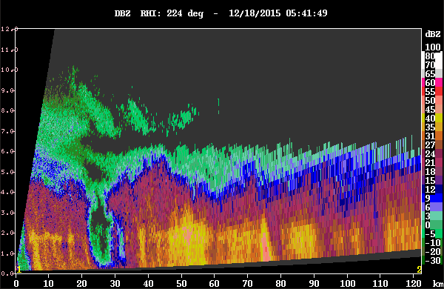
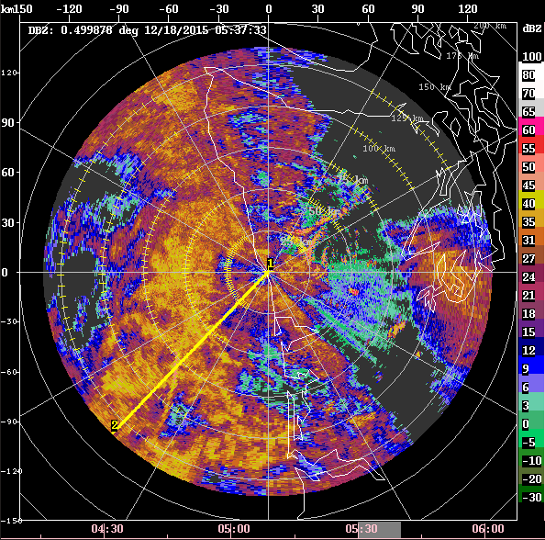
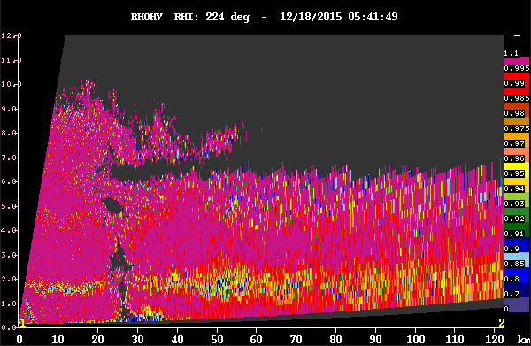
Frontal passage
18 Dec 2015
Z
ρ_{HV}

Slide 11
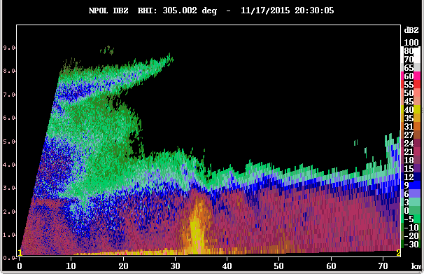
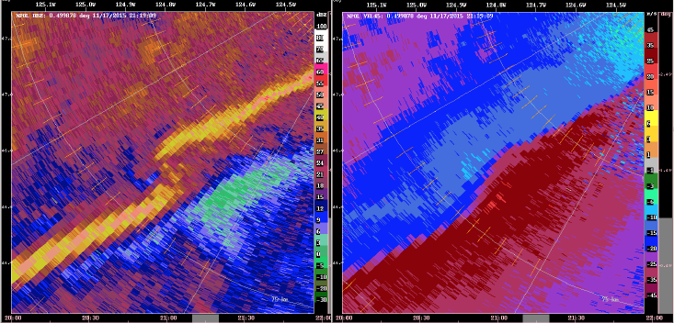
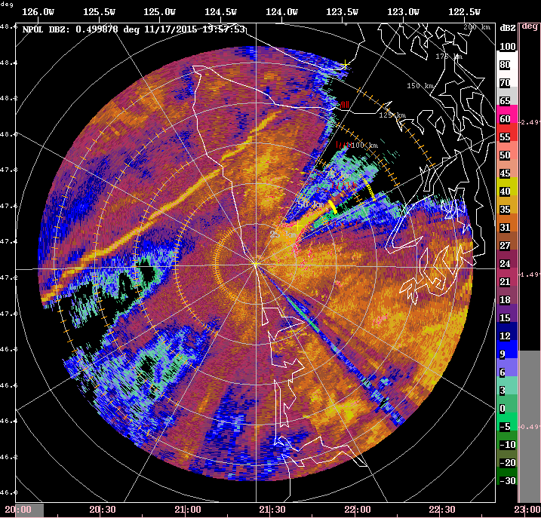
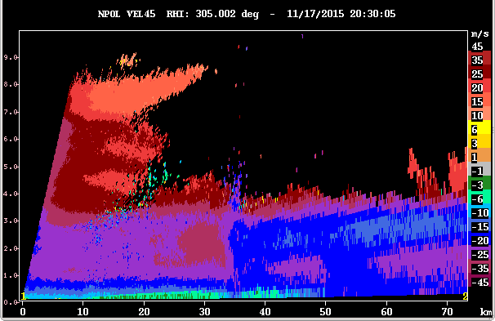
Narrow Cold Frontal Rainband
17 Nov 2015
Z
V
2000-2300 UTC

Slide 12
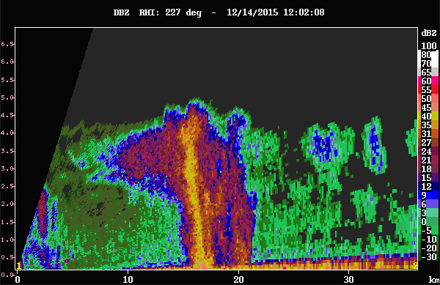
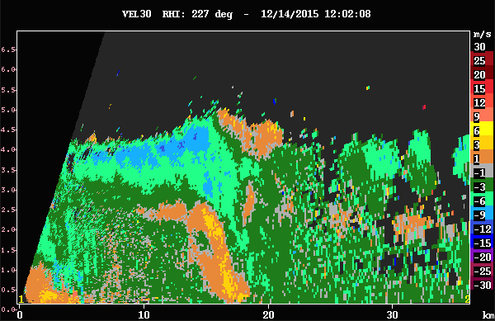
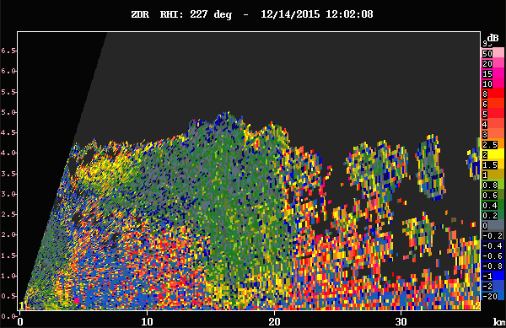
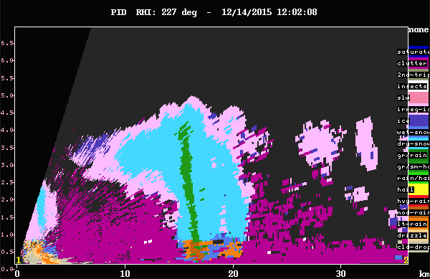
Post-frontal convection
14 Dec 2015
Z
V
Z_{DR}
Graupel!
PID
Notes:
In post-frontal regimes, aircraft and ground-based radar noted intense convective cells
Significant ice scattering and lightning
Graupel observed at NPOL

Slide 13
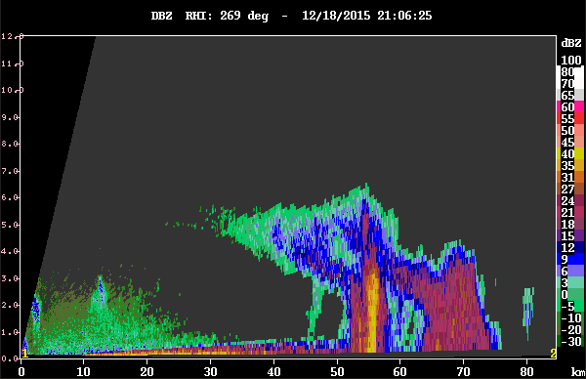
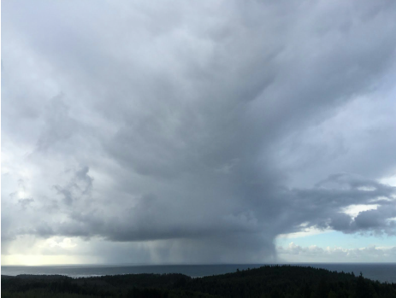
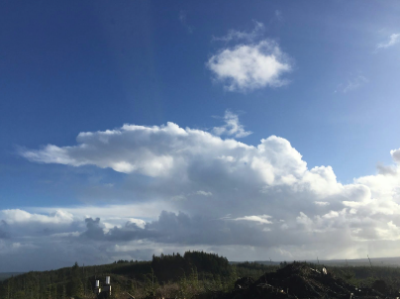
Post-frontal convection
18 Dec 2015

Slide 14
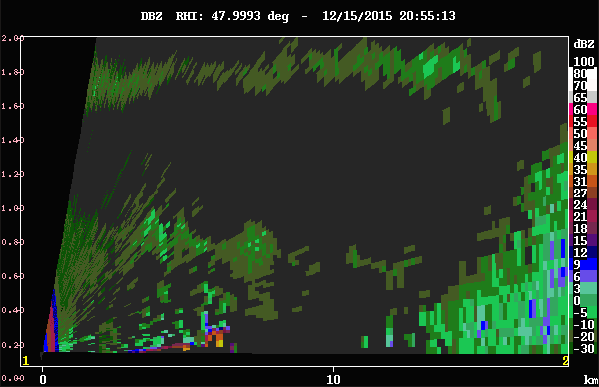
Mantle echoes
15 Dec 2015
2 km
Z
1 km
Notes:
In addition to the shallow precipitating cells observed primarily over the ocean, several Bragg/cloud layers were observed : below 1 km, at 2 km, just above 3 km, and at 5 km height (Figure 5). The shallow layer of easterly winds near the surface persisted. With time, mantle echoes and eventually shallow nonprecipitating clouds were observed forming on the lowest Bragg layer near 1 km height (Figure 6). At 2055 UTC, see mantle echoes then more pronounced cloud signature at 2115 UTC, with cloud droplets below ~1.2 km (melting level) and small ice crystals above. Near-zero ZDR, RHOHV near 1, enhanced reflectivity at cloud top, reaching 05 dBZ.

Slide 15
NPOL Summary
High vertical resolution for studying microphysical processes
Brightband
Dendritic growth/aggregation
Role of topography
Ocean vs. valley
Lifting air
Precipitation enhancement (K-H waves)
Warm-sector stratiform to post-frontal convection
Sensitivity for studying full cloud lifecycle

Slide 16
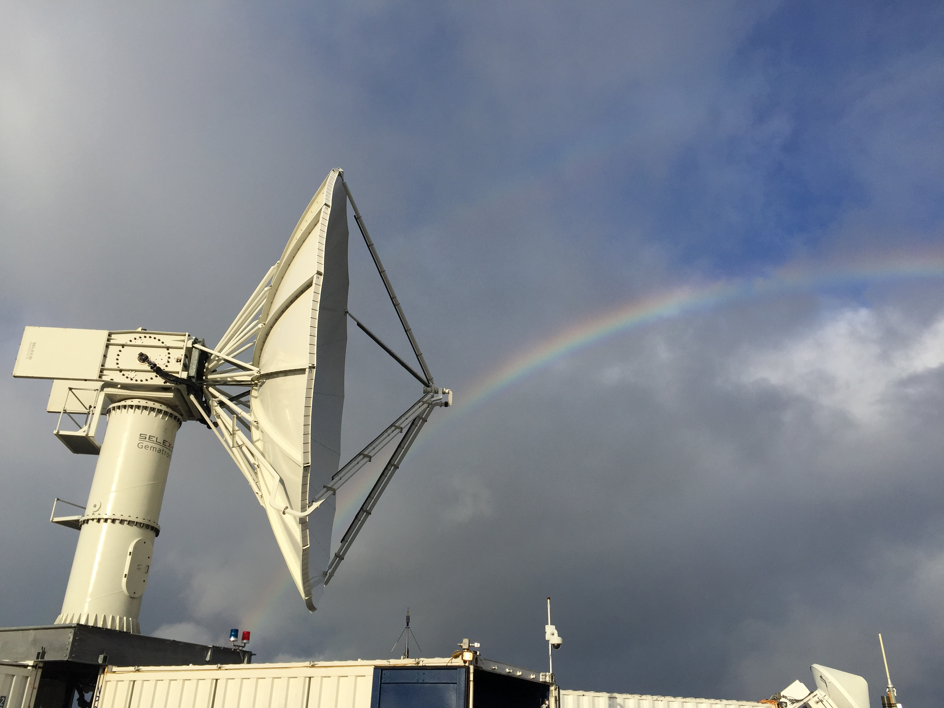
Thank you!
This work is supported by NASA Grants #NNX13AG71G, #NNX15AL38G, #NNX16AD75G, and NSF Grant #AGS-1503155

