Slide 1
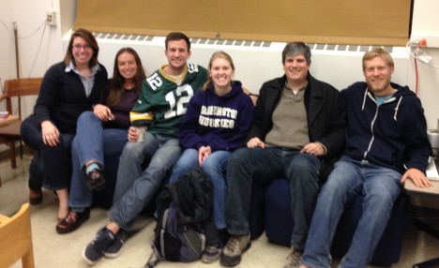
A Day in the Life of an OLYMPEX forecaster
Jennifer DeHart Luke Madaus
Nick Weber
3.4.16
NASA grants NNX13AG71G, NNX15AL38G, and NNX16AD75 and NSF grant AGS-1503155.

Slide 2
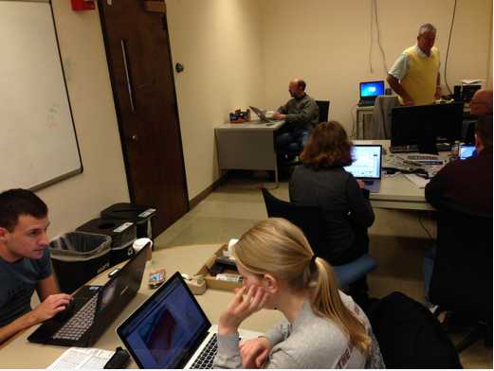
Responsibilities
Provide daily weather updates
Flight support
Ground maintenance
DOW
Documentation

Slide 3
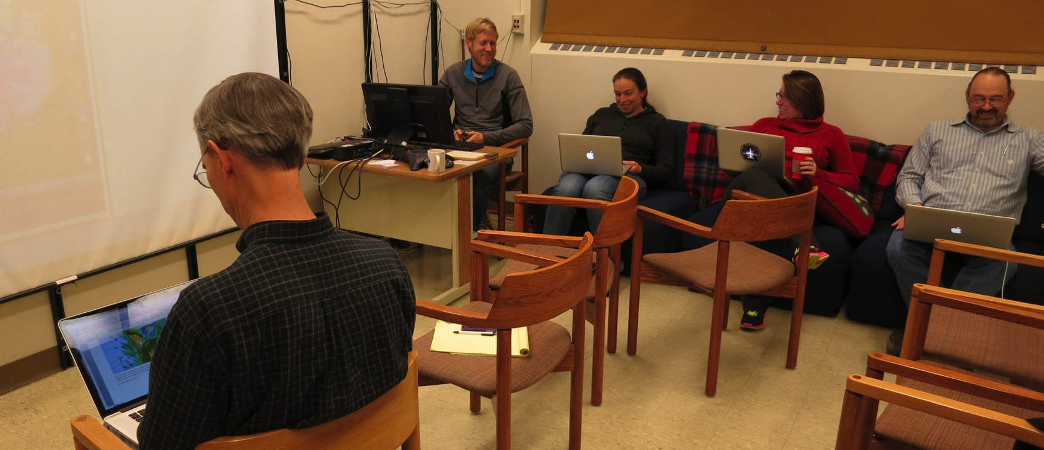
Daily Briefing
20-30 minute summary every morning
Helped determine flight plans, DOW operations, ground maintenance, soundings

Slide 4
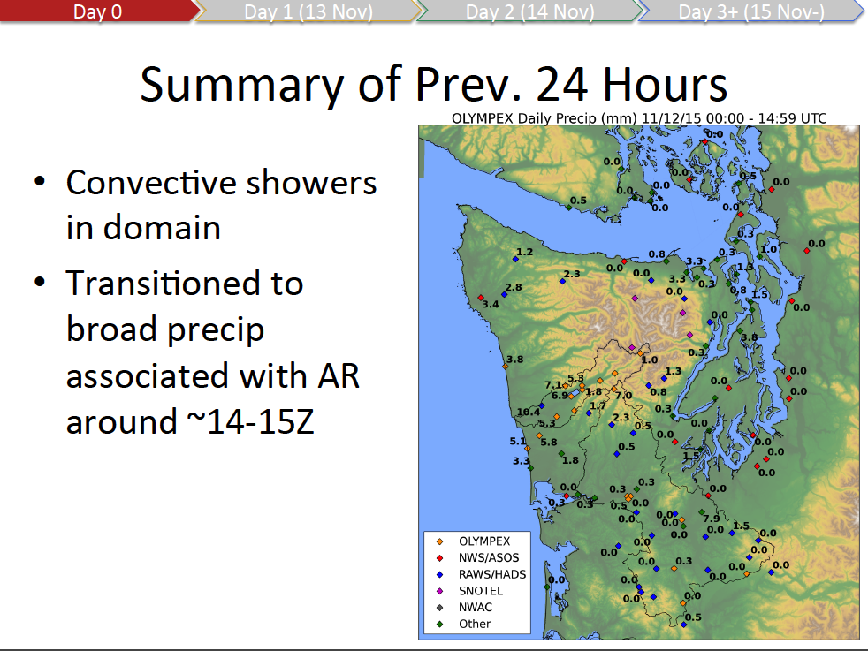
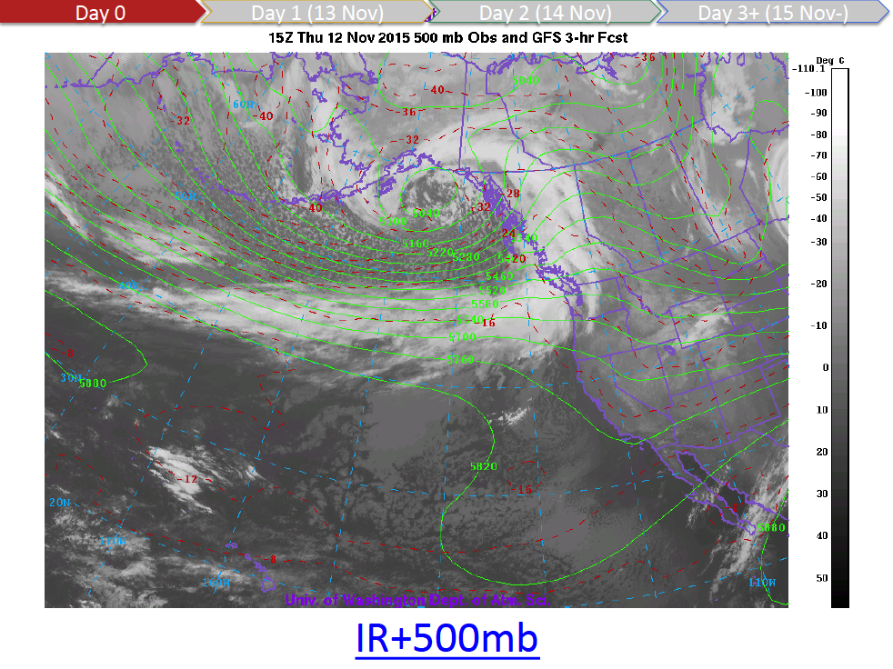
Briefing
Graphics and script courtesy of Luke Madaus

Slide 5
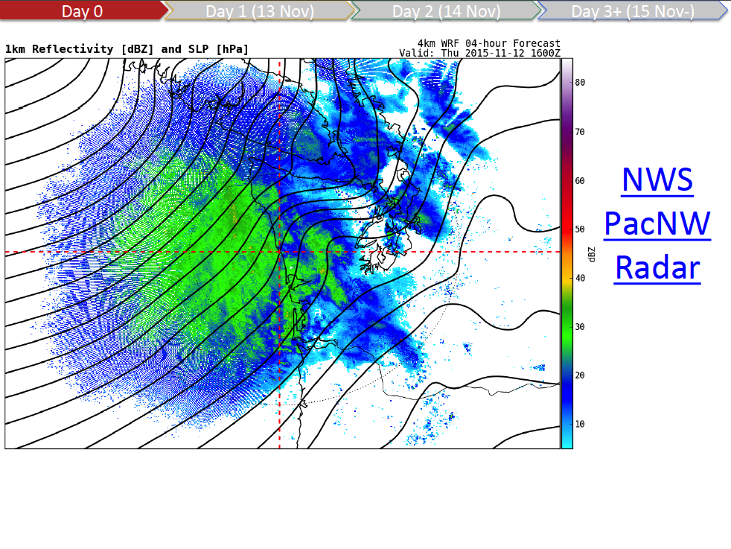
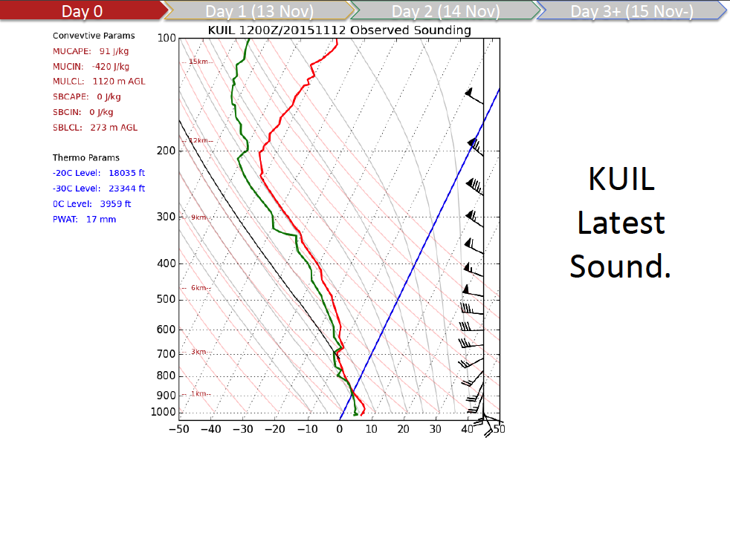
Briefing

Slide 6
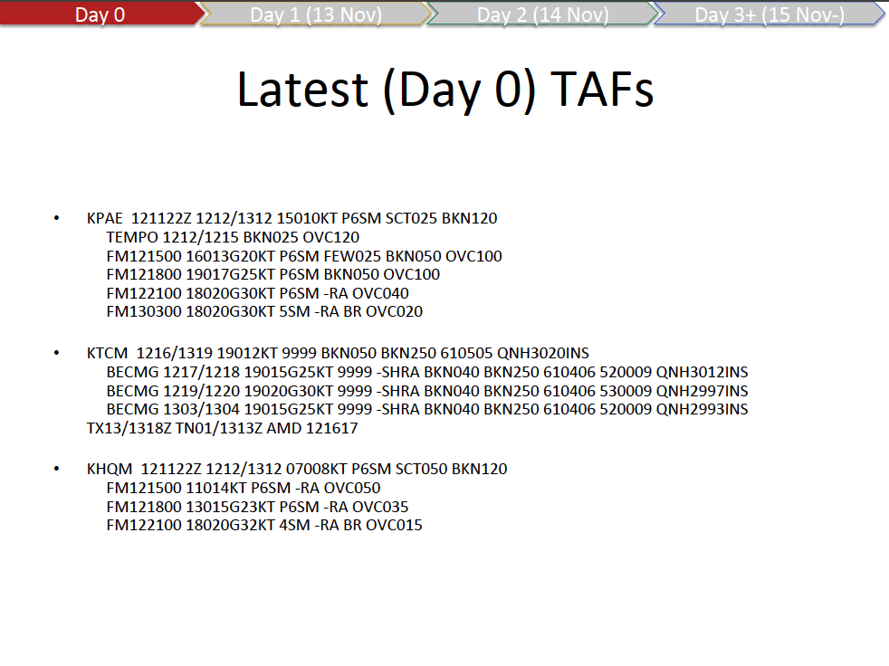
Briefing

Slide 7
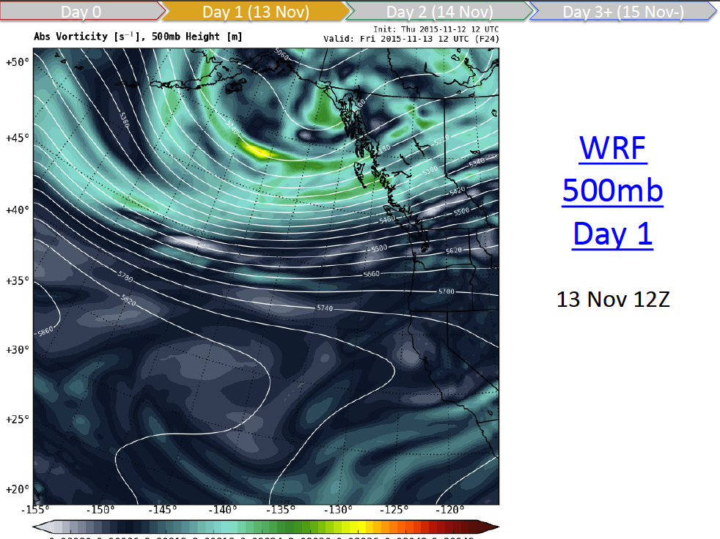
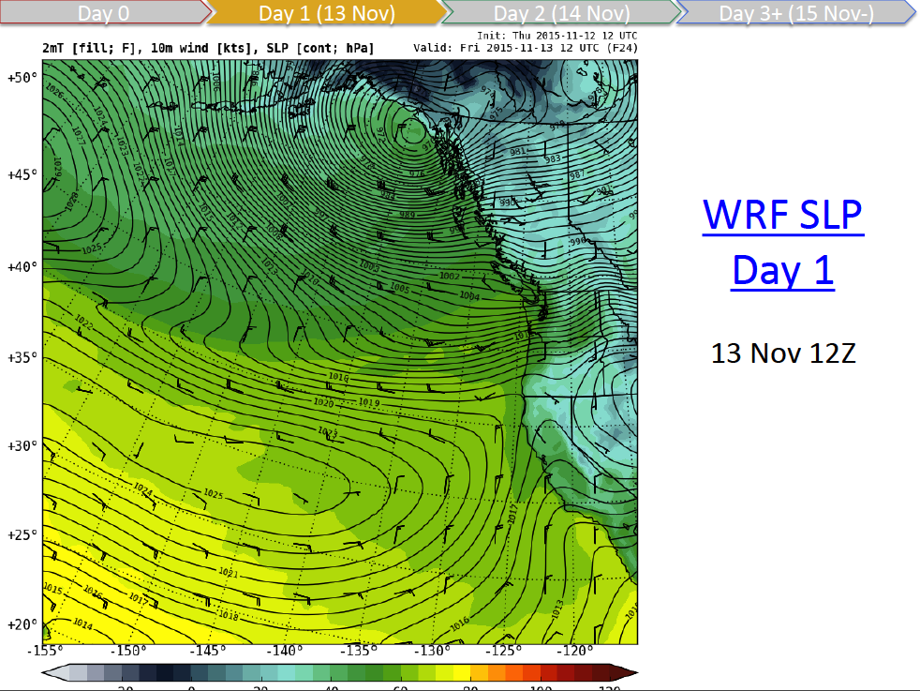
Briefing

Slide 8
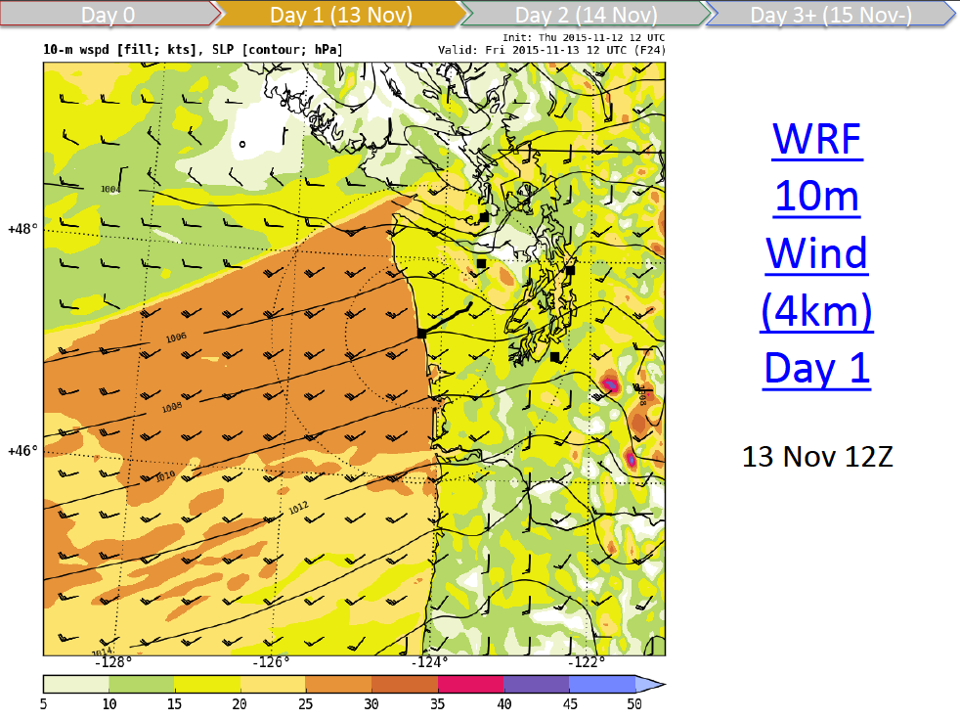
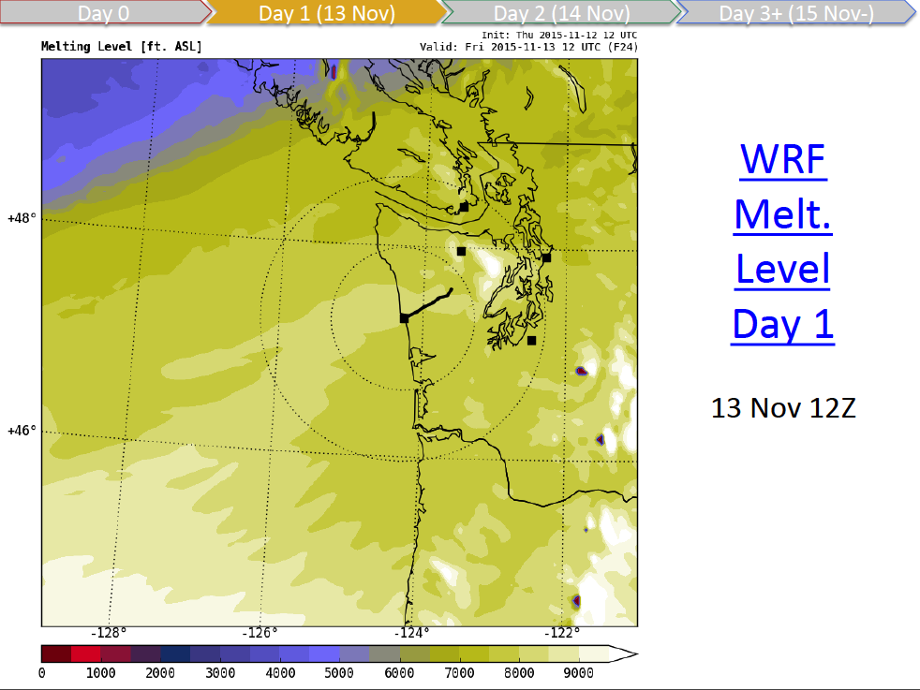
Briefing

Slide 9
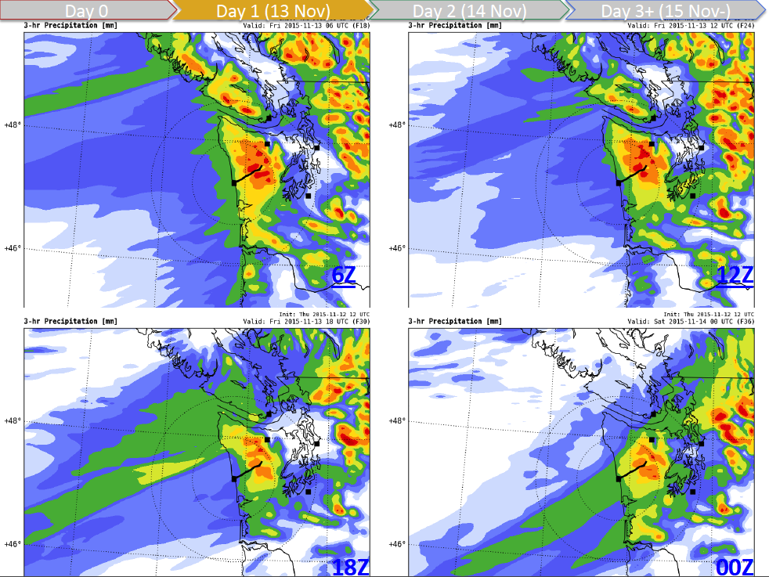
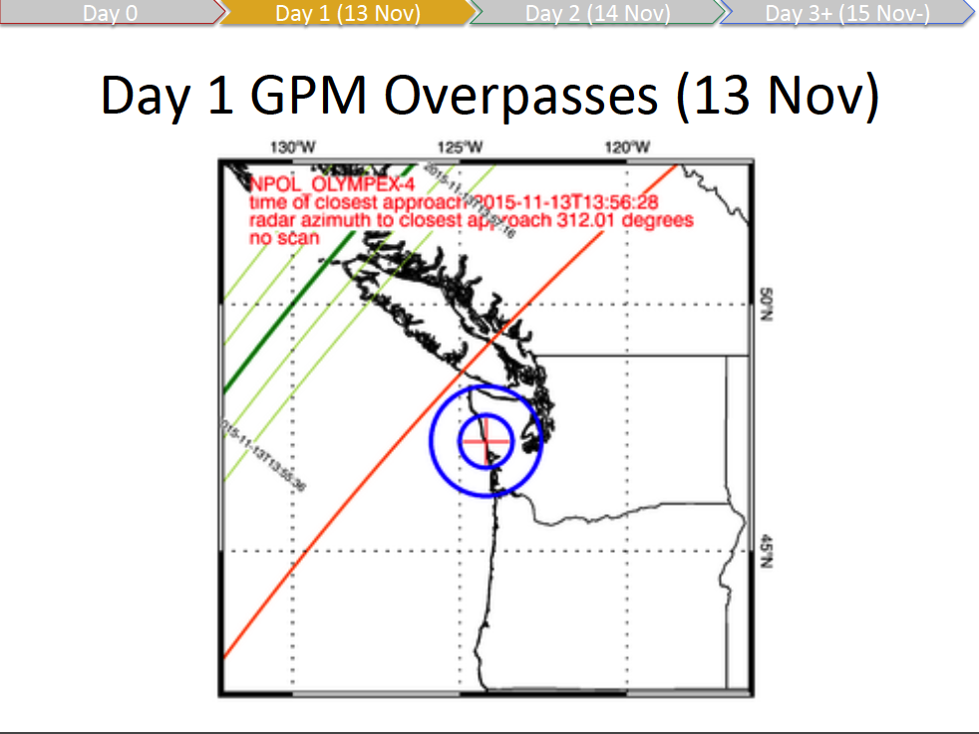
Briefing

Slide 10
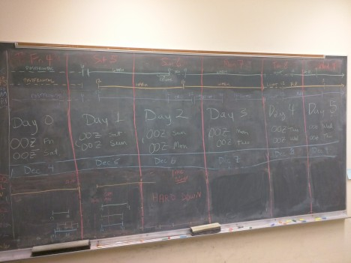
Briefing

Slide 11
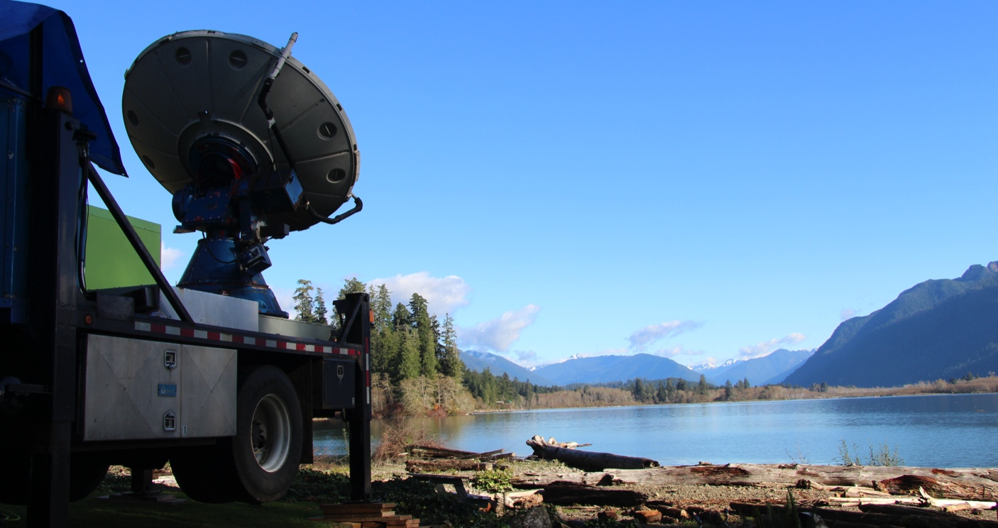
Forecast Successes!
Flight planners didn’t have complaints
Long lead time for some events
Thanksgiving break (literally) ☺

Slide 12
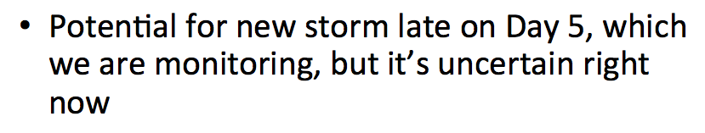
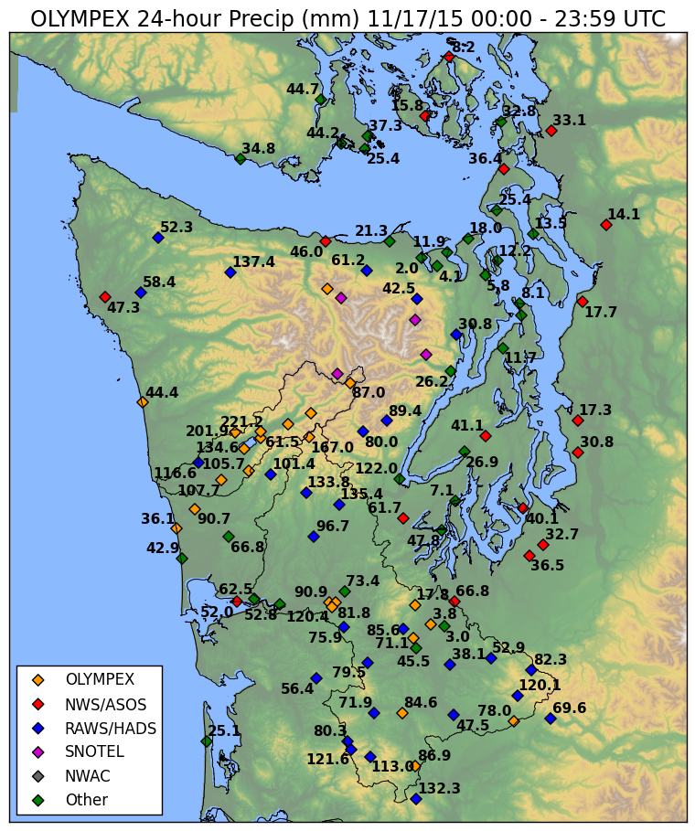
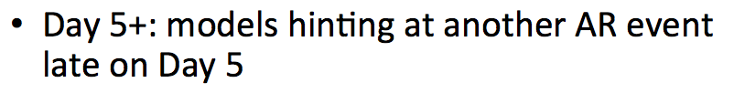
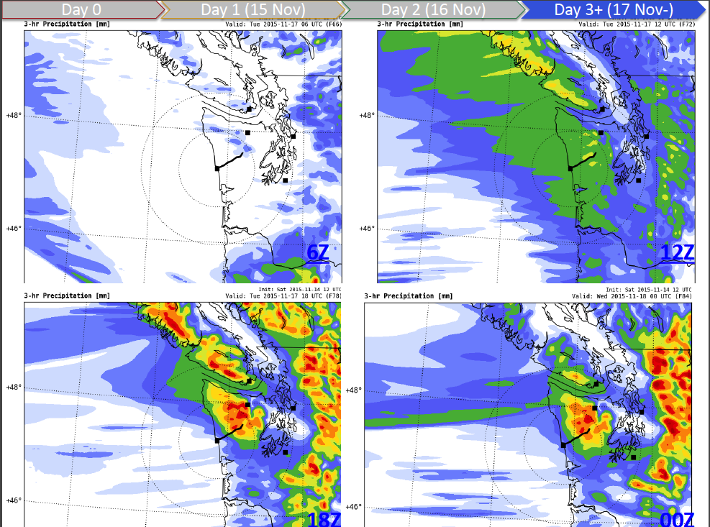
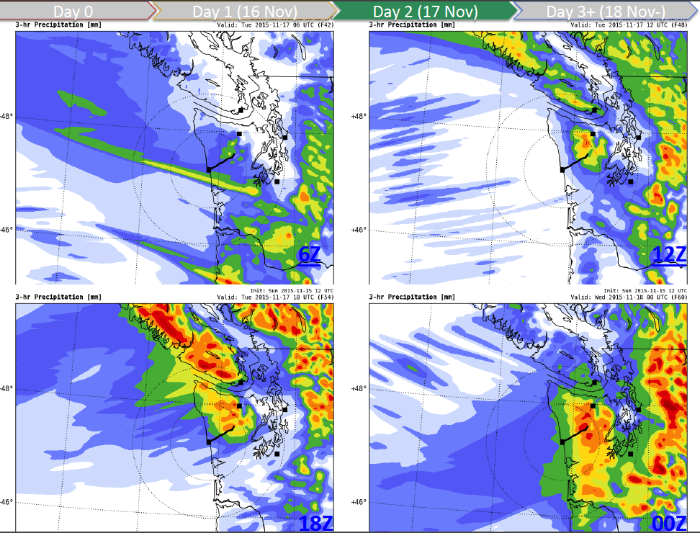
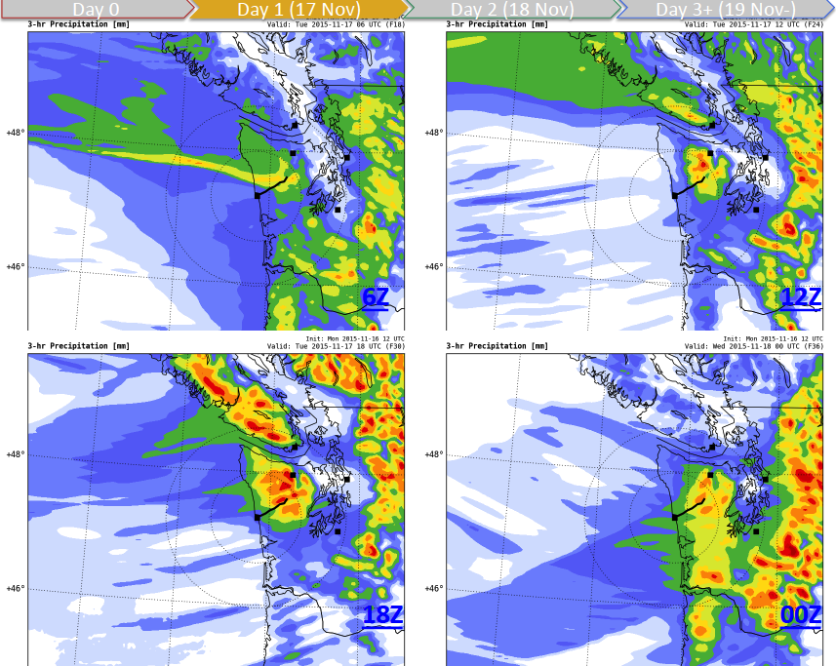
Large rain event 11/17/15
Notes:
13th, 8th-9th, 17th,

Slide 13
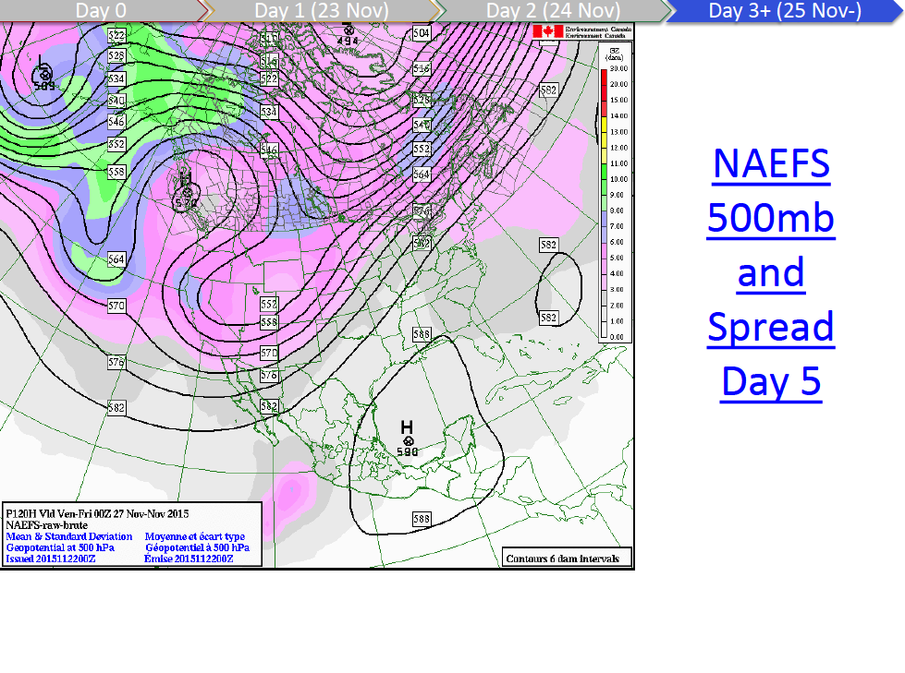
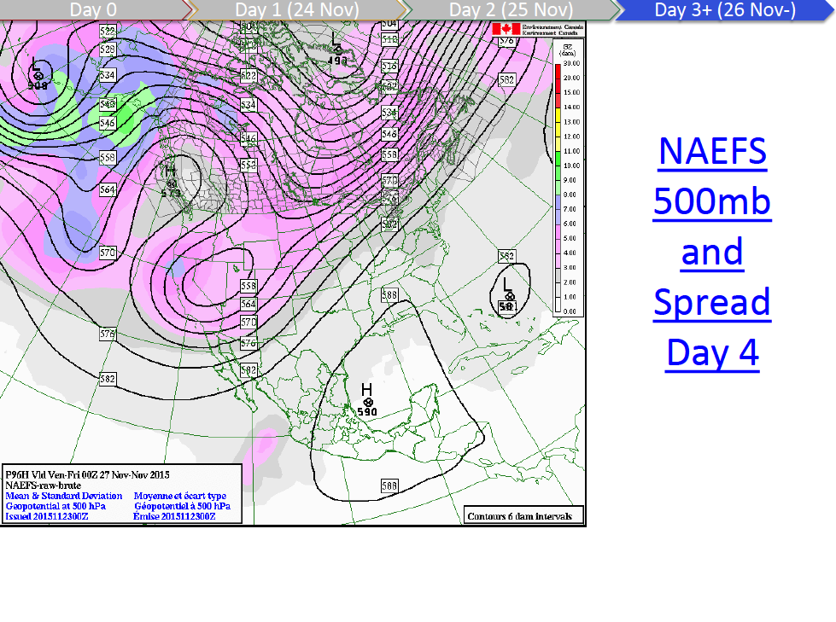
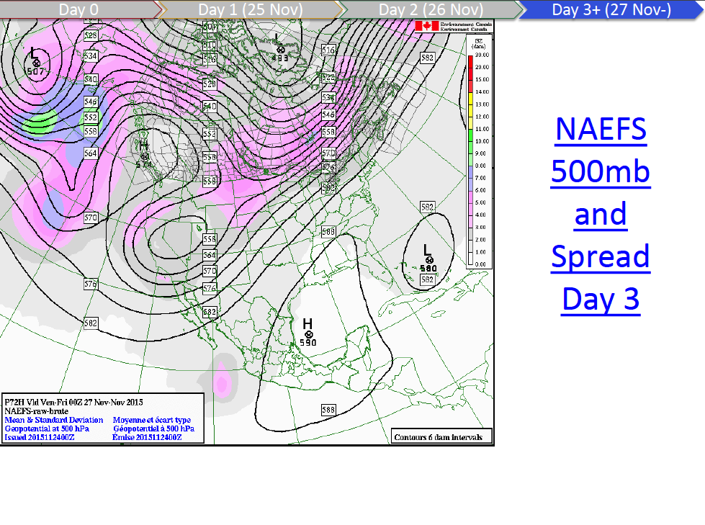
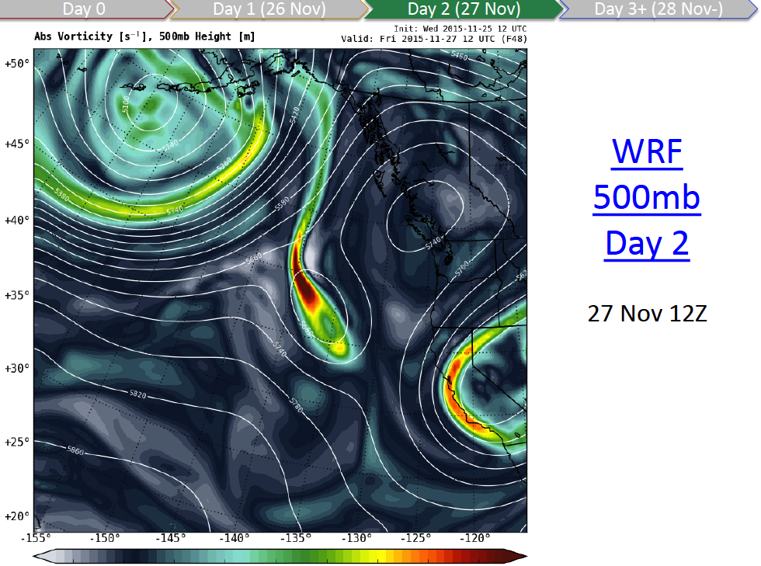
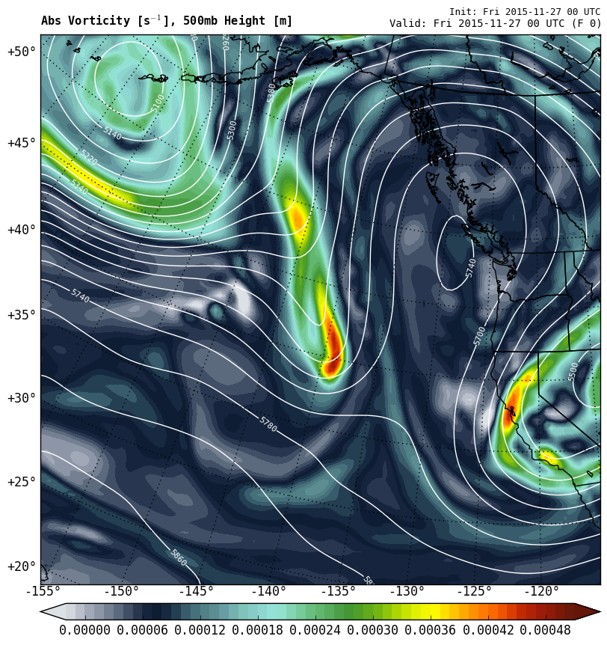
Dry spell over Thanksgiving
Notes:
First mentioned 11/21

Slide 14
Challenges
Early wake-up calls
DOW and flooding
Inherent difficulties of forecasting

Slide 15
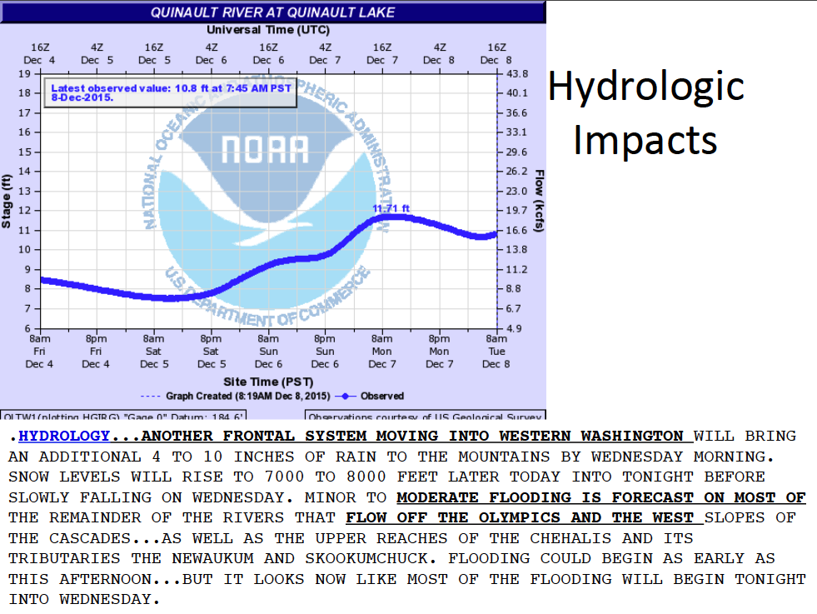
Meteorologists turned Hydrologists?

Slide 16
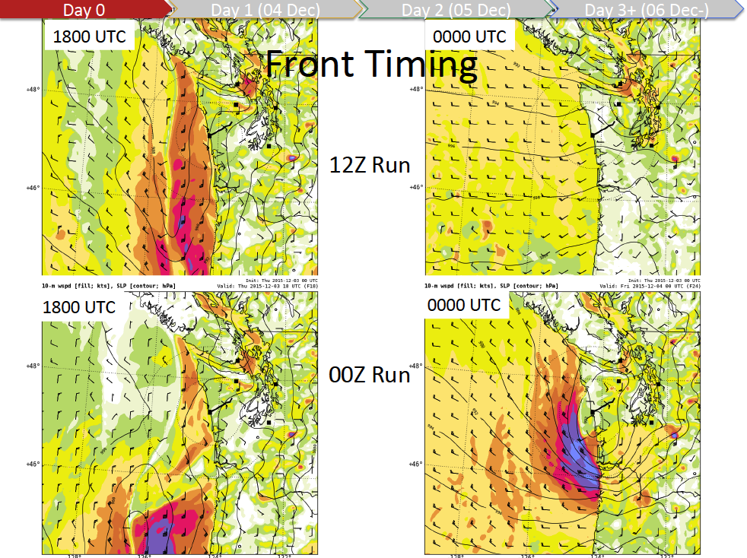
Model Run Variability

Slide 17
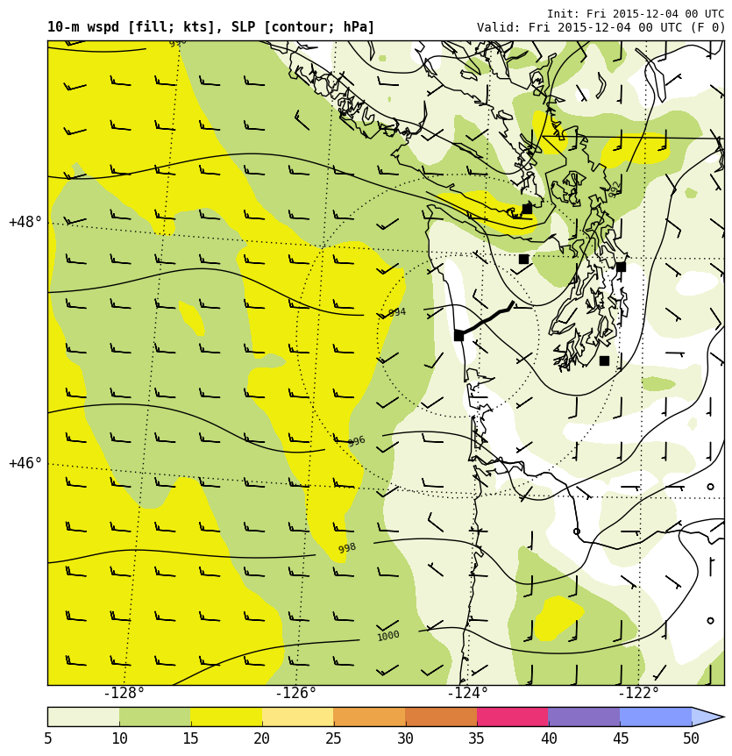
Model Run Variability
After much discussion, heeded the new guidance.
The ground crew out for maintenance bunkered down.
And the verification...

Slide 18
Communicating Uncertainty
Limited time within briefing
  Need to plan flights a couple days out
  Long term planning for DOW
Long term forecasts require ensembles
Postage stamps, violins, paintball plots, plumes, spaghetti plots

Slide 19
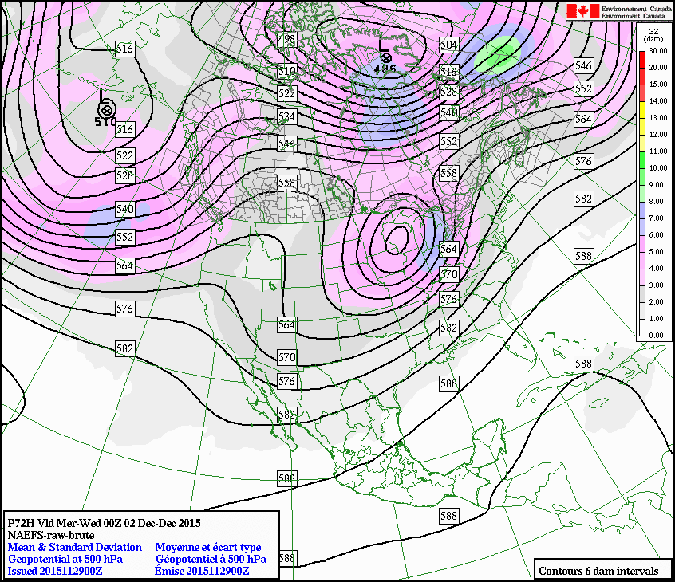
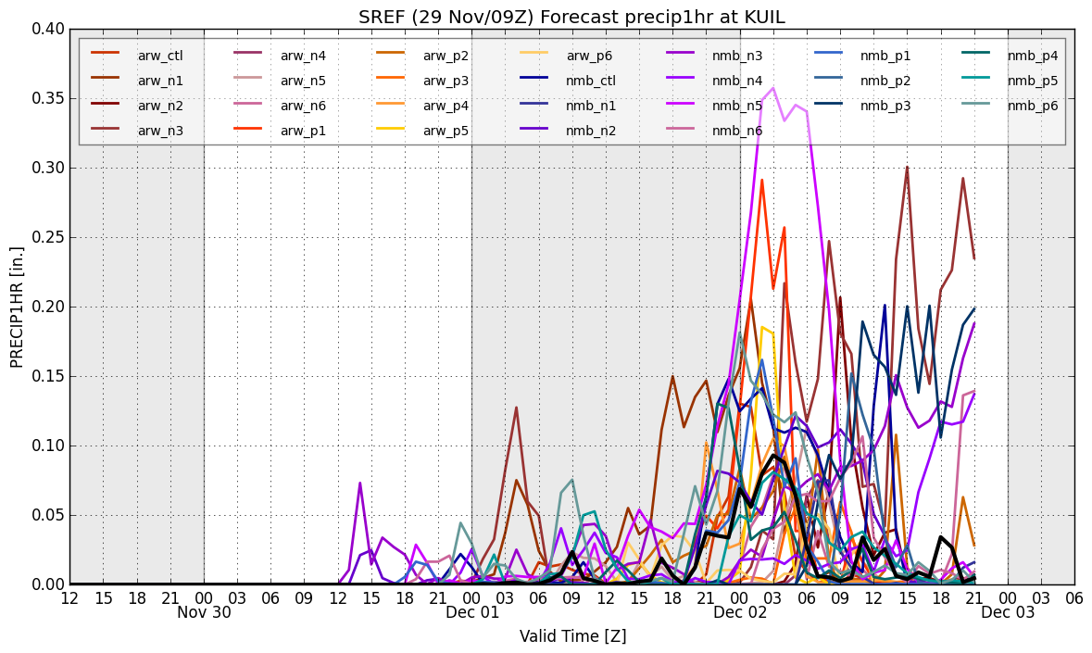
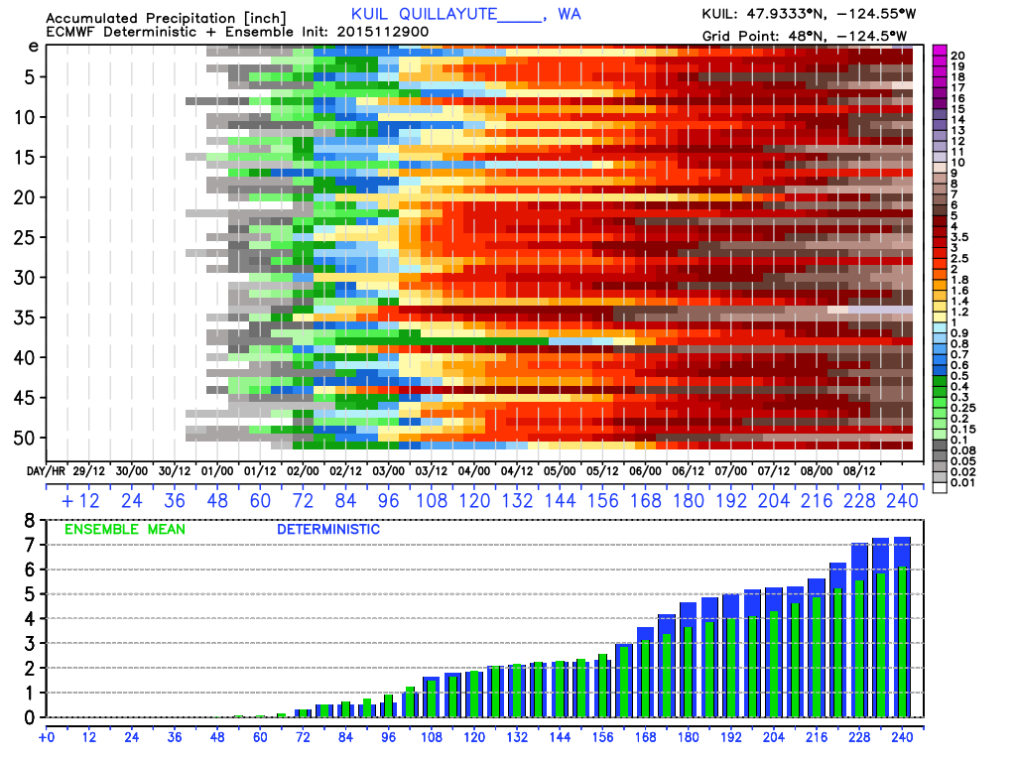
Numerous Ensemble Products

Slide 20
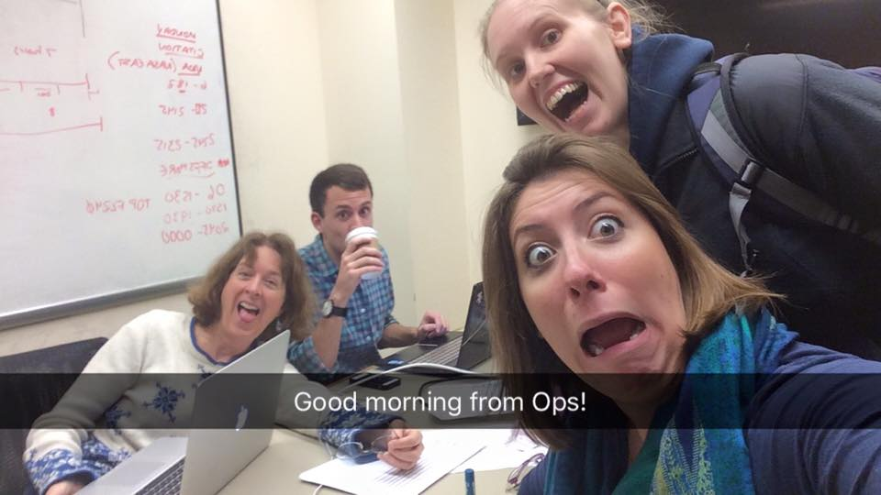
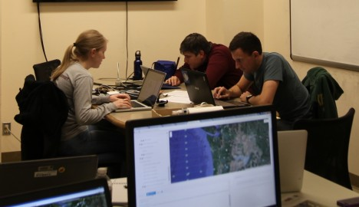
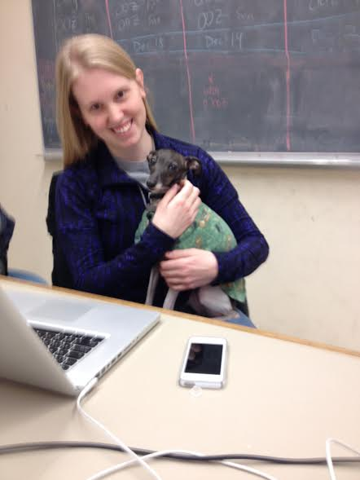
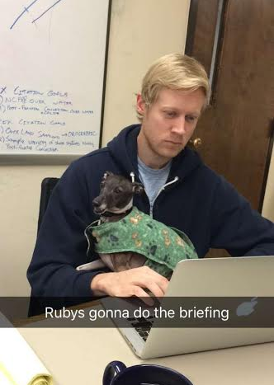
Overall...
8 forecasters
60 days
68 weather briefings

