Slide 1
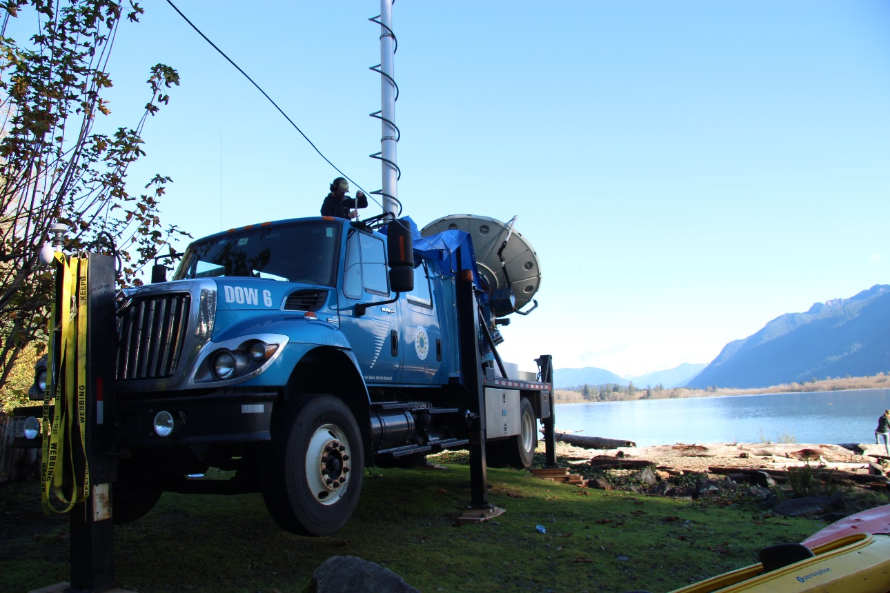
Orographic enhancement of precipitation as observed by a DOW X-band radar during the OLYMPEX field campaign
Megan Chaplin
UW Department of Atmospheric Sciences
Pacific Northwest Weather Workshop
March 4, 2016
ACKNOWLEDGEMENTS:
NASA grants NNX13AG71G, NNX15AL38G, and NNX16AD75G
and NSF grant AGS-1503155

Slide 2
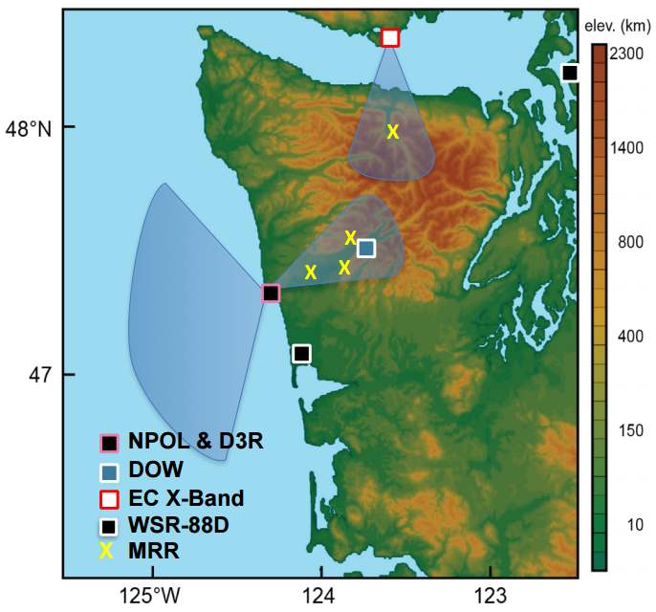
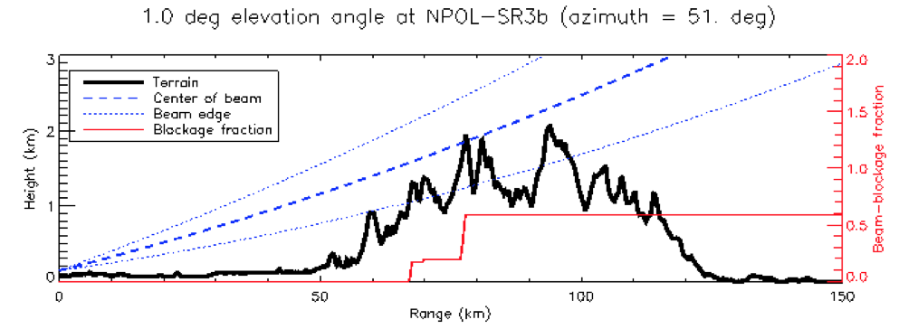
DOPPLER ON WHEELS (DOW)
LOCATION:
Lake Quinault valley
DOW will obtain duel-polarization data in Quinault Valley below the beam of the NPOL radar
PURPOSE:
Understand low-level flow
Orographic effects on precipitation
Notes:
-DOW located in Lake Quinault valley looking up valley into Olympic mountains, DOW measurements will supplement the NASA NPOL radar by obtaining duel-pol data in the Quinault valley below the beam of the NPOL radar. → Objective to determine the dynamical and microphysical processes leading to rapid growth and fallout of precipitation on the windward sides of mountain ranges.
-want to understand the potential impact of the low level flows on microphysical properties
→ DOW will complete the picture of documenting the orographic processes and making measurements at the levels lower than what the NPOL can see

Slide 3
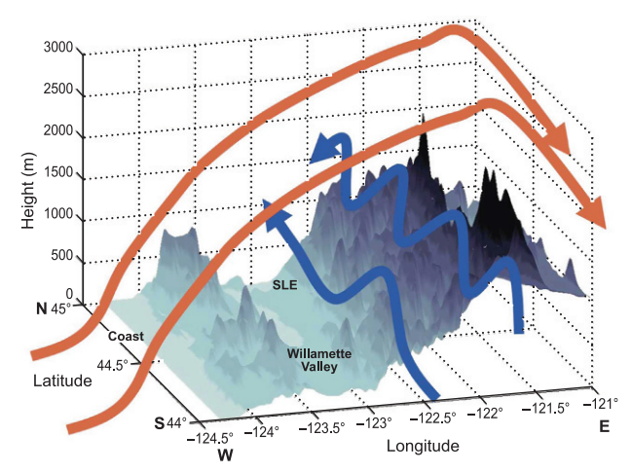
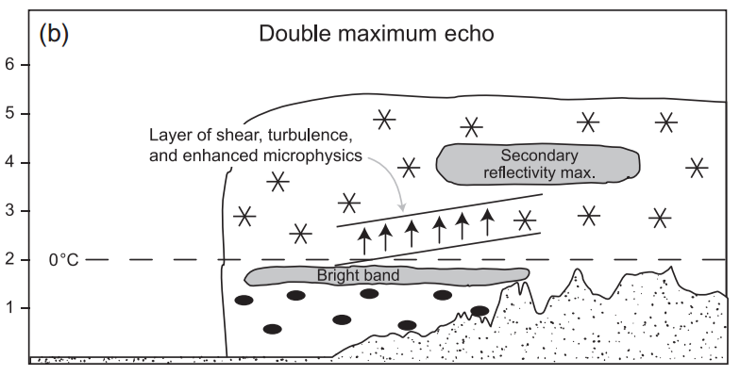
OROGRAPHIC EFFECTS
Medina et al. (2007)
Garvert et al. (2007)
LIFTING → ADIABATIC COOLING → CONDENSATION/PRECIPITATION
Notes:
1. Schematic of topography and wind flow over the Oregon cascade mountains (southerly airflow at low levels along windward slopes; upslope flow over it)
2. Schematic of the typical radar reflectivity structure observed in midlatitude Pacific cyclone passages over the Cascade mountains
-Bright band = region of higher reflectivity near the elevation of the melting layer between snow and rain
-presence of the shear layer and its suggested role in enhancing microphysical processes through turbulence

Slide 4
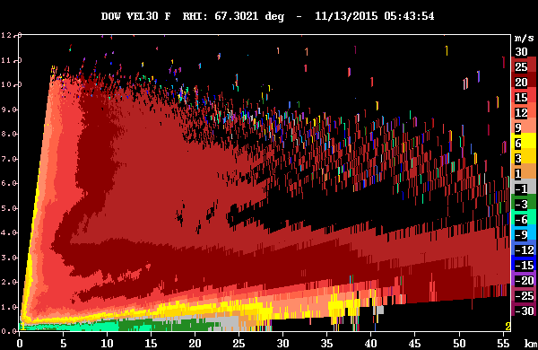
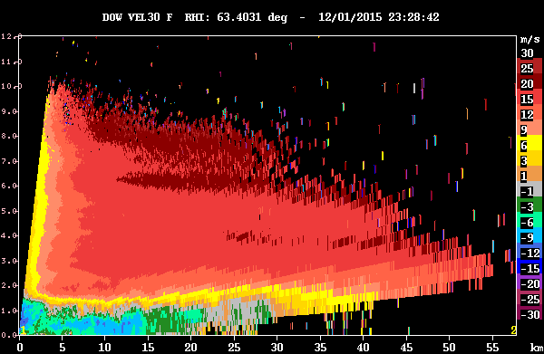
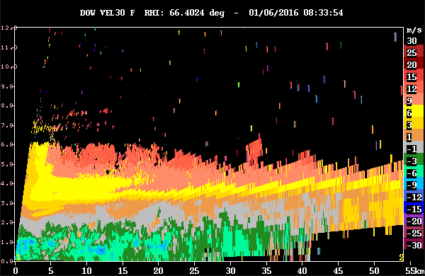
AIRFLOW IN QUINAULT VALLEY
COMMON DURING OLYMPEX:
Down-valley, low-level flow
Up-valley, upper-level flow
CAUSED BY: Cold air exiting valley OR forced by large-scale pressure gradients
DOW
11/13/15 Enhanced prefrontal precipitation
12/01/15 Weak front with extensive stratiform precipitation
01/06/16 Disorganized band of precipitation
Notes:
-Pacific storm airflow within the Quinault Valley during OLYMPEX
-It was very common for there to be down valley flow at low levels, and up valley flow at upper levels
→This can be due sometimes to cold air exiting the valley (as it cools and sinks from the mountains) or can sometimes be due to the large scale conditions → (when didn’t see shear layer)
-Strong shear layer was much rarer during these Pacific storm events, and the production of KHI waves and turbulence was very uncommon
11/13 – Down valley flow occurring near sfc-weaker- due to evaporative cooling/sinking from mountains within valley
12/1- stronger down valley flow associated with mountains as well, cold air exiting valley at low levels-weaker upper level flow
1/6- down valley flow much deeper –due to synoptic flow- see jagged edges in radial velocity, but no waves associated in other fields, Mostly stratiform precip associated with disorganized band

Slide 5
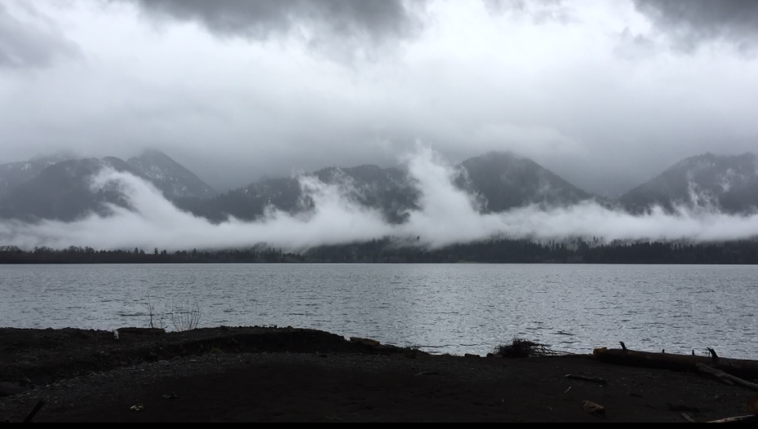
KELVIN-HELMHOLTZ WAVES
STRONG UP-VALLEY
OPPOSING AIR FLOWS
SHEAR LAYER
WEAKER DOWN VALLEY
Photo credit: Ali Gingrey
Notes:
-Occur when there is velocity shear (two layers of air moving at different speeds) → which leads to instability and turbulent flow → wave structure forms; the upper layers of air are moving at higher speeds and scoop the top of the cloud layer into wave-like structures
-In this image -up valley flow above 1.5 km, and down valley flow below 1.5 km

Slide 6
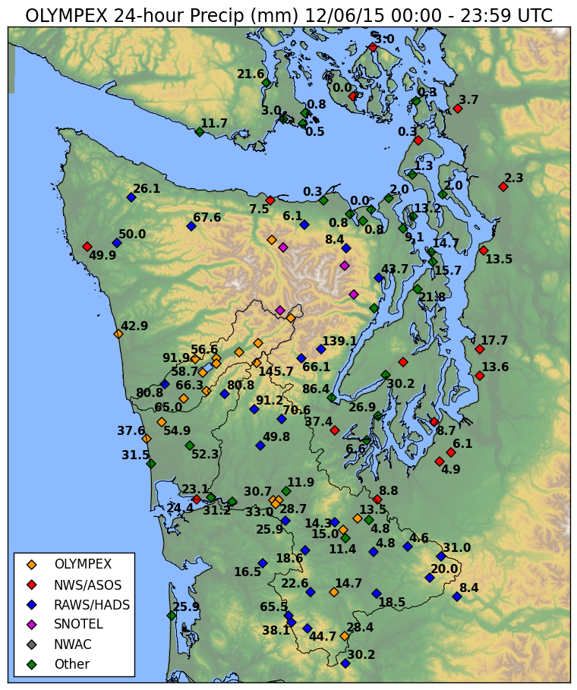
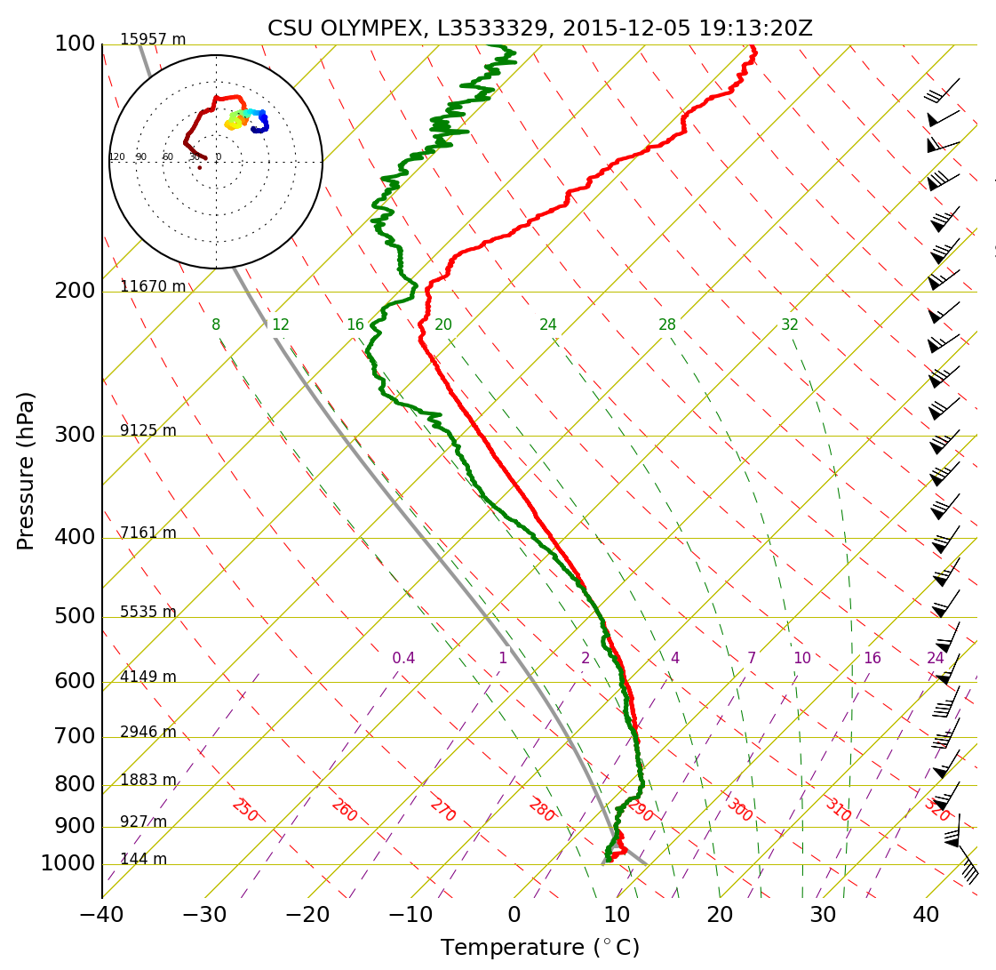
CASE STUDY: December 5-6 Broad Frontal Cloud System with Strong Wind Shear
Notes:
Extensive stratiform precipitation area → Over 200 mm in Quinault region over 2 day period
KH wave outbreak -Strong southwesterly winds at 900 hPa and above, surface winds moderate and southeasterly → shear at low levels

Slide 7
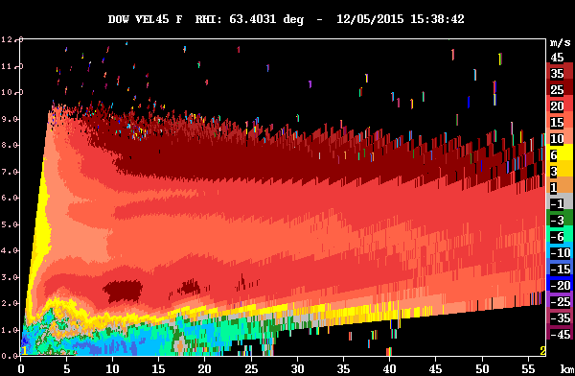
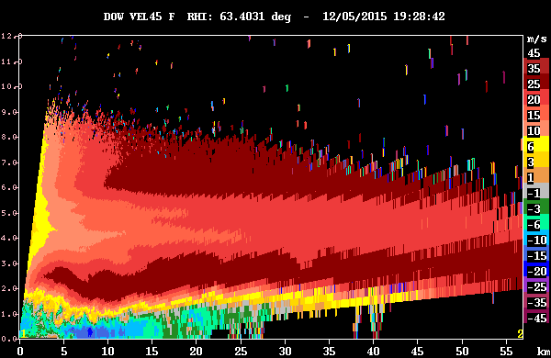
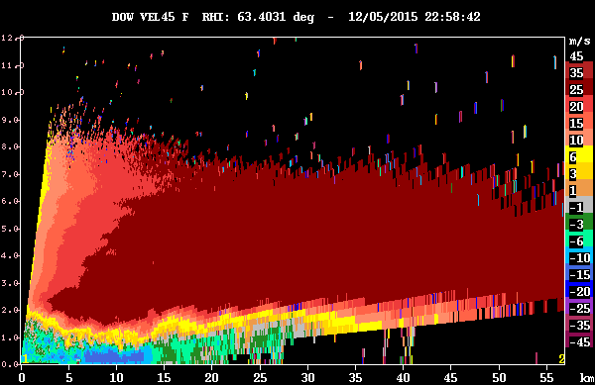
FLOW PATTERN
RADIAL VELOCITY: direction of particles from radar
(blue – toward; red – away)
DOW
Down-valley flow at low levels
Up-valley flow at upper levels
KH Waves
→
STRONG SHEAR LAYER
→
Notes:
-Even though KH waves are rare in this region, when they did occur – we were able to recognize the waves in the radar data and here are some examples of what they look like
-As shown in coastal sounding, low level flow was weak and south easterly; leading to down valley flow at low levels in the Quinault valley (blues = toward DOW), and up valley flow at upper levels (away from the DOW)
-This leads to a very strong shear layer, which then leads to the Kelvin Helmhotlz waves

Slide 8
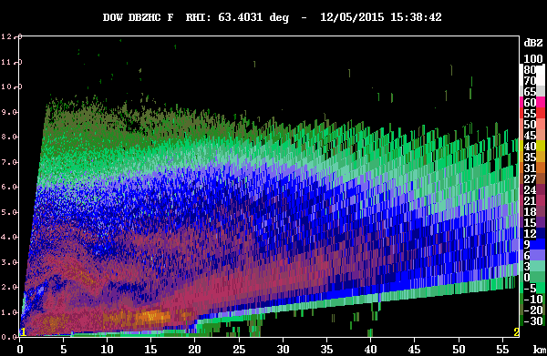
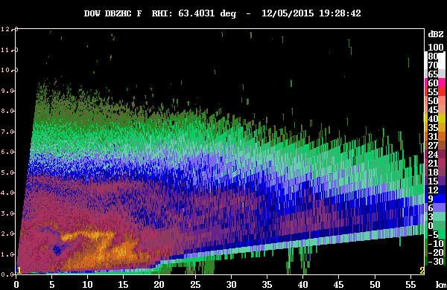
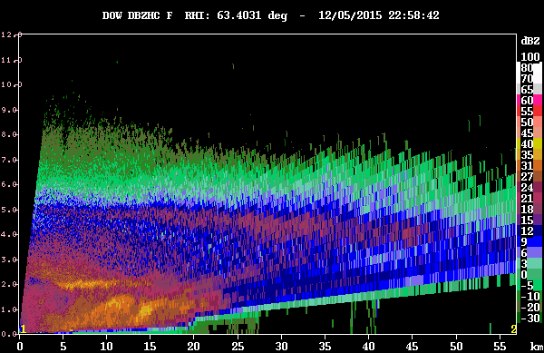
PRECIPITATION INTENSITY
→ RADAR REFLECTIVITY: used to estimate precipitation intensity
DOW
ENHANCEMENT IN SHEAR LAYER AND AT TERRAIN
Notes:
-Want to look at the potential impact of this strong shear layer on microphysical properties of precipitation and cloud droplets
-Shear layer modifies the intensity of the precipitation and bright band precipitation

Slide 9
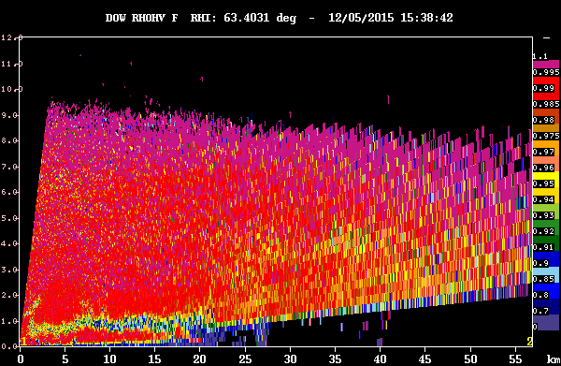
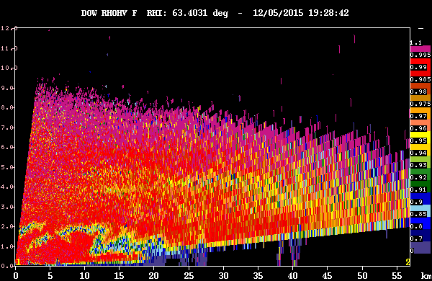
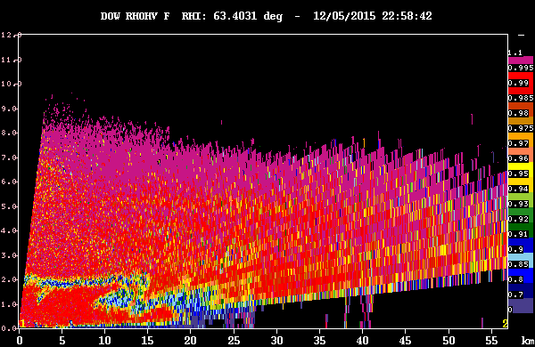
MICROPHYSICAL EVOLUTION
→ CORRELATION COEFFICIENT: measure of similarity between horizontal/vertical pulses within volume
DOW
MODIFICATION OF MELTING LEVEL
Notes:
-Potential impact of different low level flows into the valley/hitting mountains on microphysical properties
-See evolution of the melting level in rho-hv plots, which are a measure of the correlation coefficient → how similar in shape/size droplets are → represent melting level because of change from snow to rain

Slide 10
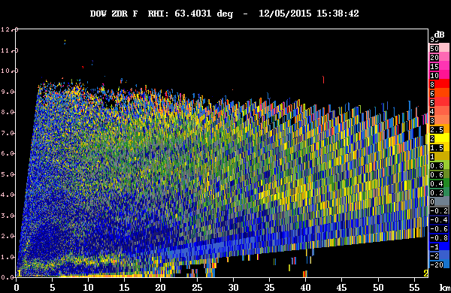
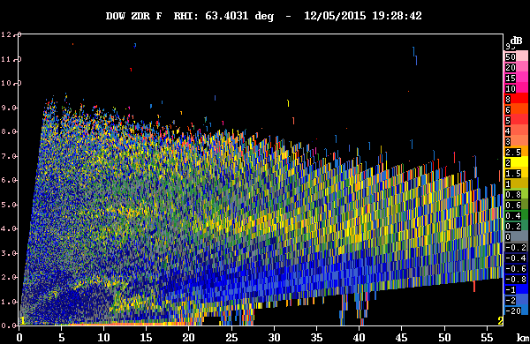
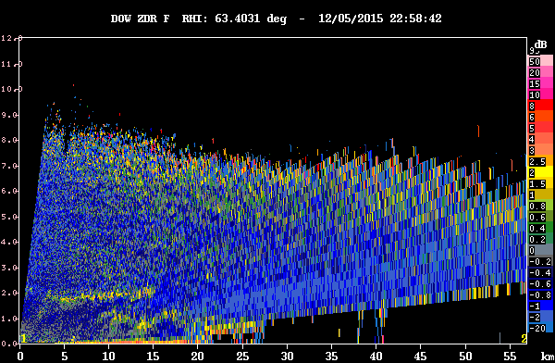
MICROPHYSICAL EVOLUTION
→ DIFFERENTIAL REFLECTIVITY: ratio of reflected horizontal and vertical power returns, depends on median shape/size of droplets
DOW
MODIFICATION OF MELTING LEVEL due to SHEAR LAYER and TERRAIN
Notes:
-ZDR plots show the difference in returned energy between the horizontal and vertical pulses. → Larger particles/drops (more horizontally extensive)= more contribution to reflectivity factor
-Also a way to measure bright band/melting level within the storm system (Important for seeing transition from liquid to snow)
-One thing to mention is that the biases have not yet been removed from these data, so the higher reflectivity values around the top edge are a product of the radar and aren’t ‘real’
-Similar modification of bright band due to shear layer!

Slide 11
SUMMARY
Better understanding of LOW-LEVEL FLOW
Orographic enhancement of precipitation
Impact of shear layer on microphysics
Further research in microphysical and dynamical processes associated with winter storms and interactions with WA coast and mountains
Notes:
That there were many other cases of orographic enhancement (with and without KH waves) and, of course, several other examples of KH waves in this data, similar to what has been described in the recent Medina and Houze paper that described the presence of KH waves in the Alps and Oregon Cascades using radar data

