Slide 1
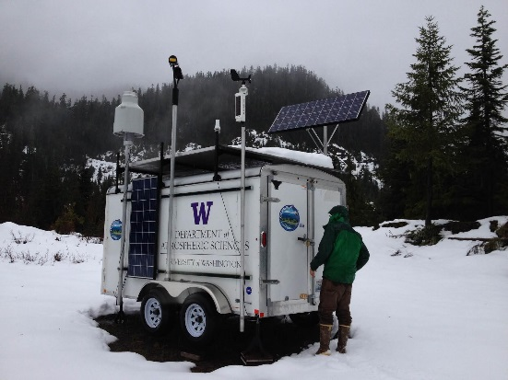
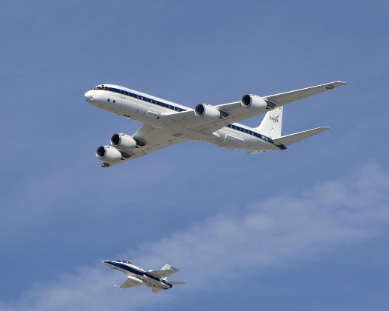
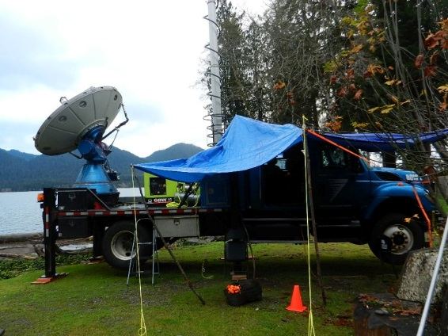
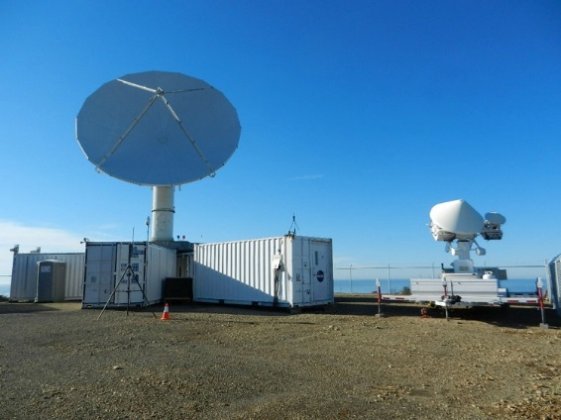
From Synoptic to Microscale:
A Case Study of a Frontal Passage using Multiple OLYMPEX Observations
Hannah C. Barnes
University of Washington
Pacific Northwest Weather Workshop
4th March 2016
NOAA Western Regional Center, Seattle, WA
Funded by NASA grants NNX13AG71G, NNX15AL38G, and NNX16AD75G and NSF grant AGS-1503155.
Notes:
- Show how use multiple data sources to obtain a detailed understanding of weather event

Slide 2
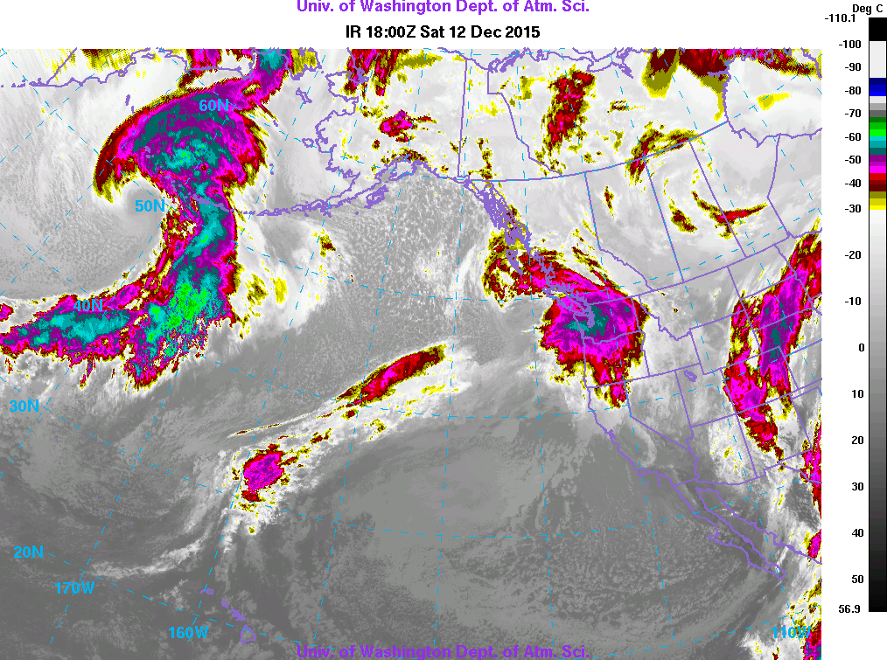
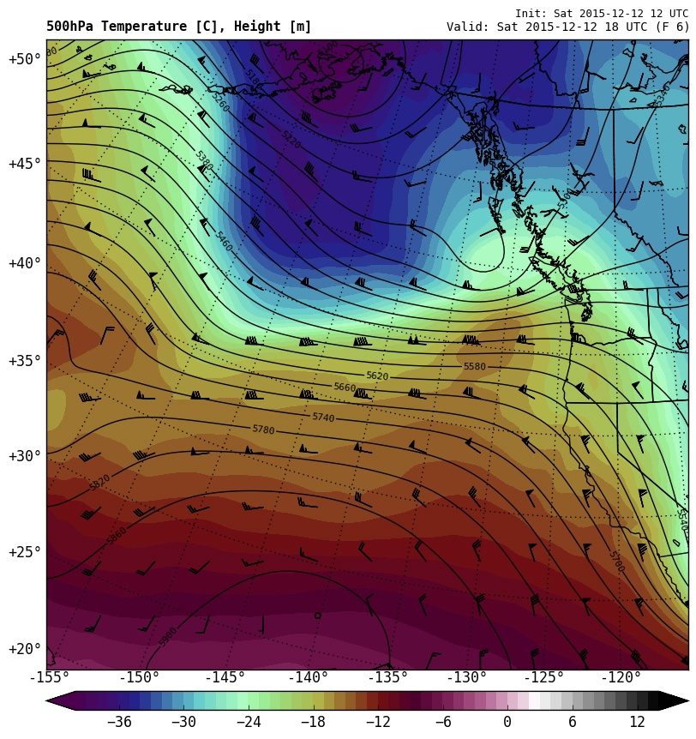
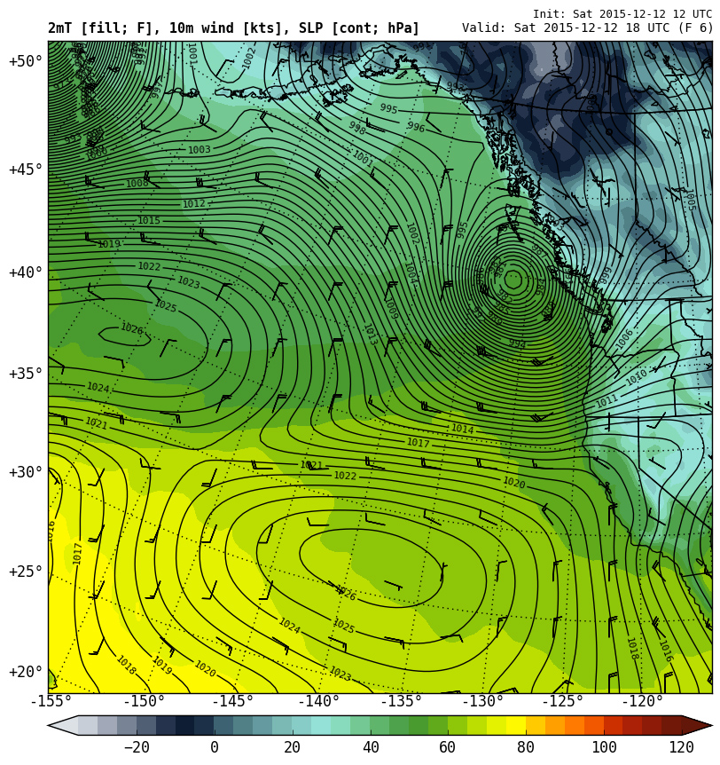
Occluded Front
Synoptic Conditions
1800 UTC 12 December
IR Satellite
2 m temperature
10 m wind speed
Sea-level pressure
500 hPa temperature, height, wind
Notes:
As my title suggests we are going to start at the largest scales and work our way down. So we will start by looking at the synoptic setup
On the left is 500 hPa temperatures in shading and heights in contours. At 1800 UTC there was a 500 hPa shortwave located north of Vancouver Island and zonal winds were over the OLYMPEX domain.
On the right is the 2 m temperature, 10 m winds, and sea-level pressure. This shortwave is associated with an surface low. And you can see a small occluded front approaching the coast. Associated with a surface wind shift but little change in temperature.
On top see that this feature associated with a large cold cloud shield. That at this time was already over Washington and Oregon.

Slide 3
What happened during the passage of the occluded front?

Slide 4
12 December 2015 Timeline
12
13
14
15
16
17
18
19
20
21 UTC
Pre-Frontal
Frontal
Post-Frontal
Weather Events
KHI Waves
DOW Radar
NPOL Radar
D3R Radar
Env. Can. Radar
Quillayute Soundings
Env. Can. Soundings
NPOL Soundings
ER-2 Aircraft
DC-8 Aircraft
Citation Aircraft
Ground Instruments
Notes:
For this talk I will be focusing on an occluded front that occurred on Dec 12th. This is a rough timeline of the event showing the timing of the front in the top row. All the other rows show all the other instruments were operational. On top of these also had the UW WRF and satellite data
With 12 mins way to much to discuss every stage of the frontal passage or to discuss every data source so I am going to focus on the frontal period and these seven data sources.

Slide 5
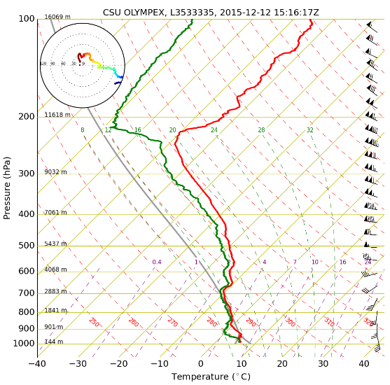
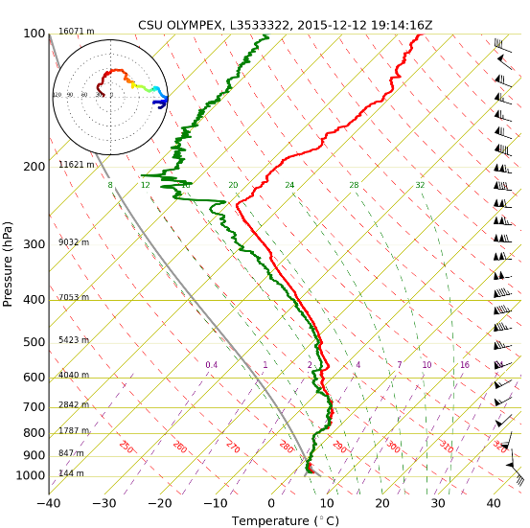
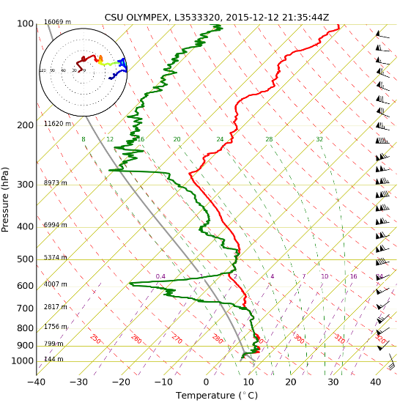
NPOL Soundings
12 December
1516 UTC
1914 UTC
2123 UTC
Pre-Frontal
Frontal
Post-Frontal
Increase winds
Melting level rise
Notes:
Launched soundings at the NPOL radar sight during this event and was able to sample all three phases of the passage of the occluded front.
First I want to highlight how the stability changed throughout the event. That the atmosphere was very stable during the frontal passage iteself, with a deep layer of temperatures increasing with height. However, this stabliity did not last long and the atmosphere quickly began to destabilize during the post-frontal regime.
You also notice that the atmosphere rapidly dried starting in the post-frontal period, espeically at midlevel levels. The pre-frontal and frontal periods were nearly saturated everywhere.
The melting level also increased substantially during the post-frontal period. Was very low, especially dring the frontal passage. But much higher during the post-frontal period.
Finally, you notice that the winds and vertical wind shear increased substanitally starting during the frontal period.

Slide 6
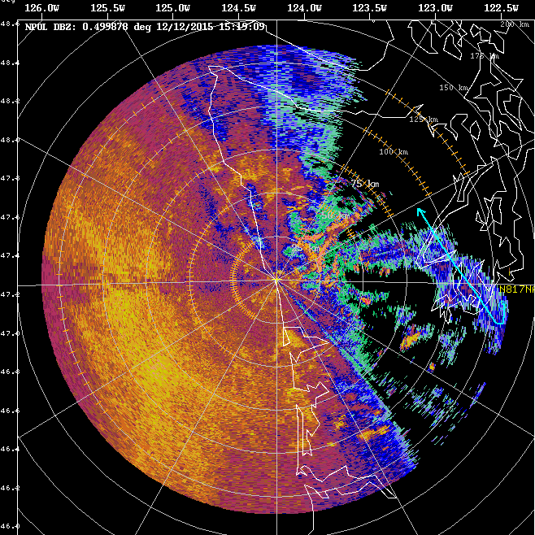
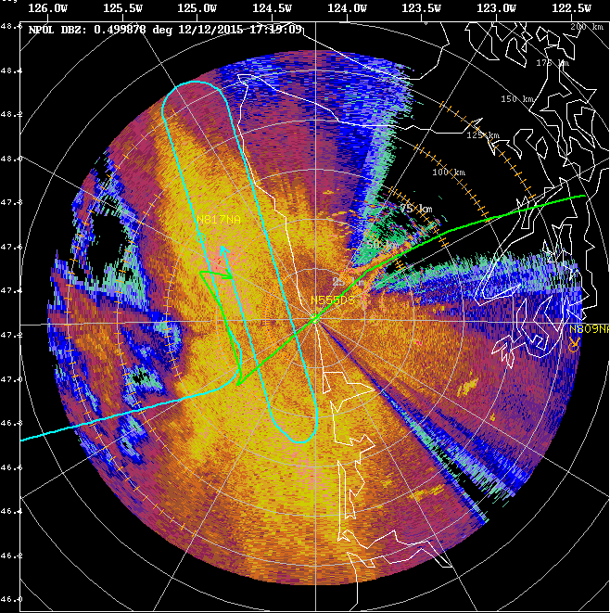
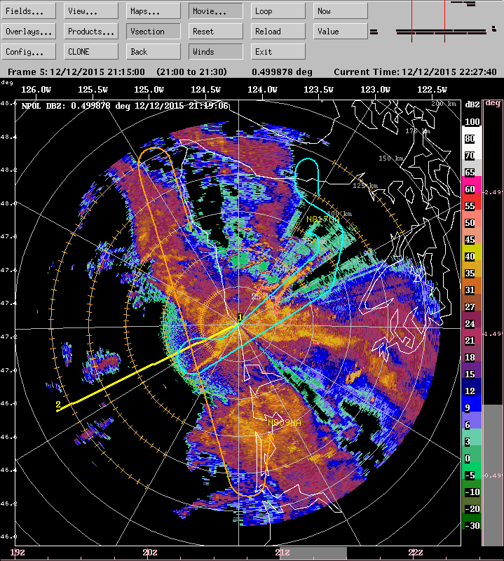
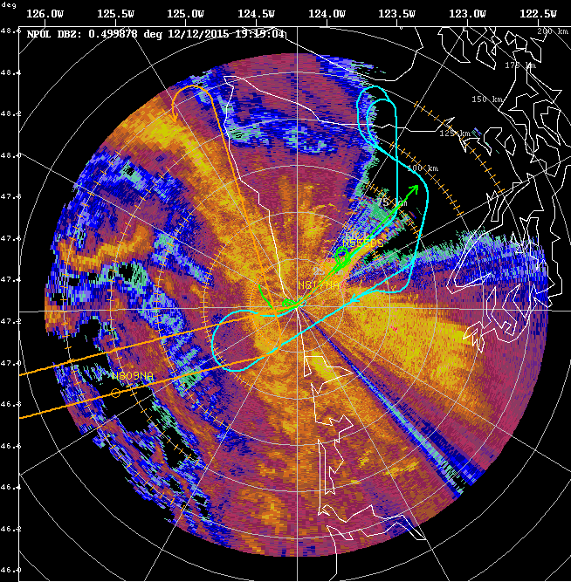
NPOL Reflectivity and Flight Tracks
1519 UTC
1719 UTC
Pre-Frontal
Frontal
1919 UTC
2119 UTC
Post-Frontal
Frontal
Post-Frontal
Notes:
How did this changing atmosphere relate the precipitation?
- What did the passage of the front look like from a radar perspective. Here is a sequence of images every two hours from the NPOL radar. These are horizontal maps of reflectivity out to 150 km away from NPOL. The lines on top of the radar images show the flight tracks of our research aircraft. During the pre-frontal period there was an expansive region of stratiform precipitation. During the frontal passage itself this stratiform precipitation become more intense, as evident by the higher reflectivity. As we transitioned into the post-frontal period the precipitation became more isolated and convective in nature.

Slide 7
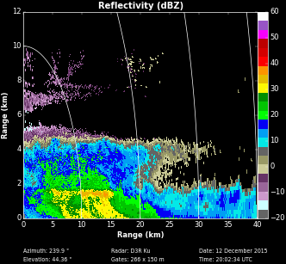
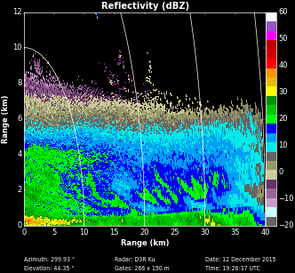
D3R Radar
Ku-Band Reflectivity
1926 UTC
2002 UTC
Height (km)
Height (km)
Melting Level
Melting Level
Frontal
Post-Frontal
dBZ
Melting level rose rapidly.
Notes:
One of the aspects of this front that I have found most interesting is the evolution of the melting level.
These are two vertical cross sections of radar reflectivity obtained by the D3R radar. The left is from the frontal period and the right is one taken from the post-frontal period. Both have a very distinct band of high radar reflectivity. This is called the brightband and it corresponds to the location of the melting level. Thus, these images are showing the rise of the melting level during the frontal passage. The remarkable thing is that these images are only 30 mins apart and the brightband rose nearly 2 km in that short time.

Slide 8
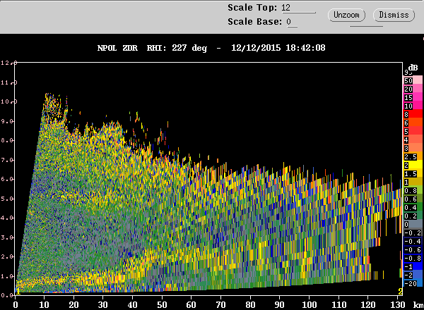
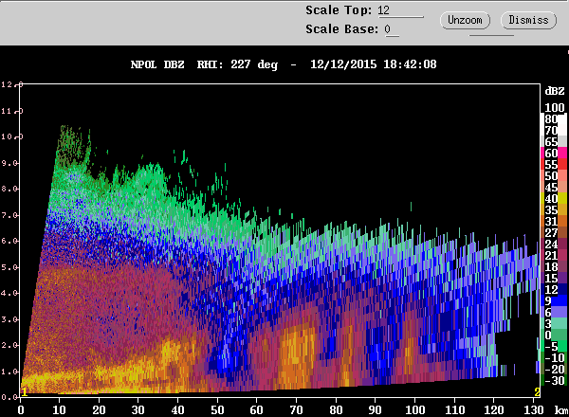
NPOL S-Band Radar
1842 UTC
12
Differential Reflectivity (Z_{DR})
11
10
9
8
7
6
5
4
3
Melting Level
2
1
Melting level rose abruptly
Nature of convection changes
0
12
Reflectivity
11
10
9
8
7
6
5
4
Convective
3
2
Stratiform
1
0
Notes:
The rapid rise of the melting level can be seen even more dramatically when you look at vertical cross-sections of radar data obtained from the NPOL radar.
This image of the left is a horizontal map of the reflectivity, showing that we are looking at the time in which the precipitation transitioned from frontal to post-frontal. If we take a vertical cross-section through the storm along this thick yellow line we get this series of images on the right.
The top two panels show vertical cross-sections of two dual-polarimetric radar variables with differential reflectivity shown in the top and correlation coefficent shown in the middle. At this point it don’t worry about the exact defintion of these variables. What I want to point out is that both of these variables can be used to identify the melting level. In differential reflectivity the melting level has high values and in correlation coefficent the melting level is characterized by low values. With this in mind you quite clearly see the melting level in this images. Notice the jump in both of these variables. That is the rise in the melting level. During this occluded front the melting level rose nearly 2 km in altitude over a horizontal distance of 20 km.
The bottom panel shows a vertical cross section of radar reflectivity of this time and you can see that as the melting level rises the nature of the precipitation changes. When the melting level was low the precipitation was uniform and stratiform. After the melting level rose the precipitation became more isolated and convective in nature.

Slide 9
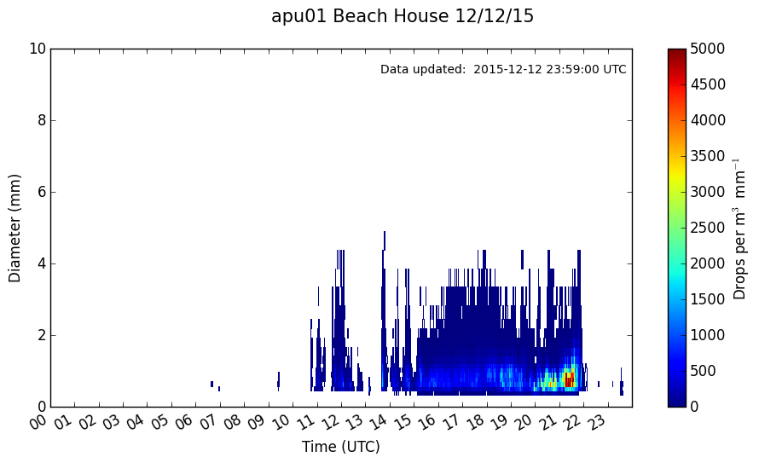
Ground Observations: Particle Size Distribution
Beach House
Diameter (mm)
Time (UTC)
Pre-Frontal and Frontal
Stratiform
Broad distribution
Post-Frontal
Convective
Lots small
Occluded Front
Notes:
This change in the nature of the precipitation is also seen through the ground observations.
This is showing the evolution of the particle size distribution observed at a location very close to the coast. The x-axis is time, the y-axis is the diameter of the particle, and the colors show how many drops were a given size. The frontal passage is marked in red.
Prior and during the front the particle distribution was broad. With the sizes of the particles being relatively equally divided among the different sizes. However, during the post-frontal period there was a sharp increase in the number of small drops as evident by the adrupt change seen here the plot. So the post-frontal period was characterized by an increase in small drops compared to the pre and frontal periods.

Slide 10
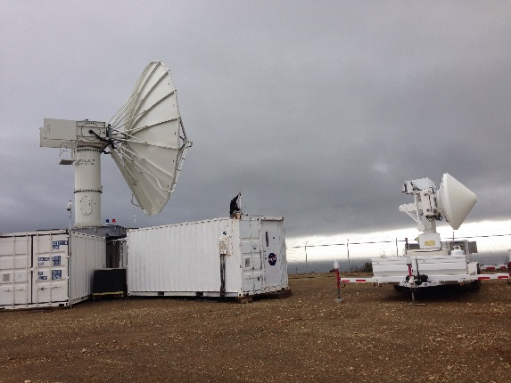
Microscale Dynamical Features
Notes:
- OLYMPEX data not only can tell use about the microscale particle changes. But our data has such high temporal and spatial resolution that we can see microscale dynamical features.

Slide 11
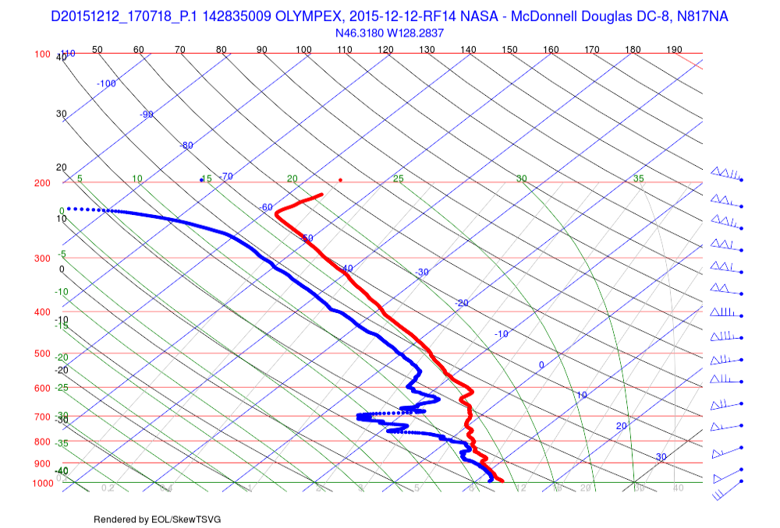
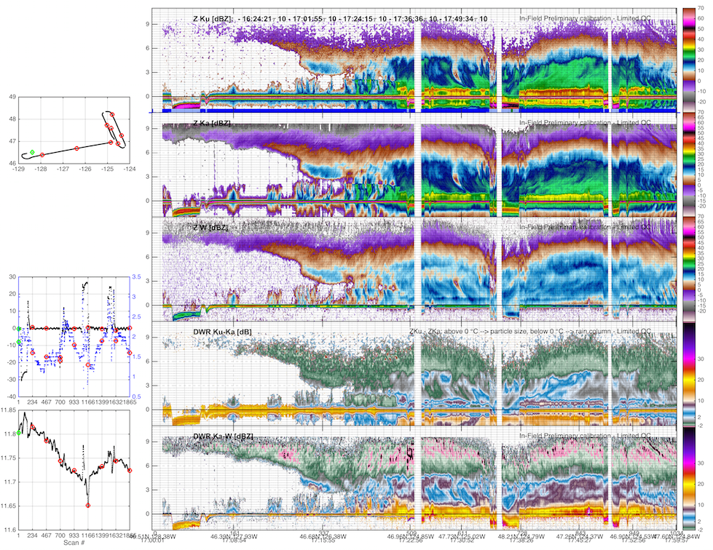
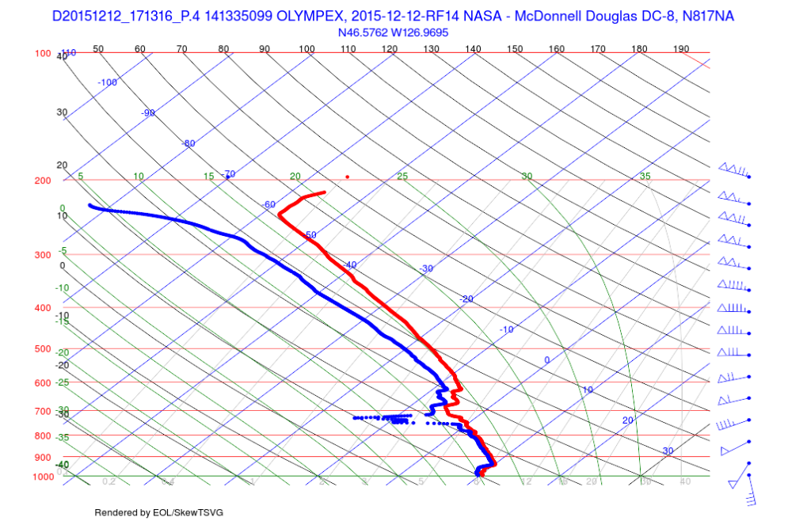
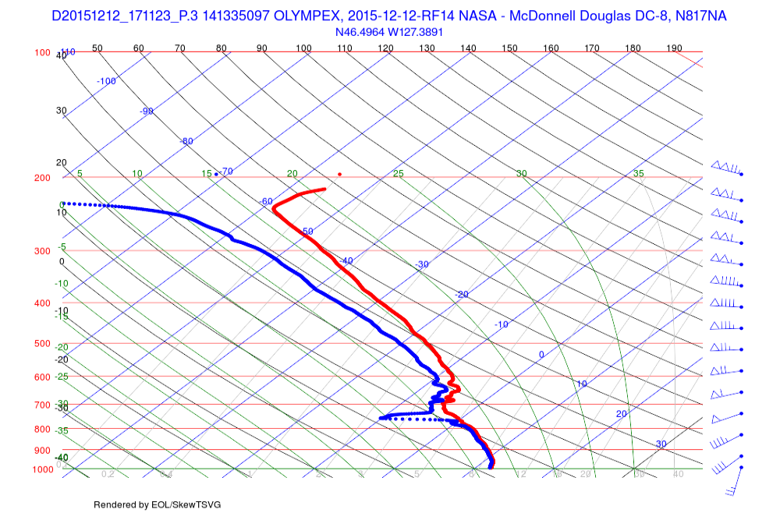
DC8 Aircraft Data - Dropsondes
Farthest
1707 UTC
46°N 128°W
Flight Track
Front
Dropsondes Toward Front
1711 UTC
46°N 127°W
Closest
1713 UTC
46°N 126°W
Notes:
One great instrument for this is the DC8 aircraft. During this event we had the fortune of having the plane fly during the frontal passage and they were able to launch several dropsondes out of the plane as they flew from behind towards the front. Dropsondes are essentially radiosondes that instead of being carried by a balloon upwards fall towards the ground after being released from an aircraft.
You can see that as they approached the front the midlevel drying steadily decreased. Also, the winds near the surface rotated from coming from the south to coming from the west.

Slide 12
DC8 Aircraft Data -
Ka-Band Reflectivity
Flight Track
Front
128°W
127°W
126°W
West
East
FRONT
More upper-level clouds and shallow precipitation as approach front.
Notes:
-This plane also had three radars on it. And we can then use that to see how the precipitaiton changed with this changing evironment. The red lines show the location of the dropsondes. We can see that as they approached the front and the midlevel moistened there was an increase o upper level and low-level clouds.

Slide 13
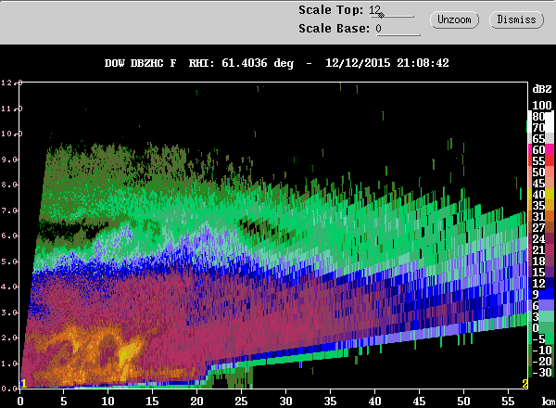
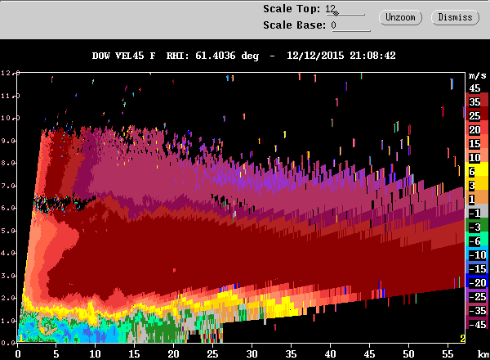
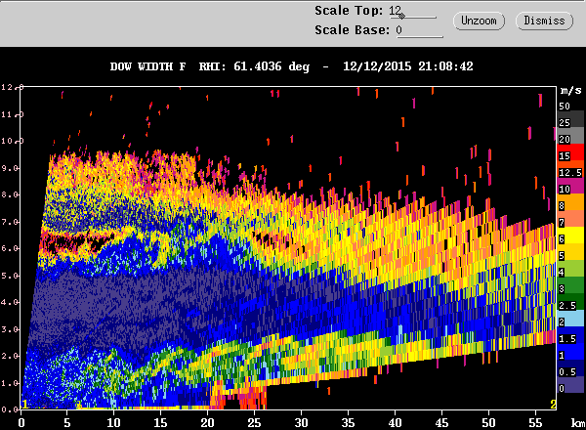
DOW X-Band Radar
2102 UTC
Shear induced Kelvin-Helmholtz waves
Reflectivity
Radial Velocity
Spectrum Width
Strong Shear
Kelvin-Helmholtz Waves
Notes:
- This is something very interesting. Remember how I mentioned how the vertical wind shear became very strong during the frontal and post-frontal periods. Well, there is evidence that this strong shear led to the development of atmospheric waves called kelvin-helmholtz waves and we can see these in the DOW radar. All these figures are vertical cross sections. The top row shows radar reflectivity. The bottom left shows radial velocity with blue colors toward the radar and red colors away. You can see that at low levels there is an adrupt change in the wind direction as it rapidly changes from toward to away. The bottom right shows what we call spectrum with, which bascially shows the variability of the radial elocity. You notice that this has a braided structure. This structure is know to be assoicated with these Kelvin-Helmholtz waves. We observed these several times and you will be hearing more about them in the coming talks.

Slide 14
Conclusions
  OLYMPEX observations allow analysis from synoptic to microscale
  12 December 2015
    Synoptic: Occluded front
    Mesoscale:
      Abrupt rise in melting level
      Stratiform -> convective
    Microscale:
      Drop size changes
      Midlevel drying behind front
      Kelvin-Helmholtz waves
  Similar analyses available for all days during OLYMPEX available at http://olympex.atmos.washington.edu/index.html?x=Science_Summaries

Slide 15
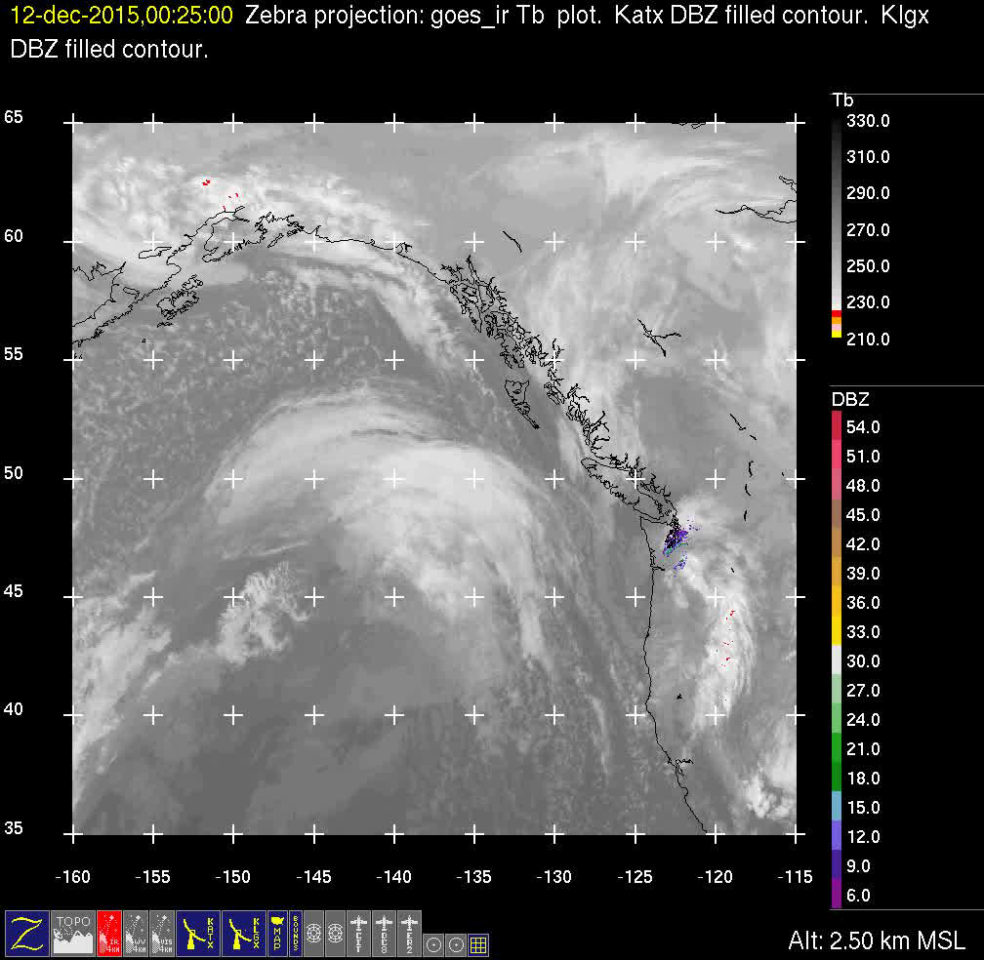
Satellite Loop

Slide 16
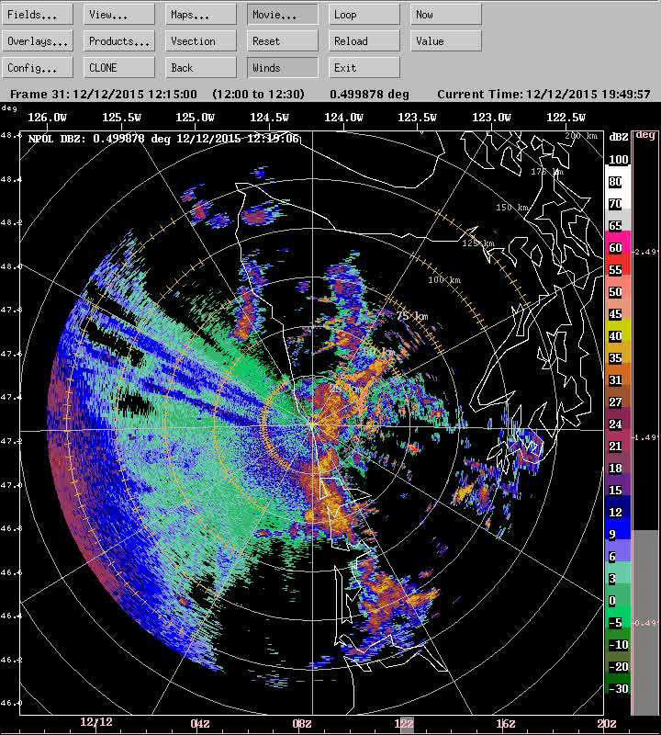
12 December 2015 Occluded Front
NPOL S-Band Reflectivity

Slide 17
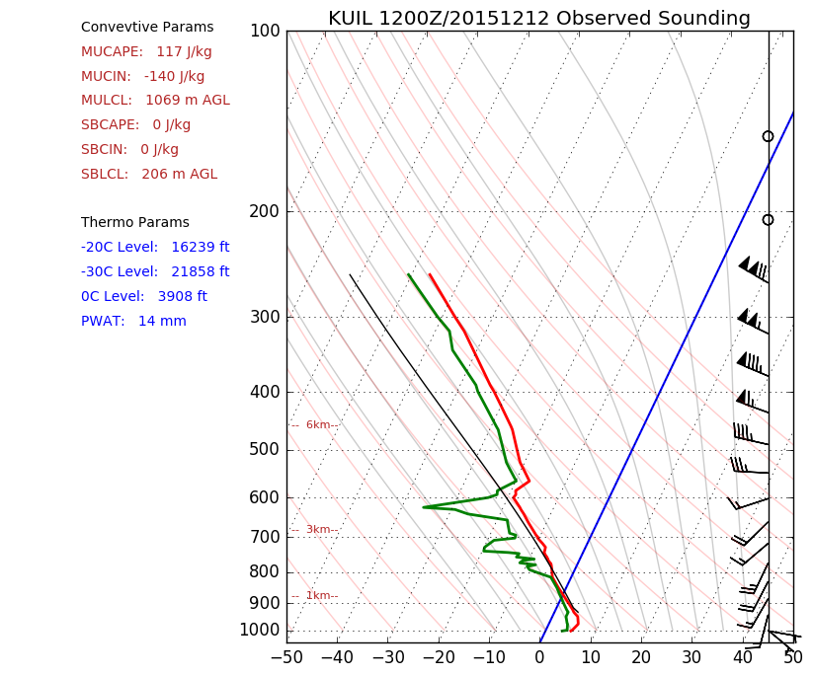
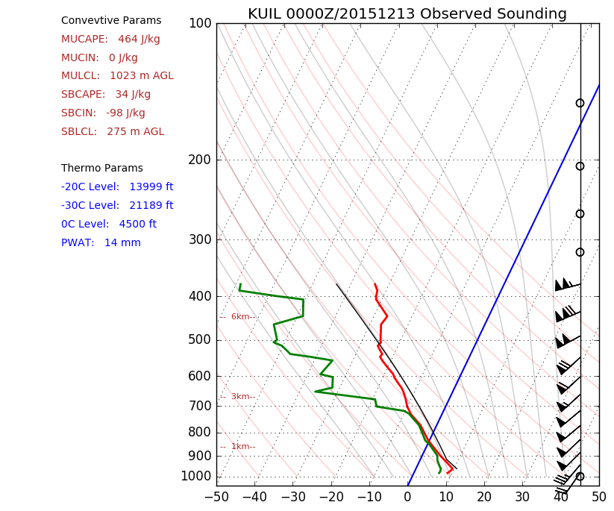
Quillayute Sounding Data
1200 UTC 12 Dec.
0000 UTC 13 Dec.
Pre-Frontal
Post-Frontal
Mid-upper troposphere dries
Destabilize
Melting level rise
Winds increase
Notes:
- Another routine tool we have for understanding these events on the coast is the Quillayute soundings. The 12 UTC Dec 12th and 00 UTC 13 Dec 13th bracketed the occluded front, one the 12th was launched in the pre-frontal period and the 13th was launched in the post-frontal enivronment. You can see that those 12 hours significant changes occurred. Red is temperature, green Is dew point. Blue line highlights the 0C line. Gray line is a lifted parcel. Some of my striking changes include a drying of the atmosphere above 700 hPa, destablization of the lower atmosphere, and a strong increase in the winds. Additionally if you look closely you can see that the height of the melting level has increased.

Slide 18
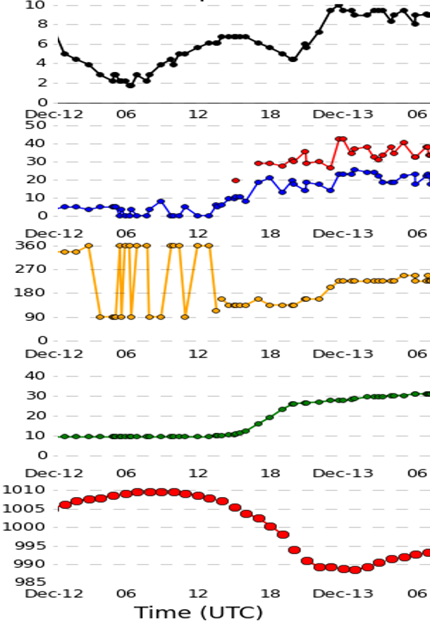
Quillayute Surface Obs. - 12 Dec. 2015
Temperature (°C)
Temperature rise
Average wind speed and gusts (mph)
Wind direction
Change in wind direction
Accumulated precipitation (mm)
Most precipitation before front
Mean sea-level pressure (hPa)
Broad pressure trough
Occluded Frontc

