Slide 1
Mesoscale Convective Systems over the Maritime Continent:
A CloudSat/Multisensor Perspective
Angela Rowe, Robert Houze, Jr.,
Katrina Virts, Manuel Zuluaga
University of Washington, Seattle, WA
CALIPSO-CloudSat Science Team Meeting
Newport News, VA
1 March 2016

Slide 2
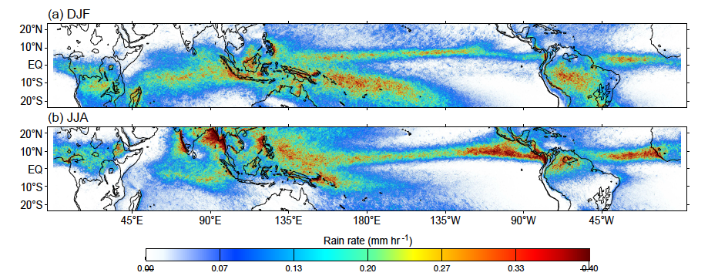
Tropical rainfall
From Houze et al. (2015)
TRMM PR
Notes:
Distribution of rainfall (average rain rates) across the tropics in Dec-Feb and Jun-Aug from 16+ years of TRMM Precipitation Radar
Tropical latent heating concentrated in three zones associated with land masses: central Africa, Amazonia, monsoonal complex extending from South Asia through the Maritime Continent to northern Australia
Significant amounts of latent heating also occurs over open oceans: ITCZ, SPCZ; note near-coastal maximization of oceanic convection occurs in connection with monsoonal climates, mountain ranges near coastlines

Slide 3
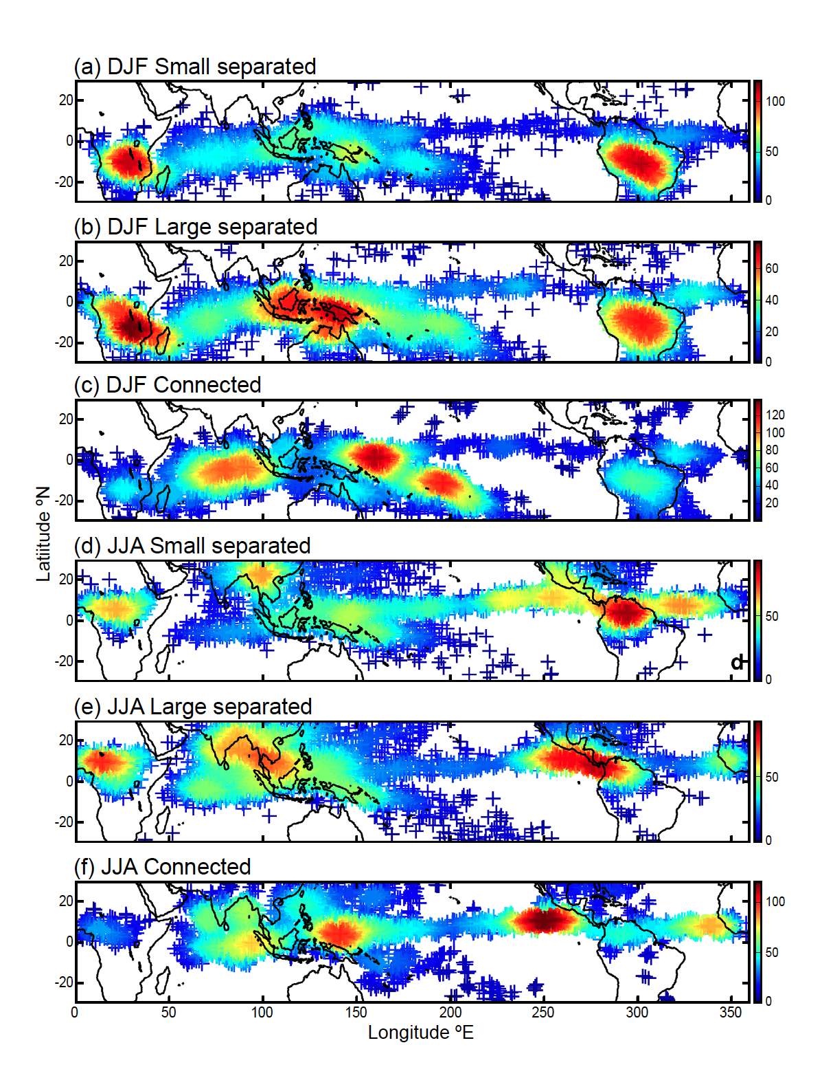
A-Train Identification of MCSs
Smallest 25% (<12,000 km²)
Largest 25% (>40,000 km²)
“Superclusters”
Yuan and Houze 2010
Yuan and Houze 2010
Aqua MODIS and AMSR-E, CloudSat CPR
Notes:
Size of MCS is size of cold cloud top. To qualify as MCS, must have large cold cloud top, large rain area, and some heavy rain. This figure shows spatial distribution of active MCSs. Color of each point shows the number of active MCSs found within a circular area with radius of five degrees centered on that point. (a) Small separated MCSs (<12,000km2; i.e., the smallest 25%) in DJF, (b) large separated MCS (>40,000km2; i.e., the largest 25%) in DJF, (c) connected MCS in DJF, (d)-(f) same as (a)-(c) except for JJA.
Small separated MCSs numerous mainly over continental regions of Africa and S. America
Large separated MCSs occur frequently in these same continental regions
Large separated MCSs occur with great frequency over the MC (relatively few small ones occur)
Oceanic conditions in the MC favor growth of MCSs to larger sizes
Connected MCSs occur mostly over warm pool regions of Indian and west Pacific Oceans (weaker diurnal cycle – strong diurnal cycle over MC likely limits large connected systems there)

Slide 4
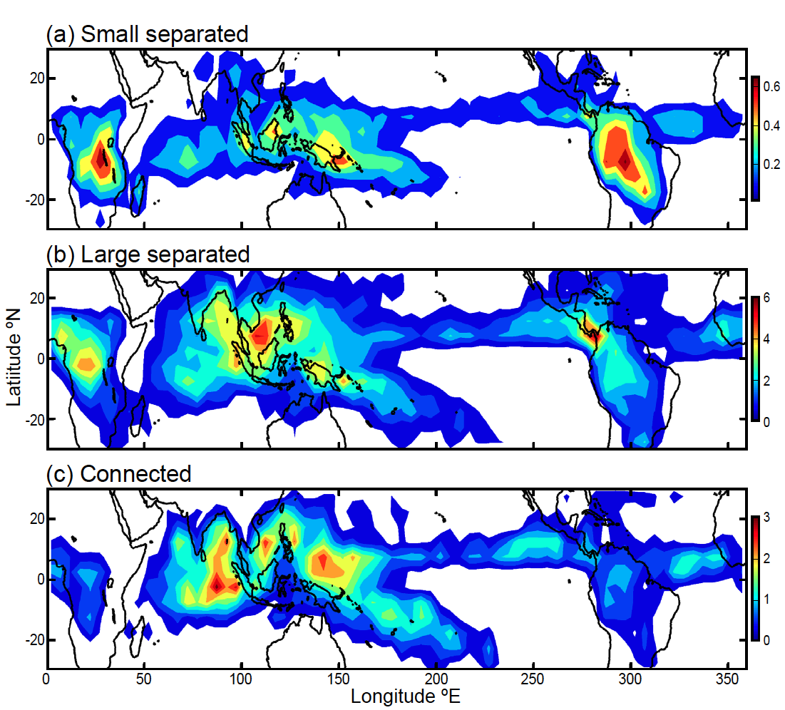
A-Train Identification of Anvils
Aqua MODIS and AMSR-E, CloudSat CPR
Yuan and Houze 2010
Notes:
Annual climatology of MCS anvil clouds for 2007. Color shows percentage of area covered by anvil clouds associated with (a) Small separated MCSs, (b) large separated MCSs, and (c) connected MCSs for each 5x5 grid.
Anvil clouds from large separated MCSs favored over open water, occur 10 times more frequently than those of small separated MCSs and cover several times more area overall
Nonraining anvils of MCs throughout tropics mostly <~10 km thick (modal thickness of ~4-5 km)
Over warm oceans of the warm pool, less thick anvils may extend out to 5 times the equivalent radii of primary rain areas of the MCs
Relationship to distance from raining core, processes forming anvil (convective/stratiform)
Differences in reflectivity distributions of anvils in MCSs over ocean, continents (thicker anvils nearly absent over continental regions)
Focus on frequency of anvils in MC, WP
Maritime Continent:
Important energy source of global circulation
GCMs still have trouble resolving convection over MC (boreal winter)
Poor representation of MJO
Significant diurnal cycle
Cloud lifecycle
Latent heating (convective/stratiform)
Radiative heating (anvil characteristics)
CloudSat CPR: vertical structure of anvils (diurnally, regionally)

Slide 5
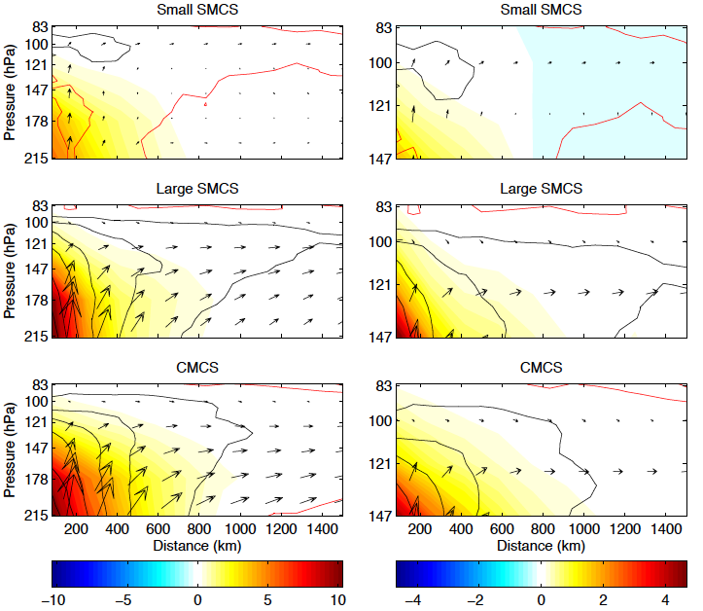
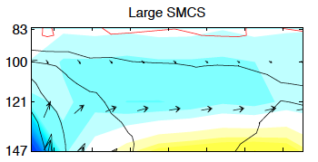
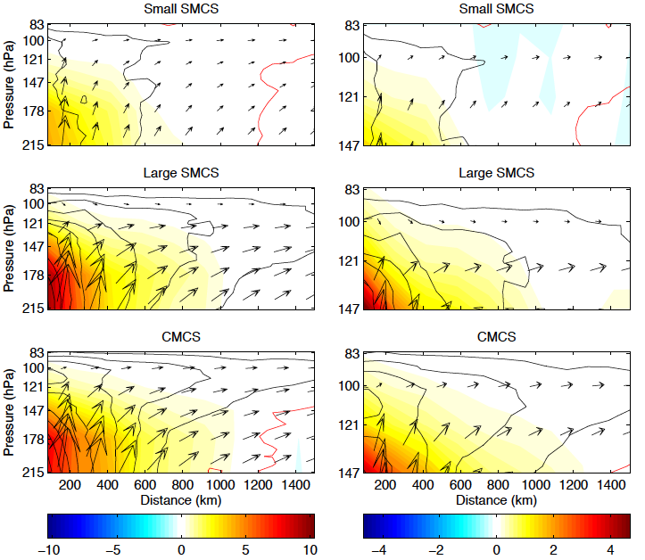
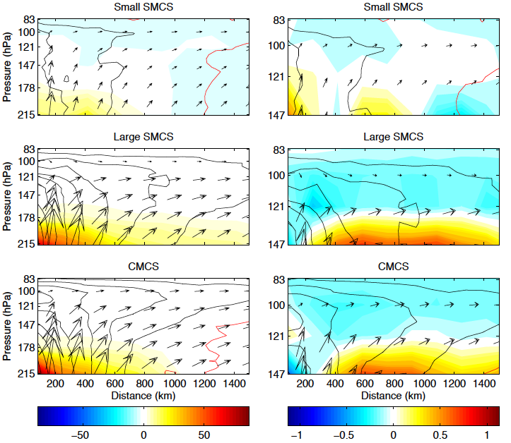
IWC anomalies
WV anomalies
MC
WP
See Virts and Houze (2015)
Aura MLS (IWC, WV: shading), CALIPSO CALIOP (cloud fraction: black contours)
Notes:
Conventions for the IWC and WV plots are as in the paper--what's plotted are anomalies from the climatological monthly mean, overlaid with CALIPSO cloud fraction and ERA-Interim wind anomalies.
IWC and water vapor mixing ratio profiles retrieved from thermal microwave emissions in five spectral regions measured by the MLS aboard A-Train’s Aura
IWC: Outward advection of cloud ice at high altitudes (TTL above 150 mb), greatest for larger systems
MC interior (left) vs West Pacific open ocean (right)

Slide 6
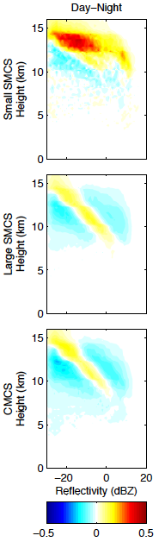
Warm Pool/MC
Day (1330 LT) – Night (0130 LT)
CloudSat CPR
Notes:
Noticeable narrowing of CFADs and decreases in overall reflectivity found when moving away from rain areas
Anvils in CMCSs tend to show a sharply peaked, narrower histogram at most levels, whereas SMCSs show a mode of high reflectivity concentration in the lower portion of the cloud
Difference CFADs:
Daytime small SMCSs stronger, broader reflectivities aloft (convective)
For large and connected MCSs, the daytime distributions are narrower, perhaps indicating their maturity (more time for size sorting/aggregation processes).
Similar for connected MCSs
Larger reflectivities in anvil clouds are due to the presence of larger particles
Broadening of PSDs with distance below cloud top due primarily to aggregation of large particles and depletion of smaller ones
Aggregation broadens the size distribution, thereby decreasing the slope
Closest to the raining centers, thick anvils have broadest distribution of reflectivity at any level
Narrowing of reflectivity distribution and weakening of overall reflectivity with increasing distance from raining center consistent with increase in age of anvils (with time, larger particles settled out – size sorting/sedimentation)
Compared to oceanic MCSs, those in continental regions appear to have broader reflectivity distributions, especially in upper portions of anvil clouds
Noticeable narrowing of CFADs and decreases in overall reflectivity found when moving away from rain areas
Anvils in CMCSs tend to show a sharply peaked, narrower histogram at most levels, whereas SMCSs show a mode of high reflectivity concentration in the lower portion of the cloud
Narrower-peaked, high-frequency distribution tilting toward weaker reflectivity with increasing height is characteristic of a stratiform cloud in which ice particle growth dominated by vapor diffusion and aggregation (less influenced by detrainment of ice from convective cores)

Slide 7
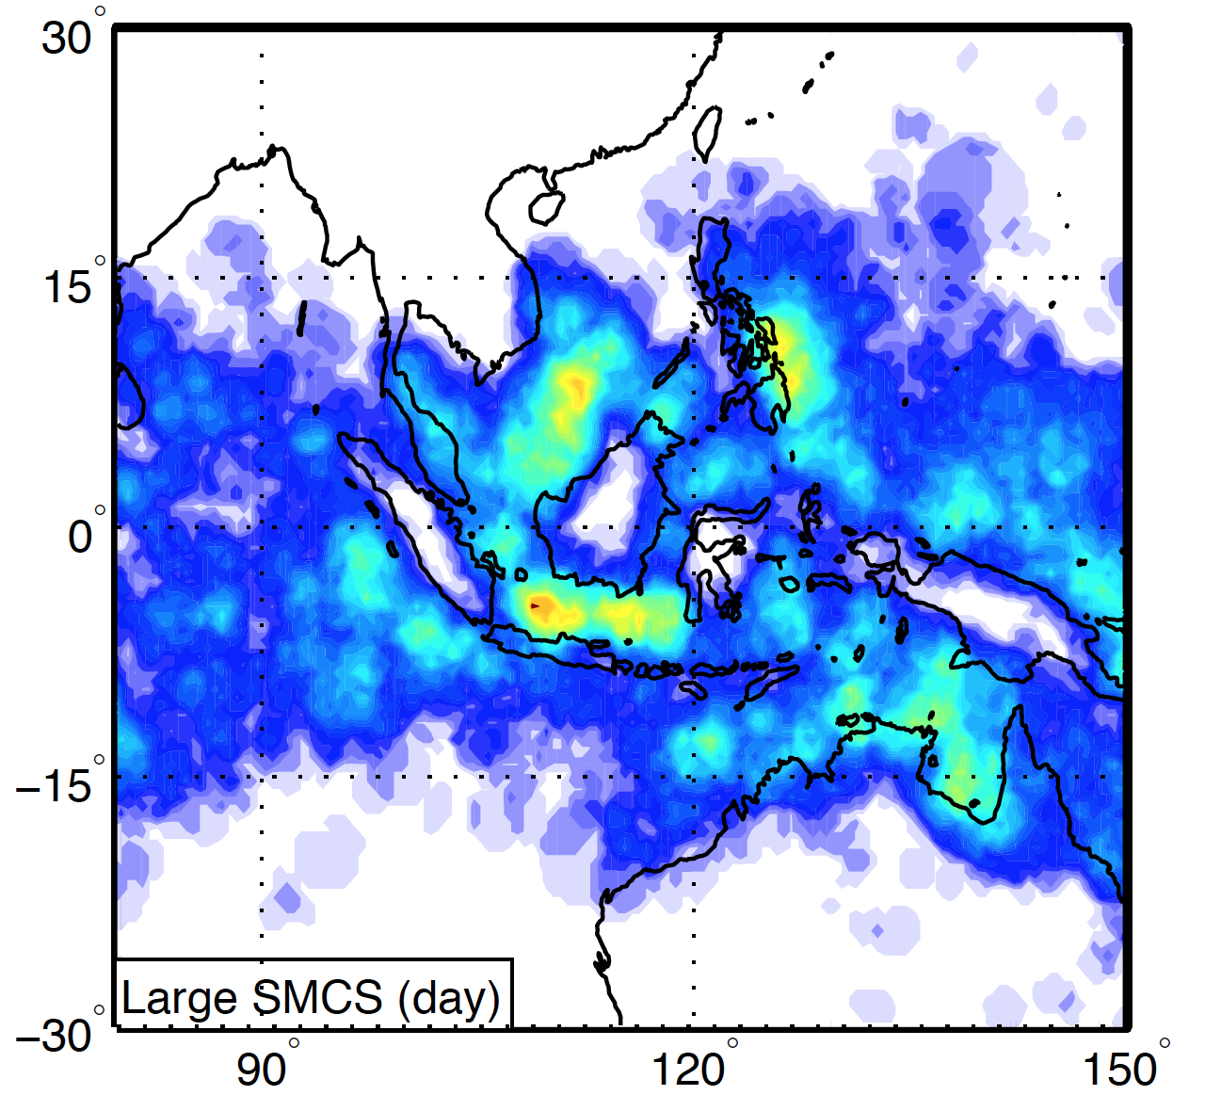
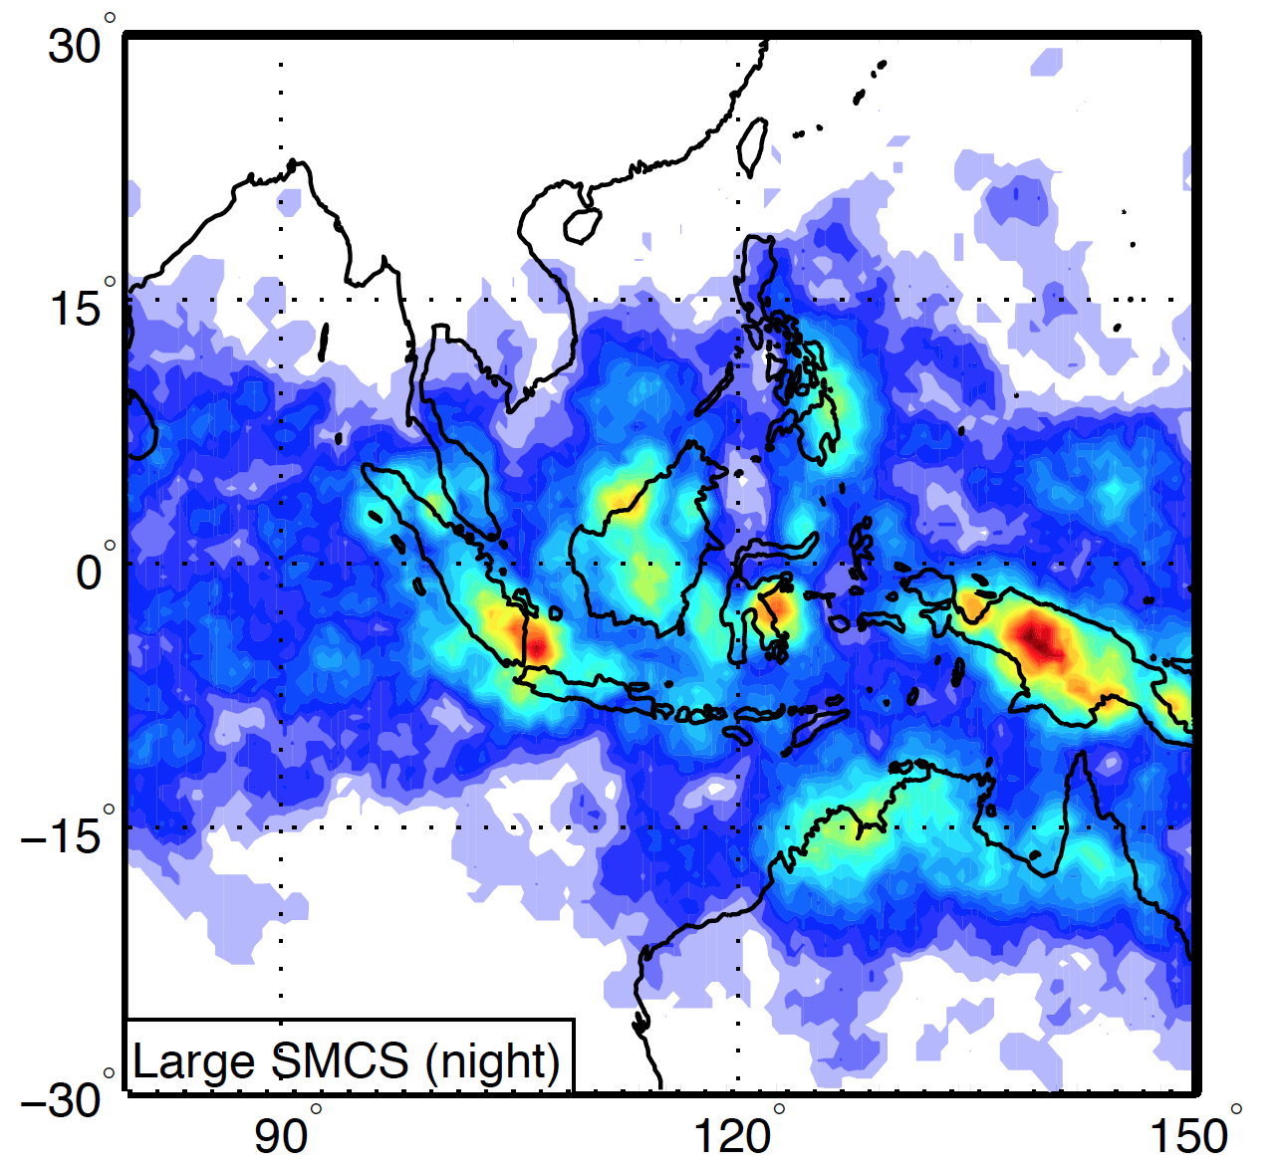
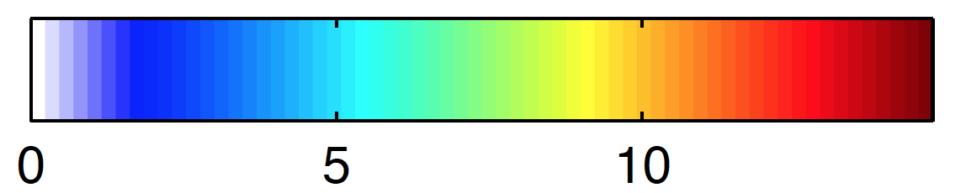
Maritime Continent
Diurnal, land/ocean
Aqua MODIS and AMSR-E
Notes:
Hot spots over land/coasts at night,
Differences in interior Maritime Continent (diurnal cycle, large separated MCSs) and western Pacific (connected MCSs)

Slide 8
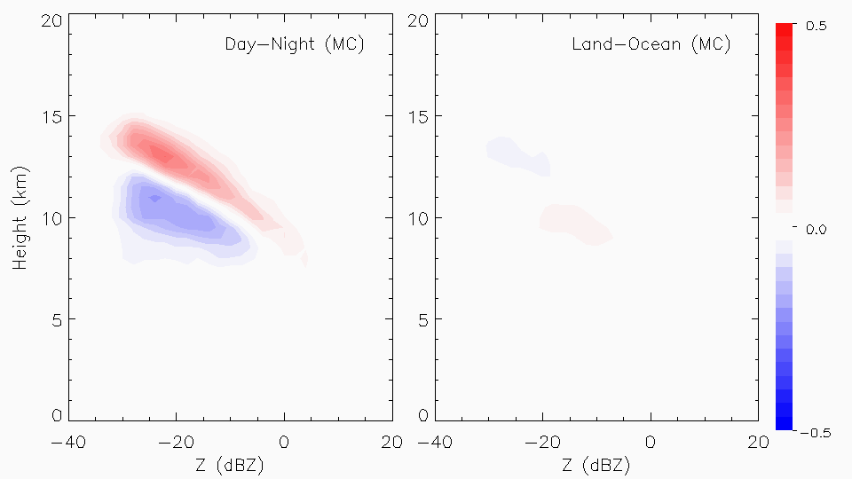
Maritime Continent - anvils
CloudSat CPR
Notes:
Over Maritime Continent: greater difference in diurnal cycle than land/ocean
Daytime: Narrower distribution/decreased slope – mature/aggregation, but higher reflectivities aloft (larger particles)

Slide 9
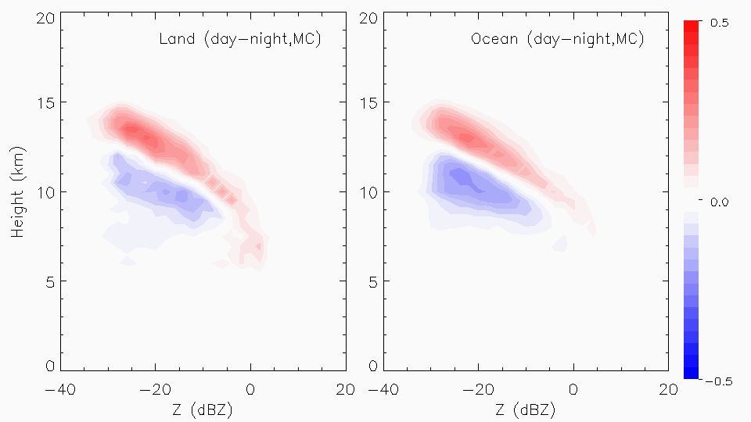
Maritime Continent - anvils
CloudSat CPR

Slide 10
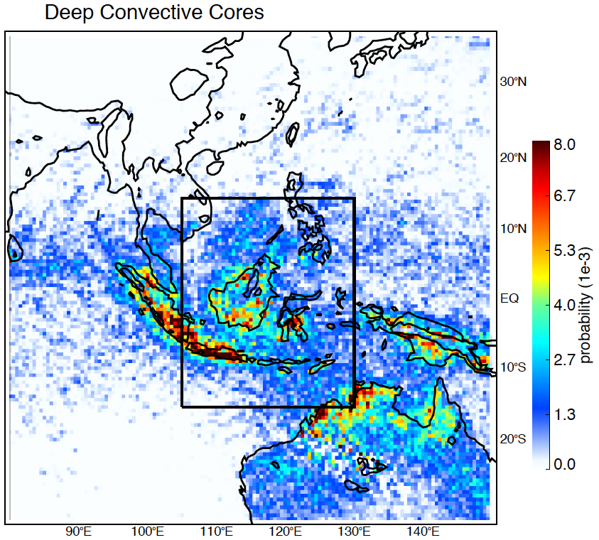
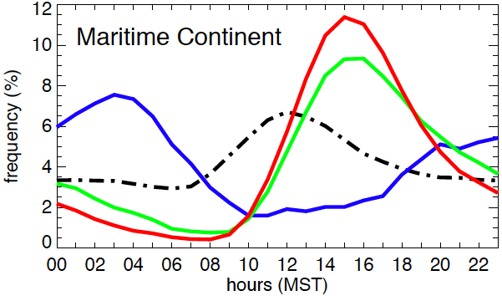
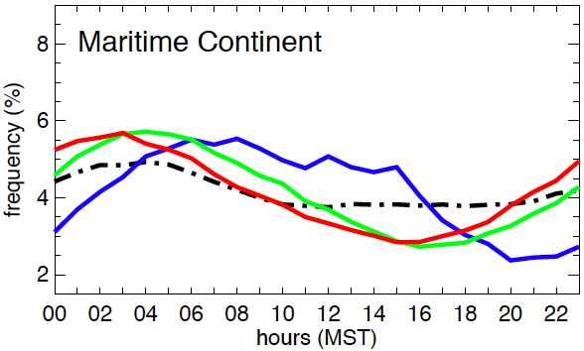
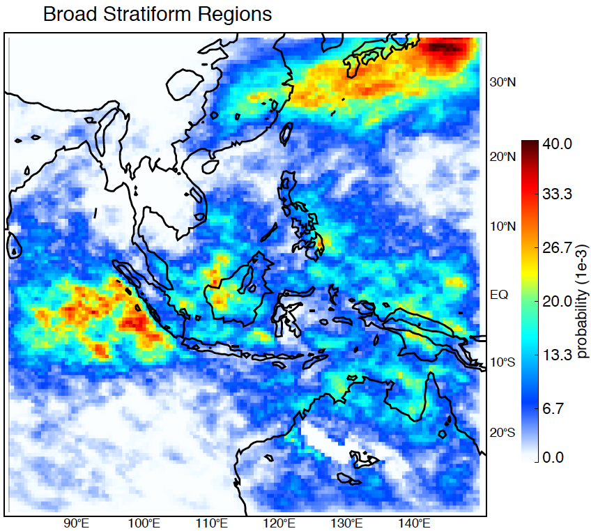
Deep Convective Cores
Diurnal Cycle
Land
Broad Stratiform Regions
Ocean
DCC
WCC
BSR
SHI
TRMM PR
Notes:
Probability of a location being under a DCC, WCC, BSR during NDJF 1998-2013
Analysis for the Maritime Continent!
At 1330 LT (CloudSat “day”):
Over land, increase in deep/wide convection (not quite peak), near min in stratiform (small separated MCSs)
Over ocean: min in convection, more stratiform (decaying)
At 0130 LT (CloudSat “night”) :
Over land, increasing stratiform, nearing min in convection
Over ocean, max convection (still less than afternoon convection over land), increasing stratiform

Slide 11
Maritime Continent - anvils
Day: Diurnally driven convection
Night: Developing system
Day: Decaying system
Night: Developing system
CloudSat CPR
Notes:
MCSs tend to form during the night then slowly spread out, weaken during the day

Slide 12
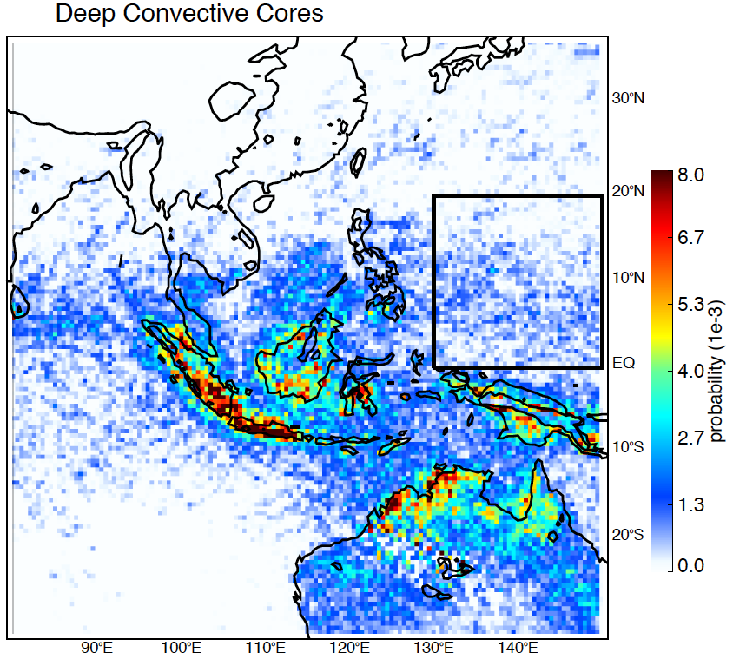
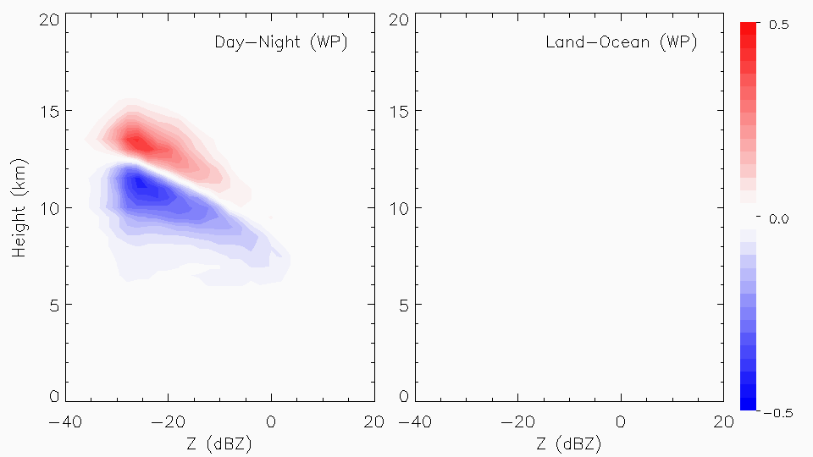
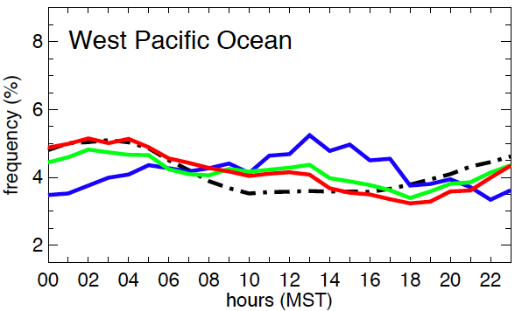
West Pacific Ocean
Ocean
Taller anvil with mature system during day, but broader distribution at night (convective)
CloudSat CPR, TRMM PR
Notes:
Similar diurnal dependence over Warm Pool (oceanic only)
Analysis for the West Pacific Ocean
At 1330 UTC (CloudSat “day”): peak in stratiform (mature)
At 0130 UTC (CloudSat “night”): min in stratiform, developing from convection
So are there differences between anvil characteristics over WP and MC?

Slide 13
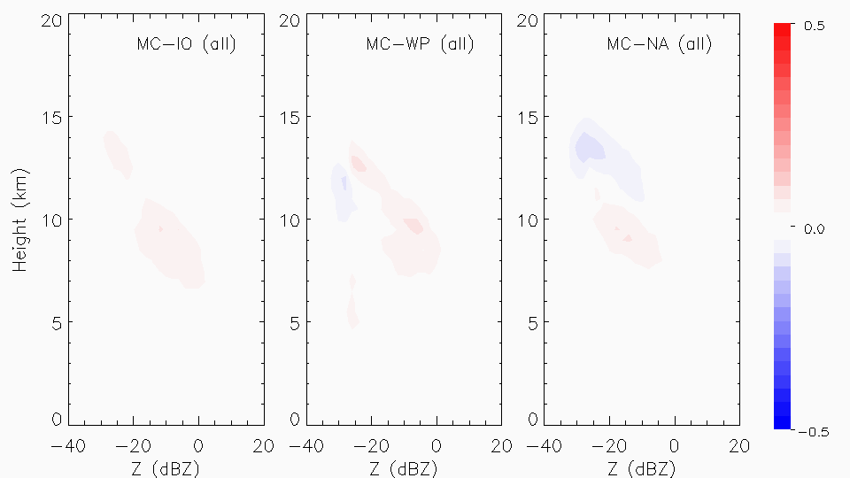
Maritime Continent vs. West Pacific
Subtle difference overall!
Taller, broader, more intense over MP
Diurnal?
Land vs Ocean?
Conv/strat?
CloudSat CPR
Notes:
Not much difference
Slight tendency for deeper, stronger, broader reflectivities over MC (land? Convection?)

Slide 14
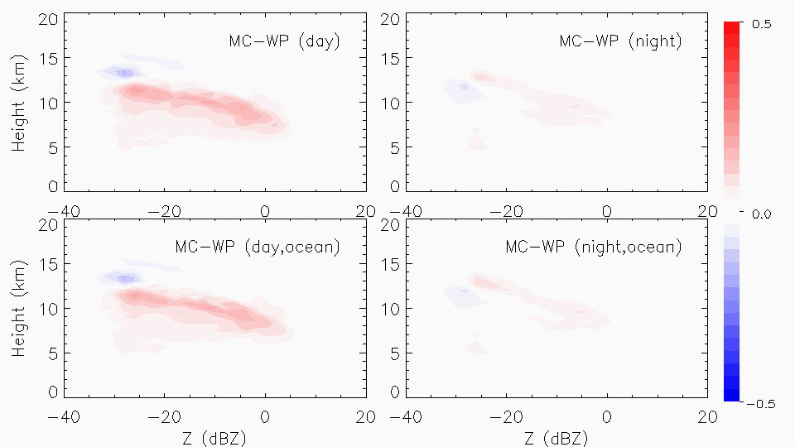
Maritime Continent vs. West Pacific
Biggest differences during day
More intense, broader over MC
Taller for WP
Taller, strong, broader over MC at night
CloudSat CPR
Notes:
At night, similar pattern to all
But during day, while reflectivity distributions are broader and stronger over MC, see deeper anvils over WP when isolate ocean areas only
Maximum anvil reflectivity over ocean located higher in altitude during day: widespread cold cloud entities slowly rising in the upper troposphere (relevant to injection of ice and water vapor into troposphere

Slide 15
Conclusions
Maritime Continent
Similar
W. Pacific
Land
Similar
Ocean
Ocean
Developing SMCSs
Decaying LMCSs
Stronger, lower
Mature LMCSs
Day
Taller,
Stronger,
Broader
Taller,
Stronger,
Narrower
Taller,
Narrower
Developing LMCSs
Developing LMCSs
Similar
Developing LMCSs
Night
Dependence on diurnal cycle, MCS type, lifecycle (multisensor)
Implications for feedbacks, Comparison to other regions
Notes:
Relationship with lifecycle (mature: more time for size sorting/aggregation, decaying, proximity to convection)
Daytime peak in stratiform over WP: widespread cold cloud entities slowly rising in upper troposphere (aggregation processes, mature)
Future work
MJO phase
Comparison with continental (Africa), green ocean (Amazonia), coastal regions

Slide 16
Thank you!
This work is supported by NASA Grants #NNX13AQ37G, #NNX13AG71G, #NNX16AD75G

