Slide 1

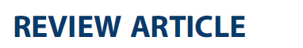
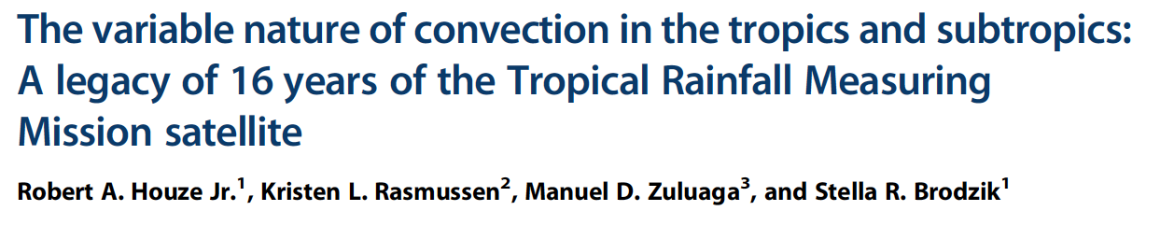
Global Distribution of Different Forms of Convection as Seen by TRMM
Robert A. Houze, Jr.
University of Washington
with: K. L. Rasmussen, M. D. Zuluaga, and S. R. Brodzik
Presented at:
UW Atmos. Sci. Colloquium, 22 January 2016

Slide 2
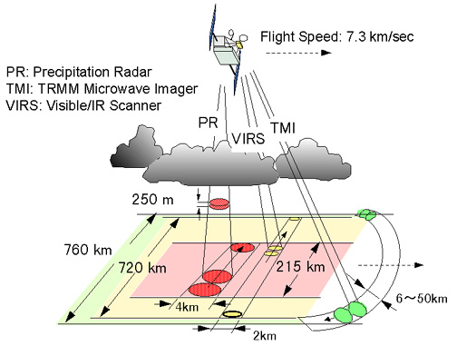
TRMM Instruments
λ= 2 cm
PR: Precipitation Radar λ = 2 cm
>
Kummerow et al, 1998
Notes:
Our work is based on the Precipitation Radar

Slide 3
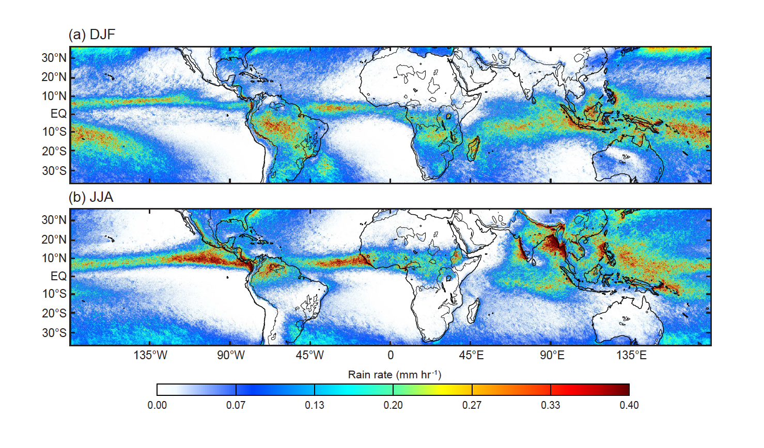
Rainfall from TRMM PR
Notes:
Primary reason for TRMM
Now well known from TRMM
Major features: ITCZ, SPCZ, MC, Africa, tropical S. America
NOTE ESP: Amazon and MC in DJF
Only seasonal difference is the addition of the S. Asian monsoon in summer

Slide 4
TRMM Instruments
λ= 2 cm
Important! Radar measures 3D structure of radar echoes
PR: Precipitation Radar λ = 2 cm
>
Kummerow et al, 1998
Notes:
TRMM PR is a radar; it samples a 3D volume with fine spatial resolution.
Like to look at the radar like a radar meteorologist

Slide 5
Re-map and interpolate the PR reflectivity field
Satellite
Interpolate
Geolocate
Notes:
Like any radar the data come in along beams at range gates.
Need to interpolate….
….and in the case of the TRMM PR locate the data relative to Earth

Slide 6
Use remapped & interpolated data to:
View PR data in visualization software
Objectively identify 3D echo objects indicative of convective lifecycle stage

Slide 7
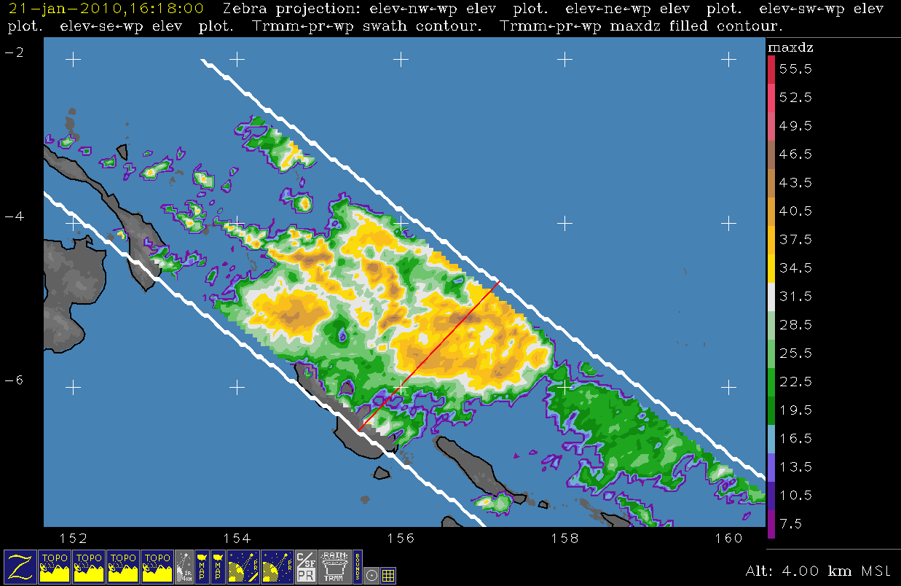
Notes:
Example
Note red line

Slide 8
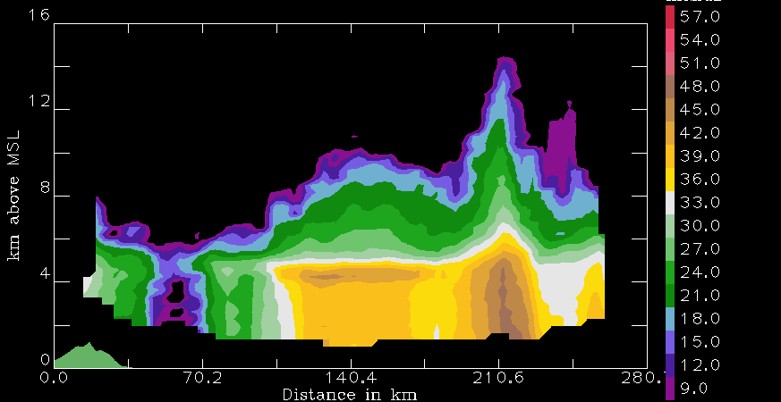
TRMM algorithm subdivisions
Other
Stratiform
Convective
Notes:
Like an RHI
See clearly conv & sf areas
TRMM algorithm→C/SF separation→imp. For latent heating calculations

Slide 9
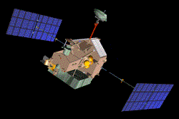
Convective cores
3D convective echo bounded
by threshold dBZ
echo
core
land
Type | Threshold | Width | Height
Shallow-isolated | 17 dBZ | 2 pixels | < 5 km
Deep-strong | 40 dBZ |  | >10 km
Deep-moderate | 30 dBZ |  | > 8 km
Wide-strong | 40 dBZ | >1000 km²
Wide-moderate | 30 dBZ | >800 km²
Notes:
First—we look at convective echo structure in the TRMM data.
To do this—identify 3D echo “cores” that are EMBEDDED in larger echoes
Shallow isolated—are generally warm rain showers or small cumulonimbus clouds—fall into the category of “congestus”
Deep cores—associated with young, extremely vigorous convection
Wide cores—indicate where intense convection is aggregating and growing upscale into mesoscale systems
Two categories
strong categories are better indicators of processes over land
moderate better over oceans

Slide 10
Broad stratiform regions
Look for ones that are broad and contiguous
Stratiform echo volume
land
Type | Width
Strong | > 50,000 km²
Moderate | > 30,000 km²

Slide 11
Terminology:
ISE—isolated shallow echoes
DCC—deep convective cores
WCC—wide convective cores
BSR—broad stratiform regions

Slide 12
More terminology:
We call a contiguous radar echo a “storm”
Note:
A storm may or may not contain a DCC, WCC, or BSR
For example:
Radar echo
“STORM”
DCC
Notes:
Interested in how much of the low-latitude rainfall is due to storms with and without storms containing these extreme forms of convective & sf echo

Slide 13
Recall
Rainfall from TRMM PR
Notes:
Interested in how much of the low-latitude rainfall is due to storms with and without storms containing these extreme forms of convective & sf echo

Slide 14
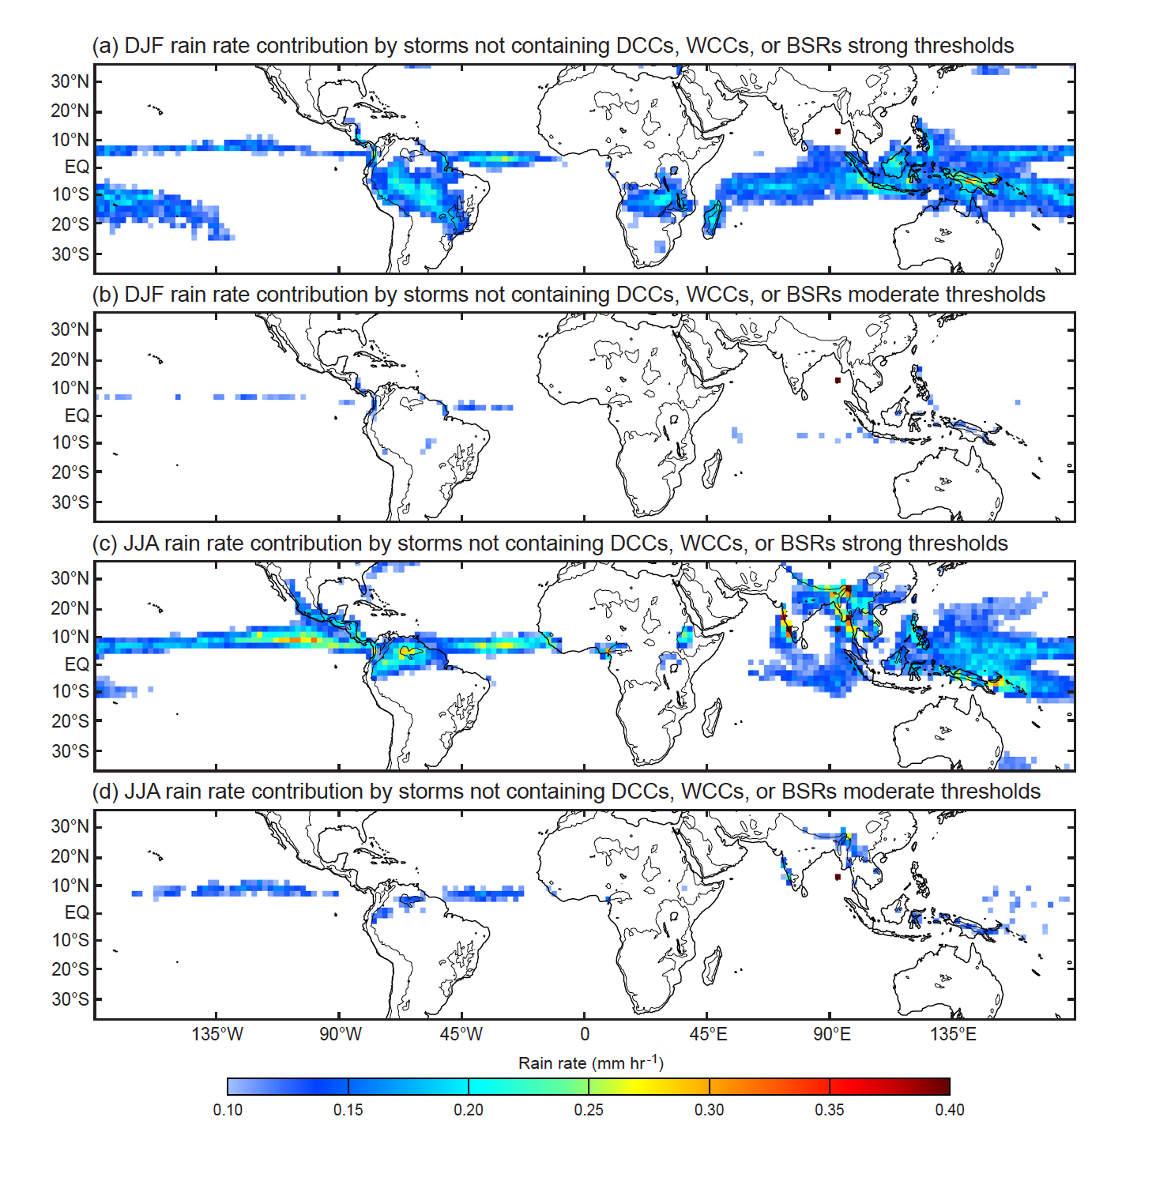
Storms with extreme echo features explain most of the precipitation in low latitudes
Notes:
Storms containing features defined by strong thresholds account quit a bit of total rain, but certainly not all
Storms containing features defined by moderate thresholds account for nearly all precipitation
Slight exceptions—ITCZ and monsoon

Slide 15
The next few slides are maps of the frequency of occurrence of ISEs, DCCs, WCCs , and BSRs defined by both the strong and moderate thresholds

Slide 16
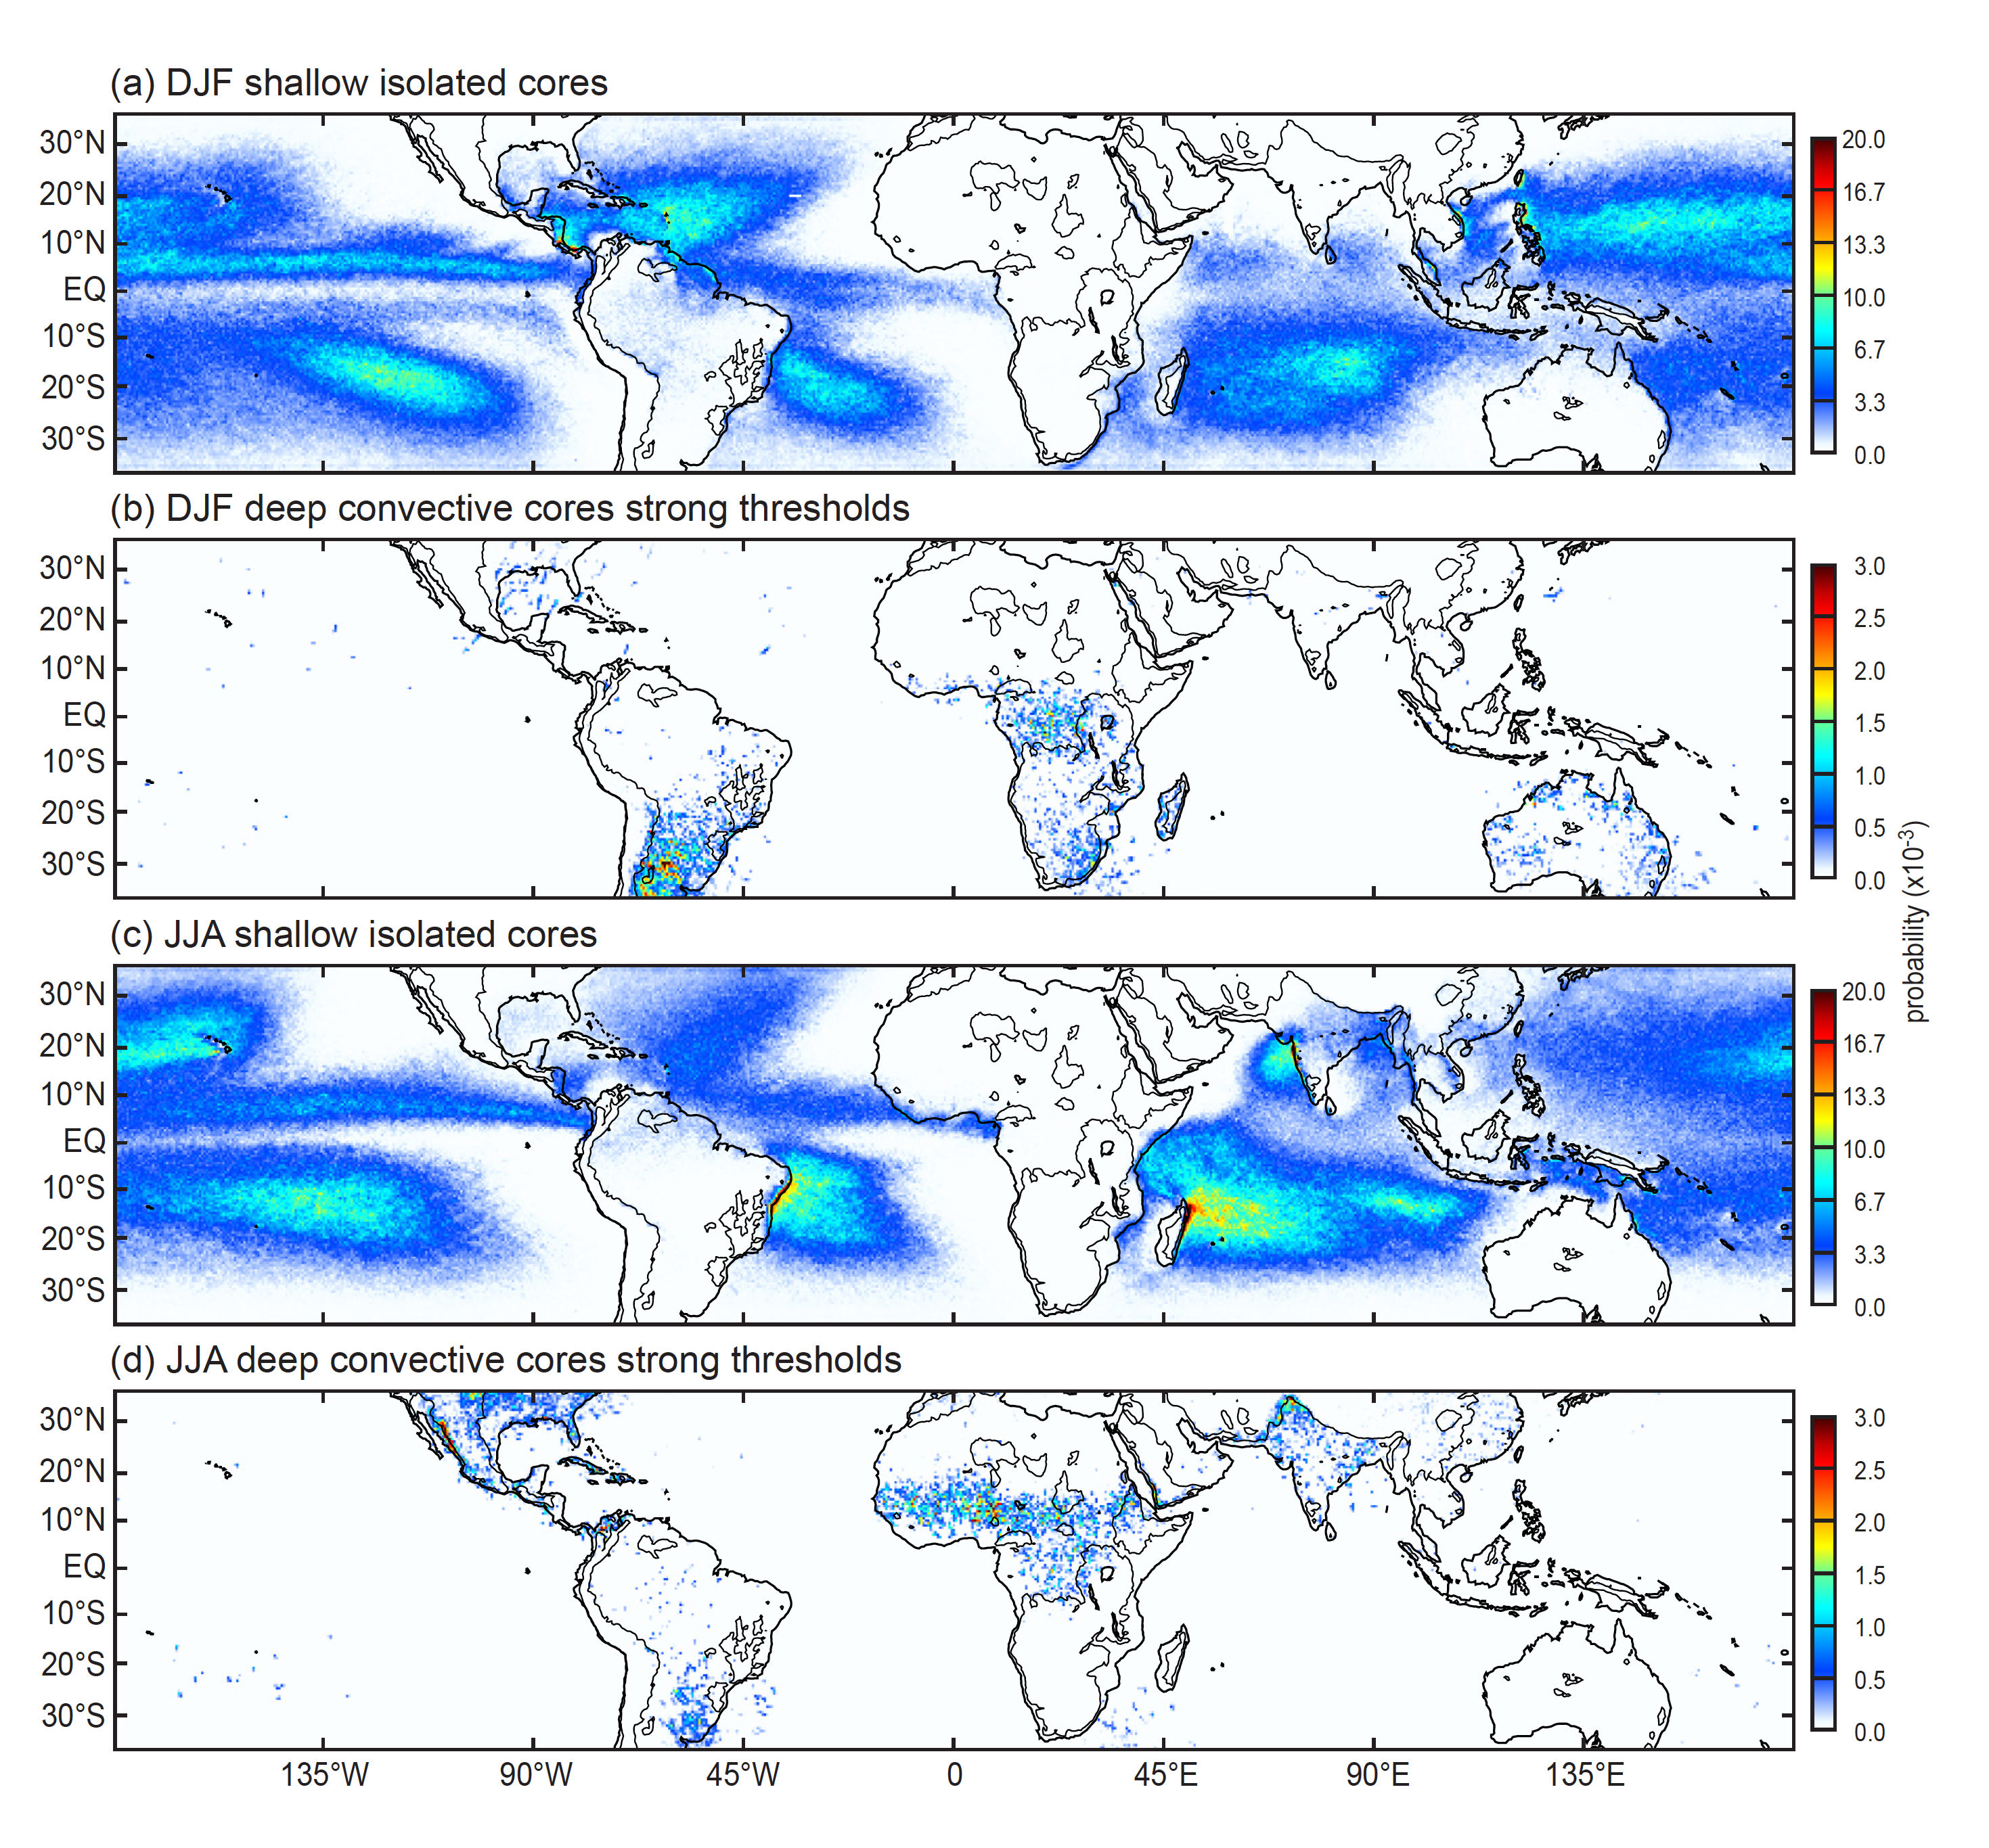
ISEs are oceanic; strong DCC echoes are continental
Notes:
ISE—oceanic
DCC, strong—continental
NOTE→DCC, strong—absent not only over open oceans but also Amazon, and Maritime Continent
Concentrations of ISEs at coastlines of S. America, Madagascar, and to a lesser extent India & Burma

Slide 17
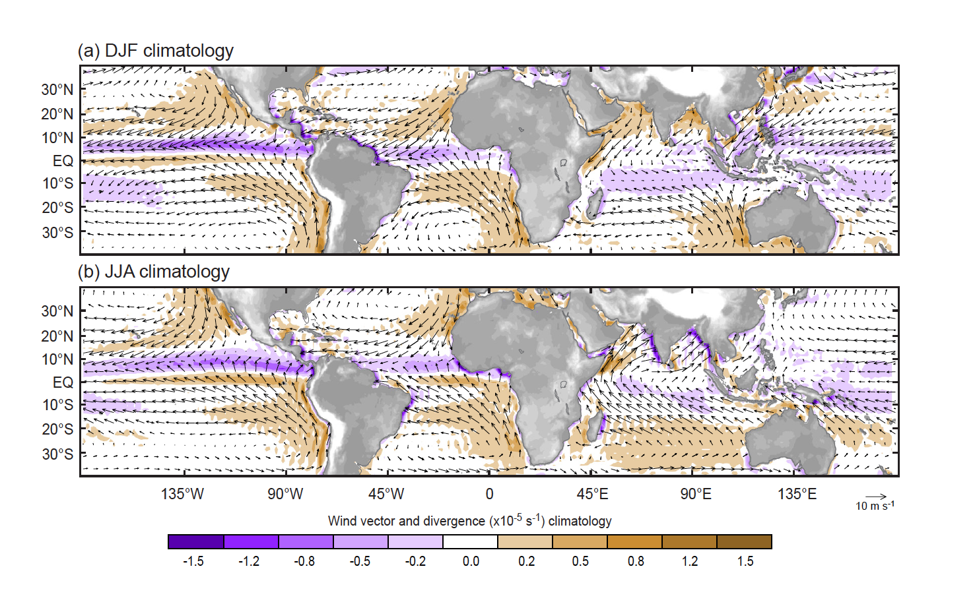
1000 hPa Climatology
Notes:
NOTE:
Convergence on on coast of South America, India, and Burma
Monsoon flow reversal

Slide 18
Recall
Rainfall from TRMM PR
Notes:
How do intensity of convection and mesoscale organization relate to this rain pattern?
In this rain map, note;
Amazonia and MC in DJF—WET
Argentina –DRY

Slide 19
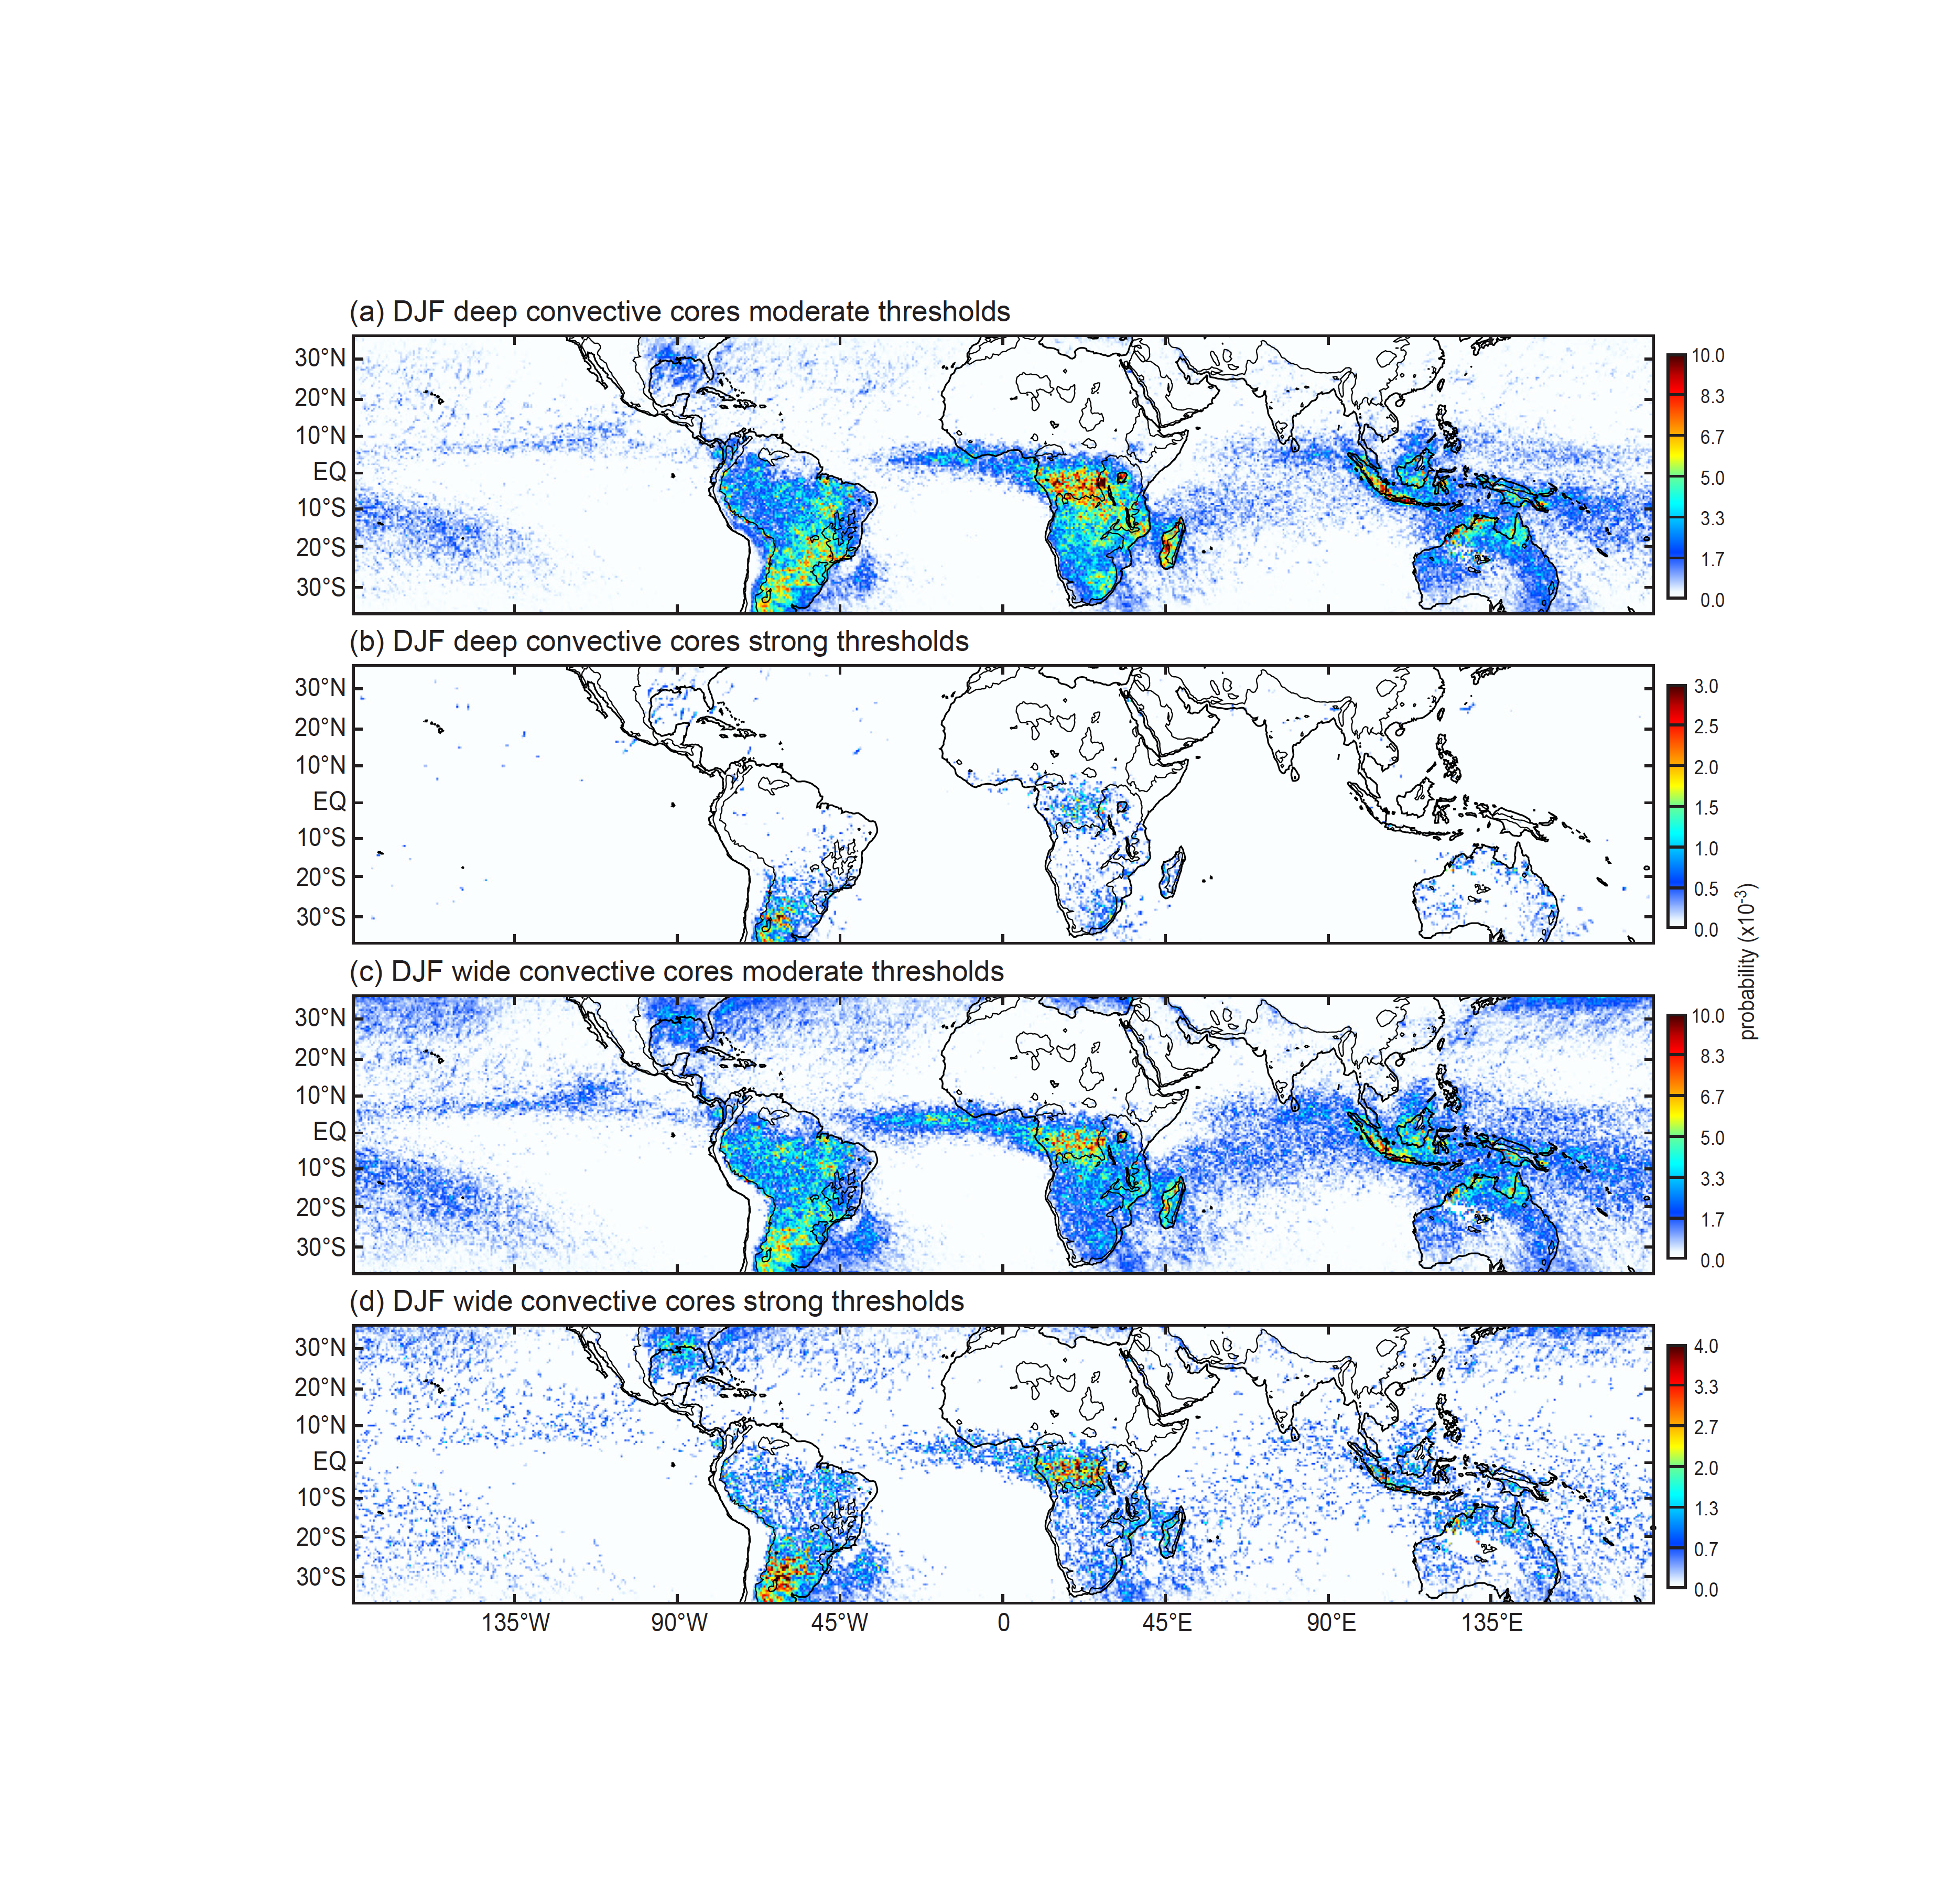
Deep and wide convective cores in DJF
Raininess is associated with
mesoscale organization
but not
intensity of convection
Notes:
WCC by moderate thresholds look most like the rain map
Moderate & strong WCCs all in same places—more over ocean with moderate thresholds
DCC strong—same as previous slide comparing with ISE—
Lacks any correspondence to the rain map don’t occur in all the same places as WCCS
Esp. over Amazon & MC & oceans
→ rainfall and mesoscale system occurrence don’t depend on having the strongest convection

Slide 20
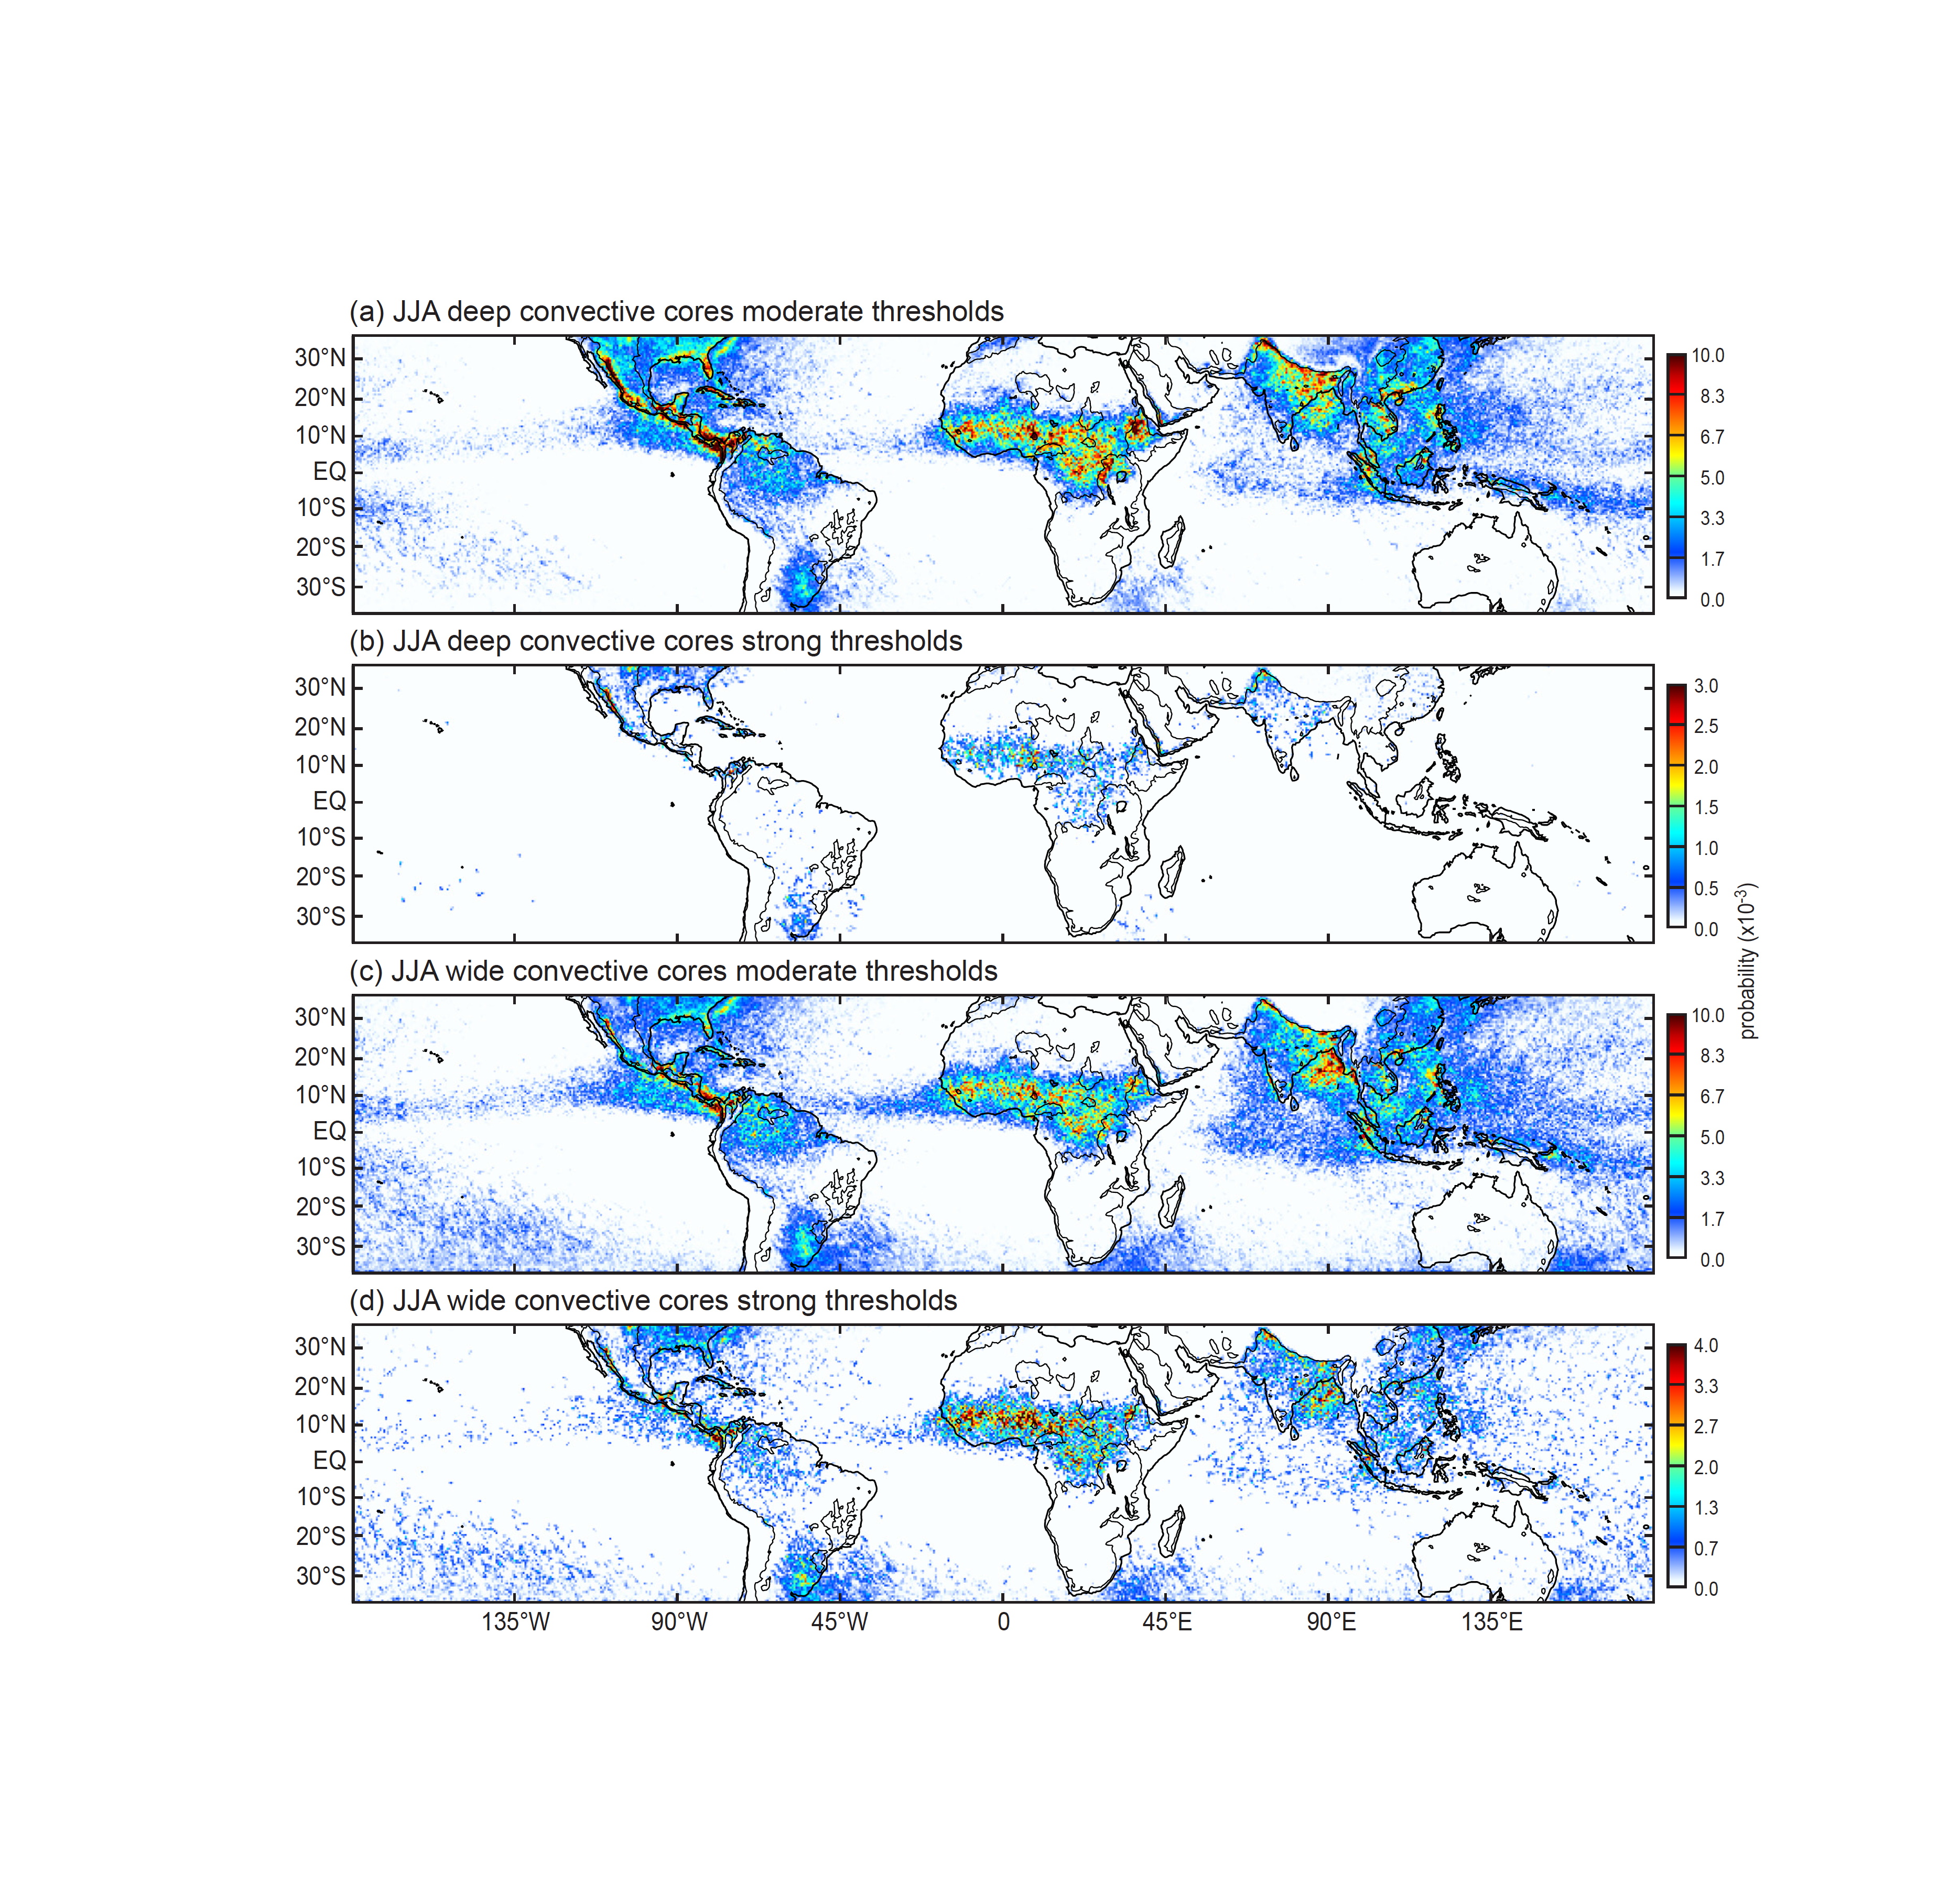
Deep and wide convective cores in JJA
JJA has additional features associated with monsoons
Notes:
Generally similar behavior with some additional features in monsoons of America and Asia
WCCs in both monsoon zones, both moderate and strong
NW subcontinent gets DCC of the strong threshold type—not so much in Bangledesh, where the DCCs are of the moderate type
Hard to see what’s going on in Mesosamerica—zoom in…

Slide 21
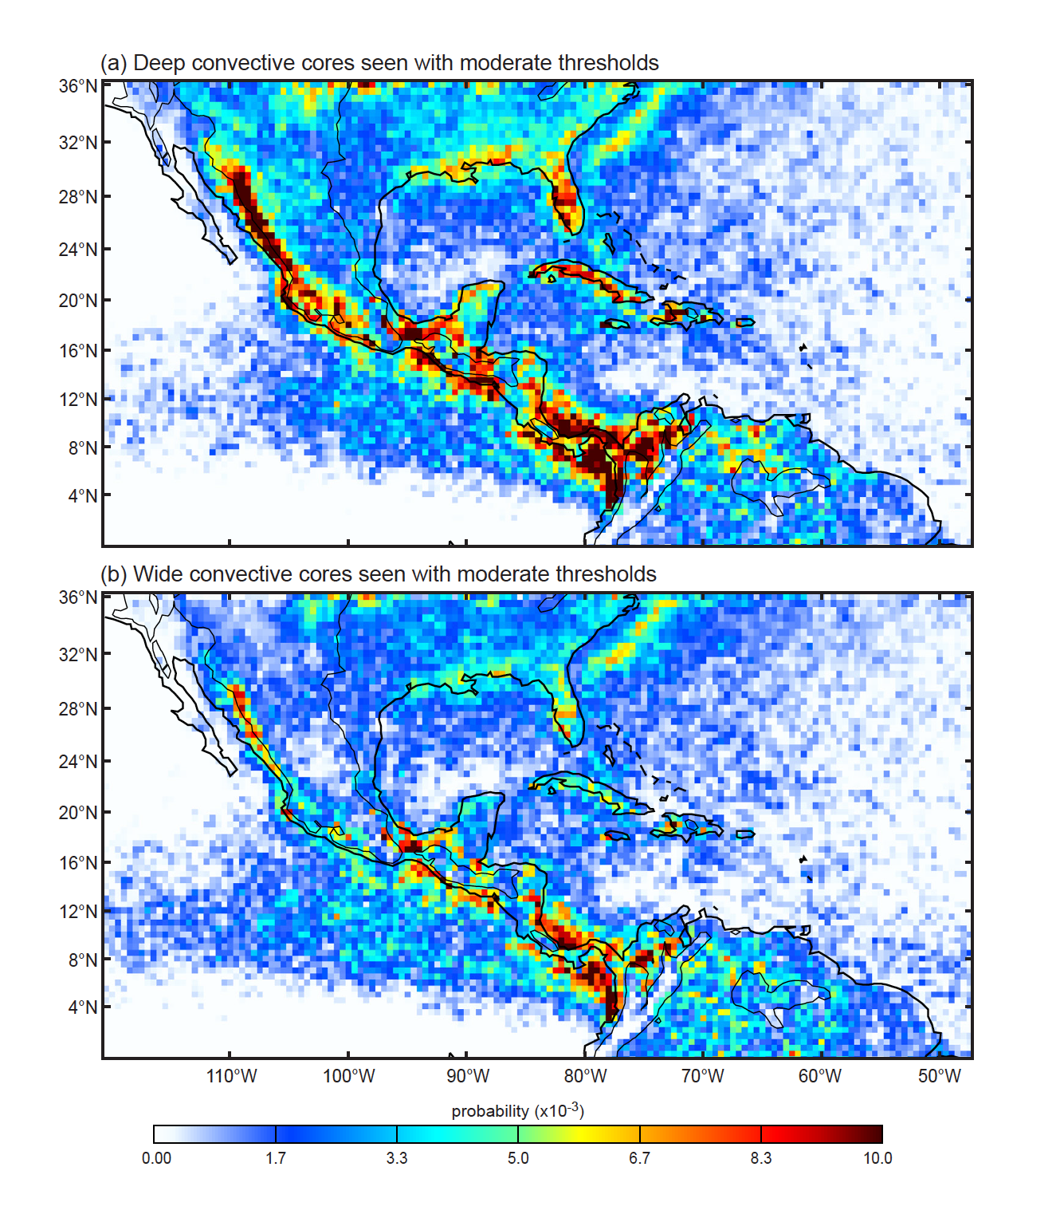
American Monsoon
DCC & WCC over Sierra Madre and coastal convergence zones
Notes:
Some over mountains
Some at base of mountains along both coastlines

Slide 22
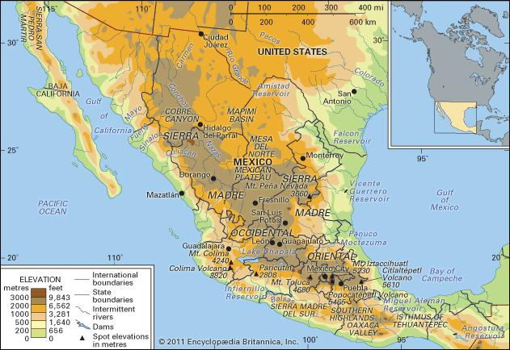
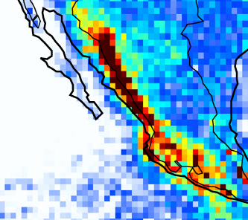

Slide 23
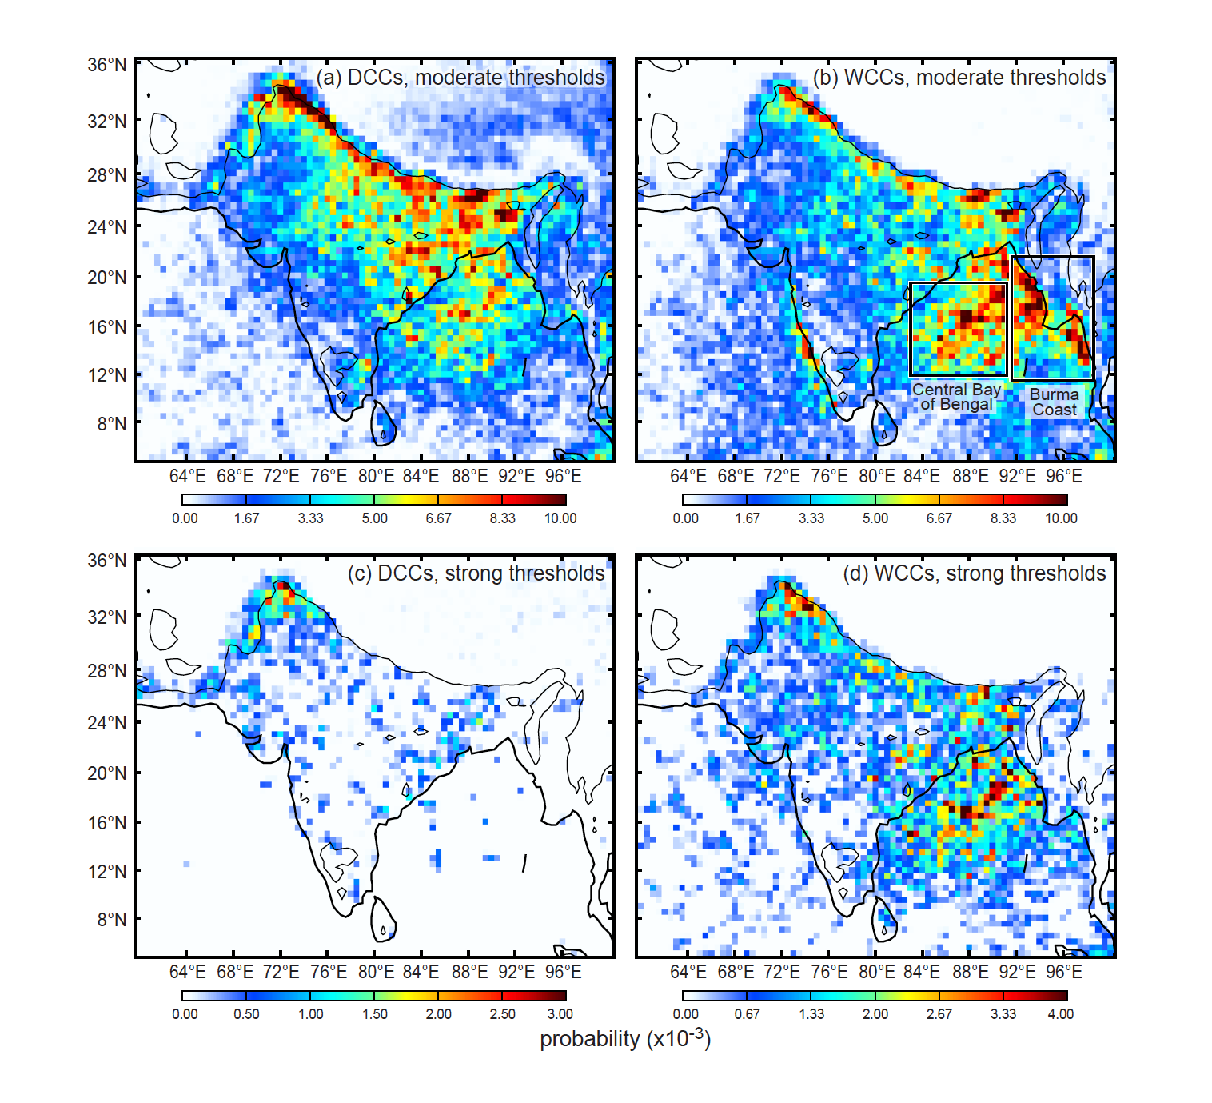
Asian Monsoon
Two types of WCCs
Notes:
Go CW from bottom left
In NW, incl. Pakistan--DCC strong—lots of lightning, tend to be vertical, some turn into WCCs, no squall lines, no BSRs.
Along Himalayan lower slopes, lots of DCC moderate, similar to Sierra Madre, as there a ffew turn into WCCs, Some WCCs on west coast not due even to moderate convection
Bay Bengal is hot spot: No strong DCCs, quite a few moderate DCCs, lots of moderate WCCs, some strong WCCs but…
Mode WCCs along Burma coast (also W. Ghats)
Will see also diff type of stratiform associated with the two types of WCCS

Slide 24
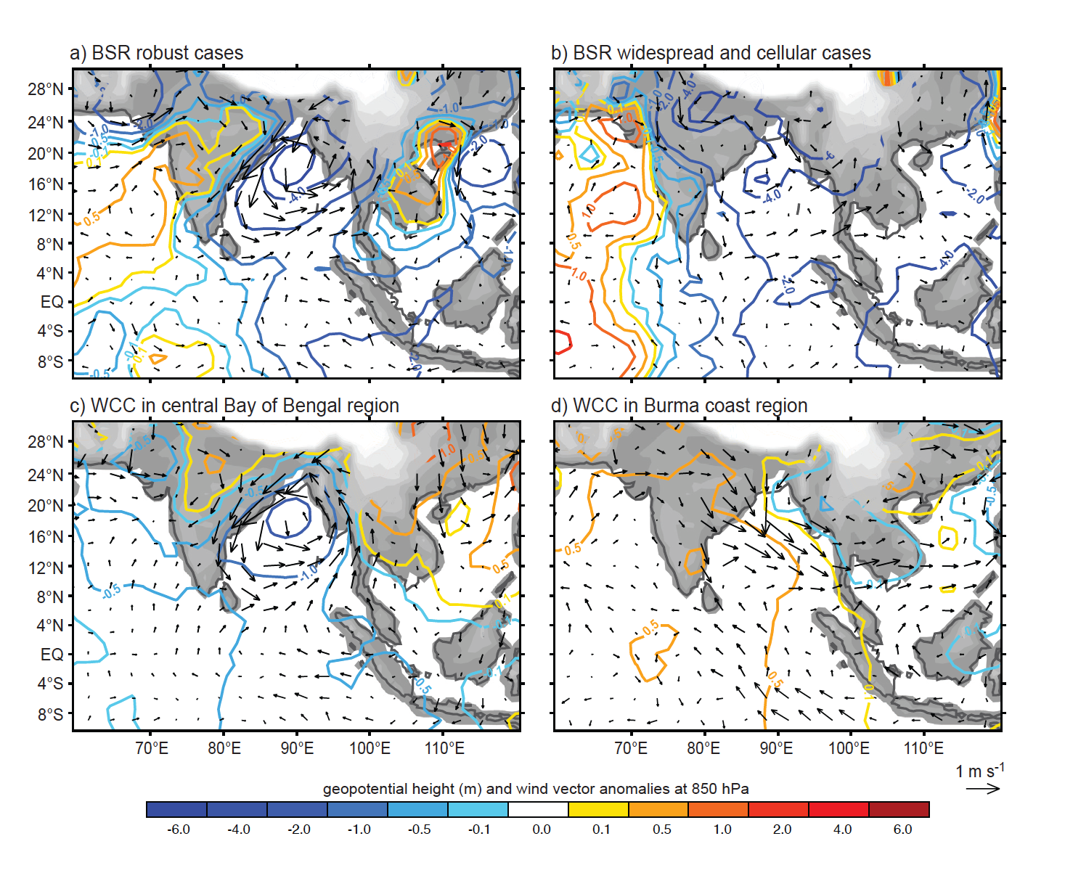
Composite 850 hPa Anomaly Fields
Notes:
Look first at bottom right

Slide 25
Extensive stratiform precipitation regions develop when well organized mesoscale convective systems reach a mature stage.
BSRs occur in regions where upscale development of mesoscale convection occurs

Slide 26
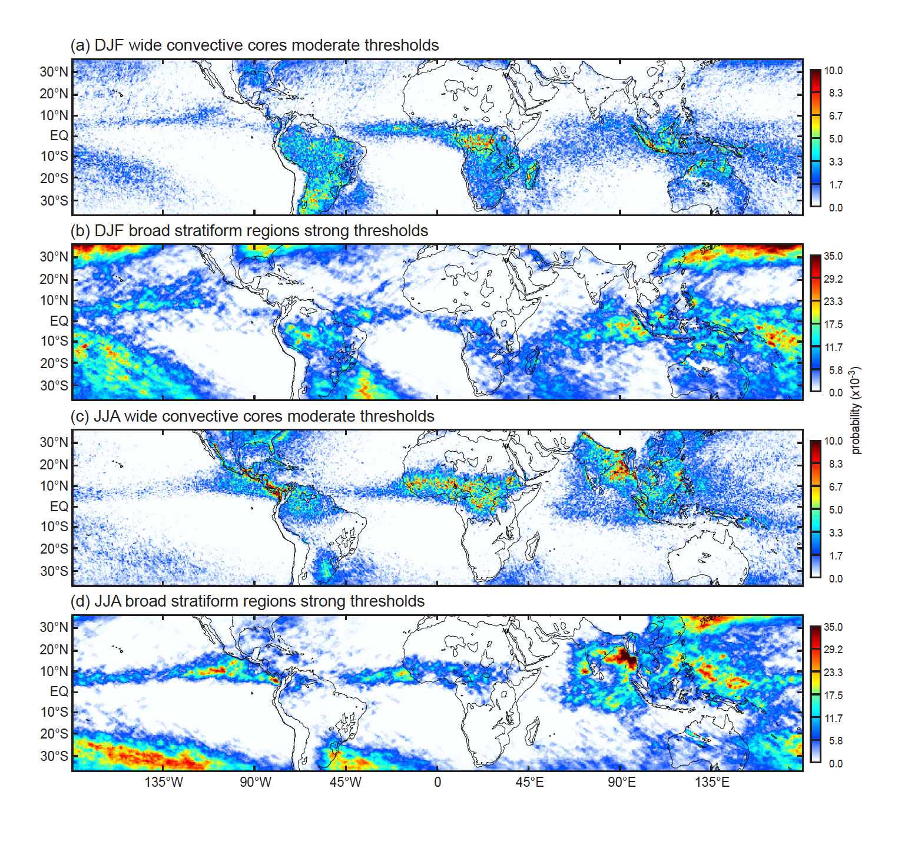
Strong BSRs develop from WCCs
Fronts produce BSRs in wintertime subtropics
Manifest more strongly over oceans
“Plum rain” region in JJA: monsoon + baroclinic effects
Notes:
Strong BSRs develop where moderate WCCs occur
Strong BSRs manifest more strongly over the oceans
True in both DJF and JJA
Fronts produce BSRs in winter hemispheres
Plum rain region is combination of midlatitude troughs and the westward extension of the Indian monsoon
Mei Yu, Baiu, Jangma

Slide 27
The stratiform radar echo structures vary regionally!
This has implications for assumptions about latent heating distributions in the tropics

Slide 28
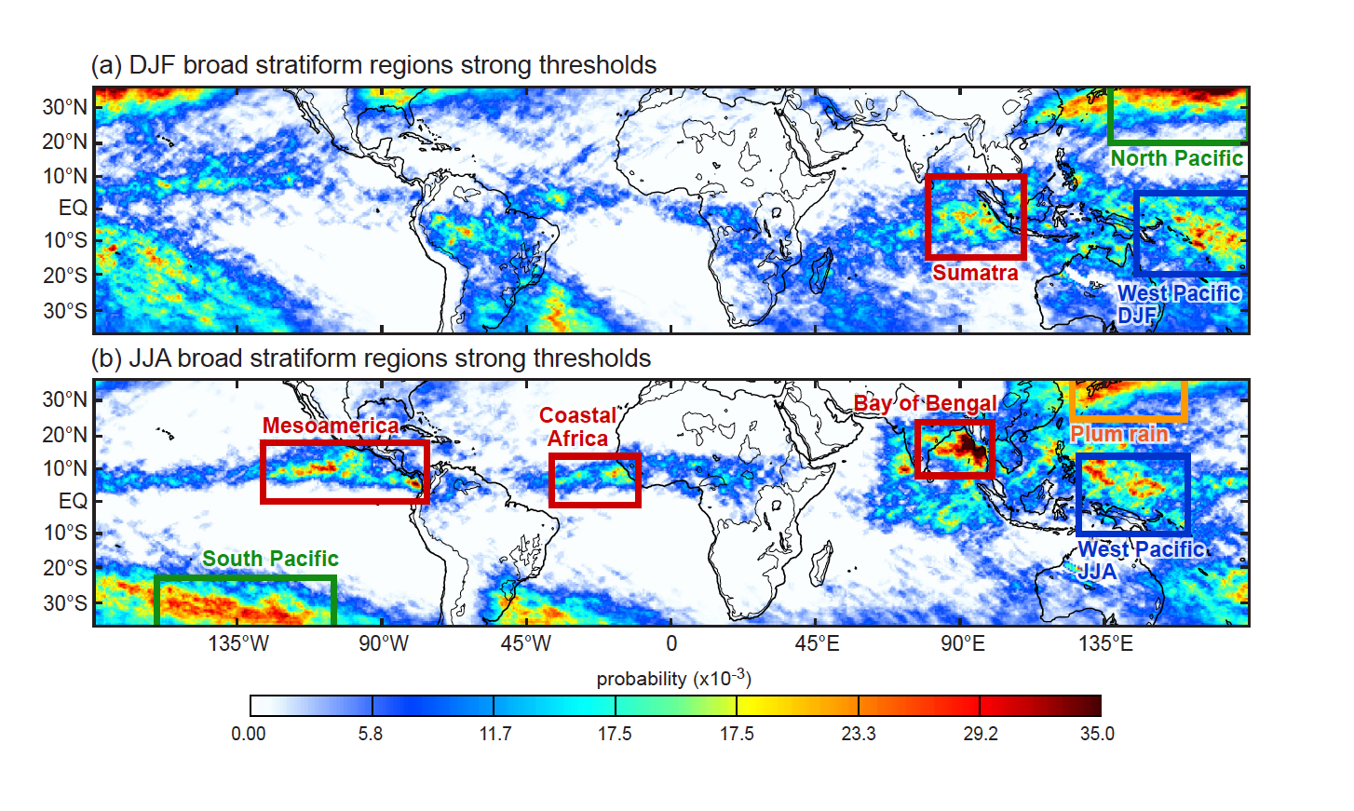
1000 hPa
Notes:
Color coding indicates where certain types of stratiform structures exist
Blue regions are the regions where the stratiform structure are most clearly associated with MCSs of the classic type
…with robust deep convection & associated SF precipitation
Red regions have two types of characteristic structures—”robust” with strong bright band, and “cellular” with shallower cells packed together and weak bright band
Green regions are where midlatitude fronts extend into the subtropics
Orange indicates Plum Rain region
What are the implications of these different types of stratiform precipitation?

Slide 29
Next we will look at some vertical cross sections obtained from the Zebra visualization software to see the different kinds of structures exhibited by the BSR echoes

Slide 30
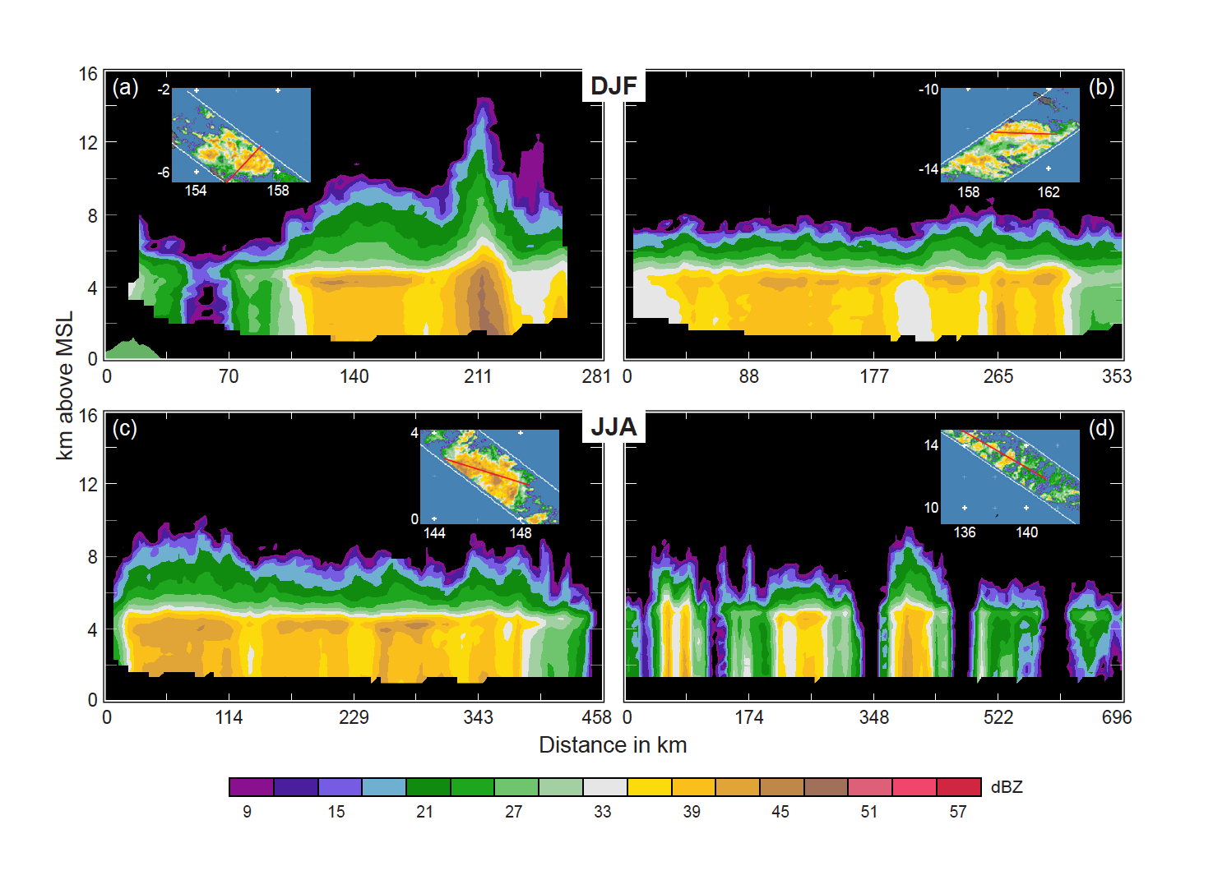
West Pacific Warm Pool
West Pacific Warm Pool
Notes:
First 3—”robust”—classic MCS structure
Last example—looks cellular but is classified 100% as SF, probably because of the faint bright band
What is it?
Previously robust but weakened?
Something else?

Slide 31
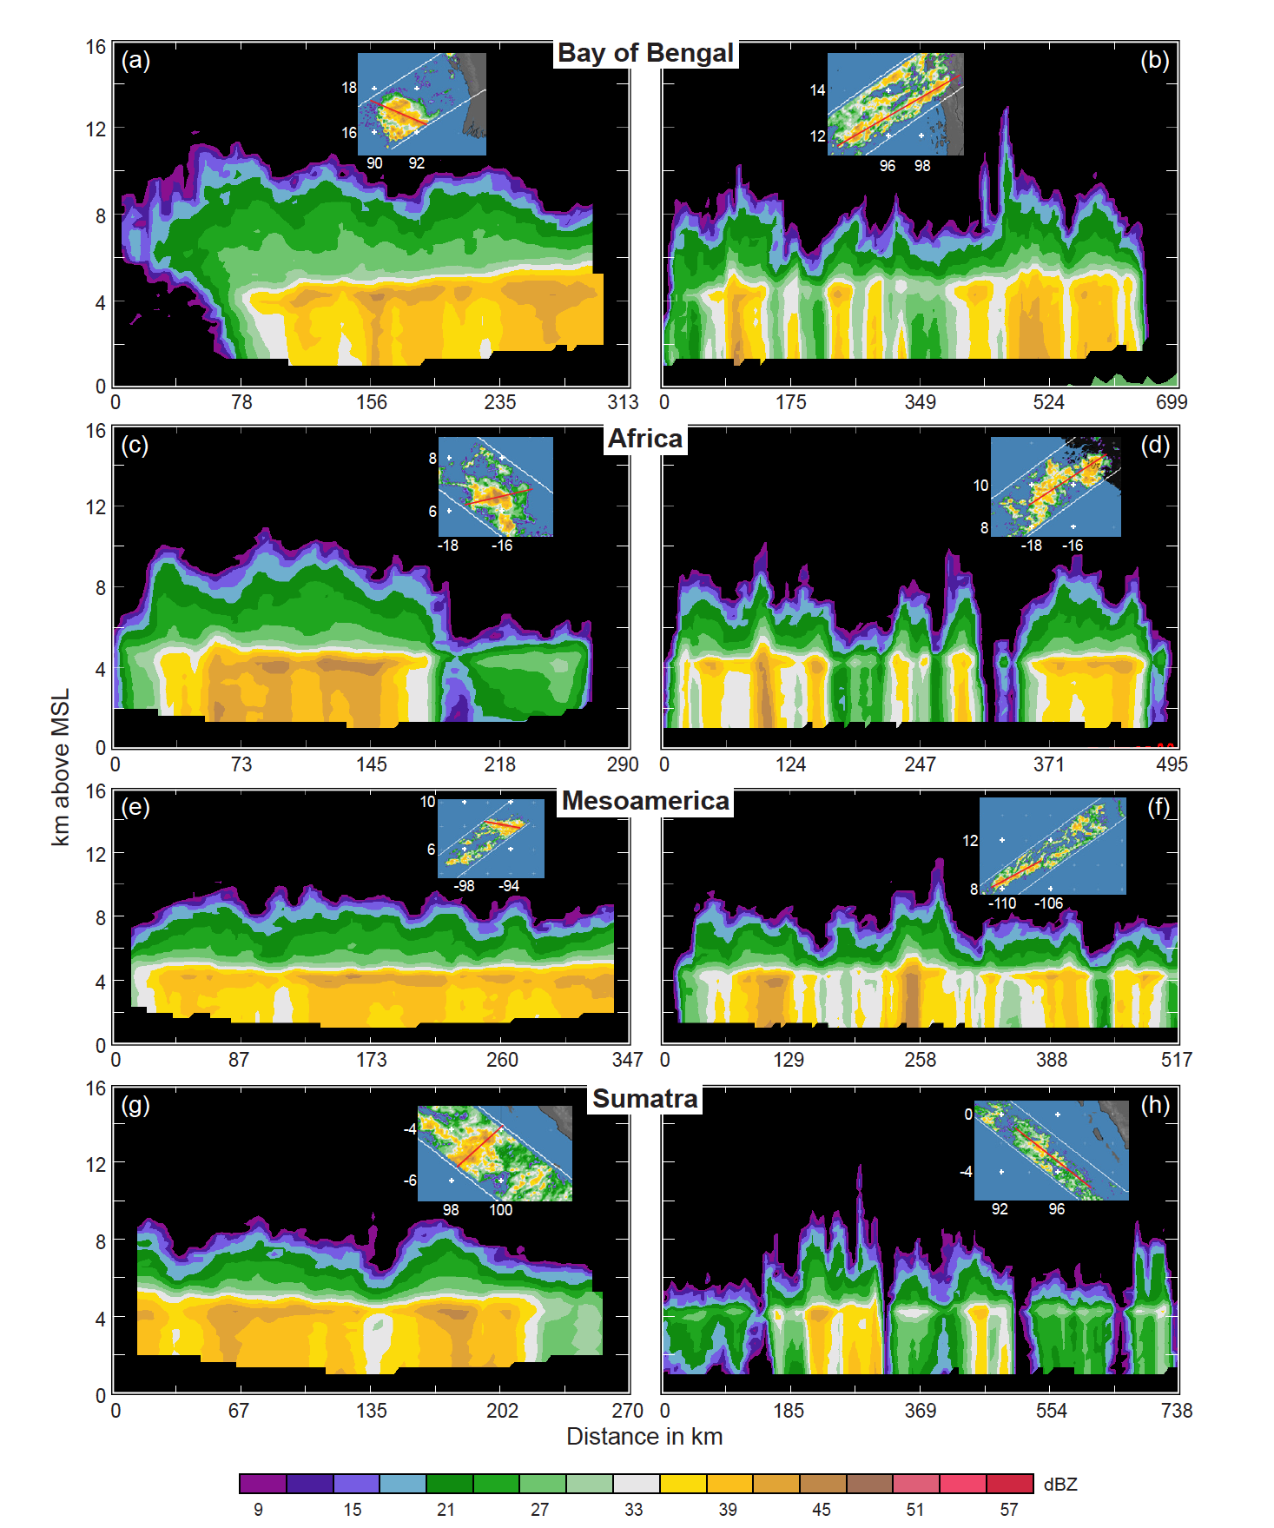
Monsoonal cases

Slide 32
Composite 850 hPa Anomaly Fields
Notes:
Look first at bottom right

Slide 33
Recall
Two types of mesoscale systems

Slide 34
Composite 850 hPa Anomaly Fields
Composite 850 hPa Anomaly Fields
Notes:
Look first at bottom right

Slide 35
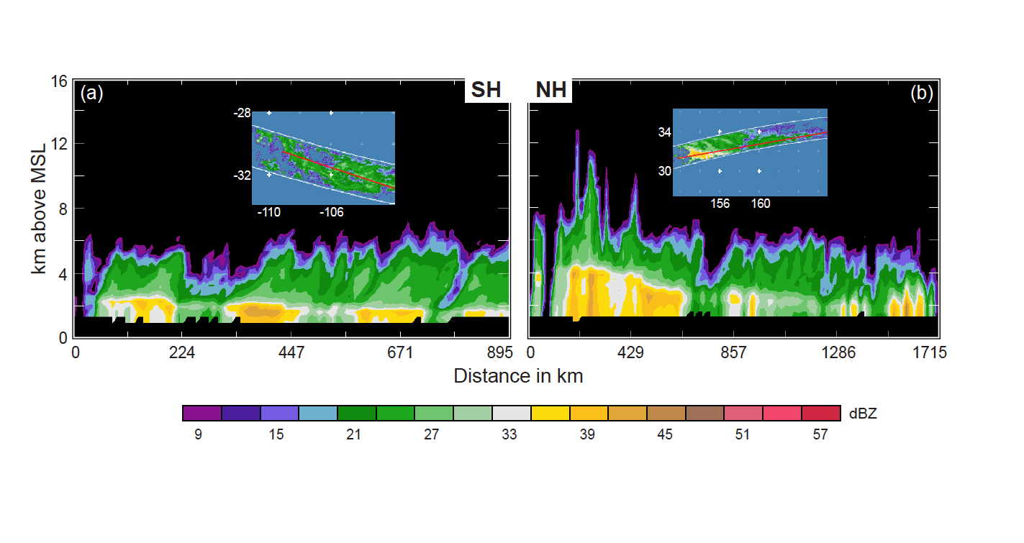
Frontal systems
Frontal Systems

Slide 36
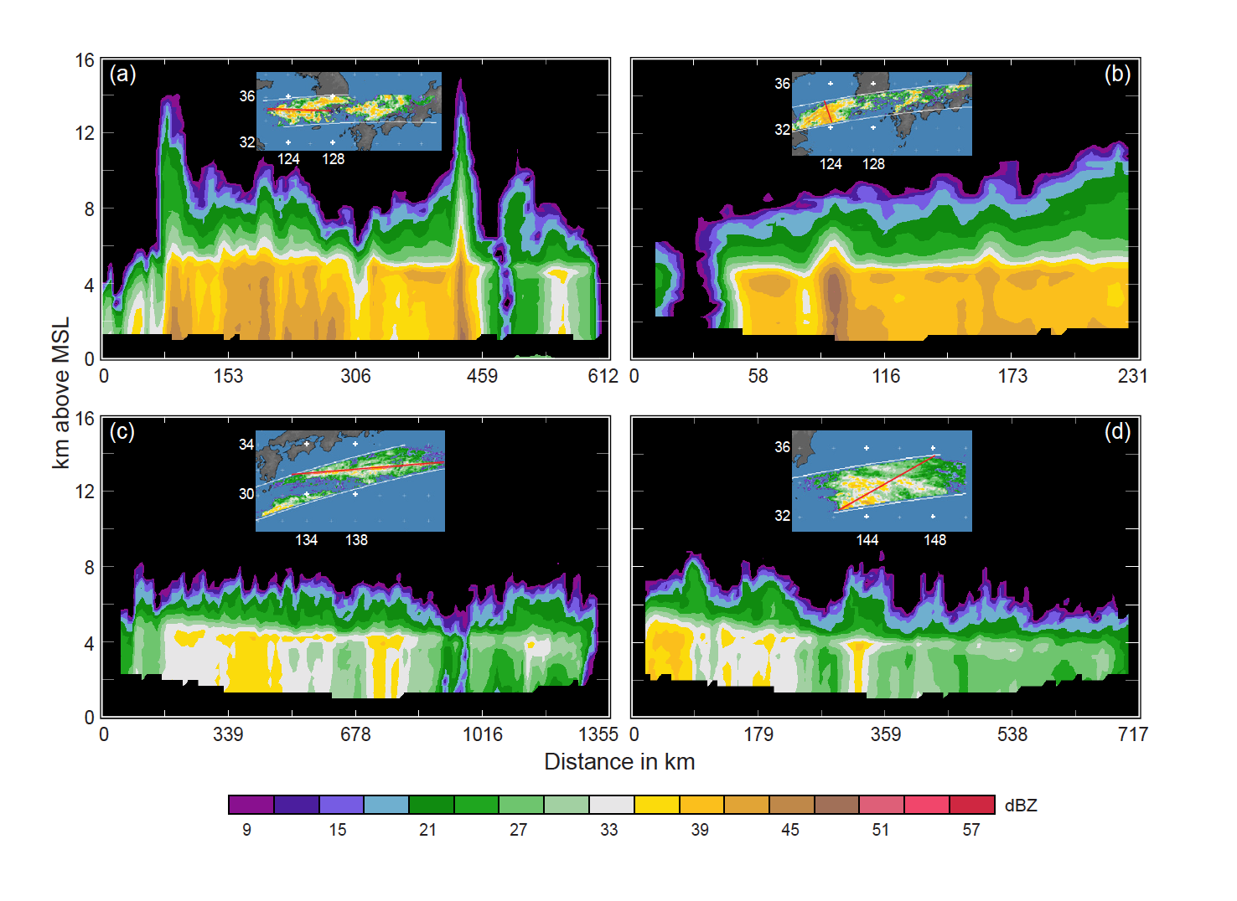
“Plum Rain” region
Plum Rain Region

Slide 37
Conclusions:
The nature of convection varies across low latitudes
Convective cores
Shallow isolated echoes—oceanic
Deep intense cores—continental, not in rainiest zones
Concentrated on upstream side of coasts and/or mountains
Upscale growth of convection (“aggregation,” “organization”)
Mesoscale organization coincides with rainiest areas
Mesoscale organization associated with less deep & intense convection
Stratiform development
Wherever mesoscale aggregation occurs
Manifests most strongly over oceans
Stratiform structure varies!
Mesoscale system type—over open tropical oceans
Widespread cellular form—in ITCZ and monsoonal coastal regions
Frontal—over subtropical oceans in winter

Slide 38
End
This research is supported by: NASA grant NNX13AG71G

Slide 39
End
This research is supported by: NASA grant NNX13AG71G

