Slide 1

Angela Rowe, Robert Houze, Jr., Lynn McMurdie, Joe Zagrodnik,…
University of Washington
Richland, WA, 27 October 2015
Supported by NASA grant NNX15AL38G

Slide 2
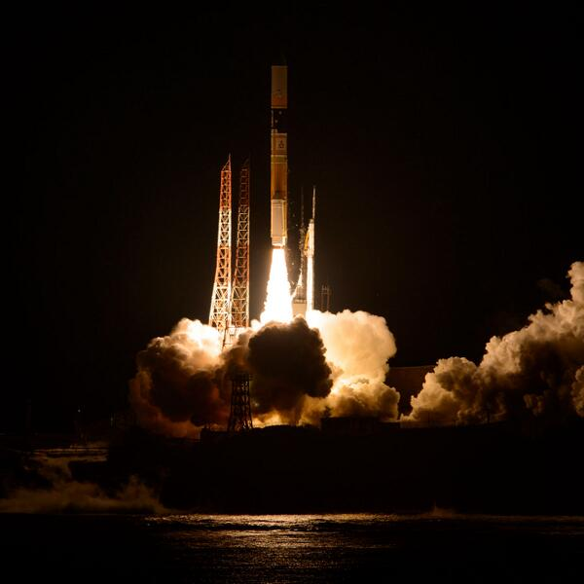
GPM
Precipitation is difficult to measure accurately
Multi-scale processes
Lack of global coverage of ground-based instruments
Satellite-based precipitation estimates fill in gaps
Core satellite of Global Precipitation Measurement (GPM) mission launched Feb 2014 from Japan

Slide 3
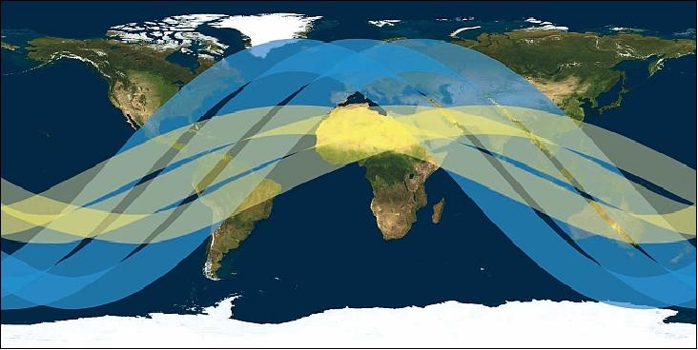
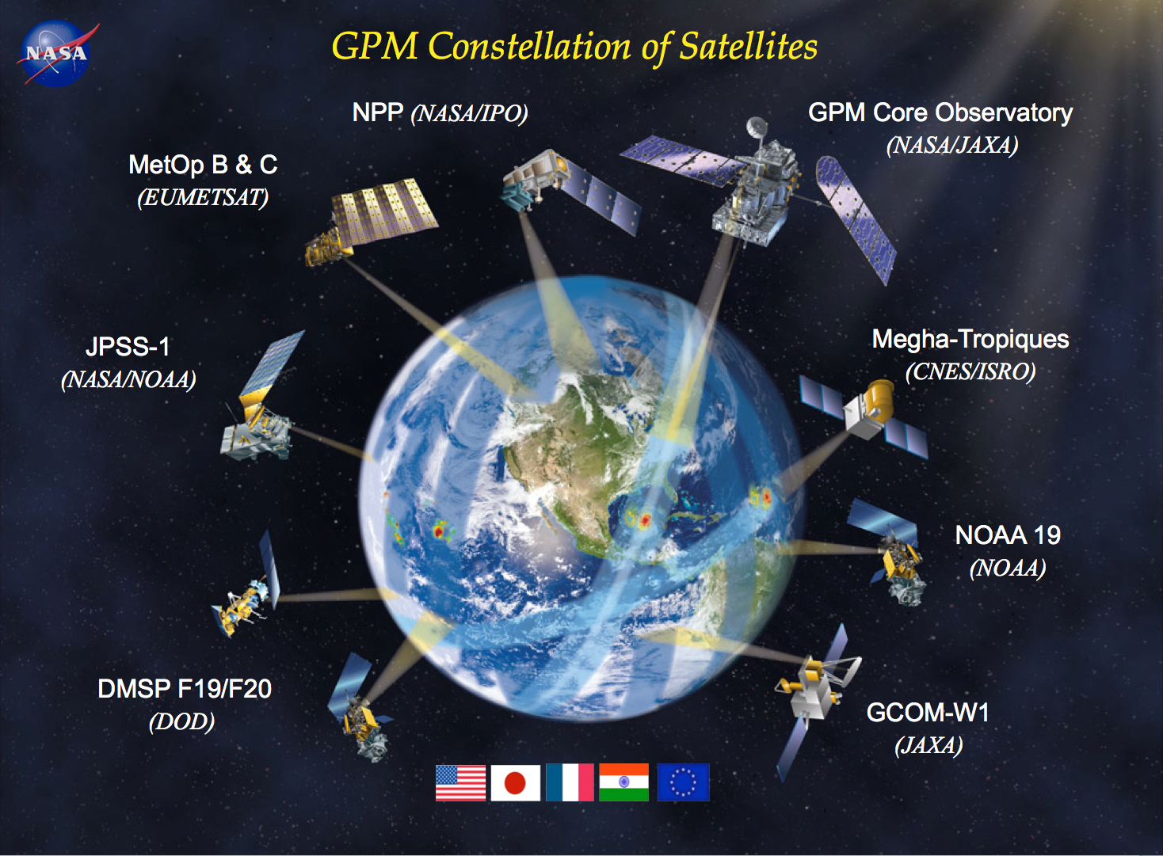
GPM
GPM
TRMM
Core satellite: Polar Orbiting, non-sun synchronous (crosses equator at variable local times)
Consortium of precipitation measuring satellites
Goals:
Measure rain and snow globally over wide range of intensities (0.2 mm/hr-110 mm/hr), locations (ocean to complex terrain), regimes (tropical rainfall to high-lat snowfall)
Apply to high impact events (flood, drought)

Slide 4
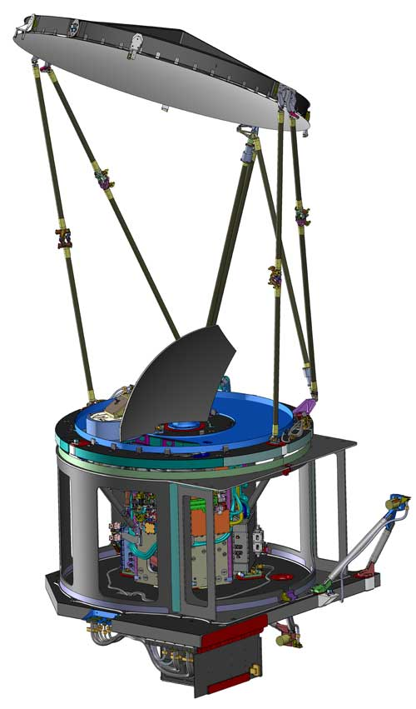
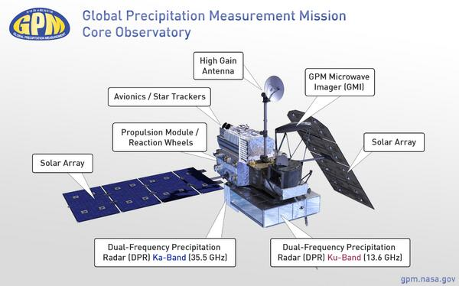
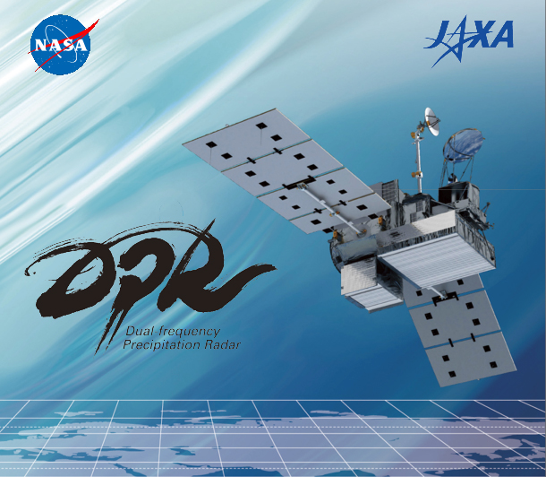
GPM
GMI
DPR
GPM Microwave Imager (GMI)
Passive microwave instrument
904 km swath width
Has frequencies sensitive to falling snow
Dual Precipitation Radar (DPR)
Measures 3-D structure of precipitation
Ku-band (245 km width swath) and Ka-band (120 km width swath)
Sensitive to a range of precipitation intensities

Slide 5
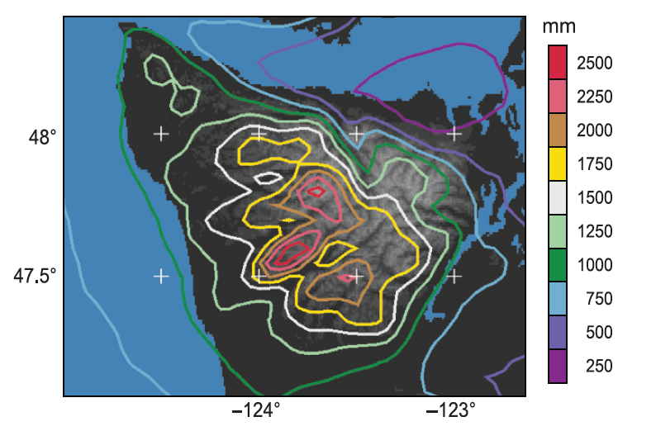
Olympic Peninsula
Precipitation distribution from WRF model runs confirmed with rain gauge observations
Mean annual precipitation from PRISM – observations + elevation model

Slide 6
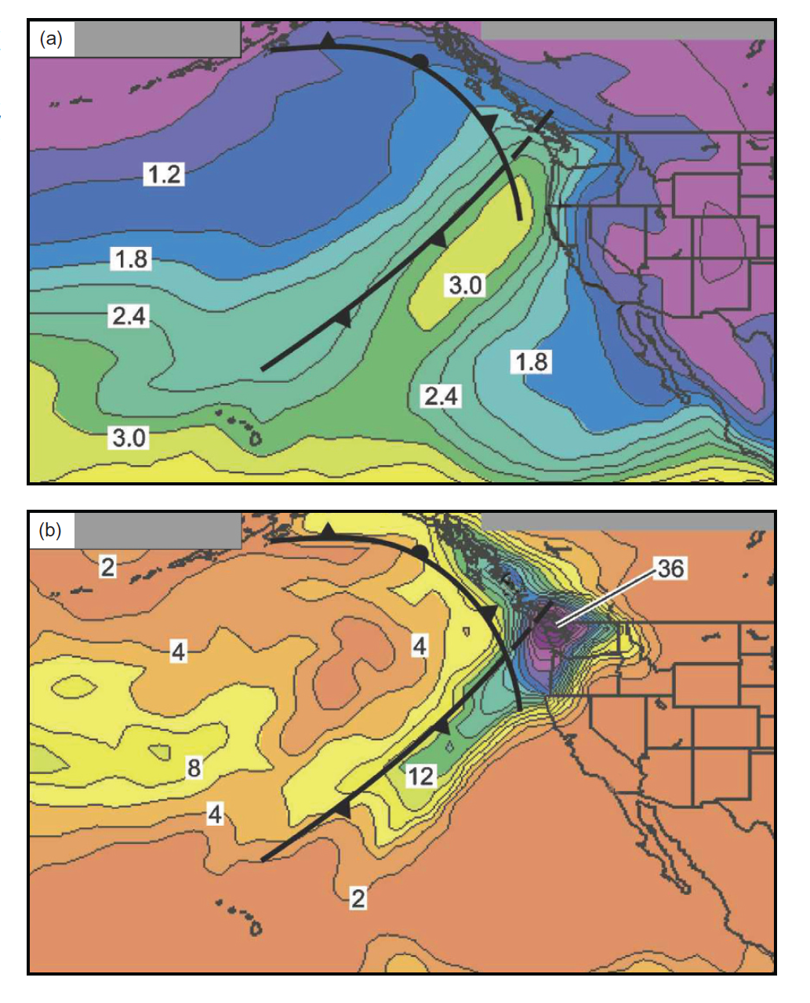
Atmospheric Rivers
vapor (cm)
rain (mm)
Newell et al. [1992]

Slide 7
Olympic Peninsula
Mean sea level pressure for November – February from reanalysis data

Slide 8
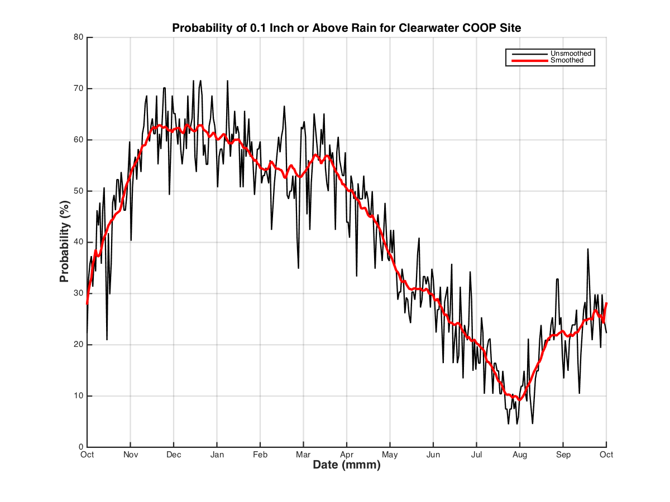
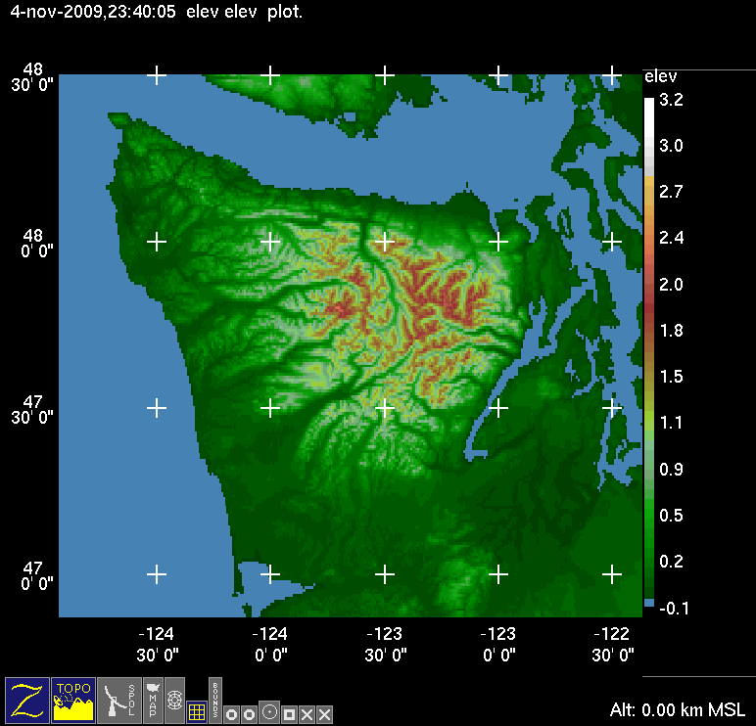
Olympic Peninsula
OLYMPEX – Nov 10 – Jan 15
60%
Probability of receiving at least 2.5 mm (0.1”) of precip
Average rainfall during Nov, Dec and Jan is 400 mm (16”) each month. Range is 75 – 750 mm (3 – 30”) per month from 98 years of data.

Slide 9
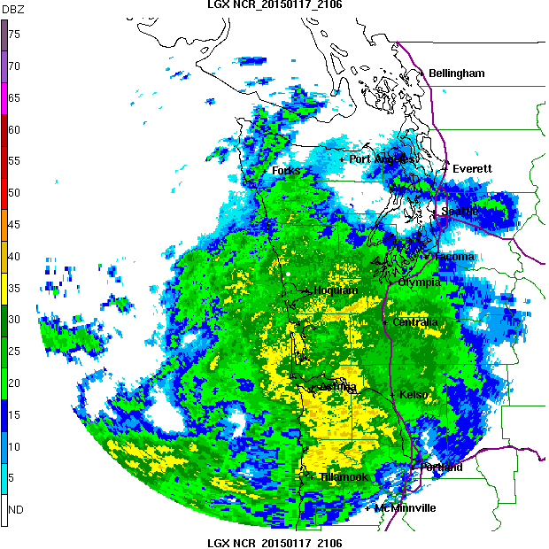
Mid-latitude
Pacific Cyclone
Prefrontal:
Precipitation occurs well out ahead of surface fronts
Environment characterized by warm advection, large static stability, stratiform precipitation, relatively high or rising melting level (case dependent)
Nagle and Serebreny (1962)

Slide 10
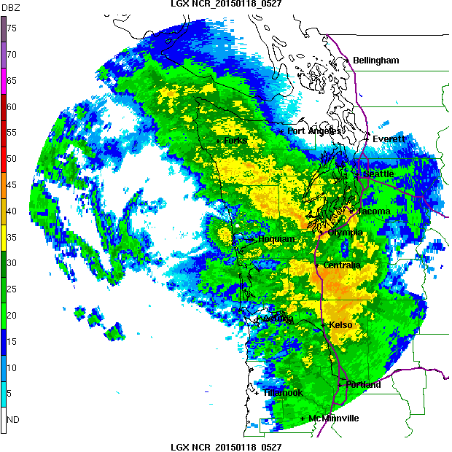
Mid-latitude
Pacific Cyclone
Frontal:
Precipitation intense at front
Strong upward motion at front
Rapid drop of melting level
Transition from stratiform to convective
Nagle and Serebreny (1962)

Slide 11
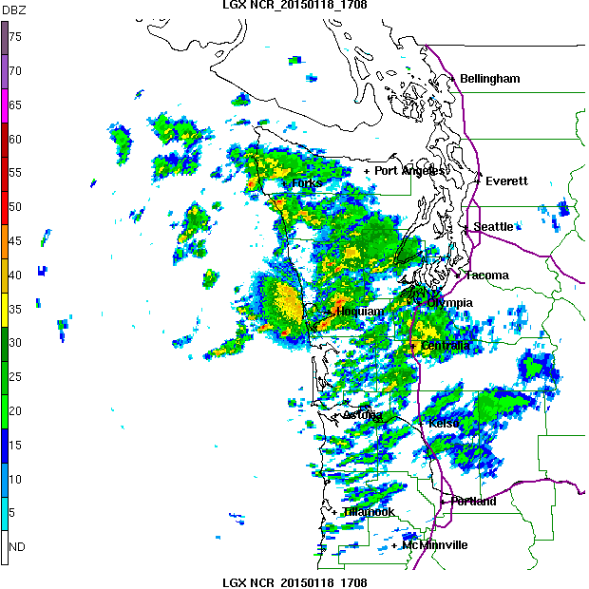
Mid-latitude
Pacific Cyclone
Postfrontal:
Shallow convection
Cold-air advection
Low stability
Low melting level
Produce significant precipitation (windward)
Significant snowfall at higher elevations
Nagle and Serebreny (1962)

Slide 12
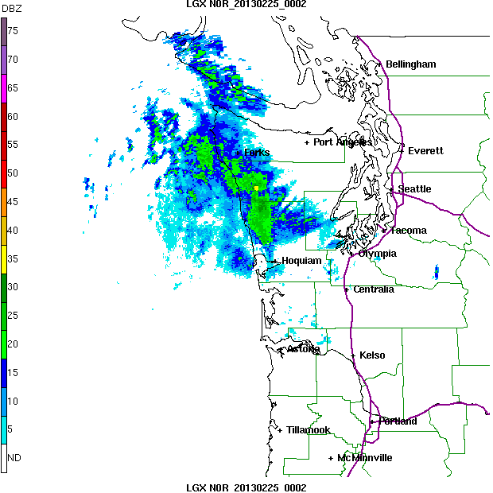
Frontal Passage
Example 2 Radar Loop
Prefrontal -> Frontal -> Postfrontal
Example 1= 15 hr
Example 2 = 12 hr
Example 3 = 12 hr
However, postfrontal period can go on for additional 12-24 hrs, and prefrontal can last 12 hr also.
Need to keep in mind these storms can produce precip for 1-3 days
In some regimes (strong westerlies), storm frequency is
1 1/2 days – 2 days

Slide 13
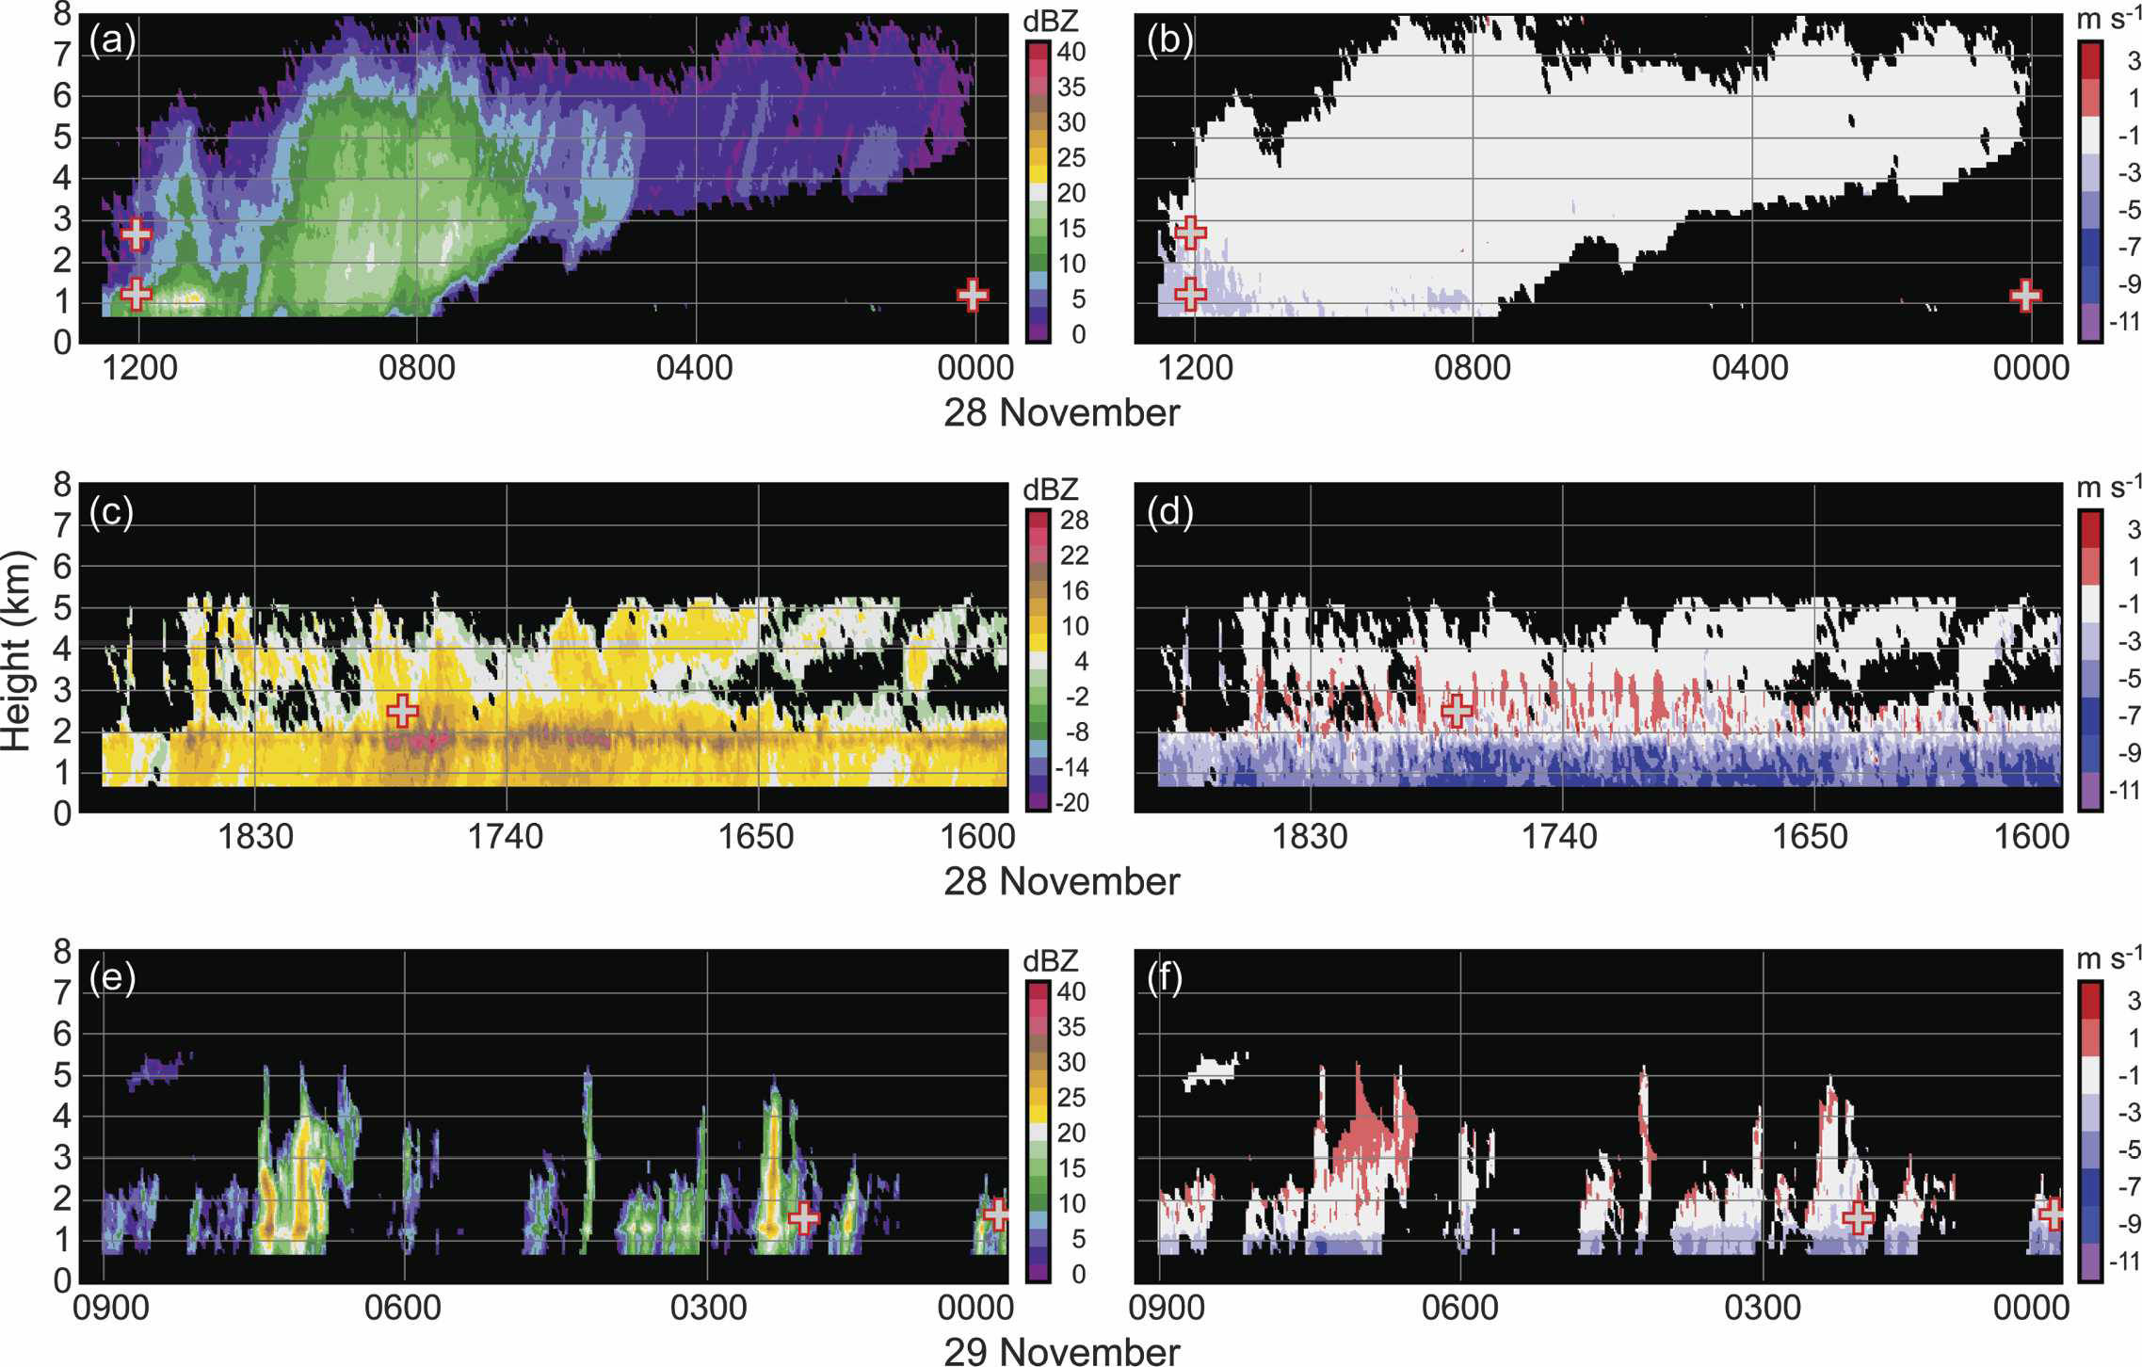
Mid-latitude Pacific Cyclone (IMPROVE-2)
Medina et al. (2007)

Slide 14
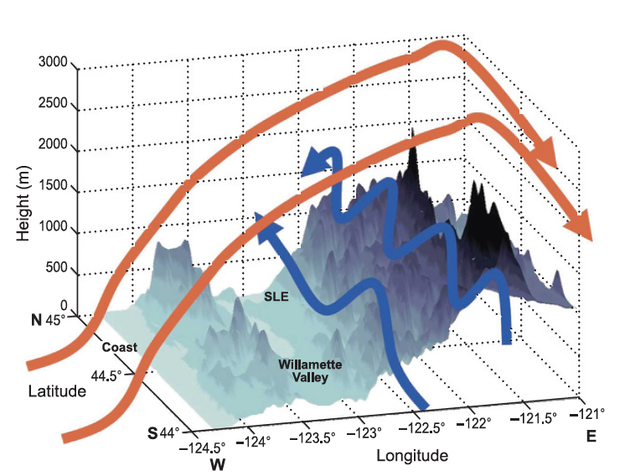
IMPROVE-2
3-D idealized schematic of flow over the IMPROVE study area from 2300 to 0100 UTC 13–14 Dec 2001
Blue arrows: Strong southerly low-level flow along the windward (west facing) slopes of the Cascades
Red arrows show the cross- barrier flow that exhibited a vertically propagating mountain- wave structure
Garvert et al. [2007]

Slide 15
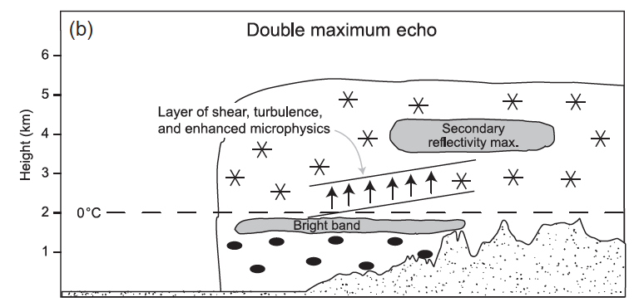
IMPROVE-2
Frontal precipitation
Medina et al. [2007]

Slide 16
Olympic Peninsula
Histogram of 0°C isotherm at UIL for onshore moist flow

Slide 17
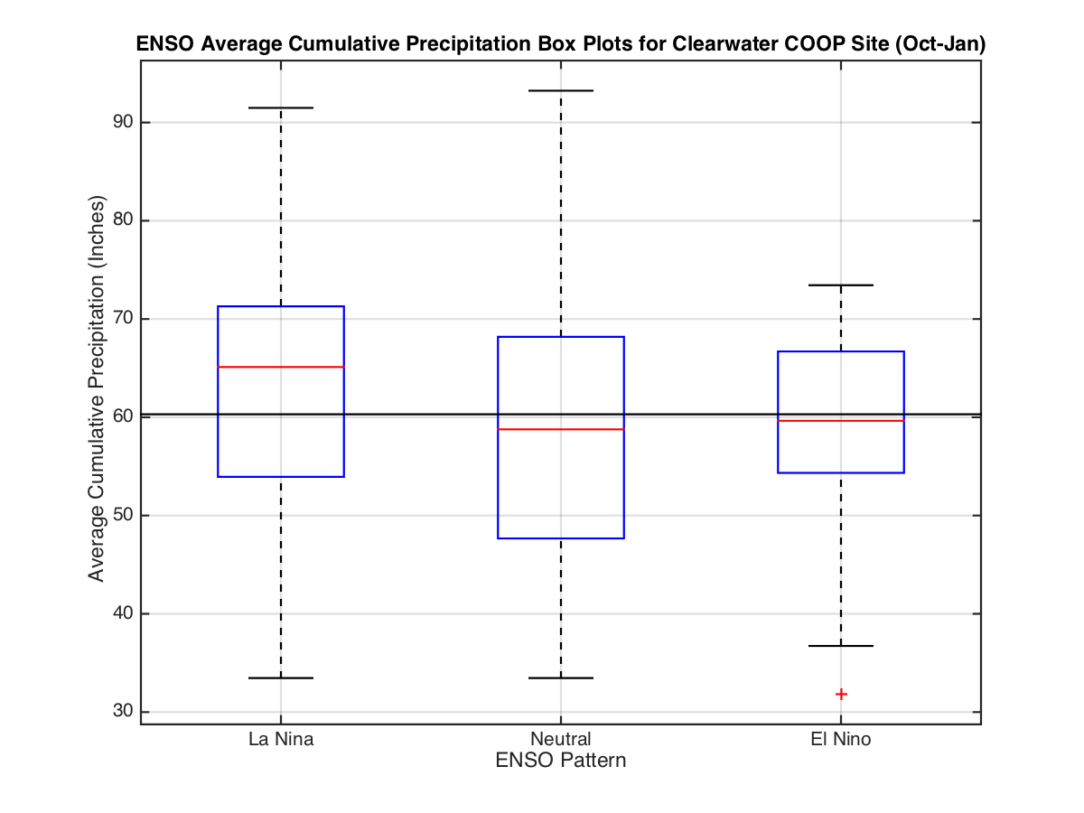
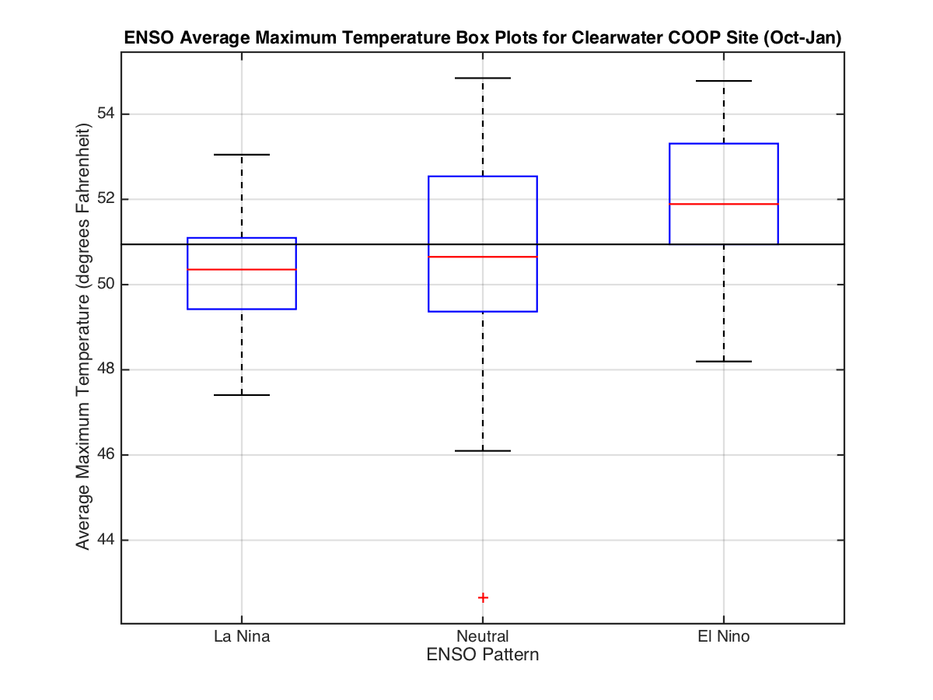
El Nino

Slide 18
OLYMPEX Goals
Physical validation of precipitation algorithms (GMI, DPR)
Rainfall characteristics (DSD, crystal size/habit, rainfall intensity)
Changes in rain/snow distribution from ocean to terrain
Modification of frontal precipitation by terrain (affect on GPM rainfall estimation uncertainties)
Melting level variability
Environmental characteristics
Quantifying accuracy and uncertainty of the GPM precipitation data and its hydrologic applicability
Snow pack accumulations
Hydrological response
Merging numerical modeling and satellite observations to optimize precipitation estimation

Slide 19
OLYMPEX
Ground instrumentation (precipitation gauges, microphysical instruments, snow cameras, snow surveys): Oct 2015 – Apr 2016
Ground-based weather radars: Nov 2015 – 21 Dec 2015, 2-15 Jan 2016
Aircraft-based measurements: 6 Nov – 21 Dec 2015
Observe 3 sectors of systems and 4 geographical regions

Slide 20
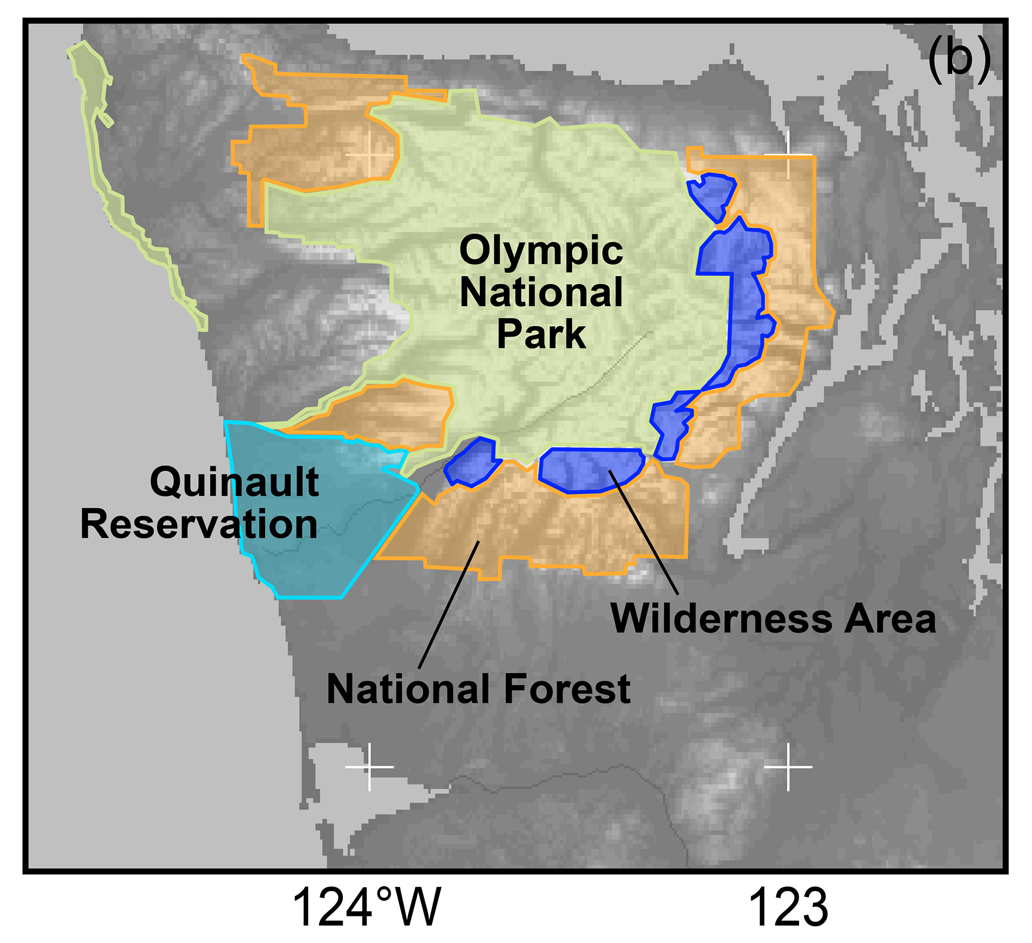
Regions
Leeside
m
Quinault
High Terrain
Chehalis
Ocean
Windward side

Slide 21

OLYMPEX Network
x
Legend
= WSR-88D
= NPOL
= DOW
= EC X-Band
= MRR = SNOTEL
= Ground Obs sites
= Snow camera network = UW Tipping bucket network
= Chehalis rain gauge network
x
x
x
x
x
x
x
x
x
x
x
x
x
x
x
x
x
x
x
x
x
DC-8
ER-2
Citation

Slide 22
OLYMPEX Network
m
x
x
Legend
= WSR-88D
= NPOL and D3R
= DOW
= EC X-Band
= MRR
= Soundings
= SNOTEL
= Ground Obs sites
= Snow camera network = UW Tipping bucket network
= Chehalis rain gauge network
x
x
x
x
x
x
x
x
x
x
x
x
x
x
x
x
x
x
x
x
x
x
x
DC-8
ER-2
Citation

Slide 23
OLYMPEX Radar Network
Significant investment in documenting the structure, characteristics and distribution of precipitation and how they change with complex terrain

Slide 24
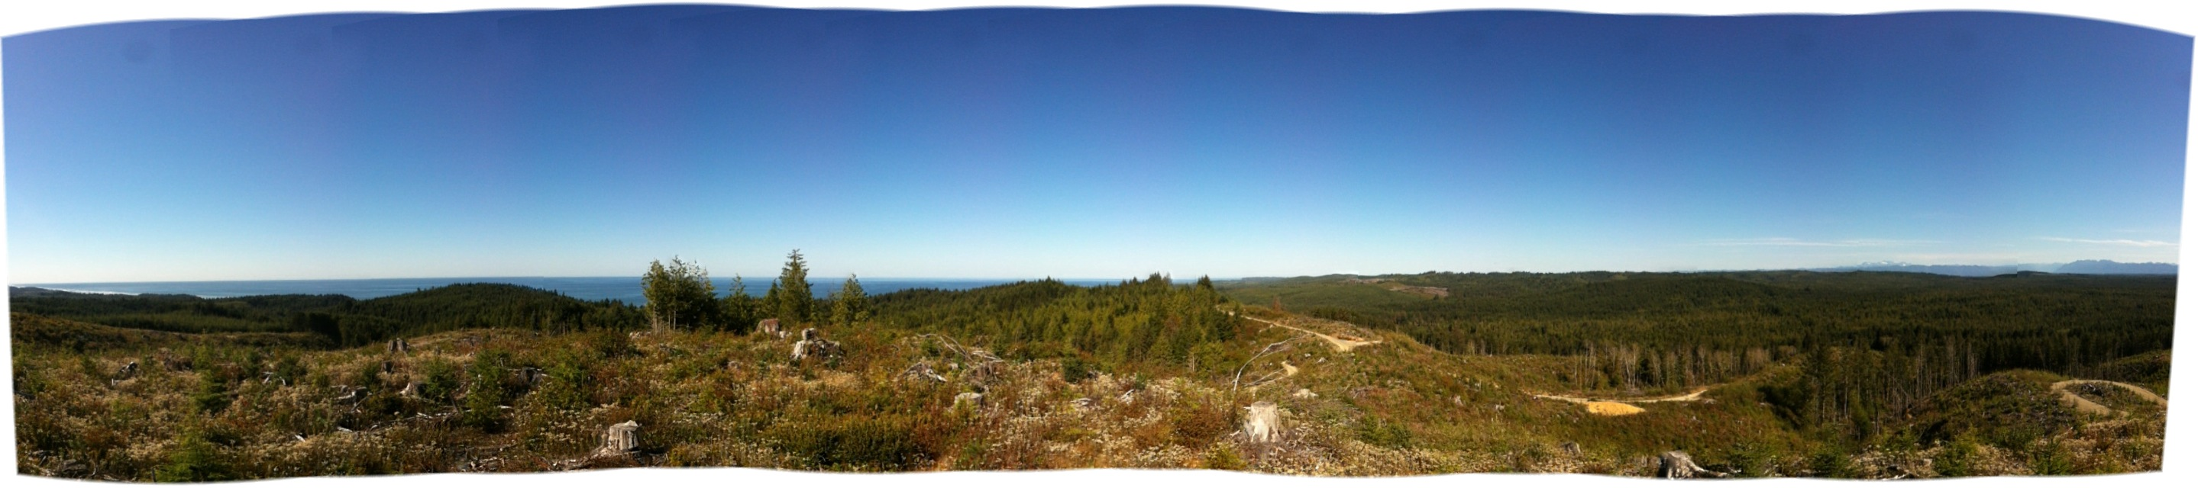
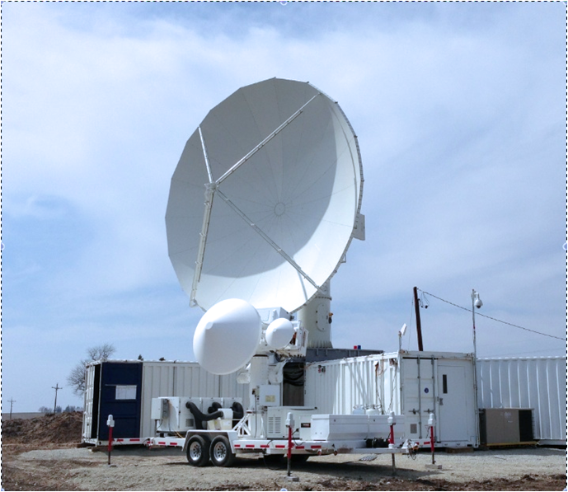
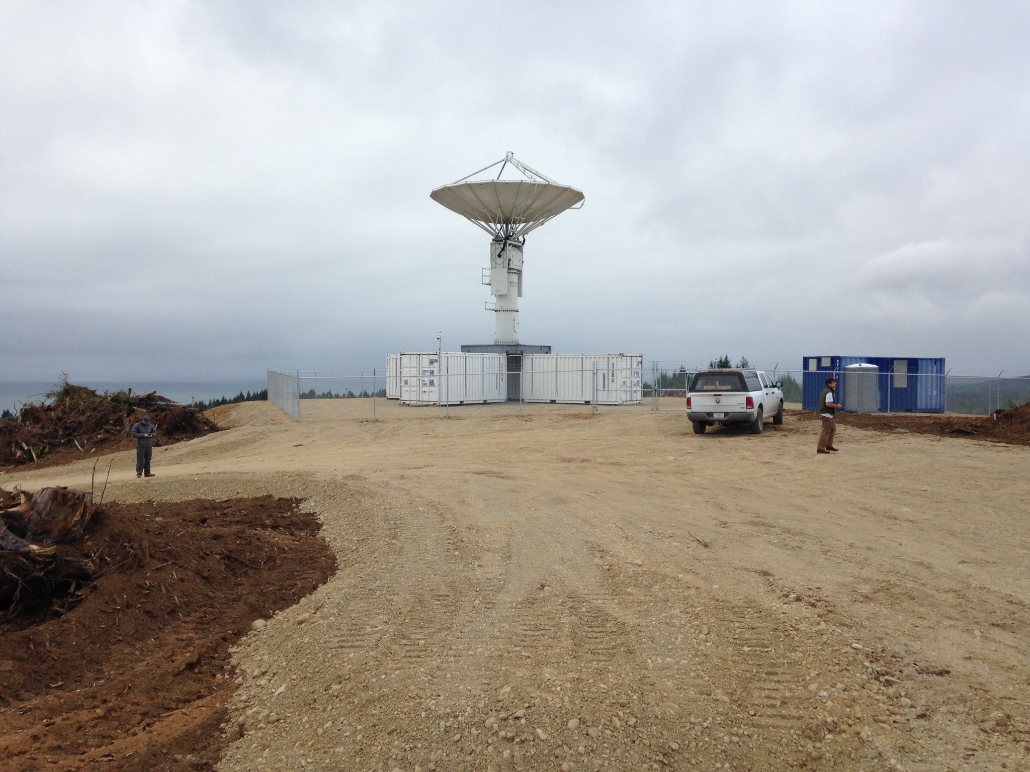
NPOL/D3R
On Quinault Indian Nation land near the coast - clear views towards the ocean and towards the Olympic Mountains up the Quinault River
Olympic Mts. (NE)
Pacific Ocean (SW)
NPOL
D3R

Slide 25
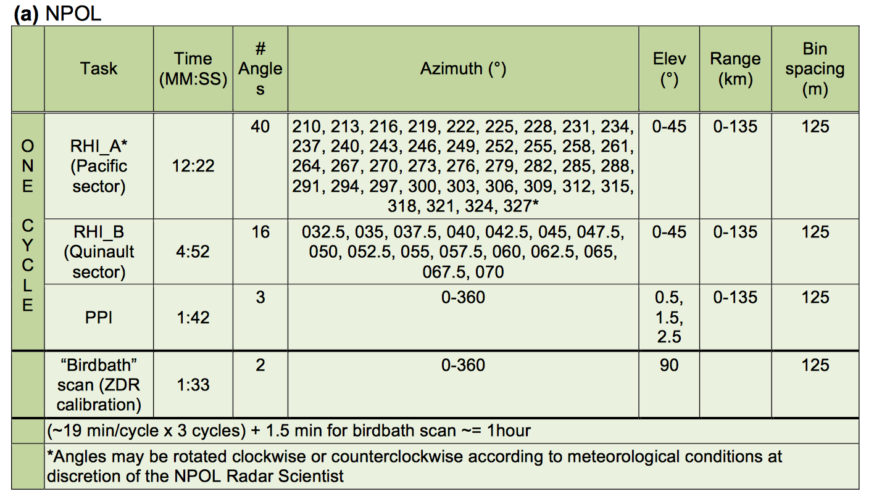
NPOL

Slide 26
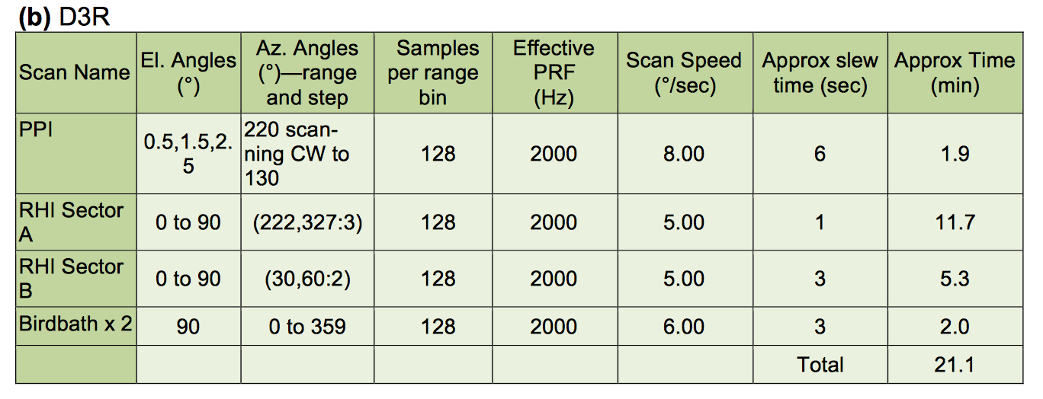
D3R

Slide 27
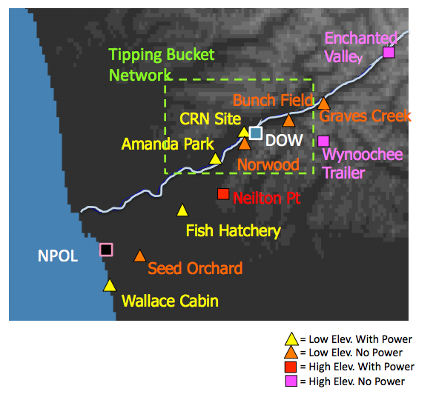
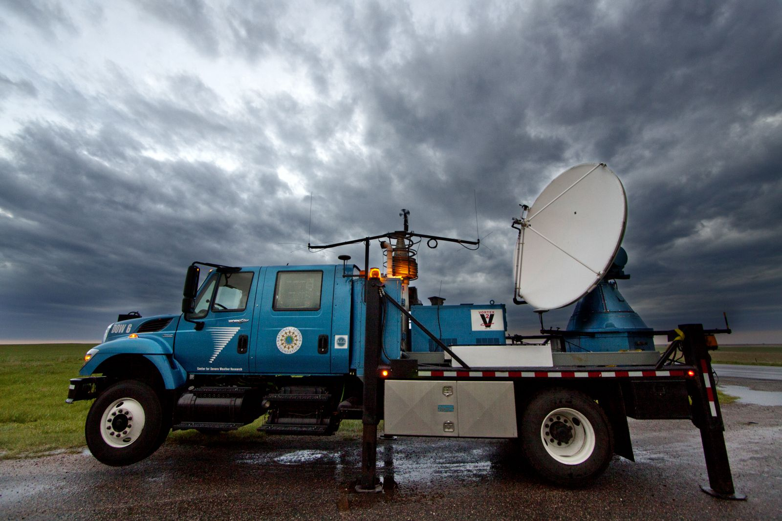
Doppler on Wheels (DOW)
Lake Quinault
Sample under lowest NPOL beam
Range of 40 km

Slide 28
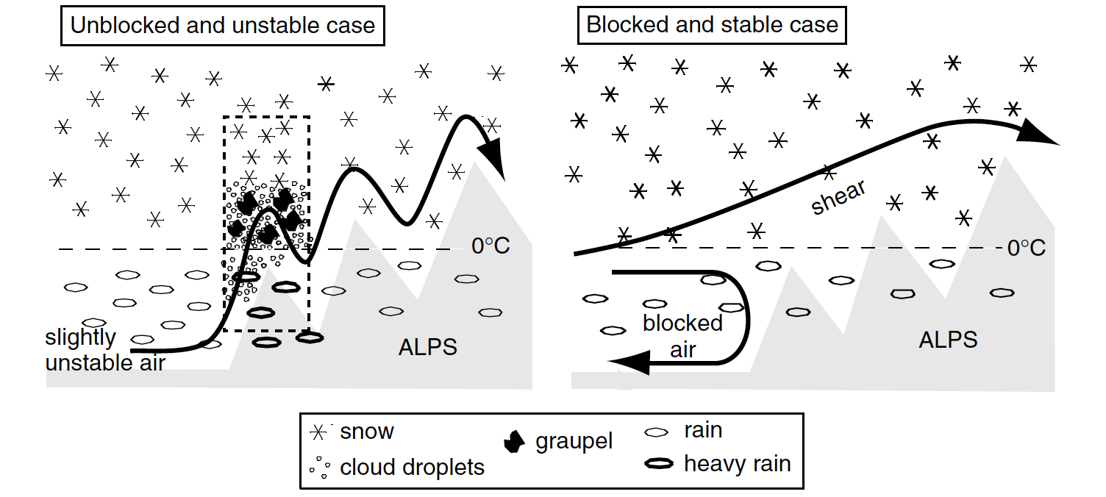
Doppler on Wheels (DOW)
Testing hypothesis:
Rapid precipitation enhancement of frontal precipitation occurs on the lower slopes of a mountain barrier In highly unstable flows convection is released
In stable conditions, the lower flow is retarded or blocked so that it is “decoupled” (i.e., separated from the midlevel flow by a shear layer) and overturning in the shear layer contributes to windward-side enhancement
Rotunno and Houze 2007

Slide 29
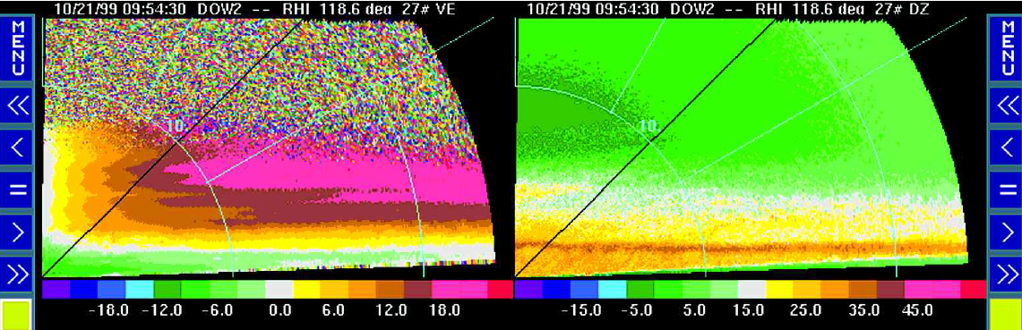
Doppler on Wheels (DOW)
Observations of the low-level flow, including situations in which the shear layer separating it from the midlevel flow occurs in connection with decoupling
Single Doppler data in RHI sectors looking up and down the valley will allow the windward flow documentation
The reflectivity data associated with the Doppler velocity will allow the precipitation structure to be associated with the velocity structures
Dual-pol data
Radial velocity
Reflectivity
Upslope flow
Shear layer
Melting
Downslope flow
DOW in MAP (Alps) [ Steiner et al. 2003]

Slide 30
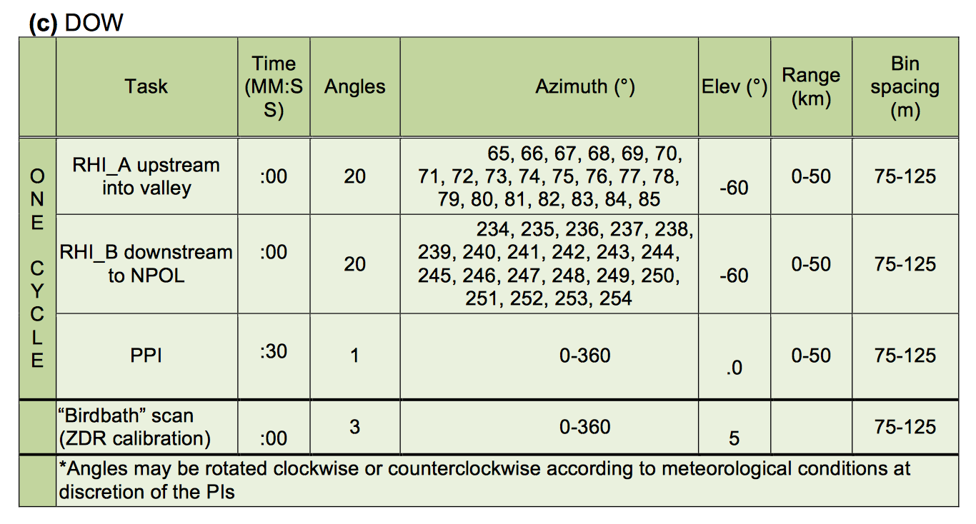
DOW

Slide 31
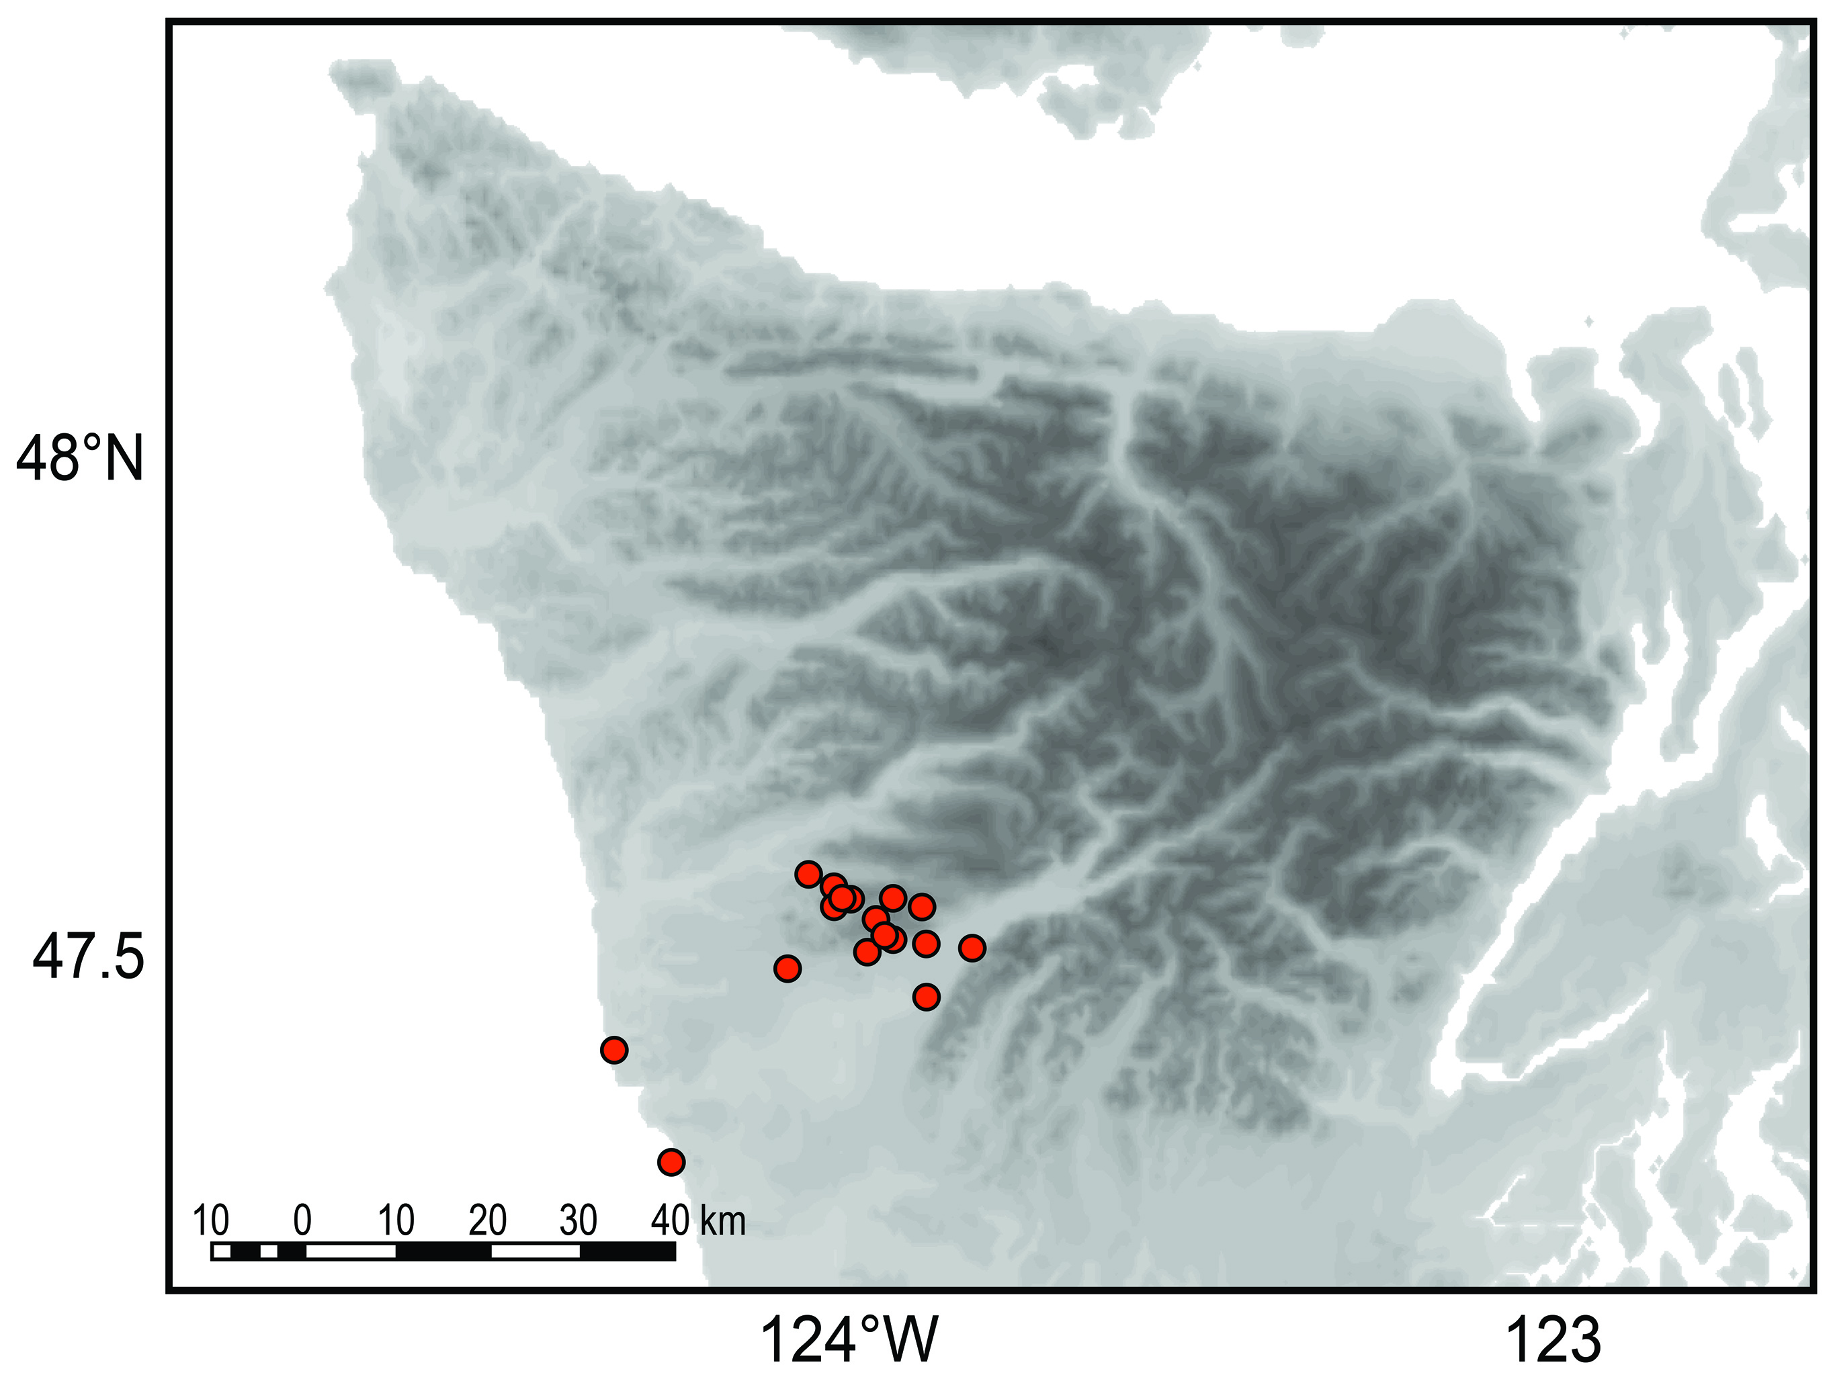
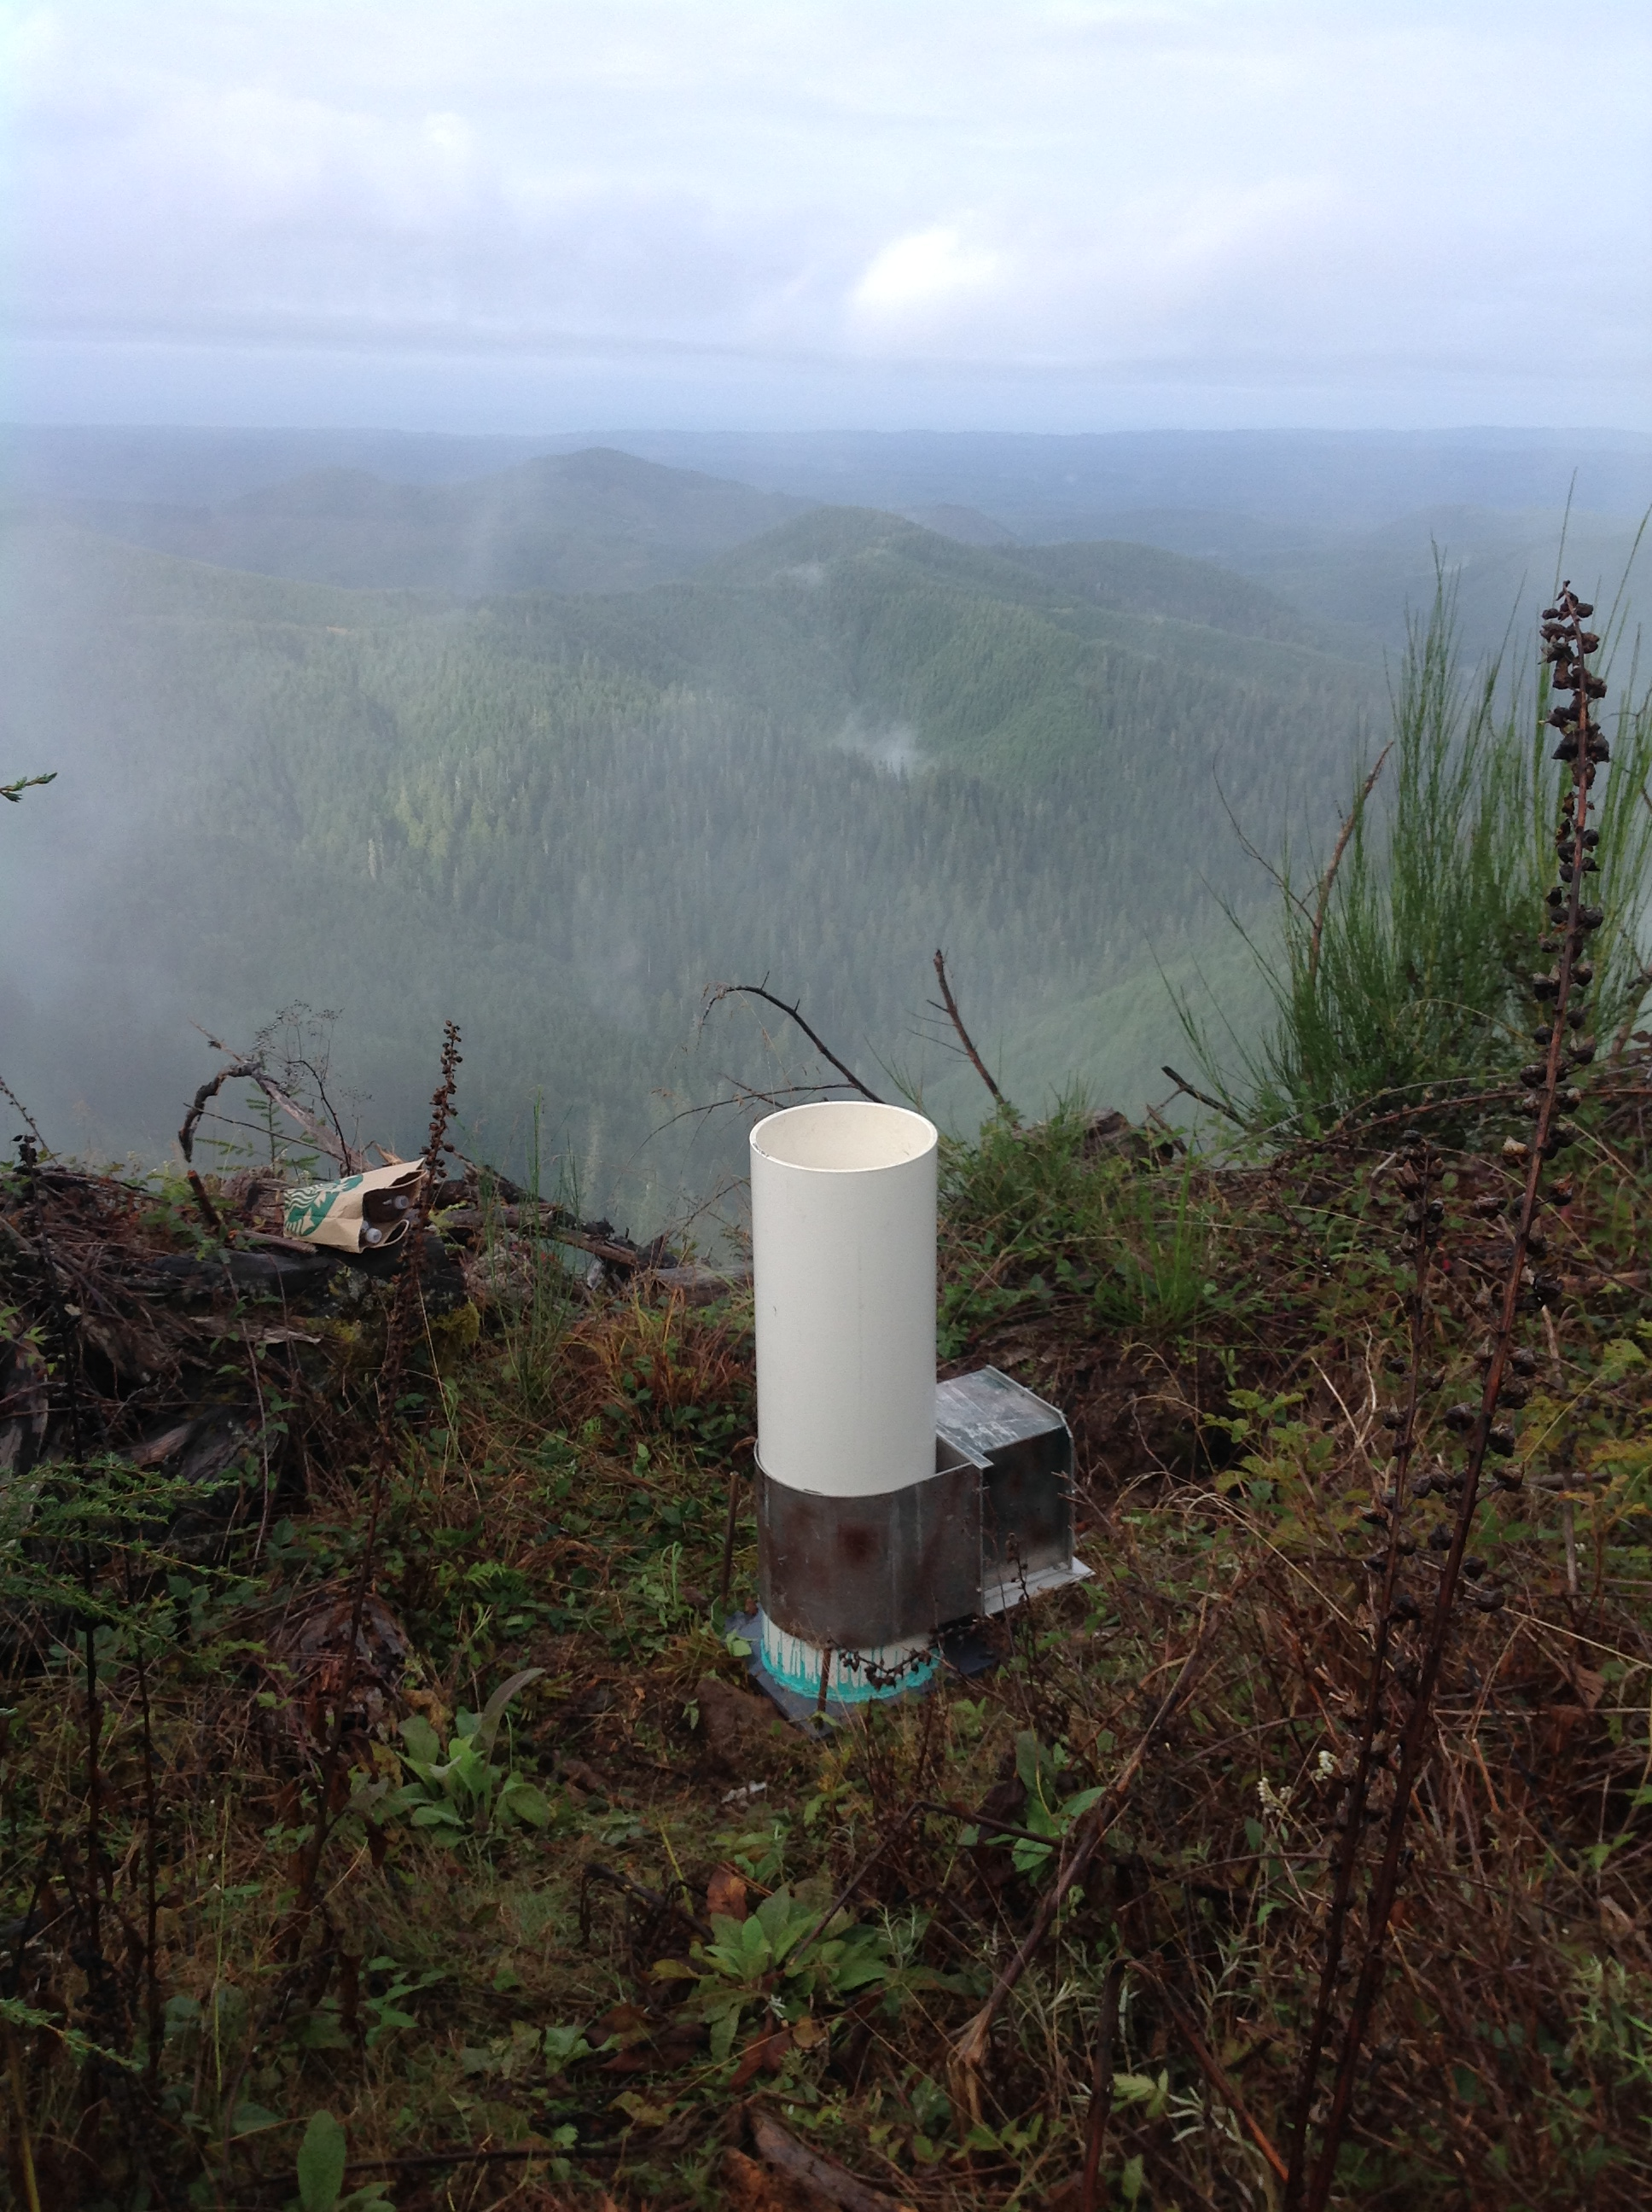
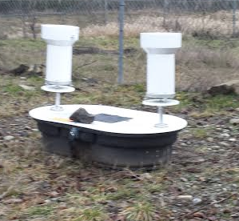
Rain gauge networks
Quinault Valley: Single bucket
Chehalis: 10-15 dual gauges, CoCoRaHS, Coop observers

Slide 32
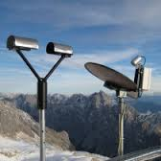
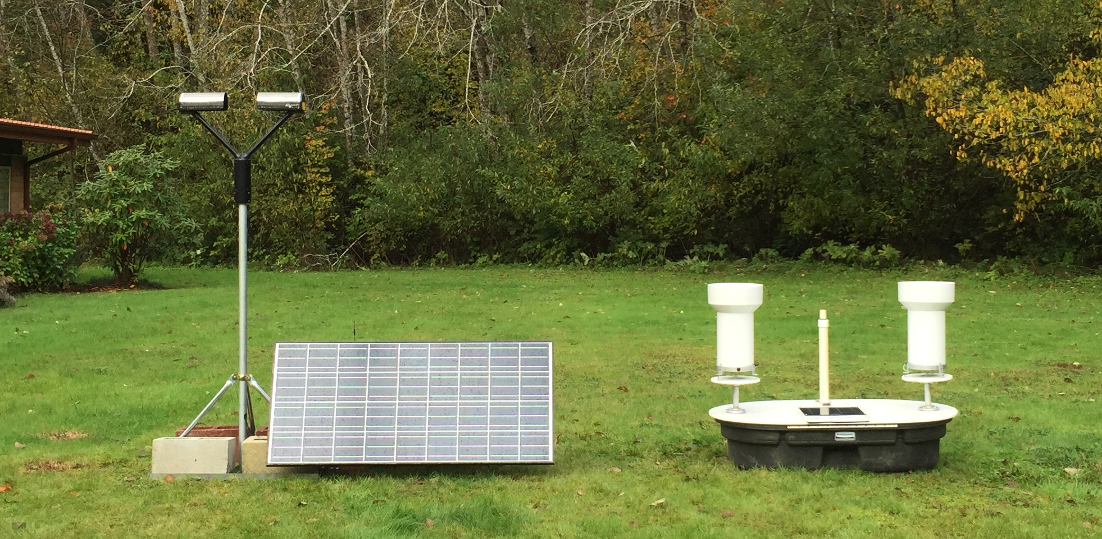
Ground sites (rain)
Low elevations with power
Micro Rain Radar (MRR)
Parsivel (disdrometer)
2DVD
Rain gauge (dual bucket)
Parsivel MRR
Low elevations without power
Parsivel (solar/battery)
Rain gauge (dual bucket)

Slide 33
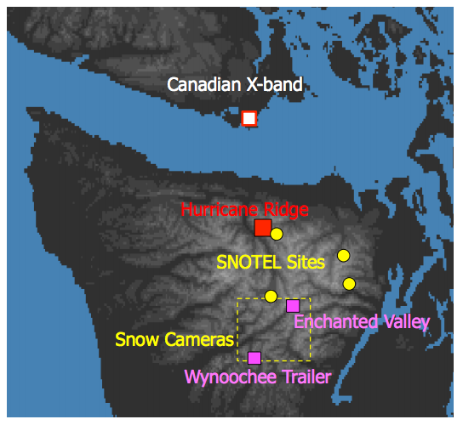

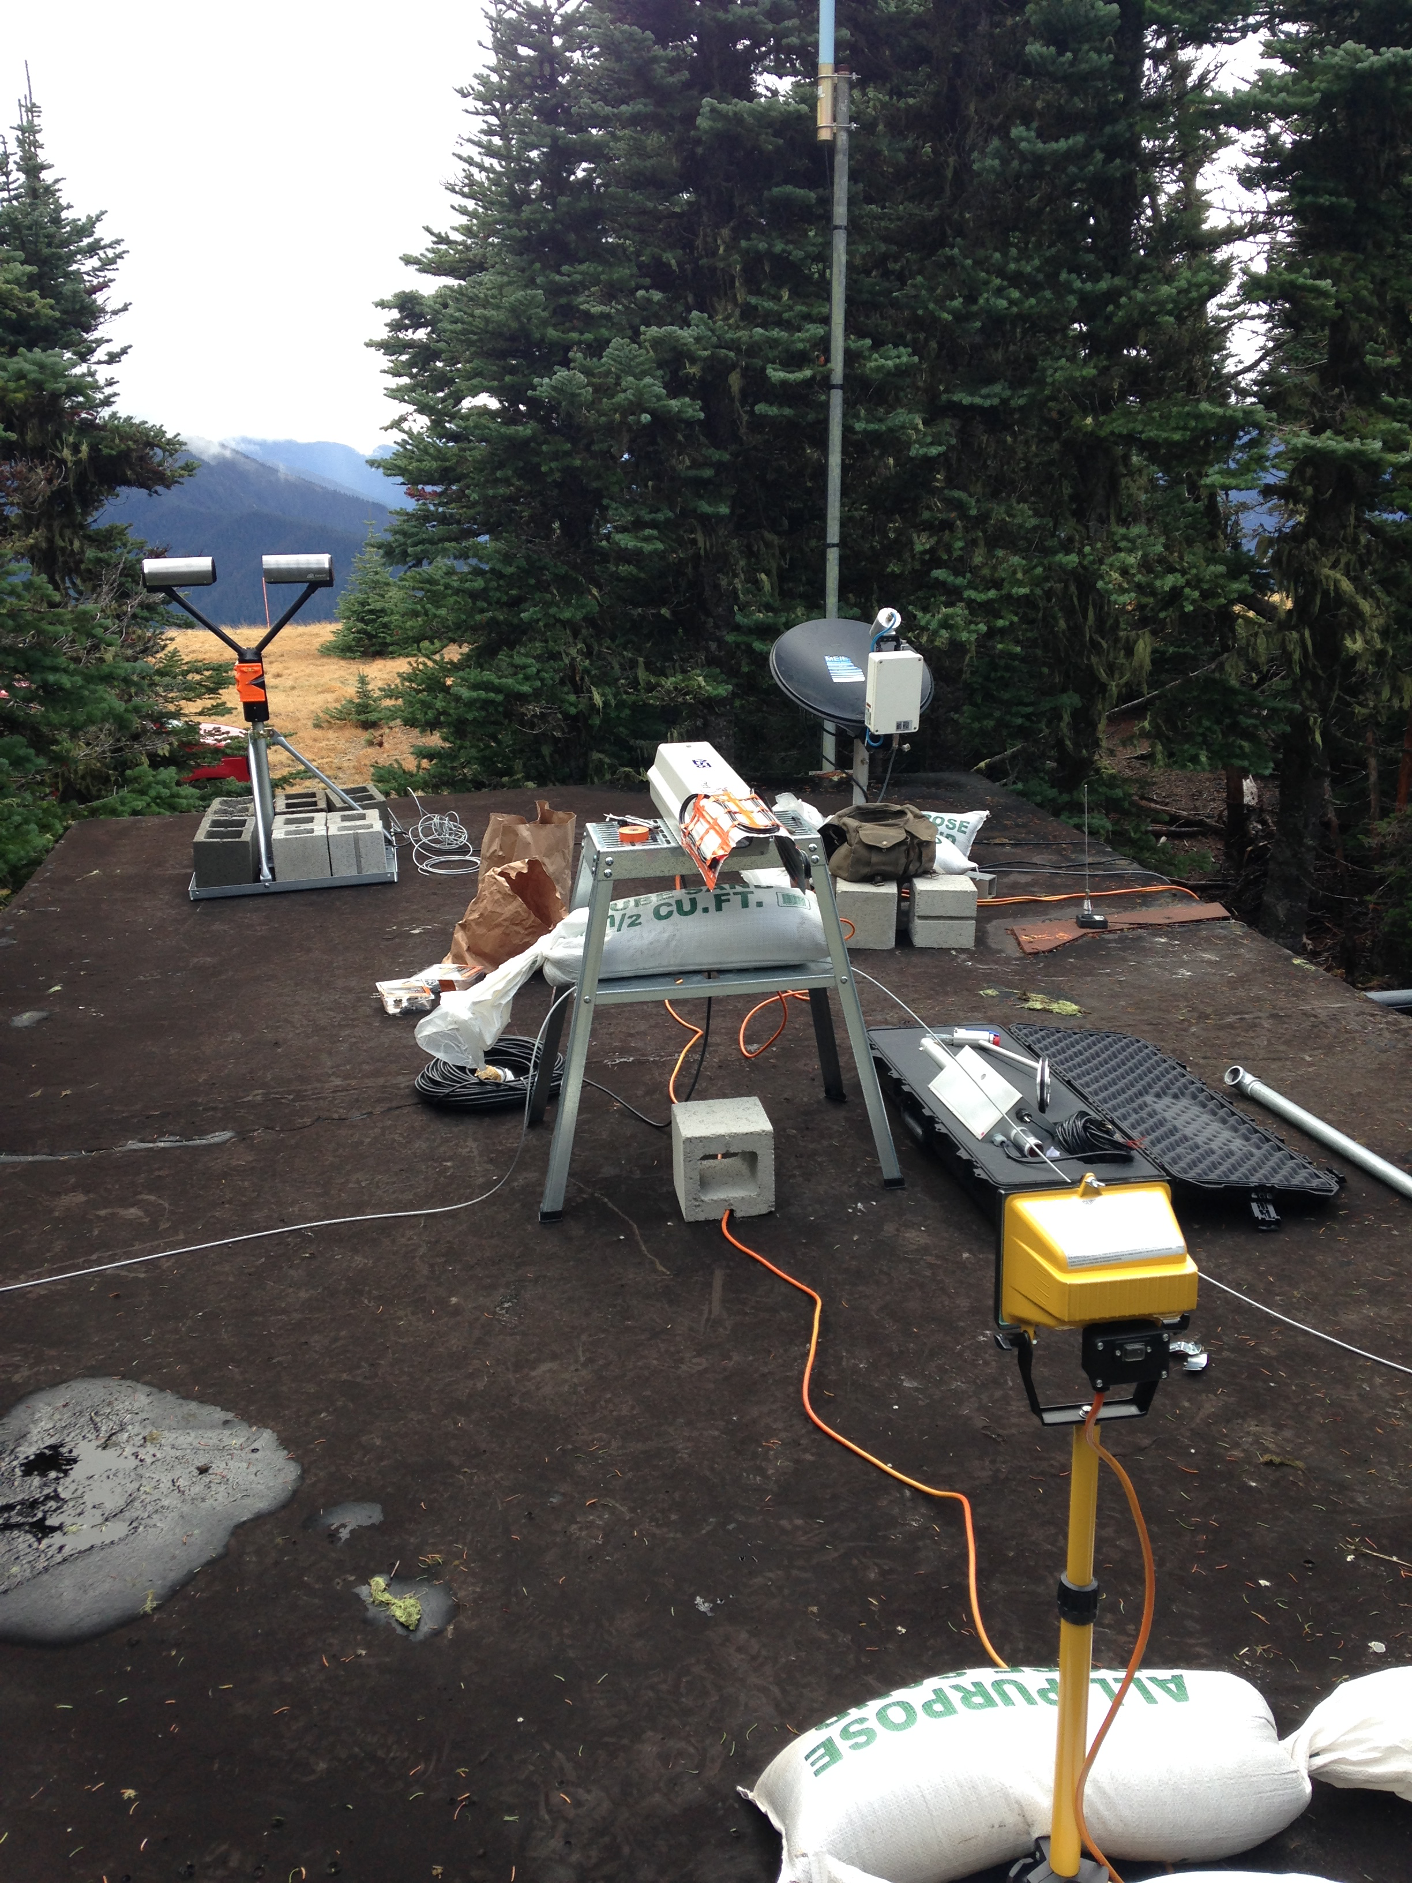
Ground sites (leeside)
Coordinated with Env. Canada radar
Power
MRR, Parsivel, PIP, Hot Plate

Slide 34
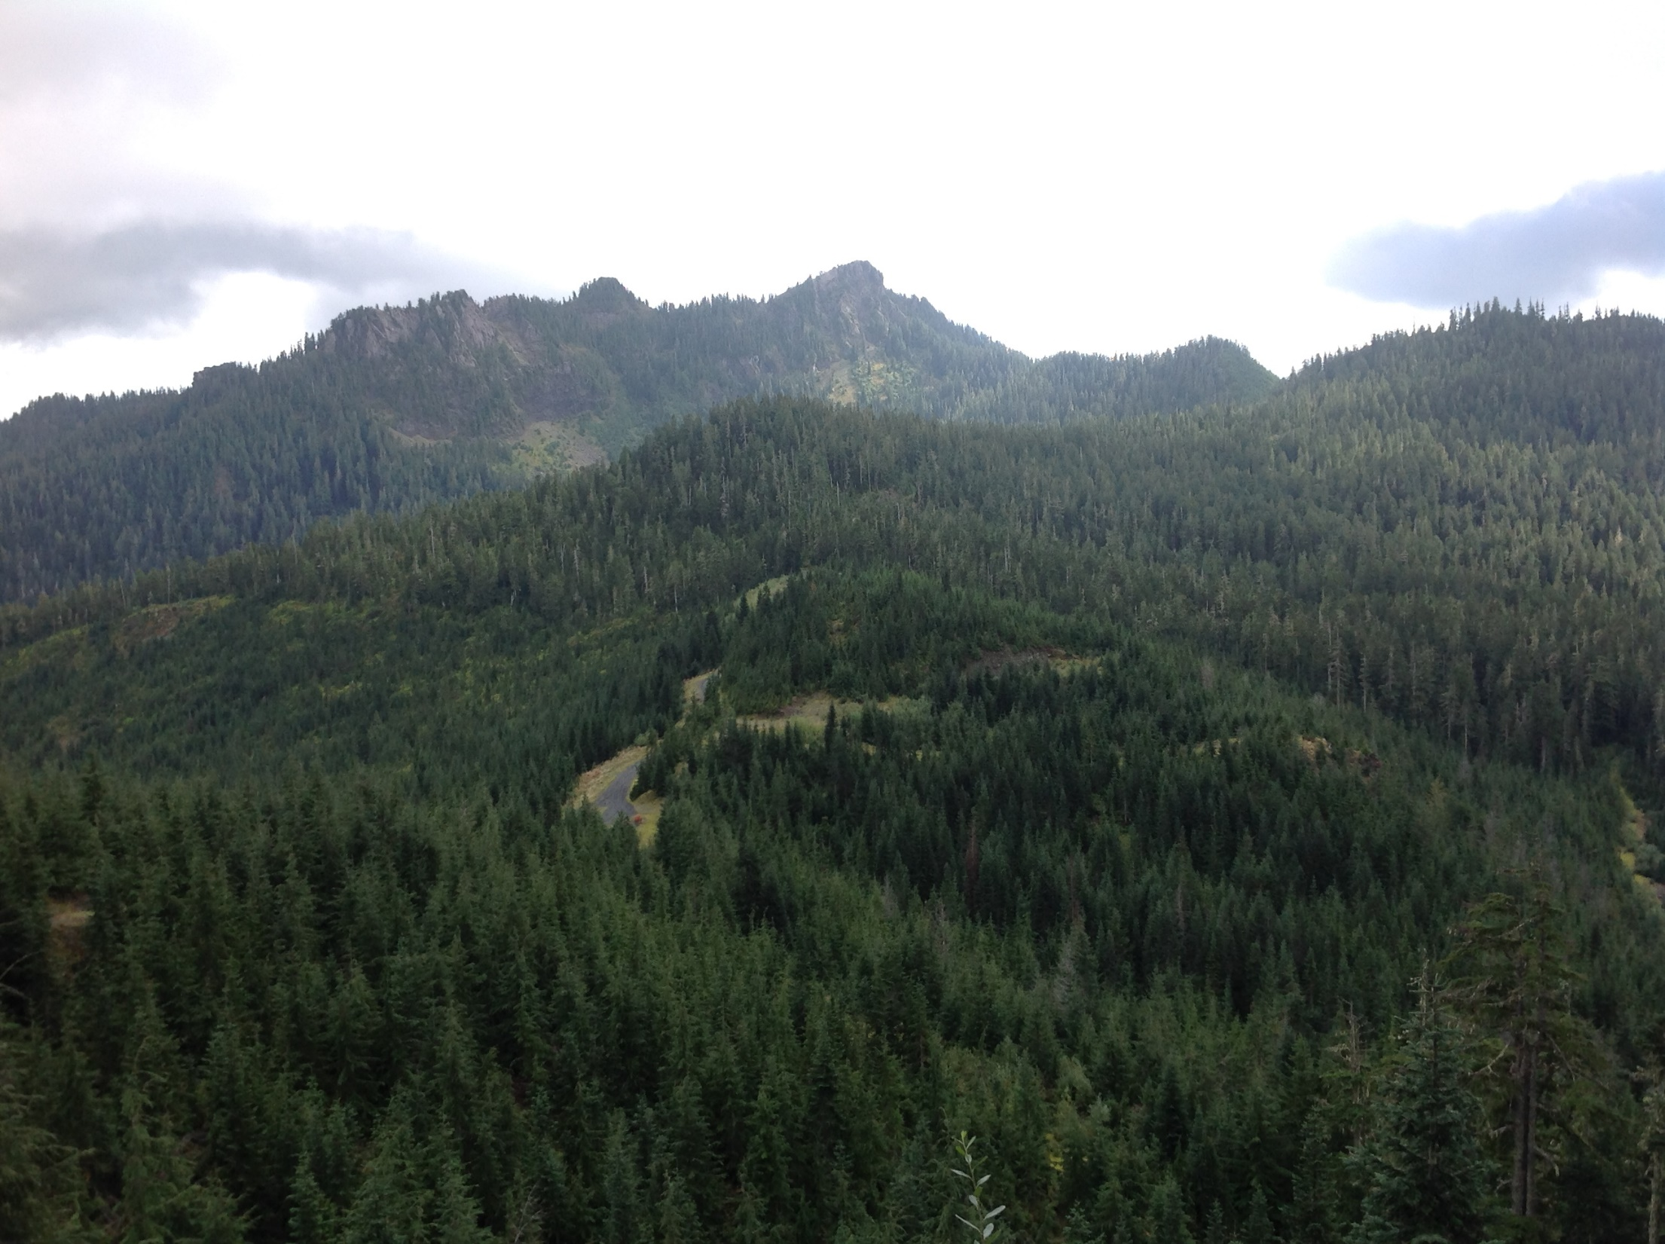
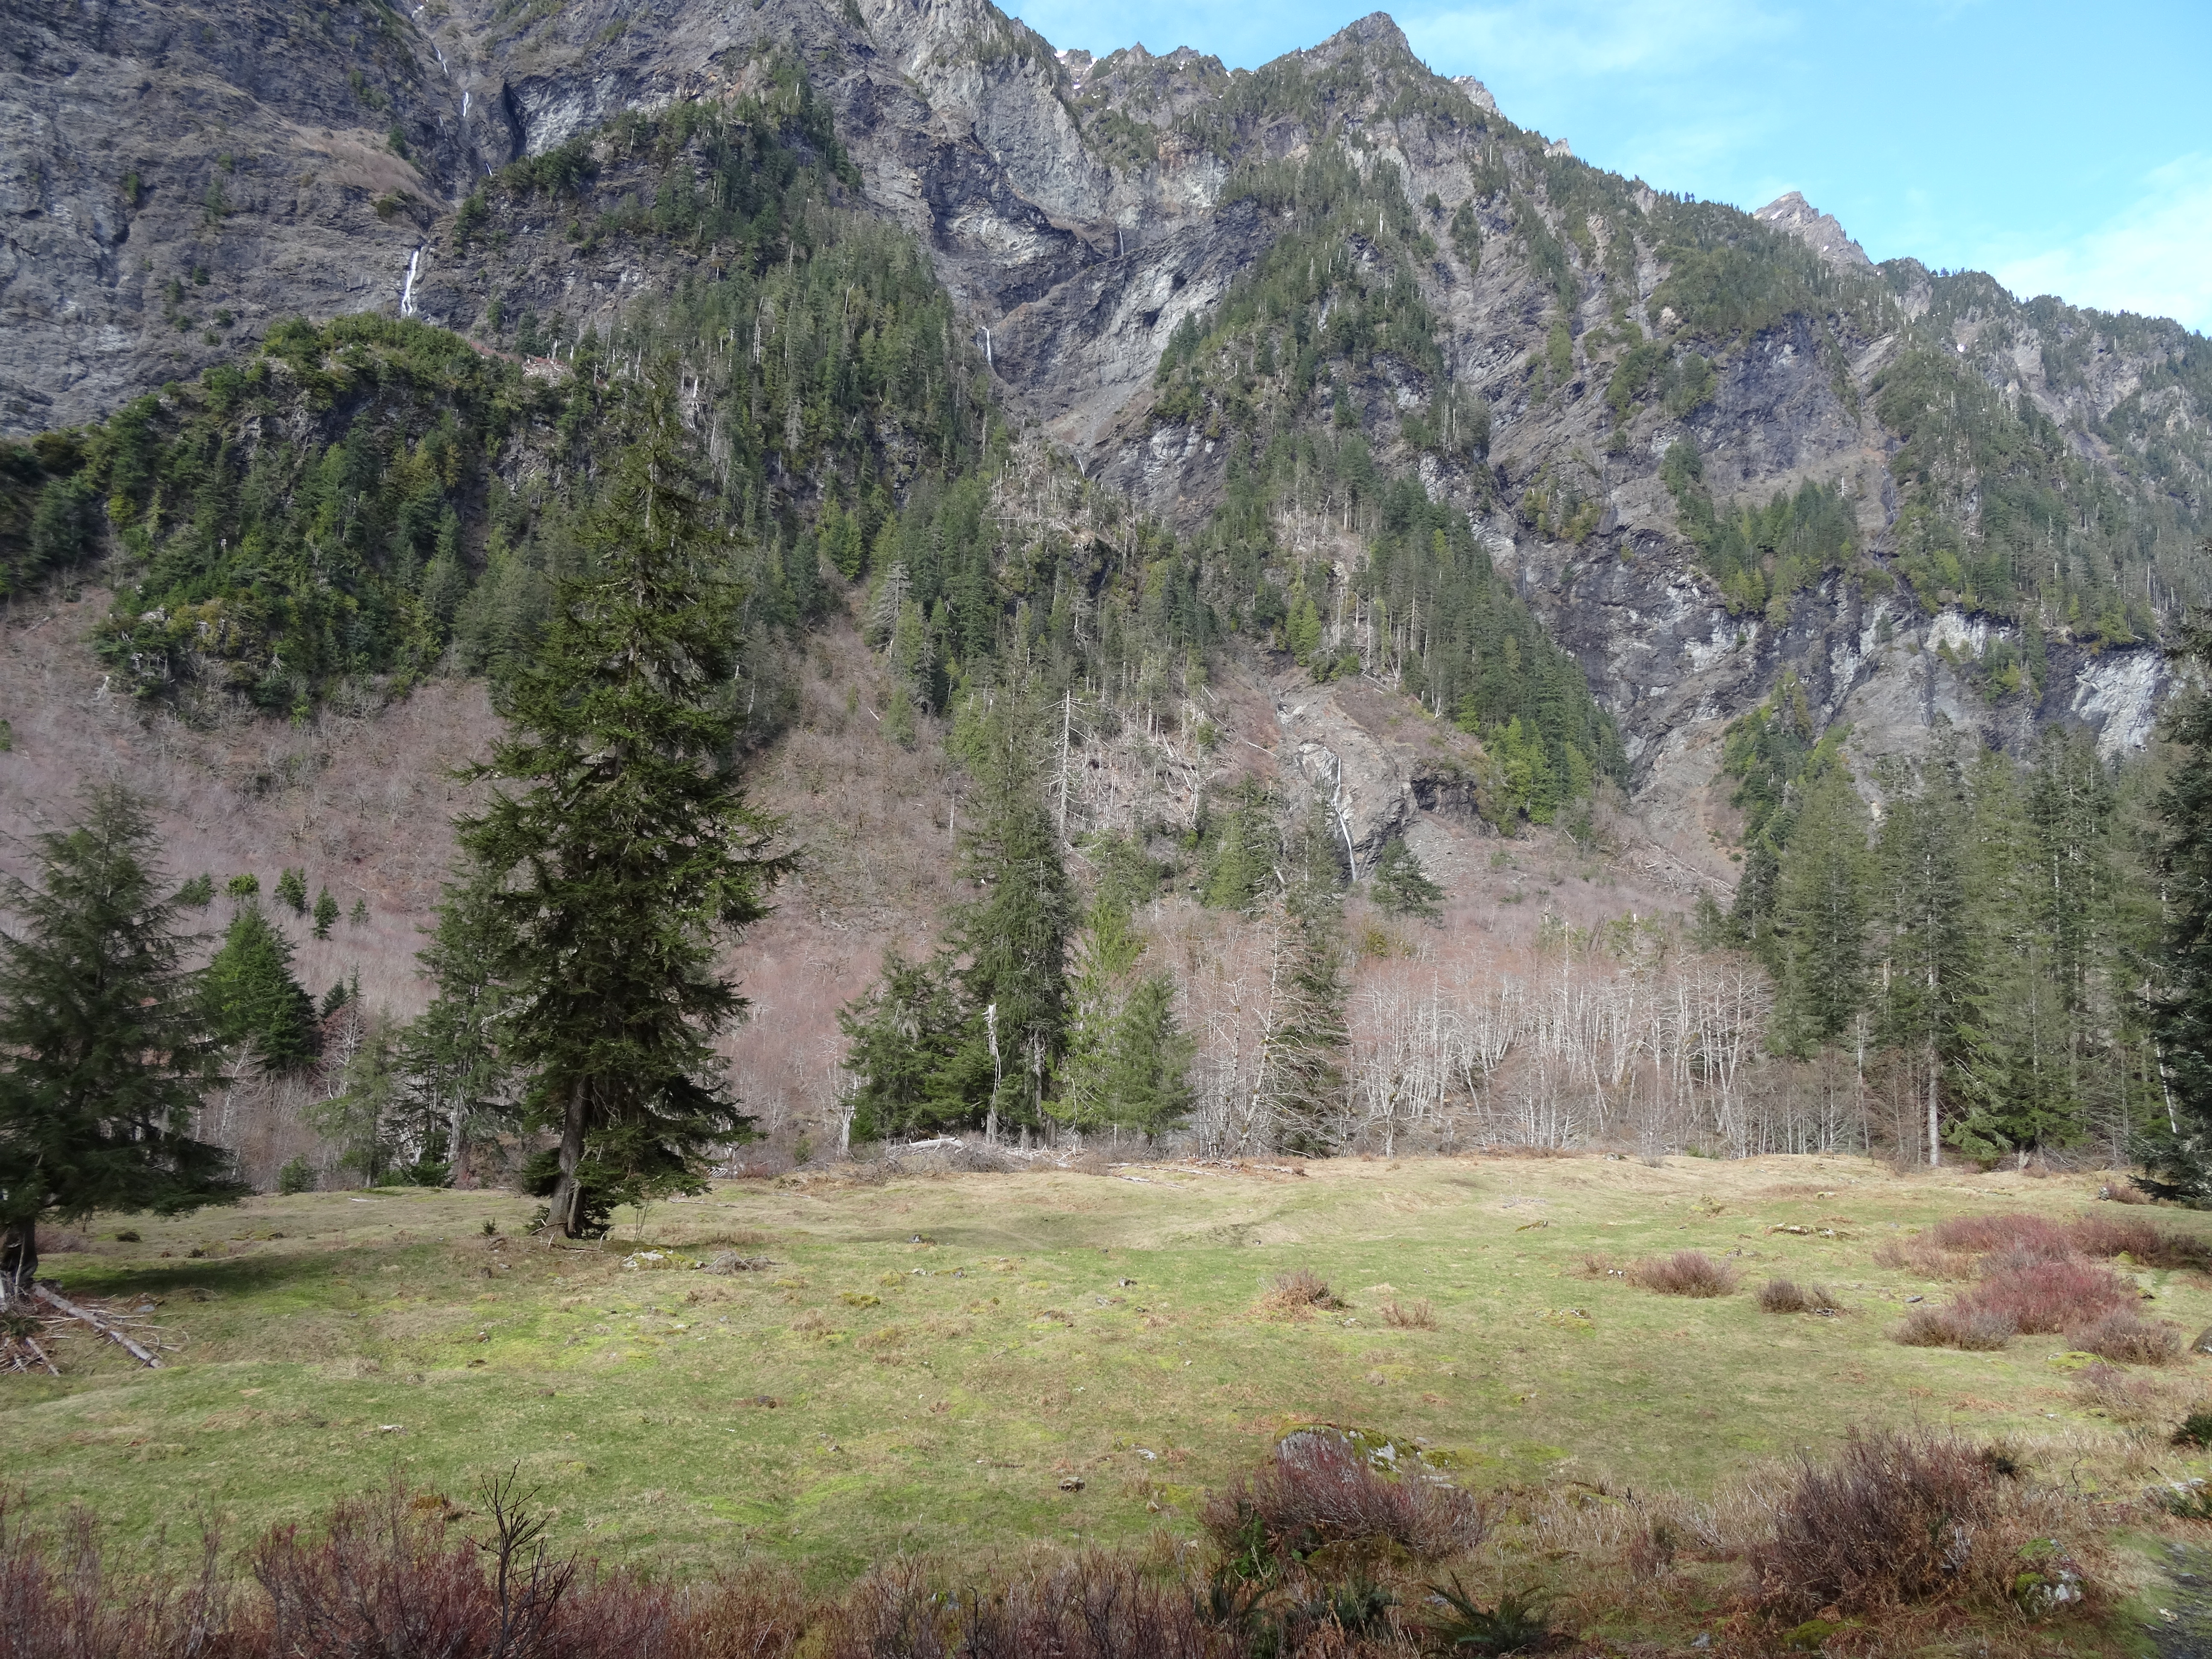
High Elevation Ground Sites (No Power)
2200 ft
3000+ ft
13 miles by pack animals

Slide 35
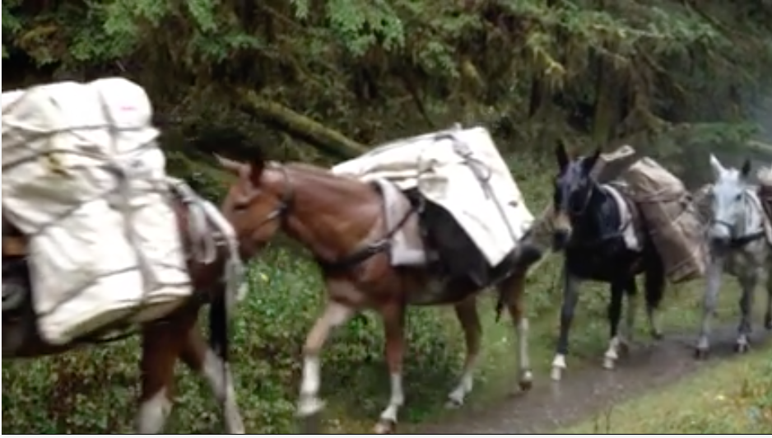
High Elevation Ground Sites (No Power)

Slide 36
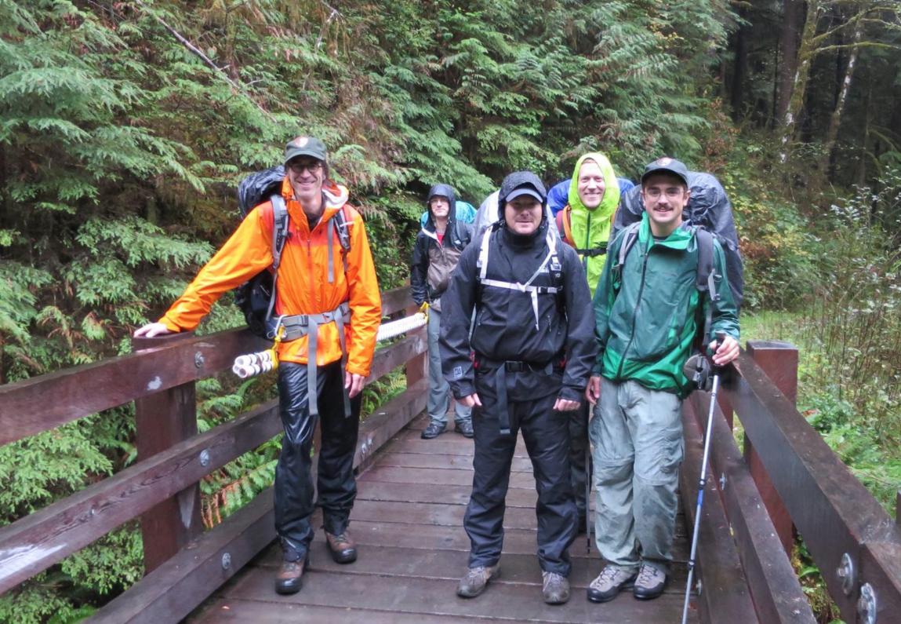
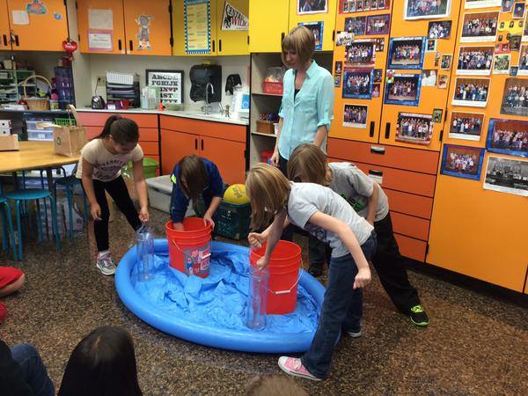
OLYMPEX

Slide 37
High Elevation Ground Sites (Snow)
For measuring snow depth and SWE of accumulating snowpack and for measuring falling snow microphysical characteristics
SNOTEL sites (existing sites)
Snow Cameras – 18 on windward side (Lundquist)
Additional Snow surveys at cameras
Hurricane Ridge installation
Enchanted Valley installation

Slide 38
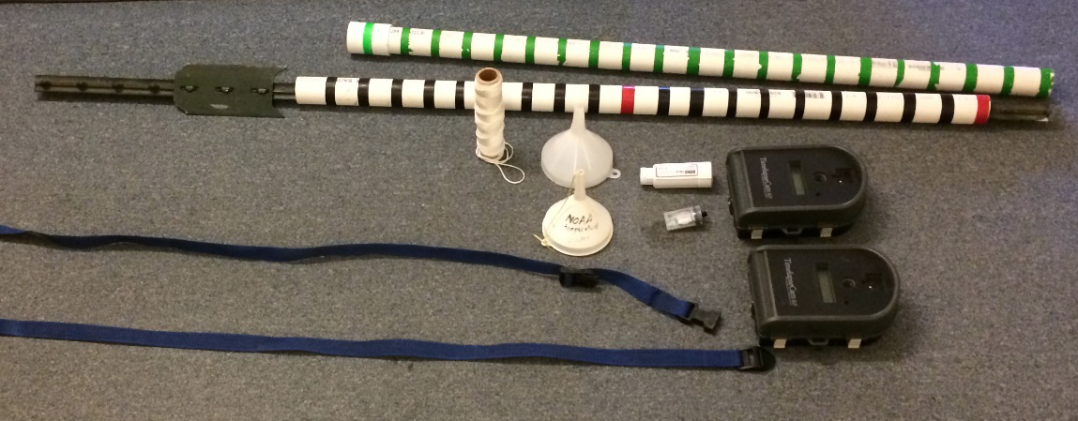
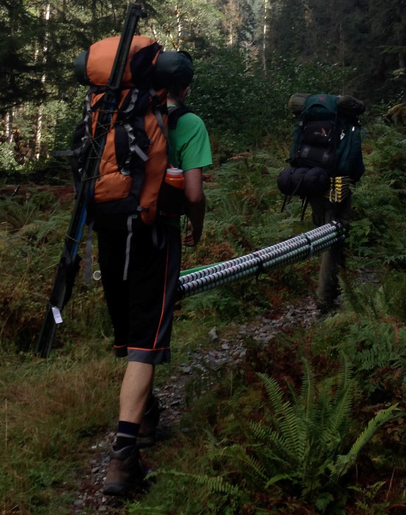
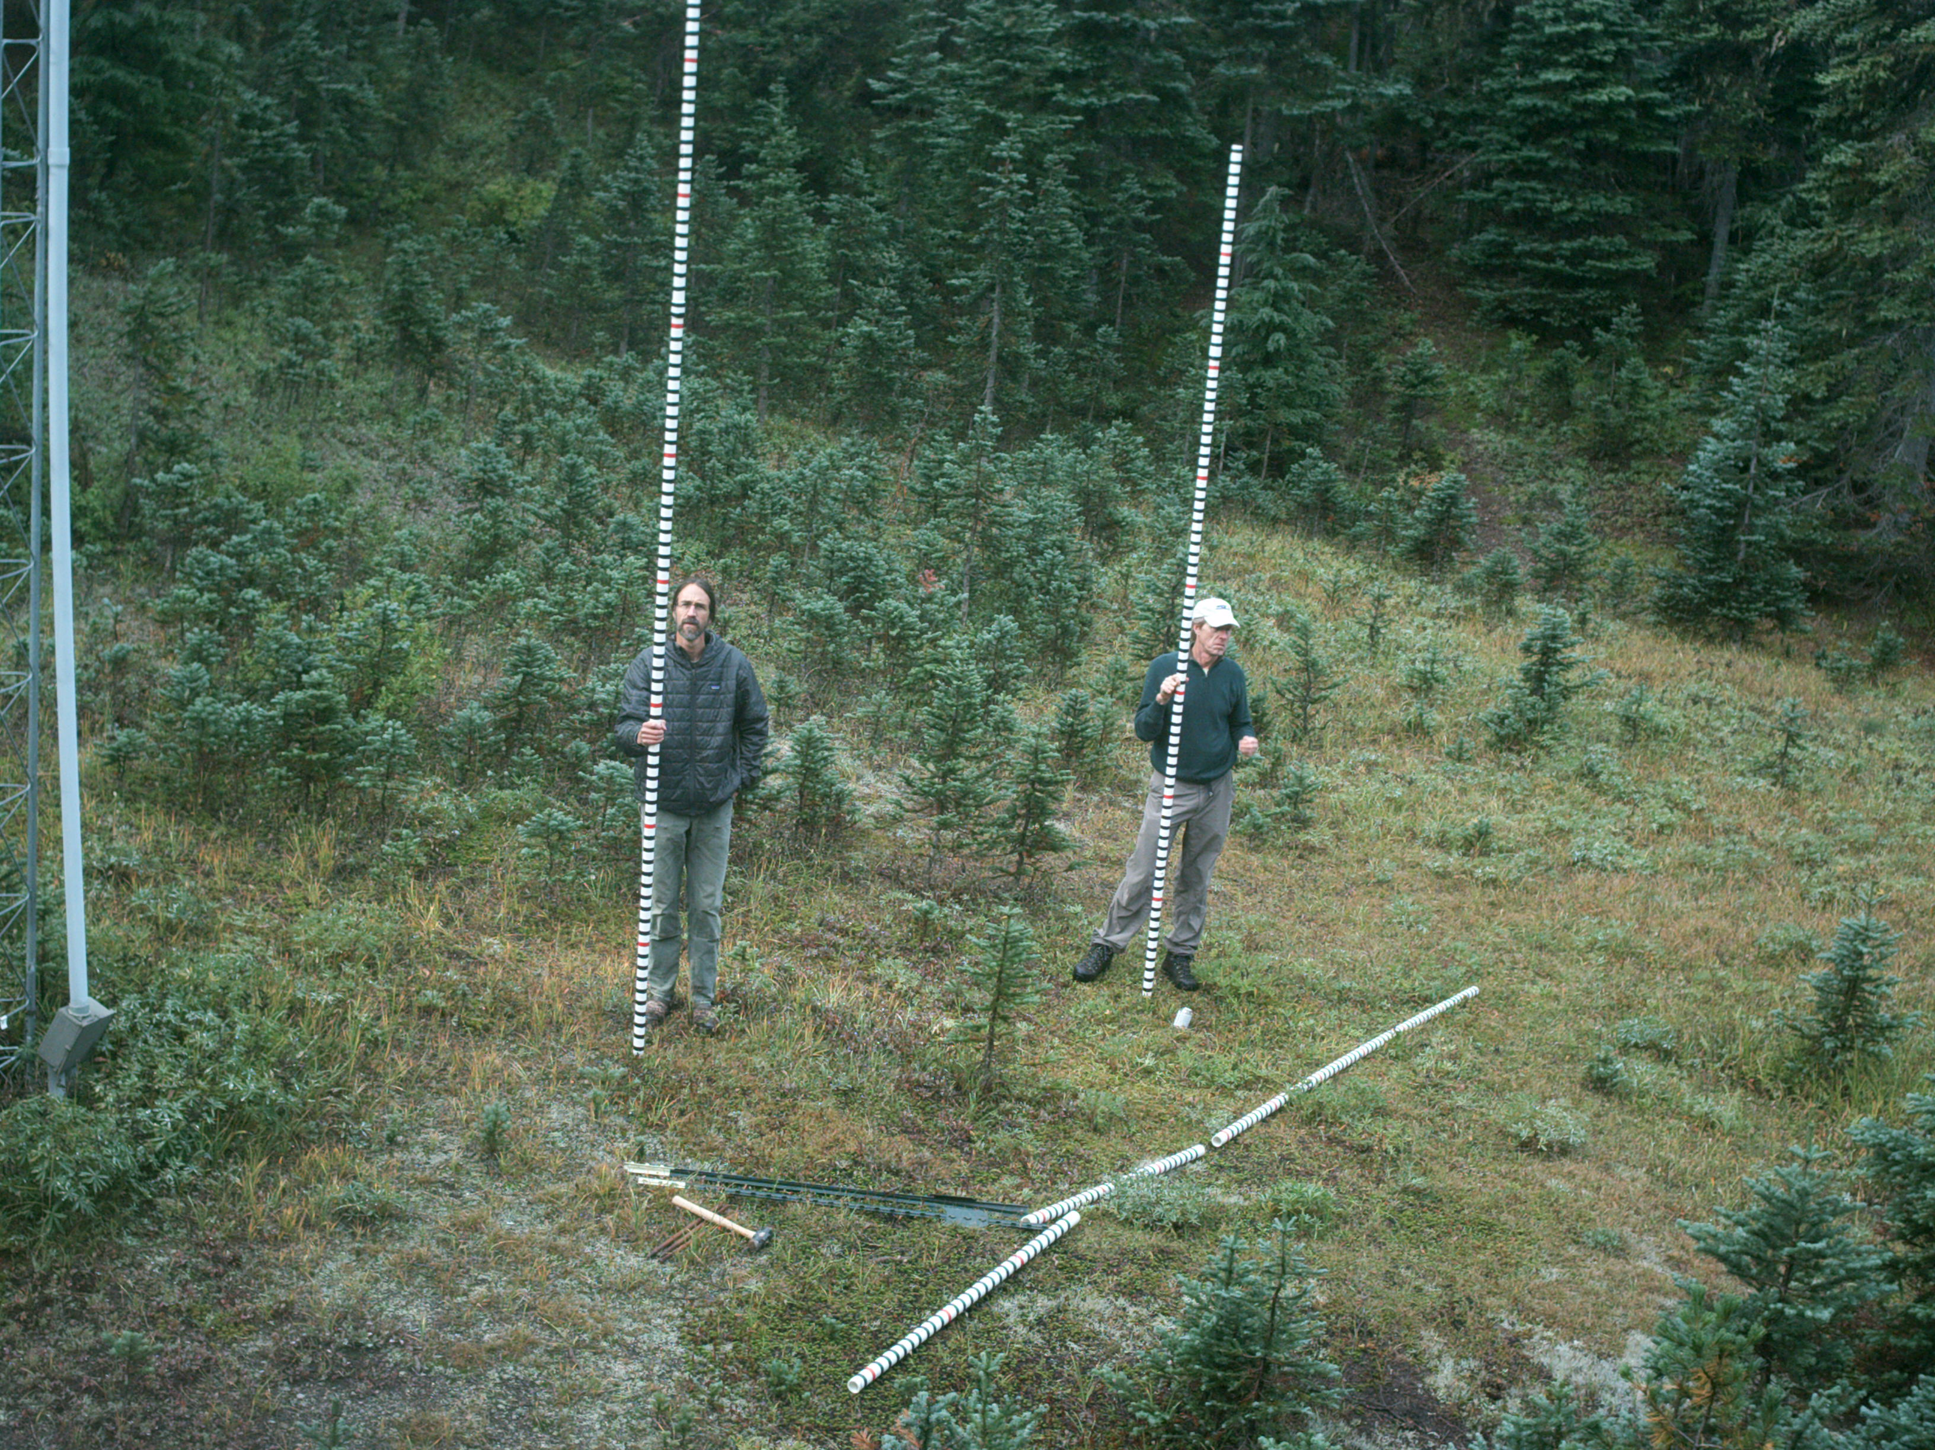
Snow camera installations

Slide 39
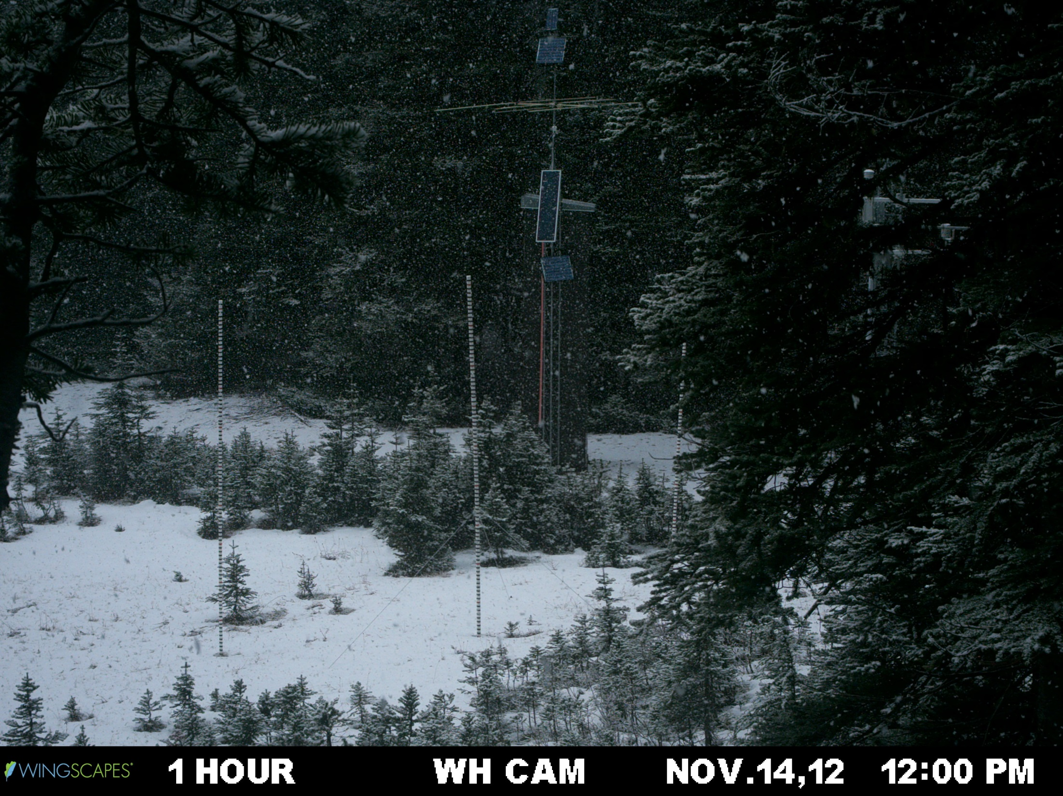
Precipitation event (snow) + Accumulation 1 of 2

Slide 40
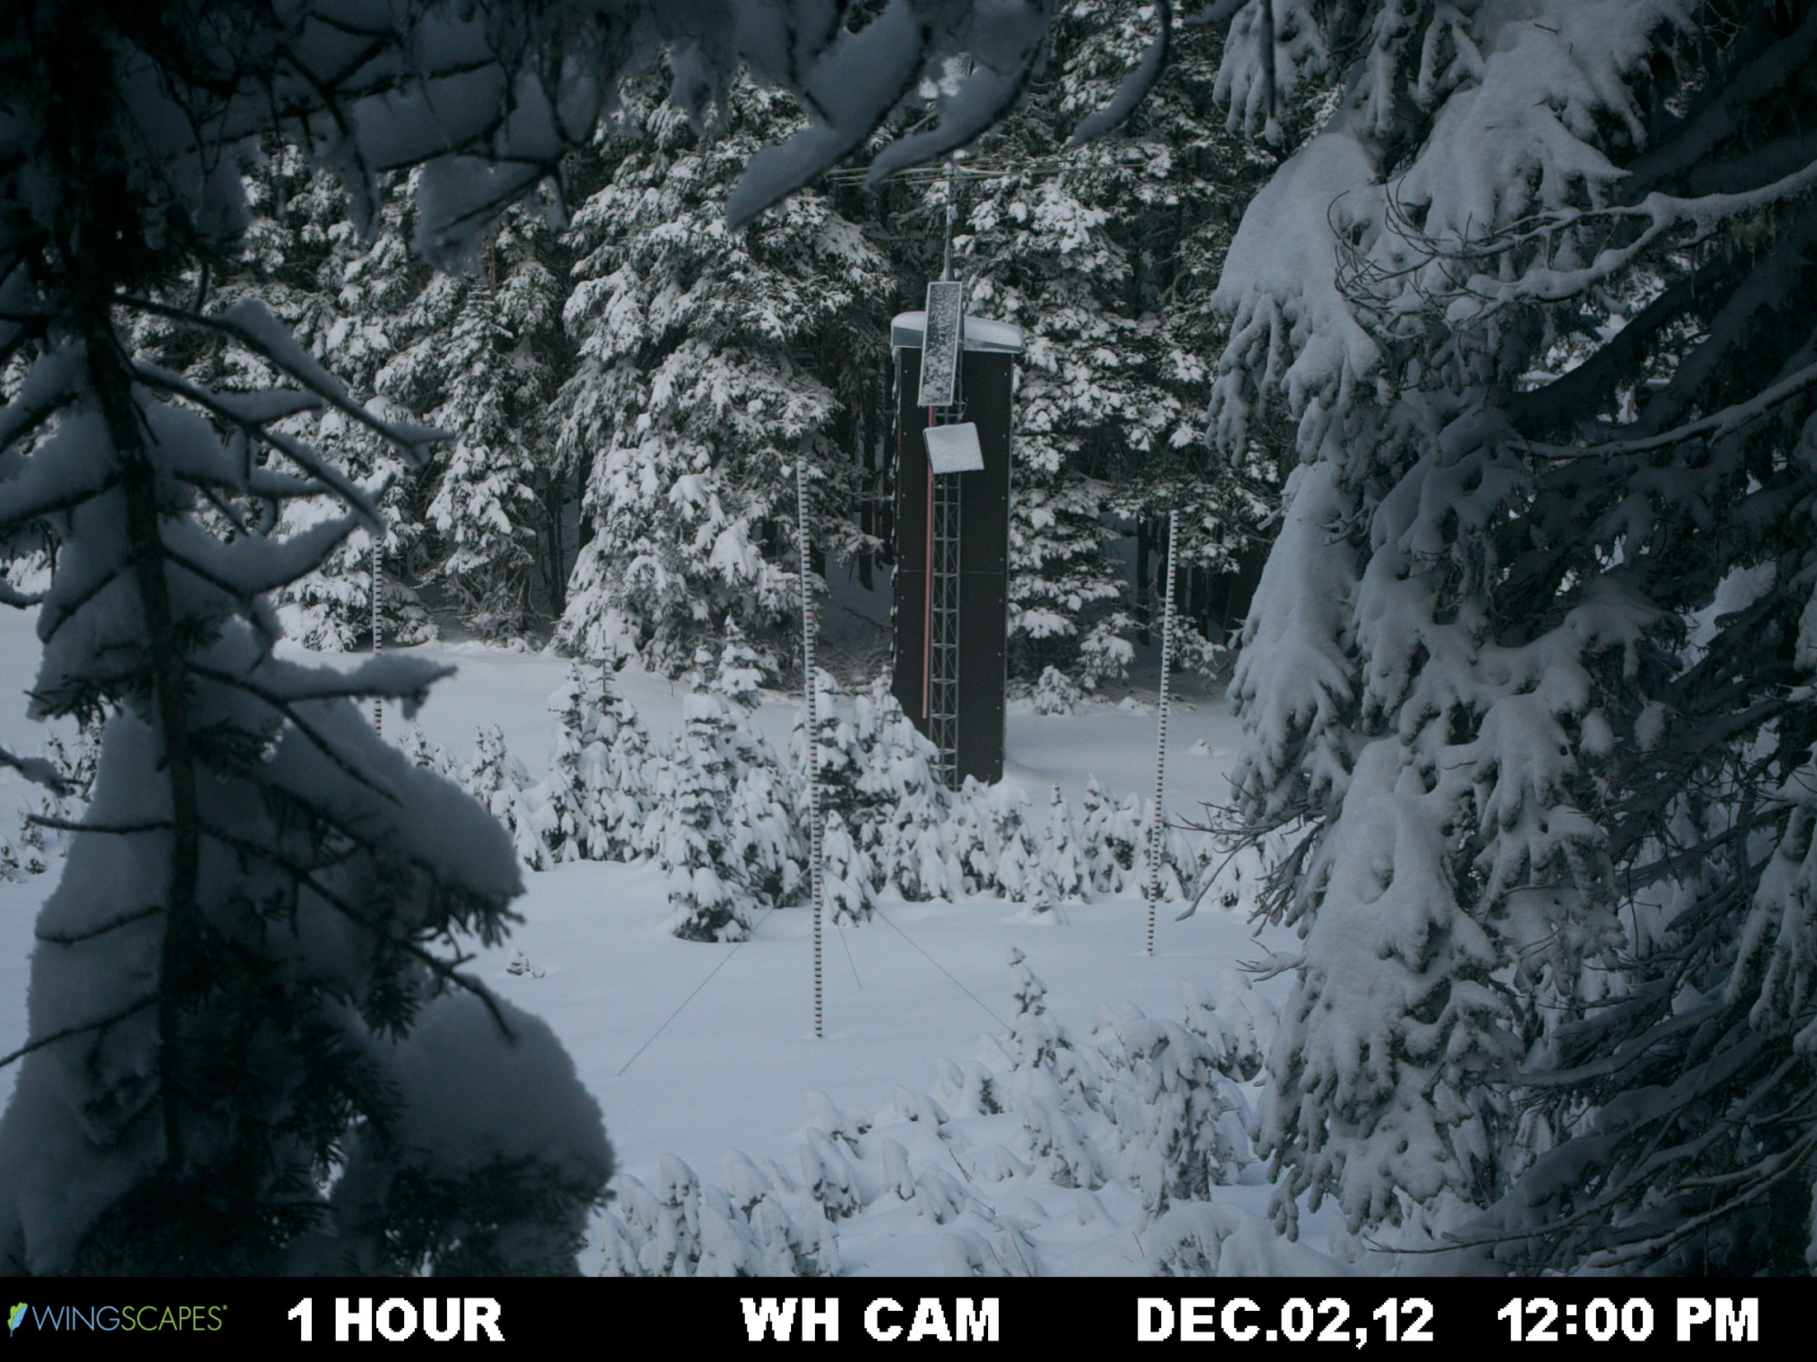
Accumulation 2 of 2

Slide 41
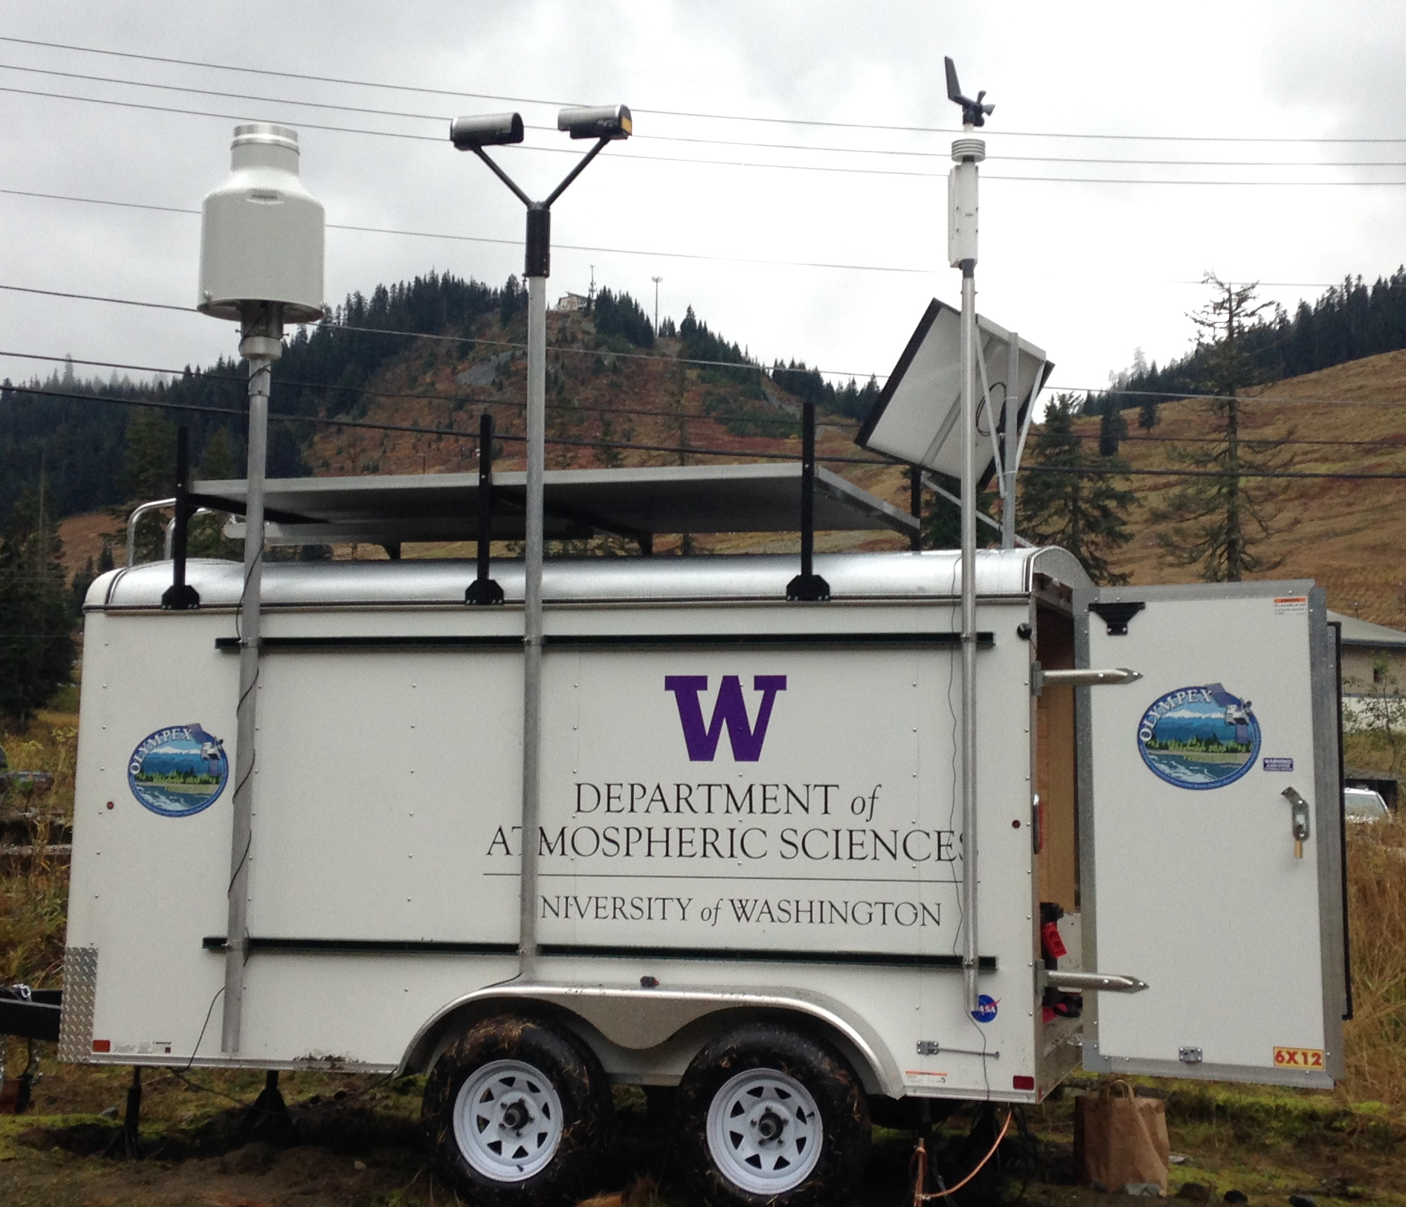
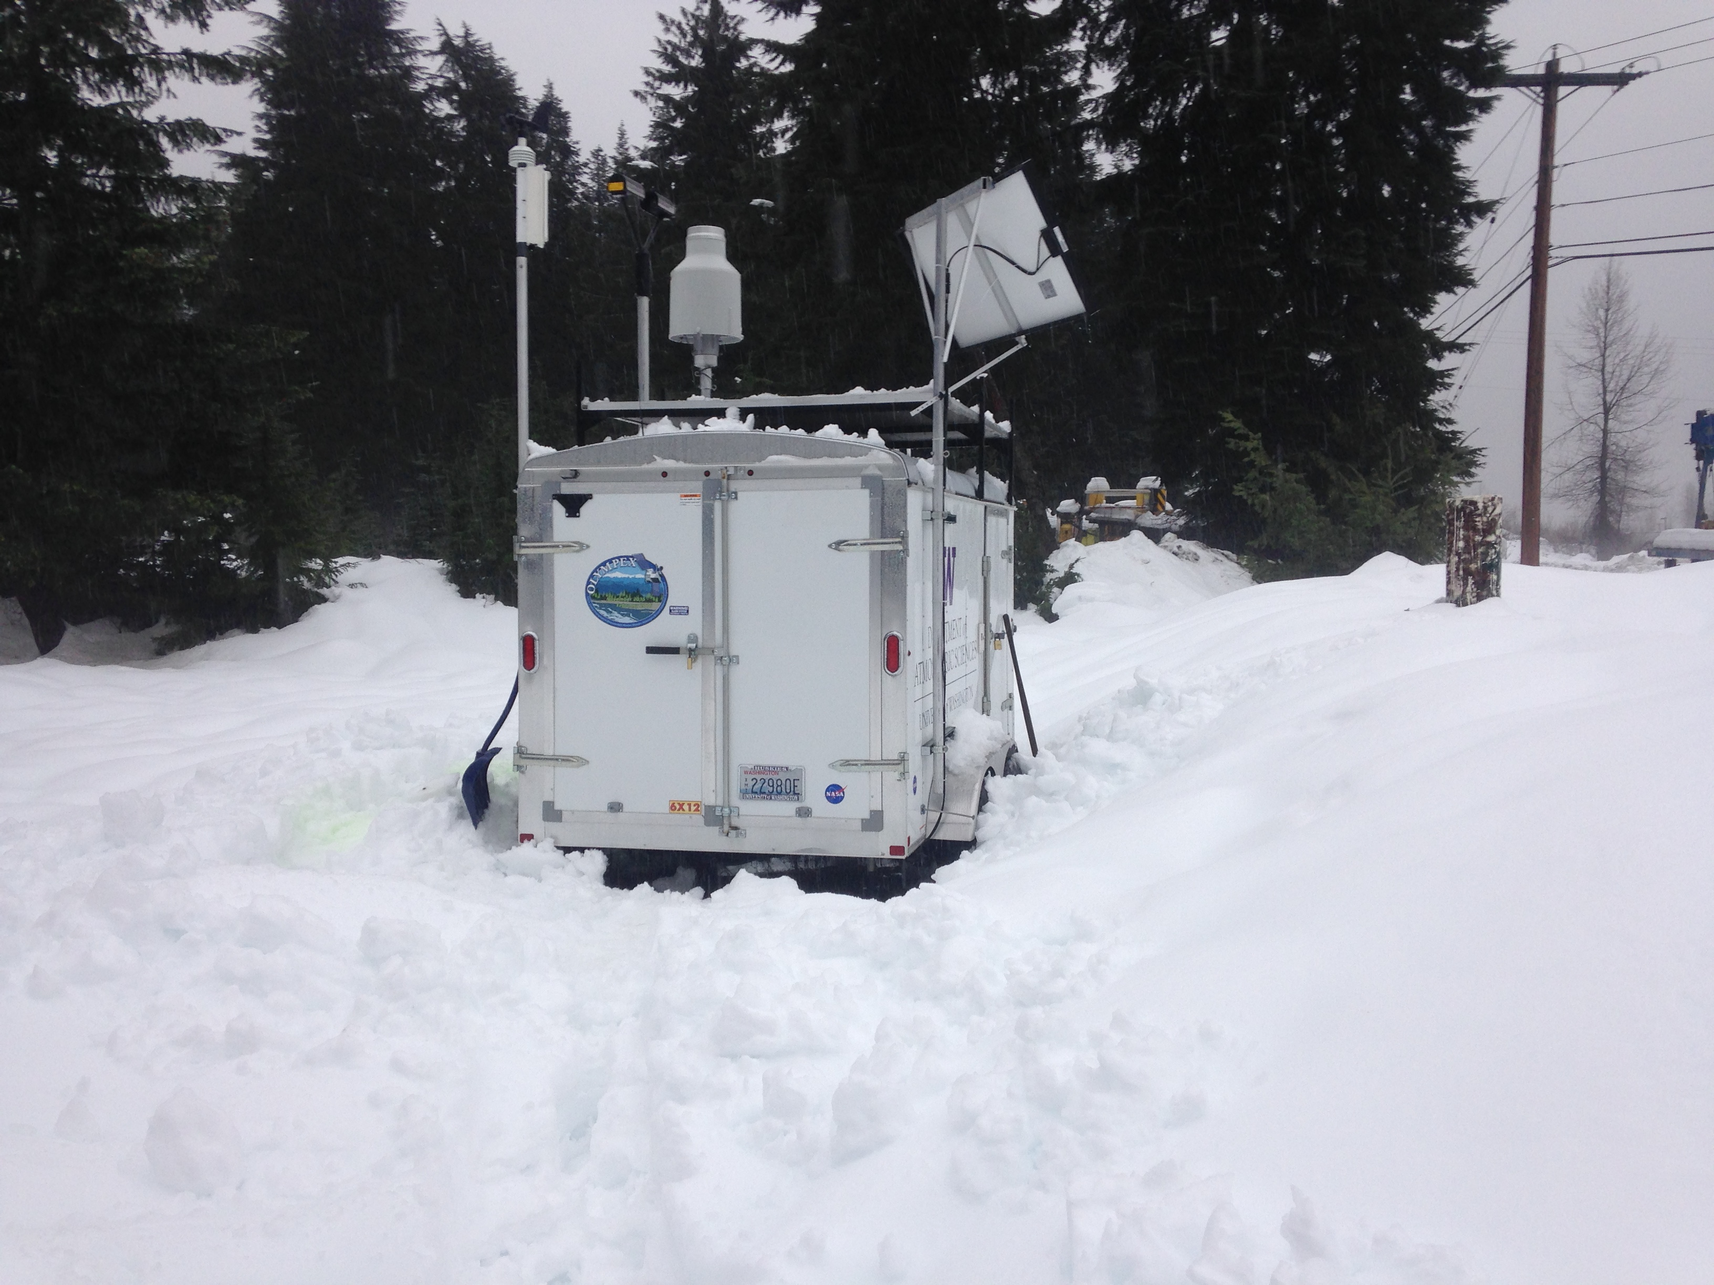
High elevation trailer (Wynoochee)
15-ft anchored trailer
8 deep-cycle batteries, electronics, computer inside
Solar panel to recharge batteries
Pluvio and Parsivel mounted to be above snow

Slide 42
OLYMPEX Network
Test deployments this winter:
Hurricane Ridge
Quinault Fisheries
Snoqualmie Pass
m
x
x
Legend
= WSR-88D
= NPOL and D3R
= DOW
= EC X-Band
= MRR
= Soundings
= SNOTEL
= Ground Obs sites
= Snow camera network = UW Tipping bucket network
= Chehalis rain gauge network
x
x
x
x
x
x
x
x
x
x
x
x
x
x
x
x
x
x
x
x
x
x
x
DC-8
ER-2
Citation

Slide 43
Considerations – Power, Nature
Hurricane Ridge
Strong winds (SWE underestimated by hotplate)
Noisy Parsivel data
Couldn’t test riming (abnormal year)
Quinault Fisheries
Solar panel + 1 battery = 2-3 weeks
Need to change batteries in dual tipping buckets every month
Snoqualmie Pass (high elevation, no power)
Solar panel + 8 batteries = all winter (1.5-2 mo in normal rainy year)
Pluvio needs to be emptied at least every 3-4 weeks
No cell coverage

Slide 44
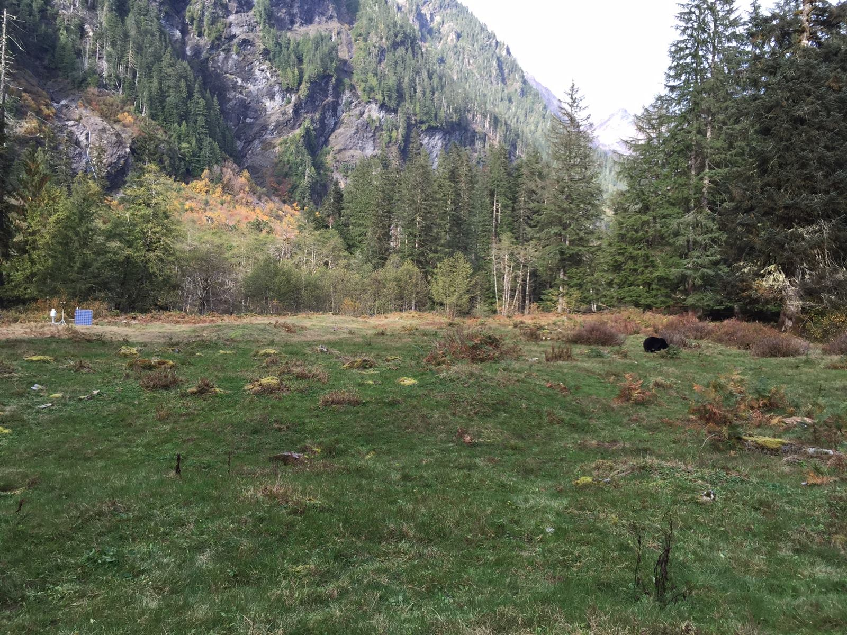

Considerations - Visitors

Slide 45
Considerations: IOPs
Forecasting approaching storm
Achieve OLYMPEX goals?
10 AM planning meeting
Decisions for Day 1, 2, 3-5
When to start soundings (NPOL)
Increase frequency as storm progresses?
100 available at NPOL
If/when/which aircraft fly
If/when/how many dropsonde DC-8 launches
DC-8: 80 h
ER-2: 54 h (daylight)
Citation: 75 h (60 for OLYMPEX)
Distributed between different regions, storm sectors, RADEX (offshore)

Slide 46



Aircraft
Citation
DC-8
Satellite Simulator instruments
Dropsondes over the ocean
Flies at ~30,000 ft
Cloud Microphysics instruments
Flies at 2000 ft above highest obstacle
ER-2
Satellite Simulator instruments and Flies at ~60,000 ft

Slide 47
Resources
OLYMPEX webpage: http://olympex.atmos.washington.edu
Social media: http://www.facebook.com/OLYMPEX, @UW_OLYMPEX
Education: http://pmm.nasa.gov/olympex

Slide 48

Looking Forward

