Slide 1
AMIE, MC3E, and GOAmazon:
An opportunity to understand MCSs in differing environments
Angela Rowe
Robert Houze, Jr.
University of Washington
PNNL Seminar
Richland, WA
26 October 2015

Slide 2
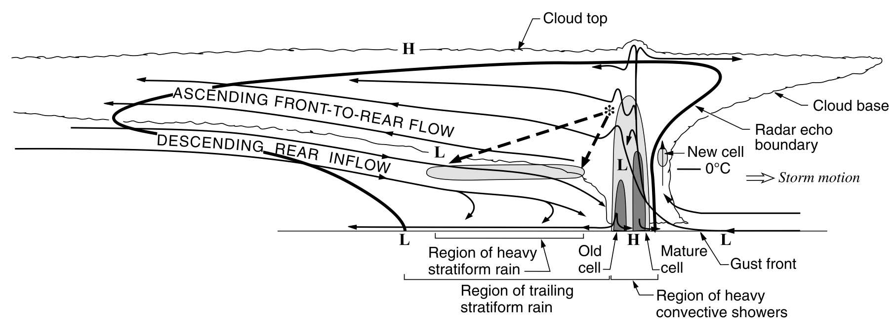
Mesoscale Convective Systems
Contiguous precipitation area > 100 km [Houze 2004]
  Stratiform: Decay of older convective cells, broader-sloping mesoscale layer ascent
Houze [1989]

Slide 3
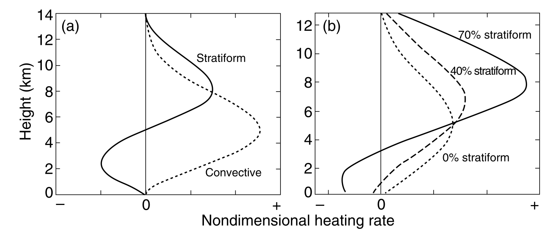
Mesoscale Convective Systems
Important link between convection and the larger-scale circulation
Vertical distribution of heating
  Stratiform: Net heating aloft (condensation), Cooling below (melting/evaporation)
  The greater the stratiform fraction, net heating becomes more elevated and intense
Schumacher et al. [2004]

Slide 4
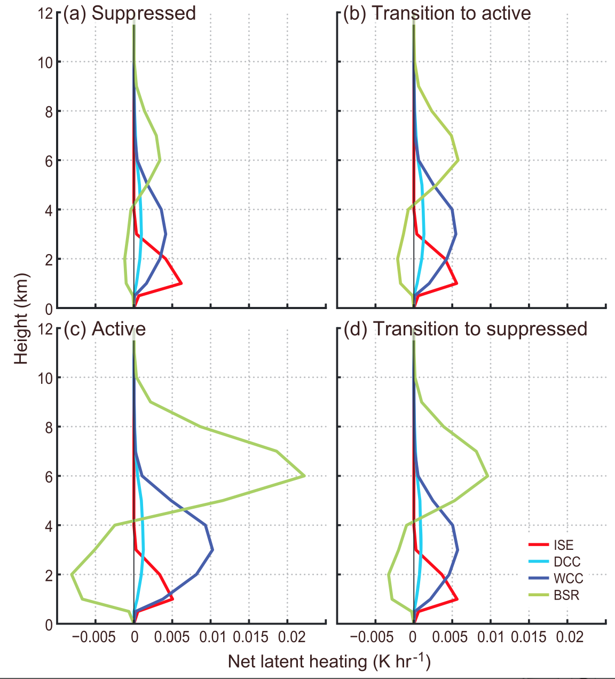
Indian Ocean (Oct-Feb) 1998–2012
MJO
Greatest variation for broad stratiform regions
  Transition to suppressed > Transition to active
  Peaking during active phase
Barnes and Houze [2015]

Slide 5
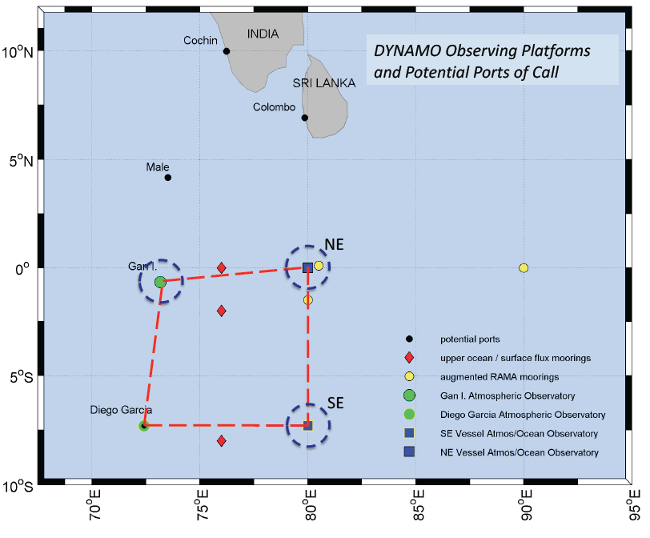
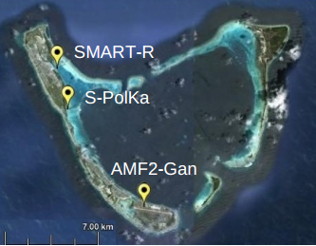
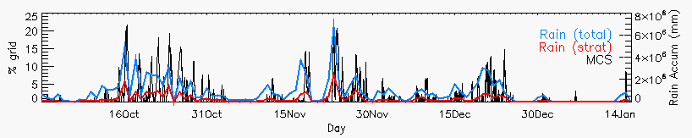
AMIE/DYNAMO
Rowe and Houze [2014]

Slide 6
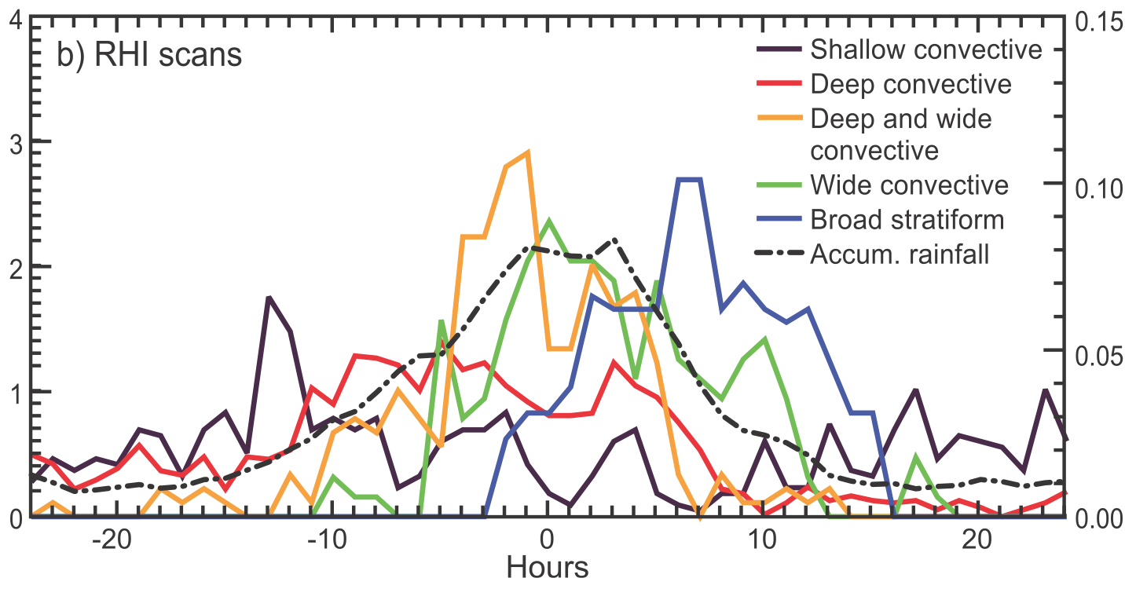
MJO
Zuluaga and Houze [2013]

Slide 7
AMIE/DYNAMO
Rowe and Houze [2014]

Slide 8
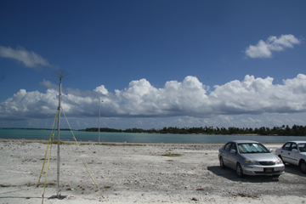
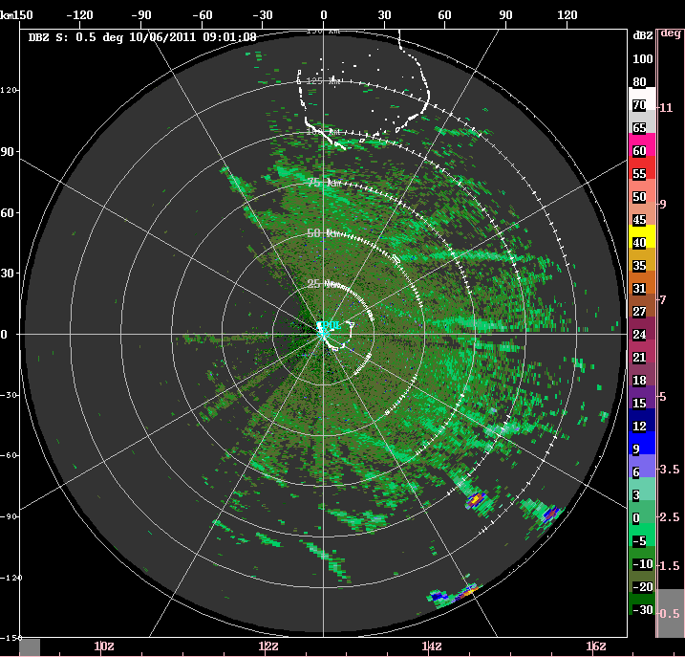
Early suppressed
Photo: Bob Houze
1) Cloud lines oriented parallel to wind direction and (initially) to low-level shear
2) Shallow precipitating clouds produce cold pools during afternoon

Slide 9
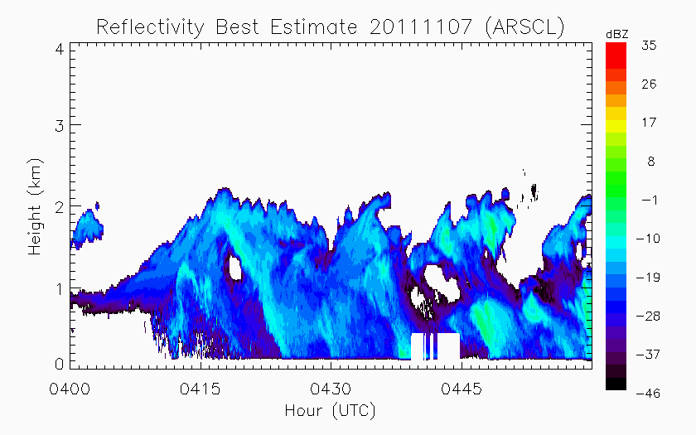
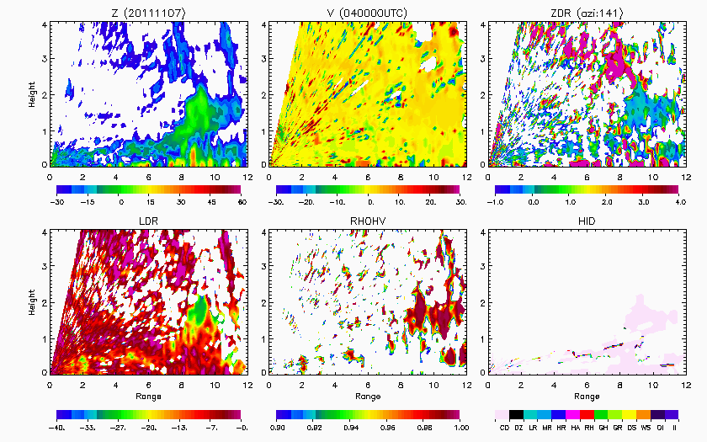
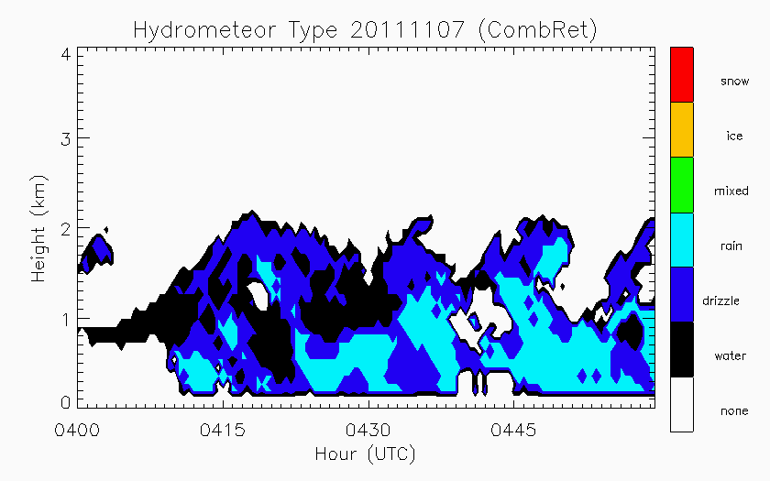
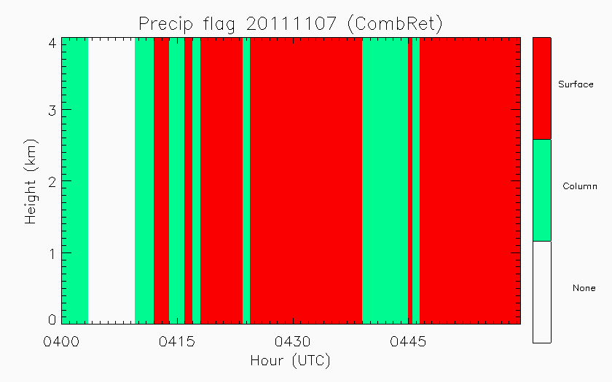
Nonprecipitating echo
Water/drizzle
Cloud droplets
KAZR-ARSCL: Active Remote Sensing of CLouds
COMBRET: Combined Remote Sensor Retrieval Algorithm (radar + lidar)

Slide 10
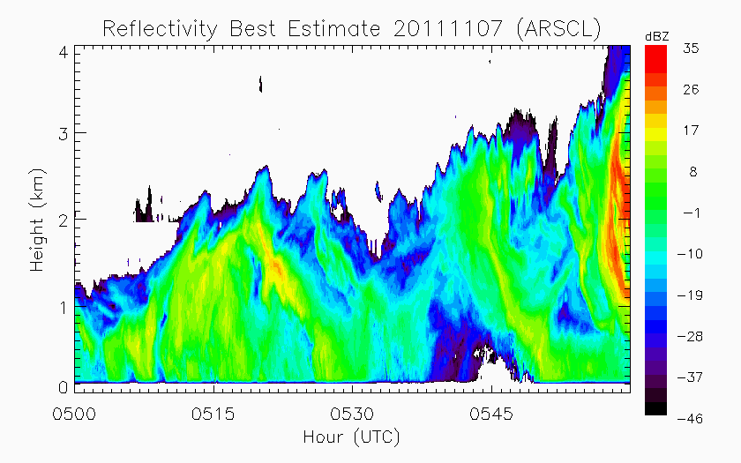
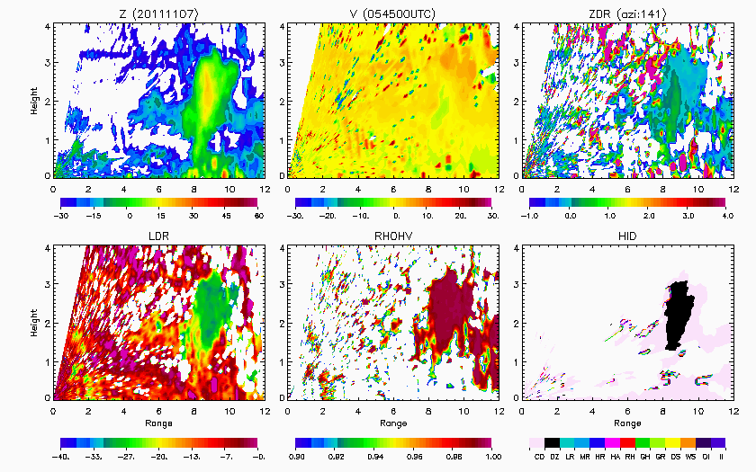
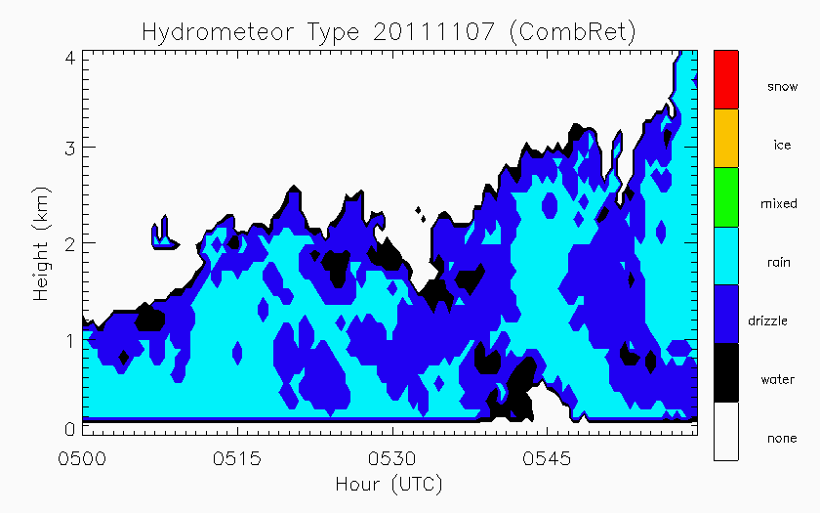
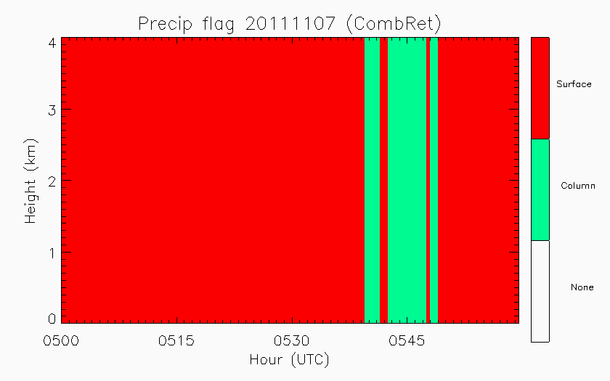
Development of precipitation
Drizzle/rain
Drizzle

Slide 11
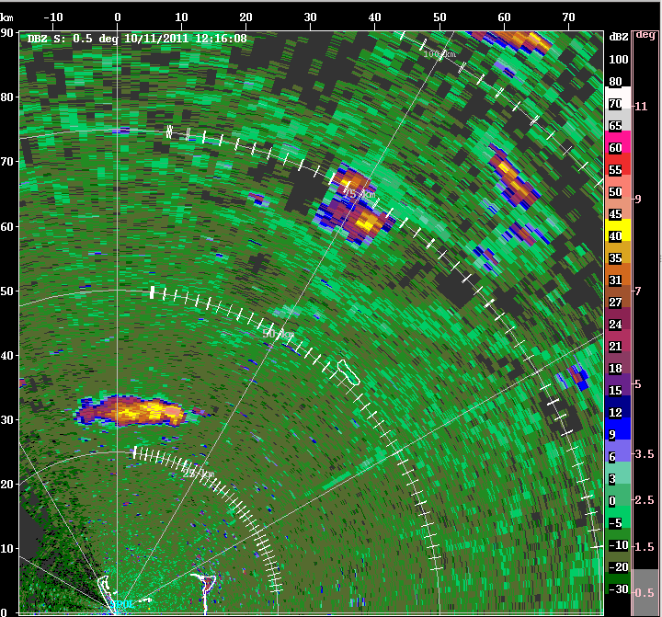
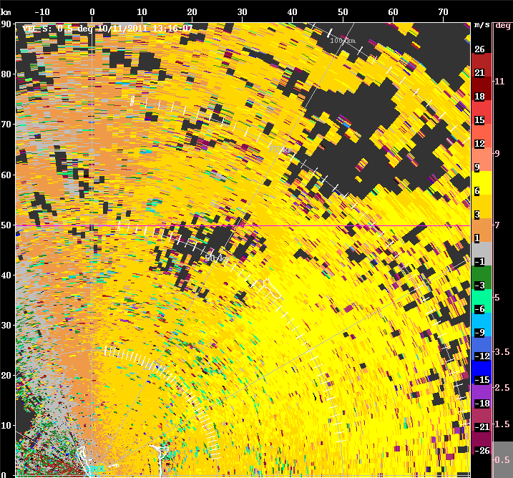
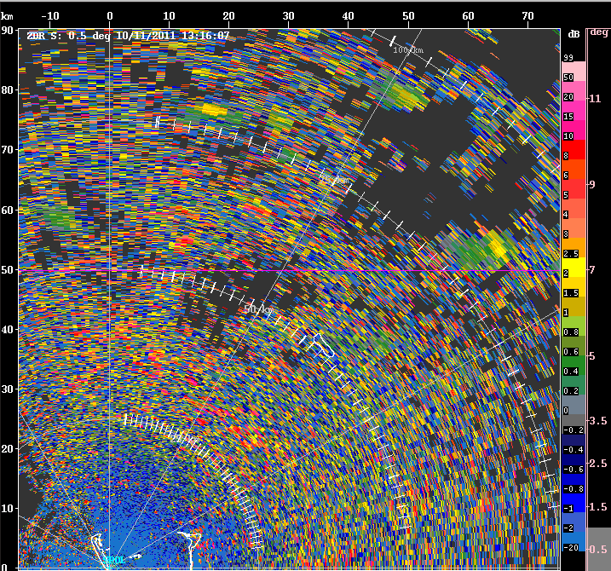
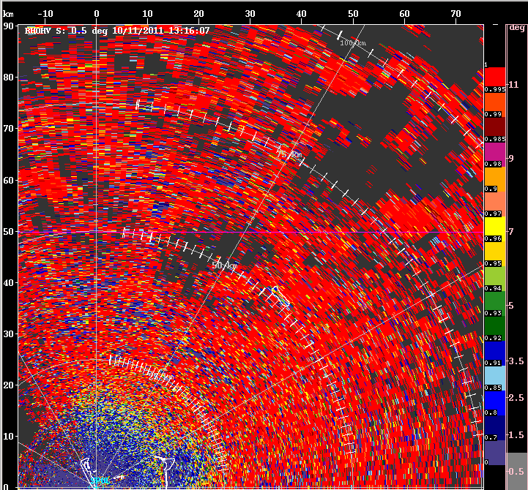

Cold Pools
V
Z_{DR}
ρ_{HV}

Slide 12
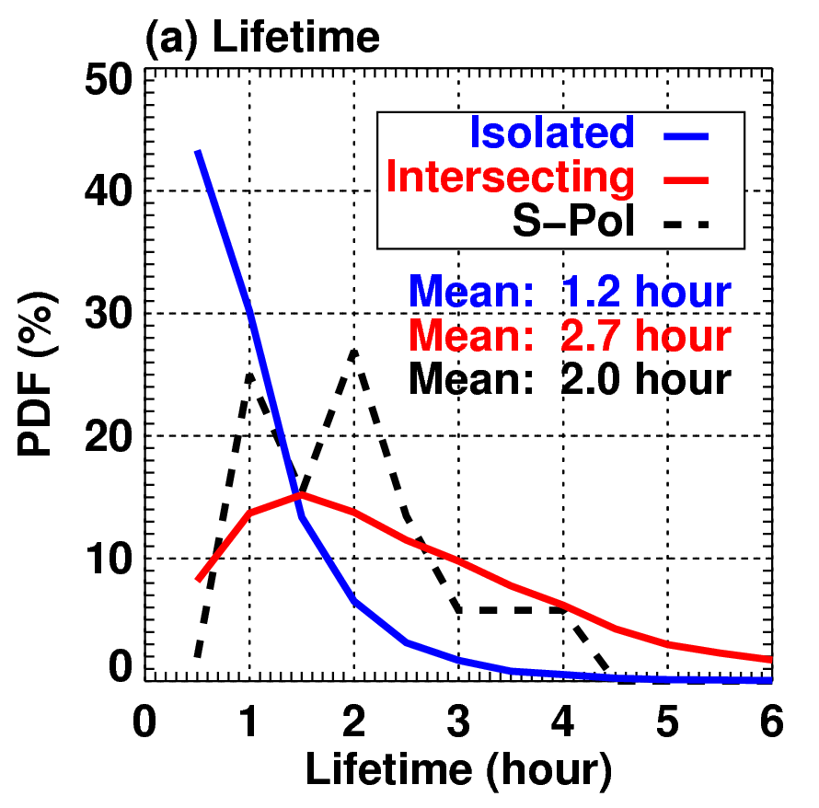
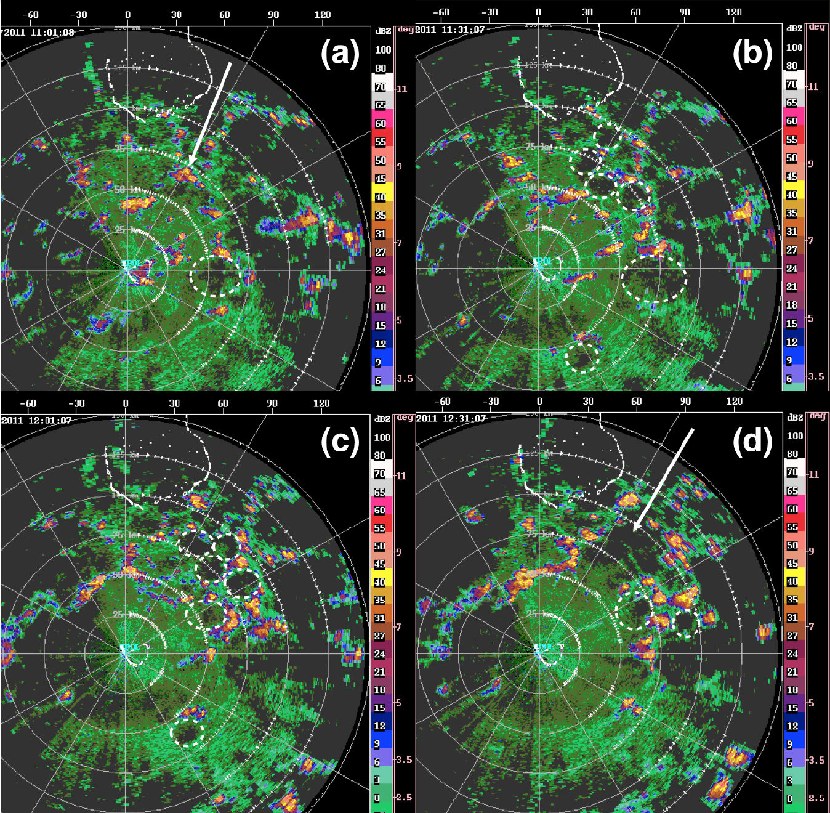
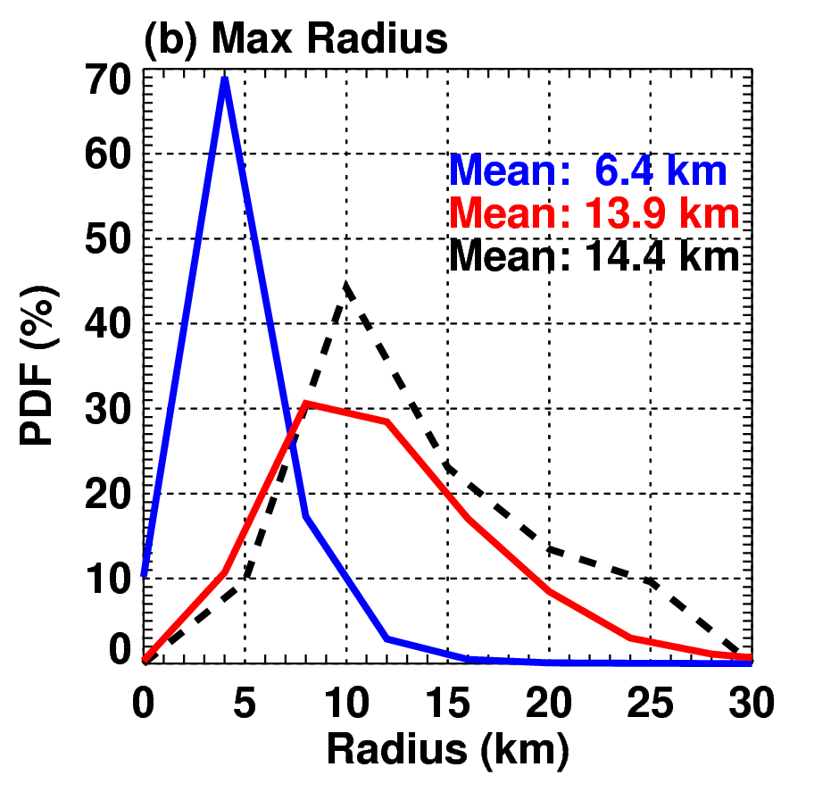
Cold pools
Feng et al. [2015]

Slide 13
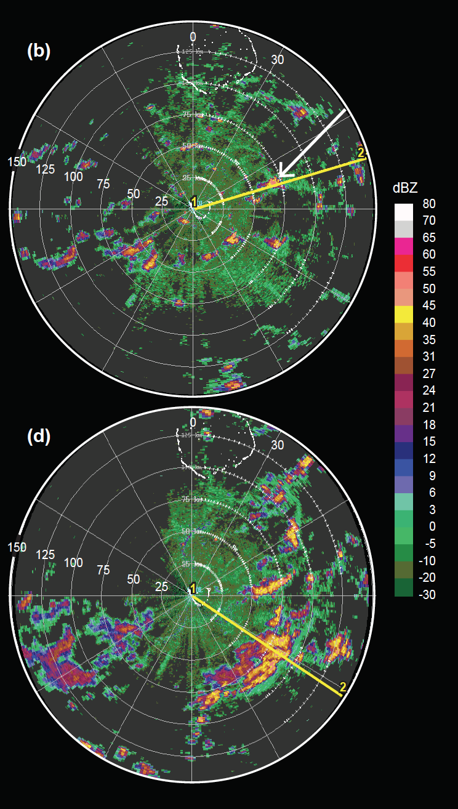
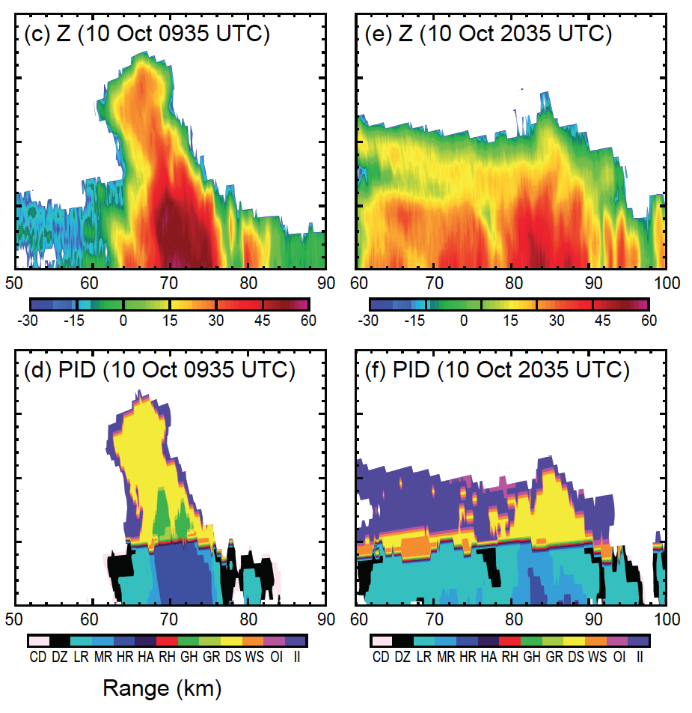
Upscale growth
Rowe and Houze (2015)

Slide 14
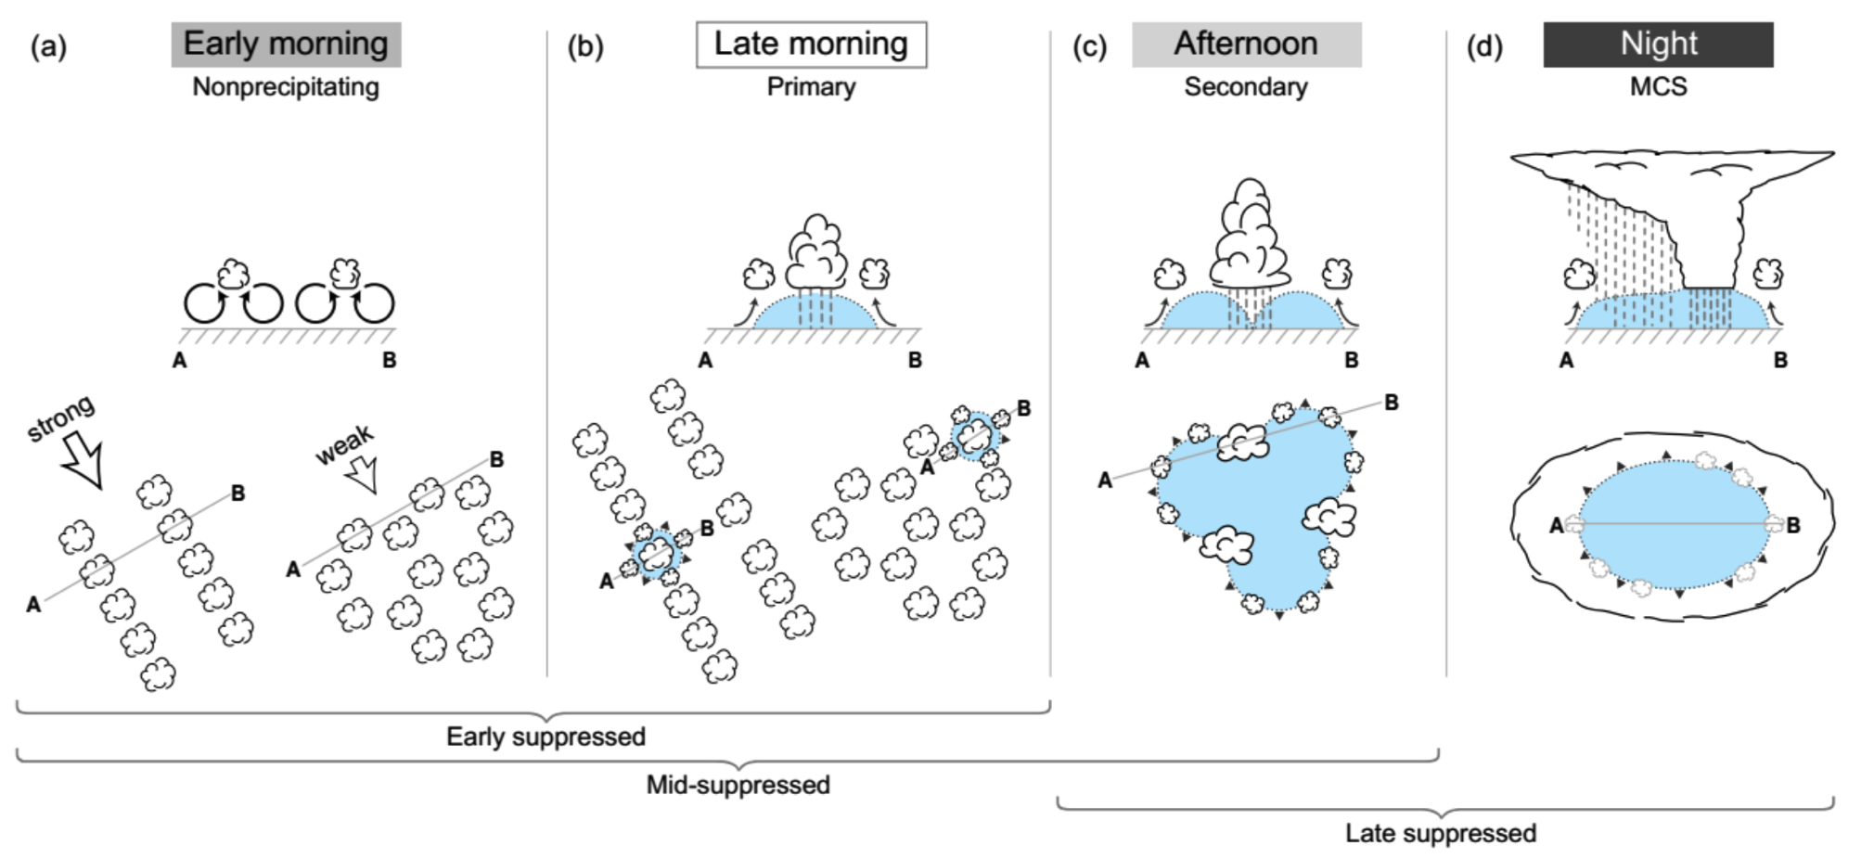
Transition to active periods
Rowe and Houze [2015]

Slide 15
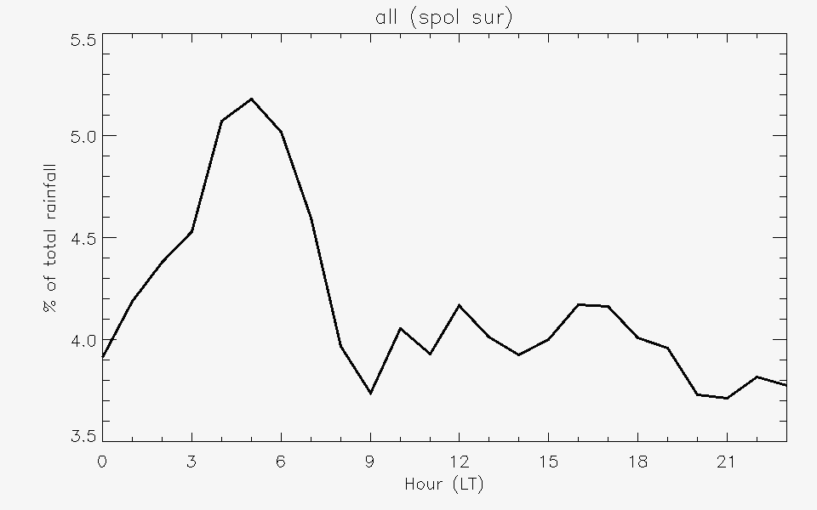
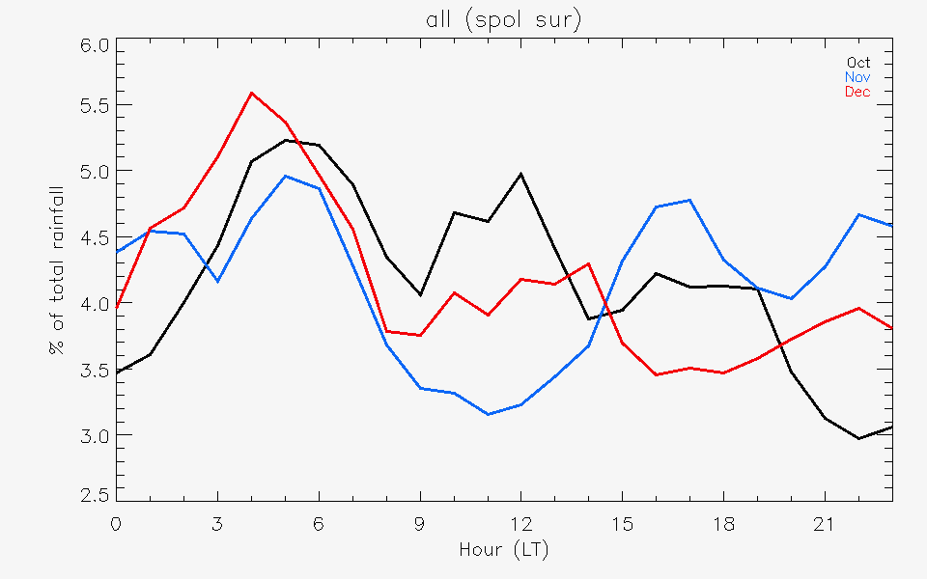
Diurnal cycle
For entire period (suppressed and active)
  Early-morning peak in rainfall
  Minimum around 0900 AM (LT)
  Earlier afternoon peaks in Oct and Dec

Slide 16
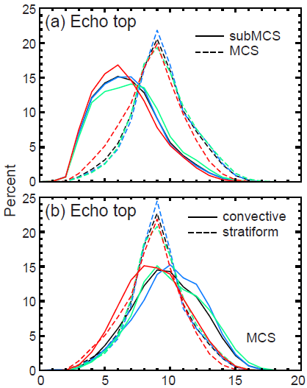
Echo distributions
Rowe and Houze [2014]

Slide 17
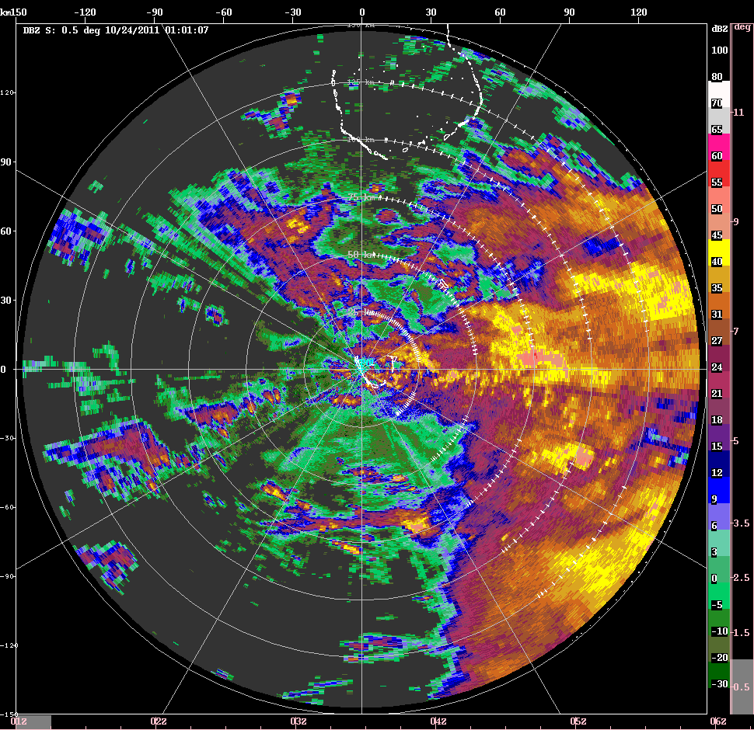
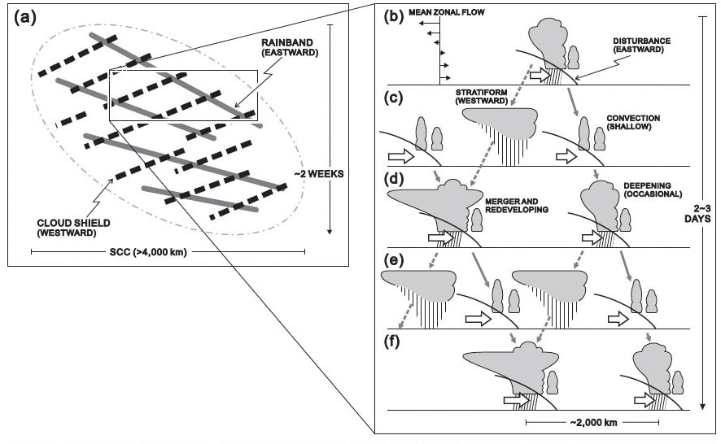
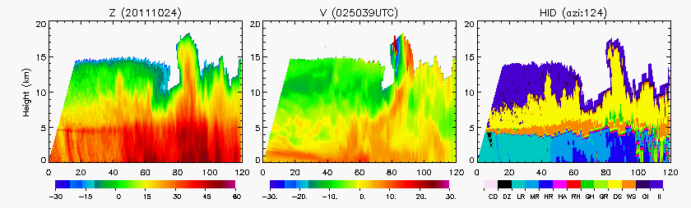
Oct, Nov
Yamada et al. [2010]
MISMO

Slide 18
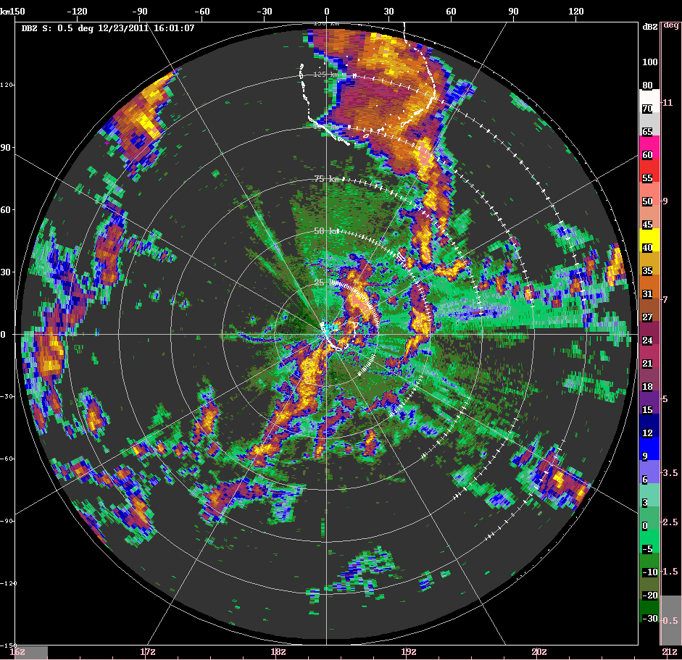
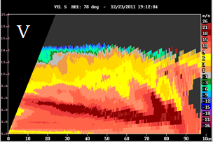
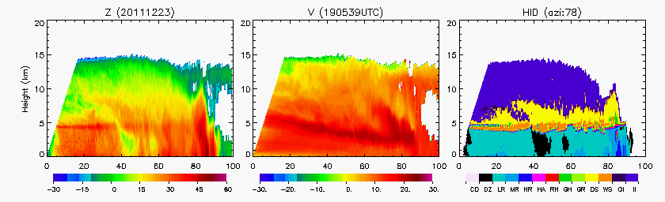
December
TOGA COARE [Houze et al. 2000]

Slide 19
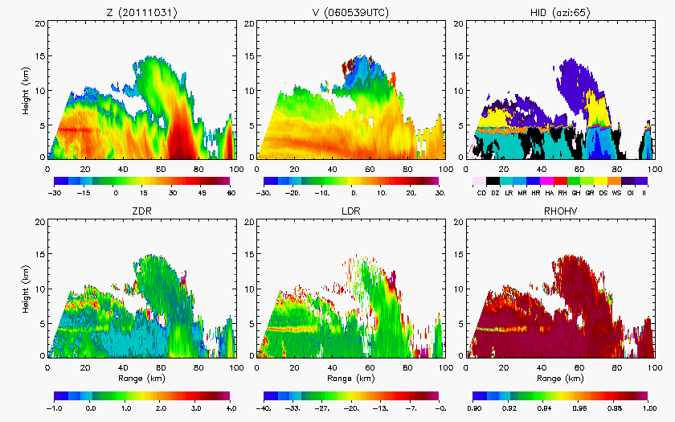
Transition back to suppressed

Slide 20
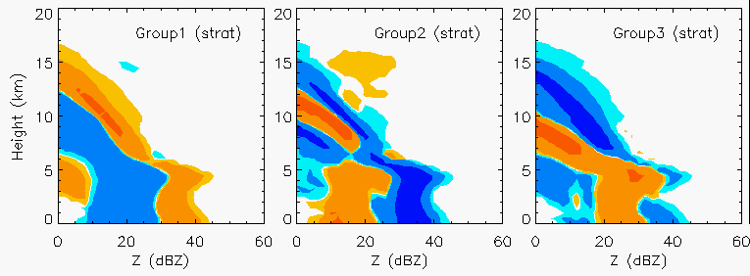
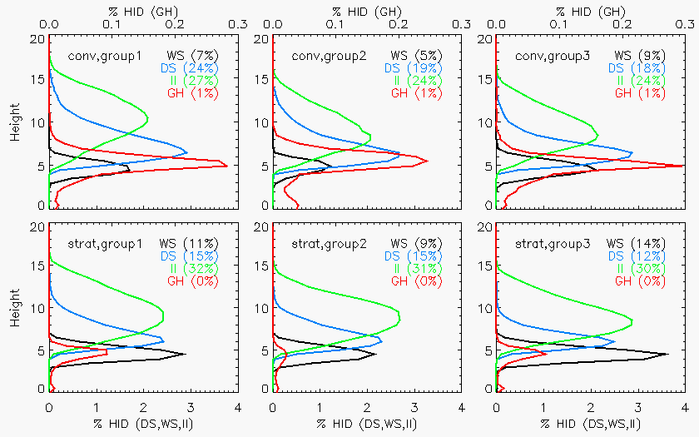
MCSs
Group 1: Embedded convection decaying in widespread stratiform (Oct, Nov)
Group 2: Transition
Group 3: Fast-moving squall-lines (Dec)

Slide 21
AMIE/DYNAMO
Occurrence of boundary layer rolls/open cellular overturning is key to the formation of the first clouds that are robust enough to precipitate and generate cold pools
  Chain reaction necessary for evolution of cloud population to more active MJO
  Cloud evolution across diurnal cycle, precipitation event, and MJO phase
December active period characterized by shallower convection, less robust stratiform, fast-moving squall lines
Less widespread stratiform, fast moving systems as active phases transitioned back to suppressed conditions

Slide 22
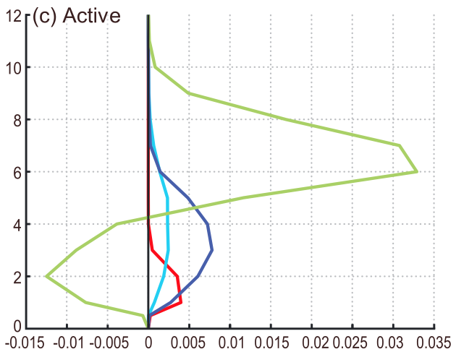
Indian Ocean (Oct-Feb) 1998–2012
MJO
Greatest variation for broad stratiform regions
  Peaking during active phase
  Transition to suppressed > Transition to active
Above 5 km, BSRs contribute more heat in West Pacific than in Central Indian Ocean
W. Pac
Barnes and Houze [2015]

Slide 23
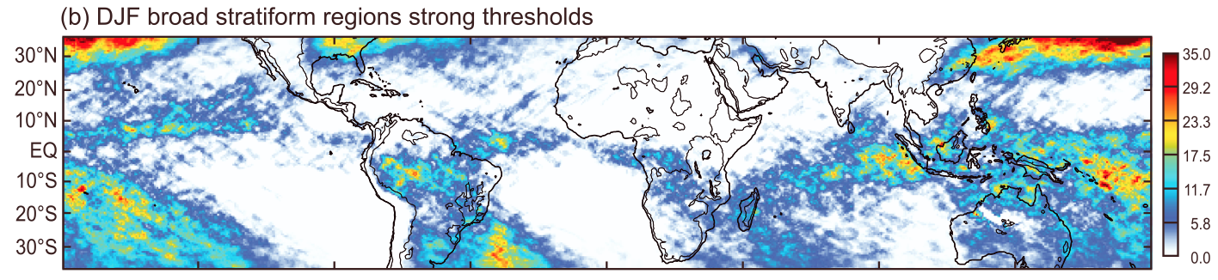
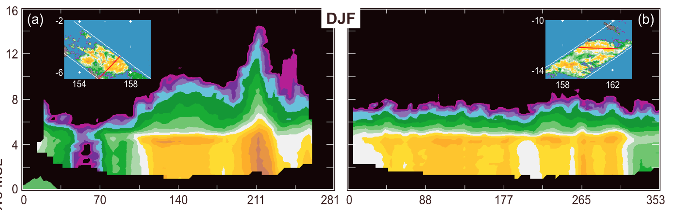
Stratiform across the Tropics
Houze et al. [2015]
ROBUST!

Slide 24
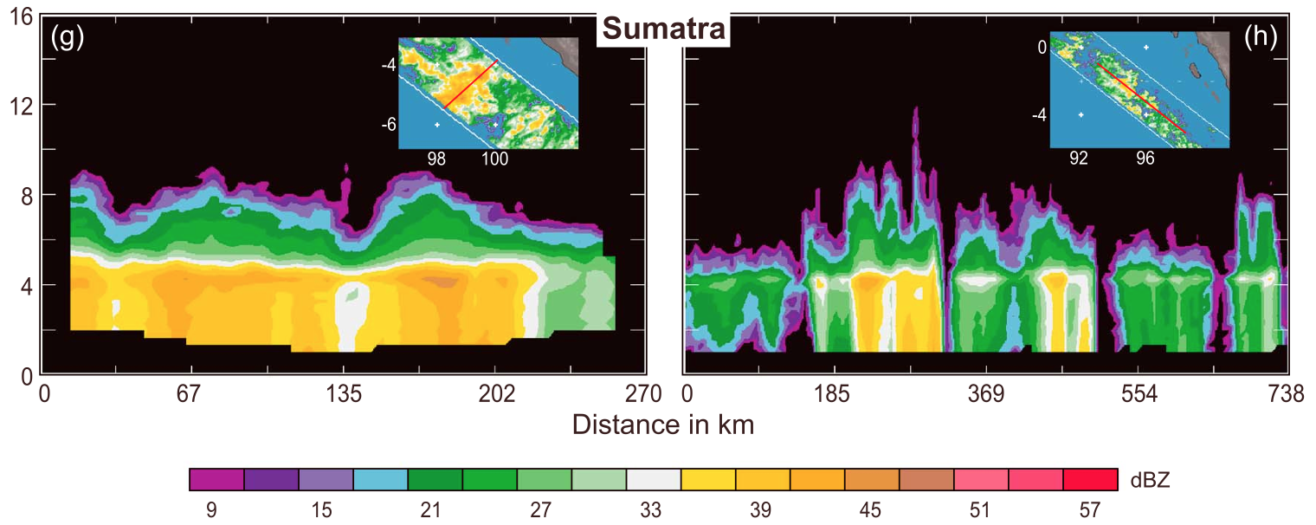
Stratiform across the Tropics
Houze et al. [2015]
Mature
Cellular

Slide 25
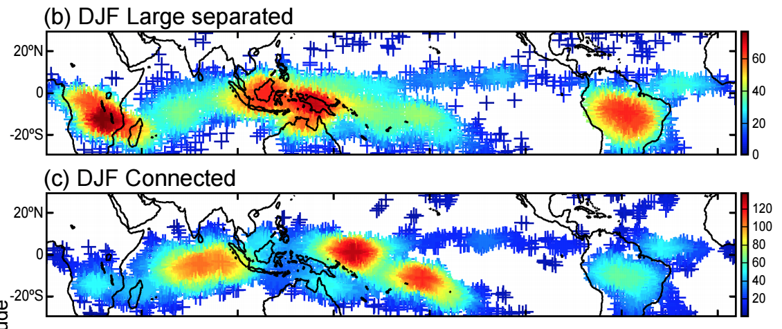
MCSs in the Tropics
Houze et al. [2015]
Yuan and Houze [2010]

Slide 26
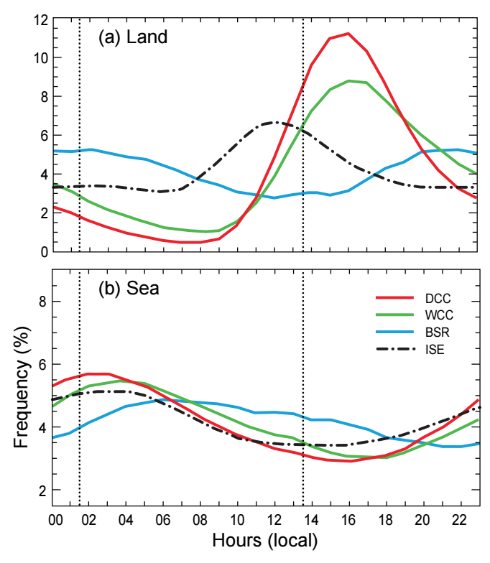
Tropical rainfall
Land
  Shallow (late morning)
  Deep (afternoon)
  Wide
  Stratiform (overnight)
Ocean
  Overnight convection, stratiform into afternoon
  Smaller amplitude

Slide 27
MCSs in the Tropics
Houze et al. [2015]
Yuan and Houze [2010]

Slide 28
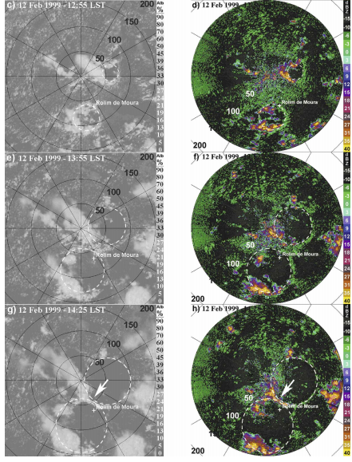
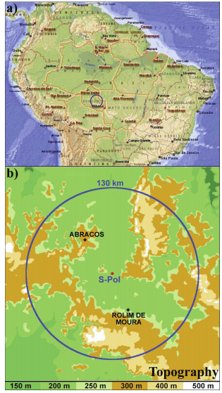
TRMM-LBA
GOES-8
Lima and Wilson [2008]

Slide 29
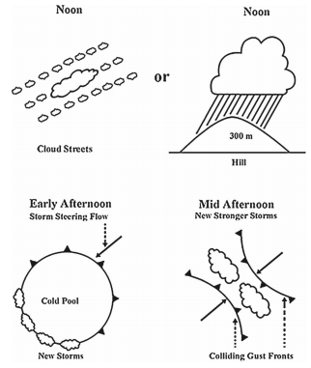
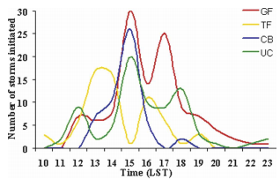
TRMM-LBA
Gust Front
Terrain Forcing
Colliding Boundaries
Lima and Wilson [2008]

Slide 30
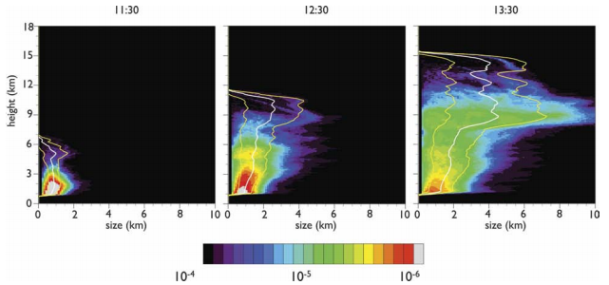
TRMM-LBA
High-res 3-D simulation based on idealization of observations from TRMM-LBA PDF of cloud size as function of height for 3 simulation times
Cumulus convection starts shallow, gradually developing into congestus, becoming deep
  Cold pools needed to generate thermals big enough to support growth of deep clouds
  Bigger clouds less diluted
Khairoutdinov and Randall [2006]

Slide 31


TRMM-LBA
0015 LT
0215 LT
Rickenbach [2004]
Easterly

Slide 32


Nocturnal drizzle
Rickenbach [2004]

Slide 33


TRMM-LBA
Pereira and Rutledge [2006]
Schumacher et al. [2007]

Slide 34
GOAmazon
What is the role of the daily transition of convection from shallow to deep?
  Land surface heterogeneity (evolution and dynamics of systems)
  Cloud microphysical properties
How do storms evolve over tropical rain forests from severe in the dry season to large but less intense in the wet season?
  Intense convection during transition from dry to wet and the beginning of the wet season
  Large-scale states and statistical distributions of cloud properties
How does this compare to other tropical and ARM environments?
  “Synthesizing a unified understanding of cloud life cycle processes based on a multi-site data set”

Slide 35



GOAmazon/Chuva
2120 UTC 17 Feb 2014
S-band, Doppler operational radar
X-Pol for Chuva
  RHIs over ARM site
GPM overpasses
2100 UTC 18 Feb 2014
Machado et al. (2014)

Slide 36

Beyond the Tropics
Cloud Resolving Models
Mid-latitude continental (PRE-Storm) vs. tropical oceanic (TOGA-COARE)
Low-/mid-level condensational heating in leading convection
Upper-level heating, low-level cooling in trailing stratiform
Alternating cooling-heating pattern in upper levels (gravity wave dispersion) more significant for deep convection during PRE-Storm
Cooling in stratiform larger and deeper for PRE-Storm (drier)
Tao et al. (2006)

Slide 37

MC3E
April-June 2011
Convective systems and their environments
Cloud radars, wind profilers, lidars, disdrometers, aircraft,…
Dual-pol radar network
  3 X-SAPRs
  C-SAPR
  NPOL (S-band)

Slide 38

MC3E – 25 Apr

Slide 39


MC3E – 25 Apr

Slide 40


Slide 41


MC3E – 20 May
Upward motion along leading convective line, weak ascent above melting level in stratiform region
Hydrometeor characteristics

Slide 42






MC3E
Over-the-top RHIs (X-SAPR)
Decaying convection

Slide 43
Looking Forward
Opportunity to investigate MCS characteristics over range of environments (AMIE: tropical oceanic, MC3E: midlatitude continental, GOAmazon: Green Ocean)
  Shallow-to-deep transition, Microphysics, Spatial Extent, Stratiform
Investigate characteristics across range of timescales
  Cloud lifecycle, Diurnal, Event, Seasonal, Interannual
Improvement of models of varying resolutions
  Cloud-resolving, Parameterization
Role in climate
  Feedback, Changing

Slide 44

Thank you!
Research supported by NASA grant NNX13AG71G and NSF grant AGS-1355567

