Slide 1
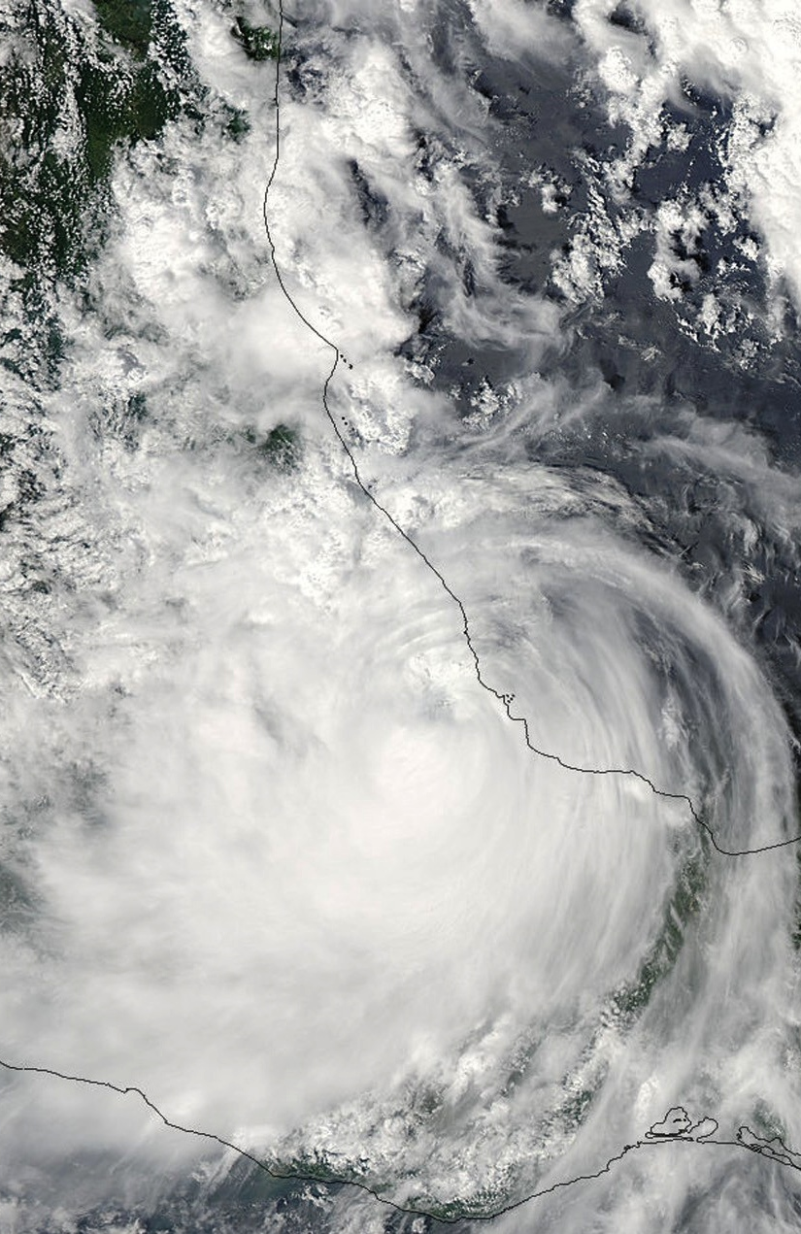
Hurricane Karl’s landfall as seen by high-resolution radar data and WRF
Jennifer DeHart and Robert Houze
Cyclone Workshop
10.26.15
NASA grants: NNX13AG71G / NNX12AJ82G

Slide 2
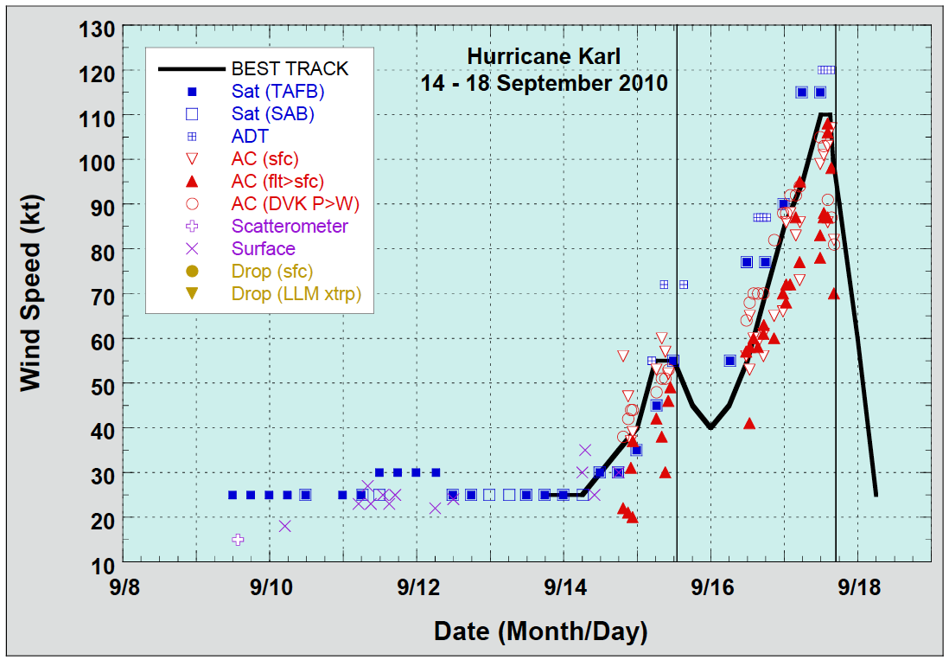
Karl Best Track and Flights
Flight
Image: NHC
Notes:
Karl’s best track in terms of wind speed, reaching Category 3. Can see initial landfall on Yucatan peninsula and intensification after reemerging over the warm ocean water. NASA’s GRIP campaign flew several flights into Karl, but today I’ll be focusing on the flight during Karl’s second landfall.
Transition: While Karl was one of many hurricanes during a busy 2010 season, it’s remembered in Mexico for the mudslides caused by the rain.

Slide 3
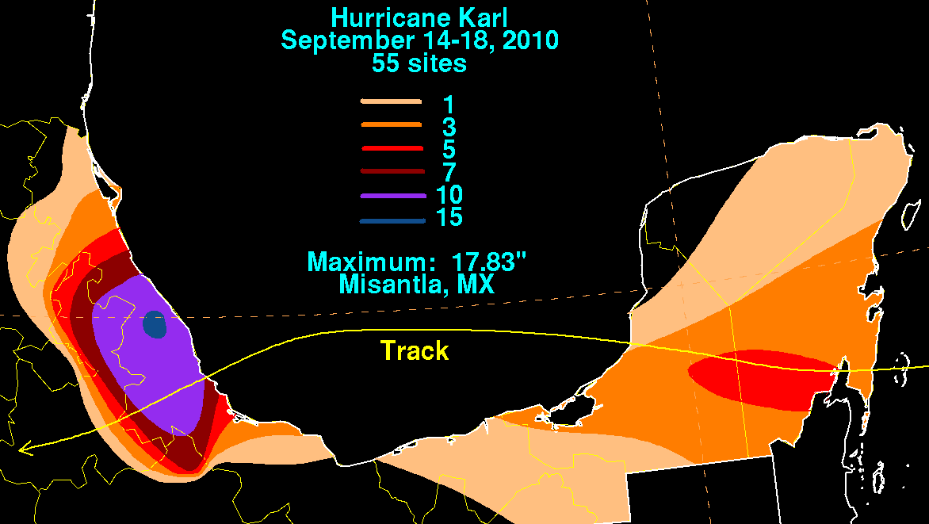
Rainfall and Mexican Topography
Intense rainfall collocated with eastern edge of Mexican topography
Maximum rainfall measured on the northern side of triangular feature
Image: David Roth, NOAA
Notes:
Coming on the heels of a very wet summer in Mexico, Karl dumped an additional 10 inches (250 mm) over already saturated soil. Flooding and mudslides were the biggest destruction. Plots of rainfall from David Roth at NOAA and mexican topography. Large swath of rainfall within Veracruz, with the total amount maximizing north of the triangular feature jutting out towards the gulf.
Transition: Looks like orographic enhancement clearly played a role, but I’d like to investigate exactly what Karl’s structure was as it made landfall.

Slide 4
Science Questions
What is the vertical structure of precipitation in Hurricane Karl during landfall over the mountainous terrain of Mexico?
What can WRF simulations tell us about the underlying processes?

Slide 5

NASA GRIP
DC 8 Flight Track – 09/17/2010
August and September 2010
Key instrument: APR-2 radar on DC8
  -10 km flight level
  -Ku / Ka band
  -high resolution
  -downward pointing
  -cross-track scan
Notes:
I’ll be trying to answer those questions with data collected during NASA’s GRIP campaign during the summer of 2010. Featured planes with a number of instruments, but today I’ll be looking at data from the APR-2 radar on the DC-8. Specs. Track from the 17th is shown on the left.
Transition: First, let’s again look at the surface context

Slide 6
Notes:
Here’s the 24 precipitation totals through 13Z on 9/18. Again, precipitation totals maximize in the regions surrounding both the inner core and surrounding the triangular topographic feature. Of course, it’s important to understand the temporal evolution of precipitation when examining the structure.
Transition: Data from Mexico is sparse (and somewhat vague), but there are some datasets available.

Slide 7
3-Hour Precip Locations
Notes:
First, I’ll start with locations where data exists every 3 hours. Today, I’ll focus on two sites: Jalapa and Orizaba.

Slide 8
Orizaba
?
Jalapa
flight
?
data from NCDC/NHC
Notes:
Timeseries of 3-hour precipitation totals. NHC reports storm totals of ~8 inches/200 mm, in contrast Veracruz received ~10 inches/250 mm. Of course, like most field campaigns, GRIP flight did not capture the periods of greatest precipitation. Regardless, we can still examine the structure. During the flight period, Orizaba measured a paltry amount – 10 mm in 3 hours. Jalapa measured 40 mm (1.5 inches).
Transition: start with Jalapa.

Slide 9
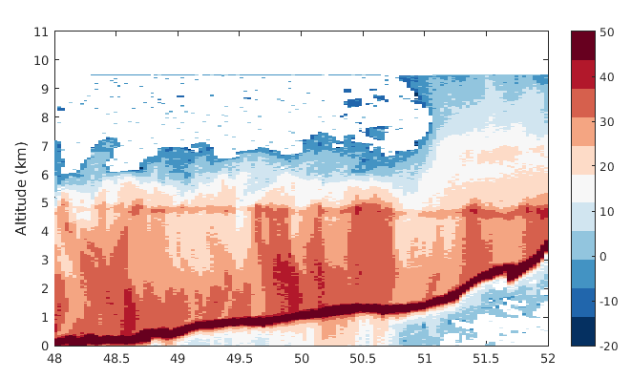
Structure near Jalapa
Minutes after 18 Z
Increased reflectivity intensity near surface
Notes:
Here we have a vertical cross-section through the radar swath – this is the nadir most beam. Blue arrow denotes direction. First, there are some interesting structural features. Further east, the vertical extent of the echo is quite reduced – only extending up to 6 km. There’s a sudden jump in reflectivity height moving further west – likely due to where air mass originated. However, I want to focus on the low-level structure. Despite fairly average reflectivity intensities, there is a general increase in reflectivity moving down towards the surface. While it’s possible this could be due to larger rainfall particles settling, give the positioning relative to the terrain, likely that it’s enhancement due to terrain. Additionally, orographically enahnced precip often thought of as convection kicked off by forced ascent or low-level production of cloud water that’s caught by falling raindrops. Don’t currently have processed doppler velocity data, but the raw doppler velocity doesn’t show strong upward motion. Would think this would be cloud water.
Transition: what does thermodynamic environment look like?

Slide 10
Upstream Sounding
Notes:
Upstream sounding from just a couple minutes before the radar swath showing a very moist, almost neutral environment – this supports the notion that enhanced reflectivity is due to rainwater collecting cloud droplets created by forced ascent.
Transition: can now look further to the south to compare the structure.

Slide 11
10-Minute Precip Locations
Notes:
Turns out there is 10-minute data at some stations, including Cordoba, which is not far from Orizaba.

Slide 12
data c/o
Michel Rosengaus
Cordoba
Notes:
Since these data are complete, here plotted are the cumulative rainfall totals for those 6 cities and Cordoba I’ve highlighted here. Again, we precede the largest precipitation amounts and only flew during weak rain periods.

Slide 13
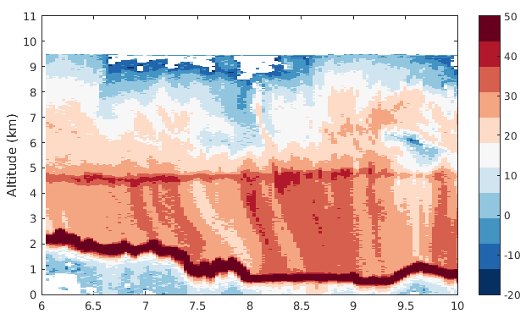
Structure near Orizaba/Cordoba
Minutes after 19 Z
Low-level enhancement not present
Notes:
Another vertical cross-section near Orizaba and Cordoba and the overall structure is quite different. First, much higher vertical extent of the radar echo. Overall reflectivity intensity is the same, slightly stronger in the bright band. However, most notable difference is the low-level structure. There is no increase in reflectivity at low-levels, in fact looks more like the the particles are being moved by the wind.
Transition: Obviously, given positioning of the storm center, we would expect this.

Slide 14
Karl Circulation at 19Z
Notes:
Here is the 19Z positioning (interpolated from the NHC best track) of Karl in reference to the cities mentioned before: leg around xalapa would experience a strong easterly component of the flow, which could easily ride up the topography. orizaba and cordoba on the other hand aren’t favorably situated to experience enhancement. observations from cordoba indicate wind with a northerly and even westerly component.
Transition: given paltry rainfall rates at each city during the time, this emphasizes another key point: background precipitation is important.

Slide 15
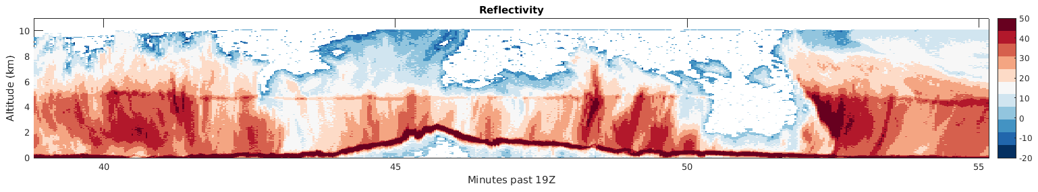
A larger view...
Background precipitation important to determining enhancement
Landfall complicates matters by removing energy source
Notes:
Here’s a long cross section through the center. Cuts through some outer convection, more stratiform precip just north of the triangular feature, potential remnant convection in the eyewall and then the southern portion of the storm. See the big difference in echoes to the north and south, much shorter to the north and taller to the south (more continuous too). Not entirely sure what’s causing this, though potentially a combination of northerly shear and landfall. Also see increased low-level reflectivity to the north of the triangular feature too. Low rainfall rates likely attributed weaker background reflectivity values - this has been shown before. Landfall complicates matters by removing the low-level heat source – big difference between how islands interact with TCs.
Transition: probably noticed in second plot that rain total wasn’t just weak rain rates over a long time…

Slide 16
Cordoba
Notes:
Again, here’s the cumulative rainfall plot showing Cordoba. Bulk of the rain seen there comes in a 6 hour period after 00z.

Slide 17
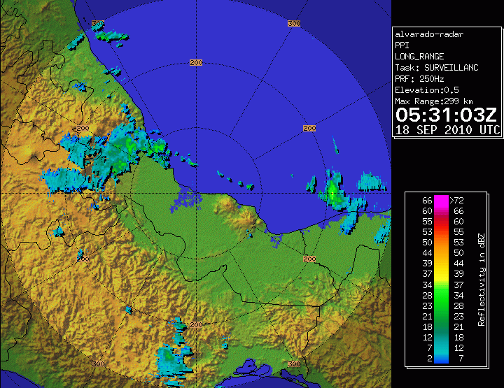
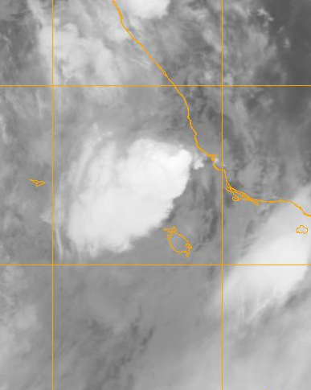
0530Z Convection
Notes:
As the center continued to track west and flow became more favorable, there was large burst of convection near Cordoba and Orizaba. Here’s a radar image from 530Z and the corresponding IR showing it as it has matured. Quite high rain rates (~15 mm in 10 minutes) and it didn’t move too quickly.

Slide 18
Notes:
CAPE = 1000, sounding from veracruz.

Slide 19
Observations Summary
Precipitation values maximize near center of Karl and around topography
  compared to other TCs, somewhat low
Orographic enhancement seen where positioning is conducive for upslope flow
  in Karl, primarily occurs in the low-levels as a warm-cloud process
Background precipitation important for final rainfall totals
What can simulations reveal?

Slide 20
WRF Details
WRF 3.4.1
Initialized at 00Z on 9/15/2010
4 domains: 54, 18, 6, 2 km
  6 and 2 km domains follow vortex
Tested combination of microphysics and boundary layer schemes
  WSM, Goddard, Thompson, Morrison, WDM
  YSU, MYJ

Slide 21
Intensity for MYJ runs
Karl’s intensity is underestimated, but in general schemes do fairly well
Combination of Goddard and MYJ used here, due to ability to reproduce intensity and track

Slide 22
Observed and Simulated Tracks
Goddard, like other schemes, moves Karl too quickly after 12Z on 9/17, but best follows the observed track

Slide 23
Cloud/Rain Mixing Ratios - Goddard
1 km – Hour 66
Increased cloud water concentrations hug line of topography
Notes:
cloud and rain mixing ratios at 1 km from a characteristic time. grey is no data – aka in the mountain. see the center in the rain field and to the north there is a strong band of fairly continuous cloud mixing ratios hugging the terrain line. See some rain associated with that, but let’s take a cross section through this line.

Slide 24
Cloud/Rain Mixing Ratios - Goddard
Hour 66
Increased cloud water concentrations top of topography
Rain mixing ratios increase towards surface
Notes:
plots of vertical cross section of cloud mixing ratio and rain mixing ratio as well as the wind component in this plane. where the wind maximizes (aka when the wind is parallel to the plane), see enhanced cloud water mixing ratios, particularly at low-levels following the terrain. At the same time, the rain mixing ratios maximize near the surface, suggesting that rain is collecting the newly formed cloud water.

Slide 25
Conclusions
Upslope flow produces enhanced low-level reflectivity in Karl
  cloud water production collected by falling raindrops
  radar doesn’t provide explicit microphysical or dynamical information
WRF simulations suggest cloud water production is responsible for enhanced rain
Future work: WRF simulations with modified topography/land surface

Slide 26
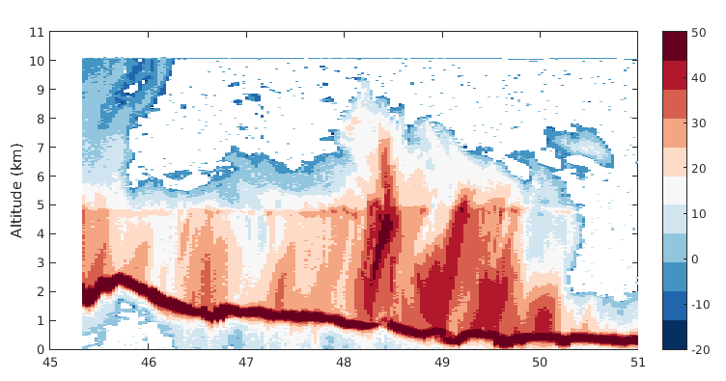
Jalapa 2

Slide 27
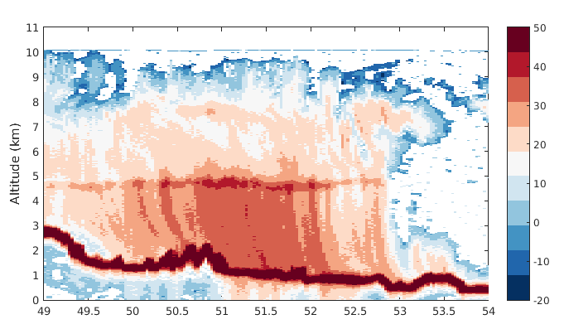
Orizaba/Cordoba - 2

Slide 28
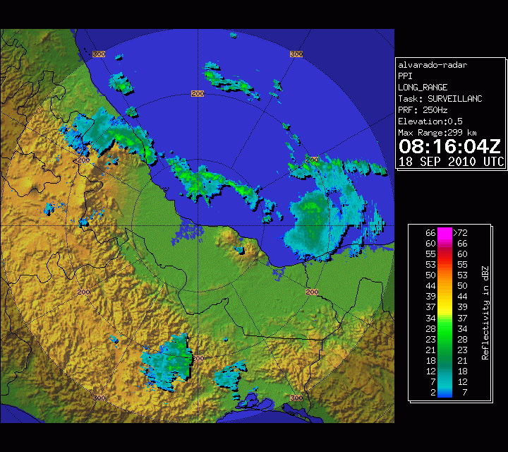

Slide 29
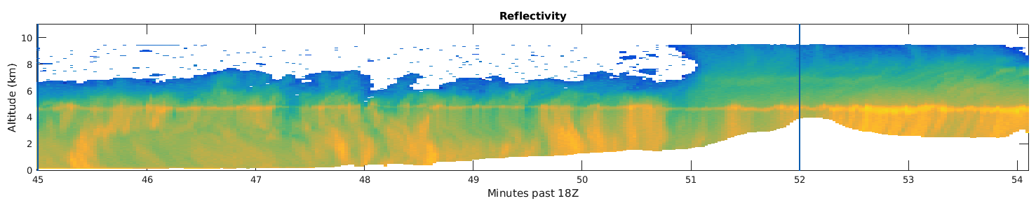

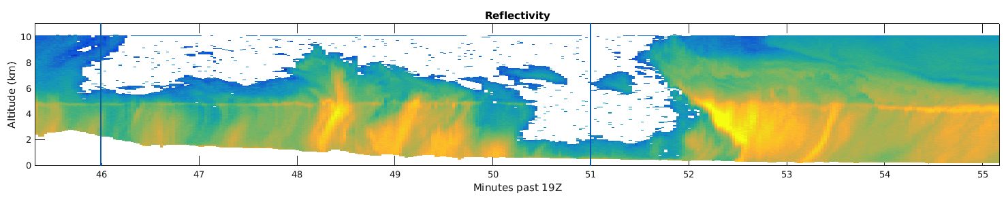
SE Reflectivity – Legs 1 and 2
dBZ
Echo depth substantially reduced
Small region of intense reflectivity in eyewall, but convection doesn’t seem as healthy
Notes:
Start with 2 of the legs closer to the center of the storm. Immediately notice that the echo depth has been substantially reduced – no longer extends up to where the radar can first pick up returns. Even though leg 1 doesn’t intersect the eyewall, leg 2 does. Small region of remnant eyewall convection, but does not look healthy.

Slide 30
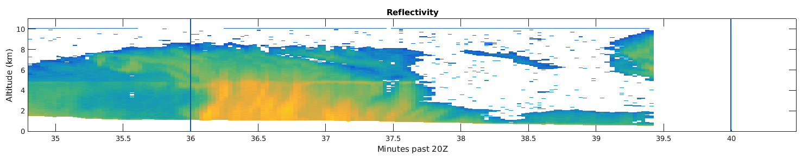
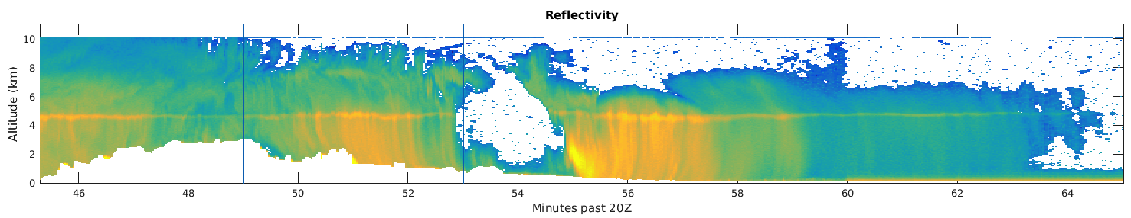
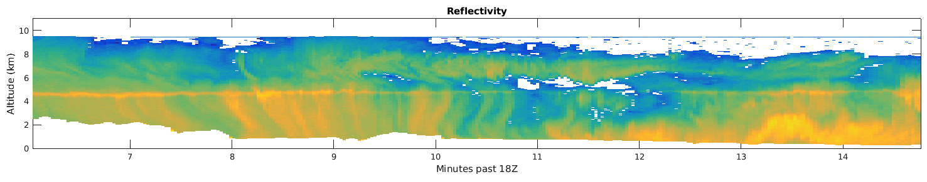
SE Reflectivity – Legs 3, 4 and 5
dBZ
Notes:
The other three legs don’t look as depleted. Still a decrease in echo top height and more breaks in the returns. Might be slight enhancement over the sloping land surface.

Slide 31
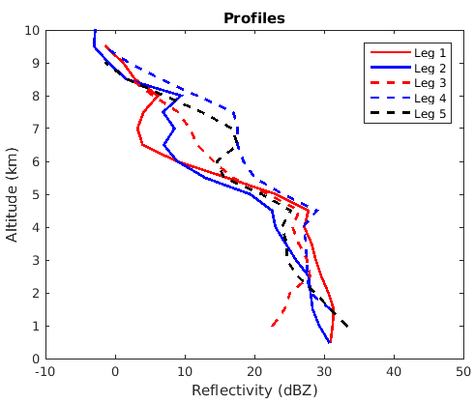
Mean Reflectivity - SE
Decrease in mean reflectivity values with height
Notes:
Mean reflectivity profiles show decrease in height below melting level and weaker returns aloft in legs 1 and 2.
Now we can look at the legs that are further from the center.

Slide 32
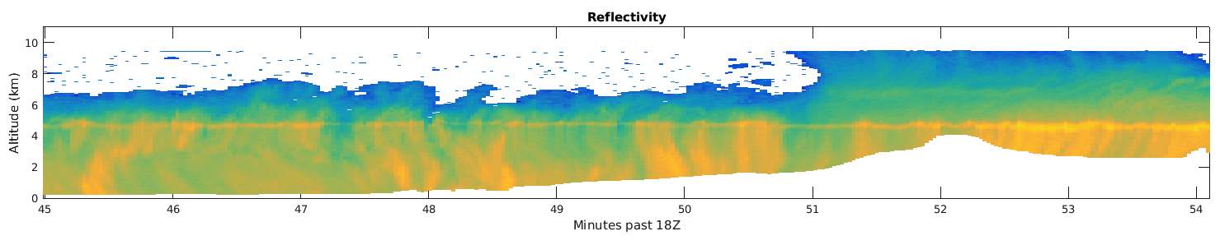
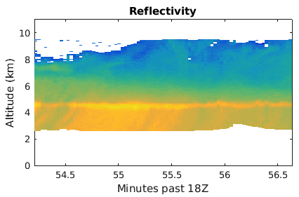
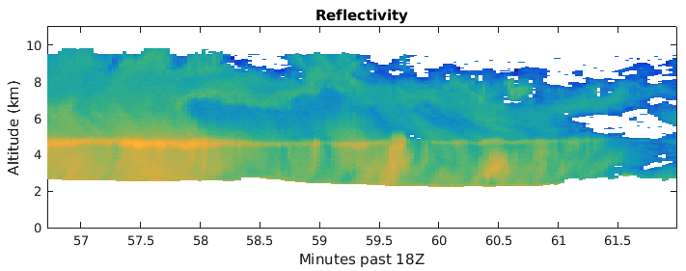
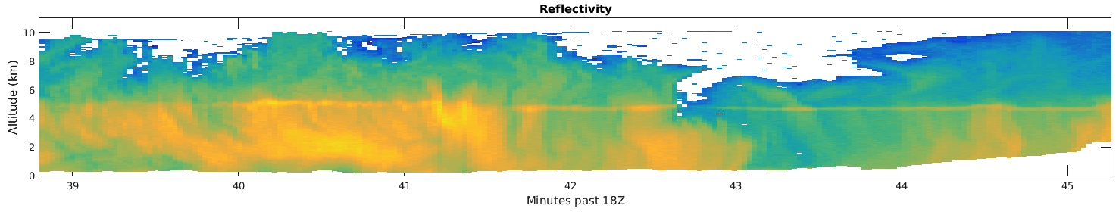
NW Reflectivity
dBZ
Strong, continuous reflectivity just past mountain edge along flow
Convective before mountain
Notes:
Upstream of the mountain (dashed red line), see the convective structure seen in the satellite image. At the tail end transitions to stratiform (closer to mountain edge), could be transitioning? Red and blue lines are slightly inland of mountains and structure is more stratiform with strong brightbanding. Additionally, pretty intense returns below the melting layer. Moving even more inland (blue dashed line), reflectivity intensity weakens. In this area, convective clouds rise over the mountains, enhancing fall out which is eventually depleted.

Slide 33
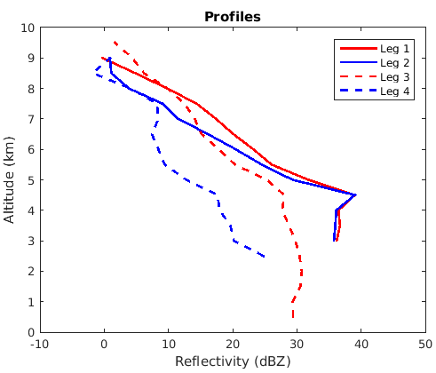
Mean Reflectivity - NW
Mean reflectivity most intense after passing over highest tops
Comparable reflectivity strength upstream of mountains compared to other regions of the storm
Weak mean returns further inland as fall out depletes storm
Notes:
Legs 1 and 2 here have the strongest mean reflectivity of any leg, even compared to the mature hurricane.

