Slide 1
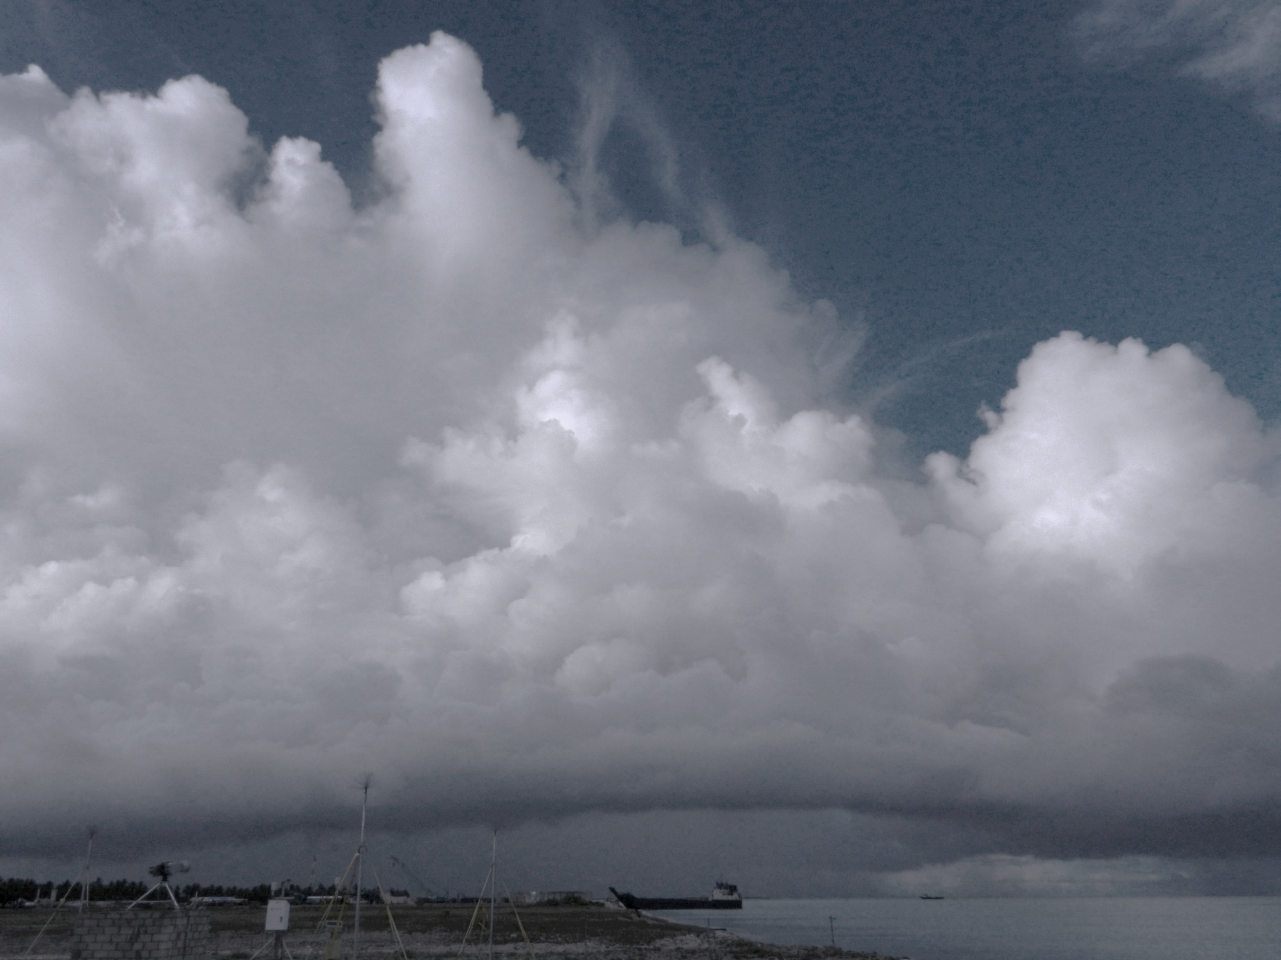
The Organization of Microphysical Processes in Mesoscale Convective Systems over the Central Indian Ocean
Hannah C. Barnes, Robert A. Houze Jr.
University of Washington
PNNL Seminar
1st October 2015
PNNL, Richland, WA
Funded by NSF Grant AGS-1355 and DOE Grant DE-SC0008452

Slide 2
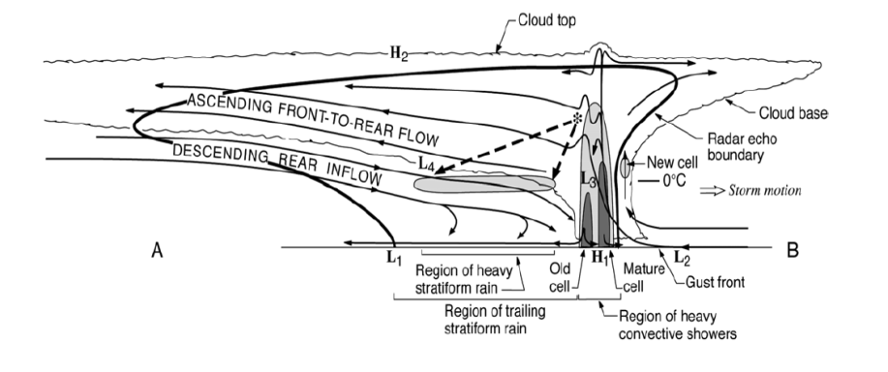
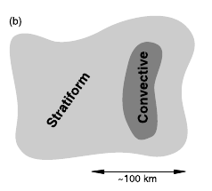
Mesoscale Convective Systems (MCSs)
Contiguous precipitation over 100 km
~ 60% of tropical precipitation
Stratiform Region
Convective Region
Y
X
Houze 1997, 1989, 2004

Slide 3
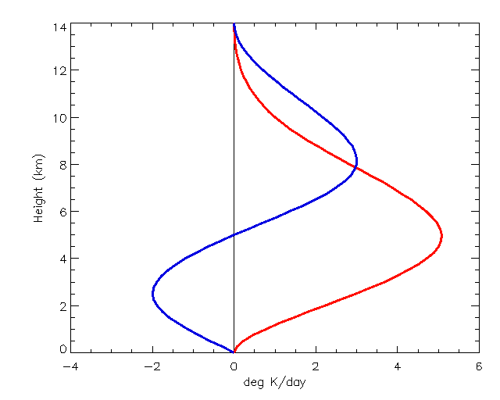
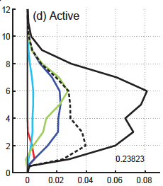
MCSs: Latent Heating
Convective, stratiform distinctly different
MCSs important source
Influences storm dynamics and large-scale circulation
Mesoscale Contribution to MJO Latent Heating based on TRMM PR
Idealized Profiles
14
Shallow
Deep Convective Storms
Wide Convective Storms
Broad Stratiform Storms
Weaker Storms
All Storms
12
12
Height (km)
10
10
8
8
Height (km)
6
Stratiform
6
4
4
2
Convective
2
0
Active MJO Phase
-4
-2
0
2
4
6
0
Latent Heating (Kday⁻¹)
0
0.02
0.04
0.06
0.08
Net Latent Heating (Khr⁻¹)
Schumacher et al., 2004; Barnes et al., 2015

Slide 4
MCSs: Latent Heating and Microphysical Structure
Microphysical processes associated with latent heat
Theorized but direct observations and validation limited
Houze, 1989

Slide 5
Microphysical Structure of MCSs
Observation and validation difficult
Observation / Validation Method | Aircraft Observations | Particle ID (PID) from dual-polarimetric radar | Numerical Simulations
Advantages | In situ | Large spatial coverage Increased temporal coverage | Complete spatial coverage Complete temporal coverage All processes
Disadvantages | Spatially limited Temporally limited | Difficult to validate Theory & observation based Limited by radar quality Dominant only | Difficult to validate Theory based Parameterizations Different schemes
Objective: Is microphysical structure from PID and WRF consistent with each other and dynamics?
Notes:
Given that important to obtain correct microphysical structure for latent heating but our two data sources that provide the holistic structure are uncertain, we need to know if …
Consistent with dynamics important since the microphysical structure is a response to the dynamical structure of the storm and MCSs have a well know dynamical structure.

Slide 6
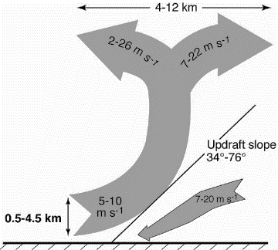
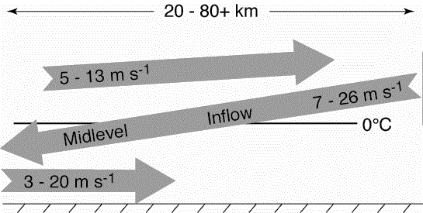
MCSs: Kinematic Structure
Layered airflow
Three-dimensional
Convective
Stratiform
Kingsmill and Houze, 1999a
Notes:
Both components important but for this talk focus on MLI

Slide 7
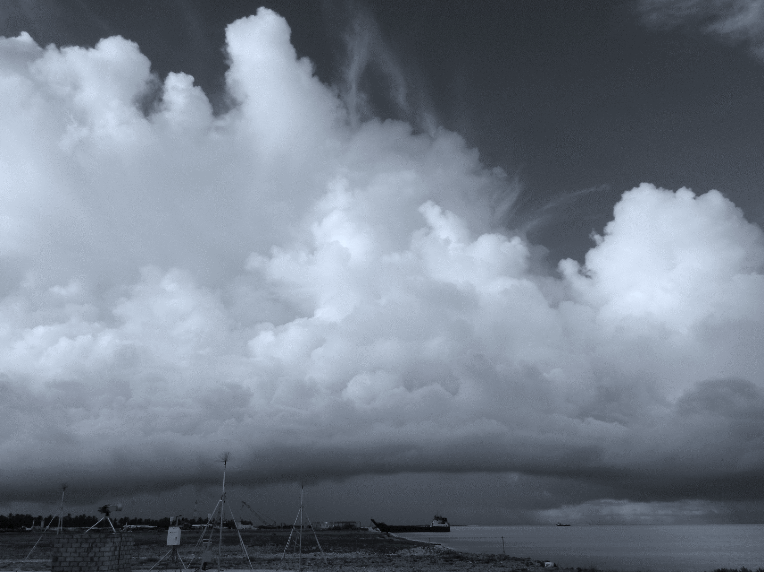
Outline
Spatial organization of hydrometeors / ice processes around midlevel inflow
Part 1: Radial Velocity and Dual - Polarimetric Radar Analysis
Systematic hydrometeor organization around midlevel inflow
Frozen hydrometeors ~ Ice microphysical processes
Part 2: WRF Simulations
Force squall by assimilating radial velocity
Part 3: Intercomparison
Broad structure similar
Details differ
Notes:
First, show how first use radial velocity to identify MLI in observations and then composite the dual-polarimteric data to show that …. Also highlight that frozen ….
Then, in part two I will show how I use data assimilation to force my simulations to have midlevel inflow layers and how I composite the model’s process around those inflow layers.
Final, compare the structure of the processes in the two showing ….

Slide 8
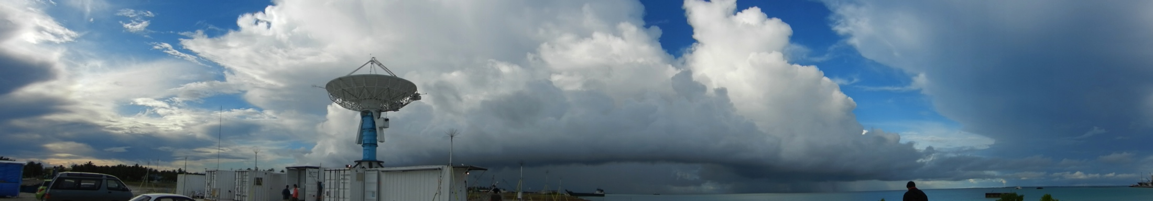
Part 1: Radial Velocity and Dual – Polarimetric Radar Analysis

Slide 9
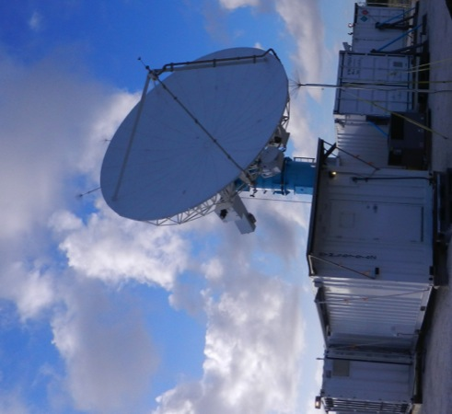
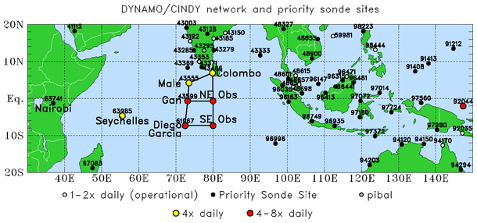
NCAR
S - PolKa Radar
DYNAMO / AMIE (Oct 2011 – Jan 2012)
Addu Atoll, Maldives
S - Band
Single Doppler
Dual - polarimetric

Slide 10
Dual - Polarimetric Radar
Reflectivity
Reflectivity
15
dBZ
40
0150 UTC
18 November 2011
10
Emit and receive vertical and horizontal pulses
Variables
Differential Reflectivity (Z_{DR})
Shape, phase
Specific Differential Phase (K_{DP})
Water content
Correlation Coefficient (ρ_{HV})
Phase, diversity
Linear Depolarization Ratio (LDR)
Phase, orientation, diversity
20
5
0
0
0
20
40
60
Differential Reflectivity
Correlation Coefficient
Height (km)
15
dB
1.5
15
1
10
1
10
0.98
5
0.5
5
0
0
0
0
20
40
60
0
0
20
40
60
Specific Differential Phase
Linear Depolarization Ratio
15
°km⁻¹
15
dB
-18
1
-20
10
0.5
10
-22
0
-24
5
5
-26
0
-0.5
0
-28
0
20
40
60
0
20
40
60
Distance from S-PolKa (km)
Notes:
Melting evident, but many other processes present. Trained expert can identify, but takes a long time even for them. Not feasible to thoroughly analyze three months of data.

Slide 11
NCAR Particle Identification Algorithm (PID)
Algorithm
Categories
Mimics radar expert
Identifies most likely dominant hydrometeor
Based on theory, observations, experience
Rain
Heavy Rain
Moderate Rain
Light Rain
Graupel/Rimed Aggregates
Wet Aggregates
Dry Aggregates
Small Ice Crystals
Horizontally-Oriented Ice
Particle ID
Mixed Phase
15
Height (km)
10
Frozen
5
0
0
40
60
20
Distance from S-PolKa (km)
0150 UTC 18 November 2011
Vivekananda et al., 1999
Notes:
Figure shows organization to hydrometeors. Is this structure repeated throughout the data set? To answer that developed a spatial compositing technique that determines where each of these hydrometeor types are located relative to the midlevel inflow.

Slide 12
Compositing Methodology

Slide 13
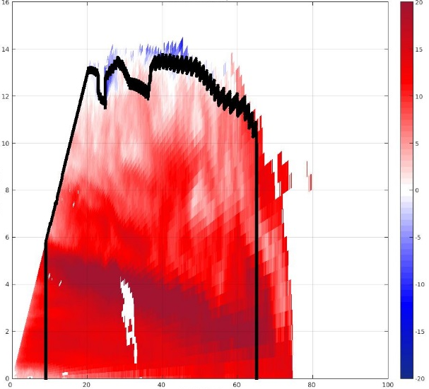
Methodology: Case Selection
Subjectively identify RHIs
Radial velocity
Midlevel inflow
One per storm
37 midlevel inflows analyzed
Reflectivity PPI
Radial Velocity RHI
Distance from S-PolKa (km)
100
Height (km)
16
20
14
15
50
12
10
10
5
0
8
0
Distance from S-PolKa (km)
6
-5
-50
4
-10
2
-15
-100
-100
-50
0
50
100
0
-20
0
20
40
60
80
100
Distance from S-PolKa (km)
1900 UTC 23 December 2011
Notes:
Three step process. First select cases

Slide 14

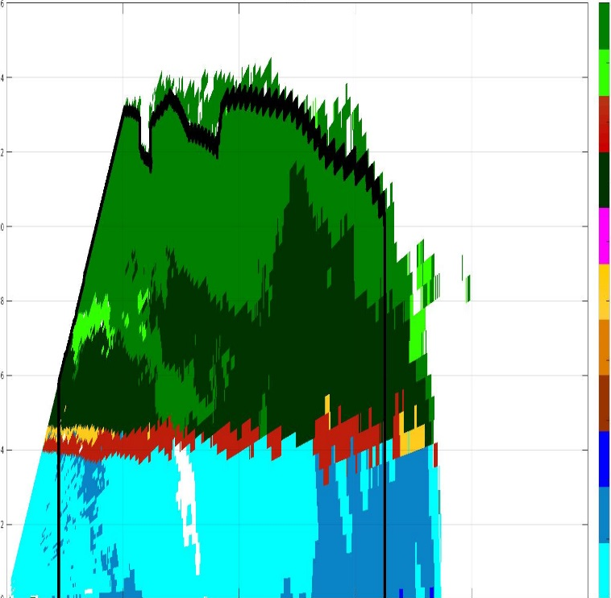
Methodology: Compositing
1.) Map kinematics and hydrometeors using radial velocity and PID
2.) Composite around layer lifting model
1900 UTC 23 Dec 2011
Generic Midlevel Inflow
Particle ID
Radial Velocity
m/s
16
20
SIC
HIC
14
15
WA
12
10
Height (km)
DA
10
G/R
5
8
G/RA
0
H
6
-5
H/R
4
HR
-10
MR
2
-15
Z Scale Factor
X Scale Factor
LR
0
40
60
80
100
-20
0
20
Distance from S-Polka (km)
Notes:
Second step manually map the location of the midlevel inflow and hydrometeors…..
Third step, fit into a generic midlevel inflow …..

Slide 15
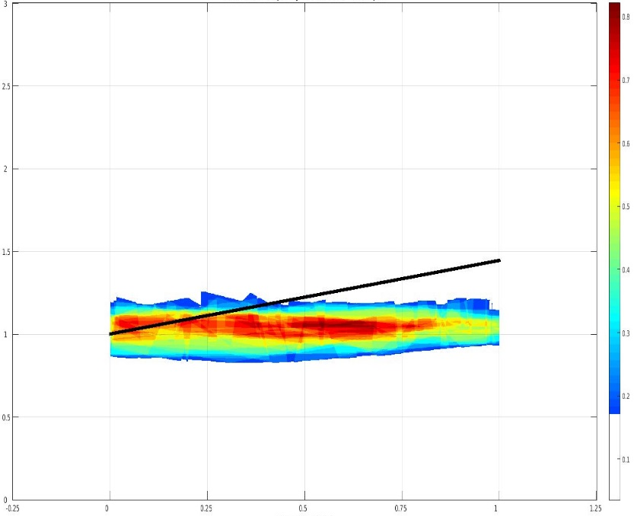
Methodology: Composite Results
Wet Aggregates
Normalized Height
4
0.8
3
0.7
2
0.6
0.5
1
0.4
0
0.3
-1
0.2
-2
0.1
-0.25
0
0.25
0.5
0.75
1
1.25
Normalized Range
Notes:
Describes plot
Wet aggregates tendency to be in a narrow layer.

Slide 16
Midlevel Inflow Composites
Graupel /
Rimed Aggregates
Heavy Rain
Moderate Rain
Light Rain
Normalized Height
4
4
4
4
3
3
3
3
2
2
2
2
1
1
1
1
0
0
0
0
-1
-1
-1
-1
-2
0
0.25
0.5
0.75
1
-2
0
0.25
0.5
0.75
1
-2
0
0.25
0.5
0.75
1
-2
0
0.25
0.5
0.75
1
Normalized Range
Wet Aggregates
Dry Aggregates
Small Ice Crystals
Horz. Oriented Ice
4
4
4
4
3
3
3
3
2
2
2
2
1
1
1
1
0
0
0
0
-1
-1
-1
-1
-2
0
0.25
0.5
0.75
1
-2
0
0.25
0.5
0.75
1
-2
0
0.25
0.5
0.75
1
-2
0
0.25
0.5
0.75
1
Notes:
Rain
Frozen
Graupel. Surprised wanted to verify that PID functioning correctly. First step look directly a the polarimetric data.

Slide 17
Graupel in Stratiform 0150 UTC, 18 November 2011
Particle ID
Height (km)
Reflectivity
50
Graupel/Rimed Agg.
Wet Aggregates
15
15
Height (km)
40
10
10
30
20
5
5
10
0
0
0
0
2
4
6
0
2
4
6
Distance from S-PolKa (km)
Distance from S-PolKa (km)
Radial Velocity
Height (km)
Differential Reflectivity
1.5
15
15
Height (km)
10
10
1
5
5
0.5
0
0
0
0
2
4
6
0
2
4
6
Distance from S-PolKa (km)
Distance from S-PolKa (km)
Notes:
Bright band uniform. But different relatively high variable. Want to look more closely at this variability so take two profiles.

Slide 18
Graupel in Stratiform 0150 UTC, 18 November 2011
Graupel / Rimed Aggregates
Wet Aggregates Only
Reflectivity Profile (dBZ)
Height (km)
Differential Reflectivity Profile (dB)
Height (km)
Notes:
Explain plots, remember the colored dots.
Combination of low ZDR and high DBZ indicates riming. Which produces graupel.
Radar data is consistent with PID, still really suprises and wonder if this seen before.

Slide 19
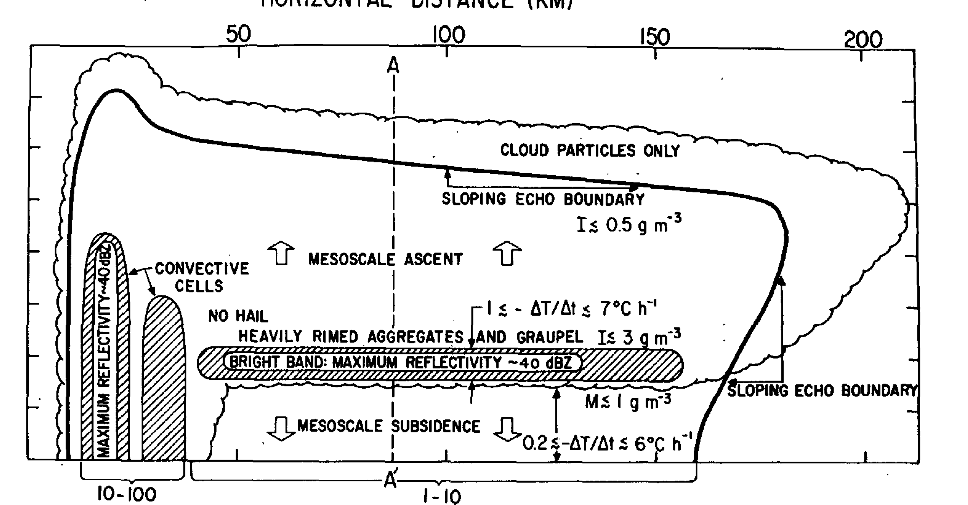
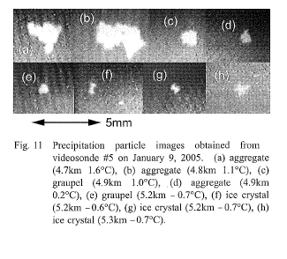
Graupel in Stratiform
Theoretical Support
Videosonde Observations
9 January 2005:
Central Indian Ocean
Thick stratiform, gentle rain, bright band
Graupel
5.2 km
0.7°C
Aggregate
4.8 km
1.1°C
Aggregate
4.9 km
0.2°C
5 mm
Leary and Houze, 1979
Suzuki et al., 2006
Notes:
In fact seen before

Slide 20
Radar Analysis Conclusions
Conceptual Model of Hydrometeor Type within Midlevel Inflow
Small Ice Crystals
Horz.-Oriented Ice
-20˚C
Dry Aggregates
Graupel / Rimed Aggregates
Wet Aggregates
0˚C
Light Rain
Are ice processes layered in WRF?
Z
X
Moderate Rain
Heavy Rain
Frozen hydrometeor categories indicate microphysical process
Small Ice Crystals & Horz. Oriented Ice = Deposition
Dry Aggregates = Aggregation
Graupel / Rimed Aggregates = Riming
Wet Aggregates = Melting
Barnes and Houze, 2014
Notes:
Now that confident in Graupel categorization put all the composites together to make one conceptual diagram. Now PID gives names in terms of hydrometeors but as alluded to before with the graupel category these are more indicative of processes, especially the frozen hydrometeors. Can be interpreted in terms of …..
This ice process organization is so robust, is it also present in models. Organization in processes in models an area of limited research. Brings to second part.

Slide 21
Part 2: WRF Simulations
Must have midlevel inflow
Notes:
If want to directly compare WRF and PID need WRF to have same midlevel inflow structure. To accomplish this assimilate radial velocity

Slide 22
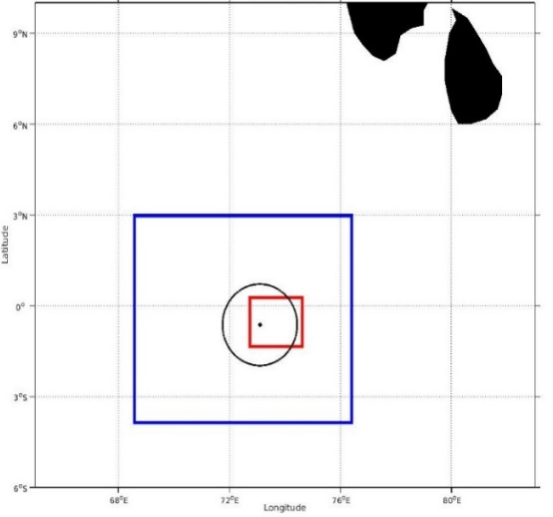
Penn State University EnKF / WRF
WRF Data Assimilation
Simulation Time | 23 Dec 2011 1200 - 2000 UTC
Assimilation Time | Every 15 mins starting at 1800 UTC
Initialization | ERA - Interim
Vertical Levels | 39, Top at 26 km
Domains | 3 km, 1 km
Members | 50
Assimilate | S - PolKa radial velocity
Planetary Boundary Layer Parameterization | Bretherton and Park (UW)
Longwave Radiation Parameterization | RRTM
Shortwave Radiation Parameterization | Dudhia
Surface Layer Parameterization | MM5 Similarity
Microphysics Parameterization | Milbrandt – Yau Morrison WDM6
9
S-PolKa and WRF Domains
6
Domain 1 (3 km)
3
Longitude
S-PolKa
0
Domain 2 (1 km)
-3
-6
Latitude
68
72
76
80
Group production terms by process
All processes
Provides rate (kg kg⁻¹ s⁻¹)
Composite members containing midlevel inflow
Notes:
I use PSU .. All details here but only highlight a few things. Assimilate radial velocity every 15 mins. Has 50 members. Three MP schemes
Interested in structure of ice processes. While calculated in WRF not standard output, so modify WRF to output these extra variables. Nice amount WRF is that it outputs every process that is occurring at a given location and provides it rate. While cannot verify the rate with the PID data , we can use the rate to understand the spatial structure of these processes.
Given that ensemble of 50 slight different members the MLI each member varies, so I have developed a compositing method that unifies all the members.

Slide 23
Compositing Methodology

Slide 24
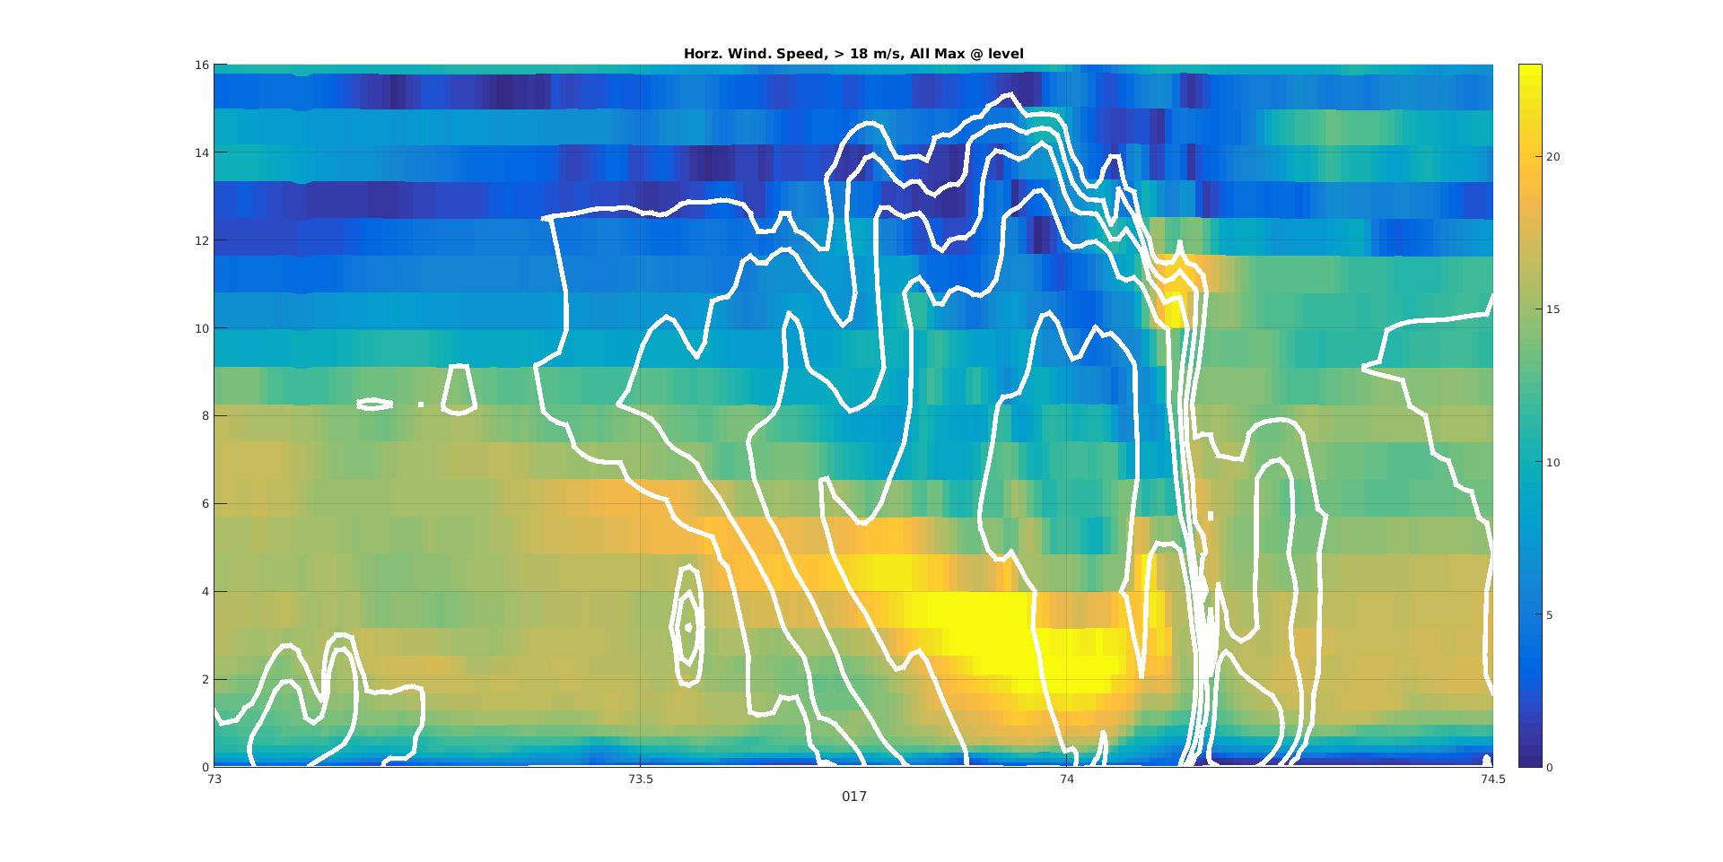
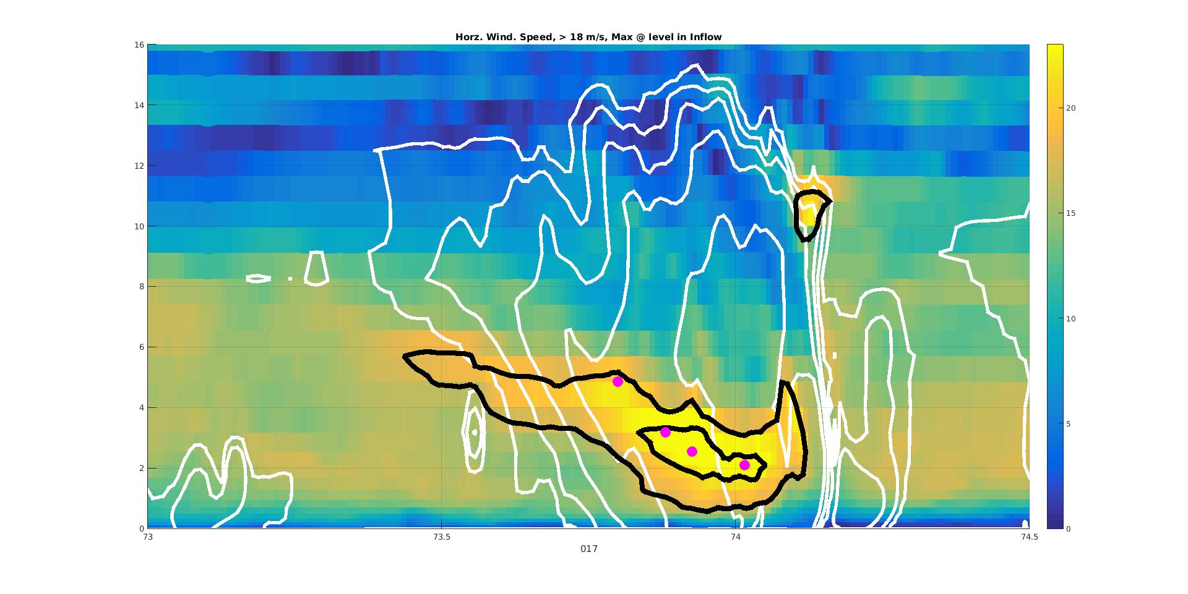
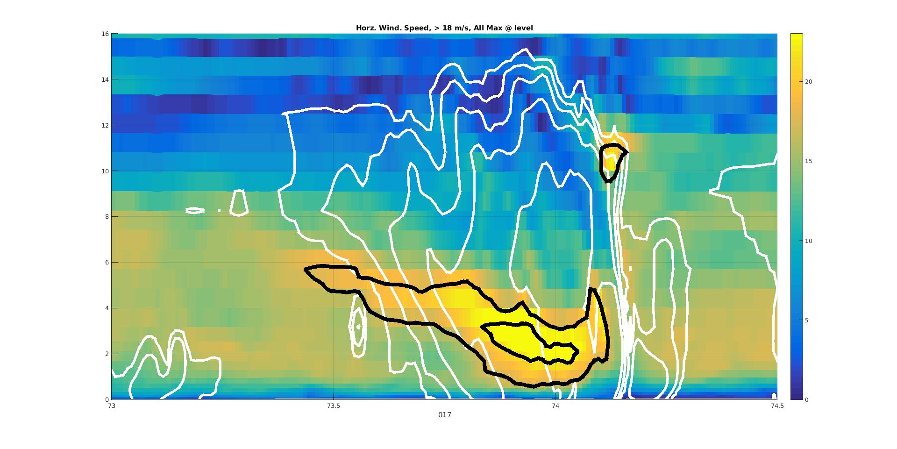

Midlevel Inflow Member Selection
16
Shading: Horz. Speed
White Contours: Reflectivity
Black Contours: Horz. Speed > 18 m/s
Shading: Horz. Speed
White Contours: Reflectivity
Black Contours: Horz. Speed > 18 m/s
Dots: Max Speed at level post tests
m/s
Shading: Horz. Speed
White Contours: Reflectivity
Black Contours: Horz. Speed > 18 m/s
Dots: Max Speed at level
Shading: Horz. Speed
White Contours: Reflectivity
14
20
12
10
15
Height (kn)
8
10
6
4
5
2
0
74
74.5
0
73
73.5
Longitude
Milbrandt: Member 17
1930 UTC 23 Dec 2011
Notes:
Take cross at some location in each member. Showing winds speed in colors and reflectivity in contours. First isolate where winds > 18 m/s to approximate location of MLI. Then find the location of the maximum wind at each model level. Select only those fit criteria including nothing right of the lowest point, not too far separate, no holes in the radar data. This is my region of interest.

Slide 25
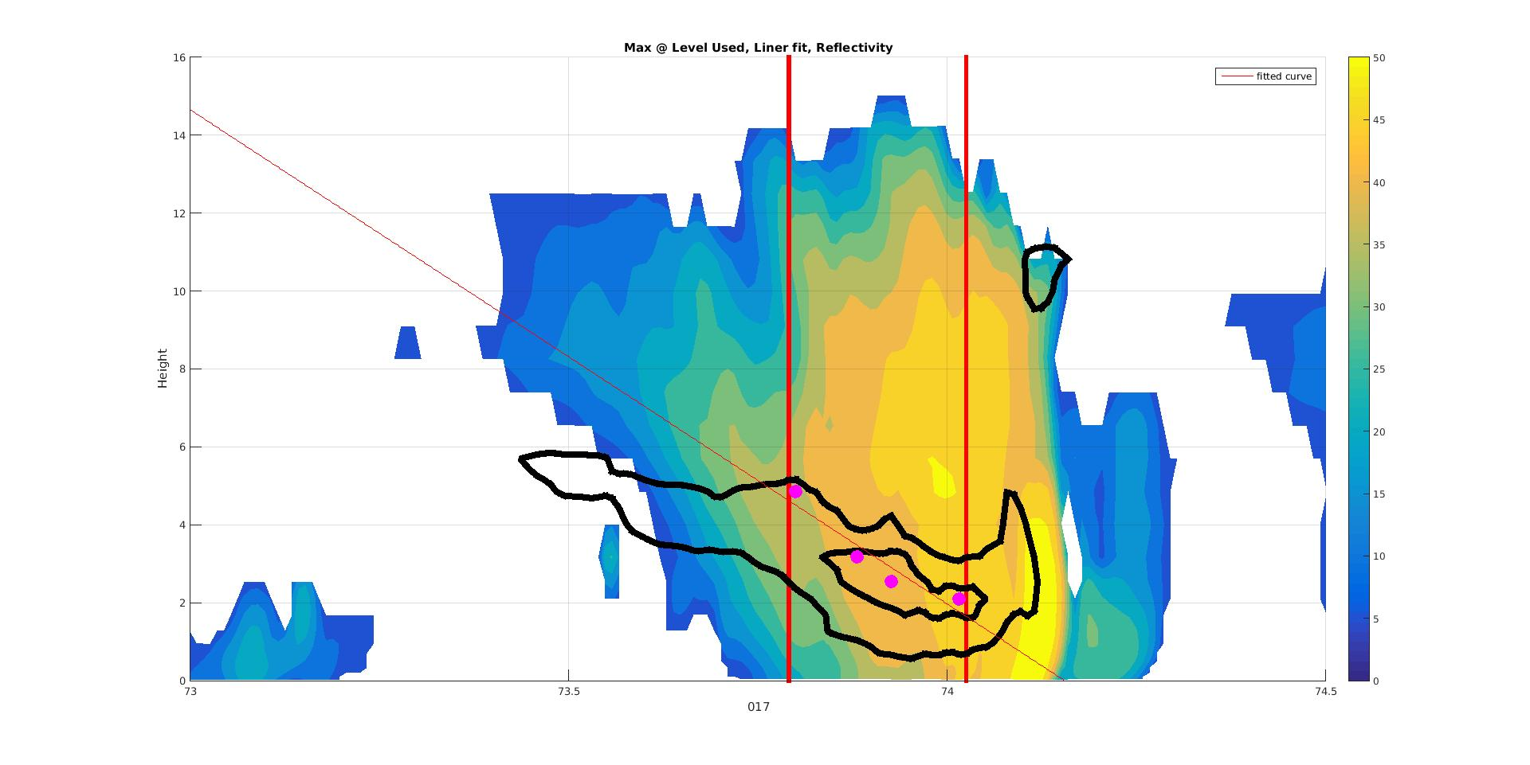
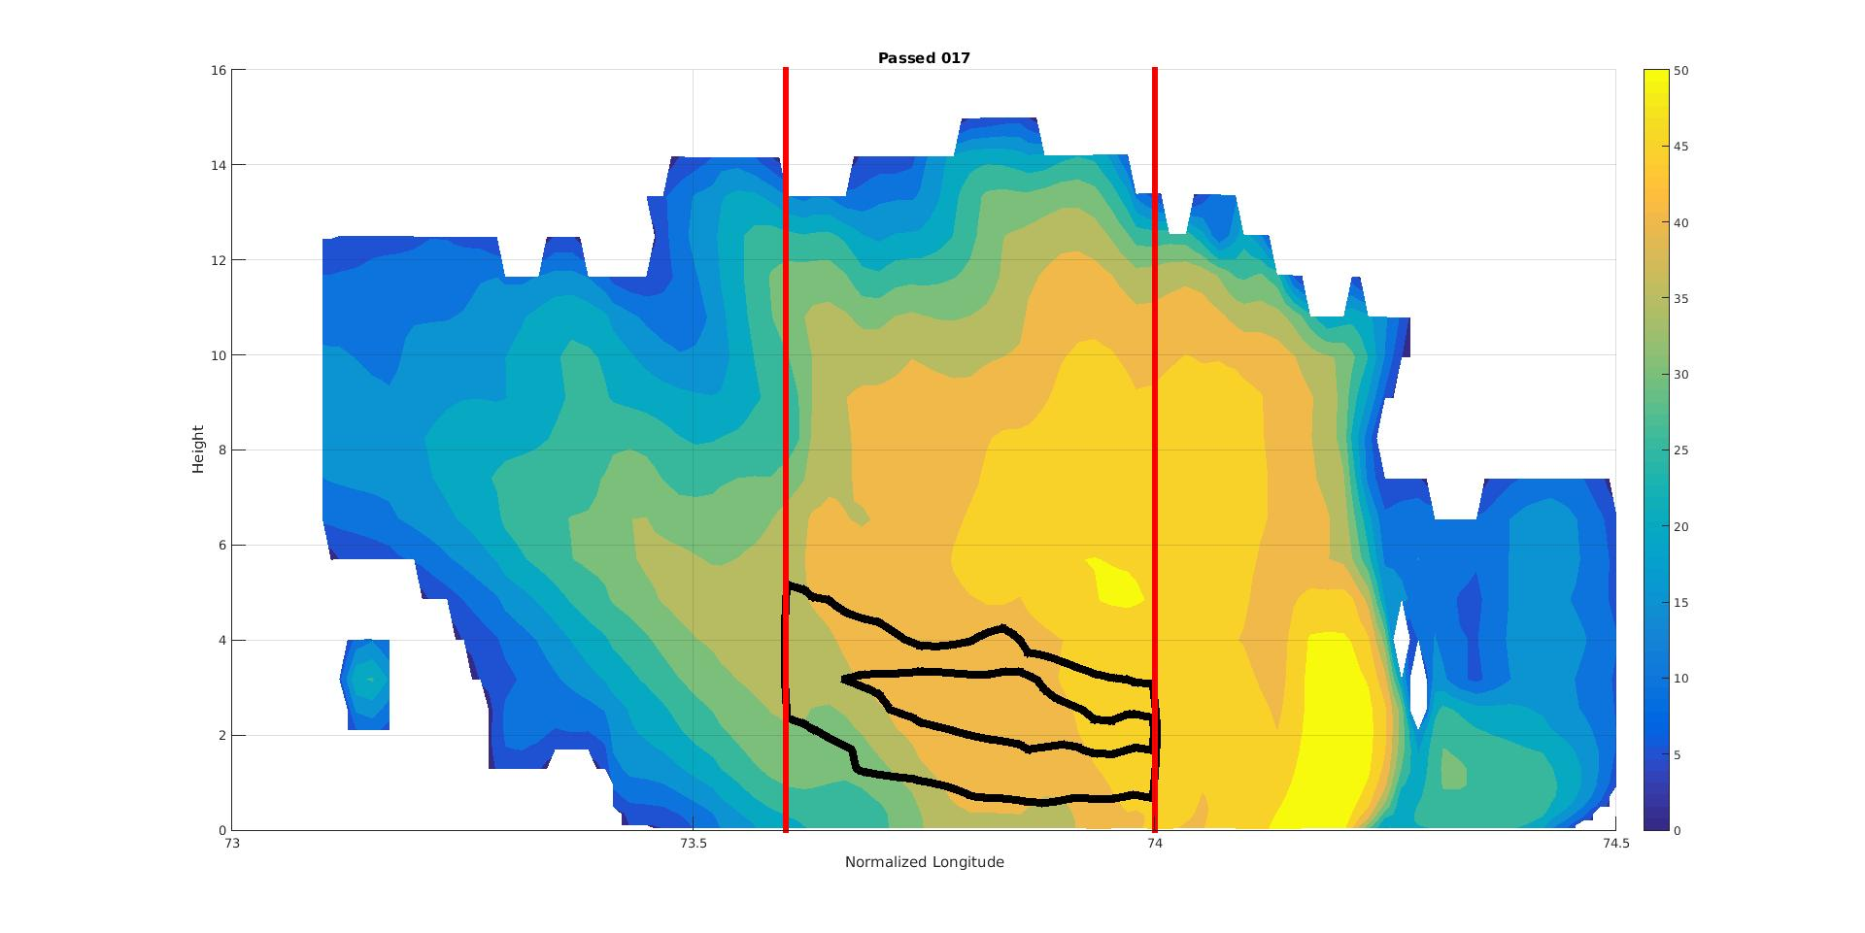
Midlevel Inflow Compositing
dBZ
16
Shading: Reflectivity
Black Contours: Horz. Speed > 18 m/s
Dots: Max speed at level post test
Red Lines: Analysis boundaries
50
14
45
12
40
35
Original
10
30
Height (km)
8
25
6
20
4
15
10
2
5
0
73
Longitude
74.5
0
73.5
74
dBZ
16
Shading: Reflectivity
Black Contours: Horz. Speed > 18 m/s
50
14
45
12
40
35
Scaled
10
30
Height (km)
8
25
6
20
4
15
10
2
5
0
73
Longitude
74.5
0
73.5
74
Milbrandt: Member 17
1930 UTC 23 Dec 2011
Notes:
Once I have my region of interest I then composite the cases. I do this my stretching or compressing the data so that its MLI is 0.4deg long. That is what is shown here for radar reflectivity, but same process for all the processes.
So I have discussed a lot about the model and my compositing methodology, lets see some actual results. Starting with what my squall lines look like.

Slide 26
Squall Line
1930 UTC, 23 December 2011

Slide 27
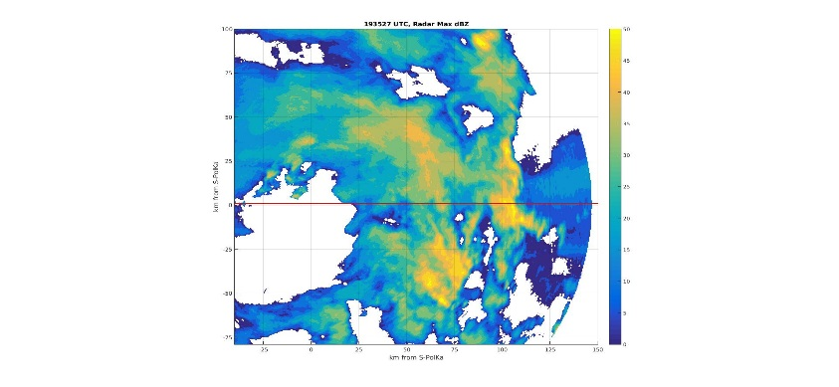
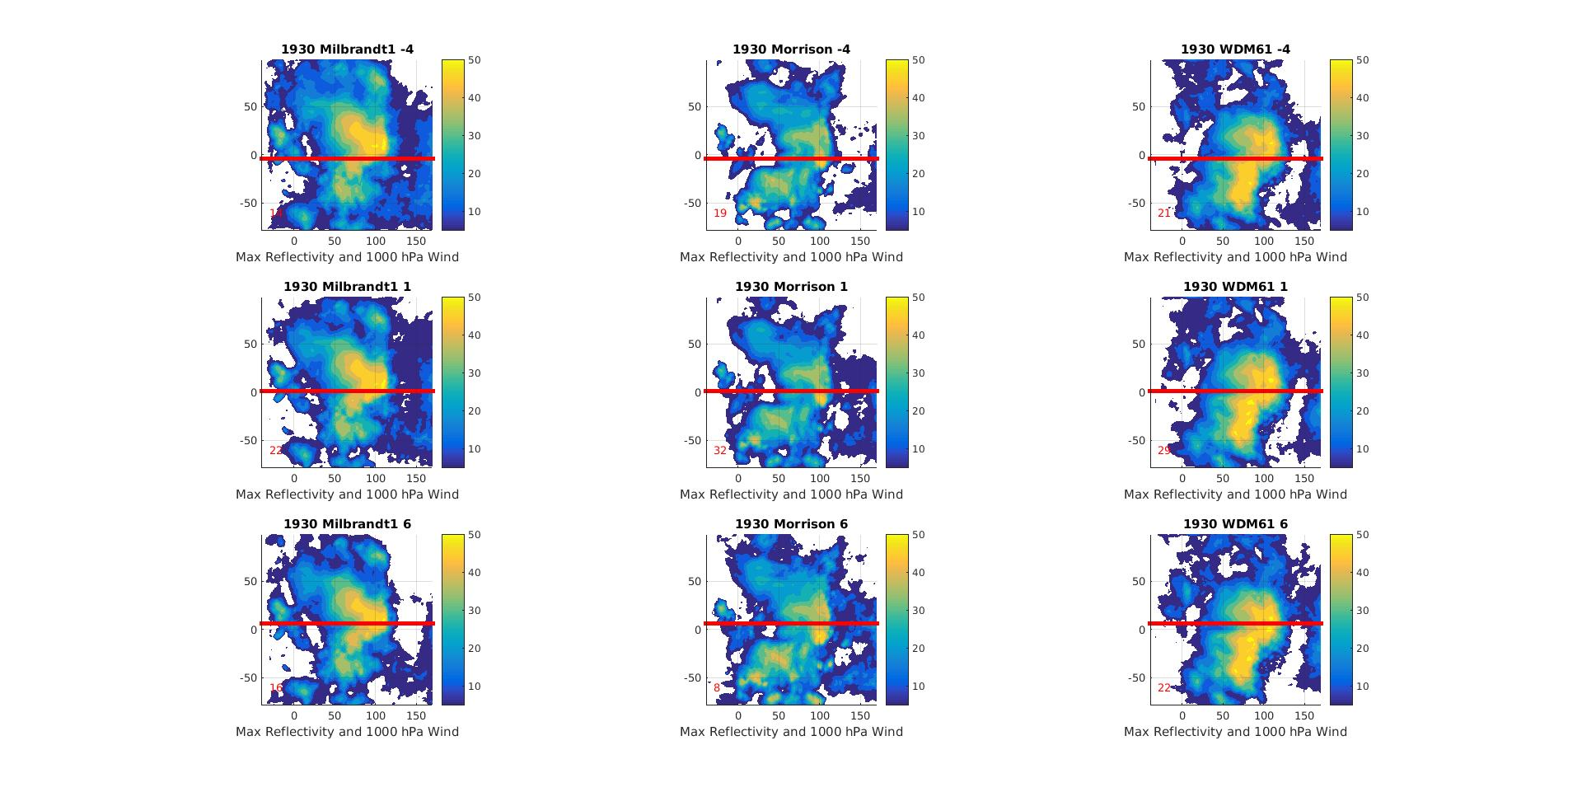
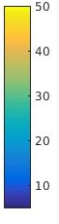
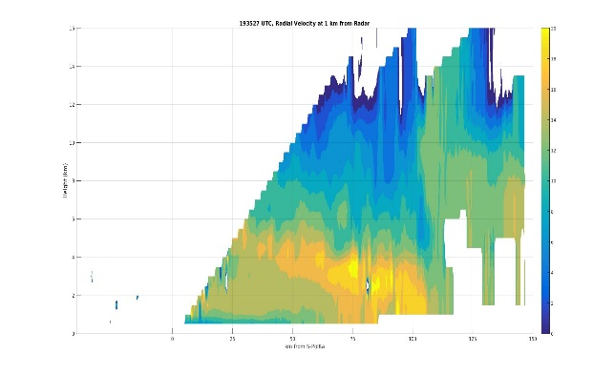
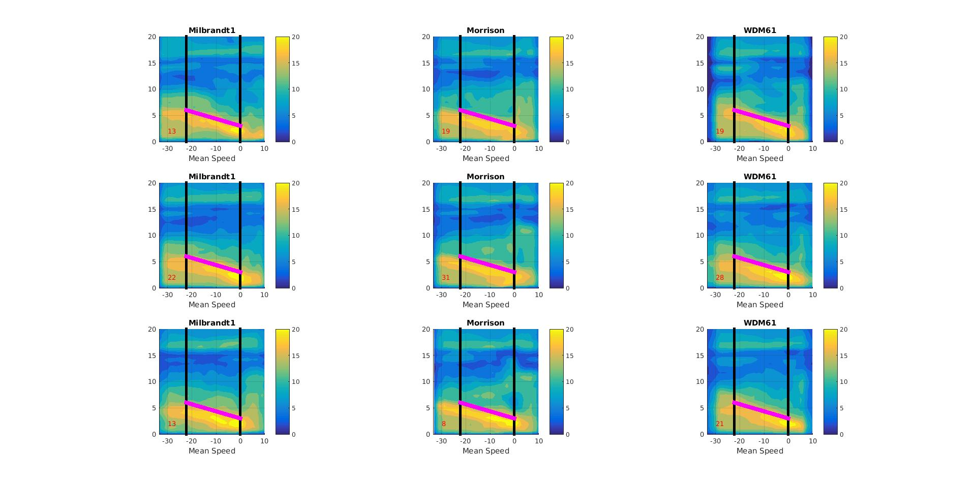
Squall Line Structure
S-PolKa
Milbrandt - Yau
Morrison
WDM6
Maximum Reflectivity Map
100
75
50
25
Distance from S-PolKa (km)
Distance from S-PolKa
0
-25
-50
-75
-25
0
25
50
75
100
125
150
Distance from S-PolKa (km)
Distance from S-PolKa (km)
Wind Speed Cross Section (along red line above)
16
14
12
10
8
Height (km)
Height (km)
6
4
2
0
0
25
50
75
100
125
150
Distance from S-PolKa (km)
Normalized Zonal Distance
Notes:
Describes plots. Reflectivity structures differ. But what is important is that the wind speed structure are incredibily similar. This is the lynch pin of this analysis. These similar structures are a direct result of the assimilation and without them the following intercomparison would be impossible.

Slide 28
Part 3:
Intercomparison
WRF
All
Type, Location, Rate
PID
Dominant only
Type, Location
Compare location only
Notes:
Before jump into the comparison I want to remind you that there remains a few differences between the data sources. The PID only tells the dominant type and its location, not every process is accounted for. On the other hand WRF provides us with every process every where, along with its location and rate. Thus, based on the limitations of the PID we can only compare the spatial structure of the microphysical processes. But this itself will be insightful because the spatial structure of microphysical processes dictate the latent heating structure of these storms.

Slide 29
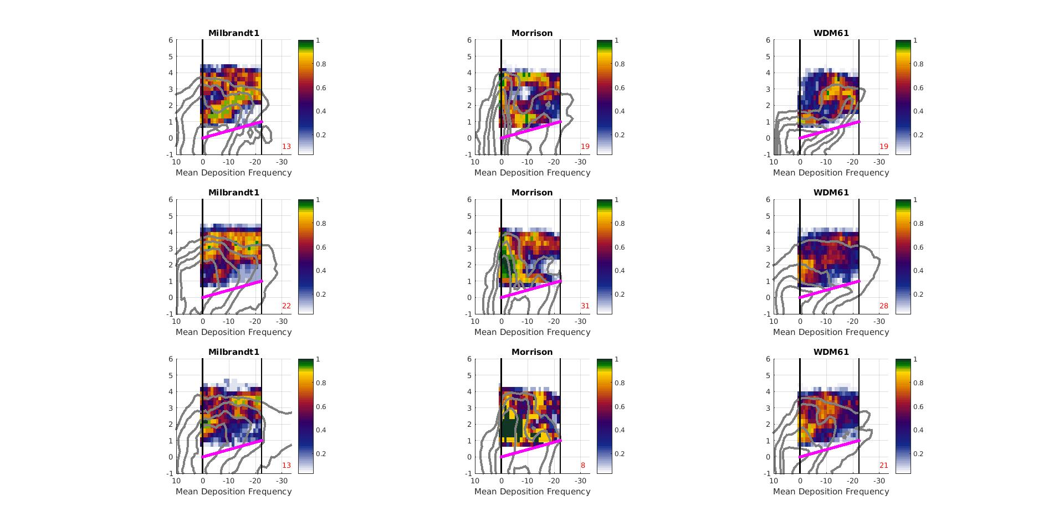
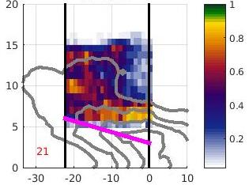
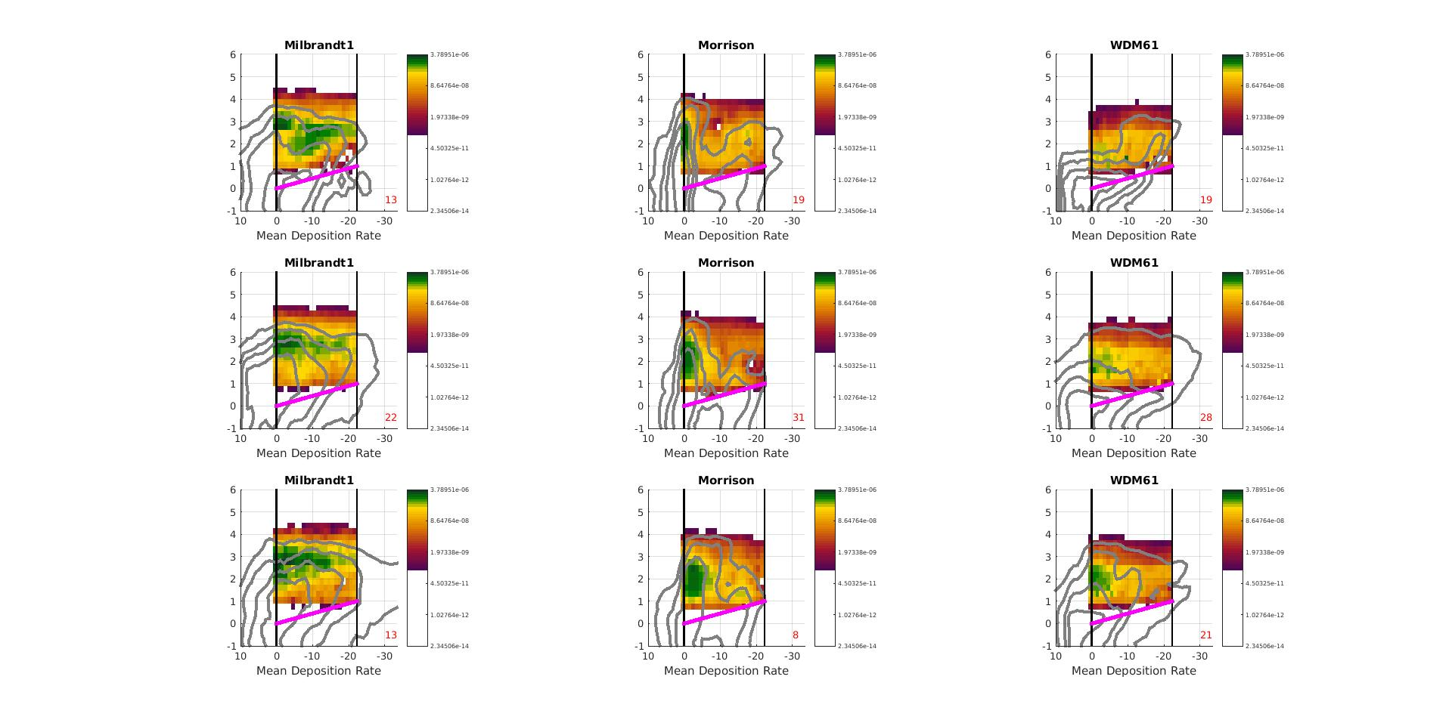
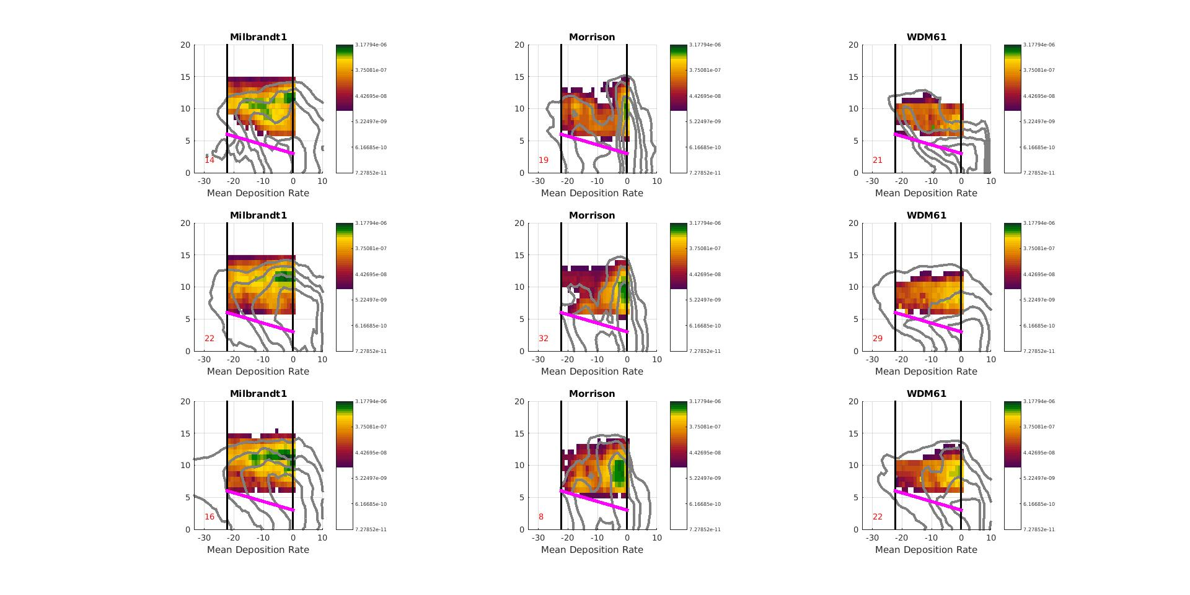
Deposition
S-PolKa PID
Milbrandt - Yau
Morrison
WDM6
Occurrence Frequency
Small Ice Crystals = Deposition
4
Adjusted Height
-20°C
3
0.5
2
-20°C
0.4
Normalized Height
0.3
1
0°C
0°C
0
0.2
-1
0.1
-2
0
0.25
0.5
0.75
1
Mean Production Rate (kg kg⁻¹ s⁻¹)
Normalized Range
3.1e-6
3.7e-7
-20°C
4.4e-8
Adjusted Height
5.2e-9
0°C
Normalized Zonal Distance
Notes:
Production Rate = How much added to hydrometeor by this process per second (how many kg added by process to 1 kg of hydrometeor per second)
Describe plots.
PID suggests that deposition dominant at cloud top. WRF rate suggests occurs everywhere, but frequency suggests more common higher in the squall line. Thus, there is a general consistency between the two in the fact that it appears to be most frevelant higher in the cloud. Differences may be attributable to PID only picking dominant type.

Slide 30
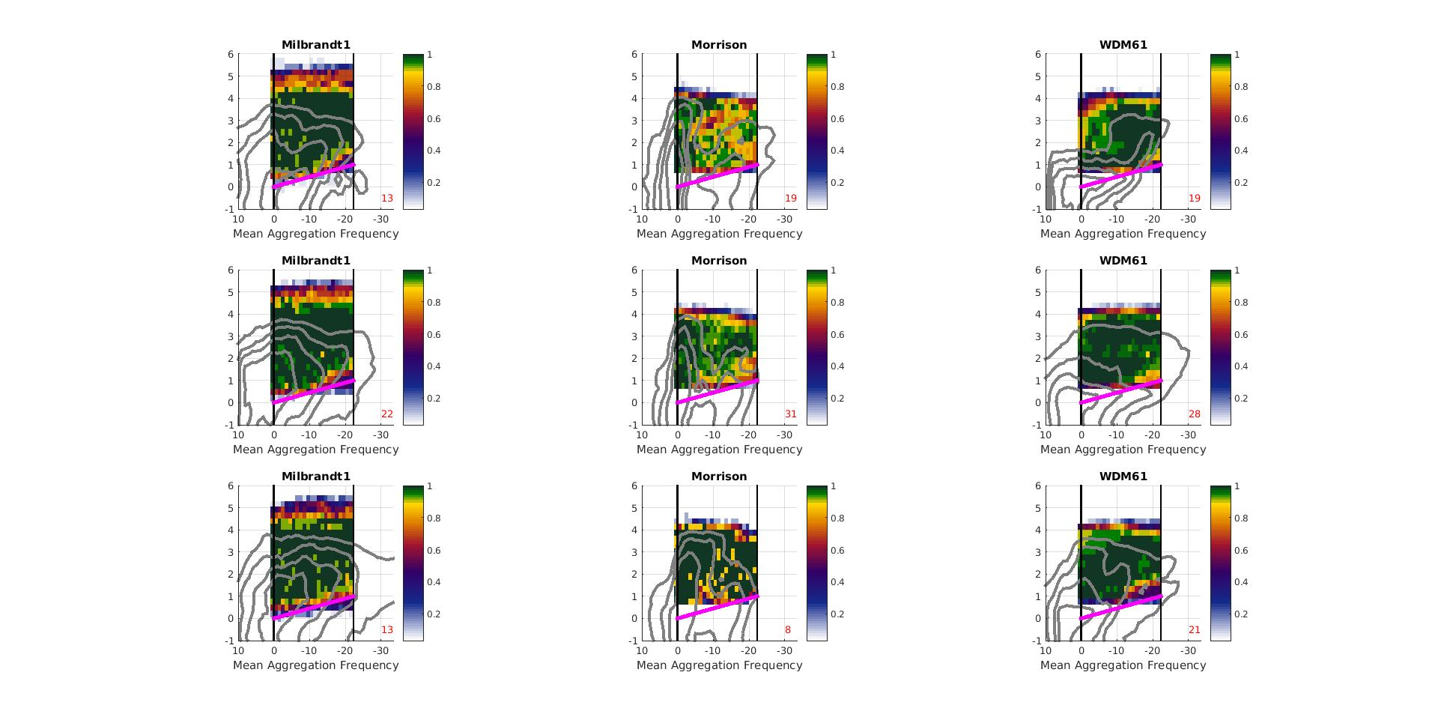
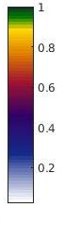
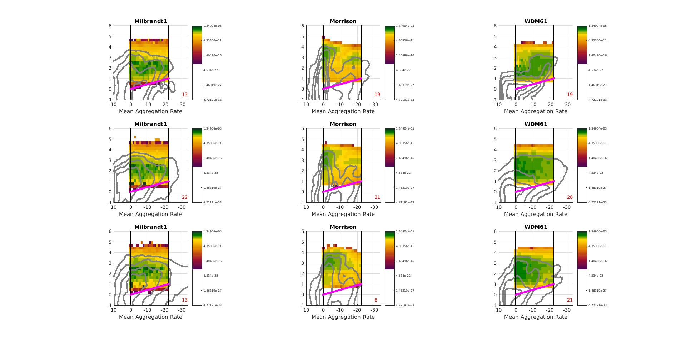
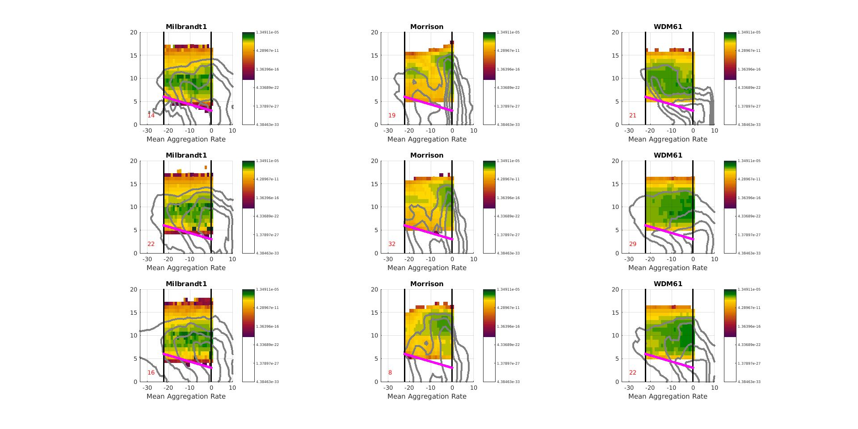
Aggregation
Frozen Collecting Frozen
S-PolKa PID
Milbrandt - Yau
Morrison
WDM6
Occurrence Frequency
Dry Aggregates = Aggregation
4
3
0.9
-20°C
-20°C
Adjusted Height
2
0.7
Normalized Height
1
0°C
0.5
0
0.3
0°C
-1
0.1
-2
0
0.25
0.5
0.75
1
Normalized Range
Mean Production Rate (kg kg⁻¹ s⁻¹)
1.3e-5
4.2e-11
-20°C
1.3e-16
Adjusted Height
4.3e-22
0°C
Normalized Zonal Distance
Notes:
PID aggregates at mid levels, stritchly follows theoretical temperature range. WRF indicates throughout depth. However, notice unlike deposition aggregation is very frequent at lower levels. Thus, both provide an indication that aggregation is dominant below deposition. Can individual ice crystals aggregation above -20C?

Slide 31
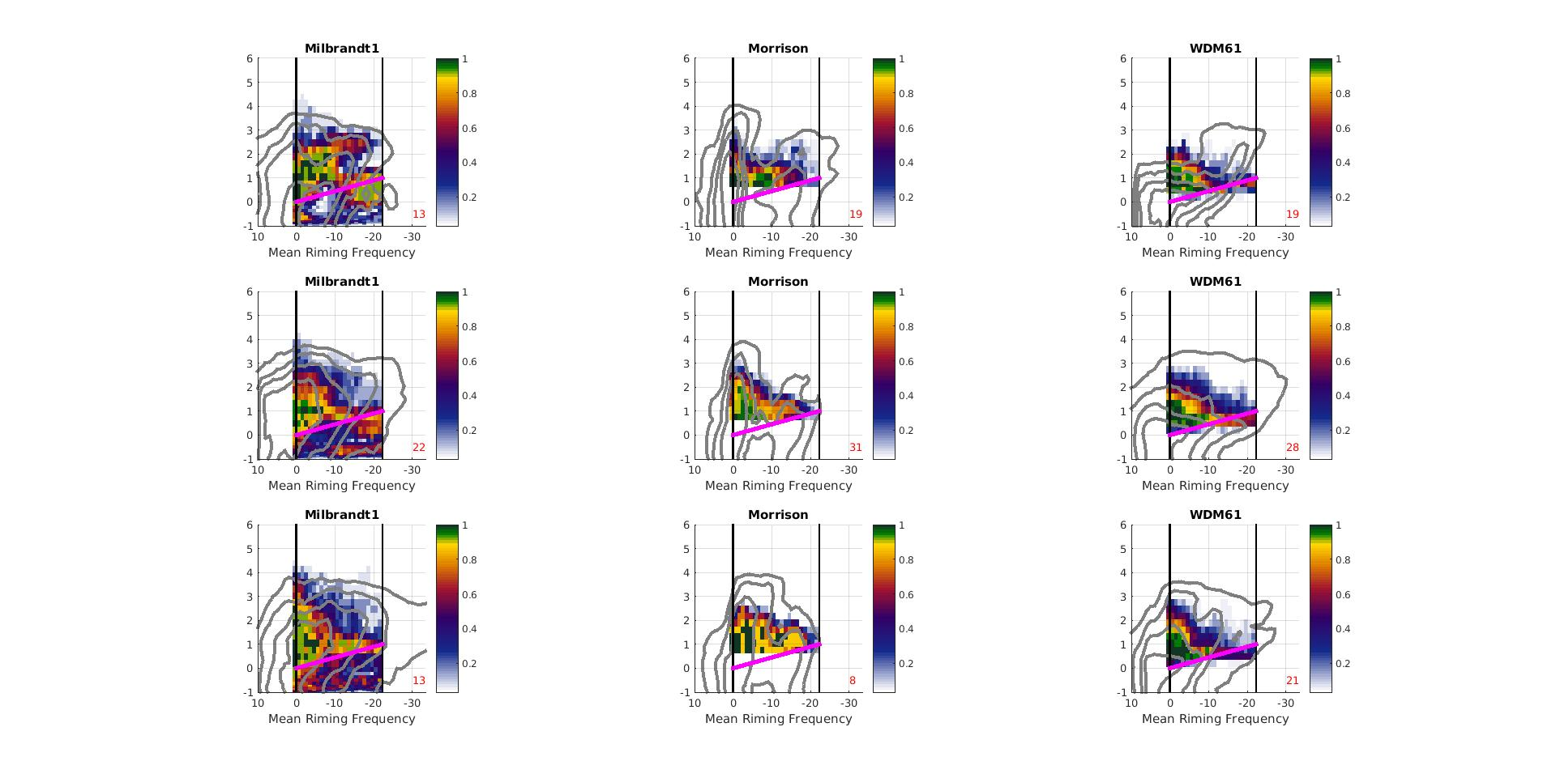
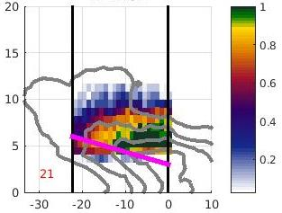
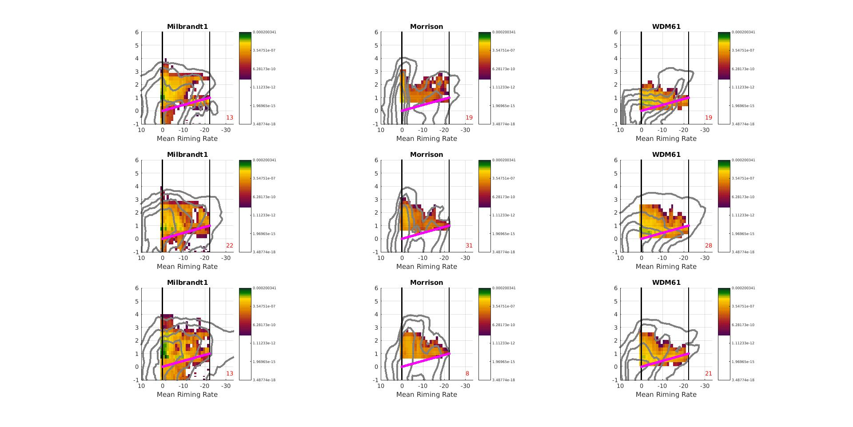
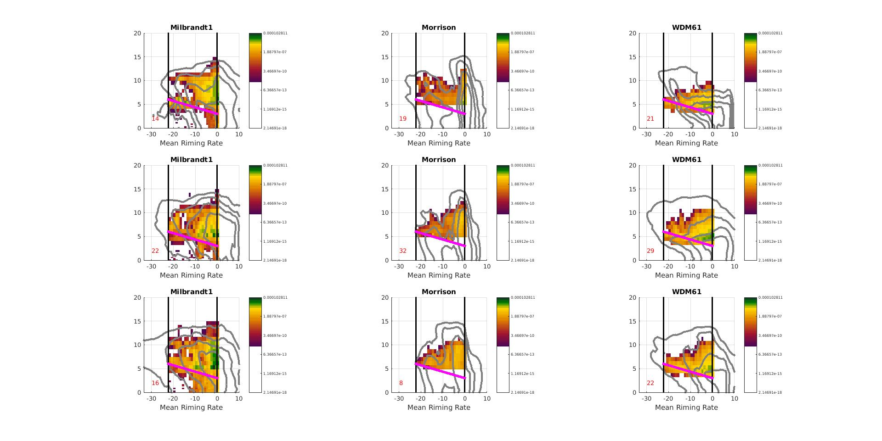
Riming
Frozen Collecting Liquid
S-PolKa PID
Milbrandt - Yau
Morrison
WDM6
Occurrence Frequency
Graupel/Rimed Aggregates = Riming
4
3
0.2
-20°C
-20°C
Adjusted Height
2
0.16
1
0°C
Normalized Height
0.12
0°C
0
0.08
-1
0.04
-2
0
0.25
0.5
0.75
1
Mean Production Rate (kg kg⁻¹ s⁻¹)
Normalized Range
1e-4
1.8e-7
-20°C
Adjusted Height
3.4e-10
0°C
6.3e-13
Normalized Zonal Distance
Notes:
Largest differences. PID shallow, isolated. WRF consistently over a rather deep layer, especially near convective end. Differences may be the result of limited sensitive of PID or convection is too strong in WRF. One thing that does standout has highly questionable is Milbrant-Yau.

Slide 32
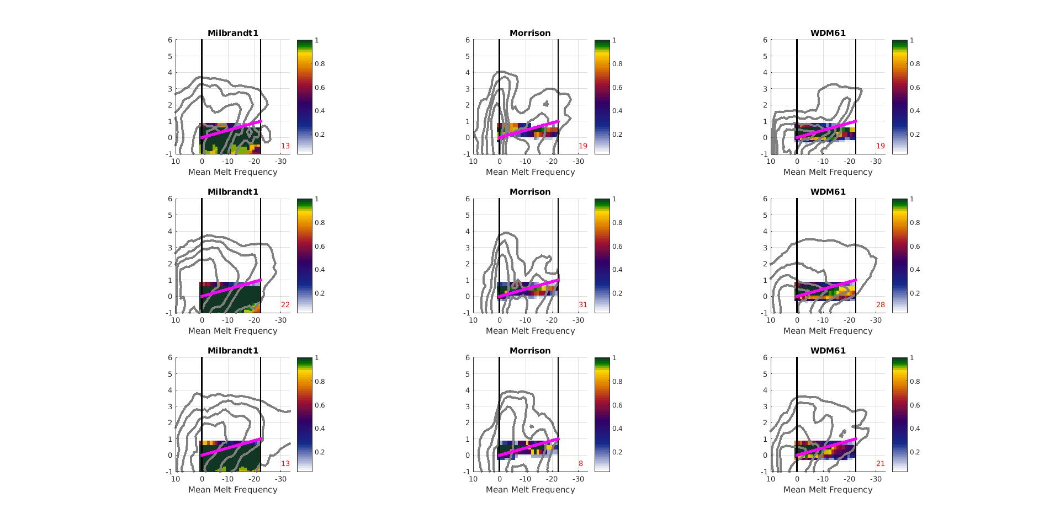
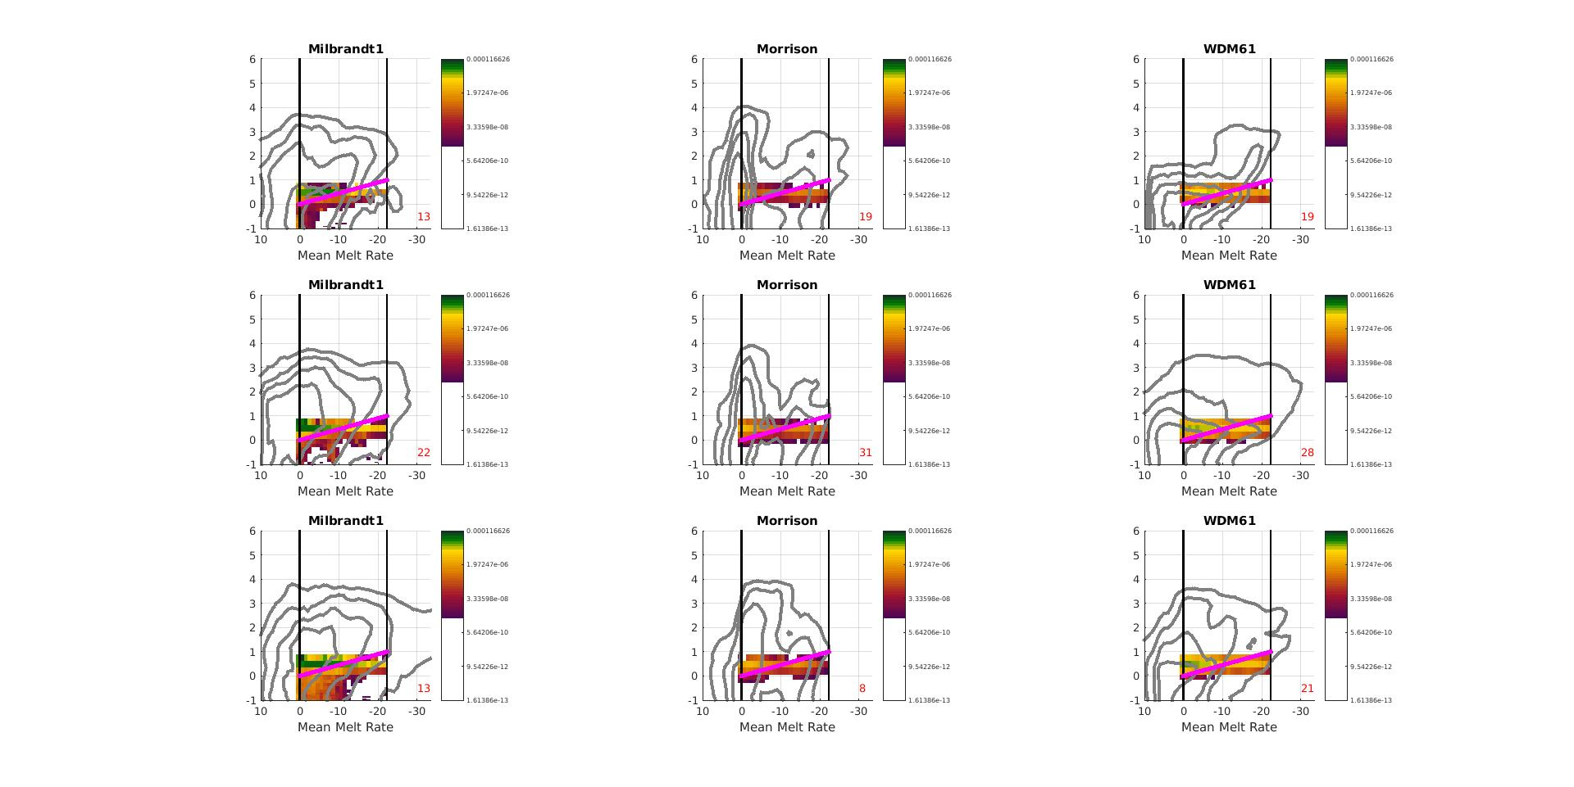
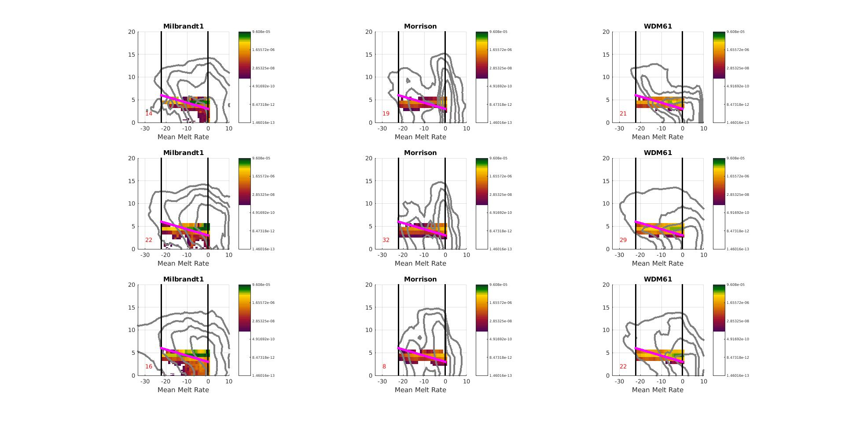
Melting
S-PolKa PID
Milbrandt - Yau
Morrison
WDM6
Occurrence Frequency
Wet Aggregates = Melting
4
3
0.8
-20°C
-20°C
Adjusted Height
2
0.6
Normalized Height
1
0°C
0.4
0
0°C
--1
0.2
-2
0
0.25
0.5
0.75
1
Normalized Range
Mean Production Rate (kg kg⁻¹ s⁻¹)
9.6e-5
1.6e-6
-20°C
2.8e-8
Adjusted Height
4.9e-10
0°C
Normalized Zonal Distance
Notes:
Finally, melting. PID shows narrow layer, which is very similar to the structure seen the rate plots. However, once again Milbrandt-Yau.

Slide 33
Conclusions
Ice microphysical processes have layered structure
Broadly similar
Details differ
Aggregation and riming - WRF deeper
Deposition – WRF extends lower
Melting – Consistent except Milbrandt-Yau
Large-scale similarities encouraging
Research needed to resolve detail differences
Small Ice Crystals
Horz.-Oriented Ice
Dry Aggregates
-20˚C
Graupel / Rimed Aggregates
Wet Aggregates
0˚C
Light Rain
Z
X
Moderate Rain
Heavy Rain
Conceptual Model of Hydrometeor Type within Midlevel Inflow
Notes:
Based on that intercomparison we are able to conclude that the spatial structure of the microphysical processes in the PID and WRF have a broadly similar layered structure. However, the details differ. Overall, we find this encouraging that two different data sources have a similar large-scale structure and suggests that we are at a good starting point. In terms of the details of these structures it is hard to decide which model or method is correct. Highlights that additional research is needed into microphysical processes. But we are on the right track.

Slide 34
Back Up
Slides

Slide 35
Particle Identification Algorithm (PID)
Polarimetric Data
Z, Z_{DR}, K_{DP}, LDR, ρ_{HV}, Temp
PID Algorithm
Characterize how well categories represented by data
Fuzzy logic based
Interest value
Hydrometeor Classification
Max interest value

Slide 36
Microphysical Process Definitions
Definition | Ice Nucleation | Aggregation | Riming | Melting | Deposition | Sublimation | Raindrop Collection | Condensation | Evaporation
 | New frozen hydrometeors forming | Frozen hydrometeors collecting other frozen hydrometeors | Frozen hydrometeors collecting liquid hydrometeors | Frozen hydrometeors melting into liquid hydrometeors | Frozen hydrometeors collecting water vapor | Frozen hydrometeors losing mass to water vapor | Liquid hydrometeors collecting liquid or frozen hydrometeors | Liquid hydrometeors collecting water vapor | Liquid hydrometeors losing mass to water vapor
Milbrandt - Yau | QFZci, QNUvi, QFZrh | QCLis, QCLig, QCLsh, QCNis, QCNsg, QCNgh, QCLih | QCLcs, QCLcg, QCLch, QCLrg, QCLrs, QCLri, QCLrh | QMLir, QMLsr, QMLgr, QMLhr | QVDvi, QVDvs, QVDvh, QVDvg | QVDvi, QVDvs, QVDvh, QVDvg | RCAUTR, RCACCR, QCLsr, QCLgr |  | QREVP
Morrison | mnuccd, mnuccr, mnuccc | prai, prci | psacws, pgracs, psacwi, psacwg, pgsacw, psacr, pracg, pracis, praci, piacrs | psmlt, pgmlt | prd, prdg, prds | eprdg, eprds, eprd | piacr, pra, prc | pre, pcc, evpmg, evpms | pre, pcc, evpmg, evpms
WDM6 | Pigen | Psaci, Pgaci, Psaut, Pgacs, Pgaut | Psacw, Pgacw, Paacw, Piacr, Psacr, Pgacr, Pracs | Psmlt, Pgmlt | Pidep, Psdep, Pgdep | Pidep, Psdep, Pgdep | Praut, Pracw, Praci, Pseml, Pgeml | Pcond | Prevp, Psevp, Pgevp

Slide 37
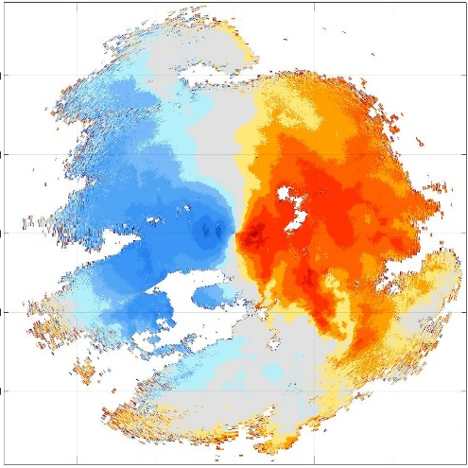
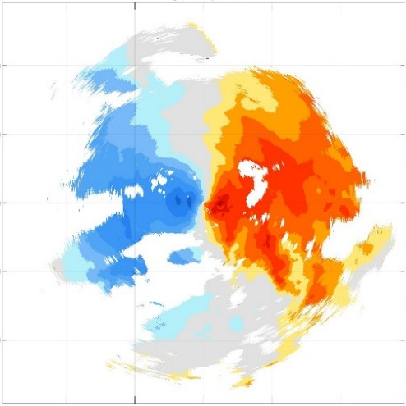
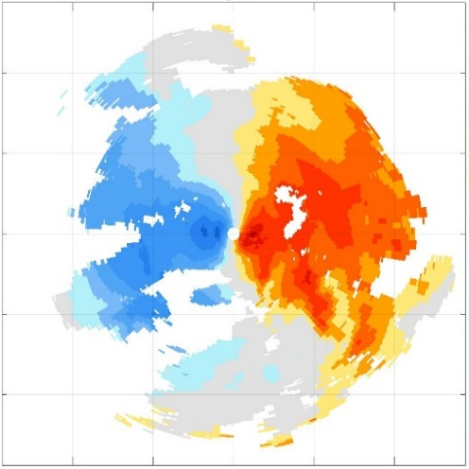

Radial Velocity Prep
Radar Quality Control (NCAR)
Locations were PID present only
PID used to remove
Insects
2nd trip
Saturation
Remove pixels with:
Low signal-to-noise ratio
Clutter
High spectral Width
Super-Observations
Bins: 2° x 1 km
Quality control: < |45 ms⁻¹|
Rules:
< 2 obs in each bin
Remove all Obs
std(bin) > std(all)
Remove all obs
(obs – bin mean) > 2*std(bin)
Remove obs at fault
Median value
Raw Radial Velocity
QCed Radial Velocity
SuperObs Radial Velocity
150
150
150
100
100
100
50
50
50
Distance from S-PolKa (km)
0
0
0
-50
-50
-50
-100
-100
-100
-150
-100
-50
0
50
100
150
-150
-100
-50
0
50
100
150
-150
-100
-50
0
50
100
150
Distance from S-PolKa (km)

Slide 38
Ensemble Initialization
Steps
Create ensemble of control vectors with mean = 0 and standard deviation = 1
Perturb each control vector using BE (U,V, θ, q_{v})
Update boundary conditions so consistent with perturbations
Background error covariance (BE)
BE = describes random errors in background field
Generated from cv5 option in WRFDA
From 60 member ensemble with random microphysics scheme
Allows the generated ensemble to be consistent with domain-specific background error statistics

Slide 39
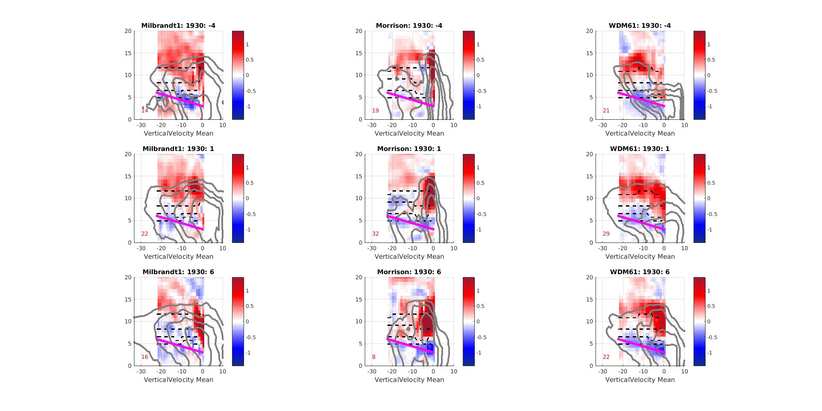
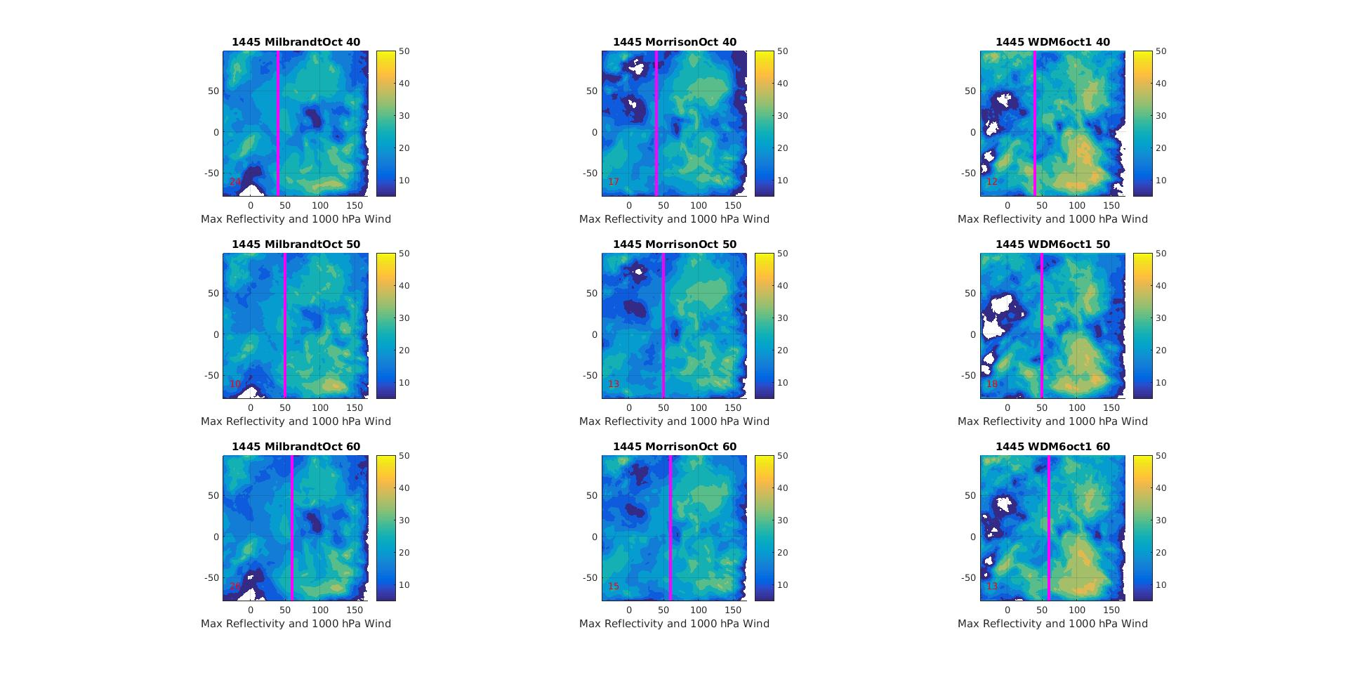
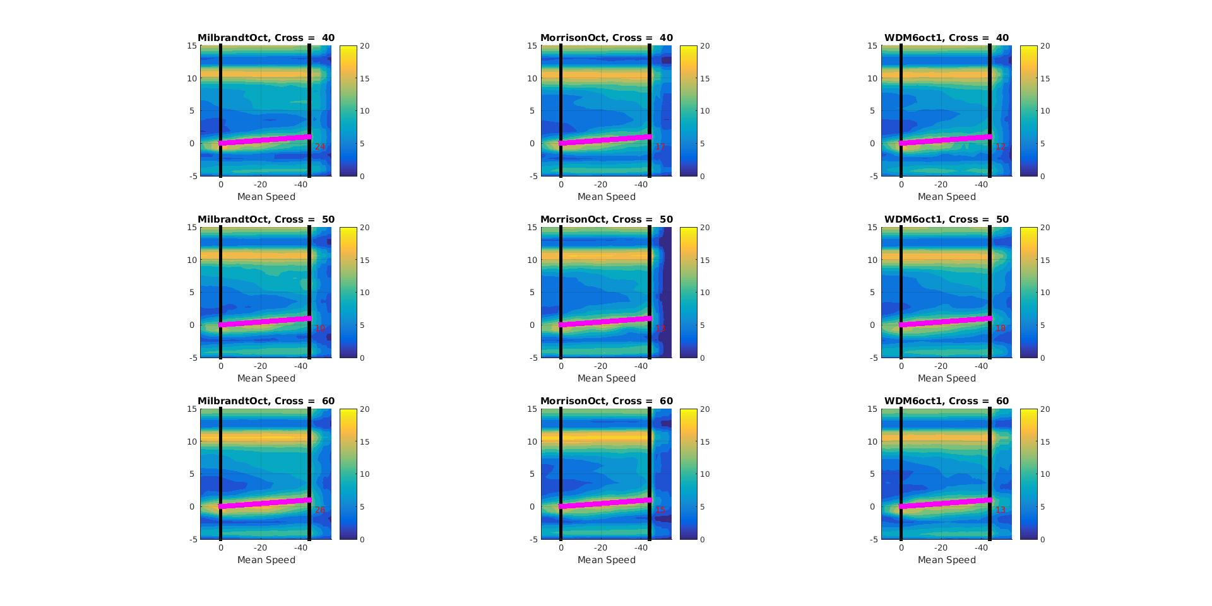
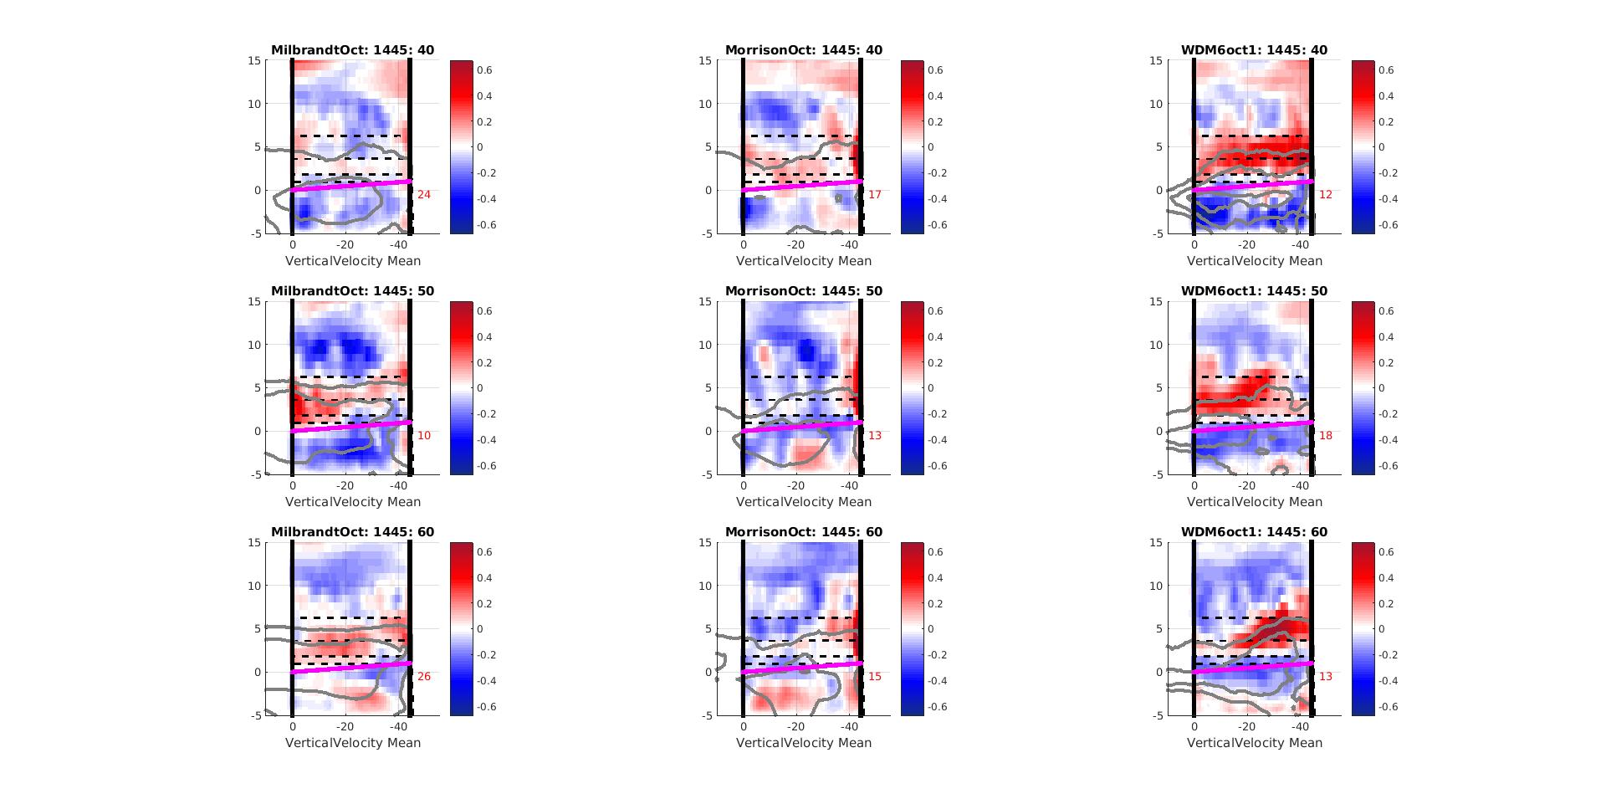
16 Oct vs. 23 Dec - Milbrandt
Max. dBZ PPI
Horz. Wind RHI
Vertical Velocity RHI
-40°C
23 December
-20°C
-5°C
0°C
16 October
Normalized Distance

Slide 40
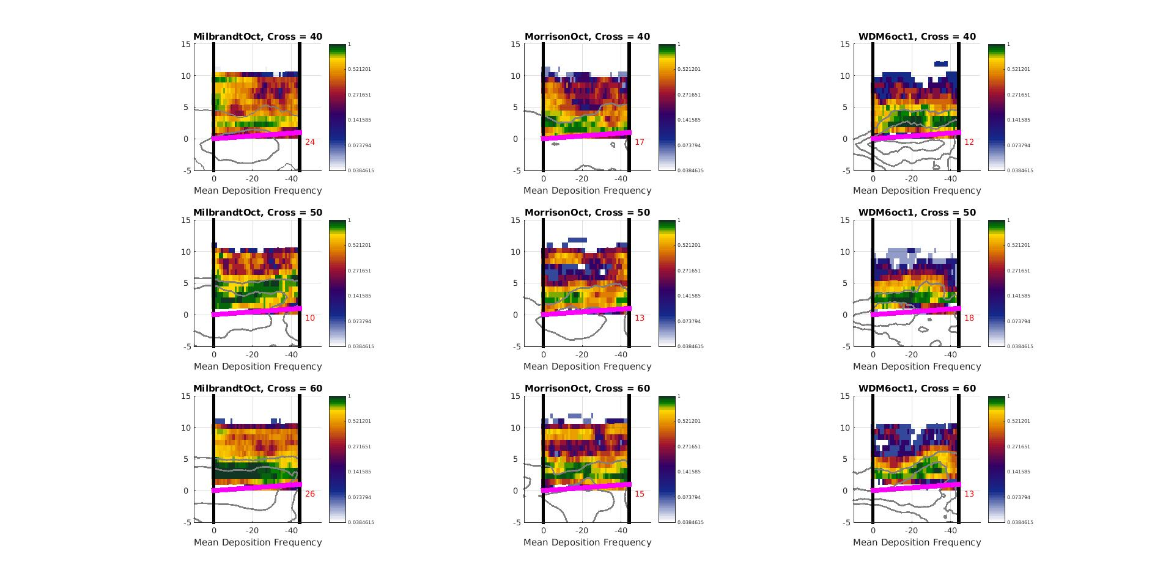



16 Oct vs. 23 Dec - Milbrandt
Deposition
Aggregation
Riming
Melting
23 December
Normalized Height
16 October
Normalized Distance

Slide 41
16 Oct vs. 23 Dec - Morrison
Max. dBZ PPI
Horz. Wind RHI
Vertical Velocity RHI
23 December
-40°C
-20°C
-5°C
0°C
16 October
Normalized Distance

Slide 42
16 Oct vs. 23 Dec - Morrison
Deposition
Aggregation
Riming
Melting
23 December
Normalized Height
16 October
Normalized Distance

Slide 43
16 Oct vs. 23 Dec – WDM6
Max. dBZ PPI
Horz. Wind RHI
Vertical Velocity RHI
23 December
-40°C
-20°C
-5°C
0°C
16 October
Normalized Distance

Slide 44
16 Oct vs. 23 Dec – WDM6
Deposition
Aggregation
Riming
Melting
23 December
Normalized Height
16 October
Normalized Distance

Slide 45


Temperature, Relative Humidity & Vertical Velocity Structure
Milbrandt - Yau
Morrison
WDM6
Mean Temperature Map at 1000 hPa
Distance from
S-PloKa (km)
Composite Relative Humidity Cross Section
°
Height (km)
-40°C
-40°C
-40°C
-20°C
-20°C
-20°C
-5°C
-5°C
-5°C
0°C
0°C
0°C
Composite Vertical Velocity Cross Section
-40°C
-40°C
-40°C
Height (km)
-20°C
-20°C
-20°C
-5°C
-5°C
-5°C
0°C
0°C
0°C
Normalized Zonal Distance

