Slide 1
Polarimetric radar observations of nonprecipitating echo during DYNAMO/AMIE
Angela Rowe and Robert Houze, Jr.
University of Washington
37th Conference on Radar Meteorology
Norman, OK
15 September 2015

Slide 2
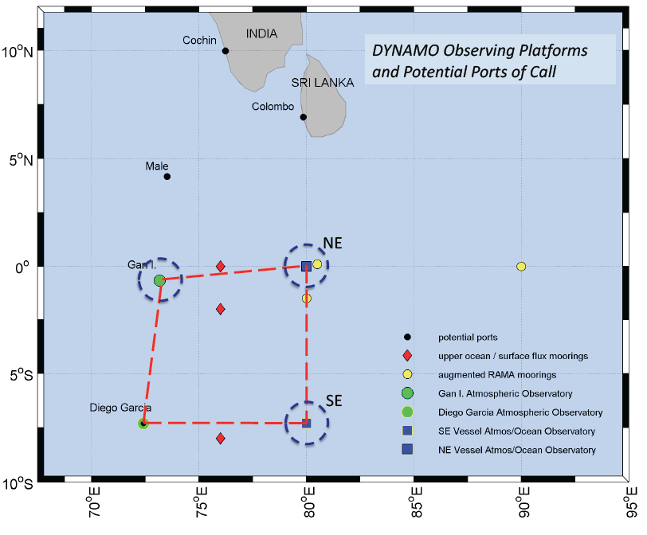
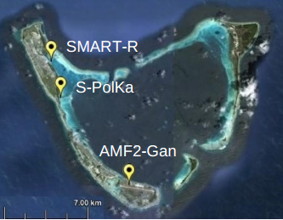
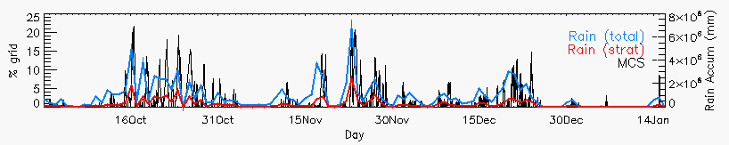
DYNAMO/AMIE
Rowe and Houze (2014)

Slide 3
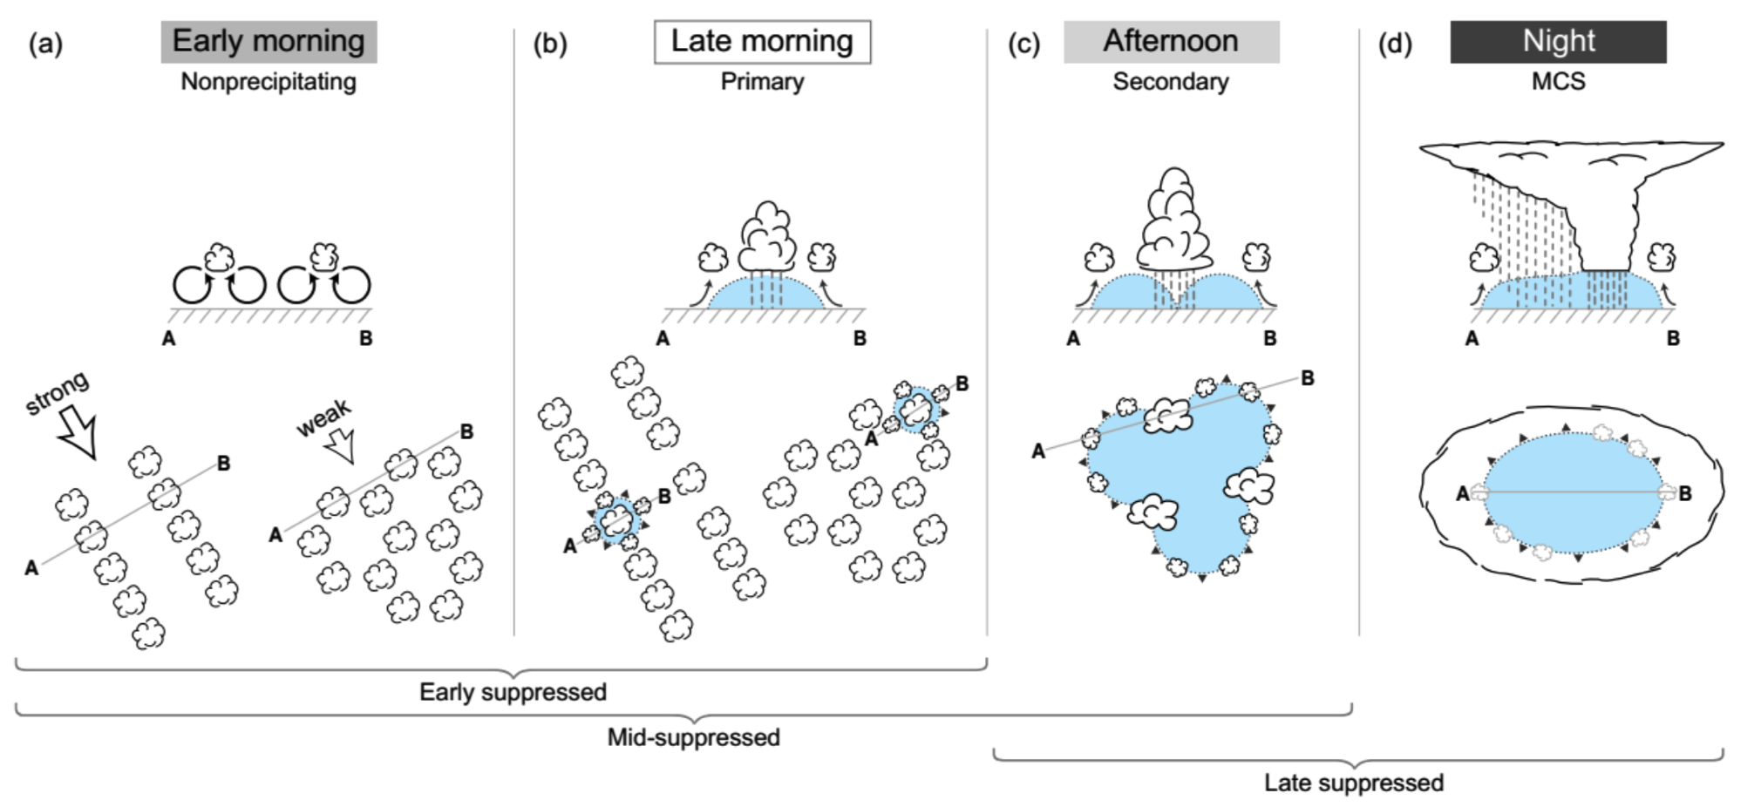
Transition to active periods
Rowe and Houze (2015)

Slide 4
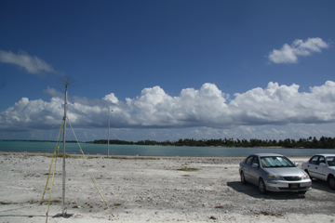
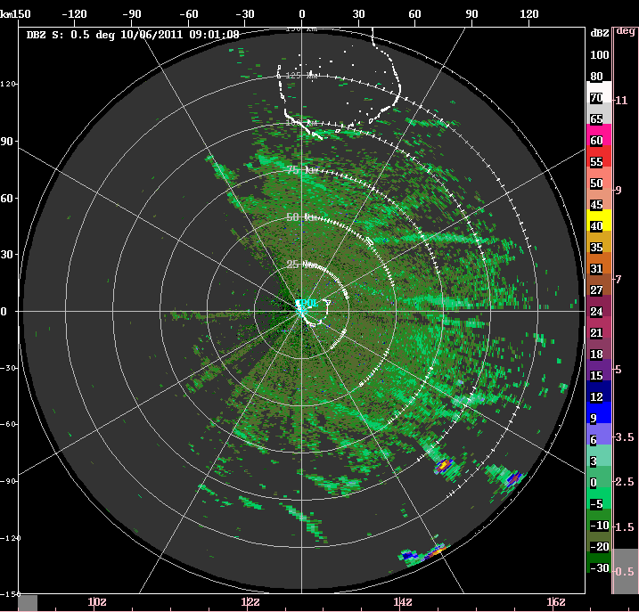
Early suppressed
Photo: Bob Houze
1) Cloud lines oriented parallel to wind direction and (initially) to low-level shear
2) Shallow precipitating clouds produce cold pools during afternoon

Slide 5
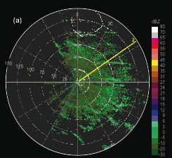
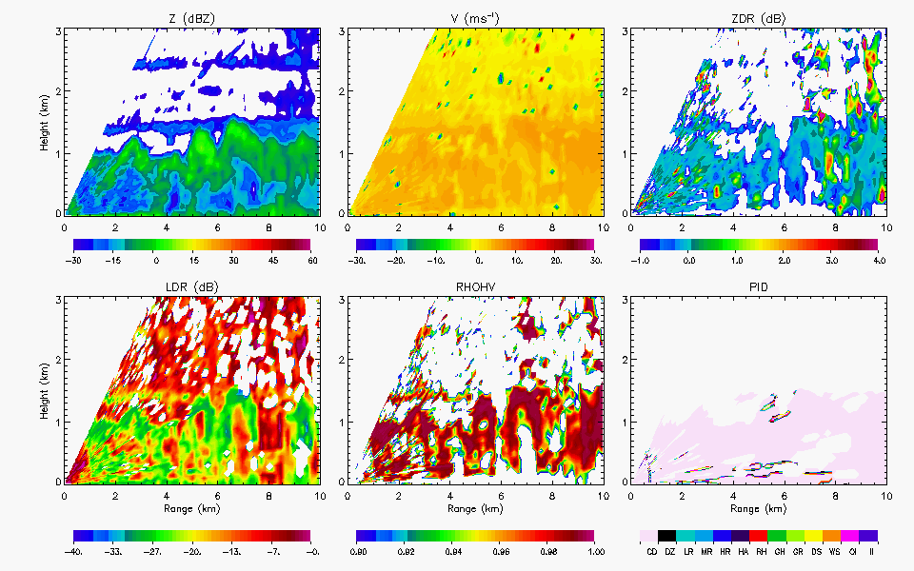
Nonprecipitating echo
Mantle echoes (Atlas 1959; Knight and Miller 1993)
Z: 0 – 7 dBZ
Z_{DR}: ~0 dB
L_{DR}: < -25 dB
ρ_{HV}: > .99

Slide 6
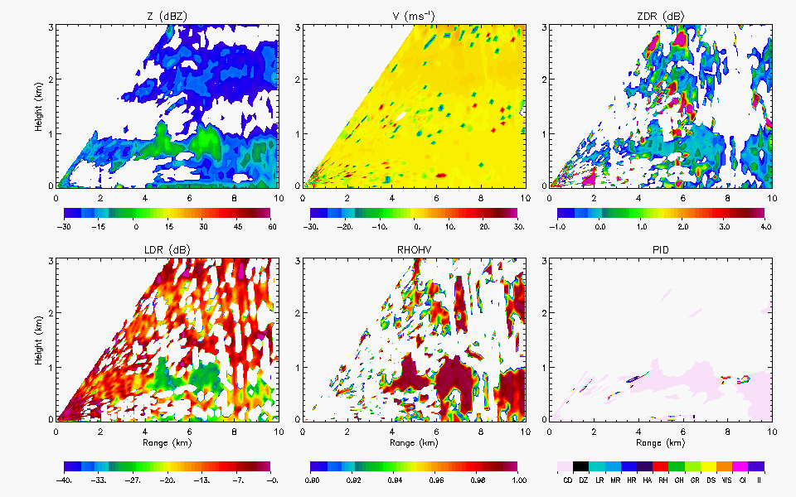
Nonprecipitating echo
Feng et al. (2014)
KAZR: best for shallow, nonprecipitating clouds
S-Pol: Reasonably detect nonprecipitating cumulus clouds (> 80%) within 30-50 km range
Bragg scattering layers (Davison et al. 2013)
Transition layer : 0.5-1 km during DYNAMO (Davison 2014)
Cloud droplets
Z: 0 – 7 dBZ
Z_{DR}: ~0 dB
L_{DR}: < -25 dB
ρ_{HV}: > .99

Slide 7
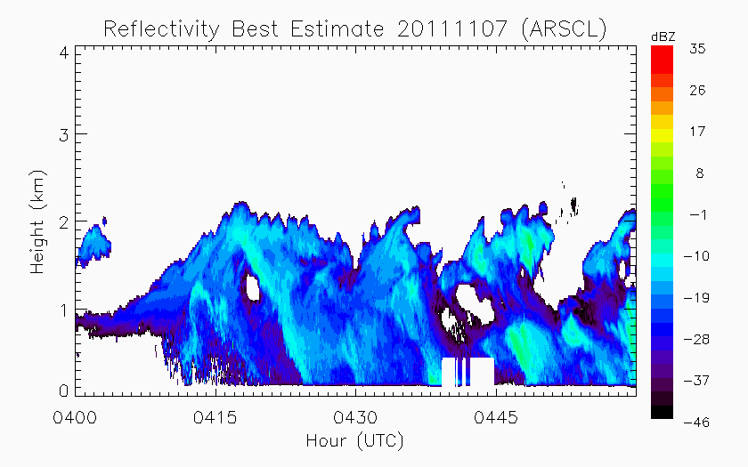
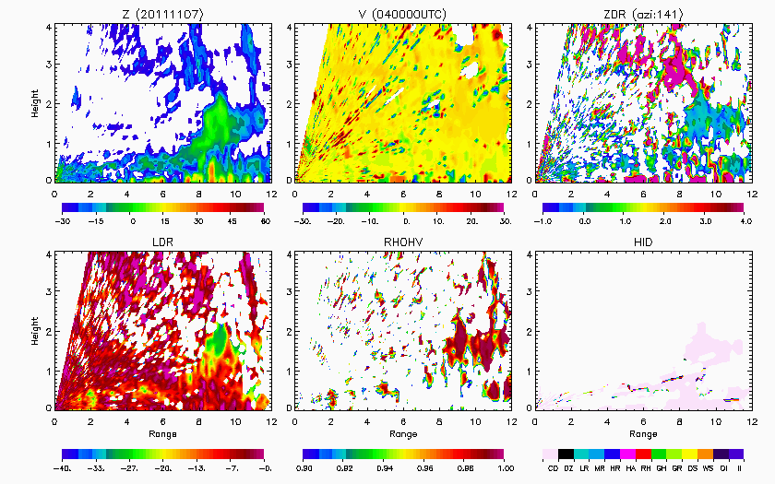
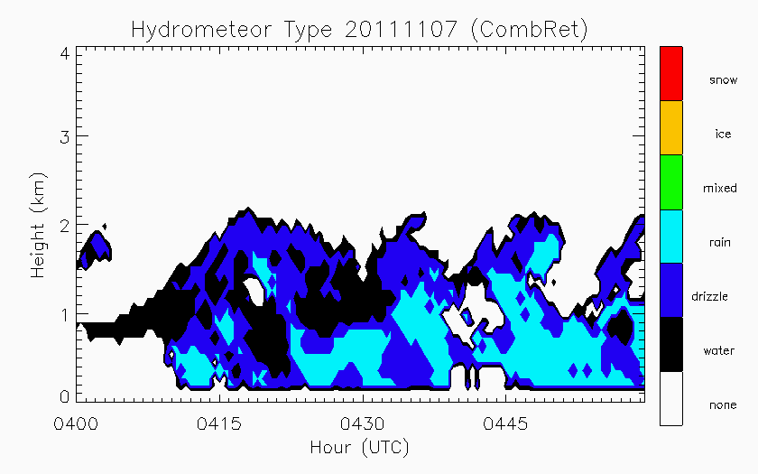
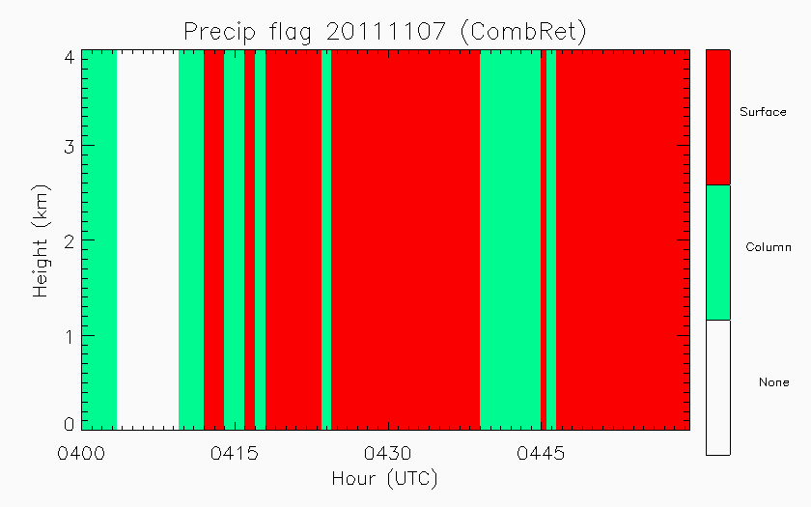
Nonprecipitating echo
Water/drizzle
Cloud droplets
KAZR-ARSCL: Active Remote Sensing of CLouds
COMBRET: Combined Remote Sensor Retrieval Algorithm (radar + lidar)

Slide 8
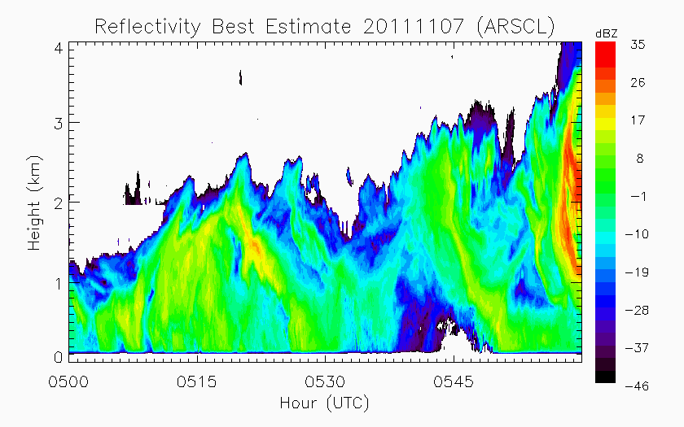
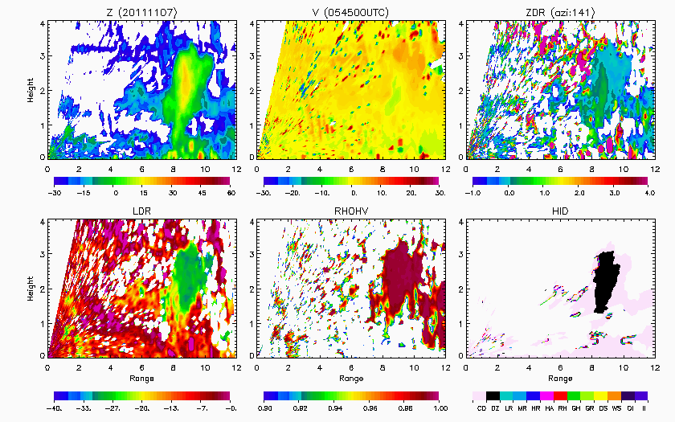
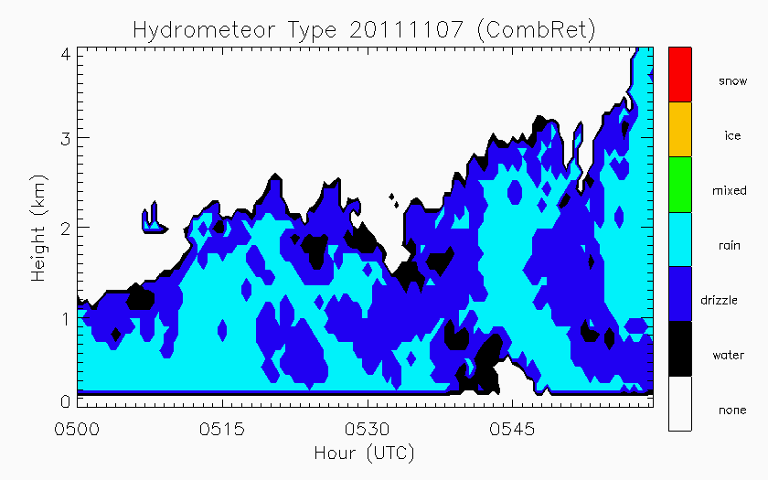
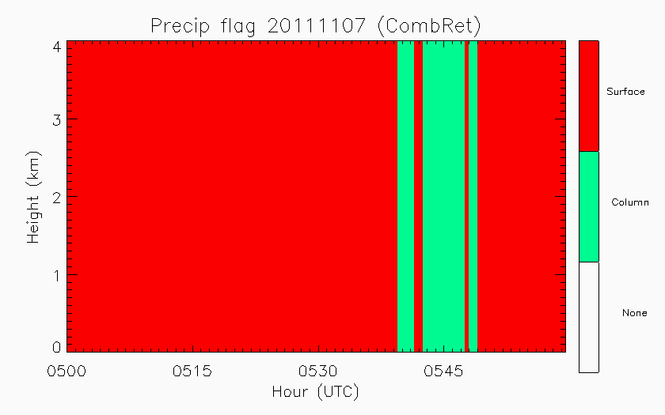
Development of precipitation
Drizzle/rain
Drizzle

Slide 9
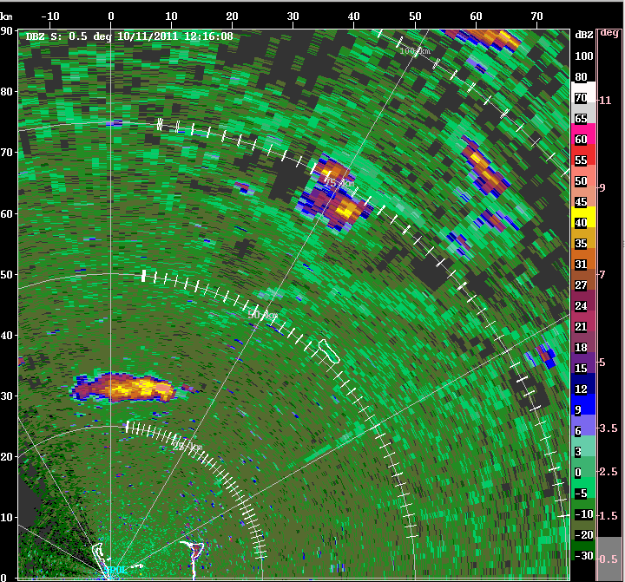
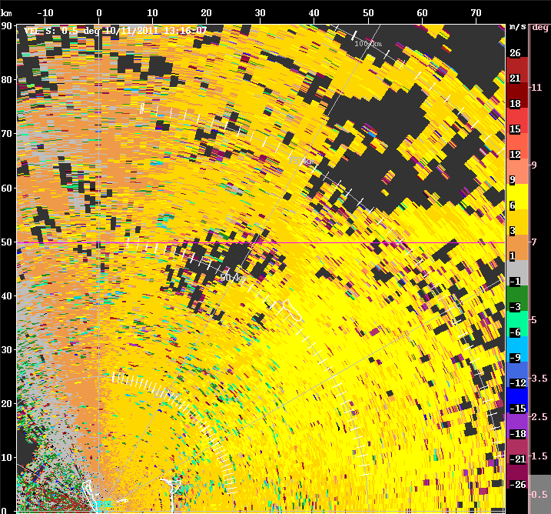
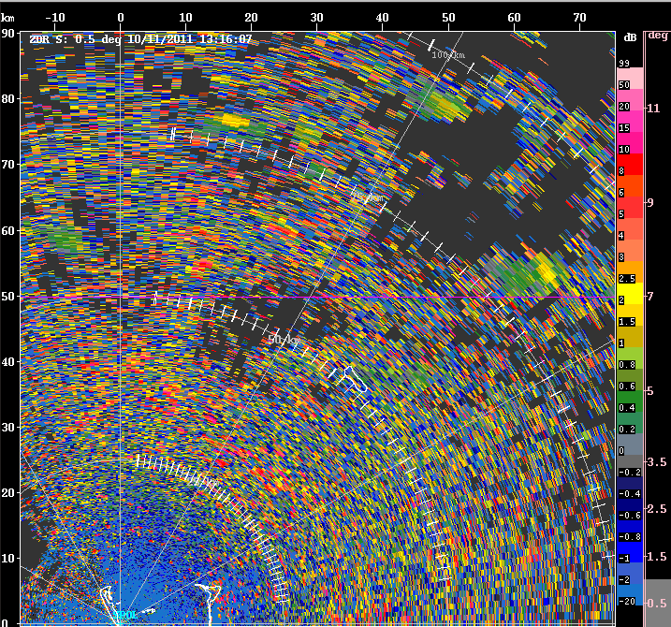
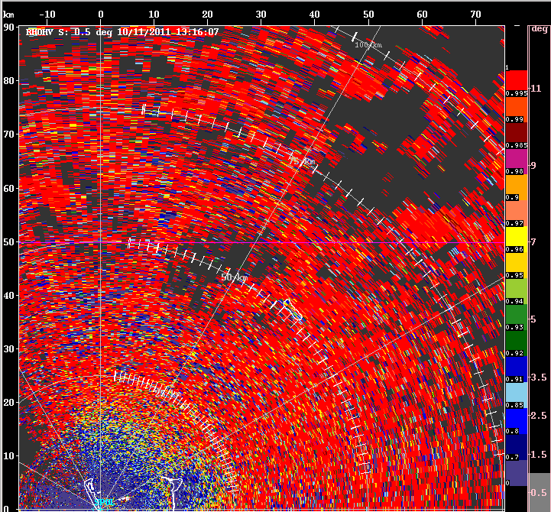

Cold Pools
V
Z_{DR}
ρ_{HV}

Slide 10
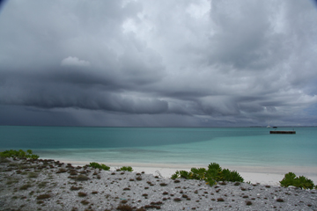
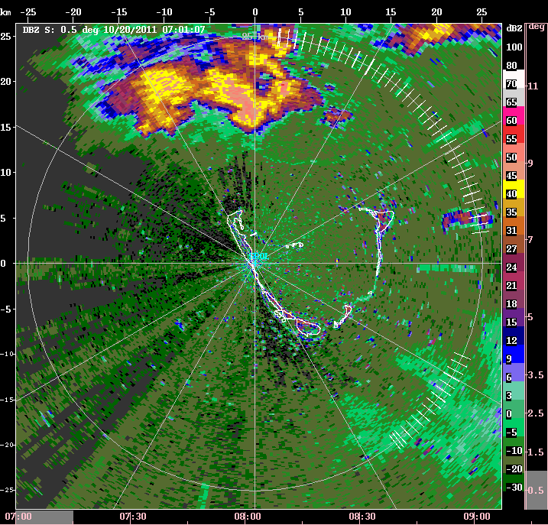
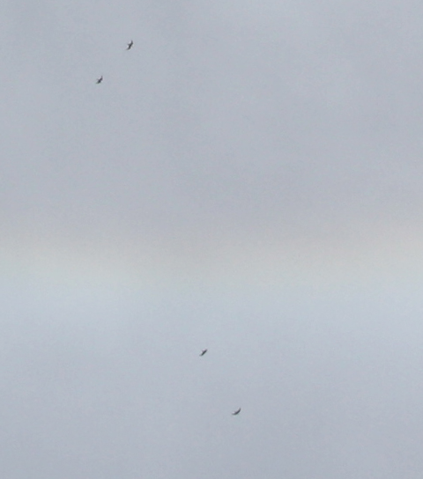
20 Oct 07-09 UTC
Gust front (0741 UTC)
Photos: Bob Houze

Slide 11
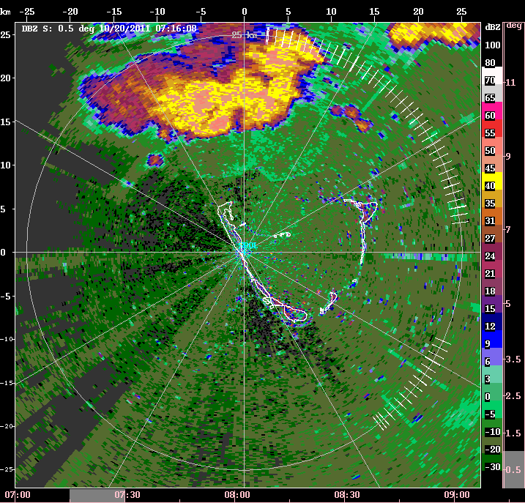
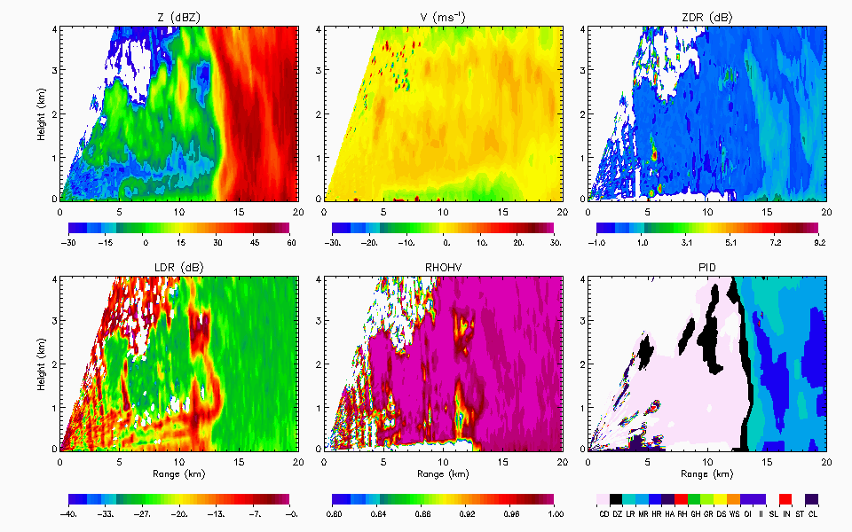
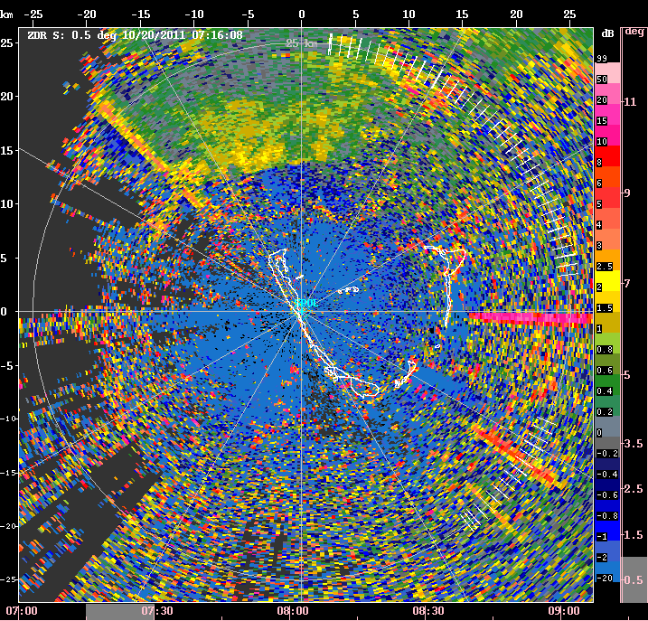
20 Oct 07-09 UTC
7+ dB

Slide 12
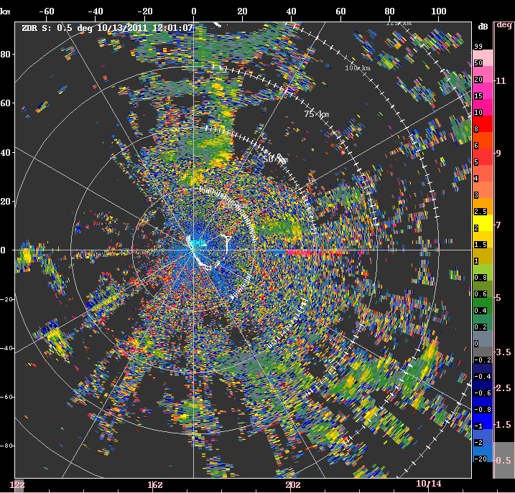
Diurnal signatures
Increase in Z_{DR} after sunset (Radar bloom)
Up to 15 dB in outflow boundaries
Active periods
Common at night, some examples during day (Dec)
Z_{DR} higher for insects (e.g., Zrnić and Ryzhkov 1998)
8-9 dB for grasshoppers along gust fronts (Achtemeier 1991)
> 10 dB (e.g., Riley 1985; Vaughn 1985; Zrnić and Ryzhkov 1998)
Nocturnally migrating birds can have high Z_{DR} values (> 6 dB) and typically larger differential phase (Zrnić and Ryzhkov 1998)

Slide 13
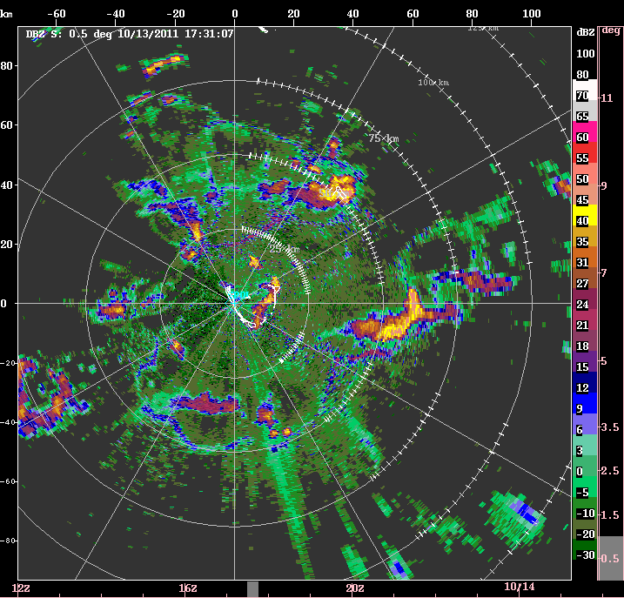
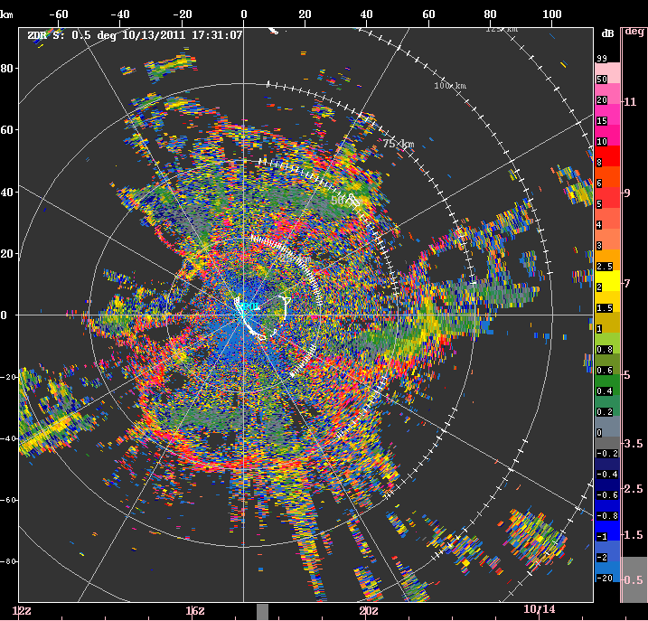
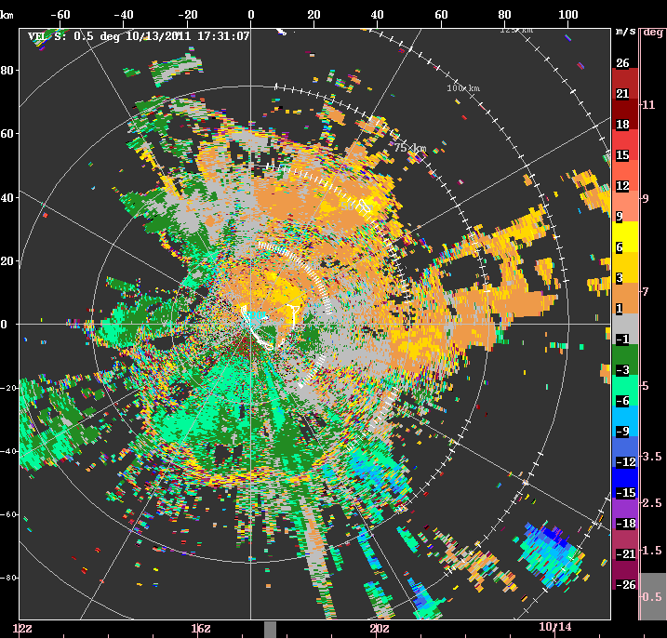
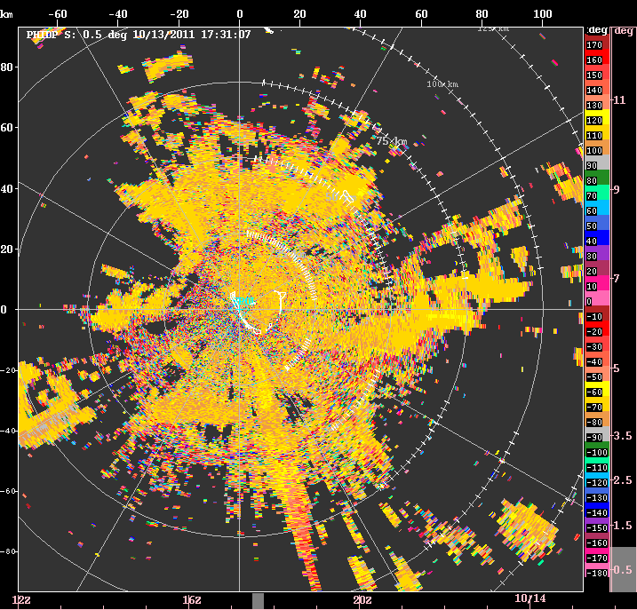
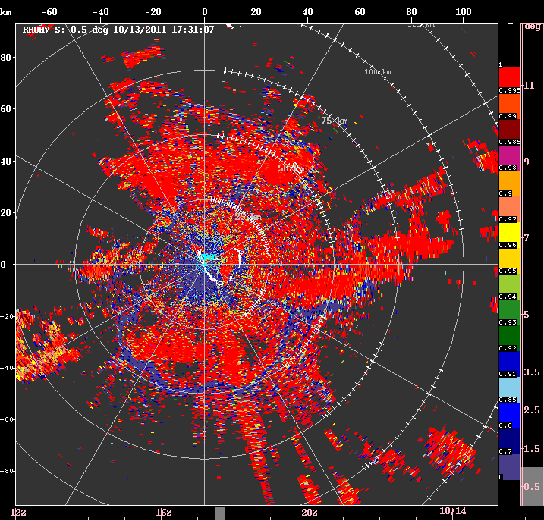
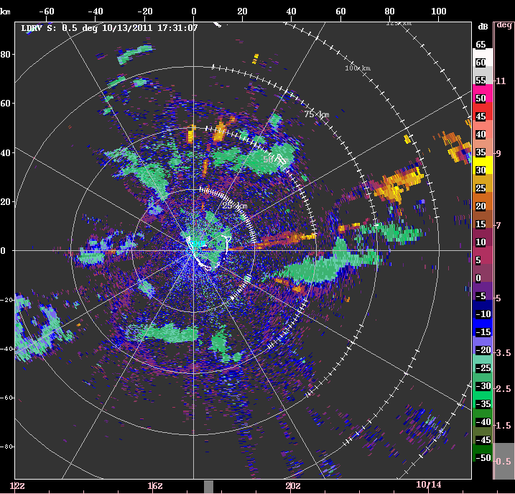
Z
Z_{DR}
V
PHIDP
ρ_{HV}
L_{DR}

Slide 14
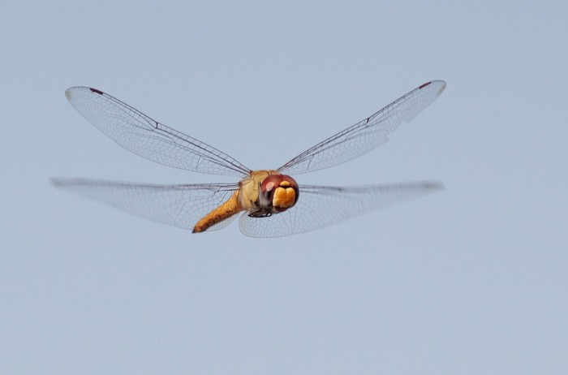
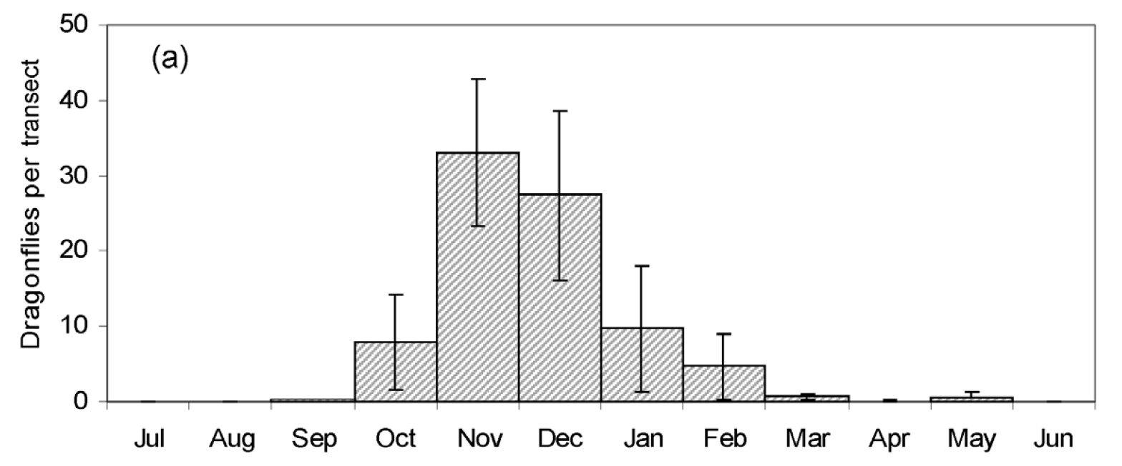
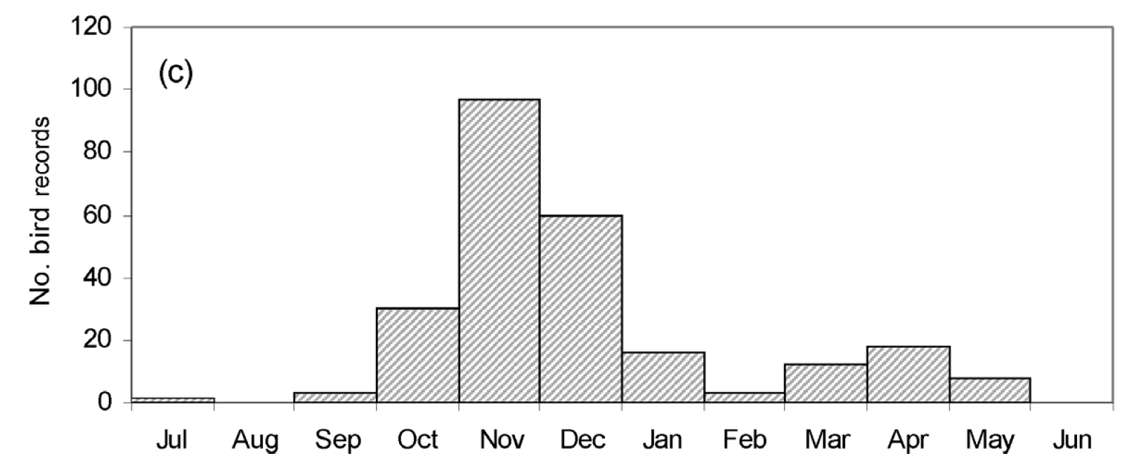
Dragonflies
Arrival of thousands in Malé in October
No fresh water breeding habitat
18,000 km migration from India to Africa (Anderson 2009)
Arrive in waves, each staying for a few days
Arrivals typically occurs following passage of storms
Pantala Flavescens
Nocturnally migrating dragonflies generally fly at altitudes of up to 1,000 m above sea level, and can migrate 150–400 km in a single flight (Feng et al. 2006; China)
4.5 cm long, 8 cm wide
Z_{DR} > 7 dB for dragonflies along boundary over Lake Michigan (van den Broeke and van den Broeke 2015)
“Wandering Glider”
(Photo: Alex Lamoreaux)
Dragonflies
(Anderson 2009)
Birds

Slide 15
Summary
Radar network during DYNAMO/AMIE provided details on full spectrum of convection
S-Pol sensitivity
Nonprecipitating shallow clouds
Cold pools/outflow boundaries
Biological scatterers
Nocturnal Z_{DR} to 15 dB
Dragonflies(?)
Remaining questions:
Periodicity in “dragonfly” signature?
What is seen in January?

Slide 16
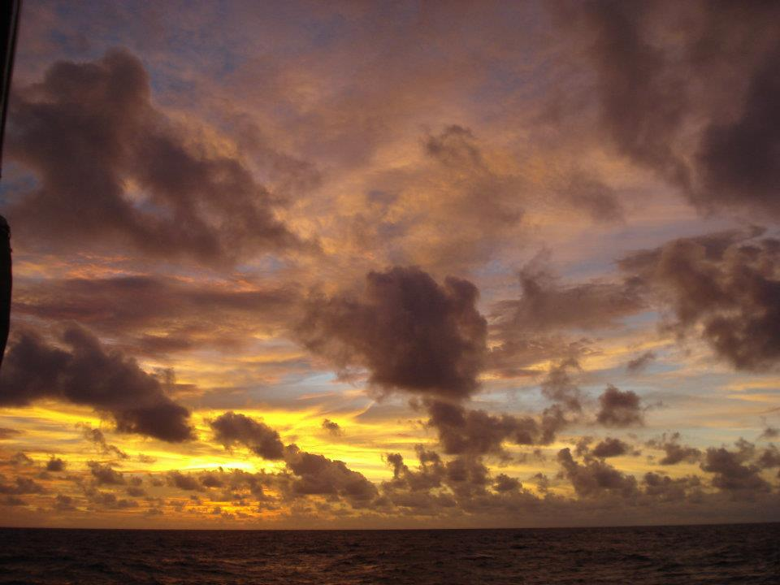
Thank you!
Research supported by NSF grants AGS-1355567/AGS-1059611 and DOE grant DE-SC0008452

