Slide 1
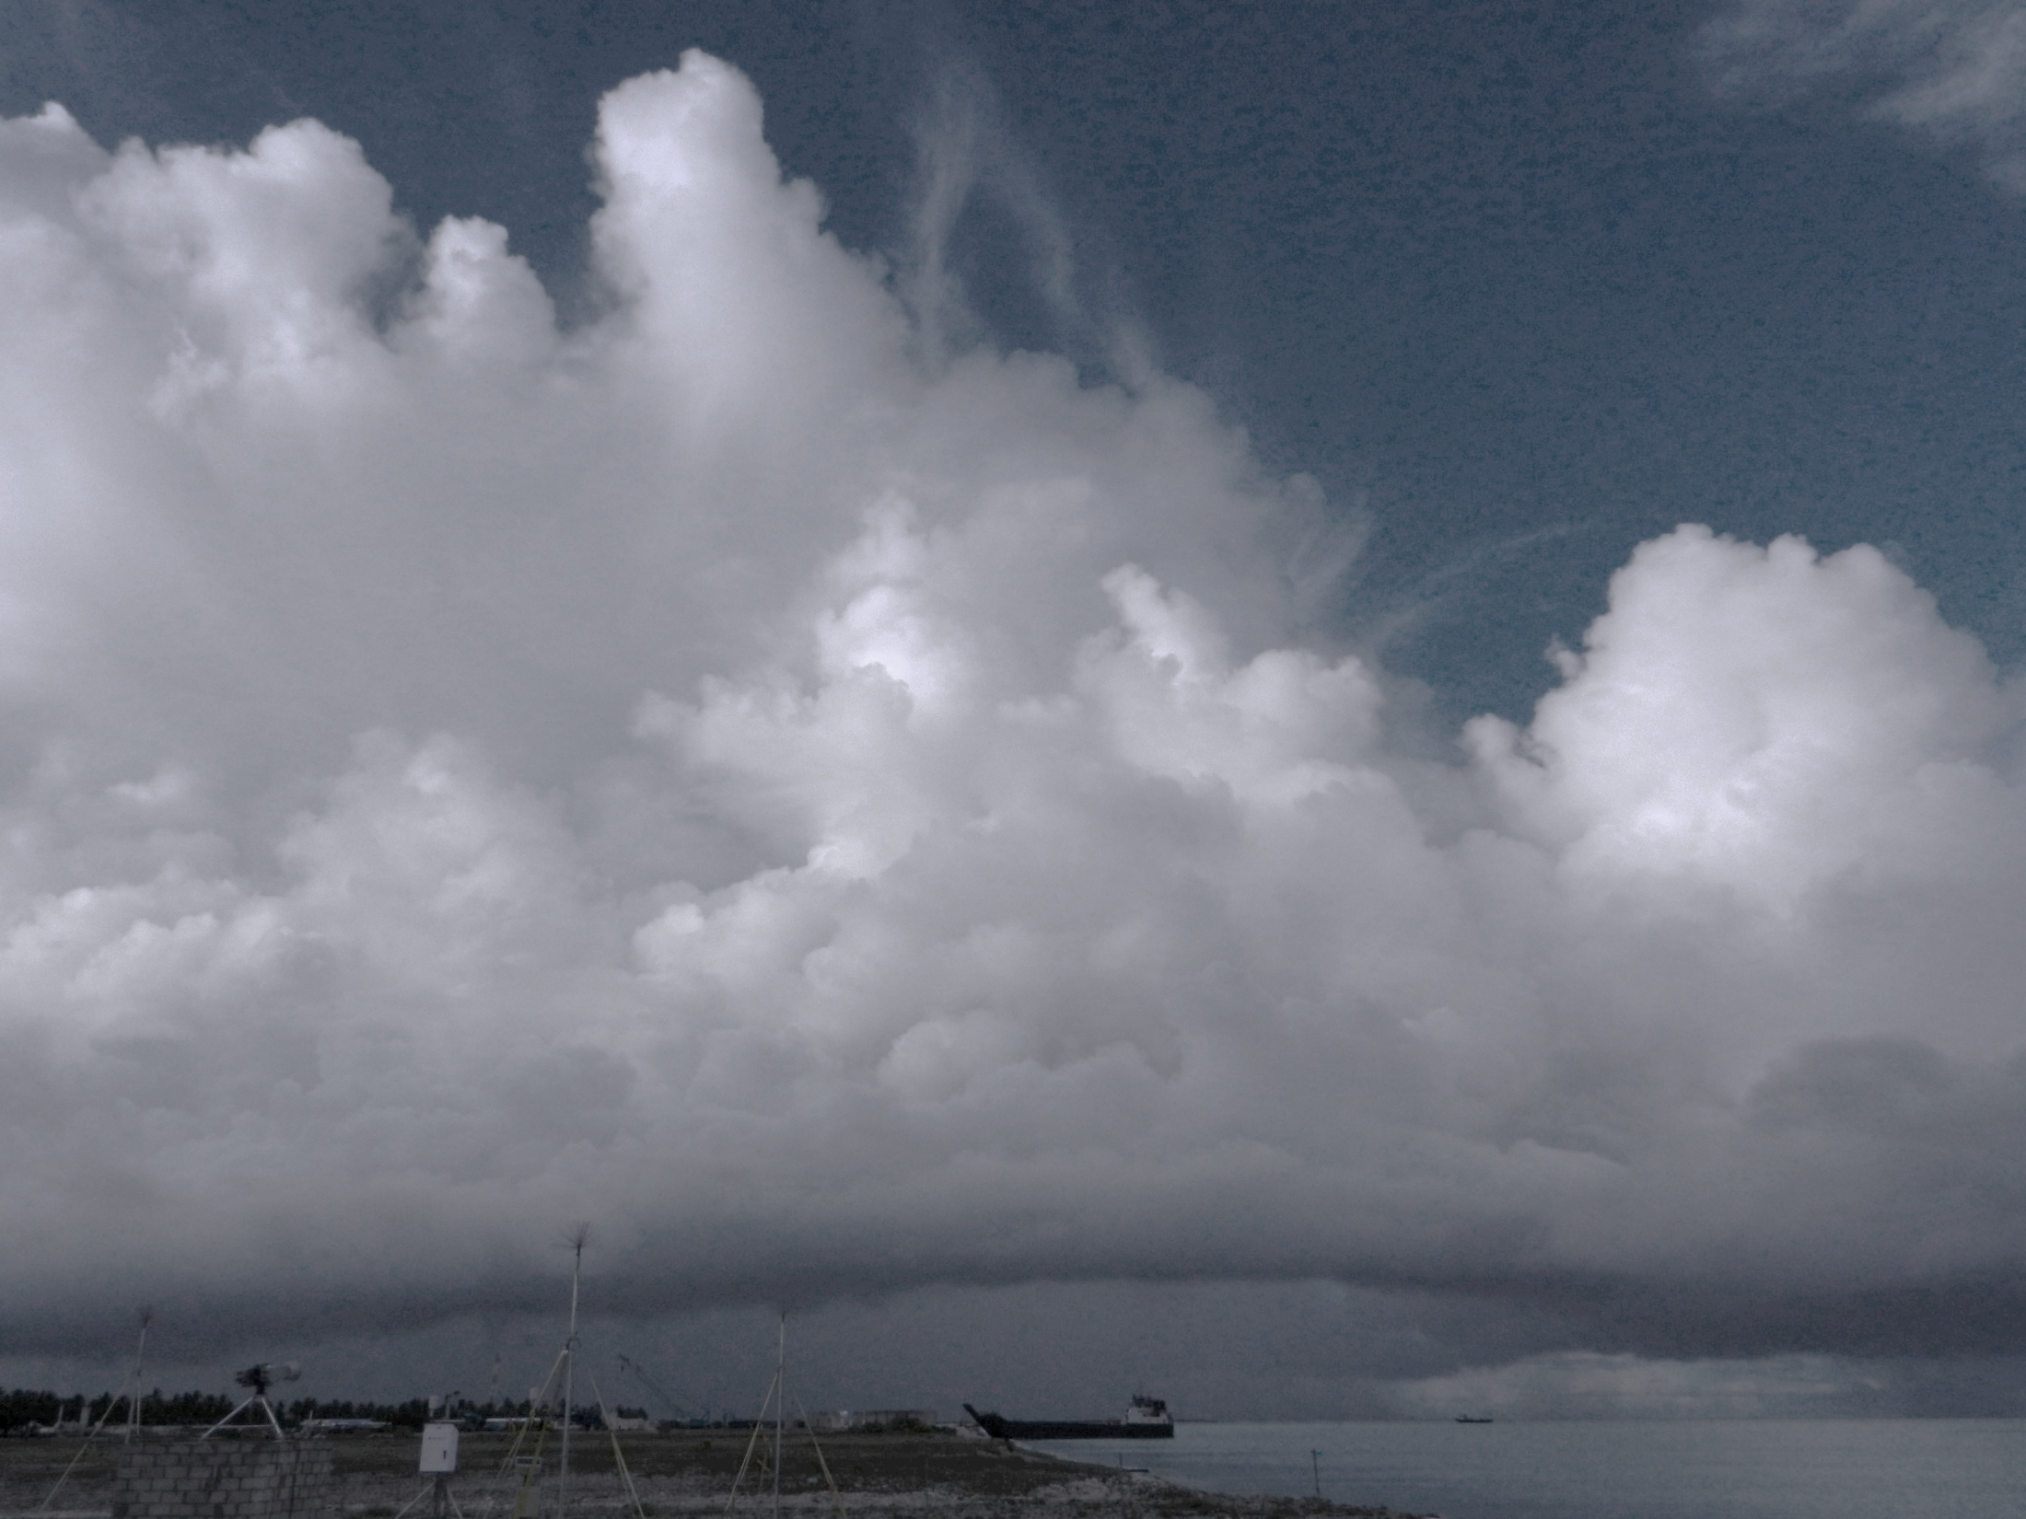
Validation of the Simulated Microphysical Structure within the Midlevel Inflow Region of a Tropical, Oceanic Squall Line
Funded by NSF Grant AGS-1355 and DOE Grant DE-SC0008452
Hannah C. Barnes, Robert A. Houze Jr.
University of Washington
37th Conference on Radar Meteorology
14th September 2015
Embassy Suites Hotel and Conference Center, Norman, OK

Slide 2
Microphysical Structure of Squall Lines
Observation and validation difficult
Observation / Validation Method | Aircraft Observations | Particle ID (PID) from dual-polarimetric radar | Numerical Simulations
Advantages | In situ | Large spatial coverage Increased temporal coverage | Complete spatial coverage Complete temporal coverage All processes
Disadvantages | Spatially limited Temporally limited | Difficult to validate Theory & observation based Limited by radar quality Dominant only | Difficult to validate Theory based Parameterizations Different schemes
Objective: Is microphysical structure from PID and WRF consistent with each other and dynamics?

Slide 3
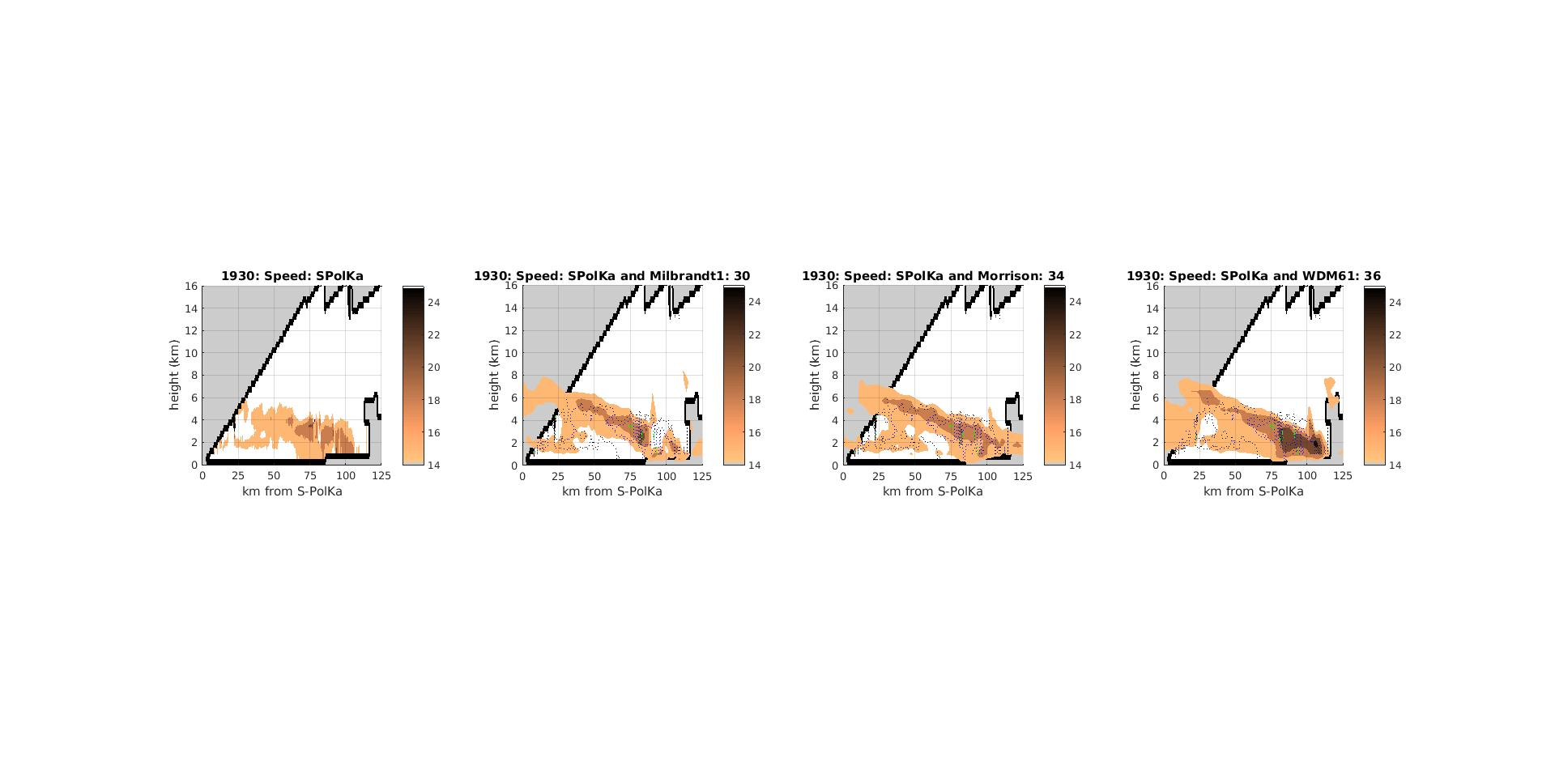
Microphysical Structure Intercomparison
Microphysical structure linked to dynamical structure
Intercomparison framed around midlevel inflow
PID Analysis (Barnes and Houze, 2014)
Midlevel inflow from radial velocity
Composite around midlevel inflow
Numerical Simulations
Assimilate radial velocity
Composite around “forced” midlevel inflow
Radial Velocity
Horizontal Wind Speed
S-PolKa
Milbrandt - Yau
Morrison
WDM6
Height (km)
Distance from S-PolKa (km)
Notes:
MLI in model due to assimilation

Slide 4
Midlevel Inflow Spatial Composites
PID Microphysical Analysis
4
Small Ice Crystals
=
Deposition
3
0.5
2
0.4
1
0.3
0
0.2
NCAR S-PolKa during DYNAMO / AMIE (Vivekanandan 1999)
Nov 2011 – Jan 2012
Central Indian Ocean
9 hydrometeor types
Uses dual-polarimetric and sounding data
Thresholds based on previous studies, theory, field experience
Dominant type only
Frozen hydrometeors represent microphysical processes
Spatially composited around midlevel inflow
Layered structure
-1
0.1
-2
0
0.25
0.5
0.75
1
4
Dry Aggregates
=
Aggregation
3
0.9
2
0.7
1
0.5
0
0.3
-1
0.1
-2
0
0.25
0.5
0.75
1
Normalized Height
4
Graupel / Rimed Aggregates
=
Riming
3
0.2
2
0.16
1
0.12
0
0.08
-1
0.04
-2
0
0.25
0.5
0.75
1
4
Wet Aggregates
=
Melting
3
0.8
2
0.6
1
0.4
0
0.2
-1
-2
0
0.25
0.5
0.75
1
Barnes and Houze, 2014
Normalized Range

Slide 5
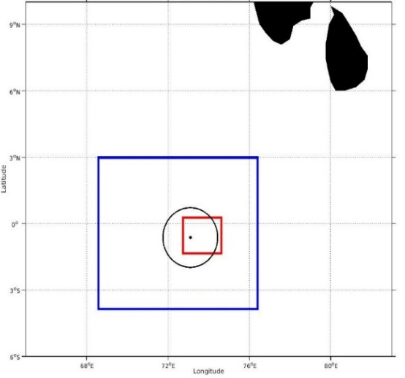
Penn State University EnKF / WRF
WRF Data Assimilation
Simulation Time | 23 Dec 2011 1200 - 2000 UTC
Assimilation Time | Every 15 mins starting at 1800 UTC
Initialization | ERA-Interim
Vertical Levels | 39, Top at 26 km
Domains | 3 km, 1 km
Members | 50
Assimilate | S-PolKa radial velocity
Planetary Boundary Layer Parameterization | Bretherton and Park (UW)
Longwave Radiation Parameterization | RRTM
Shortwave Radiation Parameterization | Dudhia
Surface Layer Parameterization | Monin-Obikhov
Microphysics Parameterization | Milbrandt – Yau Morrison WDM6
9
S-PolKa and WRF Domains
6
Domain 1 (3 km)
3
Longitude
S-PolKa
0
Domain 2 (1 km)
-3
-6
Latitude
68
72
76
80
Group production terms by process
All processes
Provides rate (kg kg⁻¹ s⁻¹)
Composite members containing midlevel inflow

Slide 6
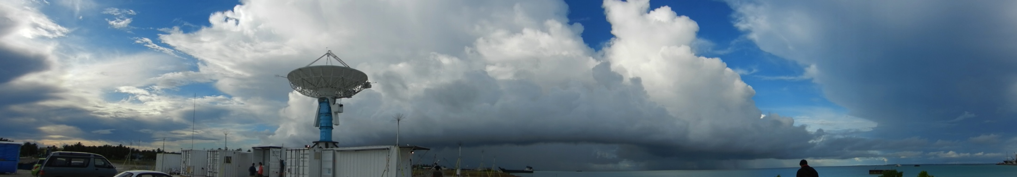
Squall Line
1930 UTC, 23 December 2011

Slide 7
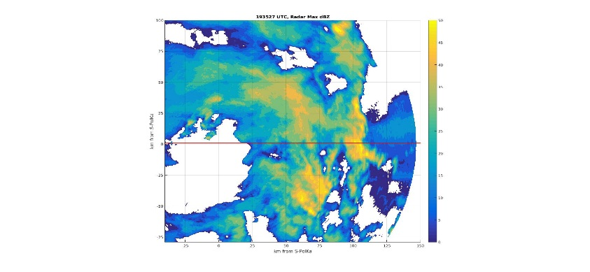
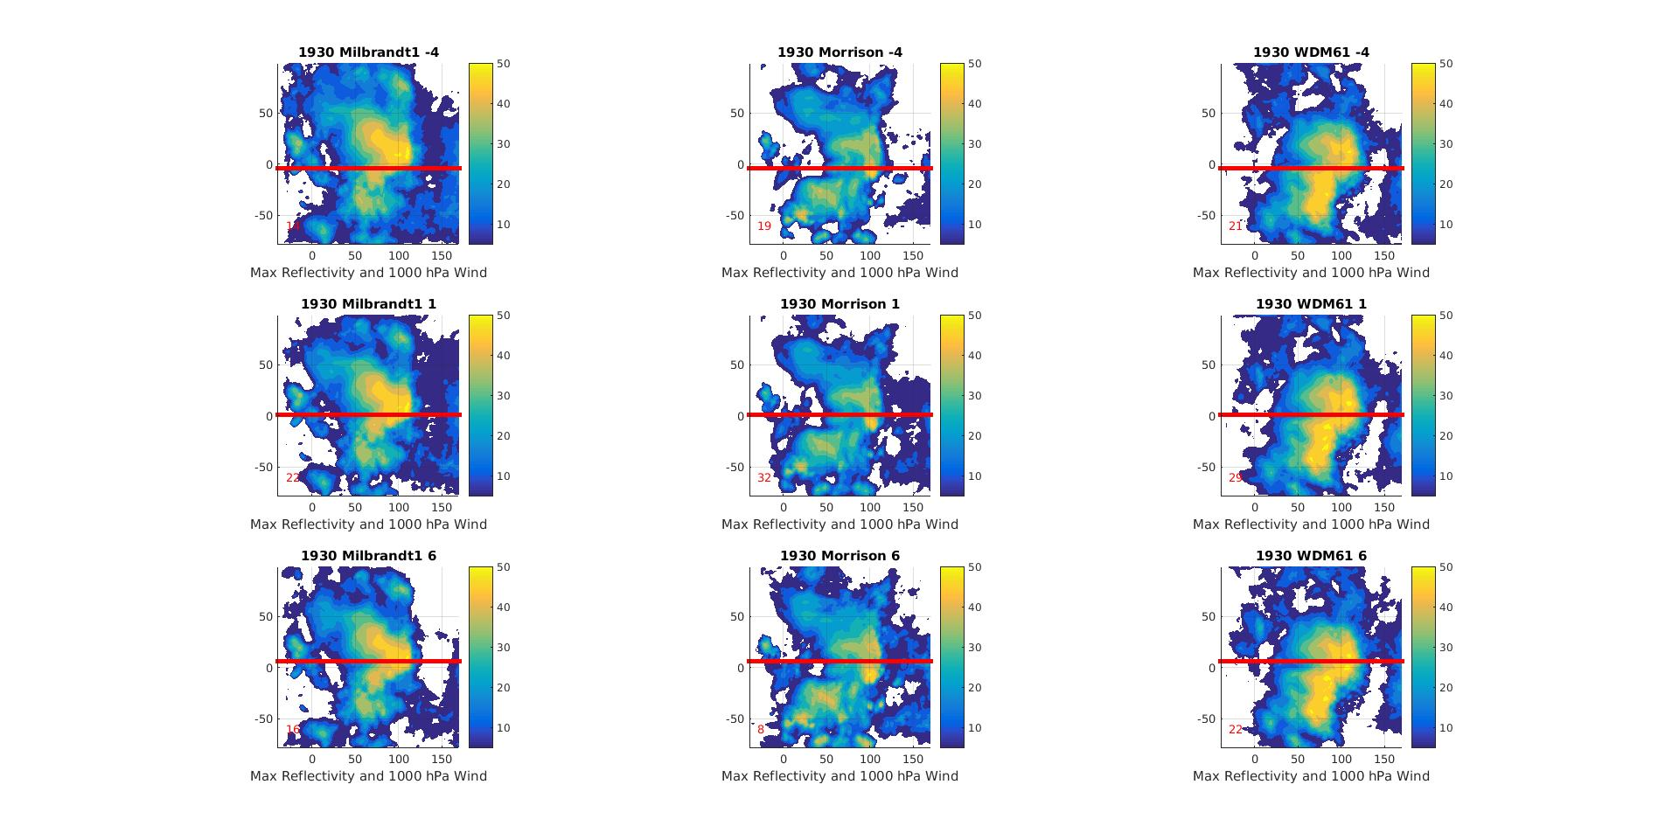
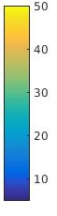
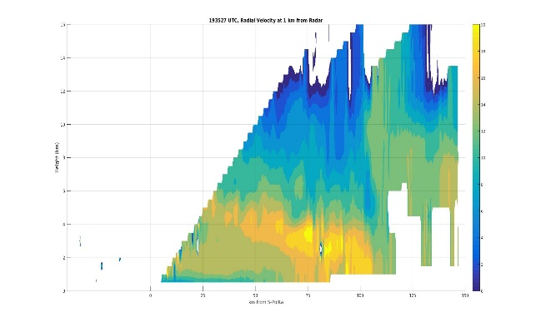
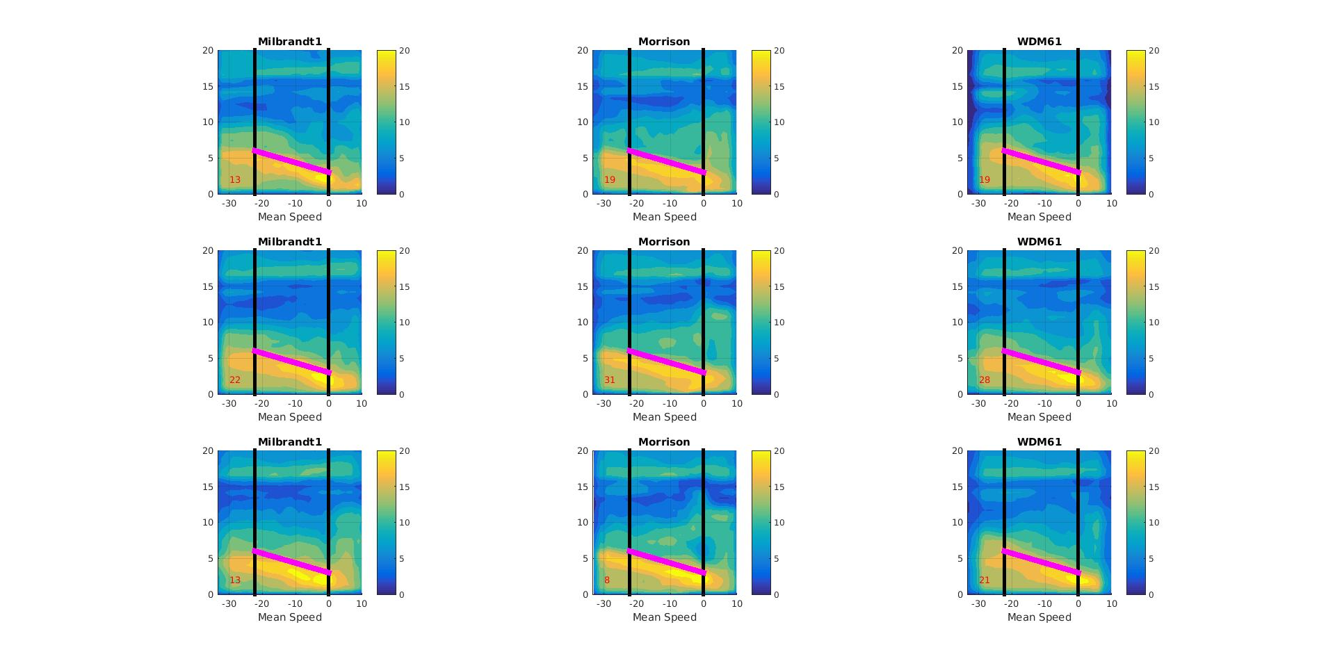
Squall Line Structure
S-PolKa
Milbrandt - Yau
Morrison
WDM6
PPI Maximum Reflectivity
100
75
50
25
Distance from S-PolKa (km)
Distance from S-PolKa
0
-25
-50
-75
-25
0
25
50
75
100
125
150
Distance from S-PolKa (km)
Distance from S-PolKa (km)
RHI Wind Speed (along red line above)
16
14
12
10
8
Height (km)
Height (km)
6
4
2
0
0
25
50
75
100
125
150
Distance from S-PolKa (km)
Normalized Zonal Distance

Slide 8
Microphysical Intercomparison
Only compare location

Slide 9
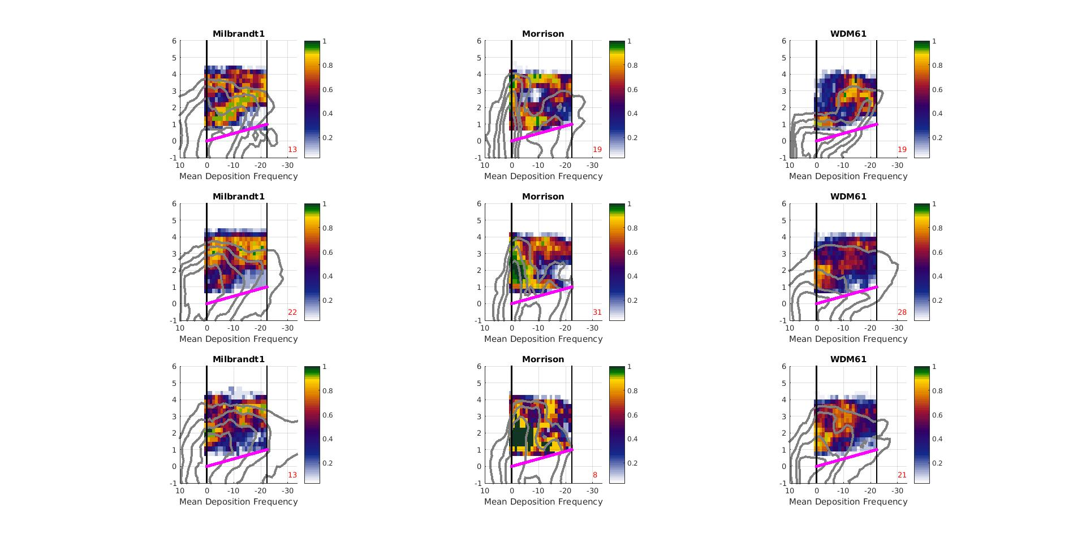
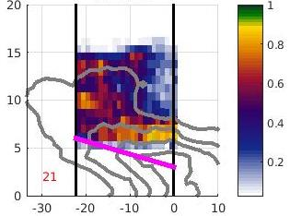
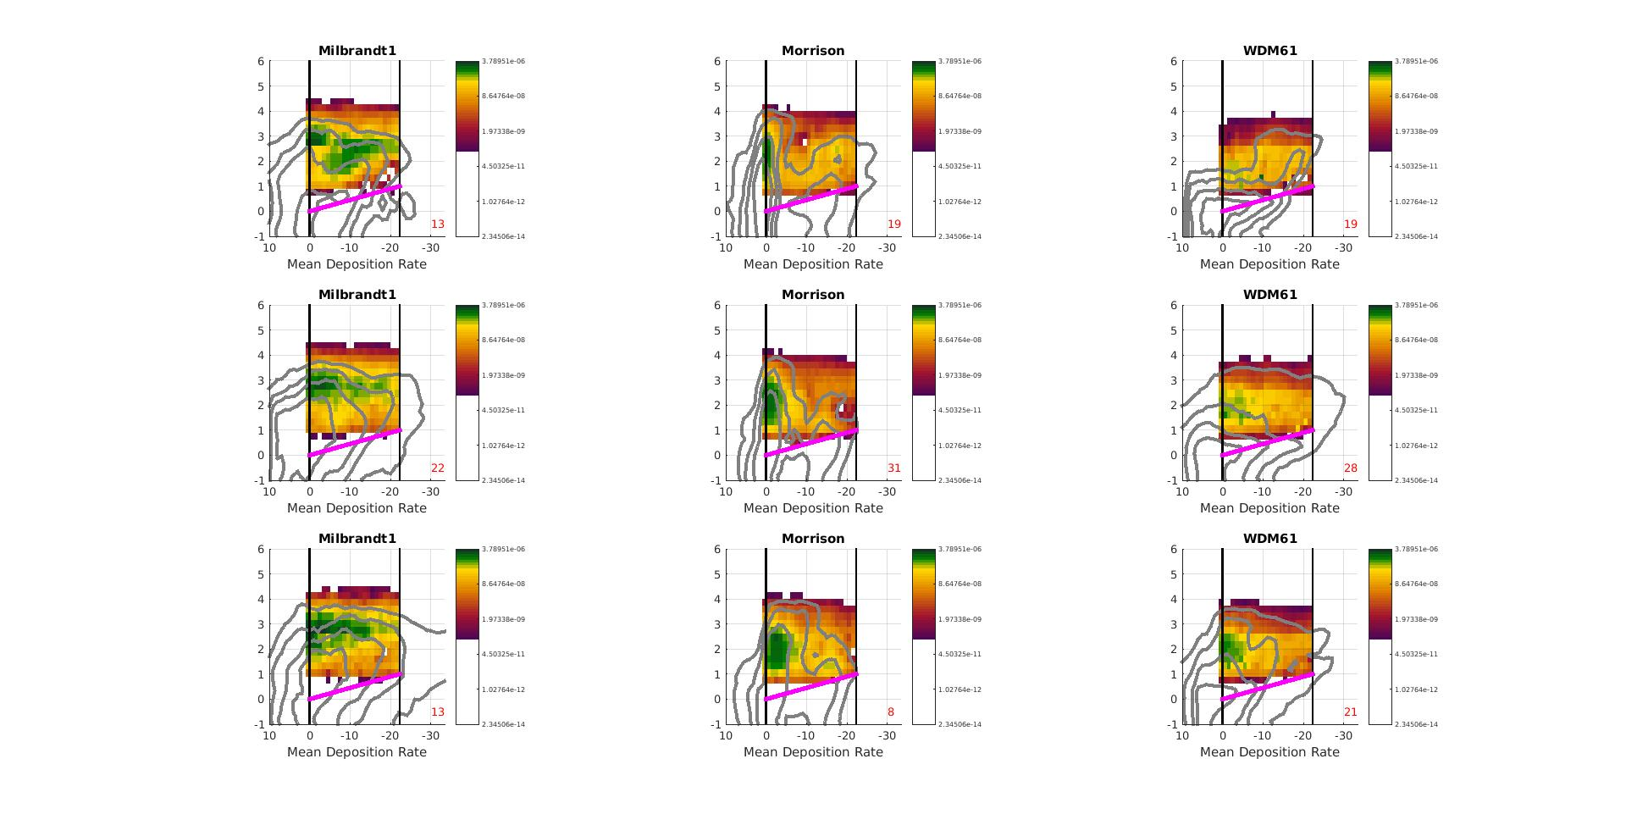
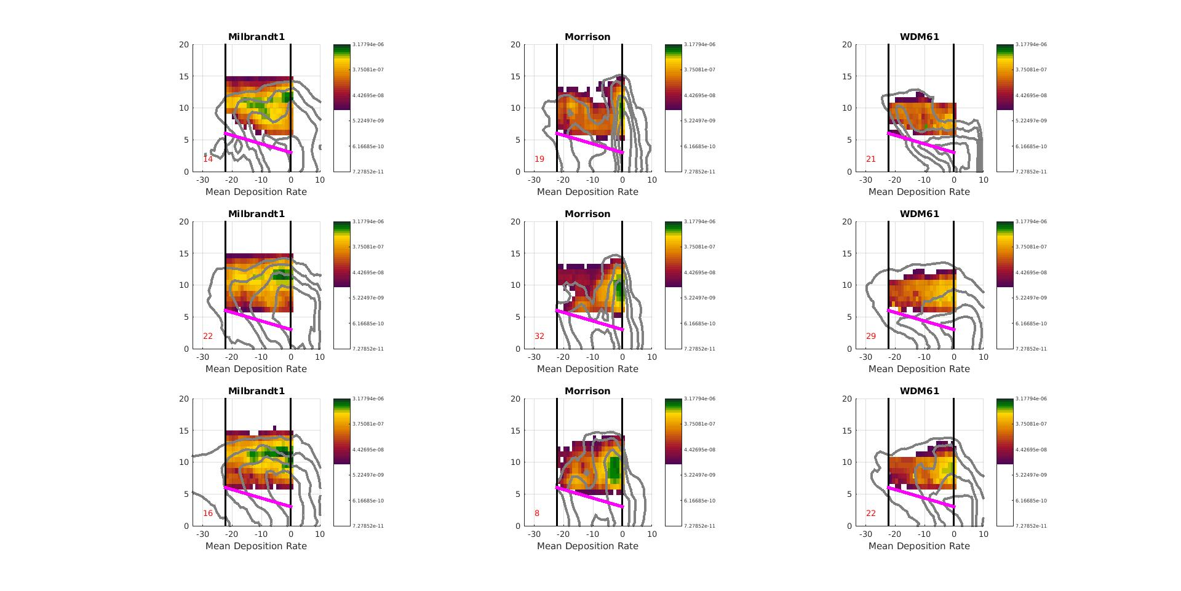
Deposition
S-PolKa PID
Milbrandt - Yau
Morrison
WDM6
Occurrence Frequency
Small Ice Crystals = Deposition
4
3
0.5
-20°C
0.4
-20°C
2
Adjusted Height
Normalized Height
0.3
1
0°C
0
0.2
0°C
-1
0.1
-2
0
0.25
0.5
0.75
1
Normalized Range
Mean Production Rate (kg kg⁻¹ s⁻¹)
3.1e-6
3.7e-7
-20°C
4.4e-8
Adjusted Height
5.2e-9
0°C
Normalized Zonal Distance
Notes:
Production Rate = How much added to hydrometeor by this process per second (how many kg added by process to 1 kg of hydrometeor per second)

Slide 10
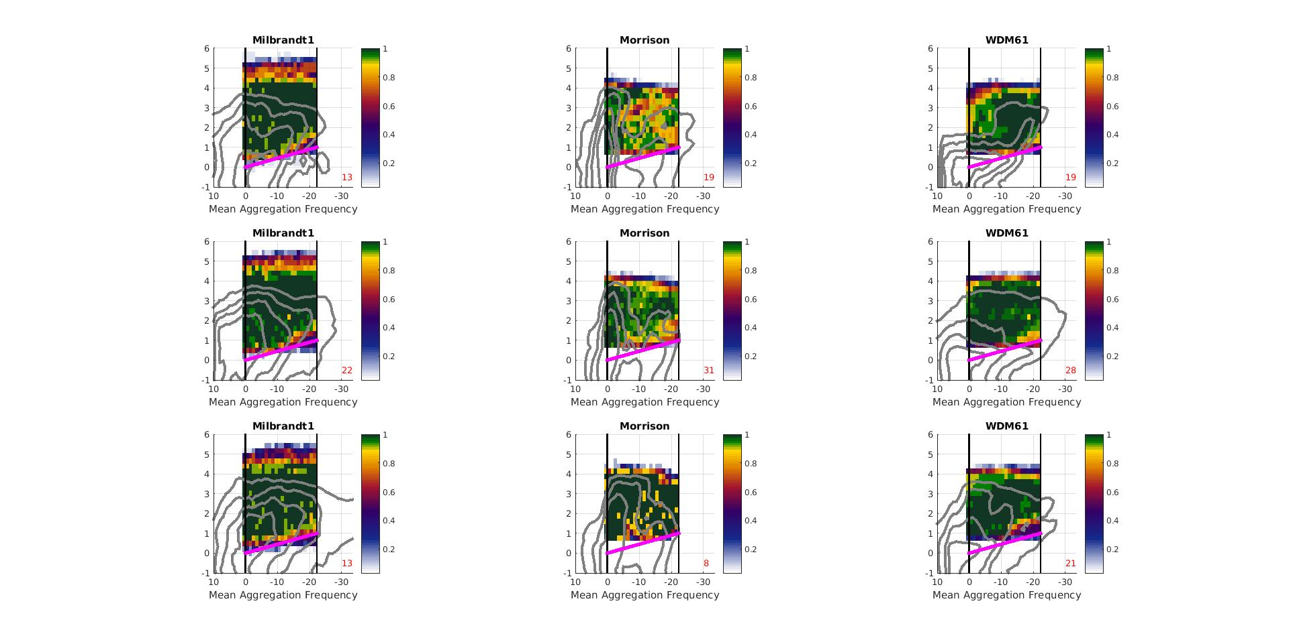
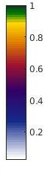
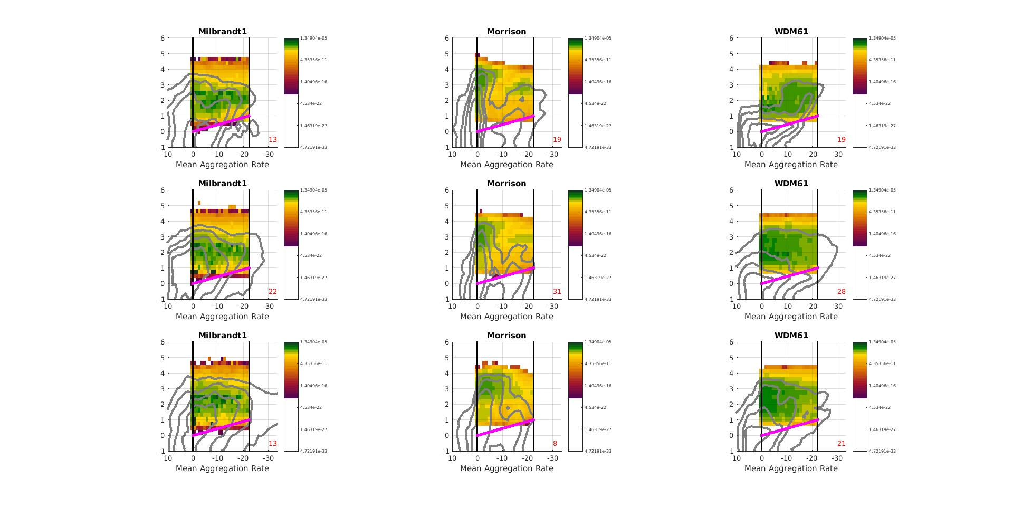
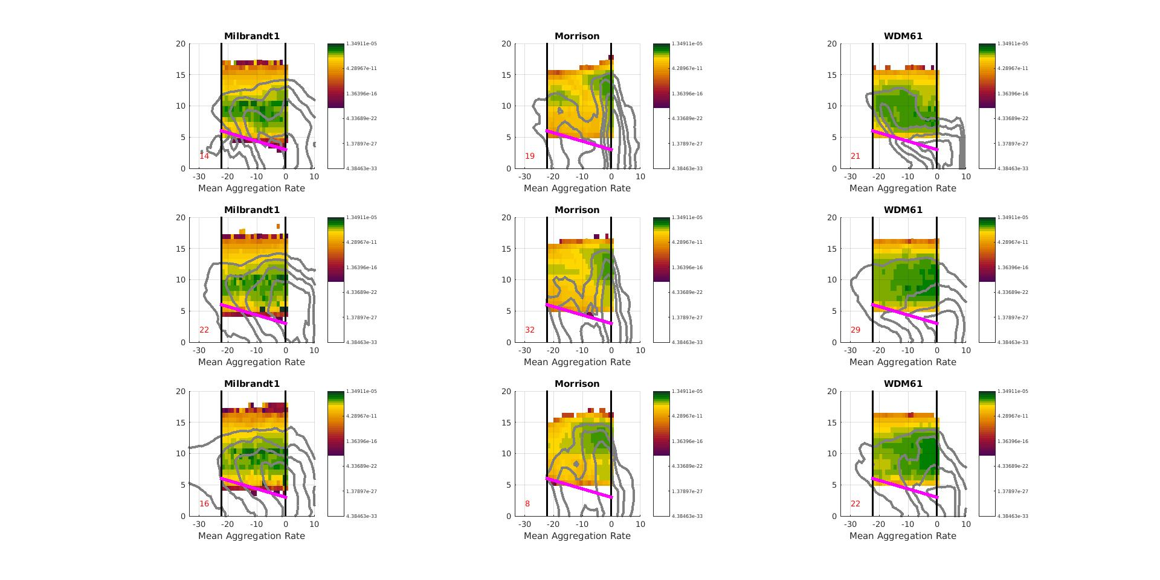
Aggregation
Frozen Collecting Frozen
S-PolKa PID
Milbrandt - Yau
Morrison
WDM6
Occurrence Frequency
Dry Aggregates = Aggregation
4
3
0.9
-20°C
Adjusted Height
-20°C
2
0.7
Normalized Height
1
0°C
0.5
0
0.3
0°C
-1
0.1
-2
0
0.25
0.5
0.75
1
Normalized Range
Mean Production Rate (kg kg⁻¹ s⁻¹)
1.3e-5
4.2e-11
-20°C
1.3e-16
Adjusted Height
4.3e-22
0°C
Normalized Zonal Distance
Notes:
PID likely missing small aggregates higher up. Only get large locations. Small aggregation above not detected. As grow and fall more then see. So likely consistent.

Slide 11
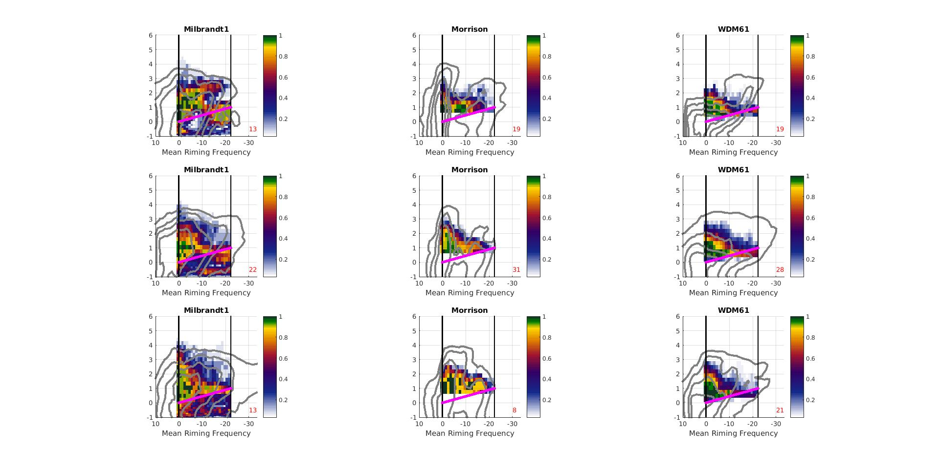
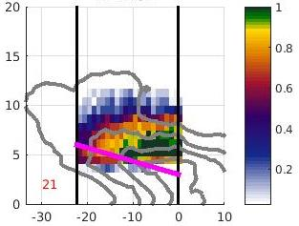
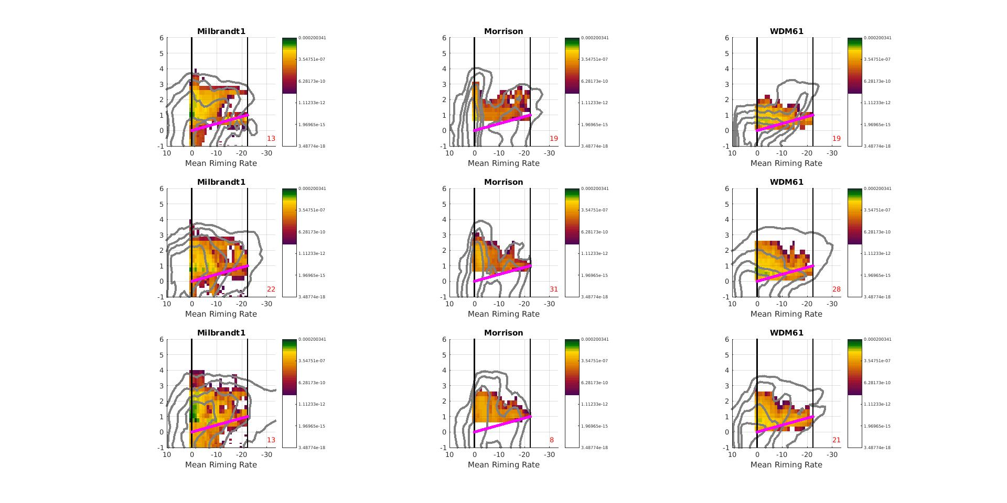
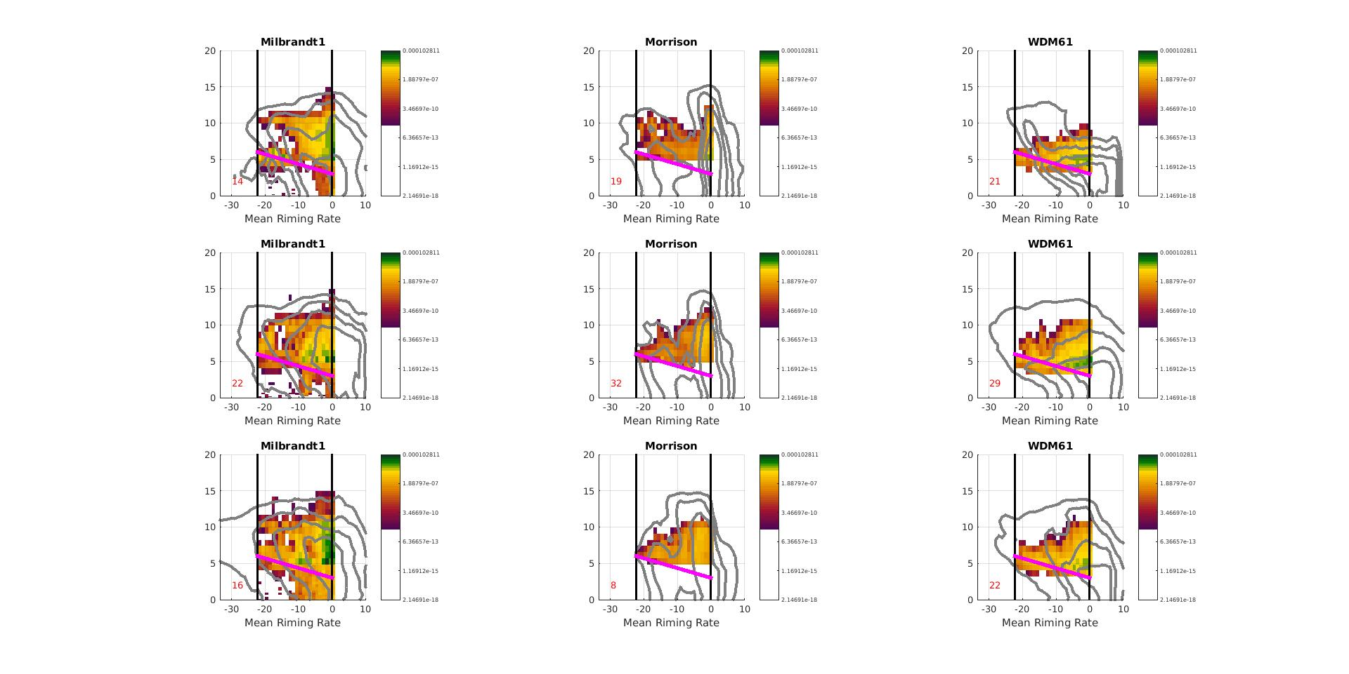
Riming
Frozen Collecting Liquid
S-PolKa PID
Milbrandt - Yau
Morrison
WDM6
Occurrence Frequency
Graupel/Rimed Aggregates = Riming
4
3
-20°C
0.2
-20°C
2
Adjusted Height
0.16
1
0°C
Normalized Height
0.12
0°C
0
0.08
-1
0.04
-2
0
0.25
0.5
0.75
1
Normalized Range
Mean Production Rate (kg kg⁻¹ s⁻¹)
1e-4
1.8e-7
-20°C
Adjusted Height
3.4e-10
0°C
6.3e-13
Normalized Zonal Distance

Slide 12
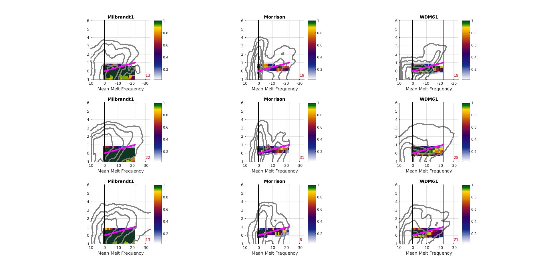
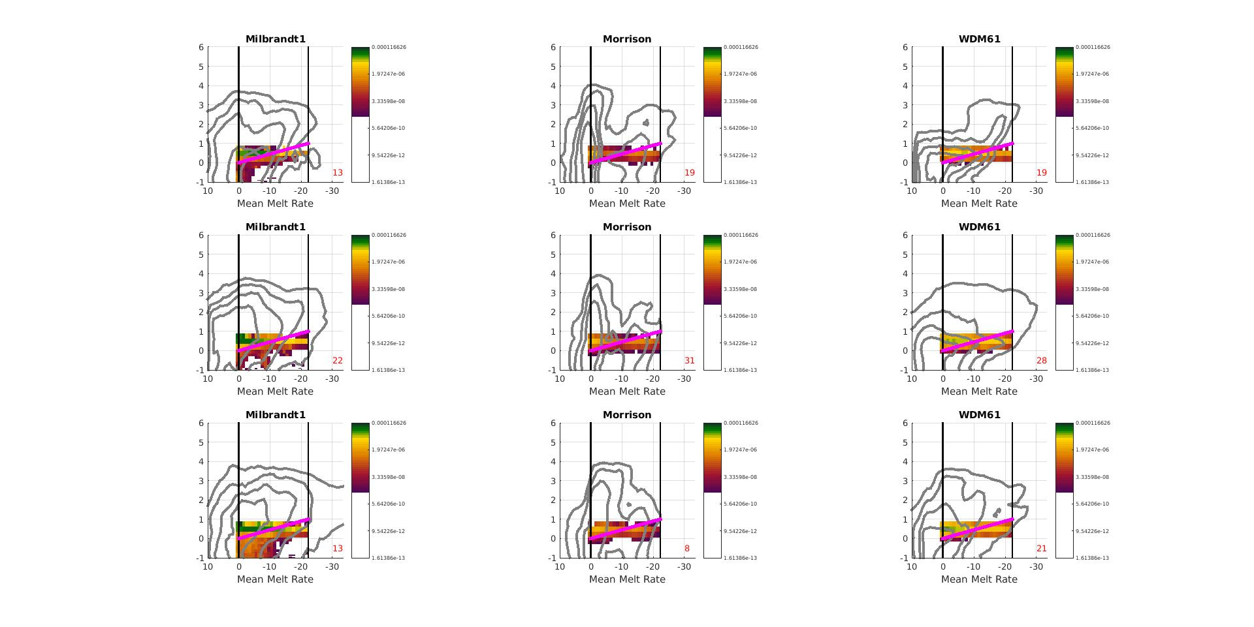
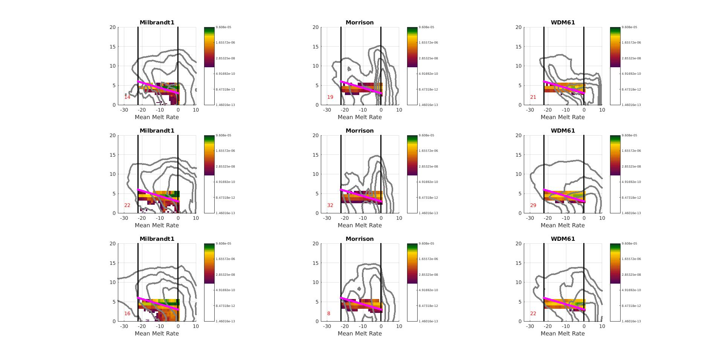
Melting
S-PolKa PID
Milbrandt - Yau
Morrison
WDM6
Occurrence Frequency
Wet Aggregates = Melting
4
3
0.8
-20°C
Adjusted Height
-20°C
2
0.6
Normalized Height
1
0°C
0.4
0
0.2
0°C
--1
-2
0
0.25
0.5
0.75
1
Normalized Range
Mean Production Rate (kg kg⁻¹ s⁻¹)
9.6e-5
1.6e-6
-20°C
2.8e-8
Adjusted Height
4.9e-10
0°C
Normalized Zonal Distance

Slide 13
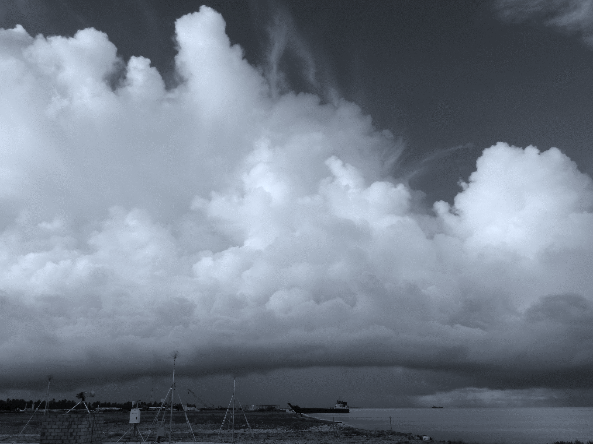
Conclusions
PID and WRF provide good spatial and temporal coverage of microphysical structure
Both difficult to validate
Do they provide complementary data?
Is microphysical structure consistent with dynamical structure and other method?
Framed around midlevel inflow
General structure consistent
Layered
Details differ
Aggregation and riming - WRF deeper
Melting – Consistent except Milbrandt-Yau
Deposition – WRF extends lower

Slide 14
Back Up
Slides

Slide 15
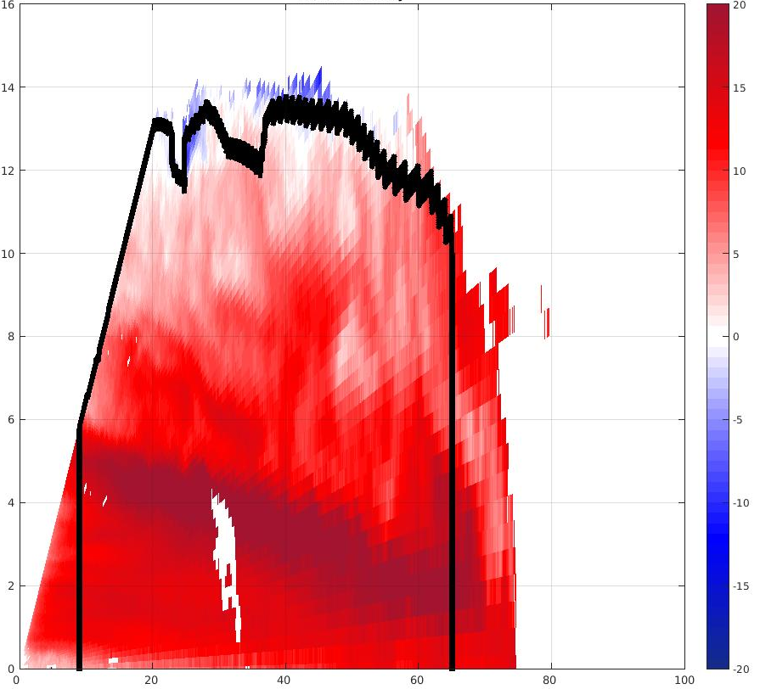
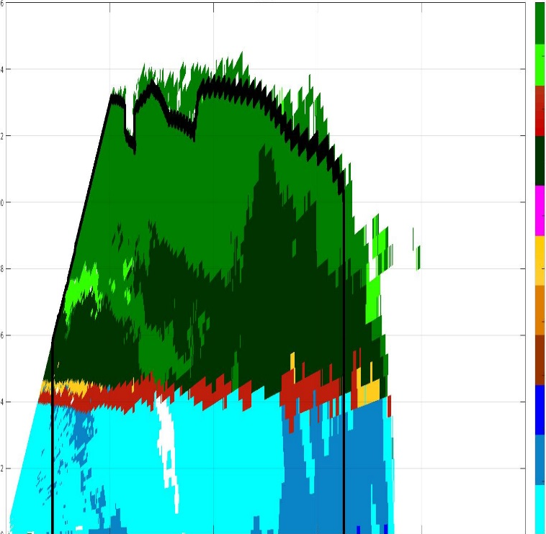
Methodology: Compositing
1.) Map kinematics and hydrometeors using radial velocity and PID
2.) Composite around layer lifting model
1900 UTC 23 Dec 2011
Generic Midlevel Inflow
Particle ID
Radial Velocity
m/s
16
20
SIC
HIC
14
15
WA
12
10
Height (km)
DA
10
G/R
5
8
G/RA
0
H
6
-5
H/R
4
HR
-10
MR
2
-15
Z Scale Factor
X Scale Factor
LR
0
40
60
80
100
-20
0
20
Distance from S-Polka (km)

Slide 16
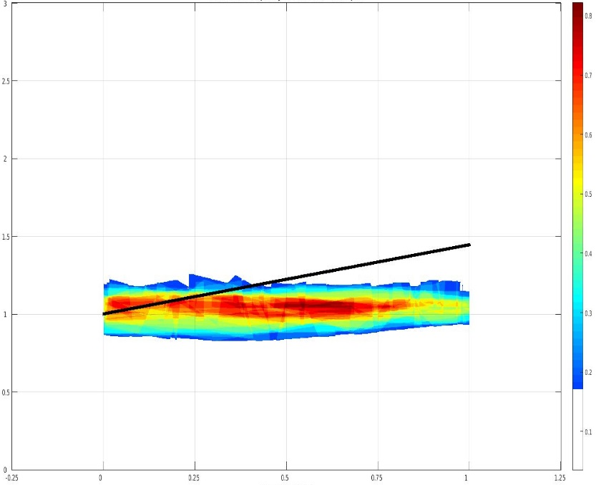
Methodology: Composite Results
Wet Aggregates
Normalized Height
2
0.8
1.5
0.7
0.6
1
0.5
0.5
0.4
0
0.3
-0.5
0.2
0.1
-1
0.25
1
-0.25
0
0.5
0.75
1.25
Normalized Range
Notes:
WET AGGREGATES ONLY FIRST
Red line is the convergent updraft.
Colors shows how often that type of hydrometeor is located at a given location. The scales in each figure or different in order to show their distribution most clearly.
Top row shows the rain categories, the middle row shows the categories with graupel (there was no hail), and the bottom line shows the snow and ice categories.
Structure is systematic
Few features to emphasize
Heavy rain just downwind of updraft
Moderate rain within updraft core
Graupel just downwind updraft in a narrow vertical column
Dry aggregates extend from the melting level to the base of the divergence signature
Non-oriented ice surround dry aggregates

Slide 17
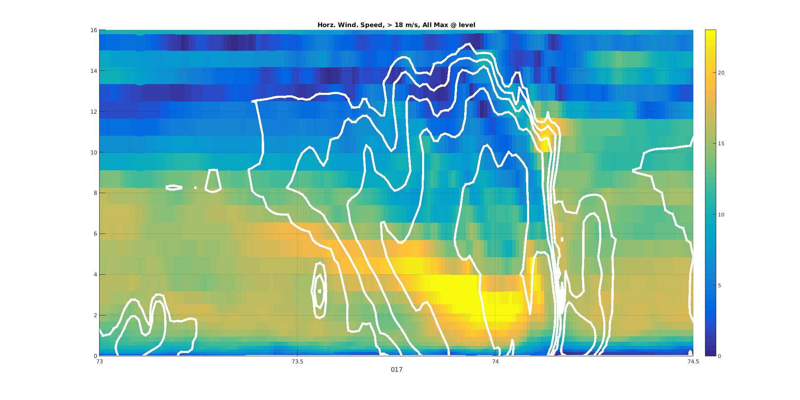
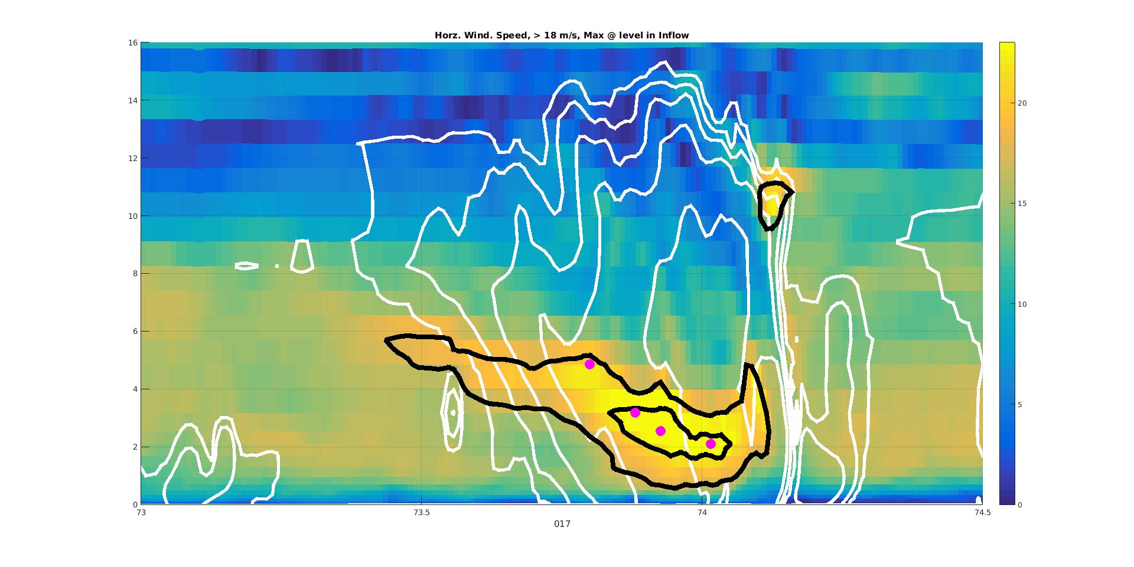
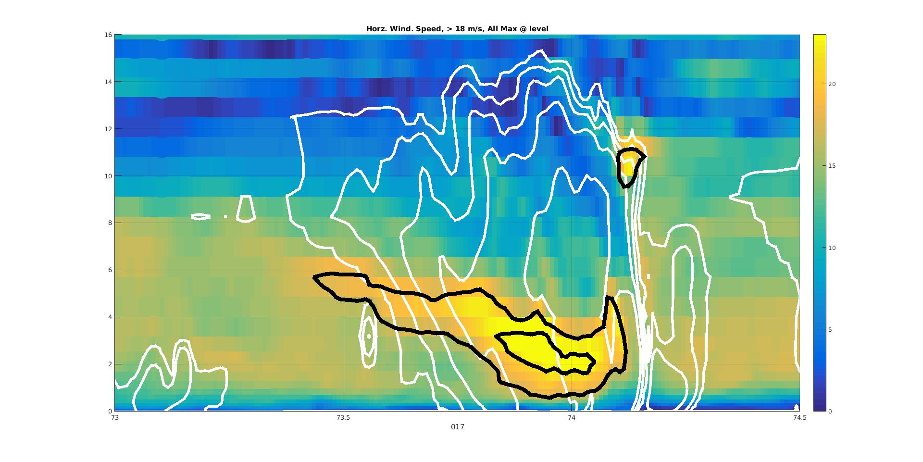

Midlevel Inflow Member Selection
16
Shading: Horz. Speed
White Contours: Reflectivity
Black Contours: Horz. Speed > 18 m/s
Shading: Horz. Speed
White Contours: Reflectivity
Black Contours: Horz. Speed > 18 m/s
Dots: Max Speed at level post tests
m/s
Shading: Horz. Speed
White Contours: Reflectivity
Black Contours: Horz. Speed > 18 m/s
Dots: Max Speed at level
Shading: Horz. Speed
White Contours: Reflectivity
14
20
12
10
15
Height (kn)
8
10
6
4
5
2
0
74
74.5
0
73
73.5
Longitude
Milbrandt - Yau: Member 17
1930 UTC 23 Dec 2011

Slide 18
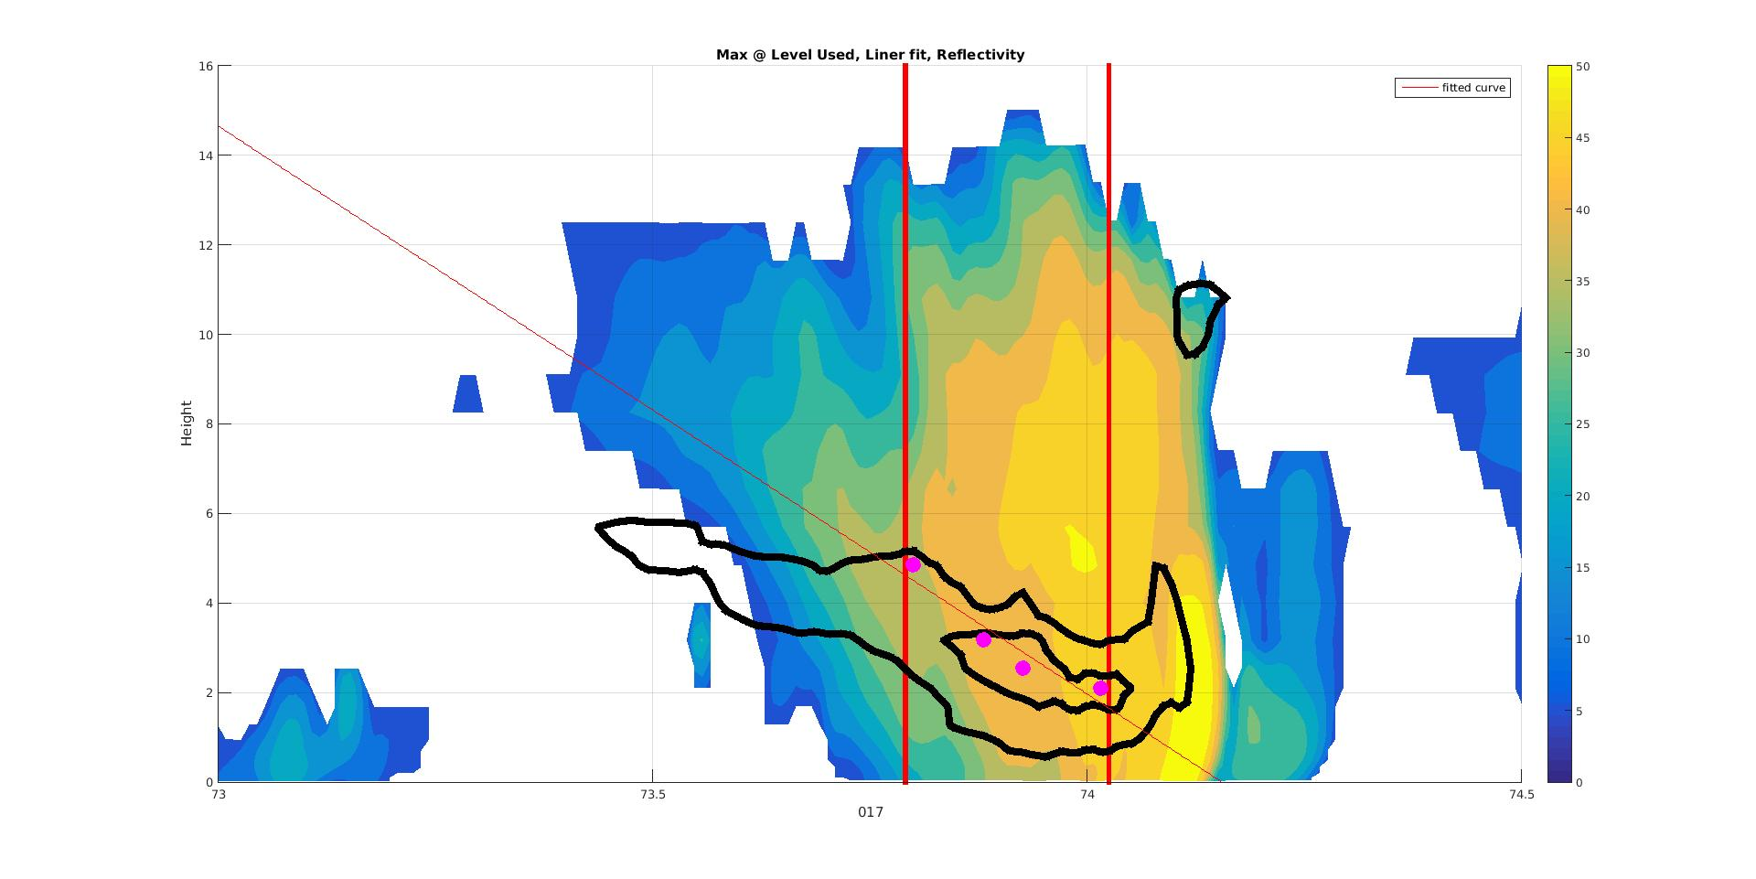
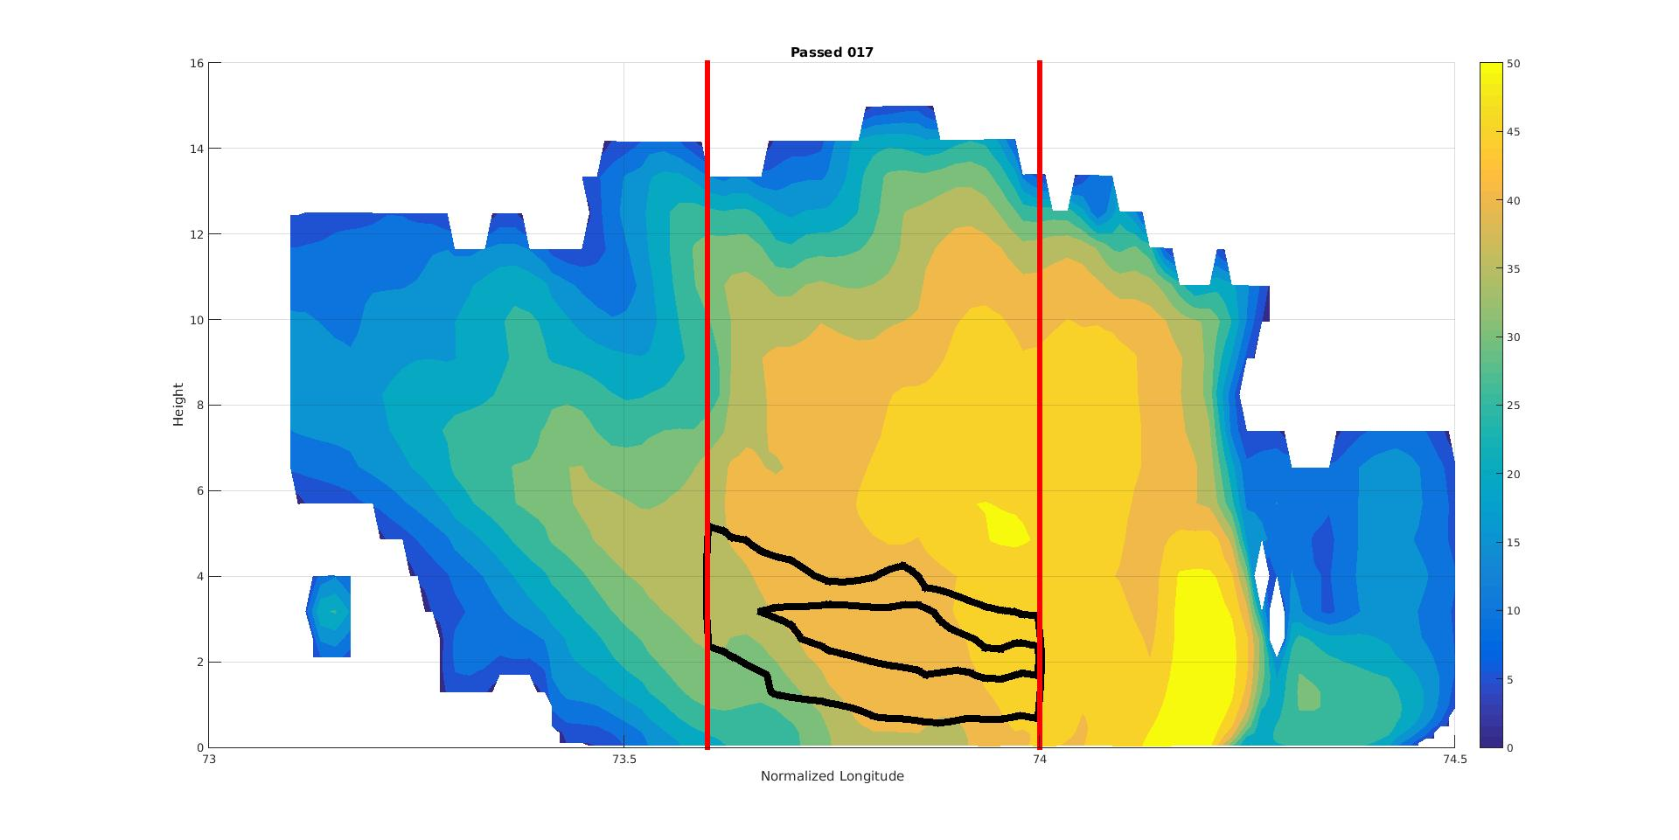
Midlevel Inflow Compositing
dBZ
16
Shading: Reflectivity
Black Contours: Horz. Speed > 18 m/s
Dots: Max speed at level post test
Red Lines: Analysis boundaries
50
14
45
12
40
35
10
30
Height (km)
8
25
6
20
4
15
Original
10
2
5
0
73
Longitude
74.5
0
73.5
74
dBZ
16
Shading: Reflectivity
Black Contours: Horz. Speed > 18 m/s
50
14
45
12
40
35
10
30
Height (km)
8
25
6
20
4
15
10
2
Scaled
5
0
73
Longitude
74.5
0
73.5
74
Milbrandt - Yau: Member 17
1930 UTC 23 Dec 2011

Slide 19
Microphysical Process Definitions
Definition | Ice Nucleation | Aggregation | Riming | Melting | Deposition | Sublimation | Raindrop Collection | Condensation | Evaporation
 | New frozen hydrometeors forming | Frozen hydrometeors collecting other frozen hydrometeors | Frozen hydrometeors collecting liquid hydrometeors | Frozen hydrometeors melting into liquid hydrometeors | Frozen hydrometeors collecting water vapor | Frozen hydrometeors losing mass to water vapor | Liquid hydrometeors collecting liquid or frozen hydrometeors | Liquid hydrometeors collecting water vapor | Liquid hydrometeors losing mass to water vapor
Milbrandt - Yau - Yau | QFZci, QNUvi, QFZrh | QCLis, QCLig, QCLsh, QCNis, QCNsg, QCNgh, QCLih | QCLcs, QCLcg, QCLch, QCLrg, QCLrs, QCLri, QCLrh | QMLir, QMLsr, QMLgr, QMLhr | QVDvi, QVDvs, QVDvh, QVDvg | QVDvi, QVDvs, QVDvh, QVDvg | RCAUTR, RCACCR, QCLsr, QCLgr |  | QREVP
Morrison | mnuccd, mnuccr, mnuccc | prai, prci | psacws, pgracs, psacwi, psacwg, pgsacw, psacr, pracg, pracis, praci, piacrs | psmlt, pgmlt | prd, prdg, prds | eprdg, eprds, eprd | piacr, pra, prc | pre, pcc, evpmg, evpms | pre, pcc, evpmg, evpms
WDM6 | Pigen | Psaci, Pgaci, Psaut, Pgacs, Pgaut | Psacw, Pgacw, Paacw, Piacr, Psacr, Pgacr, Pracs | Psmlt, Pgmlt | Pidep, Psdep, Pgdep | Pidep, Psdep, Pgdep | Praut, Pracw, Praci, Pseml, Pgeml | Pcond | Prevp, Psevp, Pgevp

Slide 20
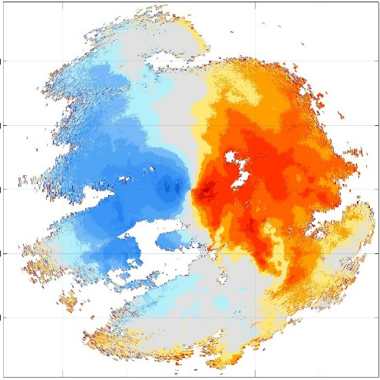
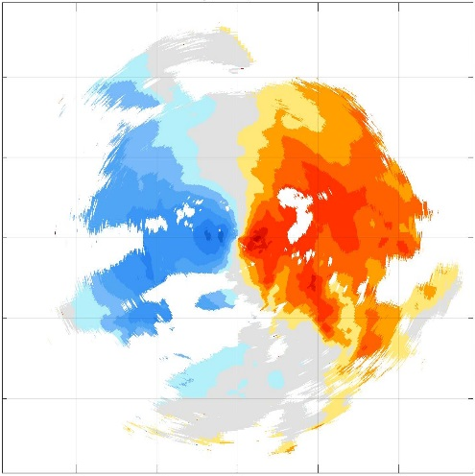
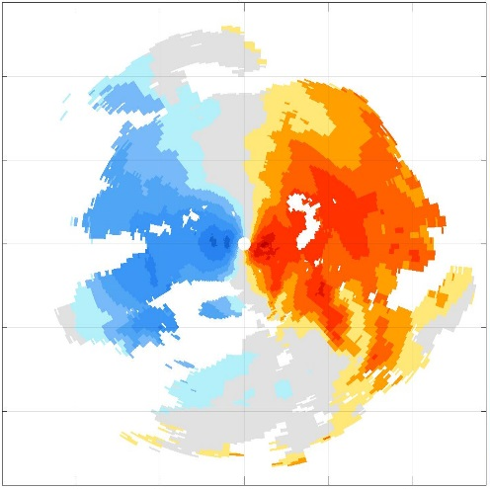

Radial Velocity Preparation
1. Radar Quality Control
Locations were PID present only
PID used to remove
Biological
2nd trip
Saturation
Remove pixels with:
Low signal-to-noise ratio
Clutter
High spectral Width
2. Super-Observations
Bins: 2° x 1 km
Quality control: < |45 ms⁻¹|
Rules:
< 2 obs in each bin
Remove all Obs
std(bin) > std(all)
Remove all obs
(obs – bin mean) > 2*std(bin)
Remove obs at fault
Median value
Raw Radial Velocity
QCed Radial Velocity
SuperObs Radial Velocity
150
150
00 UTC 24 Dec 2011: 5°
150
21
100
100
100
15
50
50
50
9
Distance from S-PolKa (km)
3
0
0
0
-3
-50
-50
-50
-9
-100
-100
-100
-15
-21
-150
-100
-50
0
50
100
150
-150
-100
-50
0
50
100
150
-150
-100
-50
0
50
100
150
Distance from S-PolKa (km)

Slide 21
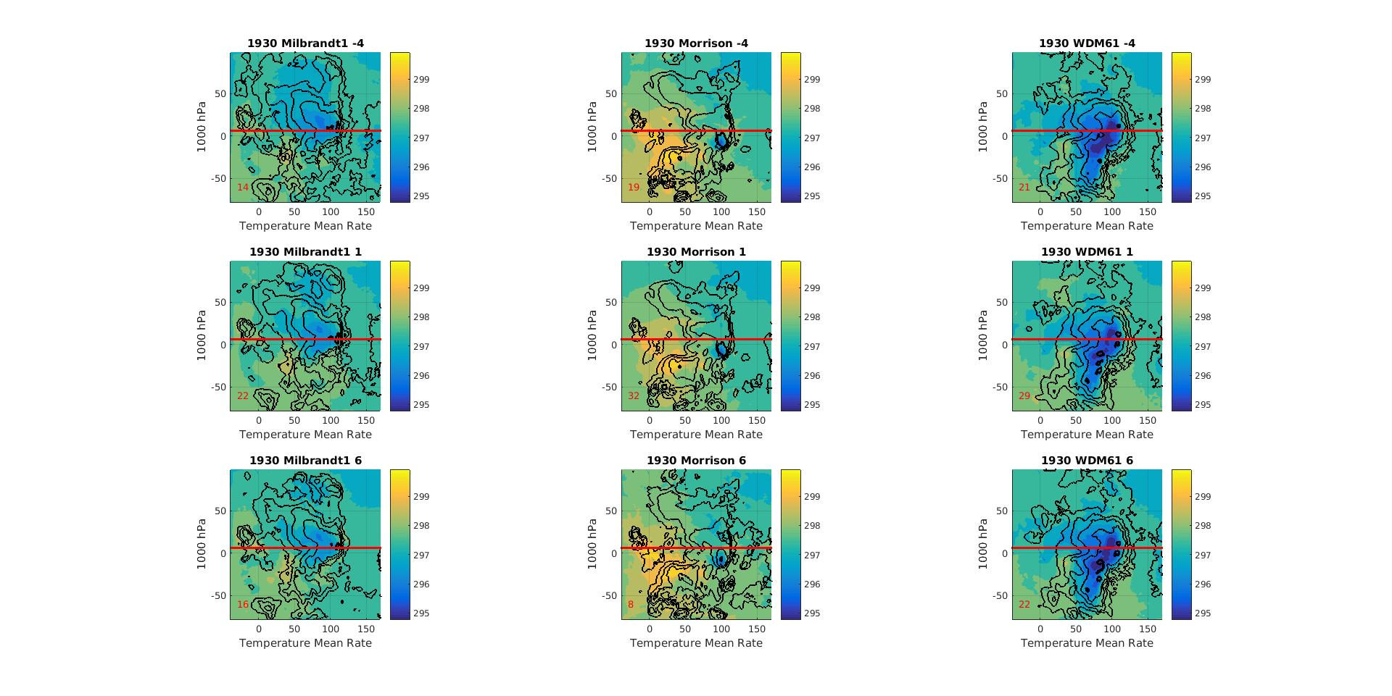
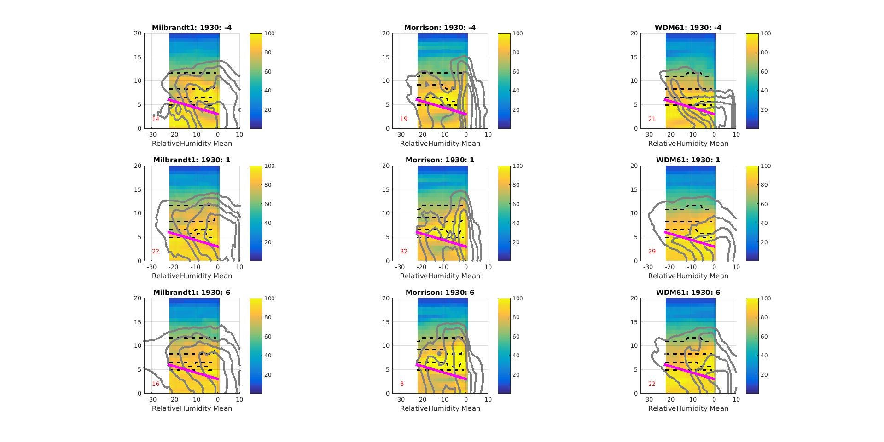
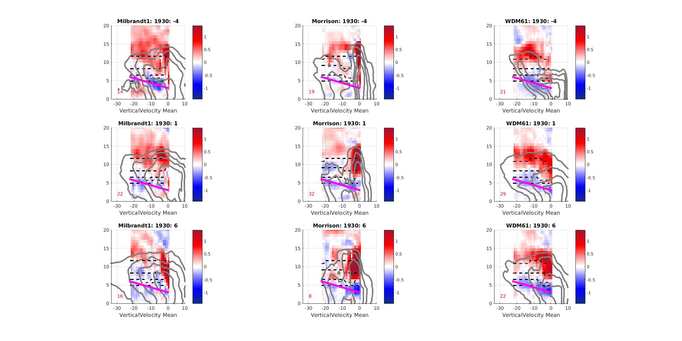
Large Scale Environmental
Milbrandt - Yau
Morrison
WDM6
Mean Temperature Map at 1000 hPa
Distance from
S-PloKa (km)
Composite Relative Humidity Cross Section with Temperature Contours
°
Height (km)
-40°C
-40°C
-40°C
-20°C
-20°C
-20°C
-5°C
-5°C
-5°C
0°C
0°C
0°C
Composite Vertical Velocity Cross Section with Temperature Contours
Height (km)
-40°C
-40°C
-40°C
-20°C
-20°C
-20°C
-5°C
-5°C
-5°C
0°C
0°C
0°C
Normalized Zonal Distance
Normalized Zonal Distance

Slide 22
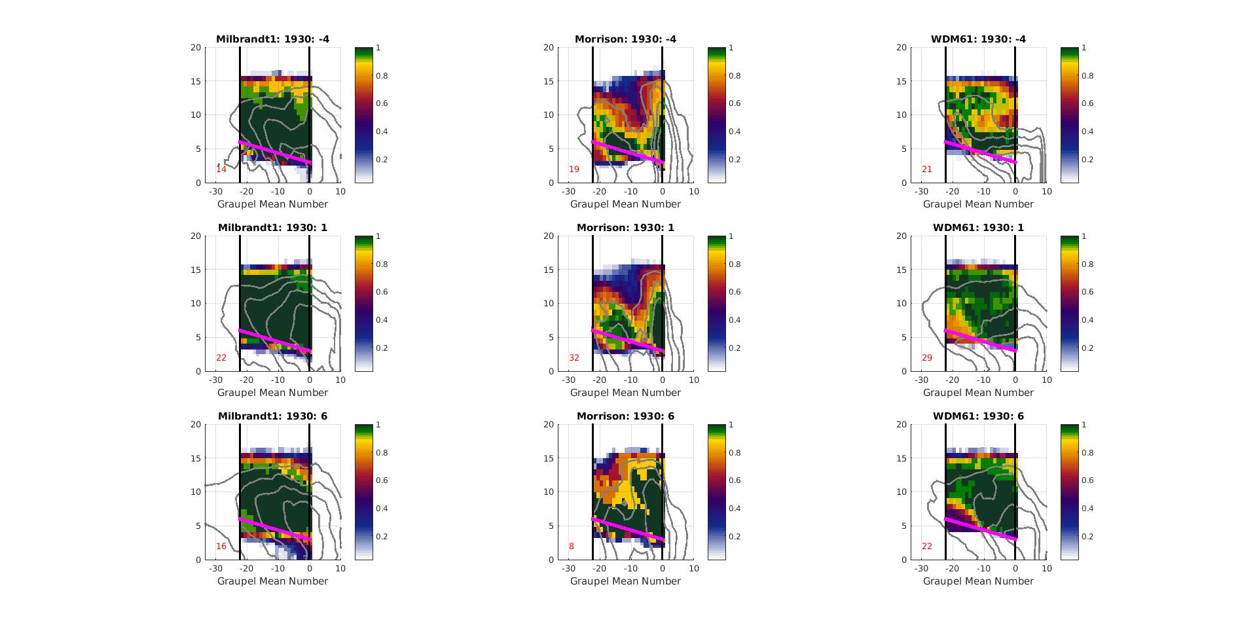
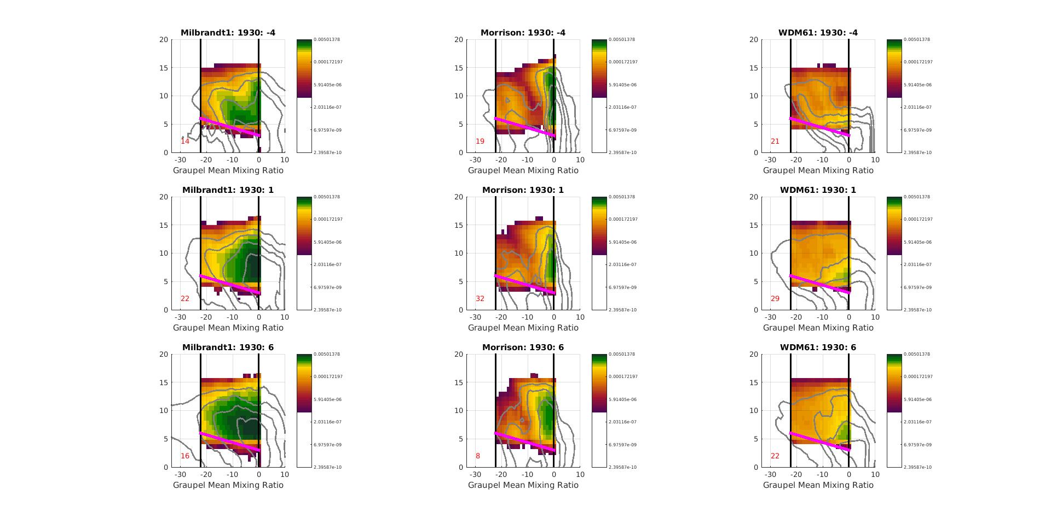
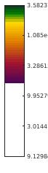
Graupel
Milbrandt - Yau
Morrison
WDM6
Occurrence Frequency
Height (km)
Mixing Ratio (kg kg⁻¹ )
5e-3
1e-6
5.9e-6
Height (km)
2e-7
Normalized Zonal Distance

Slide 23
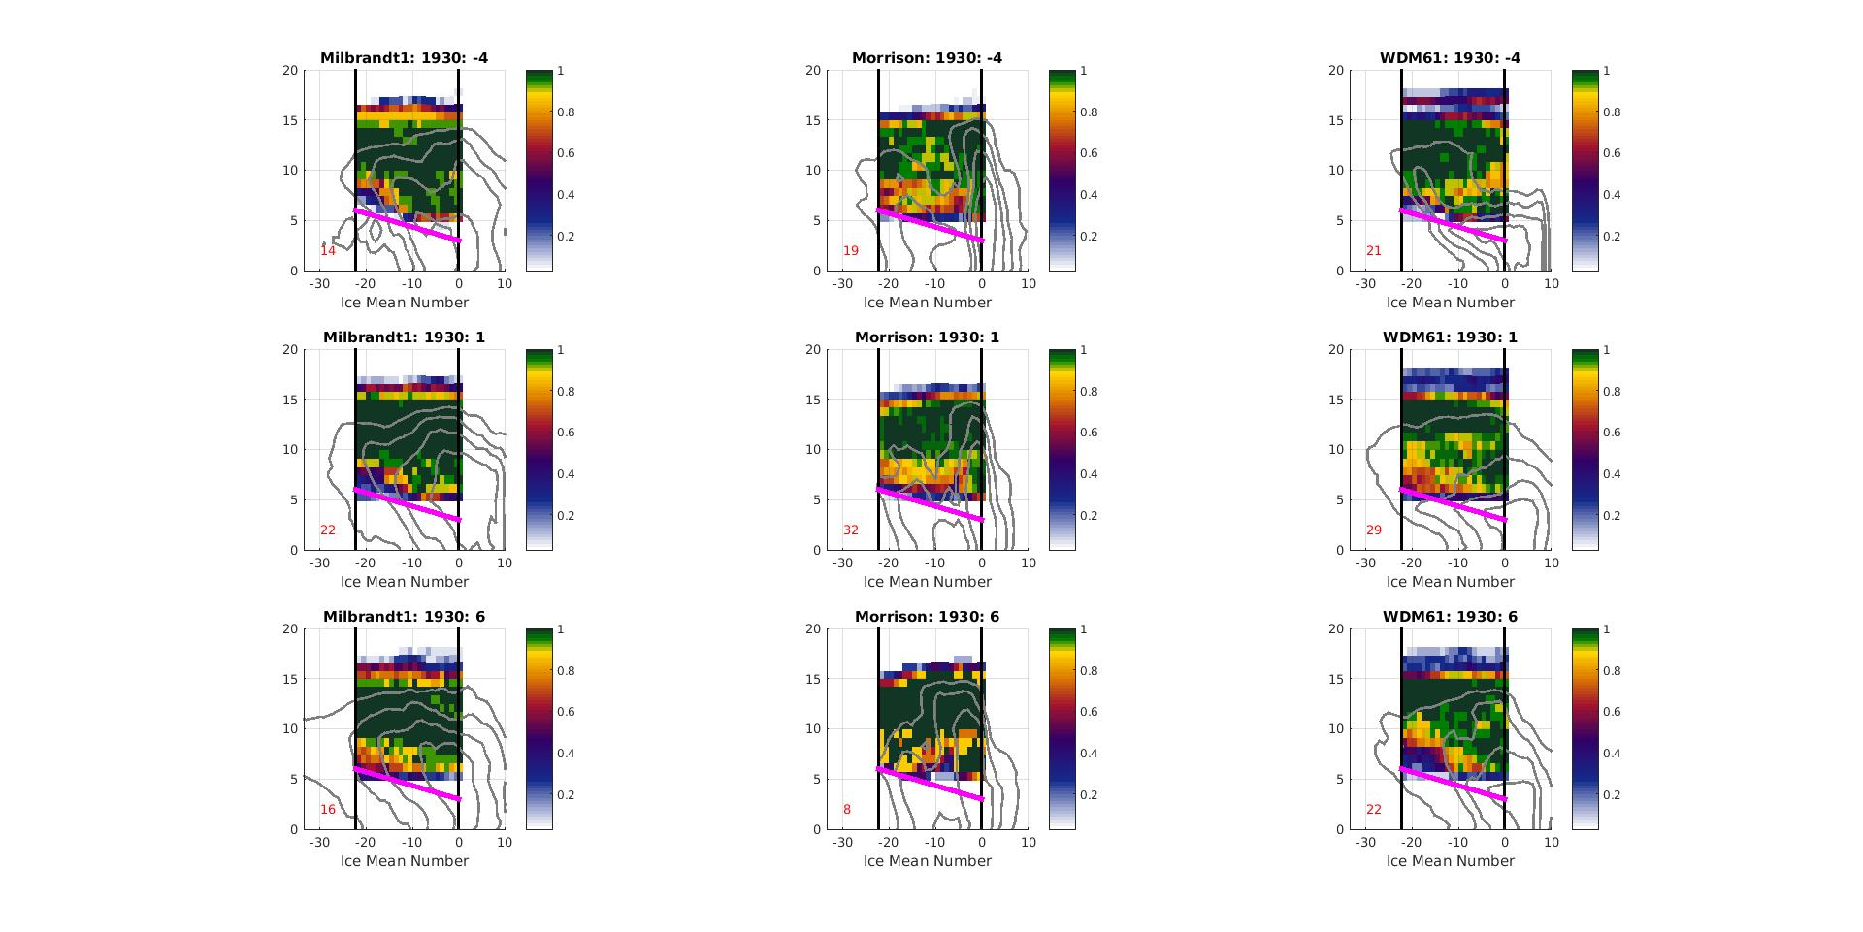
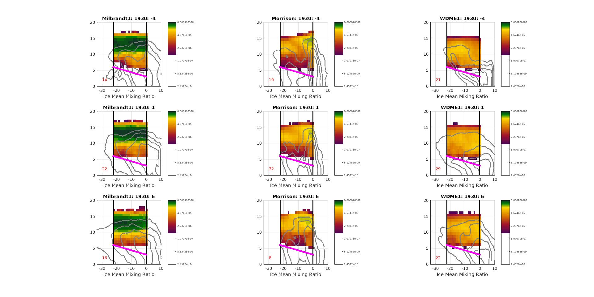
Ice
Milbrandt - Yau
Morrison
WDM6
Occurrence Frequency
Height (km)
Mixing Ratio (kg kg⁻¹)
9e-4
4.6e-5
2.2e-6
Height (km)
1e-7
Normalized Zonal Distance

Slide 24
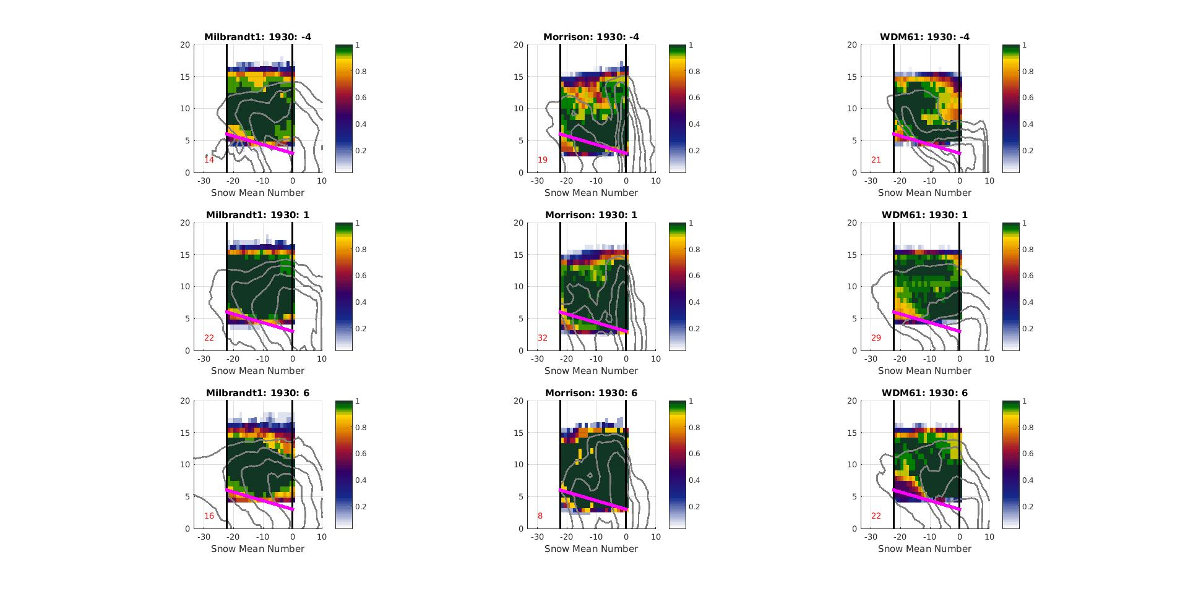
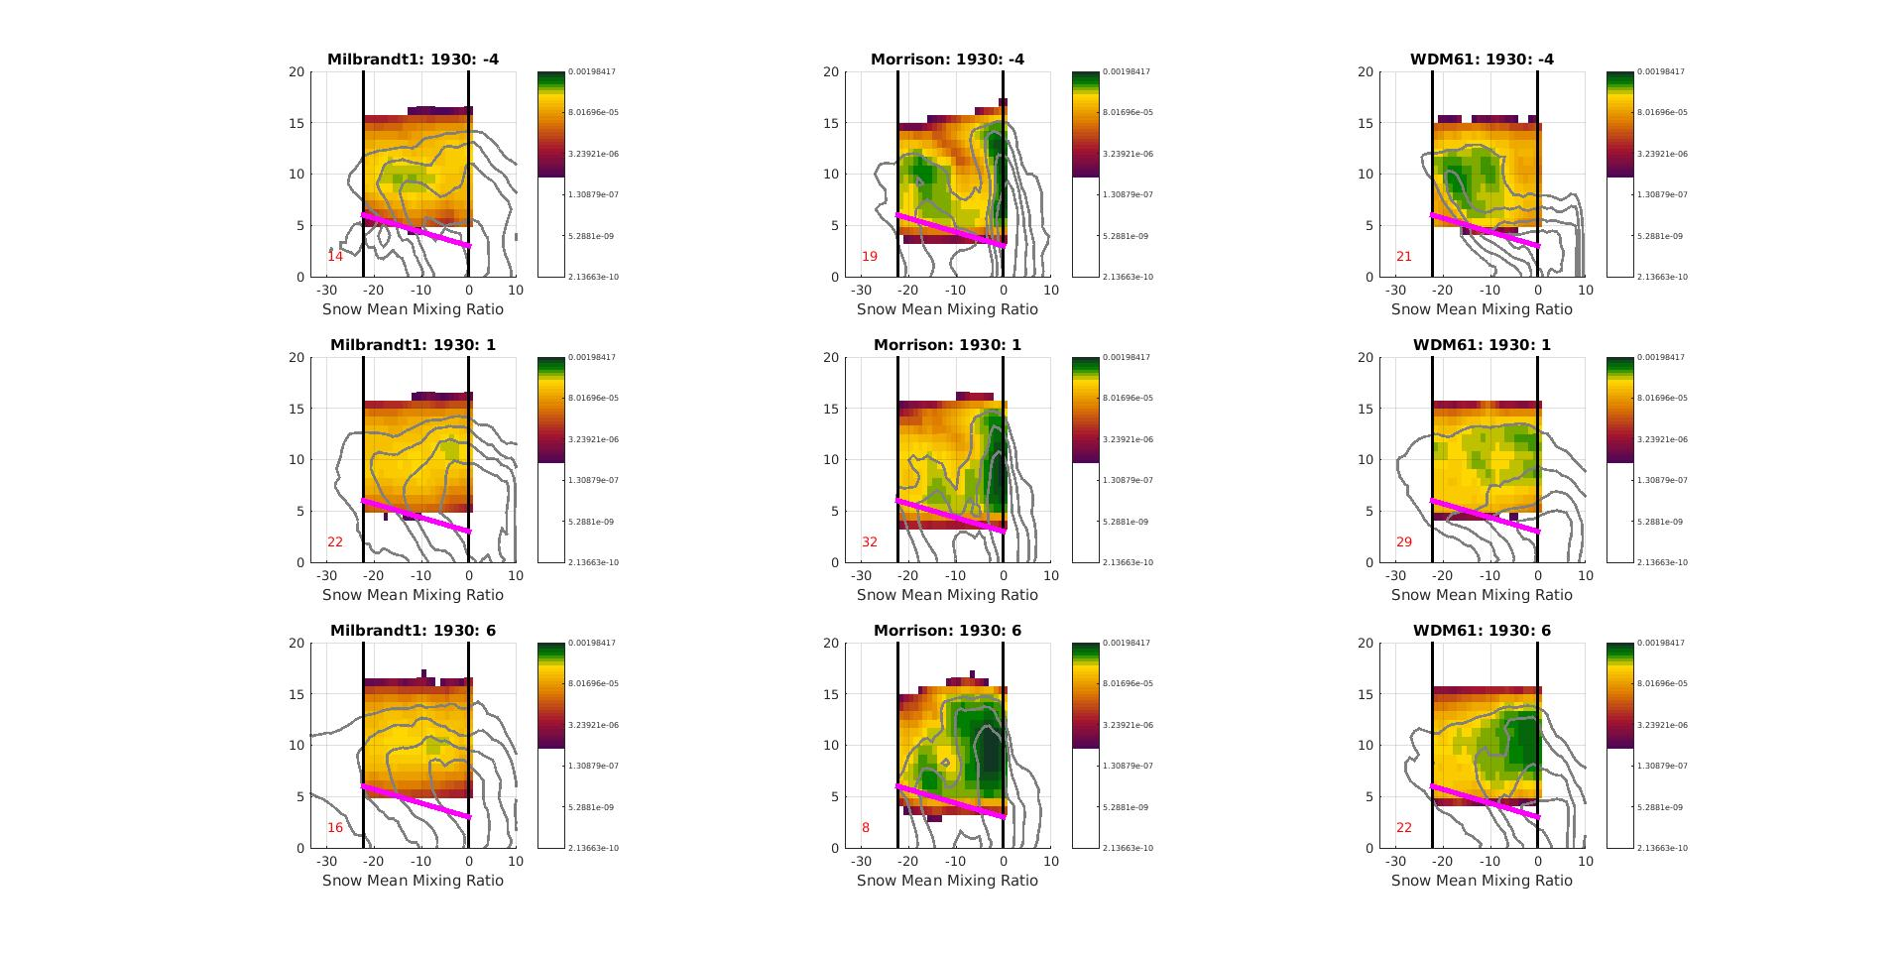
Snow
Milbrandt - Yau
Morrison
WDM6
Occurrence Frequency
Height (km)
Mixing Ratio (kg kg⁻¹)
1e-3
8e-5
3.2e-6
Height (km)
1.3e-7
Normalized Zonal Distance

