Slide 1

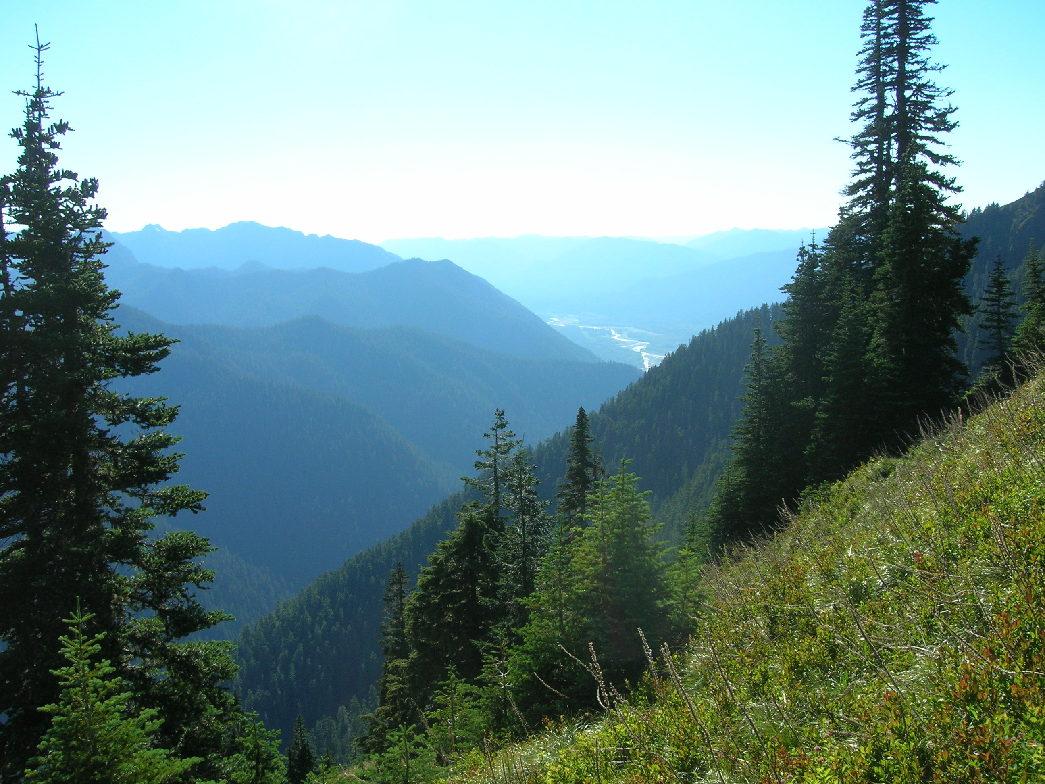
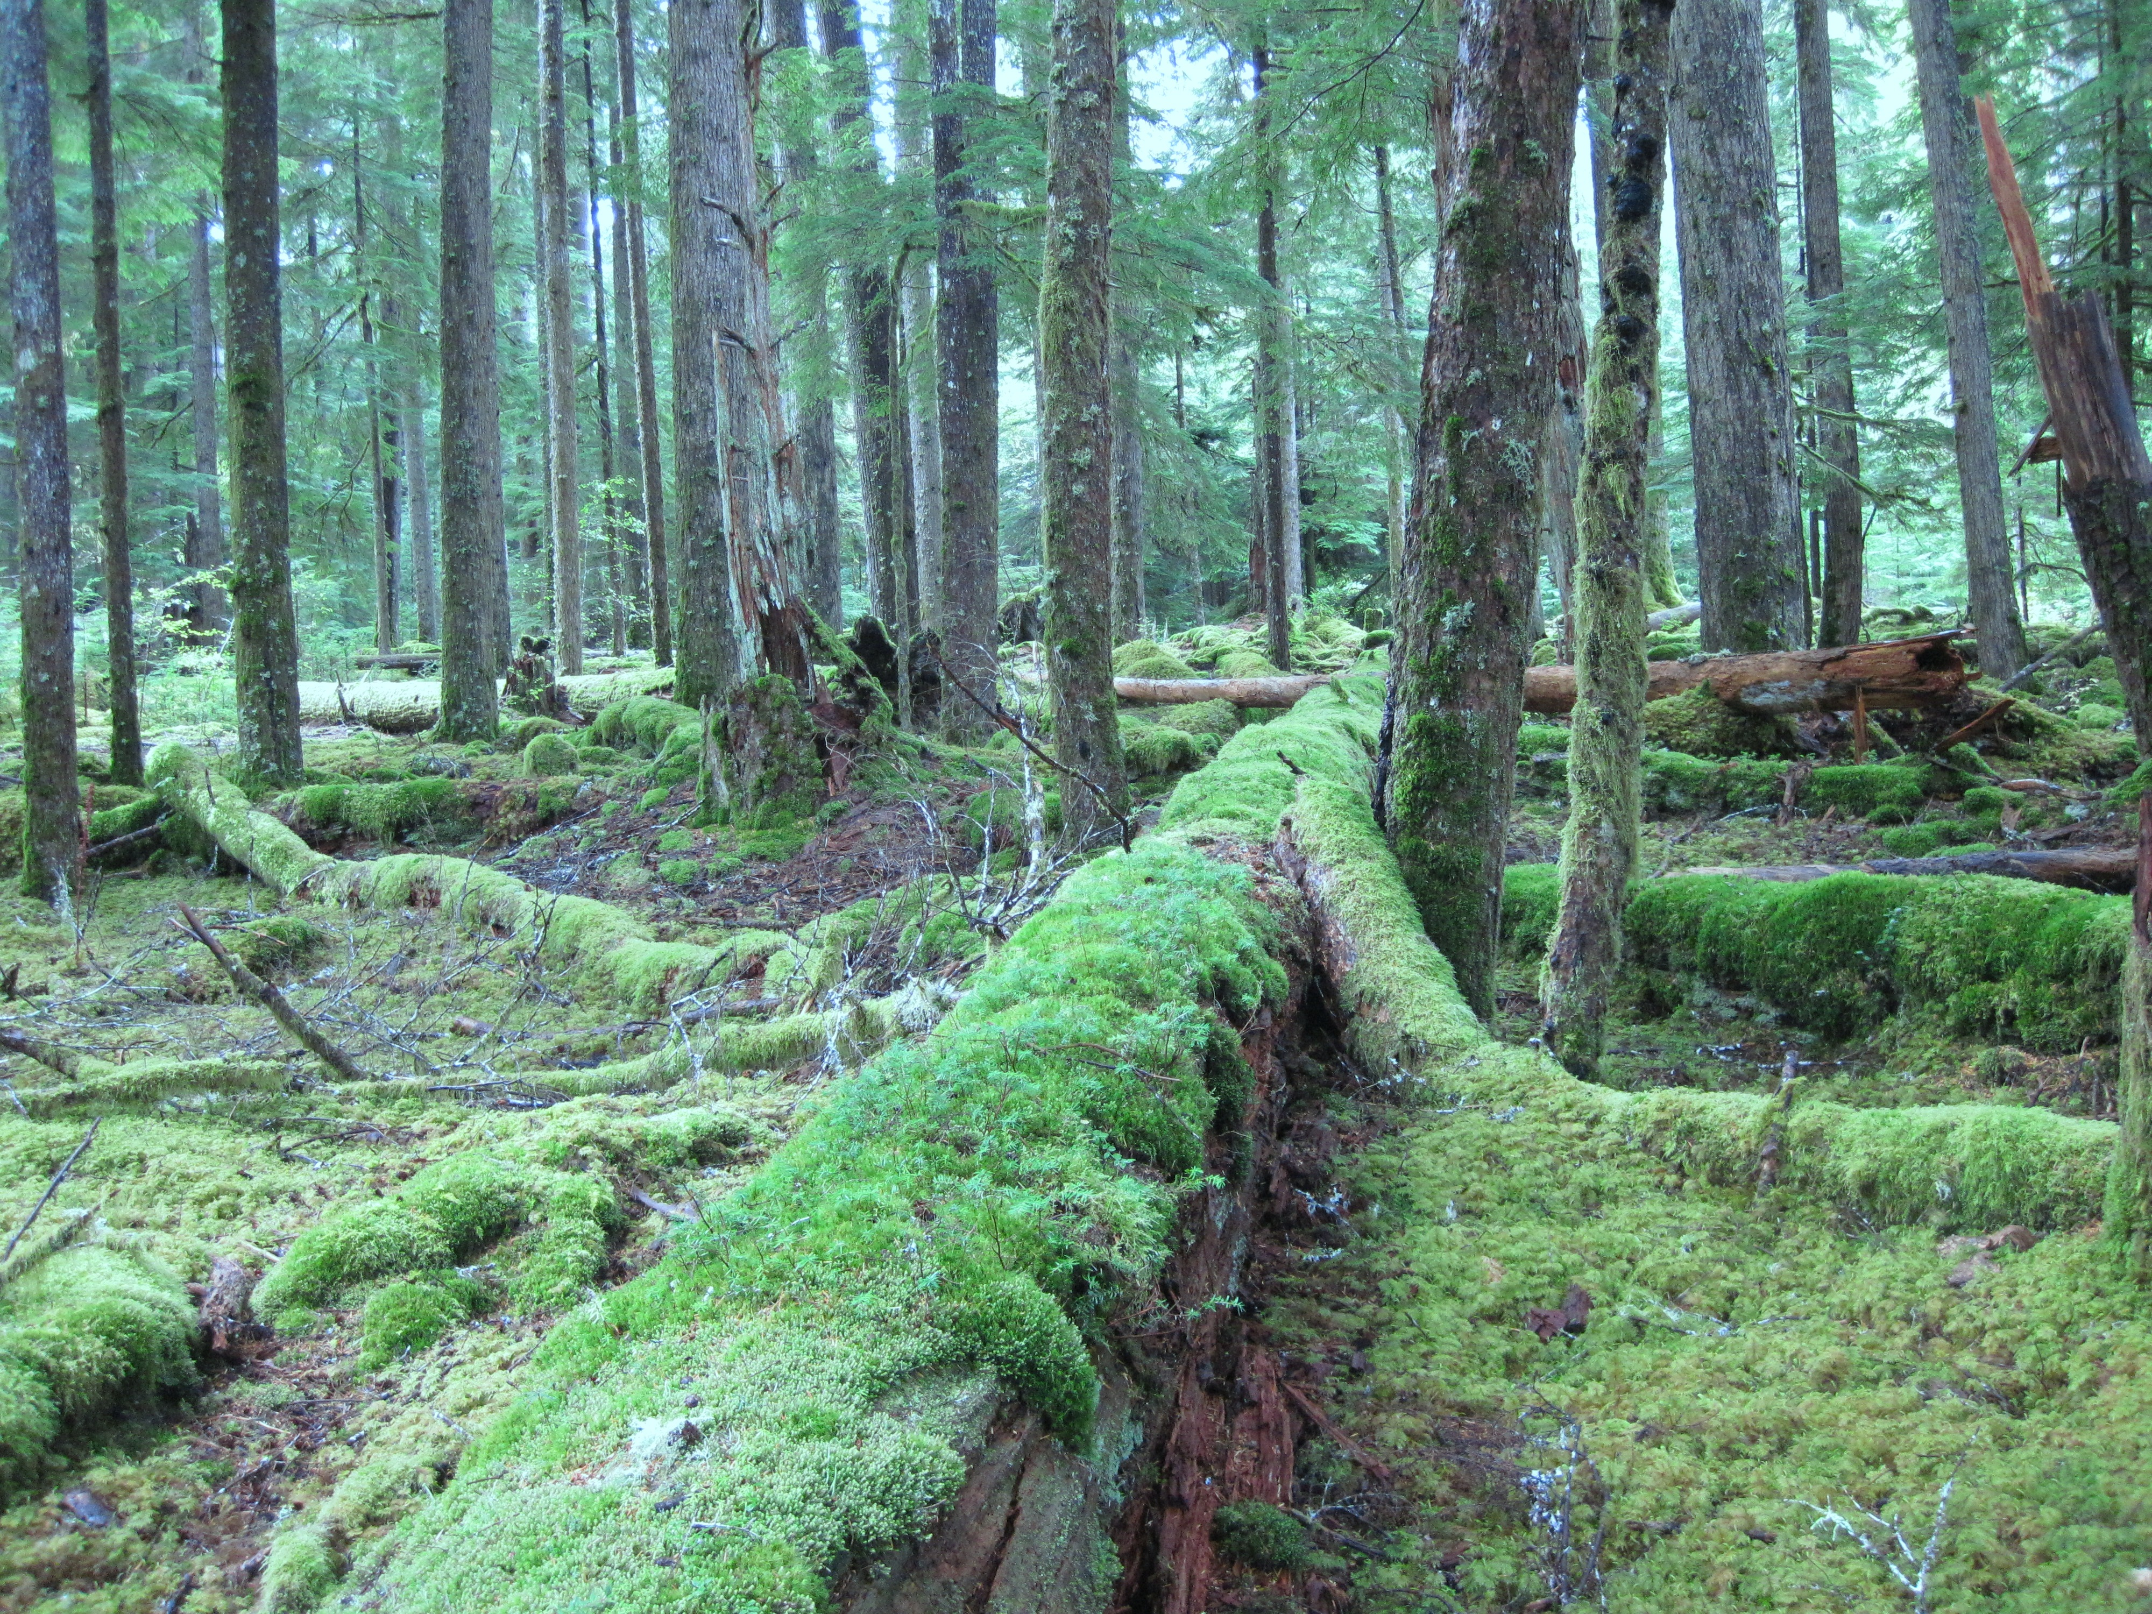

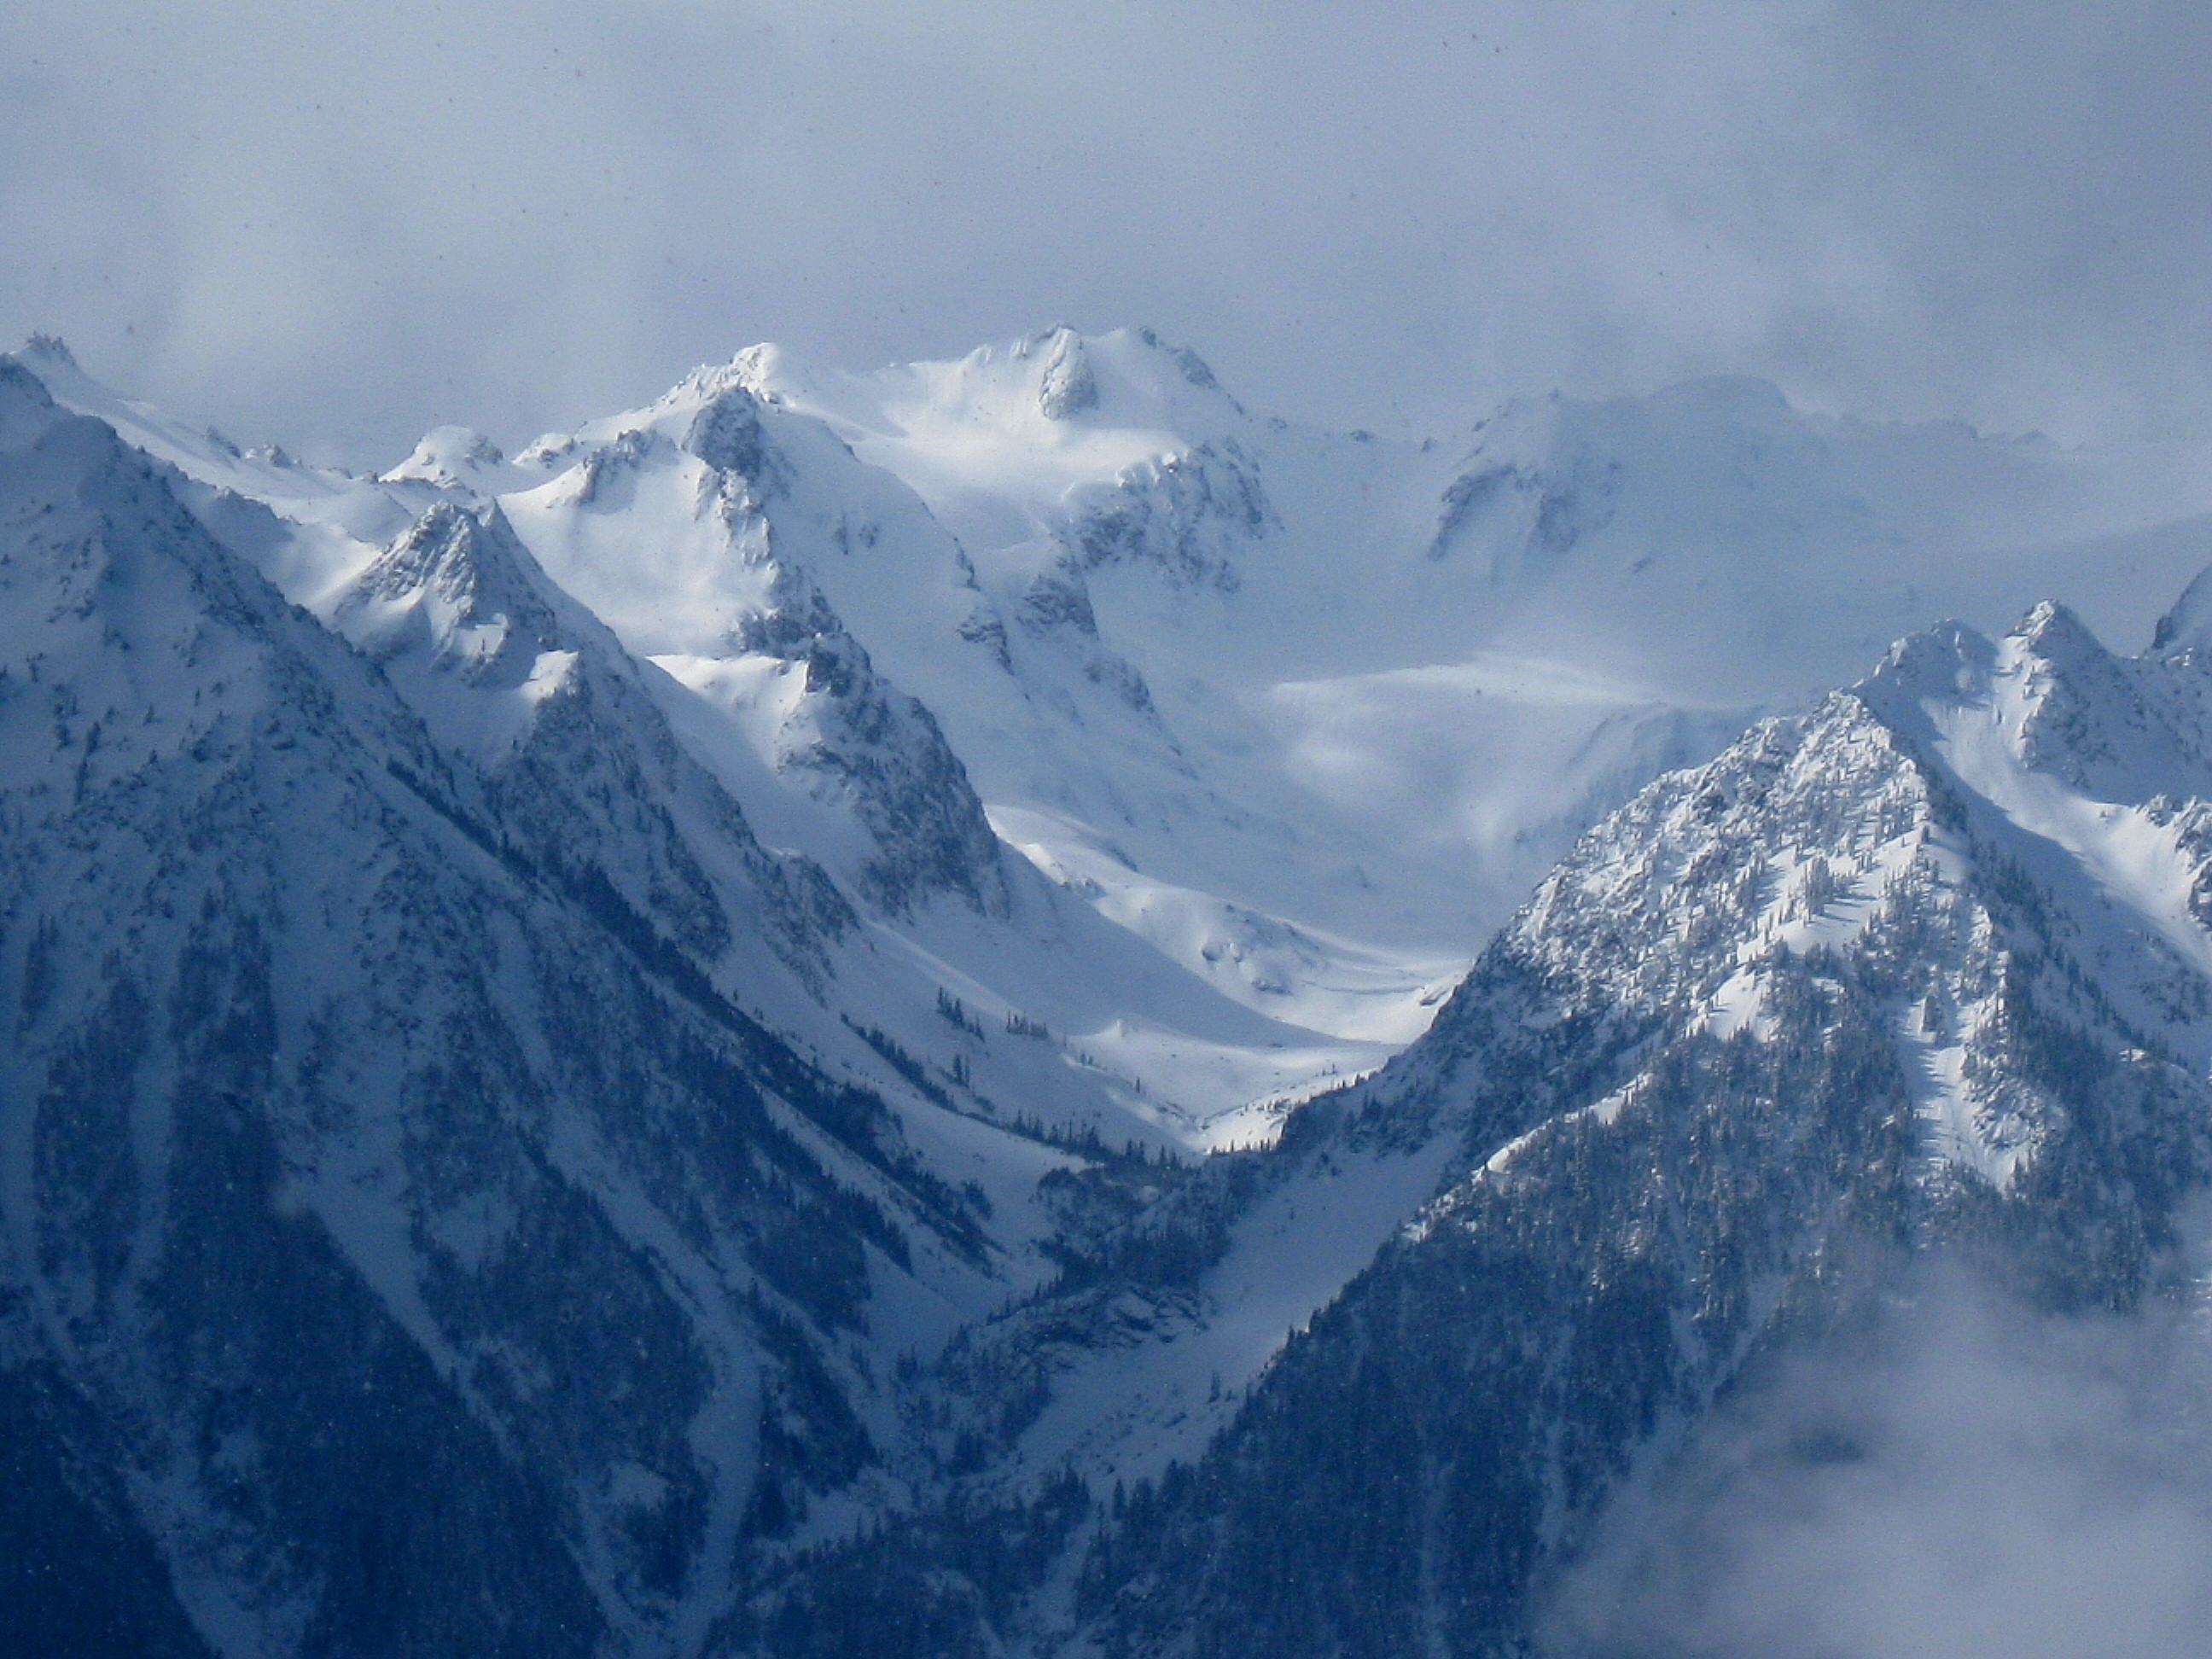
Aircraft telecon for OLYMPEX:
23 July 2015
Lynn McMurdie

Slide 2
Expected Weather during OLYMPEX
Outline:
Brief climatology and weather regimes
Frontal sectors
Examples
Scheduling sondes/dropsondes
Scenarios that could affect operations – strong winds, visibility, etc.

Slide 3
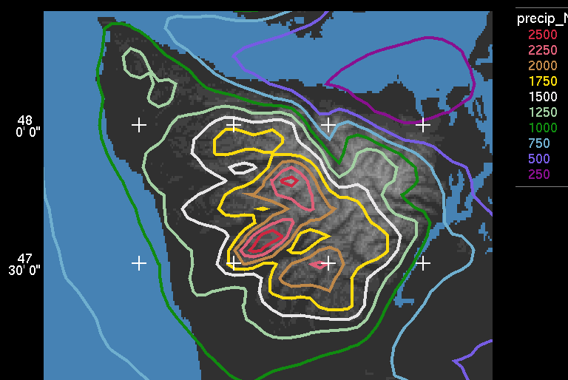
Brief Climatology
Mean sea level pressure for November – February from reanalysis data
Mean annual precipitation from PRISM – observations + elevation model
Histogram of 0°C isotherm at UIL for onshore moist flow.
Precipitation distribution over the Olympic Peninsula from WRF model runs confirmed with rain gauge observations

Slide 4
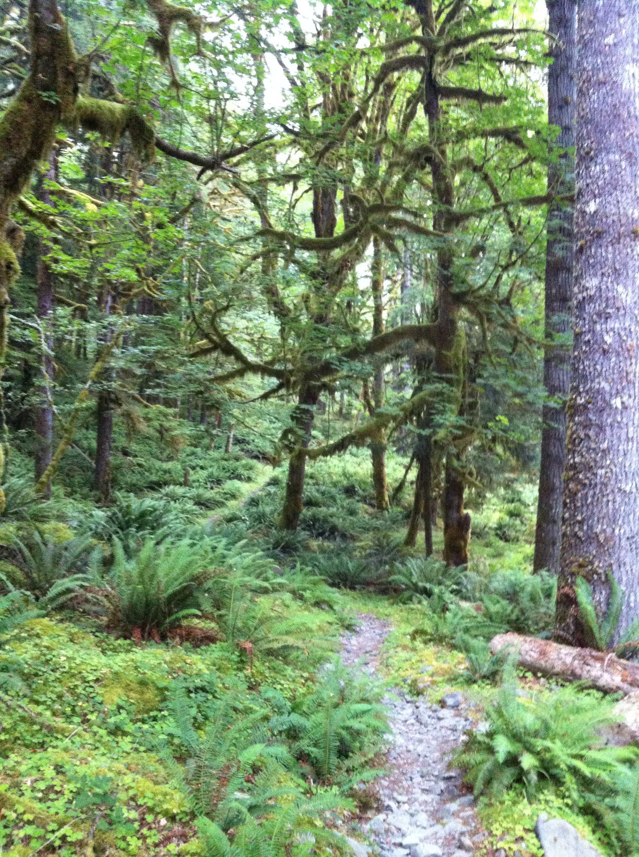
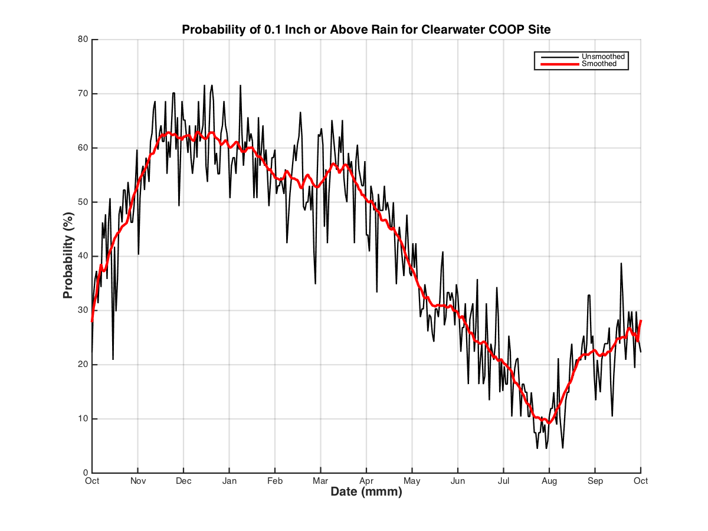
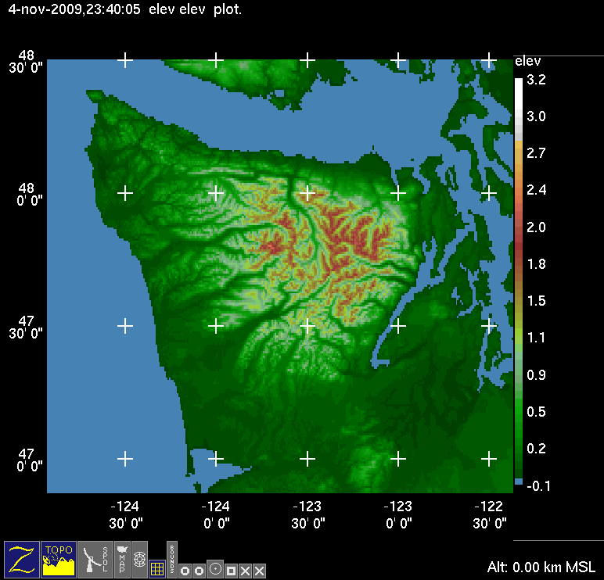
Rain Forest Climate
OLYMPEX – Nov 10 – Jan 15
60%
Probability of receiving at least 2.5 mm (0.1”) of precip
Average rainfall during Nov, Dec and Jan is 400 mm (16”) each month. Range is 75 – 750 mm (3 – 30”) per month from 98 years of data.

Slide 5
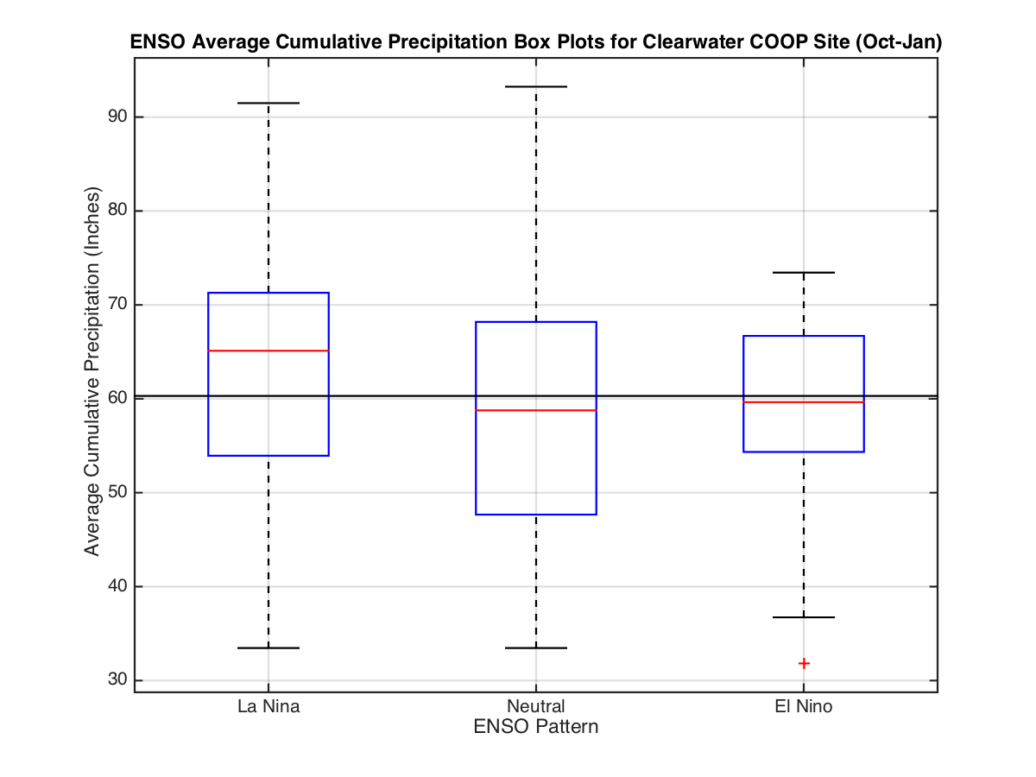
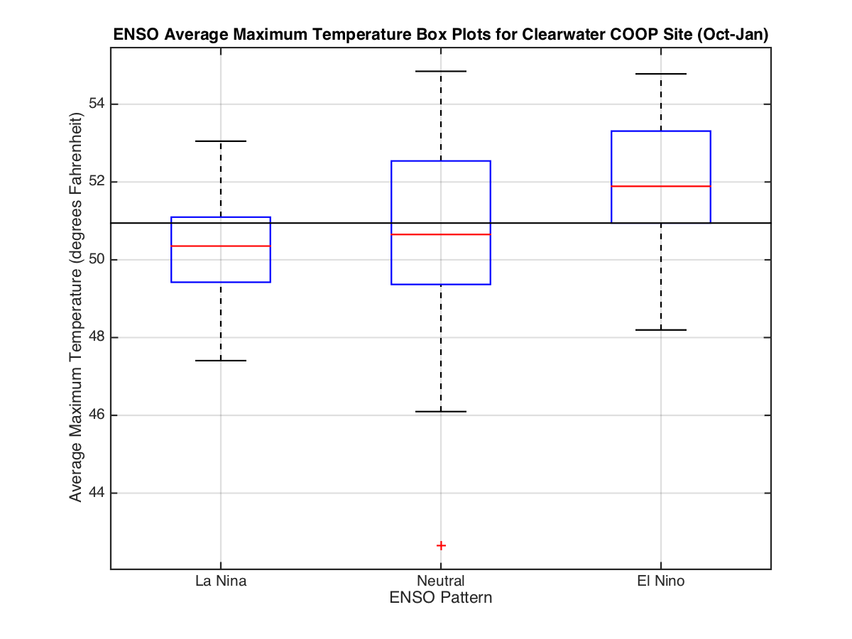
Will El Nino ruin us?
Probably Not- but not so good for snow in mountains

Slide 6
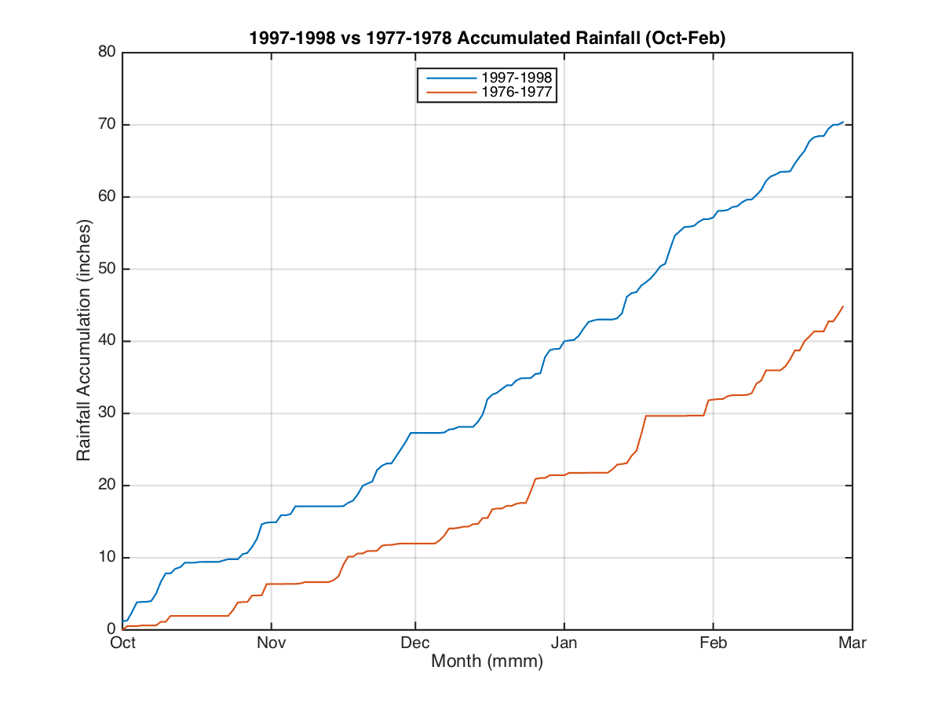
Will El Nino ruin us?
1976-1977 and 1997-1998 accumulated rainfall (Oct-Feb)
OLYMPEX
These are two different El Nino years – 1997-98 strongest recent El Nino, and 1976 – 1977: driest year on record. Both had precipitation during the OLYMPEX period in the fall

Slide 7
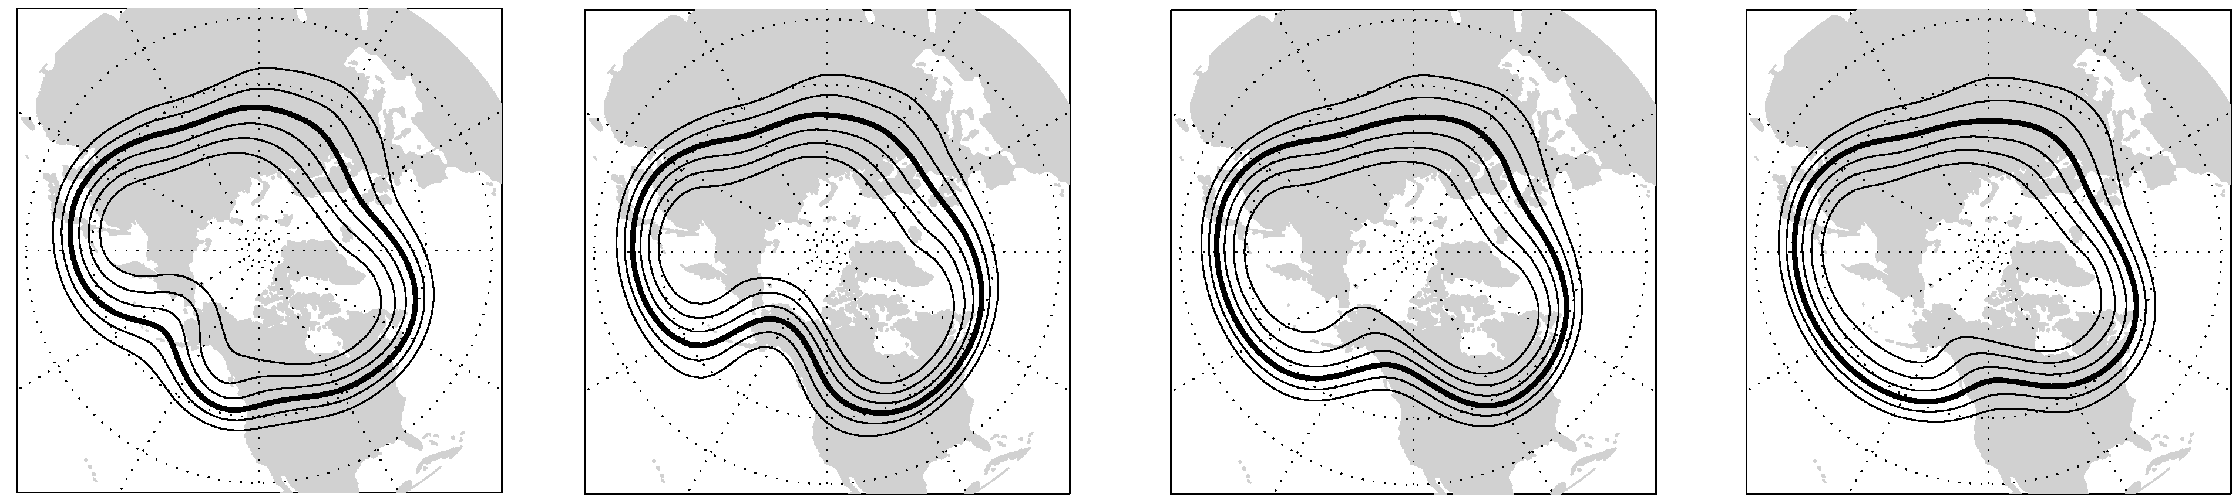
Common Upper Level Flow Regimes
Westerly flow
Northwesterly flow
Also common
Least common
Blocking
Southwesterly flow
Can set up for 1-2 week stretches.
Most common
Not all upper level flows can be classified as one of these four regimes
Figs. from Casola and Wallace 2007 and McMurdie and Casola 2009.

Slide 8
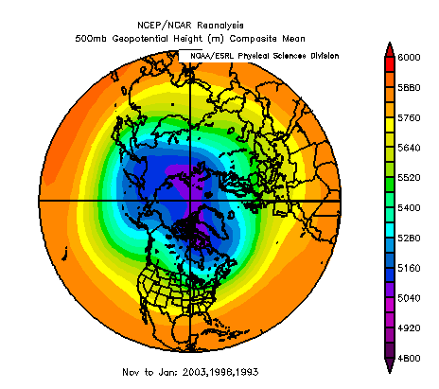
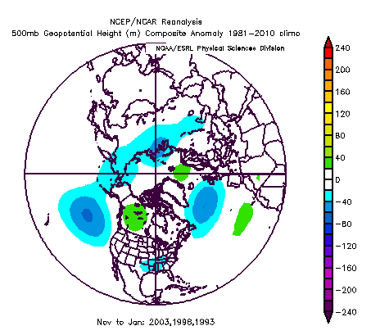
500 hPa Heights and Anomalies using 3 ENSO analog years 2003, 1998 and 1993.
Trough in Pacific deeper, ridge over Rockies slightly stronger during these three El Nino years.
El Nino years can typical have split flow over the Pac NW and weaker storm systems
Figs. Created from NOAA/ESRL Physical Science Division. Analysis to determine analog years from Ruping Mo, Environment Canada

Slide 9
Typical Pacific Cyclone Structure–
Storm Sectors – Idealized from Nagle and Serebreny (1962)
Notes:
Within upper level flow shown in previous slide, synoptic-scale storms such as depicted here develop.
This figure shows idealized precipitation pattern of an eastern Pacific storm.
Over NE Pacific, typically don’t have strong or well developed warm front or warm sector

Slide 10
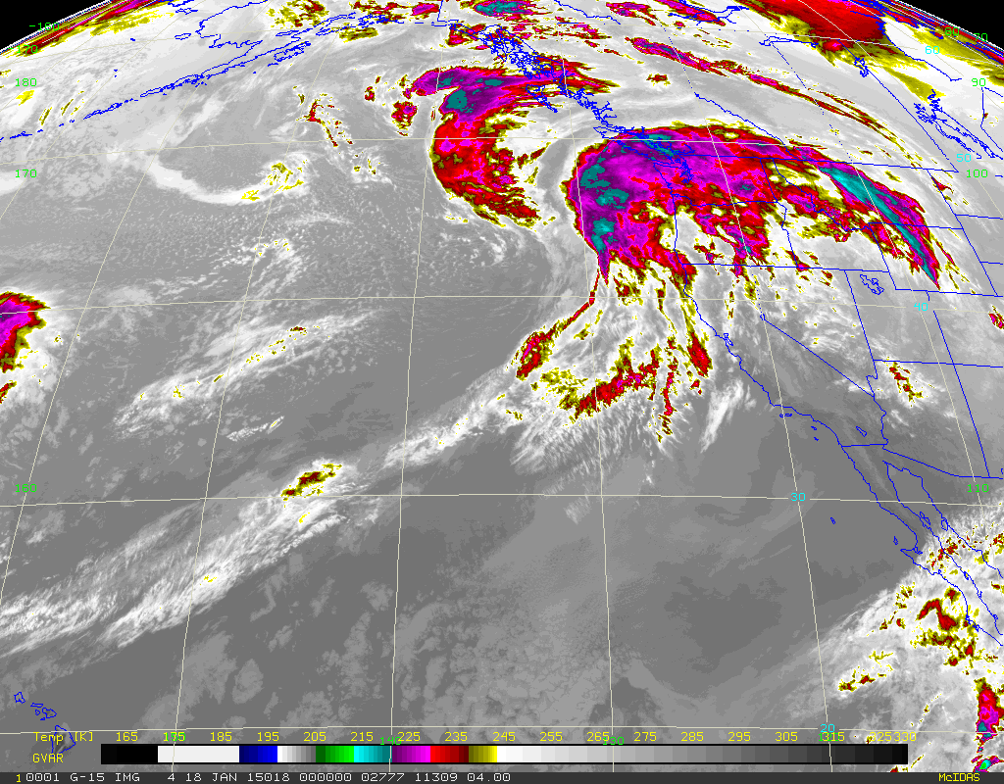
Synoptic Midlatitude Cyclone–
Example 1: Satellite picture from 00 UTC 18 Jan 2015
Notes:
Extensive cloud shield,
Surface low center well offshore
Precipitation occurring on Olympic Peninsula well ahead of cold/occluded front
L

Slide 11
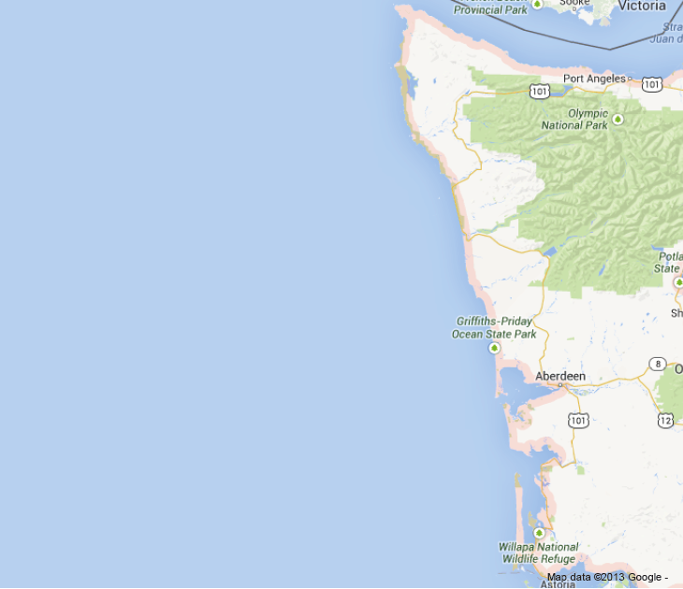
Prefrontal Sector
Idealized
Clouds extend northward
Notes:
Warm advection
Stratiform precipitation
high based clouds and radar echo
Descending cloud base
rain rates can be light
—but not from low cloud
L
Prefrontal
Postfrontal

Slide 12
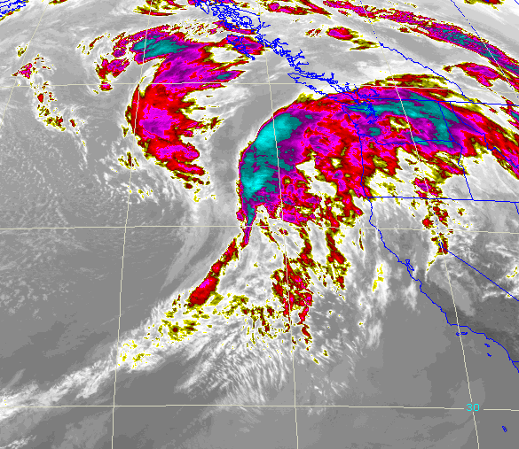
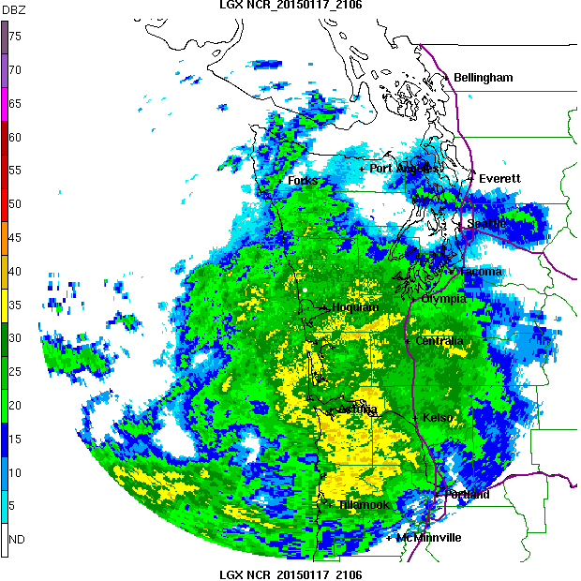
Prefrontal Sector
Example 1: 2015011721
Notes: Precipitation occurs well out ahead of surface fronts. Environment characterized by warm advection, large static stability, stratiform precipitation, relatively high or rising melting level (case dependent)

Slide 13
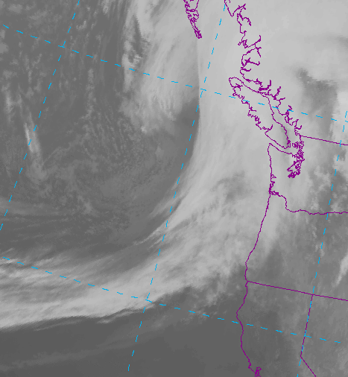
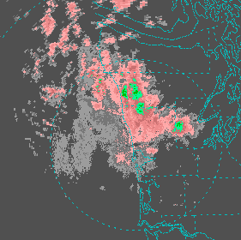
Prefrontal Sector
Example 2: 20130225
Notes: Precipitation occurs well out ahead of surface fronts. Environment characterized by warm advection, large static stability, stratiform precipitation, relatively high or rising melting level (case dependent)

Slide 14
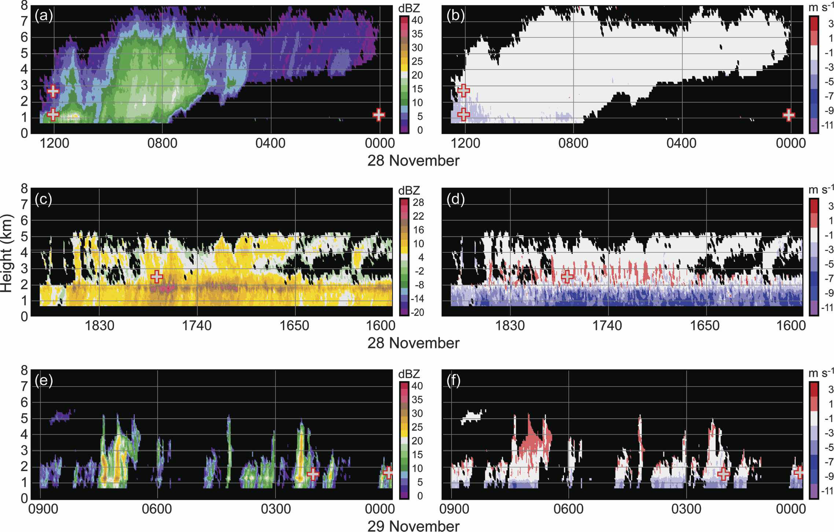
Prefrontal Sector
Example: RHI scans from 2000112900 IMPROVE-2 case
Time
Time
Reflectivity
Doppler Velocity
Notes: Cloud base lowering with time as storm approaches, weak/no vertical velocity
Figure from Medina et al., 2007

Slide 15
Frontal Sector
Idealized
Notes:
Precipitation intense at front
Strong upward motion at front
Rapid drop of melting level
Transition from stratiform to convective

Slide 16
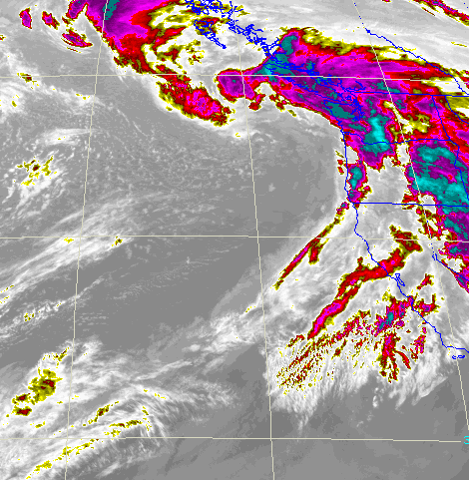
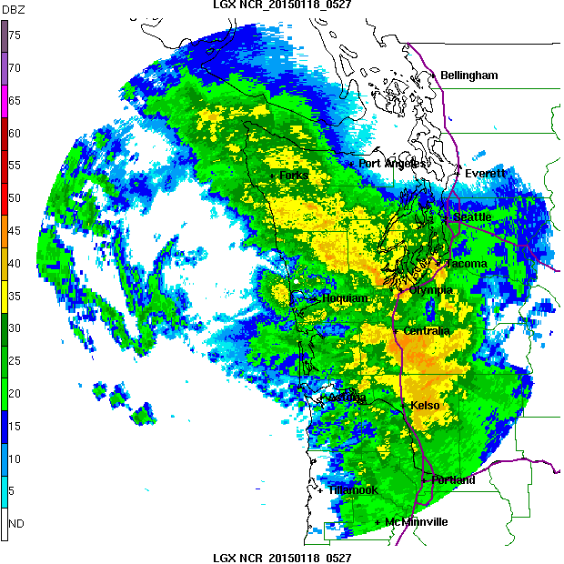
Frontal Sector
Example 1: 2015011806
Notes: Precipitation can be intense at front. Strong upward motion at front. Rapid drop of melting level at passage of (cold/occluded) front. Transition from stratiform to convective elements at front

Slide 17
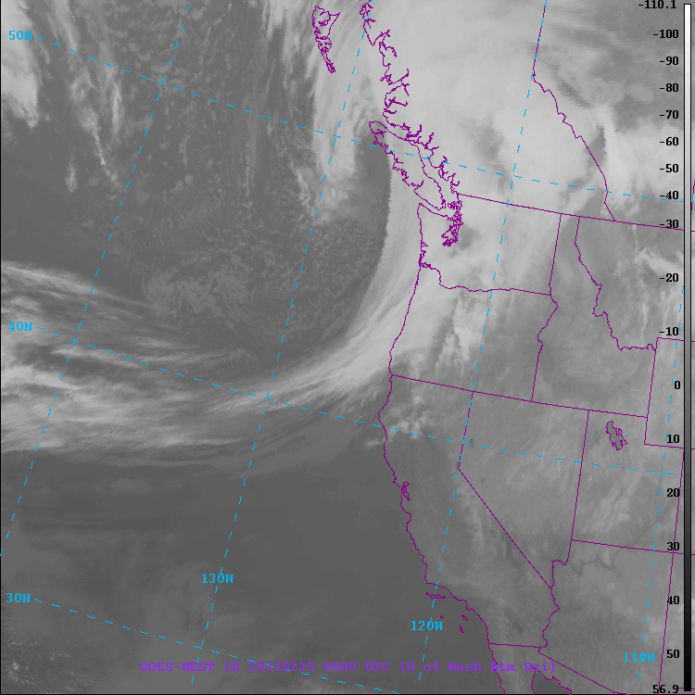
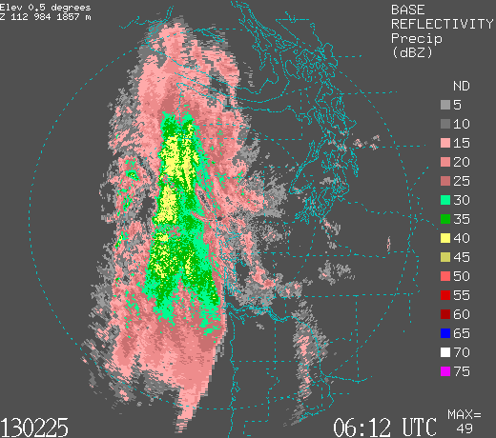
Frontal Sector
Example 2: 2015011806
Notes: Precipitation can be intense at front. Strong upward motion at front. Rapid drop of melting level at passage of (cold/occluded) front. Transition from stratiform to convective elements at front

Slide 18
Frontal Sector
Example: RHI scans from 2000112818 IMPROVE-2 case
Time
Time
Reflectivity
Doppler Velocity
Notes: Steady to intense precipitation. Convective elements imbedded, regions of strong vertical motions
Figure from Medina et al., 2007

Slide 19
Post-Frontal Sector
Idealized
Notes:
Convective elements – often shallow, but not always
cold advection
Low stability
low melting level.
Can produce significant precipitation, especially over windward slopes
Significant snowfall at higher elevations
L

Slide 20
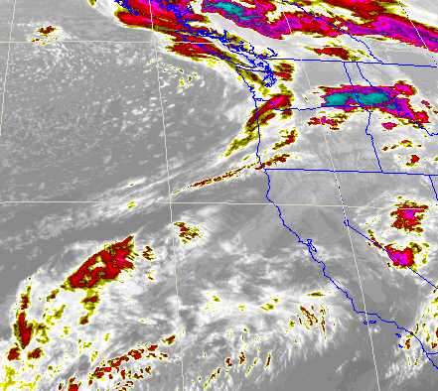
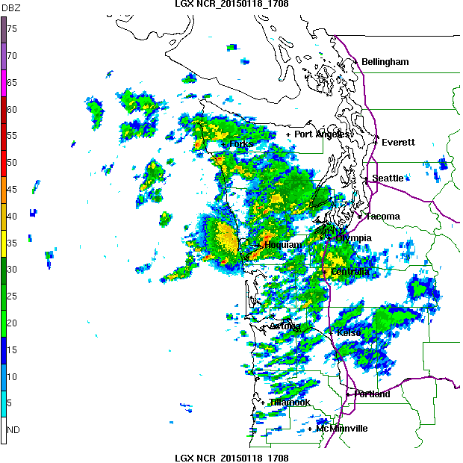
Post - Frontal Sector
Example 1: 2015011812
Notes: Environment characterized by cold advection, low static stability, lowering melting level. Can produce significant precipitation, especially in orographically enhanced regions. Significant snowfall at higher elevations

Slide 21
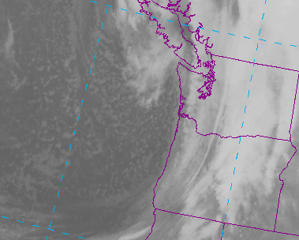
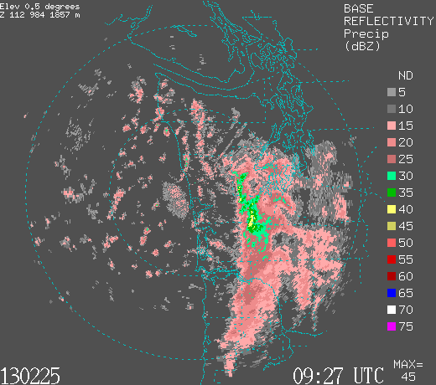
Post - Frontal Sector
Example 2: 2013022512
Notes: Environment characterized by cold advection, low static stability, lowering melting level. Can produce significant precipitation, especially in orographically enhanced regions. Significant snowfall at higher elevations

Slide 22
Frontal Sector
Example: RHI scans from 2000112900 IMPROVE-2 case
Time
Time
Reflectivity
Doppler Velocity
Notes: Isolated convective cells, pockets of significant upward motion. Cell height varies.
Figure from Medina et al., 2007

Slide 23
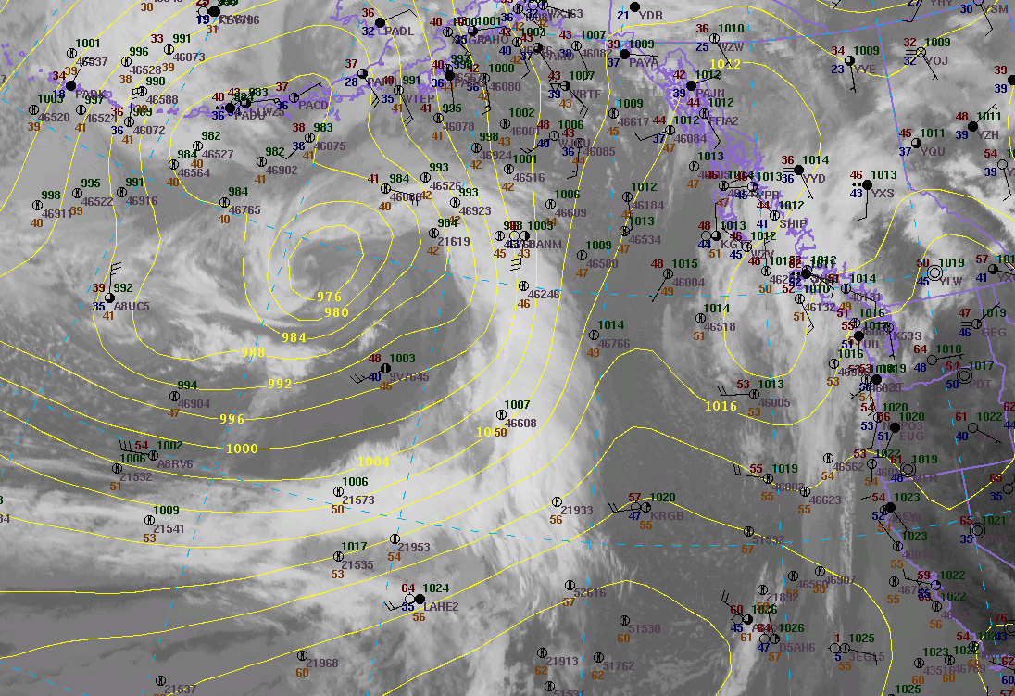
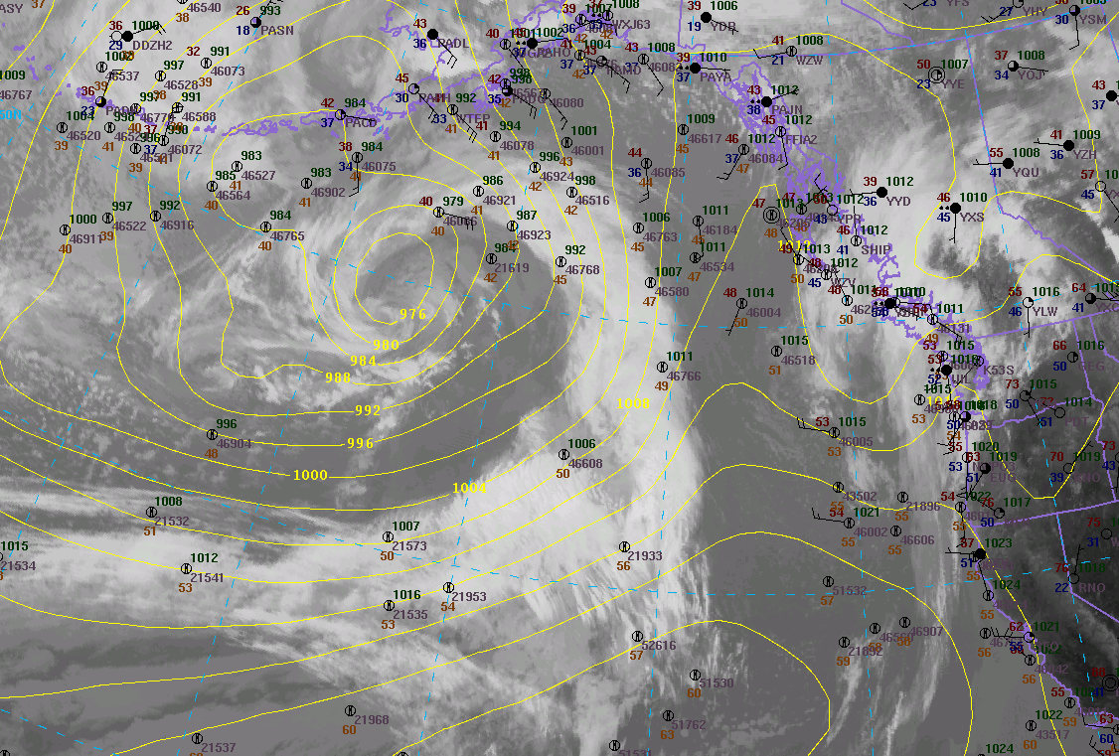
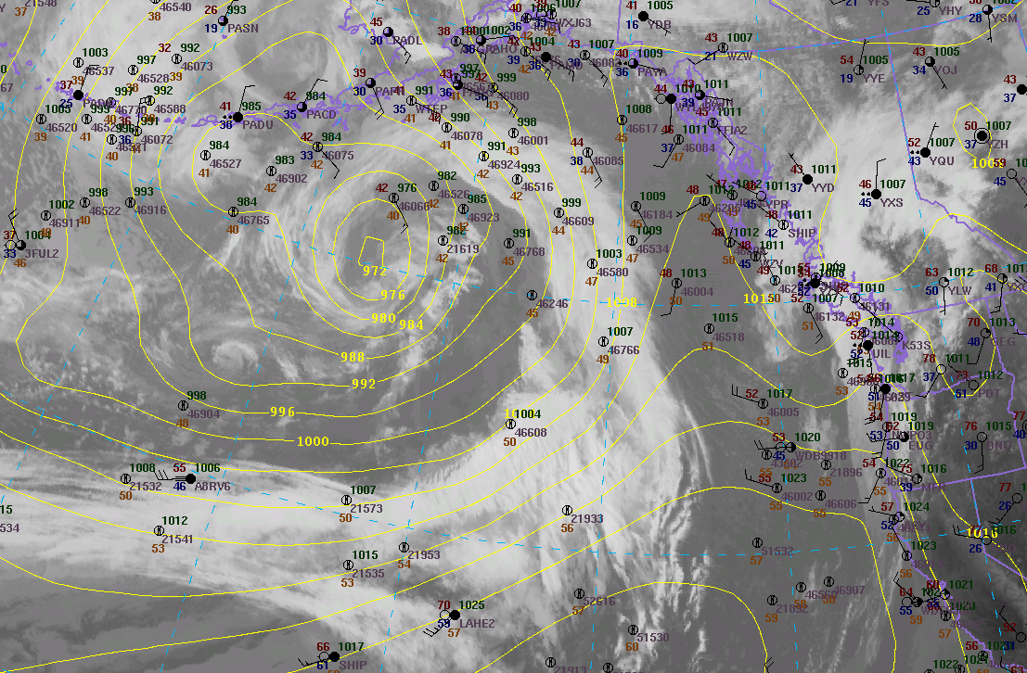
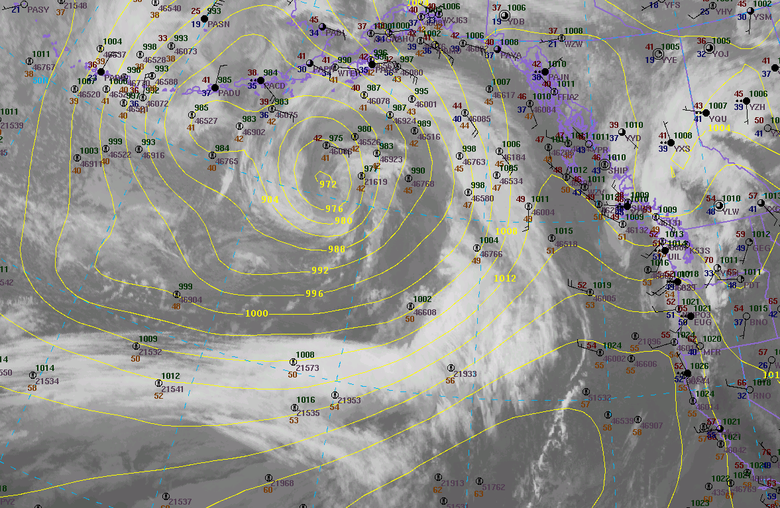
Weak Frontal system:
Event Sampled at Quinault Fisheries
Example 3: 27 – 28 March, 2015
2015032721
2015032800
2015032803
2015032718
Wimpy front

Slide 24
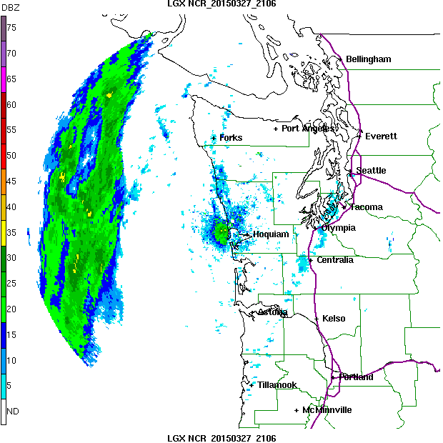
Event Sampled at Quinault Fisheries
27 – 28 March, 2015
Storm approaches from west
But flow is southerly, and cloud and rain elements stream from the south
Weak prefrontal showers, appear to form when moist flow hits coast
Enhancement by terrain plausible (coastal region has hills 100m +)
Post-frontal showers after frontal passage

Slide 25
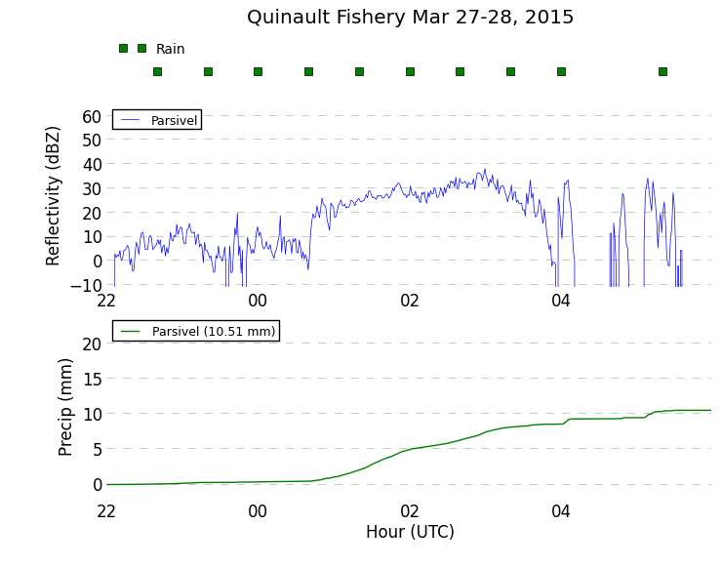
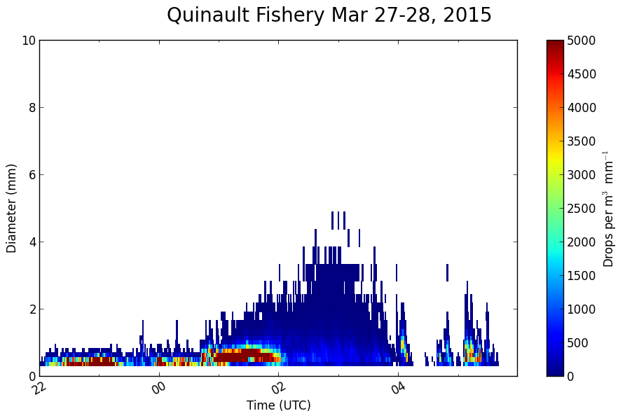
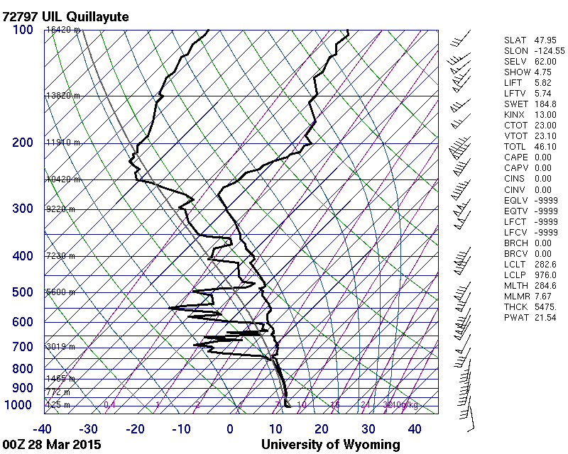
Event Sampled at Quinault Fisheries
27 – 28 March, 2015
Frontal Passage at APU30
Lots of small drops before frontal passage – Reminiscent of White et al. (2003) of non-brightband warm rain processes and like Waldvogel 1974
Droplet size growth at time of frontal passage
Reflectivity similar for prefrontal and frontal regimes
24hr total precip = 20 mm
Post-frontal showers after 0400 UTC

Slide 26
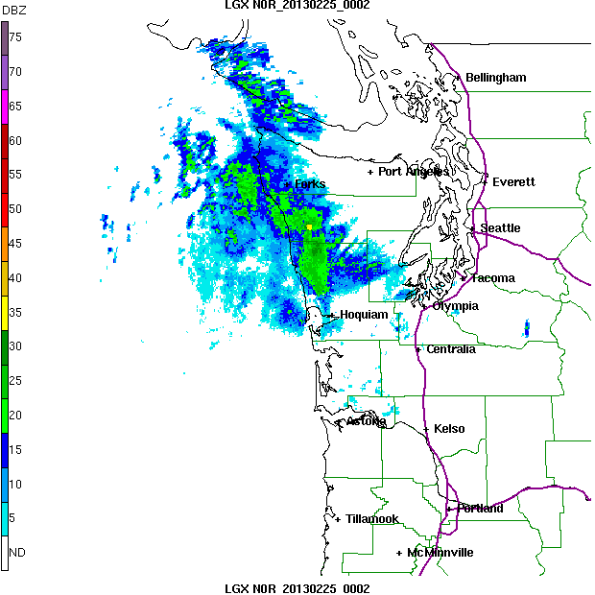
Typical Frontal Passage
Example 2 Radar Loop
Prefrontal -> Frontal -> Postfrontal
Example 1= 15 hr
Example 2 = 12 hr
Example 3 = 12 hr
However, postfrontal period can go on for additional 12-24 hrs, and prefrontal can last 12 hr also.
Need to keep in mind these storms can produce precip for 1-3 days
In some regimes (strong westerlies), storm frequency is
1 1/2 days – 2 days
Length of time in each regime:
Prefrontal = 3 – 12 hrs
Frontal = 3 hrs
Postfrontal = 6 -24 hrs
GUESSTIMATES →

Slide 27
When to deploy soundings/dropsondes?
Number of sondes available at NPOL for obs period = 100
Capture entire storm? – start during prefrontal time period and continue through postfrontal – probably a 24 hr time period
Difficult to accurately predict exact timing of fronts
Higher frequency of sondes near frontal passage time
Other considerations?
Special considerations:
Snow in high terrain
  low enough freezing level
  moisture from storm
  No special circumstances, but moist NW-flow almost guaranteed to produce snow in high terrain, esp. Hurricane Ridge
Winds at NPOL
  Some storms have strong prefrontal winds – barrier jet
  Strong wind storms are deepening low pressure systems with strongest winds in postfrontal sector
  Will need to depend on forecasts to see if winds exceed 60 mph

Slide 28
Geographical Regions
Leeside
m
Quinault
High Terrain
Olympic Peninsula
Chehalis
Ocean
Windward side

Slide 29

Network Overview
m
x
x
Legend
= WSR-88D
= NPOL and D3R
= DOW
= EC X-Band
= MRR
= Soundings
= SNOTEL
= Ground Obs sites
= Snow camera network = UW Tipping bucket network
= Chehalis rain gauge network
x
x
x
x
x
x
x
x
x
x
x
x
x
x
x
x
x
x
x
x
x
x
x
DC-8
ER-2
Citation

Slide 30
OLYMPEX objectives
Observe all 3 sectors of frontal systems
Observe storm passage over 4 regions: ocean, windward, high terrain and leeside
Determine how precipitation processes vary between sectors
Modification of processes by terrain
Hydrology
Model experiments

Slide 31
End

Slide 32
Acknowledgment
This work is supported by the National Aeronautics and Space Administration grants NNX13AG71G & NNX14AO64G

