Slide 1

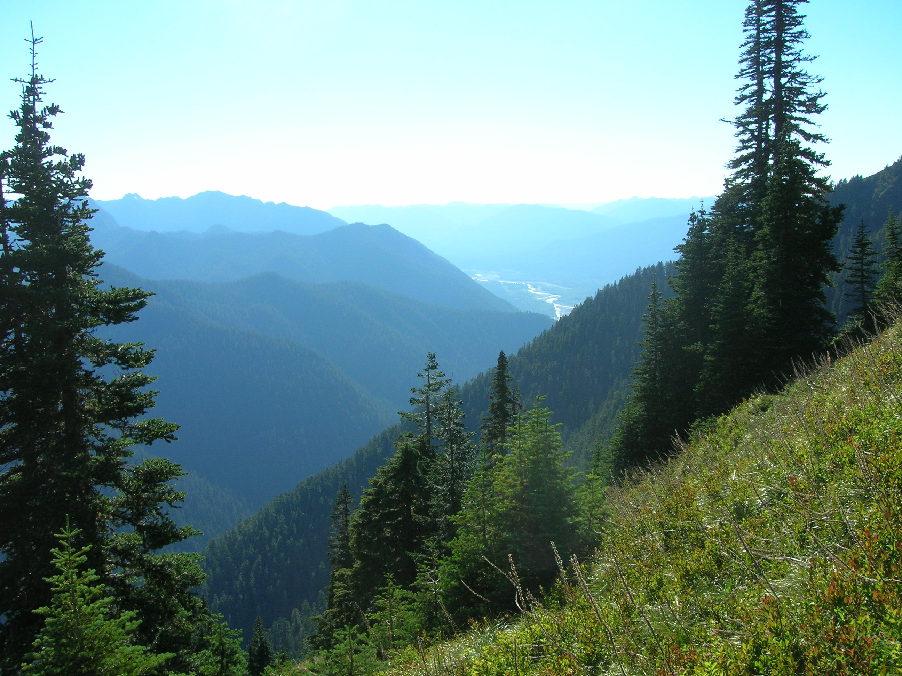
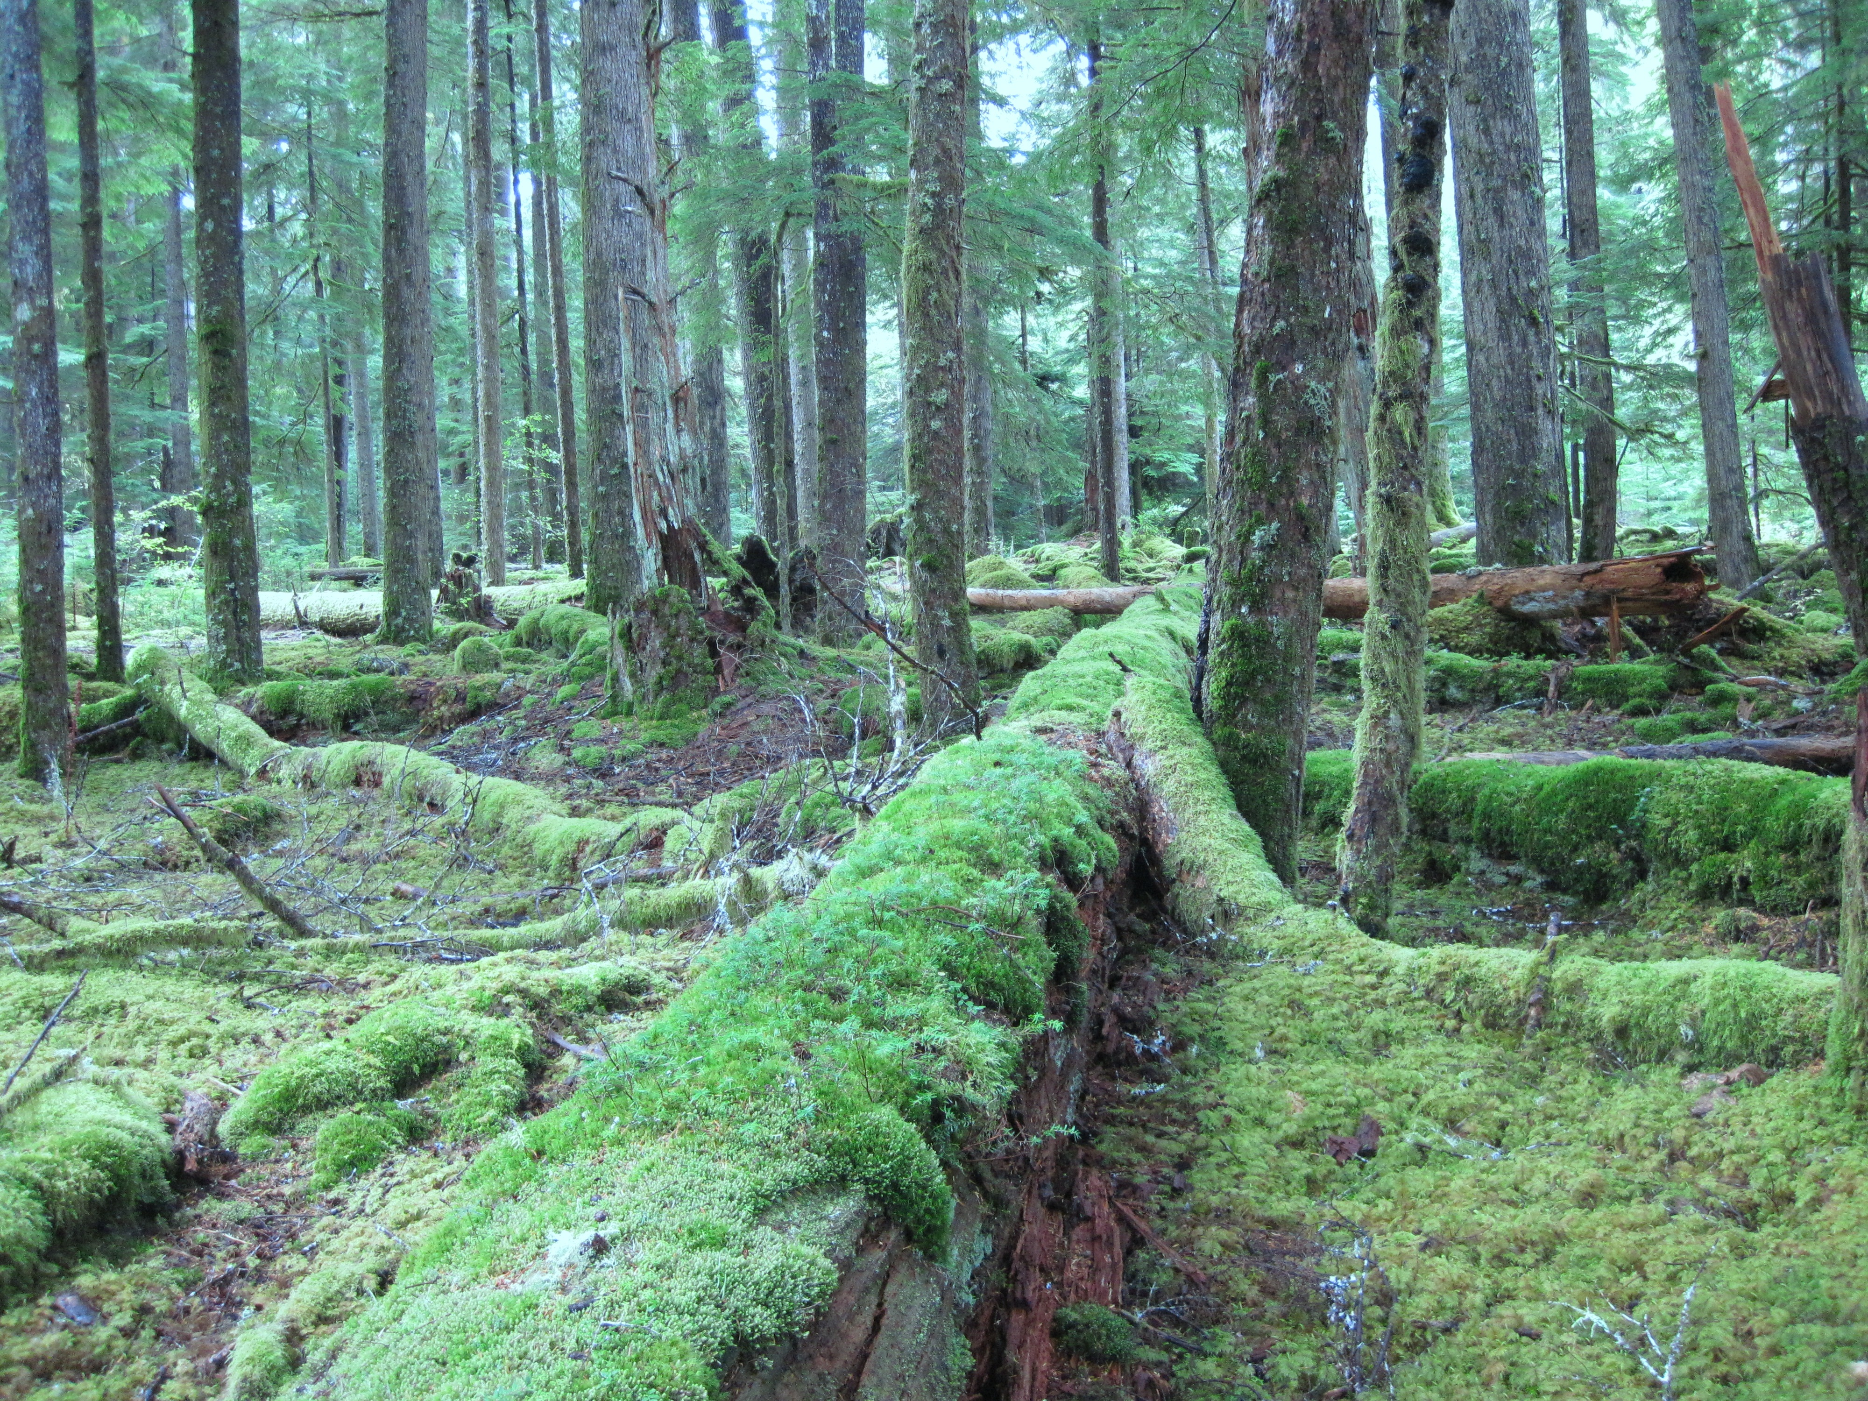
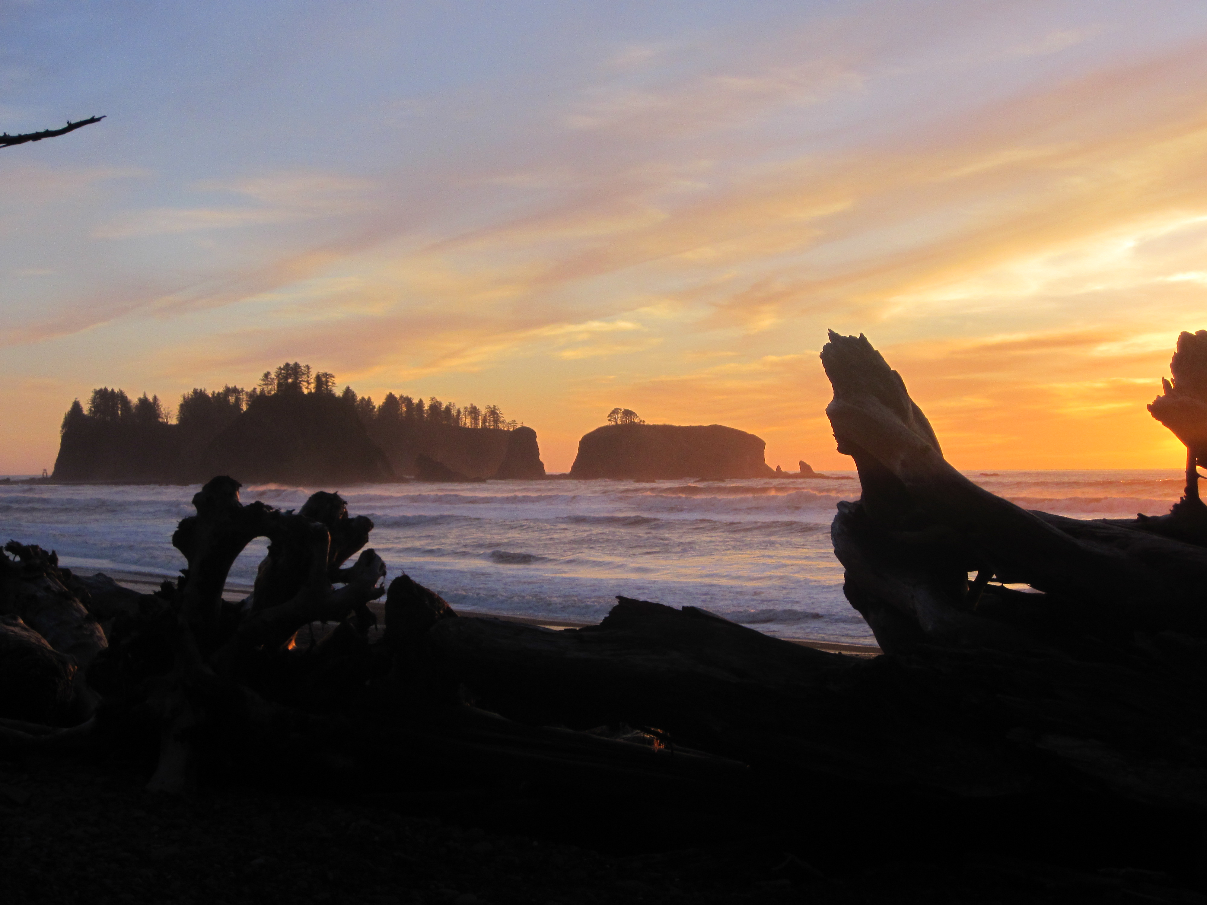
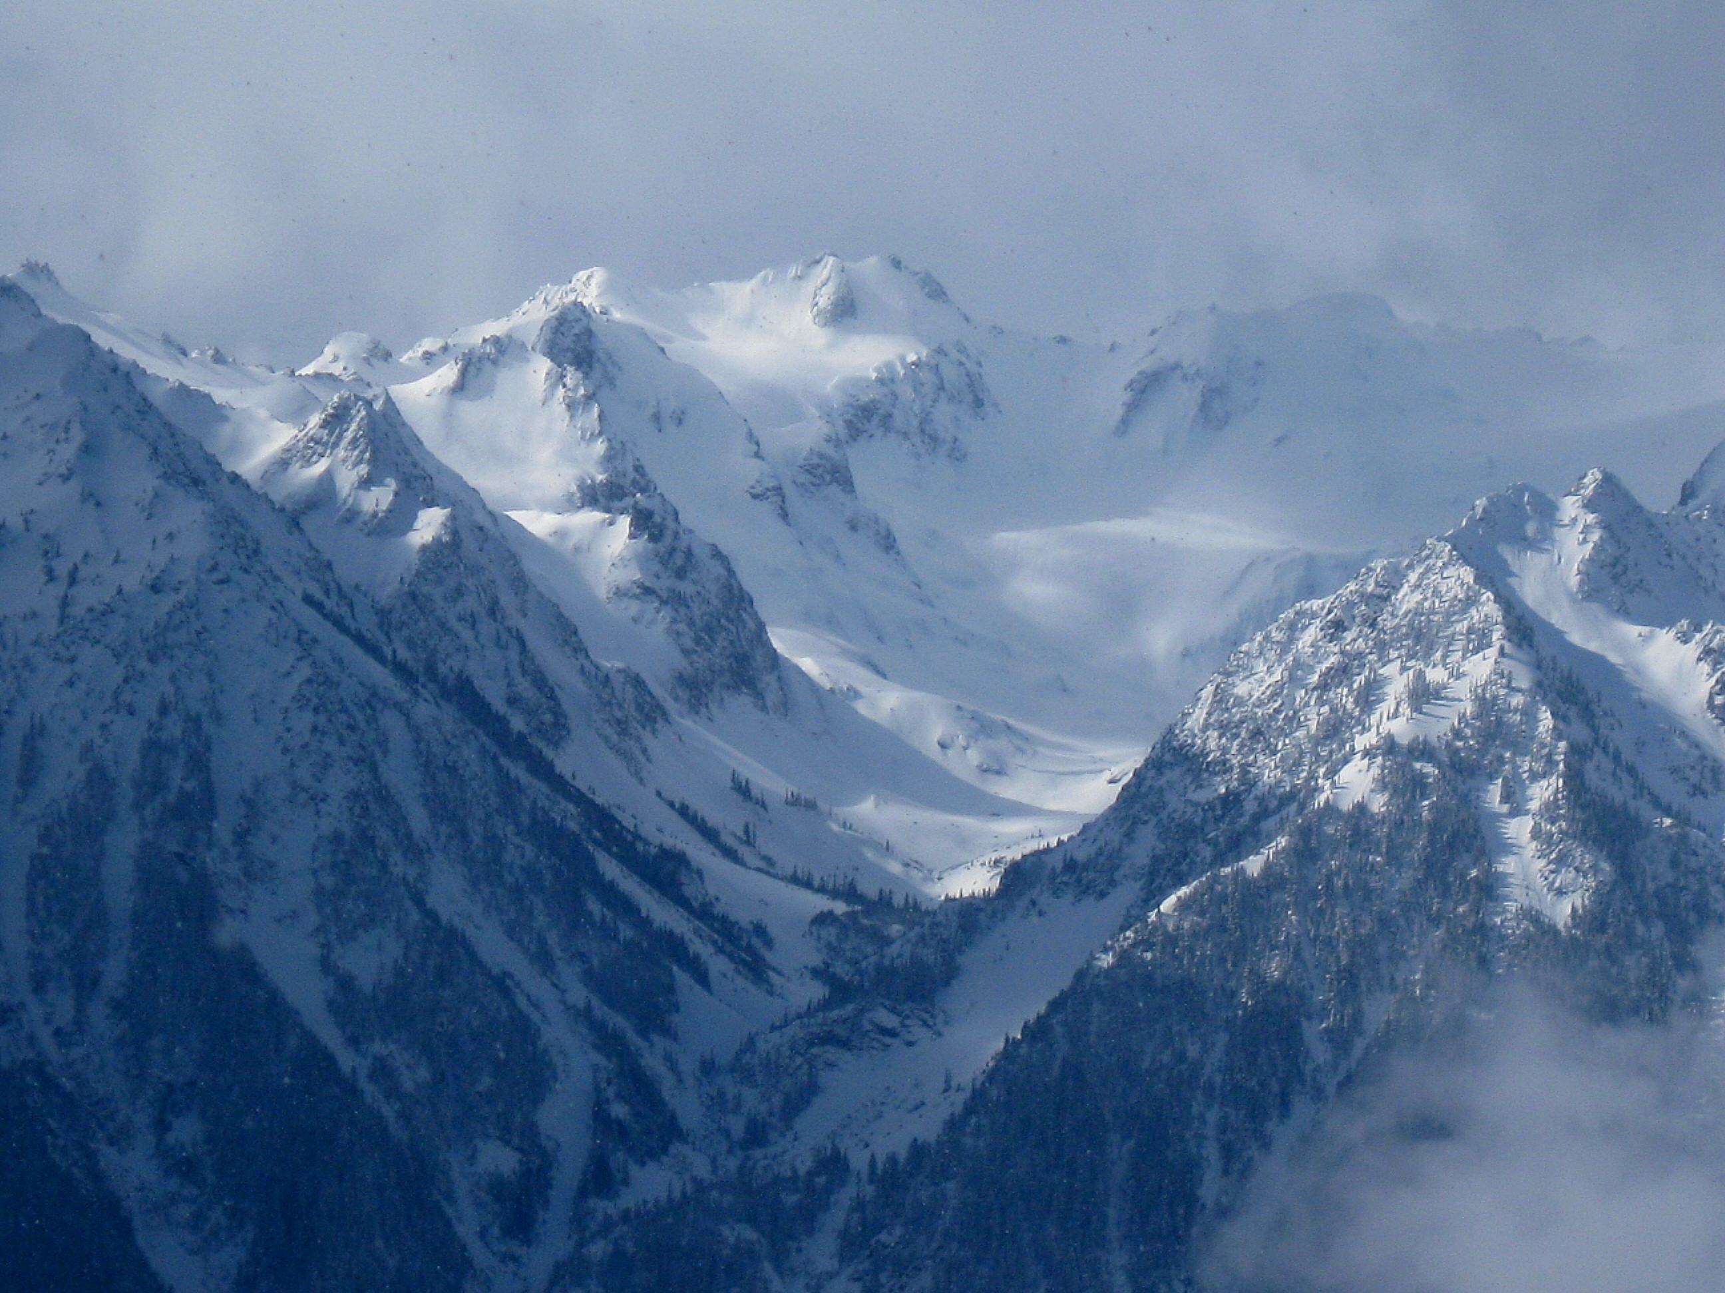
Prepared for OLYMPEX:
Breakout Session PMM 2015
Lynn McMurdie, Robert Houze, Walter Petersen, Matthew Schwaller
PMM Meeting, Baltimore, 15 July, 2015

Slide 2
Outline:
Expected weather – will keep short
Lessons learned from deployments this past year 2014-2015 – also short
Defining IOP’s and decisions
Distributing aircraft time
Scheduling
Whatever I forgot

Slide 3
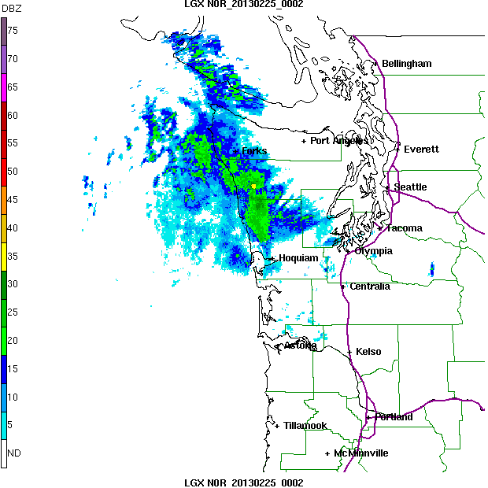
Typical Frontal Passage
Three different regimes!
Prefrontal -> Frontal -> Postfrontal
Total time of loop = 12hr
Prefrontal -> Frontal -> Postfrontal
For other case total time = 15hr
Need to keep in mind these storms can produce precip for 1-3 days
In some regimes (strong westerlies), storm frequency is
1 1/2 days – 2 days

Slide 4
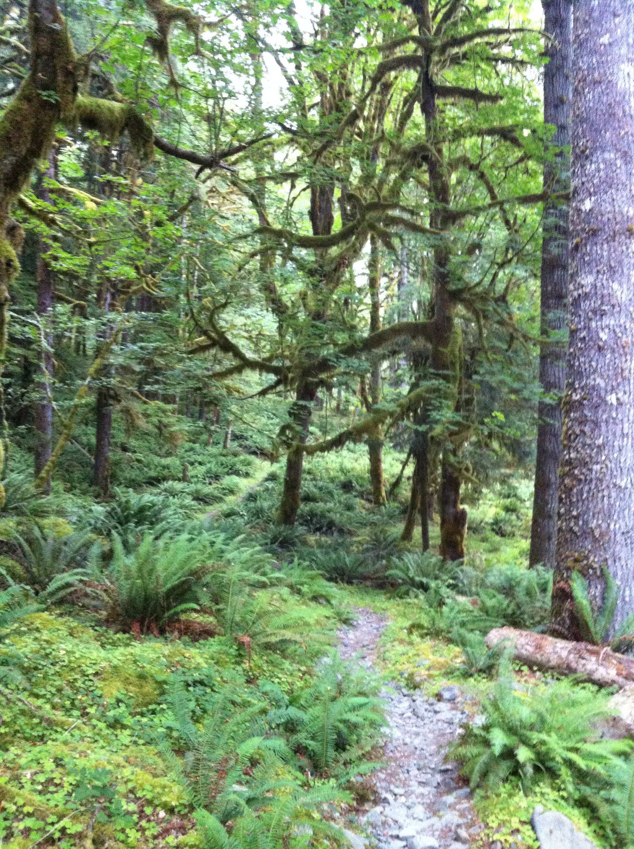
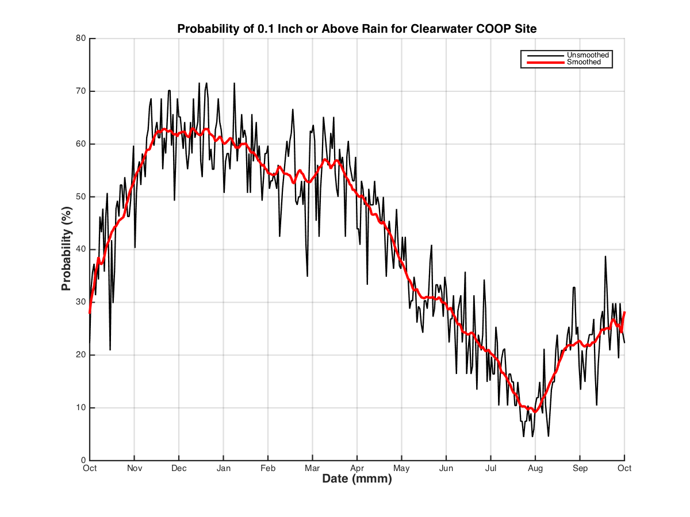
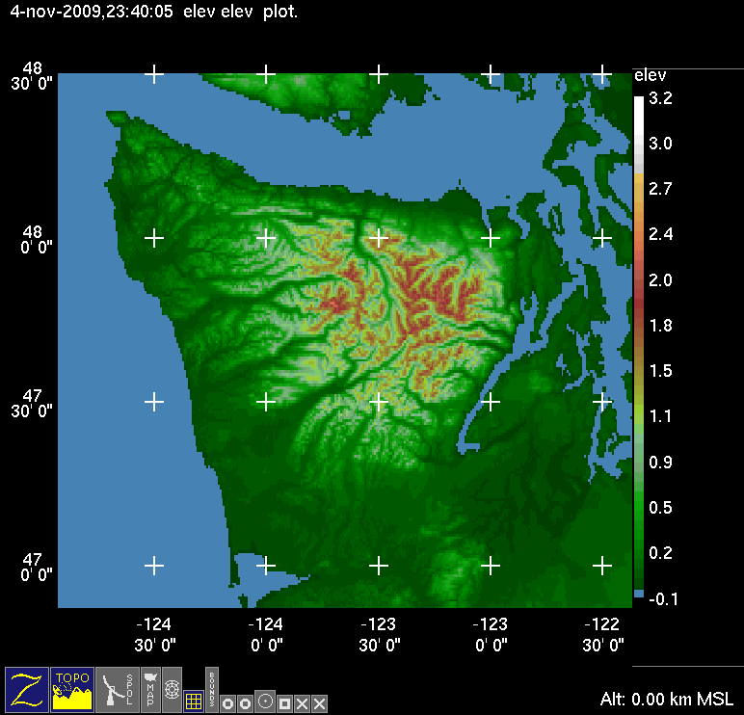
Rain Forest Climate
OLYMPEX – Nov 10 – Jan 15
60%
Probability of receiving at least 2.5 mm (0.1”) of precip
Average rainfall during Nov, Dec and Jan is 400 mm (16”) each month. Range is 75 – 750 mm (3 – 30”) from 98 years of data.

Slide 5
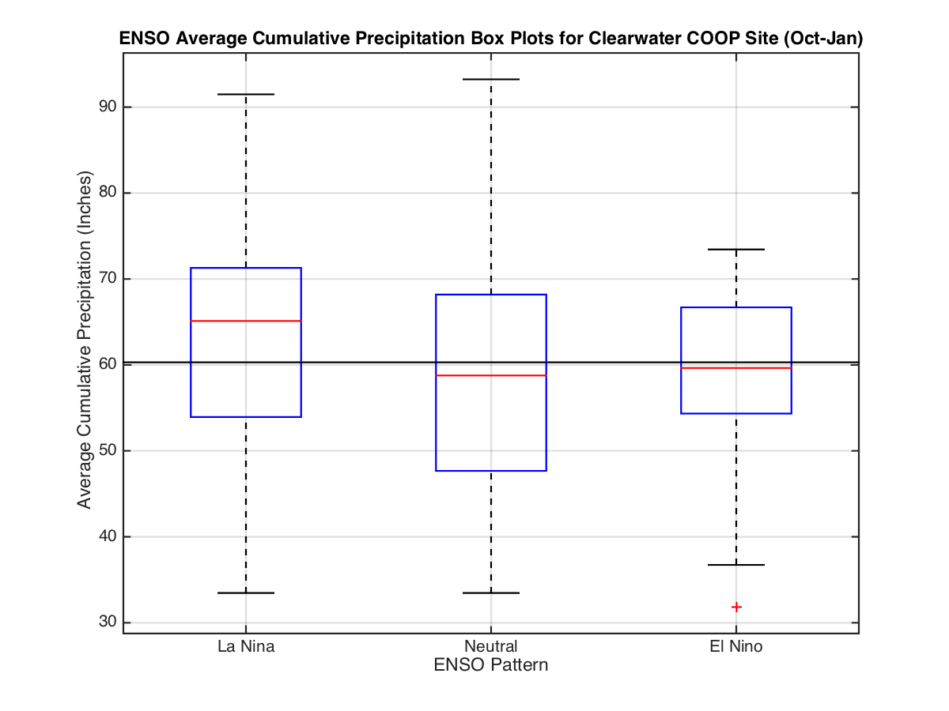
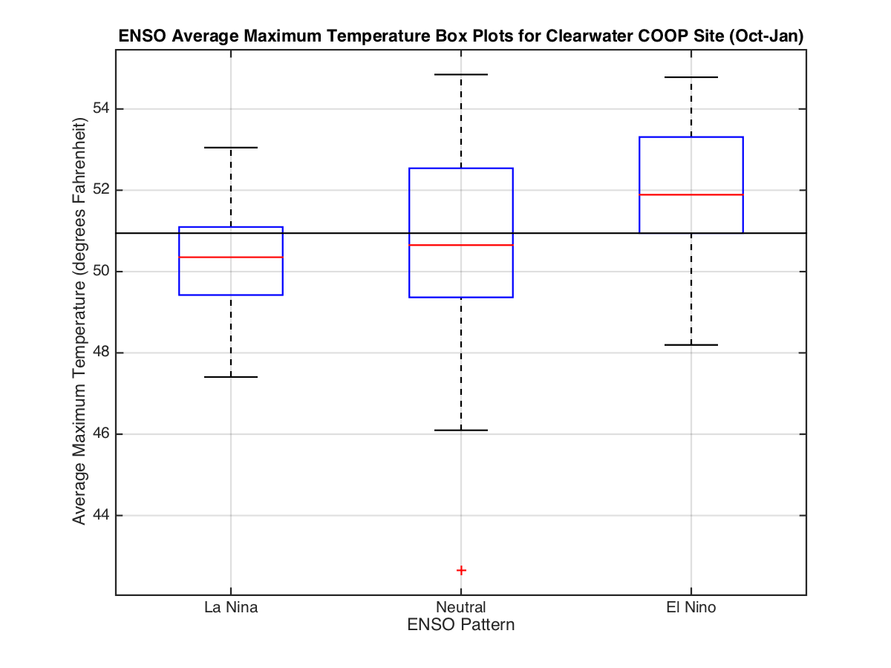
Will El Nino ruin us?
Probably Not- but not so good for snow in mountains

Slide 6
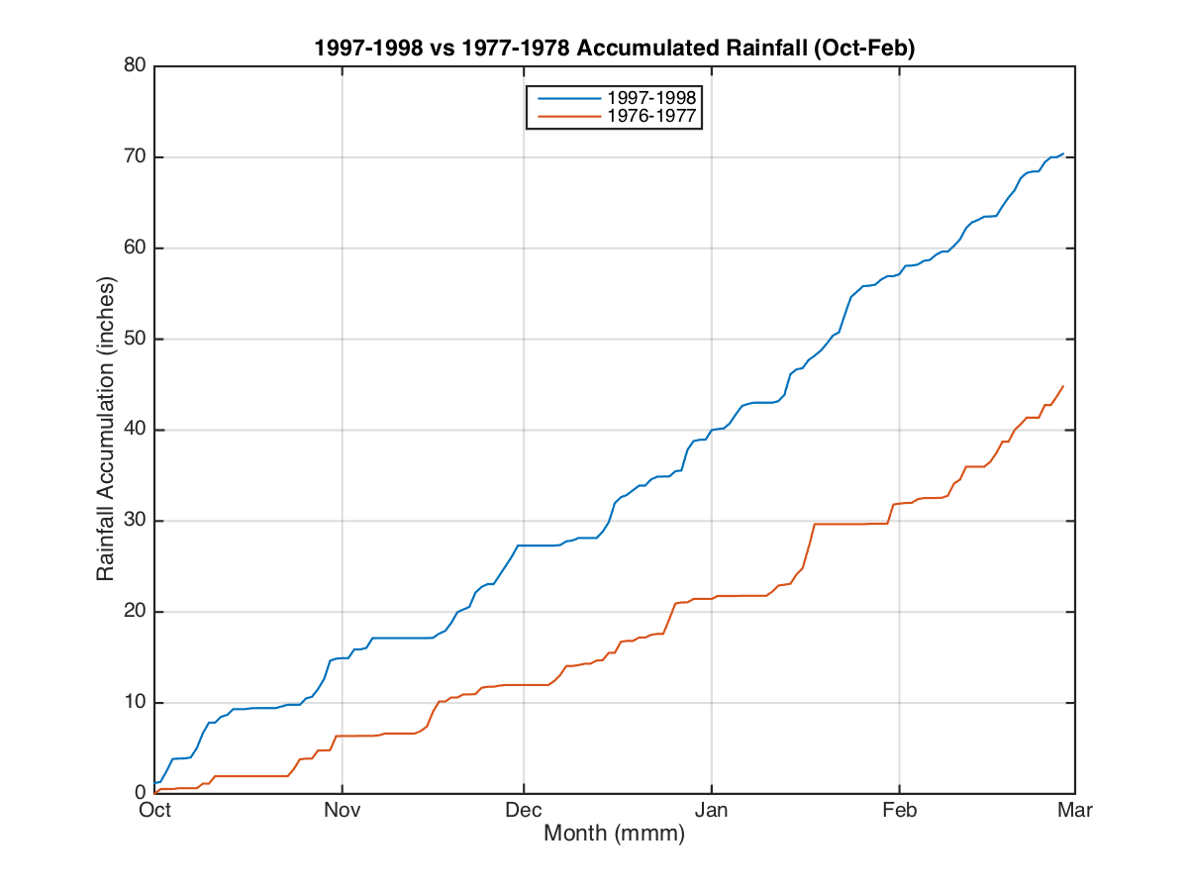
Will El Nino ruin us?
Probably Not

Slide 7
OLYMPEX objectives
Observe all 3 sectors of frontal systems
Observe storm passage from ocean to coast to upslope to leeside
Determine how precipitation processes vary between sectors
Modification of processes by terrain
Hydrology
Model experiments

Slide 8
Geographical Regions
Leeside
m
Quinault
High Terrain
Olympic Peninsula
Chehalis
Ocean
Windward side

Slide 9

Network Overview
Test deployments this winter:
Hurricane Ridge
Quinault Fisheries
Snoqualmie Pass
m
x
x
Legend
= WSR-88D
= NPOL and D3R
= DOW
= EC X-Band
= MRR
= Soundings
= SNOTEL
= Ground Obs sites
= Snow camera network = UW Tipping bucket network
= Chehalis rain gauge network
x
x
x
x
x
x
x
x
x
x
x
x
x
x
x
x
x
x
x
x
x
x
x
DC-8
ER-2
Citation

Slide 10
Lessons learned this year

Slide 11
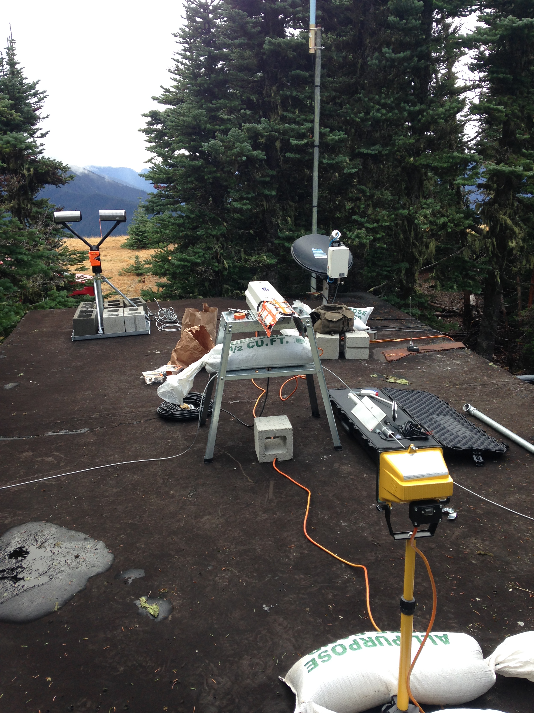
Hurricane Ridge
Communications difficult – but seemed to be solved
Strong winds during storms – SWE underestimated by hotplate
Parsivel appears noisy
PIP looks good
MRR looks good – but should vary range gates for other deployments
Not a normal year – couldn’t test out how much riming instruments may experience

Slide 12
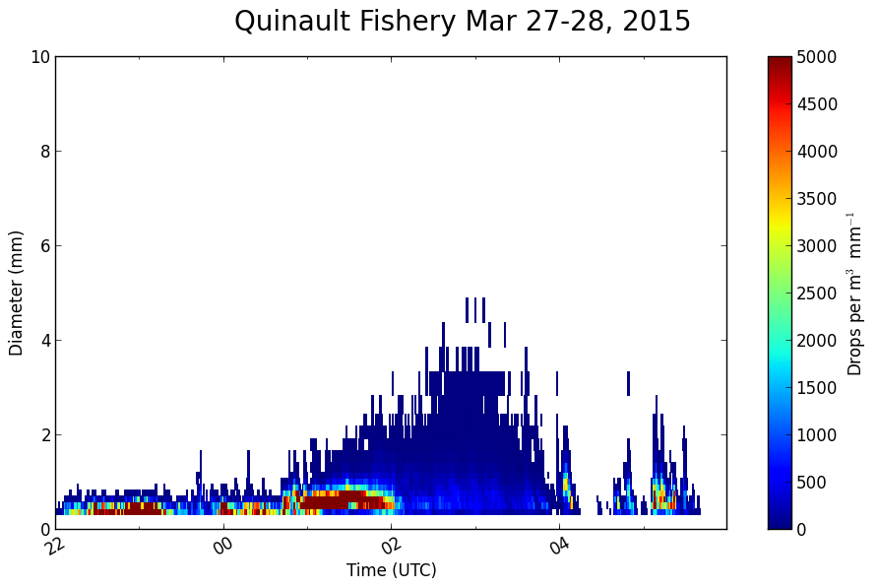
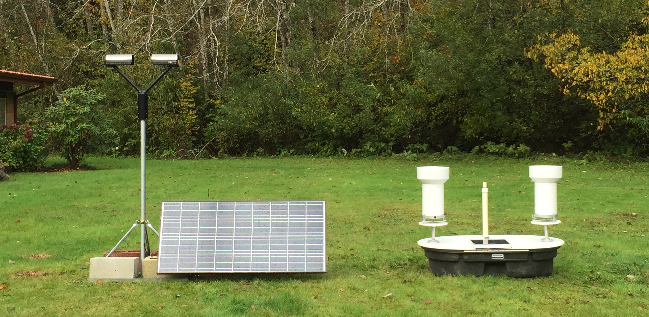
Quinault Fisheries
Solar panel + 1 battery = lasts 2-3 weeks (no direct sun in Nov-Jan)
Otherwise worked great
Dual buckets – need to change batteries every month
Testing of Low elevation site without power at the Quinault Fish Hatchery ongoing

Slide 13
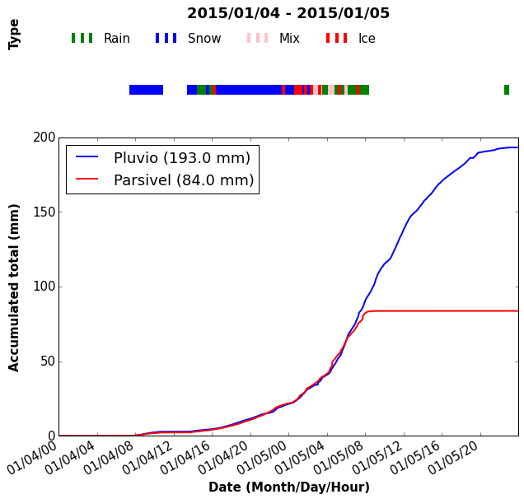
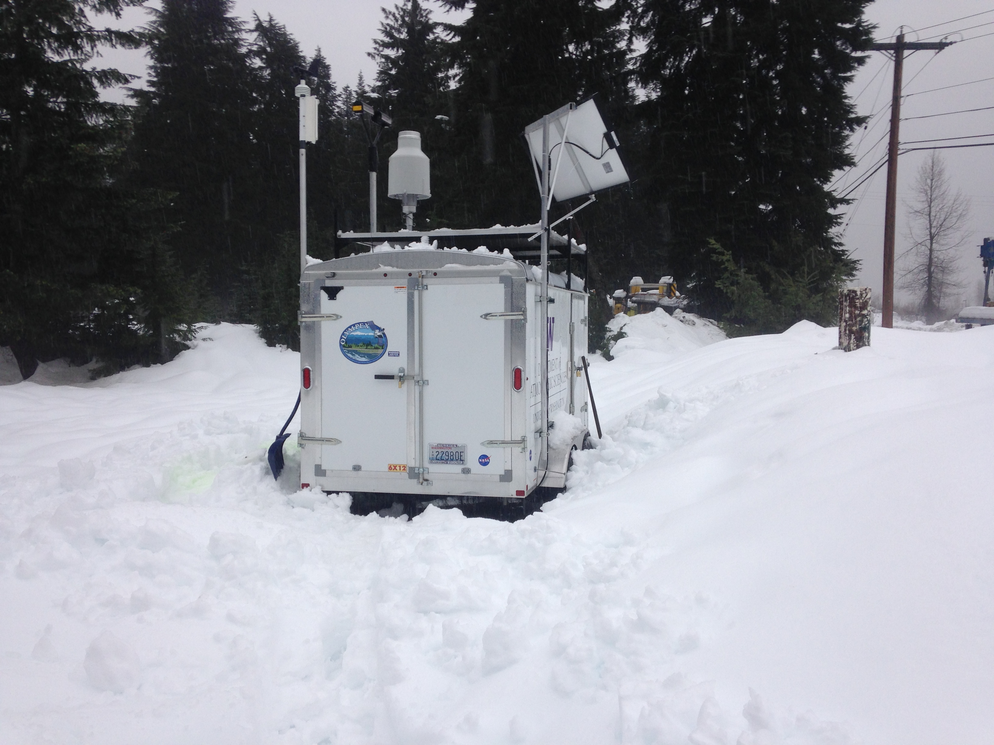
Snoqualmie Pass – Test for high elevation, no power
Solar panel + 8 battery = lasted all winter (it was sunnier than normal)
If continuously rainy/cloudy, maybe last 1 ½ - 2 months
Pluvio needs to be emptied every 3-4 weeks (could be more often)
Locations for next year will have no cell coverage – testing other ways for communication
Some interesting data collected this year – Pluvio and Parsivel compare well

Slide 14
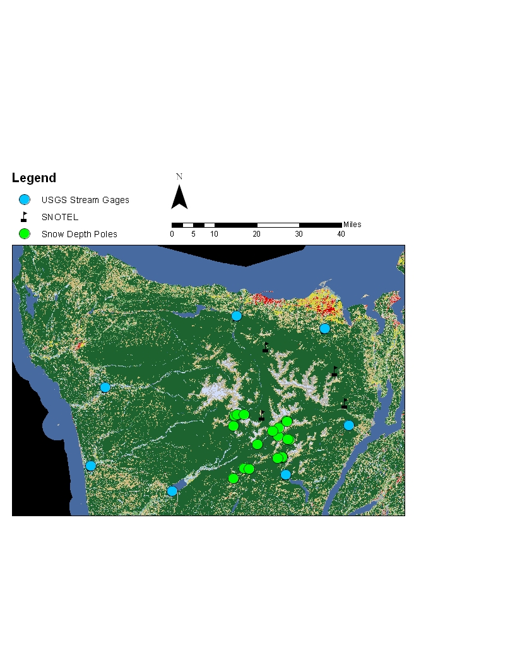
Snow camera installation at 18 locations on Olympics
Had some unexplained camera failures
Some pole damage due to winds and avalanches
The WORST snow year EVER – 14% of normal in the Olympics
Temperature sensors worked well documented that average winter temperature at all locations > 0°C

Slide 15
Reminder of ground network: Radar
Significant investment in documenting the structure, characteristics and distribution of precipitation and how they change with complex terrain

Slide 16
Defining a IOP for OLYMPEX
Weather forecast predicts an approaching storm….
Decide if this storm system will help us achieve our OLYMPEX goals and should be an IOP
Decide when to start sounding launches (at NPOL, at UIL, and at Vancouver Island) and make sure all radars are operating
As storm progresses – increase frequency of soundings?
Decide if/when/which aircraft fly
Decide if/when/how many dropsondes DC-8 launches
Weather determines the IOP

Slide 17
Keeping track of hours
Flight hours (includes transit to/from WA)
  DC-8 = 80
  ER-2 = 54 (daylight)
  Citation = 75, OLYMPEX has 60 (RADEX has 15)
  Want to stick to semi-regular schedule if possible
Soundings – how many do we have???
  NPOL =100
  X-band =80
  UIL=?
  Dropsondes = 60
Keep table of all this, including down days
10am planning meeting, make decisions about Day 1, and Days 2, 3-5. Can adjust a little for take off time
Others?

Slide 18
Distributing aircraft time
Between different regions: offshore, windward, high terrain and leeside
Between different storm sectors: prefrontal, frontal, postfrontal
Between OLYMPEX and RADEX (which has different goals, mostly focusing on offshore region)

Slide 19
Operations Center Personnel – suggested roles:
Operations Director (Head Honcho)
  Oversees everything, MC at the daily briefings
  Science Focused person – making sure that OLYMPEX goals are being met with operations
  Decides if it is an IOP and coordinates all operations
Flight Director OLYMPEX
  Oversees DC-8 and Citation flight operations
  Decides aircraft flight patterns and timing of flights
  Coordinates with Operations director and RADEX flight director
Flight Director RADEX
  Oversees ER-2 and Citation (20% of time) flight operations
  Decides flight patterns and timing
  Coordinates with Operations director and OLYMPEX flight director
Aircraft coordinator – Jan Nystrom and aircraft personnel
Mission Scientist on the planes – DC-8 and Citation???
Reminder (for me) – NASA online software for keeping track of flight tracks/weather/radar etc. realtime during flights – logins, etc.

Slide 20
Operations Center Personnel cont.
Soundings Director
  Coordinates soundings at NPOL, X-band and UIL
  Keeps tabs on readiness and instrument issues
  Reports during daily briefings
Radar Director
  Coordinates radar operations at NPOL, D3R, X-band, DOW
  Reports during briefings
Ground Director
  Works with Matt Wingo on status of ground sites
  Coordinates with ground crew and National Park person
  Reports during briefings

Slide 21
Operations Personnel – boots on the ground
Forecasters
  Will have 12 hr shifts, twice a day, 2 people/shift, with lead + help
  Give weather briefing 10am, afternoon updates, preflight briefing
  Support flight operations with Flight directors and Jan Nystrom
Soundings at NPOL
NPOL Radar operations
  Operates NPOL with NASA personnel
DOW operations
  Operates DOW with DOW personnel
Ground site maintenance
  Works with Matt Wingo and NPS personnel
  May need to hike up to Upper Quinault to charge batteries, empty Pluvio (13 mile hike in rain)
  May need to go to Trailer (9 miles) on mountain bike/ski/hike to empty Pluvio

Slide 22
SIGN UP
NOW!!

Slide 23
End

Slide 24
Acknowledgment
This work is supported by the National Aeronautics and Space Administration grants NNX13AG71G & NNX14AO64G

