Slide 1
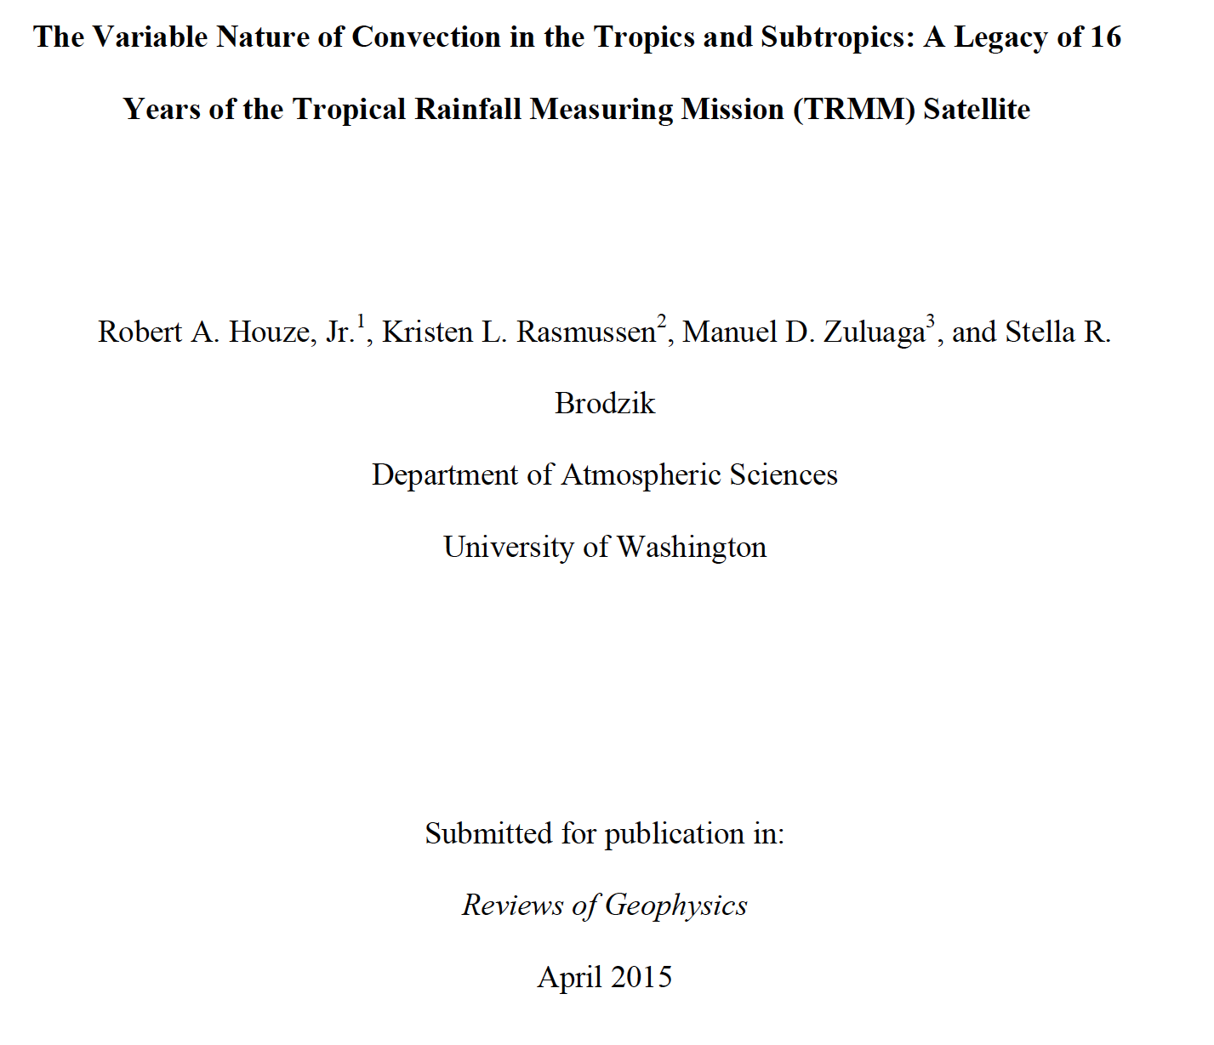
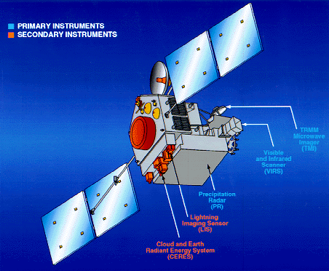
Different Forms of Broad Stratiform Rain Areas
Robert A. Houze, Jr.
PMM Science Team, Baltimore, 14 July 2015

Slide 2
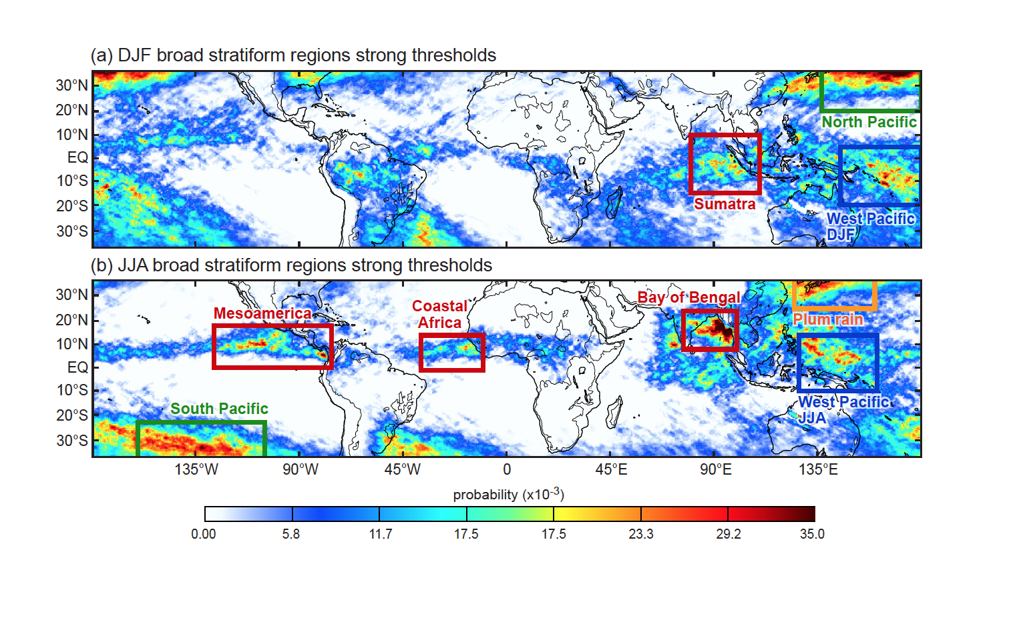
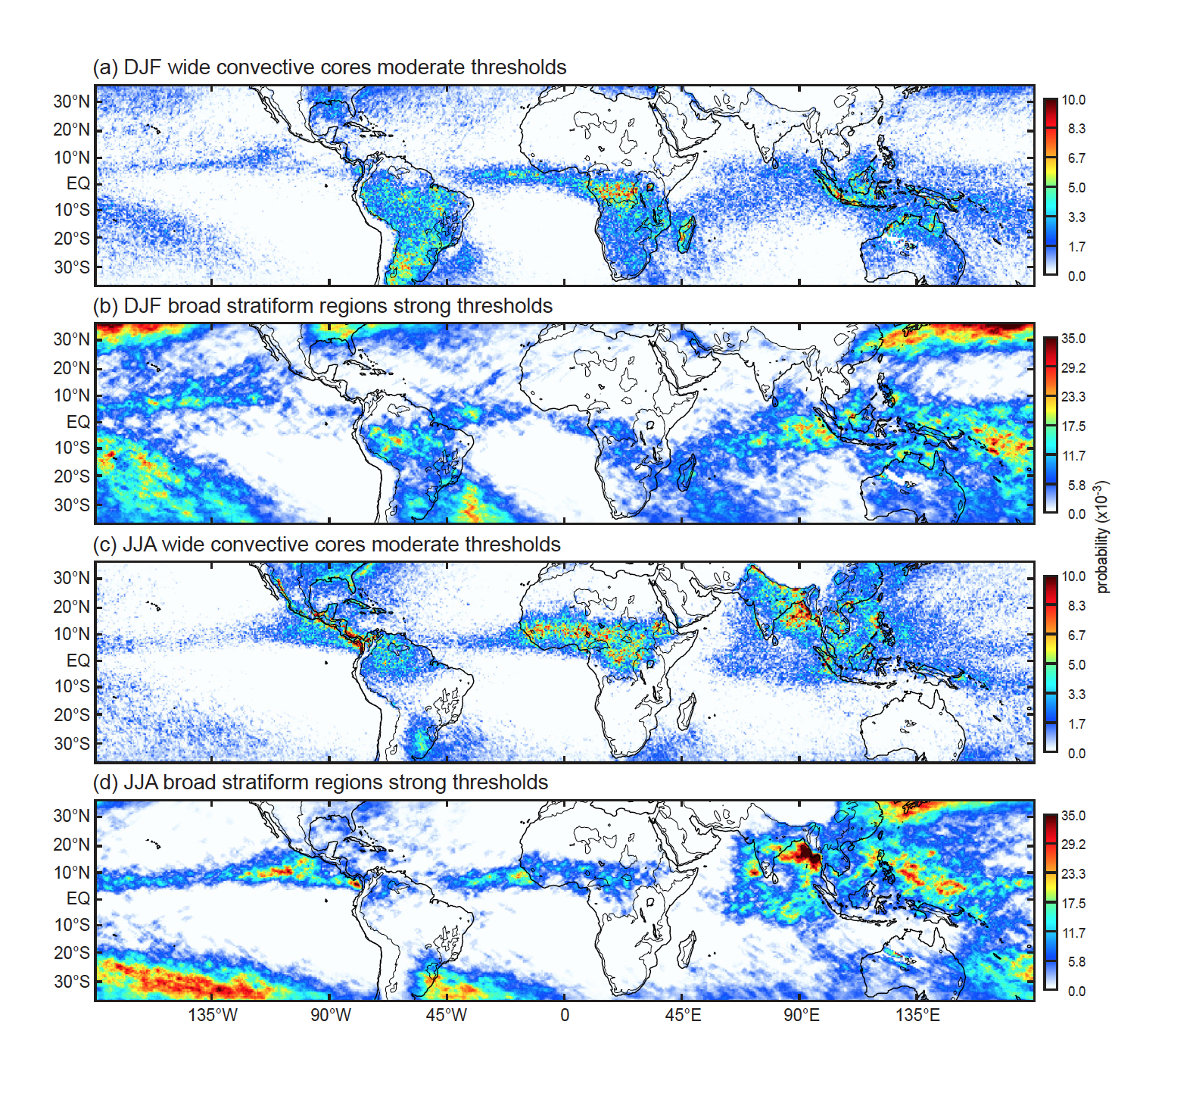
Regions of Frequent Broad Stratiform
Notes:
Looking at BSRs in both winter & summer in both hemispheres—
Several regimes: warm pool, monsoonal ITCZ, frontal, plum

Slide 3
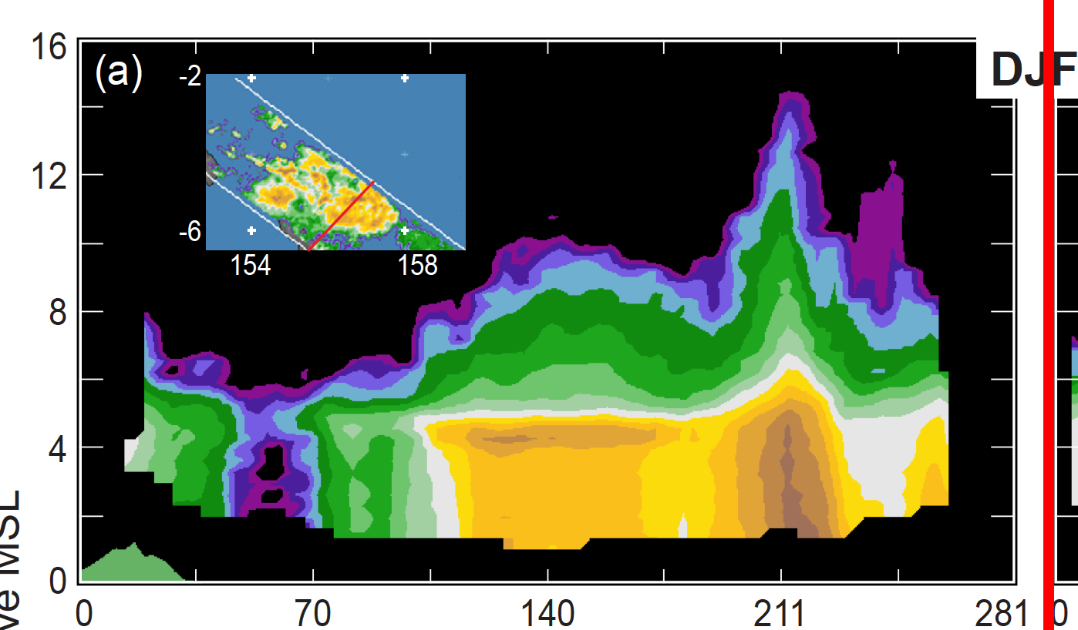
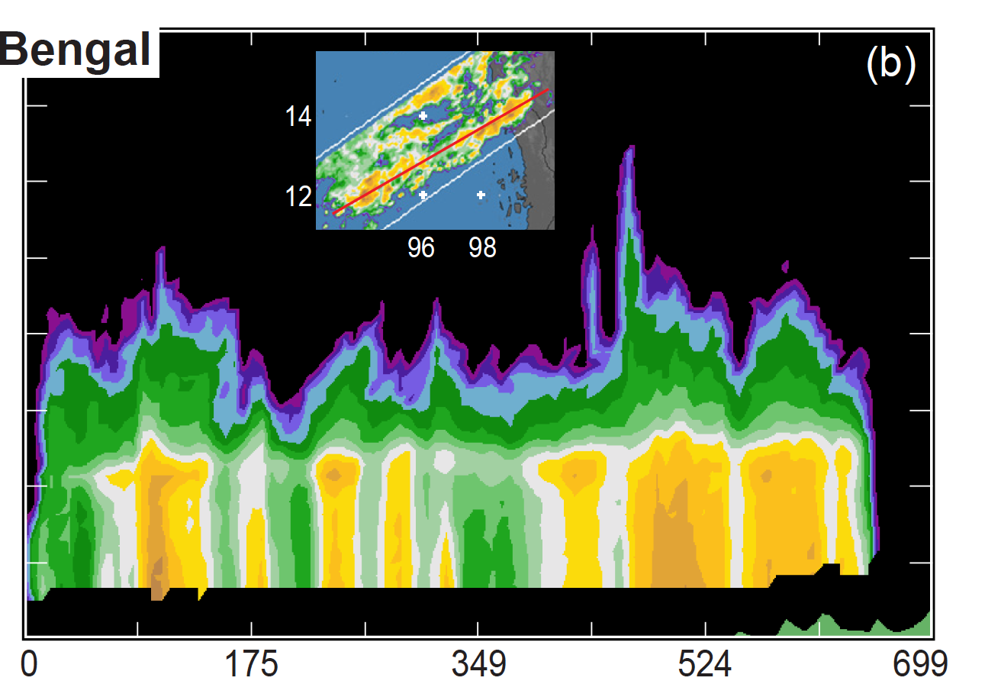
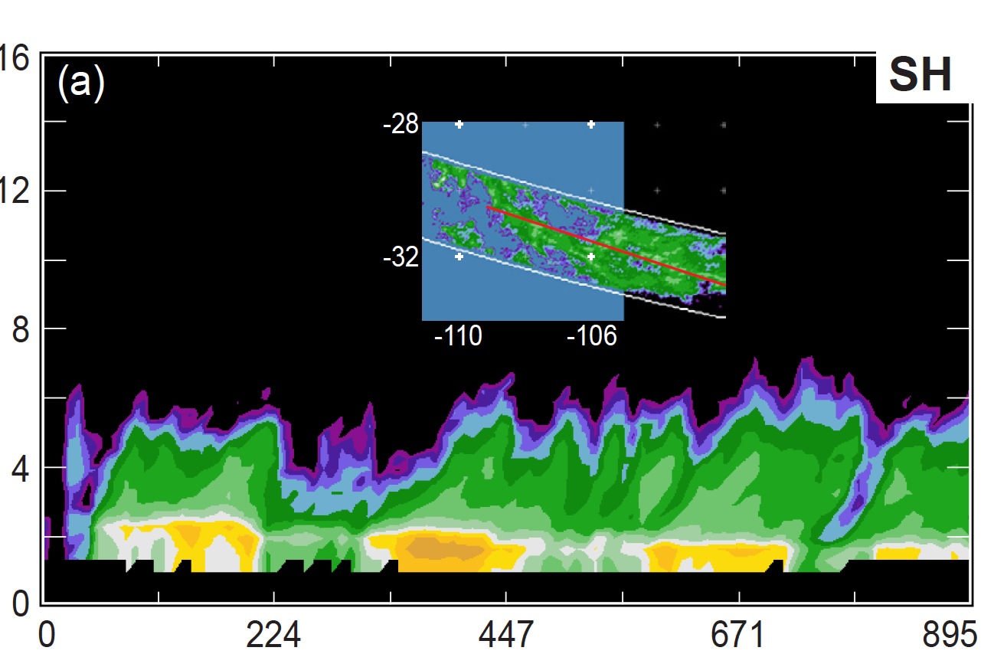
West Pacific
Km
Visualization software views of broad stratiform region echoes
Bay of Bengal
12
Height (km)
8
4
Km
Frontal system
Km

Slide 4
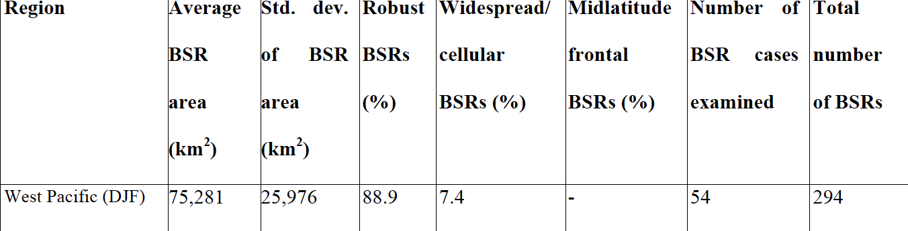
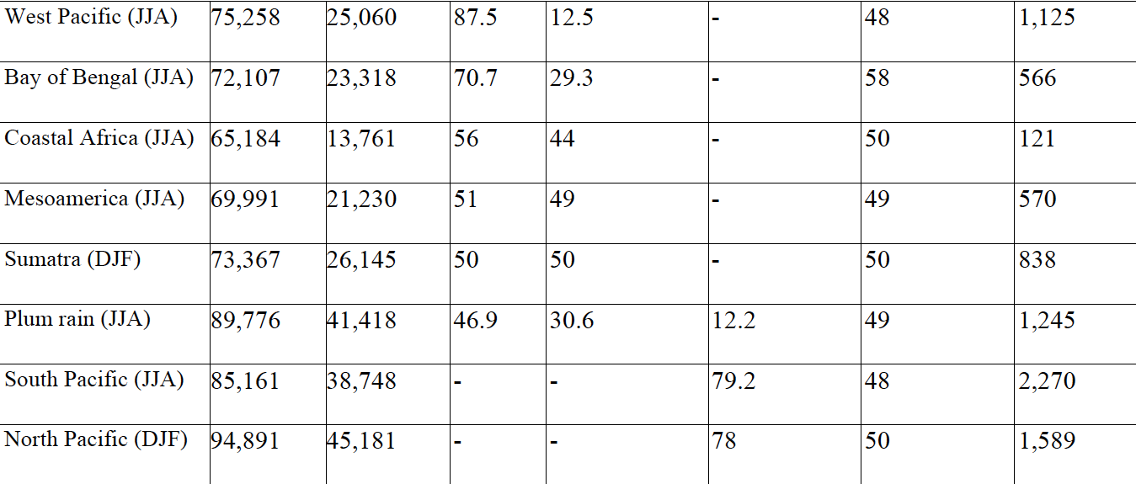
(Meiiyu, Baiu, Jangma)

Slide 5
END
This research is supported by: NASA grant NNX13AG71G

