Slide 1
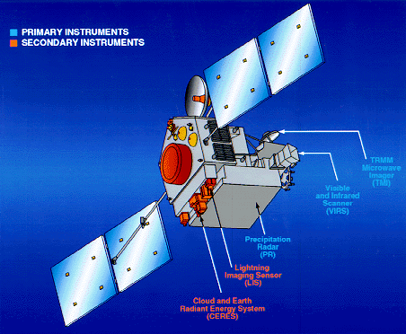
The Variable Structure of Convection at Low Latitudes
Robert A. Houze, Jr.
TRMM Celebration, Baltimore, 13 July 2015

Slide 2
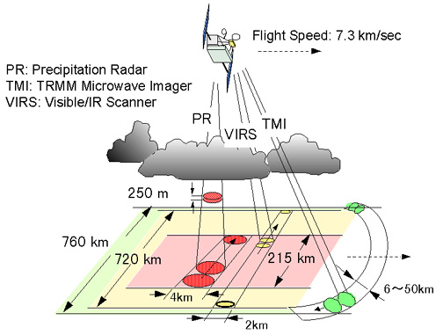
TRMM Instruments
λ= 2 cm
Important! Radar measures 3D structure of radar echoes
PR: Precipitation Radar λ = 2 cm
>
Kummerow et al, 1998
Notes:
Recall
TRMM PR samples a 3D volume.
We can
plot a histogram showing frequency of occurrence of reflectivity values at each altitude.

Slide 3
Re-map and interpolate the PR reflectivity field
Satellite
Interpolate
Geolocate

Slide 4
Use remapped interpolated data to:
View PR data in visualization software
Objectively identify 3D echo objects indicative of convective lifecycle stage

Slide 5
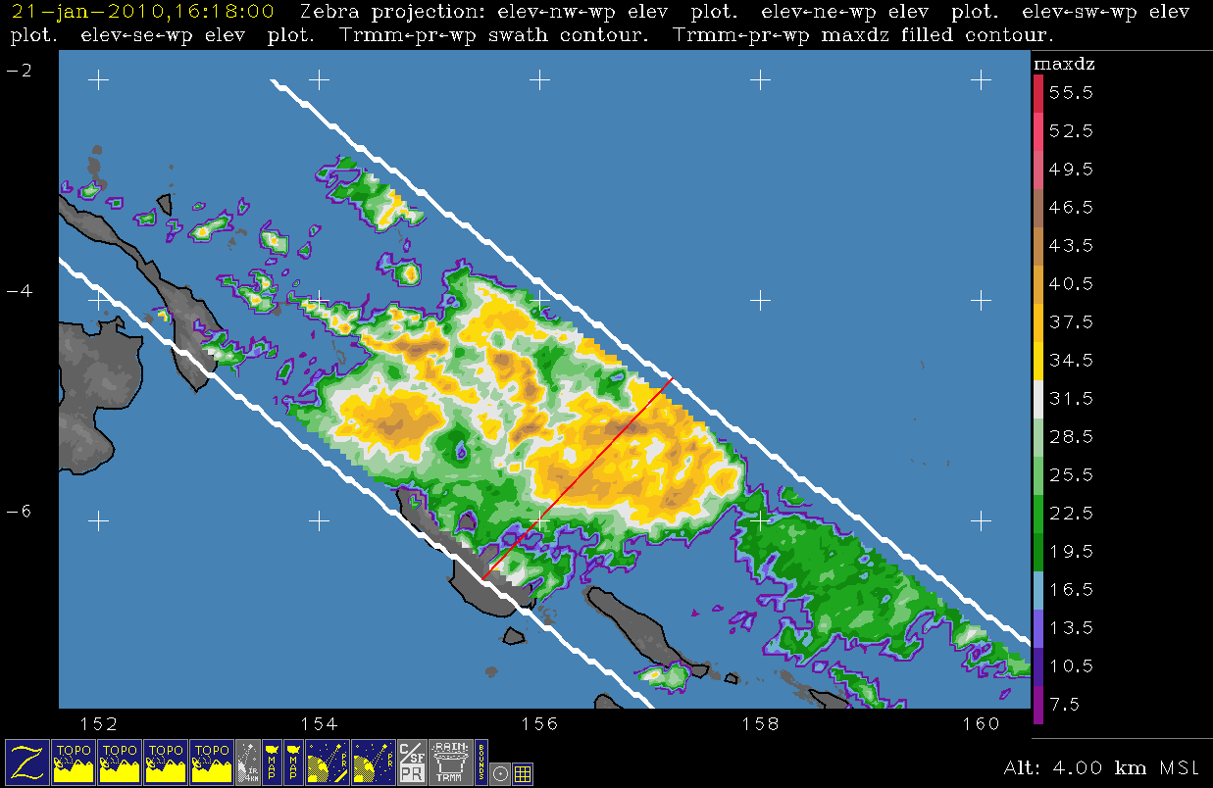

Slide 6
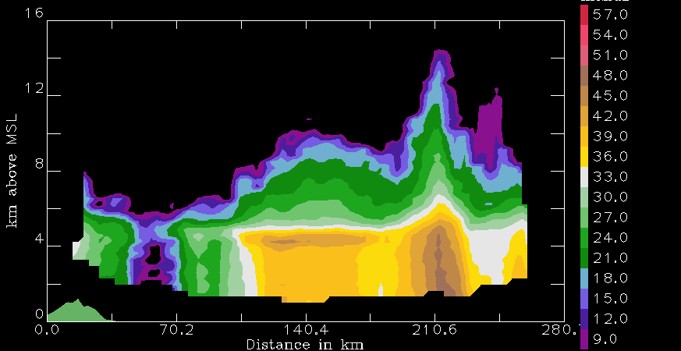
TRMM algorithm subdivisions
Other
Stratiform
Convective

Slide 7
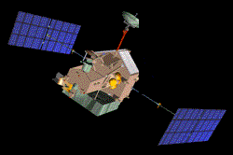
Convective cores
3D convective echo bounded by threshold dBZ
echo core
land
Type | Threshold | Width | Height
Shallow-isolated | 17 dBZ | 2 pixels | < 5 km
Deep-strong | 40 dBZ |  | >10 km
Deep-moderate | 30 dBZ |  | > 8 km
Wide-strong | 40 dBZ | >1000 km²
Wide-moderate | 30 dBZ | >800 km²
Notes:
First we will look at echoes identified as “convective” byTRMM.
To do this—identify 3D echo “cores” that are EMBEDDED in larger echoes
Deep cores—associated with young, extremely vigorous convection
Wide cores—indicate where intense convection is aggregating and growing upscale into mesoscale systems
Two categories—we find strong categories are better indicators of processes over land, moderate better over oceans
Shallow isolated—are generally warm rain showers or small cumulonimbus clouds—fall into the category of “congestus”

Slide 8
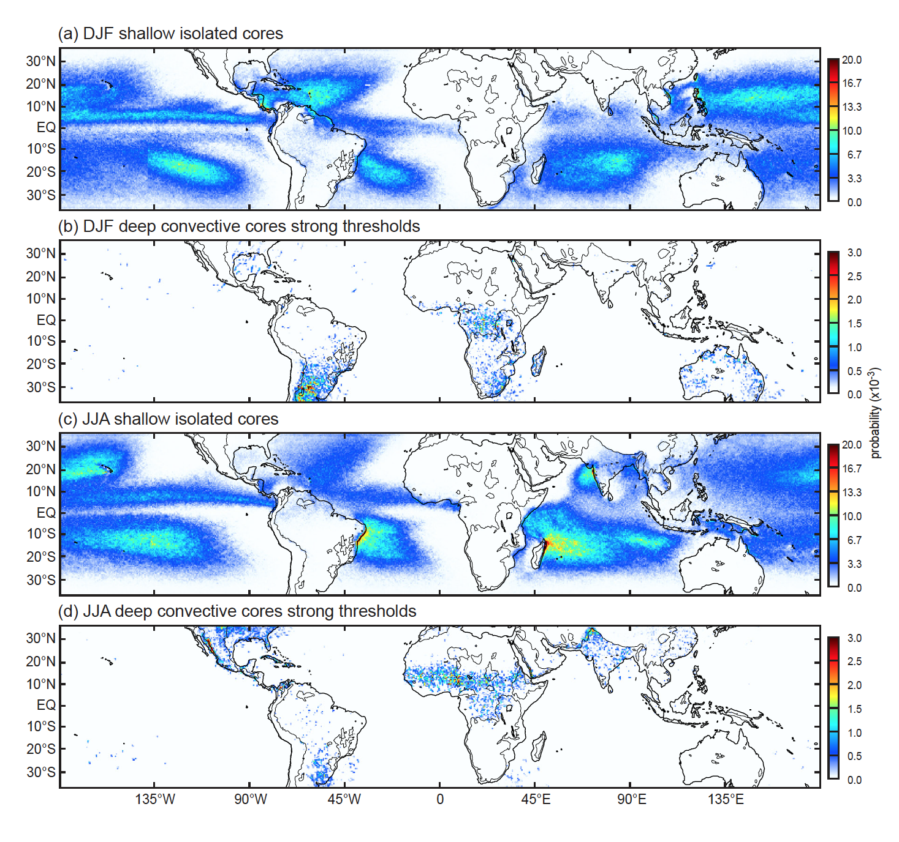
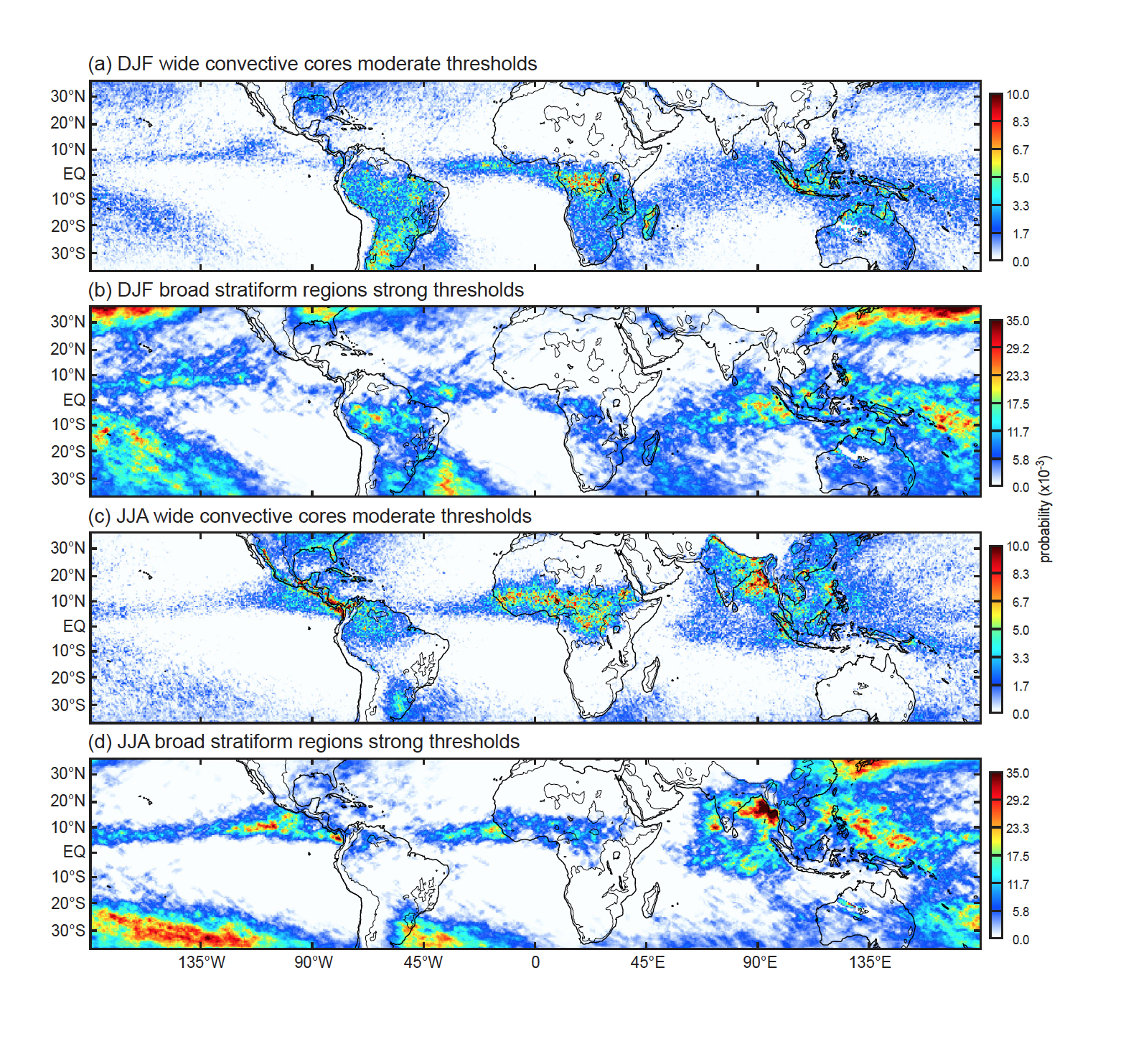
Shallow-isolated and Strong-deep in DJF
Notes:
Sample of results
Because of time limitation—showing only DJF
Shallow isolated echoes—are an oceanic phenomenon
Deepest, most intense, embedded cores--continental

Slide 9
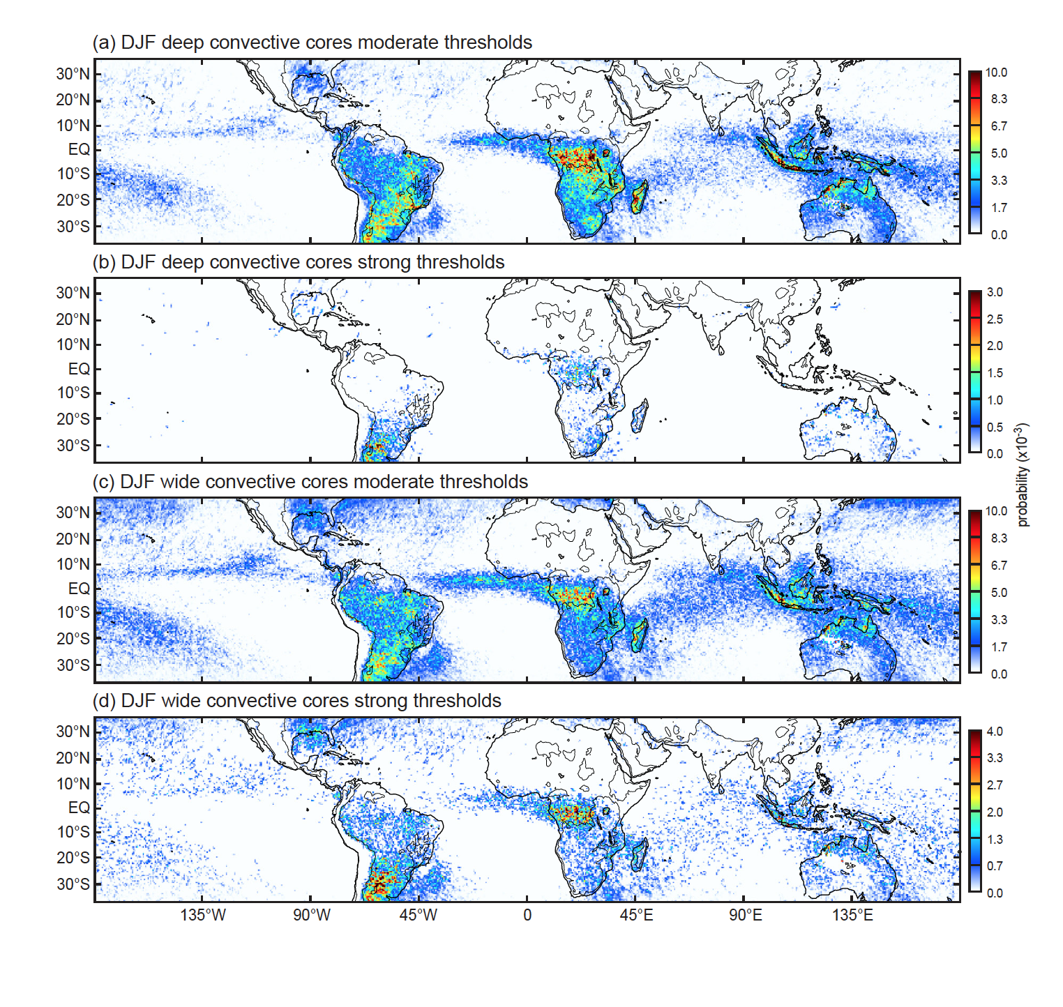
Deep and Wide in DJF
Notes:
As noted…wide cores are those growing upscale
This shows
Mesoscale development much more widespread than the occurrence of extremely deep/intense convective core occurrence
Close correspondence of moderate deep conv. cores and mesoscale development
The rainiest regions—Amazon, MC, & Gulf coast—have mesoscale development from mostly moderately deep & intense convection

Slide 10
Broad stratiform regions
Look for ones that are broad and contiguous
Stratiform echo volume
land
Type | Width
Strong | > 50,000 km²
Moderate | > 30,000 km²
Notes:
First we will look at convective echo structure in the TRMM data.
To do this—
identify 3D echo “cores”

Slide 11
Wide Convective and Broad Stratiform in DJF
Notes:
Broad stratiform regions
Manifest in regions of wide convective cores, i.e. where mesoscale aggregation & organization occur—globally
Manifests more strongly over oceans—wherever mesoscale organization is happening
Over land regions where the most intense deep & wide convective systems occur, stratiform development is not especially strong.
Over semi-oceanic regions—Amazon, MC, and Gulf, BRSs manifest more strongly than regions where mesoscale conv. aggregation manifests most strongly

Slide 12
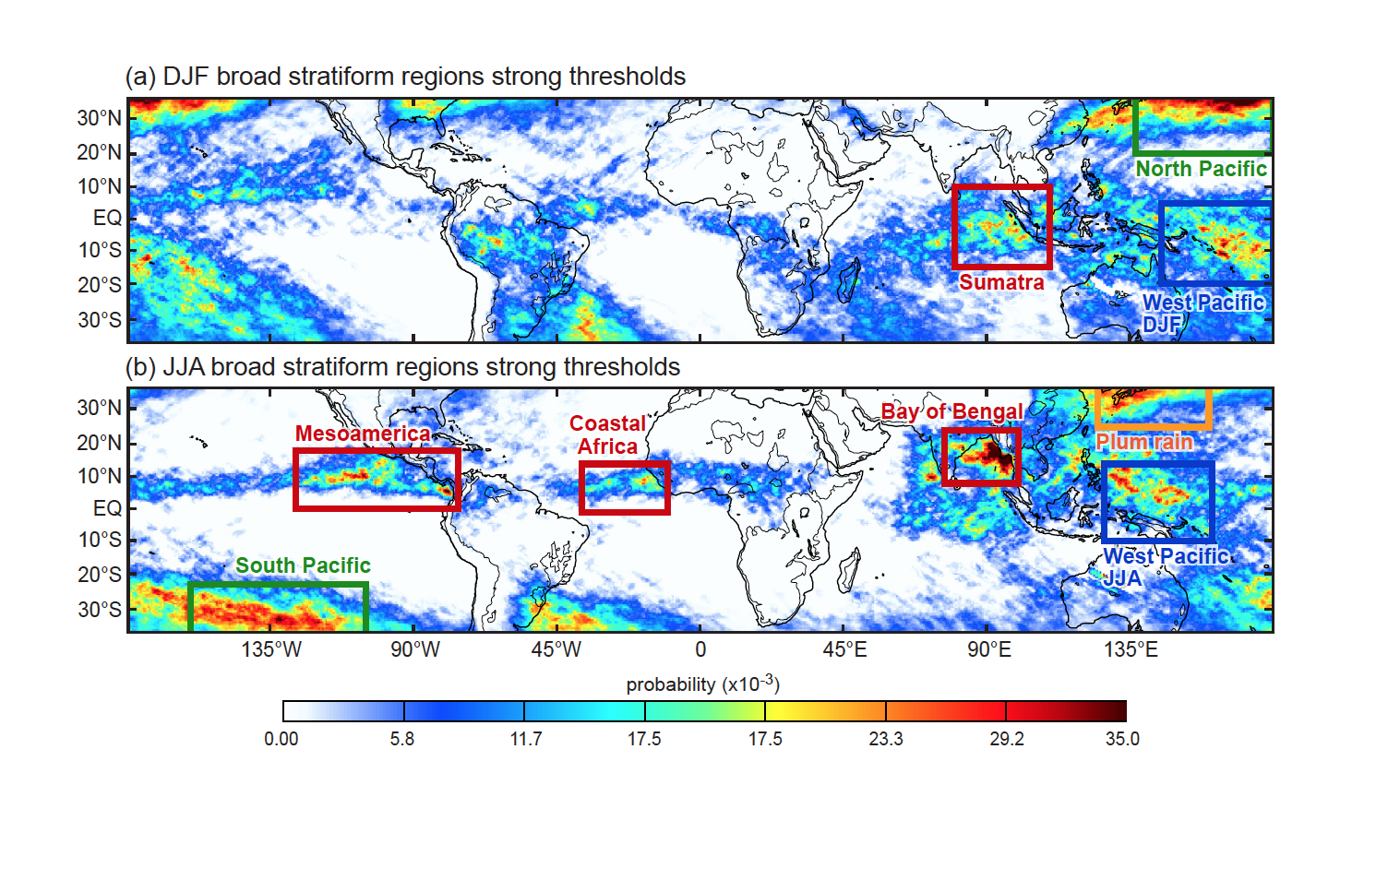
Regions of Frequent Broad Stratiform
Notes:
Looking at BSRs in both winter & summer in both hemispheres—
Several regimes: warm pool, monsoonal ITCZ, frontal, plum

Slide 13
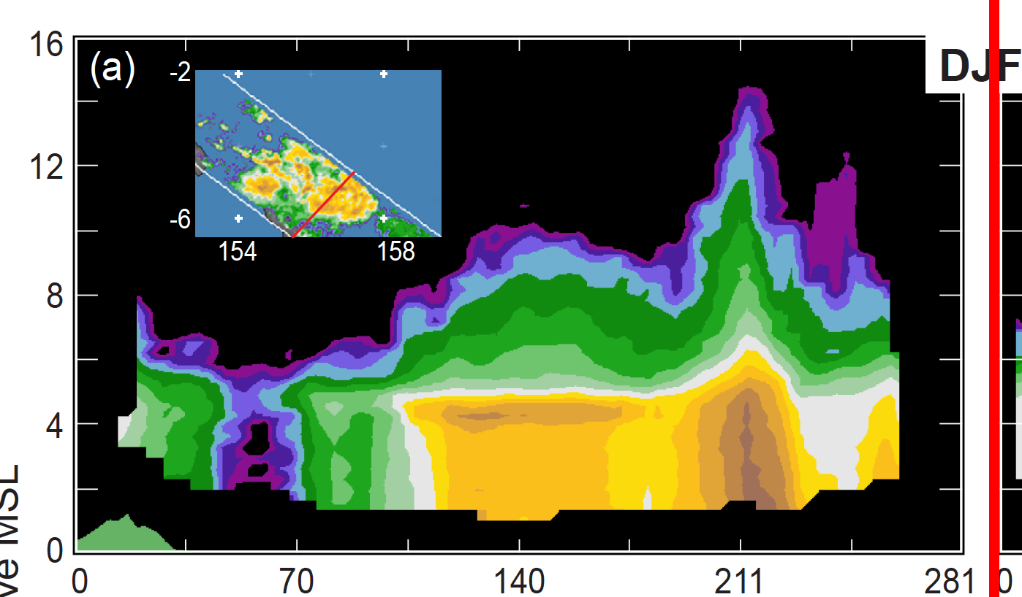
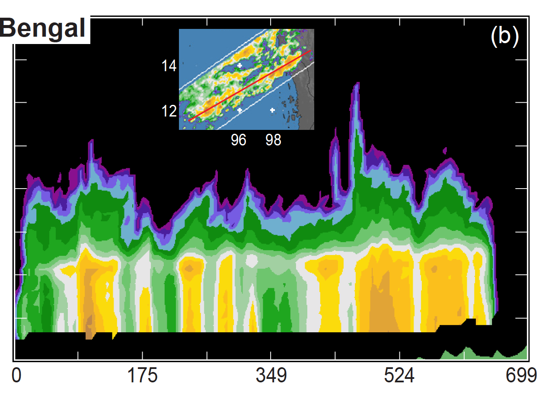
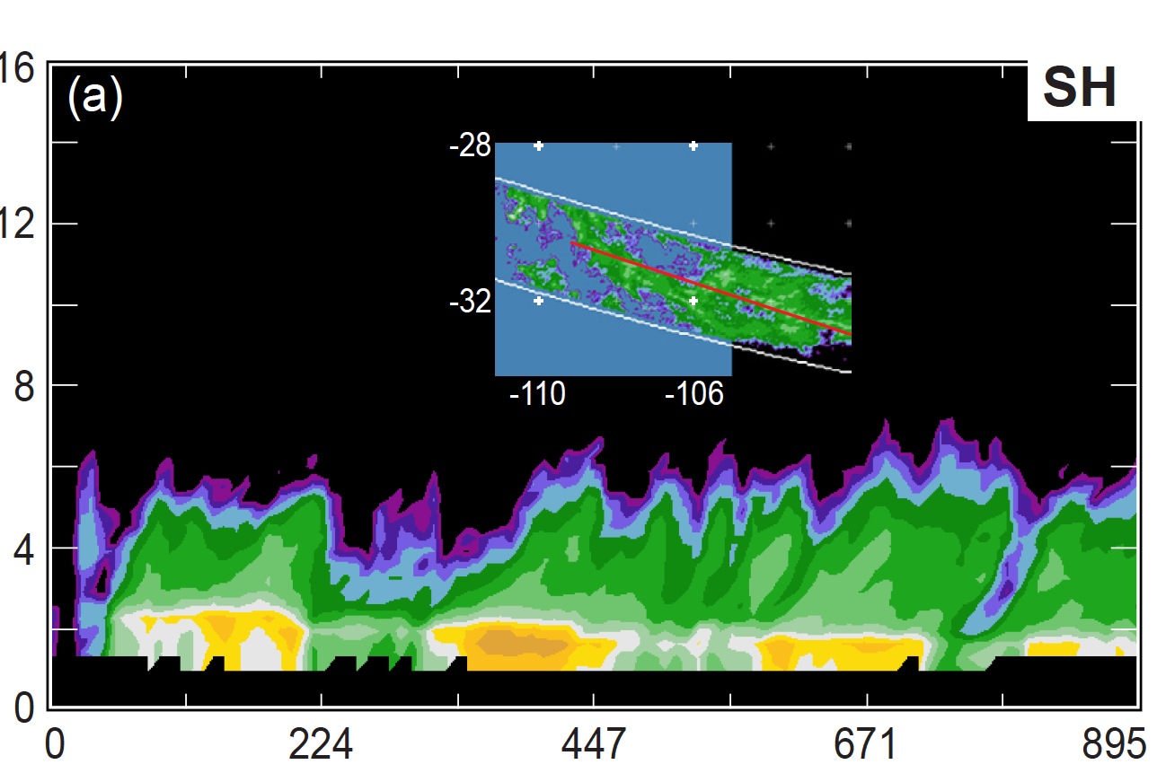
West Pacific
Km
Visualization software views of broad stratiform region echoes
Bay of Bengal
12
Height (km)
8
4
Km
Frontal system
Km

Slide 14
Lifecycle stages of convection seen by TRMM
Convective cores
Shallow isolated echoes—oceanic
Deep intense cores—continental
Upscale growth of convection (“aggregation,” “organization”)
Associated with less deep & intense conv. Cores
Stratiform development
Wherever mesoscale aggregation occurs
Mostly oceanic and semi-oceanic
Less strong over land regions—where convection is strongest
Stratiform structure
Mesoscale system type—over open tropical oceans
Weak cellular form—in ITCZ and monsoonal coastal regions
Frontal—over subtropical oceans

Slide 15
For more details, see:
Houze, Rasmussen, Zuluaga, and Brodzik (2015, Reviews of Geophysics, in minor revision)
And our new web portal:
trmm. atmos.washington.edu

Slide 16
END
This research is supported by: NASA grant NNX13AG71G

