Slide 1
Microphysical characteristics of orographic precipitation: Insights from TiMREX and beyond
Angela Rowe and Robert Houze, Jr.
University of Washington
2015 US-Taiwan Extreme Precipitation and Weather Workshop
Taipei, Taiwan
29 May 2015

Slide 2
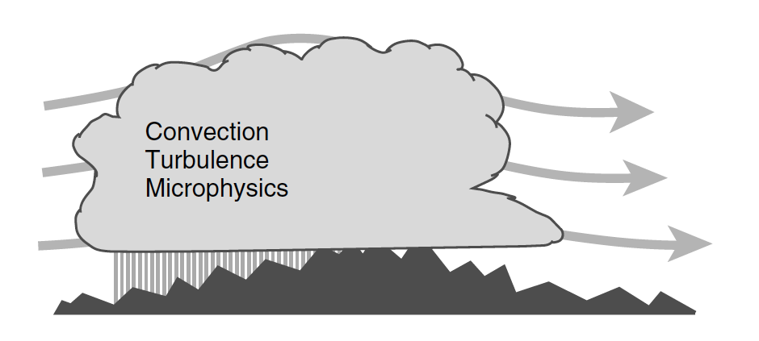
Orographic precipitation
Alteration or reorganization of one of three major storm types (convective clouds, tropical cyclones, frontal systems) when it encounters topography
  Both convective and stratiform components affected by flow over and around topographic features
Results from a complex combination of different scales of motion:
  Moist, large-scale flow
  Mesoscale orographically induced lifting
  Small-scale processes (convection, turbulence, microphysics)
Rotunno and Houze (2007)

Slide 3
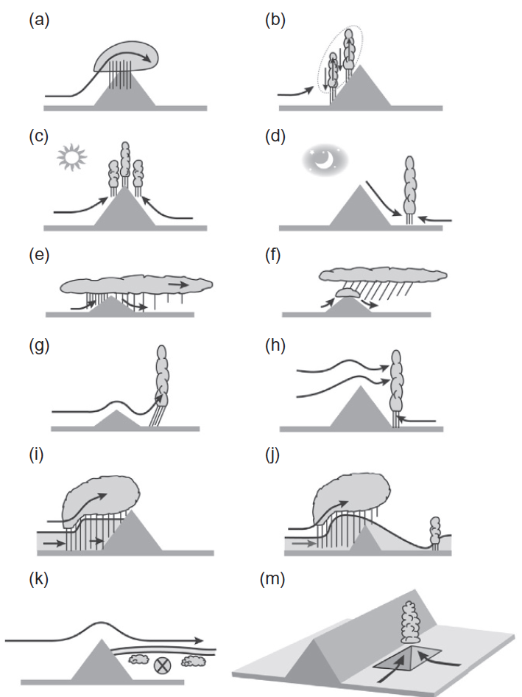
Orographic precipitation
Dynamics and thermodynamics of airflow, geometry of terrain, and microphysics affect growth and fallout of precipitation
Microphysical factors
  Concentration, size, aerosol
  Precipitation generated from upward air motion/microphysical growth processes on windward side most robust at lower levels
Houze (2012)

Slide 4
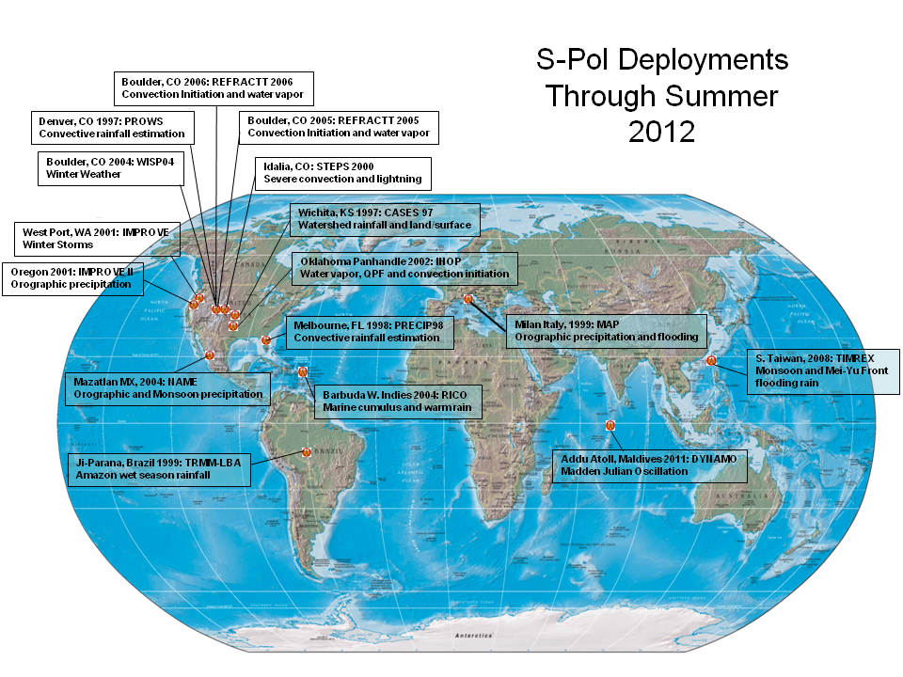
S-Pol

Slide 5
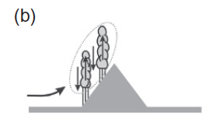
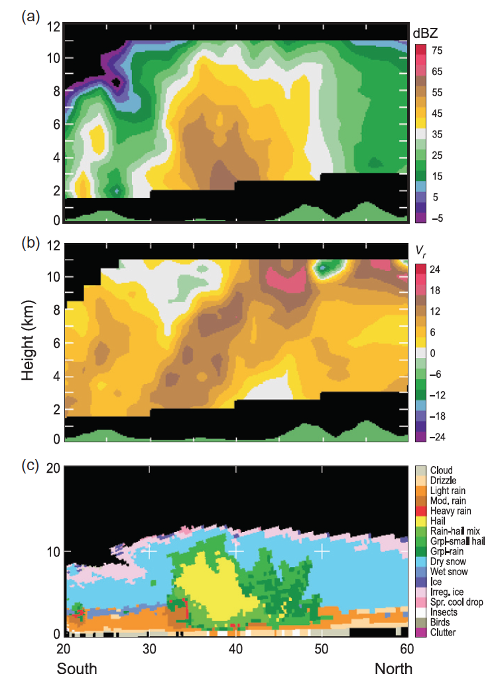
MAP
Z
Deep cumulonimbus over Mediterranean side of European Alps
  Deep unstable layer
  Upslope cross-barrier flow
  Peak reflectivity at lower levels
  Hail (yellow)/graupel (green) indicating riming processes
V
PID
Houze (2012), Seity et al. (2003)

Slide 6
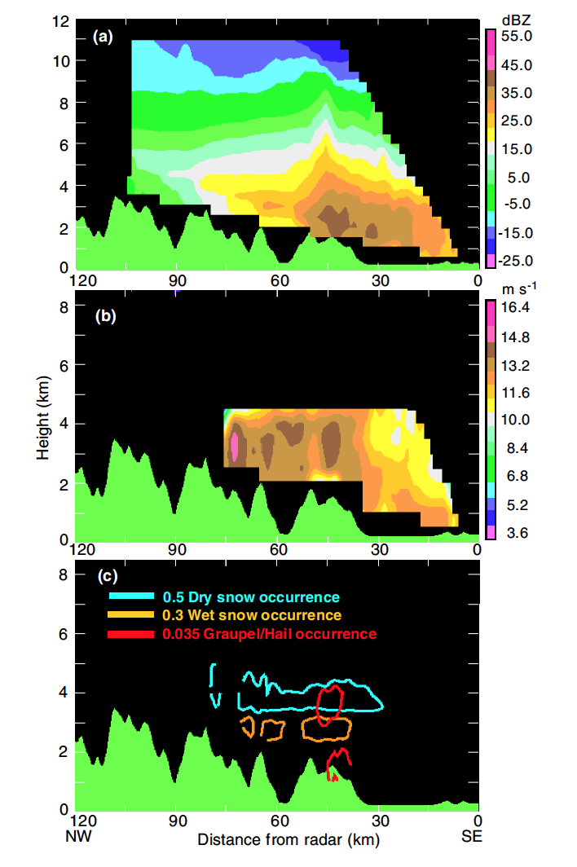
MAP
Z
Unstable, unblocked case
  Broad unstable flow rises over lower peaks
  Cellular convection embedded in stratiform precipitation
  Supercooled water, riming, graupel, melting, coalescence, heavy rain
V
PID
Medina and Houze (2003)

Slide 7
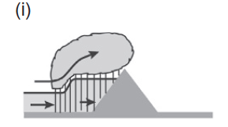
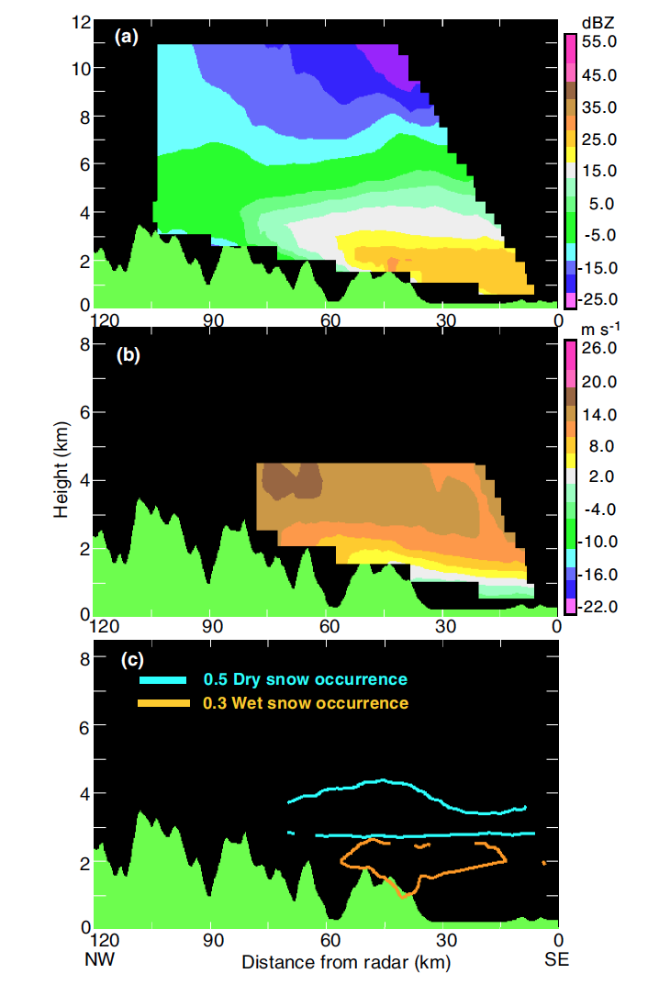
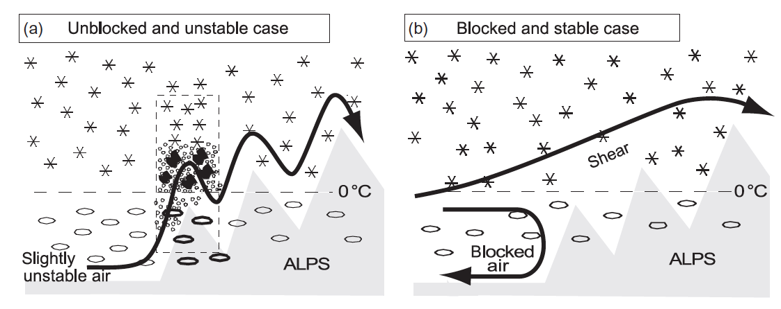

MAP
Z
Blocking effects
  Stable upstream air
  Weak cross barrier flow (Turbulent overturning in shear layer)
Blocked conditions inhibited lowest-level air from rising
  Stratiform, wet snow/melting layer
V
PID
Medina and Houze (2003)

Slide 8
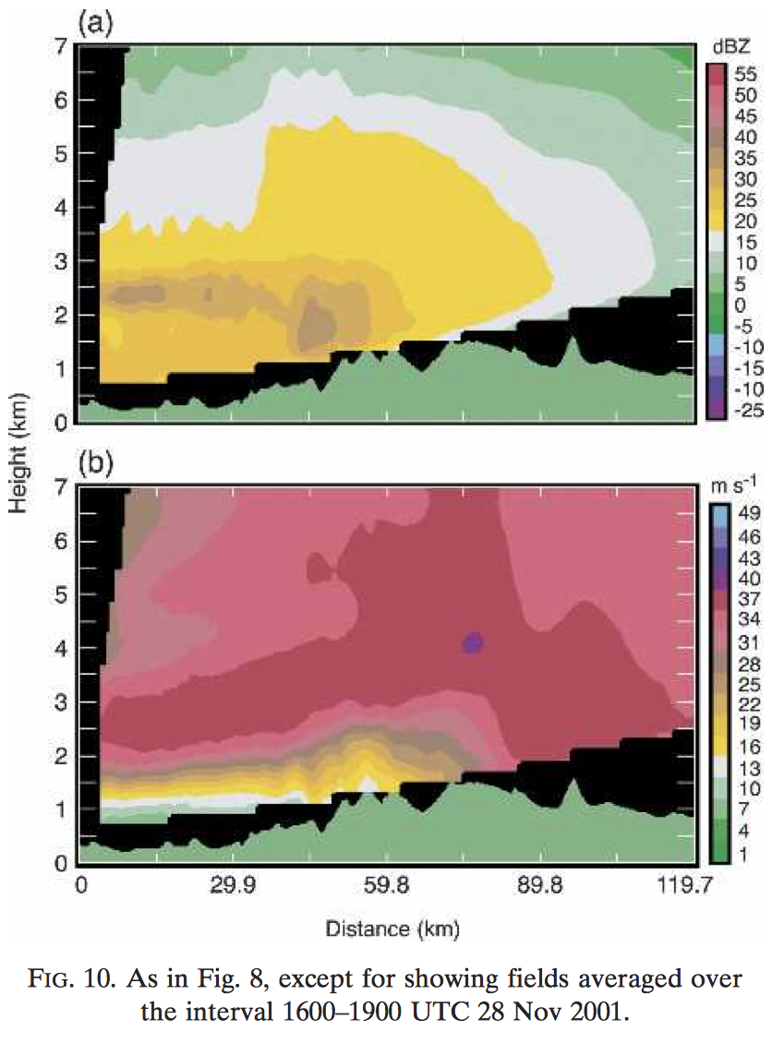
IMPROVE II
Z
Upslope cross-barrier stable flow
  Weaker at lower levels (blocking)
  Sheared layer sloping upward over terrain (similar to MAP)
Elevated layer of enhanced reflectivities
  In zone of increased westerlies
V
Shear layer: promote small-scale updraft cells
  Riming, aggregation
  Localized cooling (melting) reinforces shear layer
Medina et al. (2005)

Slide 9
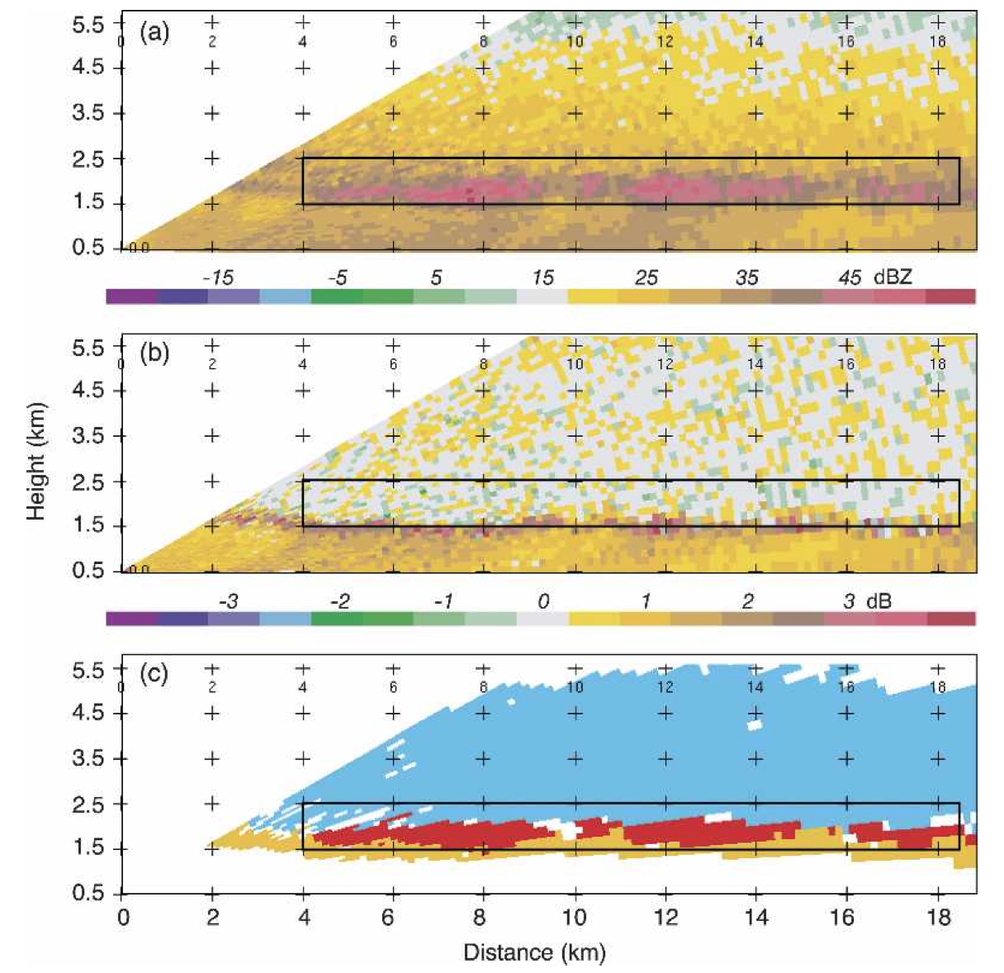
IMPROVE II
Intermittent layer of graupel and/or dry aggregates (red) in widespread frontal stratiform
  Melting aggregates (orange) noted at the bottom of the graupel/dry aggregate layer
Processes producing graupel/dry aggregates also intermittent
  Likely produced by embedded turbulent cells
Houze and Medina (2005)

Slide 10
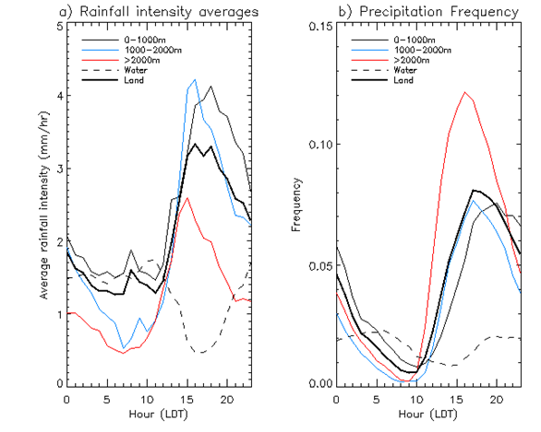
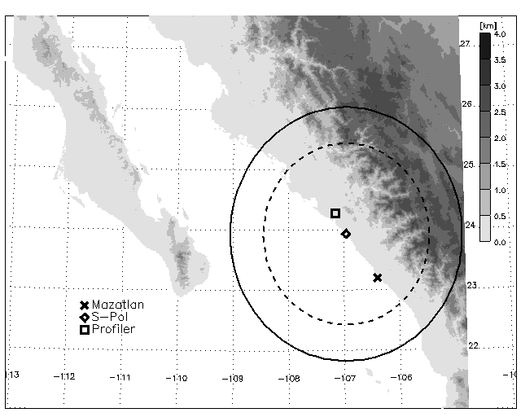
Diurnal forcing
Solar heating of elevated terrain
  Maximum of convective precipitation in the afternoon over high terrain
NAME: North American Monsoon Experiment
  Peak in rain frequency over high terrain during afternoon
  Highest rain rates over lower elevations
Rowe et al. (2008)

Slide 11
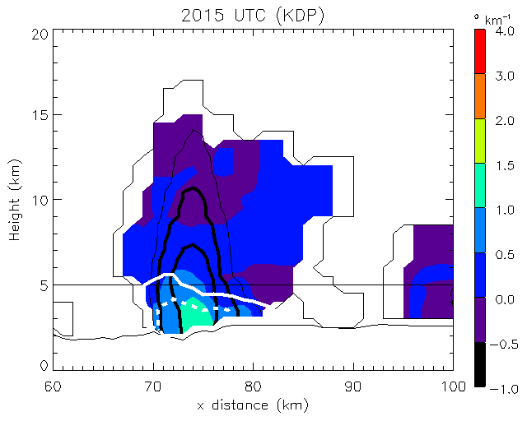
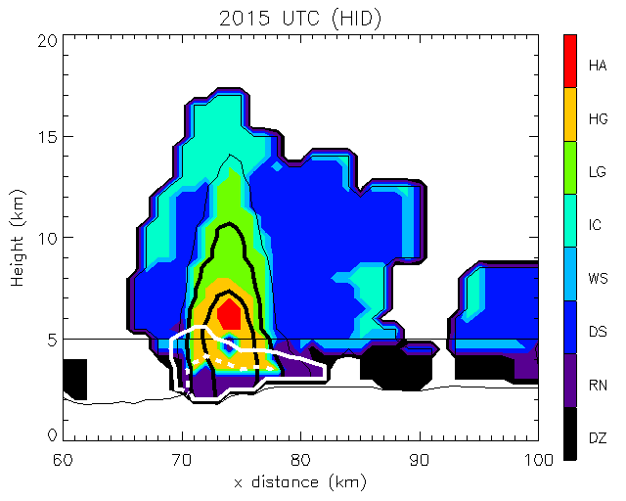
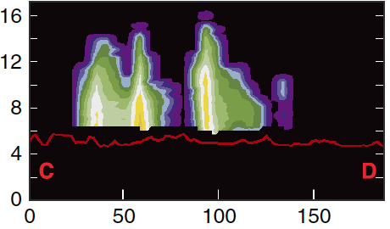
NAME
KDP
Potential for high terrain to receive brief periods of intense rainfall
Shallower warm-cloud depths, precipitation-sized ice
HID
Rowe et al. (2011)
Similar to convection over Tibetan Plateau
Houze et al. (2007)

Slide 12
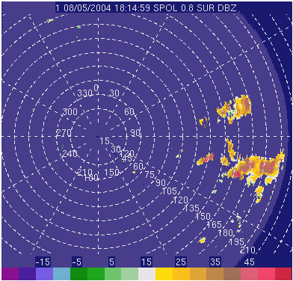
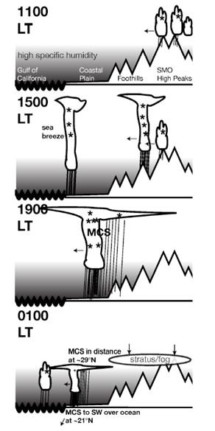
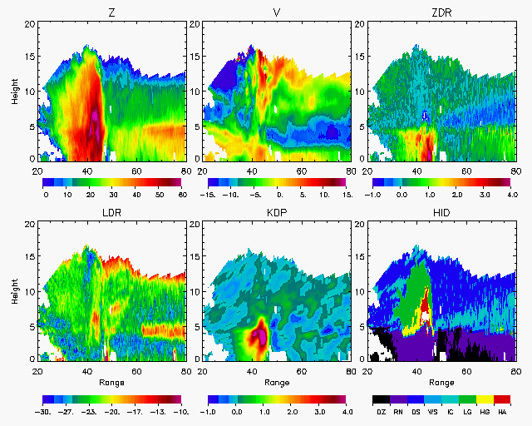
NAME
Upscale growth toward coast
Rowe et al. (2012)
Nesbitt et al. (2008)

Slide 13
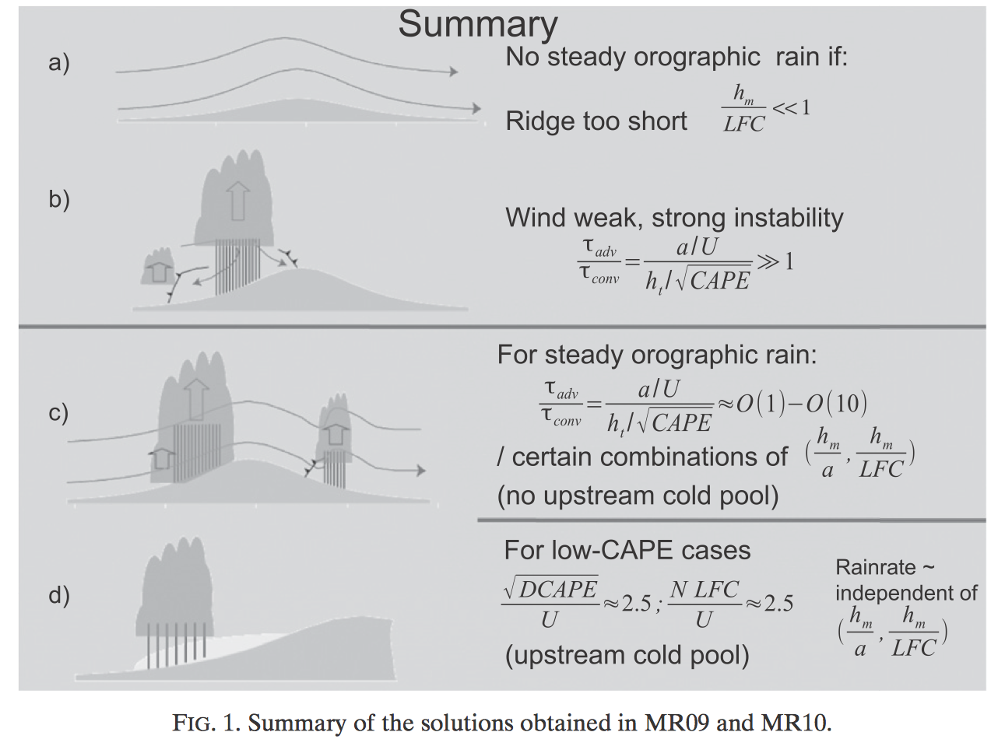
Outflow
Convectively induced cold pools and outflows can be very important for the propagation of convective systems and/or to focus, together with the orography, convective-cell development in a confined area (Senesi et al. 1996; Romero et al. 2000)
Miglietta and Rotunno (2012)

Slide 14
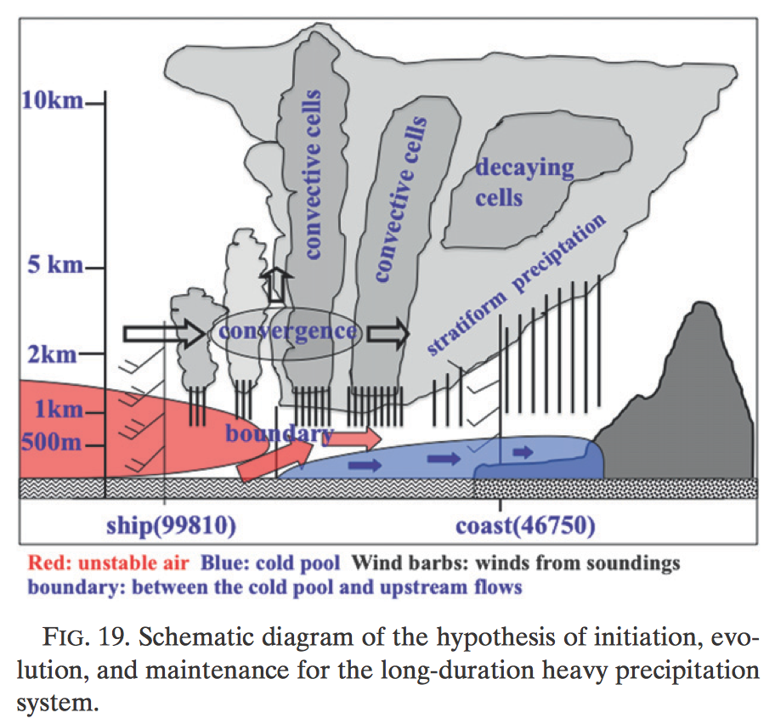
TiMREX
New convection redevelops upstream offshore at boundary between a precipitation-formed cold pool and the LLJ
  Heaviest rain over upstream ocean and coastal regions
  Warm, moist unstable air ushered by LLJ feeds MCS
Cold pool trapped by high terrain
  “Cold pool extending orographic effect”
  Cold pool from previous precipitating system forms a partial barrier to low-level moist southwest flow
  Stratiform component
Davis and Lee (2012): Importance of frontal boundaries near coast
  Reinforcement by convective downdrafts
Xu et al. (2012)

Slide 15
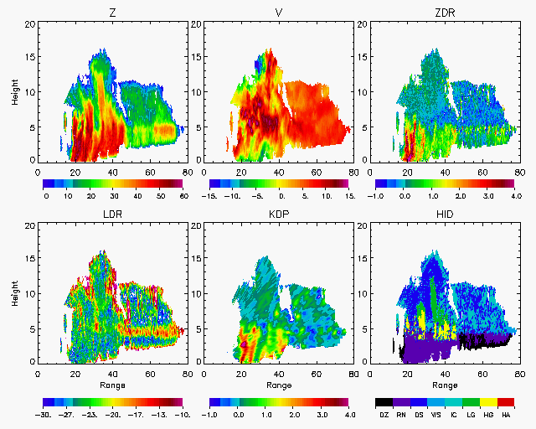
31 May
0758 UTC
Multicell
Brightband
Midlevel upslope flow
Low-level outflow
Melting ice

Slide 16
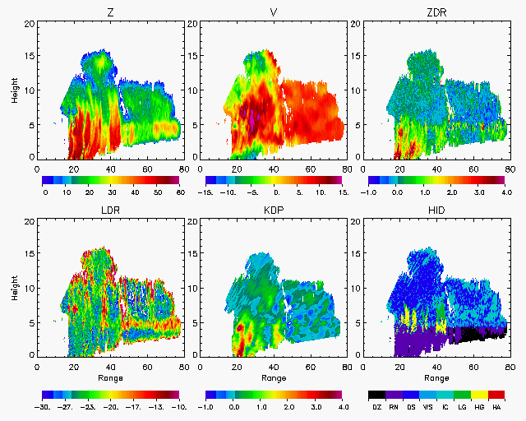
31 May
0806 UTC

Slide 17
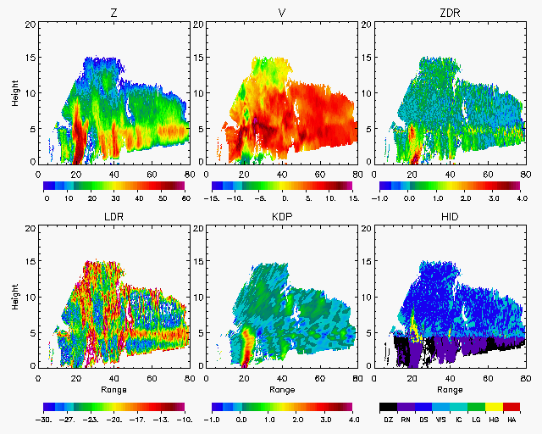
31 May
0813 UTC

Slide 18
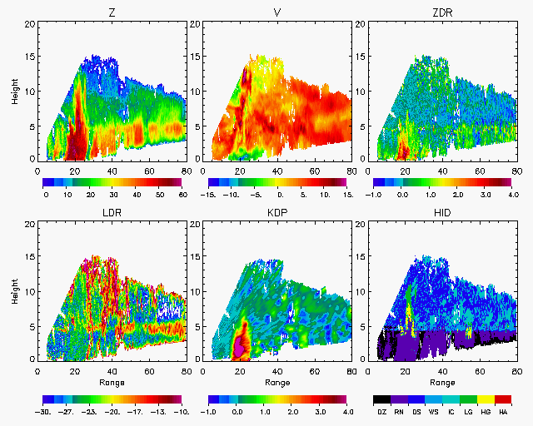
31 May
0821 UTC
New initiation

Slide 19
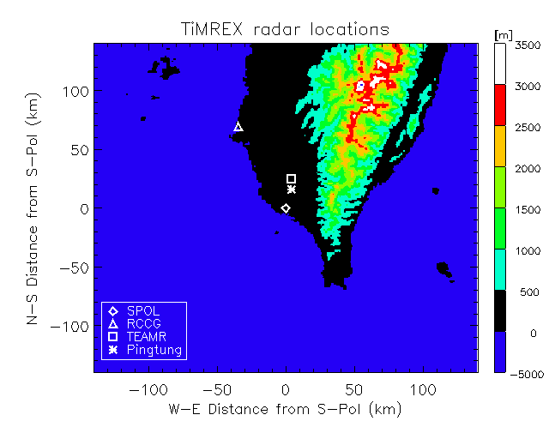
S-Pol in TiMREX
Relative roles of warm-rain and ice-based processes
Influence of terrain on microphysics
Ordinary/isolated vs. organized/MCS
  Propagation of systems toward the coast (NAME)
  Systems moving onshore (Taiwan)

Slide 20
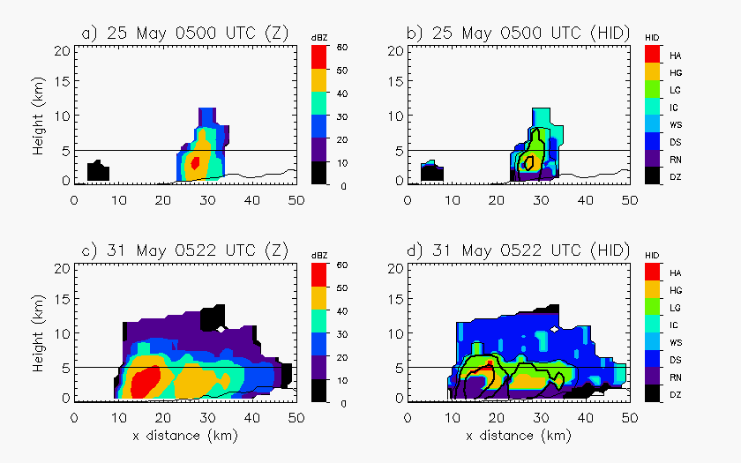
S-Pol in TiMREX
Undisturbed
  Diurnal forcing
  Convection along windward slopes
Disturbed
  Moist troposphere, stronger onshore flow
  Weakly blocked regime (Ruppert et al. 2013)
  Tilted upslope
Upslope advection of hydrometeors

Slide 21
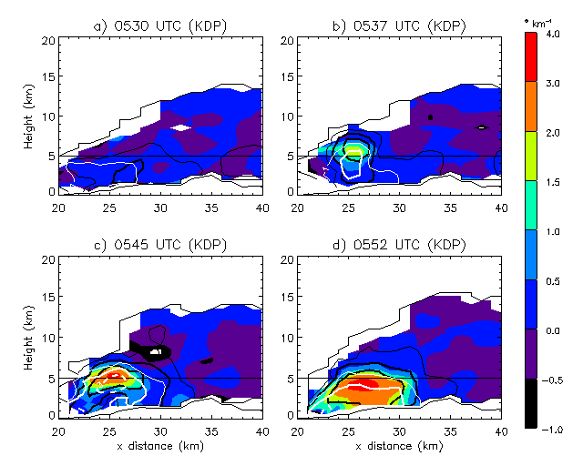
TiMREX
Disturbed
Lofting of hydrometeors above melting level
Horizontal advection upslope
Extensive stratiform

Slide 22
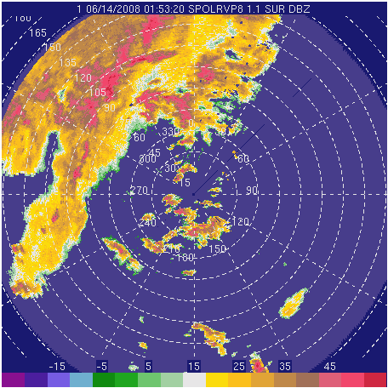
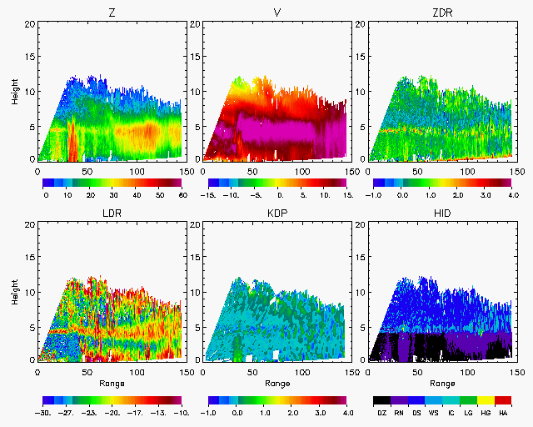
13-14 June 2008
Water
Over water
  Embedded shallow convection
  Small drops
  Lack of precipitation-sized ice

Slide 23
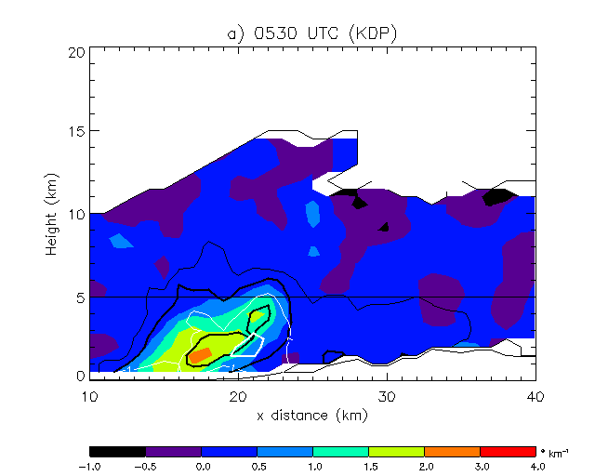
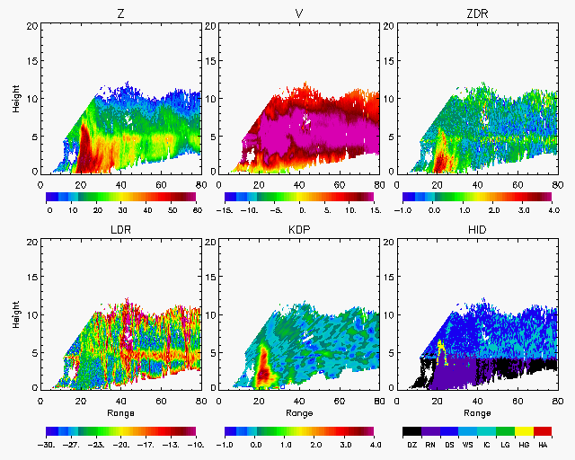
13-14 June 2008
KDP
Upslope flow (outbound velocities), strongest in mid-levels
Land
Enhancement over land
  Deeper convection near windward slopes
  Increased graupel, melting ice
Upslope tilt
  Combine roles of riming aloft, coalescence below
Recall MAP, IMPROVE 2
Xu and Zipser (2015): Robust lightning!
  Strong updrafts, rigorous ice-based processes
  Examples of weaker convection in heavy rainfall events during disturbed period

Slide 24
Moving forward
Fully exploit S-Pol polarimetric measurements statistically to investigate microphysical mechanisms associated with full spectrum of orographically influenced convection observed during TiMREX
  In context of Doppler velocity
  Use of echo tracking to examine evolution of systems from water to coast to mountains
Infer further details via WRF-simulations (Prof. Ming-Jen Yang)
  Double-moments microphysics scheme
  Disturbed (MCS evolution) and undisturbed (diurnal cycle)
NAME comparisons

Slide 25
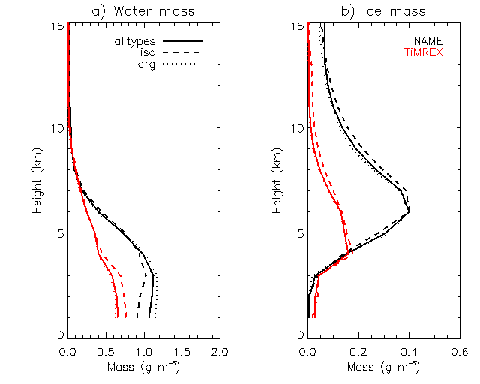
TiMREX vs. NAME
*
*
*
*
*
*
*
*
*
*
*
*
*
*
*
0°C
NAME
Greater ice mass during NAME
Larger drops during NAME
*
*
*
*
*
*
*
*
*
*
*
*
*
*
*
*
*
*
*
*
*
*
*
*
*
*
*
*
*
*
*
*
*
*
*
*
*
0°C
TiMREX

Slide 26
Final thoughts
The search for commonality of convective precipitating mechanisms in regions of complex terrain
  Upslope enhancements
  Diurnally forced convection
Integration of observations and model simulations for improved understanding of microphysical processes
  Role of terrain
  Context within environment

Slide 27

Thank you!
This research was supported by NSF grant AGS-1144105 and NASA grants NNX13AQ37G and NNX13AG71G

