Slide 1
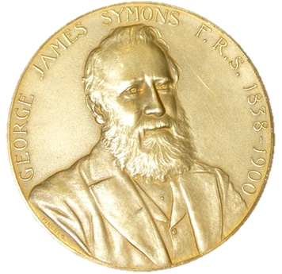
The Many Ways that Mountains Affect Precipitation: Toward a Broader View of “Orographic Precipitation”
Robert A. Houze, Jr.
Department of Atmospheric Sciences
University of Washington
Symons Lecture, Royal Meteorological Society, London, 20 May 2015

Slide 2

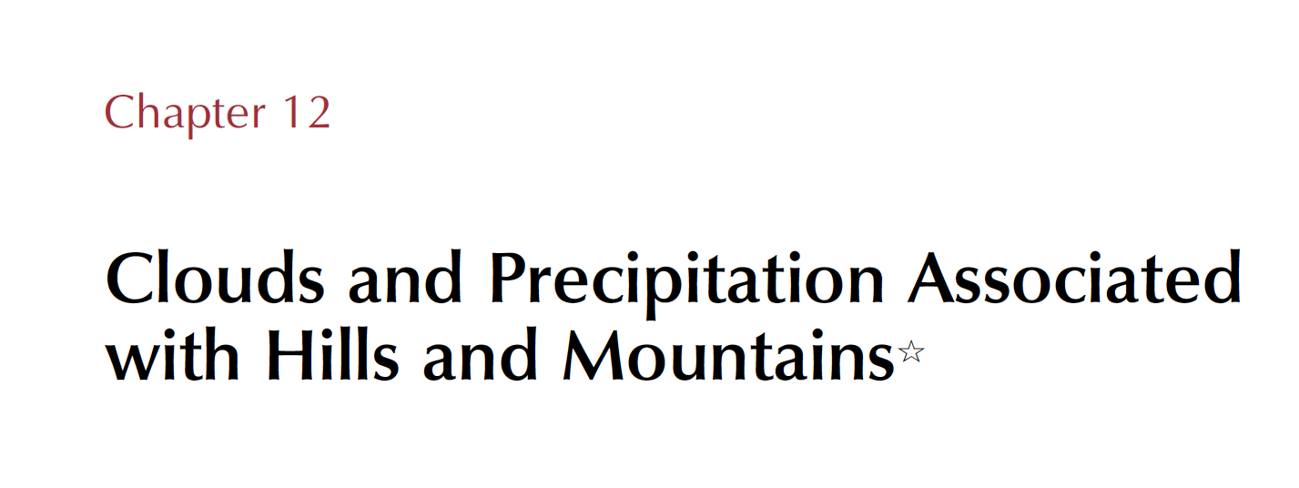

Slide 3
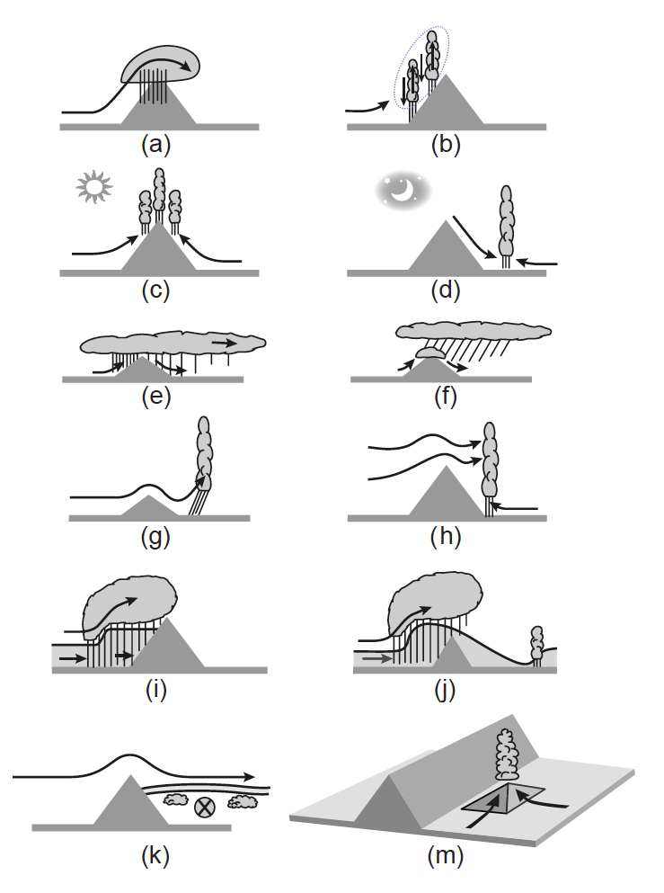
The many ways that mountains affect precipitation
Notes:
The most common discussions of

Slide 4
The many ways that mountains affect precipitation
Notes:
The most common discussions of

Slide 5
The many ways that mountains affect precipitation
Notes:
The most common discussions of

Slide 6
The many ways that mountains affect precipitation
Notes:
The most common discussions of

Slide 7
The many ways that mountains affect precipitation
Notes:
The most common discussions of

Slide 8
The many ways that mountains affect precipitation
Notes:
The most common discussions of

Slide 9
The many ways that mountains affect precipitation
Notes:
The most common discussions of

Slide 10
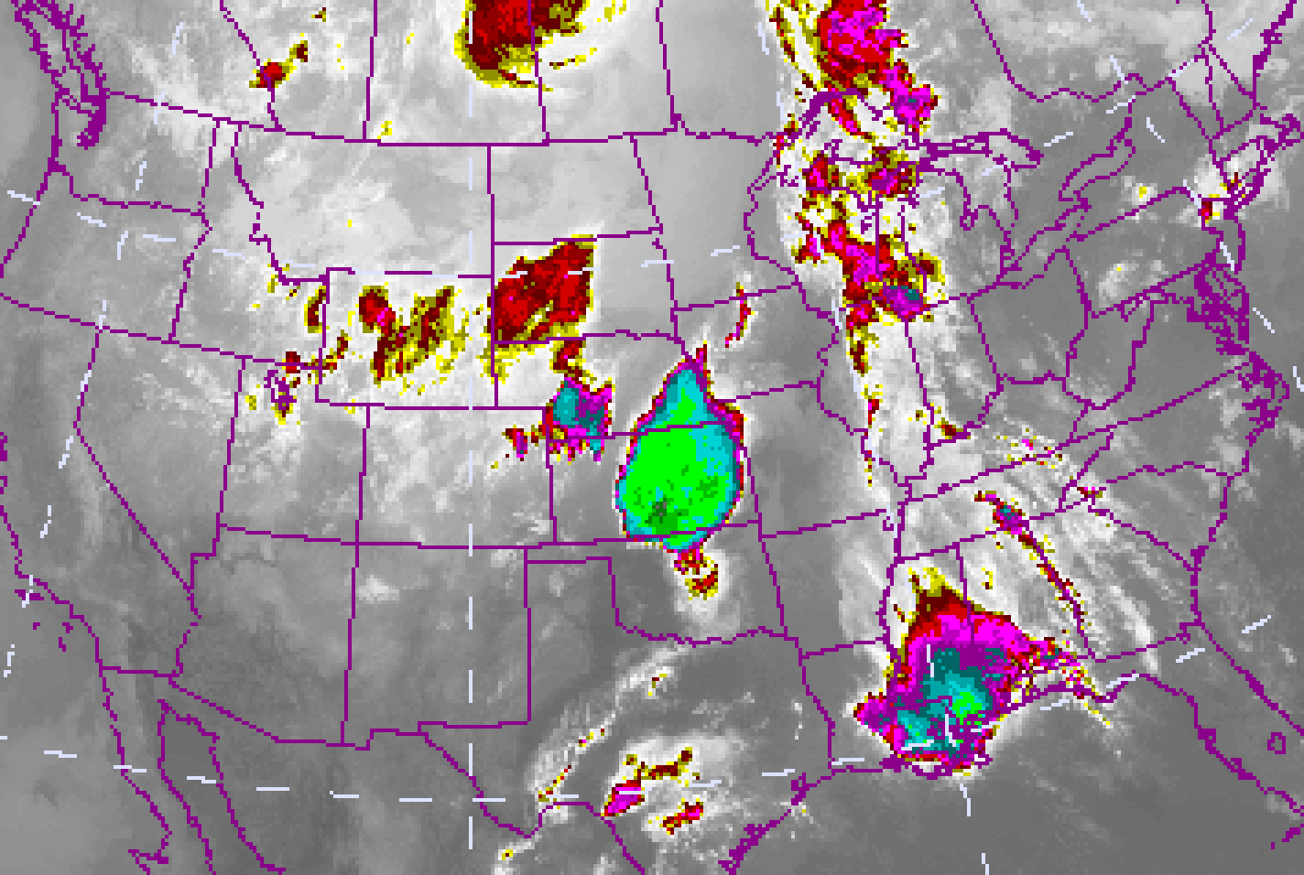
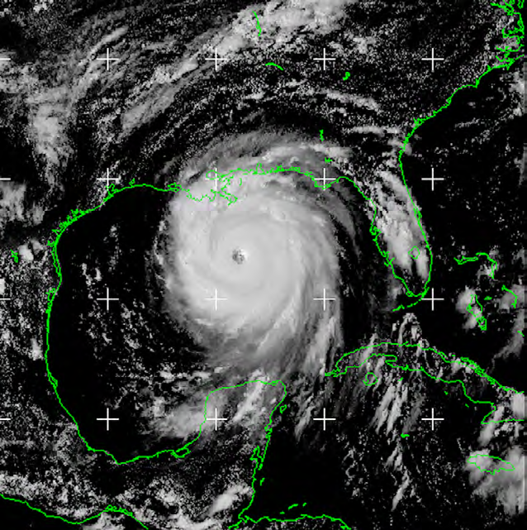
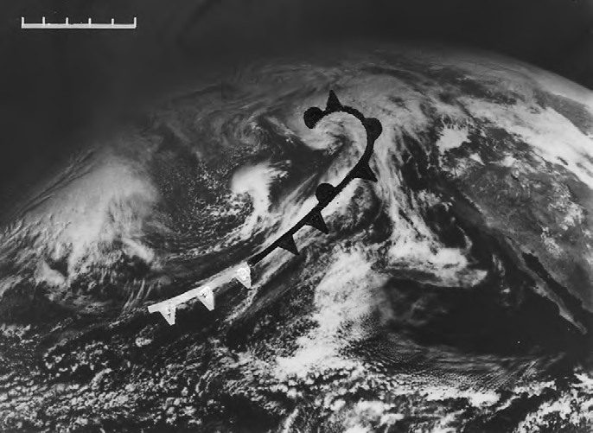
Where does nearly all Earth’s precipitation come from?
Convective storms
Tropical cyclones
Frontal systems
Notes:
The most common discussions of

Slide 11
Convective Storms

Slide 12
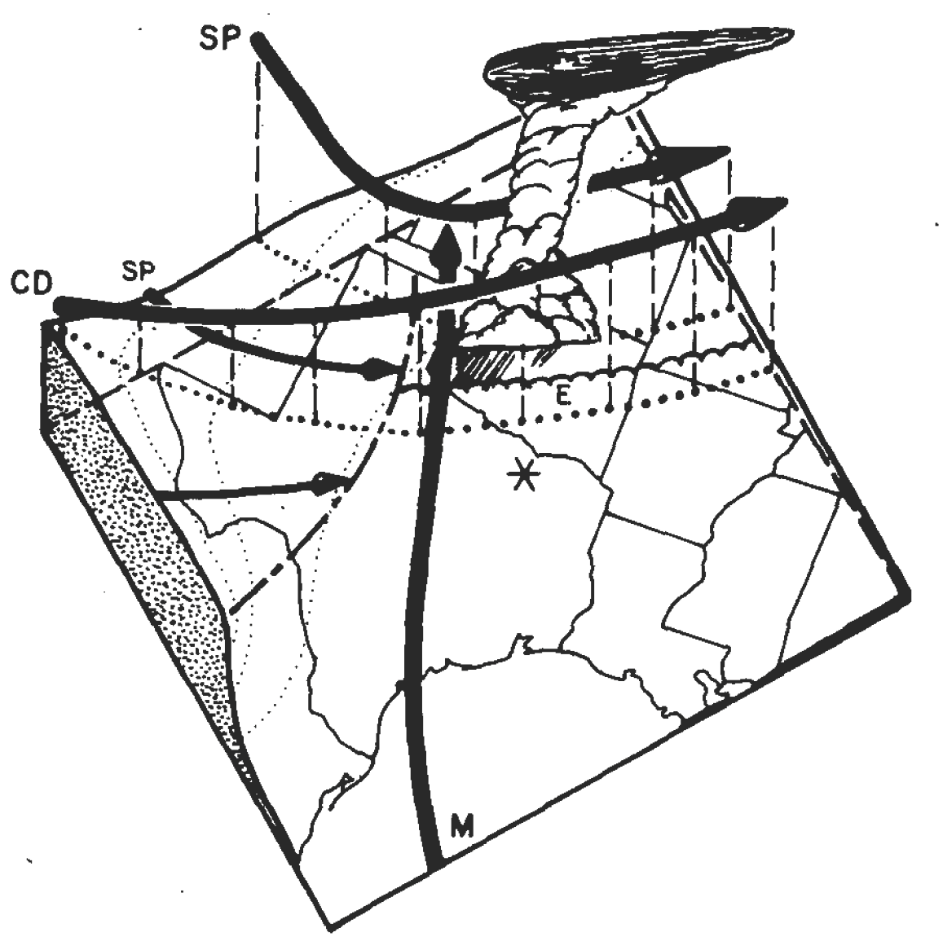
Severe Storms in the U.S.
dry,hot
moist
Mexican Plateau
Texas
Gulf of
Mexico
Carlson et al. 1983

Slide 13
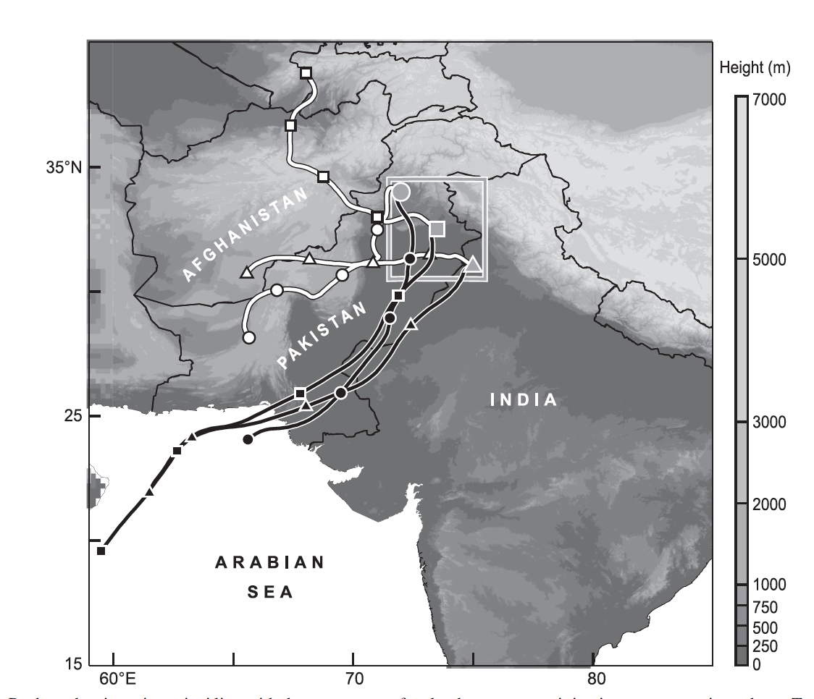
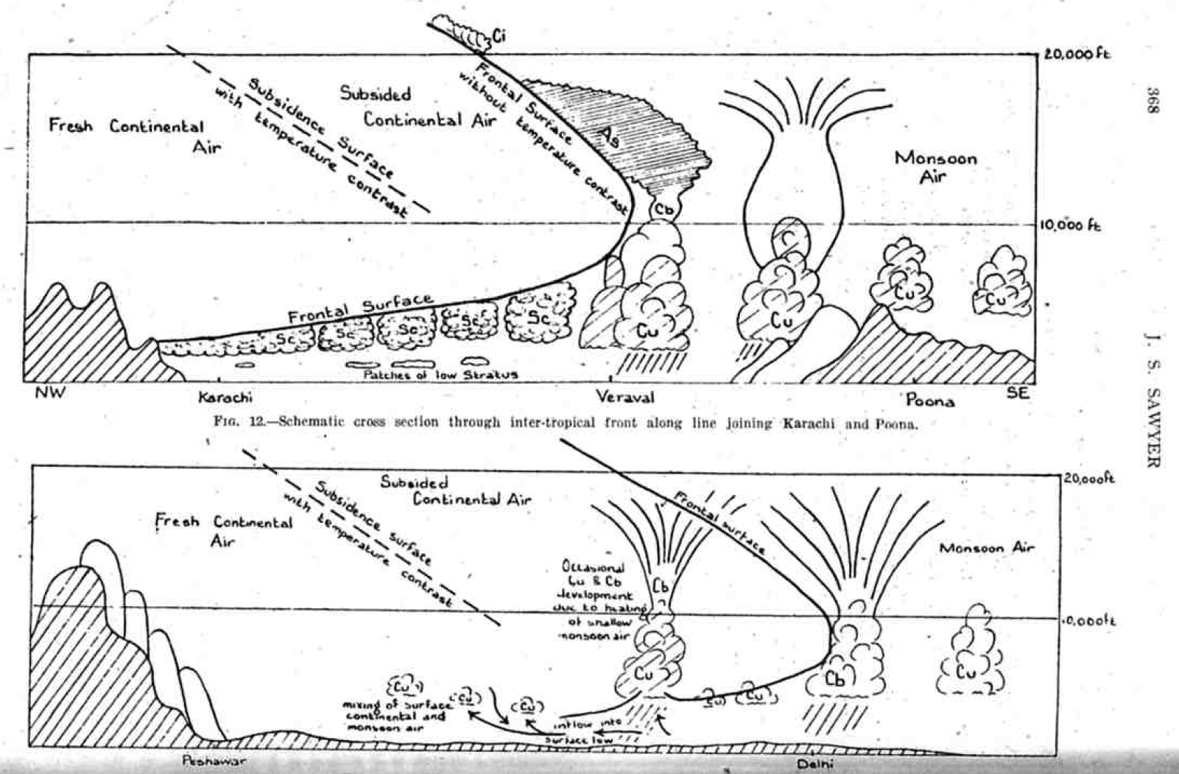
Medina et al. (QJRMS 2010)
Houze et al. (QJRMS 2007)
J. S. Sawyer (QJRMS 1947)

Slide 14
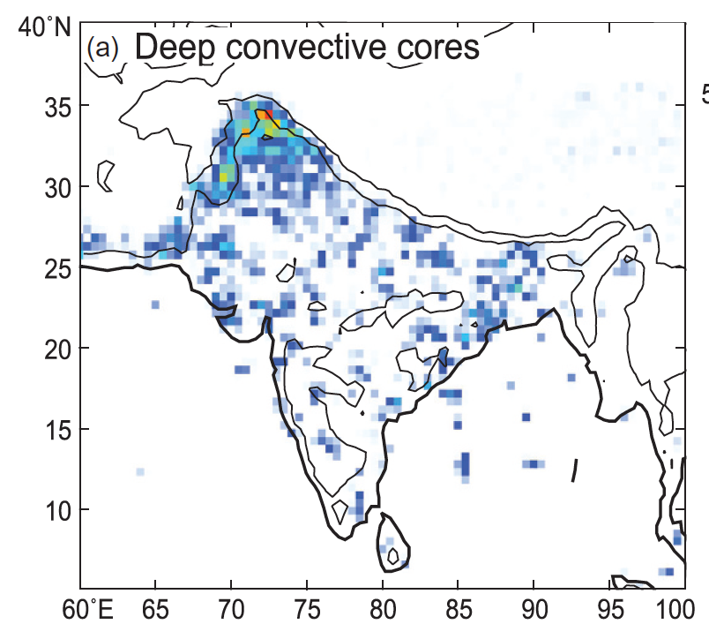
Deep intense convective echoes seen by the TRMM satellite radar
Romatschke et al. 2010

Slide 15
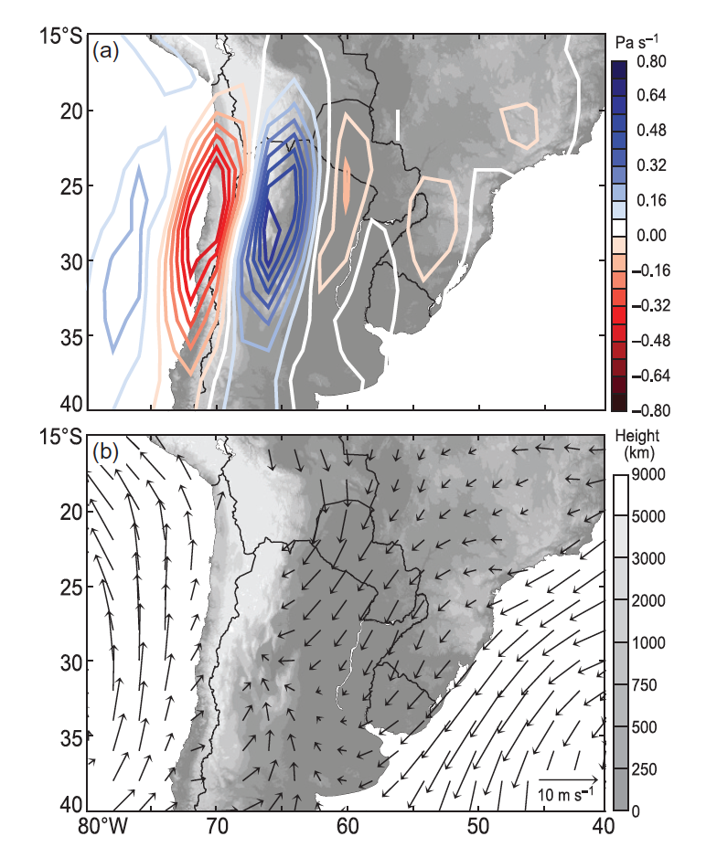
Summer in S. America
Mid-level Wind
up
down
Andes
Low-level Wind
Sierras de Cordoba
Rasmussen and Houze 2011

Slide 16
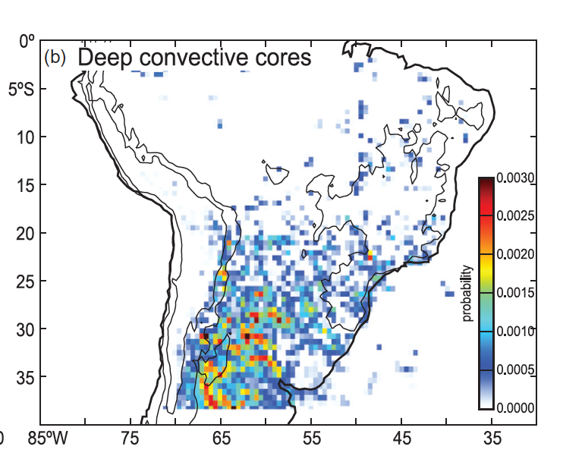
Deep intense convective echoes seen by the TRMM satellite radar
Romatschke and Houze 2010

Slide 17
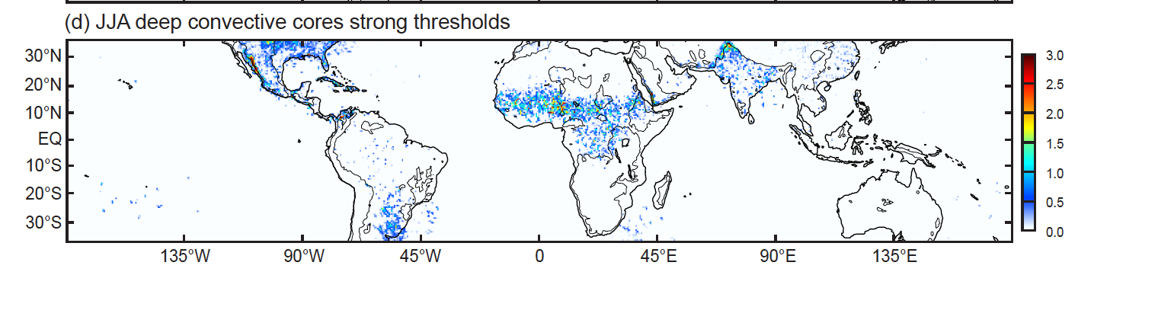
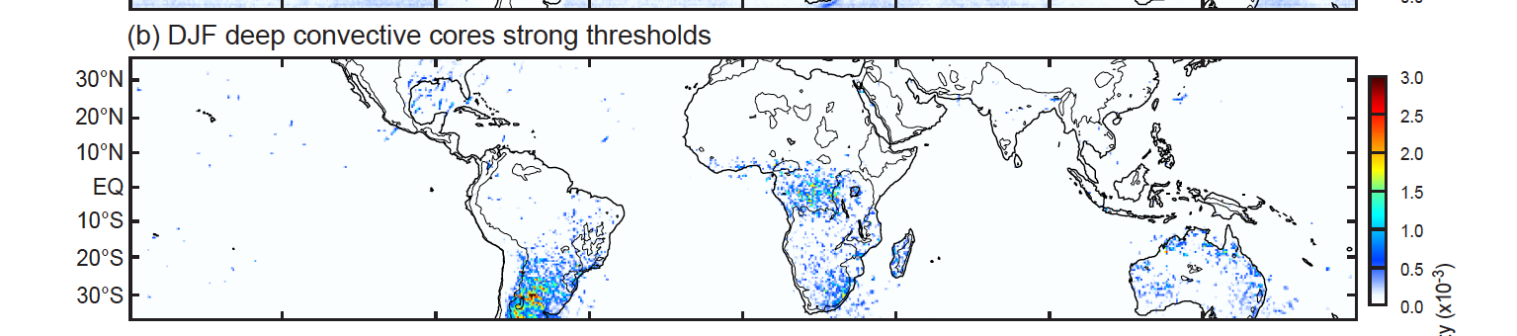
Deep intense convective echoes seen by the TRMM satellite radar
JJA
DJF
Houze et al. 2015

Slide 18
Recall
Notes:
The most common discussions of

Slide 19
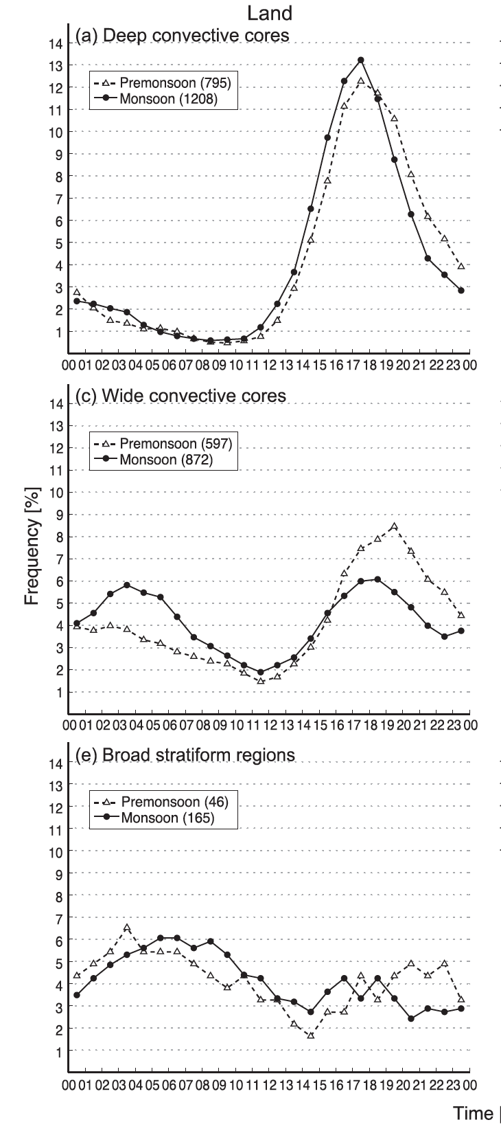
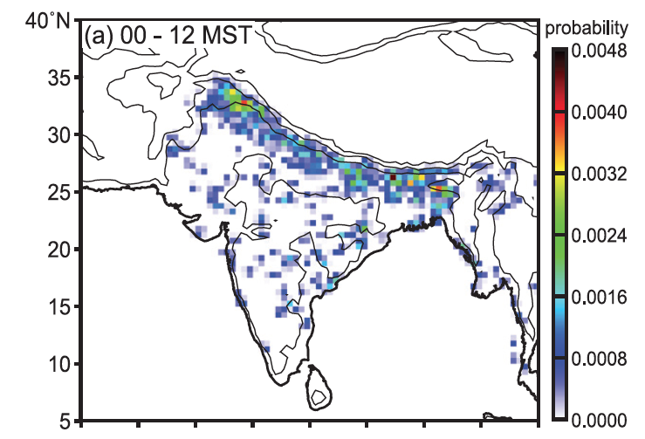
Diurnal cycles of monsoonal convection over India seen by the TRMM satellite radar
Wide convective cores

Slide 20
Tropical Cyclones

Slide 21
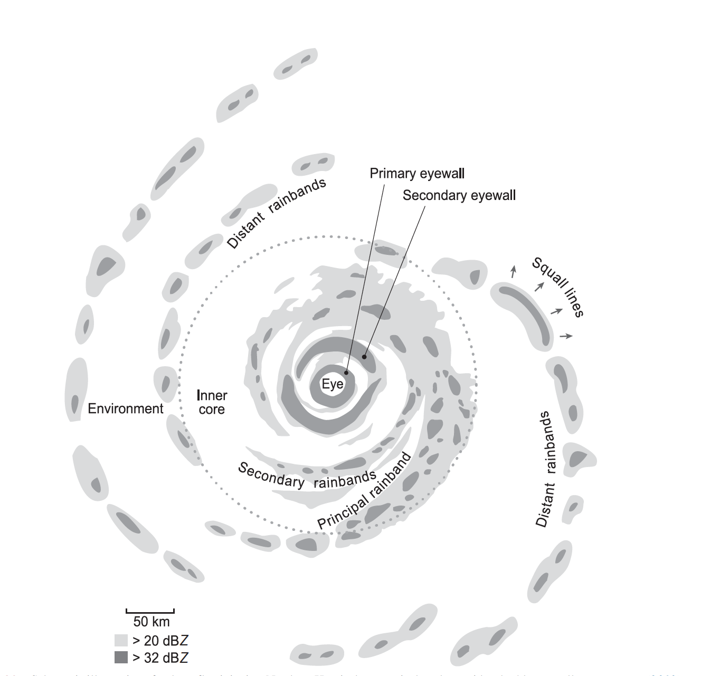
Houze 2010

Slide 22
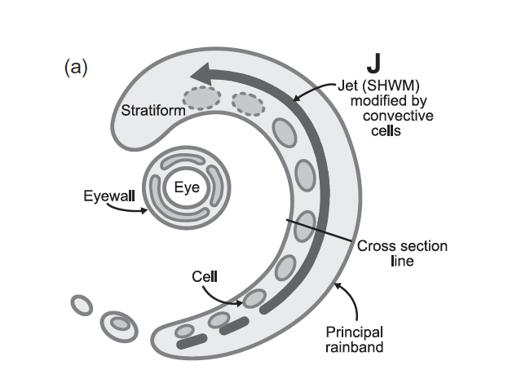
Along band jet at low-mid levels
Didlake and Houze 2009

Slide 23
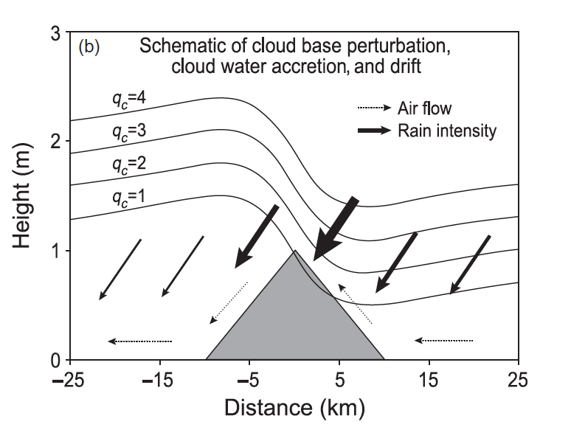
Gravity wave response of rainband jet to a small mountain
Km
Smith et al. 2009
Notes:
qc is cloud water concentration

Slide 24
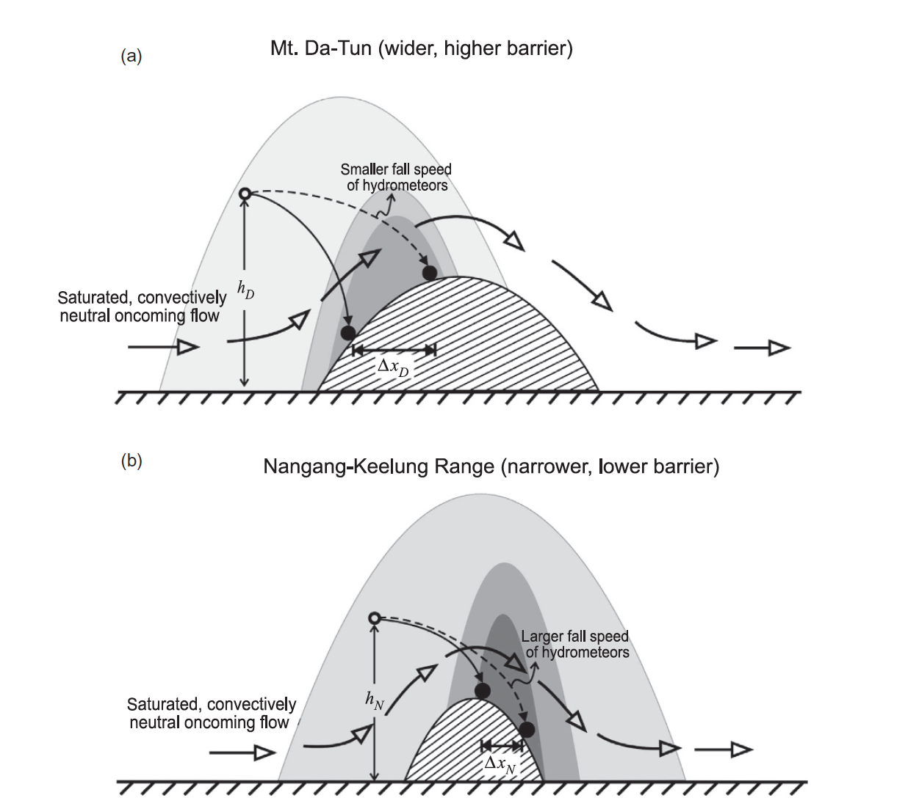
Yu and Cheng 2008

Slide 25
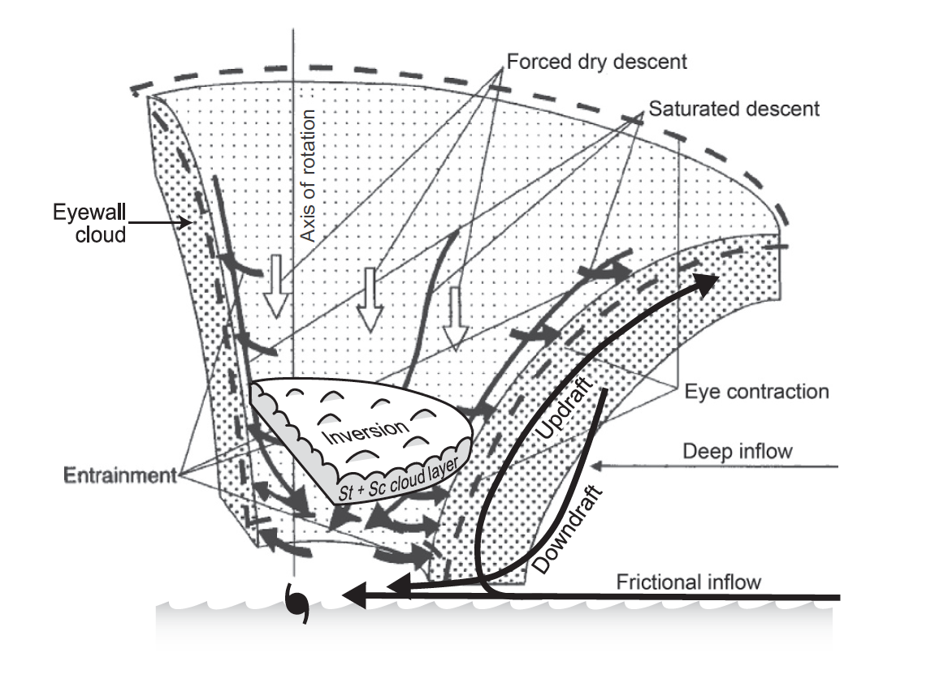
Eyewall of a tropical cyclone
Willoughby 1998

Slide 26
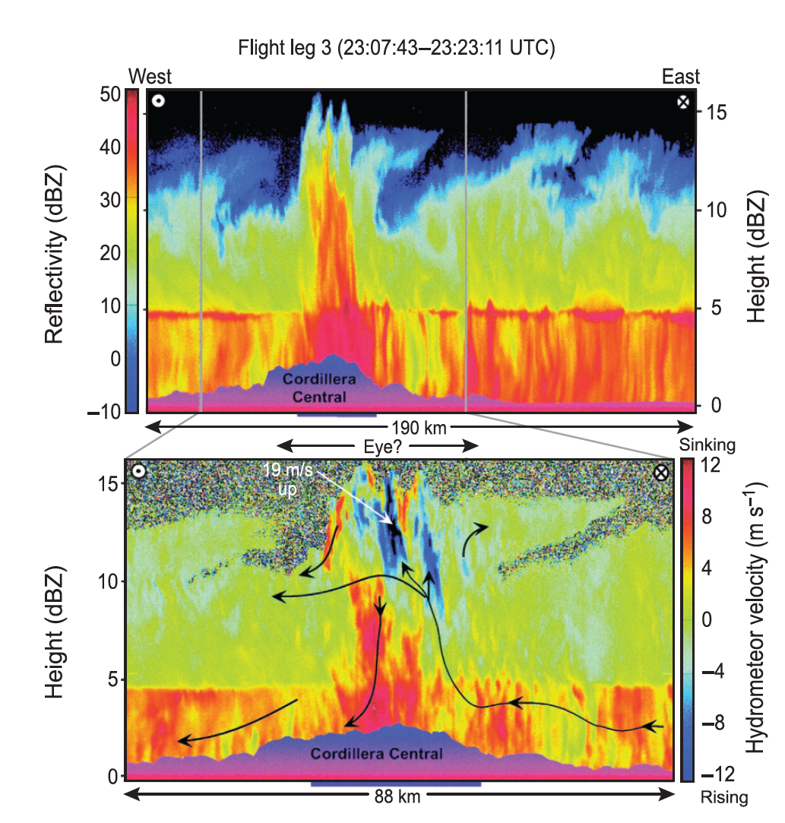
Eye of storm moving over Hispaniola
Geerts et al. 2000

Slide 27
Frontal Systems

Slide 28
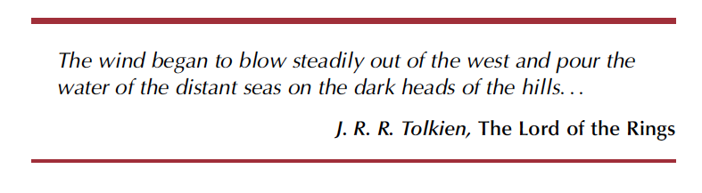

Slide 29
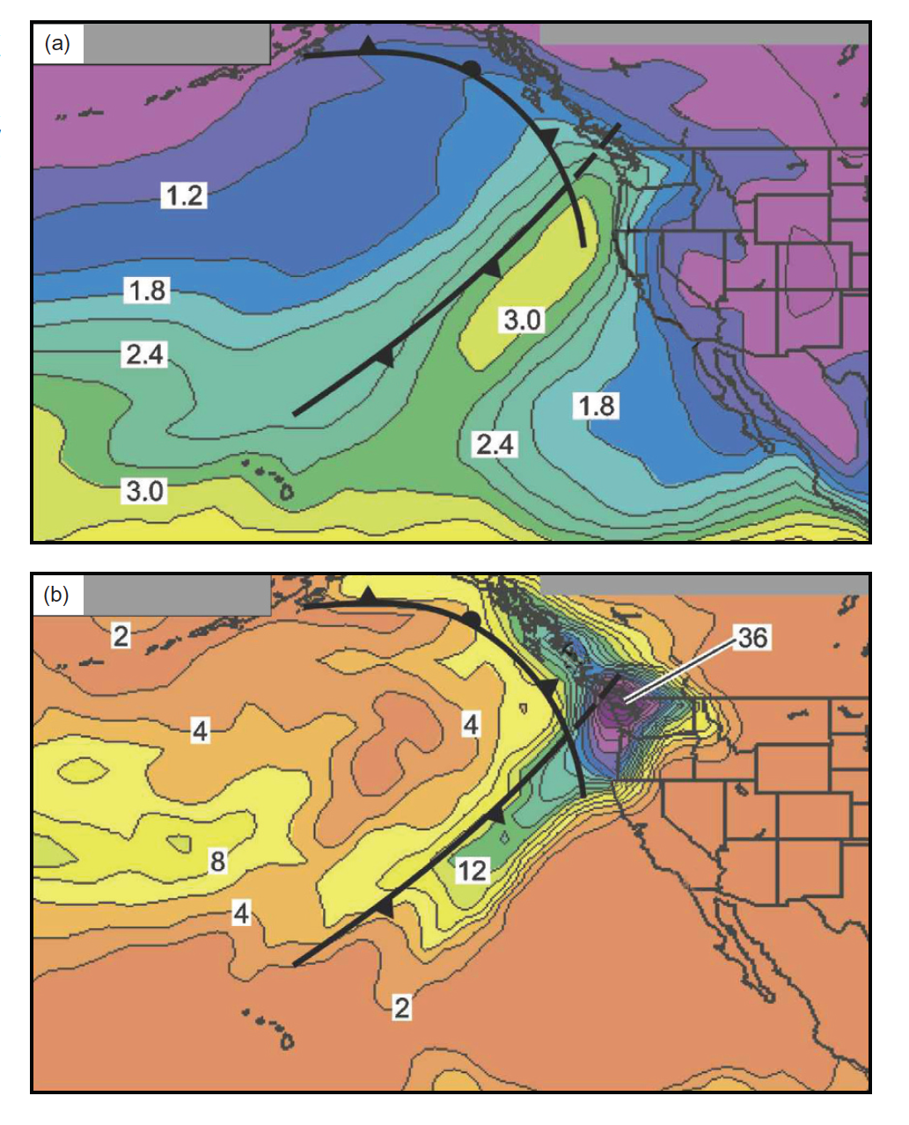
vapor (cm)
Atmospheric Rivers
Newell et al. (1992)
rain (mm)
Neiman et al. 2008

Slide 30
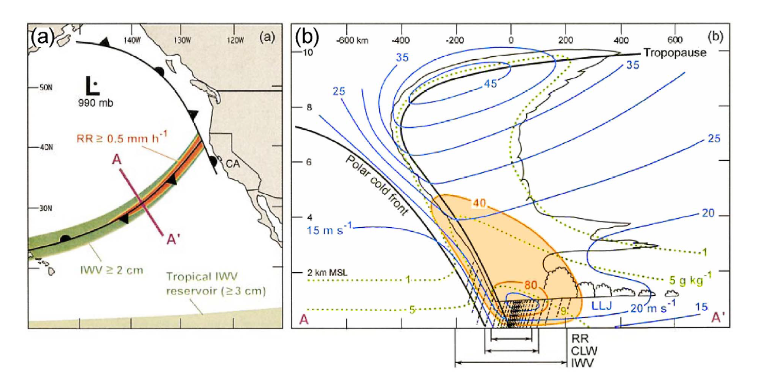
The “Atmospheric River” Newell et al. (1992)
Moisture flux along front
Ralph et al. 2004

Slide 31
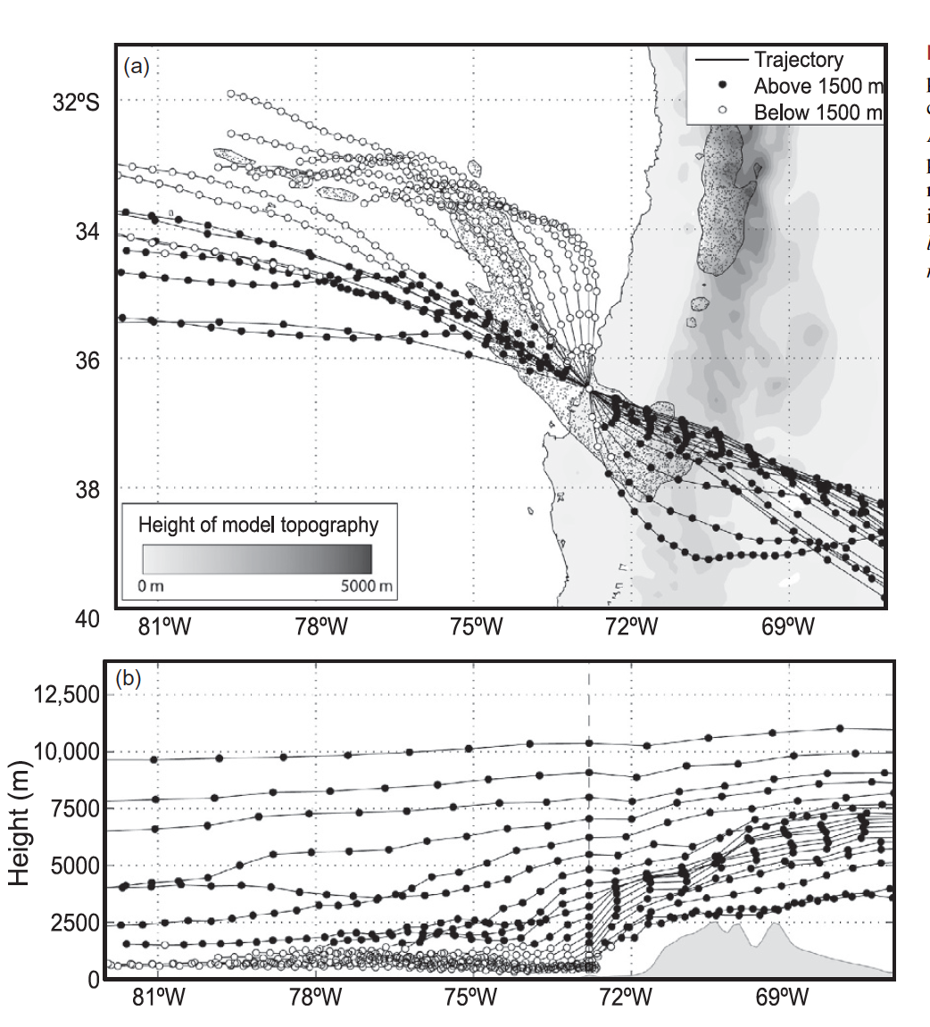
Andes
S. Pacific Ocean
Barrett et al. 2009

Slide 32
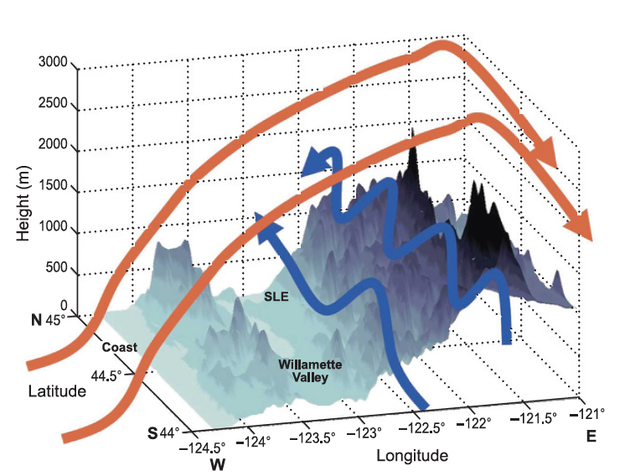
Garvert et al. 2007

Slide 33
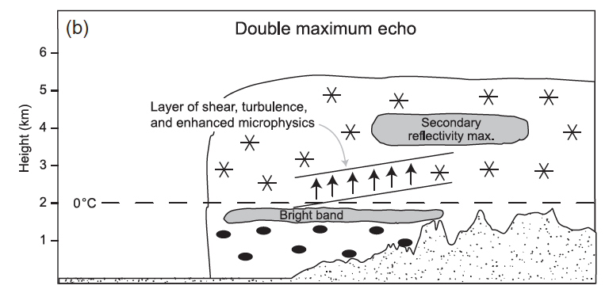
Frontal precipitation passing over a mountain range
Medina et al. 2007

Slide 34
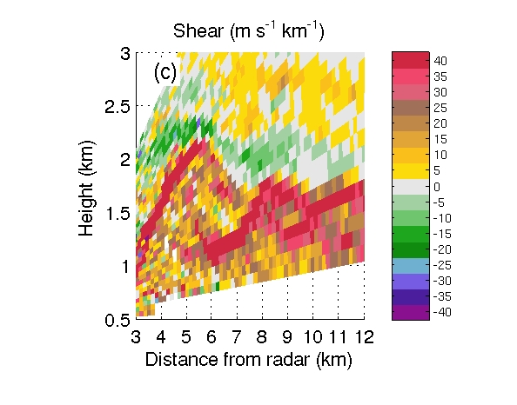
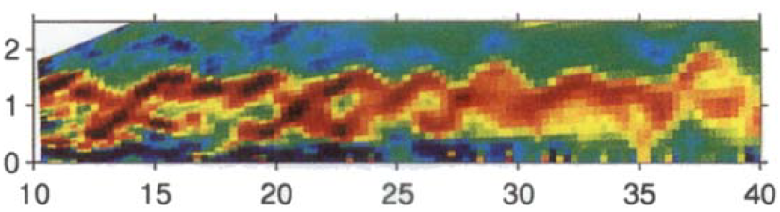
Kelvin-Helmholtz billows in the shear layer
Radar data over the Cascade Mountains
Chapman and Browning
(QJRMS 1997)
Medina and Houze 2015

Slide 35
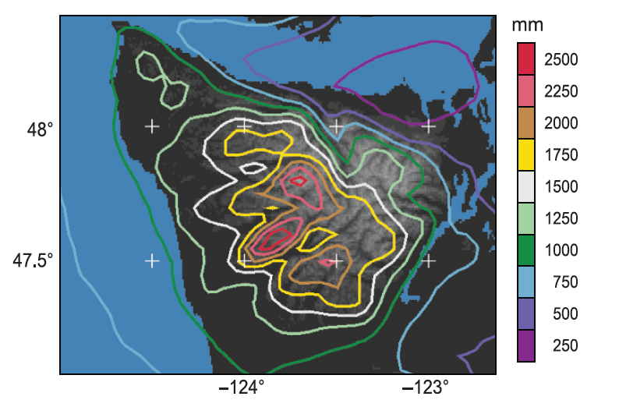
Simulation of annual rain over the Olympic Mountains
Courtesy J. Minder

Slide 36


Slide 37

OLYMPEX Network
x
Legend
= WSR-88D
= NPOL
= DOW
= EC X-Band
= MRR = SNOTEL
= Ground Obs sites
= Snow camera network = UW Tipping bucket network
= Chehalis rain gauge network
x
x
x
x
x
x
x
x
x
x
x
x
x
x
x
x
x
x
x
x
x
DC-8
ER-2
Citation

Slide 38
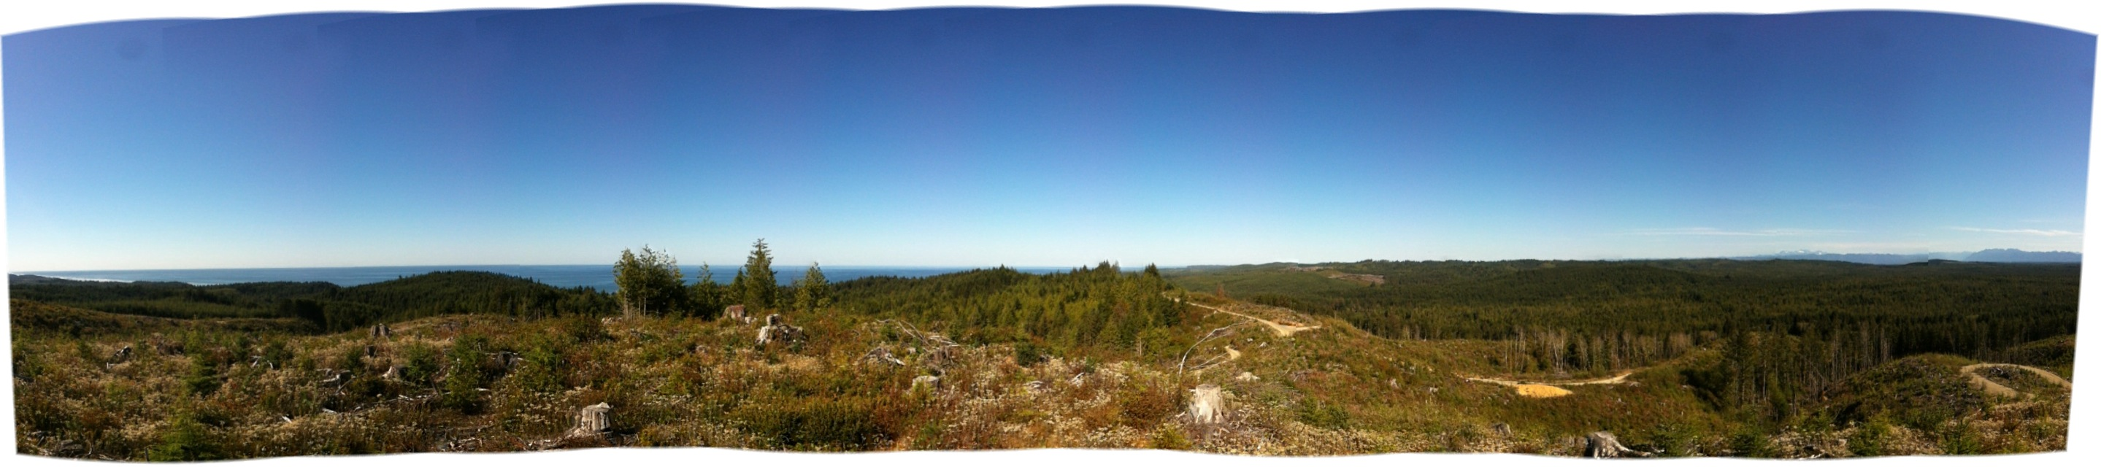
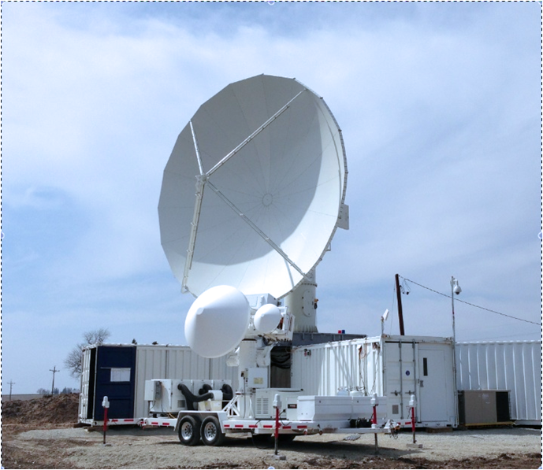
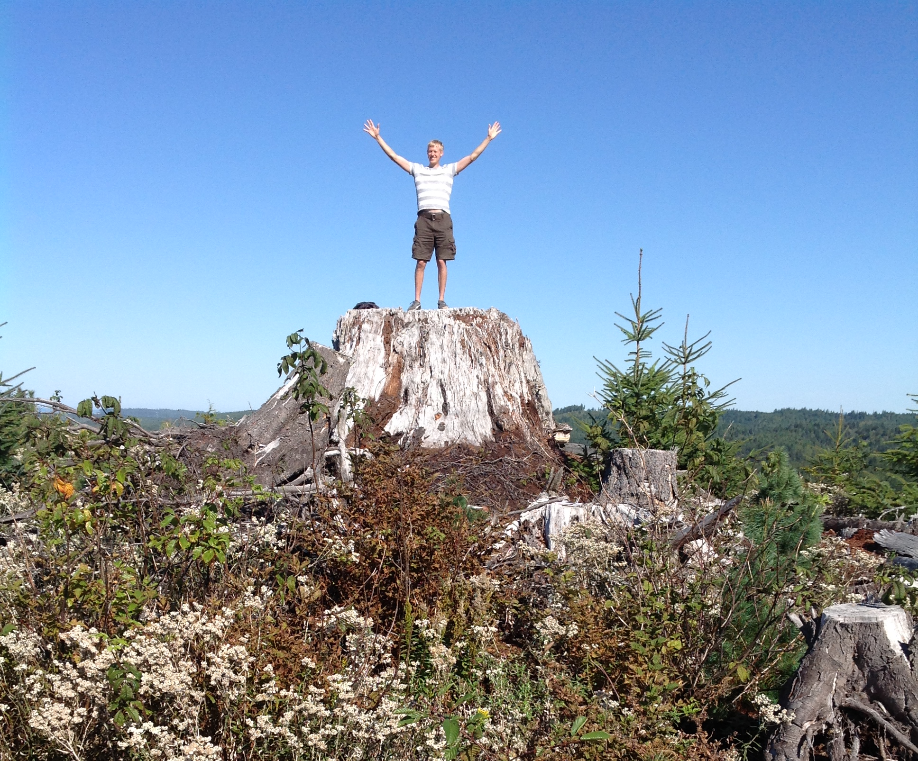
NPOL/D3R Radar Site
Olympic Mts. (NE)
Pacific Ocean (SW)
On Quinault Indian Nation land near the coast where the radar has clear views towards the Ocean and towards the Olympic Mountains and up the Quinault River
NPOL
D3R

Slide 39
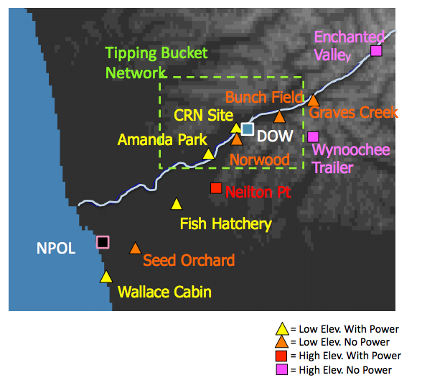
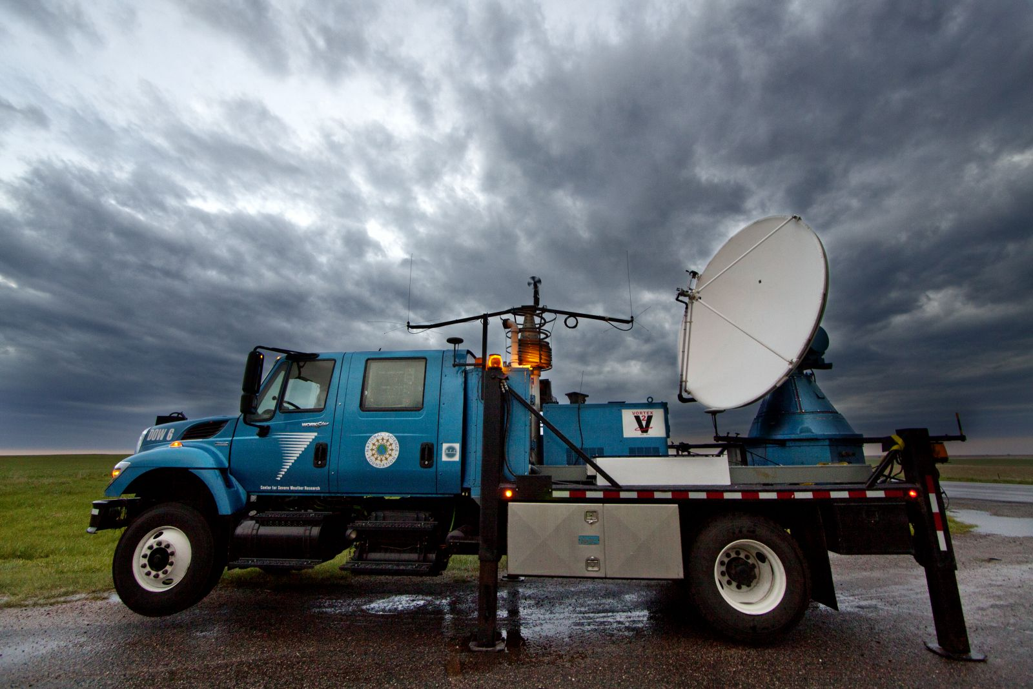
Doppler on Wheels (DOW)
Will be installed at Lake Quinault so it can make measurements where it will sample ‘under’ the lowest NPOL radar beam. It will have a range of ~40 km (can ‘see’ to NPOL and can ‘see’ to Upper Quinault Valley installation.

Slide 40
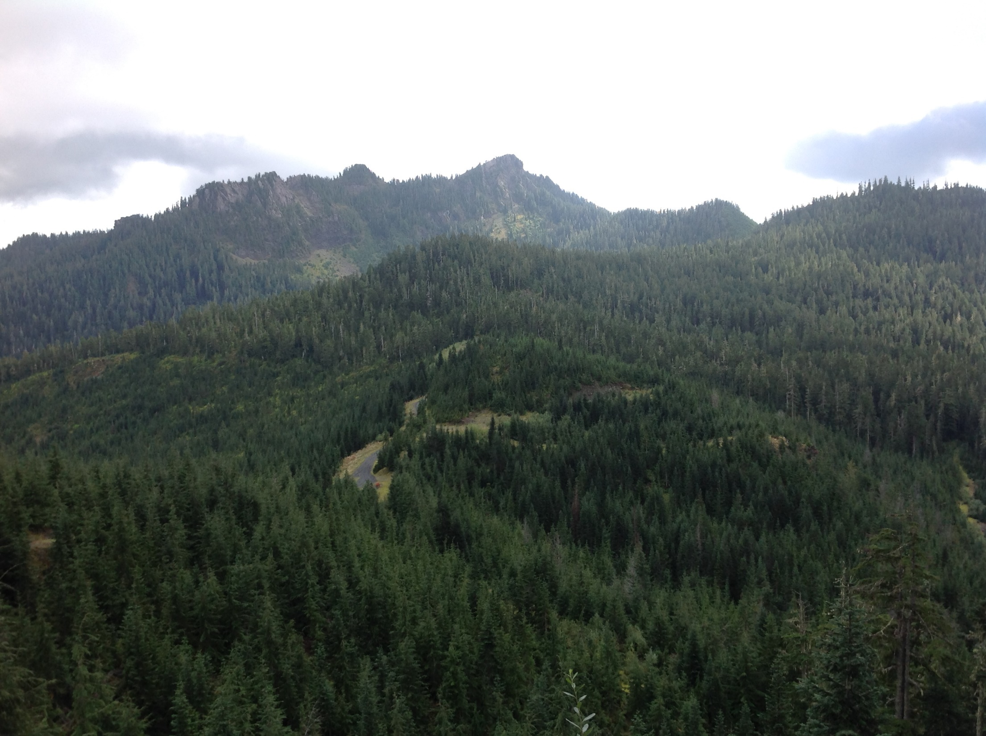
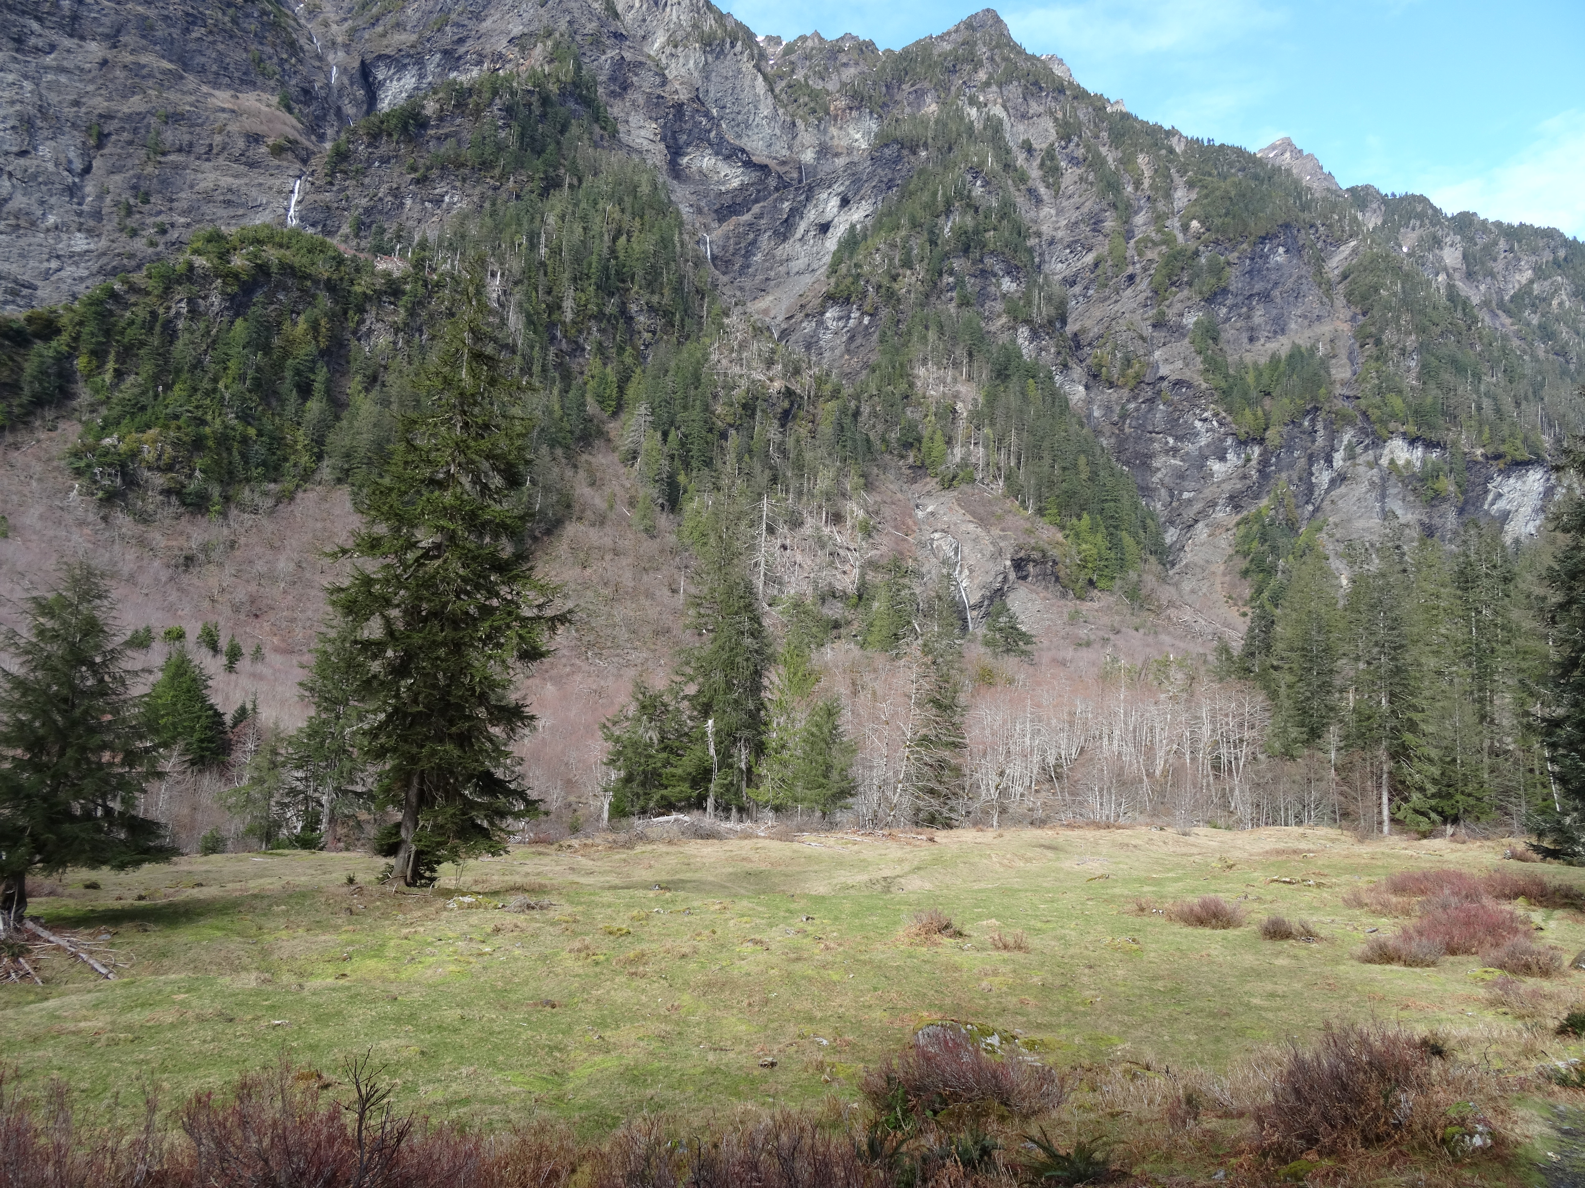
High Elevation Ground Sites – No Power
2200 ft
3000+ ft
13 miles by pack animals
Requires mountain biking and snowshoe to access site.

Slide 41
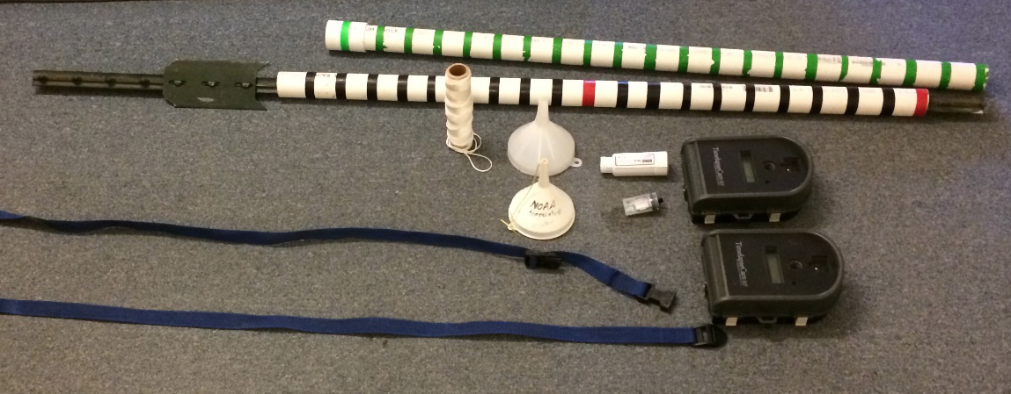
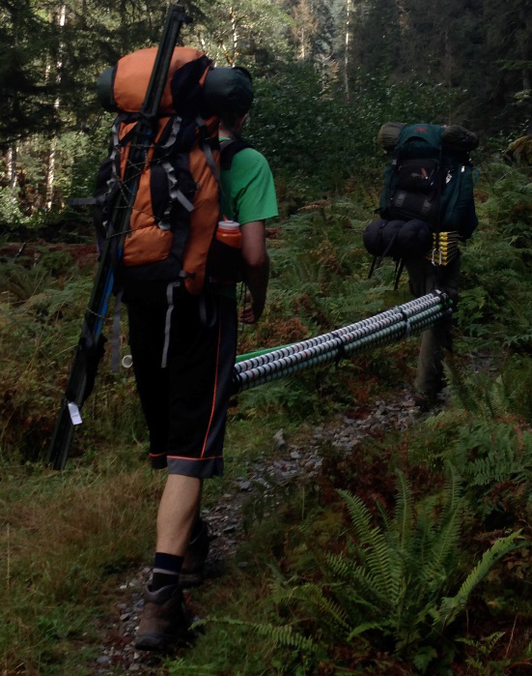
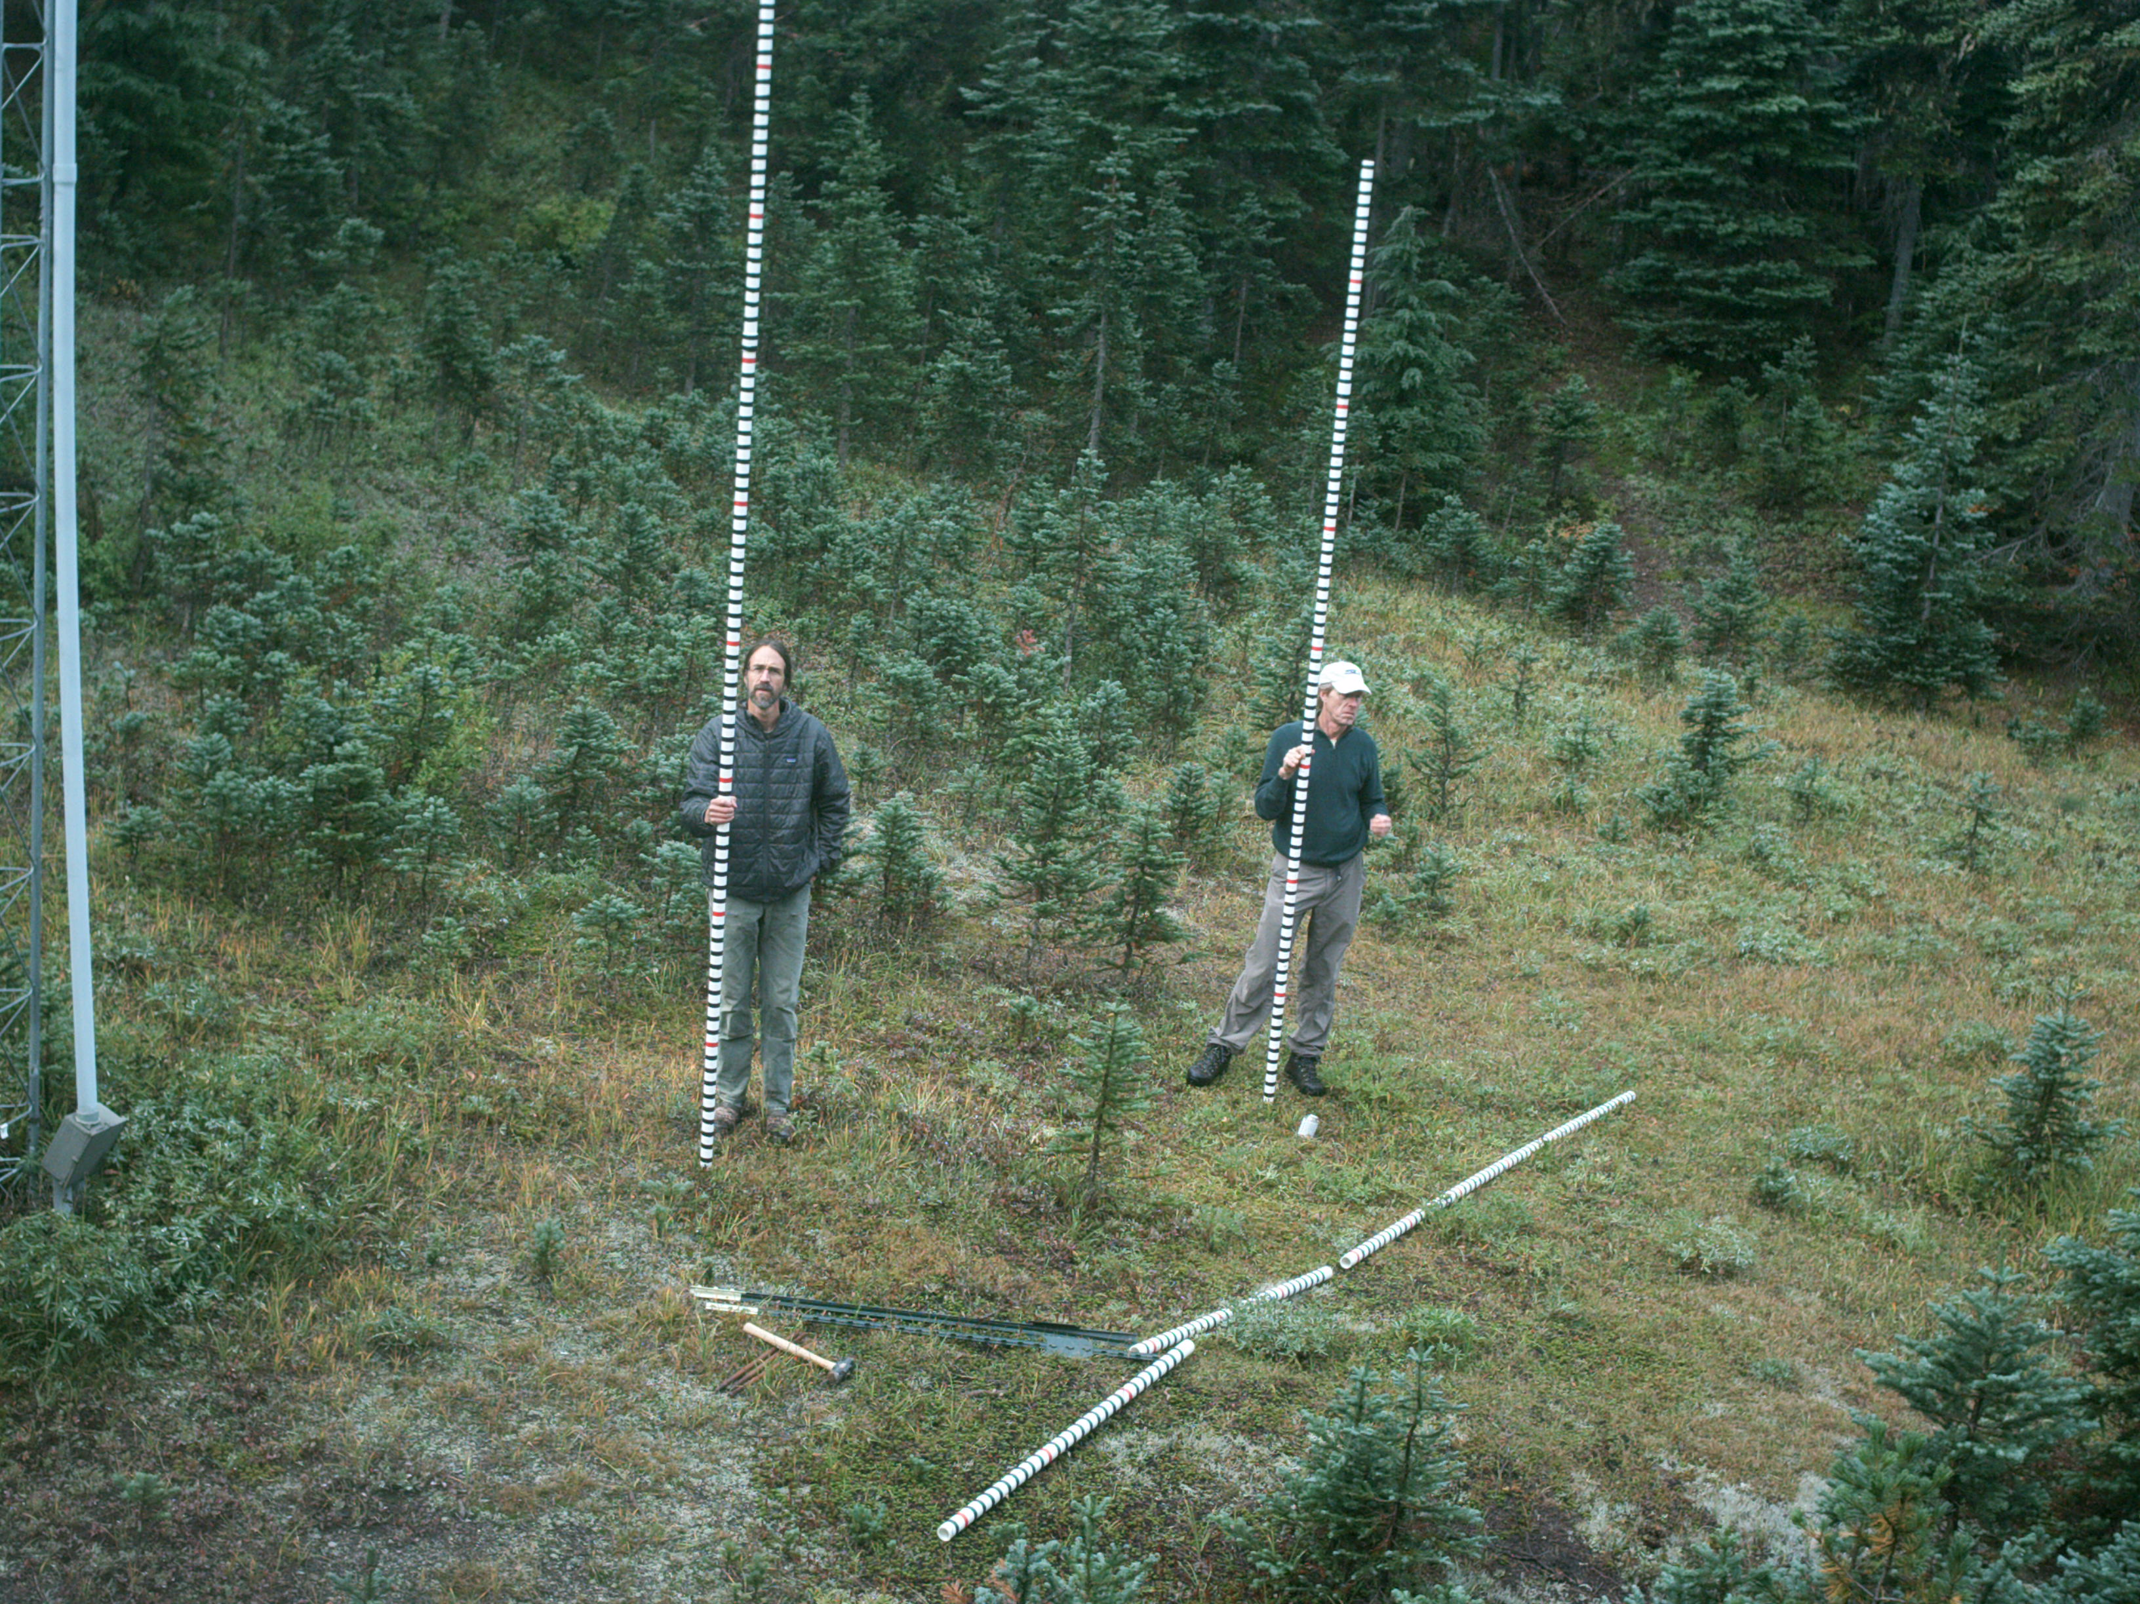
Snow Camera Installations
18 Cameras and Snow Poles at various locations on the windward side of the Olympics

Slide 42
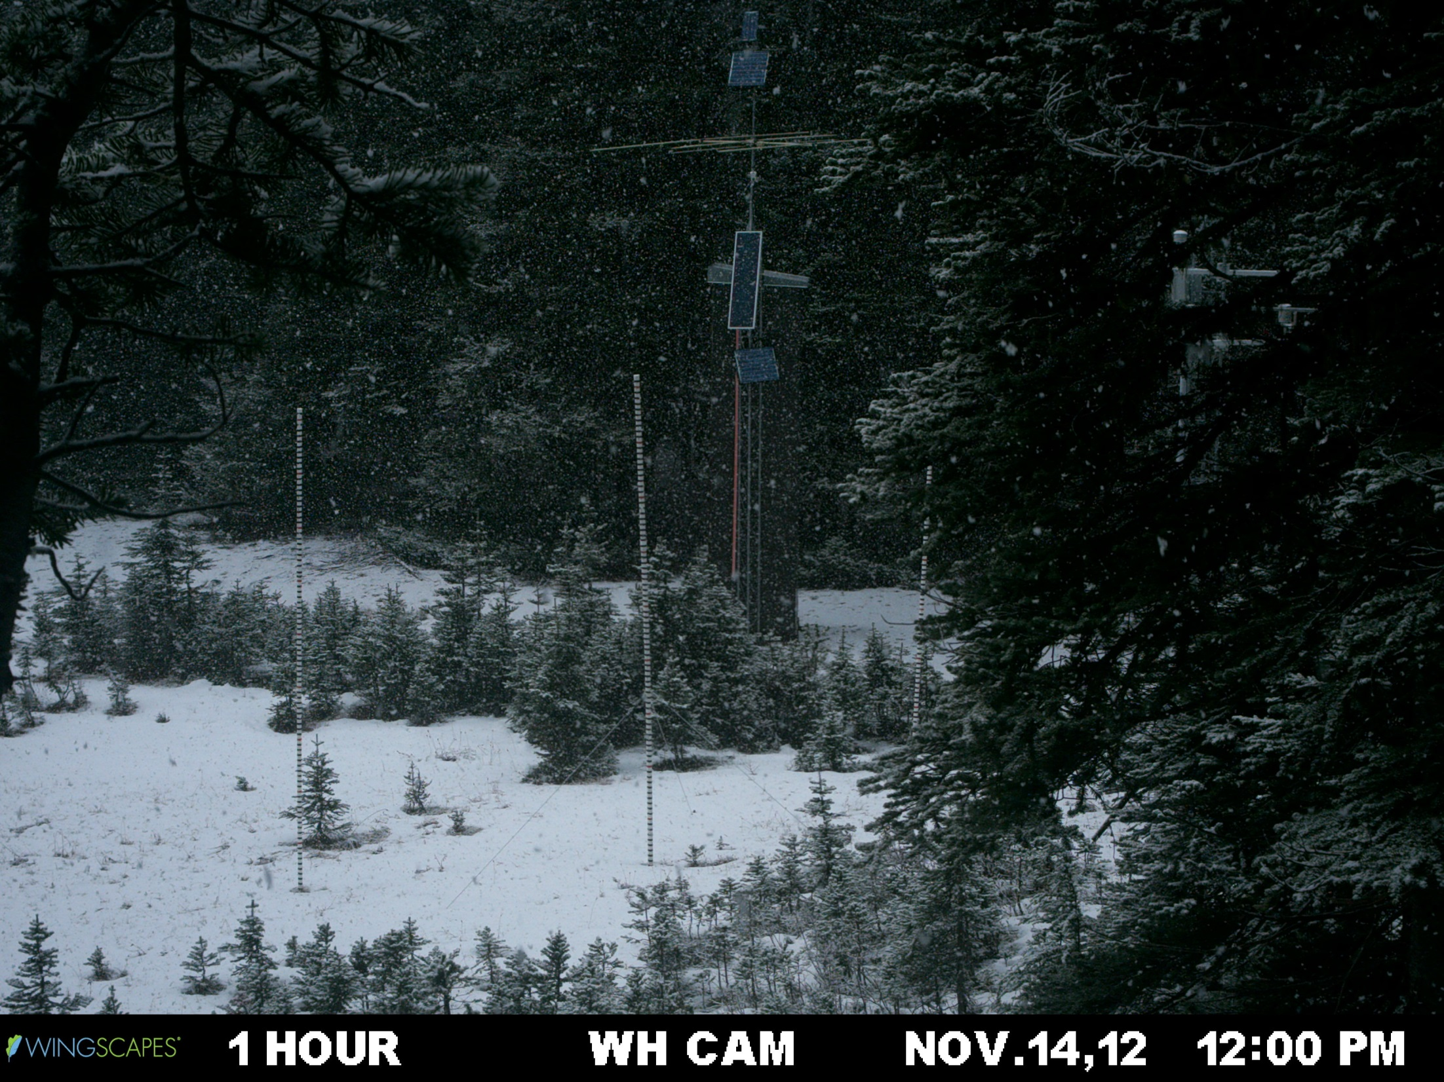
Precipitation event (snow) + Accumulation 1 of 2

Slide 43
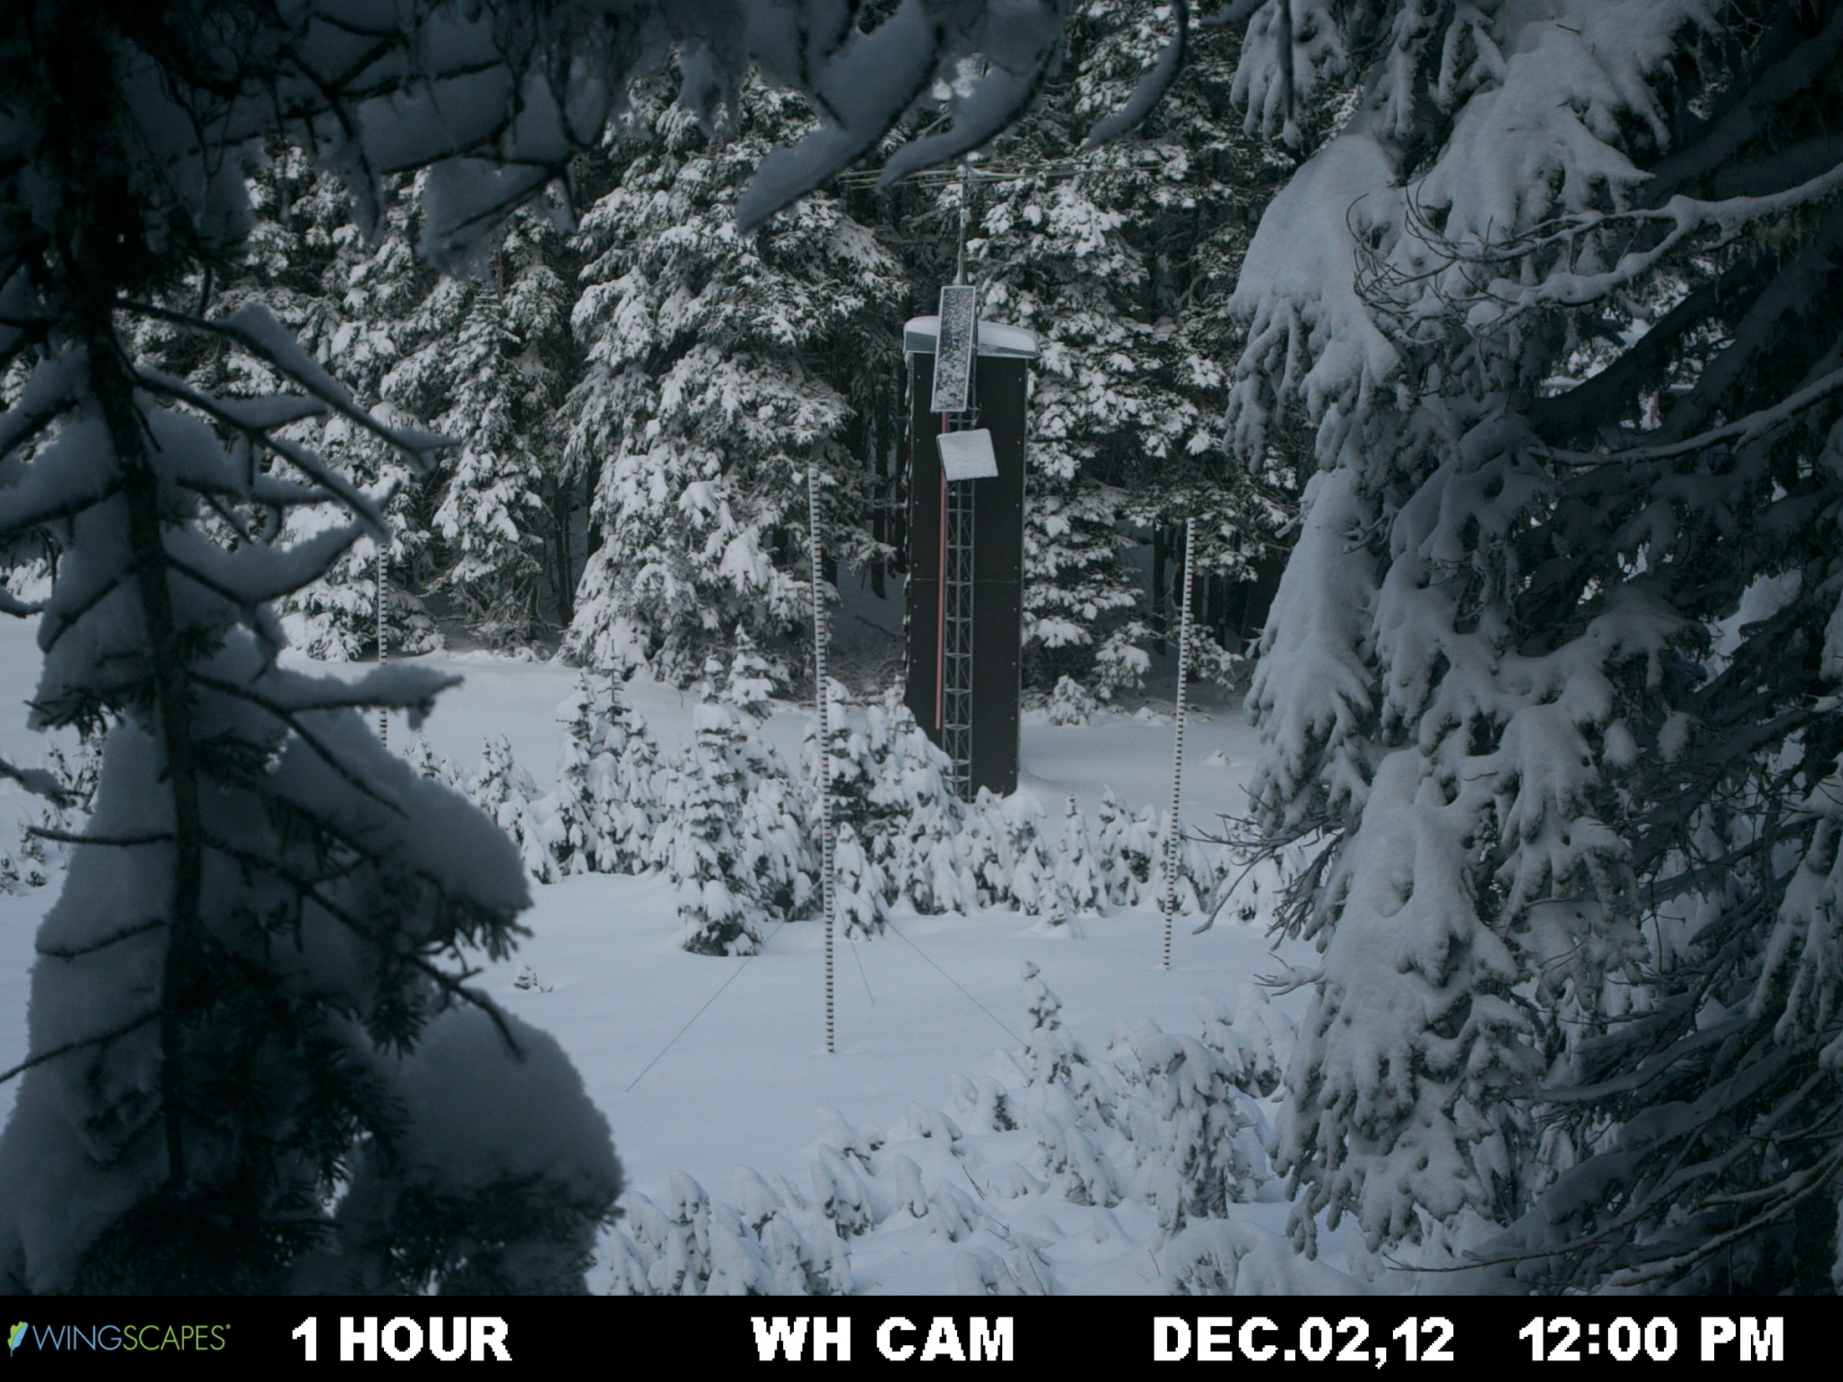
Accumulation 2 of 2

Slide 44
Summary
Mountains affect Earth’s three types of precipitating cloud systems:
Convection:
Capping and triggering of intense convection
Complex diurnal variations due to upscale growth of convection
Tropical cyclones (need much more work):
Along band winds encountering mountain barriers
Convection released in the eye passing over terrain
Fronts:
Windward side enhancement due to
–Barrier scale uplift –Tranverse ridge/valley scale gravity waves –Smaller scale turbulent enhancement

Slide 45
End
This research was funded by NSF Grant AGS-1144105 and NASA Grant NNX13AG71G

