Slide 1

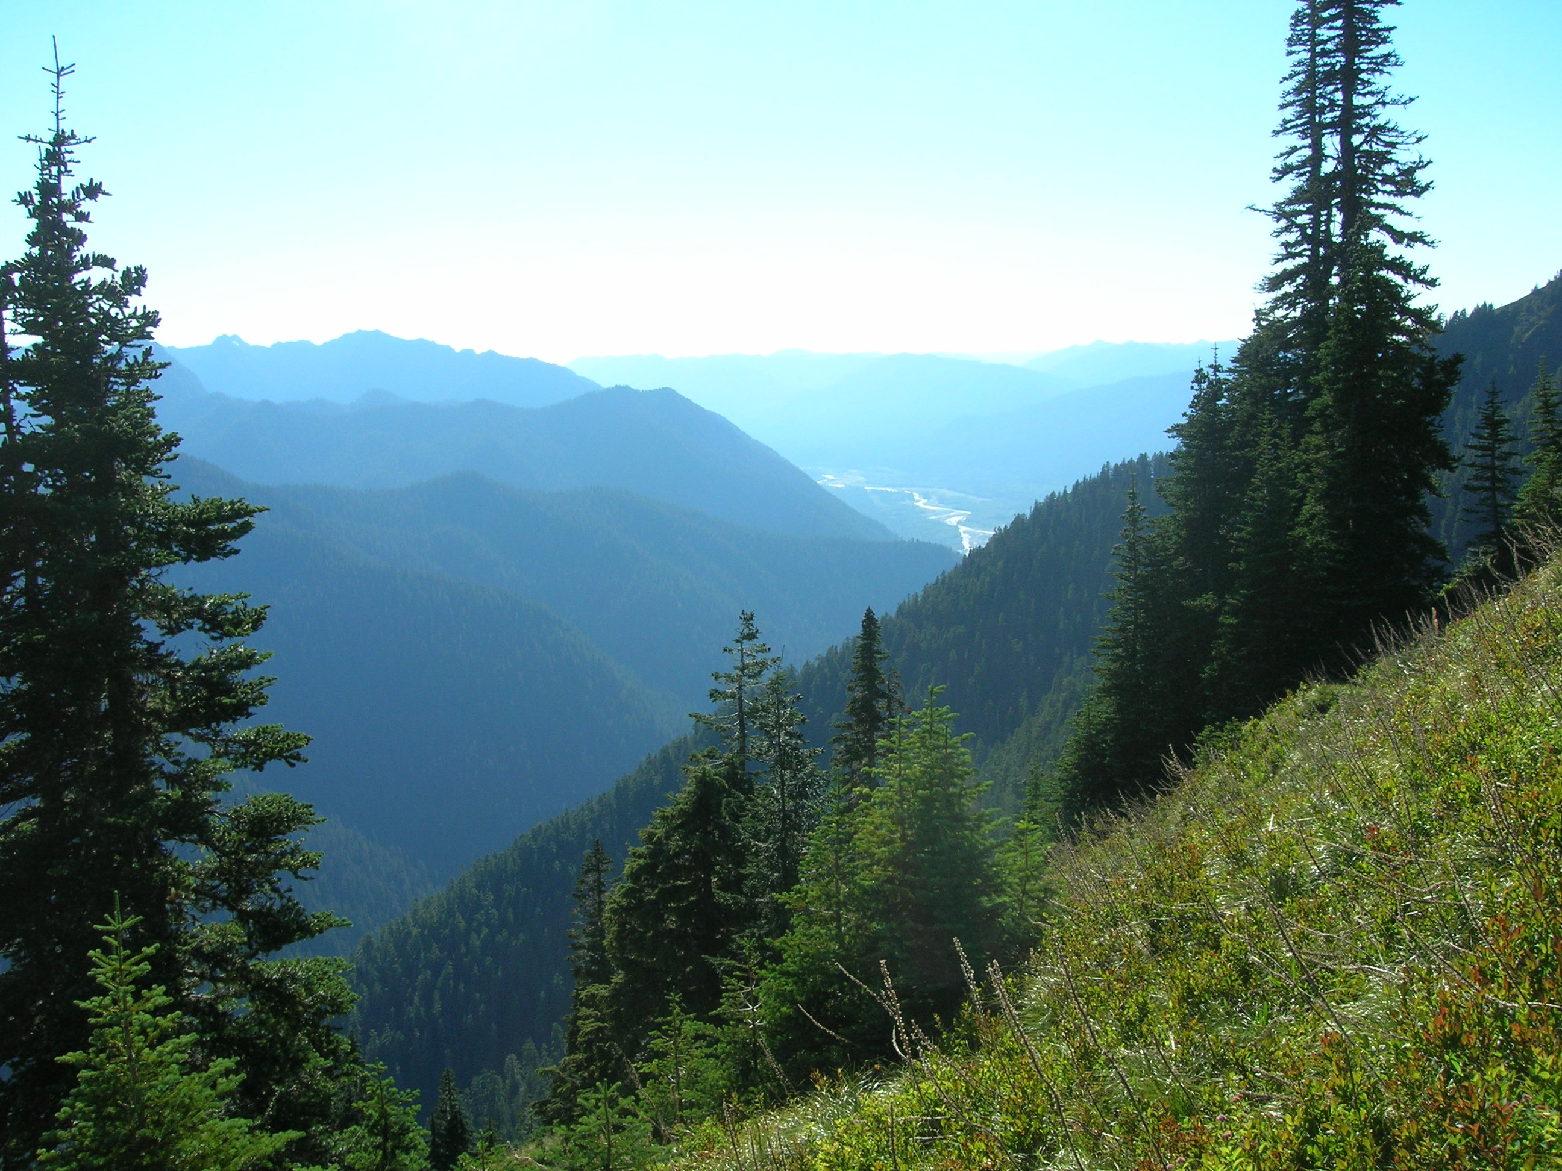
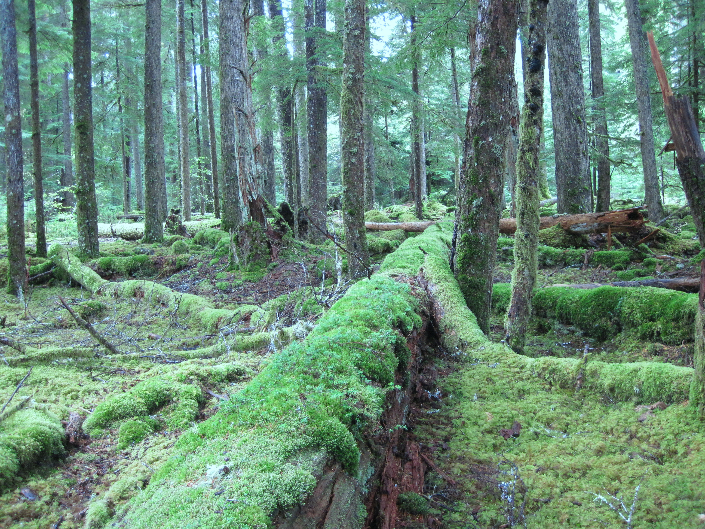
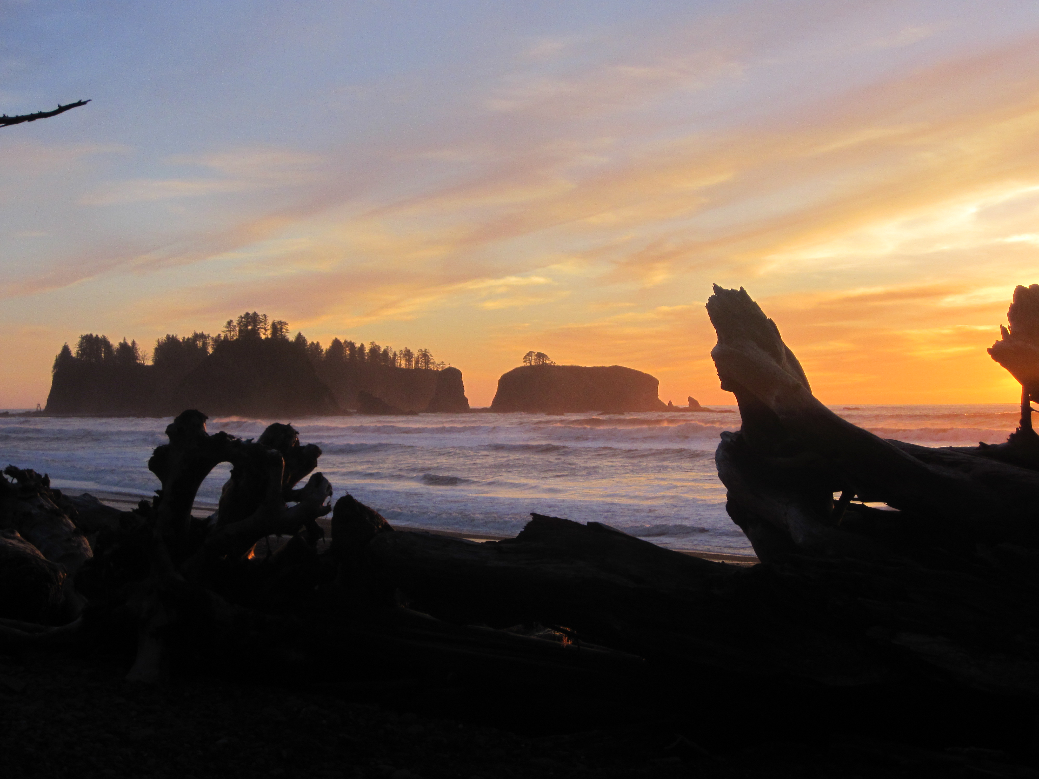
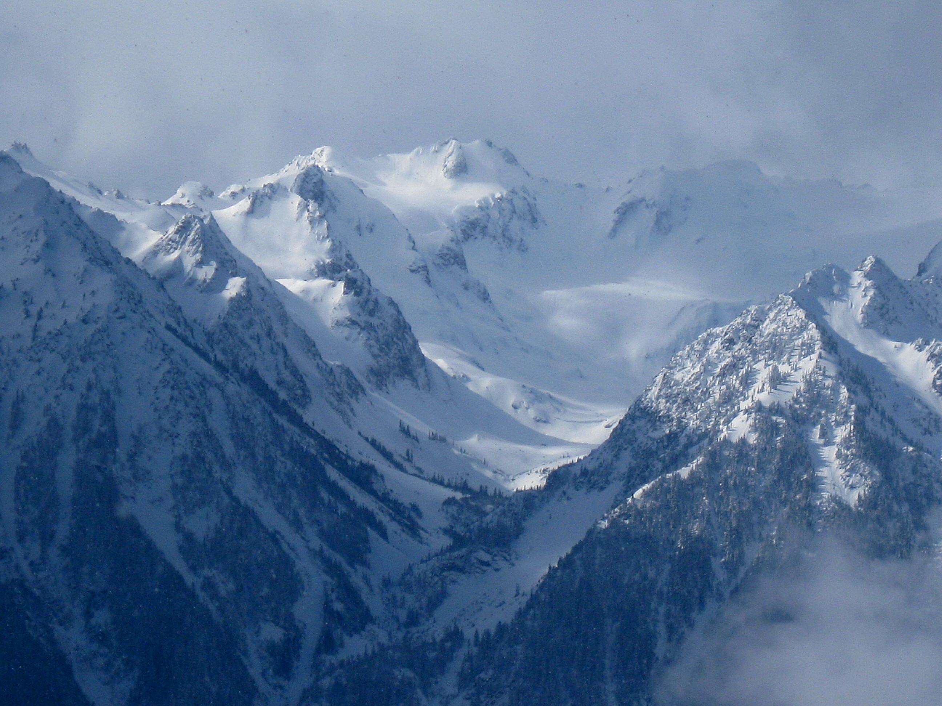
OLYMPEX: Ground Validation on the Olympic Peninsula in the
U. S. Pacific Northwest
Robert Houze, Lynn McMurdie, Jessica Lundquist, Cliff Mass, Joe Zagrodnik, William Baccus, Walter Petersen, Matthew Schwaller
7th GPM GV Meeting, Seoul, 14 May, 2015

Slide 2
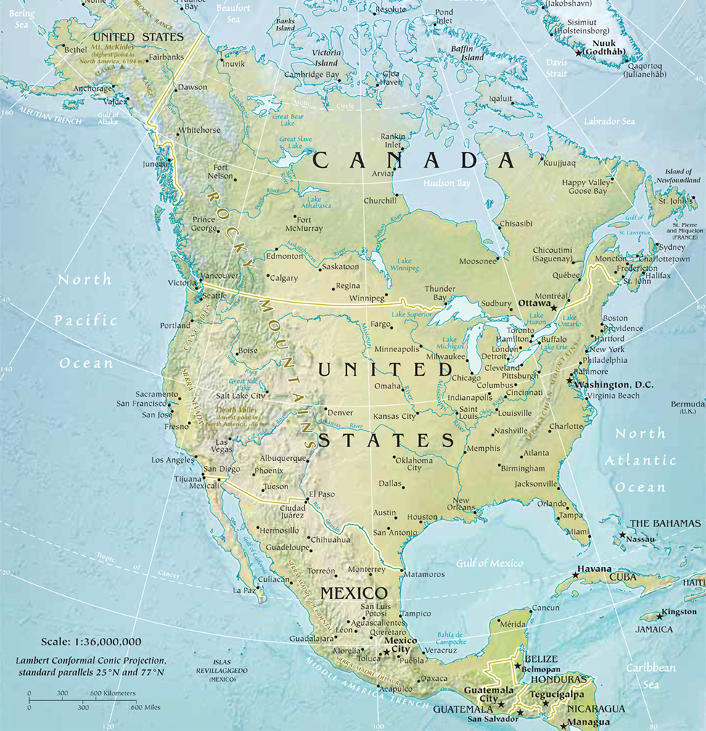
Olympic Peninsula

Slide 3
Regimes
Leeside
Quinault
High Terrain
Chehalis
Ocean
Windward side

Slide 4
The Climatology of the Olympic Peninsula
Annual average precipitation in inches from PRISM (Parameter-elevation Regressions Independent Slopes Model)
Climatology of MSLP from Nov-Feb from NCEP Reanalysis grids 1979 – 2012
Persistent moist onshore flow produces extraordinary annual precipitation totals
2500 mm (100”) on the coast and more than 4570 mm (180”) in the interior

Slide 5
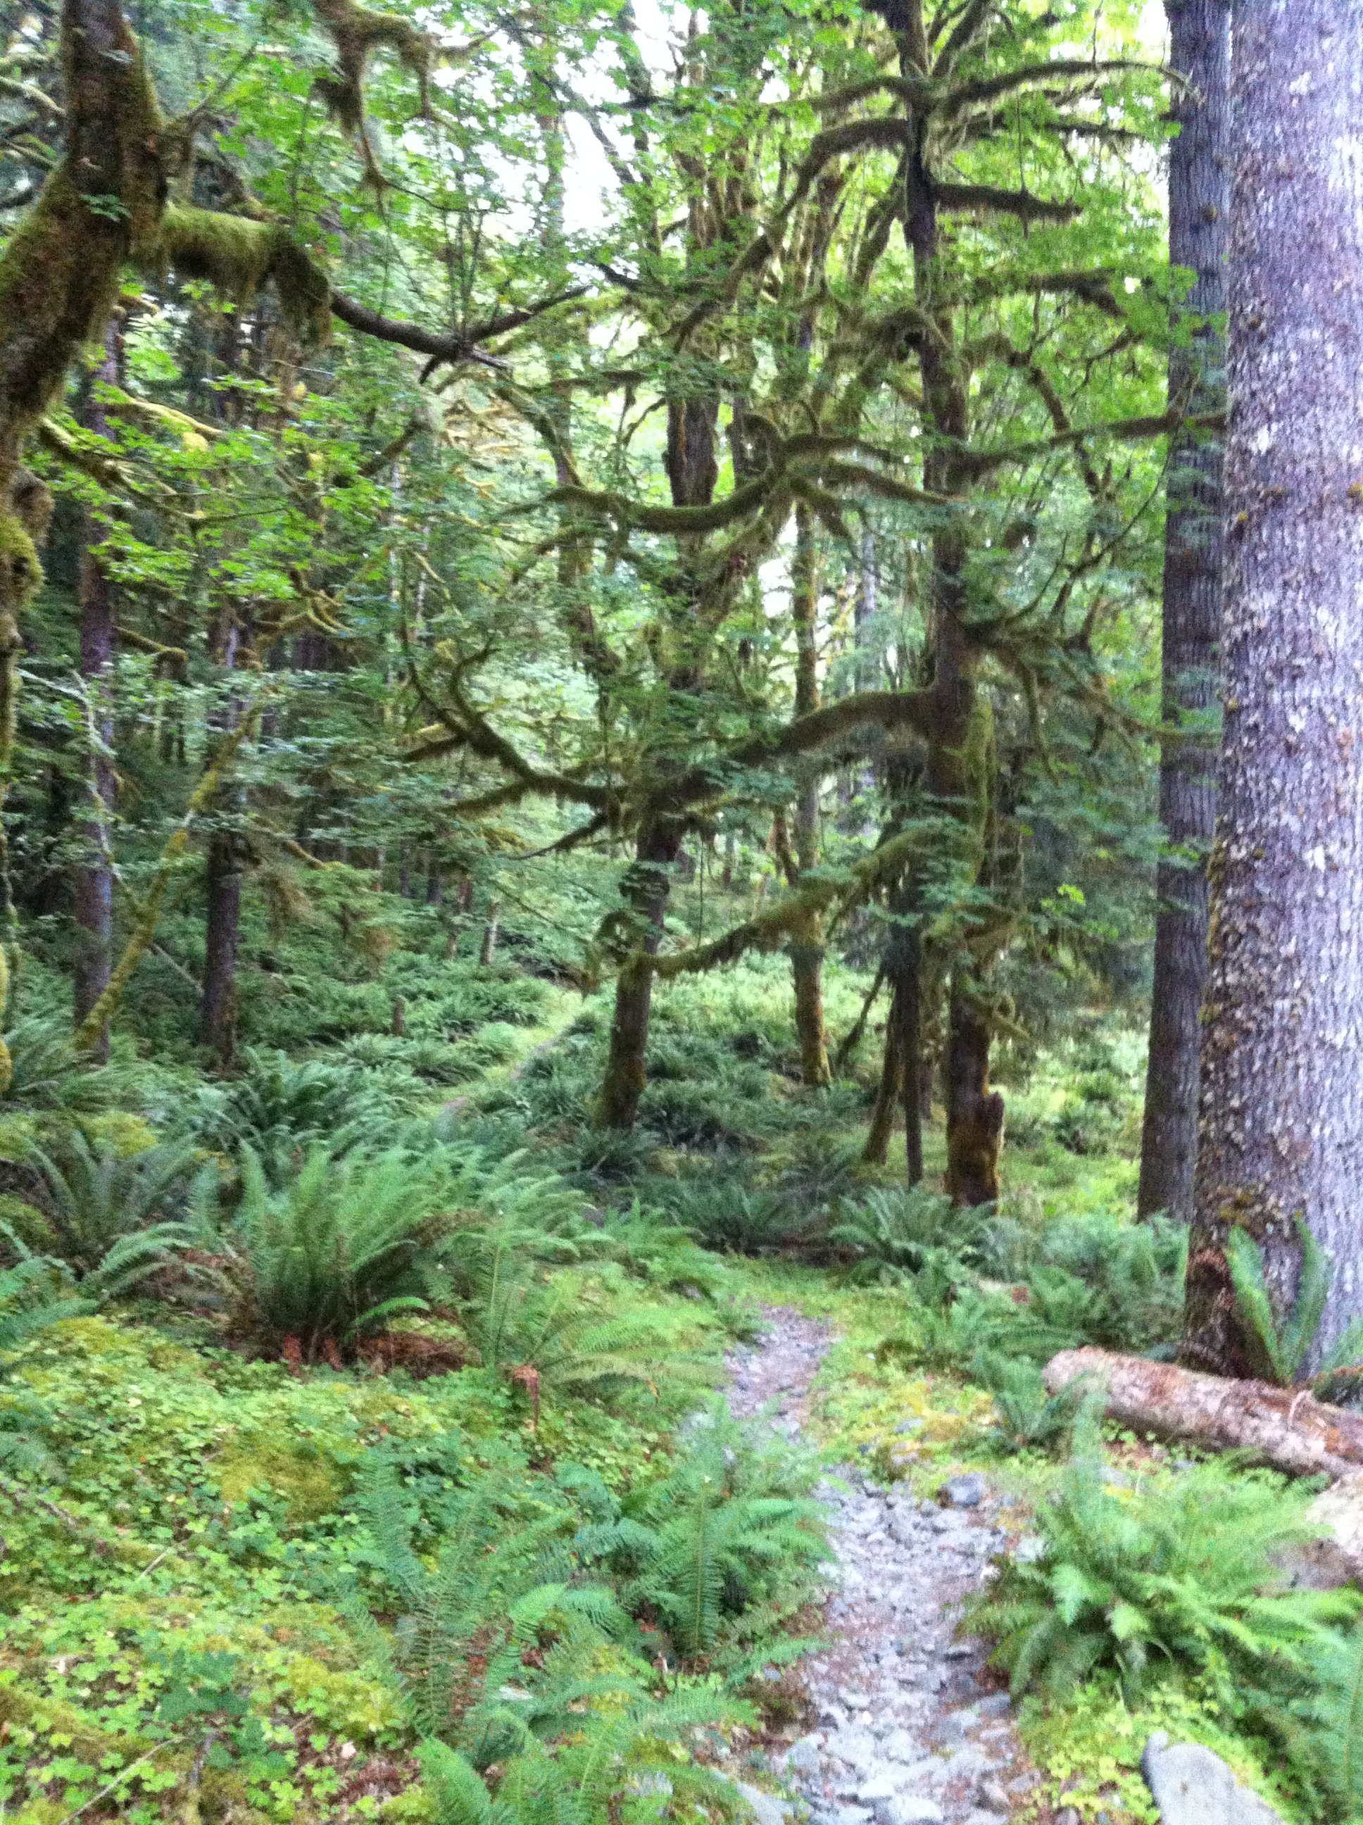
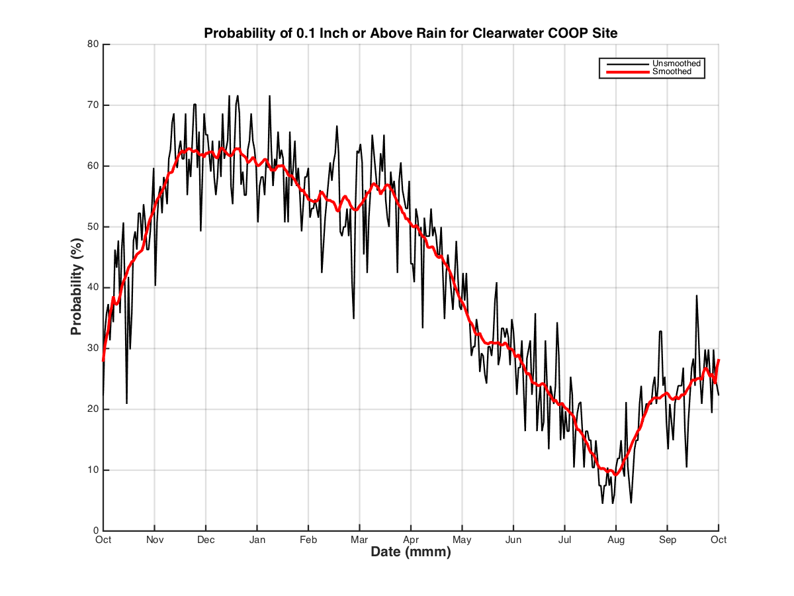
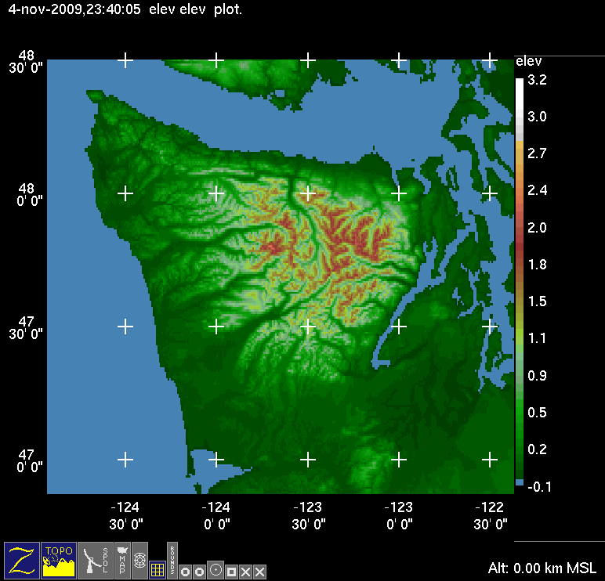
Rain Forest Climate
OLYMPEX
Probability of receiving at least 2.5 mm (0.1”) of precip
Average rainfall during Nov, Dec and Jan is 400 mm (16”) each month. Range is 75 – 750 mm (3 – 30”) from 98 years of data.

Slide 6
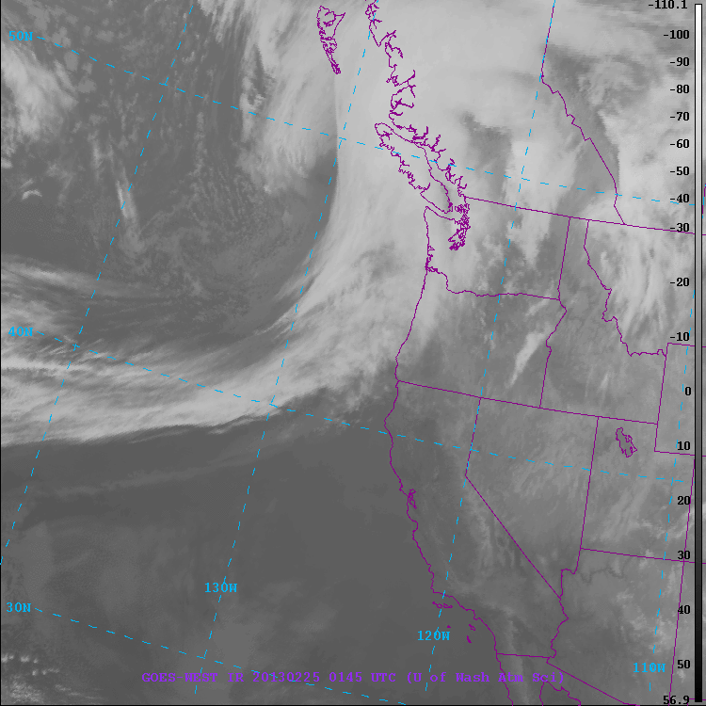
Typical Frontal Passage
Three different regimes!
Prefrontal

Slide 7
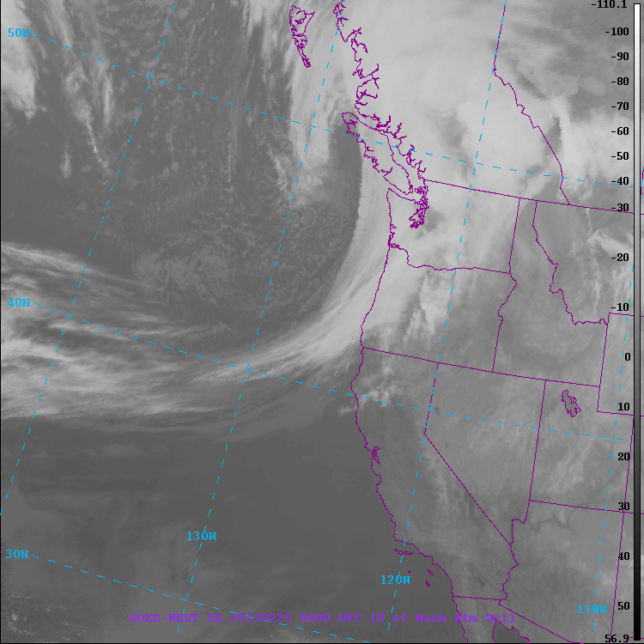
Typical Frontal Passage
Three different regimes!
Frontal

Slide 8
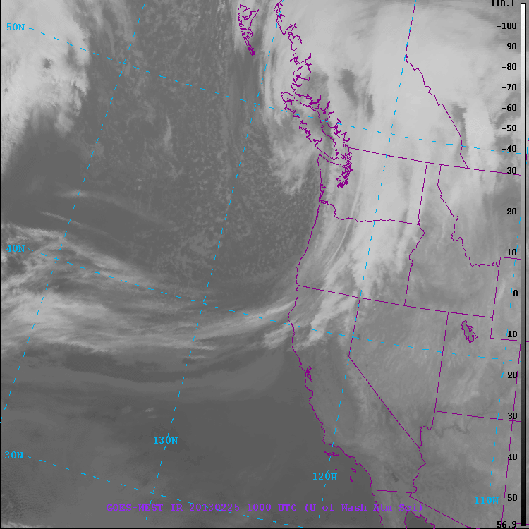
Typical Frontal Passage
Three different regimes!
Postfrontal

Slide 9
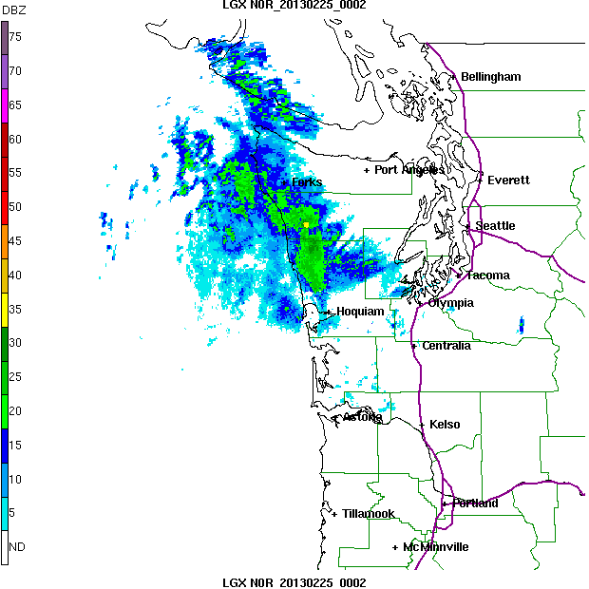
Typical Frontal Passage
Three different regimes!
Prefrontal
Frontal
Postfrontal
SW side of Olympics gets rain well ahead of front
SW side gets rain during front
SW side gets post-frontal showers

Slide 10
OLYMPEX objectives
Observe all 3 sectors of frontal systems
Observe passage from ocean to coast to upslope to leeside
Determine how precipitation processes vary between sectors
Modification of processes by terrain
Hydrology
Model experiments

Slide 11

Network Overview
x
Legend
= WSR-88D
= NPOL and D3R
= DOW
= EC X-Band
= MRR = SNOTEL
= Ground Obs sites
= Snow camera network = UW Tipping bucket network
= Chehalis rain gauge network
x
x
x
x
x
x
x
x
x
x
x
x
x
x
x
x
x
x
x
x
x
DC-8
ER-2
Citation

Slide 12
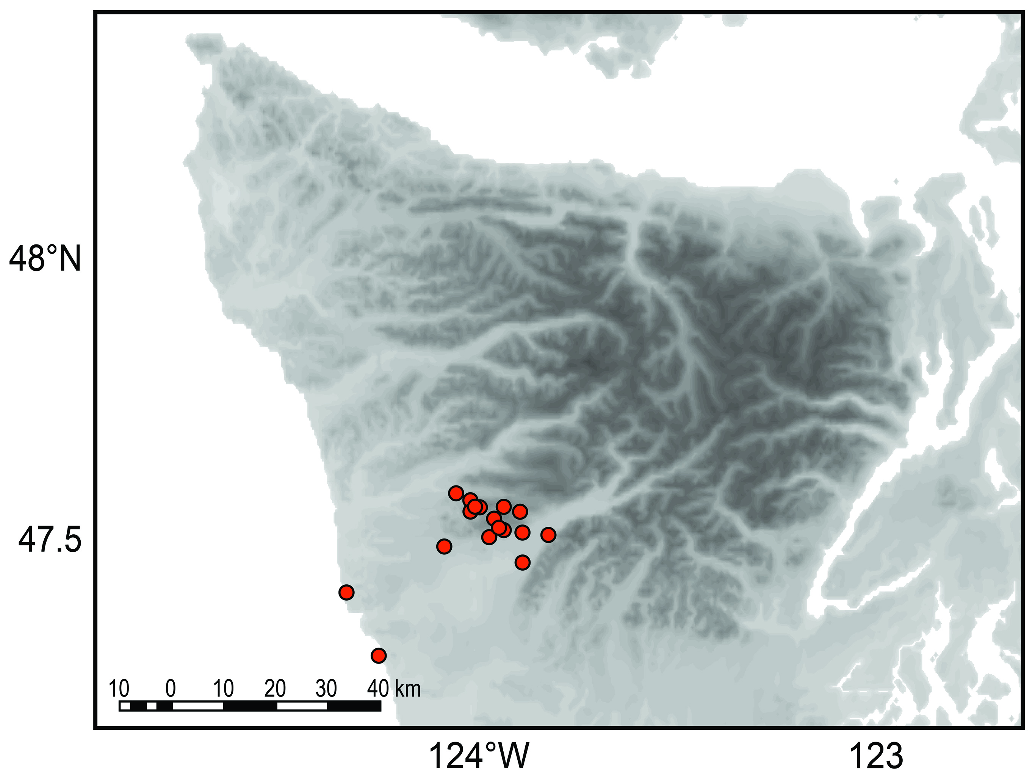
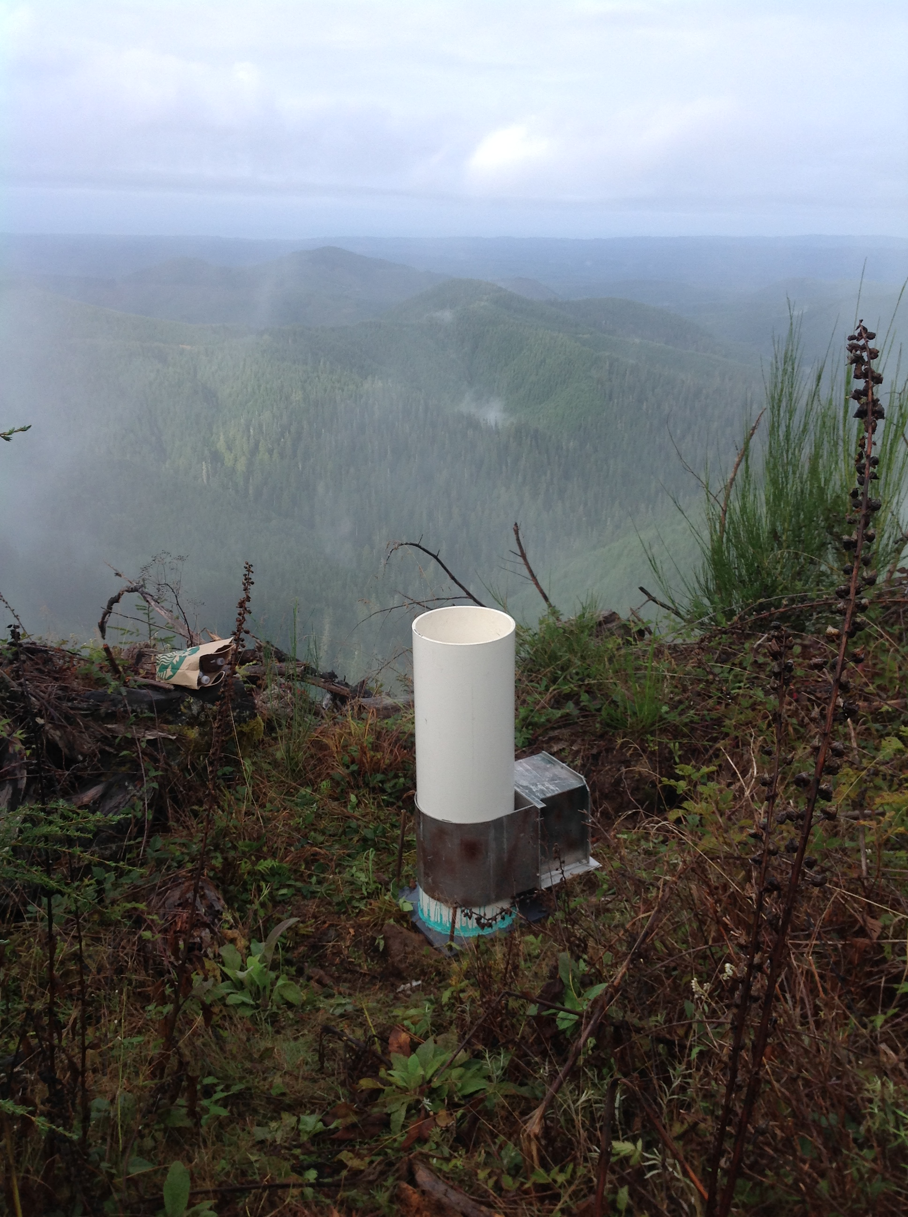
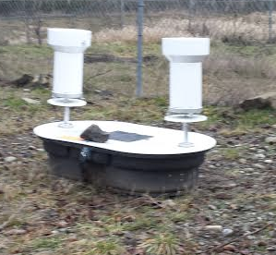
Two Rain Gauge Networks
Quinault Valley
Single bucket gauges
Chehalis
10–15 dual gauges
CoCoRahs sites
Coop observers

Slide 13
Radars

Slide 14
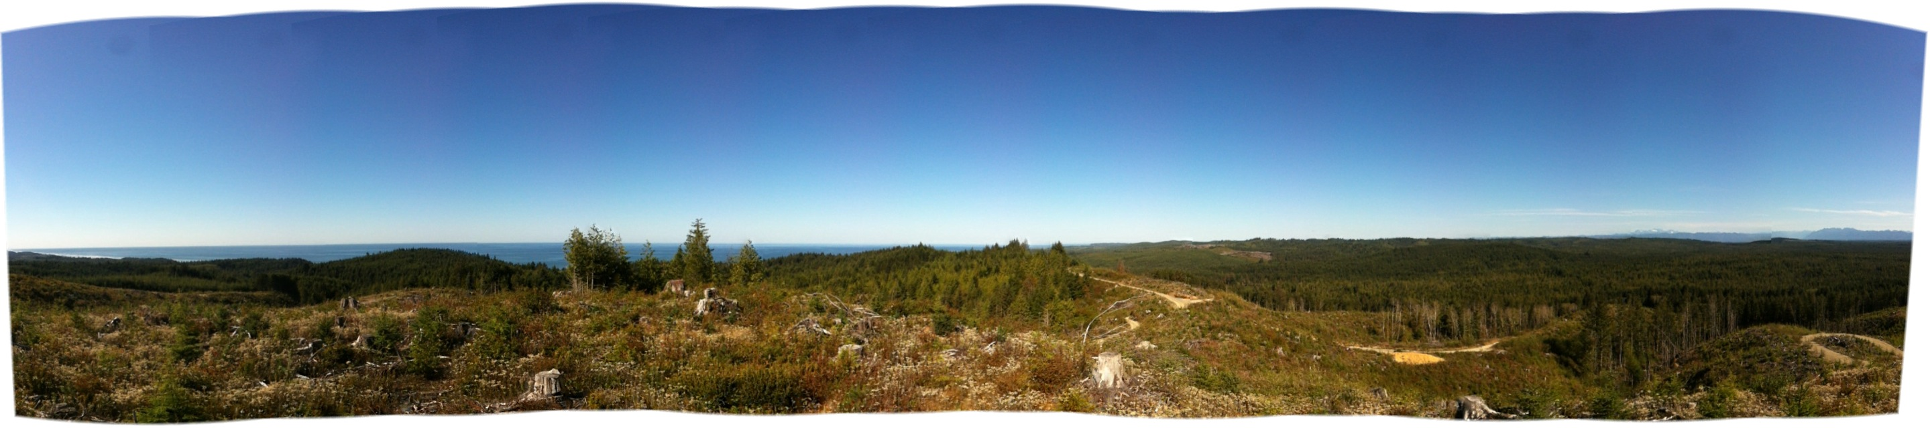
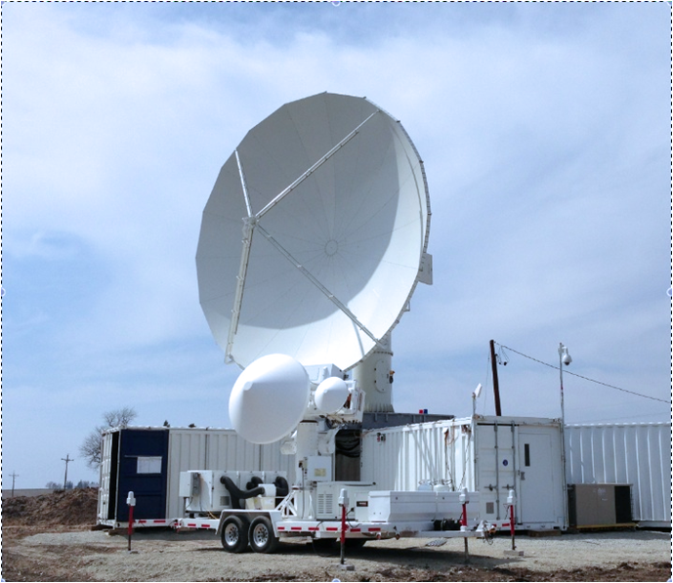
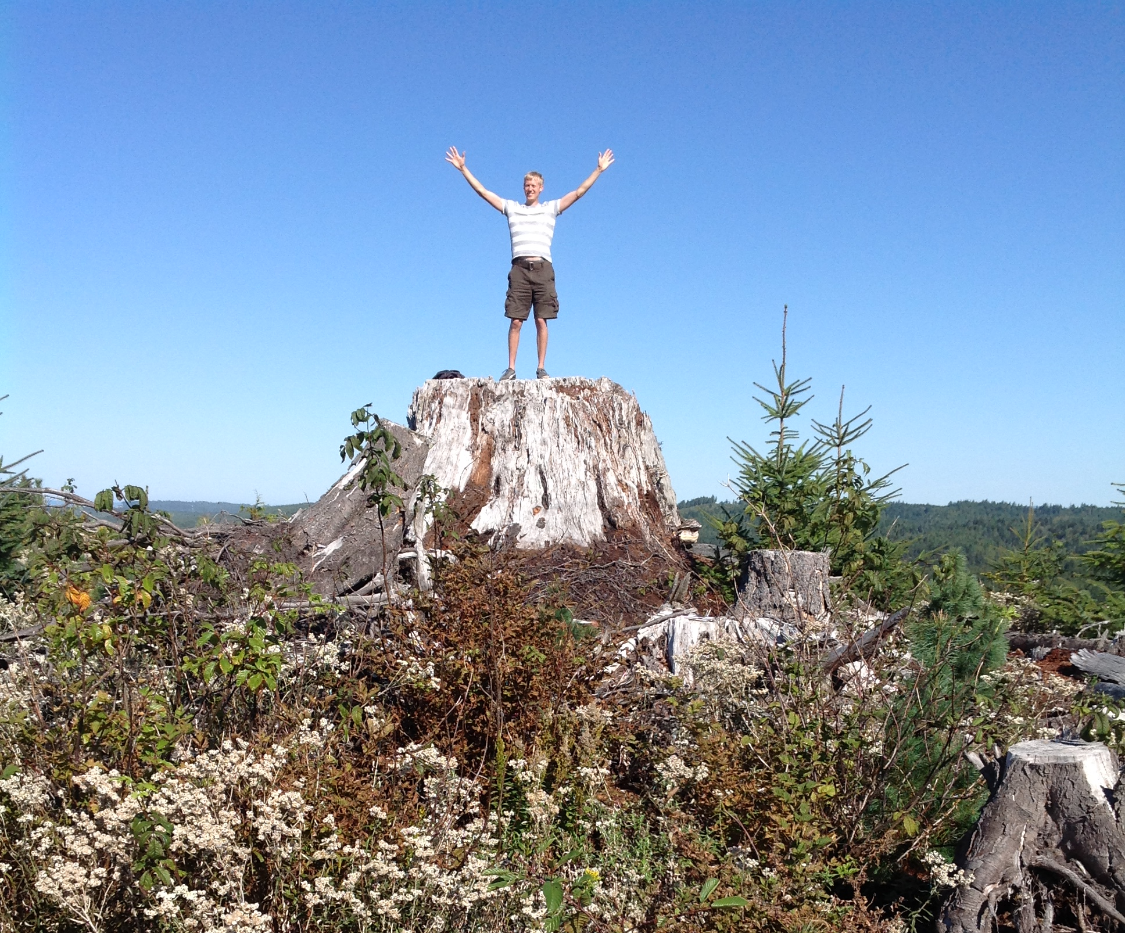
NPOL/D3R Radar Site
Olympic Mts. (NE)
Pacific Ocean (SW)
On Quinault Indian Nation land near the coast where the radar has clear views towards the Ocean and towards the Olympic Mountains and up the Quinault River
NPOL
D3R

Slide 15
Radar coverage
Scan Strategies:
NPOL: RHI scans up Quinault Valley and over Ocean
D3R: TBD
DOW: Scan up and down valley to document precipitation growth ‘under’ NPOL beam
X-Band: RHI scans over Hurricane Ridge on leeside
MRR’s: Placed to document precip growth in lowest levels

Slide 16
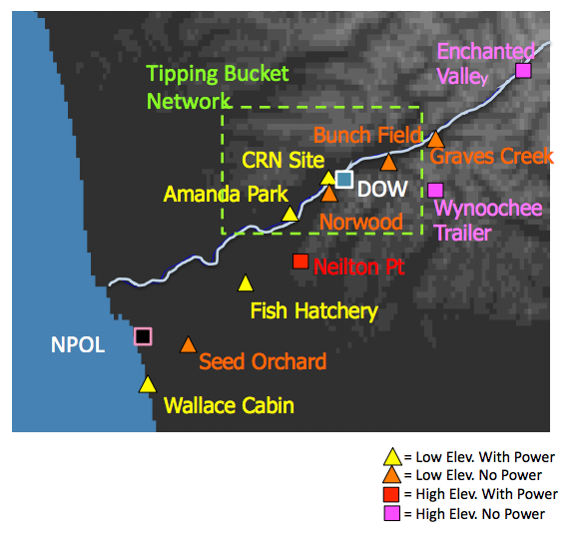
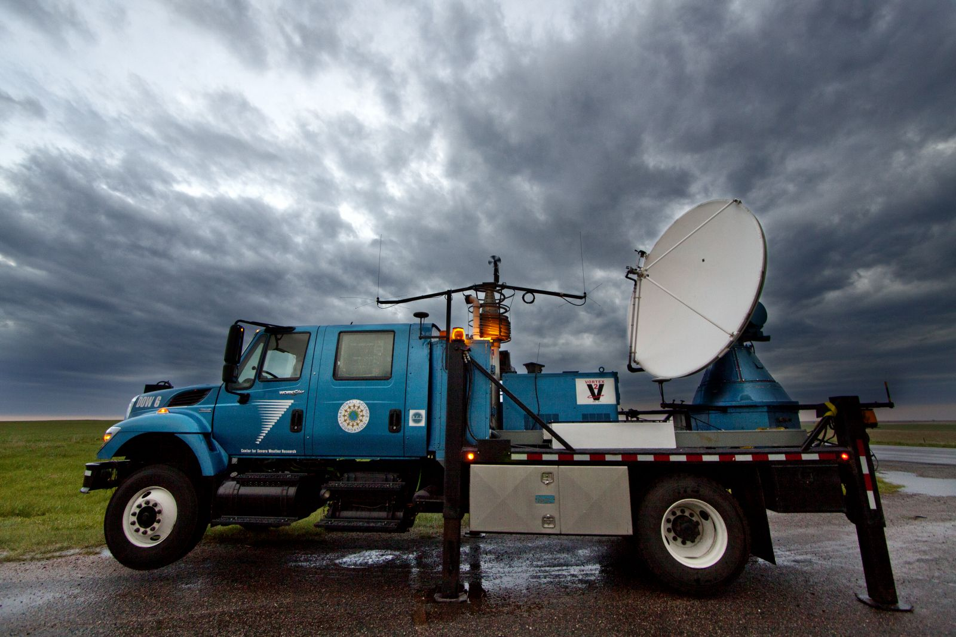
Doppler on Wheels (DOW)
Will be installed at Lake Quinault so it can make measurements where it will sample ‘under’ the lowest NPOL radar beam. It will have a range of ~40 km (can ‘see’ to NPOL and can ‘see’ to Upper Quinault Valley installation.

Slide 17
Ground instruments

Slide 18
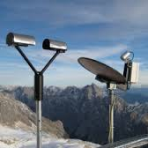
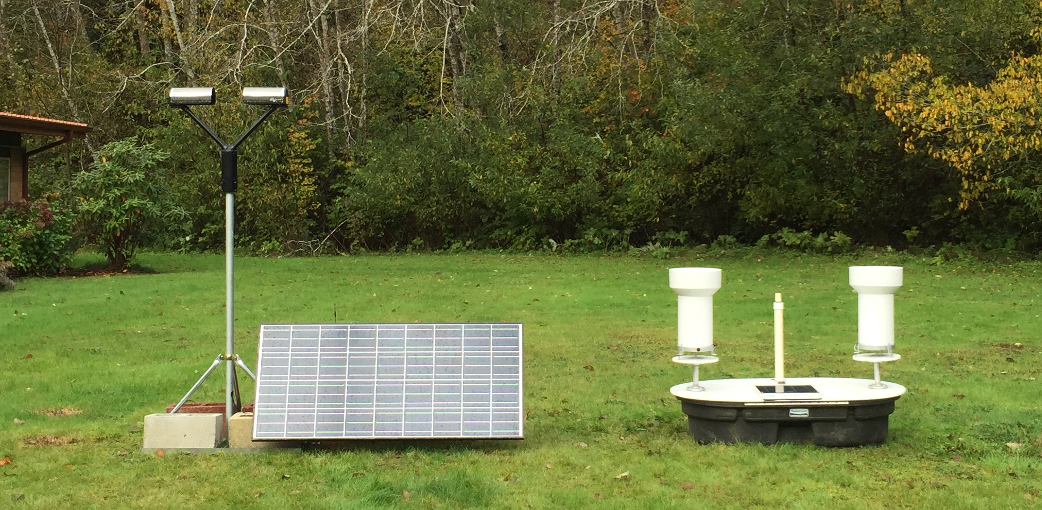
Ground Instrument Sites For Rain
Low Elevations Sites with Power
- Micro Rain Radar (MRR)
- Parsivel (disdrometer)
- 2DVD
- Rain gauge (dual bucket)
Low Elevation Sites without Power
- Parsivel (powered by solar panel/battery)
- Rain Gauge (dual bucket)
Parsivel MRR
Testing of Low elevation site without power at the Quinault Fish Hatchery ongoing

Slide 19
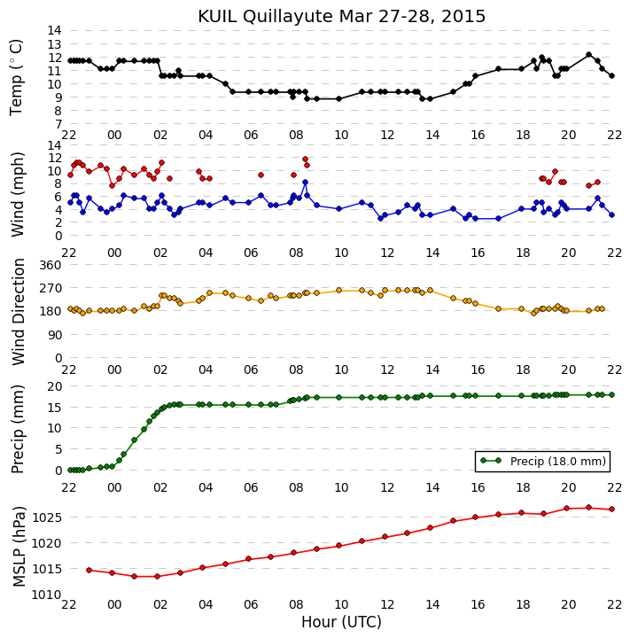
Event Sampled at Quinault Fisheries
27 – 28 March, 2015
Frontal Passage at UIL

Slide 20
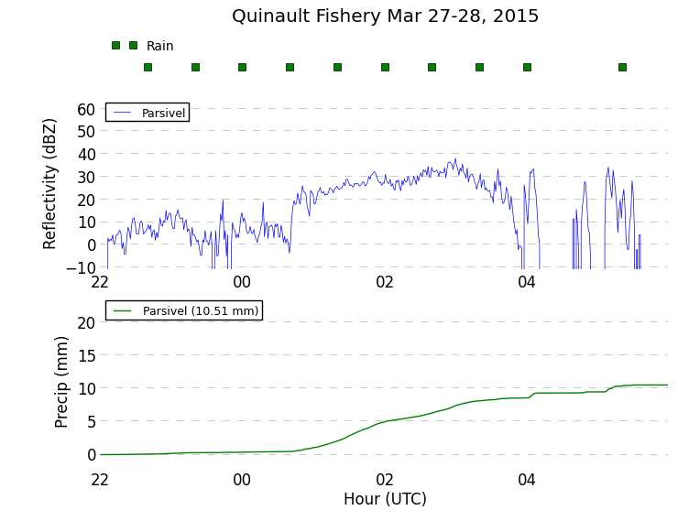
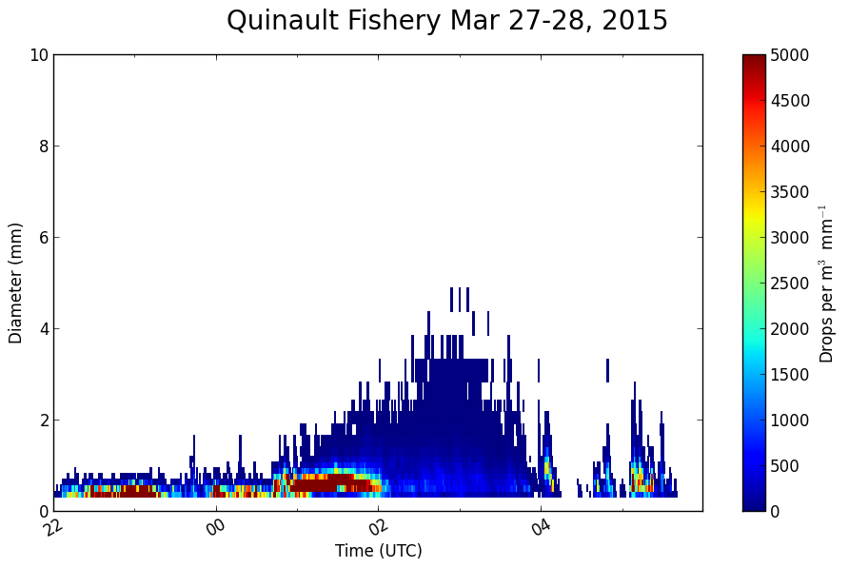
Event Sampled at Quinault Fisheries
27 – 28 March, 2015
Frontal Passage at APU30
Lots of small drops before frontal passage – Reminiscent of White et al. (2003) of non-brightband warm rain processes and like Waldvogel 1974
Droplet size growth at time of frontal passage
Reflectivity similar for prefrontal and frontal regimes
24hr total precip = 20 mm
Post-frontal showers after 0400 UTC

Slide 21
High Terrain Measurements

Slide 22
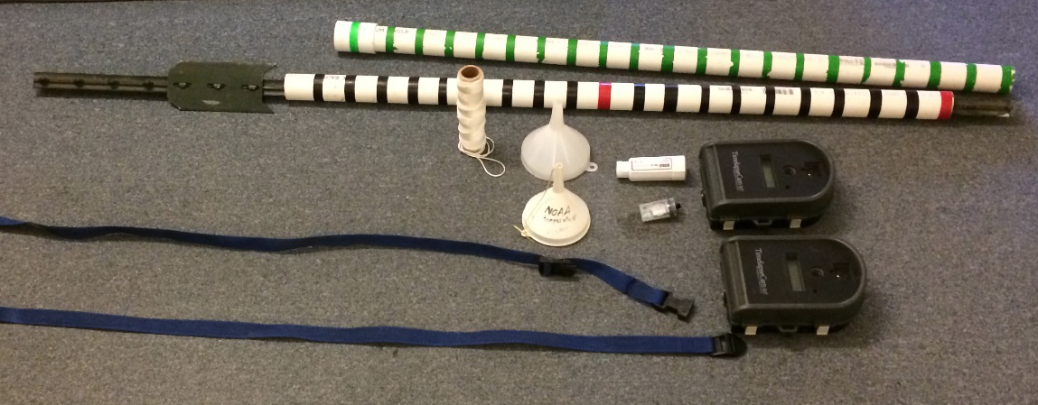
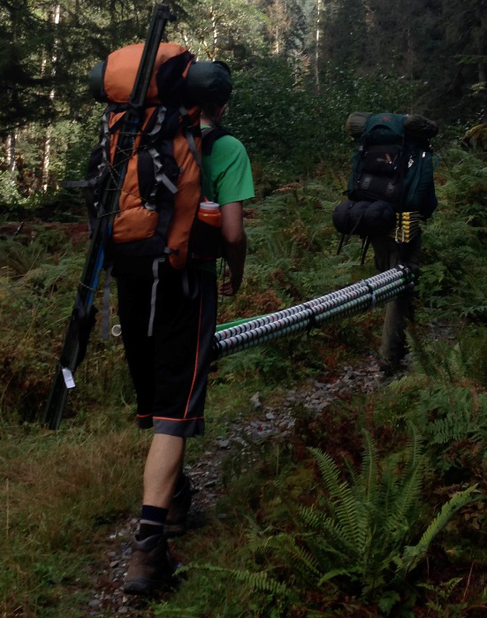
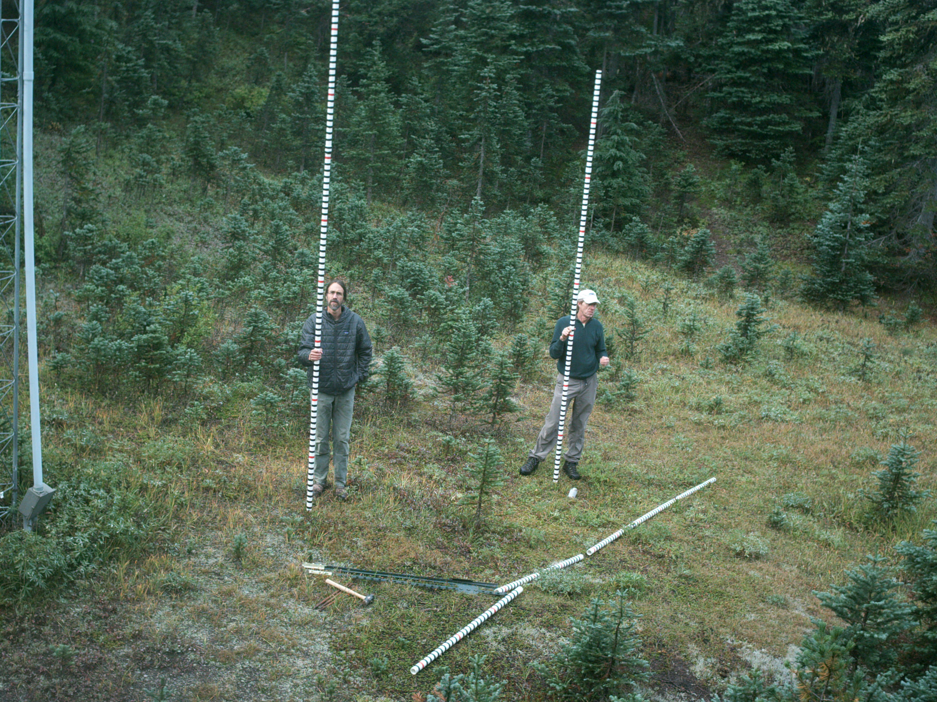
Snow Camera Installations 2014 - 2015
Jessica Lundquist’s crew installed 18 Cameras and Snow Poles at various locations near historical snow course locations and along the Quinault River and tributaries.

Slide 23

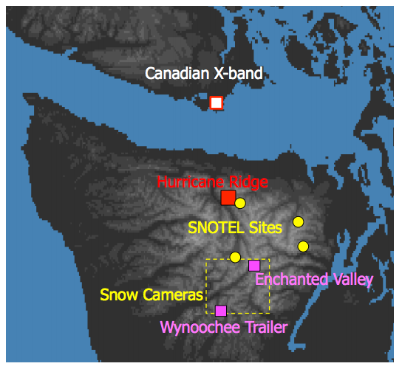
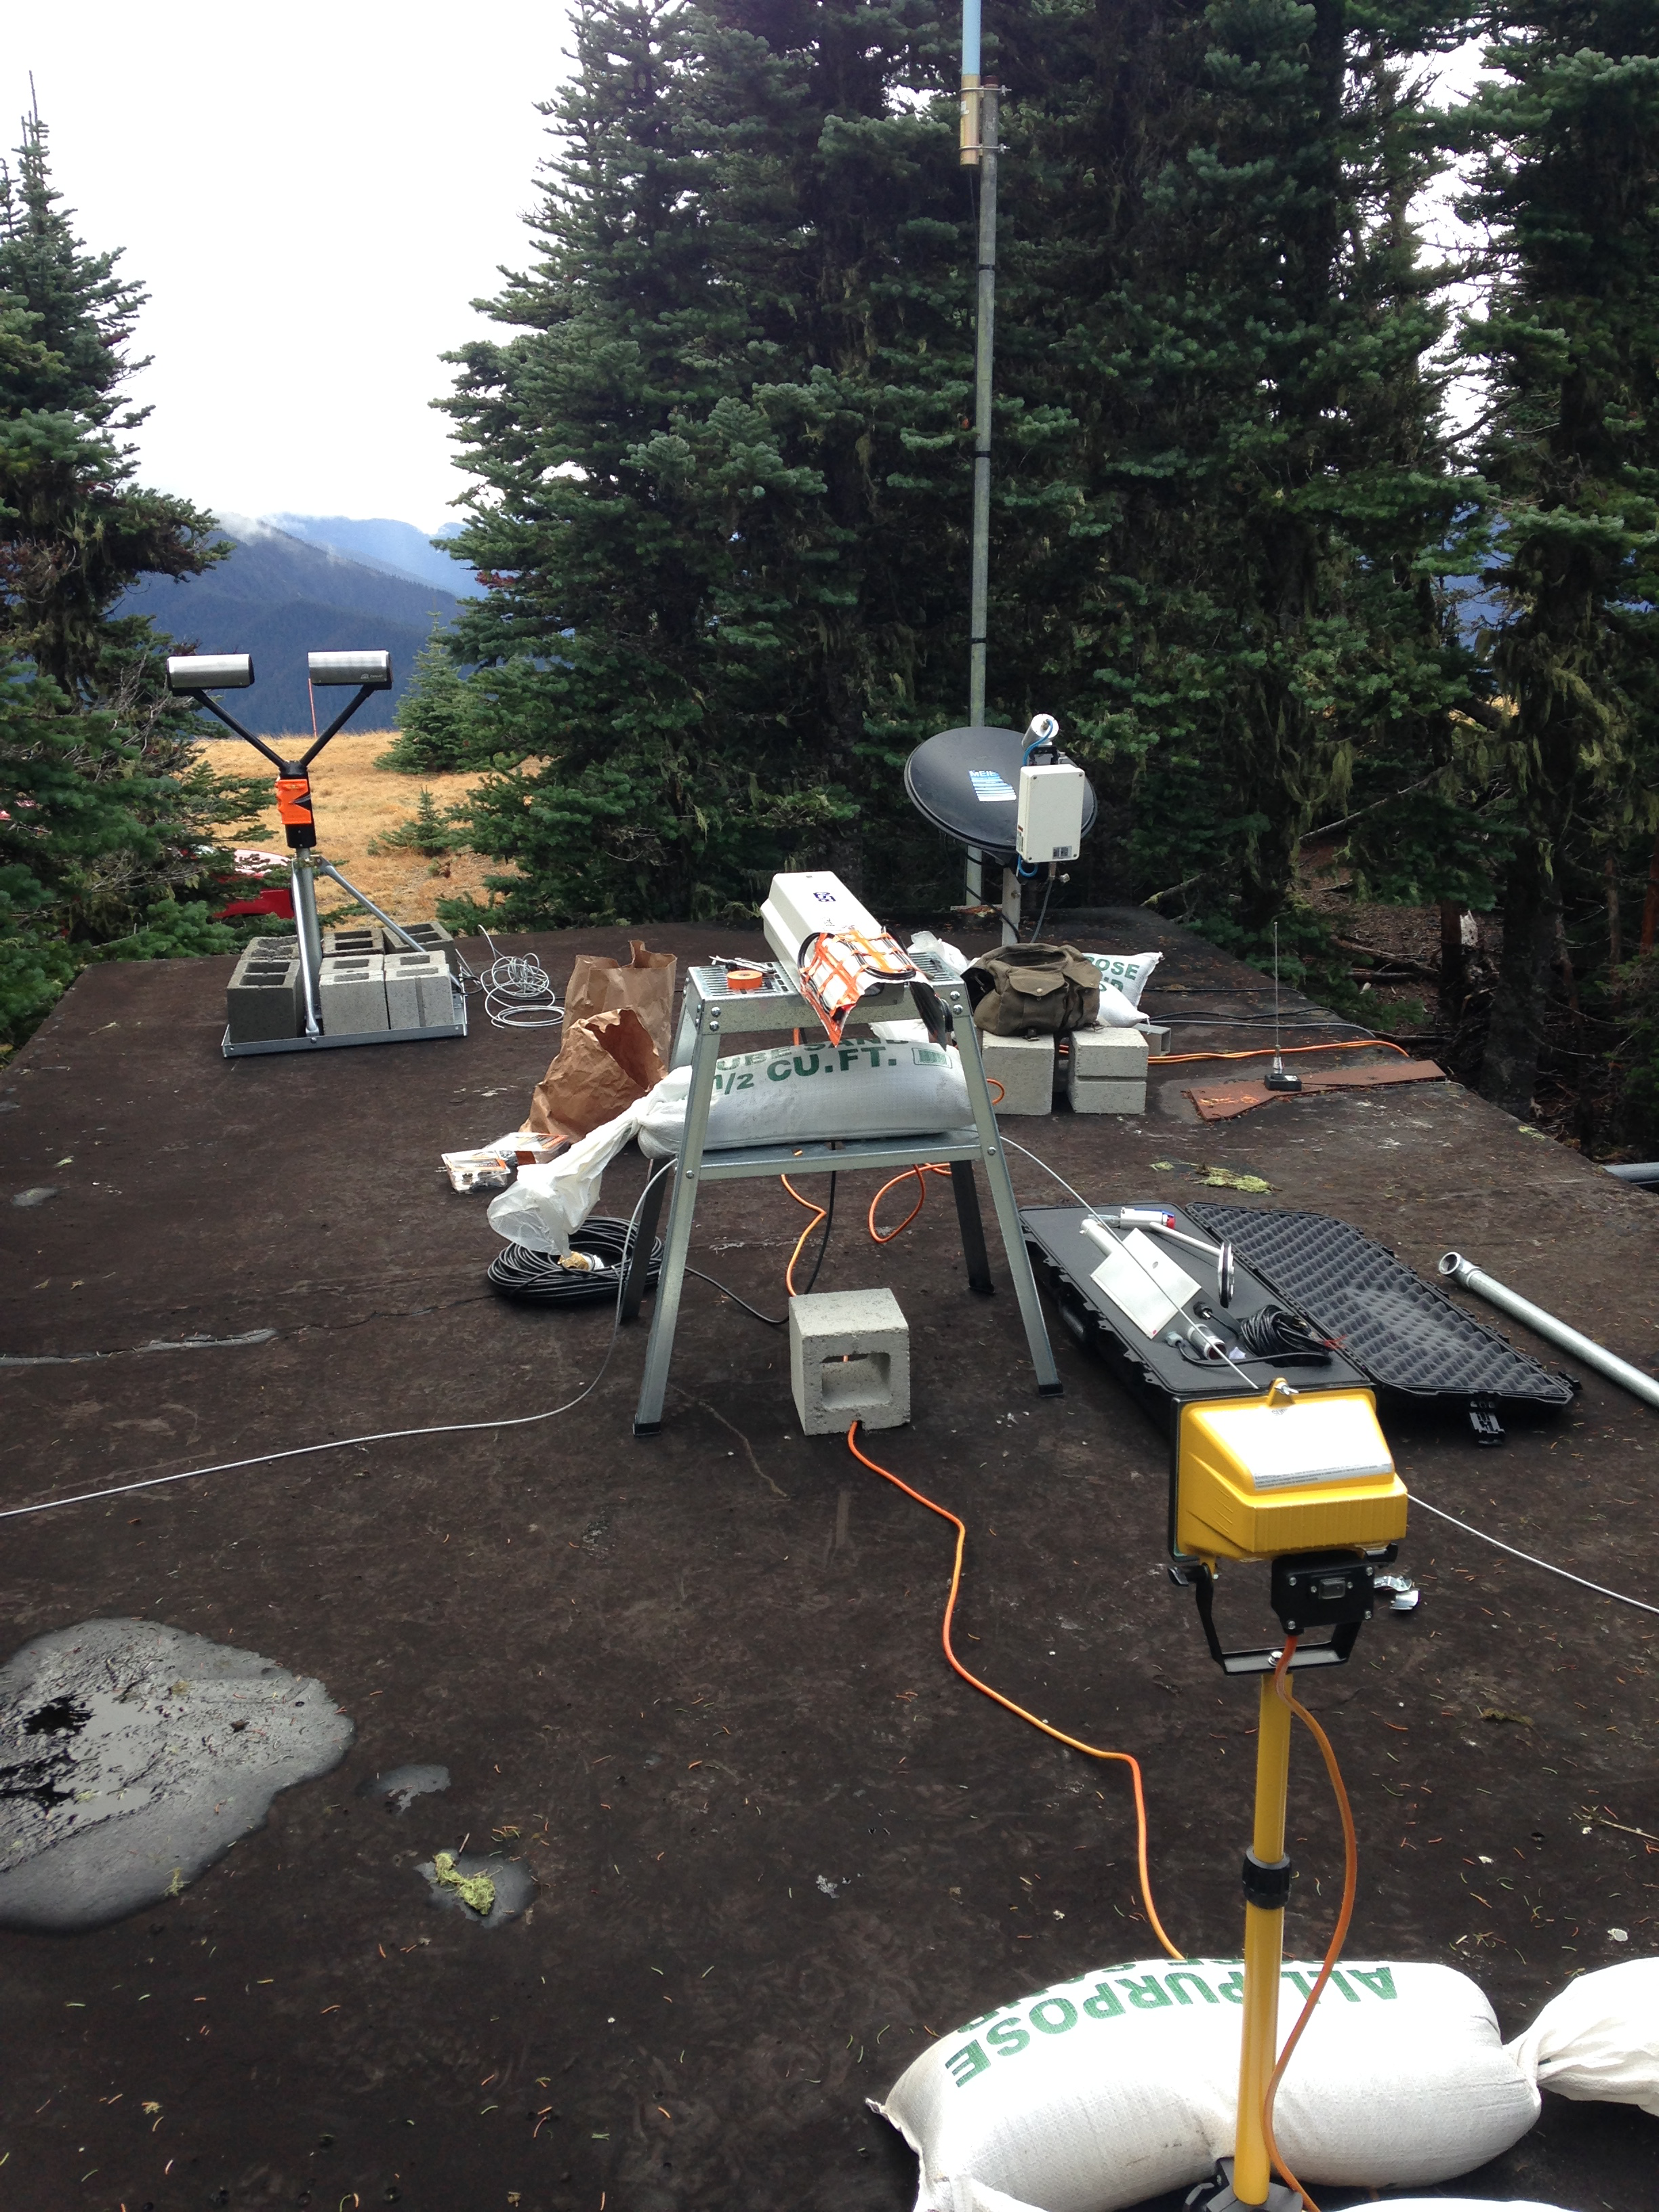
Leeside Station
Hurricane Ridge
Coordinated with Env. Canada radar
Has power
Testing during past winter
  MRR, Parsivel, PIP and Hot Plate
  Collecting data, but have not analyzed it
Potential problems:
  Snow/rime removal
  PIP alignment/bulb replacement
  Wind
Notes:
Example: PIP bulb burned out

Slide 24
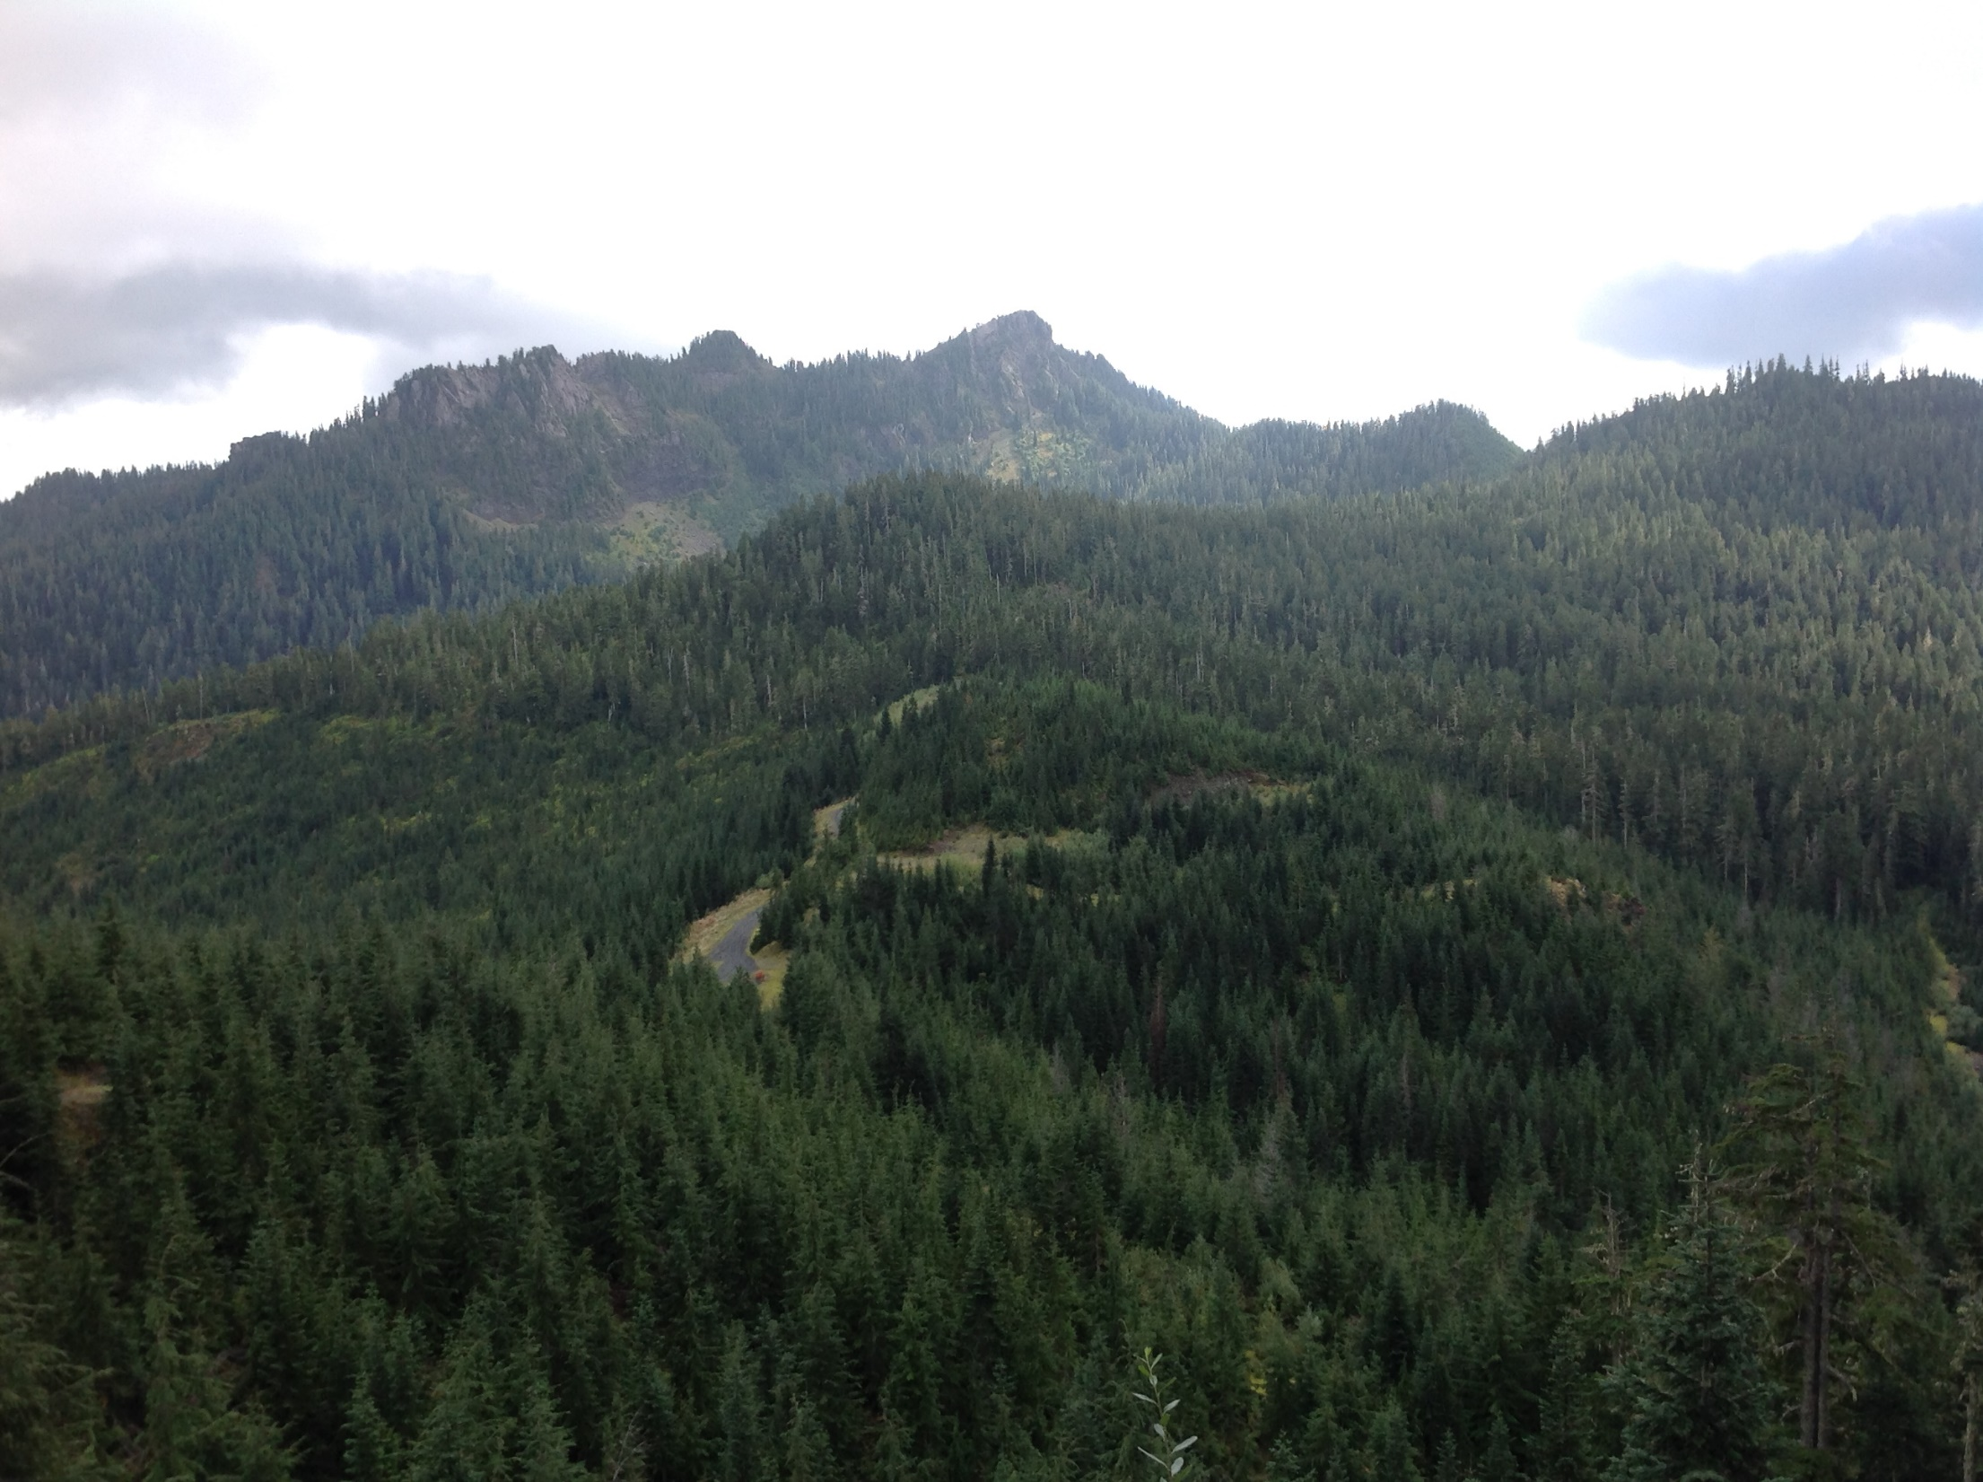
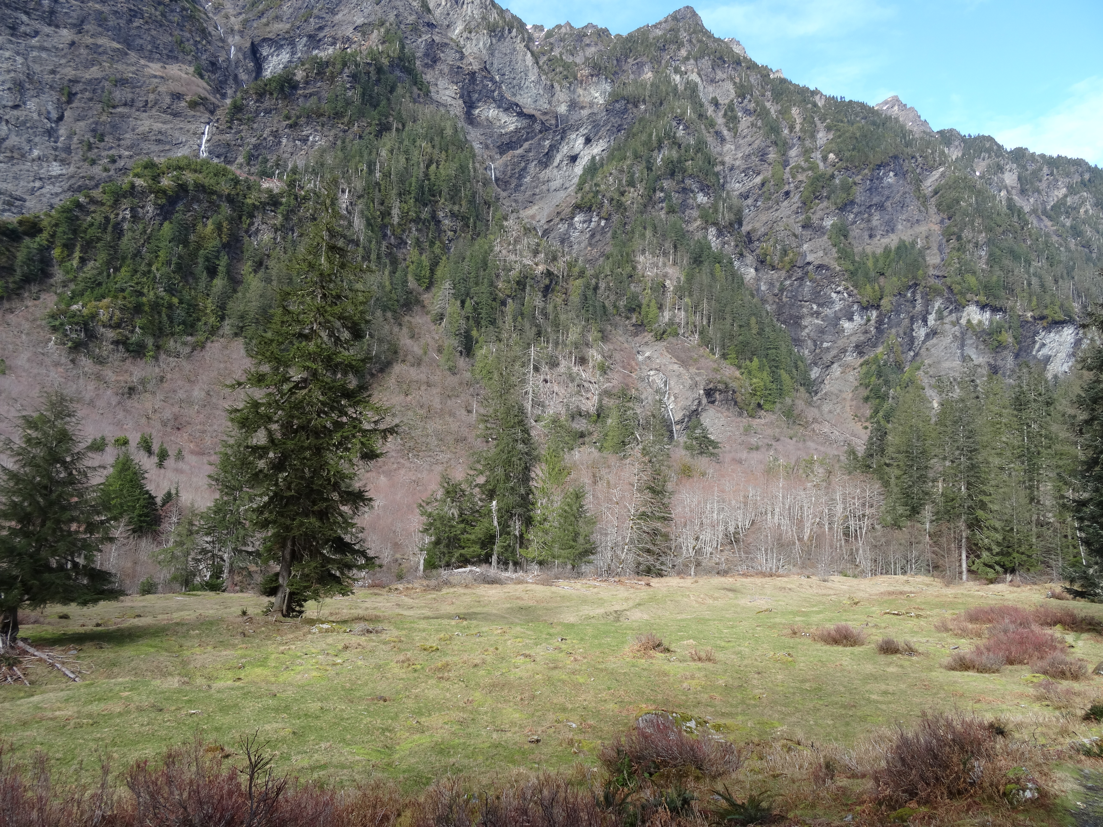
High Elevation Ground Sites with no Power
Want to put instruments to measure precipitation at 2 very remote sites with no power: North Wynoochee (3000+ ft), Upper Quinault Valley (2200+ ft)
Requires mountain biking and snowshoe to access site.
13 miles by pack animals

Slide 25
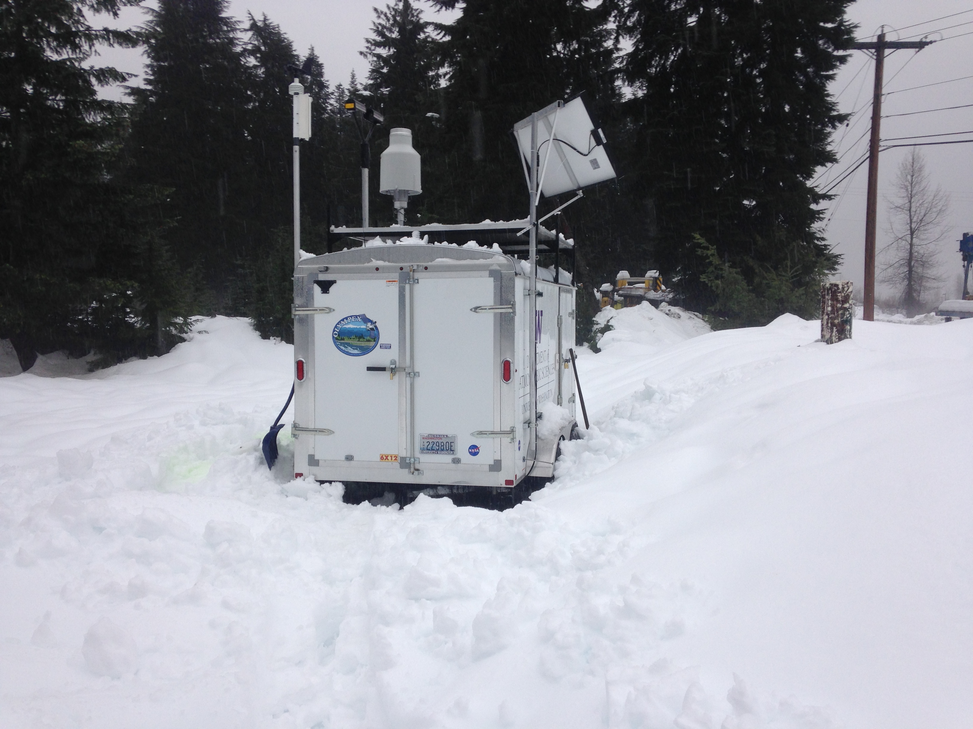
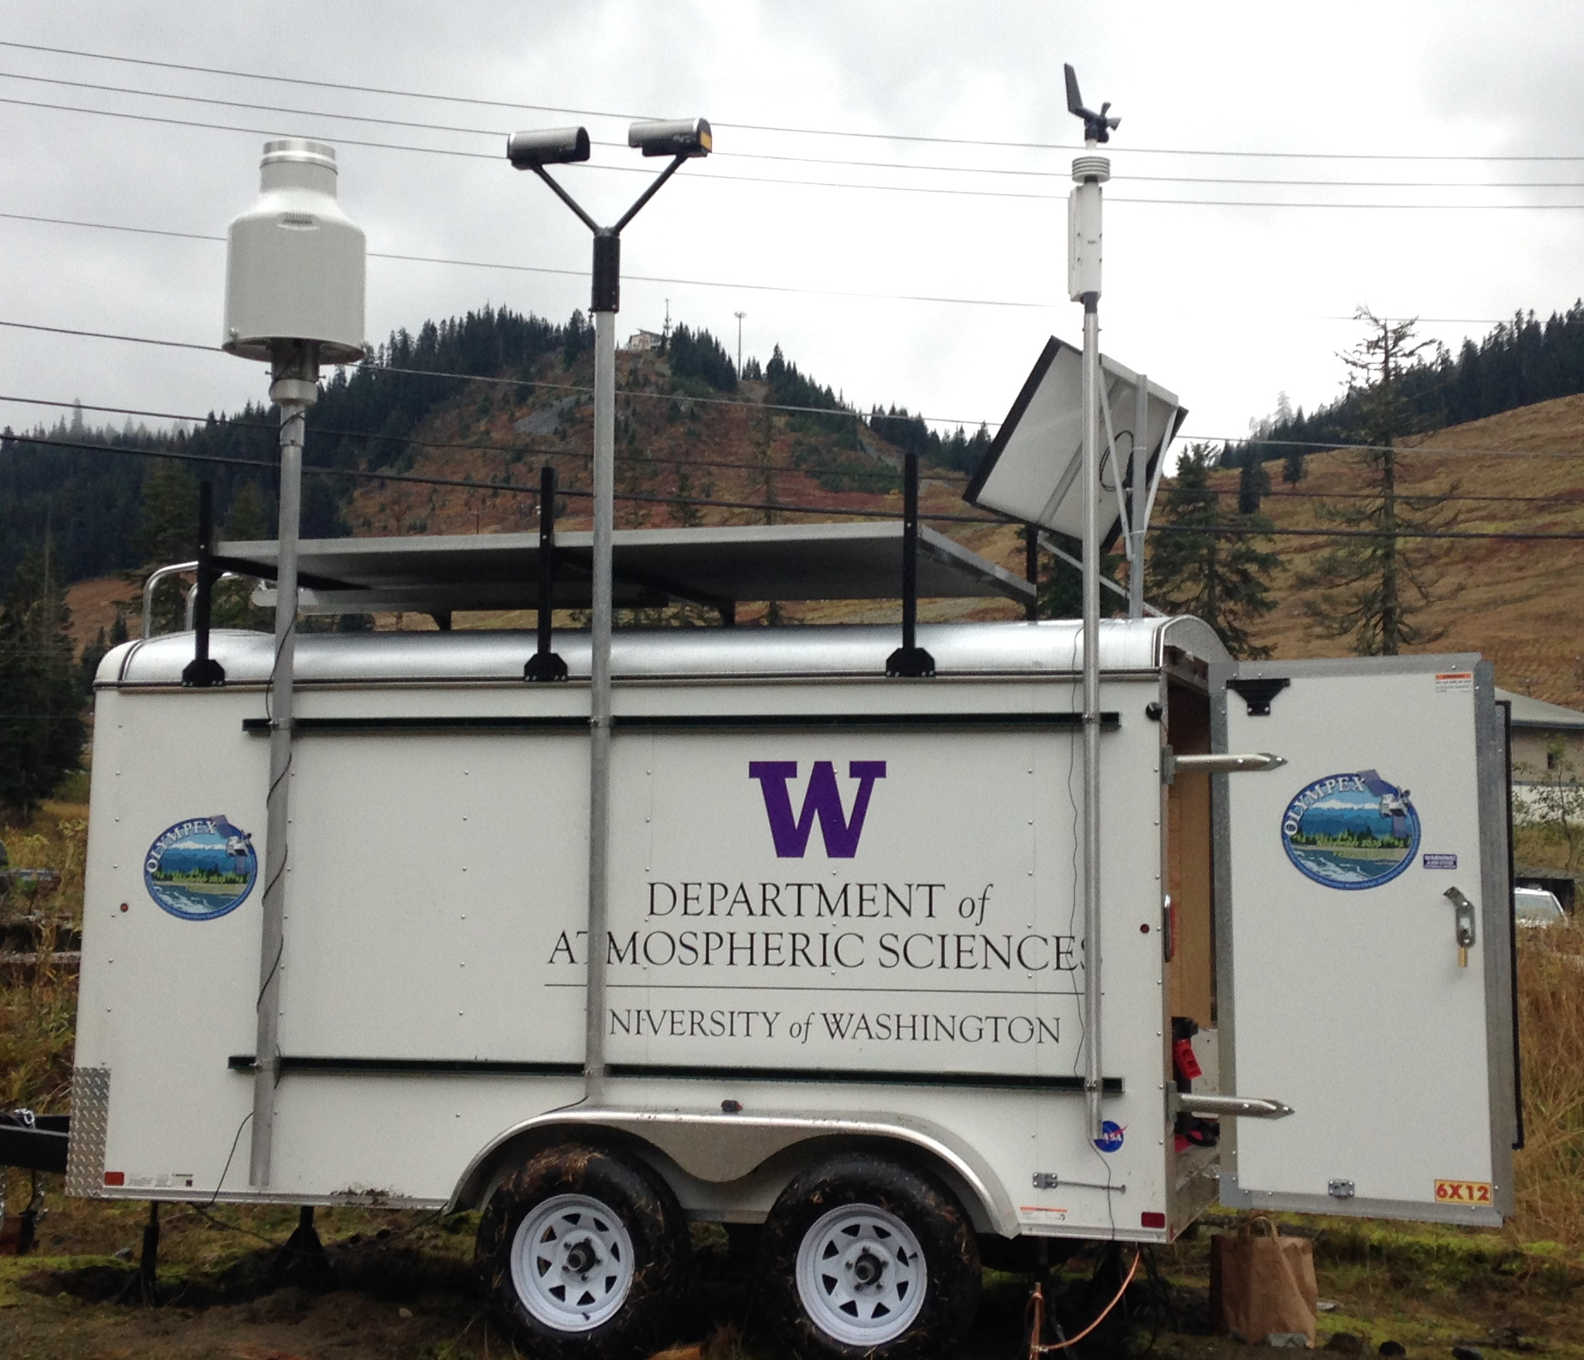
Trailer for high elevation installation at Wynoochee
15 ft trailer anchored to ground with 8 deep-cycle batteries, electronics, computer inside
Solar panel to recharge batteries
Pluvio and Parsivel mounted to be ‘above’ snowpack
Testing
  how long batteries can last
  How long instruments can operate in snowy environment
  how often is maintenance needed

Slide 26
Also
  NPS snow surveys—seasonal accumulation

Slide 27
OLYMPEX Summary
Fall 2015 — Winter 2016
Rain and snow over ocean, coast, mountains
Windward side ehancement, leeside suppression
Snowpack buildup and melt off
Two watersheds
Ground instruments at a variety of elevations and locations
Nine radars including NPOL, D3R, & DOW
3 aircraft from 6 Nov – 21 Dec 2015

Slide 28
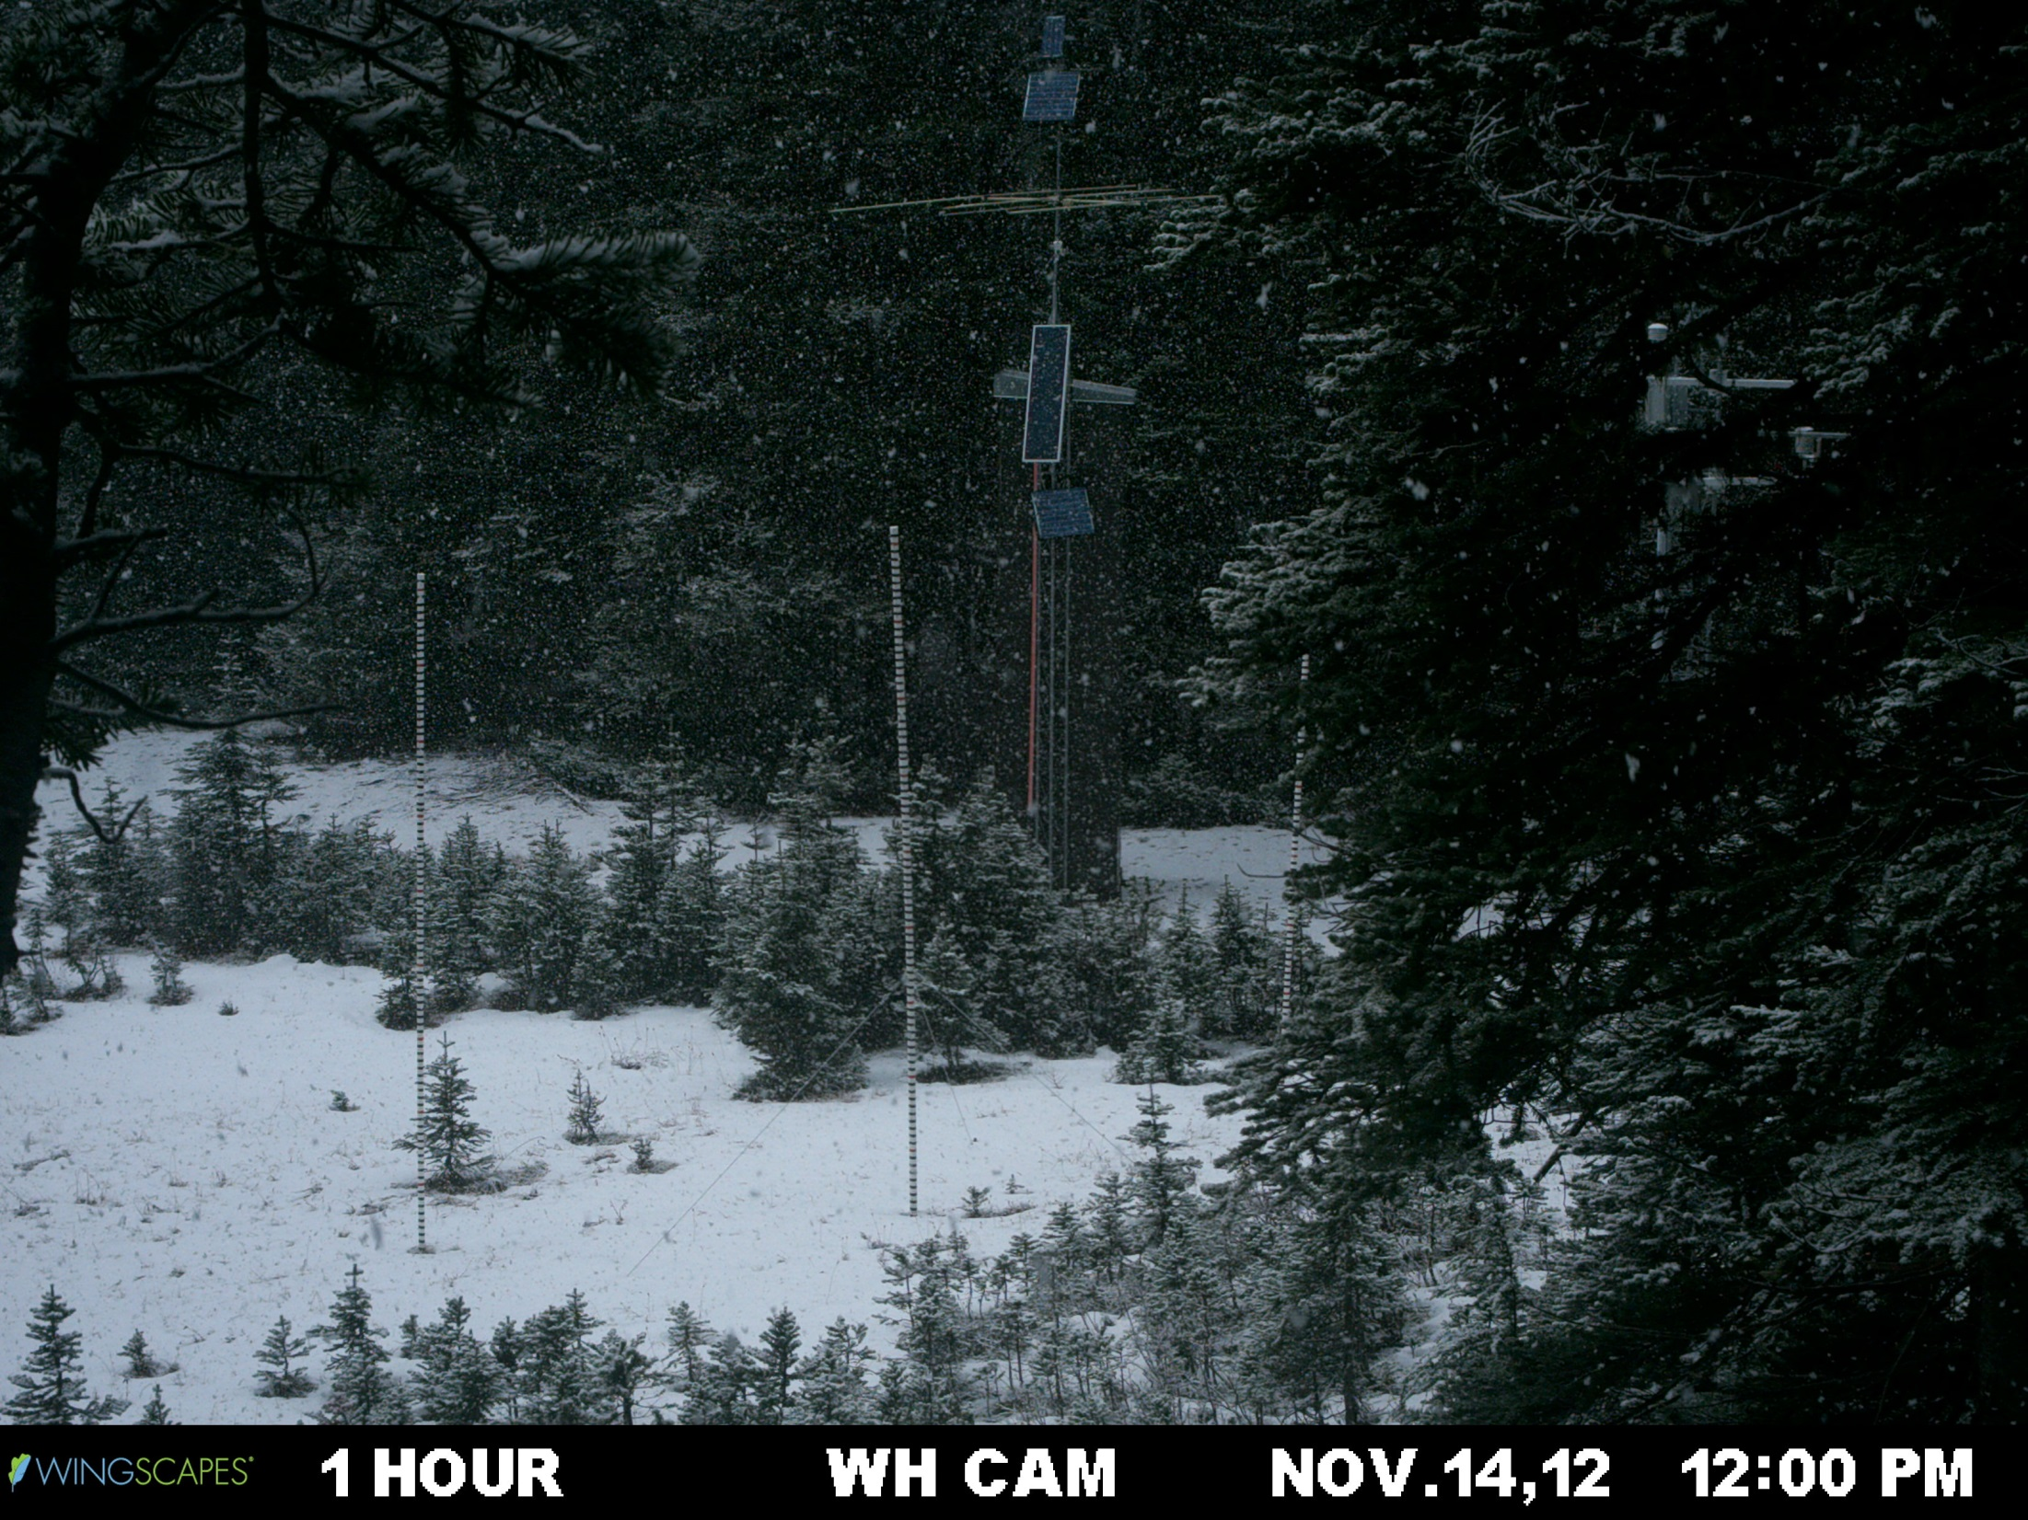
Precipitation event (snow) + Accumulation 1 of 2

Slide 29
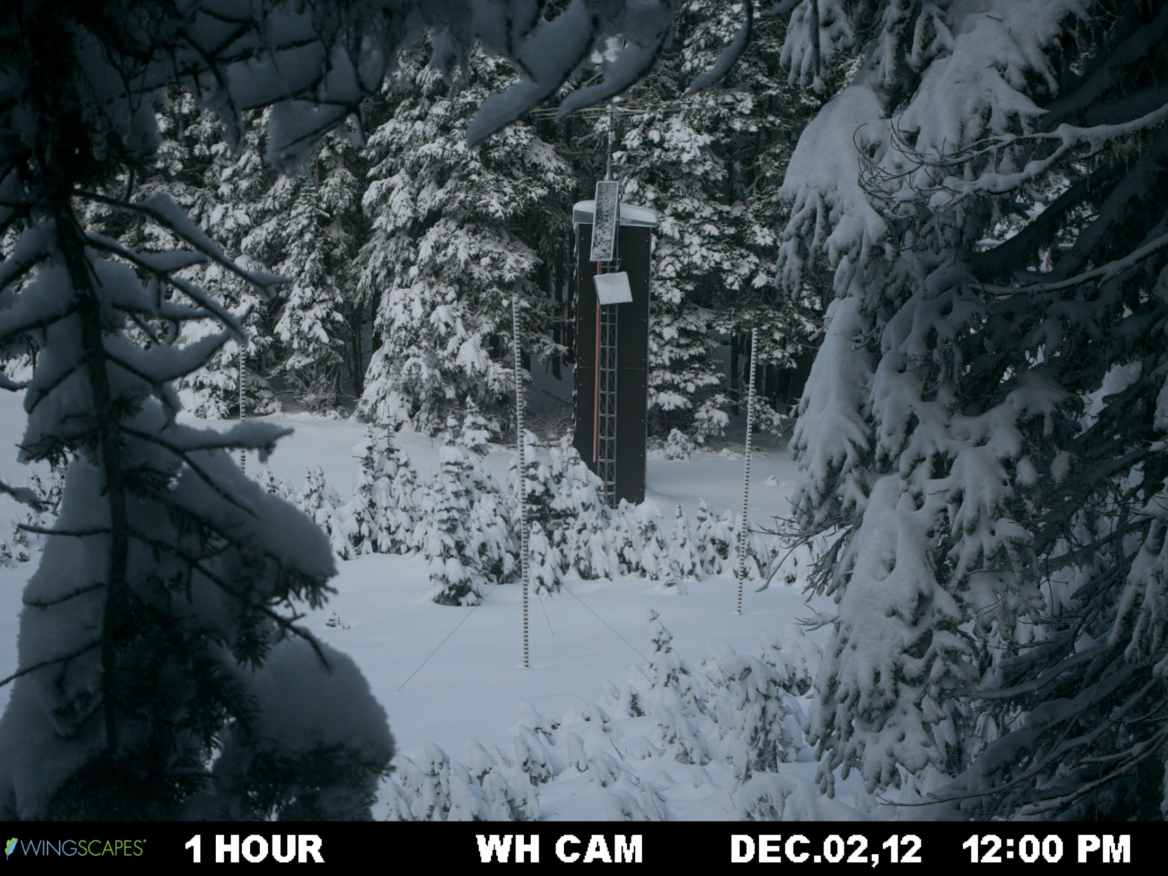
Accumulation 2 of 2

Slide 30
End

Slide 31
Acknowledgment
This work is supported by the National Aeronautics and Space Administration grants NNX13AG71G & NNX14AO64G

Slide 32
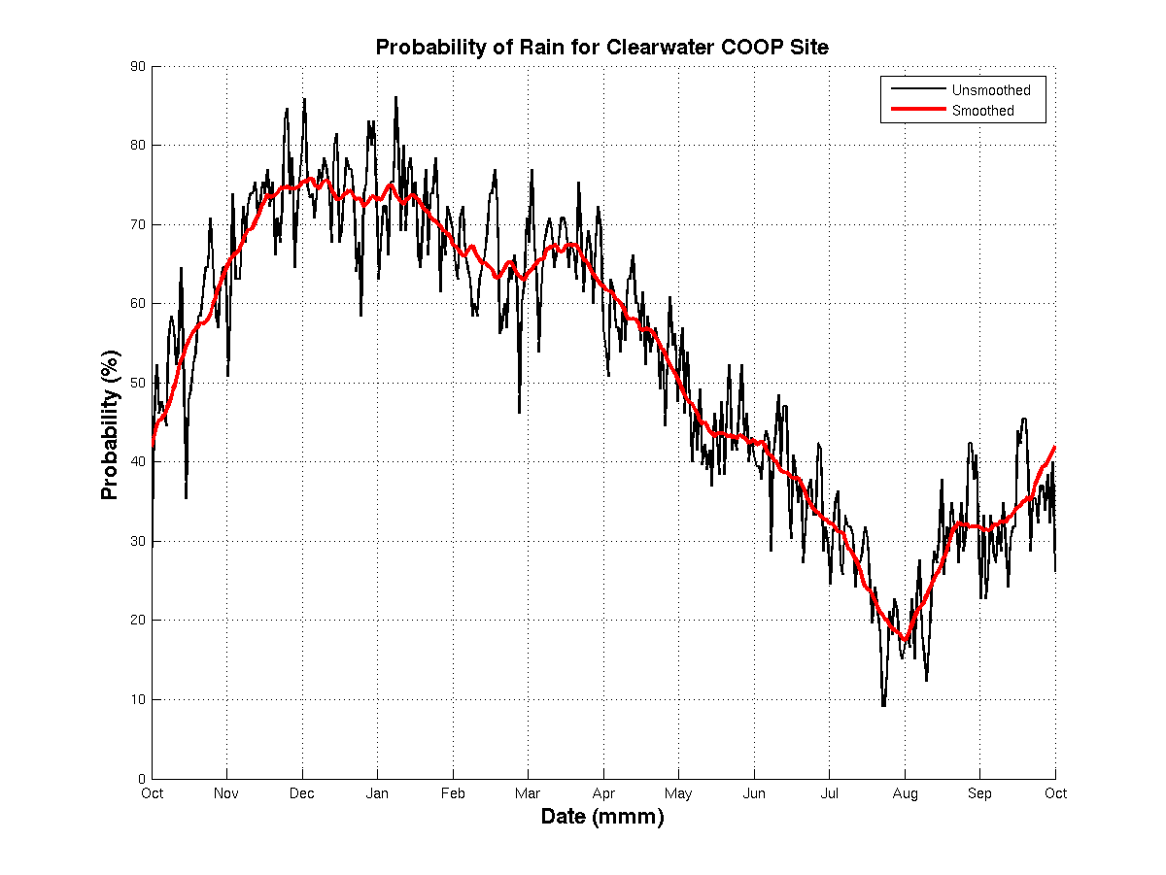
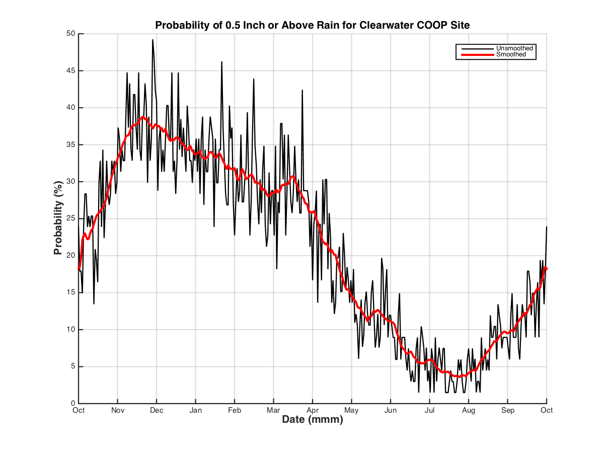
Climatology of Olympic Peninsula
Probability of receiving at least 12.5mm (0.5”) of precip
Probability of receiving at least 0.2mm (0.01”) of precip
Probability of receiving at least 2.5 mm (0.1”) of precip
Average rainfall during Nov, Dec and Jan is 400 mm (16”) each month. Range is 75 – 750 mm (3 – 30”) from 98 years of data.

