Slide 1
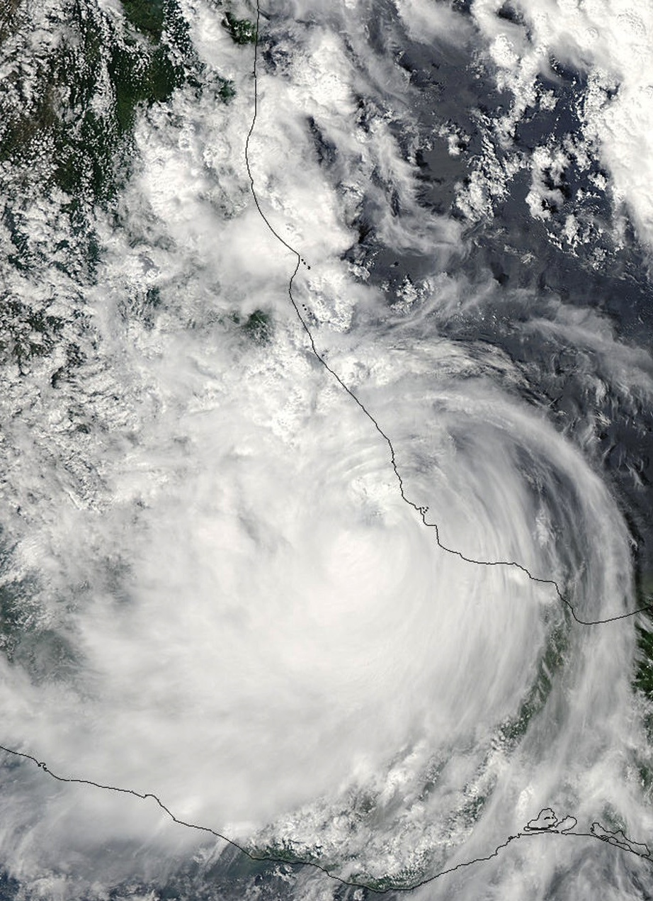
The Evolution of Hurricane Karl’s Structure
Jennifer DeHart and Robert Houze
HS3 Science Meeting
NASA Ames
May 6, 2015
NASA grants: NNX13AG71G / NNX12AJ82G

Slide 2
Science Question
How does the vertical structure of precipitation in Hurricane Karl change as Karl moves over the mountainous terrain of Mexico?

Slide 3
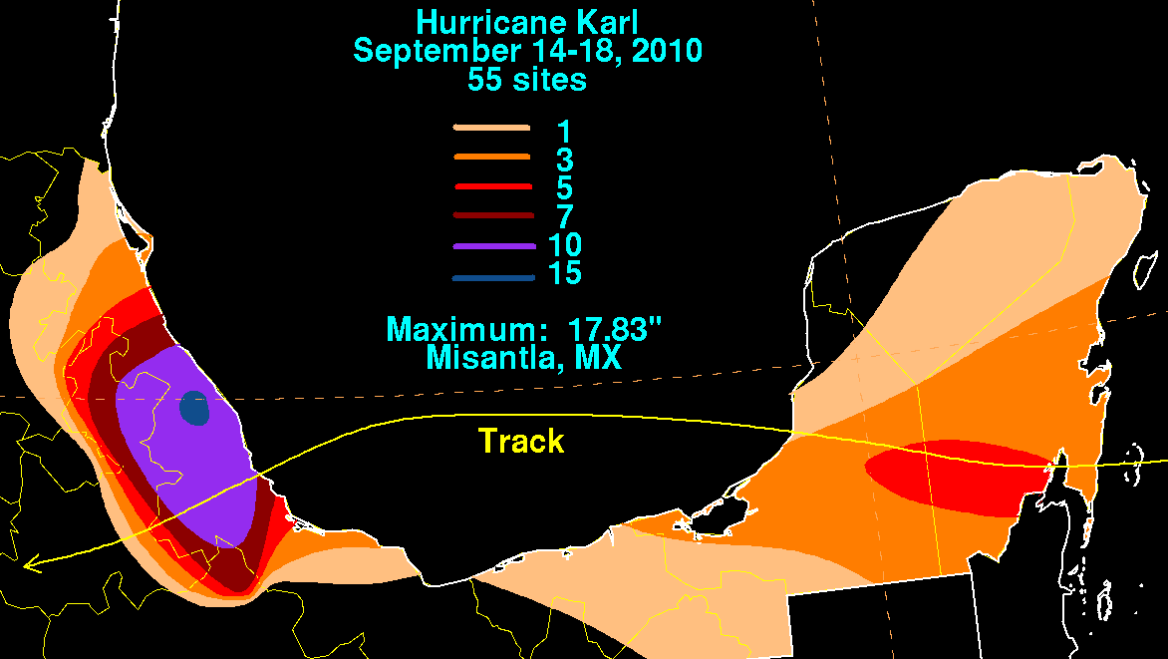
Rainfall and Mexican Topography
Intense rainfall collocated with eastern edge of Mexican topography
Maximum rainfall measured on the northern side of triangular feature
Image: David Roth, NOAA
Notes:
Plots of rainfall from David Roth at NOAA and mexican topography. Large swath of rainfall within Veracruz, with the total amount maximizing north of the triangular feature jutting out towards the gulf.
GRIP sampled this storm multiple times, I’ll be focusing on the flight over the Gulf and as Karl was making landfall.

Slide 4
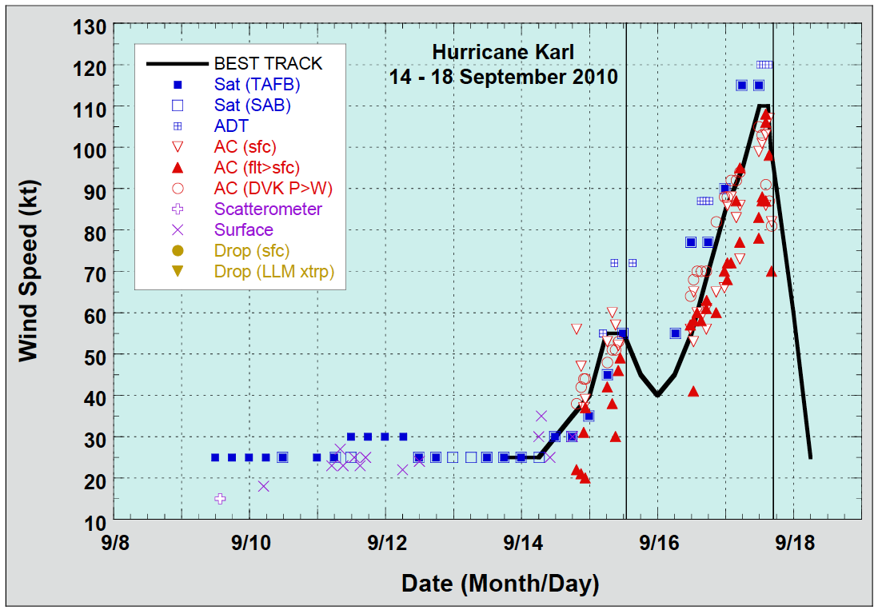
Karl Best Track
Flight 2
Flight 1
Image: NHC
Notes:
Karl’s best track in terms of wind speed. First flight took place when Karl was in the midst of intensifying. Second flight took place after landfall and while Karl was weakening.

Slide 5
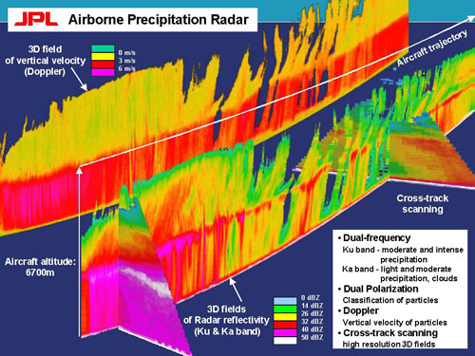
APR2 on DC8
Notes:
I’ll be looking at data from the APR2. Ku and Ka band radar with doppler velocities, but for today I’ll simply focus on the Ku band reflectivity.

Slide 6
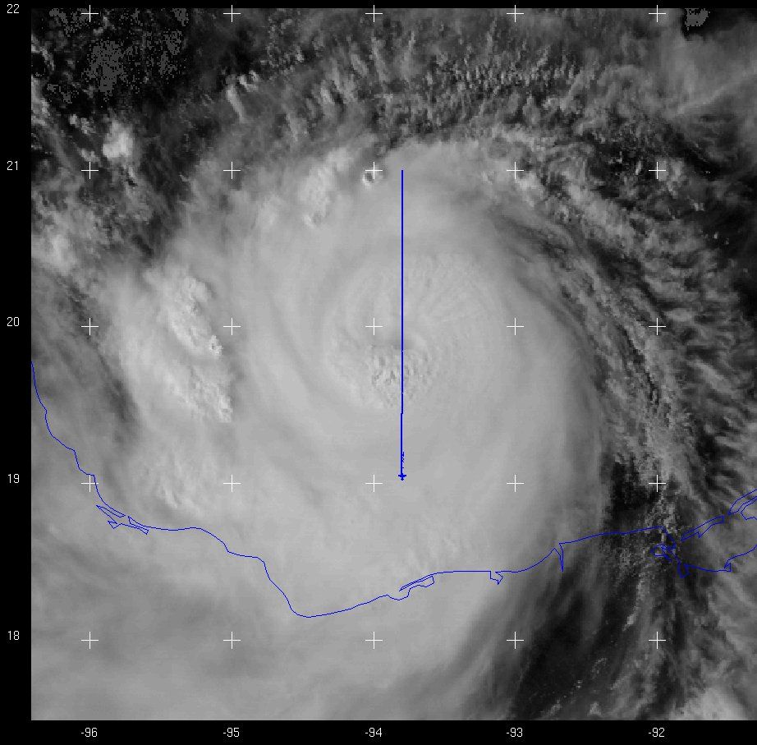
Sept. 16th - VIS
Notes:
For context, here’s the visible satellite imagery when the DC8 was flying. Shows the storm is fairly symmetrical, with the eye present.

Slide 7
Sept. 16th – Flight Track
Legs centered on eyewall passes
Notes:
Here is the full flight track from the 16th. Red segments denote the portions of each leg where I’ll be looking at the reflectivity data.

Slide 8
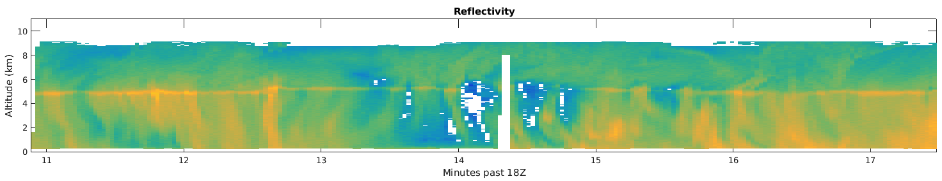

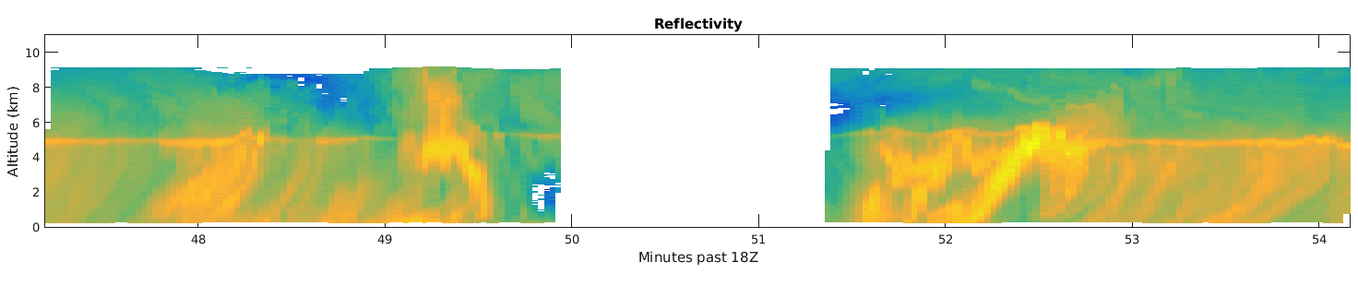
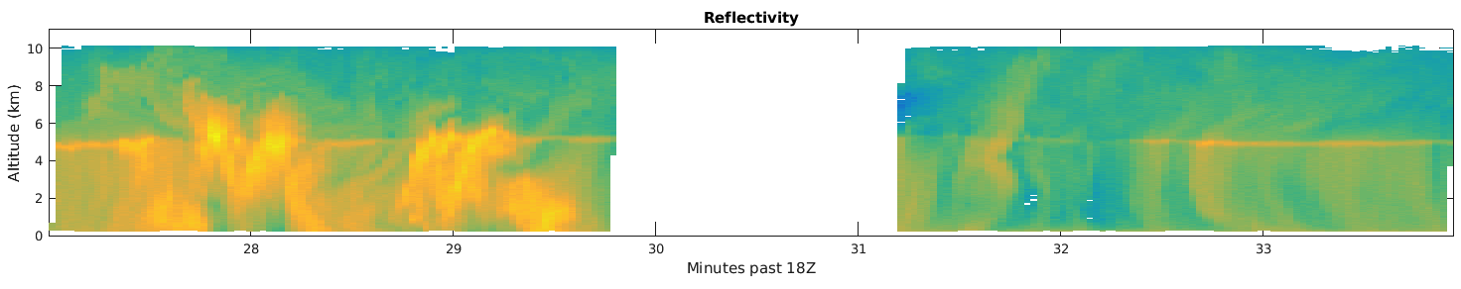
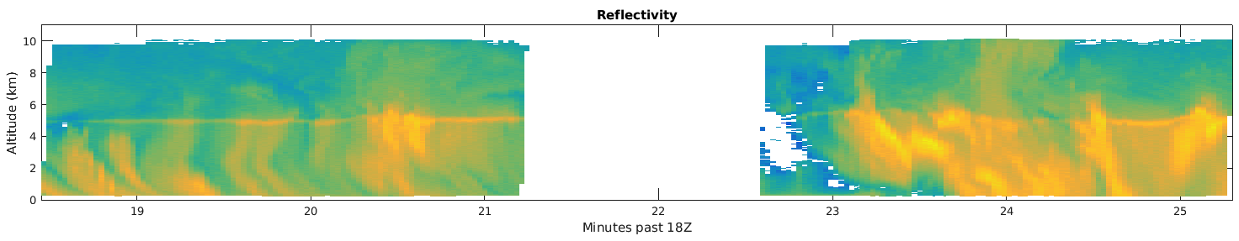
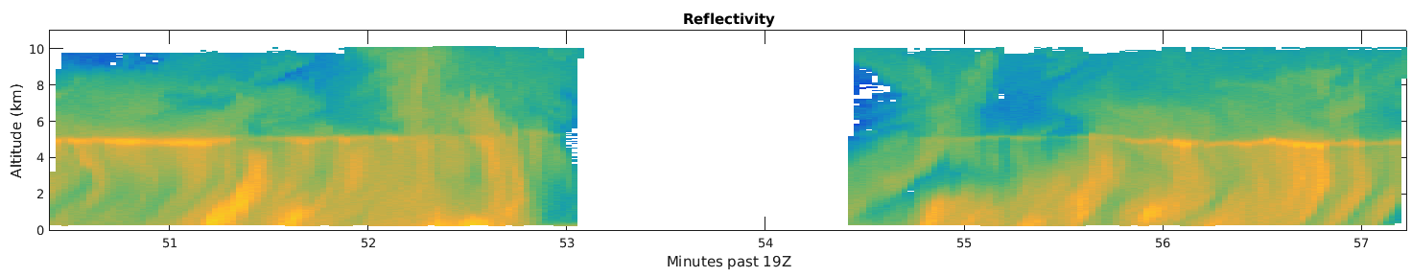
Reflectivity cross-sections – Sept. 16th
Altitude (km)
dBZ
Echo area exhibits deep vertical extent
Pockets of intense echo returns, but coverage is relatively consistent between passes
Flight Track →
Notes:
Cross-sections of the ku-band reflectivity from the nadir most scan. I’ve blocked out data from the eye, except the first where the leg was slightly off of the center. While there is variation along the flight tracks, the reflectivity returns are relatively consistent. Bright banding in some locations, convective regions and deep vertical extent of the echoes up to where the radar starts measuring.
Can also look at the statistics of each leg.

Slide 9
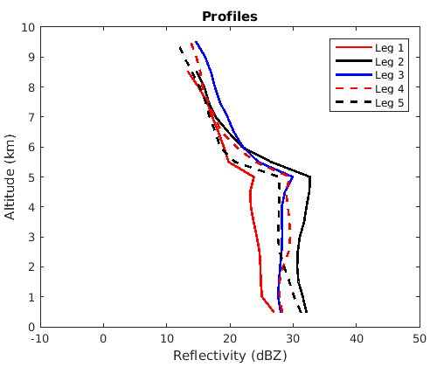
Mean Reflectivity – Sept. 16th
Notes:
Statistics confirm this. Cfads centered around 30 dBZ at lower levels, shift towards stronger reflectivity below the melting level. Mean reflectivity profiles show mean reflectivity roughly constant with altitude as well as relatively strong above the melting level.
All in all, it’s what we would expect from a hurricane. Not terribly surprising, but serves as a nice comparison with the following day.

Slide 10
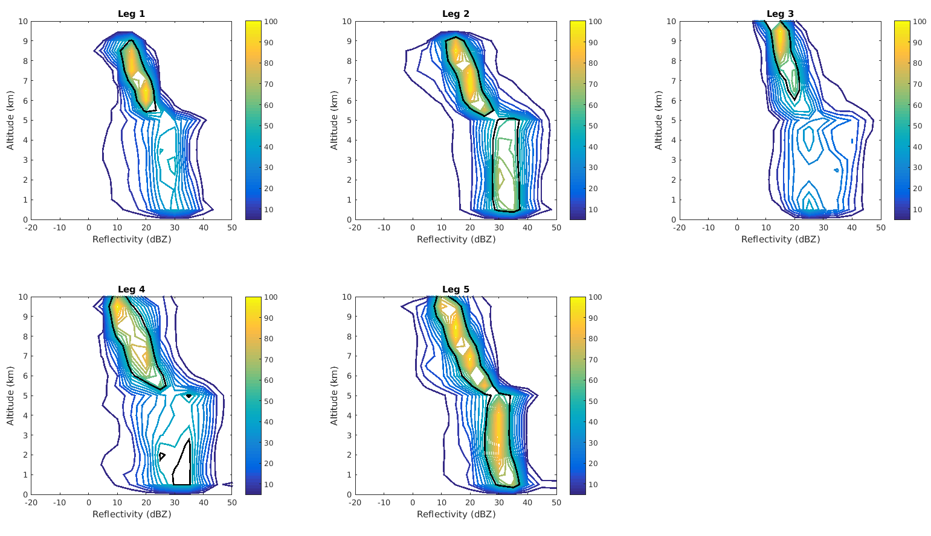
Reflectivity CFADs – Sept. 16th
Notes:
Statistics confirm this. Cfads centered around 30 dBZ at lower levels, shift towards stronger reflectivity below the melting level. Mean reflectivity profiles show mean reflectivity roughly constant with altitude as well as relatively strong above the melting level.
All in all, it’s what we would expect from a hurricane. Not terribly surprising, but serves as a nice comparison with the following day.

Slide 11
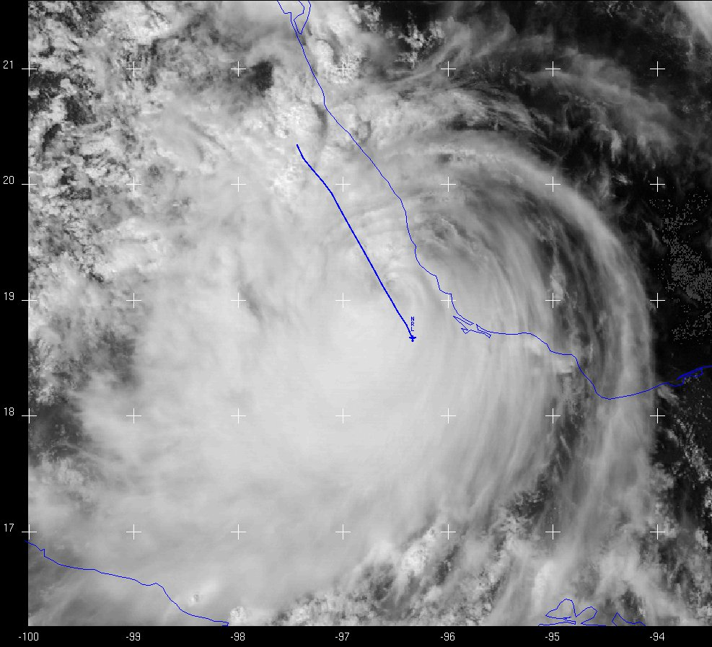
Sept. 17th - VIS
Notes:
Visible satellite image from the 17th as the DC8 was flying. Karl has already moved over land and has a ragged appearance. Clouds are thinning to the north of the storm, outflow looks strongest to the south. Can also see some convective clouds north of the triangular topographic feature I pointed out earlier. Eyewall/centermost portion of the storm is south of this feature.

Slide 12
Sept. 17th – Flight Track
Blue legs - NW
Precipitation features farther from the center
Red legs - SE
Precipitation features closer to the center
Notes:
Flight track for the 17th. For the analysis, separating the legs into two separate groups. Red = legs closer to the eyewall. Blue = segments farther from the eyewall.

Slide 13
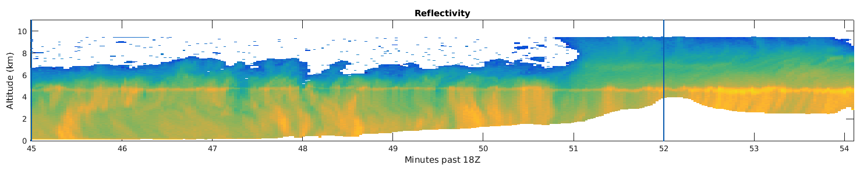
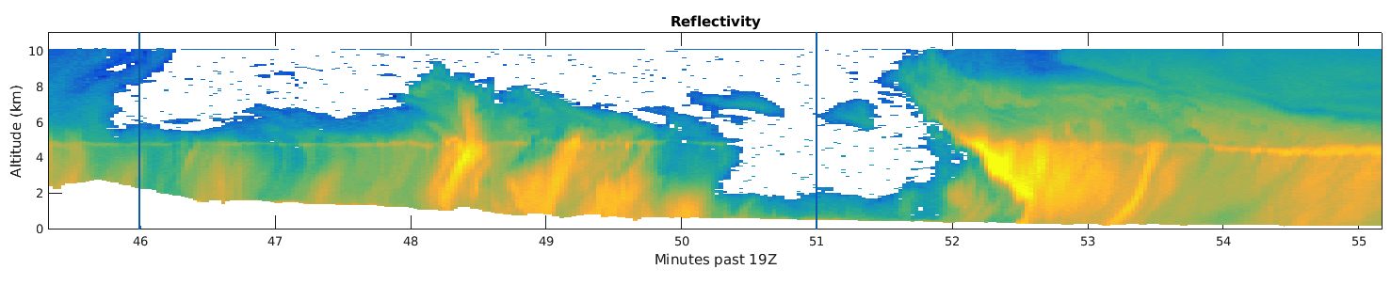
SE Reflectivity – Legs 1 and 2
dBZ
Echo depth substantially reduced
Small region of intense reflectivity in eyewall, but convection doesn’t seem as healthy
Notes:
Start with 2 of the legs closer to the center of the storm. Immediately notice that the echo depth has been substantially reduced – no longer extends up to where the radar can first pick up returns. Even though leg 1 doesn’t intersect the eyewall, leg 2 does. Small region of remnant eyewall convection, but does not look healthy.

Slide 14
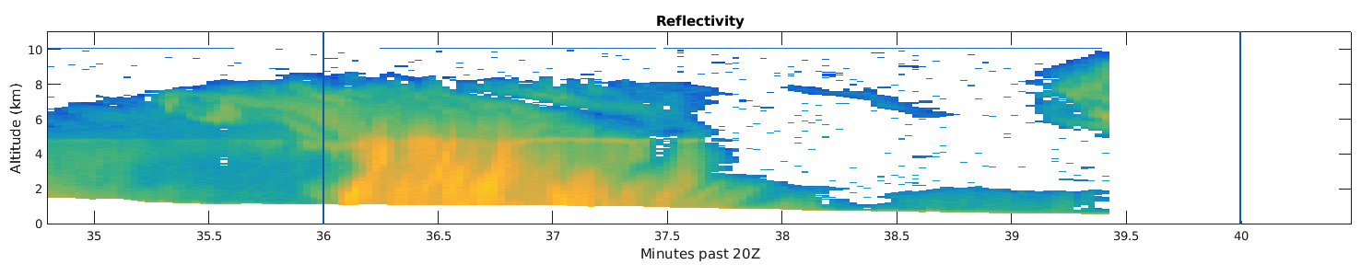
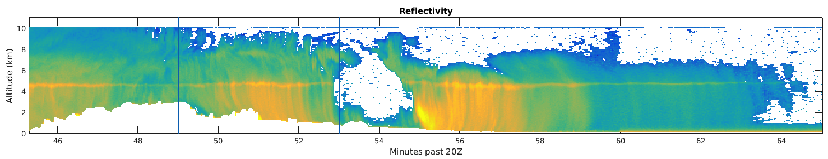
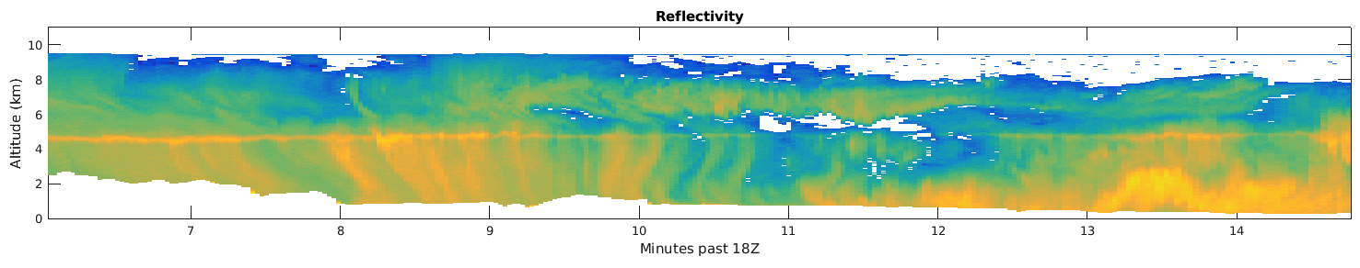
SE Reflectivity – Legs 3, 4 and 5
dBZ
Notes:
The other three legs don’t look as depleted. Still a decrease in echo top height and more breaks in the returns. Might be slight enhancement over the sloping land surface.

Slide 15
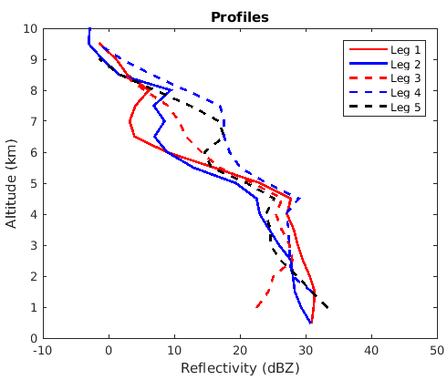
Mean Reflectivity - SE
Decrease in mean reflectivity values with height
Notes:
Mean reflectivity profiles show decrease in height below melting level and weaker returns aloft in legs 1 and 2.
Now we can look at the legs that are further from the center.

Slide 16
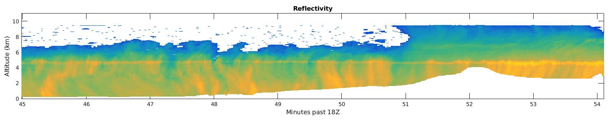
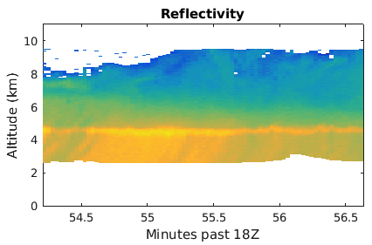
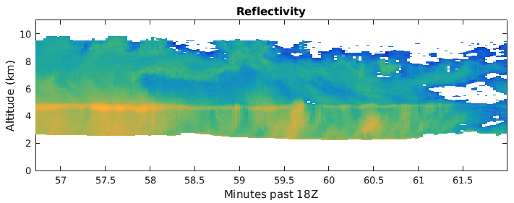
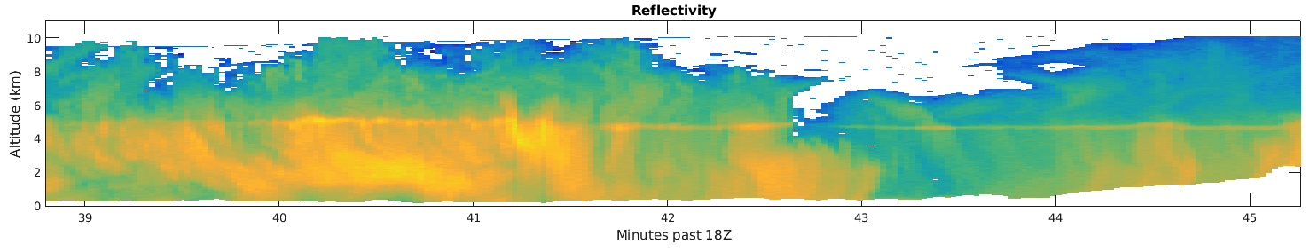
NW Reflectivity
dBZ
Strong, continuous reflectivity just past mountain edge along flow
Convective before mountain
Notes:
Upstream of the mountain (dashed red line), see the convective structure seen in the satellite image. At the tail end transitions to stratiform (closer to mountain edge), could be transitioning? Red and blue lines are slightly inland of mountains and structure is more stratiform with strong brightbanding. Additionally, pretty intense returns below the melting layer. Moving even more inland (blue dashed line), reflectivity intensity weakens. In this area, convective clouds rise over the mountains, enhancing fall out which is eventually depleted.

Slide 17
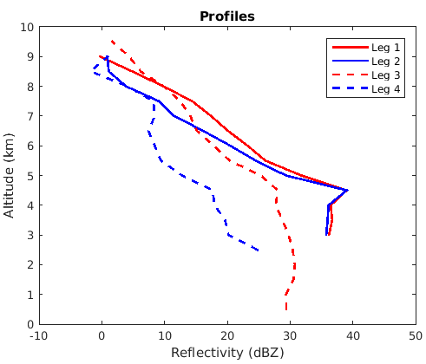
Mean Reflectivity - NW
Mean reflectivity most intense after passing over highest tops
Comparable reflectivity strength upstream of mountains compared to other regions of the storm
Weak mean returns further inland as fall out depletes storm
Notes:
Legs 1 and 2 here have the strongest mean reflectivity of any leg, even compared to the mature hurricane.

Slide 18
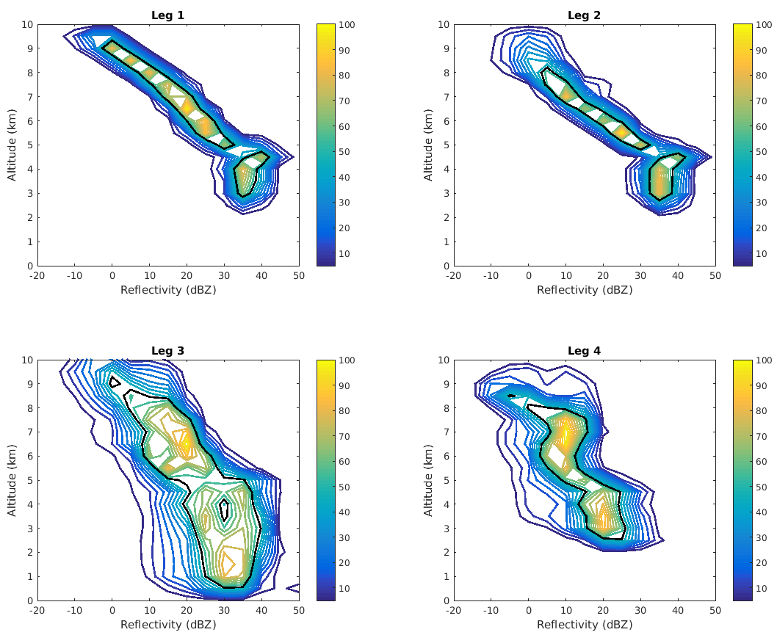
Reflectivity CFADs - NW
Distributions for legs 1 and 2 extremely narrow
Convective leg has wider range of reflectivity intensities
Further inland (leg 4), strong reduction in reflectivity intensity due to fallout

Slide 19
Conclusions and Future Work
Precipitation structure of Karl varies substantially between the 16th and 17th
Precipitation farther from the center on the 17th follows expected lifecycle of orographic modification
  Orientation of flow relative to topography, region of hurricane, etc.

Slide 20
Future Work
Analyze derived fields such as vertical velocity
WRF simulations with terrain modification

