Slide 1
Global Distribution of Different Forms of Convection as Seen by TRMM
Robert A. Houze, Jr.
University of Washington
with: K. L. Rasmussen, M. D. Zuluaga, and S. R. Brodzik
European Geosciences Union General Assembly, Vienna, Austria 17 April 2015

Slide 2
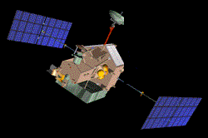
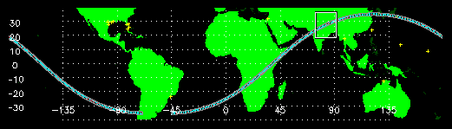
The TRMM Satellite
1997-2014
Precipitation Radar
Low altitude, low inclination orbit
Notes:
92.5 minute orbit; approximately 16 orbits per day.
Revisits specific locations 10-20 times per 30 day period (dependent on latitude).
Our data set consists of 1648 TRMM 2A23 & 2A25 rain containing orbit files from the monsoon season (June – September) in 2002 & 2003.
The TRMM 2A25 data contains corrected TRMM reflectivity data in 250 m height bins.
The TRMM 2A23 algorithm detects the presence of a bright band and categorizes precipitation as stratiform, convective or other (unclassified).

Slide 3
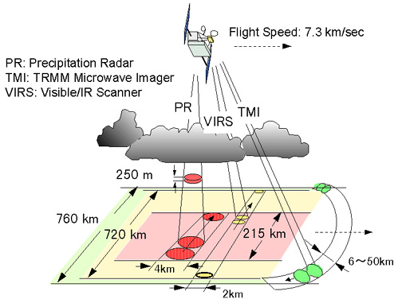
TRMM Instruments
λ= 2 cm
Important! Radar measures 3D structure of radar echoes
PR: Precipitation Radar λ = 2 cm
>
Kummerow et al, 1998
Notes:
Recall
TRMM PR samples a 3D volume.
We can
plot a histogram showing frequency of occurrence of reflectivity values at each altitude.

Slide 4
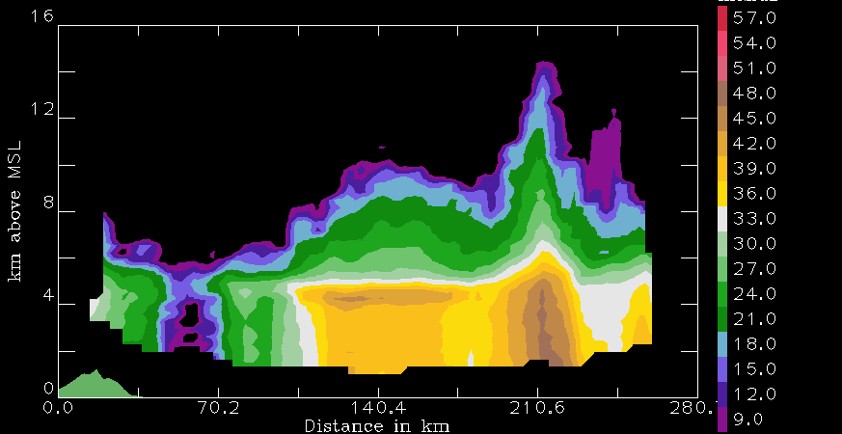
TRMM algorithm divides the echoes
Other
Stratiform
Convective

Slide 5
Convective cores
3D convective echo bounded by threshold dBZ
echo core
land
Type | Threshold | Width | Height
Shallow-isolated | 17 dBZ | 2 pixels | < 5 km
Deep-strong | 40 dBZ |  | >10 km
Deep-moderate | 30 dBZ |  | > 8 km
Wide-strong | 40 dBZ | >1000 km²
Wide-moderate | 30 dBZ | >800 km²
Notes:
First we will look at echoes identified as “convective” byTRMM.
To do this—identify 3D echo “cores” that are EMBEDDED in larger echoes
Deep cores—associated with young, extremely vigorous convection
Wide cores—indicate where intense convection is aggregating and growing upscale into mesoscale systems
Two categories—we find strong categories are better indicators of processes over land, moderate better over oceans
Shallow isolated—are generally warm rain showers or small cumulonimbus clouds—fall into the category of “congestus”

Slide 6
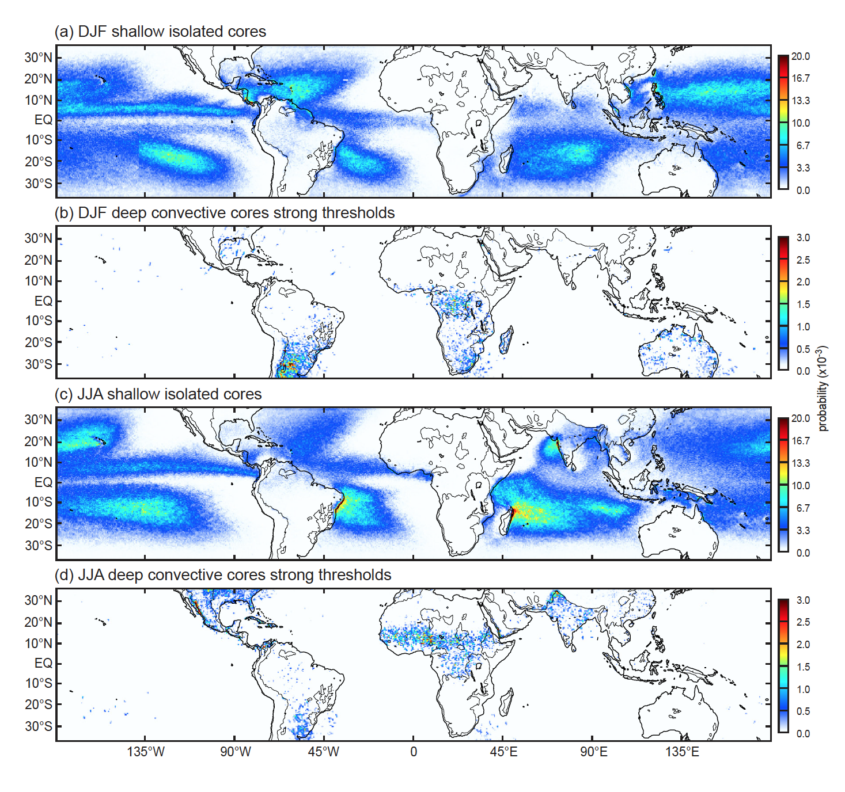
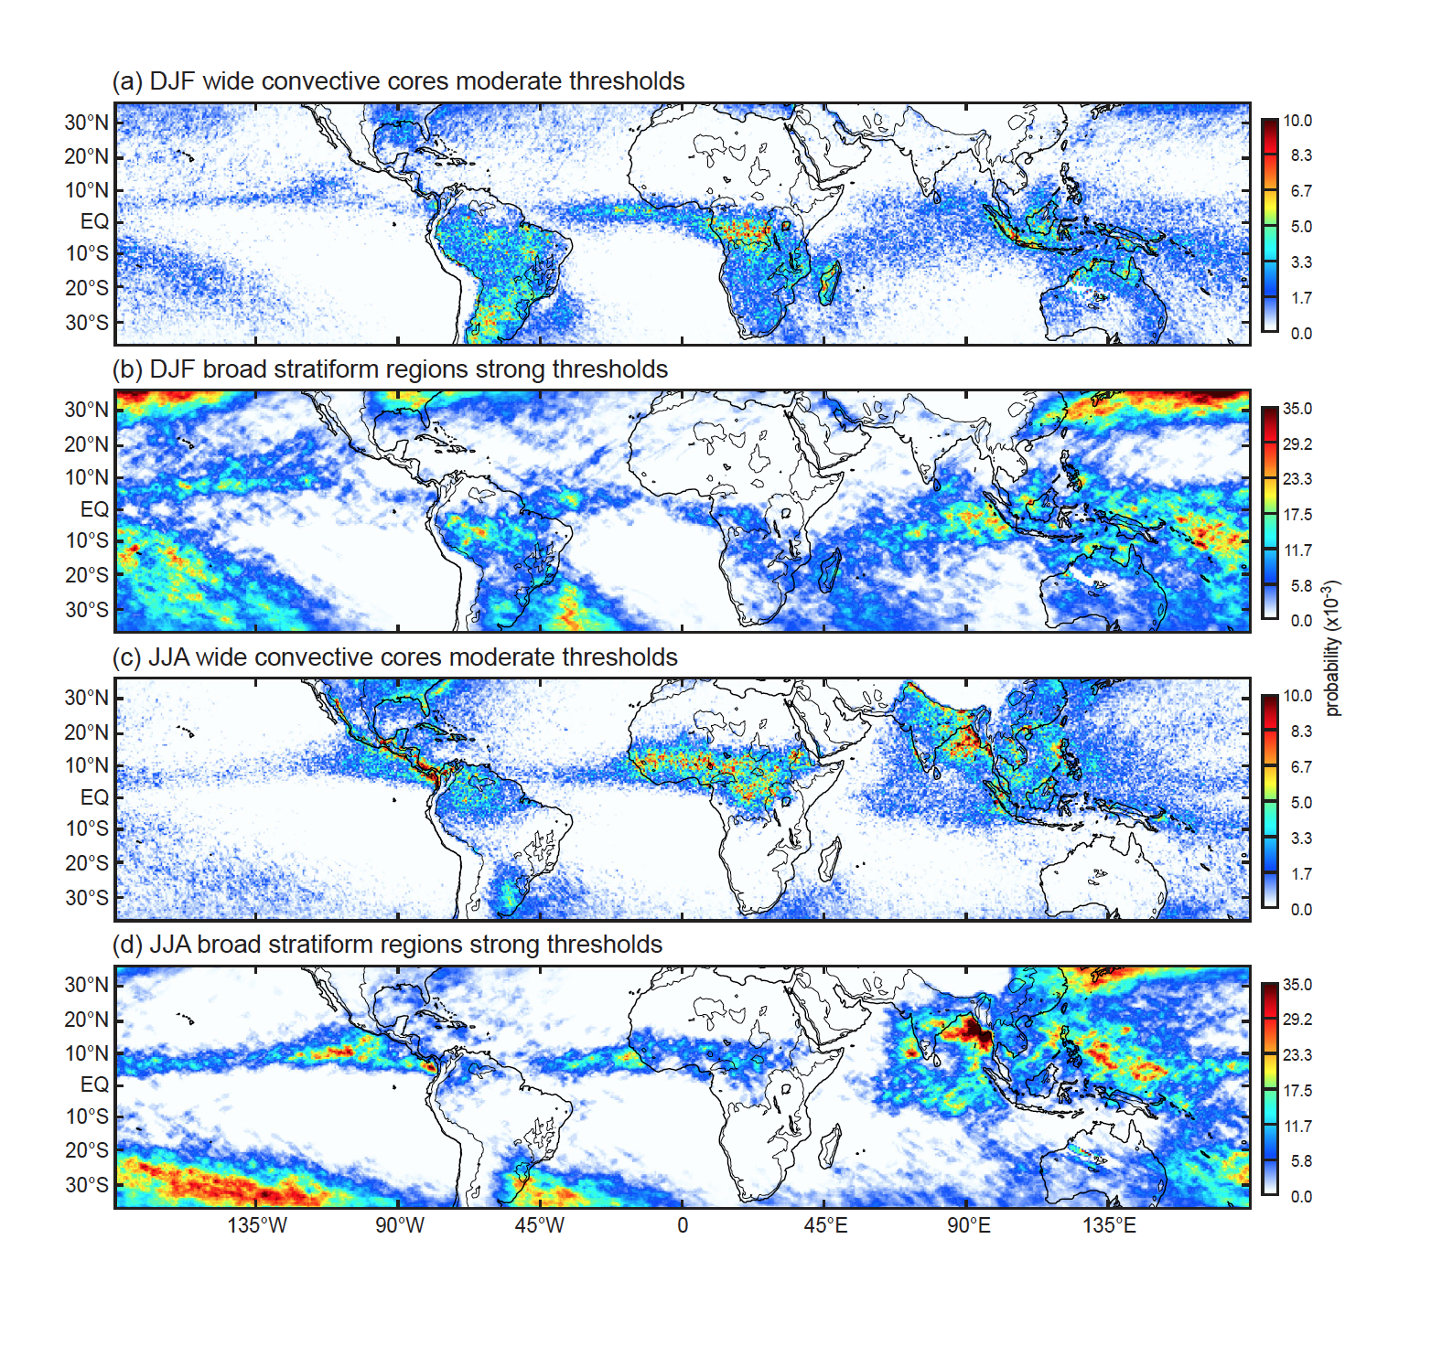
Shallow-isolated and Strong-deep in DJF
Notes:
Sample of results
Because of time limitation—showing only DJF
Shallow isolated echoes—are an oceanic phenomenon
Deepest, most intense, embedded cores--continental

Slide 7
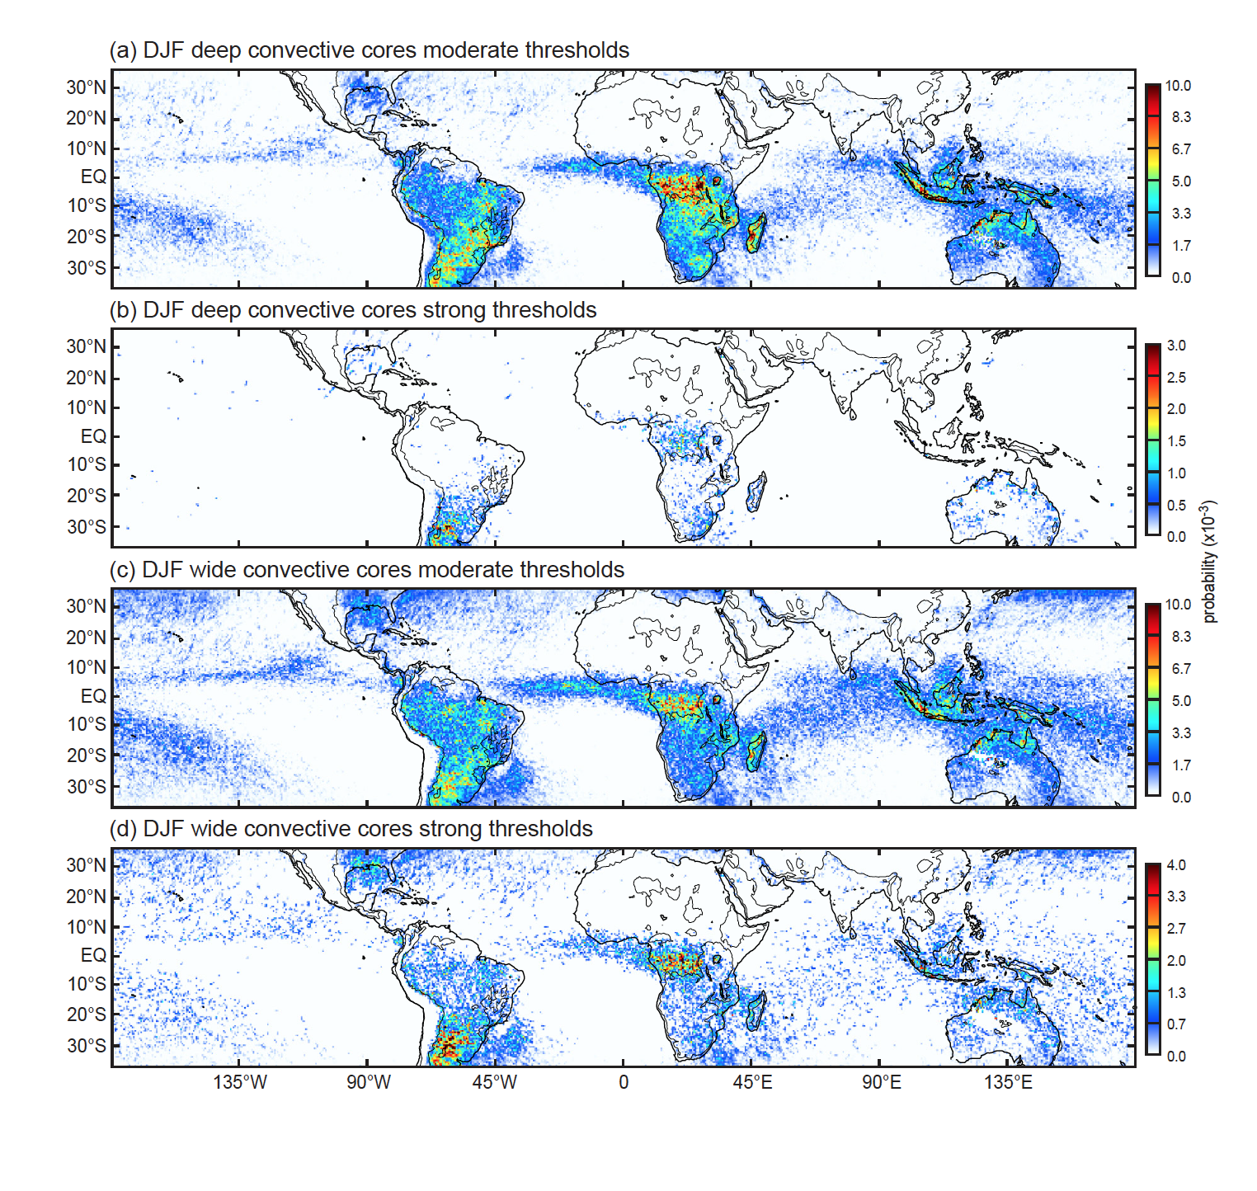
Deep and Wide in DJF
Notes:
As noted…wide cores are those growing upscale
This shows
Mesoscale development much more widespread than the occurrence of extremely deep/intense convective core occurrence
Close correspondence of moderate deep conv. cores and mesoscale development
The rainiest regions—Amazon, MC, & Gulf coast—have mesoscale development from mostly moderately deep & intense convection

Slide 8
Broad stratiform regions
Look for ones that are broad and contiguous
Stratiform echo volume
land
Type | Width
Strong | > 50,000 km²
Moderate | > 30,000 km²
Notes:
First we will look at convective echo structure in the TRMM data.
To do this—
identify 3D echo “cores”

Slide 9
Wide Convective and Broad Stratiform in DJF
Notes:
Broad stratiform regions
Manifest in regions of wide convective cores, i.e. where mesoscale aggregation & organization occur—globally
Manifests more strongly over oceans—wherever mesoscale organization is happening
Over land regions where the most intense deep & wide convective systems occur, stratiform development is not especially strong.
Over semi-oceanic regions—Amazon, MC, and Gulf, BRSs manifest more strongly than regions where mesoscale conv. aggregation manifests most strongly

Slide 10
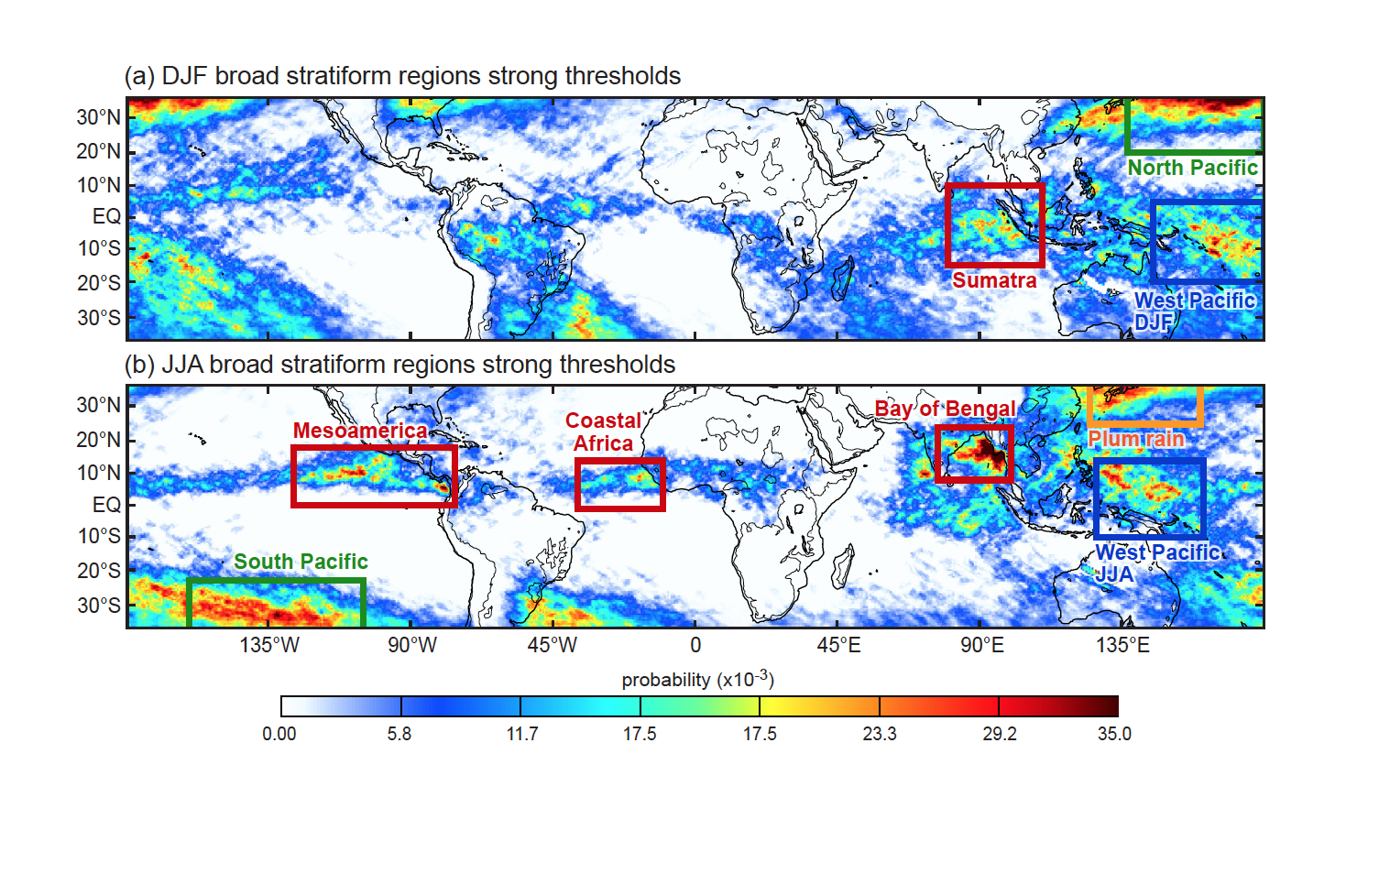
Regions of Frequent Broad Stratiform
Notes:
Looking at BSRs in both winter & summer in both hemispheres—
Several regimes: warm pool, monsoonal ITCZ, frontal, plum

Slide 11
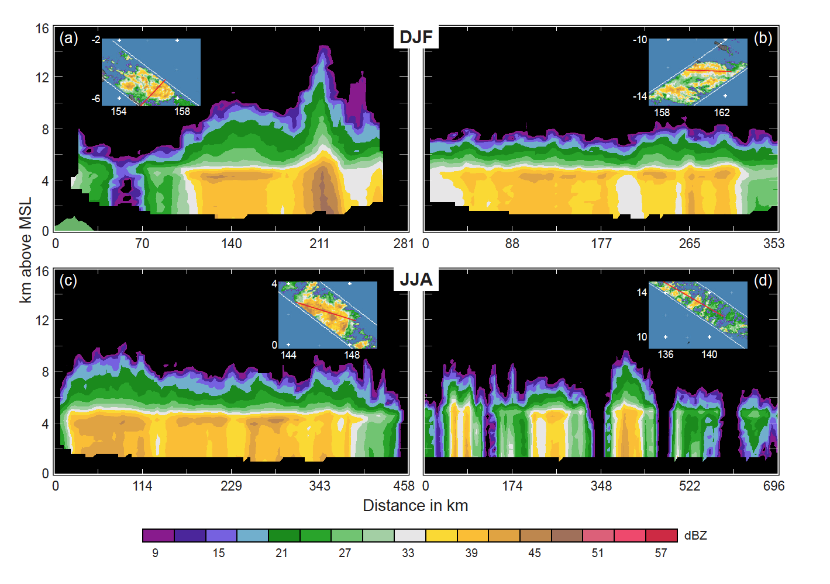
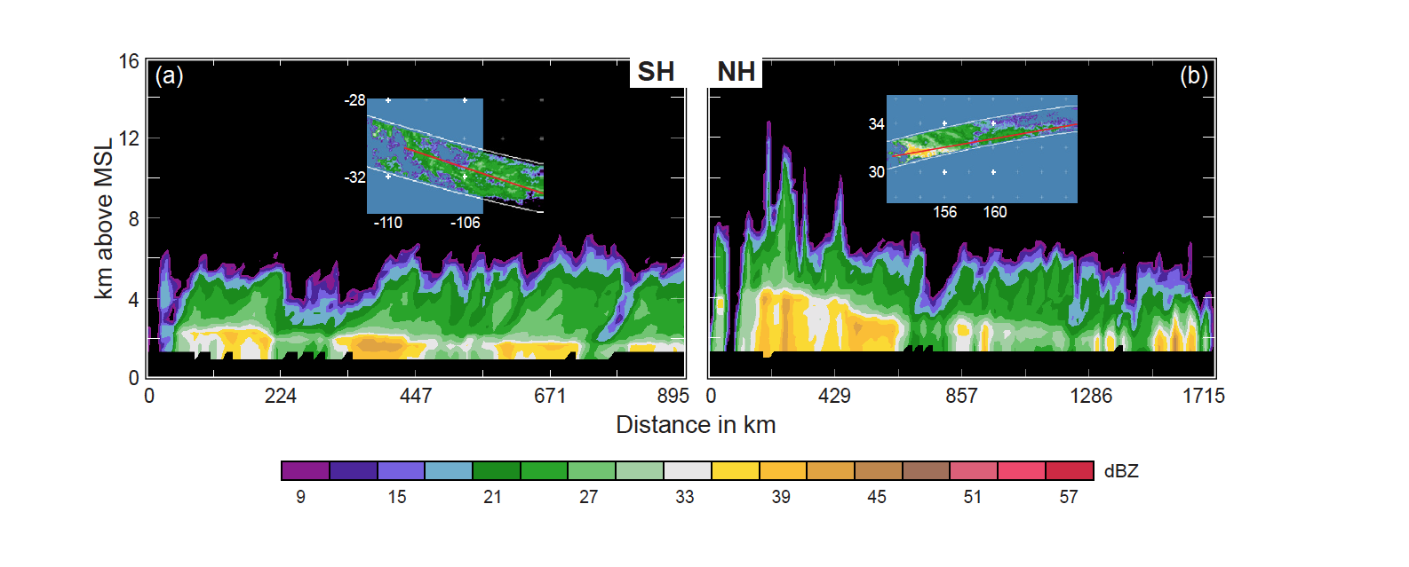
Mesoscale systems over the western Pacific warm pool

Slide 12
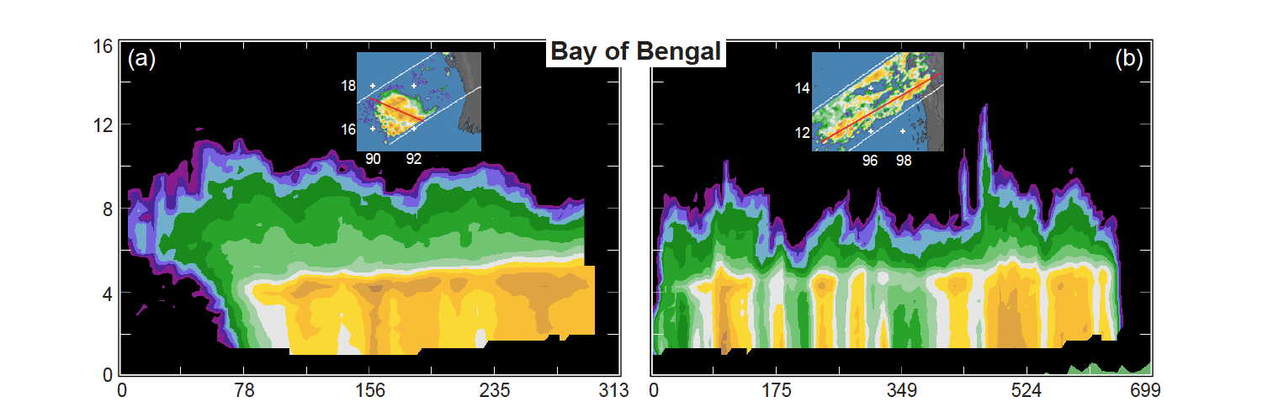
Mesoscale systems over the Bay of Bengal
Open ocean
Near coast

Slide 13
Frontal precipitation in subtropical latitudes

Slide 14
Forms of convection seen by TRMM
Convective cores
Shallow isolated echoes—oceanic
Deep intense cores—continental
Upscale growth of convection (“aggregation,” “organization”)
Associated with less deep & intense conv. cores
Stratiform development
Wherever mesoscale aggregation occurs
Mostly oceanic and semi-oceanic
Less strong over land regions—where convection is strongest
Stratiform structure
Mesoscale system type—over open tropical oceans
Weak cellular form—in ITCZ and monsoonal coastal regions
Frontal—over subtropical oceans

Slide 15
END
This research is supported by: NASA grant NNX13AG71G

Slide 16
Extra Slides

Slide 17
Re-map and interpolate the PR reflectivity field
Satellite
Interpolate
Geolocate

Slide 18
Use remapped interpolated data to locate different types of 3D embedded echoes

Slide 19
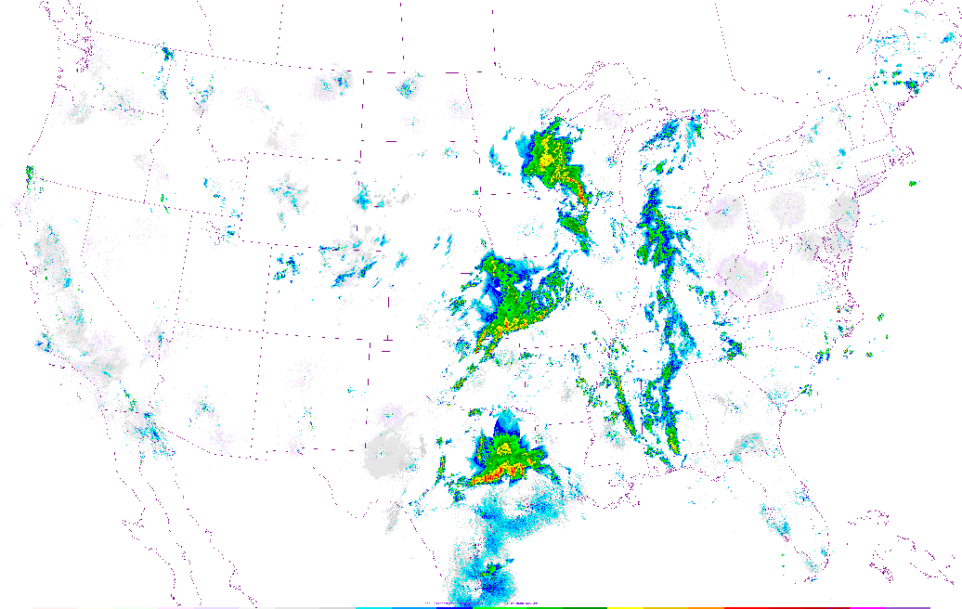
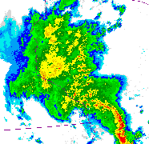
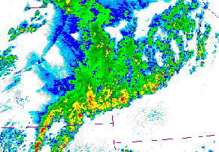
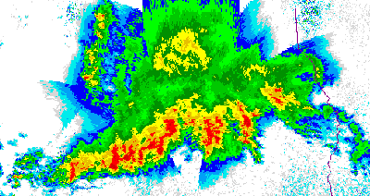
Radar echoes of convective storms contain two types of embedded features
Stratiform Precipitation
Convective Precipitation
1458GMT 13 May 2004

Slide 20
Use TRMM to find the most pronounced convective & stratiform elements
Identify every contiguous 3D echo object (“storm”) seen by PR
Convective component
Stratiform component
Extreme characteristic
Contiguous 3D volume of convective echo > 40 dBZ
Extreme characteristic
Contiguous stratiform echo with horizontal area > 50 000 km²
“Broad stratiform region”
Top height > 10 km
“Deep convective core”
Horizontal area > 1 000 km²
“Wide convective core”

