Slide 1
The Many Ways that Mountains Affect Precipitation: A Broader View of “Orographic Precipitation”
Robert A. Houze, Jr.
Department of Atmospheric Sciences
University of Washington
Brown University Seminar, Providence, 9 April 2015

Slide 2
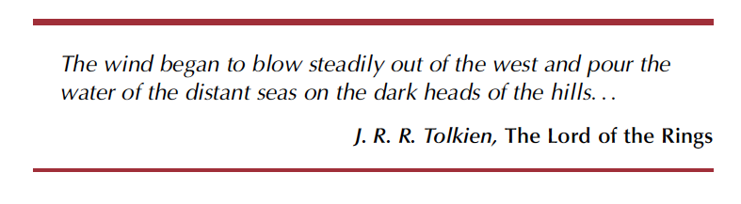

Slide 3

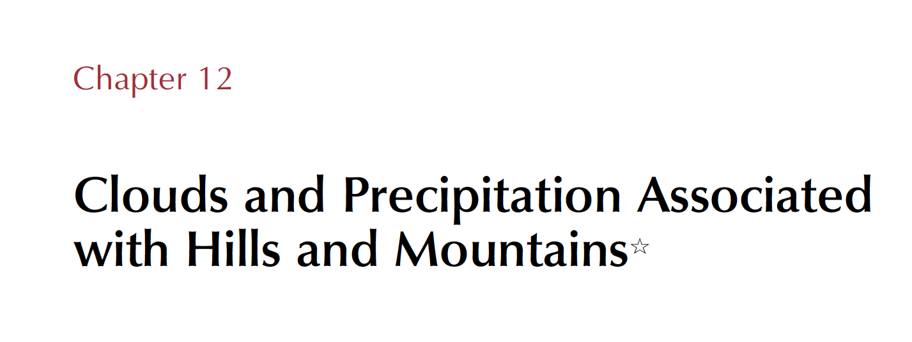

Slide 4
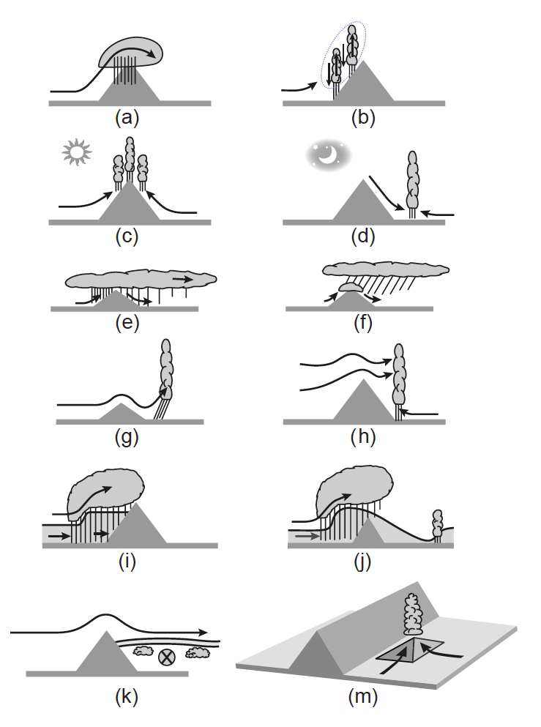
The many ways that mountains affect precipitation
Notes:
The most common discussions of

Slide 5
The many ways that mountains affect precipitation
Notes:
The most common discussions of

Slide 6
The many ways that mountains affect precipitation
Notes:
The most common discussions of

Slide 7
The many ways that mountains affect precipitation
Notes:
The most common discussions of

Slide 8
The many ways that mountains affect precipitation
Notes:
The most common discussions of

Slide 9
The many ways that mountains affect precipitation
Notes:
The most common discussions of

Slide 10
The many ways that mountains affect precipitation
Notes:
The most common discussions of

Slide 11
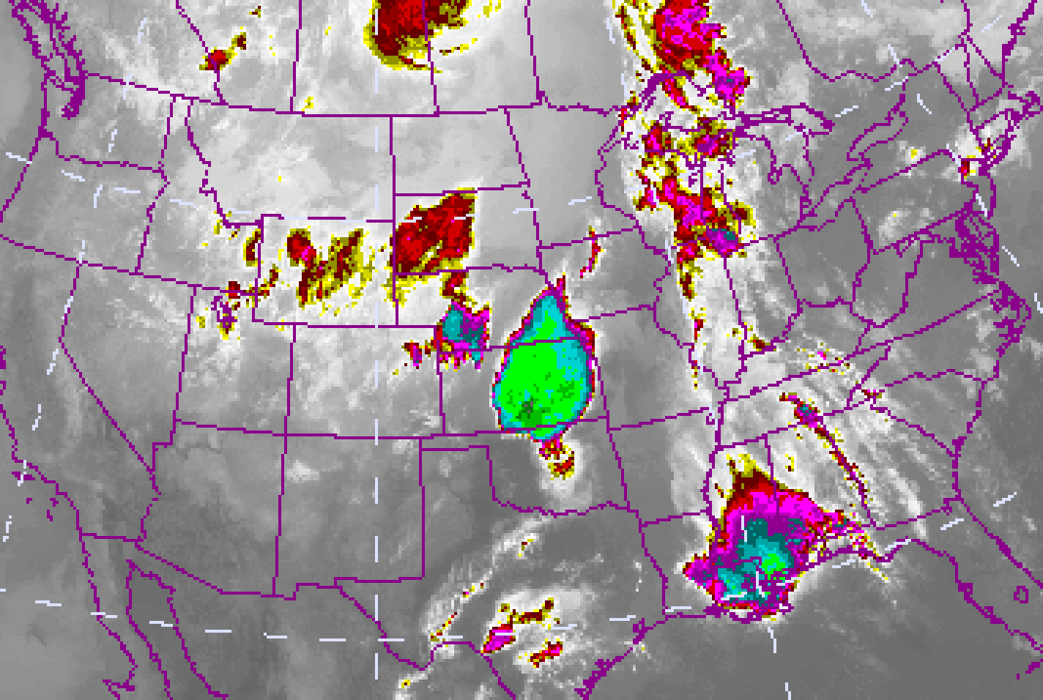
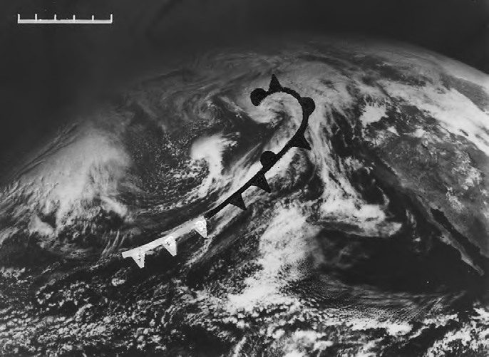
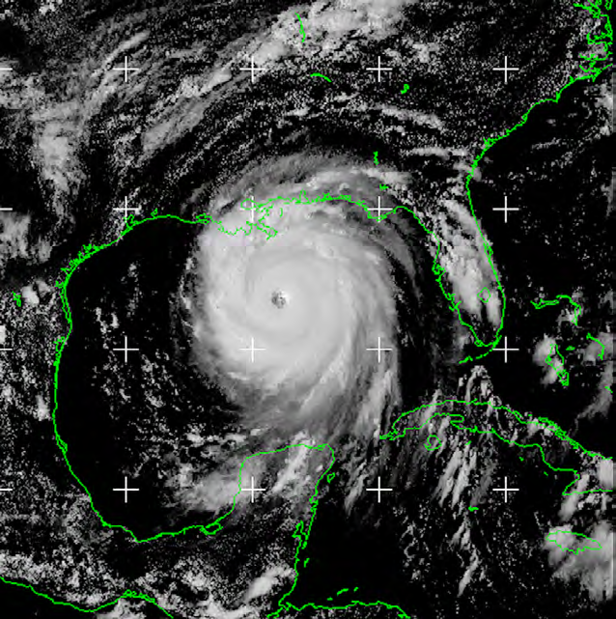
Where does nearly all Earth’s precipitation come from?
Convective storms
Frontal systems
Tropical cyclones
Notes:
The most common discussions of

Slide 12
Convective Storms

Slide 13
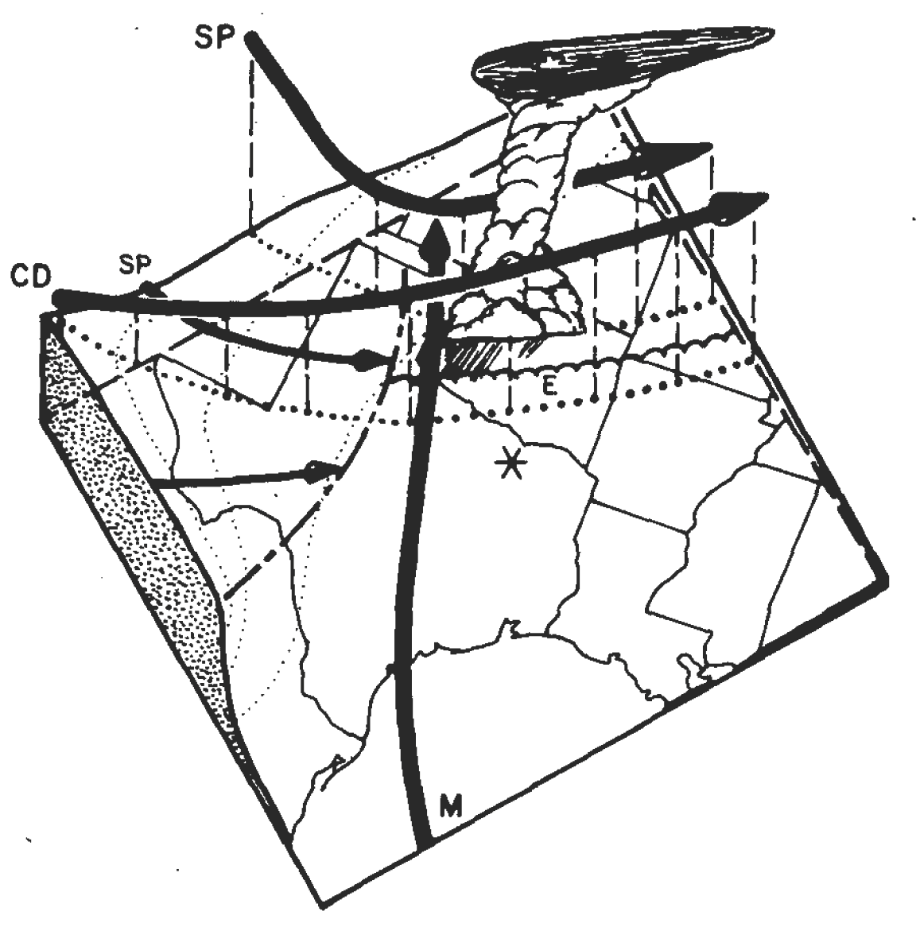
Severe Storms in the U.S.
dry,hot
moist
Mexican Plateau
Texas
Gulf of
Mexico
Carlson et al. 1983

Slide 14
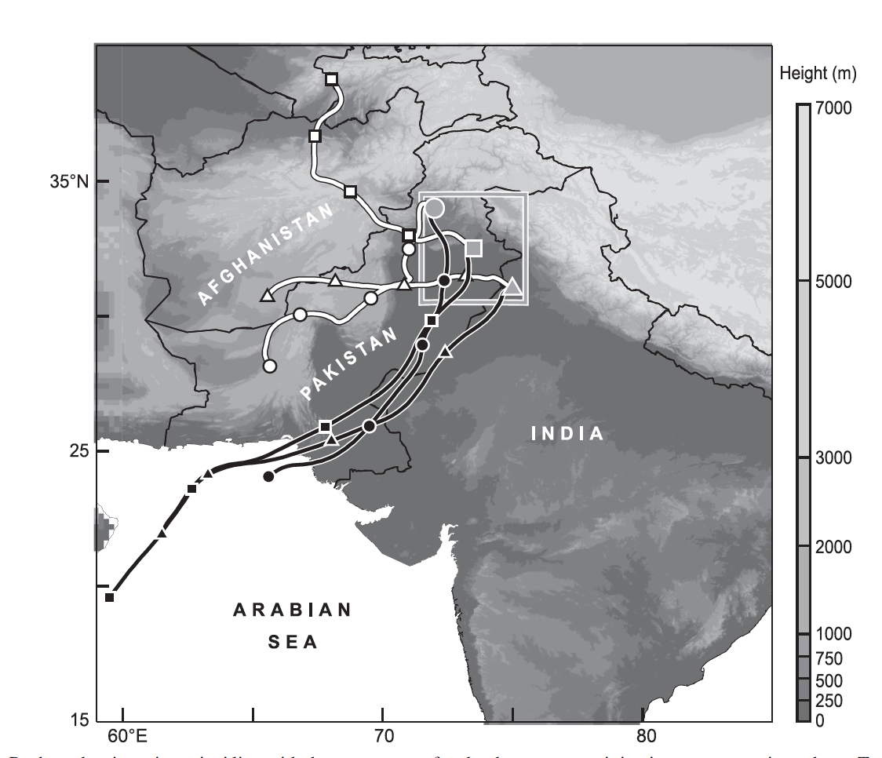
Medina et al. 2010
Medina et al. 2010

Slide 15
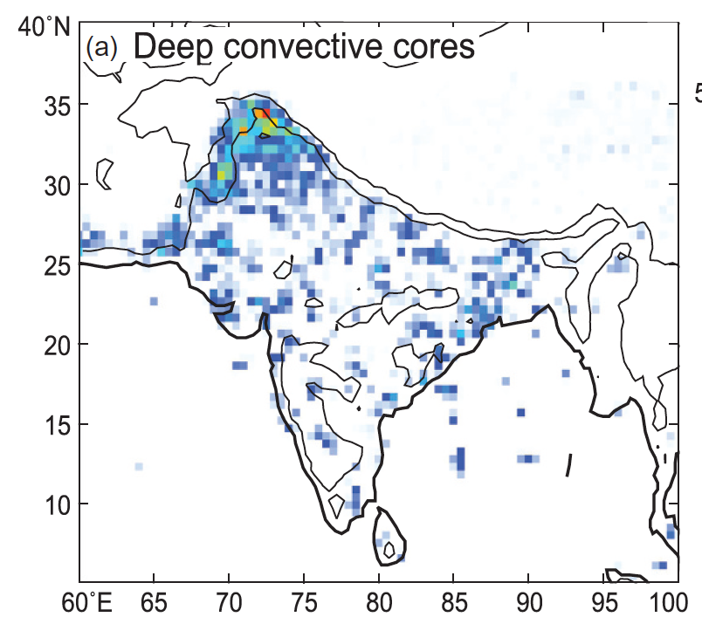
Deep intense convective echoes seen by the TRMM satellite radar
Romatschke et al. 2010

Slide 16
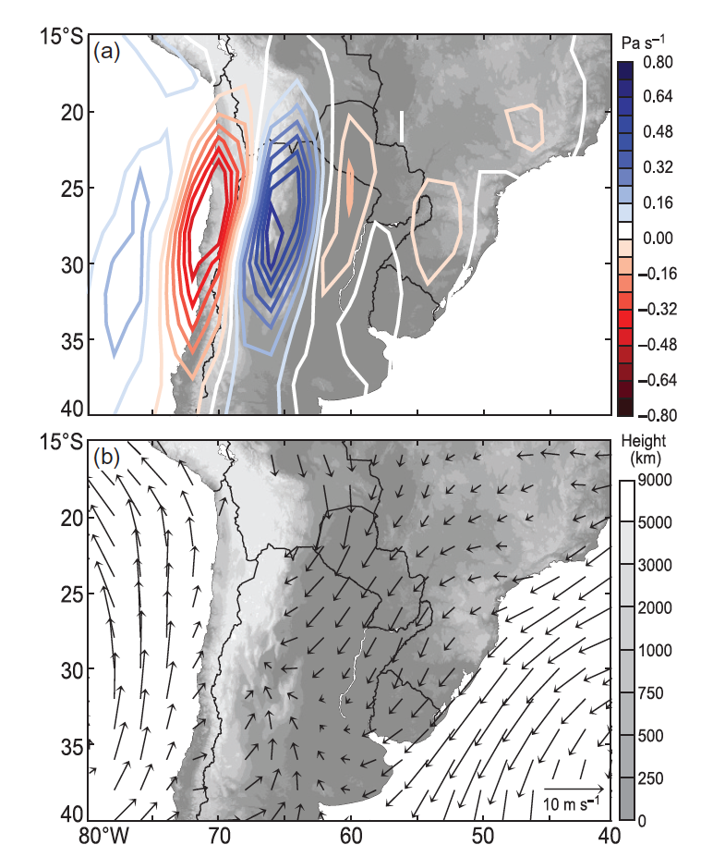
Summer in S. America
Mid-level Wind
up
down
Andes
Low-level Wind
Sierras de Cordoba
Rasmussen and Houze 2011

Slide 17
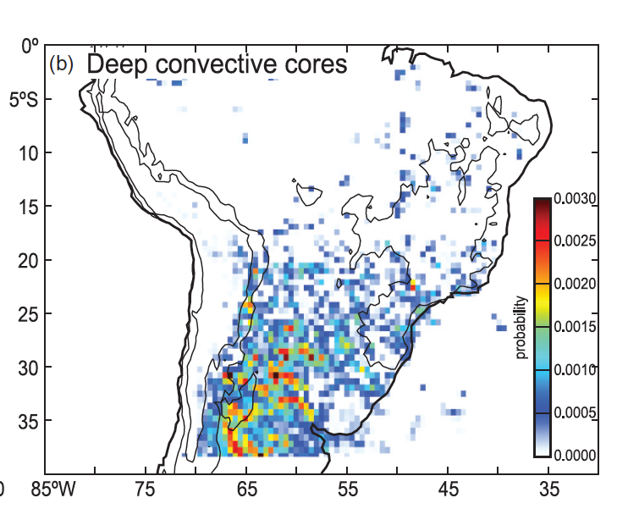
Deep intense convective echoes seen by the TRMM satellite radar
Romatschke and Houze 2010

Slide 18
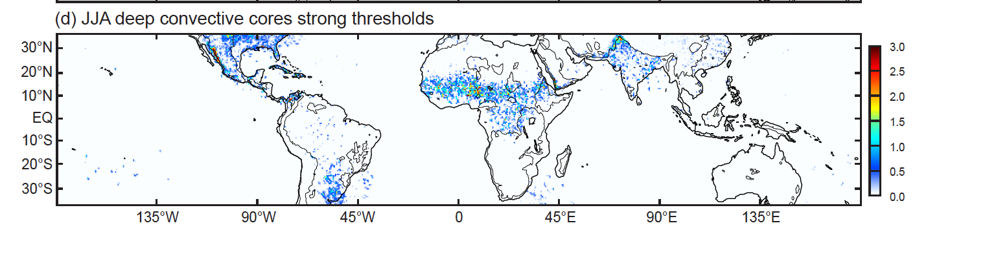
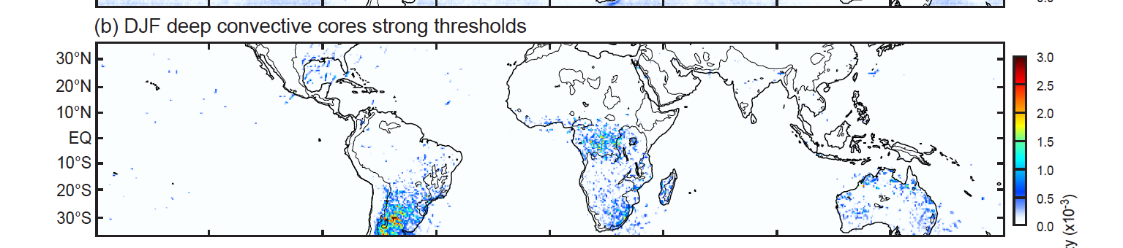
Deep intense convective echoes seen by the TRMM satellite radar
JJA
DJF
Houze et al. 2015

Slide 19
Recall
Notes:
The most common discussions of

Slide 20
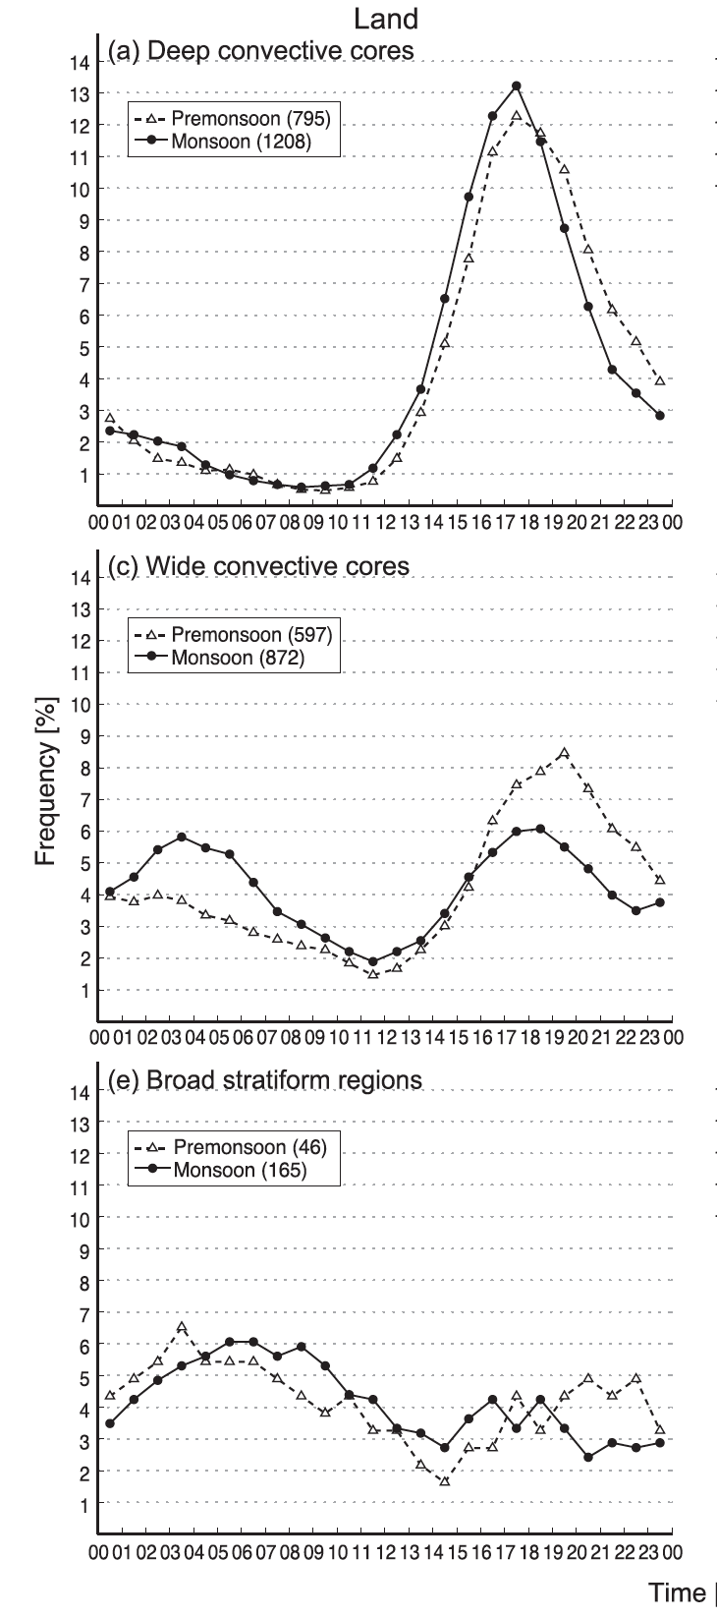
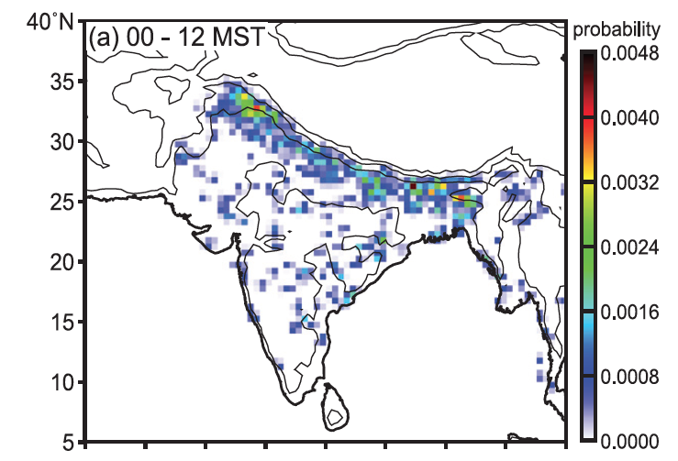
Diurnal cycles of monsoonal convection over India seen by the TRMM satellite radar
Wide convective cores

Slide 21
Frontal Systems

Slide 22
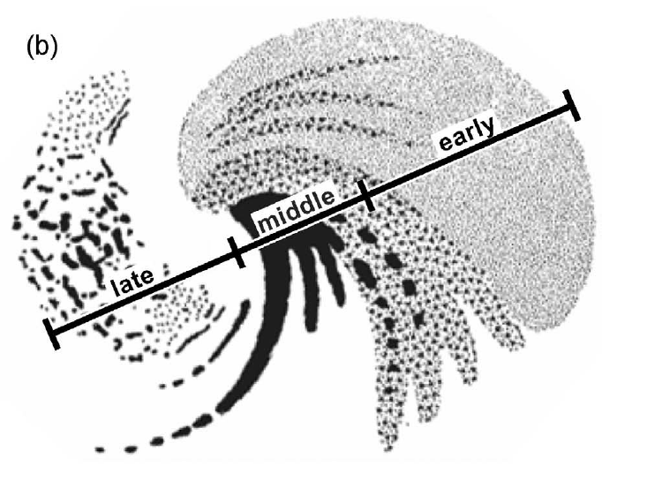
Extratropical cyclone approaching the west coast
Prefrontal
Warm Advection
LOW
Frontal
Post-frontal
Cold Advection
Storm Motion
Nagle and Serebreny 1962

Slide 23
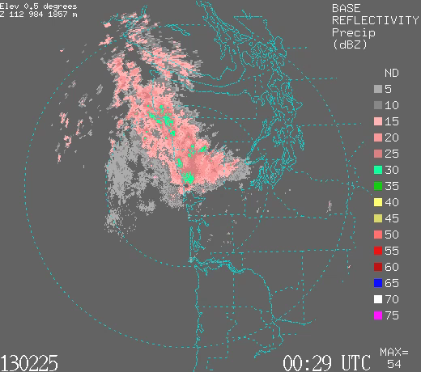

Slide 24
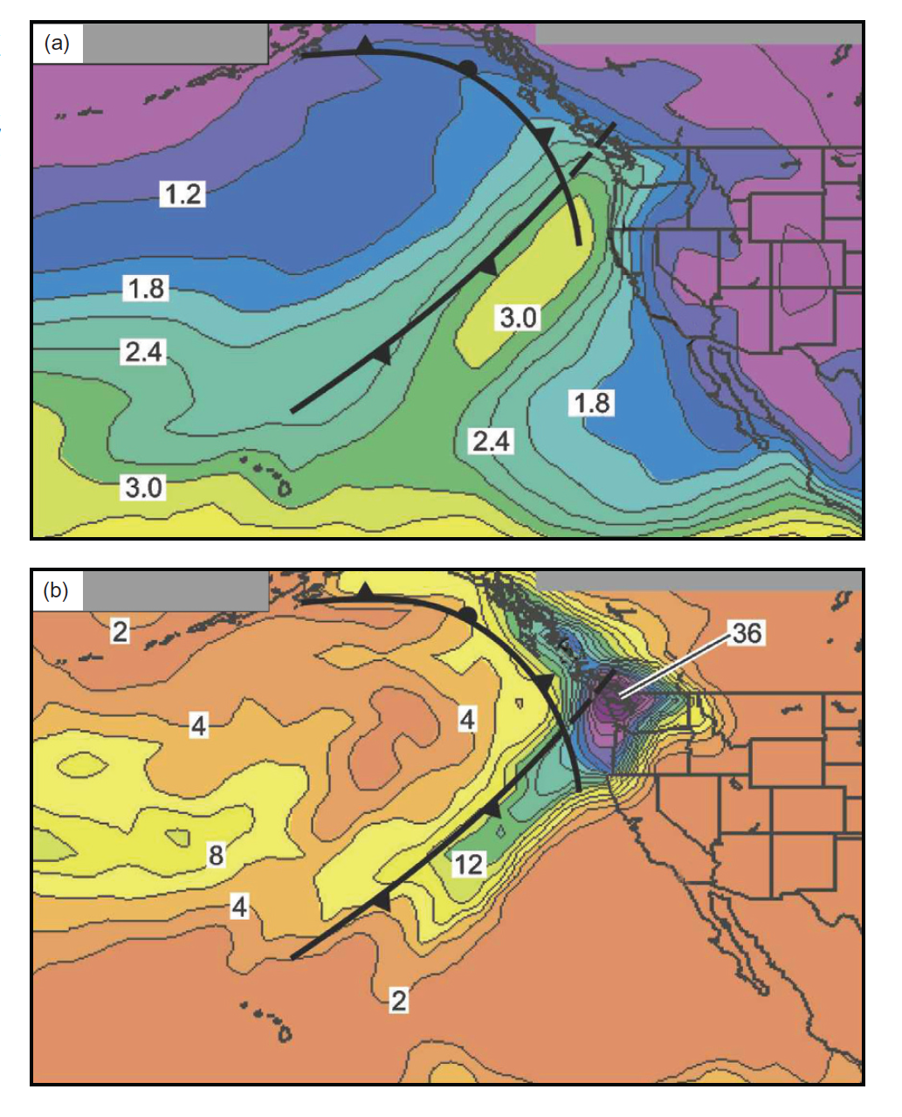
vapor (cm)
rain (mm)
Neiman et al. 2008

Slide 25
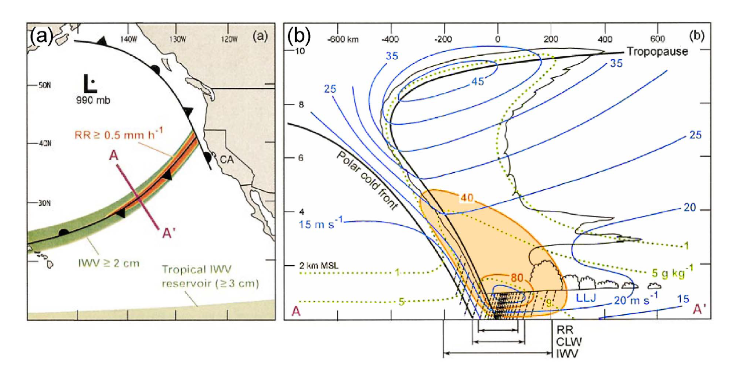
“Atmospheric River”
Moisture flux along front
Ralph et al. 2004

Slide 26
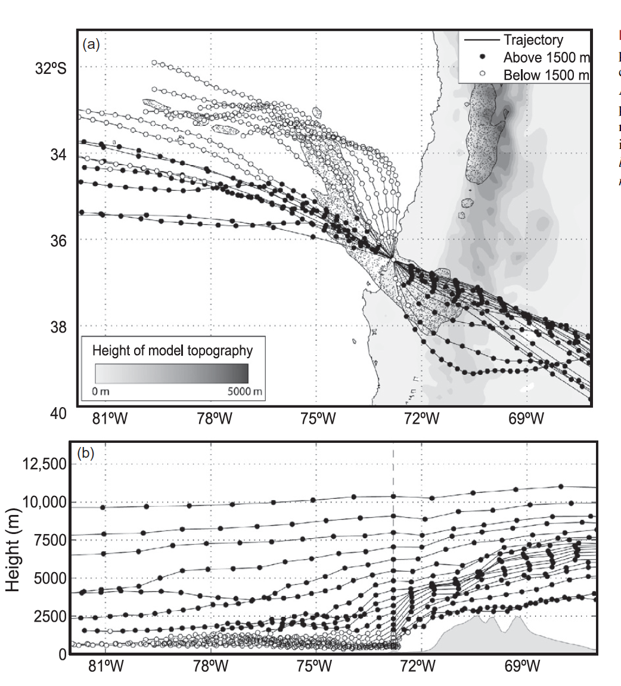
Barrett et al. 2009

Slide 27
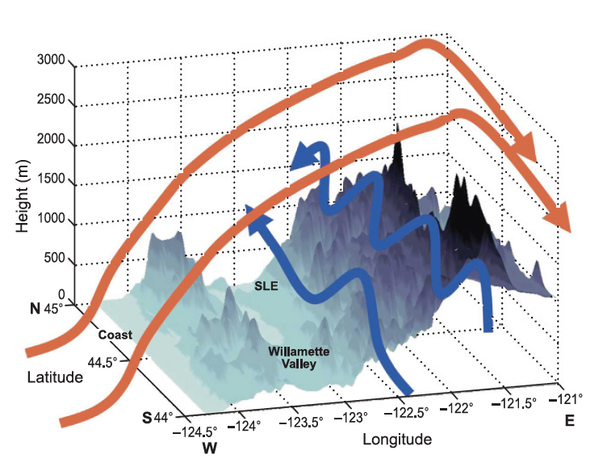
Garvert et al. 2007

Slide 28
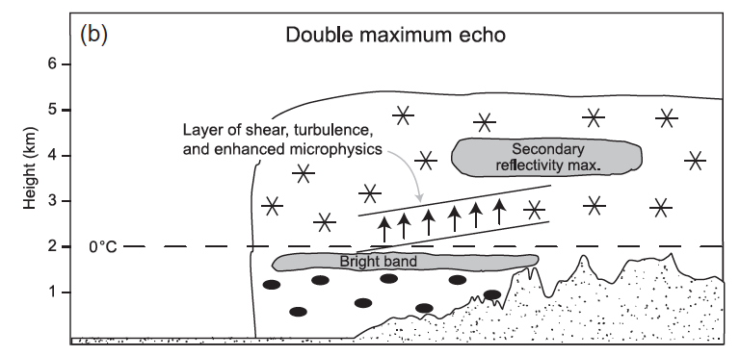
Frontal precipitation passing over a mountain range
Medina et al. 2007

Slide 29
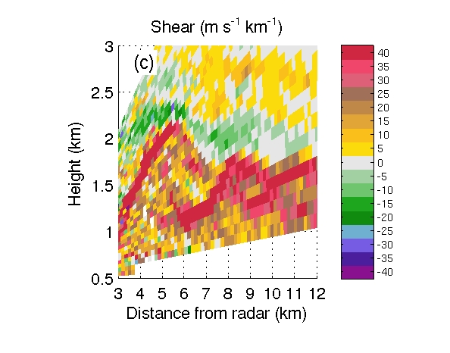
Kelvin-Helmholtz billows in the shear layer
Radar data over the Cascade Mountains
Medina and Houze 2015

Slide 30
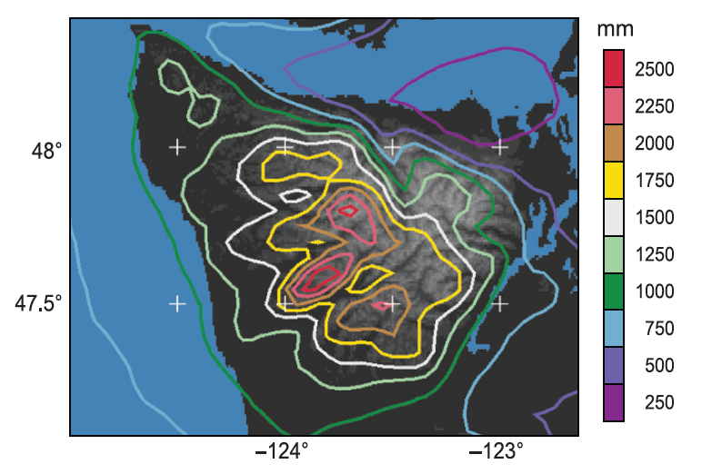
Simulation of annual rain over the Olympic Mountains
Courtesy J. Minder

Slide 31


Slide 32
OLYMPEX Ground Instrumentation
x
Legend
= WSR-88D
= NPOL
= DOW
= EC X-Band
= MRR = SNOTEL
= Ground Obs sites
= Snow camera network = UW Tipping bucket network
x
x
x
x
x
x
x
x
x
x
x
x
x
x
x
x
x
x
x
x
x

Slide 33
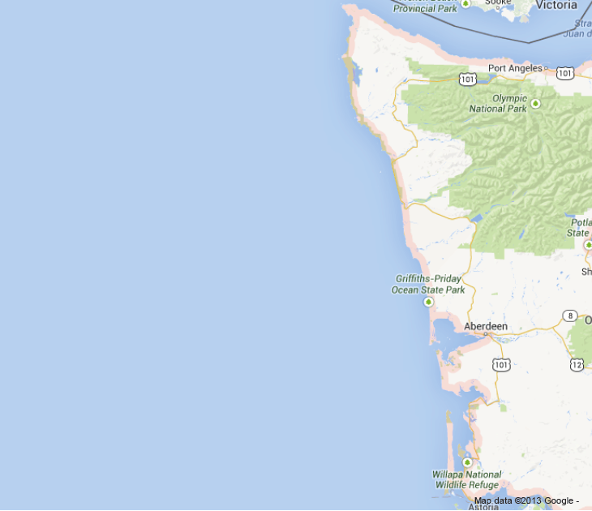
OLYMPEX Sample Flight Patterns
X-band
dropsondes
Citation
Citation
NPOL
ER-2
Spiral ascent
DC-8

Slide 34
Tropical Cyclones

Slide 35
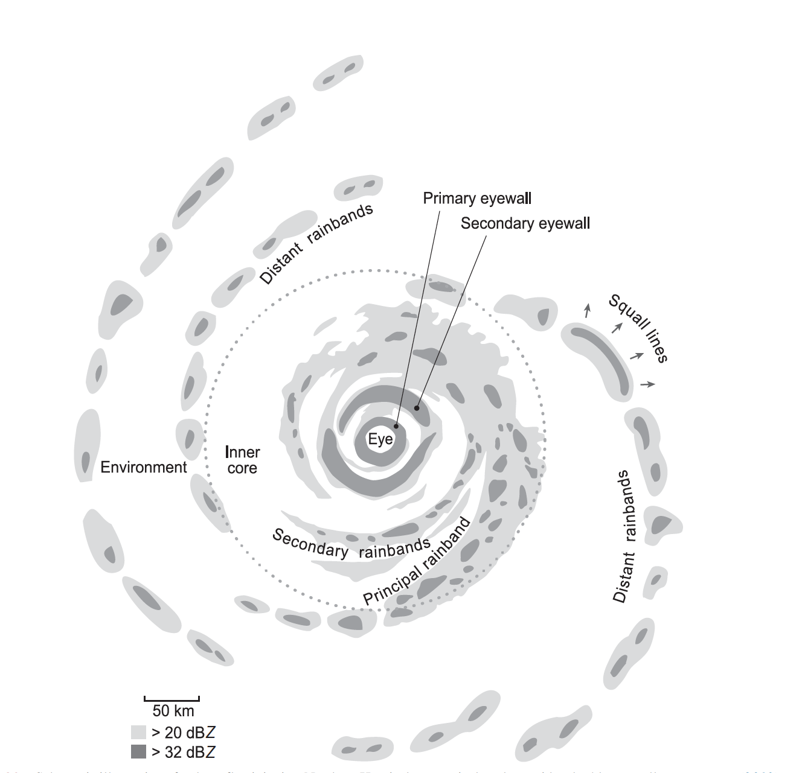
Houze 2010

Slide 36
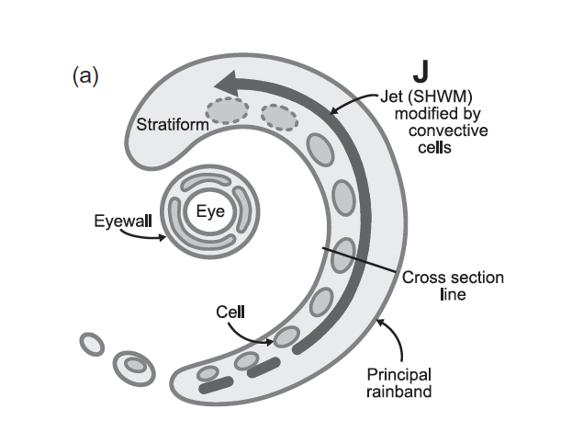
Along band jet at low-mid levels
Didlake and Houze 2009

Slide 37
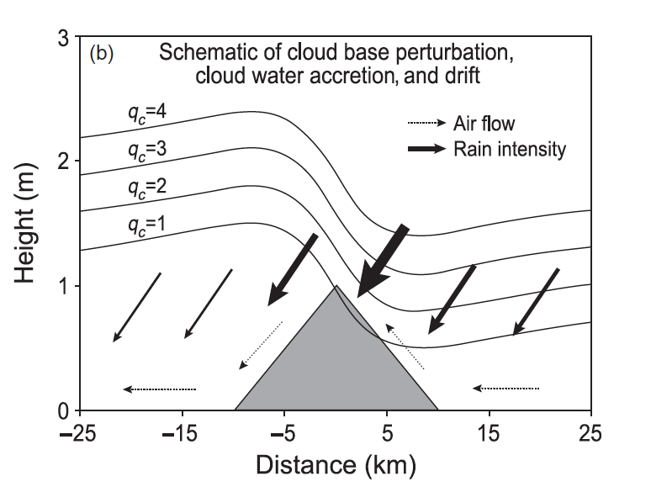
Gravity wave response of rainband jet to a small mountain
Smith et al. 2009

Slide 38
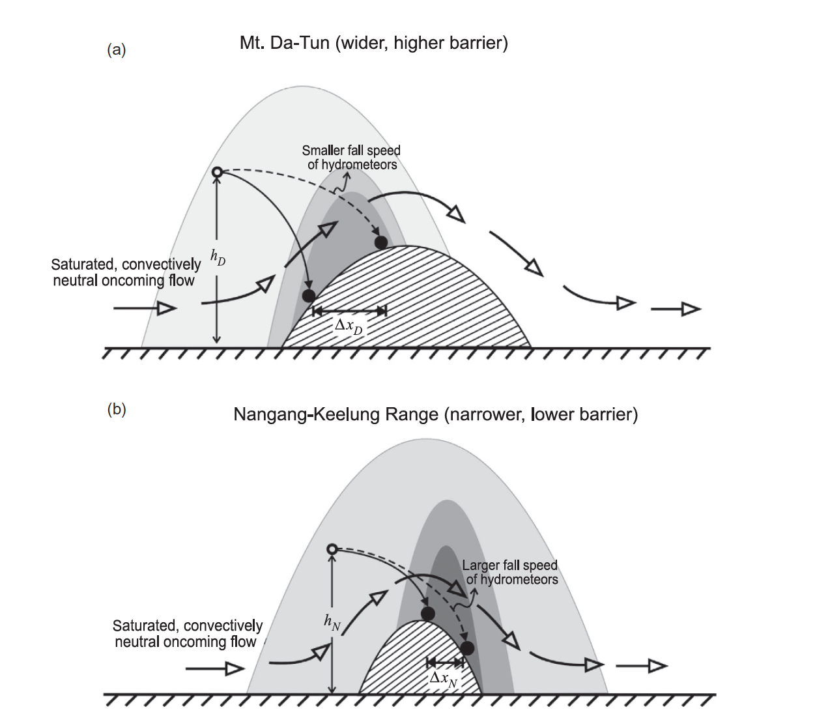
Yu and Cheng 2008

Slide 39
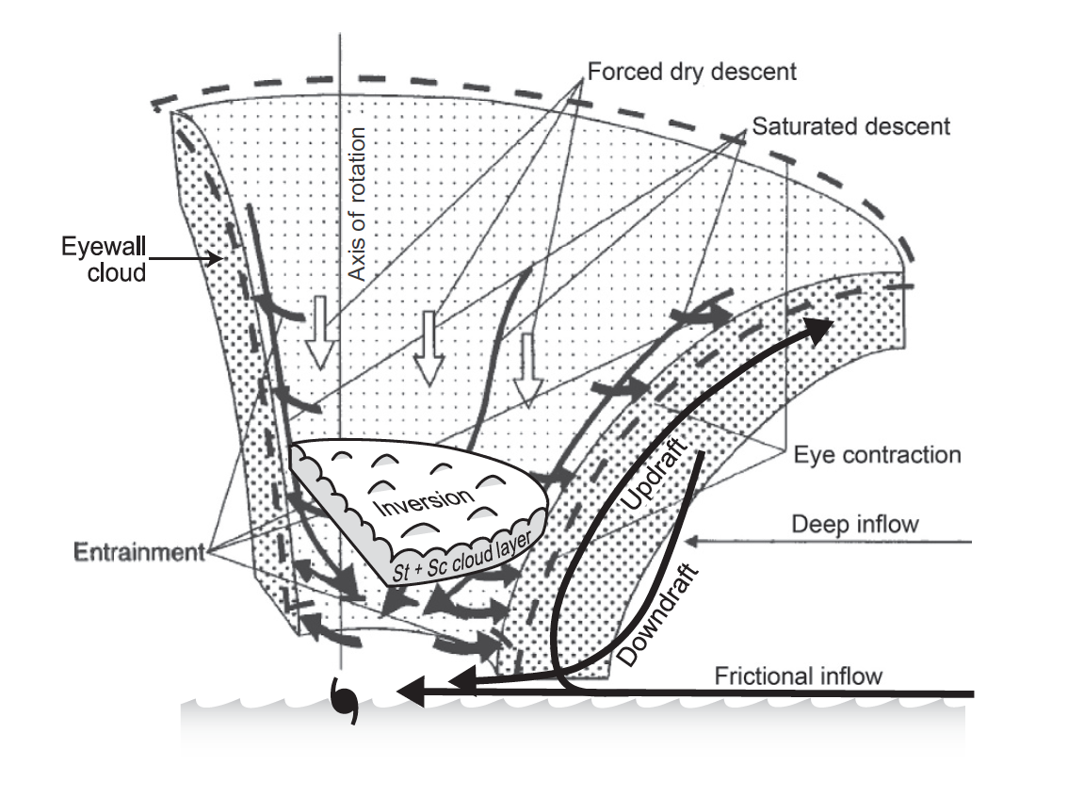
Eyewall of a tropical cyclone
Willoughby 1998

Slide 40
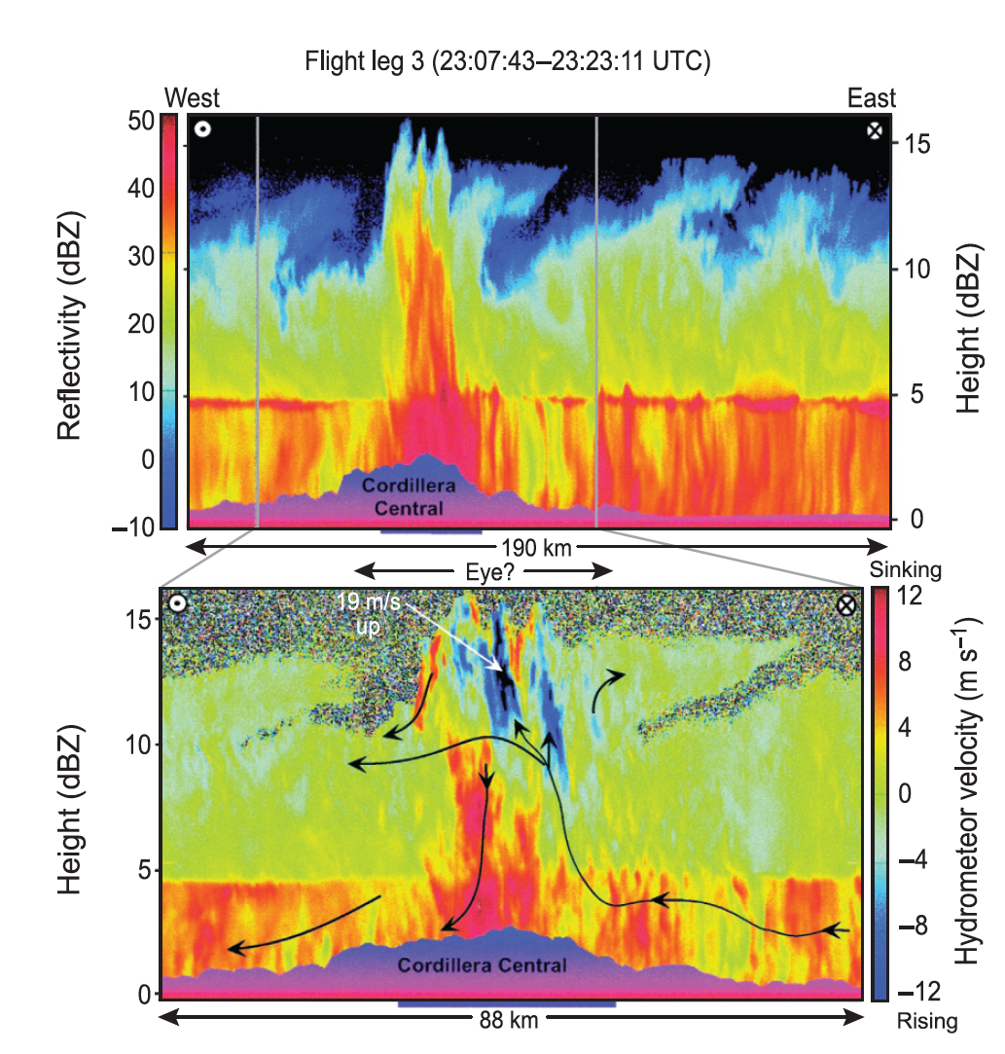
Eye of storm moving over Hispaniola
Geerts et al. 2000

Slide 41
Summary
Mountain effects on the three types of precipitating cloud systems:
Convection:
Capping and triggering of intense convection
Complex diurnal variations due to upscale growth of convection
Fronts:
Windward side enhancement due to –Barrier scale uplift –Tranverse ridge/valley scale gravity waves –Smaller scale turbulent enhancement
Tropical cyclones (need much more work)
Along band winds encountering mountain barriers
Convection released in the eye passing over terrain

Slide 42
End
This research was funded by NSF Grant AGS-1144105 and NASA Grant NNX13AG71G

