Slide 1

Understanding Convection in Relation to the Non-aerosol Environment
Robert Houze
With help from
S. Powell
E. Zipser
A. Varble
ASR Science Team Meeting, Tyson’s Corner, VA, March 17, 2015

Slide 2
To understand convection we need more info on both:
Environment (non-aerosol)
In-cloud properties

Slide 3
Non-aerosol environment issues
Shear & Buoyancy
Humidity
Clear-air w
SW & LW Radiation

Slide 4
Shear & Mesoscale “Organization”
We know about squall lines
But there are other types of mesoscale organization

Slide 5
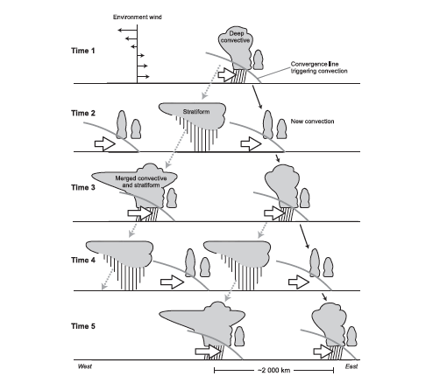
Yamada et al. 2010—Equatorial Indian Ocean
Explosive convective development

Slide 6
Humidity, Radiation, and Large-scale w

Slide 7
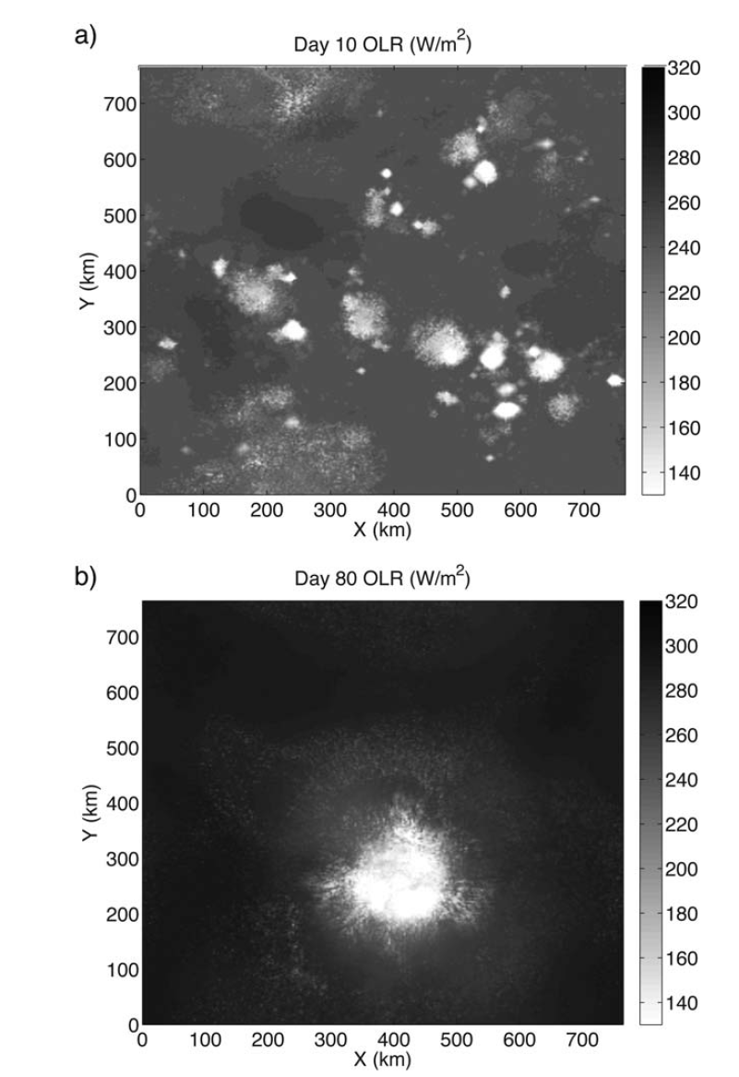
“Self Aggregation”
Emanuel et al. 2014
Wing and Emanuel 2014
Radiation in dry regions leads to them expanding
Convection clumps into mesoscale regions
Key variables to measure—upper tropospheric humidity and large-scale w

Slide 8
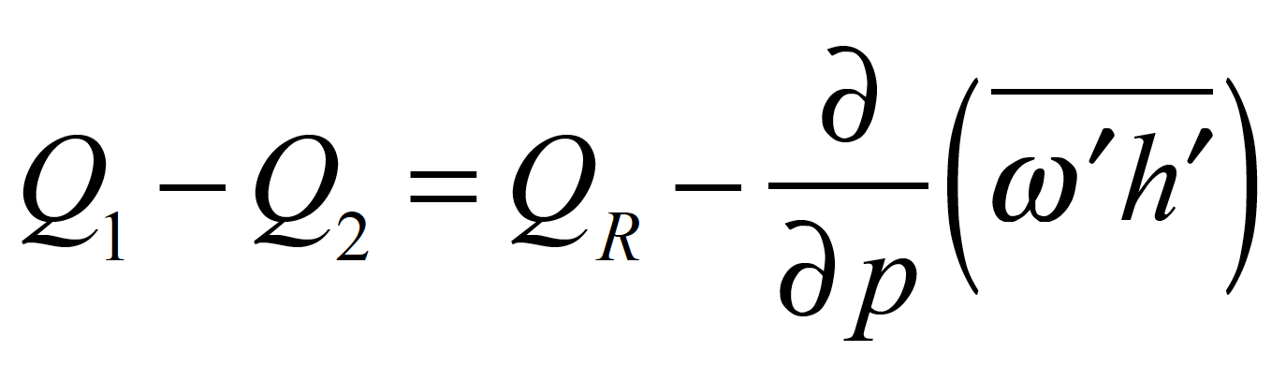
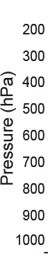
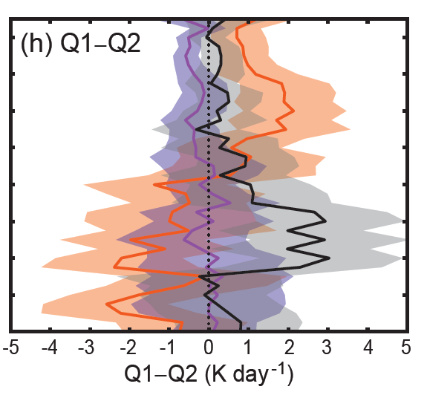
Sounding Budget in AMIE
Both depend on accurate environmental water vapor
Suppressed
Transition
Active
Powell & Houze (2015)

Slide 9
In-cloud issues:
Vertical velocity
Scale
Microphysics
Come together in cloud water budgets

Slide 10
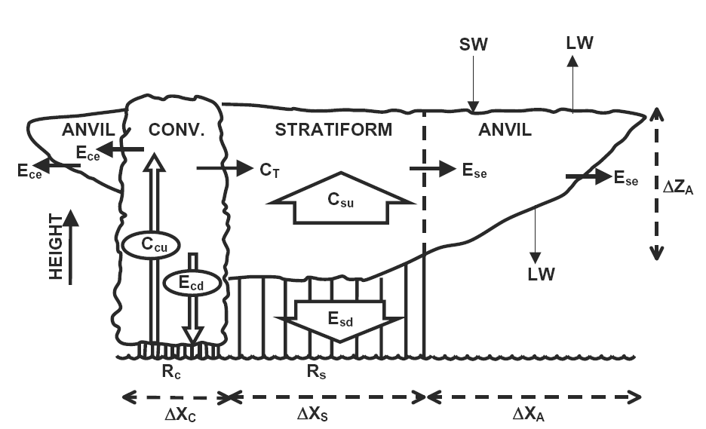
ΔZ_{AC}
IWC
A_{c}
A_{s}
IWC
A_{s}
ΔX_{AC}
Water budget underlies all the heating effects on the environment
Don’t know this numbers for any cloud systems! No baseline knowledge.
For net effects, need mass flux, not w
For microphysics, need the spectrum of w
Need to know N(w)dw, dimensions of all features, ice contents
Notes:
ARM Radiative Heating Profile Workshop, 8-9 January 2007, San Diego, CA, USA

Slide 11
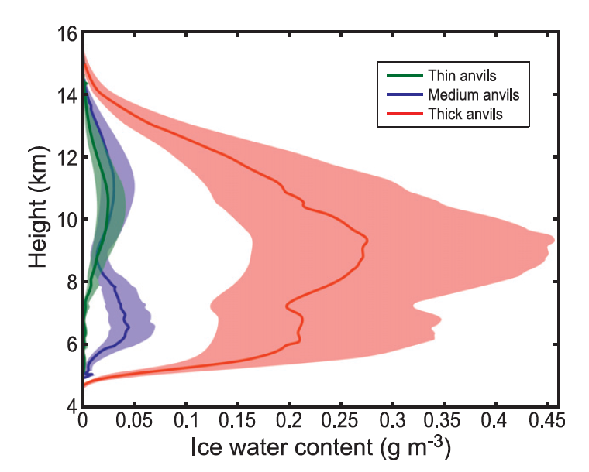
Anvil clouds observed by WACR at Niamey
Huge uncertainty!
This isn’t good enough!
From Powell et al. 2012, based on Protat et al. 2007
Notes:
From Powell et al. 2012

Slide 12
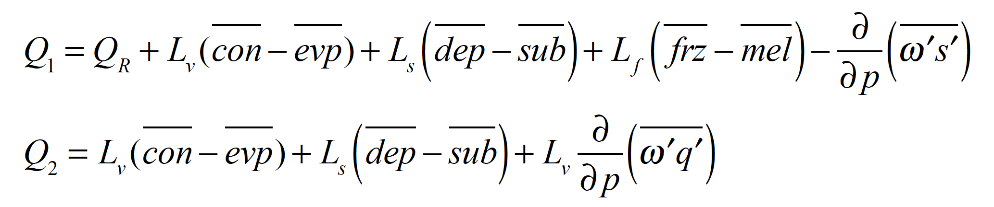
Sounding Budget in AMIE
Suppressed
Transition
Microphysics
Active
Powell & Houze (2015)

Slide 13
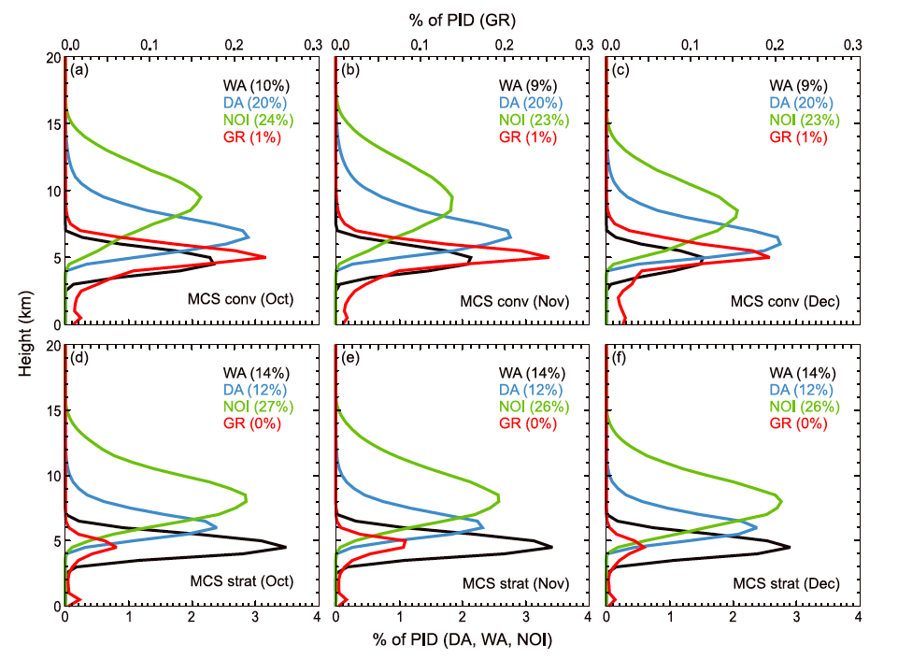
Dual-polarization radar gives us particle characteristics—need to focus model testing on processes, not mixing ratios
Wet aggregates
Dry aggregates
Non-oriented ice
Graupel
Rowe and Houze (2014)

Slide 14
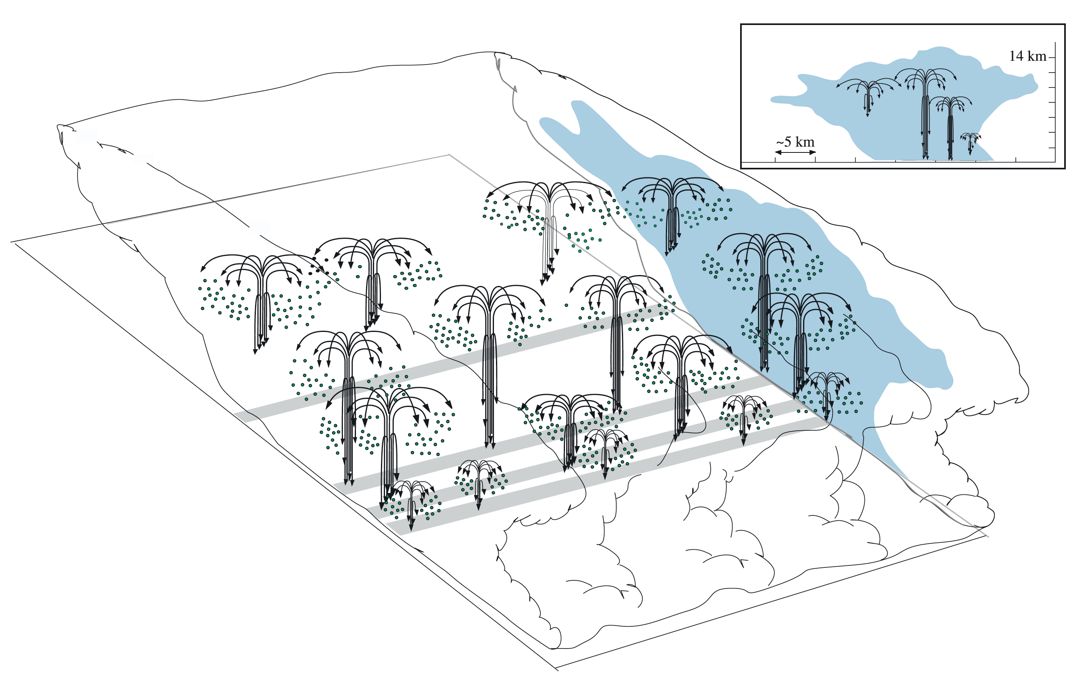
Convective cells generate particles Layered flow distributes them—need to know N(w)dw!
“Particle
fountains”
Yuter & Houze 1995

Slide 15
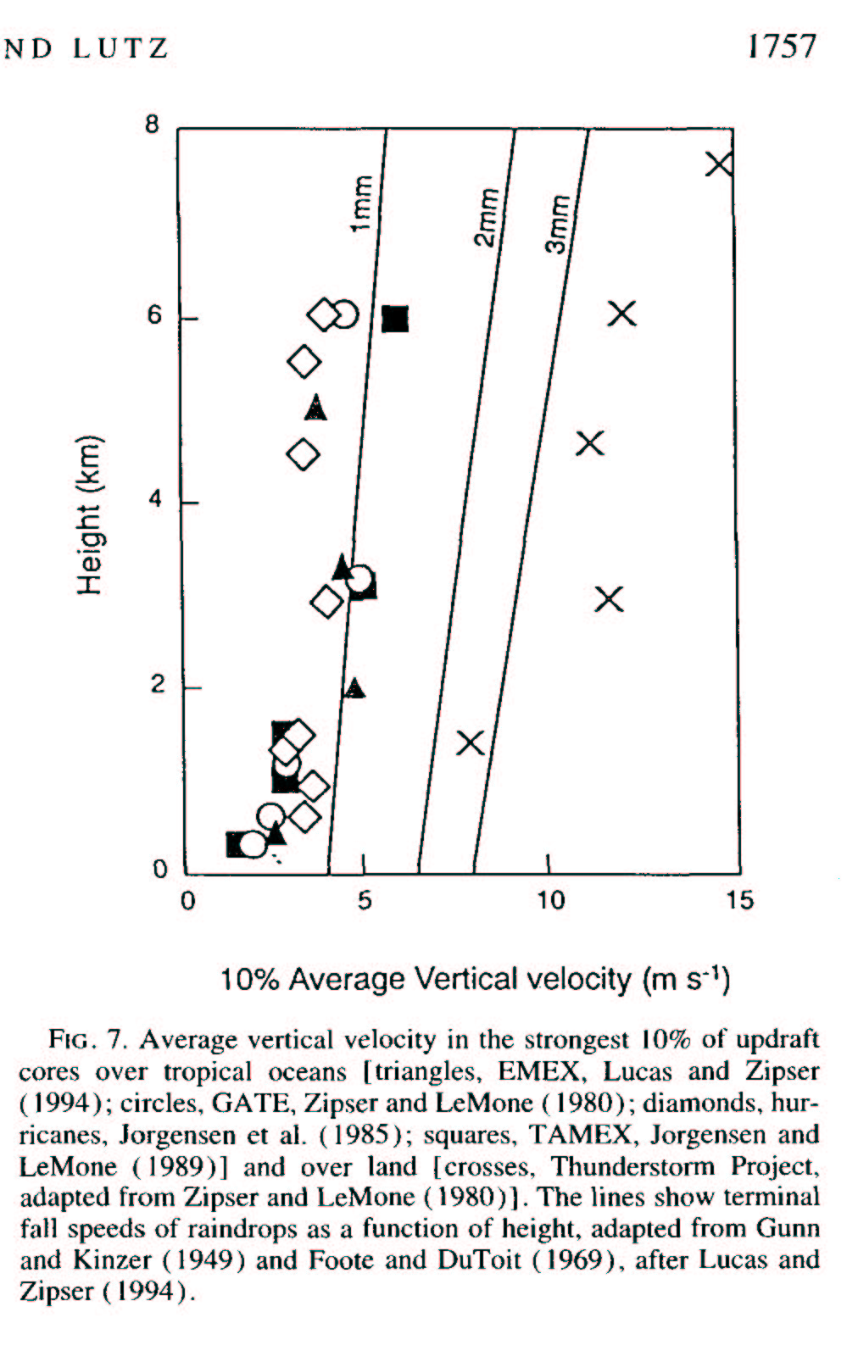
Updrafts in 100’s of aircraft penetrations of convective updrafts
Ocean flights
Continental
flights
Why?
T profiles?
Entrainment?
Zipser and Lutz 1994

Slide 16
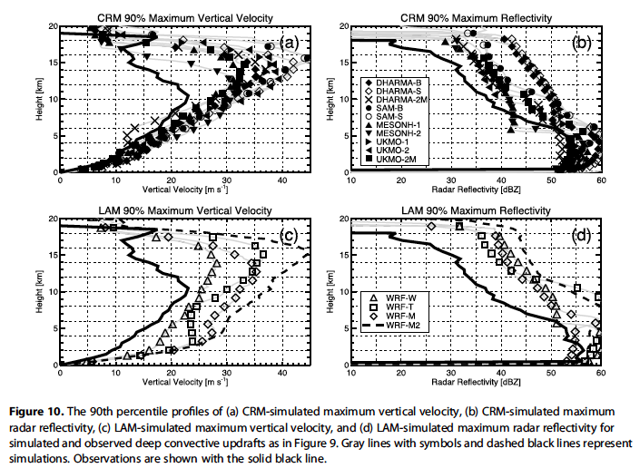
Observations
Model
Varble et al. 2014
MESSAGE: Real updrafts peak ~ 10 km, and all CRMs and LAMs (regardless of microphysics schemes) seriously over-predict convective intensity.

Slide 17
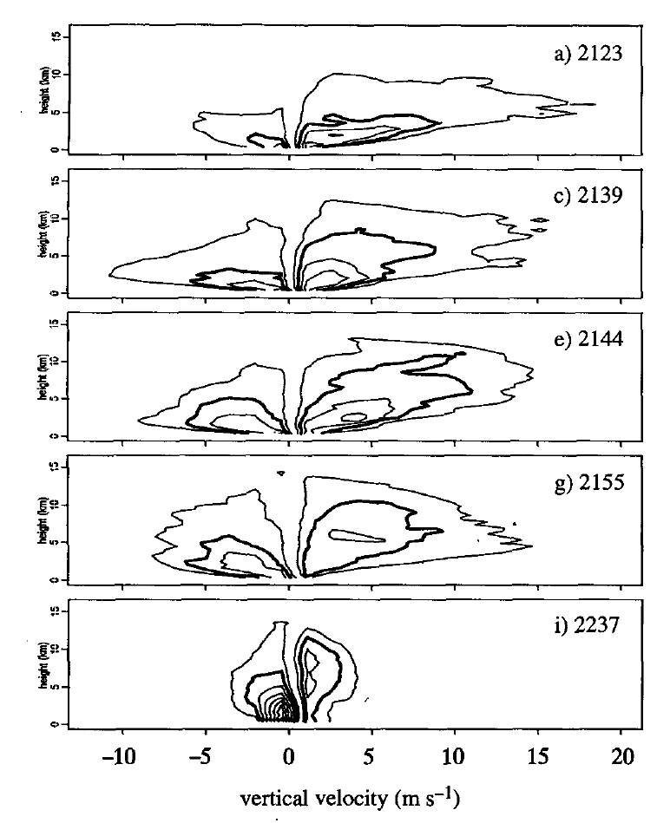
CFAD of vertical mass transport for a developing mesoscale system in Florida
Contours
25x10⁶ kg s^{–1}
Yuter and Houze 1995

Slide 18
OUTSTANDING PROBLEMS
Environment:
Modes of mesoscale organization—shear & lapse rate:
Self aggregation—humidity and radiation in the environment:
Large-scale w—humidity & radiation
In-cloud:
What factors determine w?—parcel buoyancy, entrainment, freezing, or…
Bulk mass transport—important for latent and radiative heating
Vertical velocities—important for microphysics
Microphysical processes—critical for heating calculation & must be evaluated against radar data

Slide 19
End
This research is supported by DOE grant DE-SC0008452 / ER-65460

Slide 20
Extra Slides

Slide 21
“Self Aggregation”
Emanuel et al. 2014
Wing and Emanuel 2014
Key elements
Radiation
Humidity in upper troposphere

Slide 22
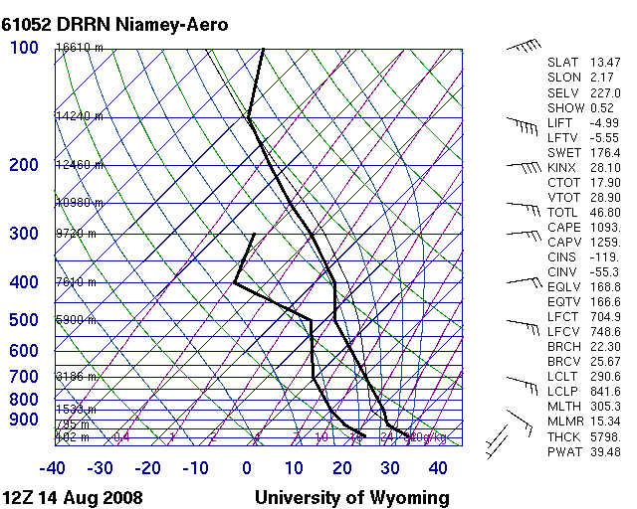
Continental sounding: West African Squall Line
Can generate huge T-T_{d}
→large w at low-mid levels
→ super cooled water, graupel, lightning
~10°
Notes:
No cap whatsoever. Very unstable all levels. LCL and LFC are elevated because air dry at lower levels. Once air gets above LFC, it can have very large buoyancy, strong updrafts, graupel, hail, lightning.

Slide 23
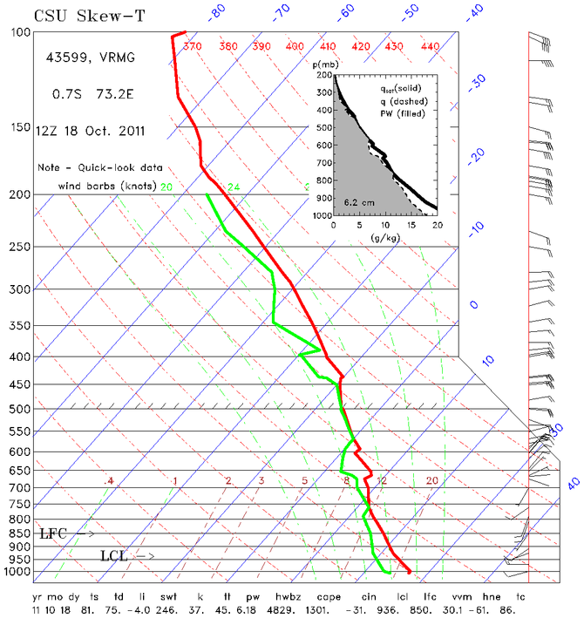
Oceanic sounding: at Gan in AMIE
Undiluted parcel

Slide 24
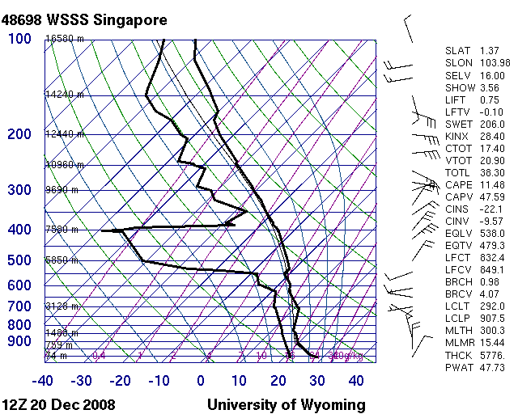
Indo/Pacific Warm Pool
Can’t generate large buoyancy—get weak vertical velocity
Notes:
Marginally conditionally unstable through depth of troposphere. LCL low. Warm moist sfc air can get above LCL and have slight buoyancy to great heights, deep clouds, but relatively weak updrafts.

Slide 25
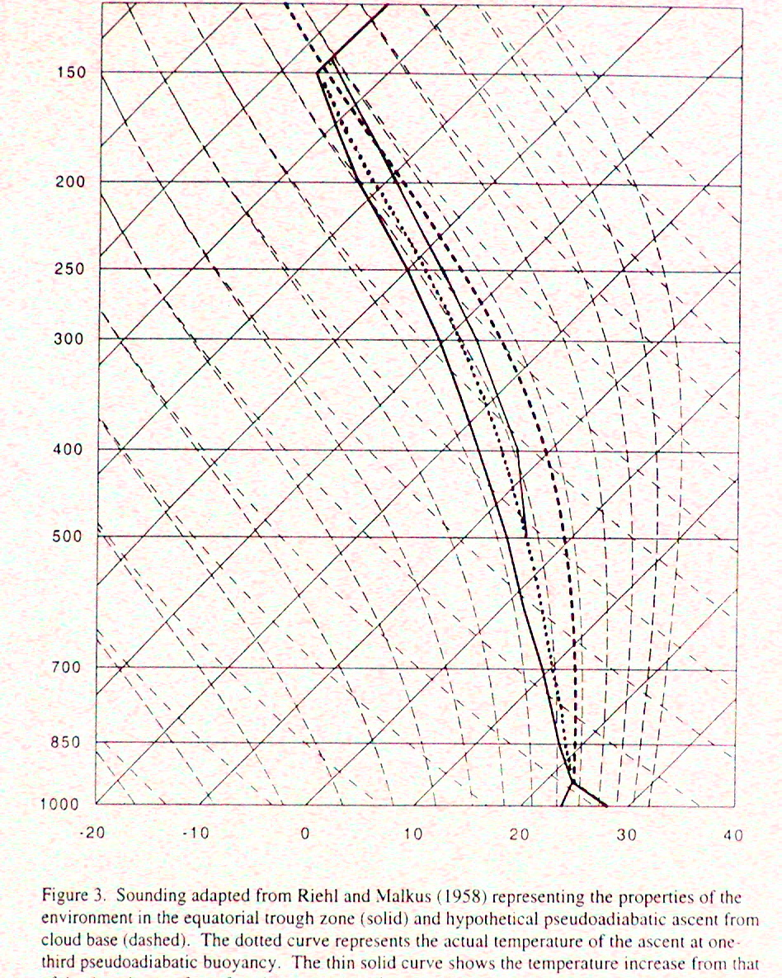
What’s going on here?
Theta-e is reduced by entrainment in low levels, but fusion heating restores it back to PBL values in upper troposphere
The famous Riehl & Malkus “undilute hot tower” sounding,
Undilute ascent—classical assumption

Slide 26
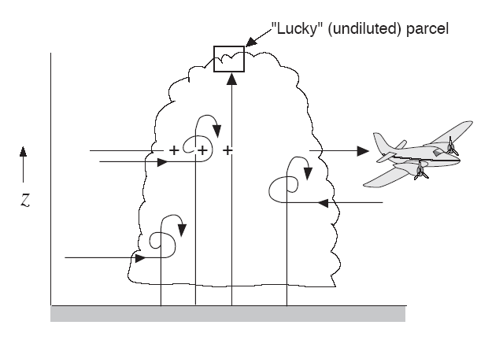
Parcel Model of Convection
Not uniform
Parcels of air arise from boundary layer
This doesn’t apply to mature MCS

Slide 27
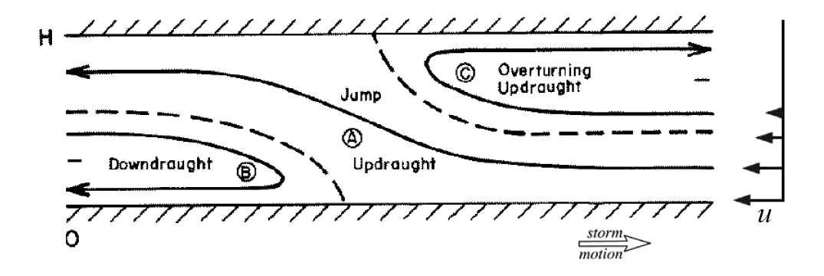
Initially entraining plume convections evolves into layer overturning on mesoscale. Why? How?
Joint adjustment to the thermal and wind stratification of the environment
Shear
B>0
Moncrieff 1992 & others

Slide 28
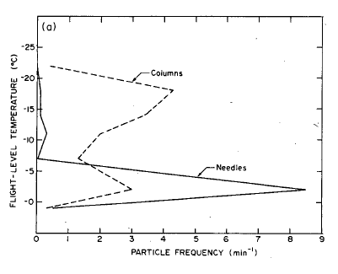
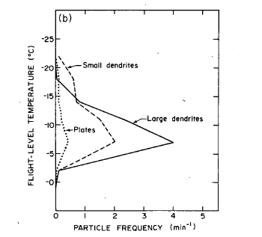
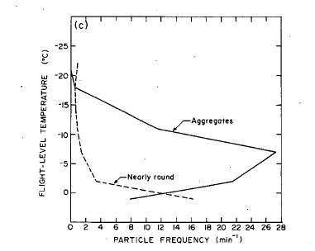
Aircraft measurements in MCSs over the Bay of Bengal
-25
Columns
Plates &
Dendrites
Aggregates & Drops
-20
Columns
Dendrites
-15
Flight Level Temperature (deg C)
-10
∗
∗
-5
Needles
0
Melting
Relative Frequency of Occurrence
Houze & Churchill 1987

