Slide 1
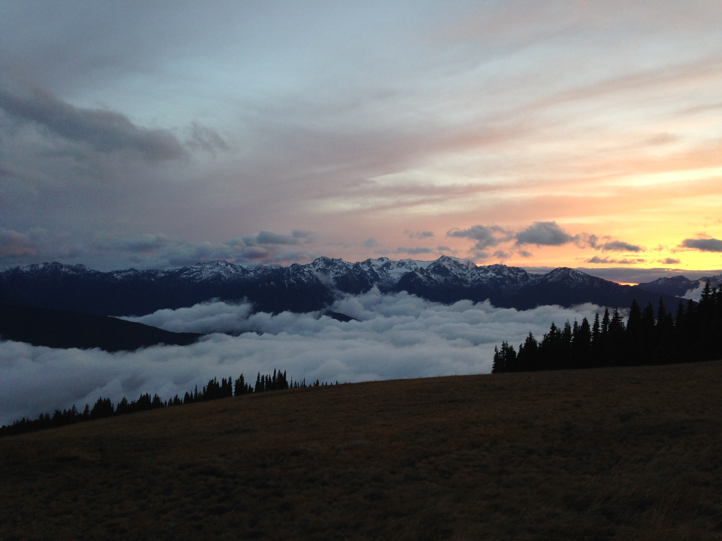
Preparing for the 2015-16 OLYMPEX Field Campaign:
Challenges of observing heavy rain and snow in remote regions of the Olympic Mountains
Joe Zagrodnik
Lynn McMurdie, Robert Houze
University of Washington
Pacific NW Weather Workshop
Feb 27, 2015

Slide 2
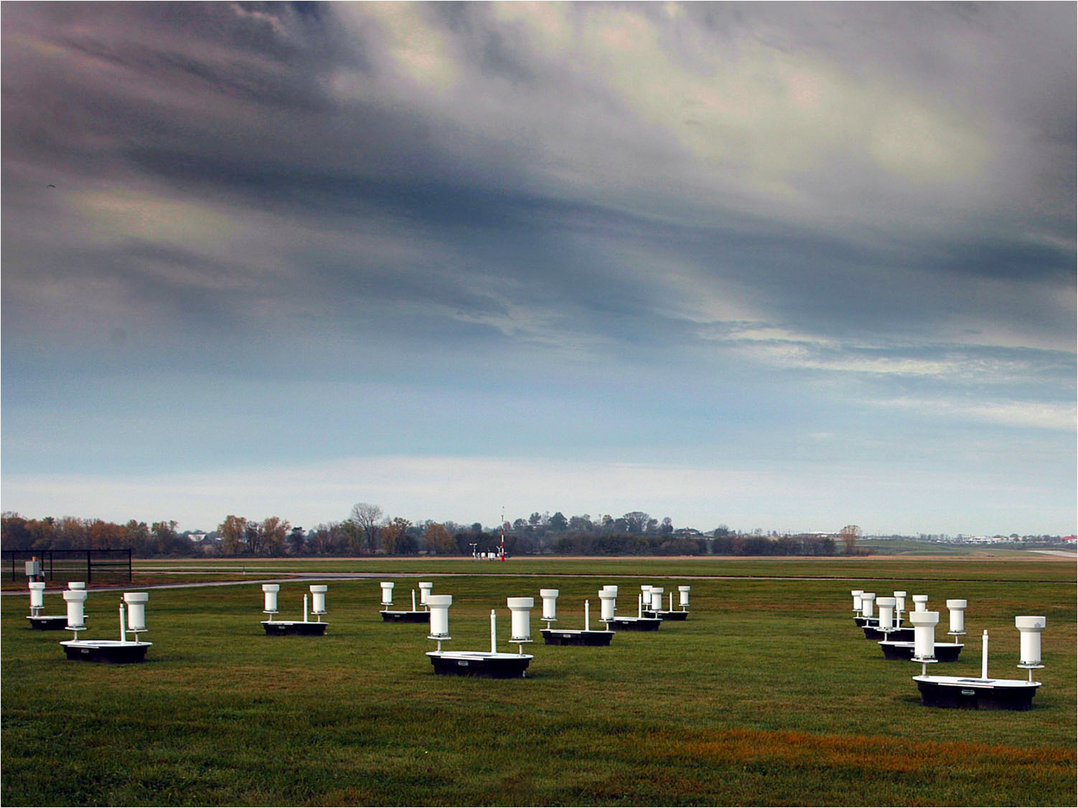
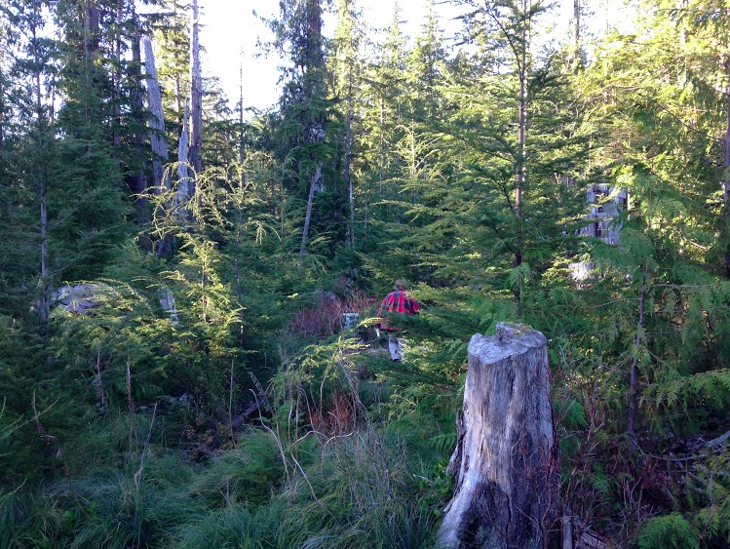
Ideal ground site…
Olympic Mountains site…
Notes:
To start, I'll give a little overview of what goes into creating the network of ground sites.
Envision the ideal ground site like this one from a prior NASA campain in Iowa. A nice wide open field--perhaps too wide open, but plenty of room and no obstructions
Then there are the Olympic Mountains. This is an actual site and there is a person in there--we had a rain gauge there but the site is becoming overgrown.

Slide 3
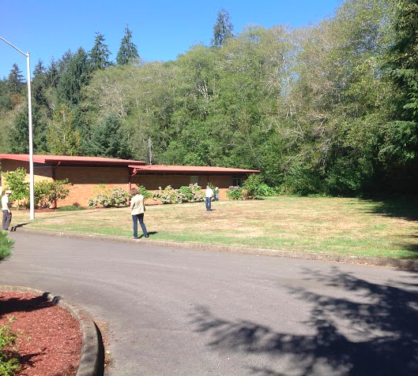
Ground Site Criteria
Science objectives
Permission
  National Park Service
  Quinault Indian Nation
  National Forest Service
  Fish and Wildlife Service
  NOAA
  WS DOT
  Local Government
  Private Landowners
Accessibility
Communication
Electricity
Vegetation
Security
Notes:
To meet the science objectives that Lynn discussed, the sites should follow the progression of precipitation as it is modified/enhanced by topography.
However, there are a number of other factors that have to be considered. First, you need permission from the land/site owner, which is the National Park Service, Forest Service, Quinault Indian Nation, Fish&Wildlife Service, NOAA, WS DOT, Communications companies, local government, and private landowners.
Then there is accessibility—there are not many roads in the study area, some are dirt roads that have experienced mudslides, blowdowns, and snow blocking the road, while the Upper Quinault/Enchated Valley site requires 13 miles of hiking to reach the instruments.
Communication—cell phone tower connection is preferred, otherwise sites have to be frequently inspected to ensure they are operating
Electricity is only available at about half of our sites, the other half are powered by solar and battery power—but of course there are a lot of clouds and trees in our state so there are challenges associated with that.
Vegetation—rain measurements are not accurate if vegetation is too close, but an exposed, open site is not ideal
Security—don’t want the instruments to be stolen, but fortunately there isn’t too much of a market for plastic rain buckets. However, rain gauges do not function with bullet holes in them—and they also don’t work when Elk or bears tip them over.

Slide 4

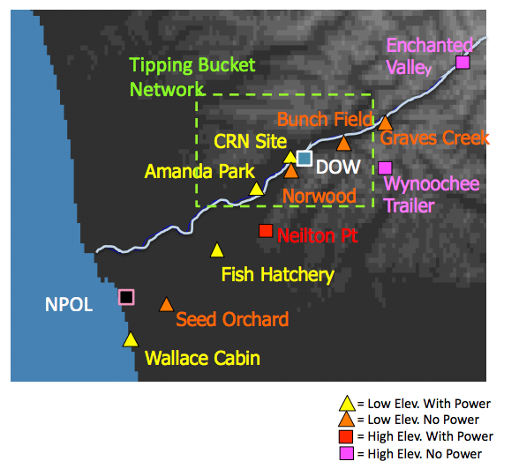
Ground Site Locations
Notes:
So the planning decisions have resulted in a network of 12 sites, about half of which have power, and most of which are accessible by road, except the site well up the Quinault Valley which would be highly beneficial

Slide 5
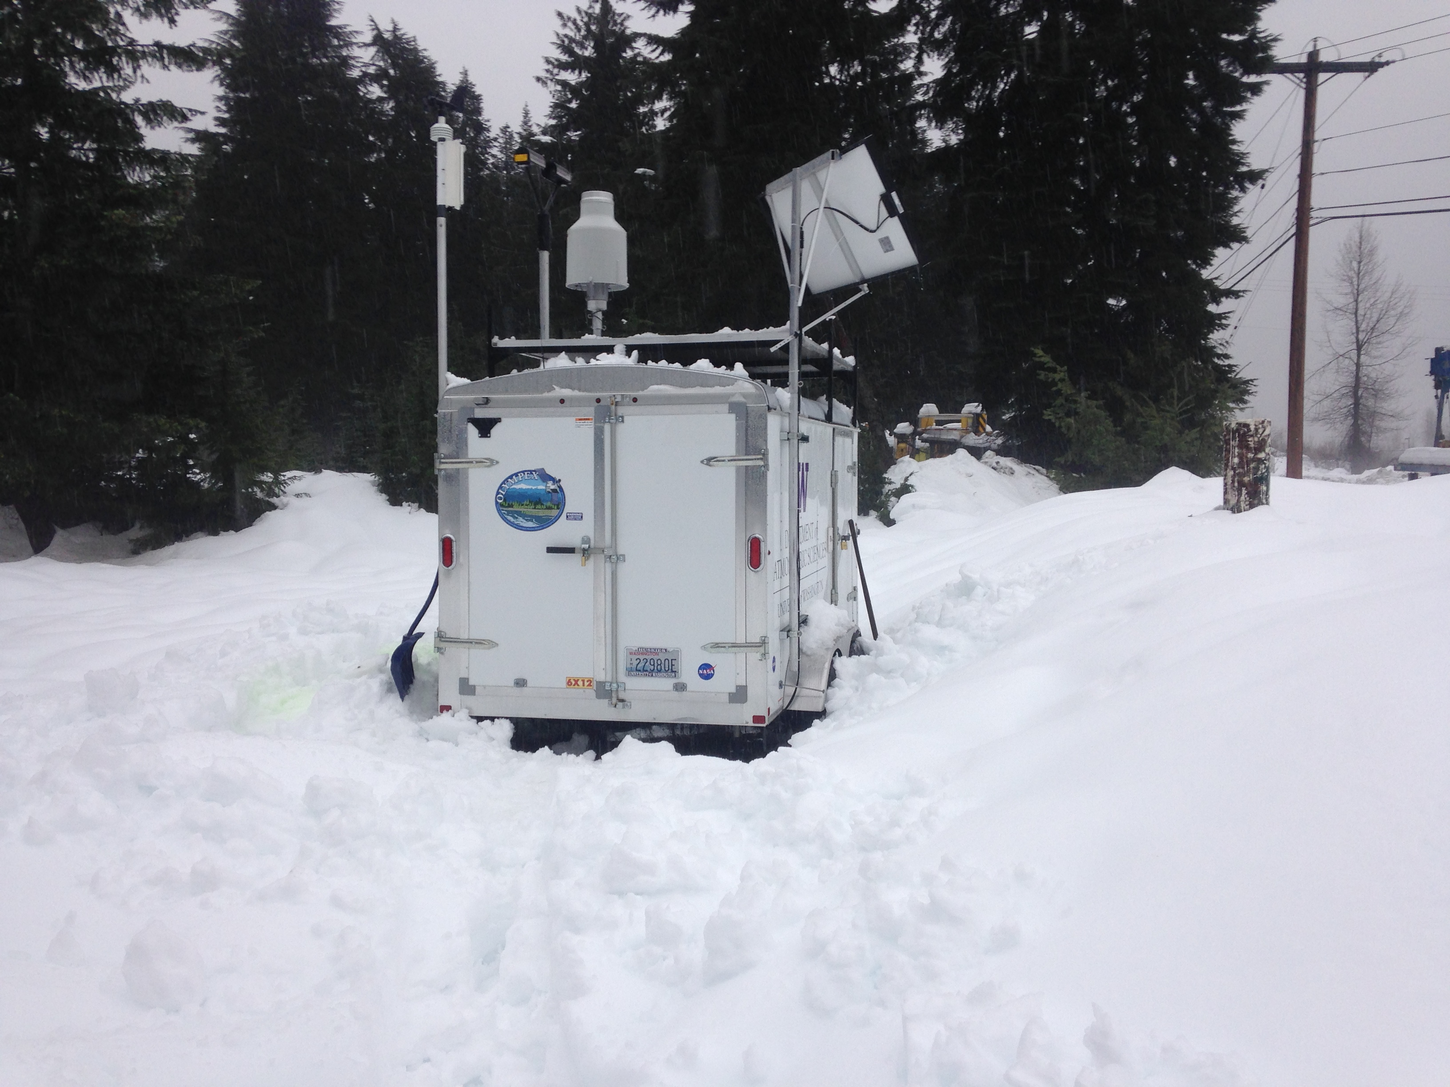
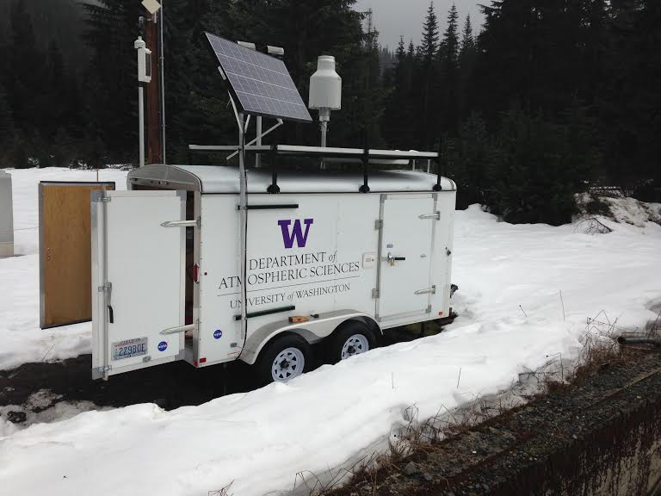
Snoqualmie Pass Trailer Test
Simulating high altitude, no power conditions
Deployed Nov 4, 2014

Slide 6
Questions to answer
  How long can the batteries last?
  Can instruments operate on batteries without heating element?
  Do the instruments make accurate and useful microphysical measurements?
  How often is maintenance needed?

Slide 7
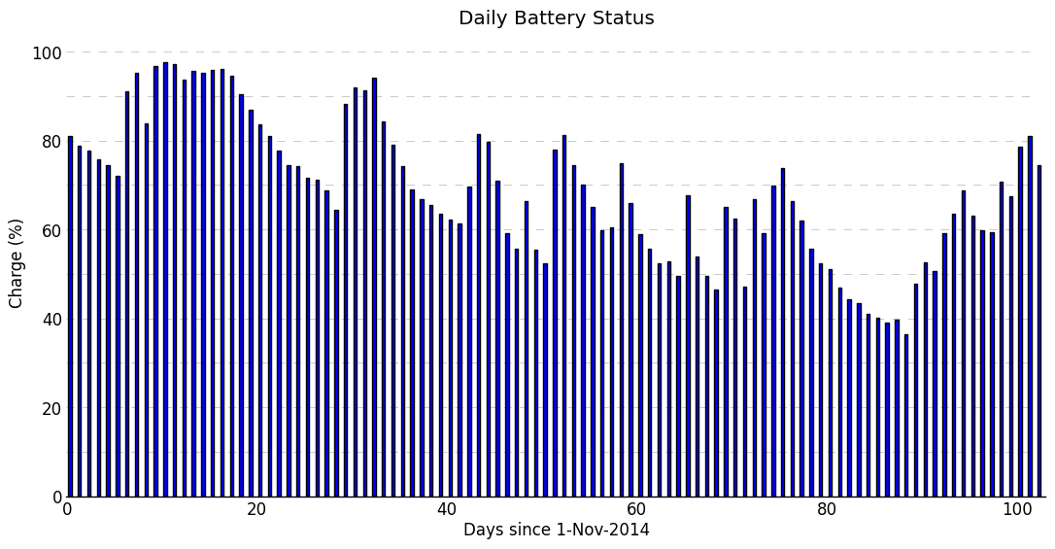
Q: How long can the battery last?
(Set of 8 deep-cycle batteries + 140 W solar panel)
Sunny periods
A: About one month if no sun, all winter if there are sunny periods
Notes:
Point out downward trend…trailer is in favorable location, Olympics are more cloudy

Slide 8
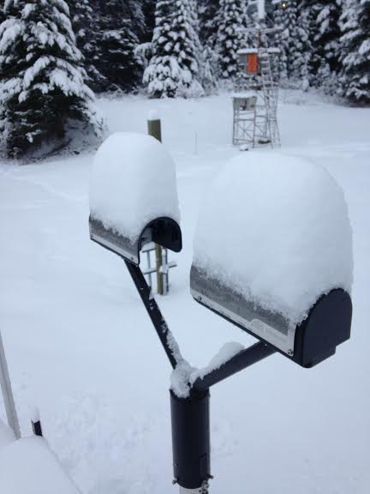
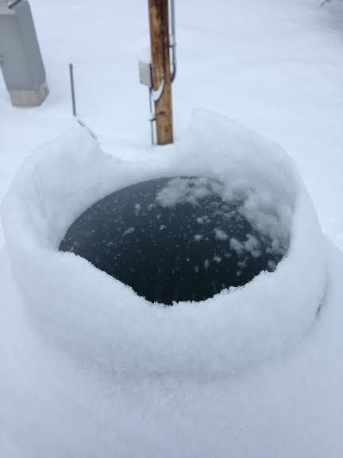
Q: Can instruments operate on batteries without heating element?
Parsivel disdrometer
Pluvio bucket

Slide 9
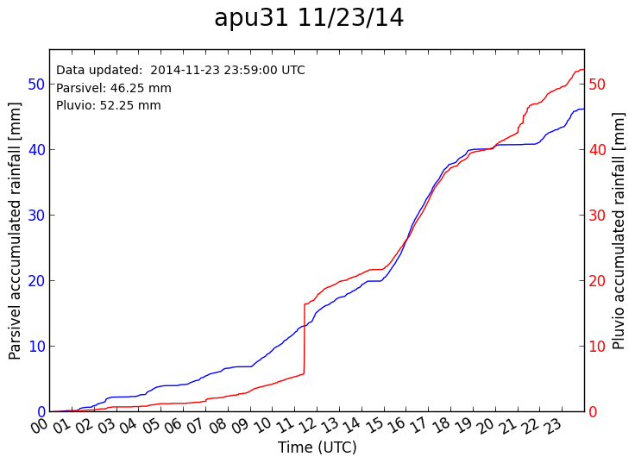
Accumulated Precipitation
NW Avalanche Center: 50.55 mm
Chunk of snow drops in bucket
Red: Pluvio (bucket) Blue: Parsivel (disdrometer)

Slide 10
Q: Can instruments operate on batteries without heating element?
A: Usually*
*Currently having issues with condensation inside of Parsivel head. Attempting to use silica gel desiccant packets to remove moisture. Preliminary results are encouraging.

Slide 11
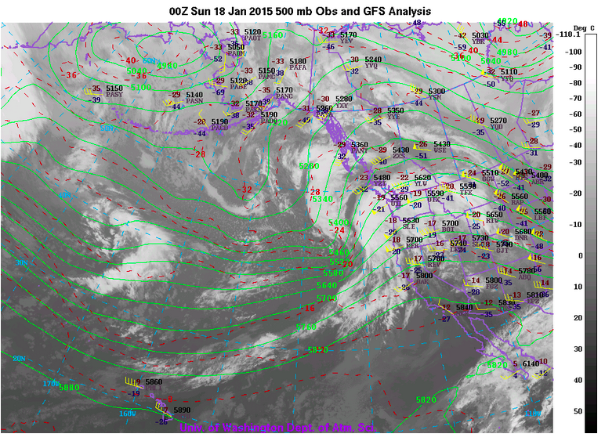
Do the instruments make accurate and useful microphysical measurements?
Case Study: Jan 18, 2015

Slide 12
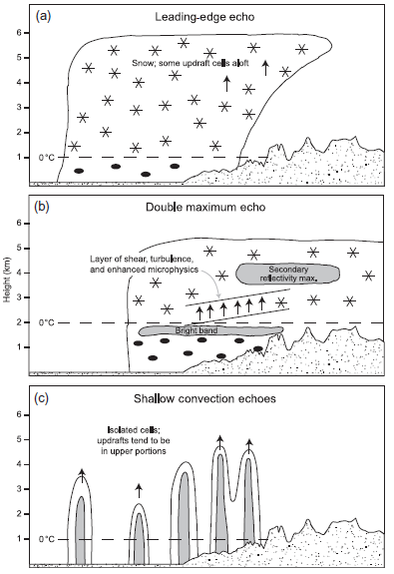
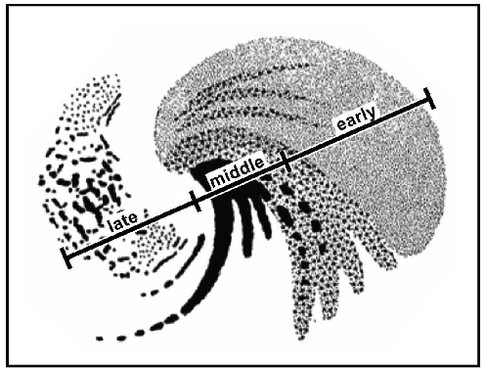
Frontal cyclone crossing a mountain range
Prefrontal
Observed as frontal sector crosses topography
Postfrontal precipitation broadened by orographic uplift
Medina et al. (2007)
Notes:
The general picture fits well with previous studies. As a frontal cyclone approaches topography, the structure of the precipitation changes in different regions of the system, and is modified by the terrain
Medina et al (2007) studied radar observations over the Oregon Cascades
-Early sector: warm front/warm advection, leading edge echo appears aloft and descends to surface, light/uniform precip
-Middle sector: low/cold/occluded front, besides the bright band (melting layer), a second, higher enhanced layer has been observed. Forced by vertically propagating gravity waves or growth by aggregation? Turbulent layer enhances hydrometer growth
-Late sector: Broadened by orographic lift as small, shallow convective cells approach topography
-We are especially interested in the variations in the brightband height and the microphysics because we are better equipped to study these features compared with previous field studies

Slide 13
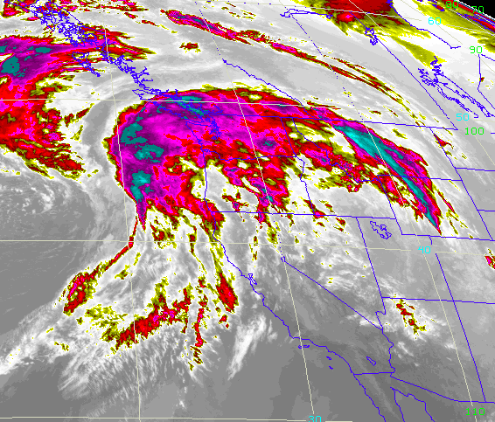
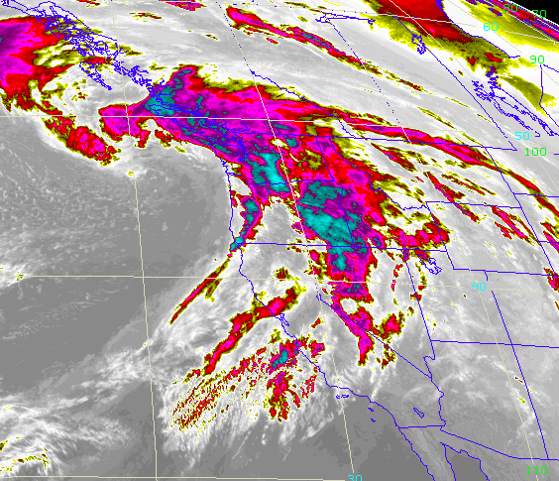
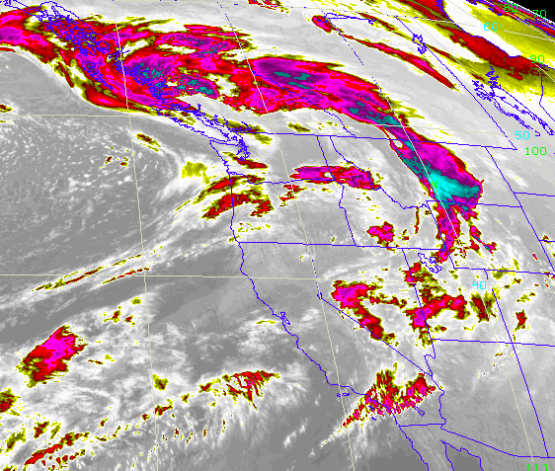
IR Satellite
Jan 18, 2015
Prefrontal: Jan 18 00 UTC
Frontal: Jan 18 06 UTC
Frontal: Jan 18 15 UTC
Notes:
Typical storm from this winter—coming from the southwest, high moisture content, mostly liquid

Slide 14
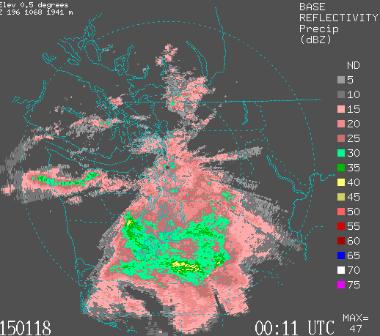
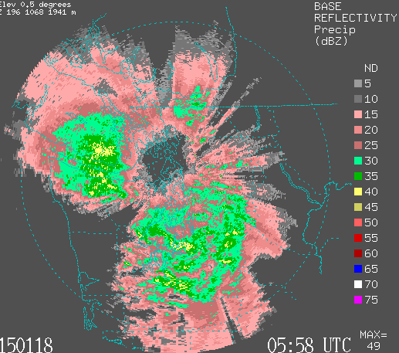
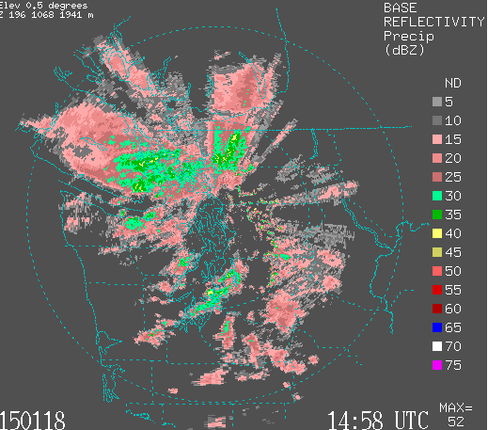
KATX Radar
Prefrontal: stratiform precipitation
Frontal: Increase in intensity
Postfrontal: shallow, convective showers

Slide 15
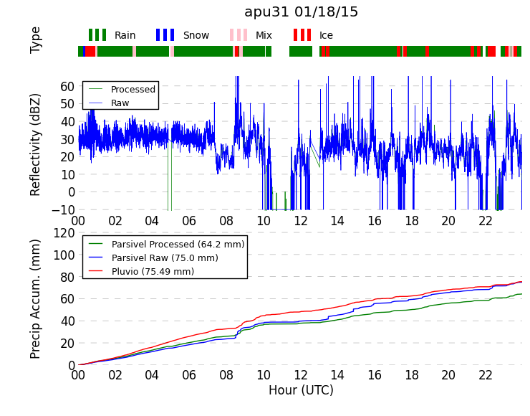
Reflectivity and Precip Accumulation
Prefrontal
Frontal
Postfrontal
Notes:
In this event, the precip was nearly all rain. There was only occasional mixing of sleet and snow.
The Parsivel data shows relatively smooth reflectivity averaging 25-35 dBZ during the prefrontal period.
In this case, we did not observe significant frontal enhancement.
The postfrontal period is clearly marked by a greater variation in reflectivity—but almost no breaks in the precipitation.
Precip accumulated 75 mm (3 inches) during this 24-hr period. We’ve observed

Slide 16
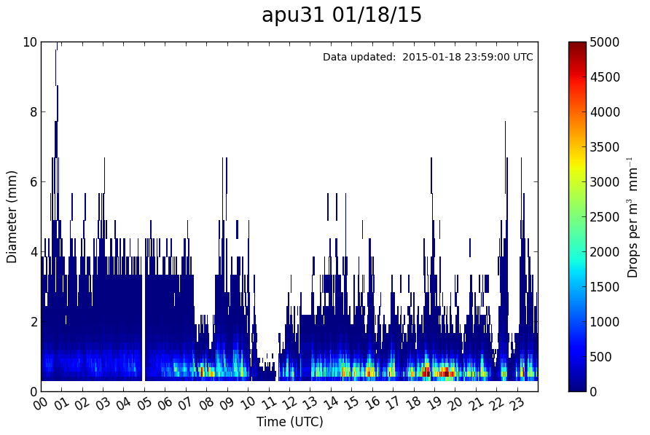
Particle Size Distribution
Prefrontal
Frontal
Postfrontal

Slide 17
Q: Can Instruments make accurate and useful microphysical measurements?
A: Yes!
Q: How often is maintenance needed?
A: Every 3 weeks or so

Slide 18
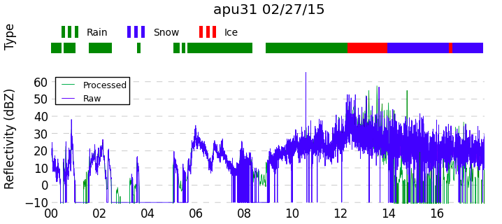
Thank you!
Follow us on Twitter @UW_OLYMPEX
Trailer test data is available at the following URL (or email jzagrod@uw.edu for link):
  http://www.atmos.washington.edu/~jzagrod/olympex/apu31/
Today at Snoqualmie Pass (through 10 AM):

Slide 19
Extra Slides

Slide 20
Management Needs
Type | # Sites | Visit Frequency | Data Retrieval | Access Issues
Low elevation with power | 4 | 4-6 weeks, as needed | Cell | -
Low elevation, no power | 4 | 1-2 weeks, as needed | Site dependent | Mudslides
High elevation with Power* | 2 | 1-2 weeks, as needed | Cell | Snow, road closures
High Elevation, no power | 2 | 1-2 weeks, as needed | ? | No vehicle access
*Includes Hurricane Ridge
Notes:
*As needed is very important—after a major 10-15” rainstorm, all Pluvios will have to be emptied
*It is expected that snow/rime removal and heavier precip rates will require higher elevation sites to be visited more frequently

Slide 21
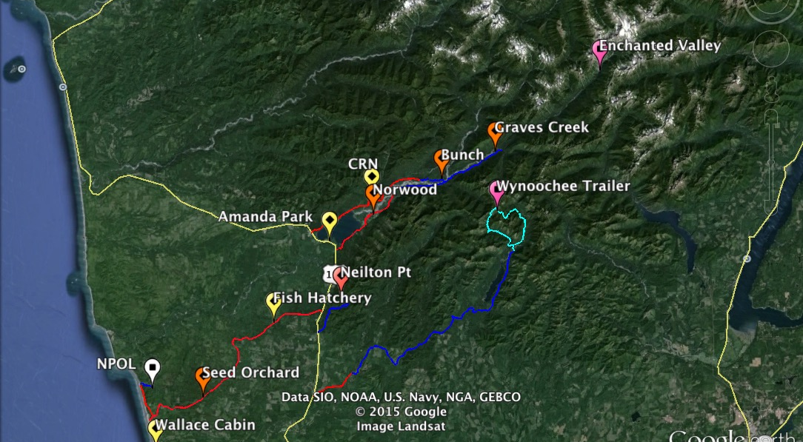
Accessibility
Mudslides likely
13-mile backcountry trail
Unmaintained after Oct-1
Snow, mudslides possible
US-101
Maintained Dirt Road
Paved Road
Unmaintained Dirt Road

