Slide 1

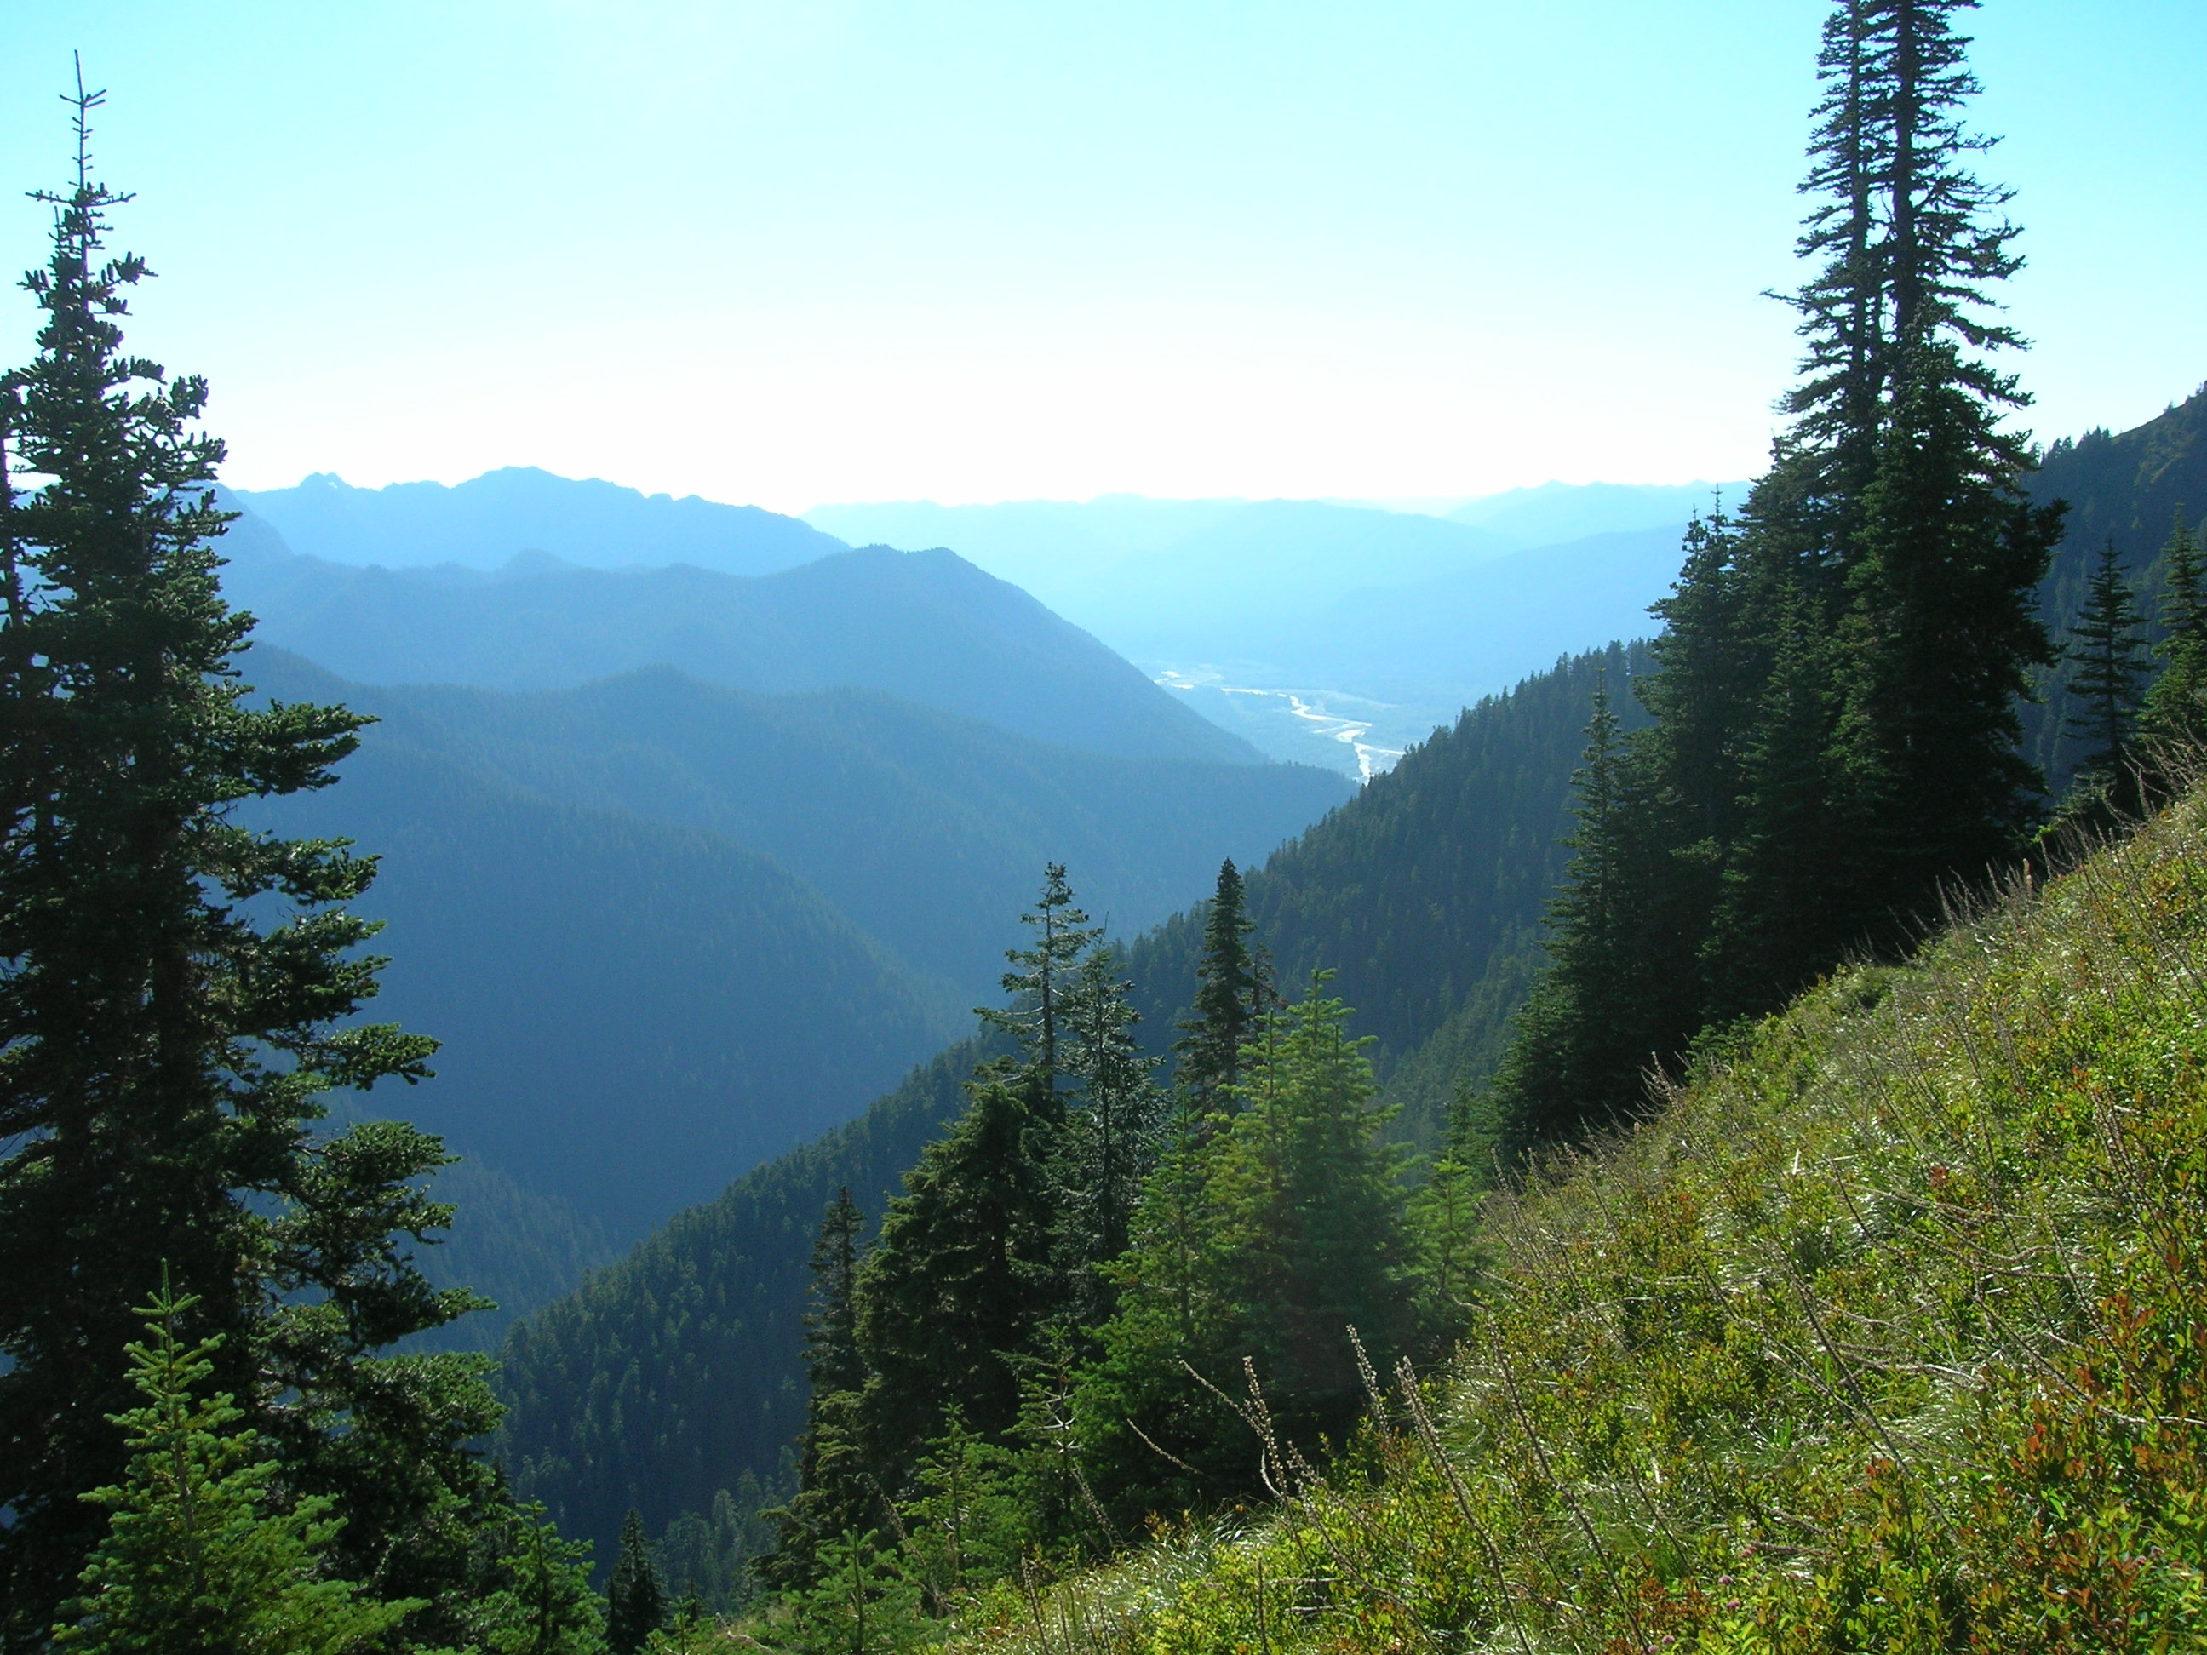
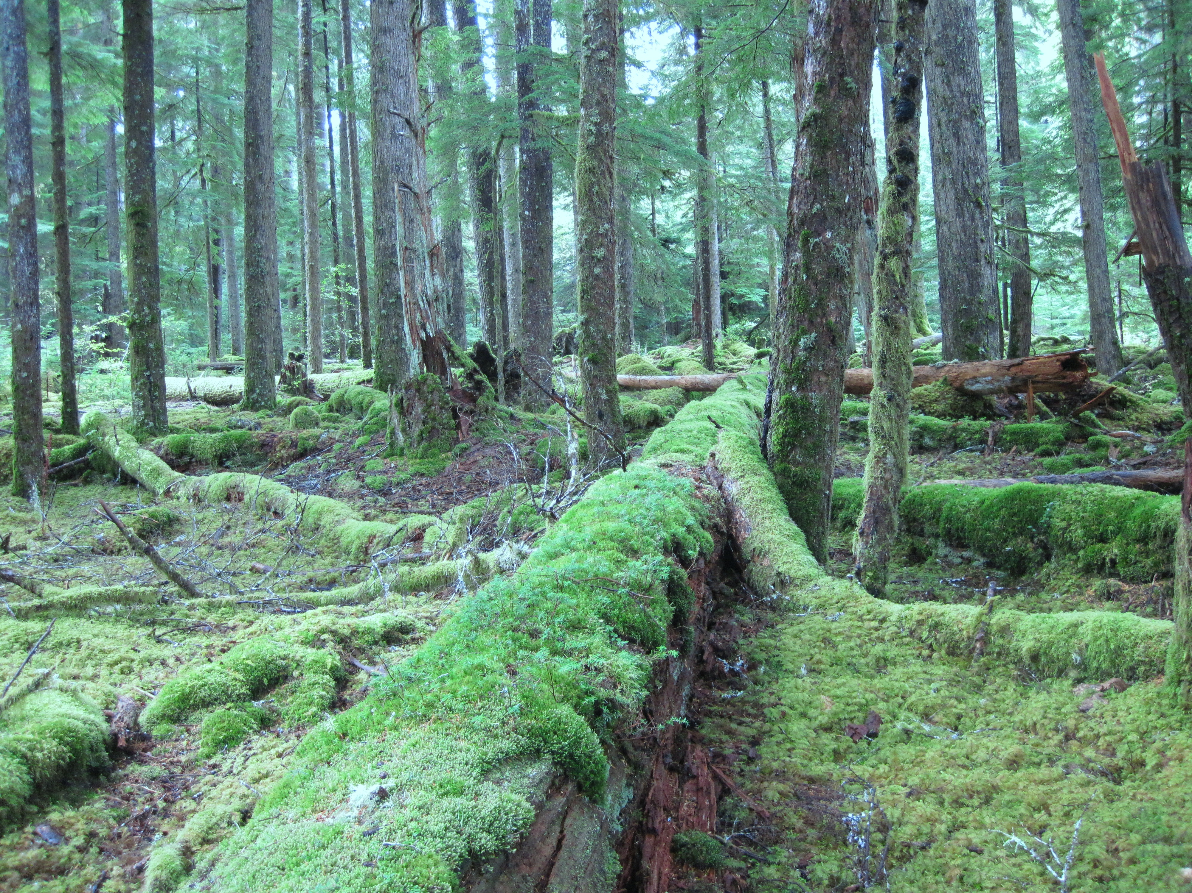
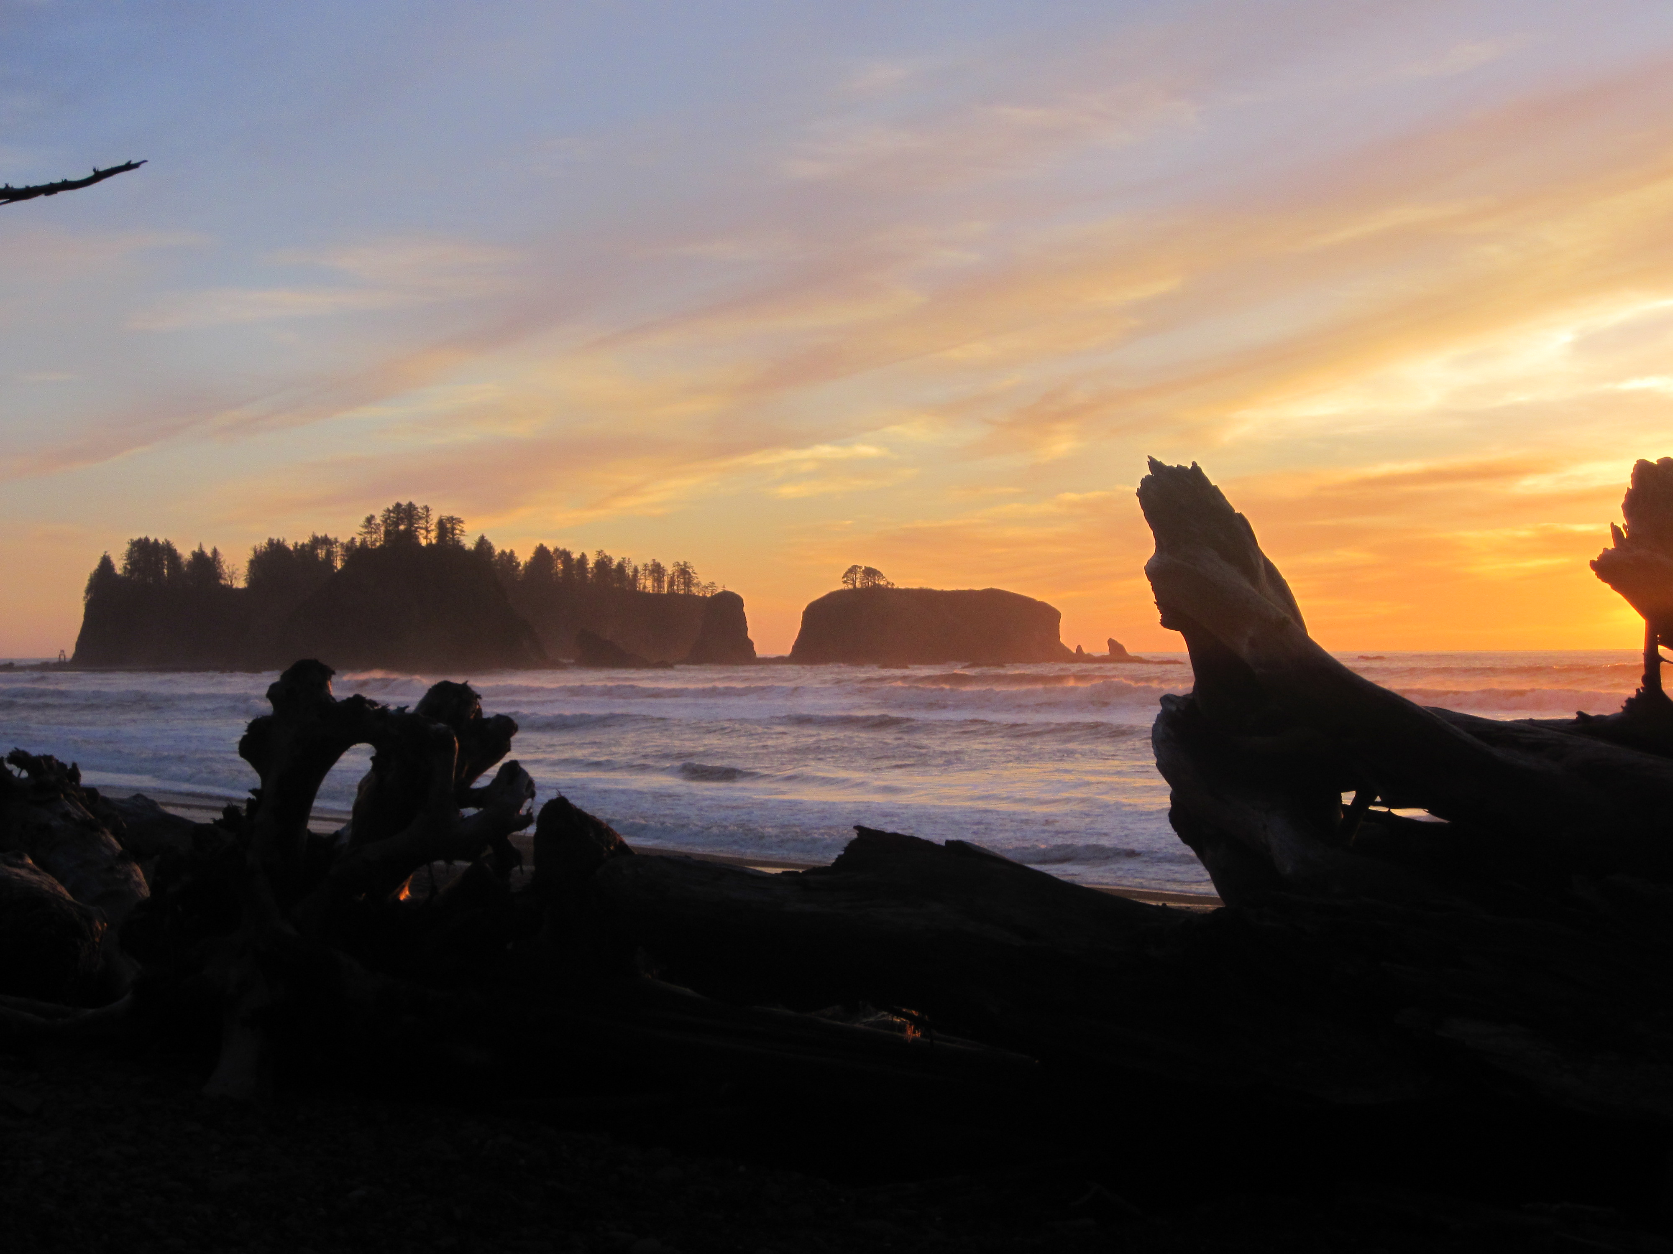
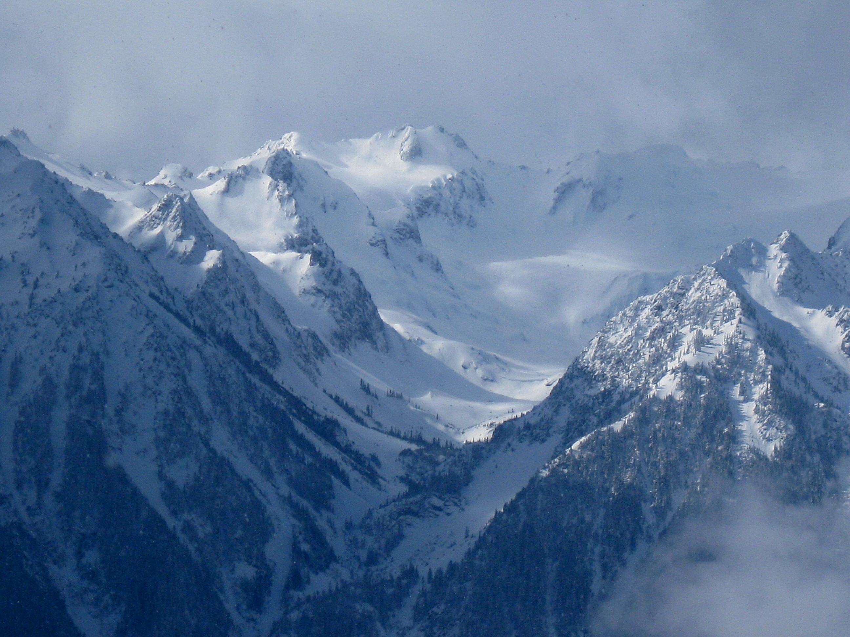
OLYMPEX: A Ground-Validation Field Campaign for the Global Precipitation Mission (GPM) Satellite on the Olympic Peninsula in the Pacific Northwest
Lynn McMurdie, Robert A. Houze, Jr., Jessica Lundquist, Cliff Mass, University of Washington, Walter Petersen NASA/Wallops, Mathew Schwaller NASA/Goddard, William Baccus, National Park Service
University of Utah, Salt Lake City UT, 18 February, 2015

Slide 2
OLYMPEX
Why should we care about rain (precipitation)???
  Produces floods, landslides when there is too much
  Produces droughts when there isn’t enough
  Produces water supply for summer when it falls as snow in the mountains during winter
  Numerical models (forecast and climate) estimates of precipitation need verification
  Precipitation important component of global heat budget
Precipitation is difficult to measure accurately
  Precipitation results from multi-scale processes
  Lack global coverage of ground-based instrumentation – gauges, radars – especially in remote regions
  A good way to fill-in the gaps in surface measurements is to use satellite-based precipitation estimates

Slide 3
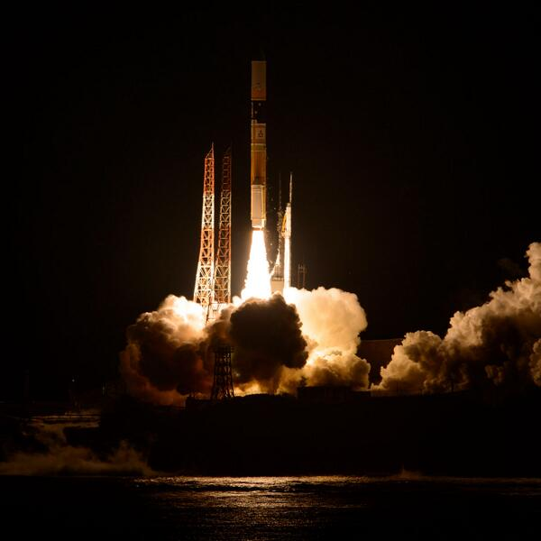
Newest precipitation satellite is the recently launched GPM satellite
The core satellite of the Global Precipitation Measurement (GPM) mission was launched at 1837 UTC 27 February 2014 (0337 JST 28 February) from the JAXA Tanegashima Space Center on Tanegashima Island, Japan.

Slide 4
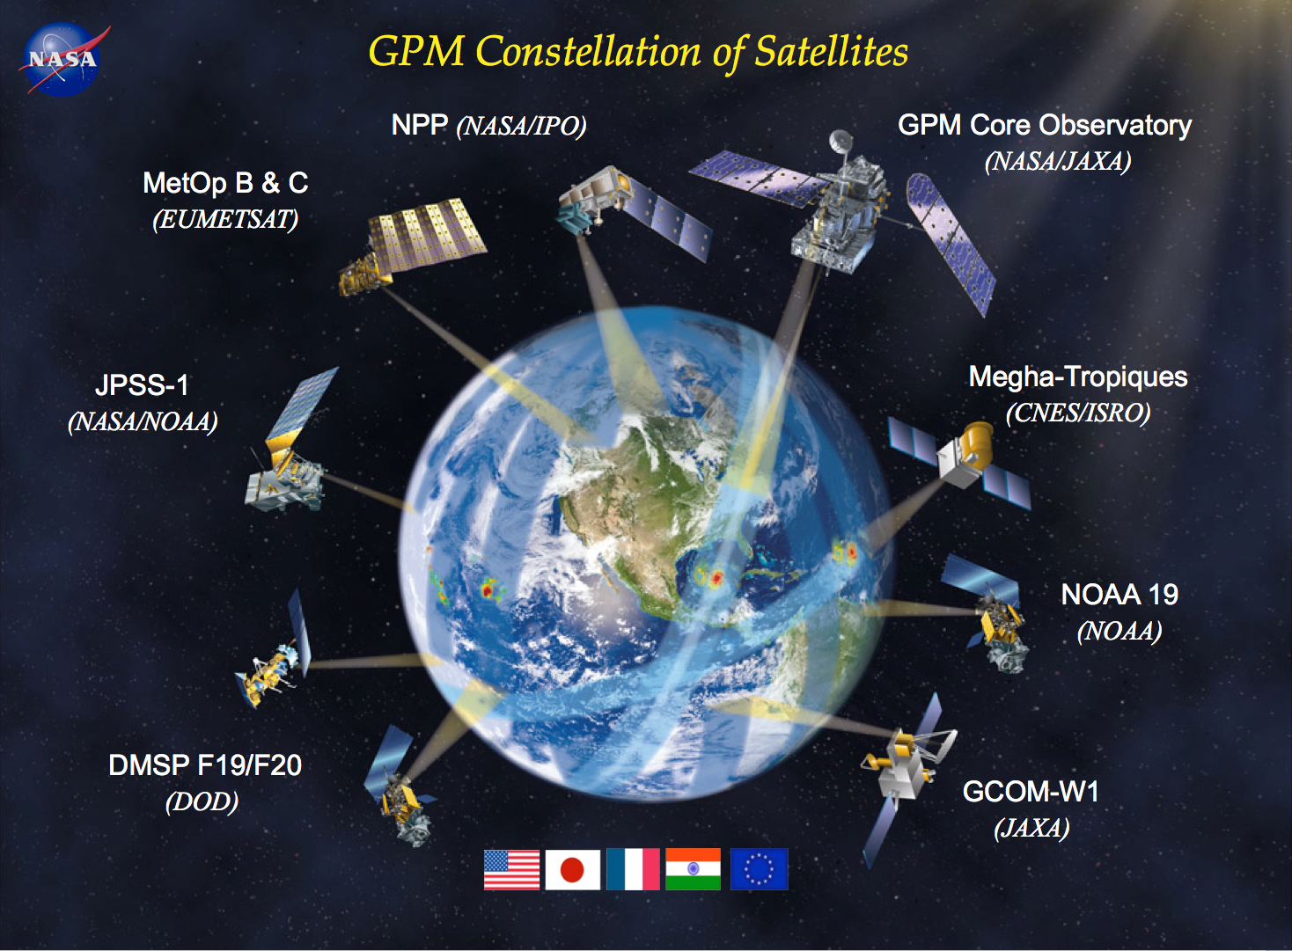
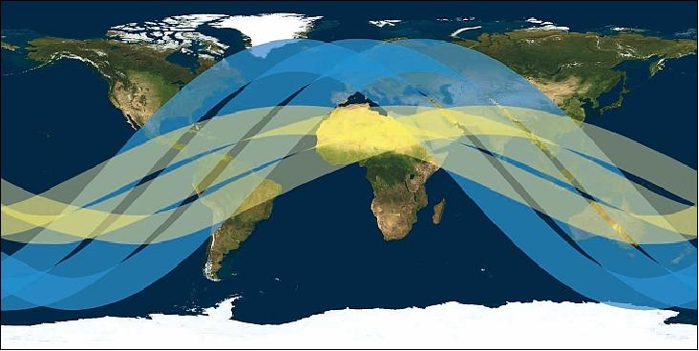
The Core Satellite of GPM
GPM
TRMM
The core satellite of GPM is a Polar Orbiting satellite sampling from Antarctic circle to Arctic circle
Non-sun synchronous orbit – crosses the equator at variable local times
Prior generation TRMM only sampled tropical regions
GPM officially means a consortium of precipitation measuring satellites (DMSP, NOAA) which together sample the globe frequently. At any given location, may have 8 overpasses

Slide 5
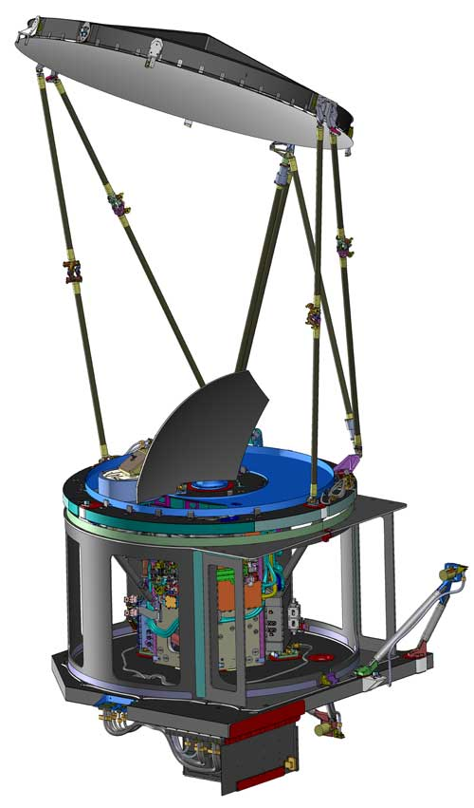
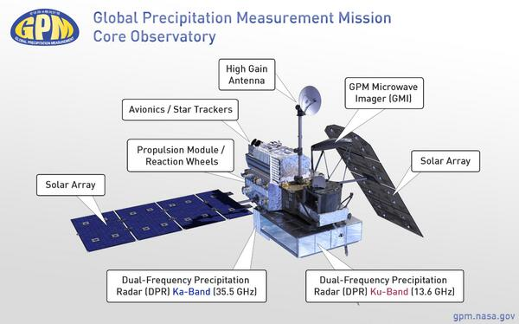
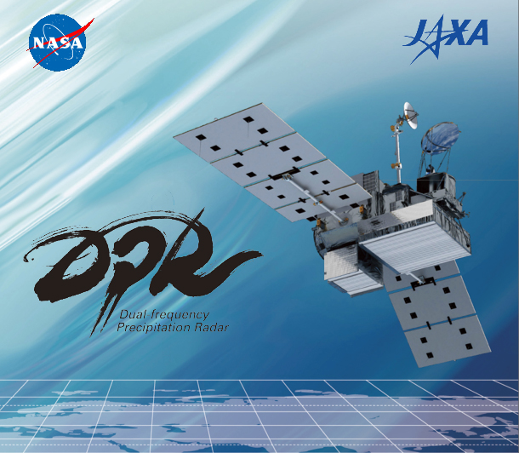
The Core Satellite of GPM – Updated Instruments
GMI
DPR
GPM Microwave Imager (GMI)
  Passive microwave instrument
  904 km swath width
  Has frequencies sensitive to falling snow
Dual Precipitation Radar (DPR)
  measures 3-D structure of precipitation
  Ku-band (245 km width swath) and Ka-band (120 km width swath)
  Sensitive to a range of precipitation intensities

Slide 6
GPM samples a Nor’easter Snow Storm
Link to NASA website of this event: http://www.nasa.gov/content/goddard/gpm-sees-noreaster-dump-snow-on-new-england/ - .VNaD3CfNUgk

Slide 7
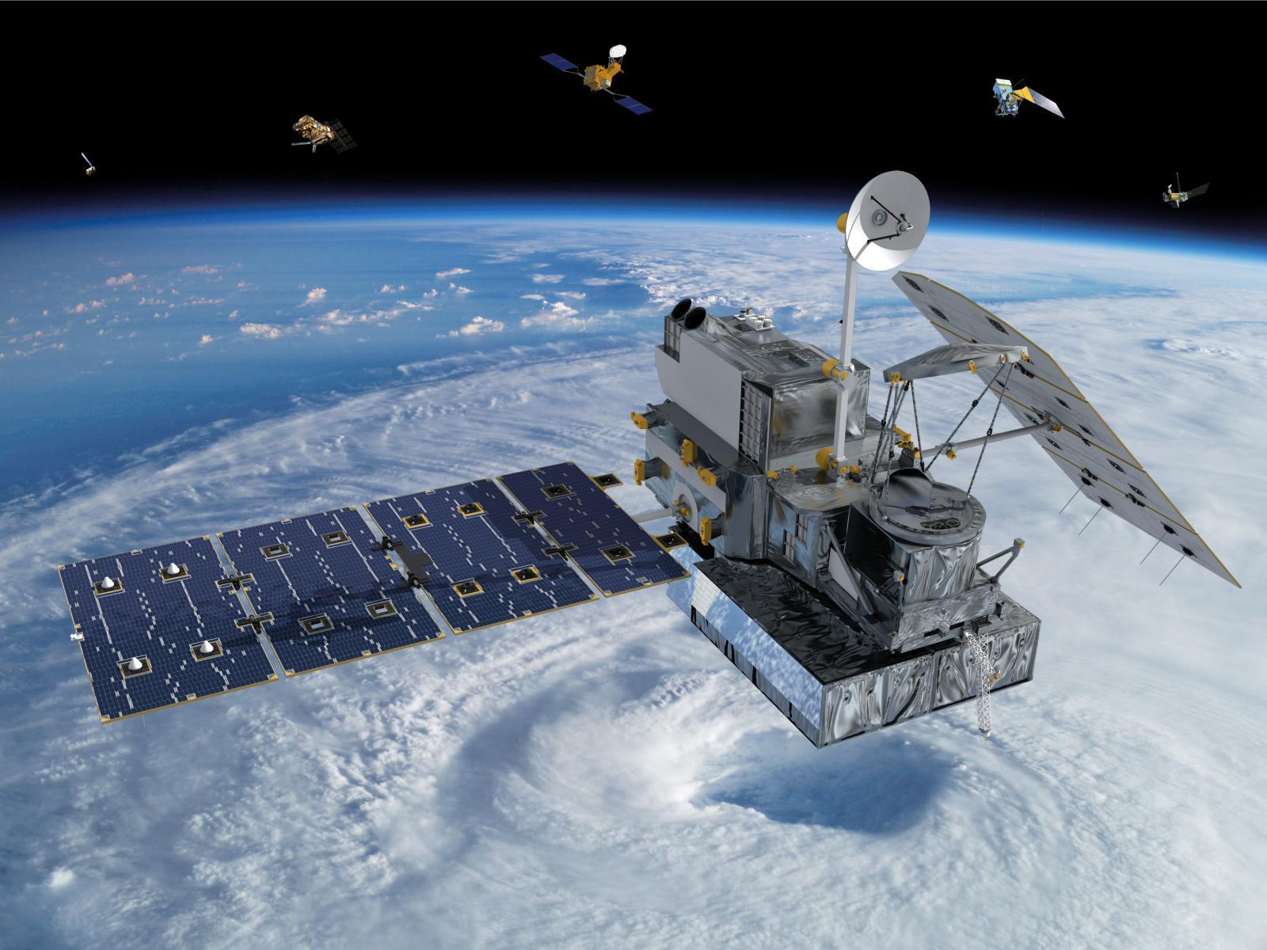
GPM
GPM Goals
  Measure rain and snow globally
    Wide range of intensities: from 0.2 mm/hr to 110 mm/hr
    Wide range of locations: From ocean to complex terrain
    Wide range of regimes: Tropical rainfall to high latitude snowfall
  Apply to high impact events
    Monitoring flood, droughts
    Monitor water supply
Need a Ground Validation (GV) Field campaigns to ensure success
  Test assumptions used in algorithms
  Calibrate satellite estimates of precipitation
  Olympic Mountains in Washington the perfect place to do this

Slide 8
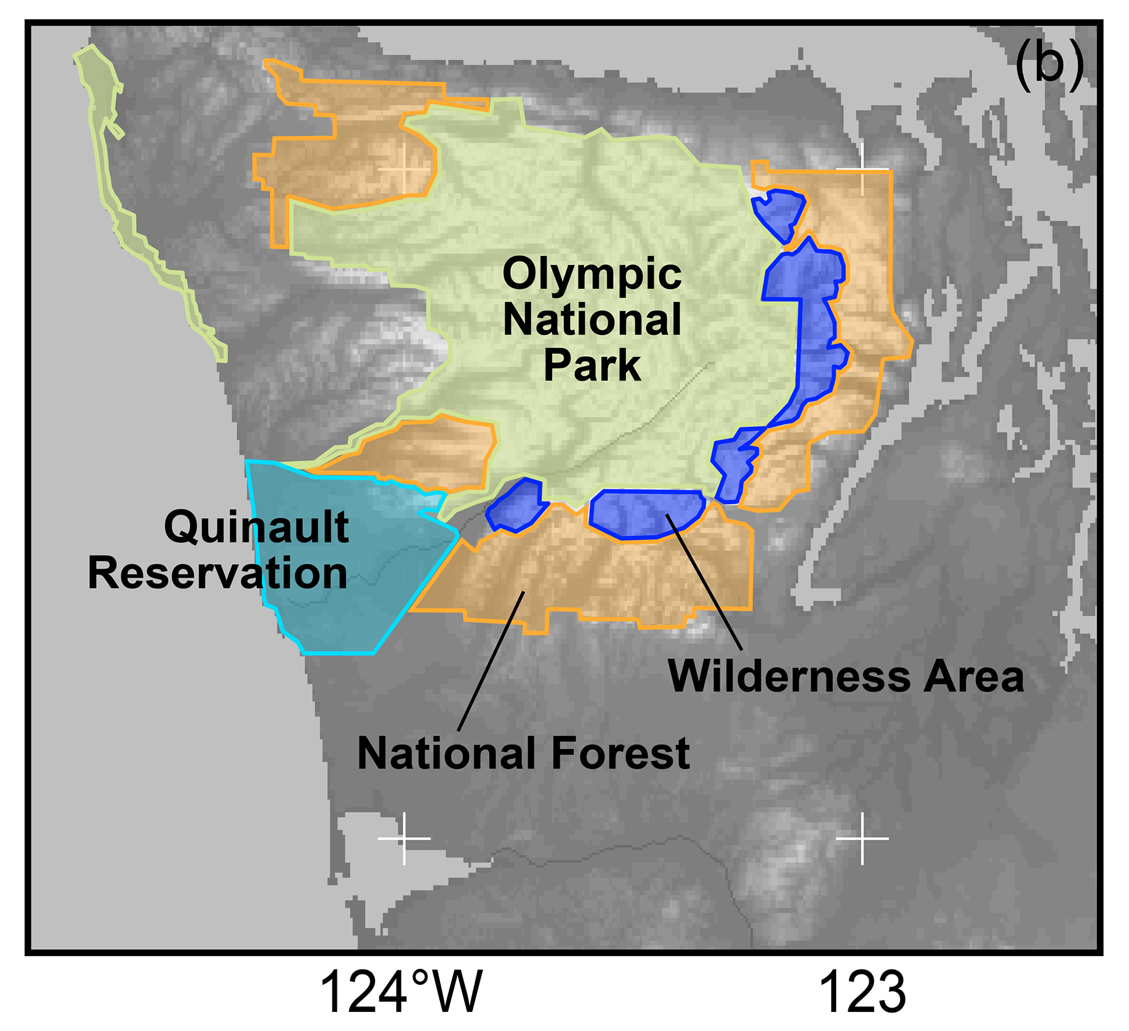
The Olympic Peninsula
Most of the region is within National Park Boundaries, especially the high terrain
Other important regions include the US Olympic National Forest and Wilderness Areas and the Quinault Indian Nation

Slide 9
The Climatology of the Olympic Peninsula
Annual average precipitation in inches from PRISM (Parameter-elevation Regressions Independent Slopes Model)
Climatology of MSLP from Nov-Feb from NCEP Reanalysis grids 1979 – 2012
Persistent moist onshore flow produces extraordinary annual precipitation totals
2500 mm (100”) on the coast and more than 4570 mm (180”) in the interior

Slide 10
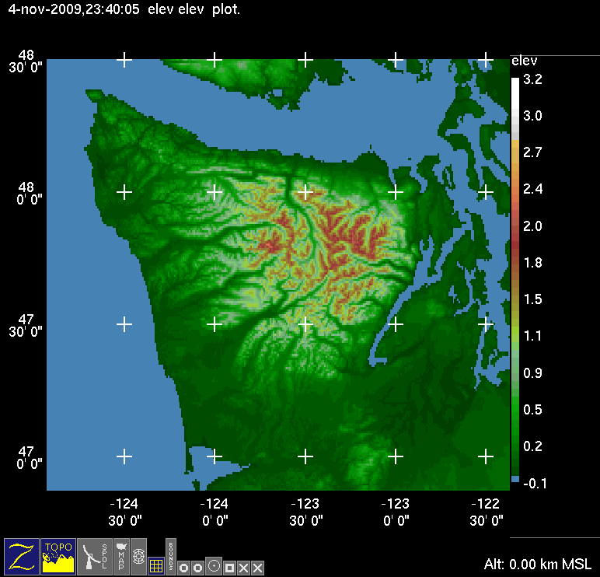
Climatology of Olympic Peninsula
Clearwater
Monthly Average Precipitation
Rainiest months: Nov, Dec, Jan. Range from 3.5” (90 mm) to 30” (750 mm) in Nov.
On any given day in Nov, Dec, Jan there is a 73% probability of receiving >0.01” rain and a 36% probability of receiving > 0.5” rain.

Slide 11
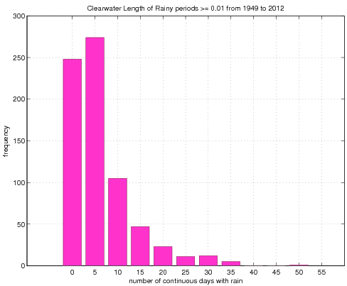
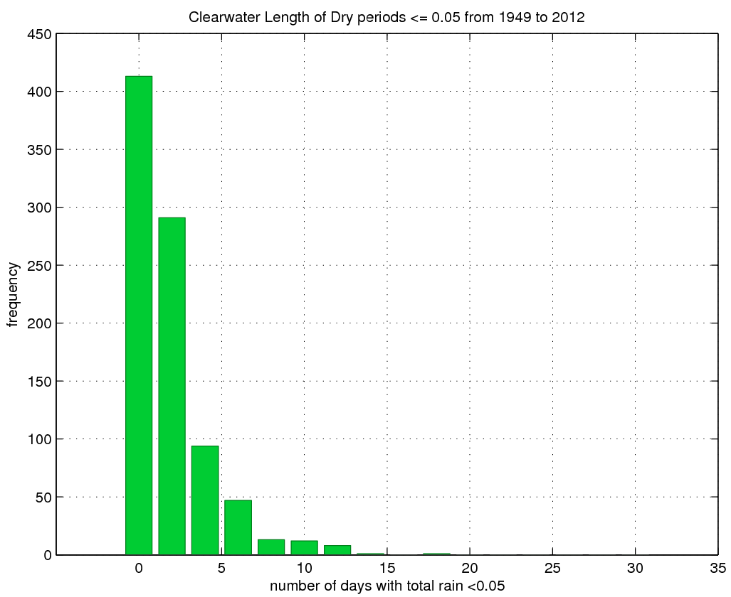
Climatology of Olympic Peninsula
Clearwater Wet Spells Nov - Feb
Clearwater Dry Spells Nov - Feb
Longest period with continuous rain (daily precip >=0.01”) = 49 days – Dec 1982.
Probability of 2 week period receiving >= 16” (~400mm) = 4%
Longest ‘dry’ period with daily precip <=0.05”) = 18 days – Dec 1985.
Probability of 2 week period of <= 0.10 (~2.5 mm) during Nov-Feb = 0.25%

Slide 12
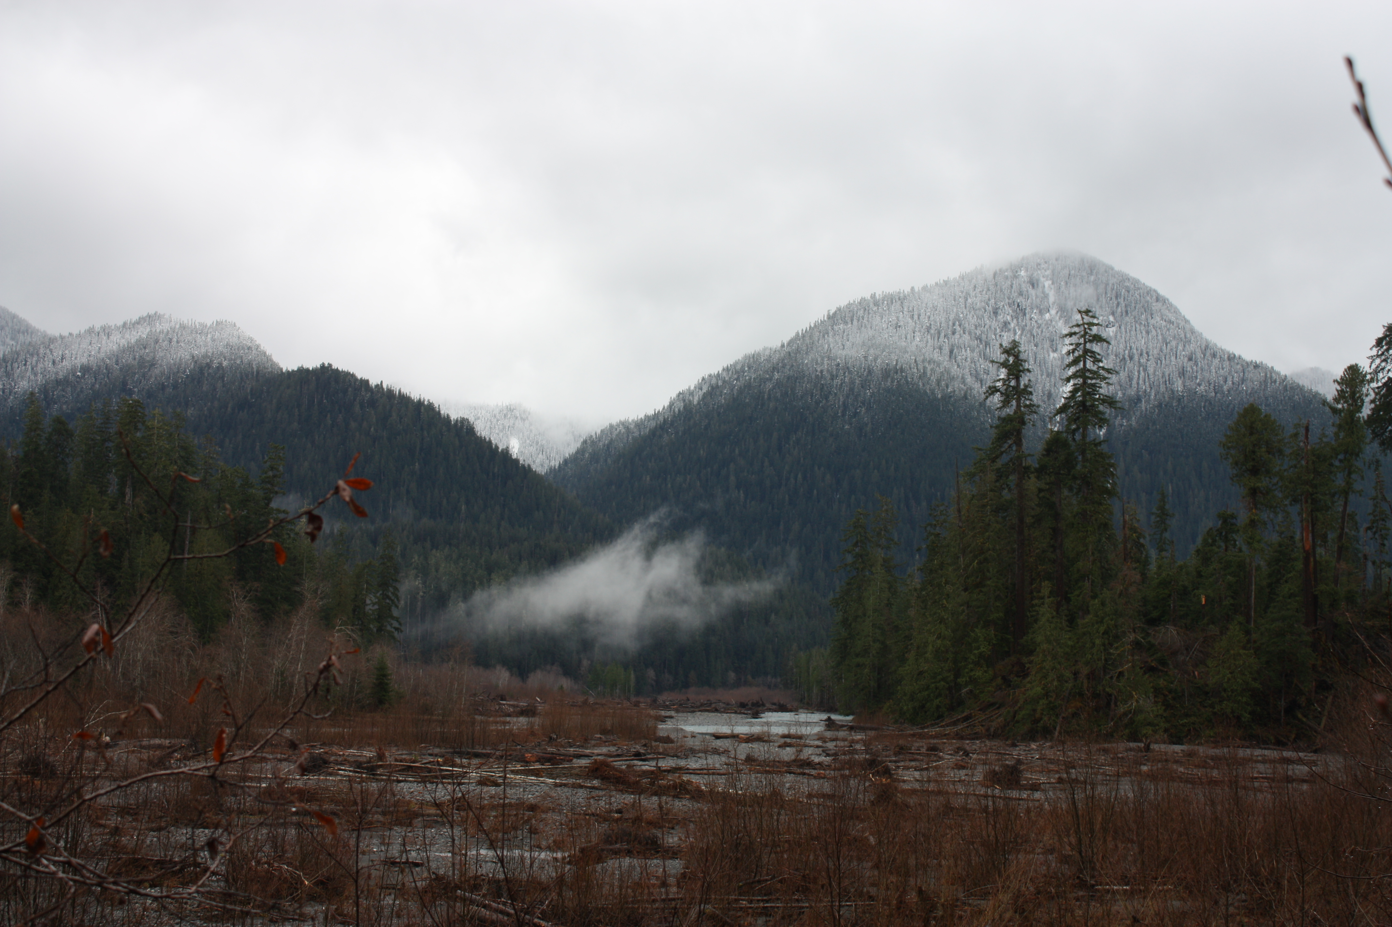

Climatology of Olympic Peninsula
KUIL
Mean 0°C level in winter during moist onshore flow = ~1.5 Km
This varies a lot from storm to storm and within each storm.

Slide 13
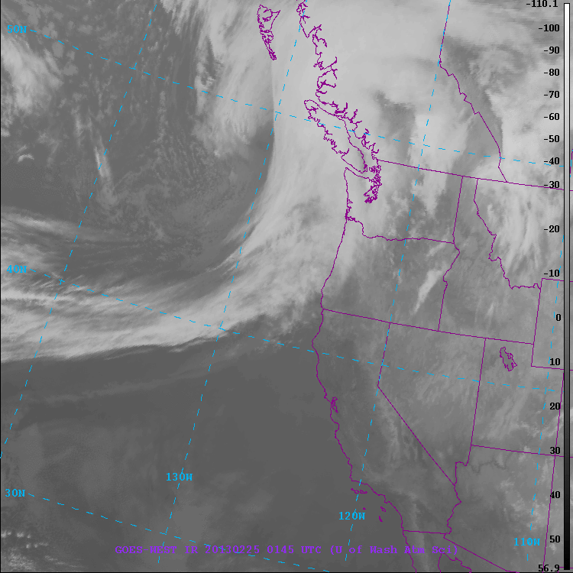
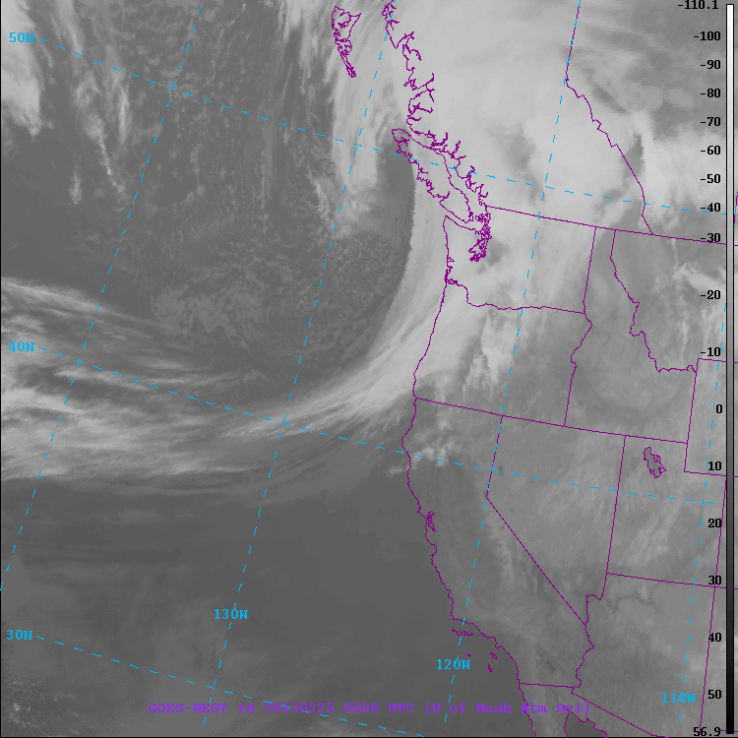
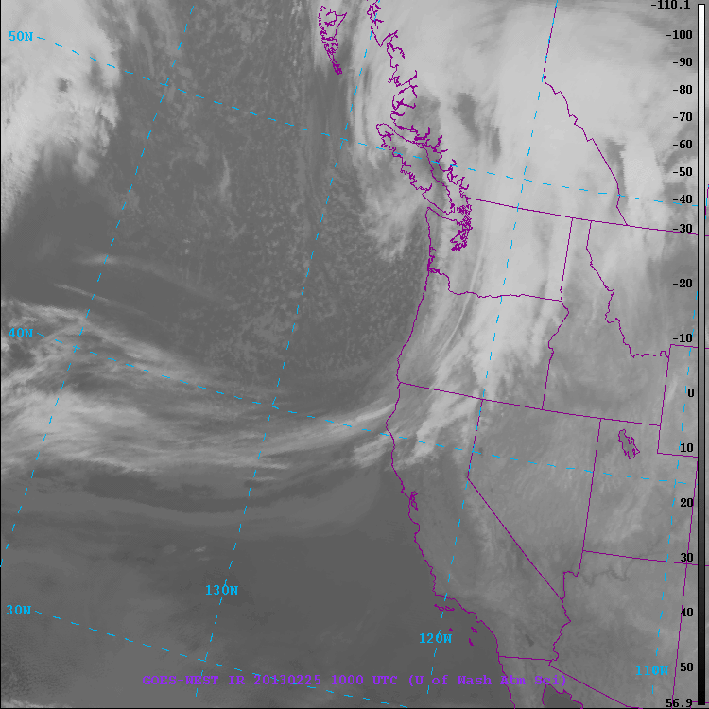
Typical Frontal Passage
Three different regimes!
Prefrontal
Frontal
Postfrontal

Slide 14
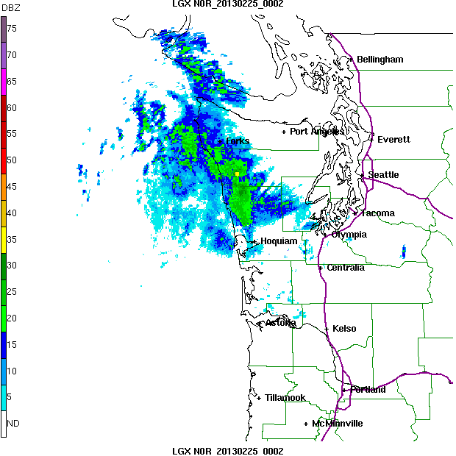
Typical Frontal Passage
Three different regimes!
Prefrontal
Frontal
Postfrontal
SW side of Olympics gets rain well ahead of front
SW side gets rain during front
SW side gets post-frontal showers

Slide 15
OLYMPEX: Goals
Physical validation of the precipitation (rain and snow) algorithms for both the GMI and DPR.
How precipitation mechanisms in all sectors of midlatitude frontal systems and their modification by terrain affect GPM rainfall estimation uncertainties.
Quantifying the accuracy and uncertainty of the GPM precipitation data and its hydrologic applicability.
Merging numerical modeling and satellite observations to optimize precipitation estimation in hybrid monitoring systems of the future.

Slide 16
How to achieve these goals?
Physical validation of precipitation algorithms
  Rainfall characteristics – Dropsize distribution, crystal size/habit, rainfall intensity
  Changes in Rain/snow distribution and characteristics as frontal systems move from ocean to coast to steep terrain
  Melting level variability – within individual storms and from storm to storm
Applications to high impact events
  Snow pack accumulation
  Hydrological response
How are we going to do that?
  Ground instrumentation (precipitation gauges, microphysical instruments, snow cameras, snow surveys) Oct. 2015 – April 2016
  Ground-based weather radars, Nov. 2015 – Dec. 21, 2015 and Jan 2 – 15, 2016.
  Aircraft-based measurements Nov. 6, 2015 – Dec. 21, 2015.

Slide 17
Geographical Regions
Leeside
Quinault
High Terrain
Chehalis
Ocean - offshore
Windward side – Quinault area and Chehalis

Slide 18
Ground Instrumentation Overview
x
Legend
= WSR-88D
= NPOL
= DOW
= EC X-Band
= MRR = SNOTEL
= Ground Obs sites
= Snow camera network = UW Tipping bucket network
= Chehalis rain gauge network
x
x
x
x
x
x
x
x
x
x
x

Slide 19
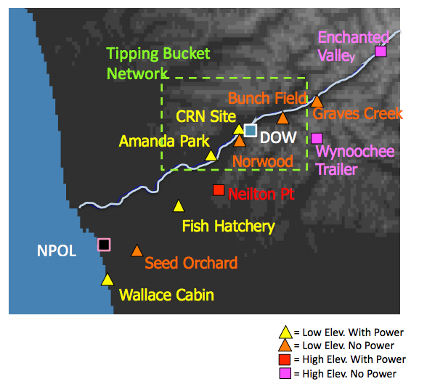
Ground Sites--Windward side of Olympics/Quinault Valley
Arranged along Quinault River Valley to examine precipitation enhancement and changes in precipitation character as storms encounter higher terrain.

Slide 20
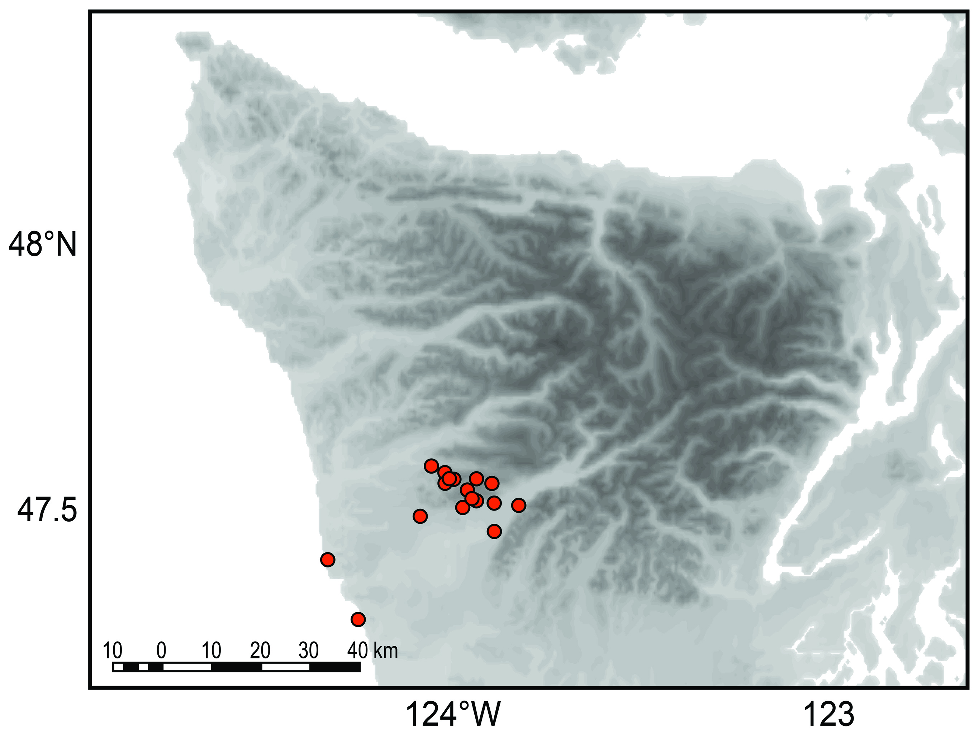
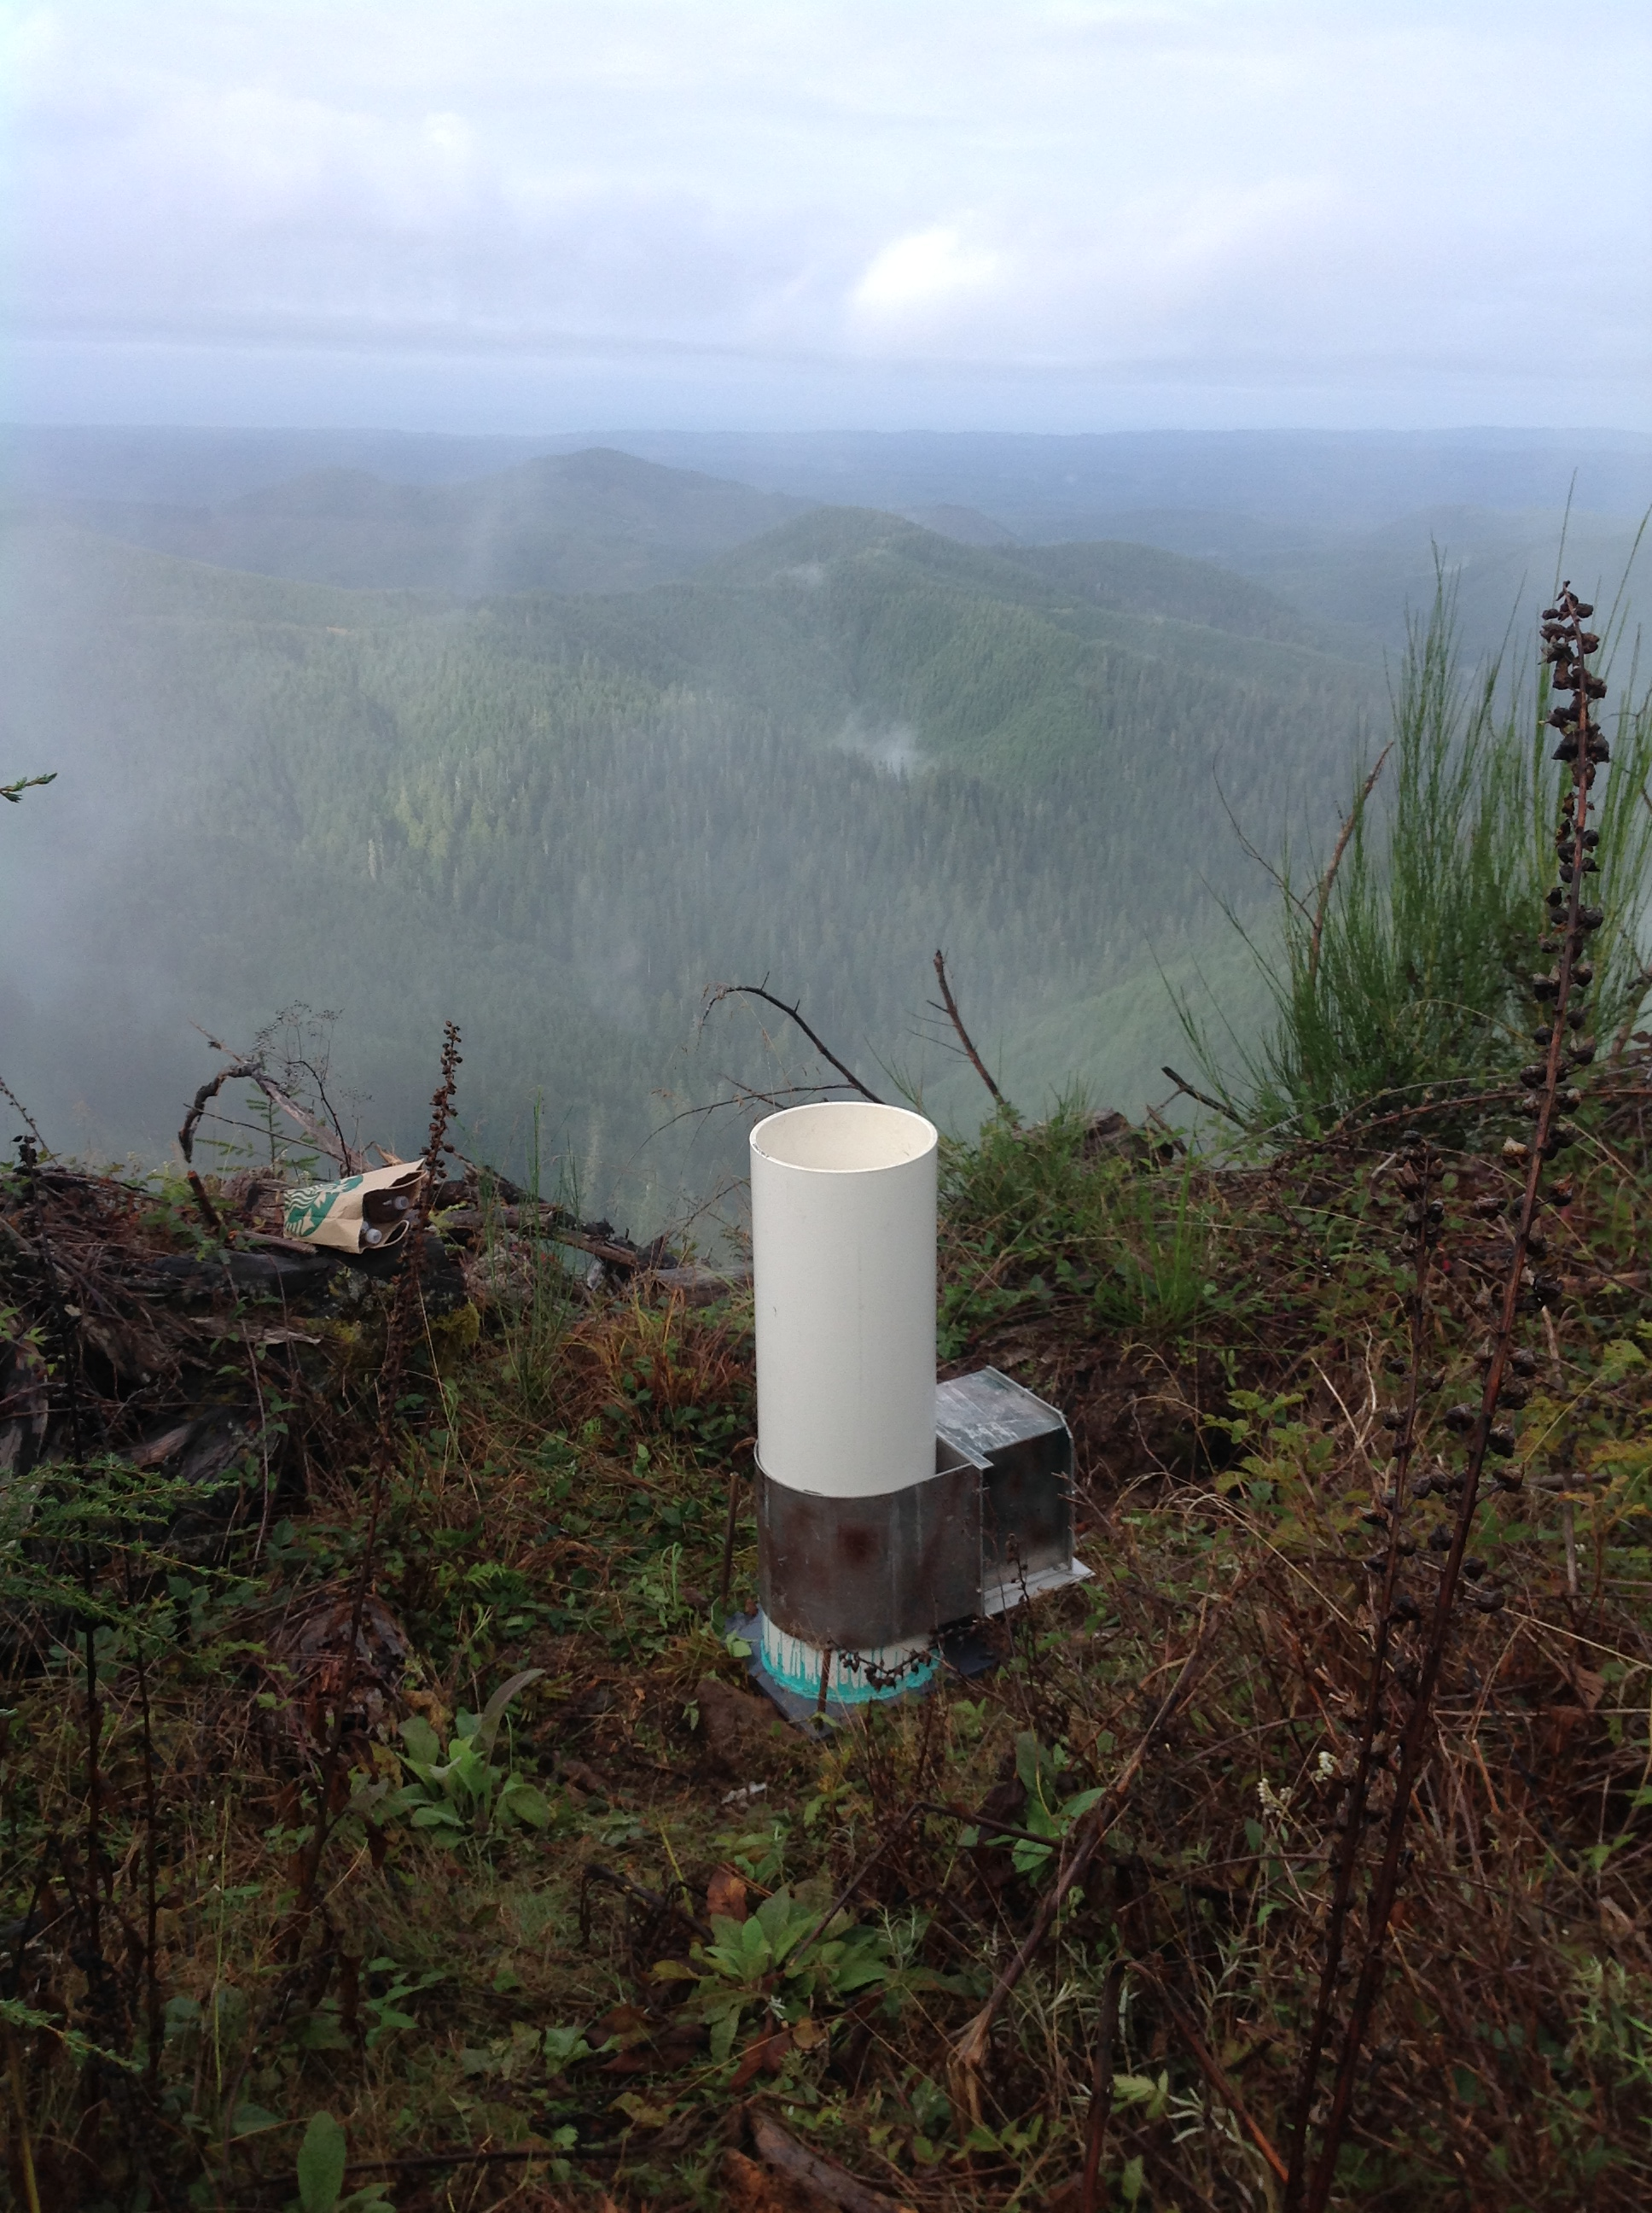
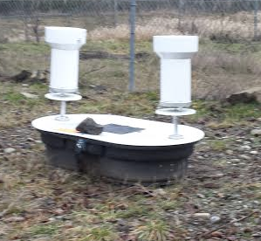
Ground Instruments – Tipping Bucket Networks
Rain Gauges
Tipping Bucket style (single and Dual)
Need to be in lower elevations
Chehalis will also have 10 – 15 dual Gauges along with CoCoRahs sites

Slide 21
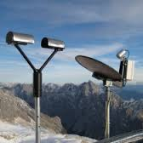
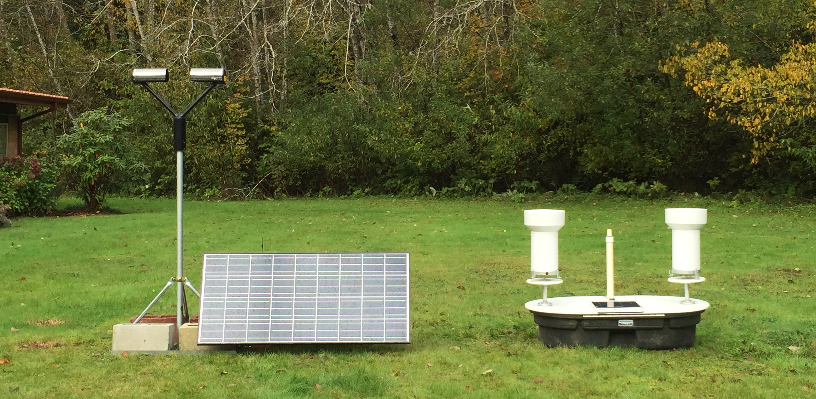
Ground Instruments – Measuring Rain
Low Elevations Sites with Power can have:
- Micro Rain Radar (MRR)
- Parsivel (distrometer)
- 2DVD
- Rain gauge (dual bucket)
Low Elevation Sites without Power can have:
- Parsivel (powered by solar panel/battery)
- Rain Gauge (dual bucket)
Parsivel MRR
Testing Low elevation site without power at the Quinault Fish Hatchery THIS winter
Trouble with condensation in electronics, some trouble with ‘computer’

Slide 22
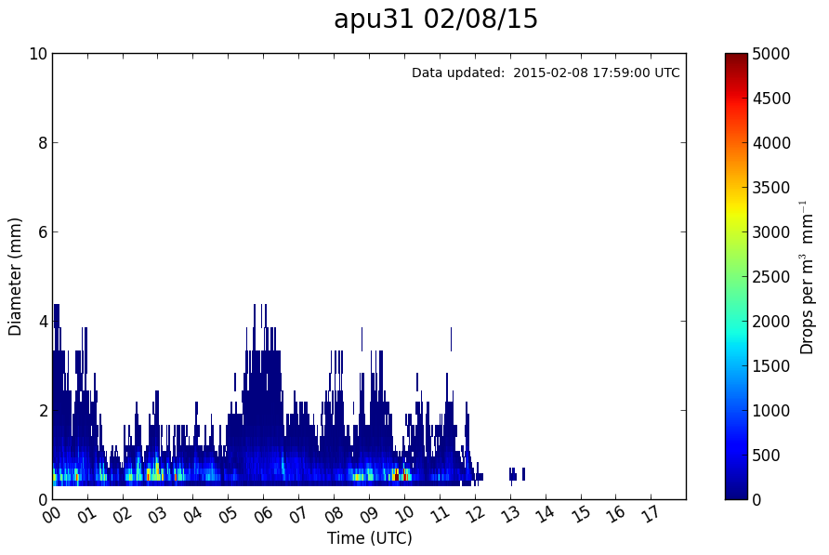
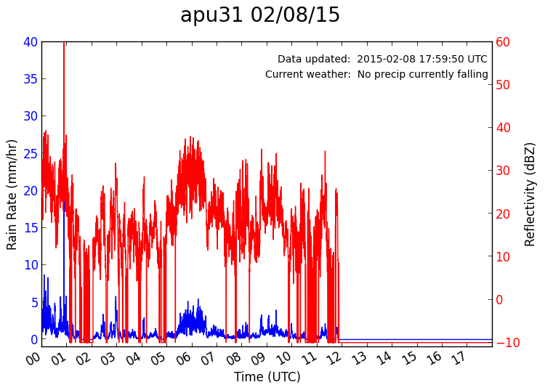
Ground Instruments – Measuring Rain
Dropsize Distribution
Rain rate and reflectivity
Typical light rainfall event: Lots of small drops. We suspect that the current Q-C software for Parsivel is throwing out the very small drops. Parsivel is under reporting precipitation compared to gauge.

Slide 23
Ground Instrumentation Radar
Legend
= WSR-88D
= NPOL
= DOW
= EC X-Band
= MRR = SNOTEL
= Ground Obs sites
= Snow camera network = UW Tipping bucket network
= Chehalis rain gauge network
x
What can Radars give us?
Precipitation distribution
Shape of falling hydrometeor
Melting level

Slide 24
Ground Instrumentation Radar
Scan Strategies:
NPOL: RHI scans up Quinault Valley and over Ocean
DOW: Placed up valley to document precipitation growth ‘under’ NPOL bean
X-Band: Scan ‘Lee side’ transition (RHI)
MRR’s: 3 Placed in Quinault to document precip growth in lowest levels
Not doing dual doppler

Slide 25
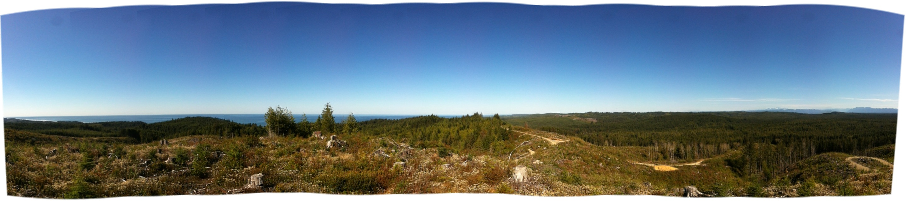
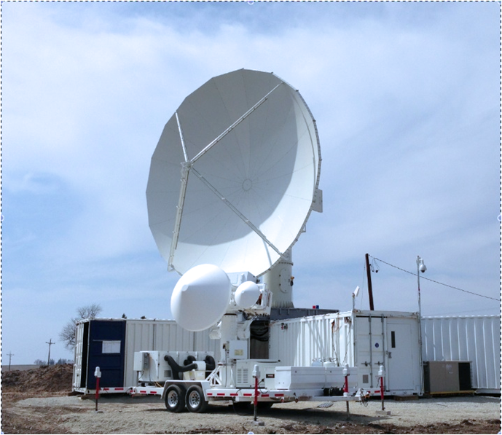
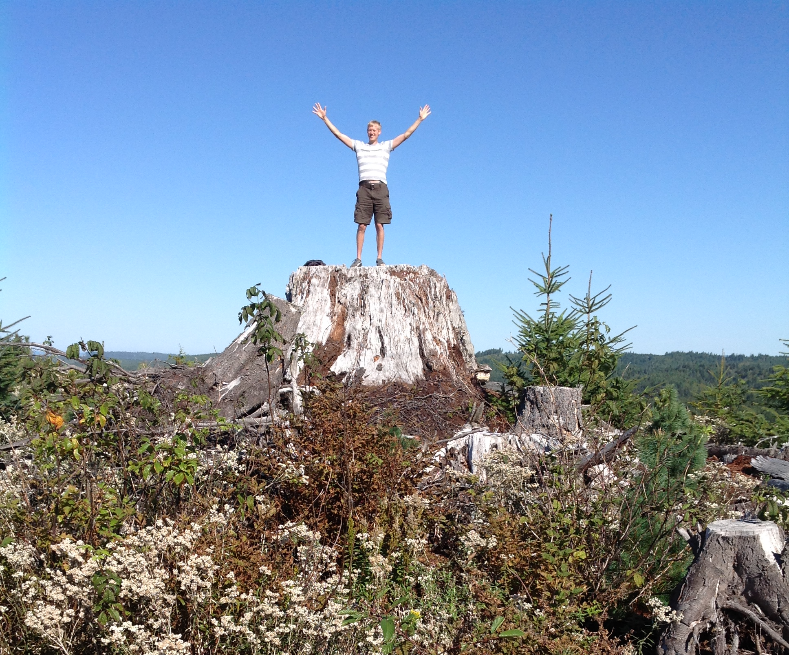
Ground Sites – NPOL Radar
Ocean View
Olympics
Will be installed on the Quinault Indian Nation near the coast along Shale Road where the radar has clear views towards the Ocean and towards the Olympic Mountains and up the Quinault River
NPOL
D3R

Slide 26
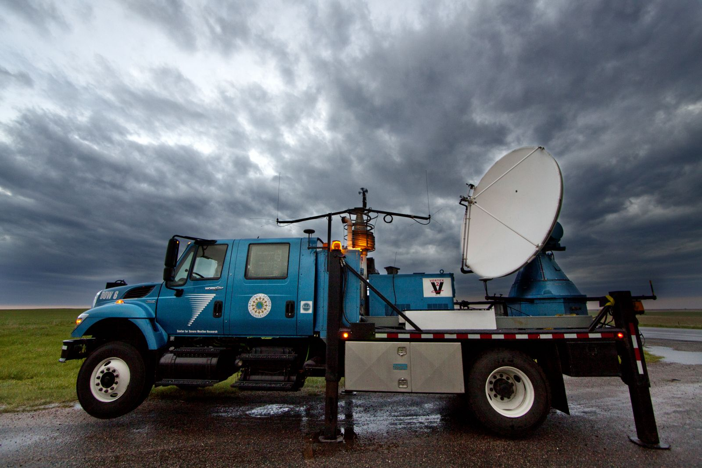
Ground Sites– Doppler on Wheels (DOW)
Will be installed at Lake Quinault so it can make measurements where it will sample ‘under’ the lowest radar beam. It will have a horizontal extent of roughly 40 km (can ‘see’ to NPOL and can ‘see’ to Upper Quinault Valley installation.

Slide 27
High Terrain Measurements
For measuring snow depth and SWE of accumulating snowpack and for measuring falling snow microphysical characteristics
  SNOTEL sites (existing sites)
  Snow Cameras (Lundquist)
  Additional Snow surveys at cameras
  Hurricane Ridge installation
  Enchanted Valley Installation
We are testing strategies this winter

Slide 28
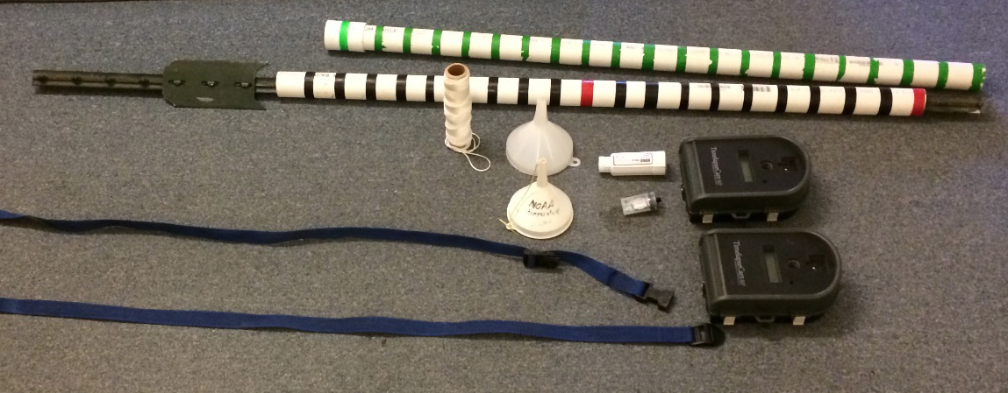
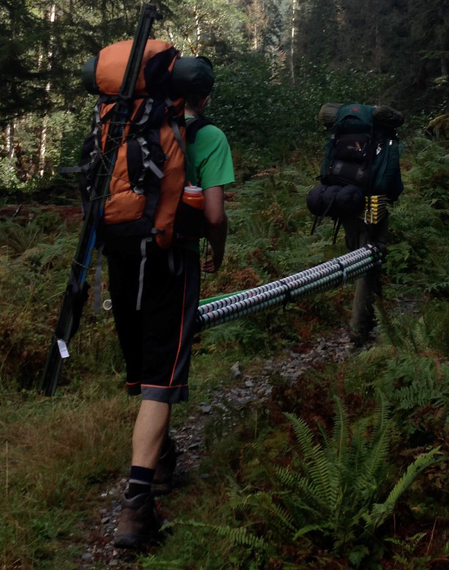
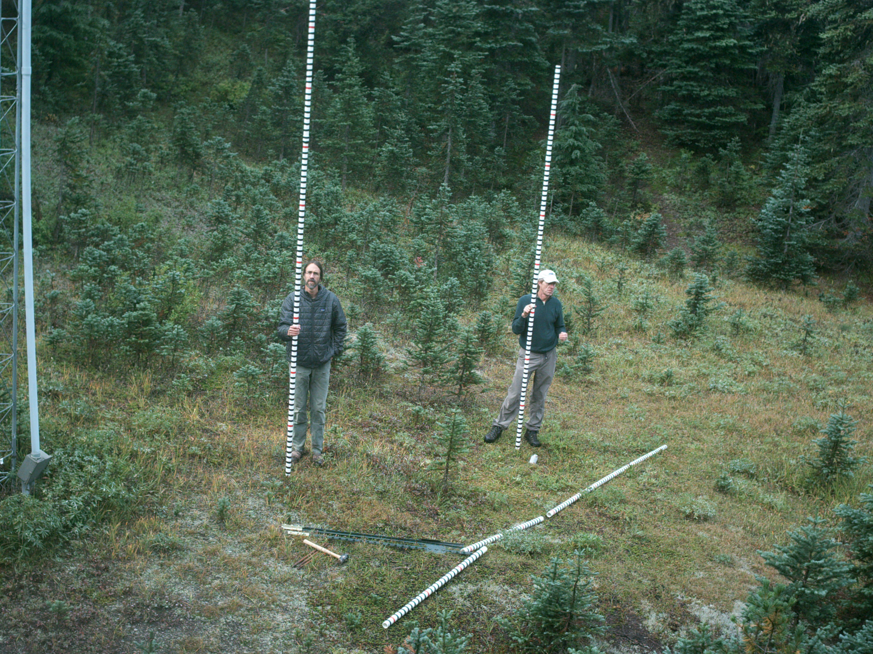
Snow Camera Installations 2014 - 2015
Jessica Lundquist’s crew installed 18 Cameras and Snow Poles at various locations near historical snow course locations and along the Quinault River and tributaries.

Slide 29
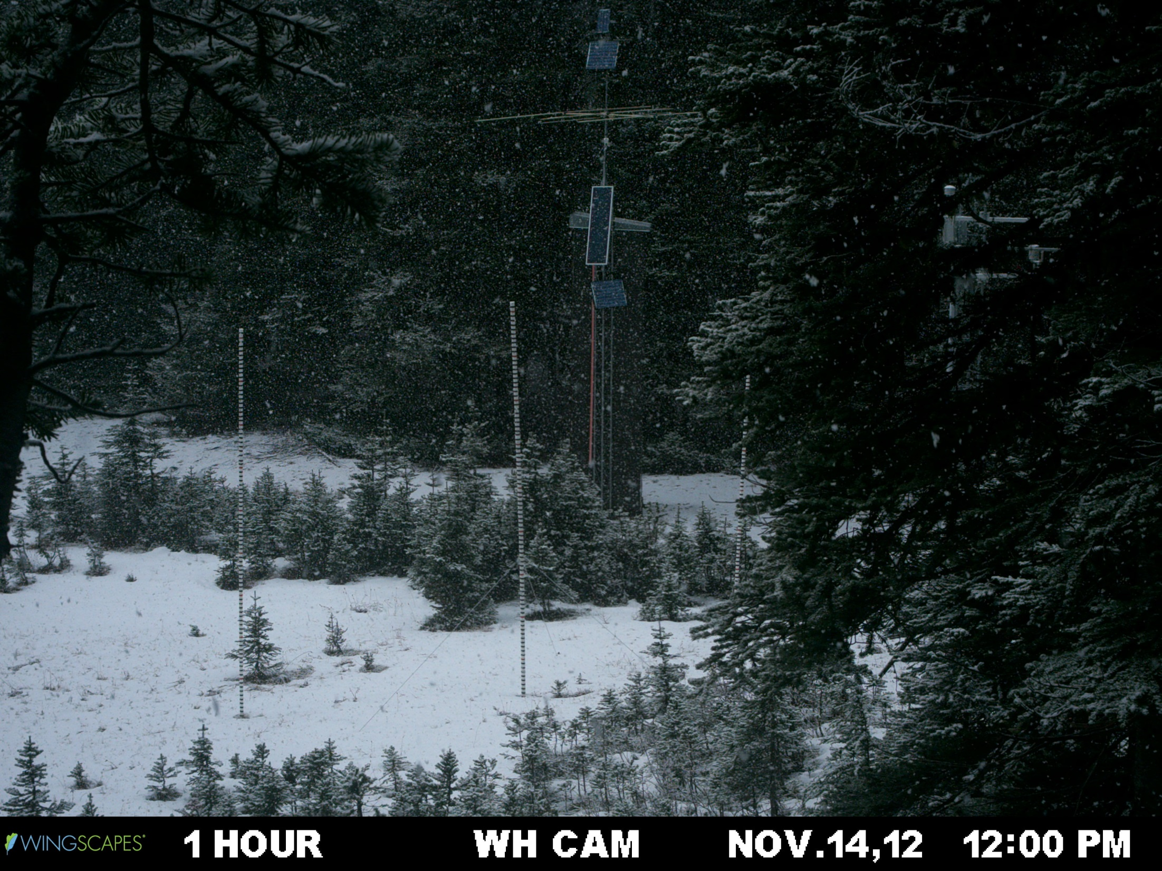
Precipitation event (snow) + Accumulation 1 of 2

Slide 30
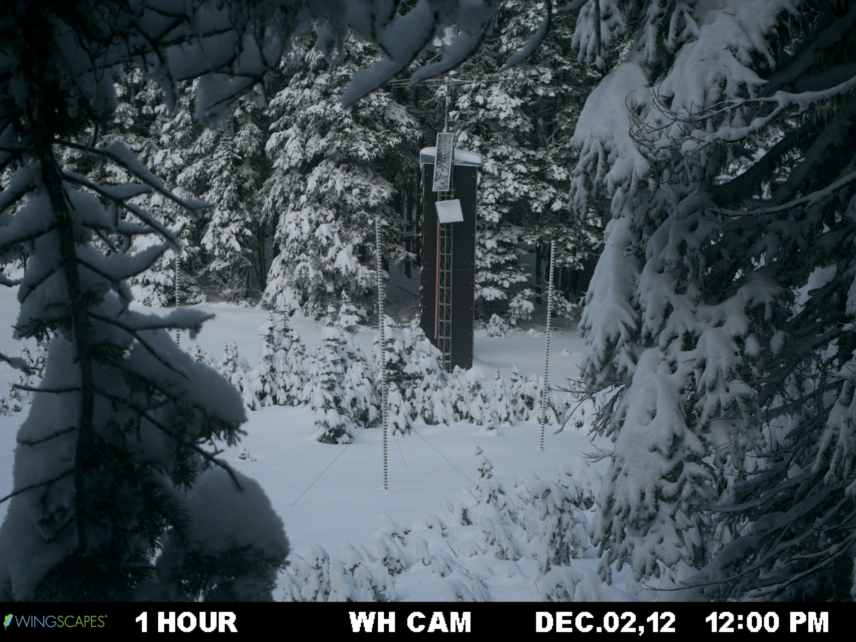
Accumulation 2 of 2

Slide 31

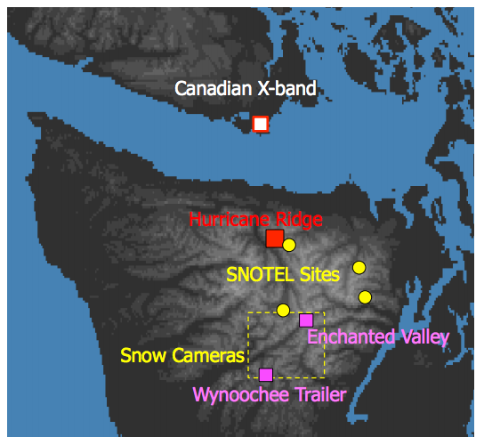
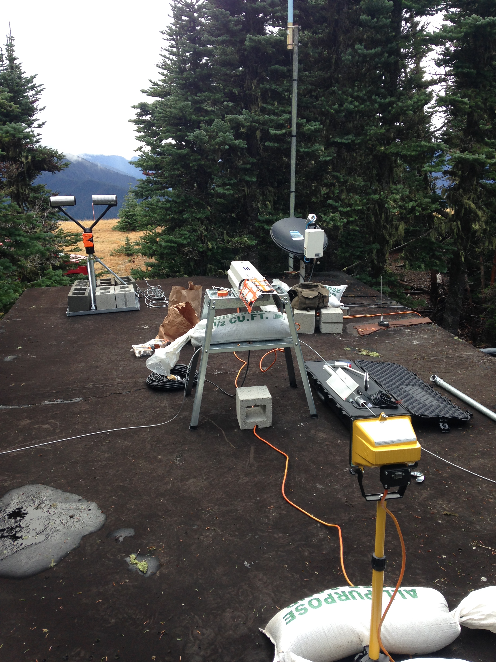
Hurricane Ridge
This winter have a collection of 4 specialized instruments installed on the roof of the generator house at Hurricane Ridge
  MRR, Parsivel, PIP and Hot Plate
  Collecting data, but have not analyzed it
Why at Hurricane?
  Only location at high elevation with power available
  Supports the radar measurements made by Canadians on Vancouver island
Maintenance:
  Snow/rime removal
  PIP alignment/bulb replacement
Notes:
Example: PIP bulb burned out

Slide 32
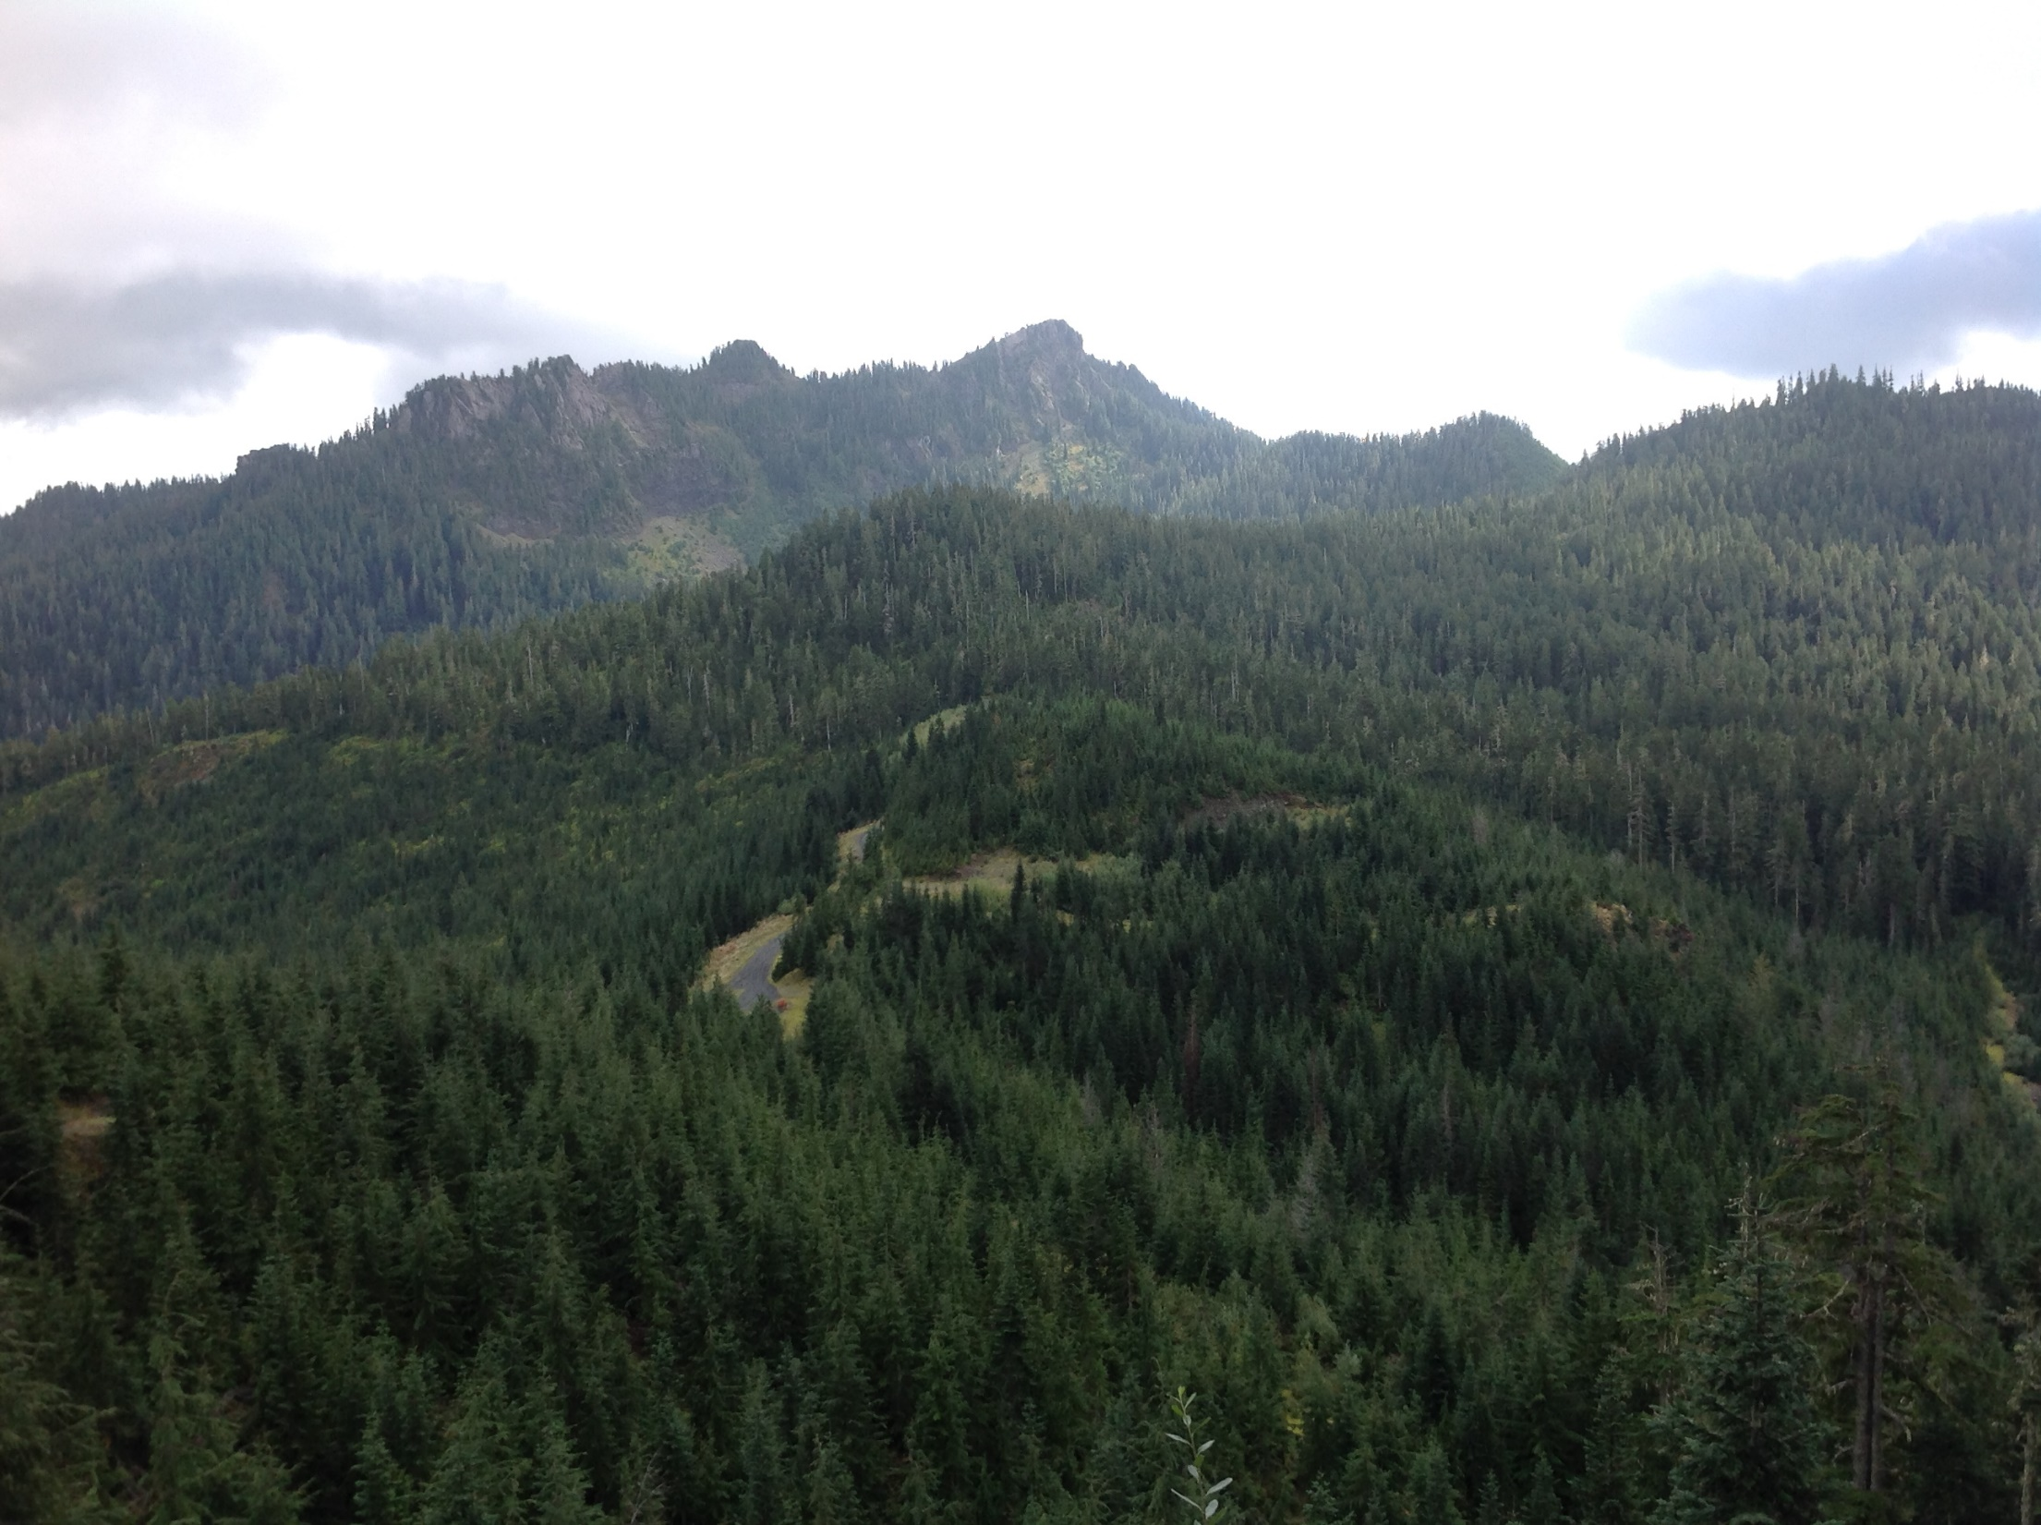
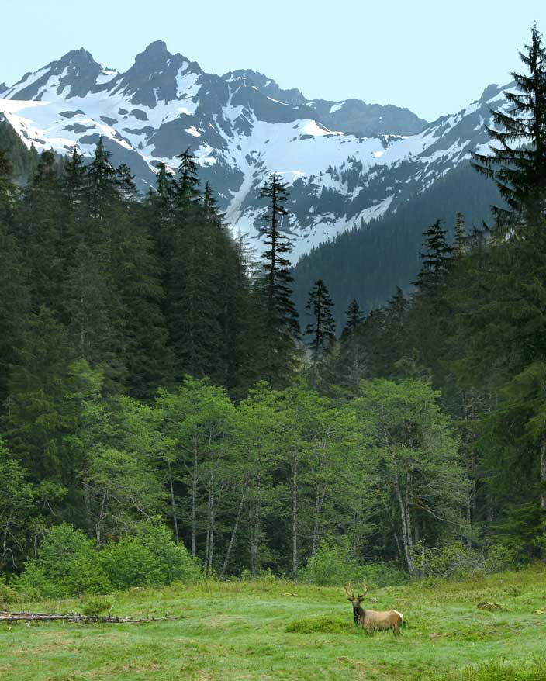
High Elevation Ground Sites – No Power
Want to put instruments to measure precipitation at 2 very remote sites with no power: North Wynoochee (3000+ ft), Upper Quinault Valley (2200+ ft)
Requires 13 mile hike in winter conditions. Needs to operate 2 weeks unattended
Requires mountain biking and snowshoe to access site. Needs to operate 2 weeks unattended
Photo by Larry Workman QIN

Slide 33
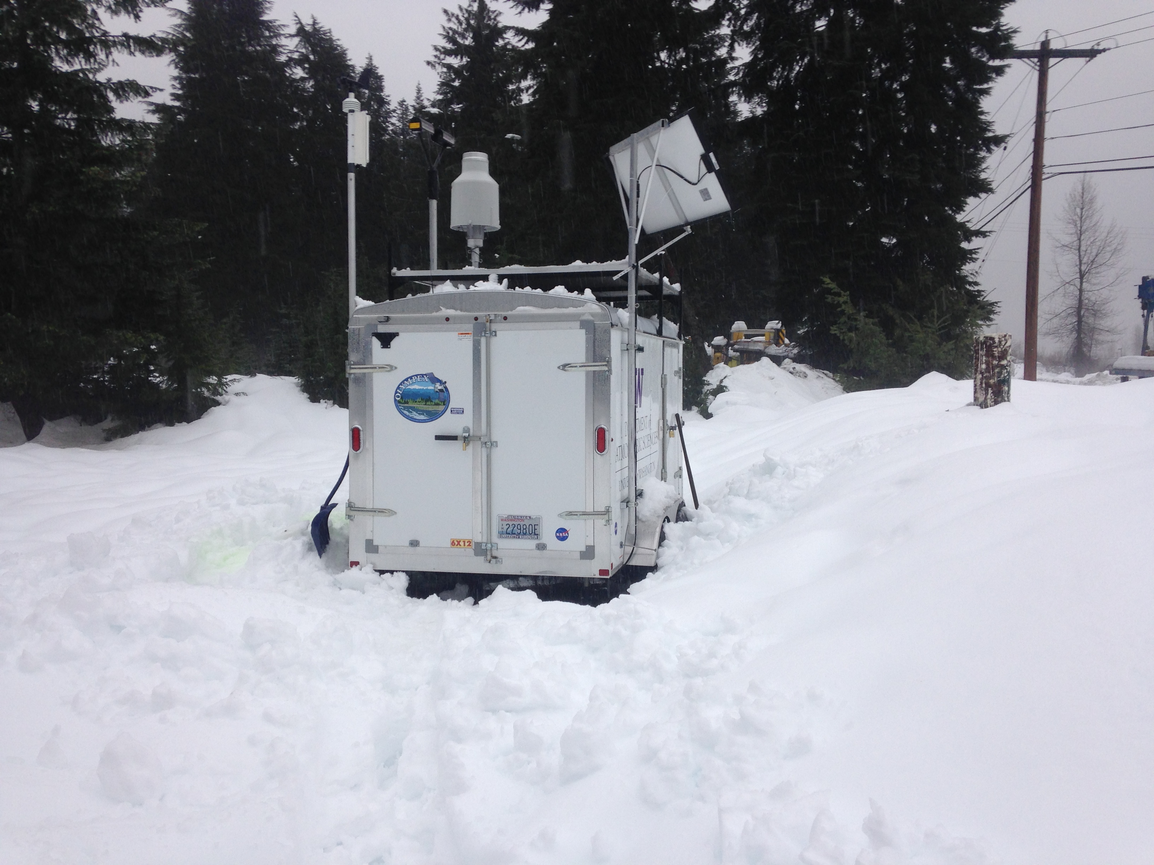
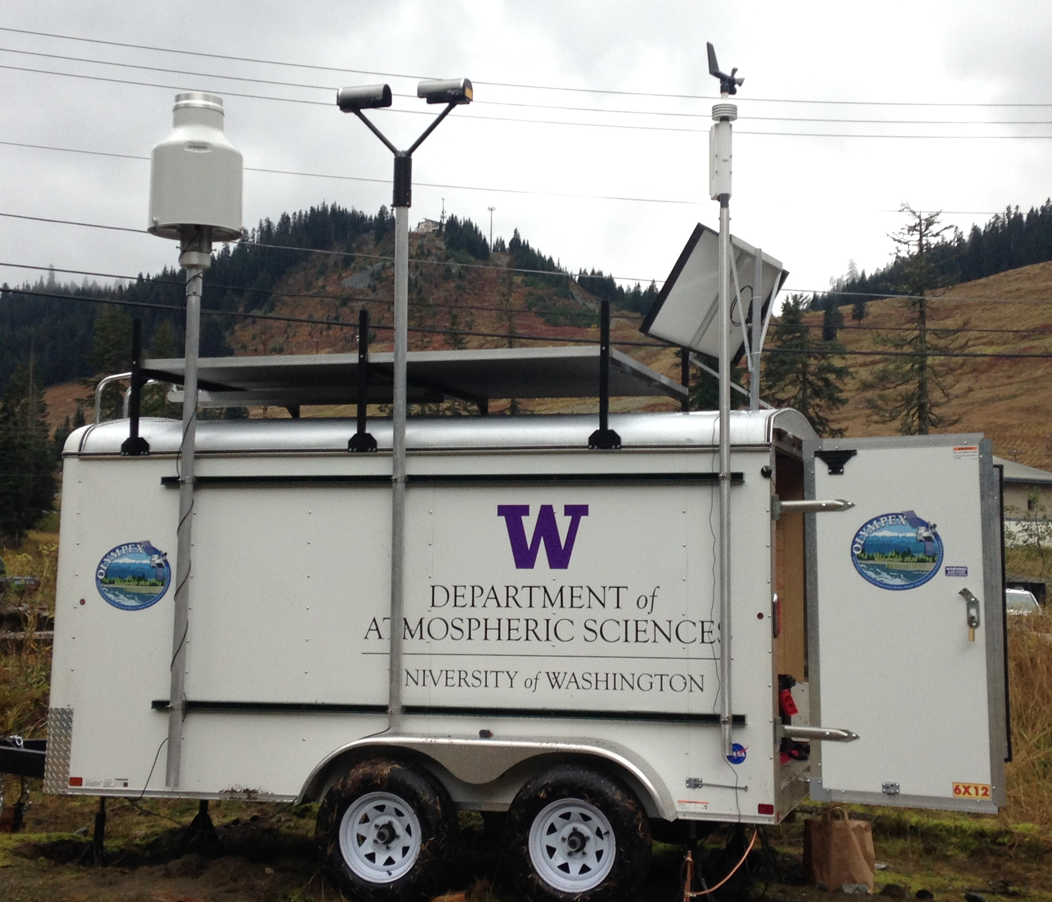
Testing this year for high elevation installations with no power – Trailer at Snoqualmie Pass
15 ft trailer anchored to ground with 8 deep-cycle batteries, electronics, computer inside
Solar panel to recharge batteries
Pluvio and Parsivel mounted to be ‘above’ snowpack
Testing
  how long batteries can last
  How long instruments can operate in snowy environment
  how often is maintenance needed

Slide 34
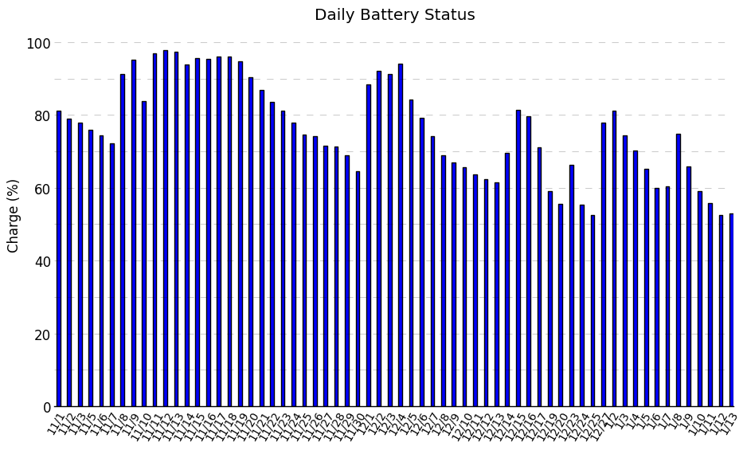
Testing this year for high elevation installations with no power – Trailer at Snoqualmie Pass
Rainy/cloudy/snowy periods – batteries can’t recharge via solar
Joe knocked off snow/ice on solar panel and sunny period recharged
Batteries can continue to operate instruments with less voltage than this
Have not had to use generator yet – batteries operating for 3 months
Morning Battery Status
If completely cloudy/rainy and no solar, looks like batteries can operate instruments for 4 – 6 weeks without recharging – will test this out this summer

Slide 35
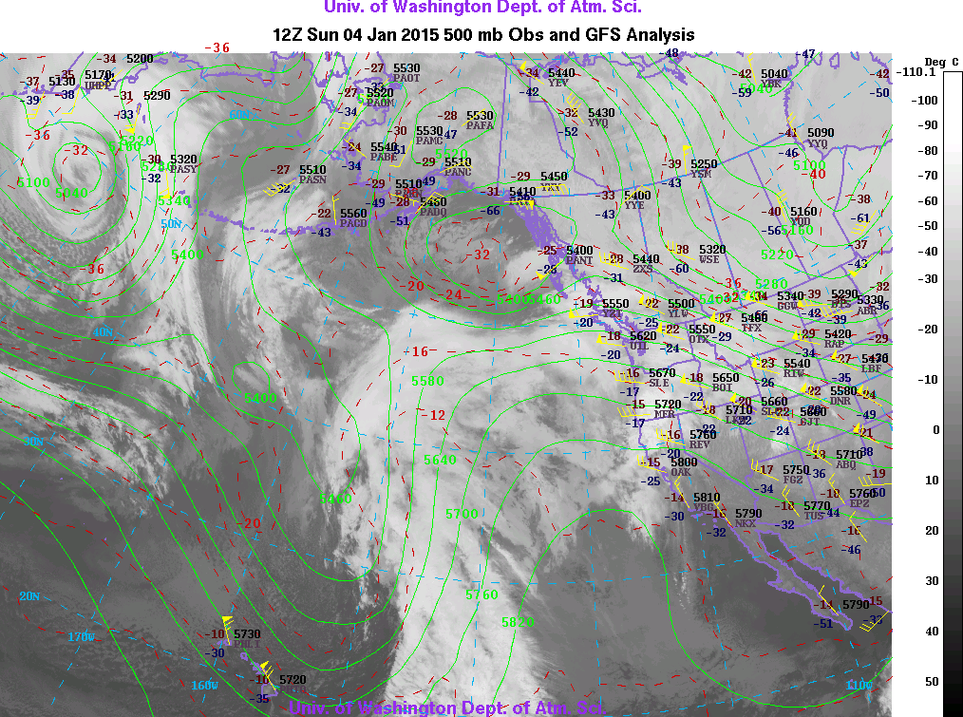
Example from trailer – Wet event

Slide 36
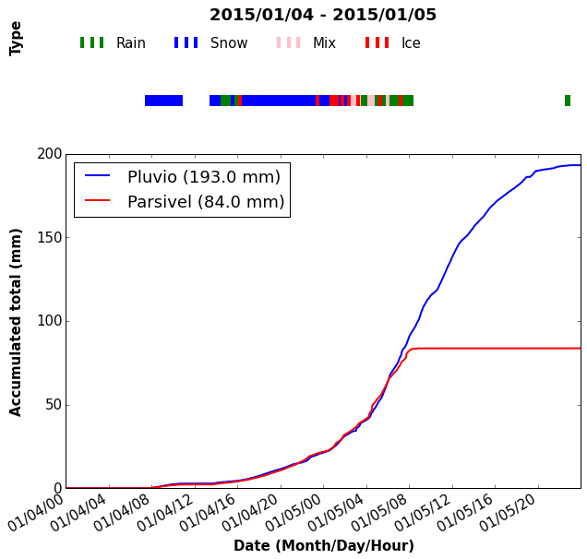
Example from trailer – Wet event

Slide 37
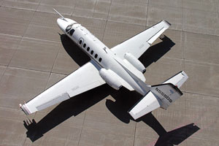
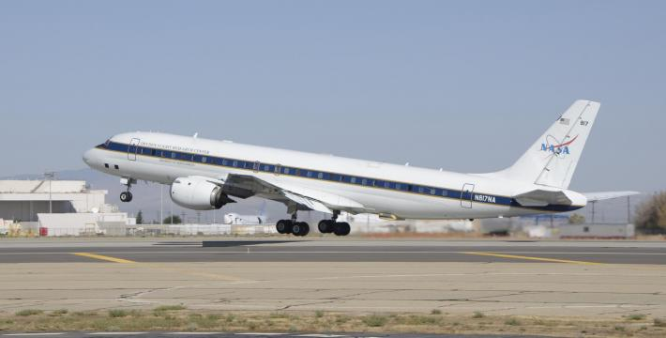
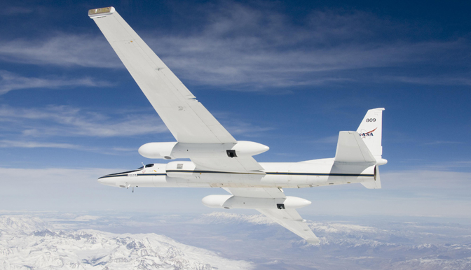
Aircraft
Citation
DC-8
Satellite Simulator instruments
Dropsondes over the ocean
Flies at ~30,000 ft
Cloud Microphysics instruments
Flies at 2000 ft above highest obstacle
ER-2
Satellite Simulator instruments and Flies at ~60,000 ft

Slide 38
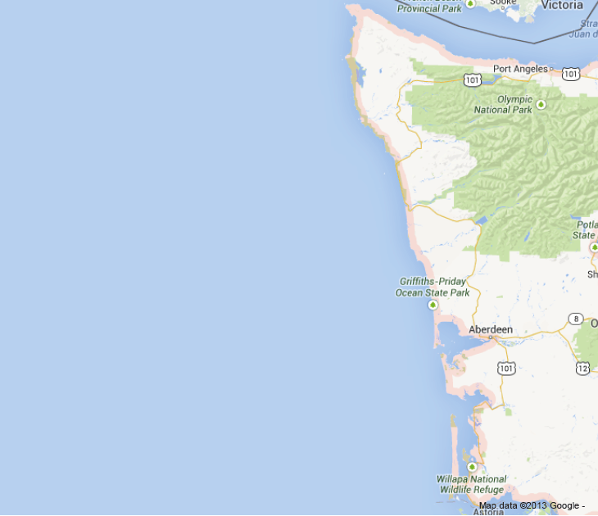
X-band
Sample Flight Patterns
dropsondes
Citation
Citation
NPOL
ER-2
Spiral ascent
DC-8

Slide 39
Summary
OLYMPEX is a ground validation campaign for the GPM satellite that will occur Fall 2015 thru Winter 2016
OLYMPEX primary objective is to measure and document the characteristics of rain/snow from ocean to coast to complex terrain.
Will have installations of ground instruments at a variety of elevations and locations to measure rain/snow amounts and precipitation characteristics
High terrain measurements include snow cameras, 2 installations of sophisticated instruments where power is available, and 2 installations running on batteries/solar.
There will be 2 radars and 4 upper-looking micro radars and one DOW.
There will be 3 aircraft from Nov 6 – Dec 21, 2015 that will fly during intensive observation periods when we have approaching storm systems (complicated operations).

Slide 40
Acknowledgments
This work is supported by the National Aeronautics and Space Administration grants NNX13AG71G & NNX14AO64G

