Slide 1

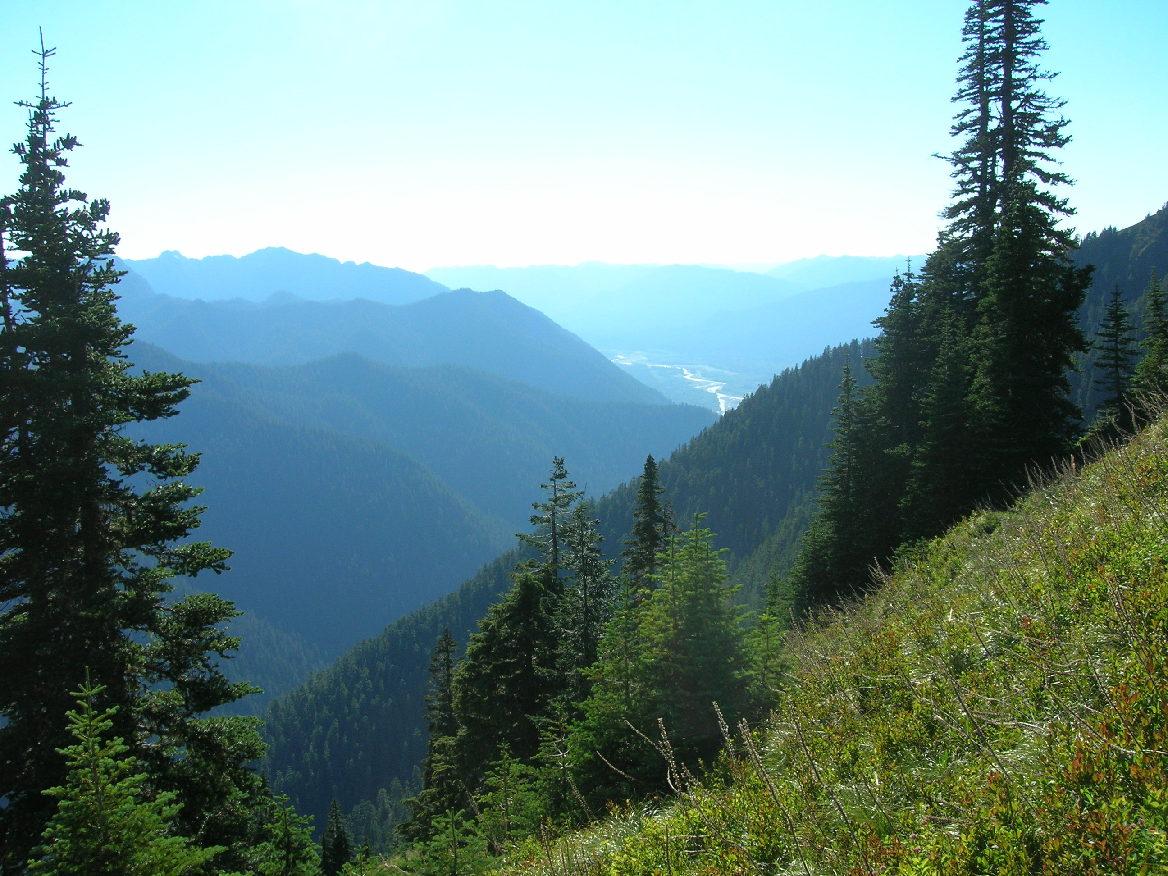
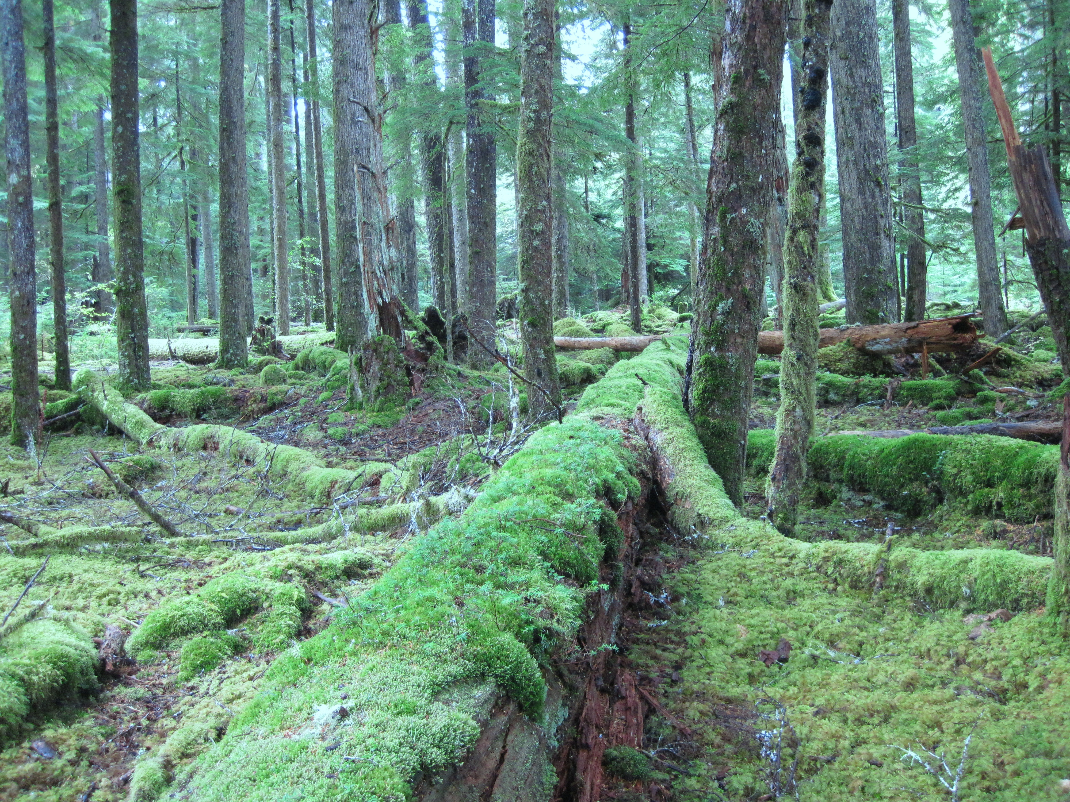
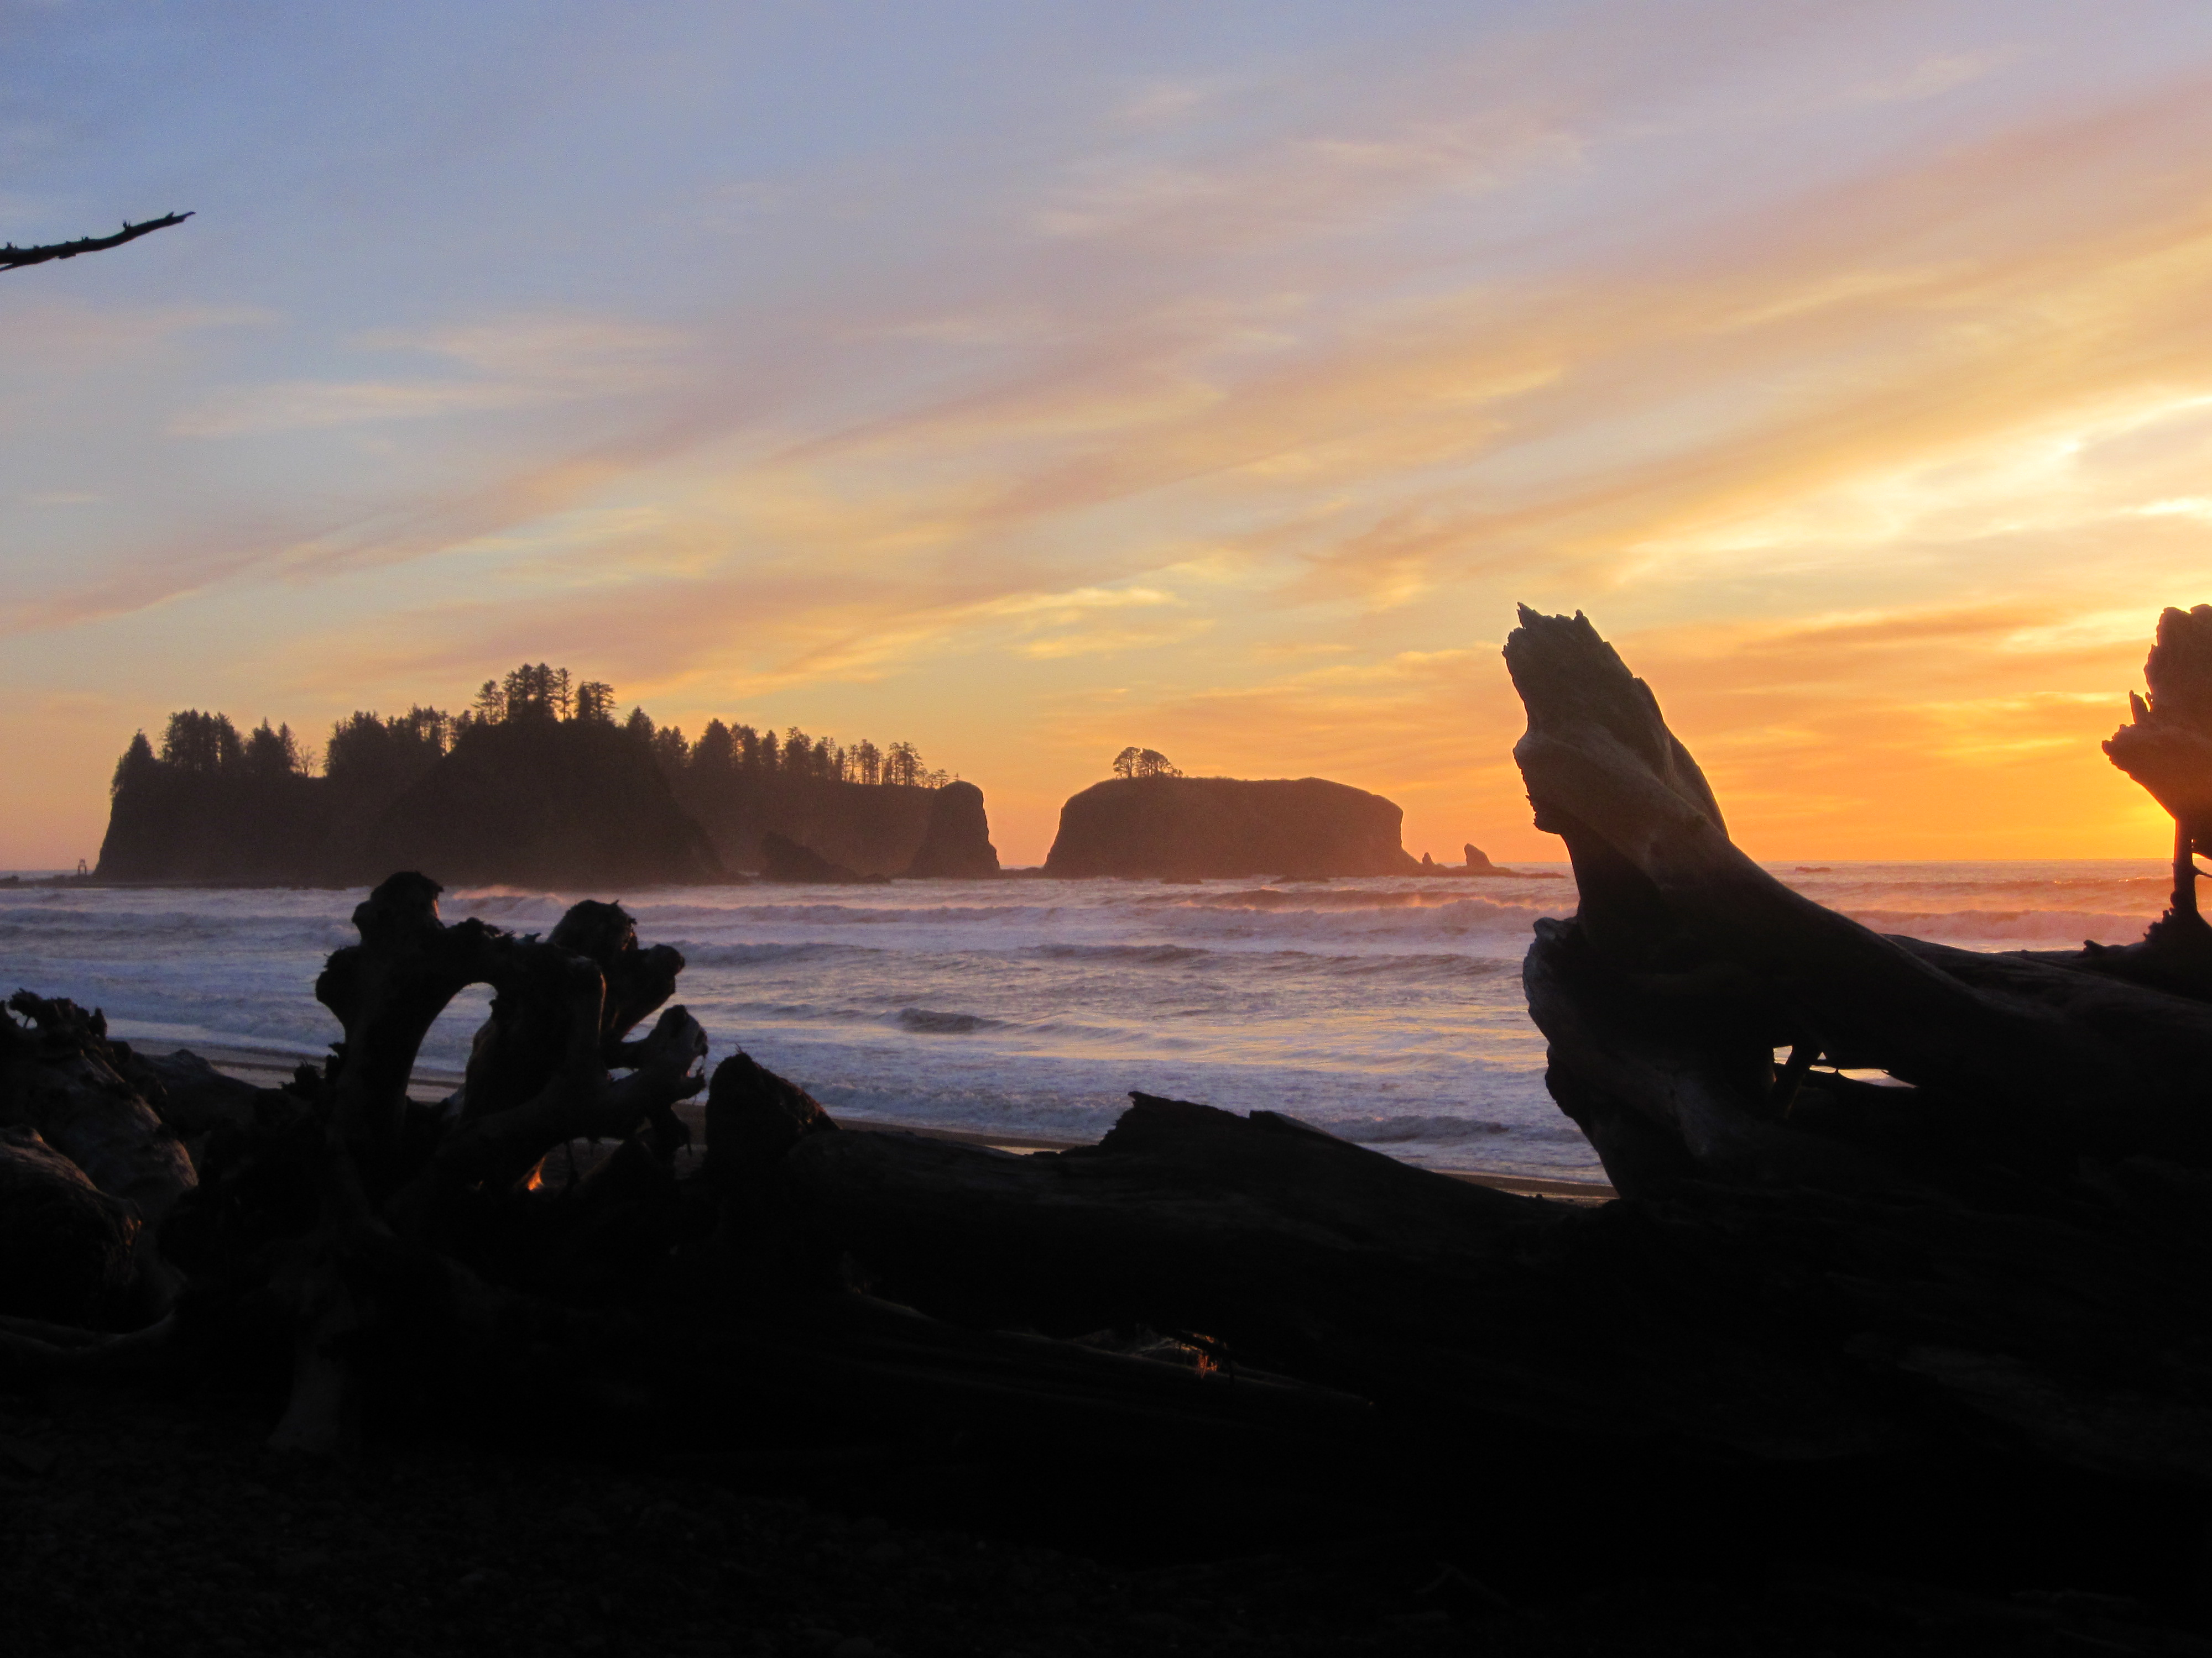
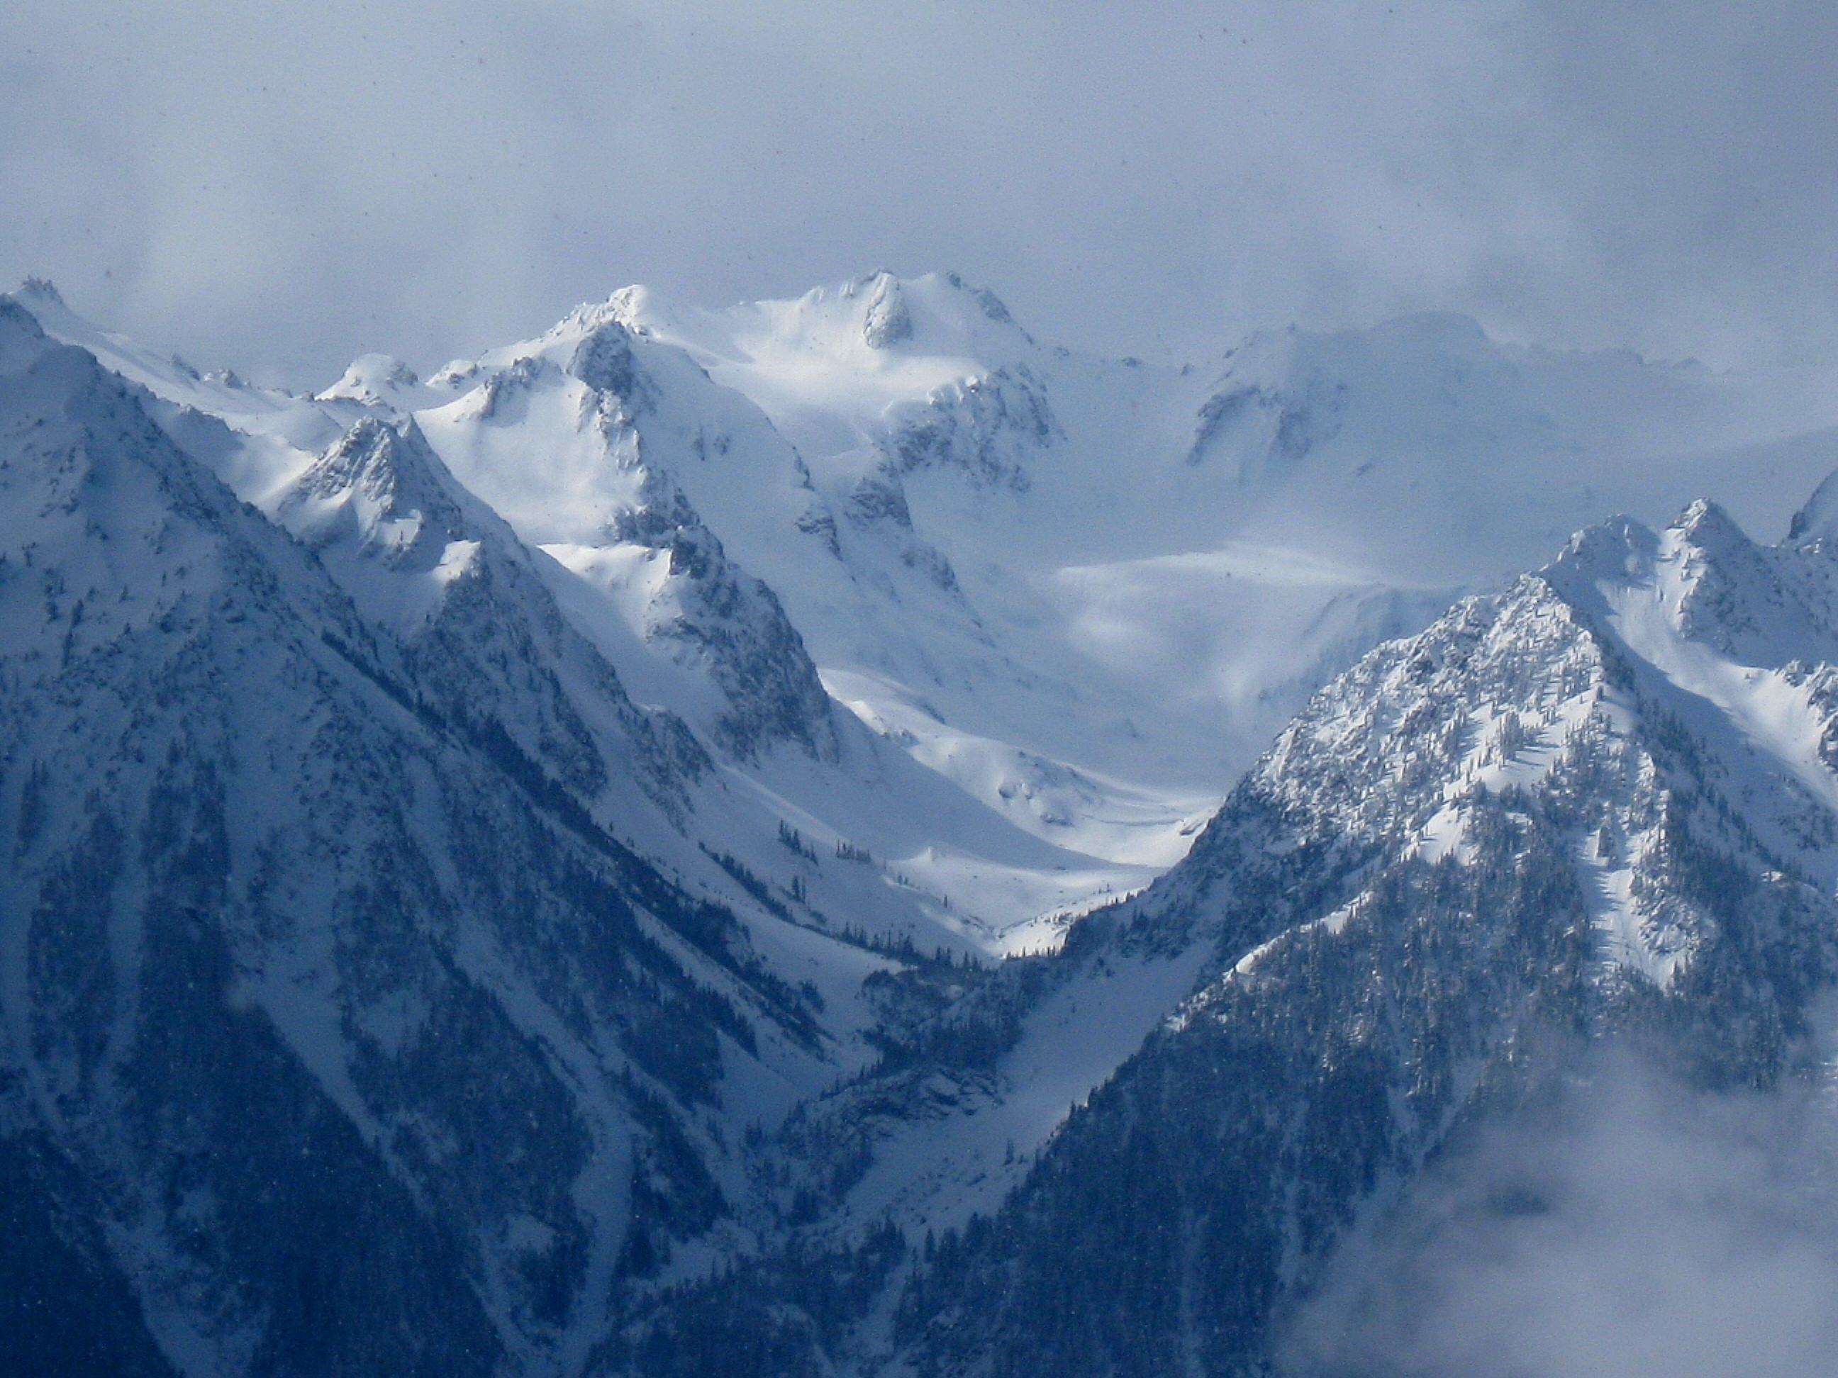
OLYMPEX Logistics Planning Meeting
Waterfront Activities Center, UW
21 – 23 January 2015
This work is supported by the National Aeronautics and Space Administration grants NNX13AG71G & NNX14AO64G

Slide 2
Wireless Access for OLYMPEX Logistics Planning Meeting
UWnetID = event0149
Password = 49yY_55rJ_34fW
PLEASE PAY Shannon/Angela for Registration $75

Slide 3
Personnel Needs for OLYMPEX
Ground site crew
_____, _____, …
Rawinsonde launchers
_____, _____, …
Radar scientists
_____, _____, …
Operations center personnel
_____, _____, …
Forecast team
_____, _____, …
Aircraft scientists
_____, _____, …

Slide 4
Overview of Expected Weather during OLYMPEX
Storm sectors:
  Prefrontal
  Frontal
  postfrontal
Geographical regions
  Ocean
  Windward
  High terrain
  Leeside
Notes:
Defining terms. Talk about active and quiet periods (related to upper level conditions)

Slide 5
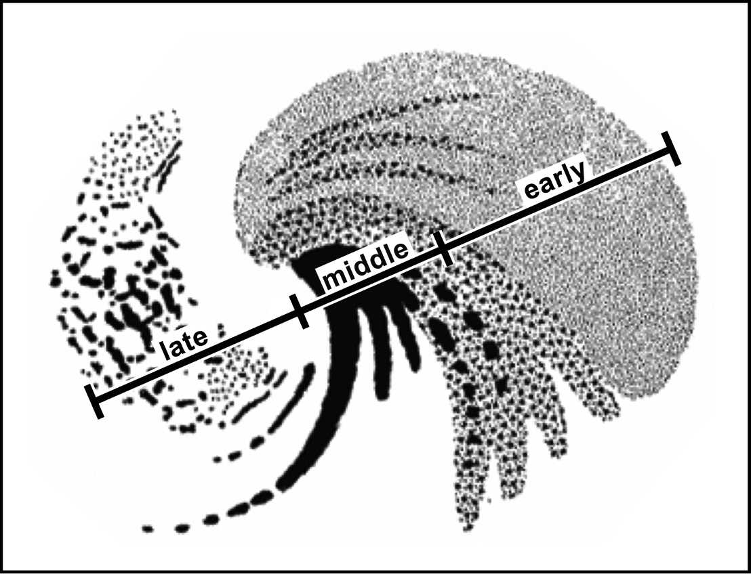
Synoptic Midlatitude Cyclone–
Storm Sectors – Idealized from Nagle and Serebreny (1962)
Notes: Idealized precipitation pattern of an eastern Pacific storm.
Early = prefrontal
Middle = frontal
Late = postfrontal
Typically don’t have strong or well developed warm front or warm sector

Slide 6
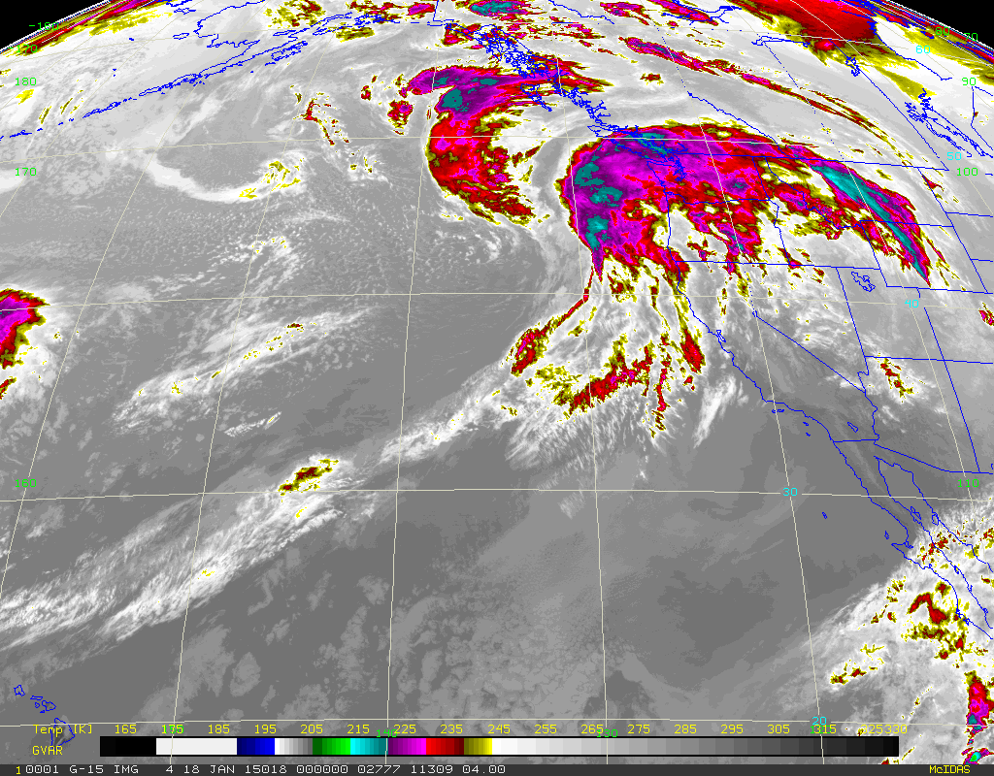
Synoptic Midlatitude Cyclone–
Satellite picture from 00 UTC 18 Jan 2015
Notes:
Extensive cloud shield,
Surface low center offshore
Precipitation occurring on Olympic Peninsula well ahead of cold/occluded front
L

Slide 7
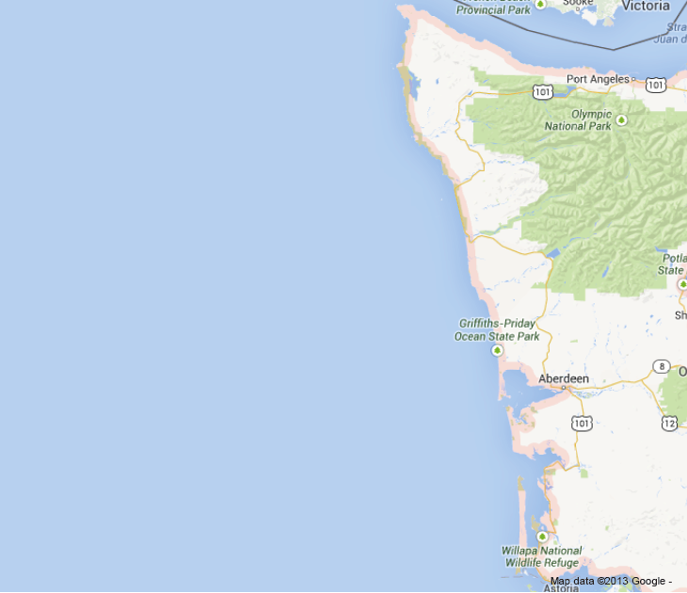
Prefrontal Sector
Idealized
Clouds extend northward
Notes:
Warm advection
Stratiform precipitation
high based clouds and radar echo
Descending cloud base
rain rates are light
—but not from low cloud
L
Prefrontal
Postfrontal

Slide 8
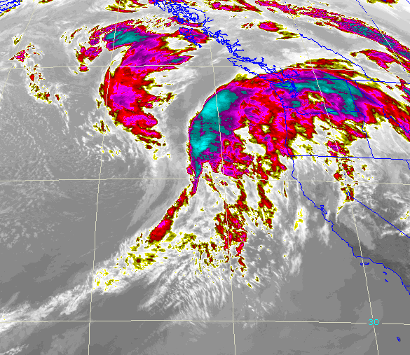
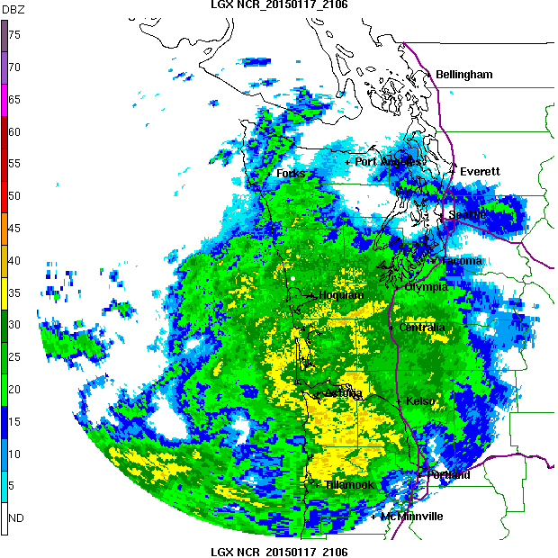
Prefrontal Sector
Example 2015011721
Notes: Precipitation occurs well out ahead of surface fronts. Environment characterized by warm advection, large static stability, stratiform precipitation, relatively high or rising melting level (case dependent)

Slide 9
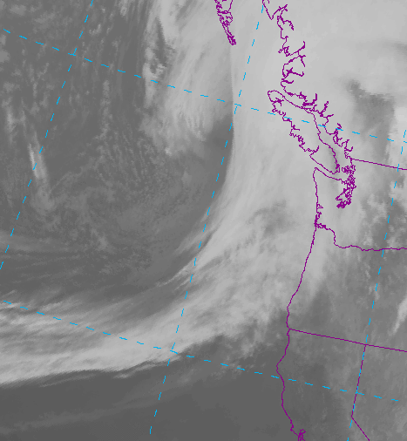
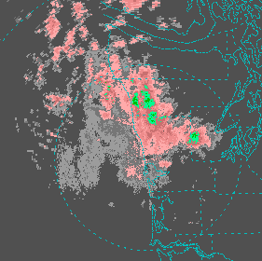
Prefrontal Sector
Example 20130225
Notes: Precipitation occurs well out ahead of surface fronts. Environment characterized by warm advection, large static stability, stratiform precipitation, relatively high or rising melting level (case dependent)

Slide 10
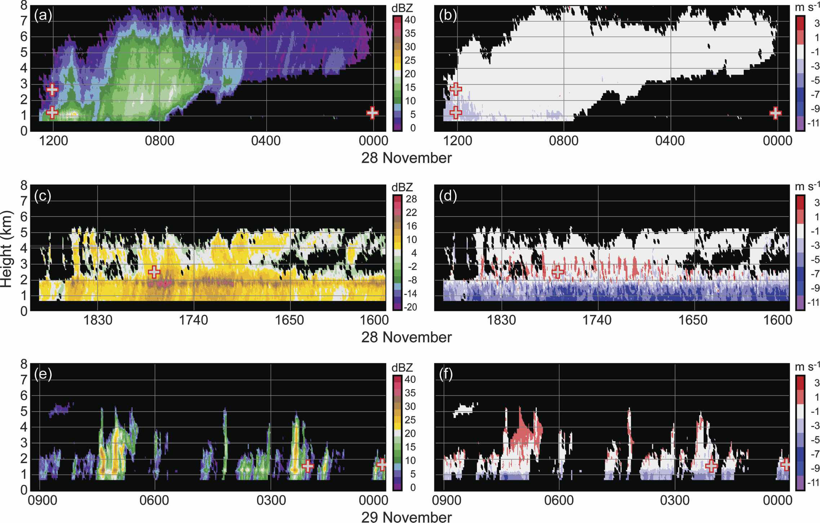
Prefrontal Sector
Example: RHI scans from 2000112900 IMPROVE-2 case
Time
Time
Reflectivity
Doppler Velocity
Notes: Cloud base lowering with time as storm approaches, weak/no vertical velocity

Slide 11
Frontal Sector
Idealized
Notes:
Precipitation intense at front
Strong upward motion at front
Rapid drop of melting level
Transition from stratiform to convective

Slide 12
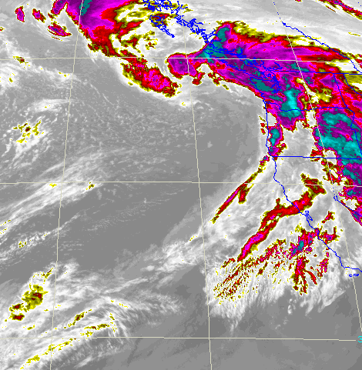
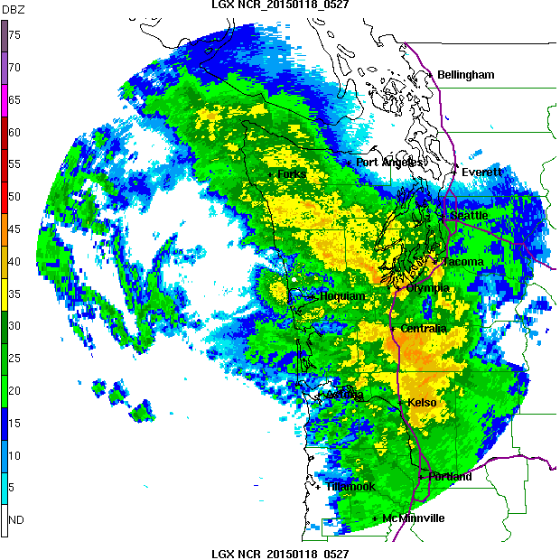
Frontal Sector
Example 2015011806
Notes: Precipitation can be intense at front. Strong upward motion at front. Rapid drop of melting level at passage of (cold/occluded) front. Transition from stratiform to convective elements at front

Slide 13
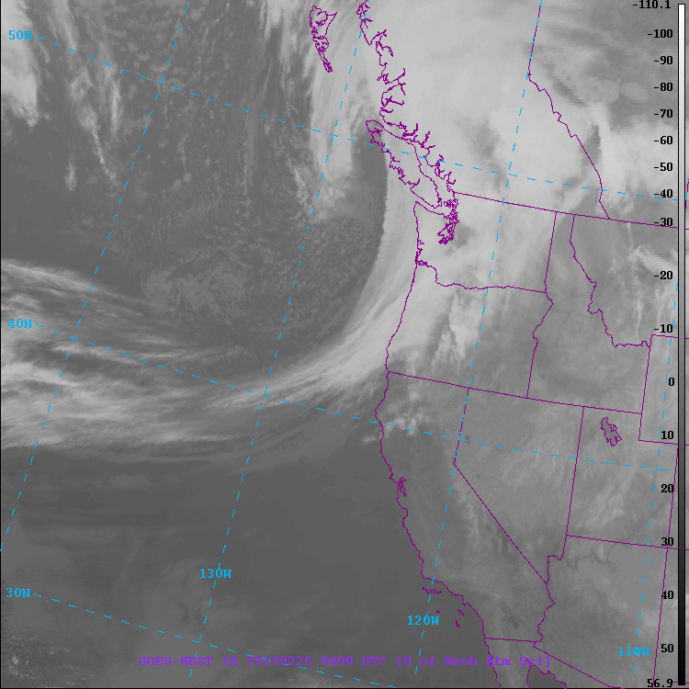
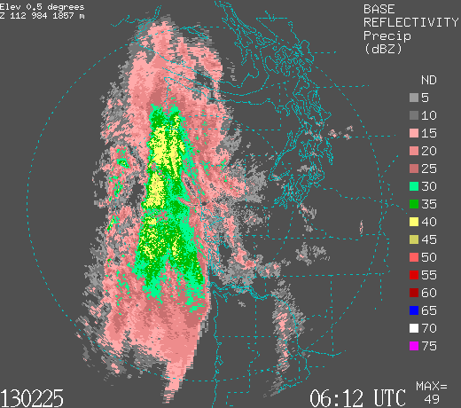
Frontal Sector
Example 2015011806
Notes: Precipitation can be intense at front. Strong upward motion at front. Rapid drop of melting level at passage of (cold/occluded) front. Transition from stratiform to convective elements at front

Slide 14
Frontal Sector
Example: RHI scans from 2000112818 IMPROVE-2 case
Time
Time
Reflectivity
Doppler Velocity
Notes: Steady to intense precipitation. Convective elements imbedded, regions of strong vertical motions

Slide 15
Post-Frontal Sector
Idealized
Notes:
Convective elements
cold advection
Low stability
low melting level.
Can produce significant precipitation, especially over windward slopes
Significant snowfall at higher elevations
L

Slide 16
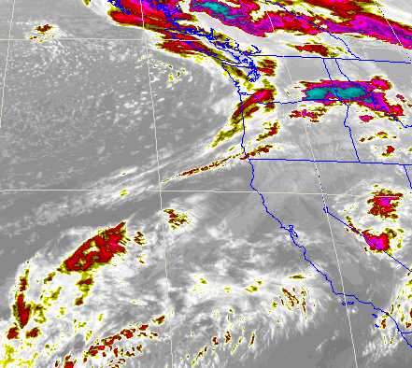
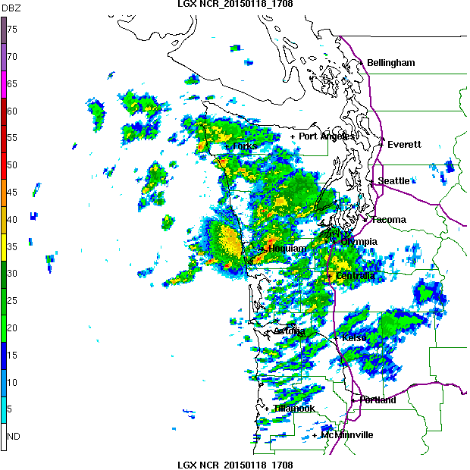
Post - Frontal Sector
Example 2015011812
Notes: Environment characterized by cold advection, low static stability, lowering melting level. Can produce significant precipitation, especially in orographically enhanced regions. Significant snowfall at higher elevations

Slide 17
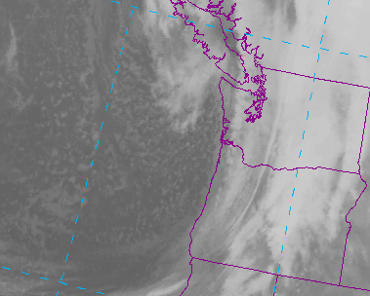
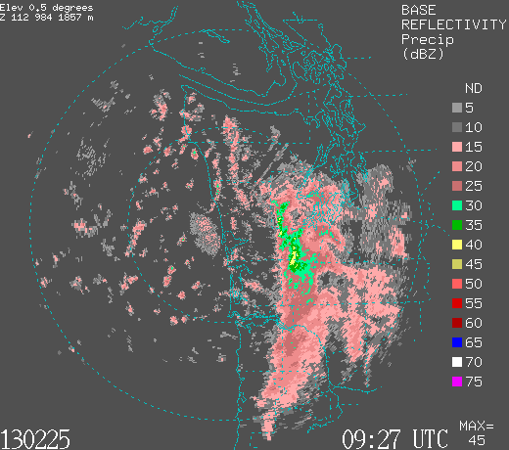
Post - Frontal Sector
Example 2013022512
Notes: Environment characterized by cold advection, low static stability, lowering melting level. Can produce significant precipitation, especially in orographically enhanced regions. Significant snowfall at higher elevations

Slide 18
Frontal Sector
Example: RHI scans from 2000112900 IMPROVE-2 case
Time
Time
Reflectivity
Doppler Velocity
Notes: Isolated convective cells, pockets of significant upward motion. Cell height varies.

Slide 19
Geographical Regions
Leeside
Quinault
High Terrain
Chehalis
Ocean - offshore
Windward side – Quinault area and Chehalis

Slide 20
GV objectives to be accomplished in OLYMPEX field operations
Precipitation variability and microphysical characteristics as a function of storm sector (prefrontal, frontal, & postfrontal and geographical region (ocean, windward side, orographic enhancement and lee side)
Melting level character and variability
Hydrological responses
Snowpack build up and melt off during winter season

Slide 21
RADEX objectives to be accomplished during OLYMPEX
Collect datasets suitable for retrieval case studies.
  Light precipitation within prefrontal sector
  Embedded convection within off-shore (narrow-band) cold/occluded fronts.
  Shallow convection with light precipitation (post-frontal).
Notes:
Can add words about not being able to show everything about the expected weather …

Slide 22
Ground Instruments
Joe Zagrodnik – Overview of Ground deployment
Jessica Lundquist – High Terrain: Snow Cameras, Laser
Scott Pattee – High Terrain: SNOTEL and Snow Surveys
Nijssen – Chehalis Basin Precipitation Network
McMurdie – Discussion Leader

Slide 23
Ground Instruments – Additional Considerations
Difficult to maintain ground instruments and obtain high quality data with the sites we have now. Best to put effort into making sure we have good data at choice sites instead of trying to install a lot more ground sites
Additional Dual tipping bucket gauges and Parsivels
  Have ~10 tipping bucket gauges for Quinault area, have 6 already slated for ground locations with no power. Use rest to replace some of our UW tipping bucket gauges
  Use extra Parsivels as spares to swap with ones in field that fail

Slide 24
Ground Instruments – Additional Considerations
Maintenance and Personnel
  High Elevation stations with no power (Enchanted Valley and Wynoochee)
    Within Park, NPS wants us to use experienced Winter backcountry personnel and a Park Ranger
    Visits should be about every 2-3 weeks
    The instruments have to remain on site throughout the winter
  High Elevation stations with power (Hurricane Ridge and Neilton)
    Need extensive winter driving experience (Neilton road is unpaved), 4WD vehicle, and possibly snowmobile
    Visits 2-3 weeks

Slide 25
Ground Instruments – Additional Considerations
Maintenance and Personnel
  Low Elevation stations
    All easily accessed from NPOL region.
    A lot of sites, so will need constant vigilance
Data Recording and transmission
  Not all locations will have adequate (or any) cell coverage
    Enchanted Valley
    Wynoochee
    Low elevation sites deep in valleys or trees (CRN)
  What are alternatives?

Slide 26
Name | Elev | Instruments X = currently deployed, P = Planned, U = Possible/Under Discussion |  |  |  |  |  |  |  | Power | Access
 |  | MRR | PIP | 2DVD | Parsivel | Pluvio | Hot Plate | Dual Tipping Gauge | Other
Lee Side
Hurricane Ridge | 5140’ | X | X |  | X |  | X |  |  | Yes | Road, Winter Conditions
Windward side (Quinault Valley region)
Wallace Cabin | Sea level | U |  | U | P |  |  |  | X= Tip Gauge | Yes | Road
Seed Orchard | 255’ |  |  |  | P |  |  | P |  | No | Road
Fish Hatchery | 170’ | P |  | P | X |  |  | X |  | Yes | Road
Amanda Park | 290’ |  |  | P |  |  |  | P |  | Yes | Road
Norwood South Shore Road | 220’ |  |  | U | P |  |  | P |  | Maybe | Road
Bunch Field | 380’ |  |  |  | U |  |  | P | X | No | Road, short walk
CRN Site | 285’ | P |  | P | P |  |  |  |  | Yes | Road
Graves Creek Campground | 563’ |  |  |  | P | U |  | P |  | No | Road and Trail
Neilton Pt | 2156’ | U | U | P | P | P | U |  |  | Yes | Road, Winter Conditions
Enchanted Valley | 2033’ |  |  |  | P | P |  |  |  | No | Trail
Wynoochee Trailer | 3160’ |  |  |  | X | X |  |  |  | No | Road, winter conditions, trail
Notes:
Explain format of table without details—go over sites, instruments, and power/access (by color)
----- Meeting Notes (1/20/15 15:22) -----
Change P* to something else`

Slide 27
Management Needs
Type | # Sites | Visit Frequency | Data Retrieval | Access Issues
Low elevation with power | 4 | 4-6 weeks, as needed | Cell | -
Low elevation, no power | 4 | 1-2 weeks, as needed | Site dependent | Mudslides
High elevation with Power* | 2 | 1-2 weeks, as needed | Cell | Snow, road closures
High Elevation, no power | 2 | 1-2 weeks, as needed | ? | No vehicle access
*Includes Hurricane Ridge
Notes:
*As needed is very important—after a major 10-15” rainstorm, all Pluvios will have to be emptied
*It is expected that snow/rime removal and heavier precip rates will require higher elevation sites to be visited more frequently

Slide 28
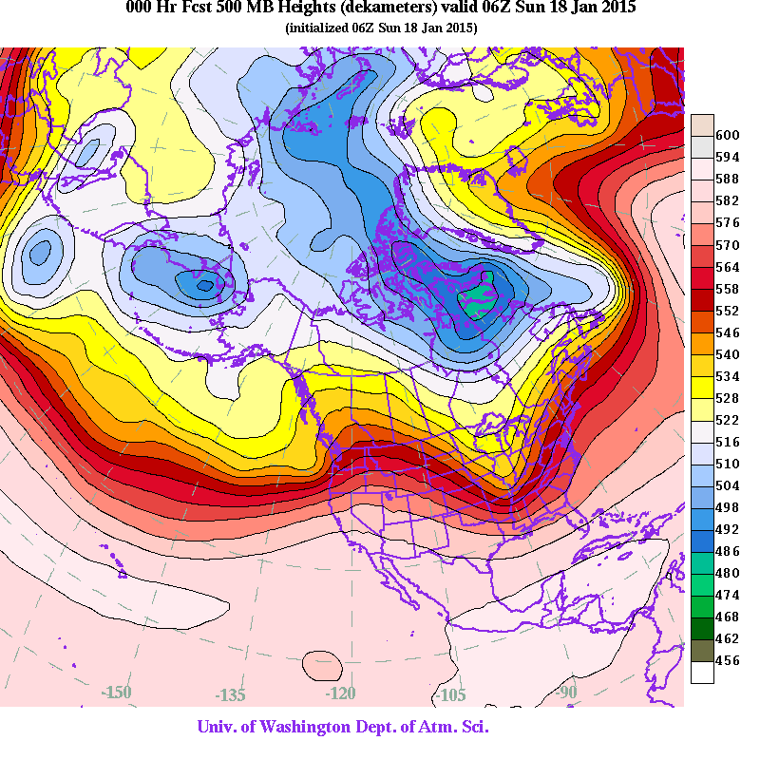
Upper Level Flow –
500mb Heights from 06 UTC 18 Jan 2015
Notes:
Upper level flow patterns indicate whether or not we have stormy or quiescent weather, and storm track and frequency

Slide 29
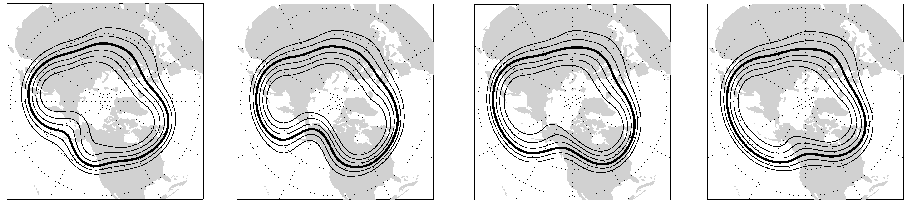
Generic Upper Level Patterns –
OT
AR
CR
RR
In PacNW – typical to have ‘regimes’ – wet periods/dry periods that last ~2 to 3 weeks
Each pattern has different positions of ridges and troughs
Offshore Trough (OT) and Rockies Ridge (RR): mobile shortwaves and synoptic-scale cyclones
Coastal Ridge (CR): ridging on the coast and lack of synoptic systems
Alaska Ridge (AR): lack of synoptic systems, cold air outbreaks or shortwaves that come from the north (least common)
Rockies Ridge is most common
Longest period with no measurable rain on coast = 18 days during CR period
Longest period with continuously measurable rain on coast = 54 days during RR
From Casola and Wallace 2007, and McMurdie and Casola 2009

