Slide 1
Cloud structure under suppressed conditions during DYNAMO
Angela Rowe and Robert Houze, Jr.
University of Washington
AMS 95th Annual Meeting
Phoenix, AZ
5 January 2015
Rowe and Houze, 2015: Cloud organization and growth during the transition from suppressed to active MJO conditions, JGR Atmospheres, In Review

Slide 2
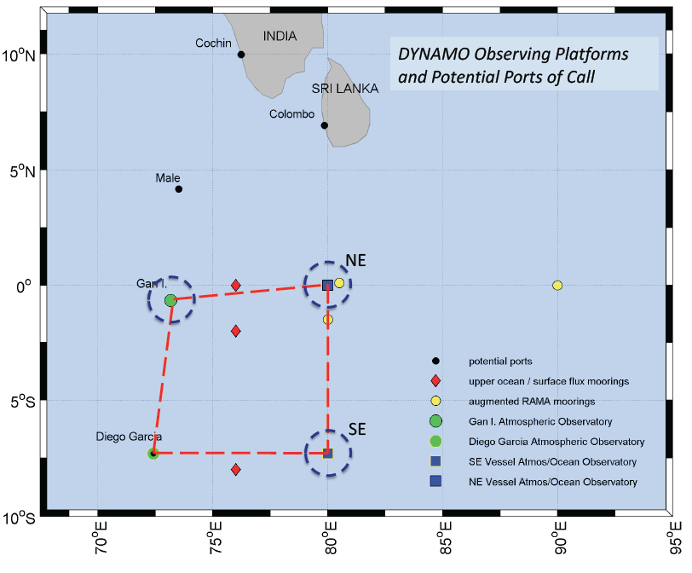
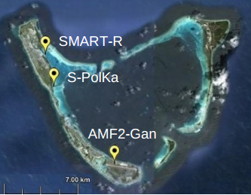
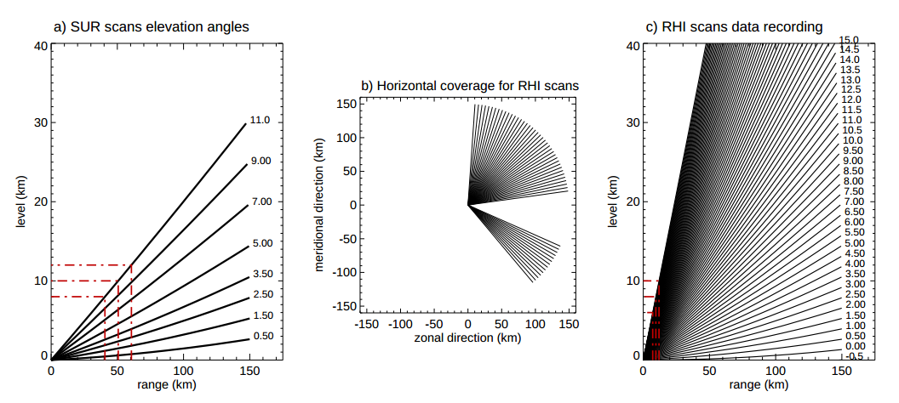
DYNAMO/AMIE/CINDY
Zuluaga and Houze (2013)

Slide 3
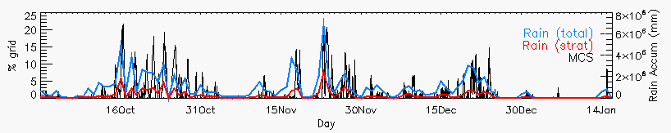
S-PolKa
Active periods: Increased rainfall/organization
Suppressed periods: Reduced rainfall, shallower convection, dry mid-levels
Objective: Describe the evolution of non-precipitating clouds to deeper convection during suppressed conditions

Slide 4
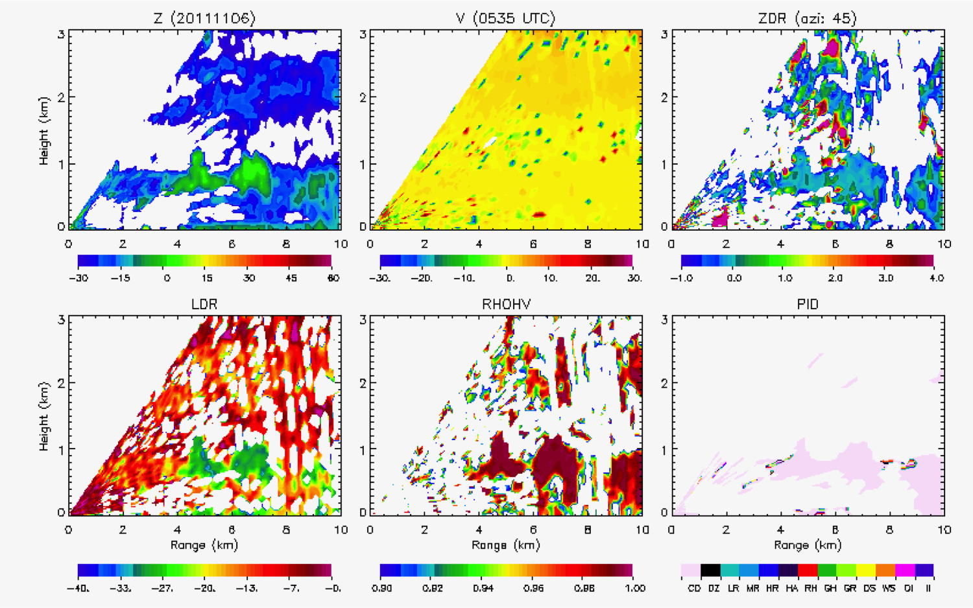
Non-precipitating echo
0-5 dBZ
No particular orientation
Homogeneous collection of scatterers
Cloud droplets

Slide 5
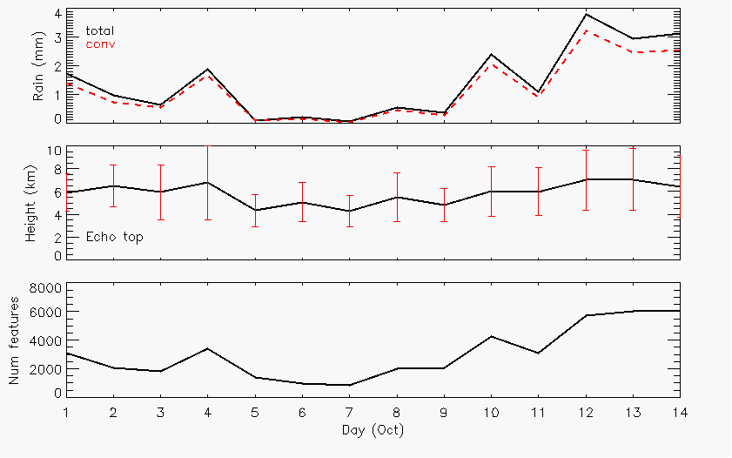
October
Rain
Echo-top heights
Number cells

Slide 6
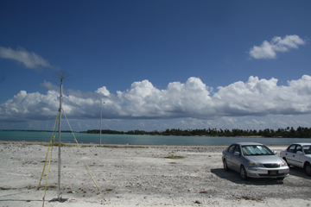
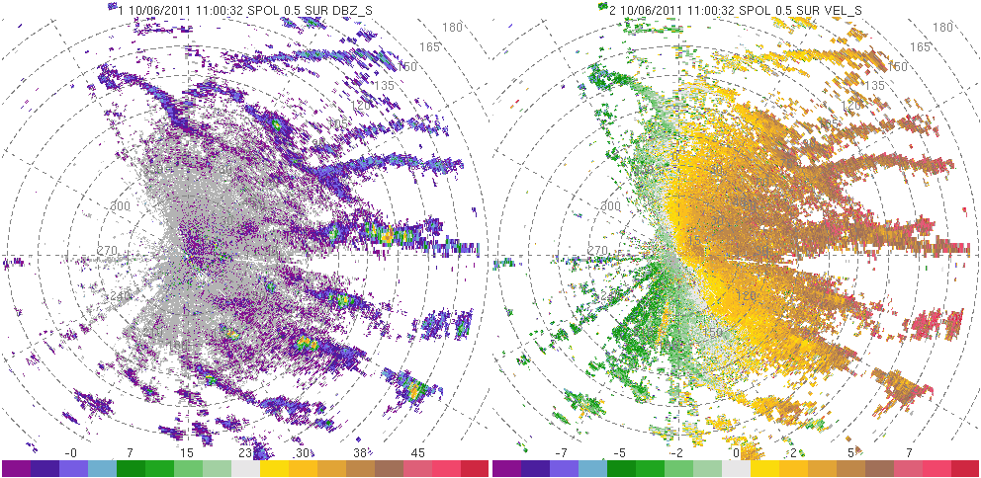
6 October
Photo: Bob Houze

Slide 7
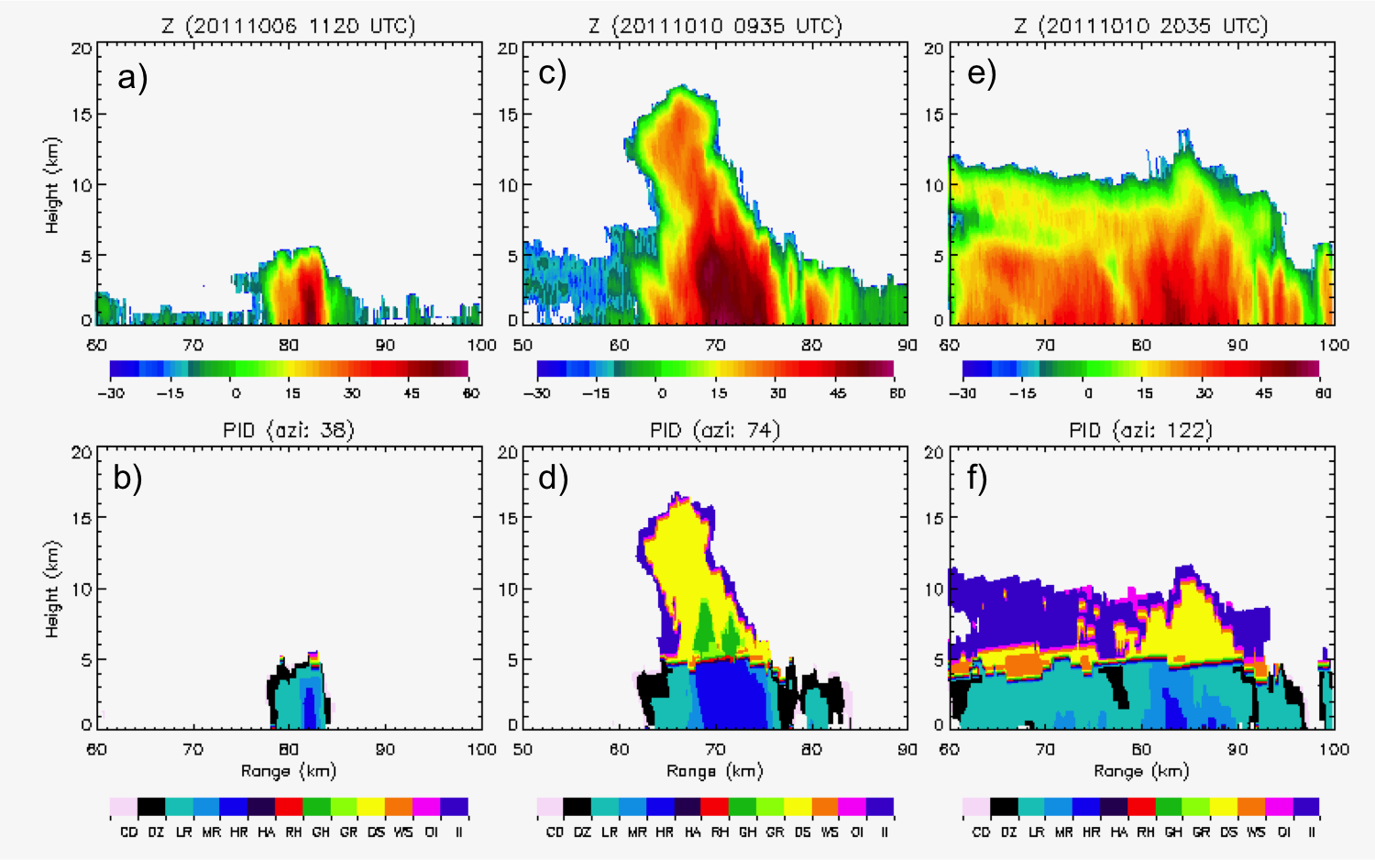
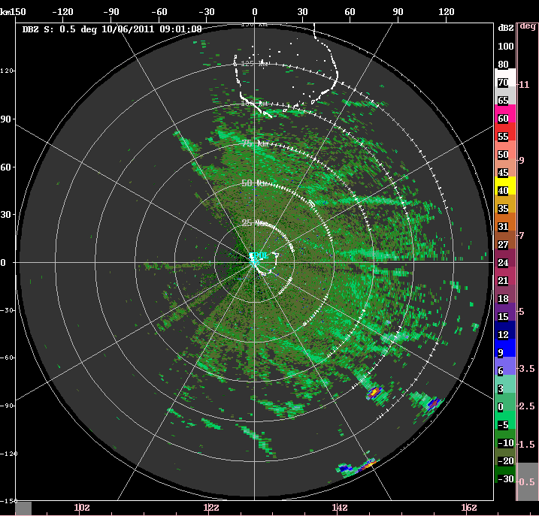
6 October
Heavy rain

Slide 8
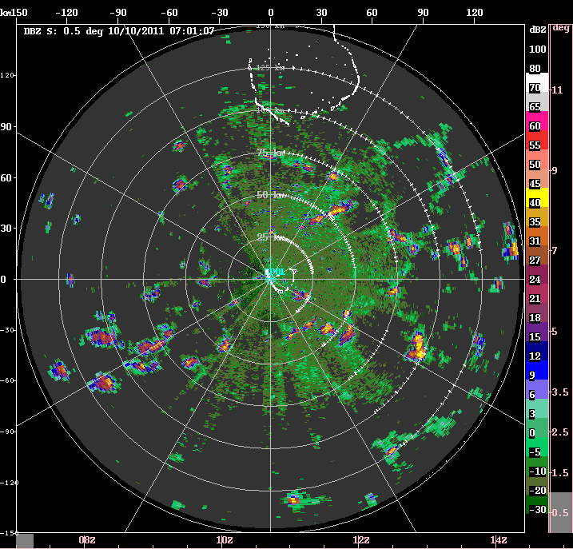
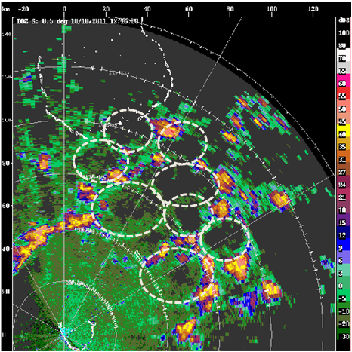
10 October
1215 UTC (1715 LT)
Feng et al. (2015): Mechanisms of convective cloud organization of cold pools over tropical warm ocean during the AMIE/DYNAMO field campaign
0700-1400 UTC (1200-1900 LT)

Slide 9
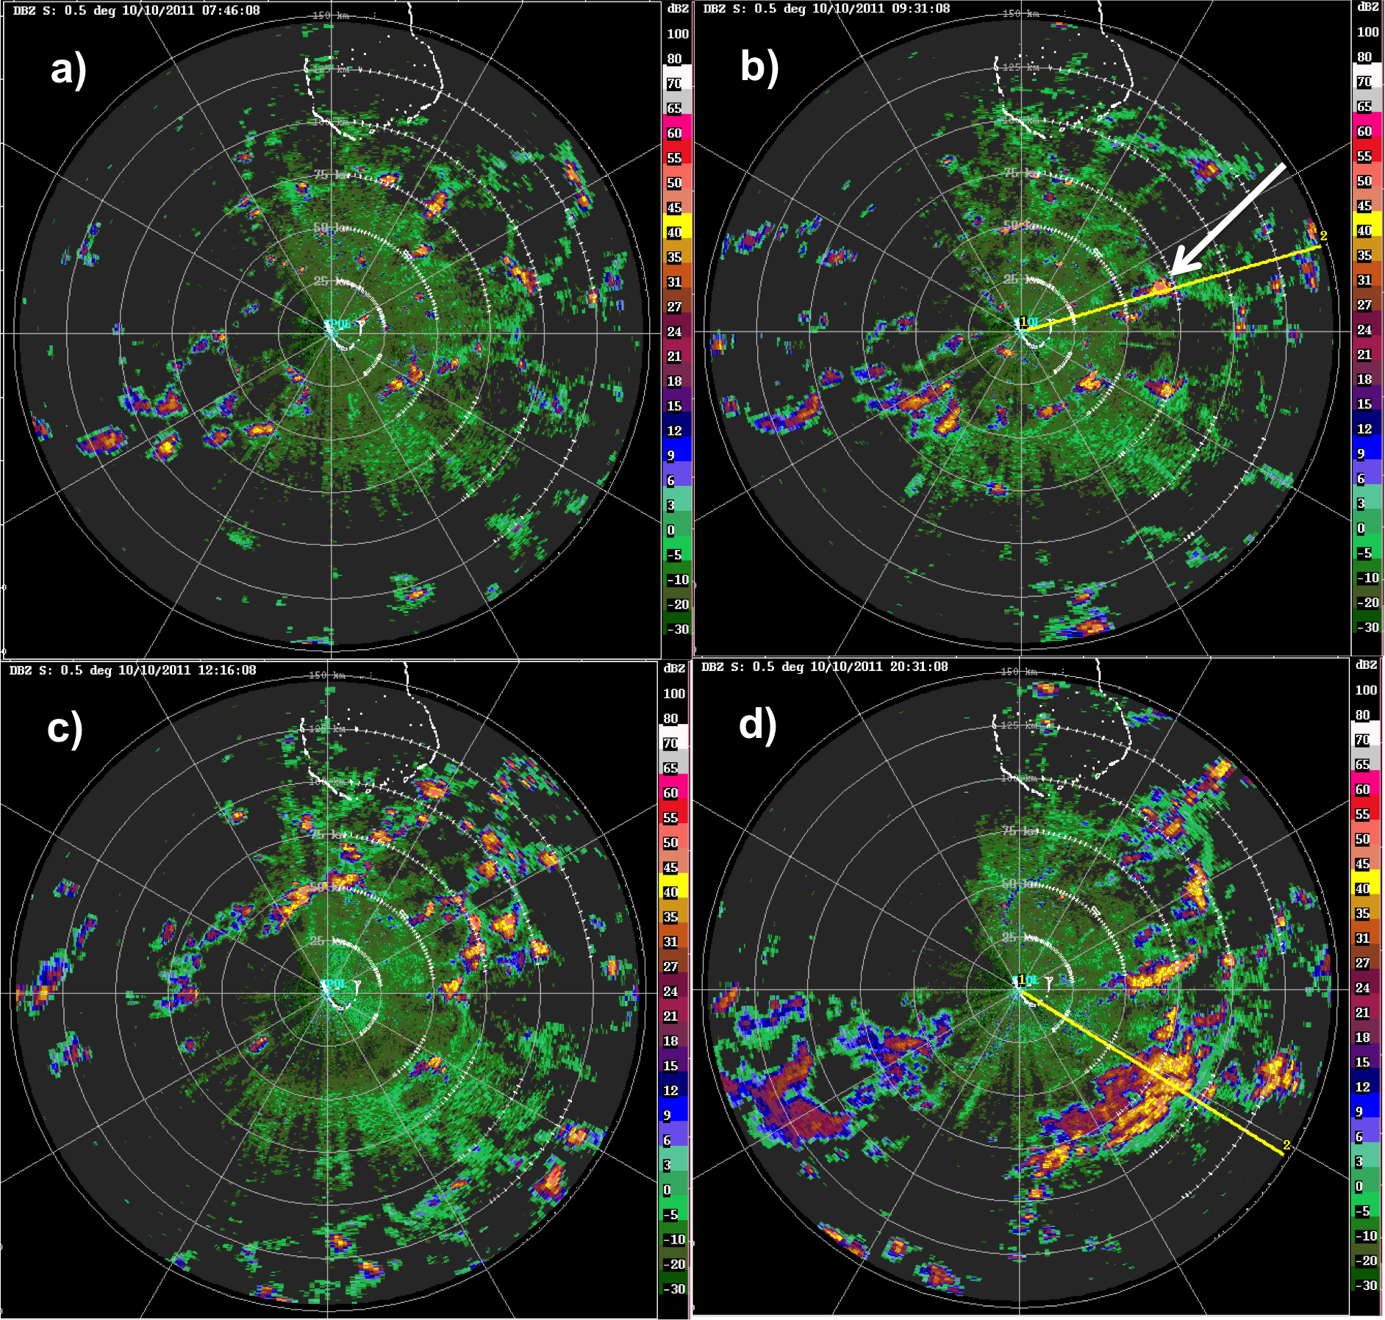
1430 LT
0130 LT
15 km

Slide 10
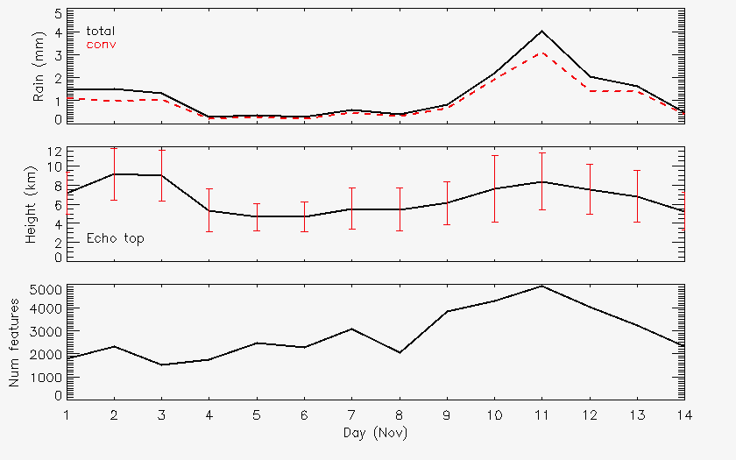
November
Rain
Rain
Echo-top heights
Echo-top heights
Number cells
Number cells

Slide 11
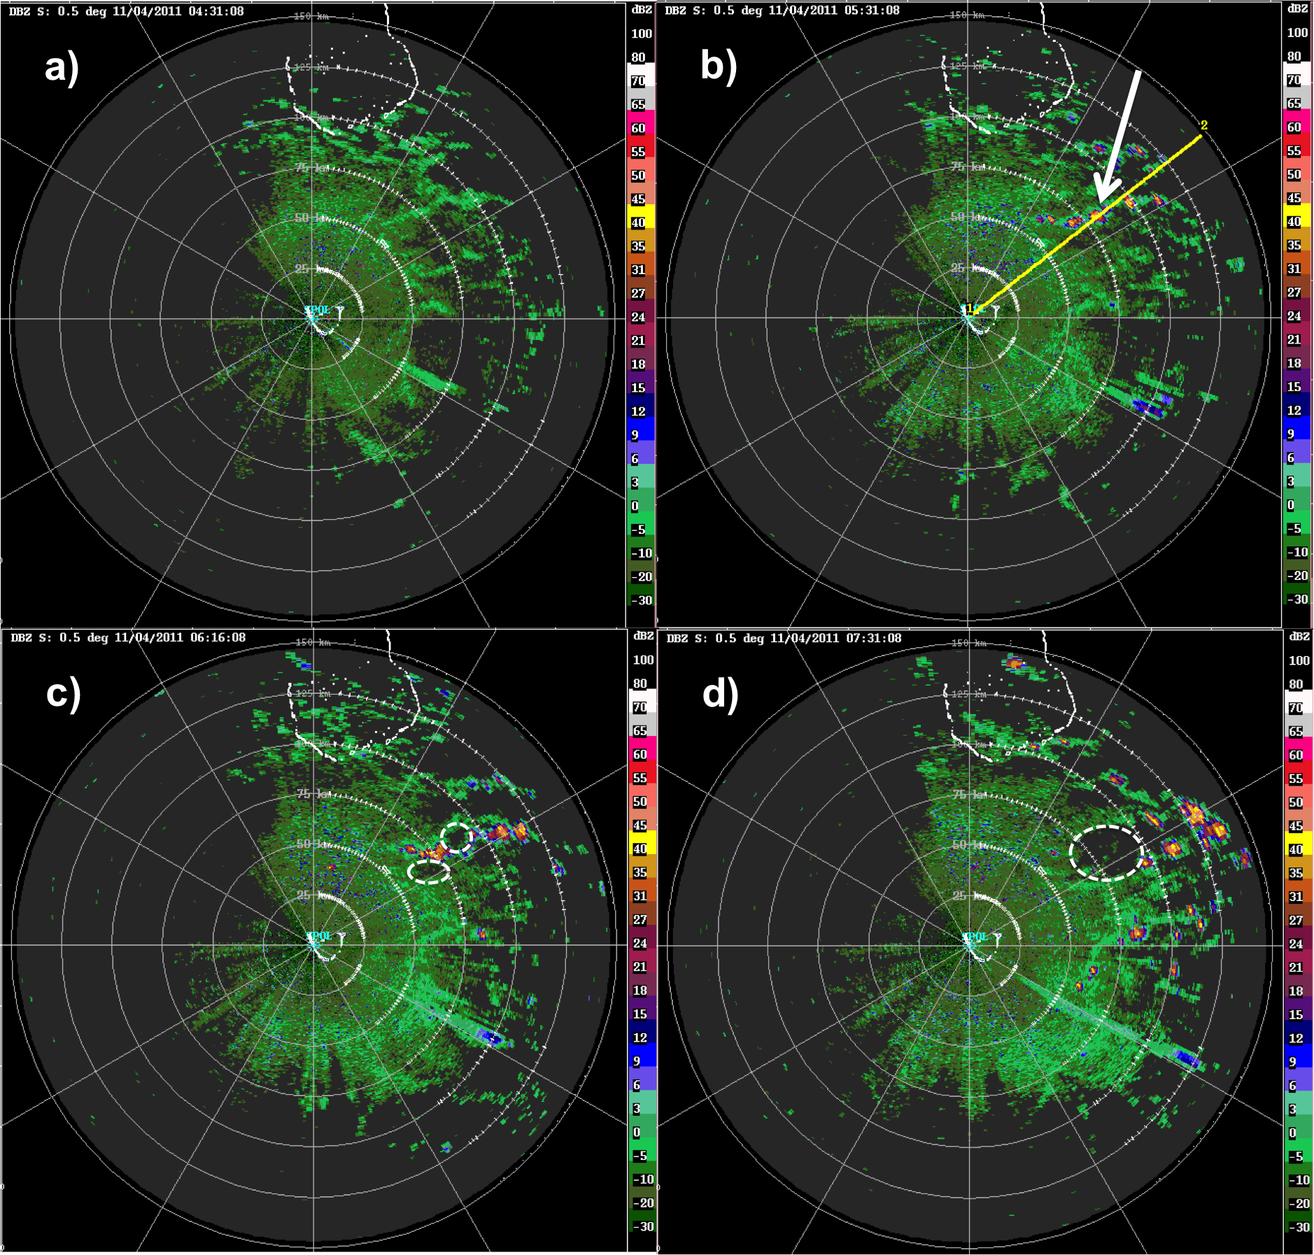
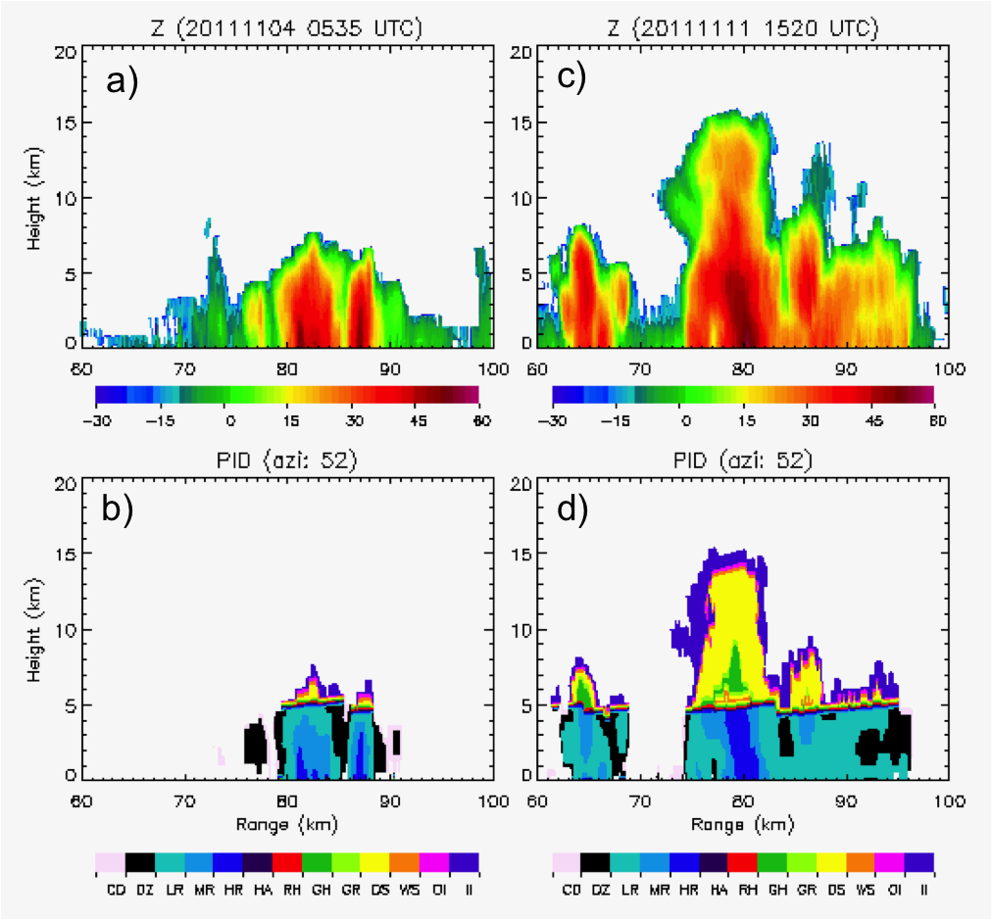
4 November
1030 LT
1230 LT
Heavy rain

Slide 12
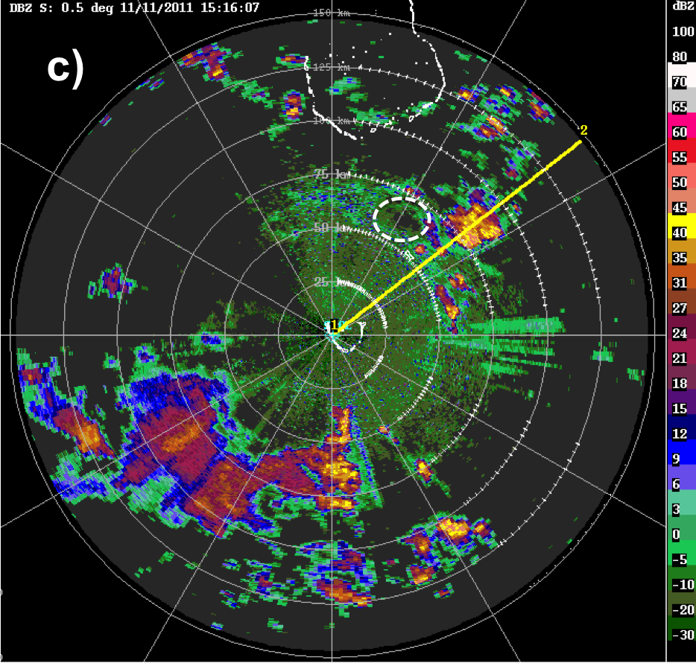
11 November
2016 LT

Slide 13
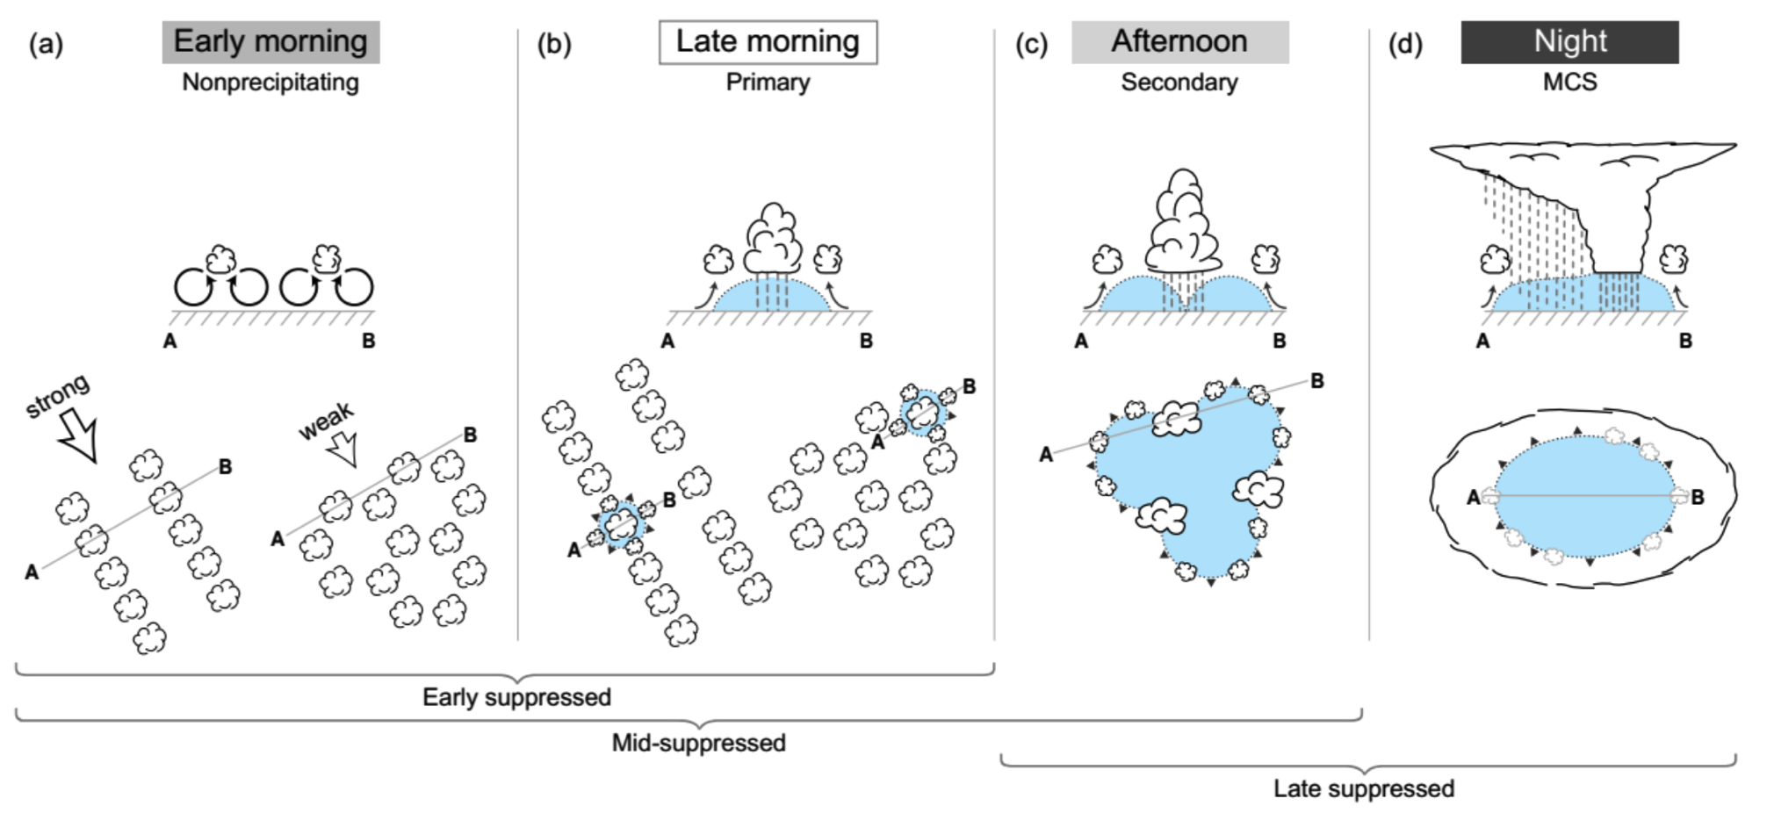
Conclusions
1. Early morning: Nonprecipitating clouds occur in horizontal lines parallel to flow (strong) or open cells (weak)

Slide 14
Conclusions
2. Late morning: Shallow clouds produce brief showers, producing small cold pools that trigger new convection

Slide 15
Conclusions
3. Afternoon: Deeper convection forms along intersecting cold pool boundaries (middle and later part of suppressed periods only)

Slide 16
Conclusions
4. Night: As transitions to active periods, convection grows upscale, leading to nocturnal MCSs

Slide 17
Take-home message
Need for accurate representation of oceanic boundary layer in models aimed at predicting MJO onset
Occurrence of boundary layer rolls/open cellular overturning is key to the formation of the first clouds that are robust enough to precipitate and generate cold pools
Chain reaction necessary for evolution of cloud population to more active MJO

Slide 18
Funded by NSF Grant #AGS-1355567 and DOE Grant #DE-SC0008452
Thank you!

Slide 19
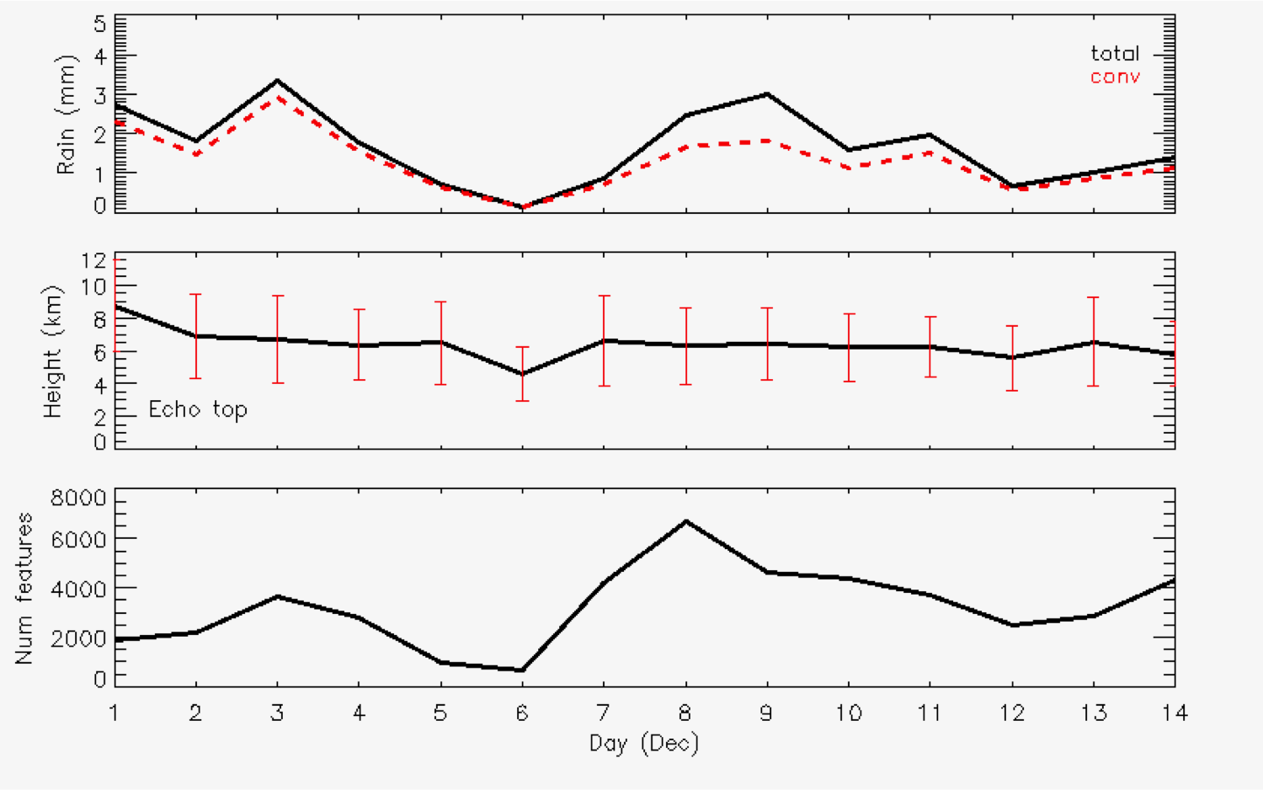
December
Rain
Rain
Echo-top heights
Echo-top heights
Number cells
Number cells

Slide 20
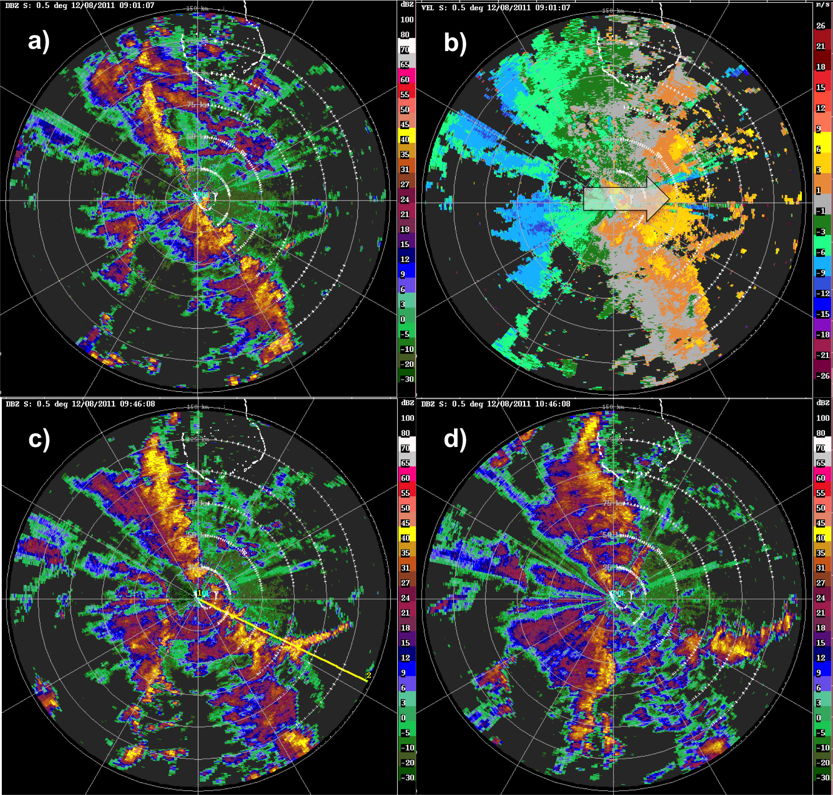

Slide 21
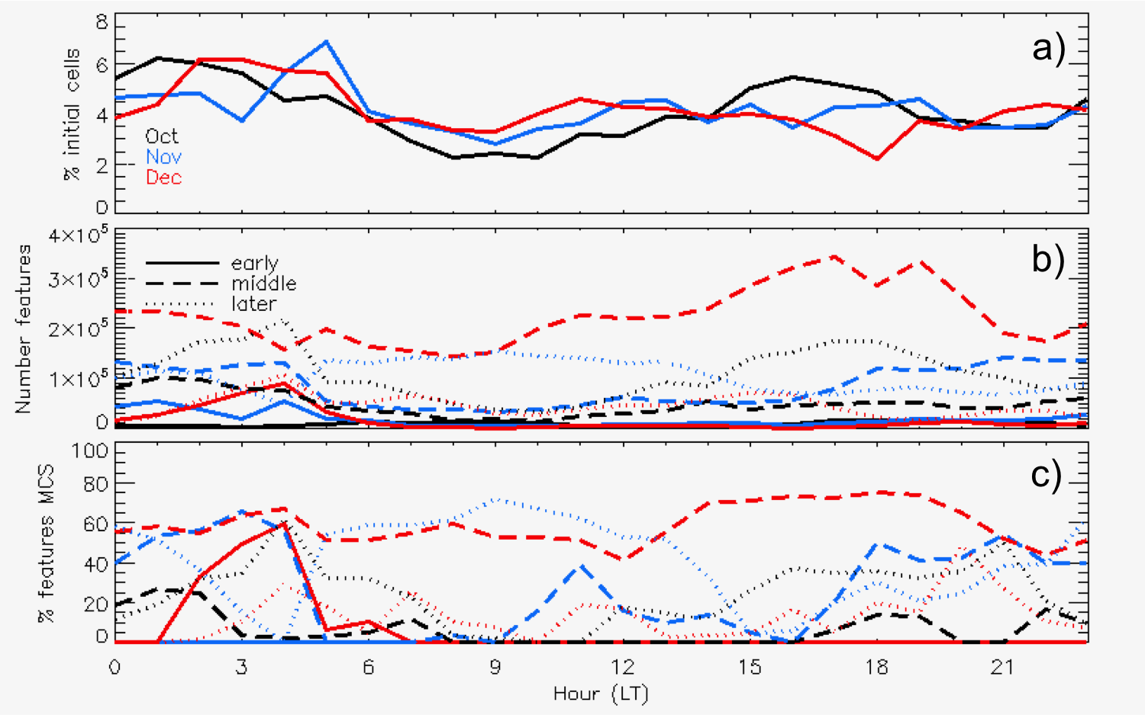
Time precipitating cells initiate
Total # precipitating features
% of features classified as MCSs

