Slide 1
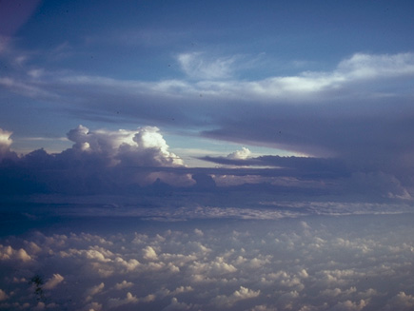
Anvil Clouds of Mesoscale Convective Systems
Robert A. Houze, Jr.
University of Washington
ASR Science Team Meetings, Bethesda, 20 November 2014

Slide 2
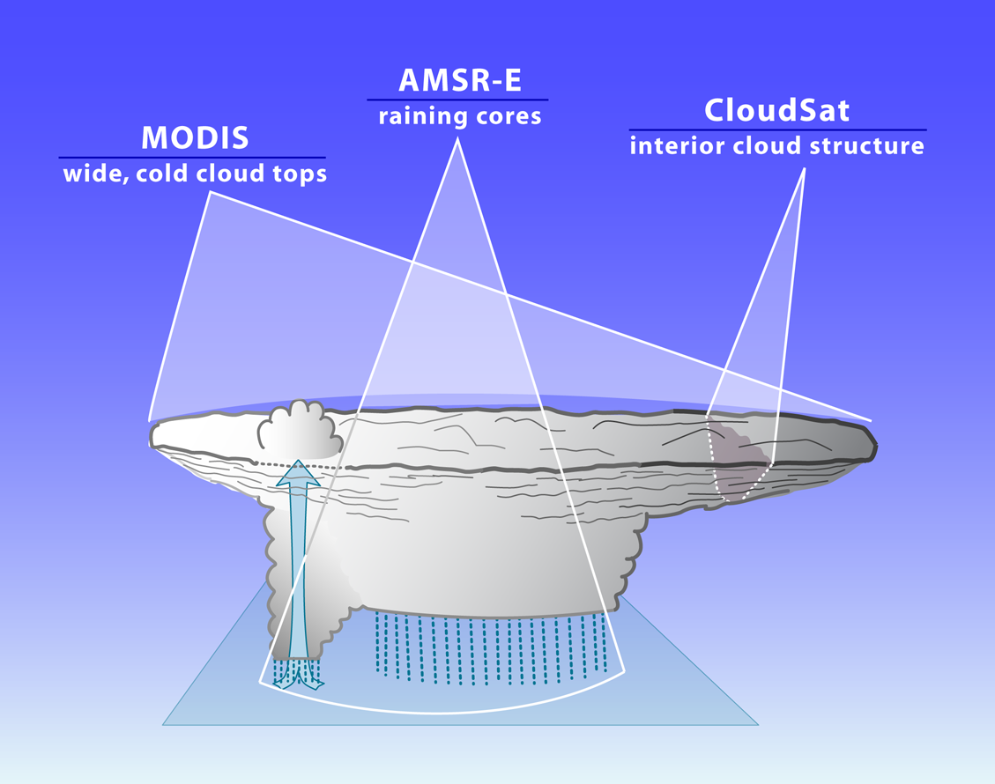
Mesoscale Convective Systems
2
3
1
From space
Notes:
CaPPM Meeting, JPL, Pasadena, October 1, 2014
A-Train offers the ability to see all 3 characteristics simultaneously. We take advantage of this ability.

Slide 3
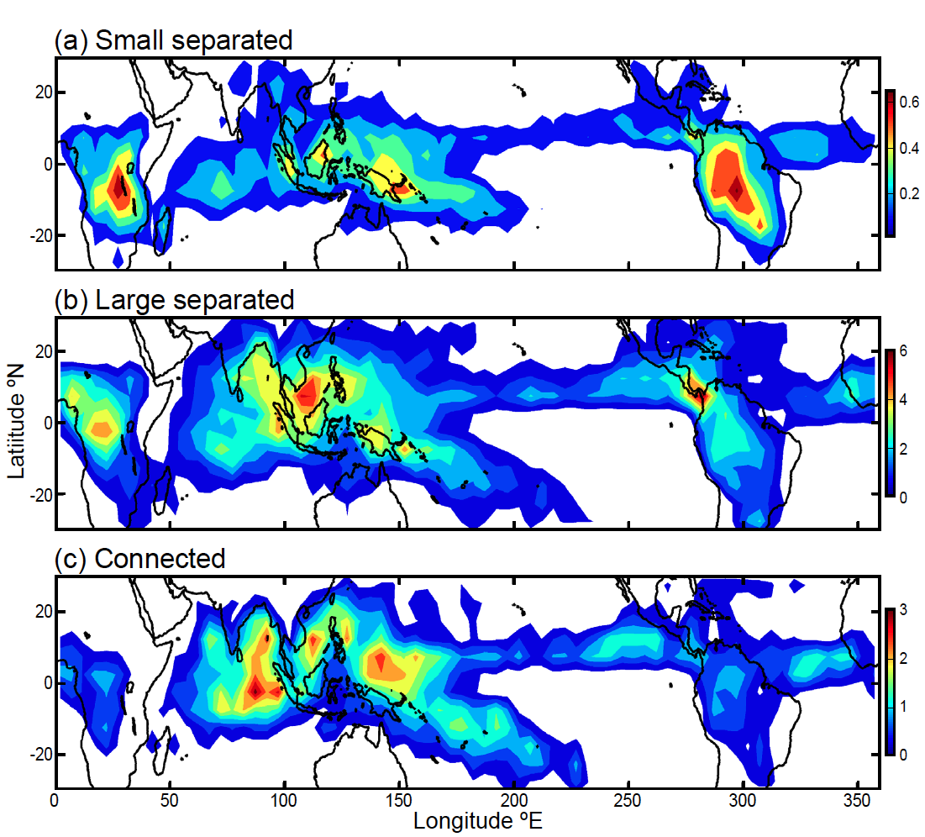
Frequency of MCS anvils over tropics
Yuan and Houze 2010
Notes:
Small: <12000 km**2
Large: >40000 km**2

Slide 4
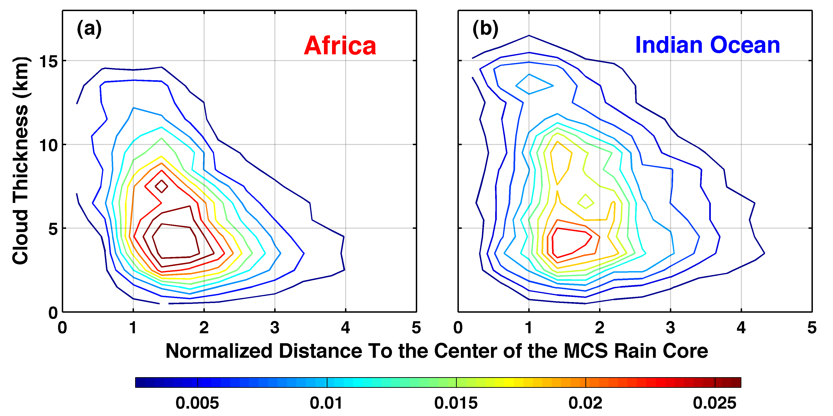
Width & thickness of MCS anvils seen by CloudSat
Africa
Indian Ocean
Yuan and Houze 2010
Notes:
CaPPM Meeting, JPL, Pasadena, October 1, 2014
Normalized by dimension of the MCS rain area

Slide 5
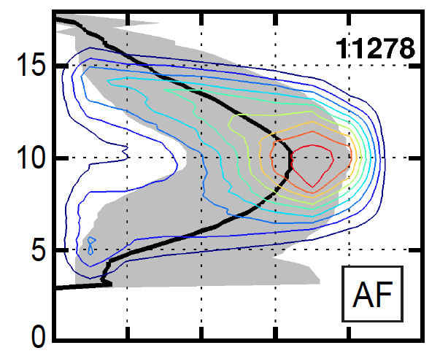
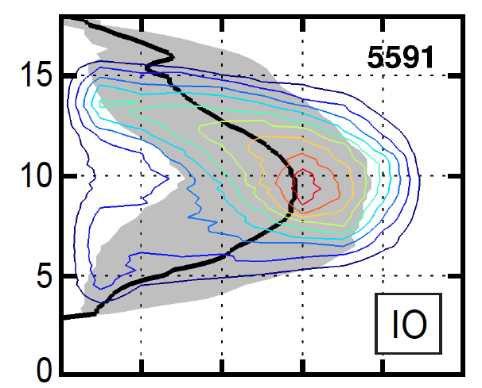

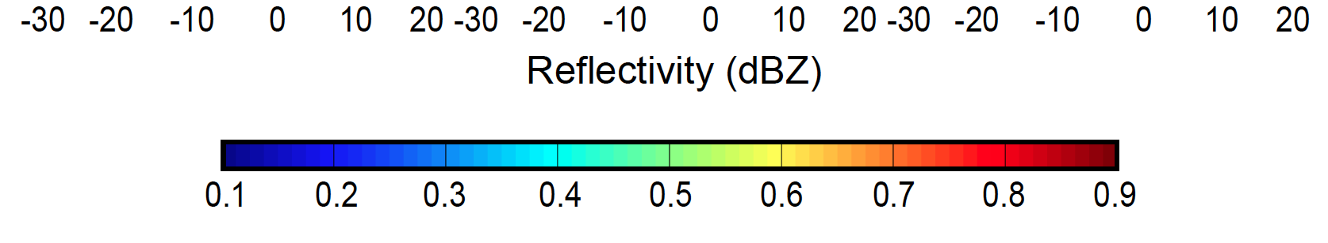
Internal structure of MCS anvils seen by CloudSat
Africa
Indian Ocean
Yuan, Houze, and Heymsfield 2011
Notes:
CaPPM Meeting, JPL, Pasadena, October 1, 2014
Black curves are medians

Slide 6
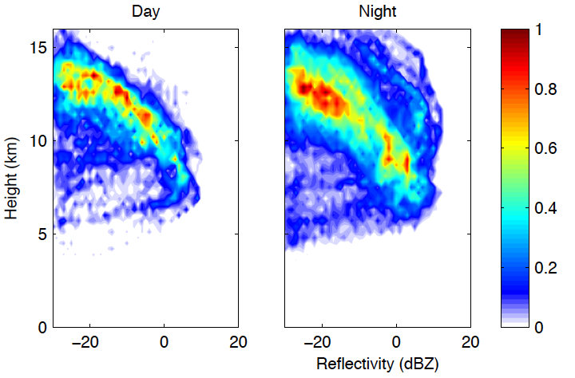
CloudSat CFADs of Large, separated MCSs over the Maritime Continent
Notes:
CloudSat Science Team Meeting, Alexandria, VA, 5 November 2014

Slide 7
Is there a framework for quantifying bulk anvil structures?

Slide 8
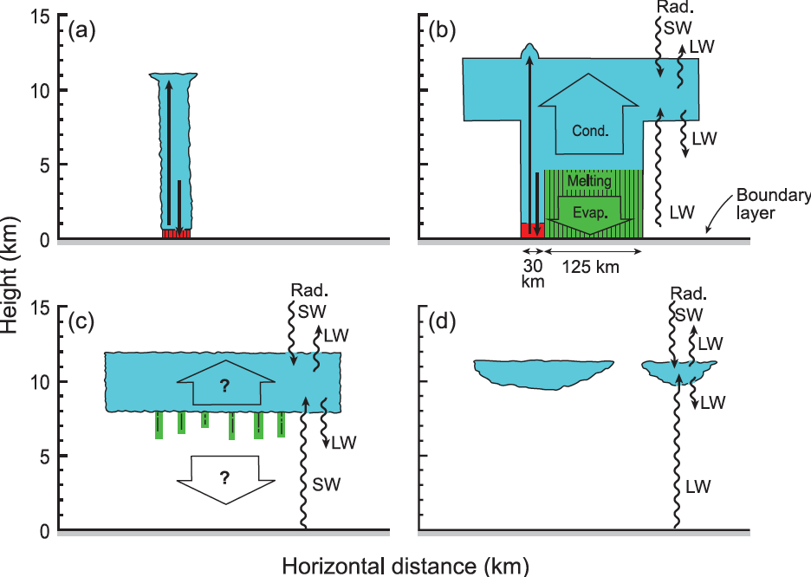
MCS anvil is the result of a life cycle process
Houze 1982

Slide 9
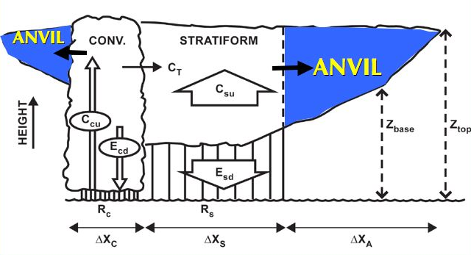
The time-integrated MCS anvil process
Mesoscale Convective System
Need to understand how anvil is related to the raining region
Extensively studied
Notes:
AGU, San Francisco, 5 December 2012

Slide 10
Dimensions and hydrometeor content of anvils are determined by the same cloud dynamics that produce the precipitation

Slide 11
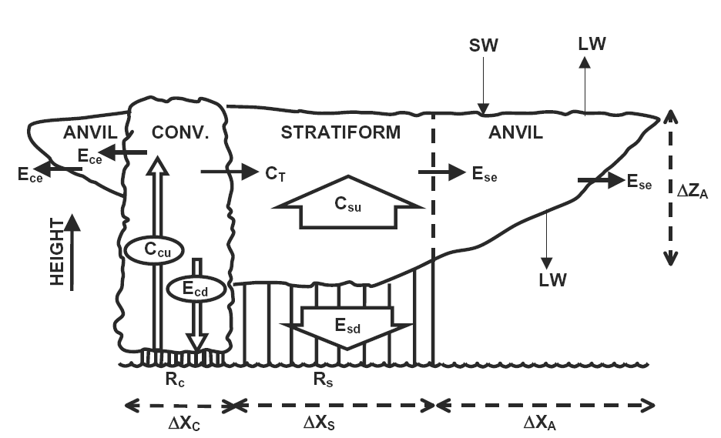
Breakdown of the water budget
ΔZ_{AC}
A_{c}
A_{s}
ΔX_{AC}
After Houze et al. (1980)
Notes:
ARM Radiative Heating Profile Workshop, 8-9 January 2007, San Diego, CA, USA
Houze et al. 1980 broke the composite system down into its key components. The SW and LW represent the radiative energy absorbed and emitted by the anvil. The other symbols represent terms in the internal water budget of the cloud system. Note that the Ese and Ece terms represent the bulk amount of hydrometeor mass input into the anvils of the convective and stratiform regions, respectively. Note that these quantities are terms within the water budget of the whole cloud system. The premise of our study is t hat all the water budget terms can be estimated empirically from special datasets, such as TWP-ICE.

Slide 12
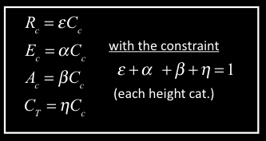
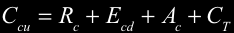
ΔZ_{AC}
A_{c}
A_{s}
A_{s}
ΔX_{AC}
Convective region water budget
with the constraint
(each height cat.)
Notes:
ARM Radiative Heating Profile Workshop, 8-9 January 2007, San Diego, CA, USA

Slide 13
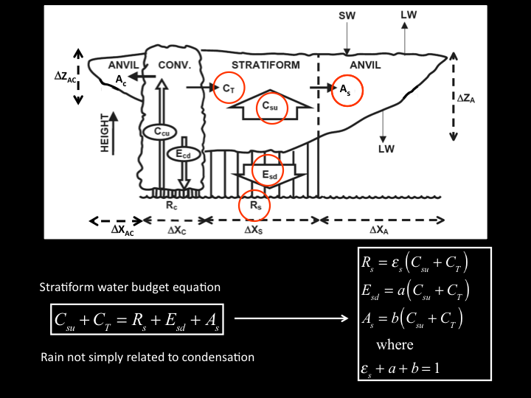
ΔZ_{AC}
A_{c}
A_{s}
A_{s}
ΔX_{AC}
Stratiform water budget equation
Rain not simply related to condensation
Notes:
ARM Radiative Heating Profile Workshop, 8-9 January 2007, San Diego, CA, USA
This slide shows how the water budget terms can be combined to give the water budget of the stratiform region. For simplicity of presentation the box on the left shows only the equations for the stratiform region. The convective region budget is analogous.
Note that the Ece and Ese terms are of primary interest for this study and for ARM in general. We plan to obtain the best observationally based estimates of these terms as a principal objective of our study.
Note that we do not simply aim to determine the magnitude of the Ecs & Ese terms. We also aim to gain insight into the processes by which the anvil is generated as a product of the convective cloud system.
Insight into processes underlies good parameterization of anvil produced by convective systems.
Insight can be gained via interrelationships of terms. Could study the interrelationships via modeling. In this study we will do it empirically.
The right-hand box shows how the terms are interrelated.
To illustrate our methods, we will indicate our approach to obtaining the Ese term from the water budget of the SF region. The Ece term is obtained by analogous procedures from the convective region water budget.

Slide 14
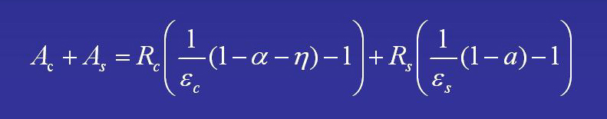
ΔZ_{AC}
A_{c}
A_{s}
A_{s}
ΔX_{AC}
Total anvil water content
Notes:
8 November 2006, ARM Cloud Processes Working Group, Annapolis, MD

Slide 15
ΔZ_{AC}
IWC
A_{c}
A_{s}
IWC
A_{s}
ΔX_{AC}
Dimensions and hydrometeor content of anvils are determined by the same cloud dynamics that produce the precipitation—need to determine them to close the MCS water budget
Notes:
ARM Radiative Heating Profile Workshop, 8-9 January 2007, San Diego, CA, USA

Slide 16
What do we know about the bulk internal structure of MCS anvils from observations?

Slide 17
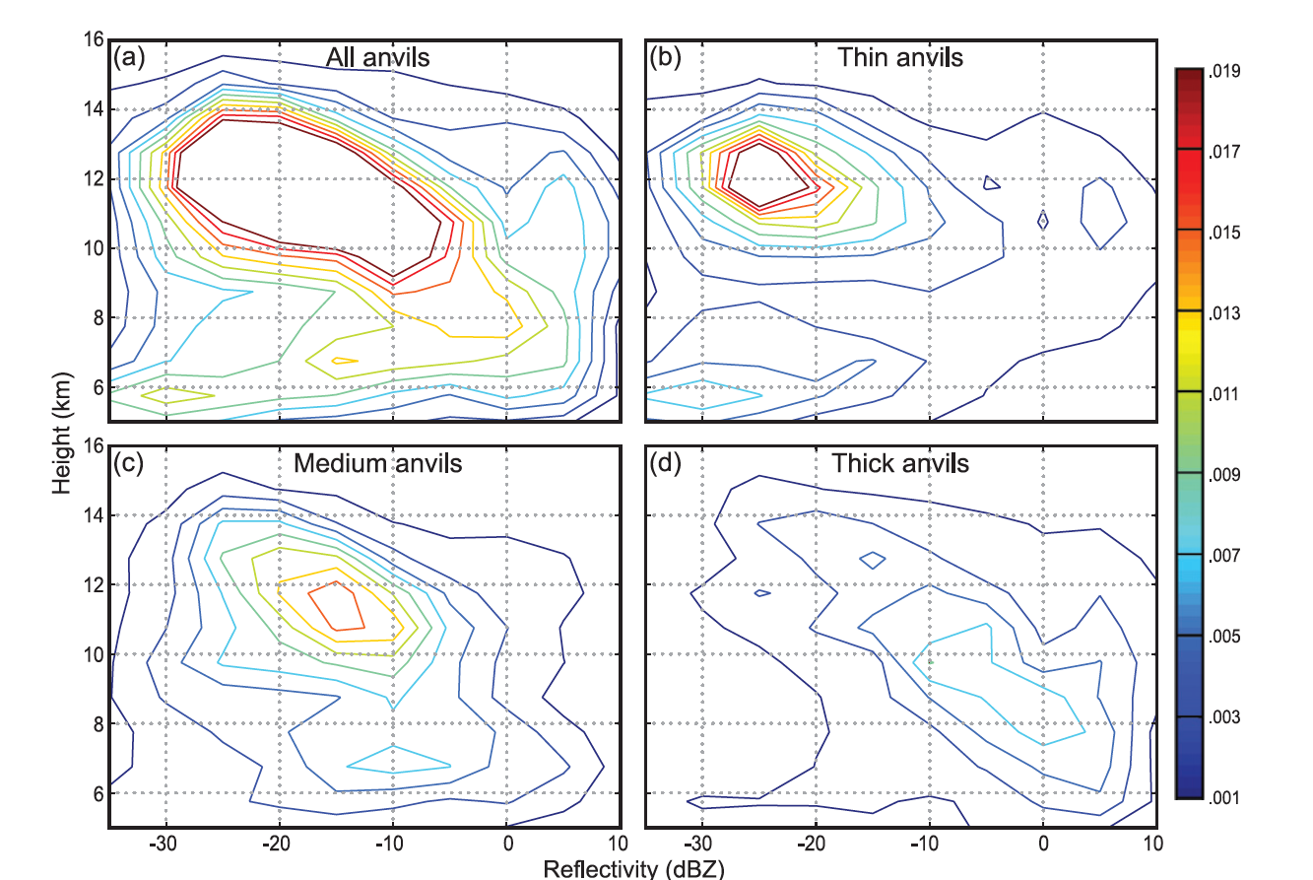
Anvil clouds observed by WACR at Niamey
Powell et al. 2012
Notes:
From Powell et al. 2012

Slide 18
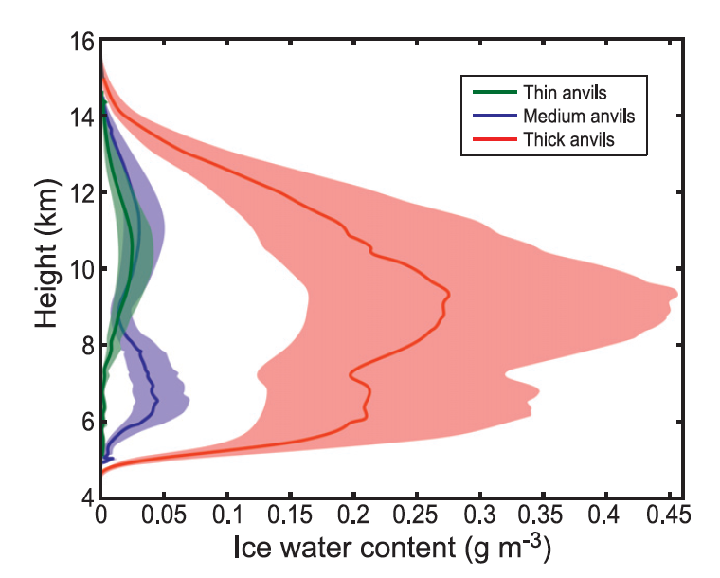
Anvil clouds observed by WACR at Niamey
Powell et al. 2012
Notes:
From Powell et al. 2012

Slide 19
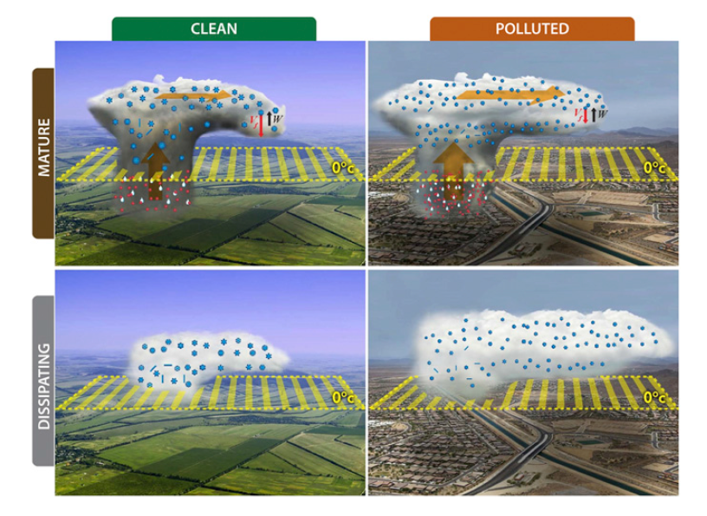
Aerosol effect on anvils
Fan et al. 2013

Slide 20
Take-home points:
Larger MCSs are primary producers of anvils over the tropics
Anvils are a product of lifecycle of the MCS → lifecycle studies are critical
Anvil characteristics determined by environment: land, ocean, day, night, …
Anvils not dynamically separate from the precipitating part of the MCS
Anvils and precipitating sectors need to be physically consistent
Anvils and precipitating sectors are linked via the MCS water budget
Latent heating and radiative heating are linked → should not be separated
Anvils are likely affected by the aerosol environment, but…

Slide 21
End
This research was supported by DOE grant DE-SC0008452 / ER-65460 and NASA grant NNX13AQ37G

Slide 22
Extra Slides

Slide 23
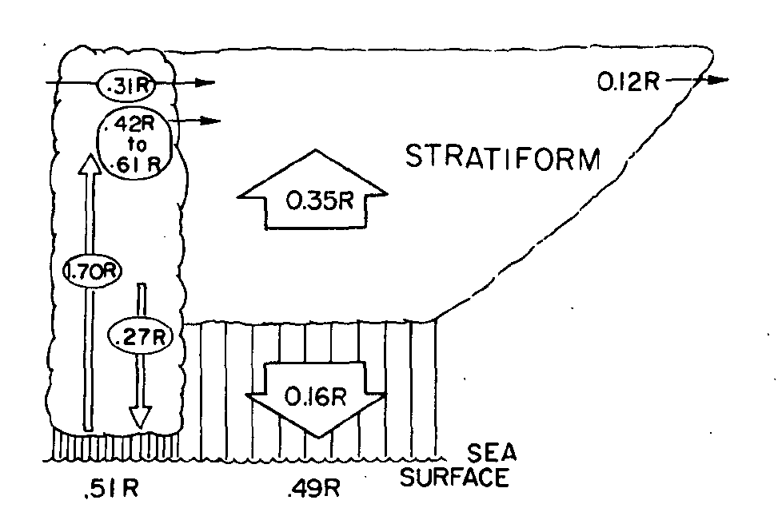
Time-integrated Water Budget
0
.13R
.37R
1.17R
.41R
GATE—oceanic
(Gamache & Houze 1983)
COPT81—continental
(Chong & Hauser 1989)
.16R
.29R
.60R
.40R
Notes:
10 July 2006, NCAR, Boulder, Heating And Momentum Feedbacks Workshop

Slide 24
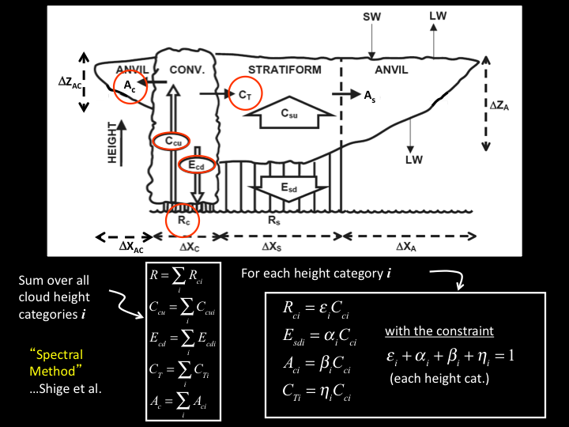
ΔZ_{AC}
A_{c}
A_{s}
A_{s}
ΔX_{AC}
Sum over all cloud height categories i
For each height category i
with the constraint
(each height cat.)
Notes:
ARM Radiative Heating Profile Workshop, 8-9 January 2007, San Diego, CA, USA

Slide 25
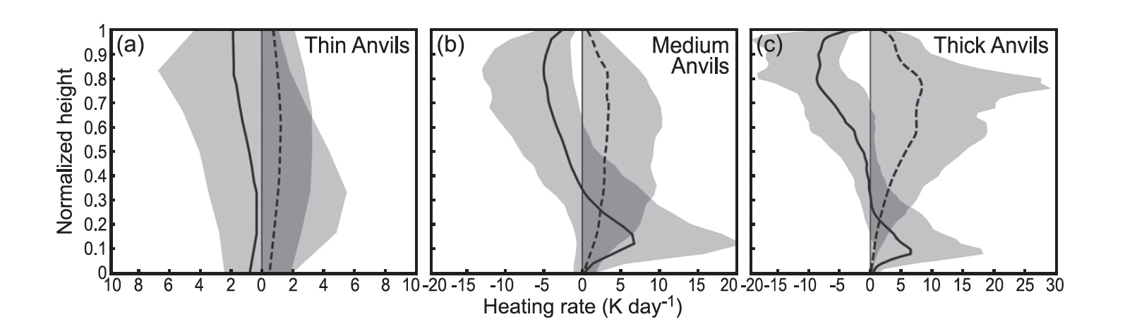
Anvil clouds observed by WACR at Niamey
Powell et al. 2012
Notes:
From Powell et al. 2012

