Slide 1
Maritime Continent Convection
—as seen by A-Train and TRMM
R. Houze, K. Virts, A. K. Rowe, M. D. Zuluaga
University of Washington
CloudSat Science Team Meeting, Alexandria, VA, 5 November 2014

Slide 2
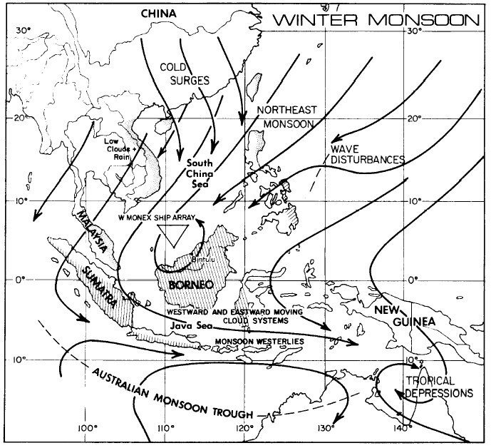

Winter MONEX
December 1978 January 1979
Johnson & Houze 1987

Slide 3
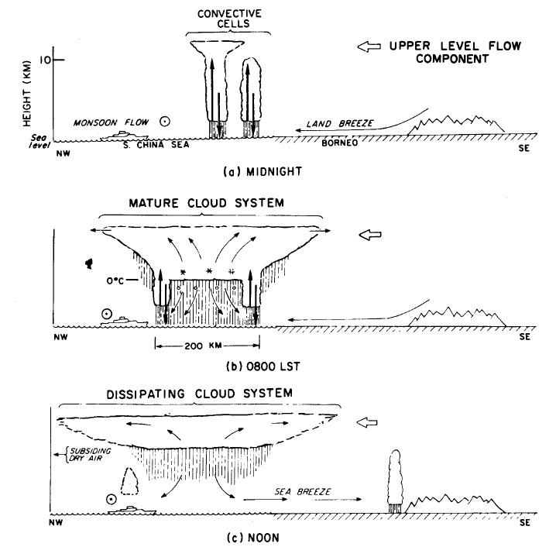

Radar Obs. of WINTER MONEX Borneo cloud system
Bintulu
S. CHINA SEA
BORNEO
Bintulu
Stratiform Precipitation
Bintlu
Houze et al. 1981

Slide 4
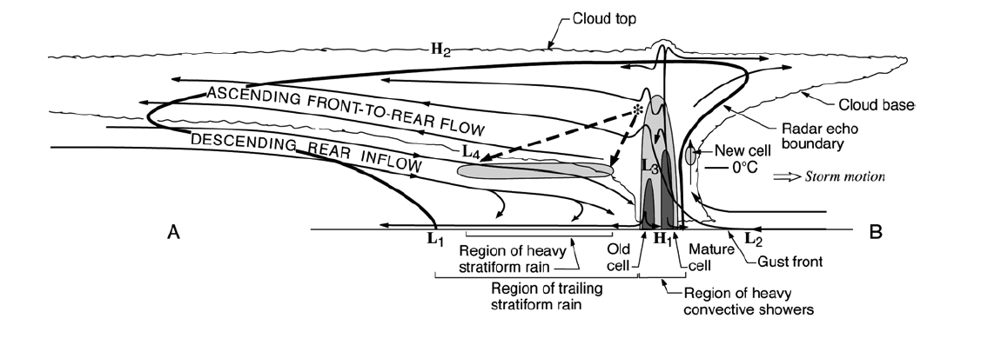
Components seen by A-Train
Cold top
Anvil
Anvil
Raining core
Houze et al. 1989
MODIS, AMSR-E, CloudSat
Notes:
The basic components of an MCS can be simplified into 3 main features, which can be identified and MEASURED by satellite. The combination of these three properties can be used to identify an MCS if they satisfy certain criteria. Thus we can determine when and where MCSs occur around the globe. In addition we can determine how the properties of these three components vary from region to region. How big and wide is the cold top; how big and intense is the raining core; how thick are the anvils; and what are the characteristics of their internal structure. And how do these properties vary around the globe? One cannot holistically determine the properties of MCSs by identifying one of these properties alone. It’s important to see and evaluate all 3.

Slide 5
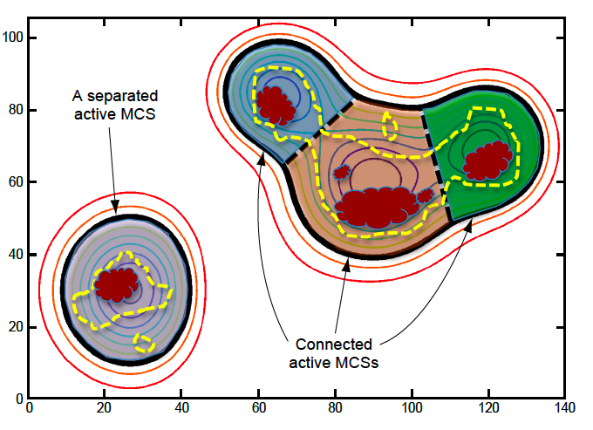
Identify Mesoscale Convective Systems
260K
HeavyRain
Closed contour
Rain
Separated
HCS
“Separated” active MCS
“MCS”
“Connected” active MCS

Slide 6
TRMM separates precipitation
Cold top
Stratiform
Convective
Anvil
Anvil
Raining core
Houze et al. 1989
Deep convective cores
Broad stratiform regions
Notes:
The basic components of an MCS can be simplified into 3 main features, which can be identified and MEASURED by satellite. The combination of these three properties can be used to identify an MCS if they satisfy certain criteria. Thus we can determine when and where MCSs occur around the globe. In addition we can determine how the properties of these three components vary from region to region. How big and wide is the cold top; how big and intense is the raining core; how thick are the anvils; and what are the characteristics of their internal structure. And how do these properties vary around the globe? One cannot holistically determine the properties of MCSs by identifying one of these properties alone. It’s important to see and evaluate all 3.

Slide 7
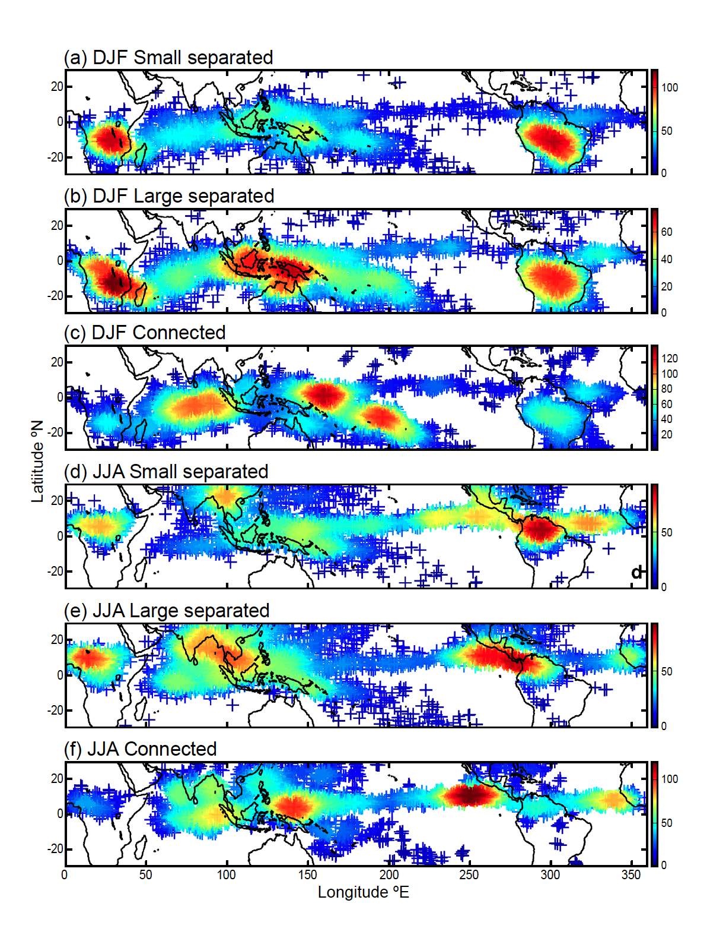
A-Train Identification of MCSs
Smallest 25% (<12,000 km²)
Largest 25% (>40,000 km²)
“Superclusters”
Yuan and Houze 2010
Yuan and Houze 2010
Notes:
Size of MCS is size of cold cloud top. To qualify as MCS, must have large cold cloud top, large rain area, and some heavy rain. This figure shows spatial distribution of active MCSs. Color of each point shows the number of active MCSs found within a circular area with radius of five degrees centered on that point. (a) Small separated MCSs (<12,000km2; i.e., the smallest 25%) in DJF, (b) large separated MCS (>40,000km2; i.e., the largest 25%) in DJF, (c) connected MCS in DJF, (d)-(f) same as (a)-(c) except for JJA.

Slide 8
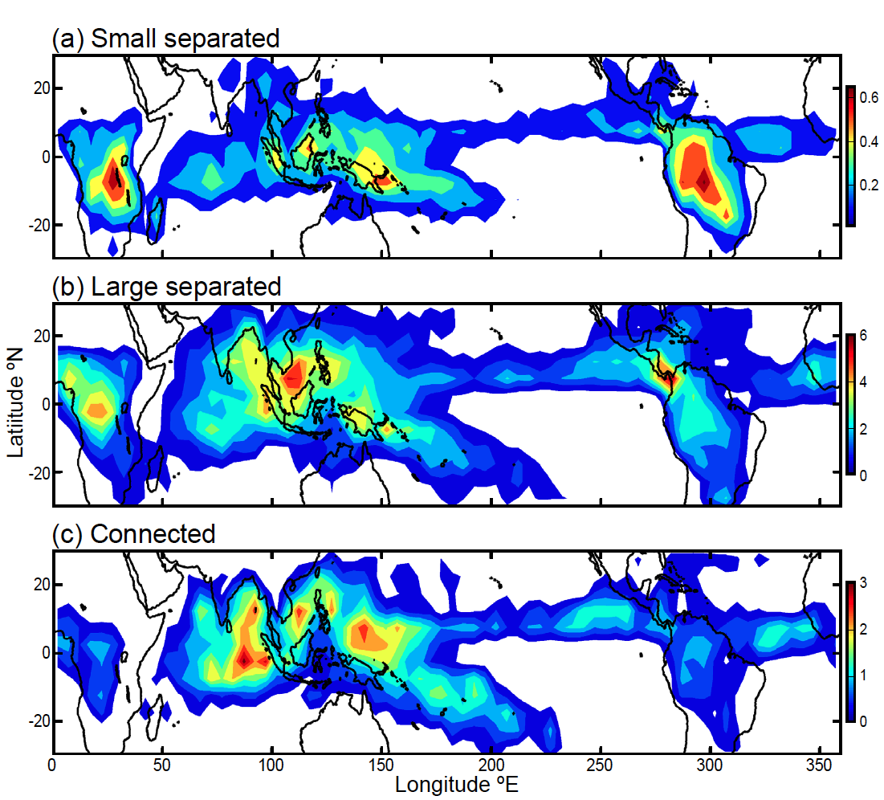
Frequency of MCS anvils over tropics
Yuan and Houze 2010

Slide 9
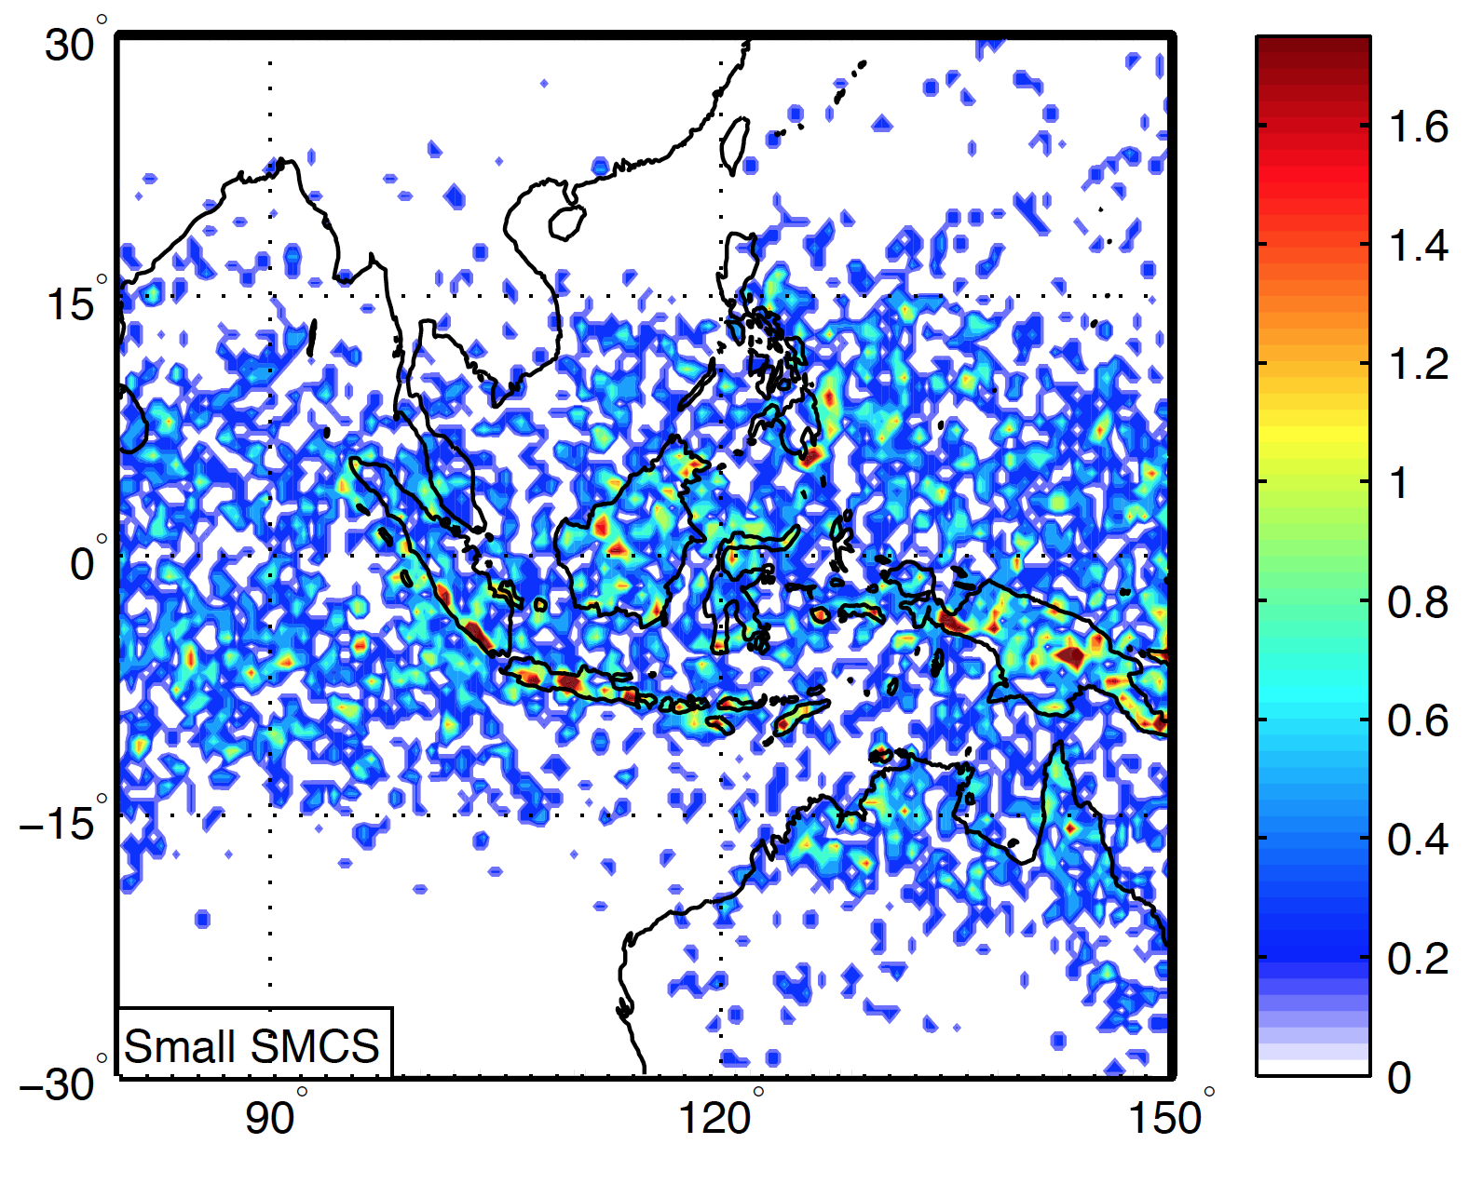
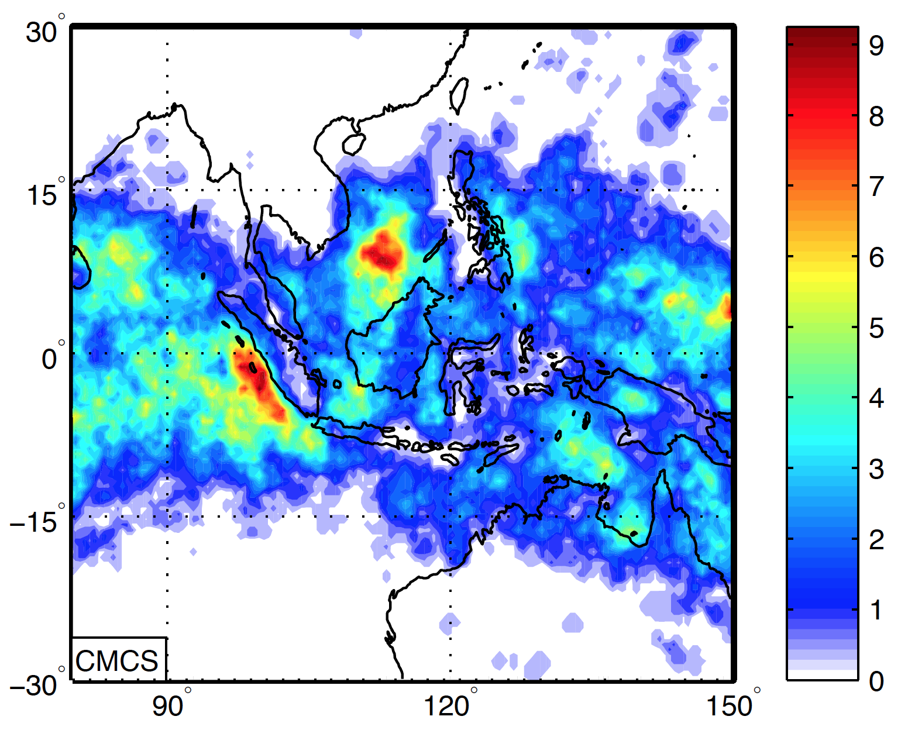
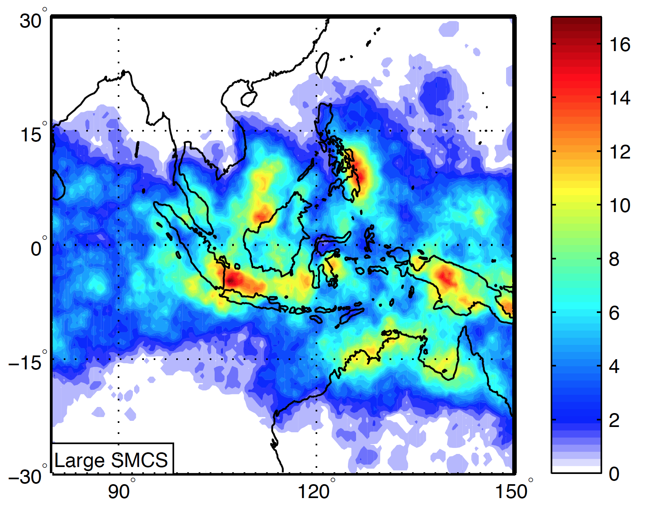
Frequency of small separated, large separated, and connected MCSs for Jan, Feb, Nov, and Dec 2007-2010 (all times)
Notes:
Frequency of connected MCSs more over ocean, while separated MCSs concentrated over land
Uses Jian’s A-Train-based MCS database

Slide 10
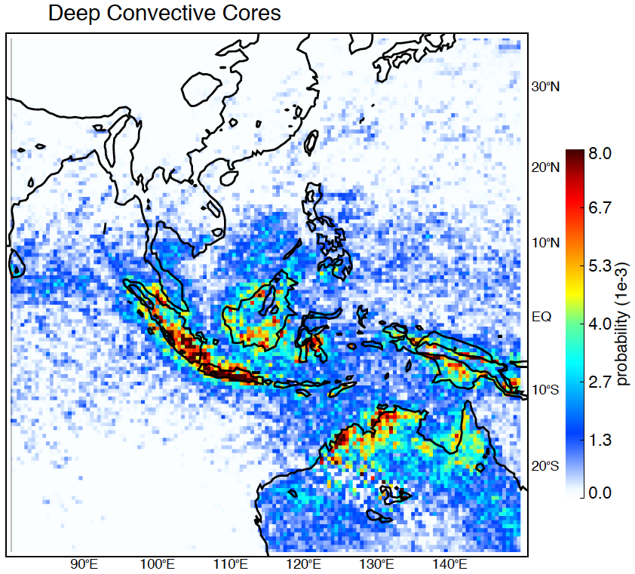
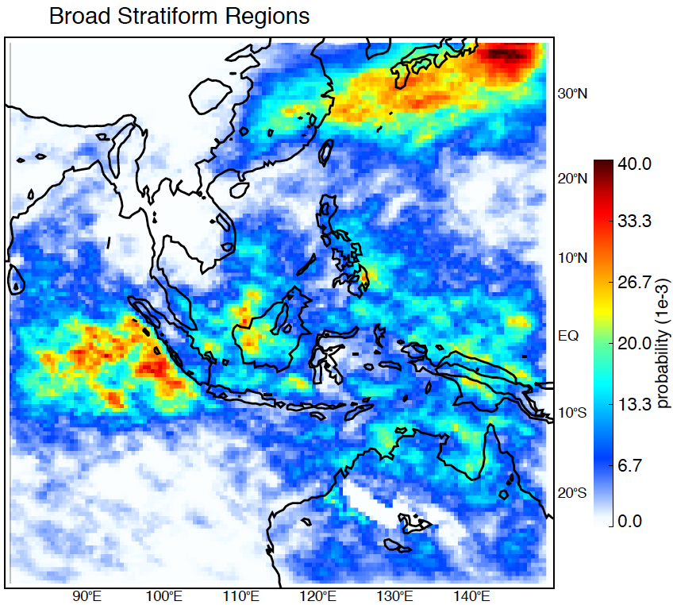
Deep Convective Cores
Broad Stratiform Regions
Probability of a location being under a Deep convective Core or Broad Stratiform radar echo during the months of NDJF of 1998-2013.

Slide 11
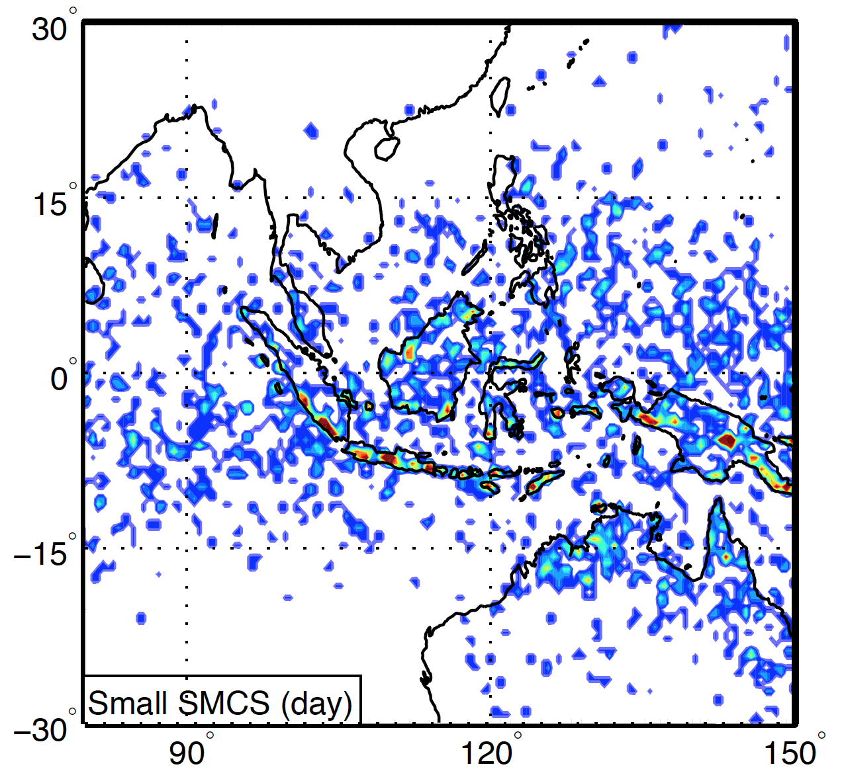
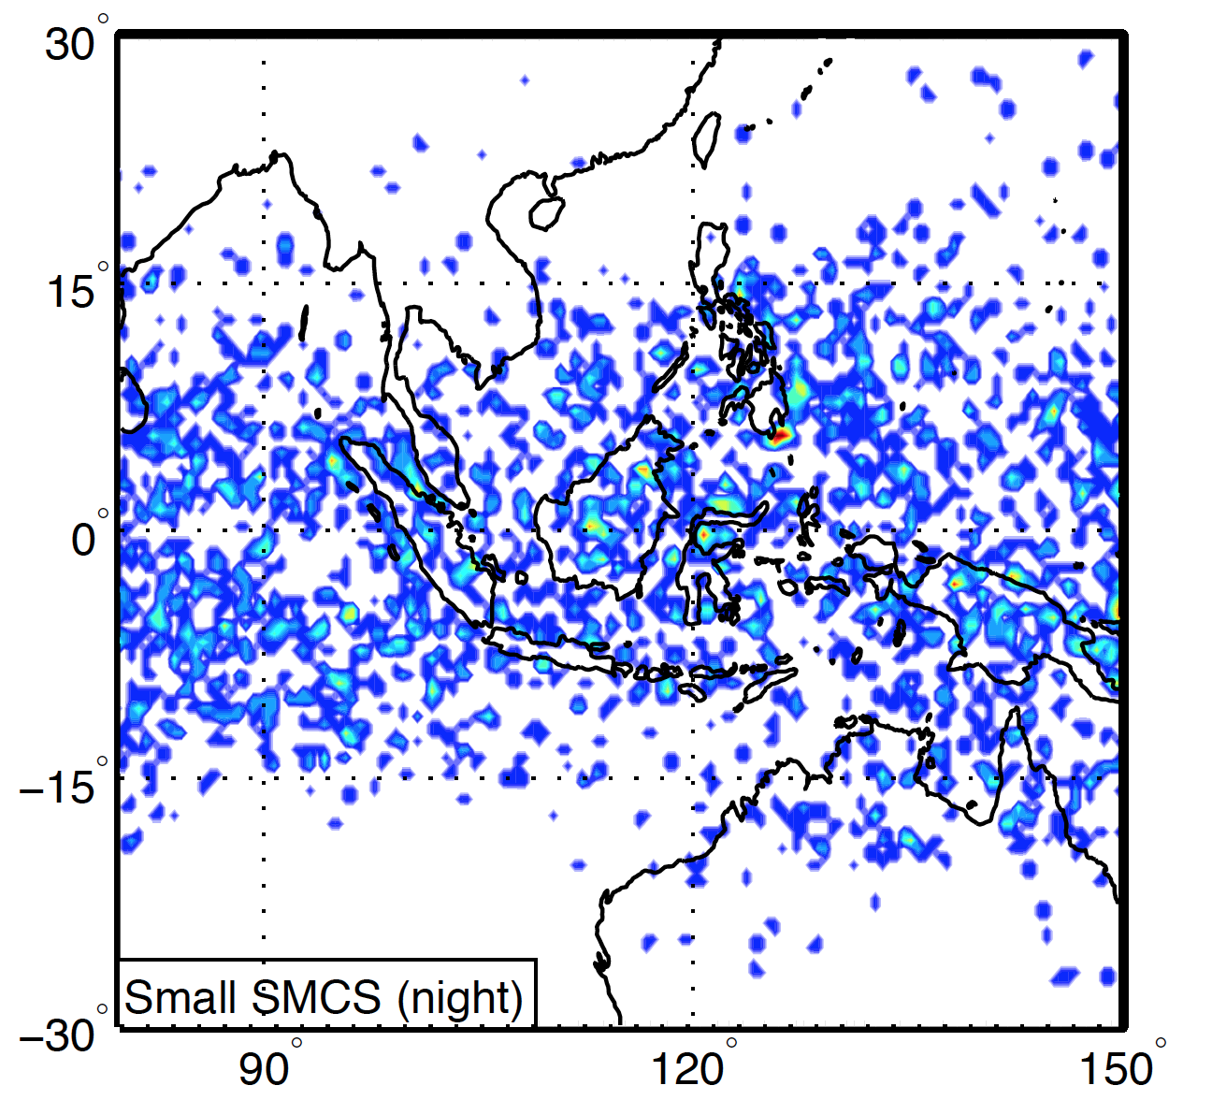
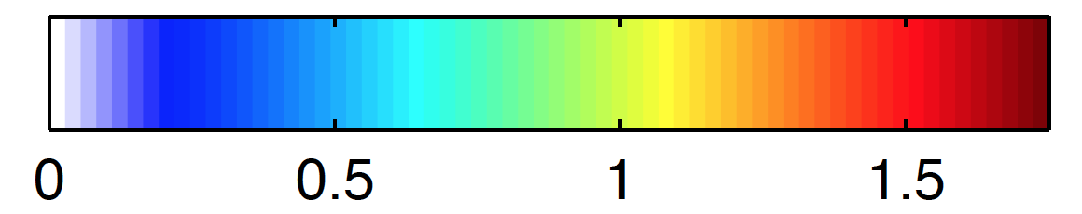
Small, separated MCSs
During day, more frequent over land, esp. coasts

Slide 12
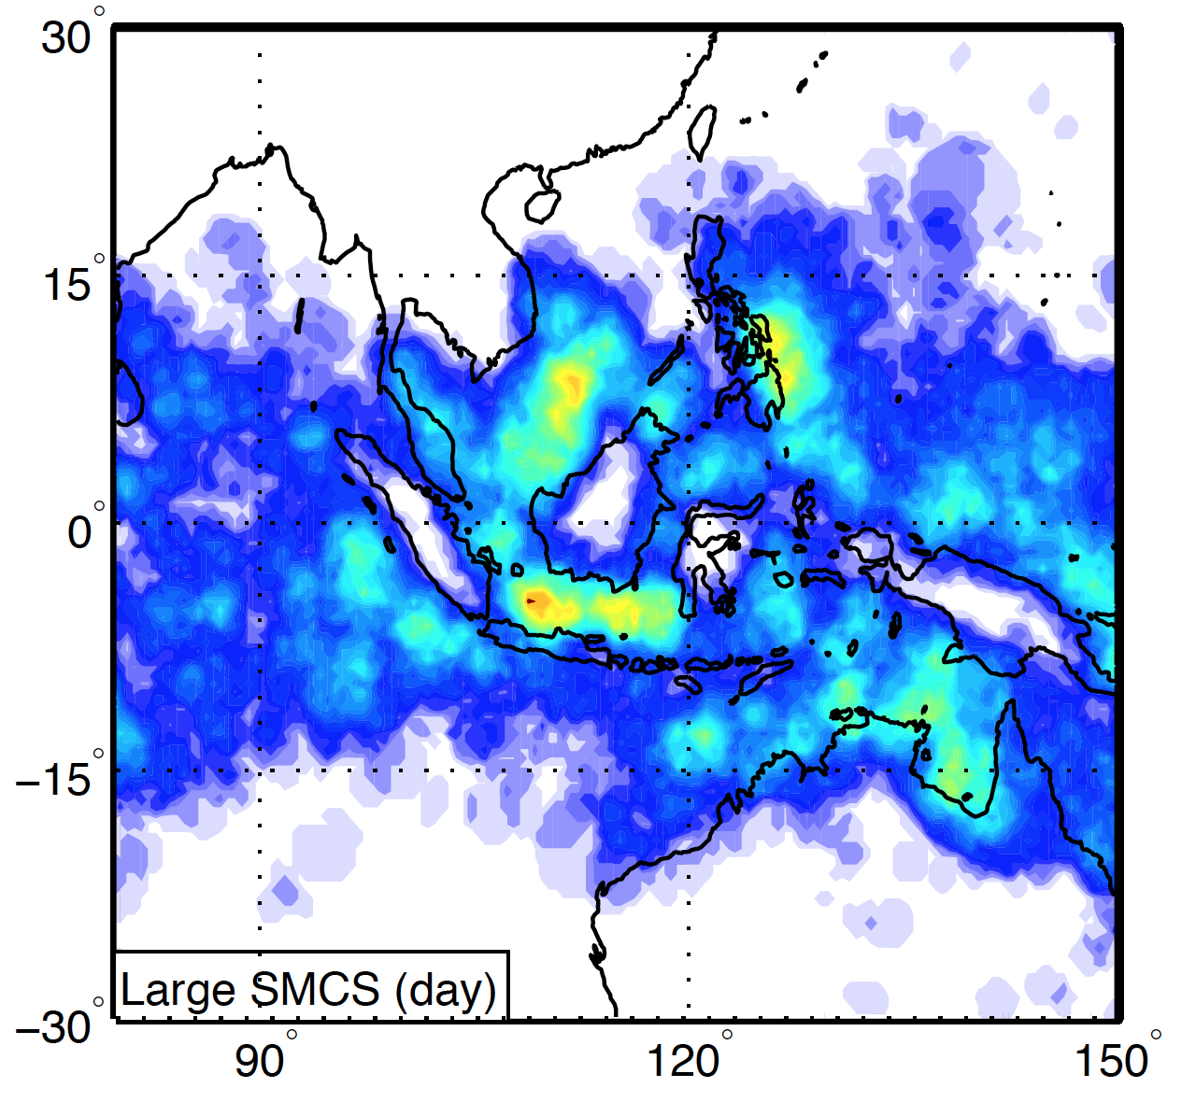
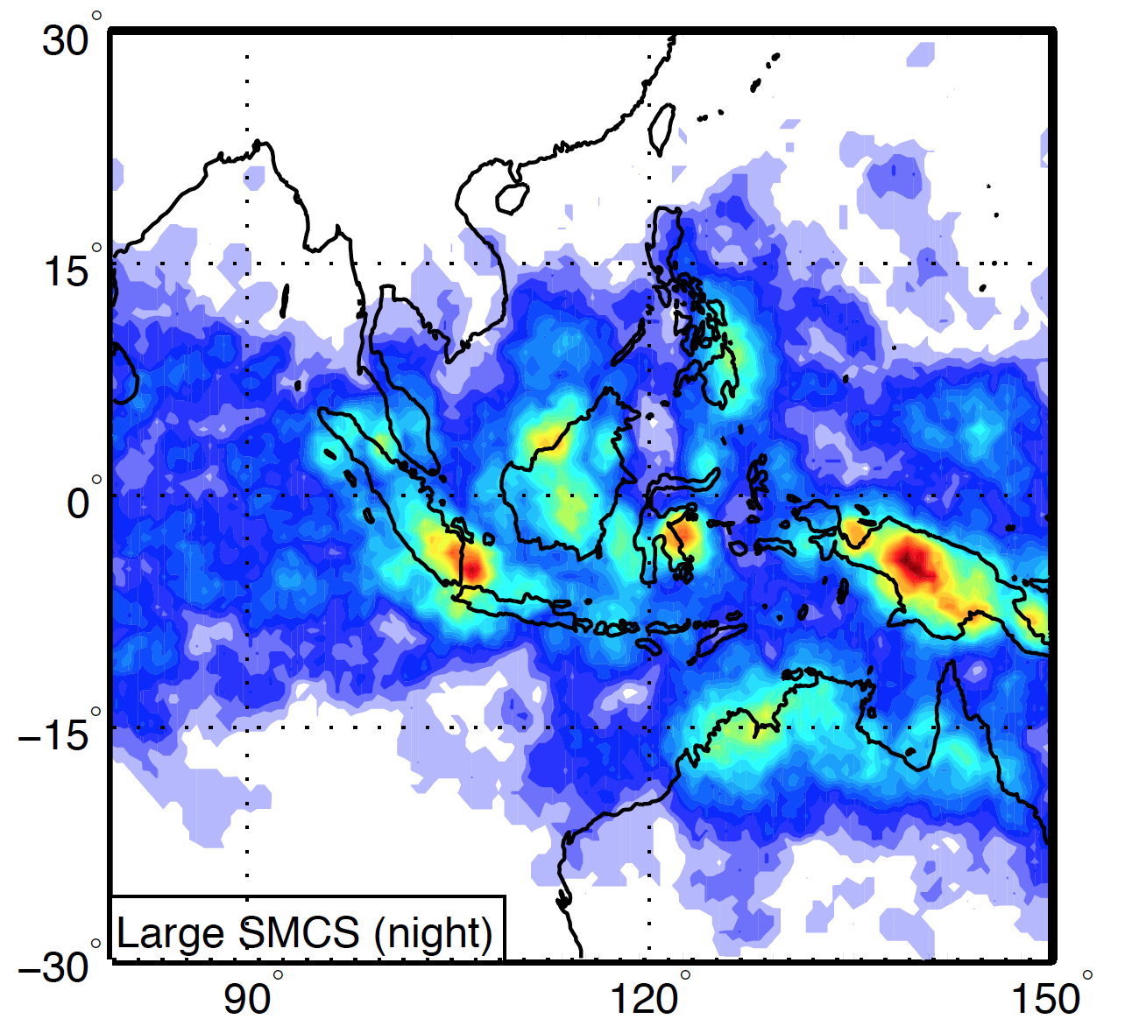
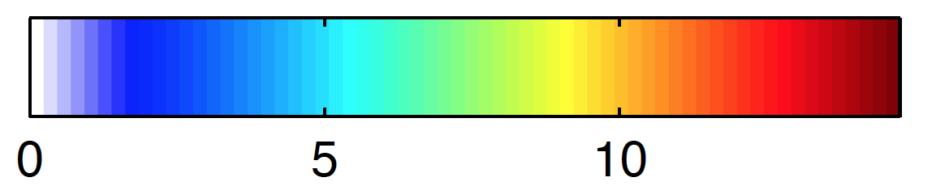
Large, separated MCSs
Hot spots over land and coasts at night
Ocean only during day, probably decaying

Slide 13
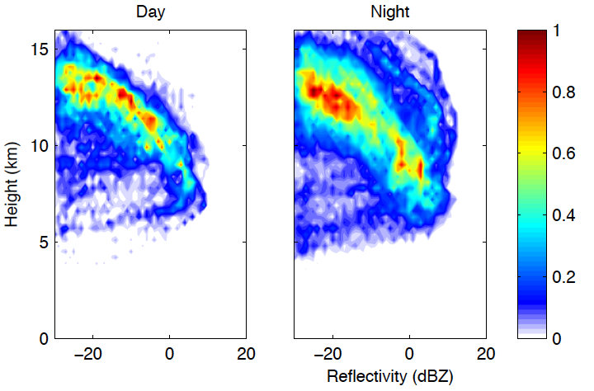
CloudSat CFADs of Large, separated MCSs

Slide 14
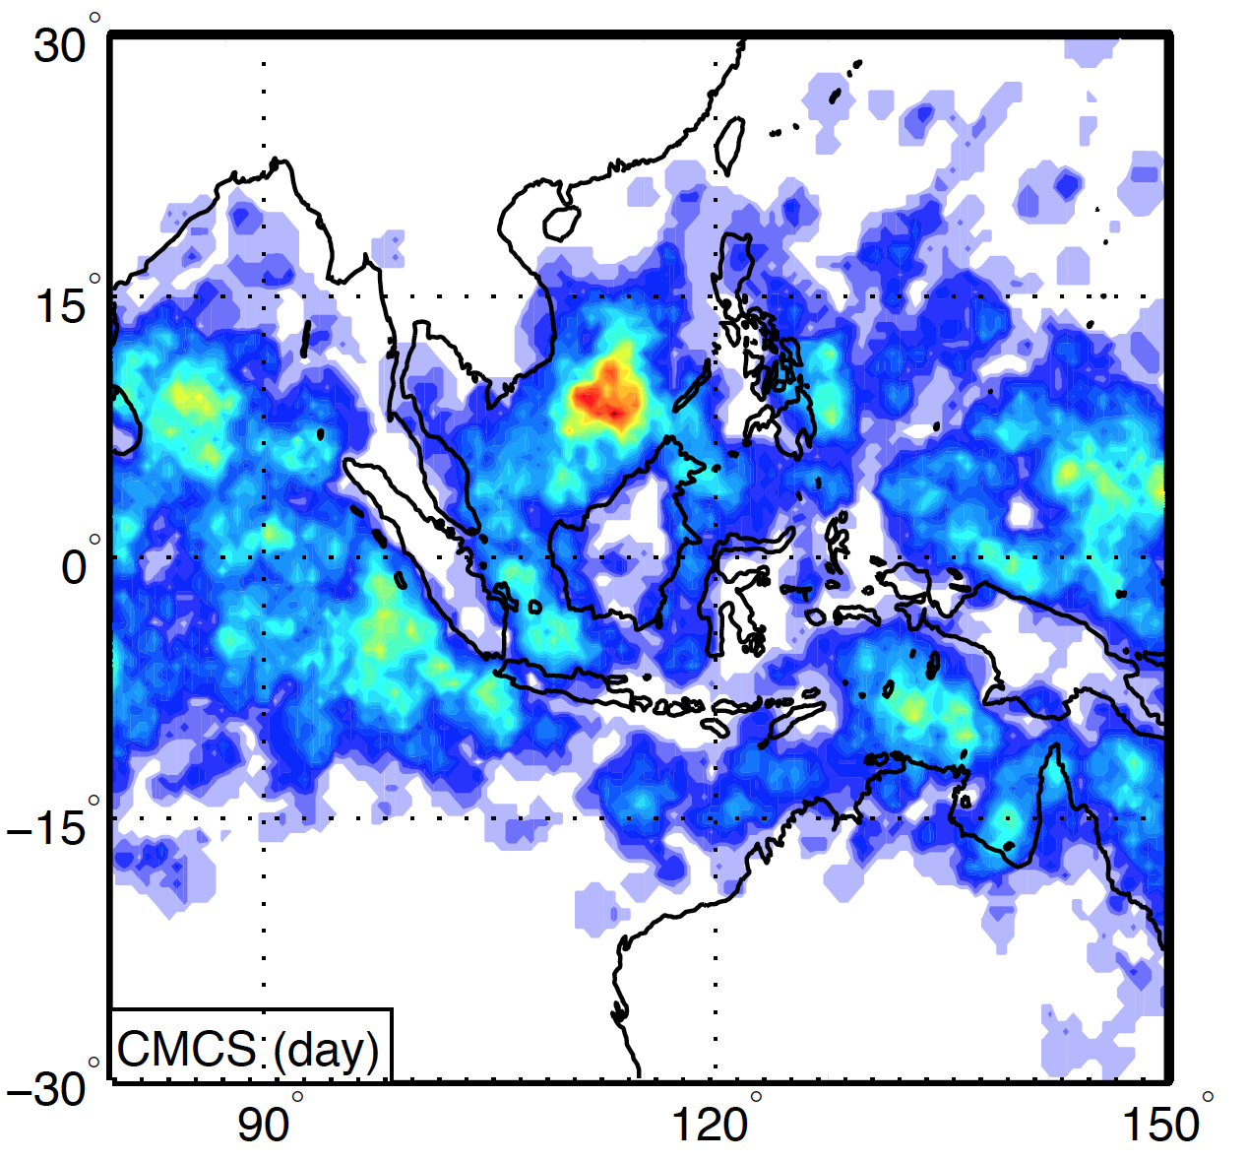
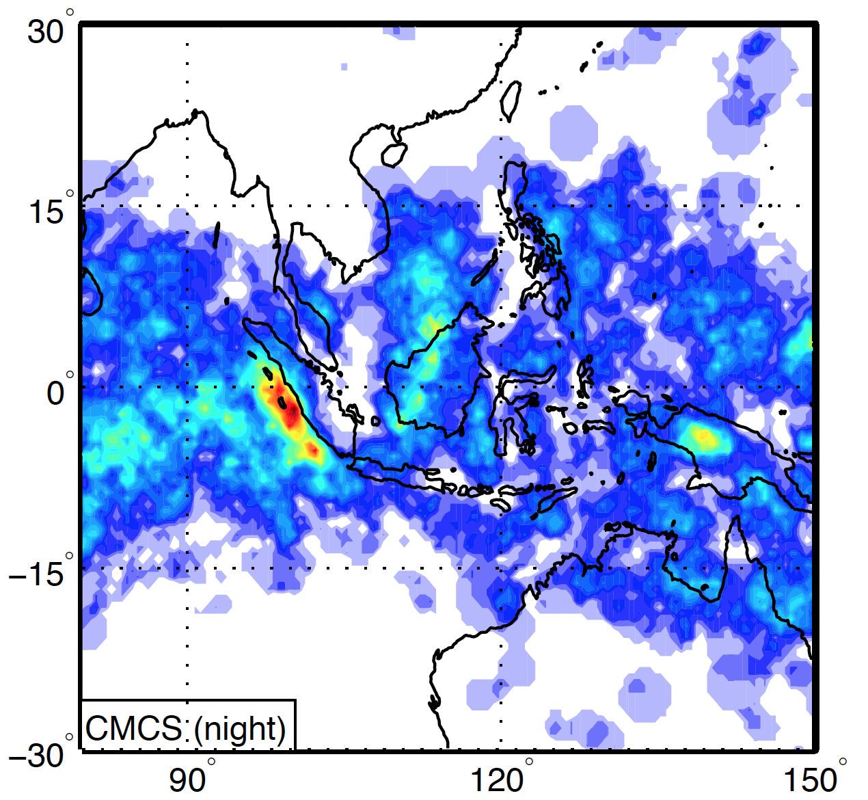
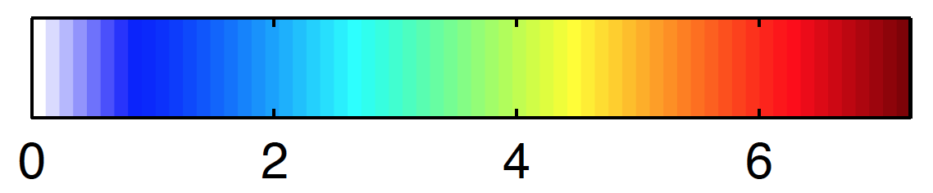
Connected MCSs
At night, off west coast of Sumatra
During daytime overpass, higher frequency to north

Slide 15
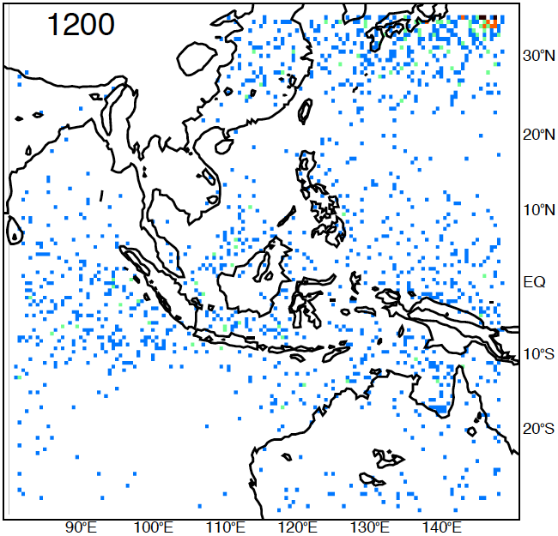
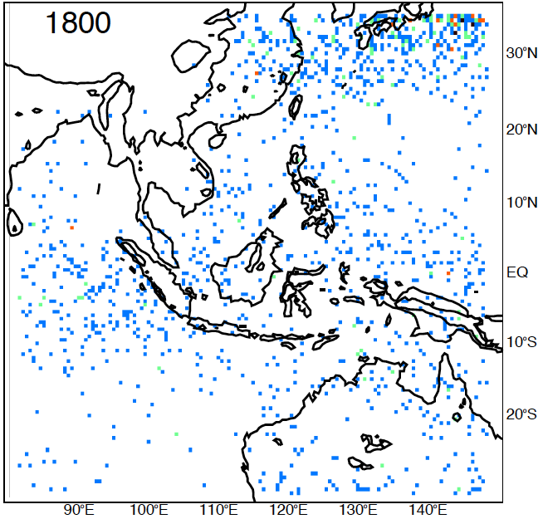
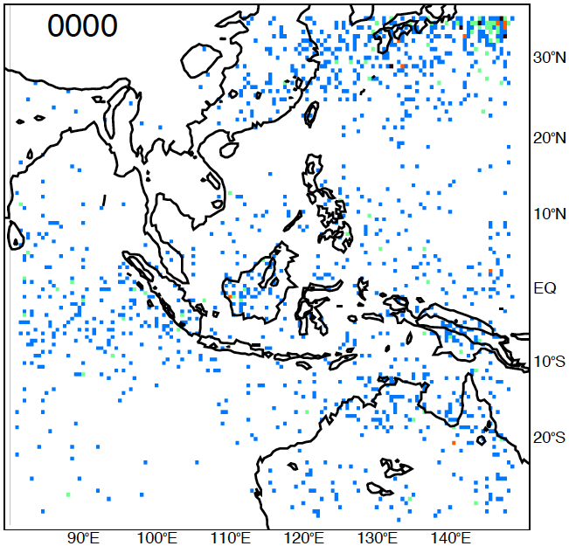
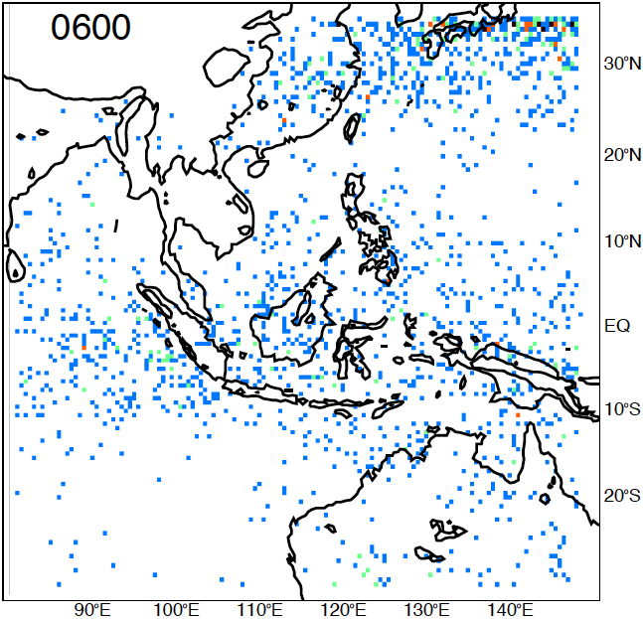
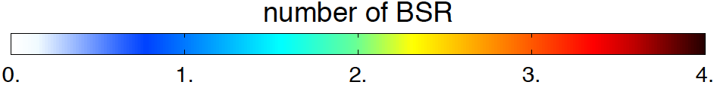
TRMM PR
Climatology
Diurnal distribution of the spatial frequency count of Broad Stratiform Echoes
Notes:
- Stratiform less frequent, but persistent over similar regions regardless of time of day

Slide 16
Conclusions
Maritime Continent convection viewed by multiple platforms of A-Train & TRMM →
Anvils mostly due to large and connected MCSs
Small, large, & connected MCSs differ in spatial patterns, diurnally, & precipitation structures
Smaller MCSs seen by MODIS/AMSR-E correspond to convection with deep intense echo cores seen by TRMM
Larger MCSs have different anvil structures seen by CloudSat over land by night and ocean by day
Connected MCSs are associated with broad stratiform areas seen by TRMM and exhibit a similar diurnal behavior

Slide 17
End
This research was supported by NASA grants NNX NNX13AQ37G and NNX13AG71G

