Slide 1
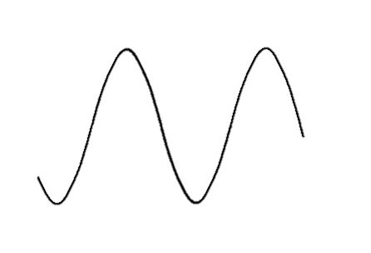
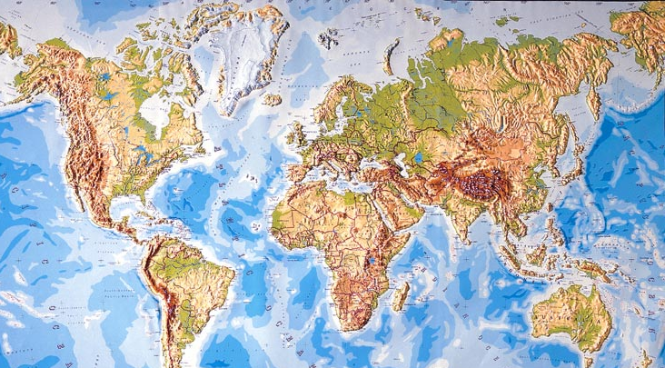
TRMM and CloudSat analyses in the tropics: Advantages and Limitations
R. Houze
University of Washington
GPM
CloudSat → EarthCare
TRMM
CaPPM Meeting, JPL, Pasadena, October 1, 2014

Slide 2
TRMM and CloudSat analyses in the tropics: Advantages and Limitations
R. Houze
University of Washington
CaPPM Meeting, JPL, Pasadena, October 1, 2014

Slide 3
A-Train
Notes:
CloudSat: W-band, 94 GHz, 3 mm
TRMM: Ka-band, 13.8 GHz, 2.17 cm

Slide 4
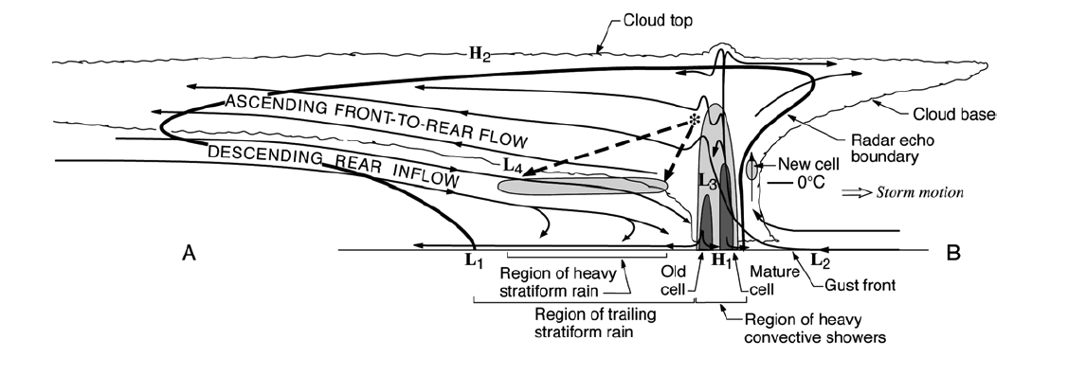
Basic components of an MCS
Cold top
Anvil
Anvil
Raining core
Houze et al. 1989
A-Train sees all of these elements
Notes:
The basic components of an MCS can be simplified into 3 main features, which can be identified and MEASURED by satellite. The combination of these three properties can be used to identify an MCS if they satisfy certain criteria. Thus we can determine when and where MCSs occur around the globe. In addition we can determine how the properties of these three components vary from region to region. How big and wide is the cold top; how big and intense is the raining core; how thick are the anvils; and what are the characteristics of their internal structure. And how do these properties vary around the globe? One cannot holistically determine the properties of MCSs by identifying one of these properties alone. It’s important to see and evaluate all 3.

Slide 5
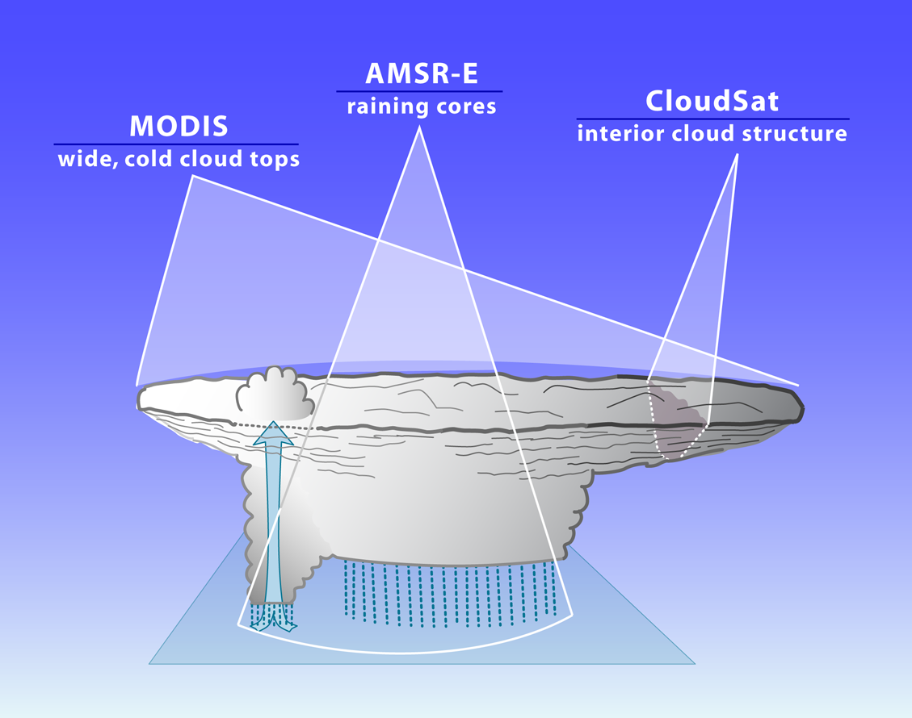
How A-Train sees the whole MCS
2
3
1
Notes:
A-Train offers the ability to see all 3 characteristics simultaneously. We take advantage of this ability.

Slide 6
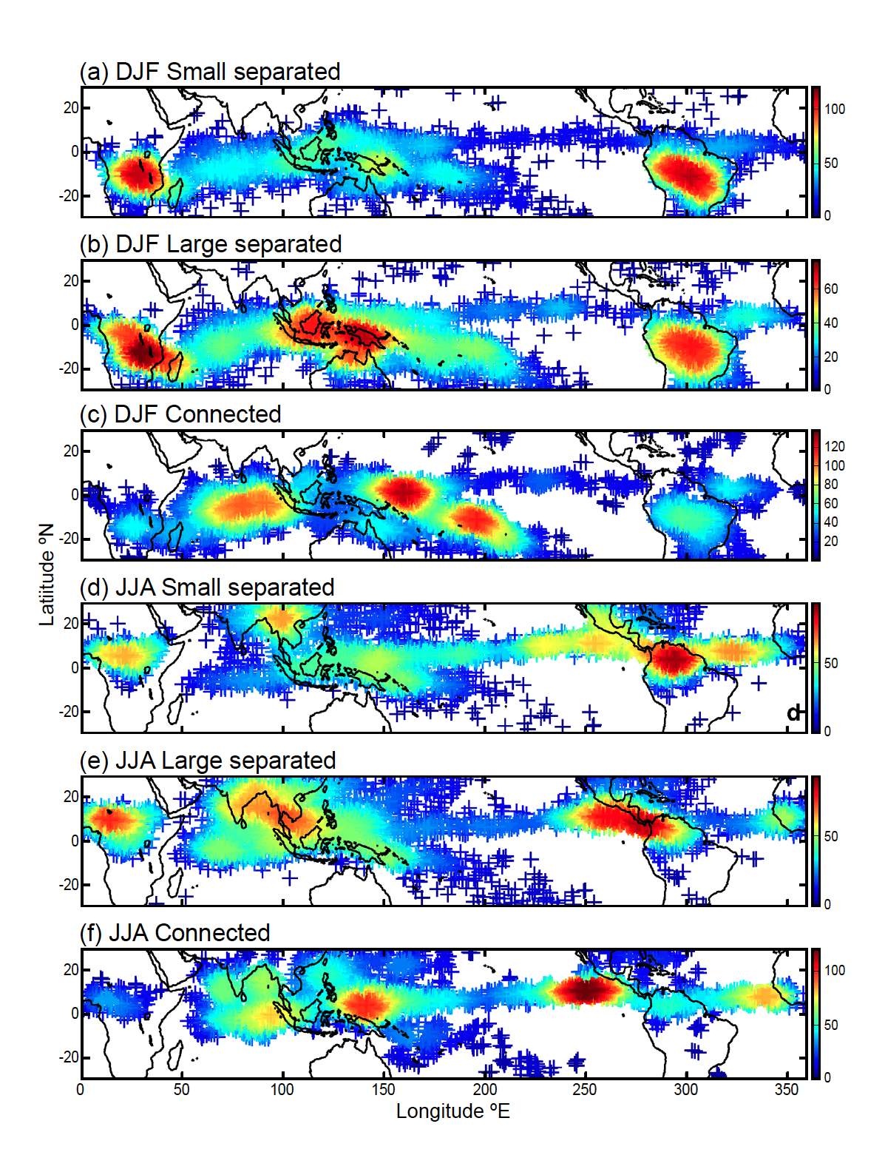
MCSs Over the Whole Tropics (DJF)
Smallest 25% (<12,000 km²)
Largest 25% (>40,000 km²)
“Superclusters”
Yuan and Houze 2010
Yuan and Houze 2010
Notes:
Size of MCS is size of cold cloud top. To qualify as MCS, must have large cold cloud top, large rain area, and some heavy rain. This figure shows spatial distribution of active MCSs. Color of each point shows the number of active MCSs found within a circular area with radius of five degrees centered on that point. (a) Small separated MCSs (<12,000km2; i.e., the smallest 25%) in DJF, (b) large separated MCS (>40,000km2; i.e., the largest 25%) in DJF, (c) connected MCS in DJF, (d)-(f) same as (a)-(c) except for JJA.

Slide 7
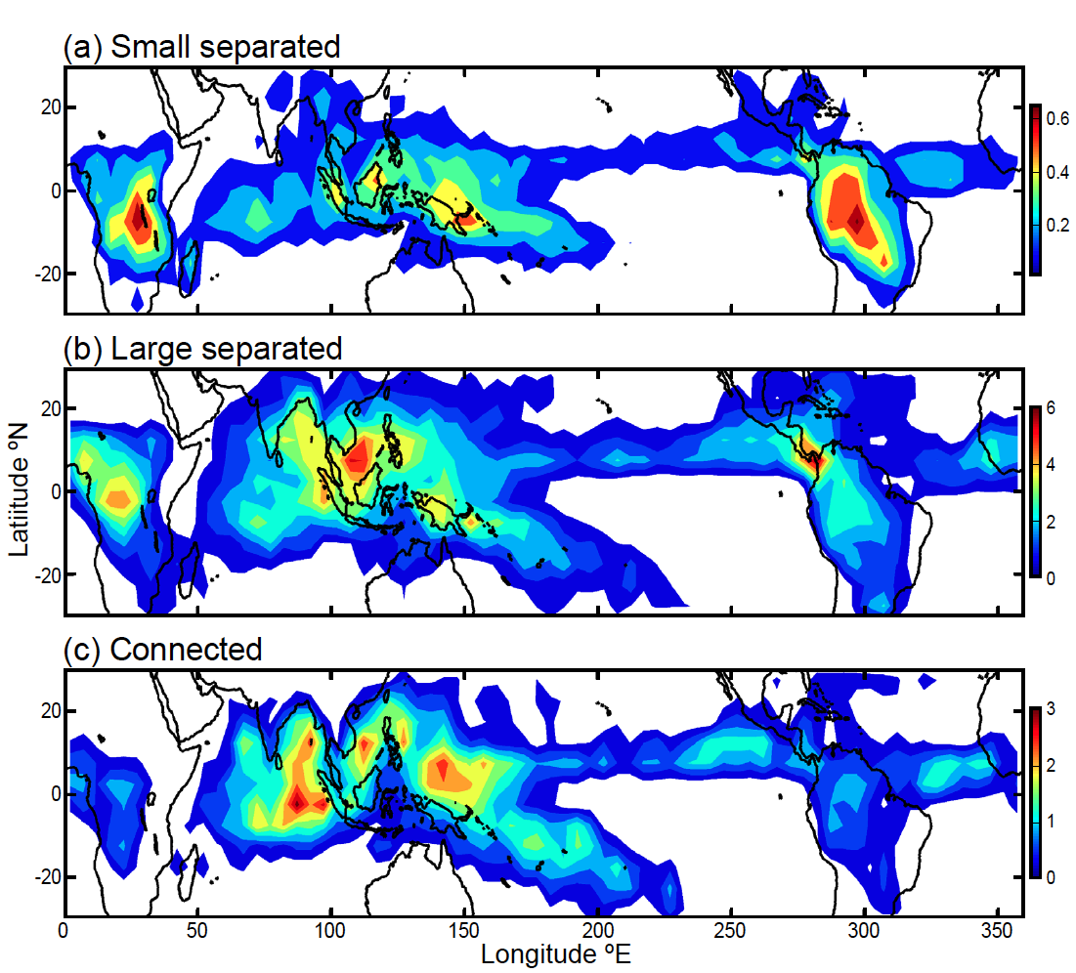
Frequency of MCS anvils over tropics
Yuan and Houze 2010

Slide 8
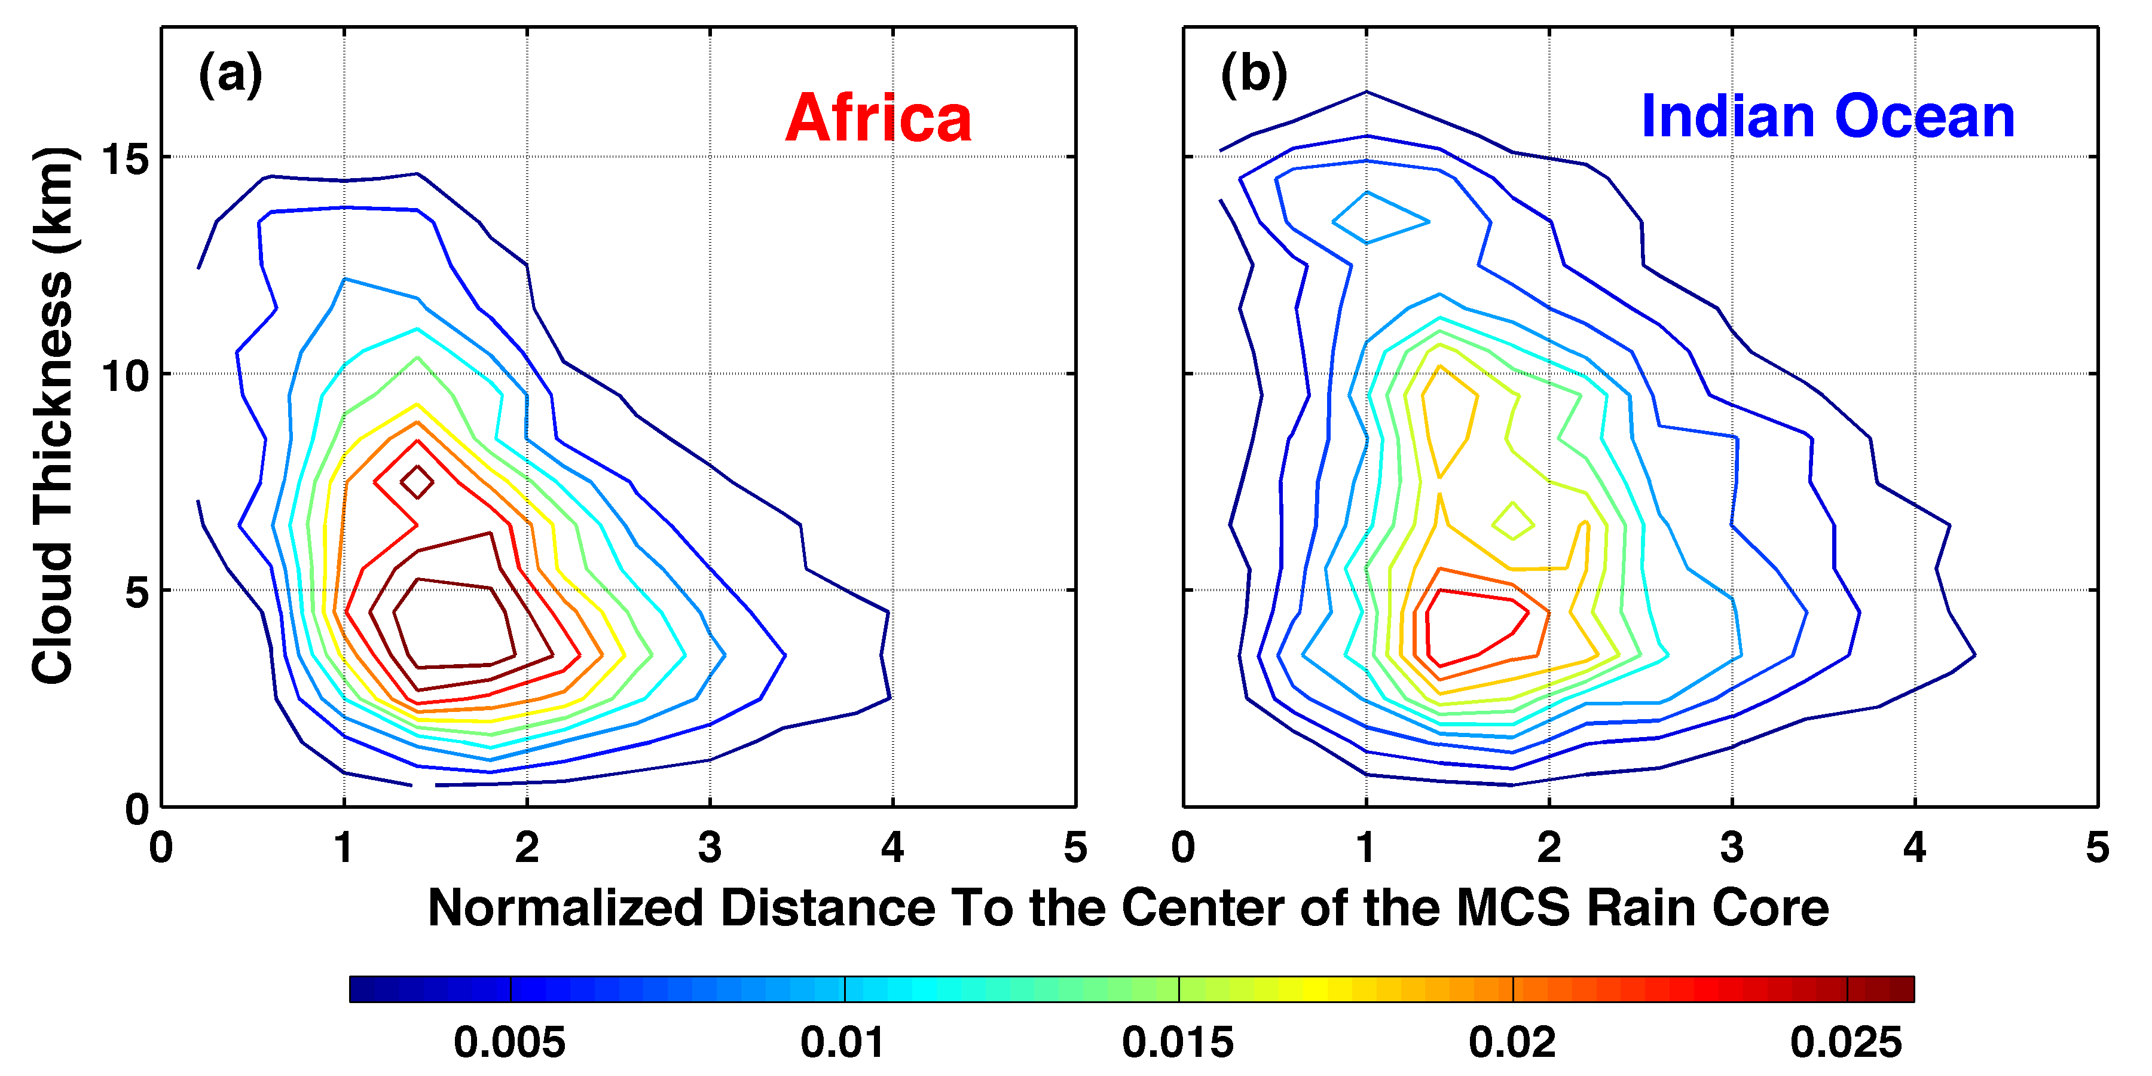
Statistics of anvil width & thickness seen by CloudSat
Africa
Indian Ocean
Yuan and Houze 2010
Notes:
Normalized by dimension of the MCS rain area

Slide 9
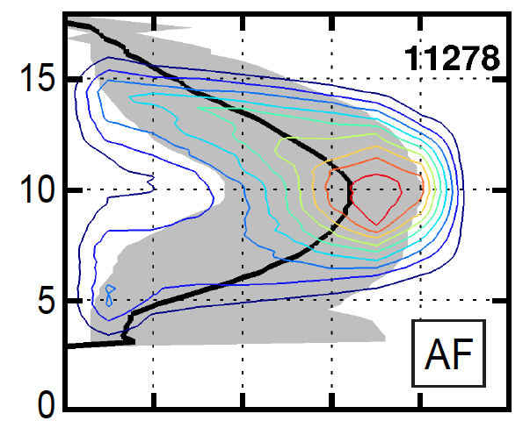
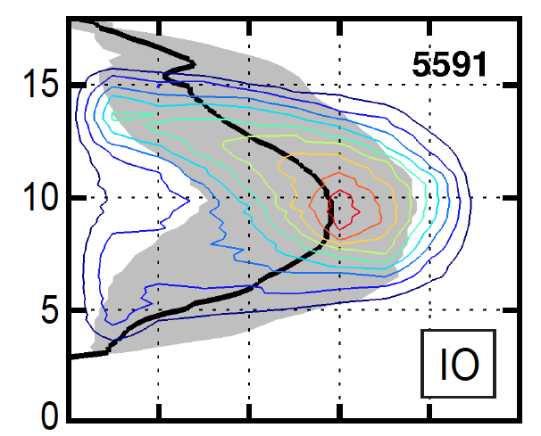

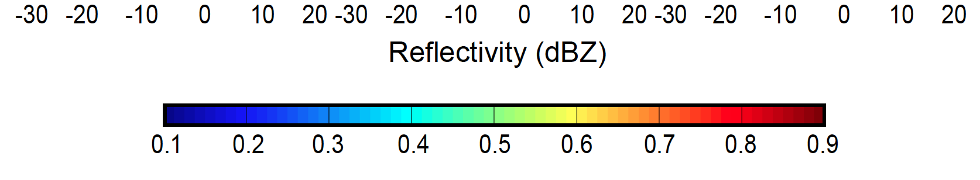
Internal structure of MCS anvils
Africa
Indian Ocean
Yuan, Houze, and Heymsfield 2011
Notes:
Black curves are medians

Slide 10
TRMM
Notes:
We now look briefly at how we combine 2 of these properties to first identify MCSs
CloudSat: W-band, 94 GHz, 3 mm
TRMM: Ka-band, 13.8 GHz, 2.17 cm

Slide 11
Basic components
Cold top
Stratiform
Convective
Anvil
Anvil
Raining core
Houze et al. 1989
TRMM separates the convective and stratiform echoes
Notes:
The basic components of an MCS can be simplified into 3 main features, which can be identified and MEASURED by satellite. The combination of these three properties can be used to identify an MCS if they satisfy certain criteria. Thus we can determine when and where MCSs occur around the globe. In addition we can determine how the properties of these three components vary from region to region. How big and wide is the cold top; how big and intense is the raining core; how thick are the anvils; and what are the characteristics of their internal structure. And how do these properties vary around the globe? One cannot holistically determine the properties of MCSs by identifying one of these properties alone. It’s important to see and evaluate all 3.

Slide 12
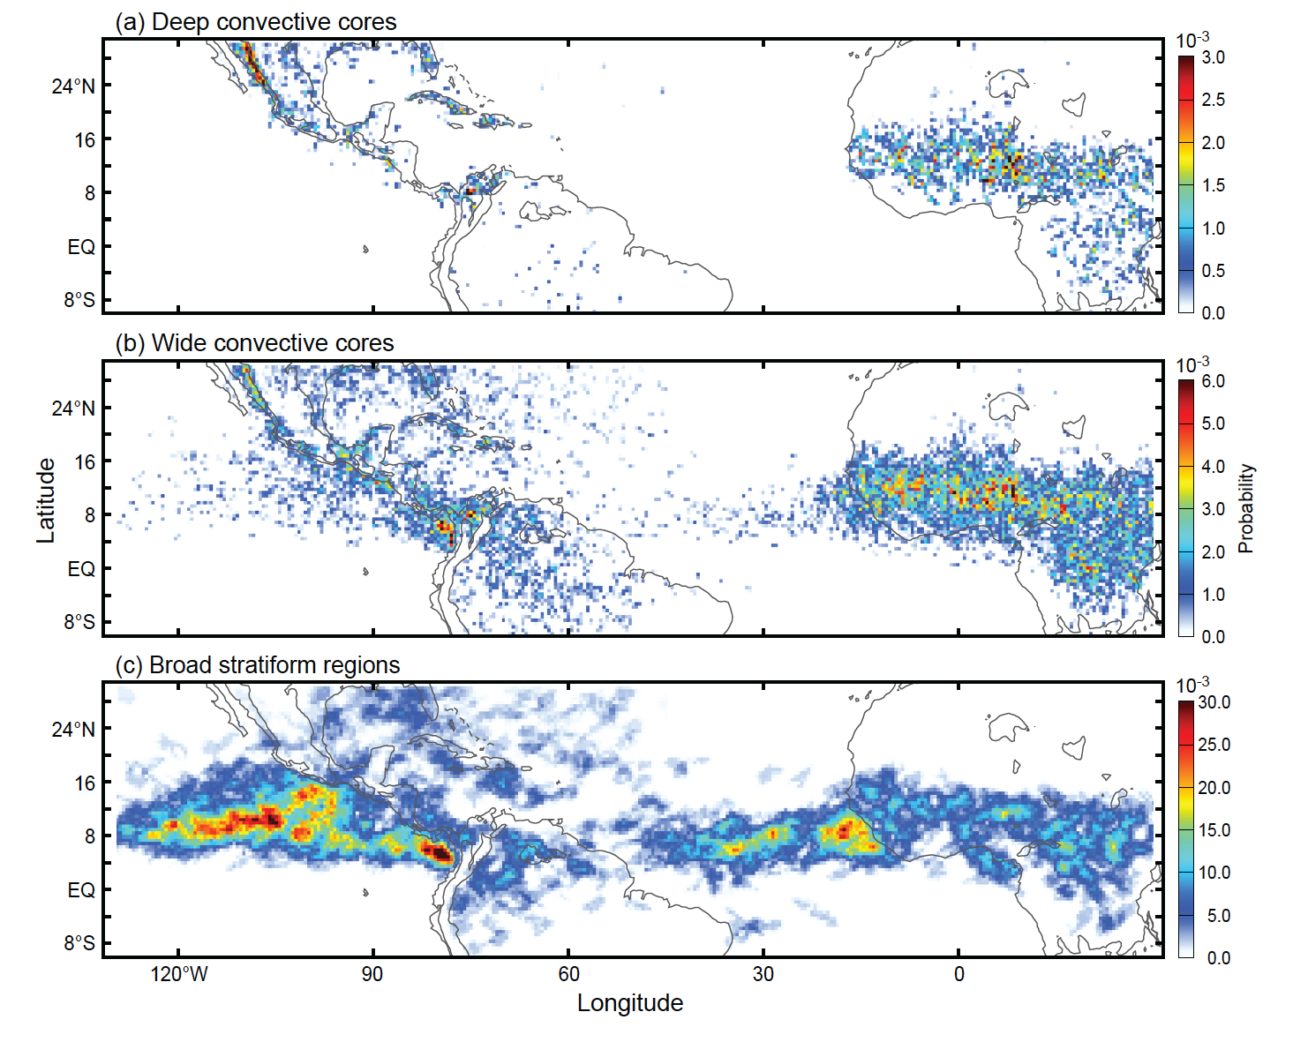
Deep Convective Cores
Wide Convective Cores
Broad Stratiform Regions

Slide 13
Madden-Julian Oscillation
Notes:
We now look briefly at how we combine 2 of these properties to first identify MCSs

Slide 14
TRMM Radar Observations of the MJO over the Indian Ocean
Active Phase
Suppressed Phase
Deep Convective Cores
Broad Stratiform Rain Areas
Phase 7

Slide 15
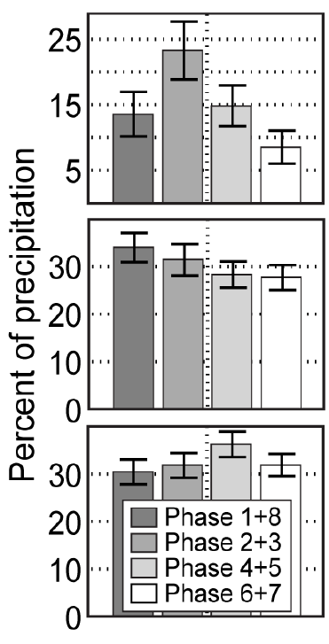
Indian Ocean MCSs Contribution to Rainfall by phase of the Madden-Julian Oscillation
Active
Suppressed
Connected MCSs
Separated MCSs
Other high cloud systems
Yuan and Houze 2012

Slide 16
Conclusions
A-Train
Identify MCSs globally
Show anvils of MCSs
Wider and weaker over ocean
Narrower but stronger over land
TRMM
Separation of convective and stratiform shows how various forms of convective organization depend on
Land surface
Ocean
Large-scale circulation
→ Limitation: Can’t relate the anvil behavior to the convective system behavior and therefore can’t get global statistics of convective system water budgets
Notes:
Cause & Effect theme:
Precipitation
Warm season rain dominated by storms with wide convective regions (MCSs) in both Africa and South America
Amazonian precipitation not affected by storms with extreme convective or stratiform features (tropical oceanic)
Equatorial Africa precipitation dominated by MCSs controlled by AEWs
Subtropical South America dominated by MCSs controlled by topography

Slide 17
End
This research was supported by NASA grants NNX13AQ37G and NNX13AG71G

Slide 18

Available Now!
Notes:
CloudSat: W-band, 94 GHz, 3 mm
TRMM: Ka-band, 13.8 GHz, 2.17 cm

