Slide 1

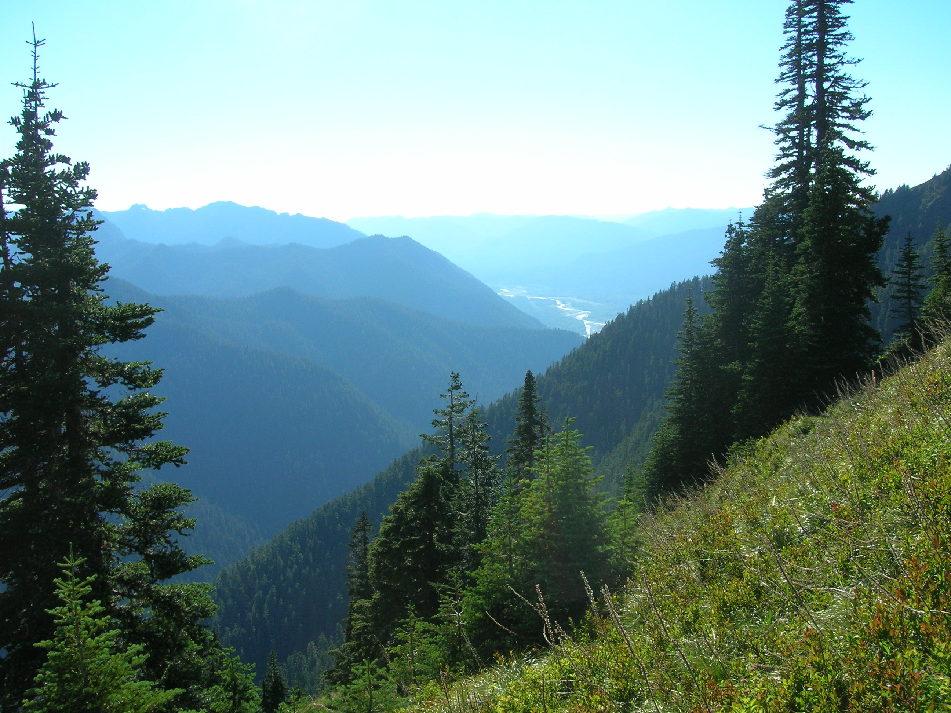
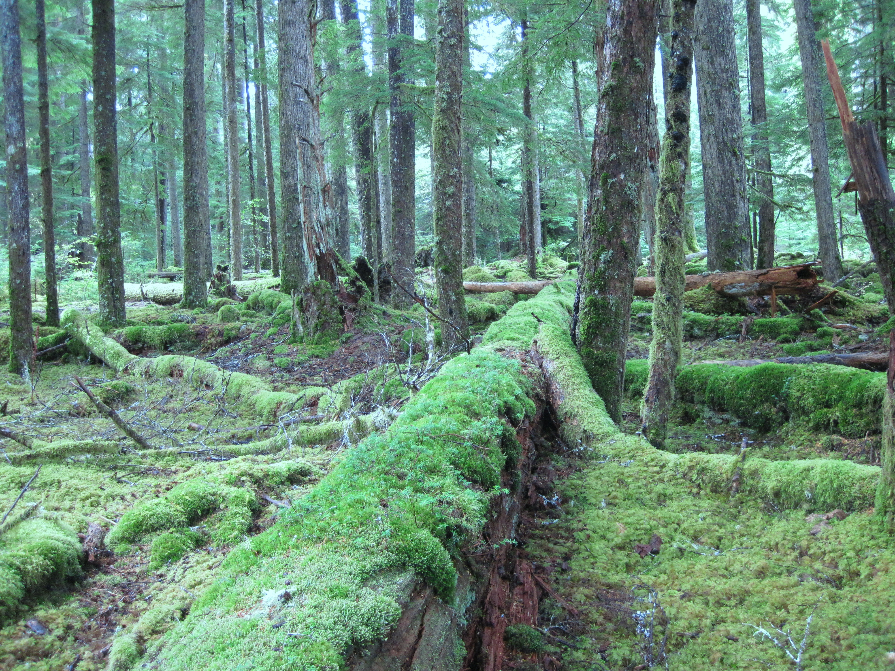
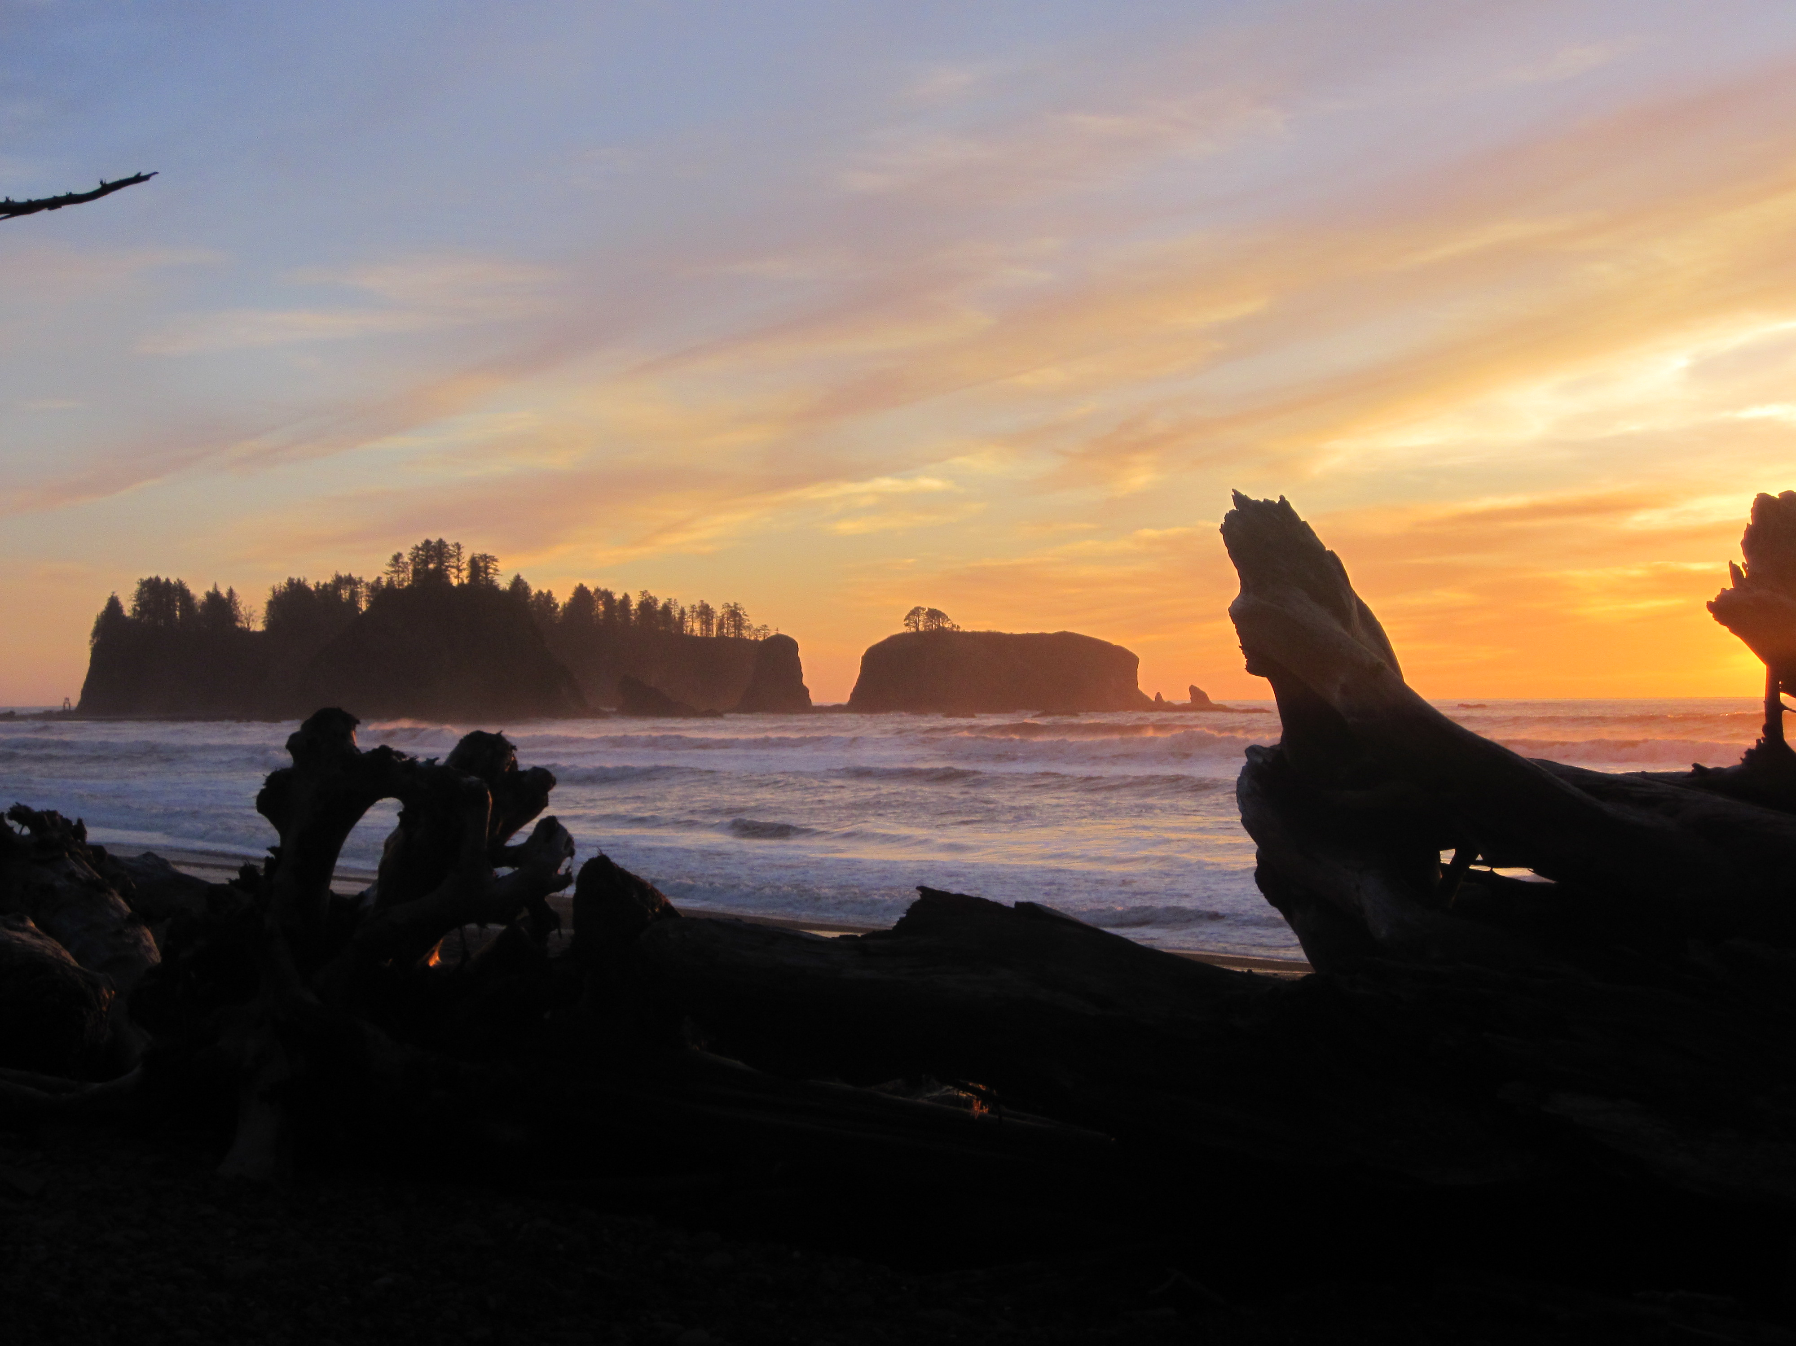
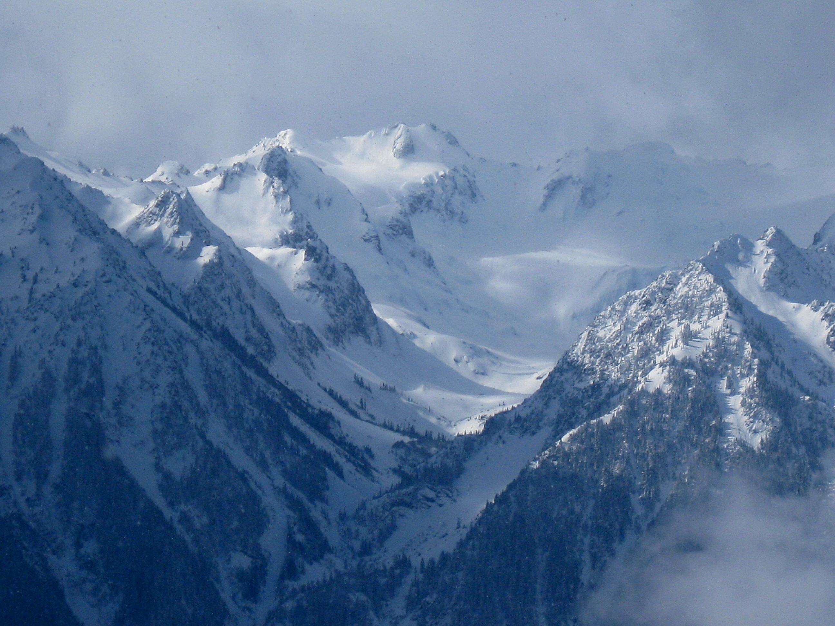
Update on OLYMPEX: A Ground Validation Field Campaign in the Pacific Northwest
Lynn McMurdie, Robert A. Houze, Jr., Jessica Lundquist, Cliff Mass, University of Washington, Walter Petersen NASA/Wallops, Mathew Schwaller NASA/Goddard.
PMM Science team presentation, Baltimore, 6 August, 2014

Slide 2
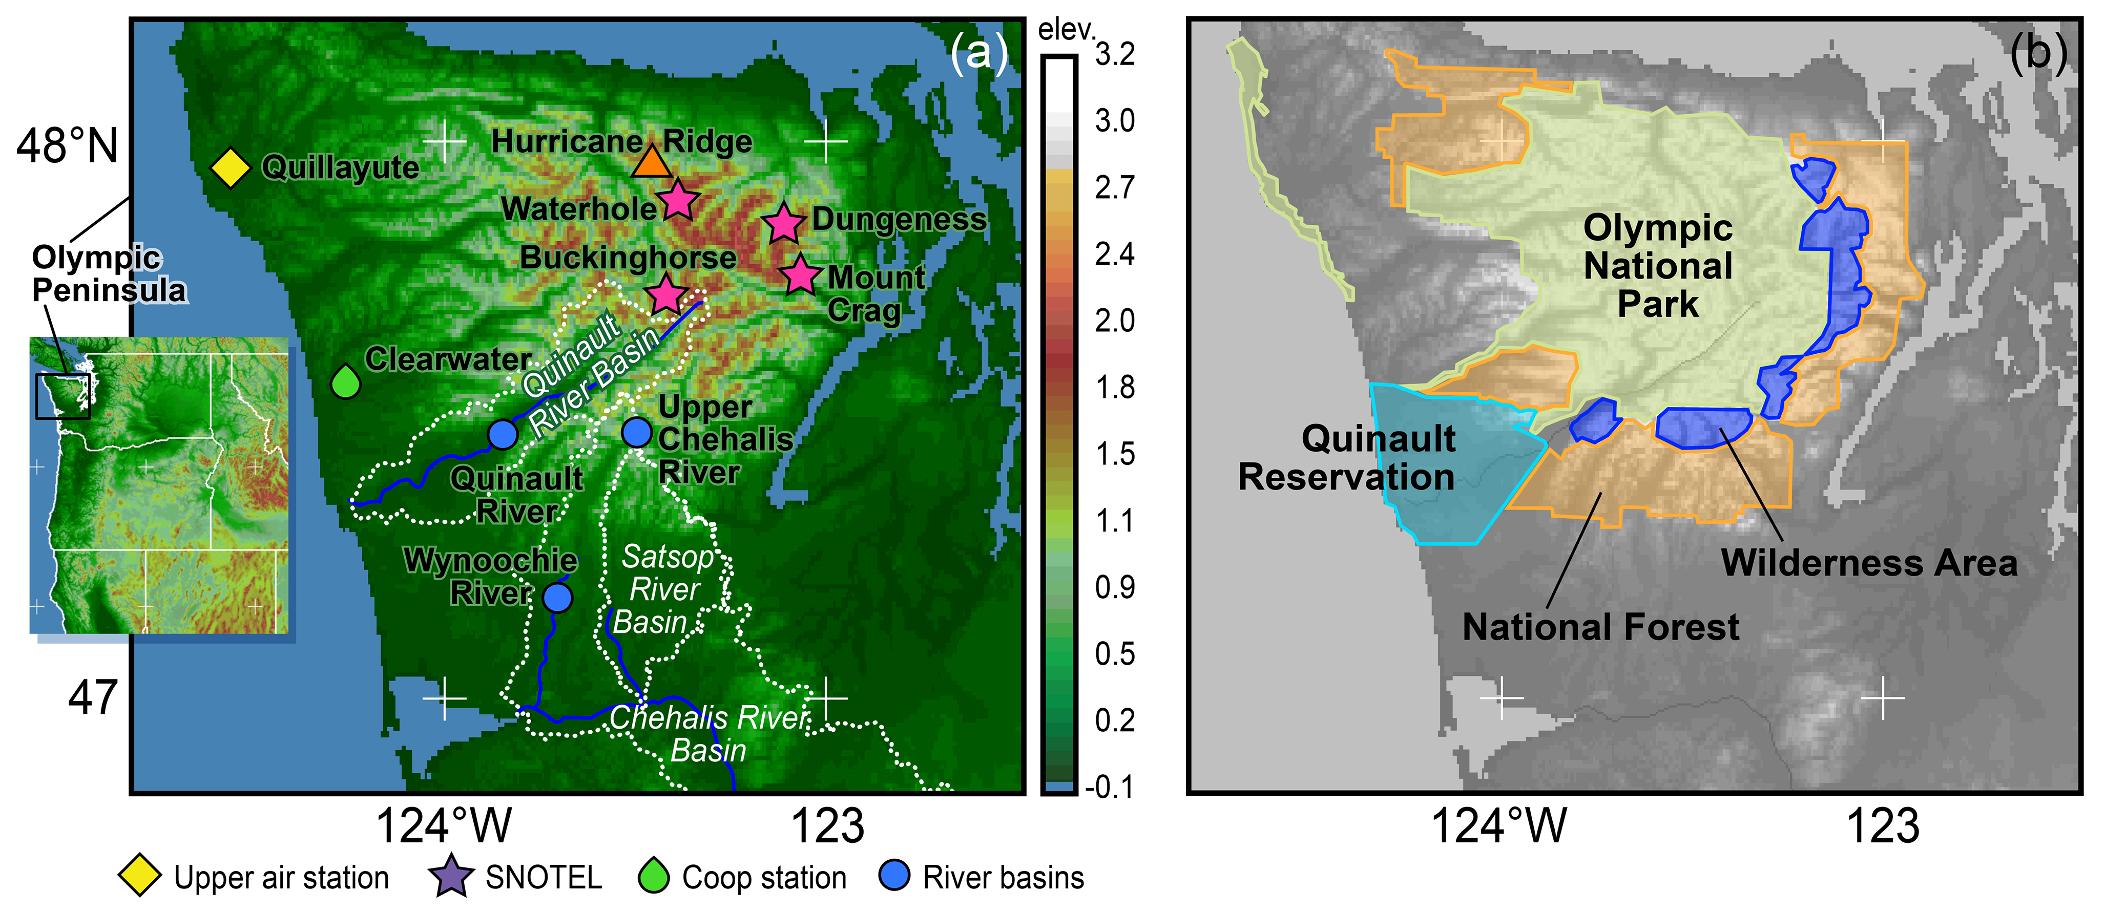
The Olympic Peninsula
Situated in the NW corner of Washington state
Olympic National Park covers the majority of the region’s high terrain and a portion of the coast
National Forest and National Wilderness areas and the Quinault Indian Reservation cover part of the Peninsula

Slide 3
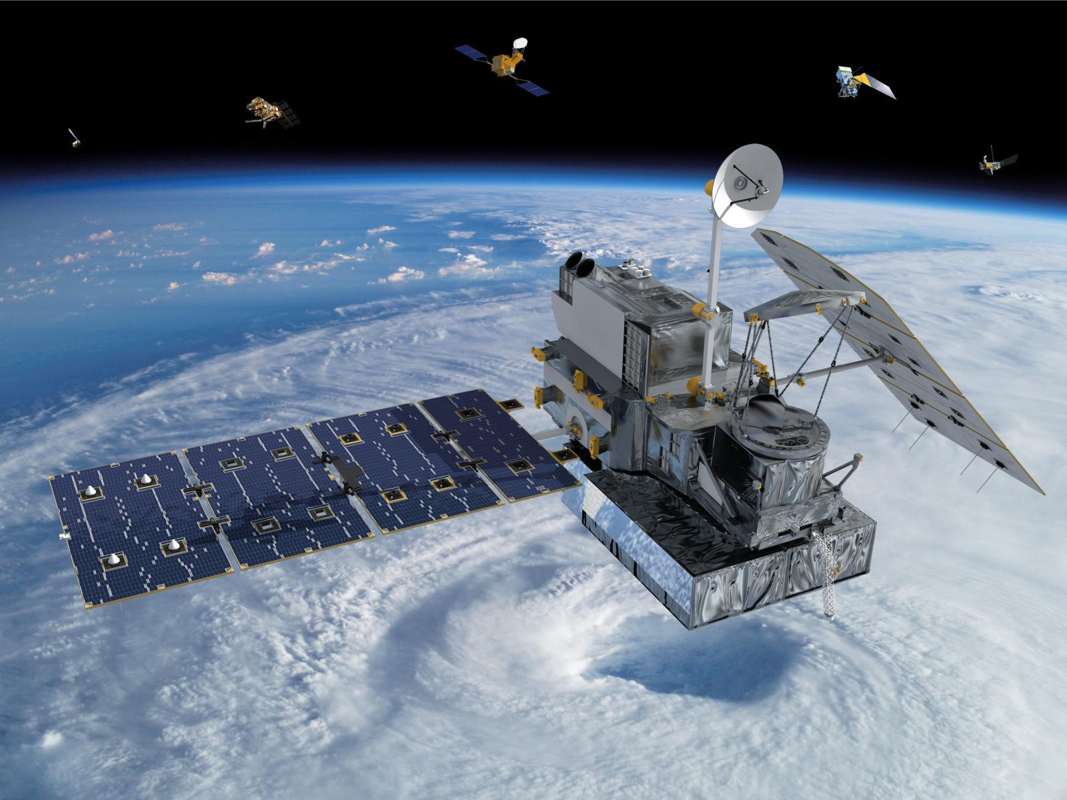
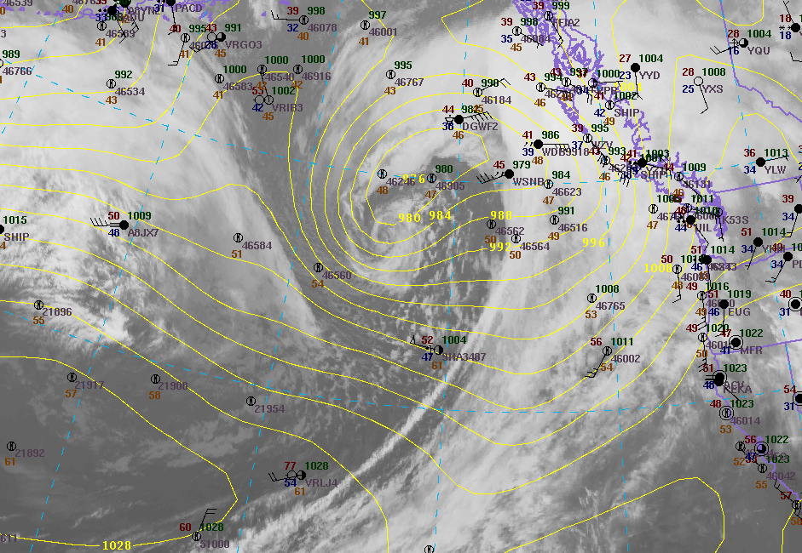
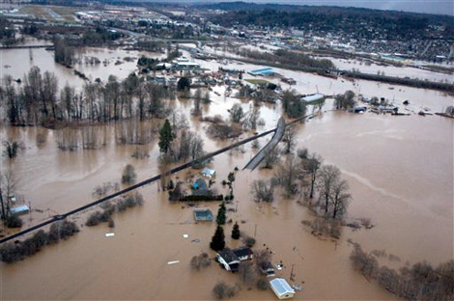
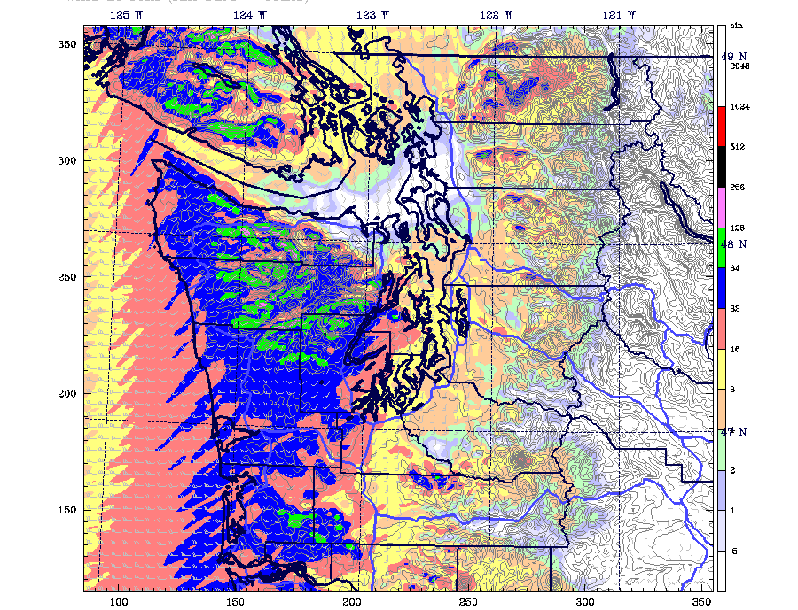
Review of the goals of OLYMPEX
Physical validation of the precipitation (rain and snow) algorithms for both the GMI and DPR.
How precipitation mechanisms in midlatitude frontal systems and their modification by terrain affect GPM rainfall estimation uncertainties.
Quantifying the accuracy and uncertainty of the GPM precipitation data and its hydrologic applicability.
Merging numerical modeling and satellite observations to optimize precipitation estimation in hybrid monitoring systems of the future.

Slide 4

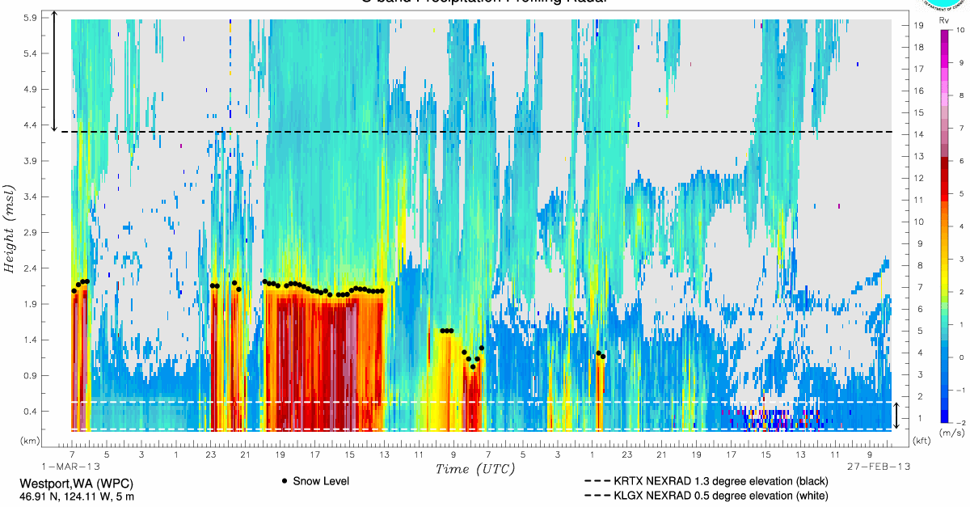
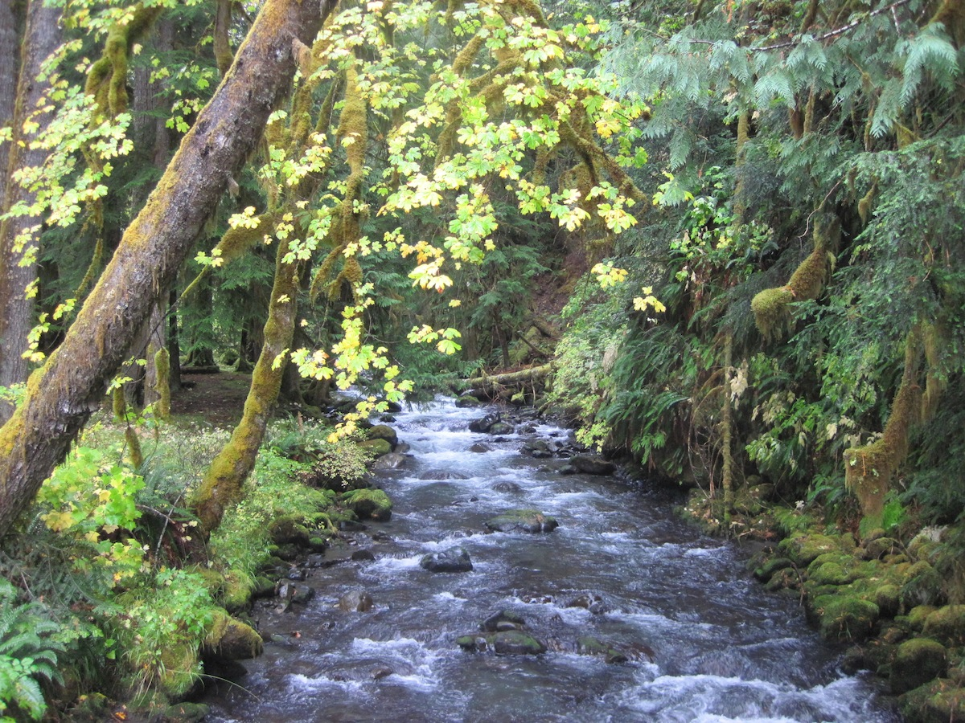
To achieve these goals, we need to observe:
Upstream Conditions – Meteorological conditions over the Pacific Ocean
Rain and Snow – At multiple sites from coast, lowlands to mountain ridges
Microphysics – Of precipitation in all sectors of midlatitude storms and variability in complex terrain
Brightband – variability in height and over ocean, coastal, and mountain surfaces
Seasonal Snowpack – In terms of SWE over the higher terrain
River – Response and runoff
Emissivity –Of a variety of surfaces: ocean, coast, forest and snow-covered mountains

Slide 5
The Climatology of the Olympic Peninsula
Climatology of MSLP from Nov-Feb from NCEP Reanalysis grids 1979 – 2012
Annual average precipitation in inches from PRISM (Parameter-elevation Regressions Independent Slopes Model)
Persistent moist onshore flow produces extraordinary annual precipitation totals
2500 mm (100”) on the coast and more than 3250 mm (150”) in the interior

Slide 6
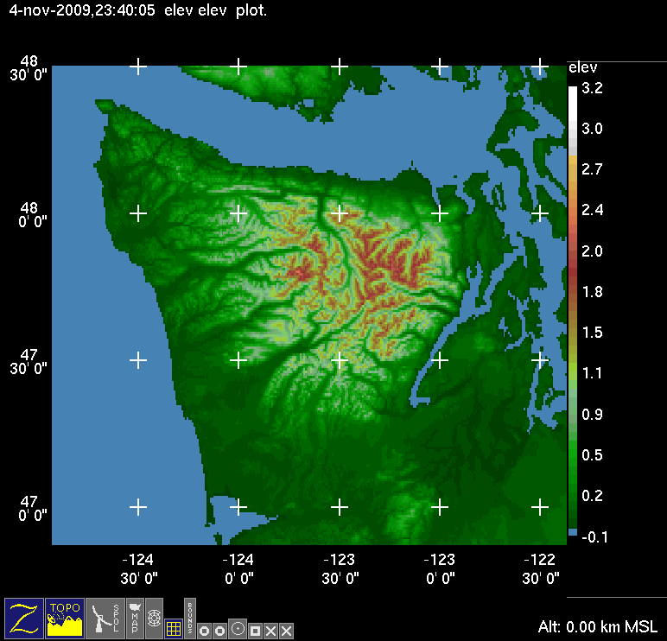
Climatology of Olympic Peninsula
Clearwater
Monthly Average Precipitation
Rainiest months: Nov, Dec, Jan. Range from 3.5” (90 mm) to 30” (750 mm) in Nov.
On any given day in Nov, Dec, Jan there is a 73% probability of receiving >0.01” rain and a 36% probability of receiving > 0.5” rain.

Slide 7
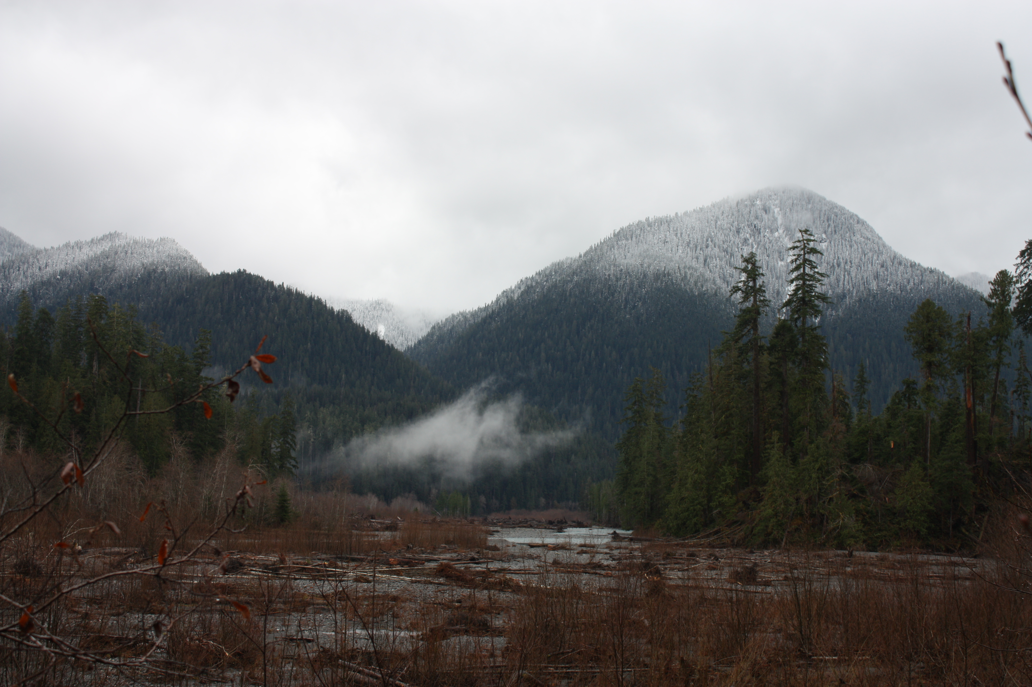

Climatology of Olympic Peninsula
KUIL
Mean 0°C level in winter during moist onshore flow = ~1.5 Km
This varies a lot from storm to storm and within each storm.
Melting layer bends downward towards sloping terrain (Medina and Houze 2005, Minder et al. 2011)

Slide 8
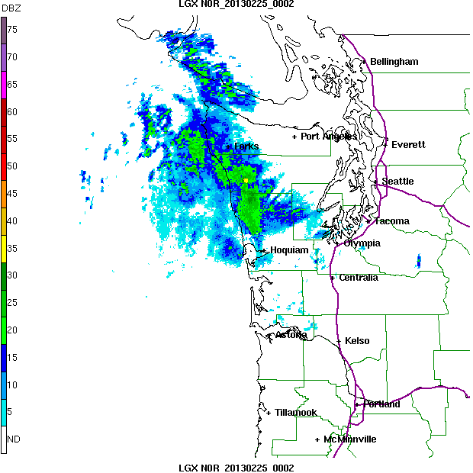
Typical Frontal Passage Three different regimes!
Prefrontal
Frontal
Postfrontal
SW side of Olympics gets rain well ahead of front
SW side gets rain during front
SW side gets post-frontal showers

Slide 9
The OLYMPEX observational network
Will focus on 2 river basins: Quinault and Chehalis
Will focus on entire Olympic Peninsula, from wetter South, Southwest side to the drier North, Northeast side
Existing observations: circles and diamonds
Enhanced observation sites: triangles
Radars: squares

Slide 10
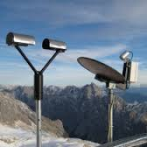
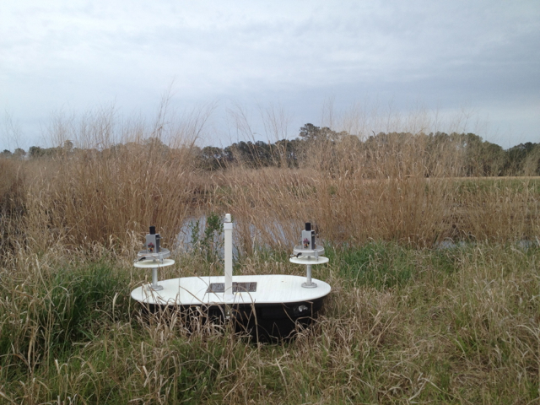
Ground observations – Rain
Precipitation amount/rate
Variety of locations
Variety of elevations (rain, mixed phase, snow)
Precipitation microphysics
Drop size distribution
Need a variety of rain gauge locations and several ‘enhanced sites with microphysical measurements

Slide 11
Ground observations – Rain
Existing observations: ASOS/AWOS, RAWS, Coop surrounding the higher terrain
Installed tipping-bucket rain gauge network: data shows mesoscale variability in precipitation amounts
Potential locations for enhanced observations identified: to install instruments such as disdrometers, dual rain gauges, 2DVD, MRR and PIP.
Existing Network
Tipping bucket Network
= enhanced sites

Slide 12
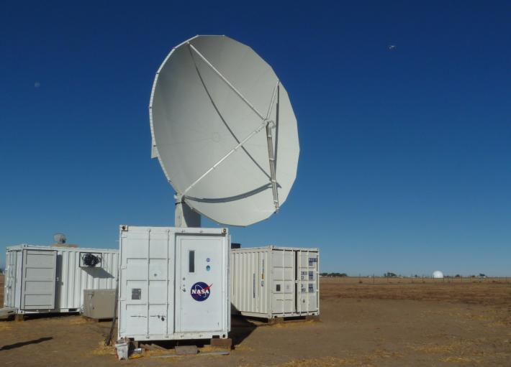
Radars
WSR-88D at Langley Hill
NPOL & DR3 on coast near Taholah
Canadian X-Band on Vancouver Island
DOW proposed to be in Quinault to fill in below lowest NPOL elevation angle
ARO reinstalled???
Others?

Slide 13
Snow Measurements in the high terrain of the Olympics
Need to measure snow microphysical characteristics
Need to measure the build up then melt down of the snowpack

Slide 14
Snow Measurements in the high terrain of the Olympics
A. Microphysical site(s)
Hurricane Ridge road is open in winter on the weekends. There is a visitor’s center at the ridge with power.
We plan to install and test out this winter instruments such as a PIP, Hotplate, Parsivel and MRR at Hurricane.

Slide 15
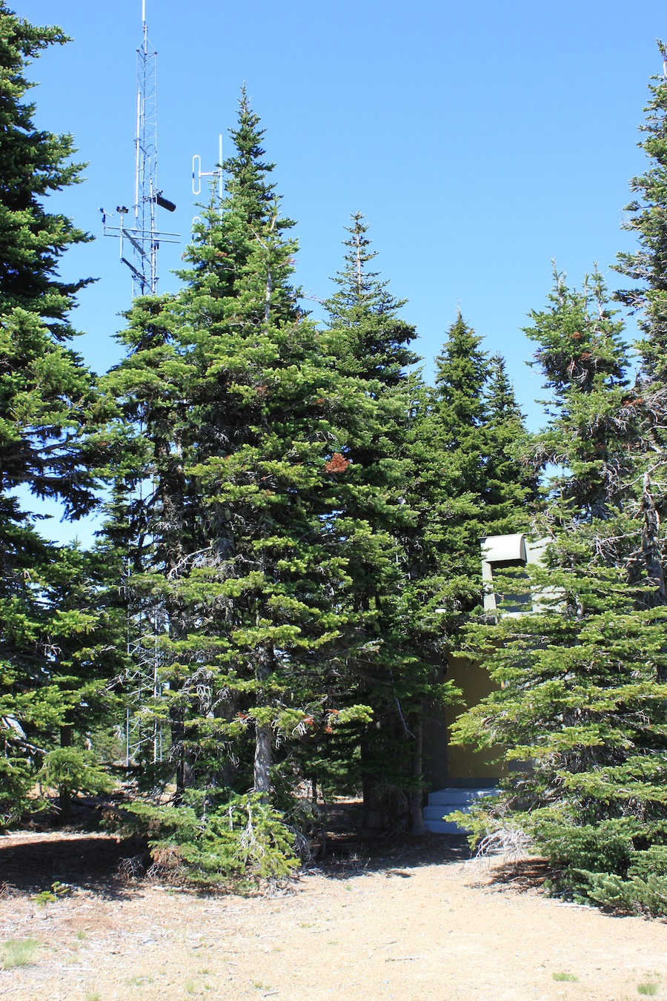
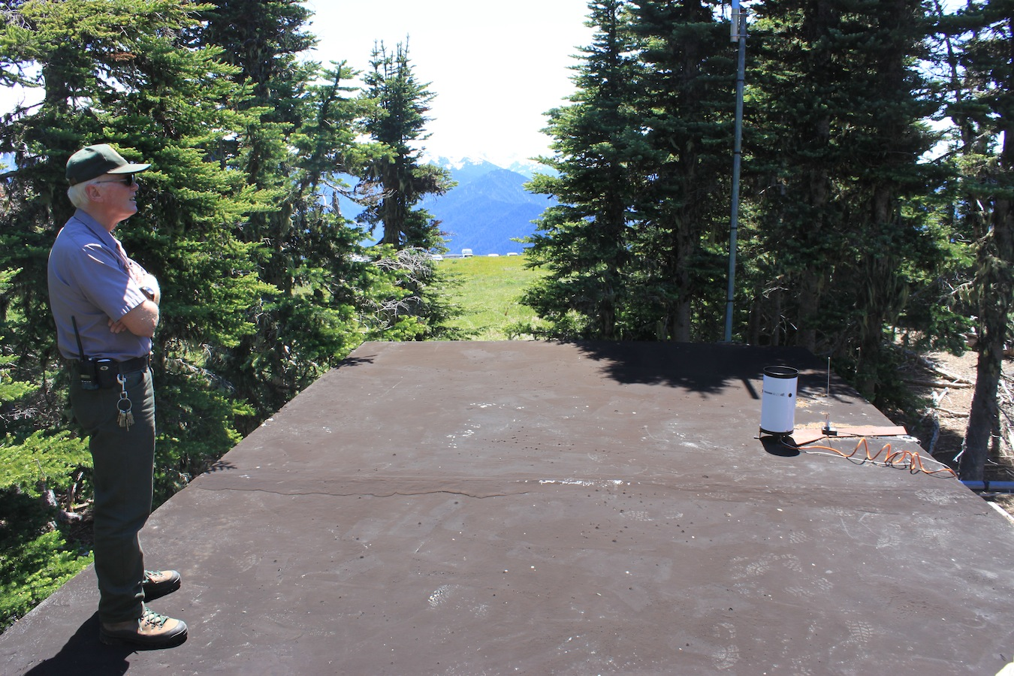
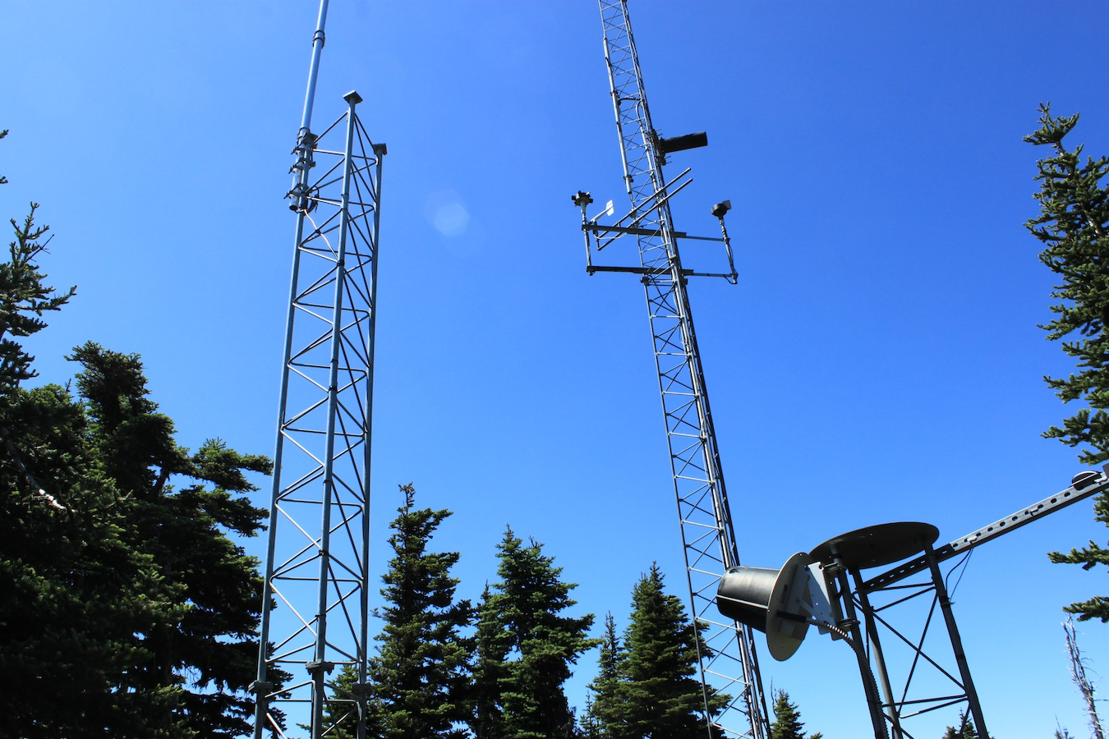
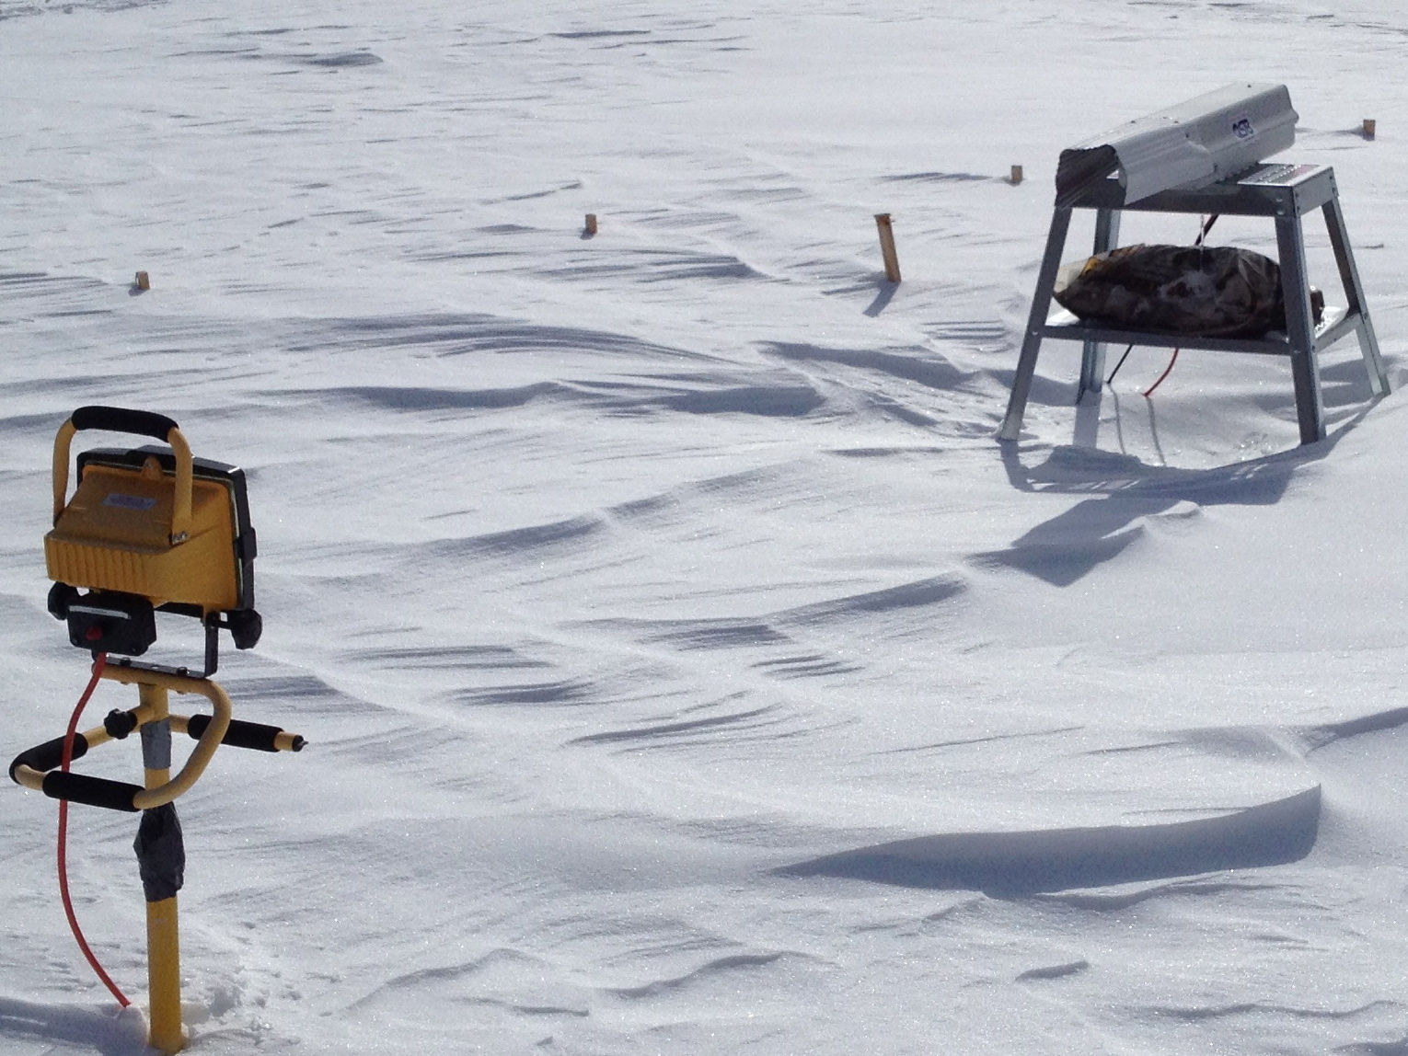
Hurricane Ridge 2014-15 Test site
The locations where we would install instruments include the roof of the Generator House and on the existing towers. These will be placed so they don’t interfere with the Radio Repeater and with the existing instrumentation.
We will work closely with the NPS and NWAC (if necessary) to assure proper installation.
Towers with instruments
Generator House
The PIP instrument

Slide 16
Snow Measurements in the high terrain of the Olympics
B. Snow Pack measurements
Existing SNOTEL sites have Snow Depth, SWE, temperature
Hurricane Ridge is a NW Avalanche center site and it has Snow Depth, SWE, temperature and winds.
Snow Cameras will be installed to monitor snow depth and infer SWE at locations unmeasured before.

Slide 17
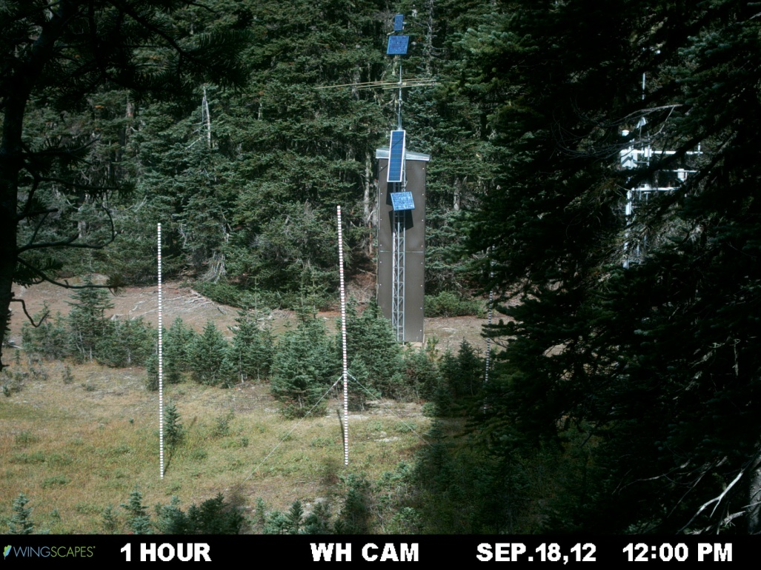
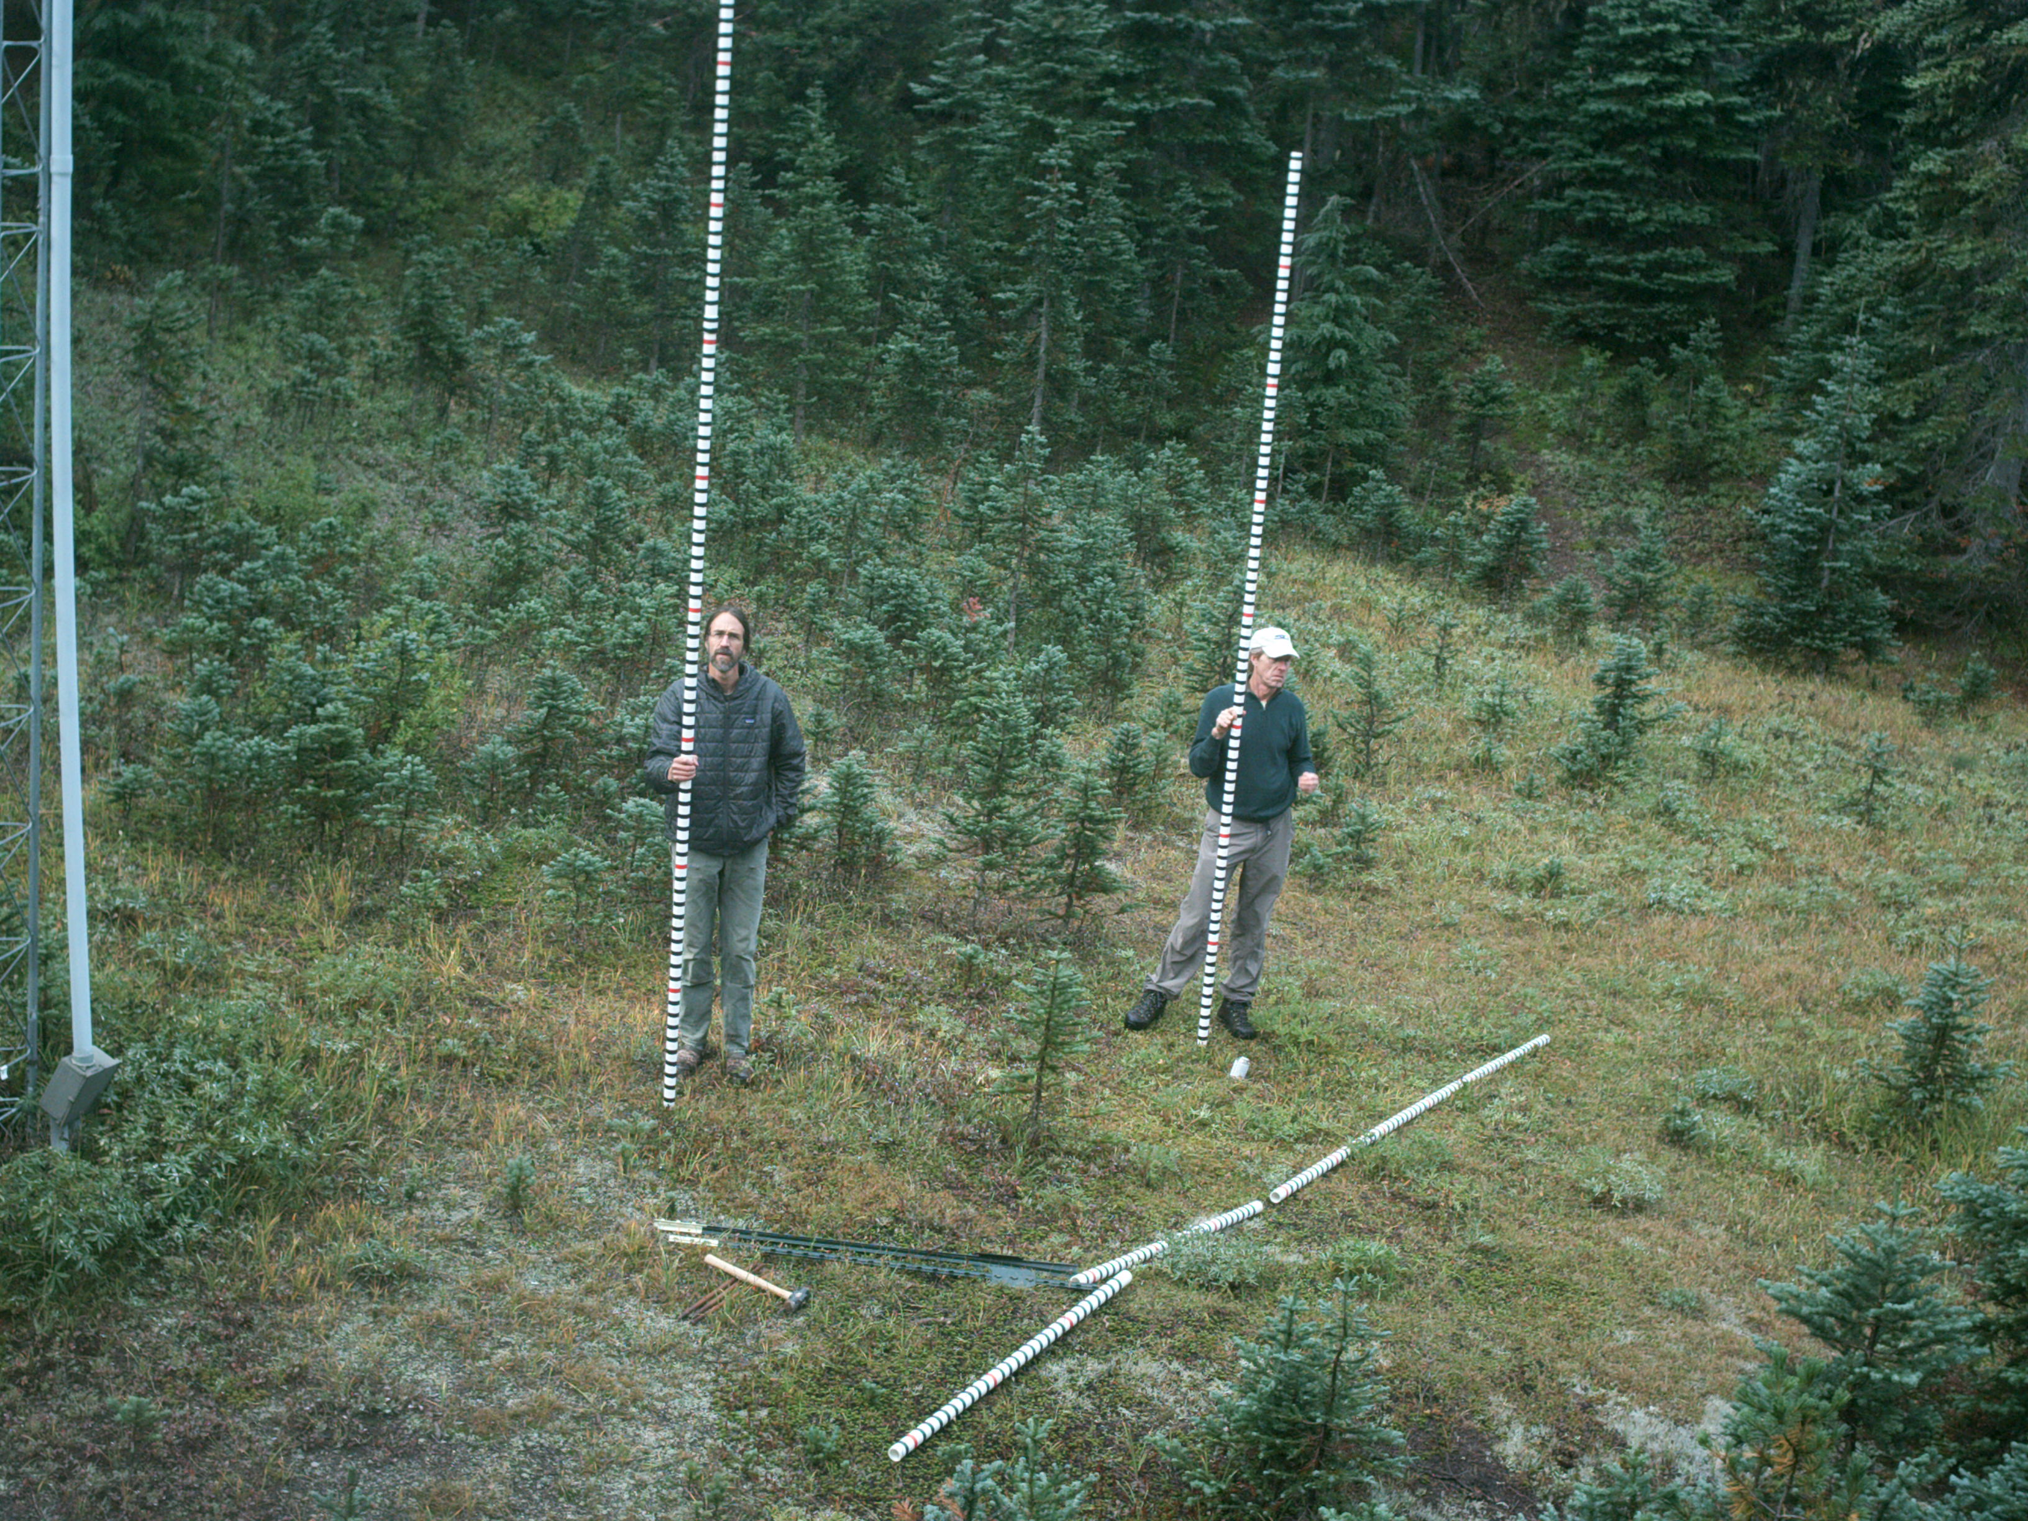
Snow Cameras in the Olympics
Snow camera installers and analysists:
Adam Massman, Derek Beal, Teddy Thorson
During 2013-2014 season, remote cameras and snow stakes installed at SNOTEL sites to calibrate the camera’s estimate of snow depth vs. SNOTEL estimate of snow depth.
This winter, remote cameras will be placed at 4 study areas (about 3-4 cameras each site) at locations on SW Olympics where measurements have not taken place since 1950’s (from snow surveys) or not at all.

Slide 18
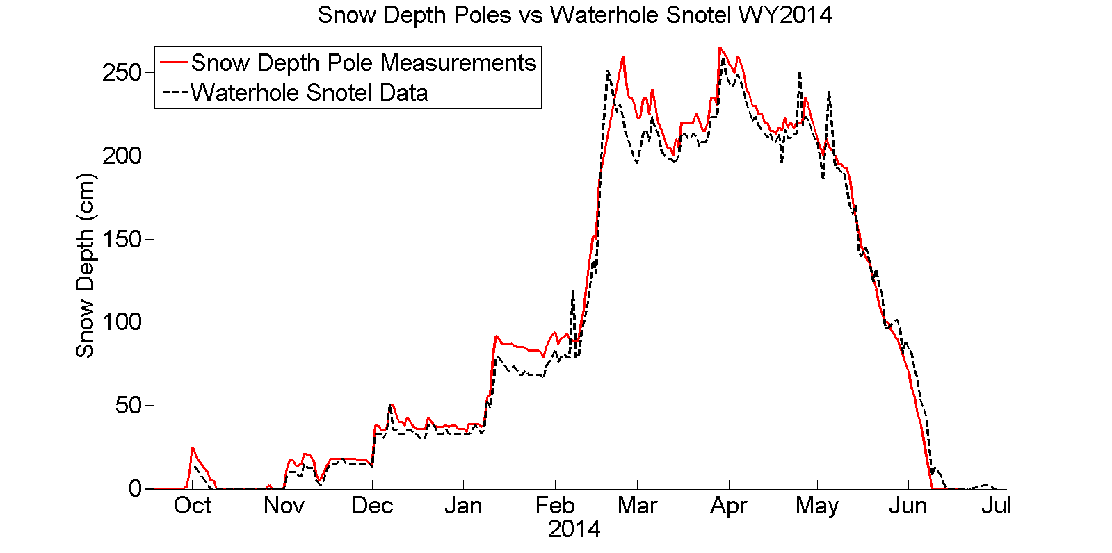
Snow depth = comparable (differences, which are <<10%, explained by within-site variability)
RMSE: 11.1 cm
Mean bias: Snow Pole 5.4 cm deeper than Snotel Acoustic Sensor
Mean absolute value difference: 8.5 cm

Slide 19
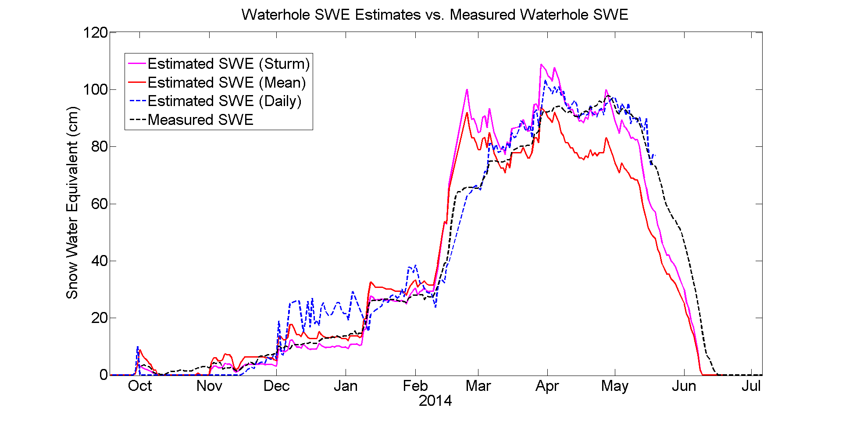
Tested 3 methods to estimate snow density to achieve SWE:
SNOTEL mean = 0.4
SNOTEL daily = snow pillow weight/depth at SNOTEL, and
Expected seasonal climatology (from Sturm et al. 2010)
Some issues with an intense, cold snow event

Slide 20
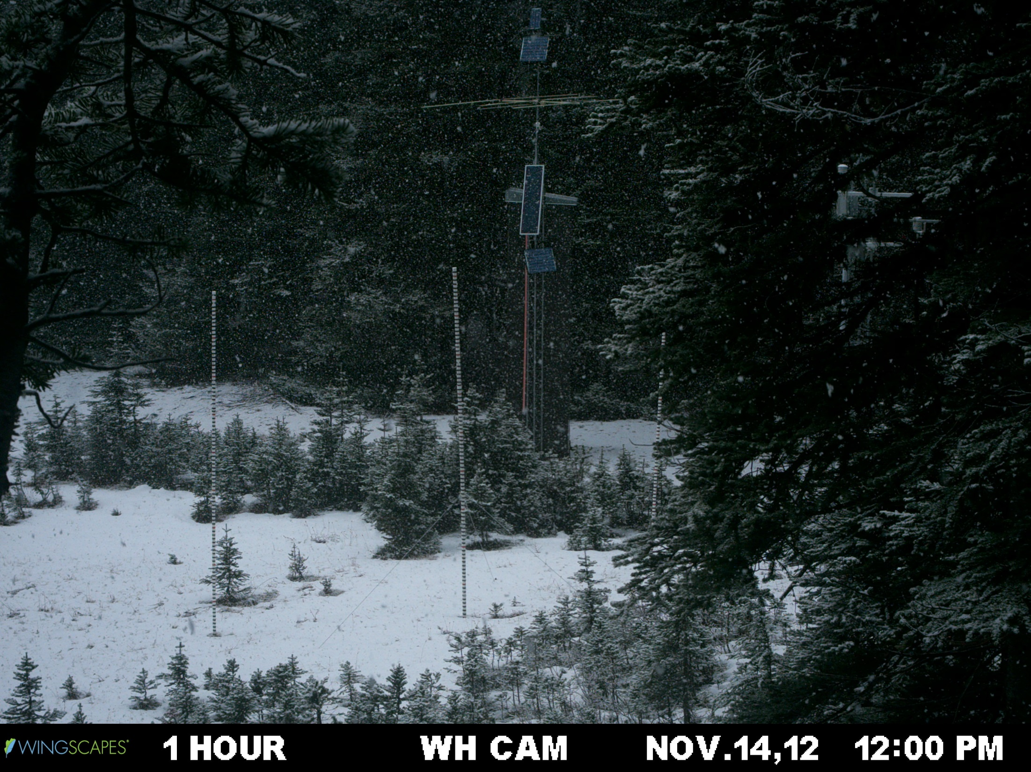
Precipitation event (snow) + Accumulation 1 of 2

Slide 21
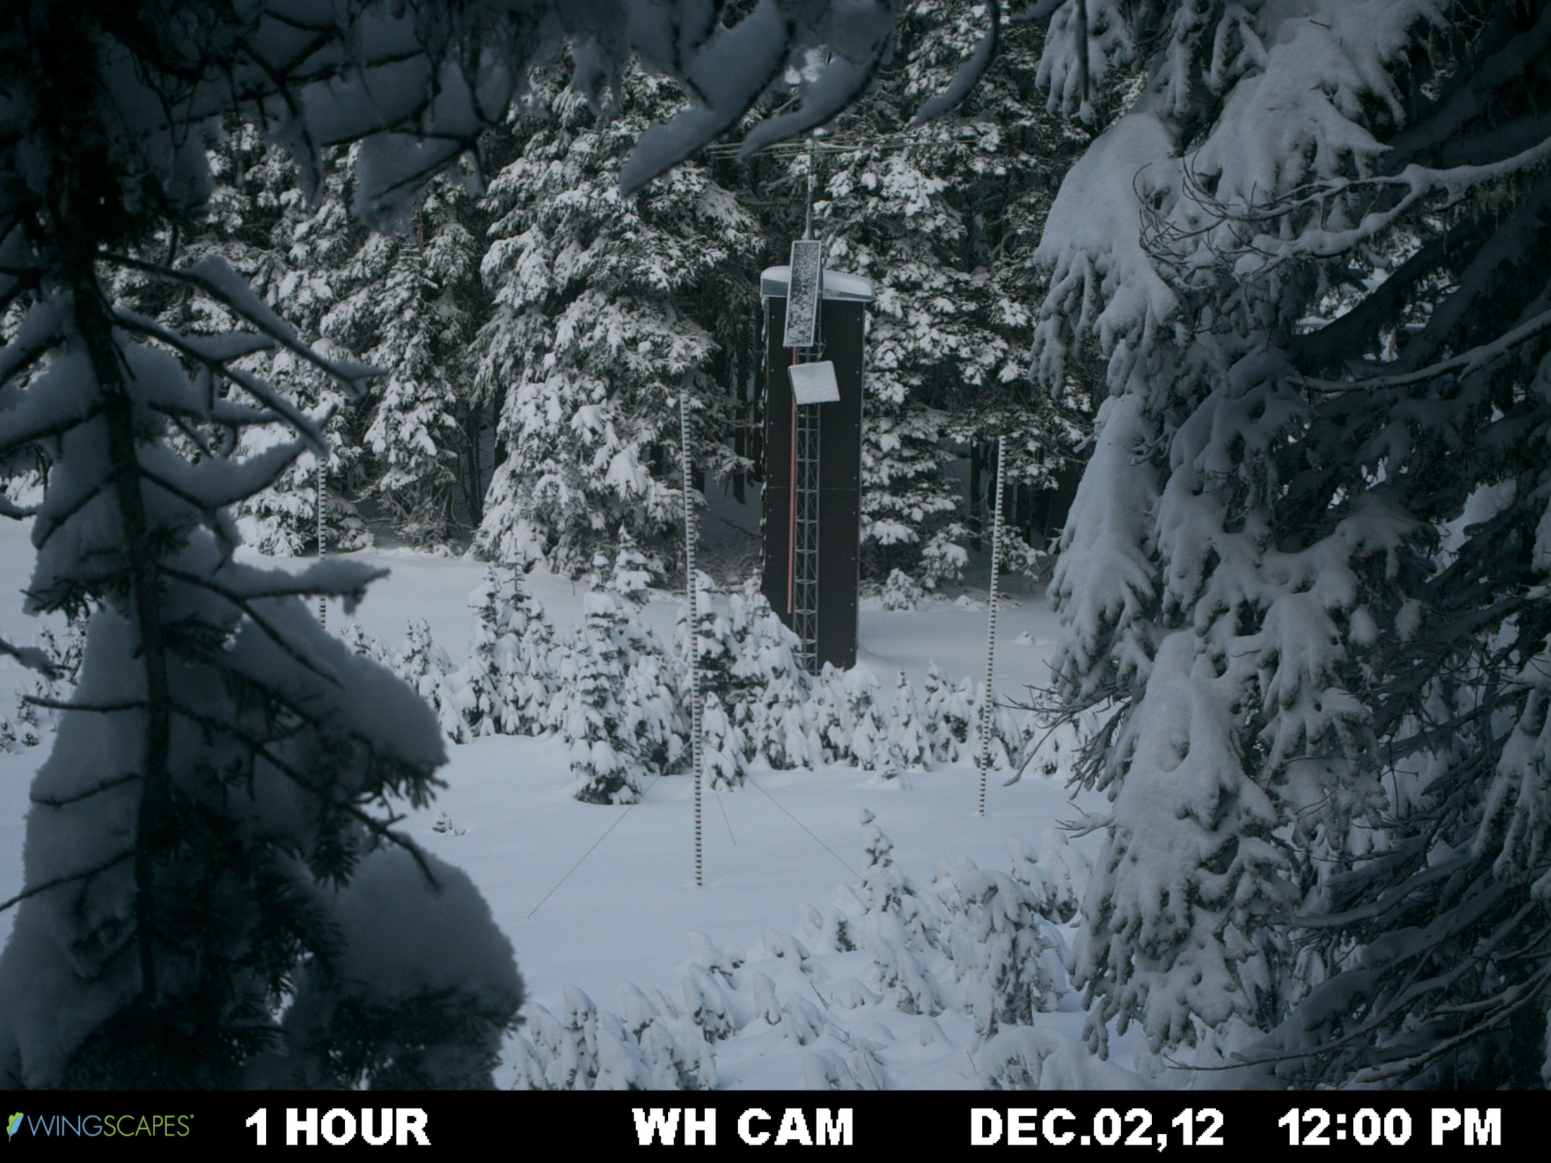
Accumulation 2 of 2

Slide 22
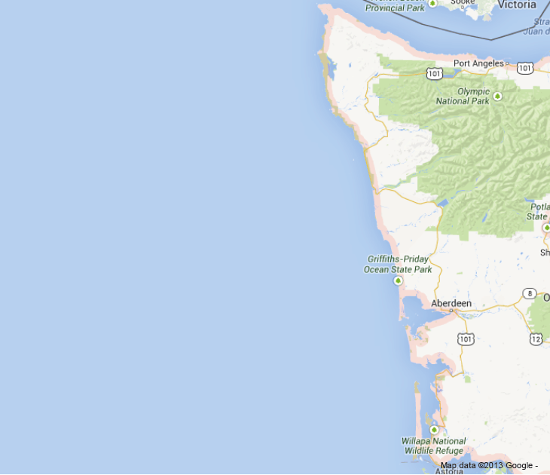
Aircraft
Committed aircraft:
DC-8 – will fly satellite simulators and deploy dropsondes over the ocean
North Dakota Citation – will fly cloud microphysical instrumentation
ER-2 – will fly satellite simulators, other instrumentation?
Proposed aircraft:
PNNL G1 – cloud microphysics and aerosols
Others?
Citation
Citation
ER-2
DC-8

Slide 23
Summary of OLYMPEX
Field campaign Fall 2015 – Winter 2016
Located on Olympic Peninsula within the midlatitude winter-time storm track
Sample precipitation systems from ocean to coast to complex terrain
Current activities this winter
Testing out instrumentation in difficult environments (Hurricane Ridge, Wynoochee – can solar panels work??, Low Divide mock-up – very remote mountain site)
Securing NPOL site location
Installing snow cameras to measure snow depth/SWE as we speak
To be addressed in coming months
Aircraft coordination
Chehalis basin rain gauge network
Rawinsonde network

Slide 24
End
Supported by NASA grants NNX13AG71G, and NNX12AL54G

