Slide 1
Latent Heating in the MJO
Computed from 16 years of TRMM Precipitation
Radar Observation
Hannah C. Barnes, Robert A. Houze, Jr., and Manuel D. Zuluaga
University of Washington
2014 NASA Precipitation Measurements Missions (PMM) Science Team Meeting
Embassy Suites - Grand Historic Venue, Baltimore, MD
5 August 2014

Slide 2
Storm Classification
Identify each contiguous 3D “Storm”
seen by TRMM PR
Convective component
Stratiform component
Extreme characteristic
Contiguous 3D volume of
convective echo > 30 dBZ
Extreme characteristic
Contiguous stratiform echo with
horizontal area > 50 000 km²
“Broad Stratiform
Region (Broad)”
Top height > 8 km
“Deep Convective
Core (Deep)”
Horizontal area > 800 km²
“Wide Convective
Core (Wide)”
“Isolated shallow echo (Shallow)”
Echo top > 1 km below freezing level and separate from deeper convection

Slide 3
Variability of Precipitating Cloud Population
Central Indian Ocean
Southeast West Pacific
1.2
1
0.8
0.6
0.4
0.2
0
Broad
Shallow
Wide
Deep
2
1.8
1.6
1.4
1.2
1
0.8
0.6
0.4
0.2
0
Broad
Shallow
Wide
Deep
Percentage of Pixels
Percentage of Pixels
2 3 4 5 6 7 8
MJO Phase
2 3 4 5 6 7 8
MJO Phase
Percentage of Pixels that are Intense Echo Features during each Phase
Barnes and Houze (2013)

Slide 4

Net Heating by Storms Containing Intense Echoes
2H25 (SLH)
Storm defined using 2A25
IE
y
x
at height z
Σ
$$2H25 grid point heating$$
= Net Heating by Storms Containing Intense Echoes
All Storms

Slide 5
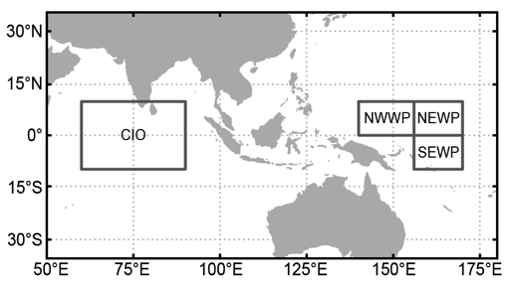
Central Indian Ocean

Slide 6
Central Indian Ocean
Active Phase
Suppressed Phase
16
14
12
10
8
6
4
2
0
16
14
12
10
8
6
4
2
0
Shallow
Deep
Wide
Broad
All Echoes
Wide
Broad
All Echoes
Broad
All Echoes
Broad
All Echoes
Deep
Wide
Broad
All Echoes
Shallow
Deep
Wide
Broad
All Echoes
All Echoes
All Echoes
Deep
Wide
Broad
All Echoes
Wide
Broad
All Echoes
Height (km)
Height (km)
0 5 10 15
0 5 10 15
Latent Heat (K/hr) (x10⁵)
Latent Heat (K/hr) (x10⁵)

Slide 7

Southeast West Pacific

Slide 8
Southeast West Pacific Ocean
Active Phase
Suppressed Phase
16
14
12
10
8
6
4
2
0
Shallow
Deep
Wide
Broad
All Echoes
16
14
12
10
8
6
4
2
0
All Echoes
Wide
Broad
All Echoes
Broad
All Echoes
Deep
Wide
Broad
All Echoes
Deep
Wide
Broad
All Echoes
Wide
Broad
All Echoes
All Echoes
Shallow
Deep
Wide
Broad
All Echoes
Broad
All Echoes
Height (km)
Height (km)
0 1 2 3 4 5 6
0 1 2 3 4 5 6
Latent Heat (K/hr) (x10⁵)
Latent Heat (K/hr) (x10⁵)

Slide 9
Conclusions
Heating from Broad Stratiform Regions most variable
Regions differ in terms of convective heating
  Central Indian Ocean
    Low-level heating dominates during suppressed stage
    Wide Convective Cores > Deep Convective Cores
  Southeast West Pacific
    Substantial mid/upper-level heating during all phases
    Wide Convective Cores ≈ Deep Convective Cores
Contribution from storms containing wide convective cores >= storms containing deep convective cores
Non-classified, mid-level heating important

Slide 10
The End
This work is funded by:
Department of Energy Grant DE-SC0008452 / ER-65460
National Science Foundation Grants AGS-1059611 and AGS-1355567
NASA PMM grant NHX13AG71G

