Slide 1
Request to embed a DOW in NASA’s OLYMPEX validation campaign for GPM (Houze)
OLYMPEX is a NASA ground validation campaign for the recently launched GPM satellite
The NPOL radar (similar to S-Pol) will be sited to make dual polarimetric Doppler radar measurements over the windward slopes of the Olympic Mountains
The NASA DC-8 aircraft will make airborne radar and passive microwave measurements, similar to those of GPM
The NASA/North Dakota Citation will make microphysical measurements
Numerous ground sites will make rain, snow, and particle size measurements.
The DOW will be embedded in this extensive network to achieve goals of the PI’s NSF grant!

Slide 2
Hypotheses based on MAP and IMPROVE II results
The NSF field programs MAP & IMPROVE II (using combos of S-Pol, DOW, & ELDORA) showed rapid precipitation enhancement of frontal precipitation on the lower slopes of a mountain barrier whether the moist airflow over the barrier is stable or not. The data suggest the 3-part hypothesis:
In highly unstable flows convection is released
In nearly neutral or slightly moist unstable flows, the lower and midlevel airflows are “coupled,” and the cross barrier wind components at lower and midlevels go up and over the barrier in unison, and deep lifting and condensation occur
In stable conditions, the lower flow is retarded or blocked so that it is “decoupled,” i. e. separated from the midlevel flow by a shear layer, and overturning in the shear layer contributes to windward-side enhancement of the precipitation

Slide 3
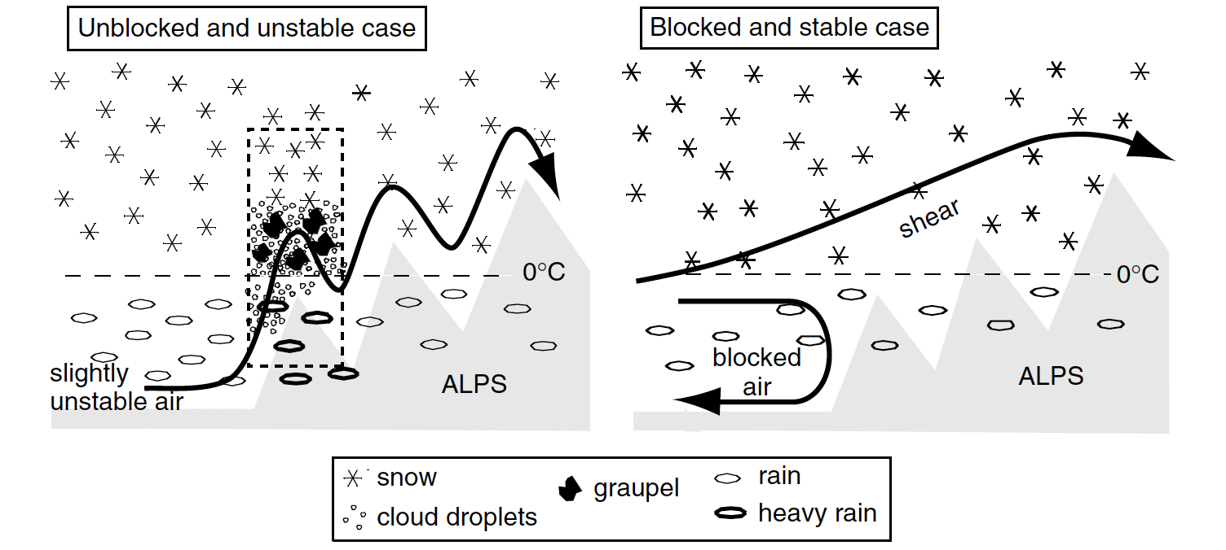
These conceptual models can be tested if DOW is added to the NASA OLYMPEX network
Coupled flow case
Decoupled flow case
Rotunno and Houze 2007

Slide 4
NASA’s OLYMPEX network
NPOL will do RHI’s in the indicated sector but will not see lower levels in the valley
DOW will be embedded in the concentrated area of observations on the SW side to observe the lower level airflow and microphysics below the lowest scans seen by NPOL
DOW will operate as it did in MAP, located in a valley, performing RHI scans looking up & down the valley
This simple strategy was highly successful in identifying the coupled and uncoupled regimes in MAP
This strategy will test the generality of the MAP & IMPROVE II results
The polarimetric capability of the current DOW (not available for MAP) will allow the microphysics and dynamics to be documented simultaneously
This network is for ground validation of GPM and without DOW will not test the hypotheses arising from MAP and IMPROVE II

Slide 5
Proposed DOW location relative to other OLYMPEX radars
The NWS WSR-88D will provide background surveillance on the SW side of the Olympics
A Canadian X-band polarimetric radar will look at the NE side of the Olympics to provide comparison between the windward and lee sides of the Olympics
NPOL will look up the Quinault Valley on the SW side of the Olympics with sectors of RHIs, but lower elevation angles will be blocked.
DOW will be located in the valley to observe the lower elevations, where many key processes occur, and the Doppler and polarimetric data will combine with the NPOL to provide a complete documentation
The combined NPOL/DOW observations on the SW side will test the generality of the processes observed in MAP
The observations will be robust enough to show whether different processes occur here than were seen in MAP and IMPROVE II

