Slide 1

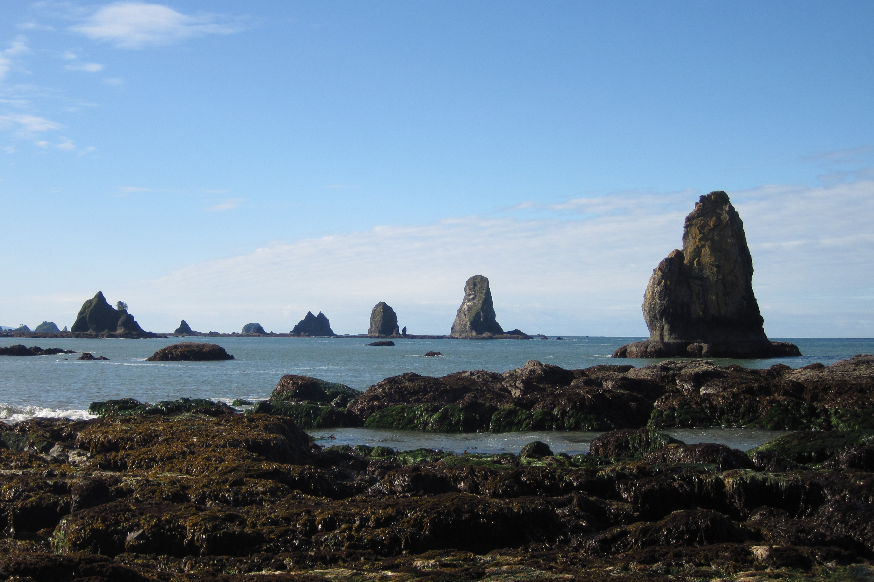
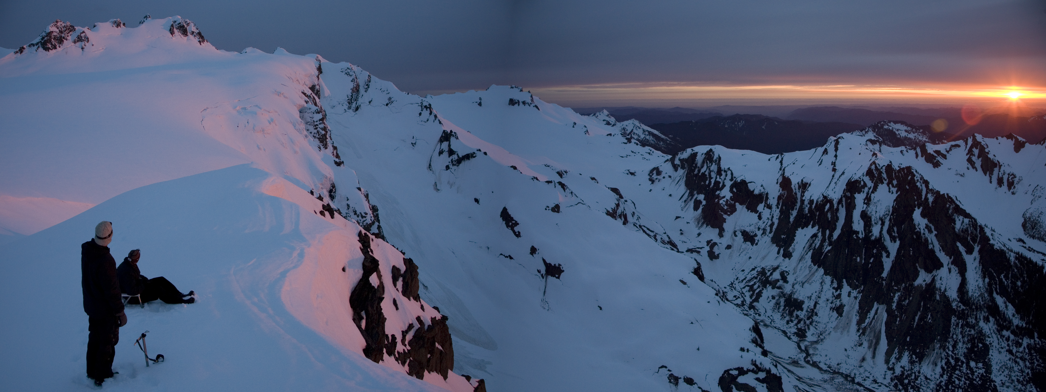
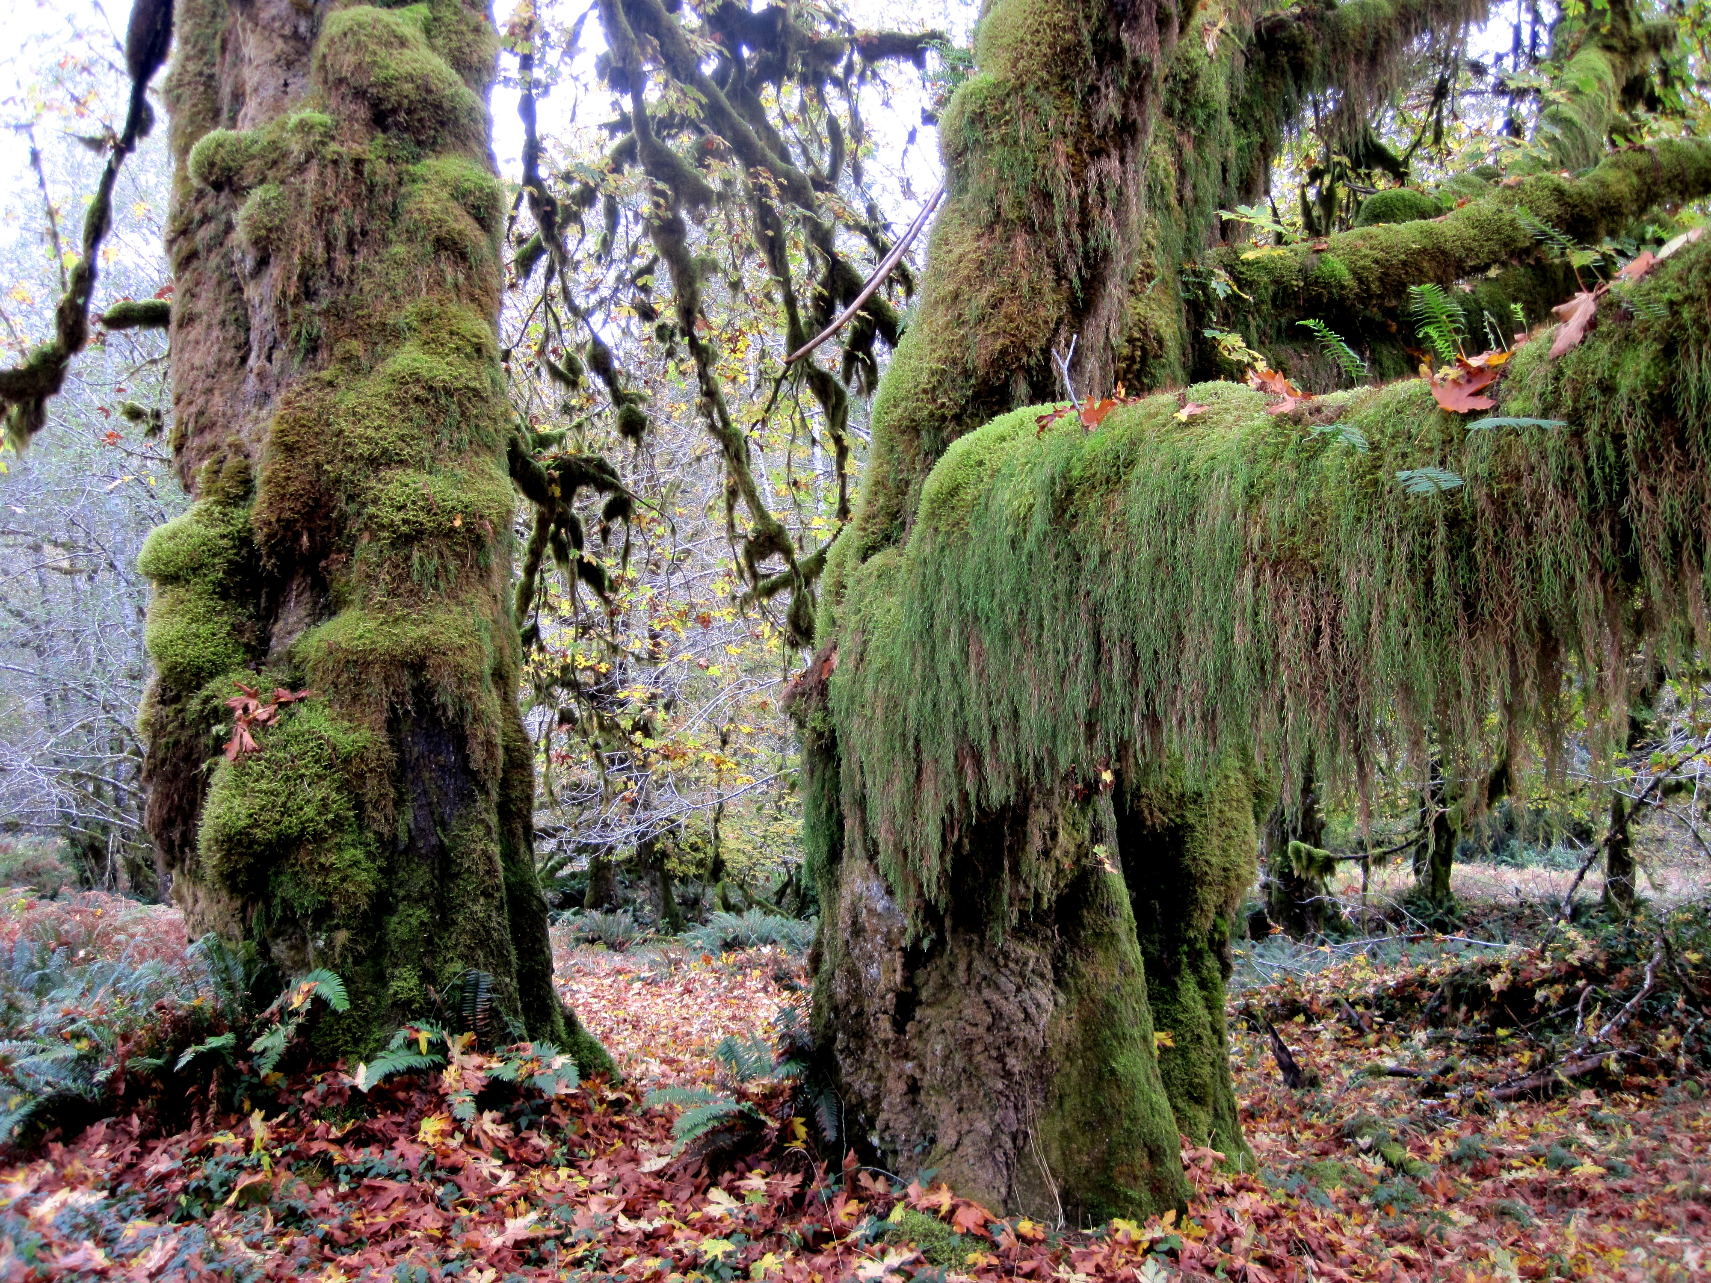
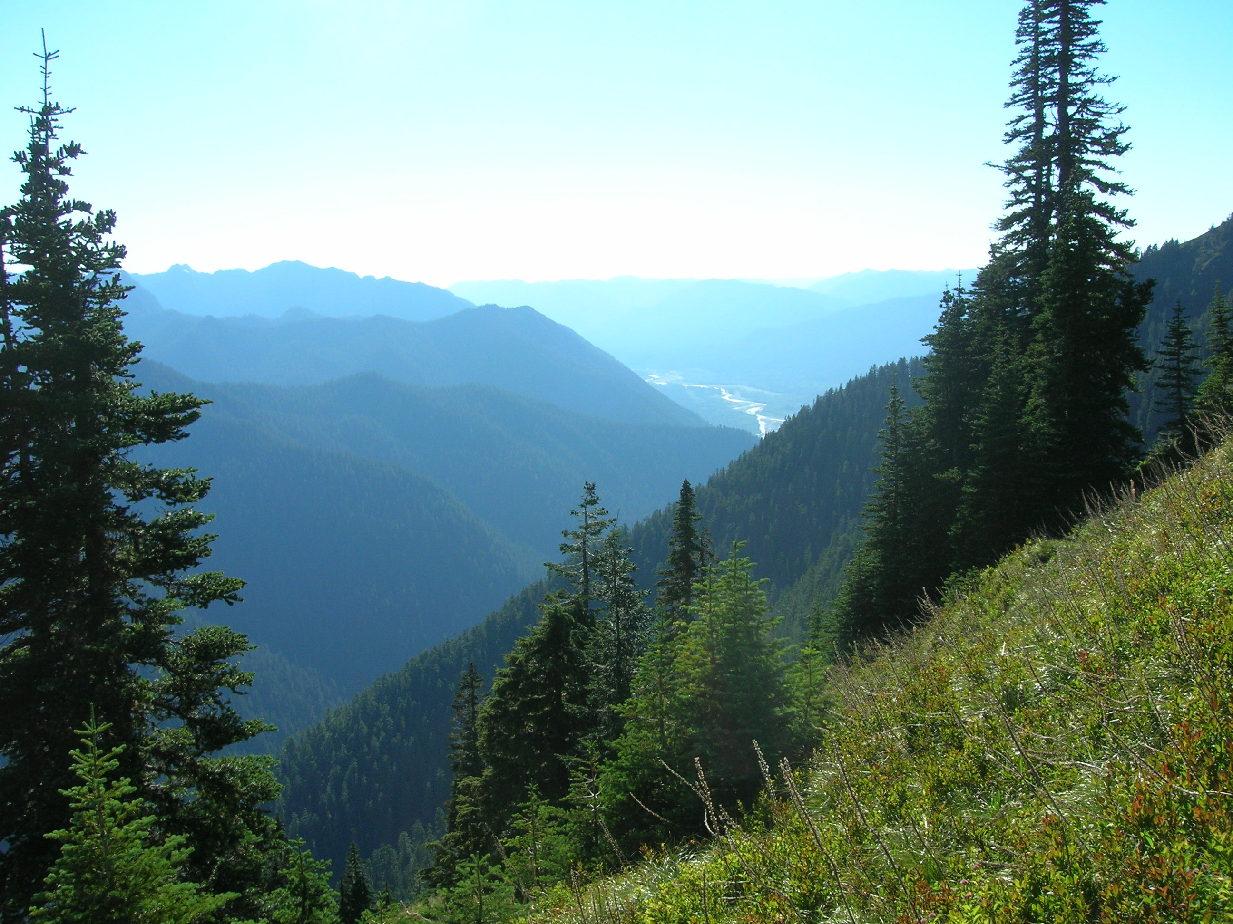
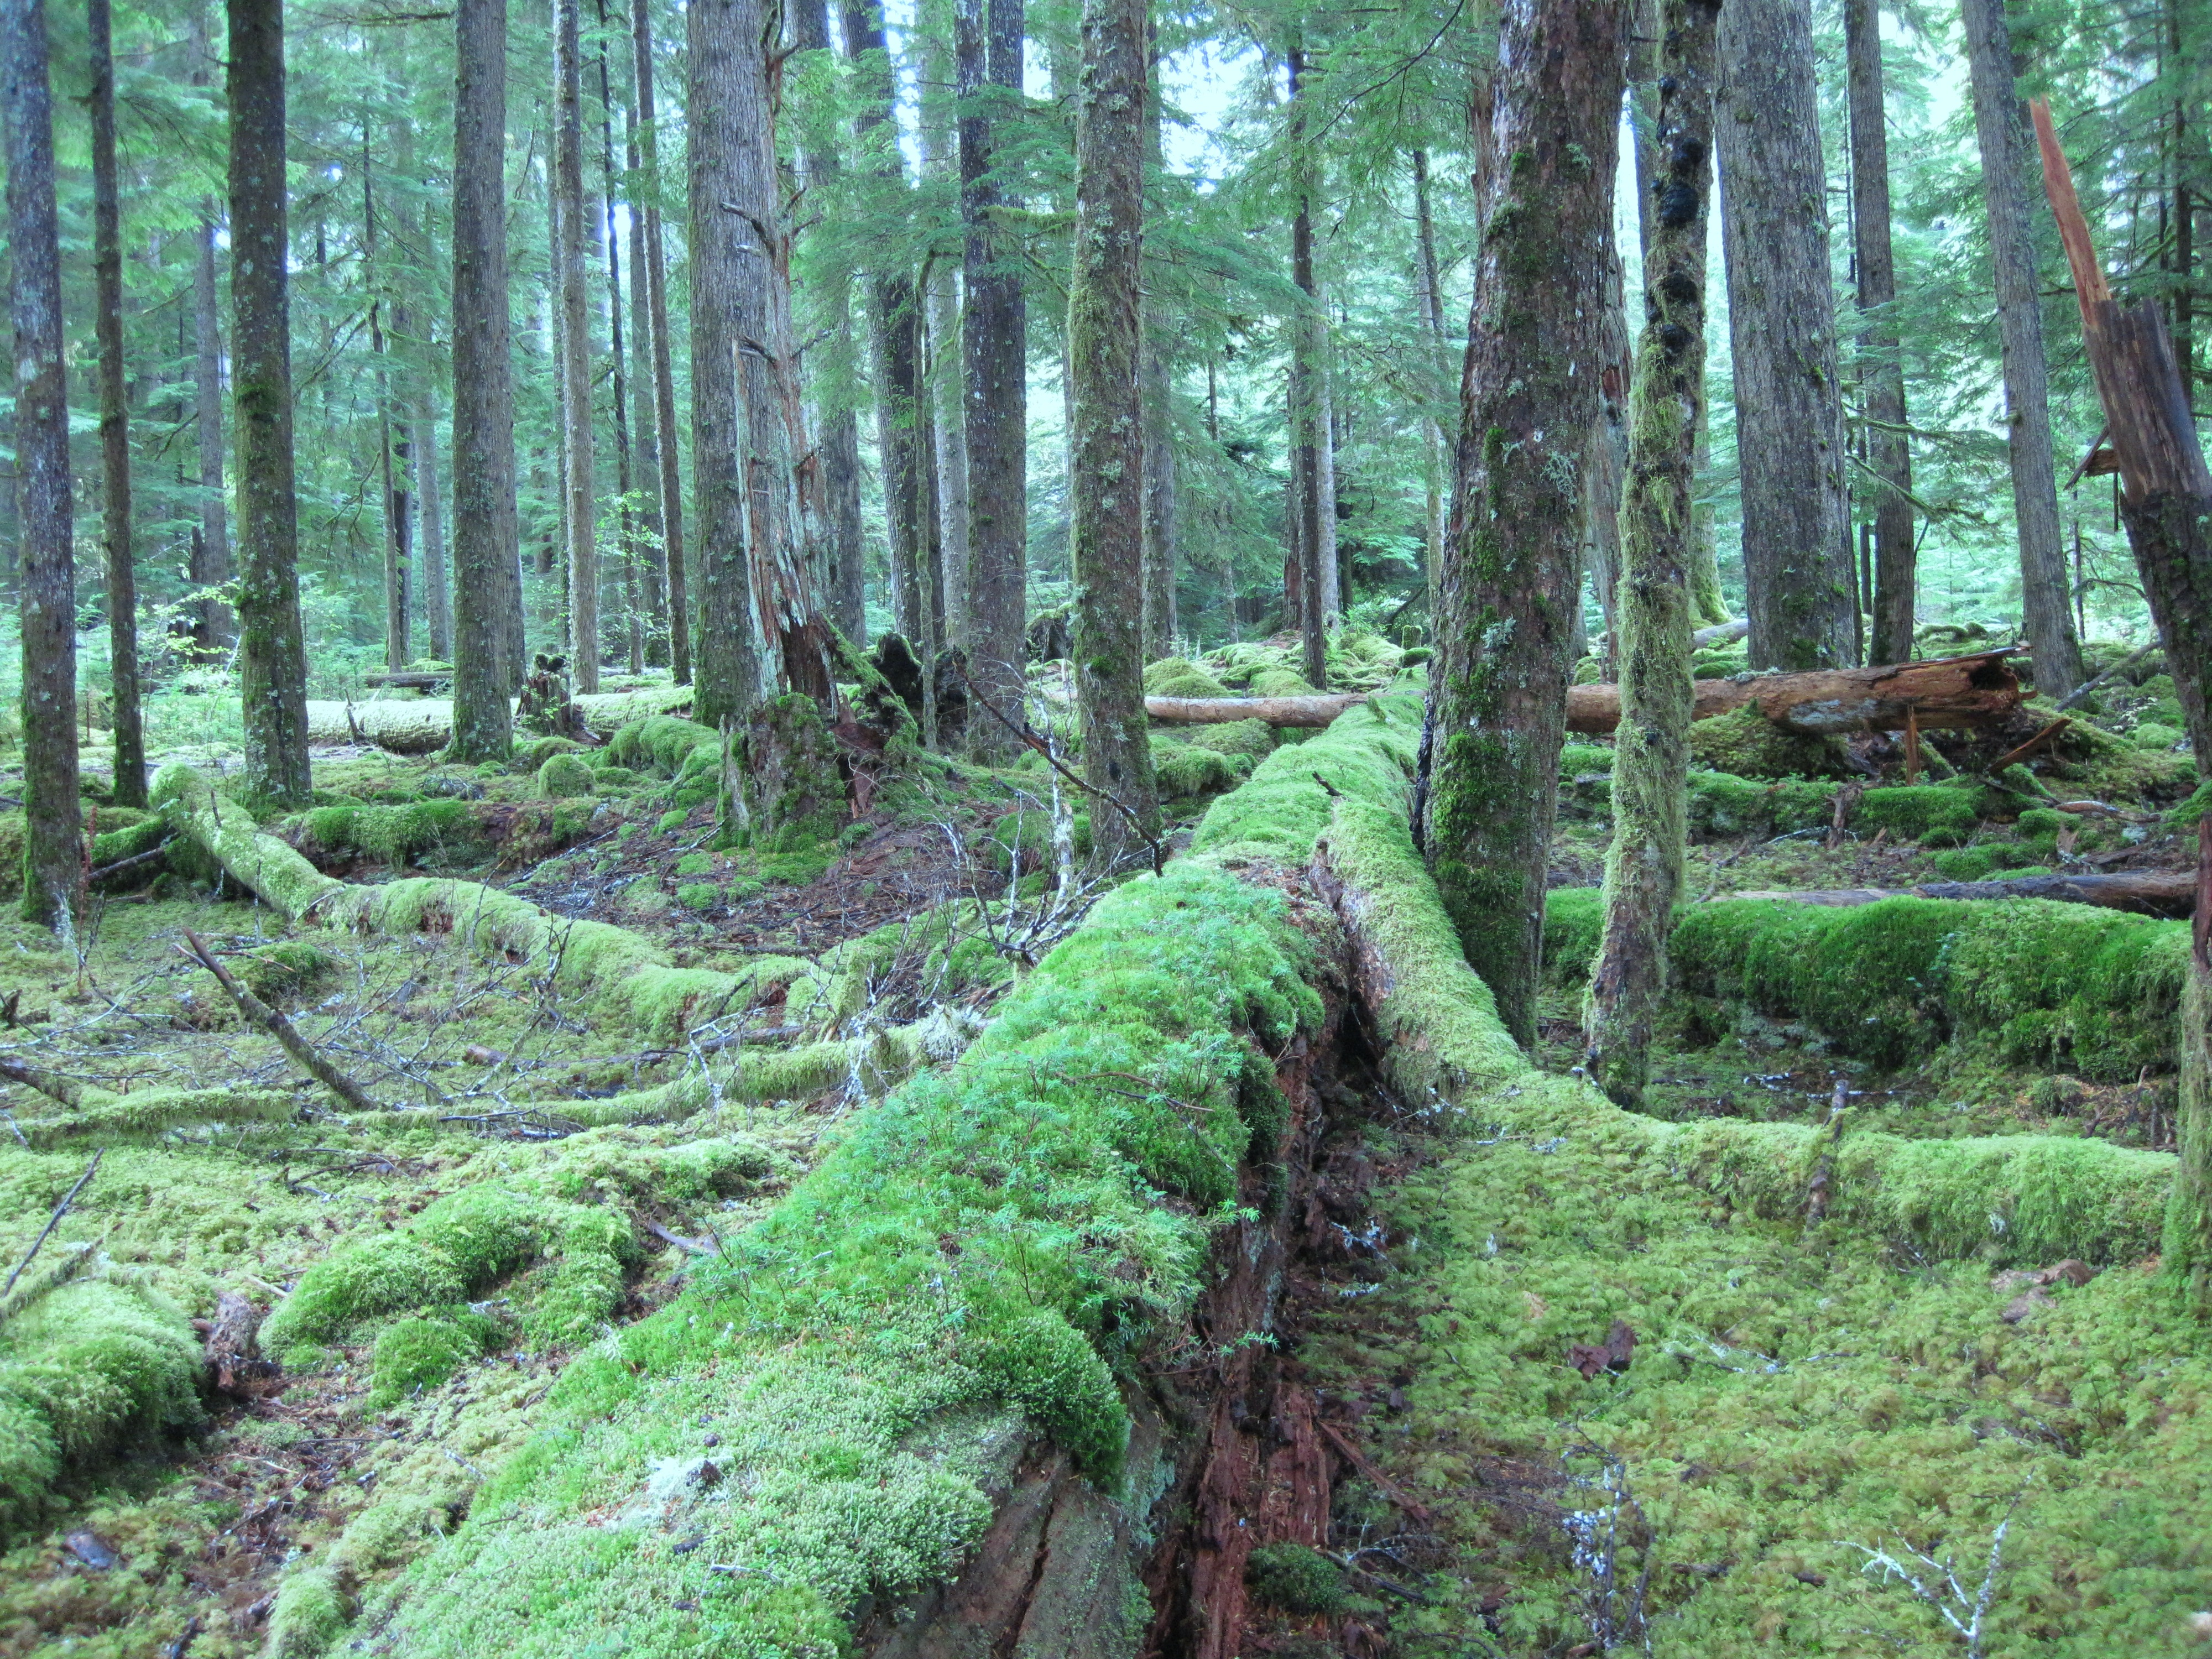
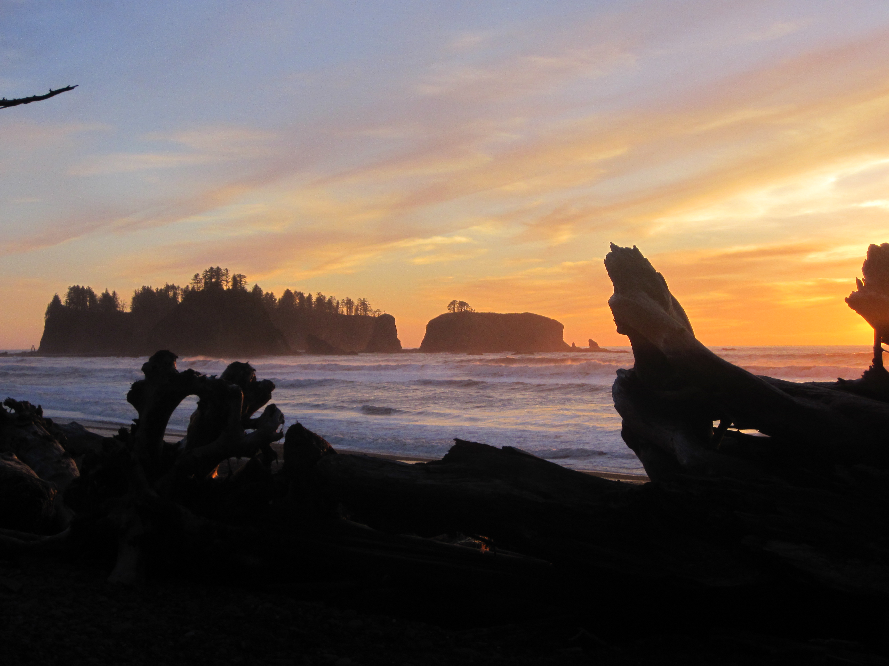
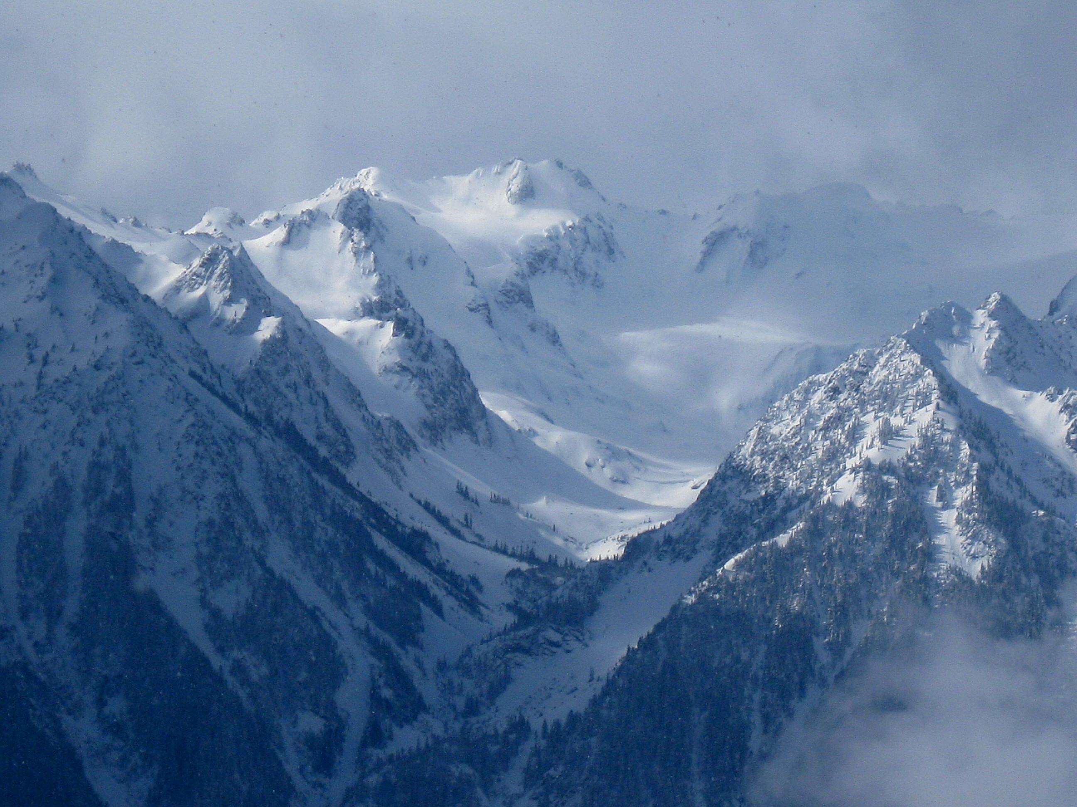
Request to Deploy One DOW in OLYMPEX
PI Robert Houze
University of Washington

Slide 2
Relationship to NSF research
The PI has an ongoing NSF grant to study orographic effects on precipitation
Fronts passing over the Alps, Cascades, Sierras, and Andes are a focus of this research
The research is related to the PI’s deployments of S-Pol and DOW in MAP and IMPROVE II
Those field projects led to working hypotheses about the mechanisms of enhancement of precipitation by fronts passing over mountain ranges
This simple deployment of a single DOW will allow these hypotheses derived from earlier NSF projects to be tested

Slide 3
NASA’s OLYMPEX in Autumn 2015 is a unique opportunity
OLYMPEX is a NASA ground validation campaign for the recently launched GPM satellite
The NPOL radar (similar to S-Pol) will be sited to make dual polarimetric Doppler radar measurements over the windward slopes of the Olympic Mountains
The NASA DC-8 aircraft will make airborne radar and passive microwave measurements, similar to those of GPM
The NASA/North Dakota Citation will make microphysical measurements
Numerous ground sites will make rain, snow, and particle size measurements.
The DOW will be embedded in this extensive network!

Slide 4
Hypotheses
Rapid precipitation enhancement of frontal precipitation occurs on the lower slopes of a mountain barrier whether the moist airflow over the barrier is stable or not
In highly unstable flows convection is released
In nearly neutral or slightly moist unstable flows, the lower and midlevel airflows are “coupled,” and the cross barrier wind components at lower and midlevels go up and over the barrier in unison, and deep lifting and condensation occur
In stable conditions, the lower flow is retarded or blocked so that it is “decoupled,” i. e. separated from the midlevel flow by a shear layer, and overturning in the shear layer contributes to windward-side enhancement of the precipitation

Slide 5
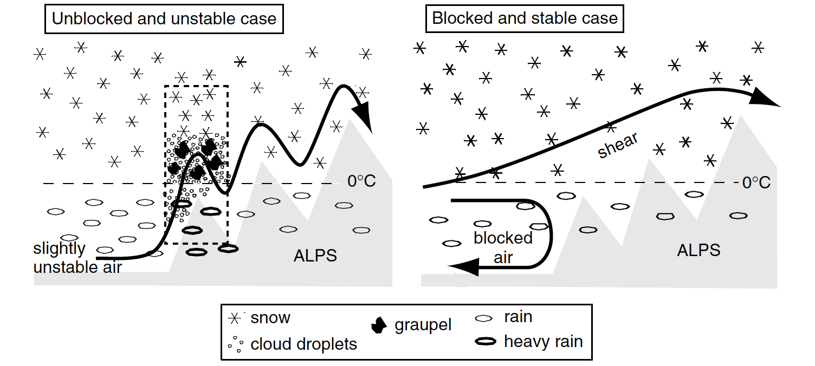
Conceptual models to test with the DOW observations
Coupled flow case
Decoupled flow case
Rotunno and Houze 2007

Slide 6
Testing the hypotheses
Deployment of the DOW in the Quinault valley will allow observations of the low-level flow, including situations in which the shear layer separating it from the midlevel flow occurs in connection with decoupling
Single Doppler data in RHI sectors looking up and down the valley will allow the windward flow documentation
The reflectivity data associated with the Doppler velocity will allow the precipitation structure to be associated with the velocity structures.
This type of deployment of the DOW was used successfully in MAP and will be used again here with the additional capability of dual polarization

Slide 7
NASA’s overall OLYMPEX network
NPOL will do RHI’s in the indicated sector but will not see lower levels in the valley
DOW will be embedded in the concentrated area of observations on the SW side to observe the lower level airflow and microphysics below the lowest scans seen by NPOL

Slide 8
Proposed DOW location relative to other OLYMPEX radars
NPOL will look up the Quinault Valley on the SW side of the Olympics, but lower elevation angles will be blocked
DOW will be located in the valley to observe the lower elevations, where many key processes occur
Canadian X-band will look at the NE side of the Olympics
WSR-88D will provide surveillance on the SW side

Slide 9
Proposed DOW observational strategy
Operate as in MAP
  DOW located in a valley
  Perform RHI scans looking up and down the valley
  This simple strategy was highly successful in MAP
  See an example RHI in next slide

Slide 10
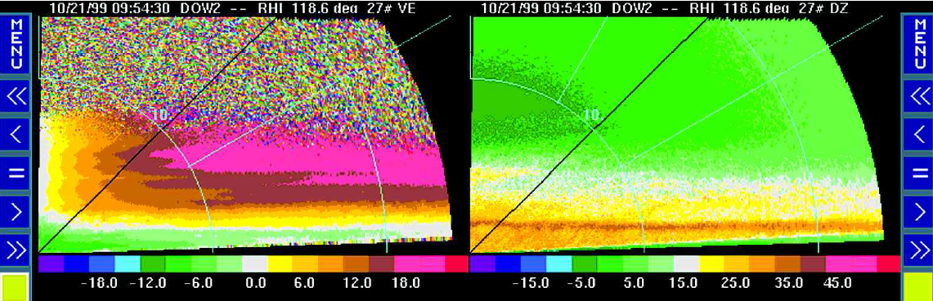
Example of a decoupled flow observed by DOW in MAP
RHI from DOW pointing upslope in the Alps in MAP
Radial velocity
Reflectivity
Upslope flow
Shear layer
Melting
Downslope flow
From Steiner et al. (2003)

Slide 11
Summary of the proposed deployment in its historical context
1999: DOW paired with S-Pol in MAP showed
  Coupled flow in neutral to slightly unstable conditions
  Decoupled flow in more stable situations
  Reflectivity suggested different microphysics in coupled and decoupled flows
2001: S-Pol in IMPROVE II
  indicated flows similar to those in MAP but DOW was not deployed
2010: Scanning C-band in SNOWV-10
  Project during 2010 Winter Olympic Games (results as yet unpublished)
  Indicated that flows over west coast mountains of British Columbia can occasionally be strongly decoupled as in MAP. DOW was not deployed.
2015: DOW in OLYMPEX
  DOW will provide key new evidence indicating the generality, or otherwise, of coupled and decoupled flows involved in the orographic enhancement of frontal precipitation
  DOW’s dual polarization will allow better inference of the microphysics occurring in the coupled and decoupled flows than was possible in MAP
  DOW deployed in OLYMPEX will allow this line of NSF research to reach its next level with a minimum of cost to NSF

