Slide 1
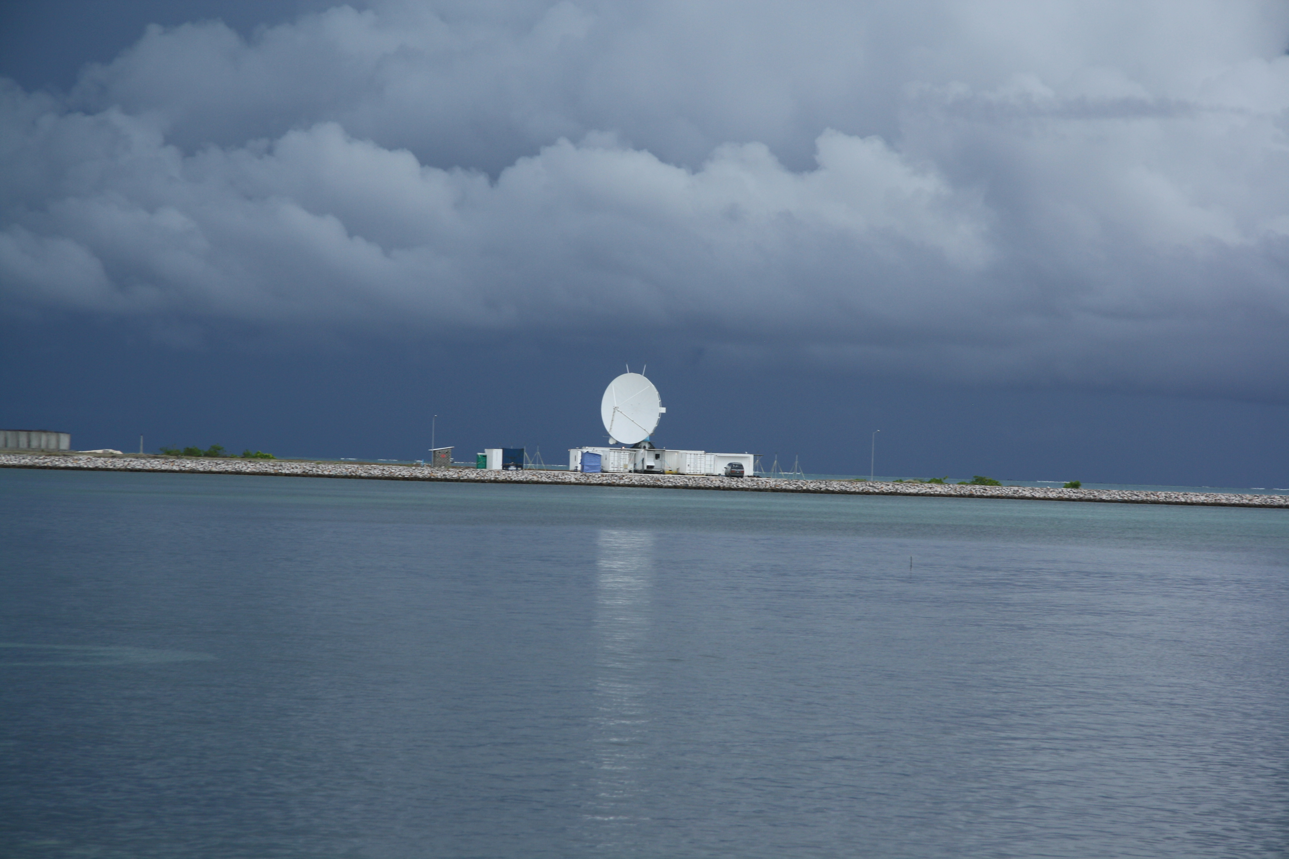
MJO Insights from the S-PolKa radar in DYNAMO
Robert A. Houze, Jr.
H. C. Barnes, S. W. Powell, A. K. Rowe, M. Zuluaga
University of Washington
Symposium on Progress of MJO Research Through Field Campaigns, Sapporo, Japan, 23-25 July 2014

Slide 2
Before DYNAMO

Slide 3
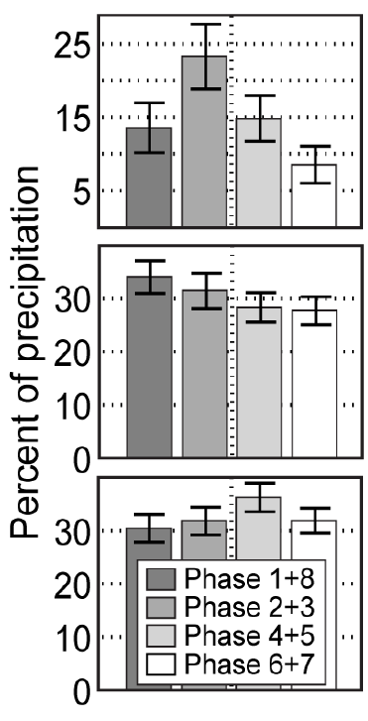
Active
Suppressed
From the A-Train constellation…
Connected MCSs
…rainfall in the MJO is dominated by the largest mesoscale convective systems
Separated MCSs
Other high cloud systems
Yuan and Houze 2012

Slide 4
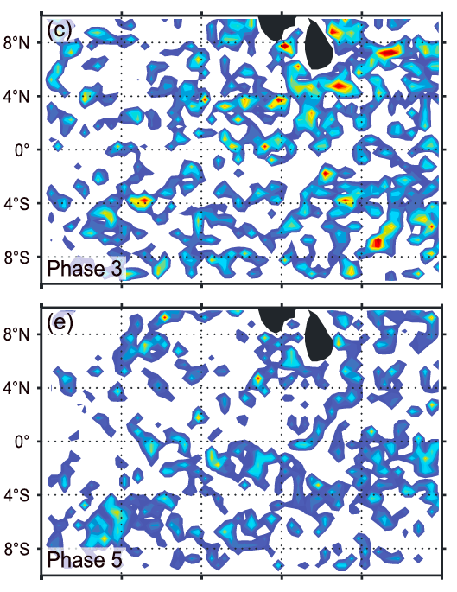
TRMM radar shows how the scale of individual convective entities vary with phase of the MJO
Shallow Isolated Echoes
Deep Convective Cores
Wide Convective Cores
Broad Stratiform Regions
Suppressed conditions
Active conditions
Barnes and Houze 2013

Slide 5
Linking S-PolKa to Satellite Observations

Slide 6
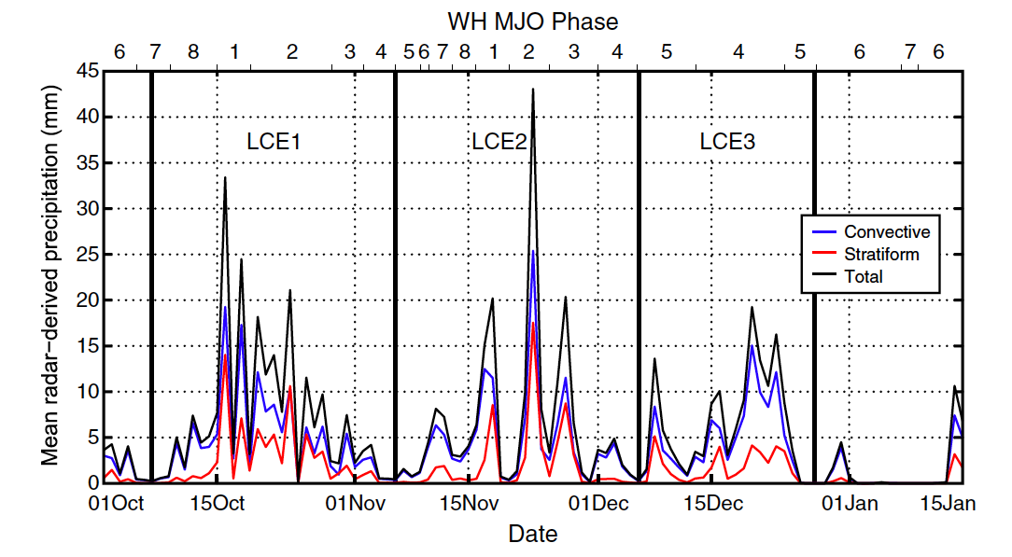
S-PolKa Radar Rainfall at Addu Atoll in DYNAMO
OLR
Powell and Houze 2013

Slide 7
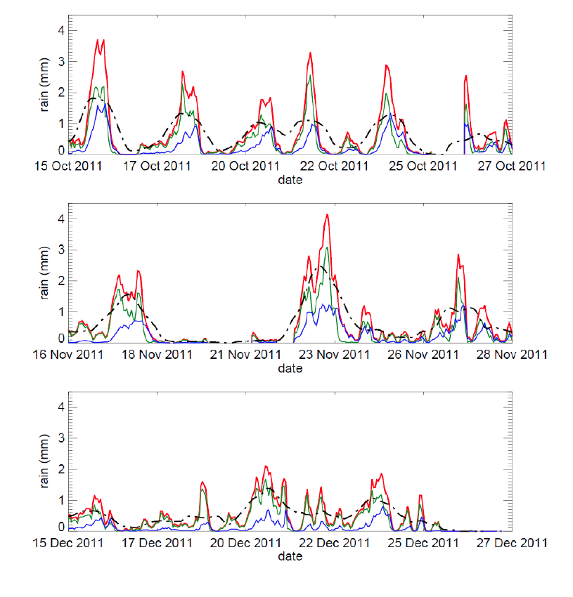
October Active Period
Rain seen by the S-PolKa radar in DYNAMO
November Active Period
Filter and composite
Occurred in “episodes” separated by ~2-7 days
December Active Period
Zuluaga and Houze 2013

Slide 8
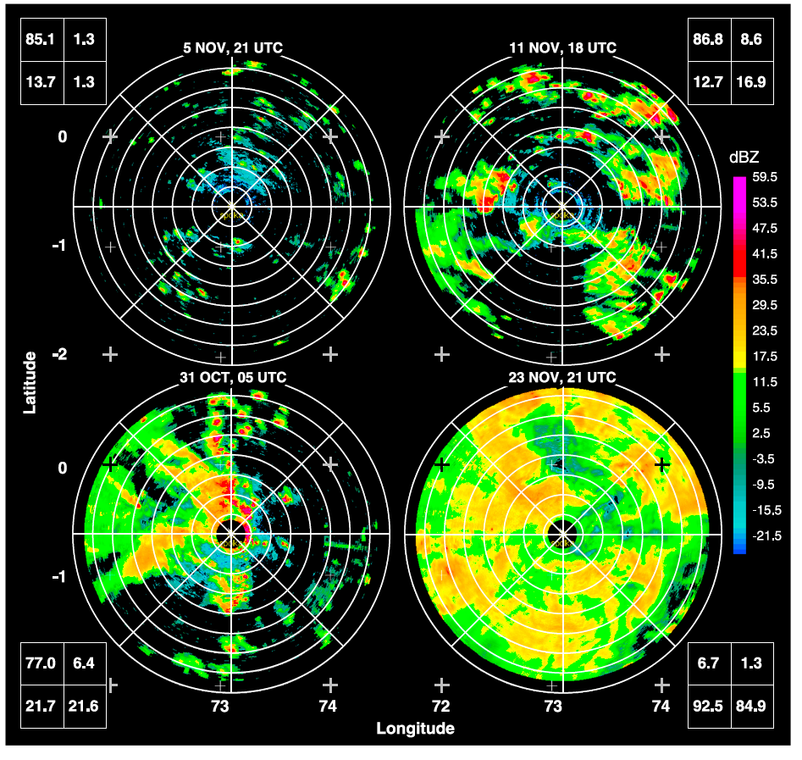
Temporal and Spatial Scales of the Echoes
Isolated weak echoes
Intense embedded cores
Examples
Wider embedded cores
Broad
Stratiform echo
From Powell and Houze 2013

Slide 9
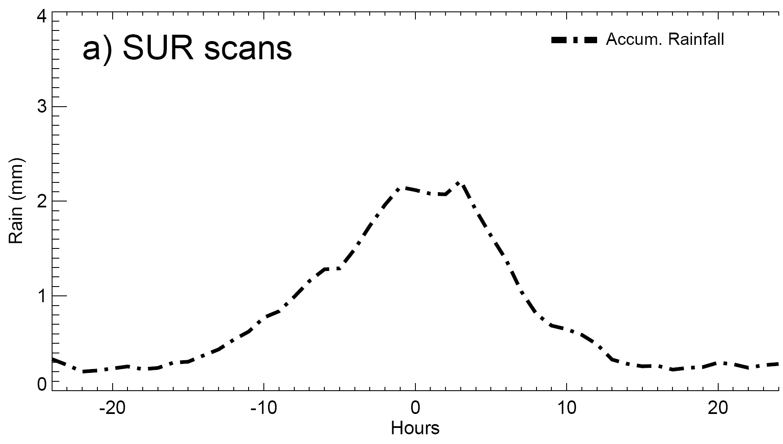
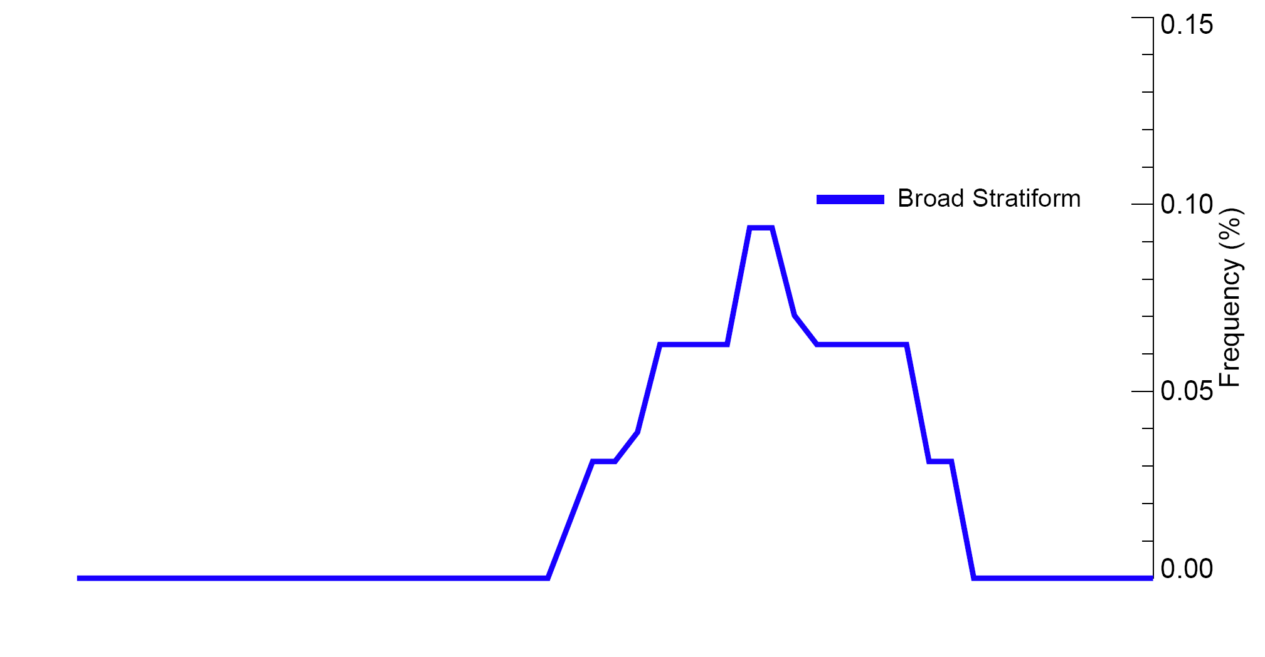
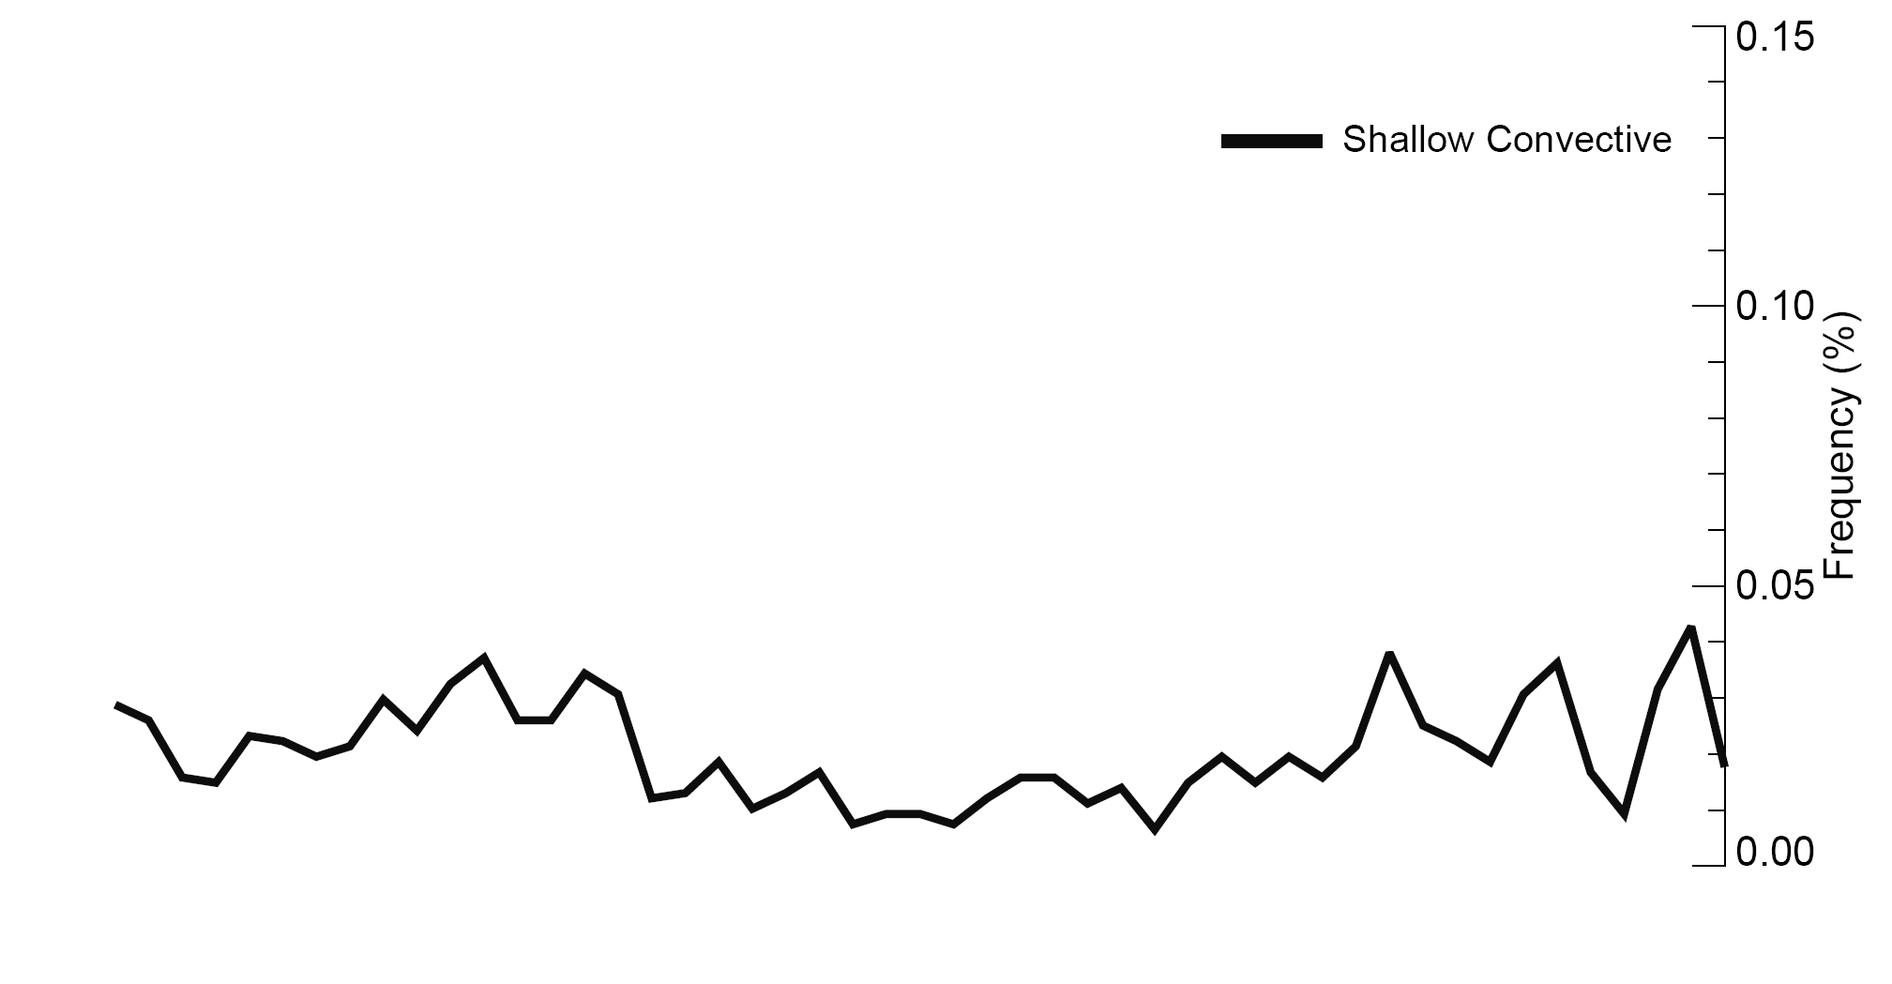
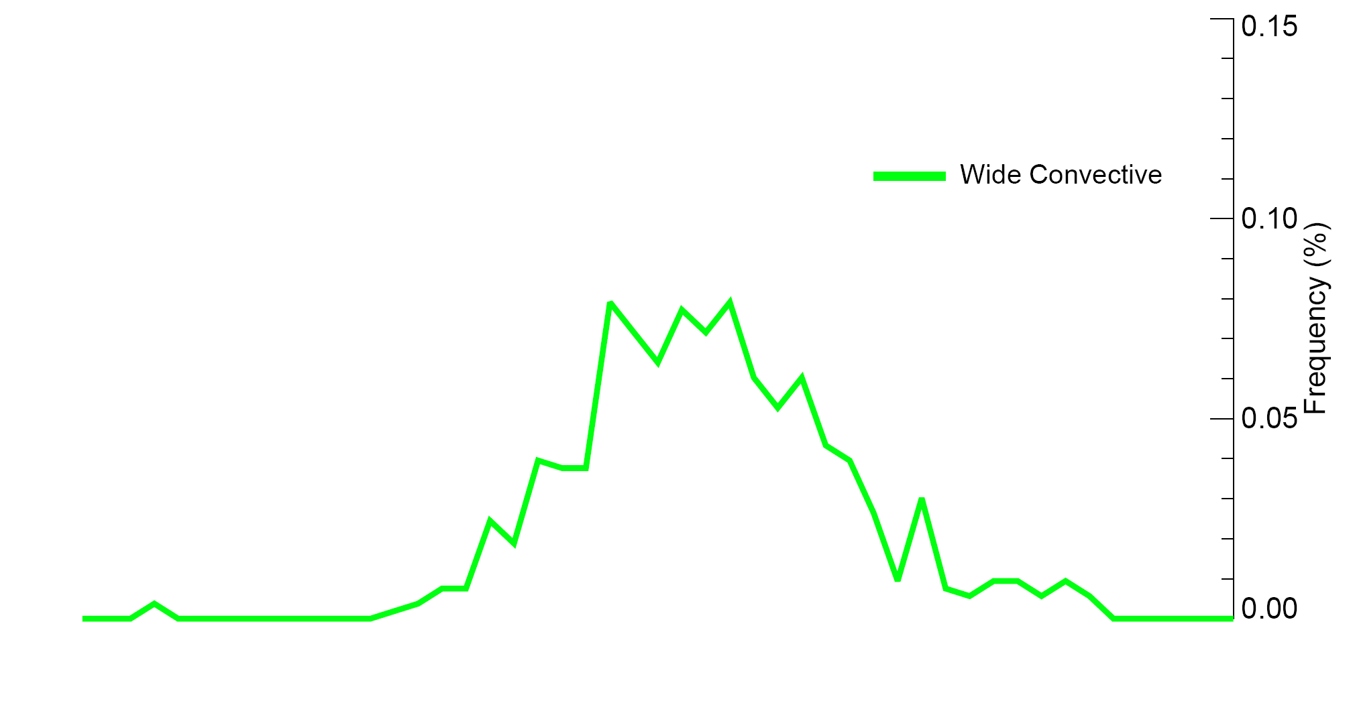
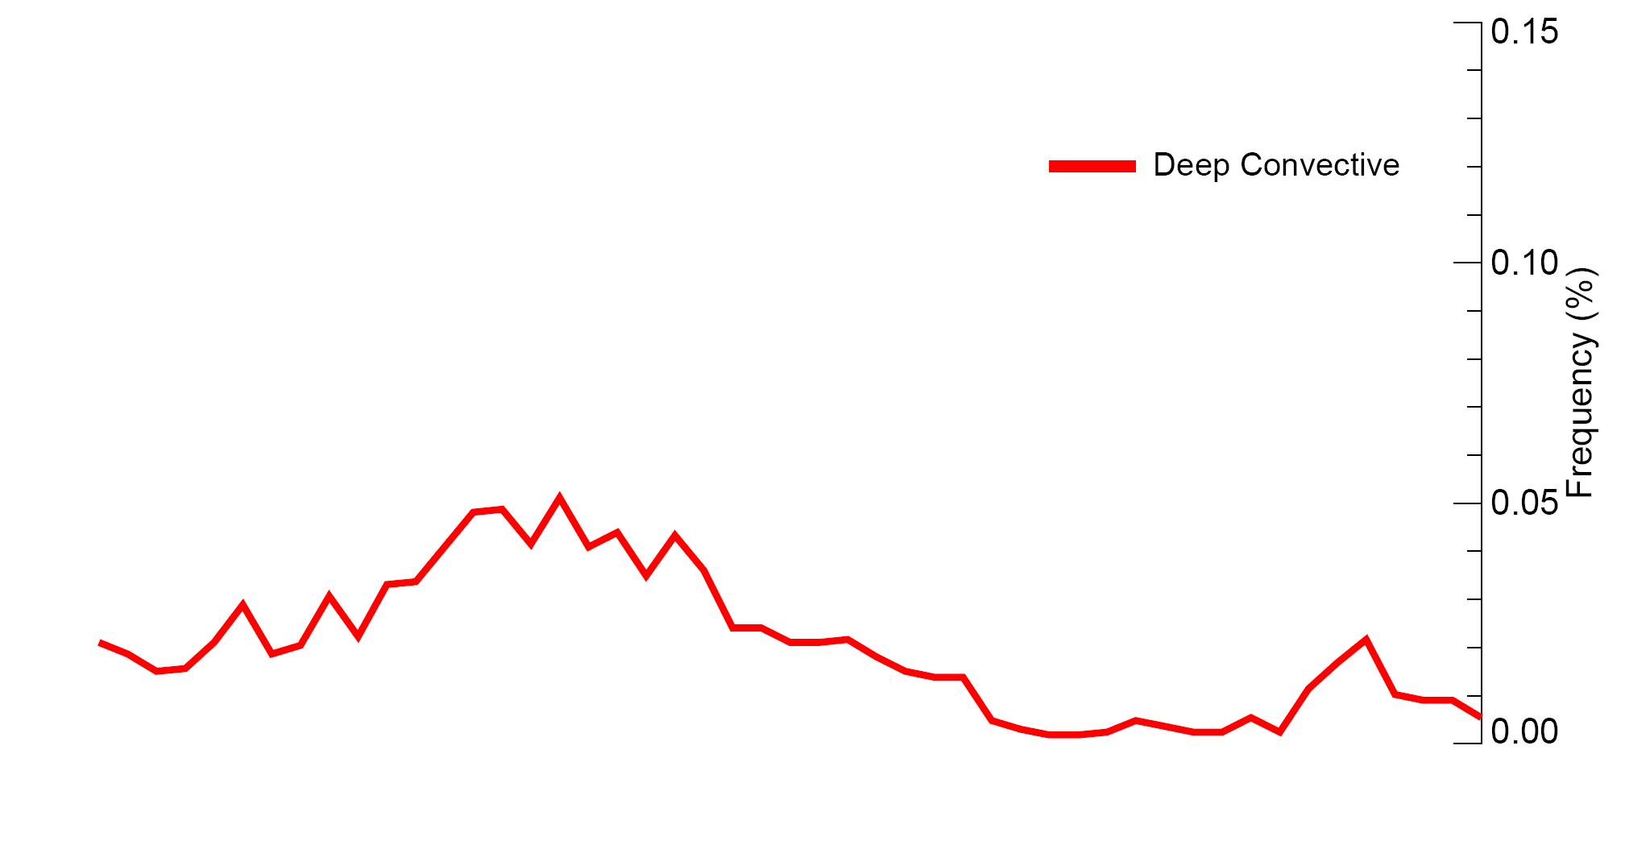
Variation of the DYNAMO radar echo population relative to a precpitation episode
Composite of all 2-day rainfall episodes
Zuluaga and Houze 2013

Slide 10
S-PolKa’s view of the early phase of a deep convective outbreak

Slide 11
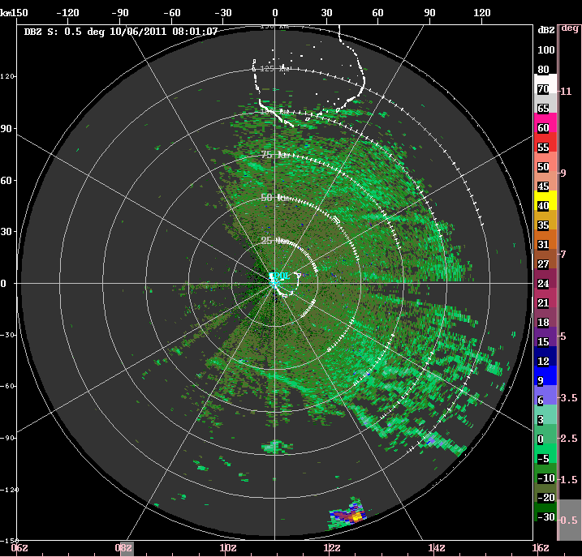
6 October
0600-1600 UTC
Rowe & Houze 2014?

Slide 12
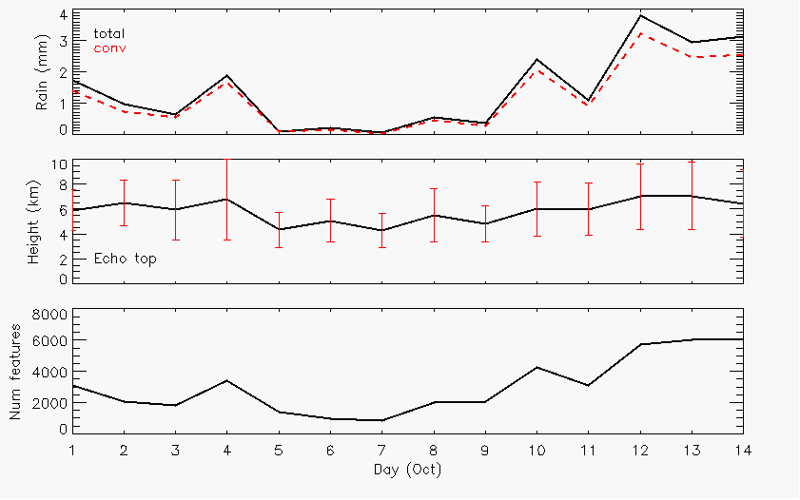
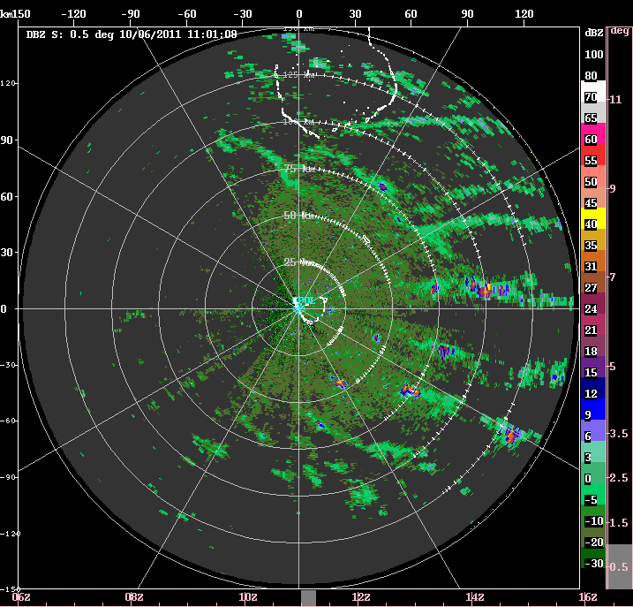
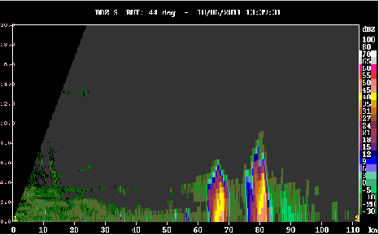
6 October
Rain
Echo-top heights
0600-1600 UTC
Number cells
1330 UTC (44deg)
8 km
Rowe & Houze 2014?

Slide 13
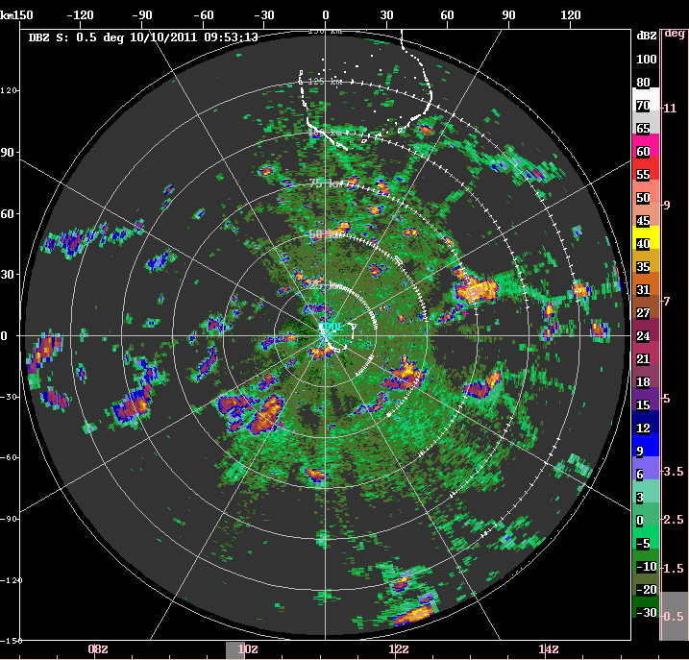
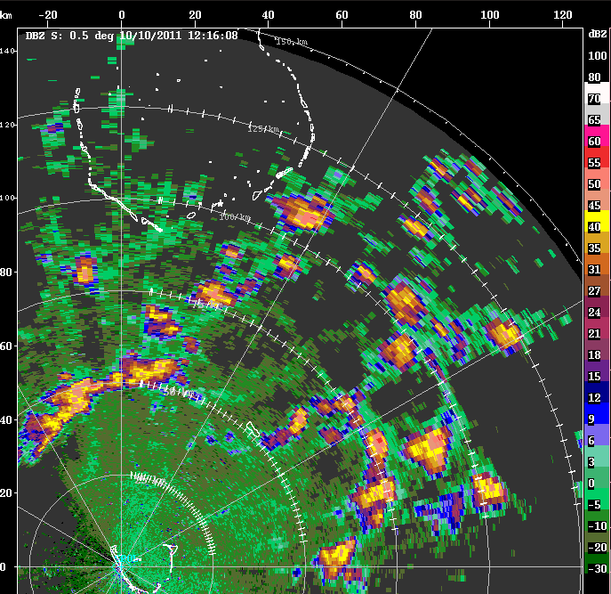
10 October
Rain
Echo-top heights
Number cells
0953 UTC
1216 UTC
20-30 km

Slide 14
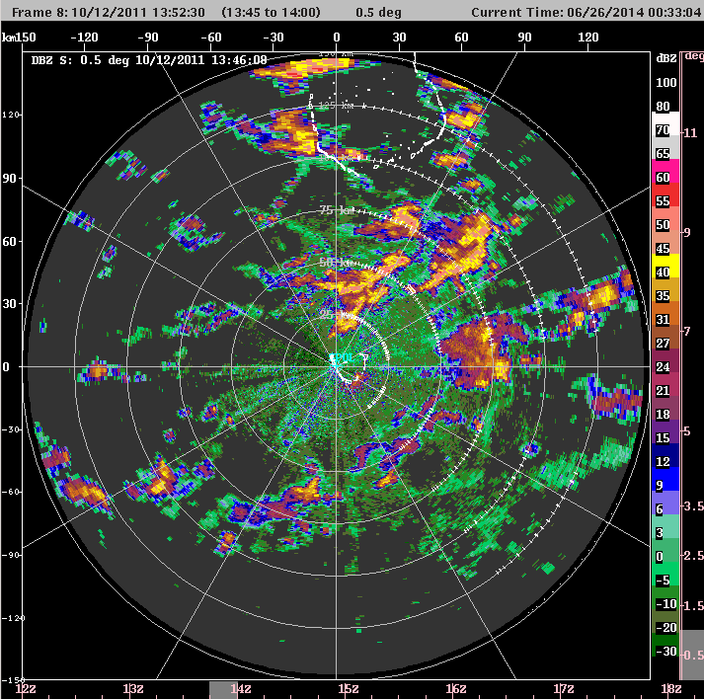
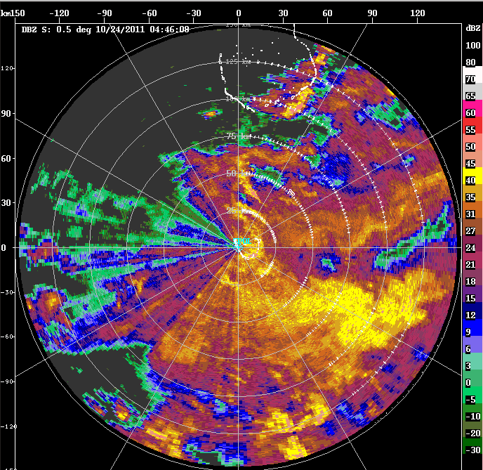
Cold pool & cell Tracking
12 Oct
Track cells (max height, reflectivity, rain rate) and estimate maximum diameter of resulting cold pools
Describe characteristics of new convection initiating along cold pool boundaries
Deeper convection forms on intersecting boundaries compared to convection forming on single cold pools (consistent with Zhe Feng’s modeling results)
More cells, more intersecting boundaries, deeper convection as move toward active phase
24 Oct

Slide 15
Microphysical aspects of deep convection

Slide 16
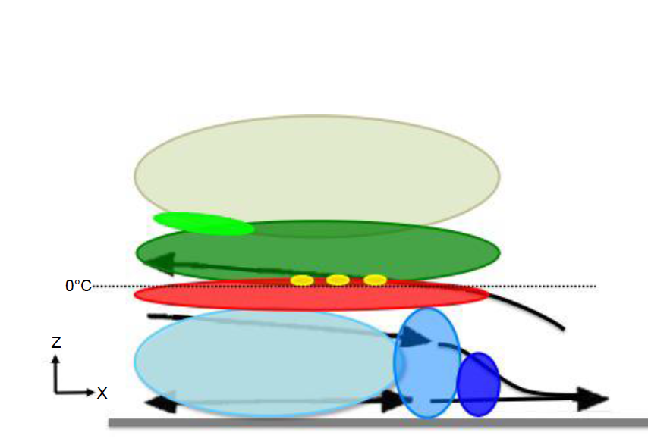
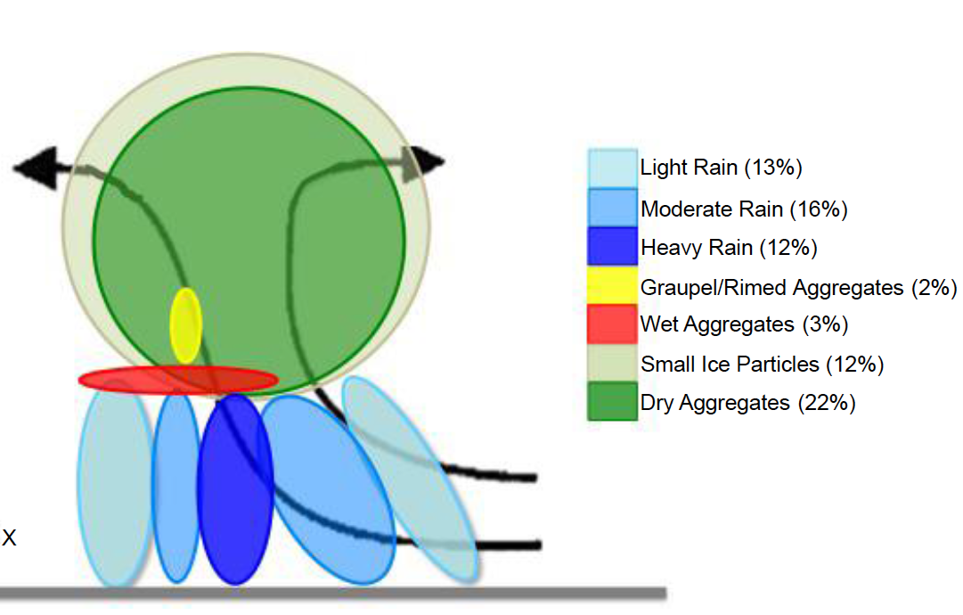
Composite microphysics in an individual MCS
Stratiform region
Convective region
Barnes and Houze 2014

Slide 17
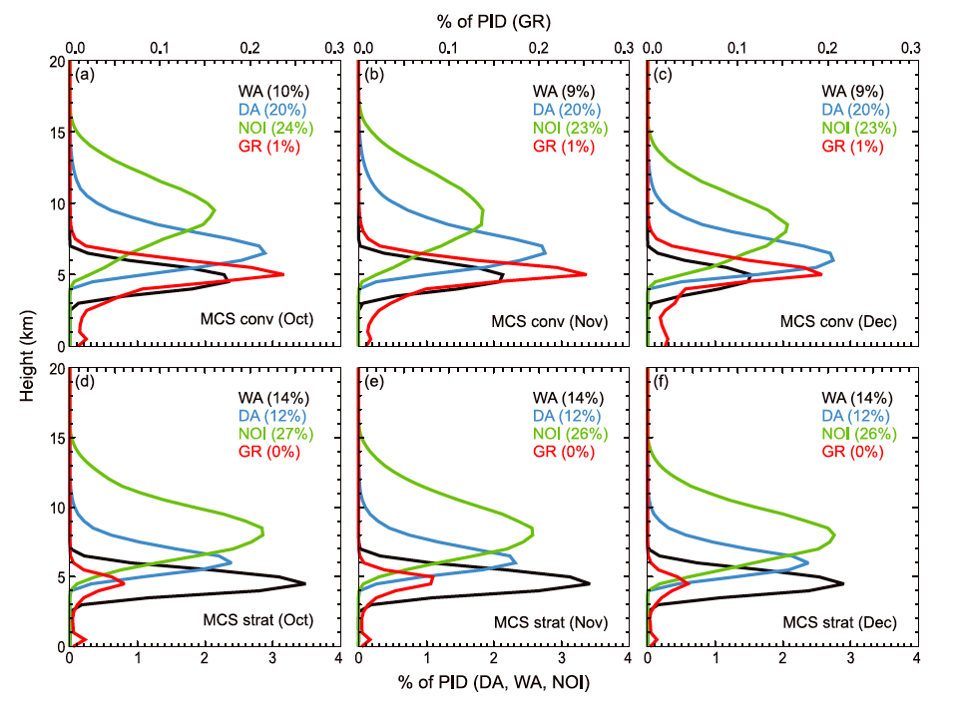
Combined microphysical characteristics of MCSs
Wet aggregates
Dry aggregates
Non-oriented ice
Graupel
Rowe and Houze (2014)

Slide 18
Apparent large-scale control of MJO convective outbreaks

Slide 19
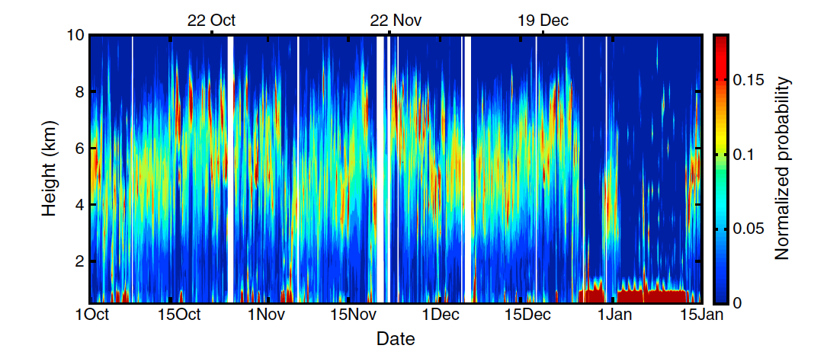
Echo Height Statistics for all of DYNAMO
Powell & Houze 2013

Slide 20
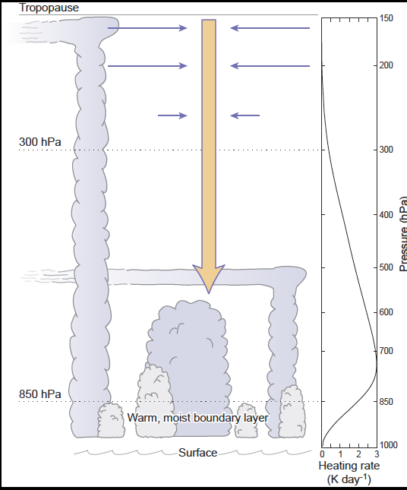
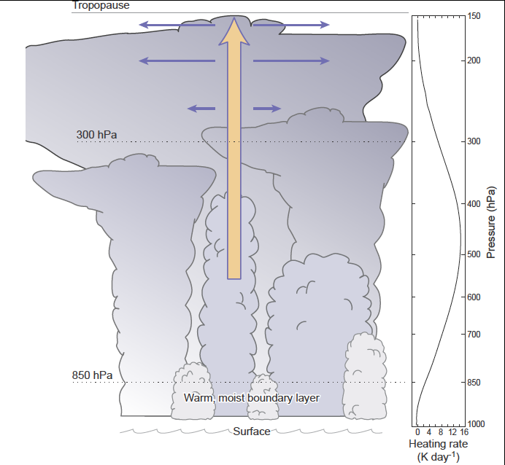
Suppressed periods
Active periods
Powell & Houze 2014

Slide 21
Transition back to suppressed

Slide 22
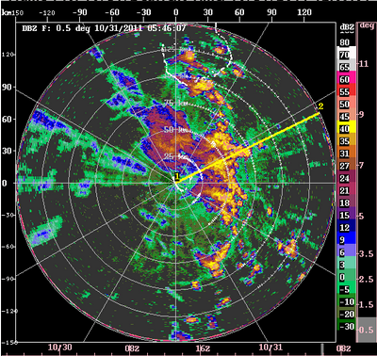
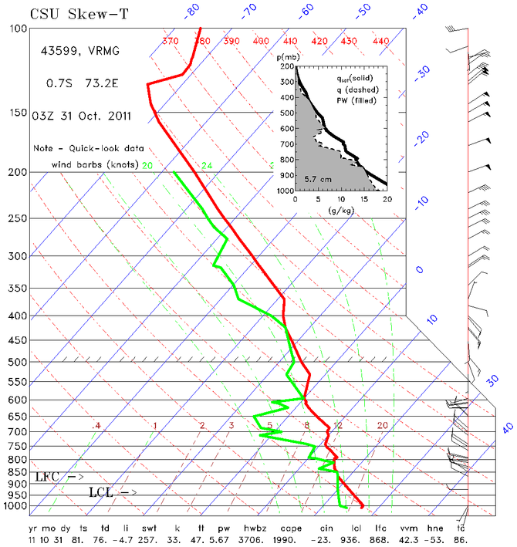
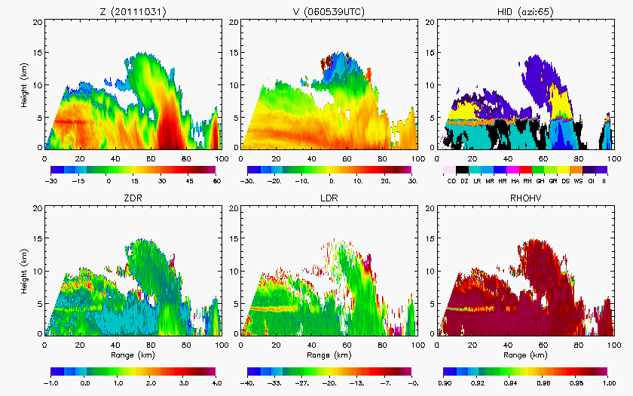
For example 31 October
Rowe & Houze 2015?

Slide 23
Conclusions from S-PolKa
Mesoscale systems with stratiform regions are the biggest change in cloud population
Episodes of deep & mesoscale convective outbreaks are ~2-6 days, not continuous for whole MJO active period
Synoptic-scale waves control episodes
Lines of nonprecipitating cumulus mark beginning of episodes
Cold pools start developing with first rainshowers and interact to produce ever deeper convection
Microphysics are similar in all convective and all stratiform rain elements, but vary quantitatively from cloud to cloud
Mesoscale systems suppressed or allowed (not caused) by large-scale upper tropospheric motions

Slide 24

Coming in September 2014
Notes:
CloudSat: W-band, 94 GHz, 3 mm
TRMM: Ka-band, 13.8 GHz, 2.17 cm

Slide 25
End
This research was supported by
NASA grants NNX13AQ37G, NNX12AJ82G, & NNX13AG71G
DOE grants DE-SC0008452 & PNNL 228238
Notes:
CloudSat: W-band, 94 GHz, 3 mm
TRMM: Ka-band, 13.8 GHz, 2.17 cm

Slide 26
Extra Slides
Notes:
CloudSat: W-band, 94 GHz, 3 mm
TRMM: Ka-band, 13.8 GHz, 2.17 cm

Slide 27
TRMM Radar Observations of the MJO over the Indian Ocean
Active Phase
Suppressed Phase
Deep Convective Cores
Broad Stratiform Rain Areas
Phase 7

Slide 28
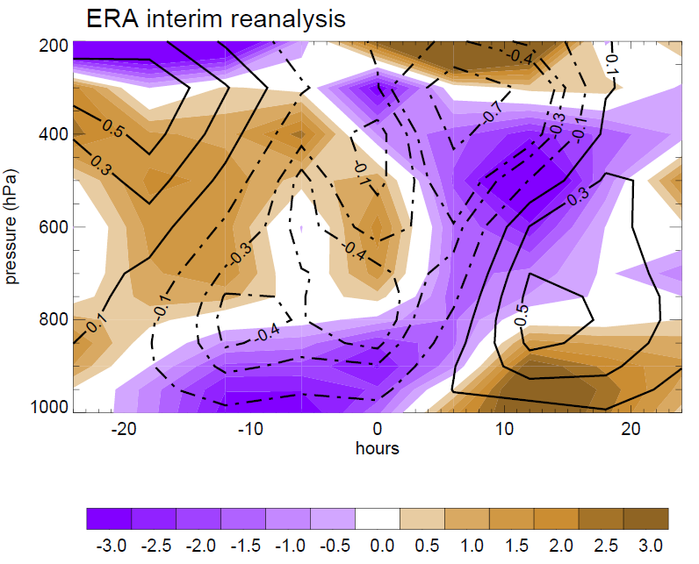
Composite large-scale divergence and vertical motion during 2-day rainfall episodes
Divergence
Zuluaga and Houze 2013

Slide 29
October
Rain
Echo-top heights
Number cells

Slide 30
For example 31 October

Slide 31
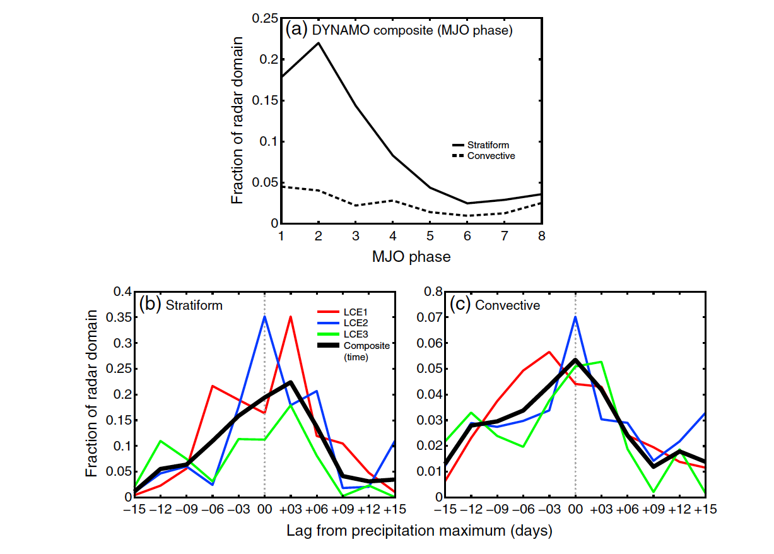
Time scales obscured by compositing

