Slide 1
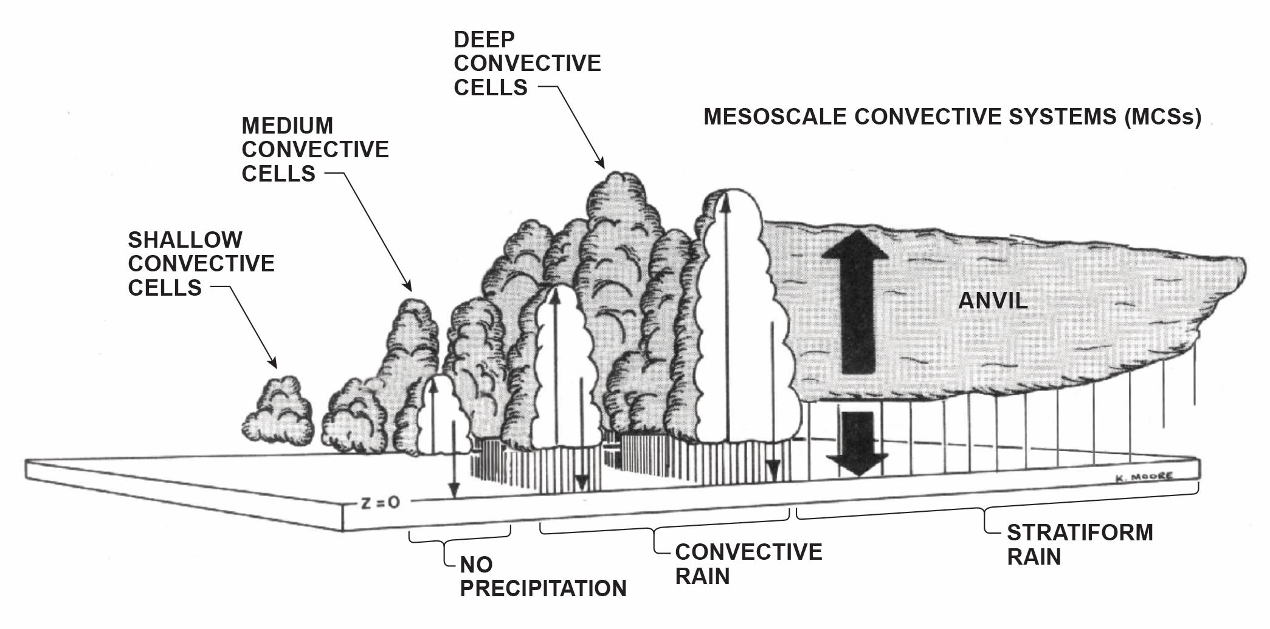
Convection:
Challenges for the Next Decades
Robert A. Houze, Jr.
University of Washington
Pacific Northwest National Laboratory, Richland, WA, June 13, 2014

Slide 2
What atmospheric
phenomena constitute
“convection?”
Microphysical
Scales
Turbulence
Scales
~10^{–6} m
Dynamic Scales
~10^{–3} m
~100 m
  Fair weather cumulus
  Cumulus congestus
  Cumulonimbus
    Single cell
    Multicell
    Supercell
    (severe tornadoes,
    extra large hail)
Mesoscale convective systems
Layered overturning
Stratiform precipitation
Extensive anvil clouds
~100 m
~10⁶ m
Is there a common
denominator?
Notes:
trillion

Slide 3
All Cumulus and Cumulonimbus
Buoyancy phenomena
Microphysics
Turbulent
Vorticity
Condensation
level
Aerosol

Slide 4
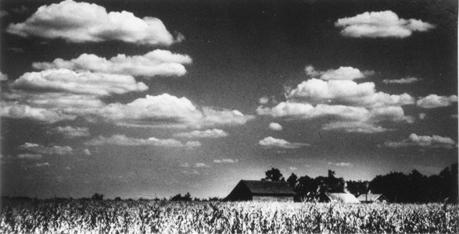
Cumulus
Condensation level
Buoyant
Updraft
Fair weather type

Slide 5
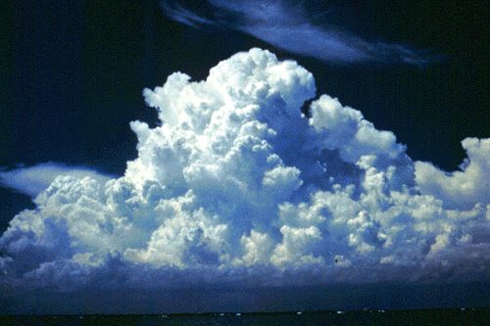
Cumulus congestus

Slide 6
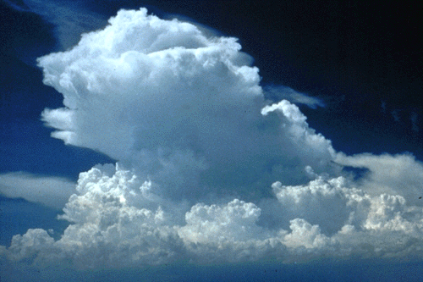
Glaciation and Anvil Formation

Slide 7
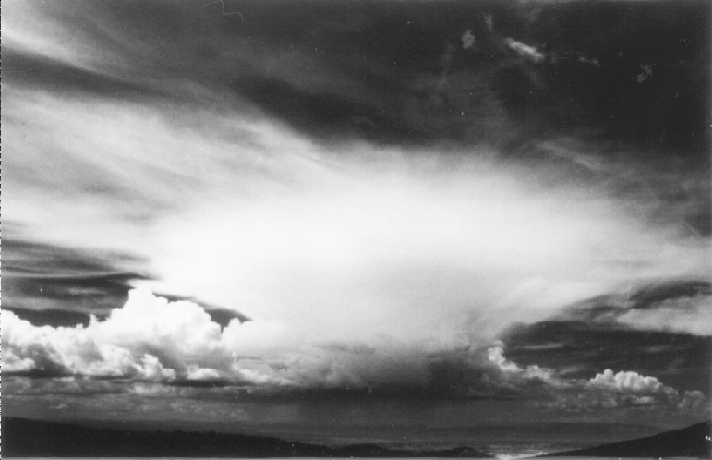
Cumulonimbus with an older anvil
The cumulonimbus produces a layer of cirrostratus

Slide 8
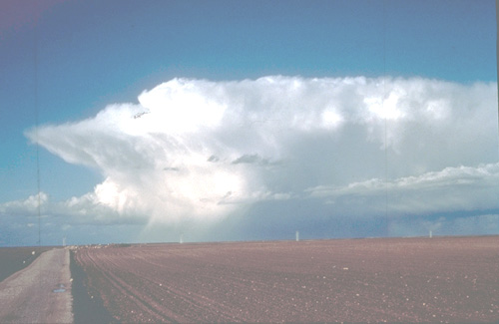
Cumulonimbus with Anvil
Hail
Rain

Slide 9
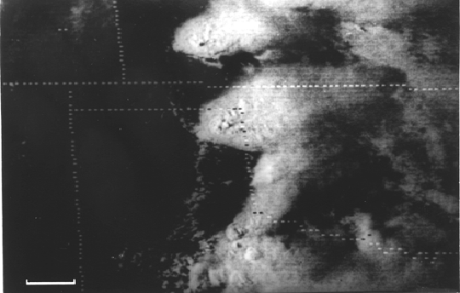
Cumulonimbus anvils viewed from space
100 km

Slide 10
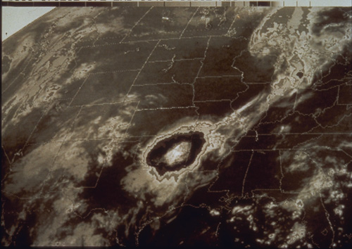
Mesoscale Convective System (“MCS”)
~500 km

Slide 11
Environment
Determines what form of convection occurs
Thermal profile
Wind shear
Humidity
Aerosol (?)

Slide 12
Thermodynamic Environment
Degree of Buoyancy Matters

Slide 13
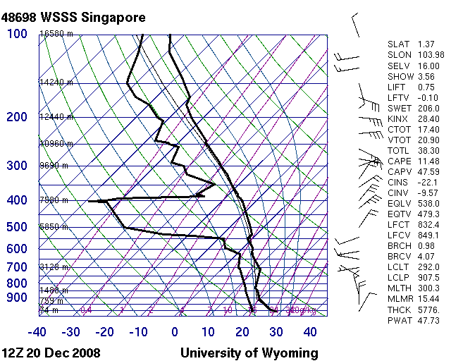
Indo/Pacific Warm Pool
Can’t generate large buoyancy
Notes:
Marginally conditionally unstable through depth of troposphere. LCL low. Warm moist sfc air can get above LCL and have slight buoyancy to great heights, deep clouds, but relatively weak updrafts.

Slide 14
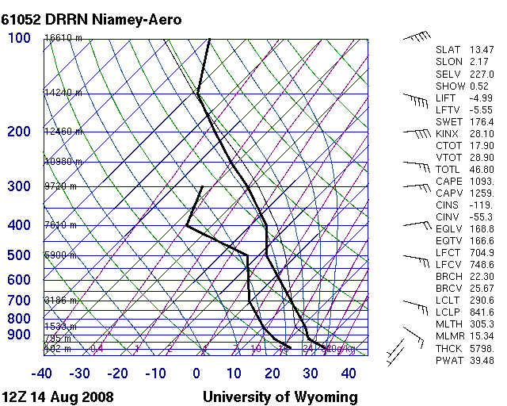
West African Squall Line
Can generate huge buoyancy
Notes:
No cap whatsoever. Very unstable all levels. LCL and LFC are elevated because air dry at lower levels. Once air gets above LFC, it can have very large buoyancy, strong updrafts, graupel, hail, lightning.

Slide 15
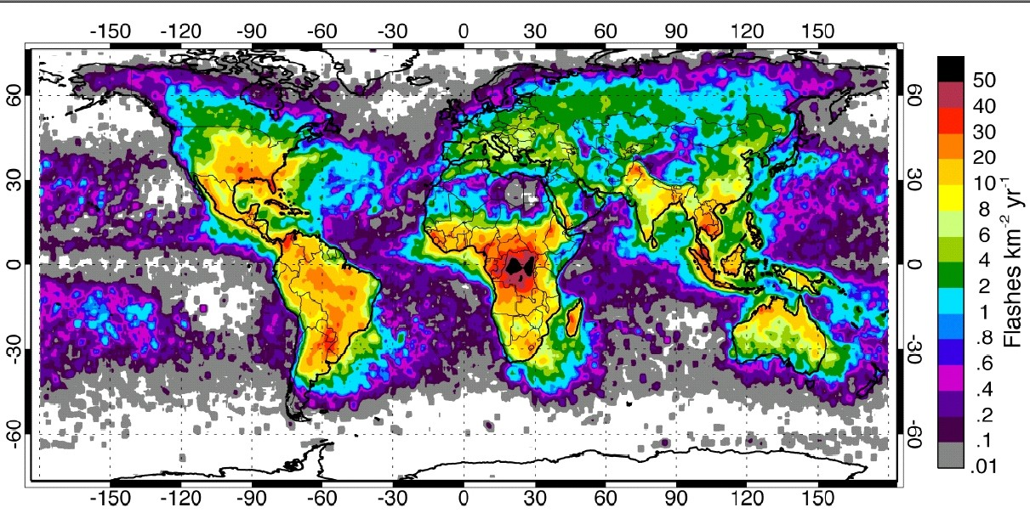
Global Lightning Occurrence
Many deep Cb over tropical oceans have extensive glaciated anvils but do NOT exhibit lightning & thunder.
Christian et al. 2002

Slide 16
Environment Wind Shear
Affects both cumulonimbus and MCSs

Slide 17
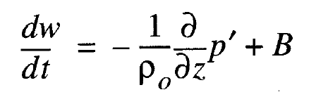
Vertical equation of motion:
Contains pressure gradient accelerations

Slide 18
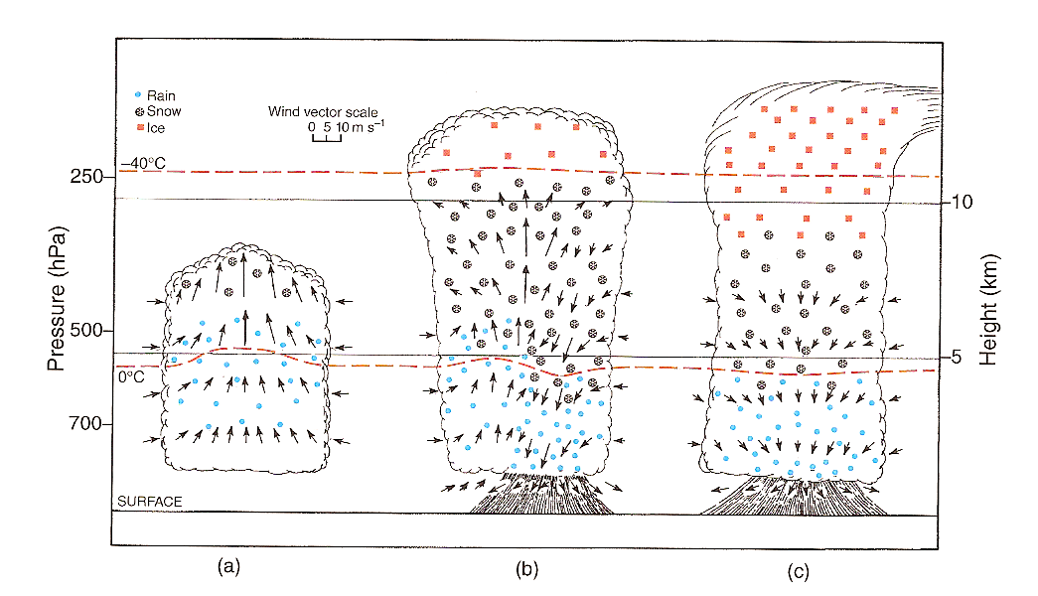
Most convective clouds have pressure perturbation fields dominated by the buoyancy
H
L
Byers and Braham (1949)

Slide 19
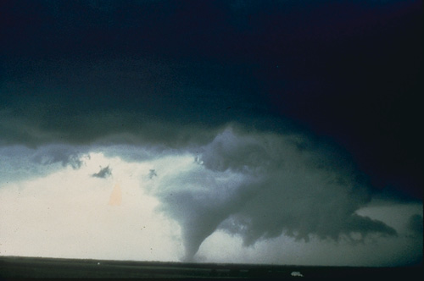
Cumulonimbus may be rotational if the environment is sheared
Tornado

Slide 20
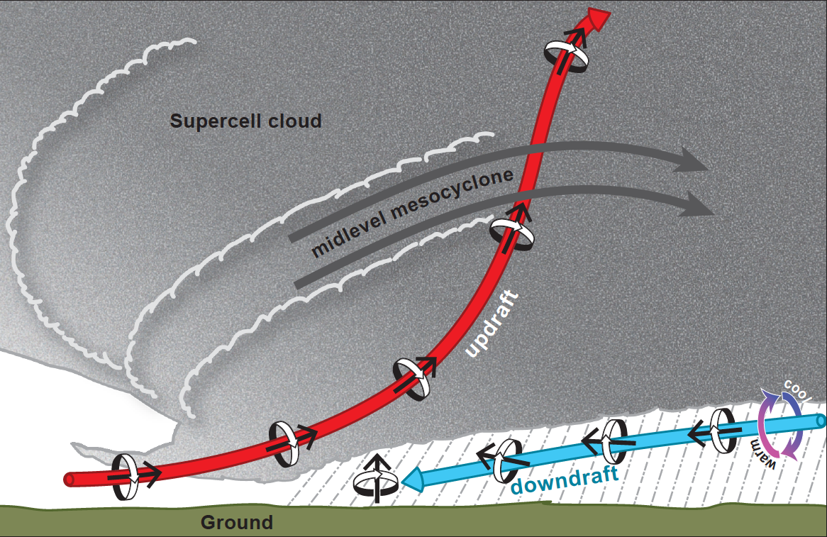
Interior of a tornadic storm
Markowski and Richardson 2013

Slide 21
Aerosol Environment
First order?
Second order but significant?
Unimportant?

Slide 22
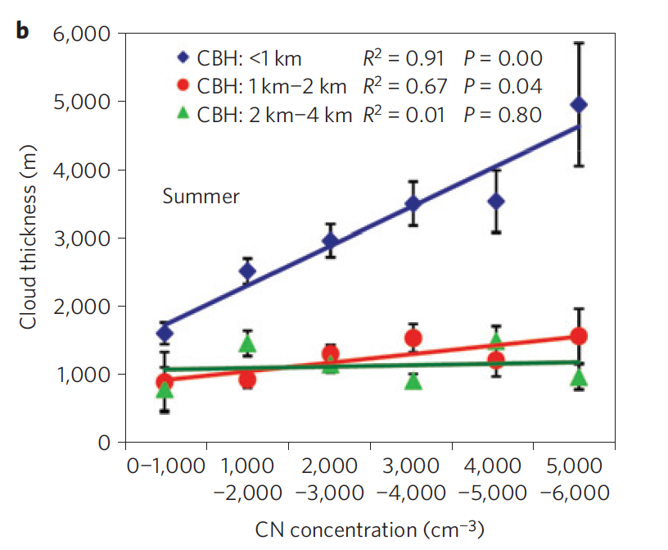
10 years of data from ARM Oklahoma “Southern Great Plains” site
Li et al. 2011

Slide 23
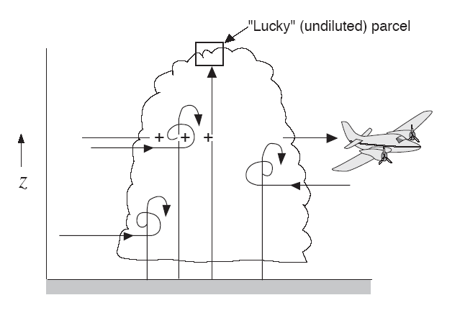
Parcel Model of Convection
Parcels of air arise from boundary layer

Slide 24
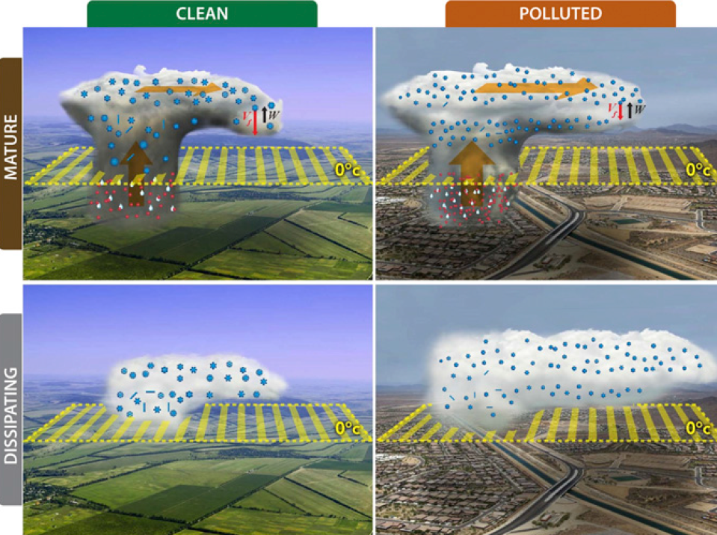
Aerosol effect on cirrus outflow
Fan et al. 2013

Slide 25
Mesoscale Convective Systems
Governed by a combination of thermodynamic and wind shear environment

Slide 26
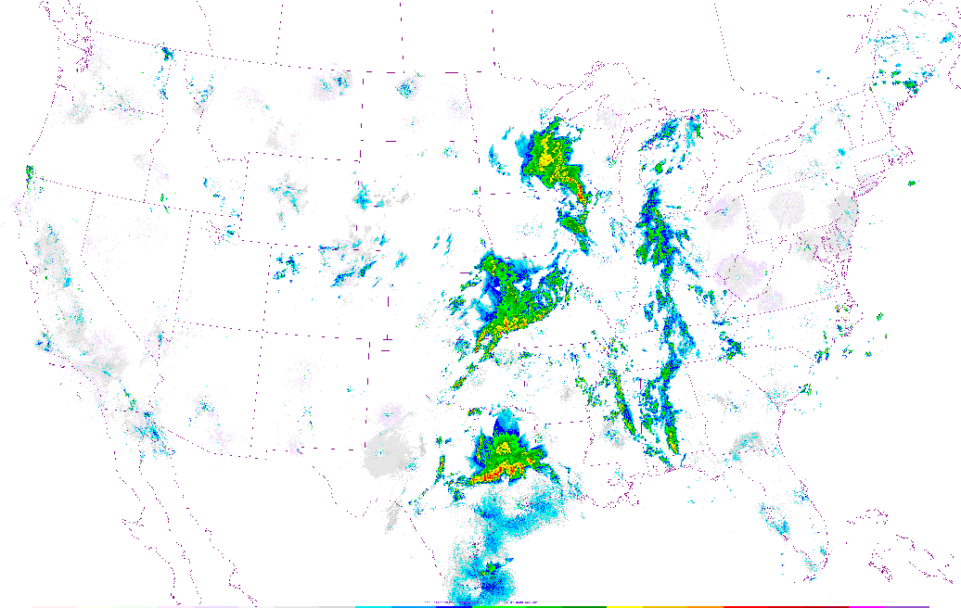
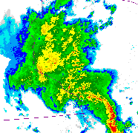
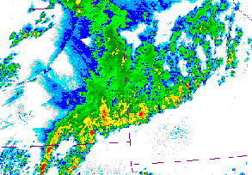
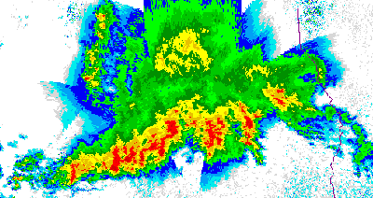
Radar Echoes in the 3 MCSs
1458GMT 13 May 2004
Stratiform
Precipitation
Convective
Precipitation

Slide 27
When convection organizes into a mesoscale convective system
parcel model doesn’t fully explain the MCS
layer lifting dominates as the MCS matures

Slide 28
Layer Lifting

Slide 29
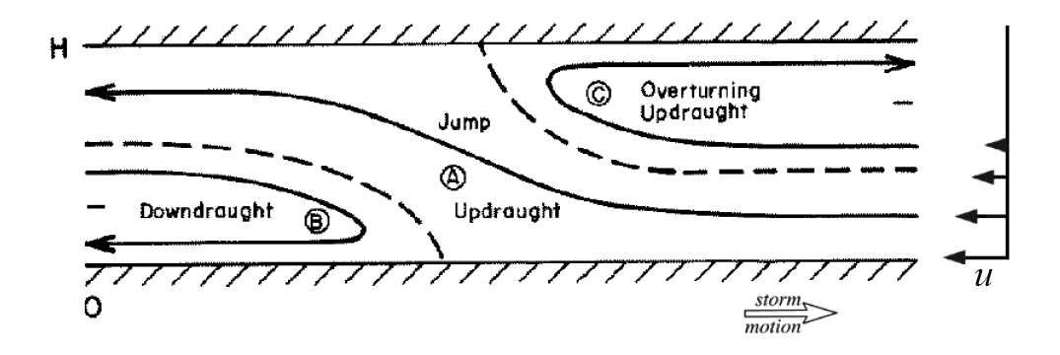
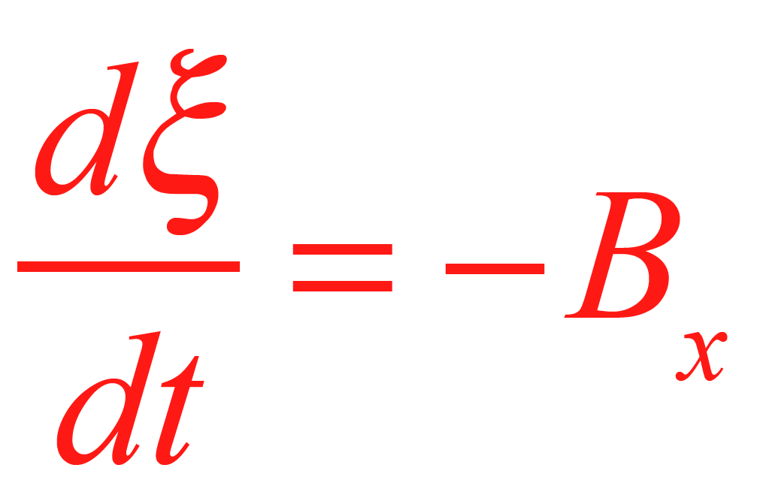
When an MCS forms in a sheared environment,
solutions to 2D vorticity equation look like this:
Joint adjustment to the thermal and wind stratification
of the environment
Shear
B>0
Moncrieff 1992 & others

Slide 30
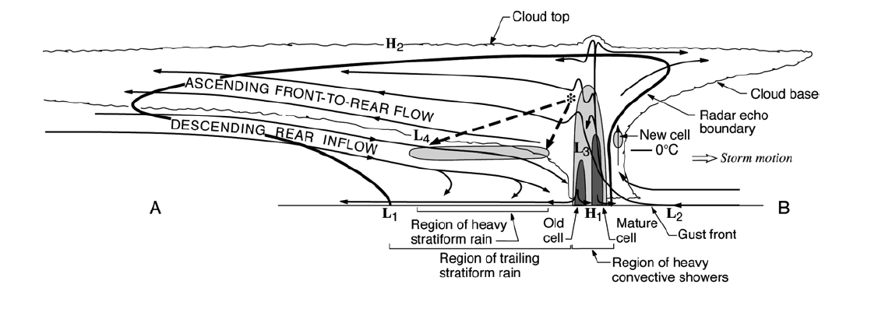
Details of a Real MCS
This type of MCS propagates with a
leading line of convection, aided by downdraft cold pool, and
trailing stratiform precipitation
Storm motion
Sheared flow leads to older convective elements being advected into the stratiform region
Houze et al. 1989

Slide 31
Microphysical Implications

Slide 32
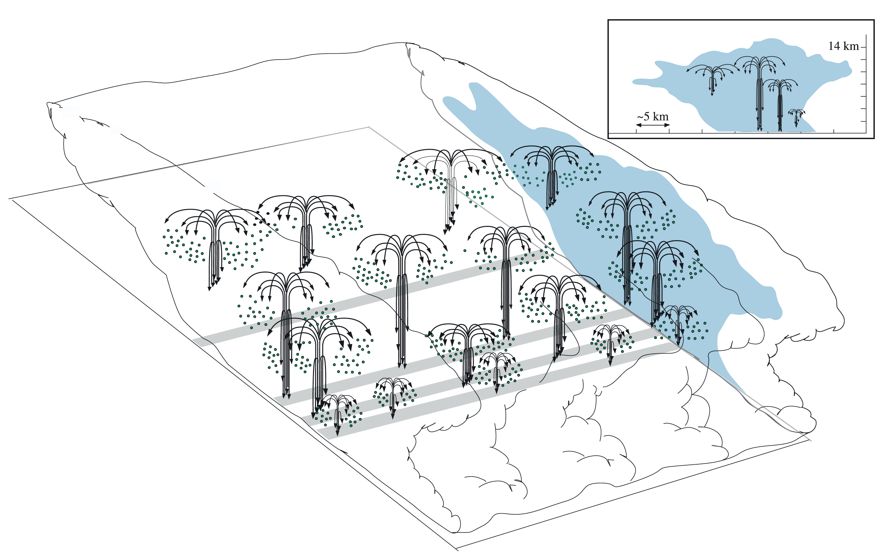
Convective cells generate particles
Layered flow distributes them
“Particle
fountains”
Yuter & Houze 1995

Slide 33
Microphysical processes of precipitation in an MCS

Slide 34
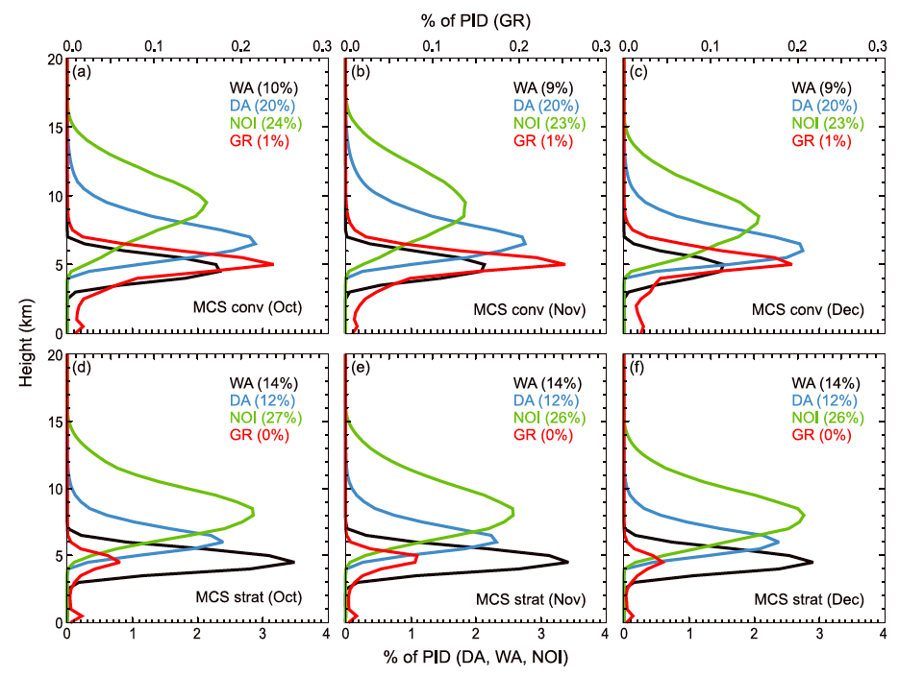
Microphysics of hydrometeors in MCSs from polarimeteric radar over the Indian Ocean
Wet aggregates
Dry aggregates
Non-oriented ice
Graupel
Rowe and Houze (2014)

Slide 35
Feedbacks to the large-scale

Slide 36
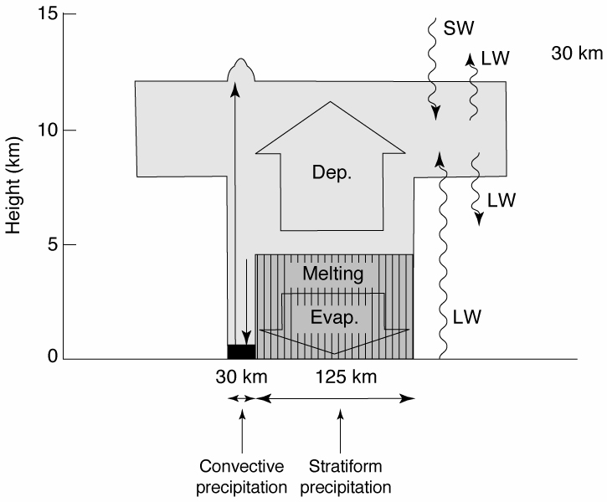
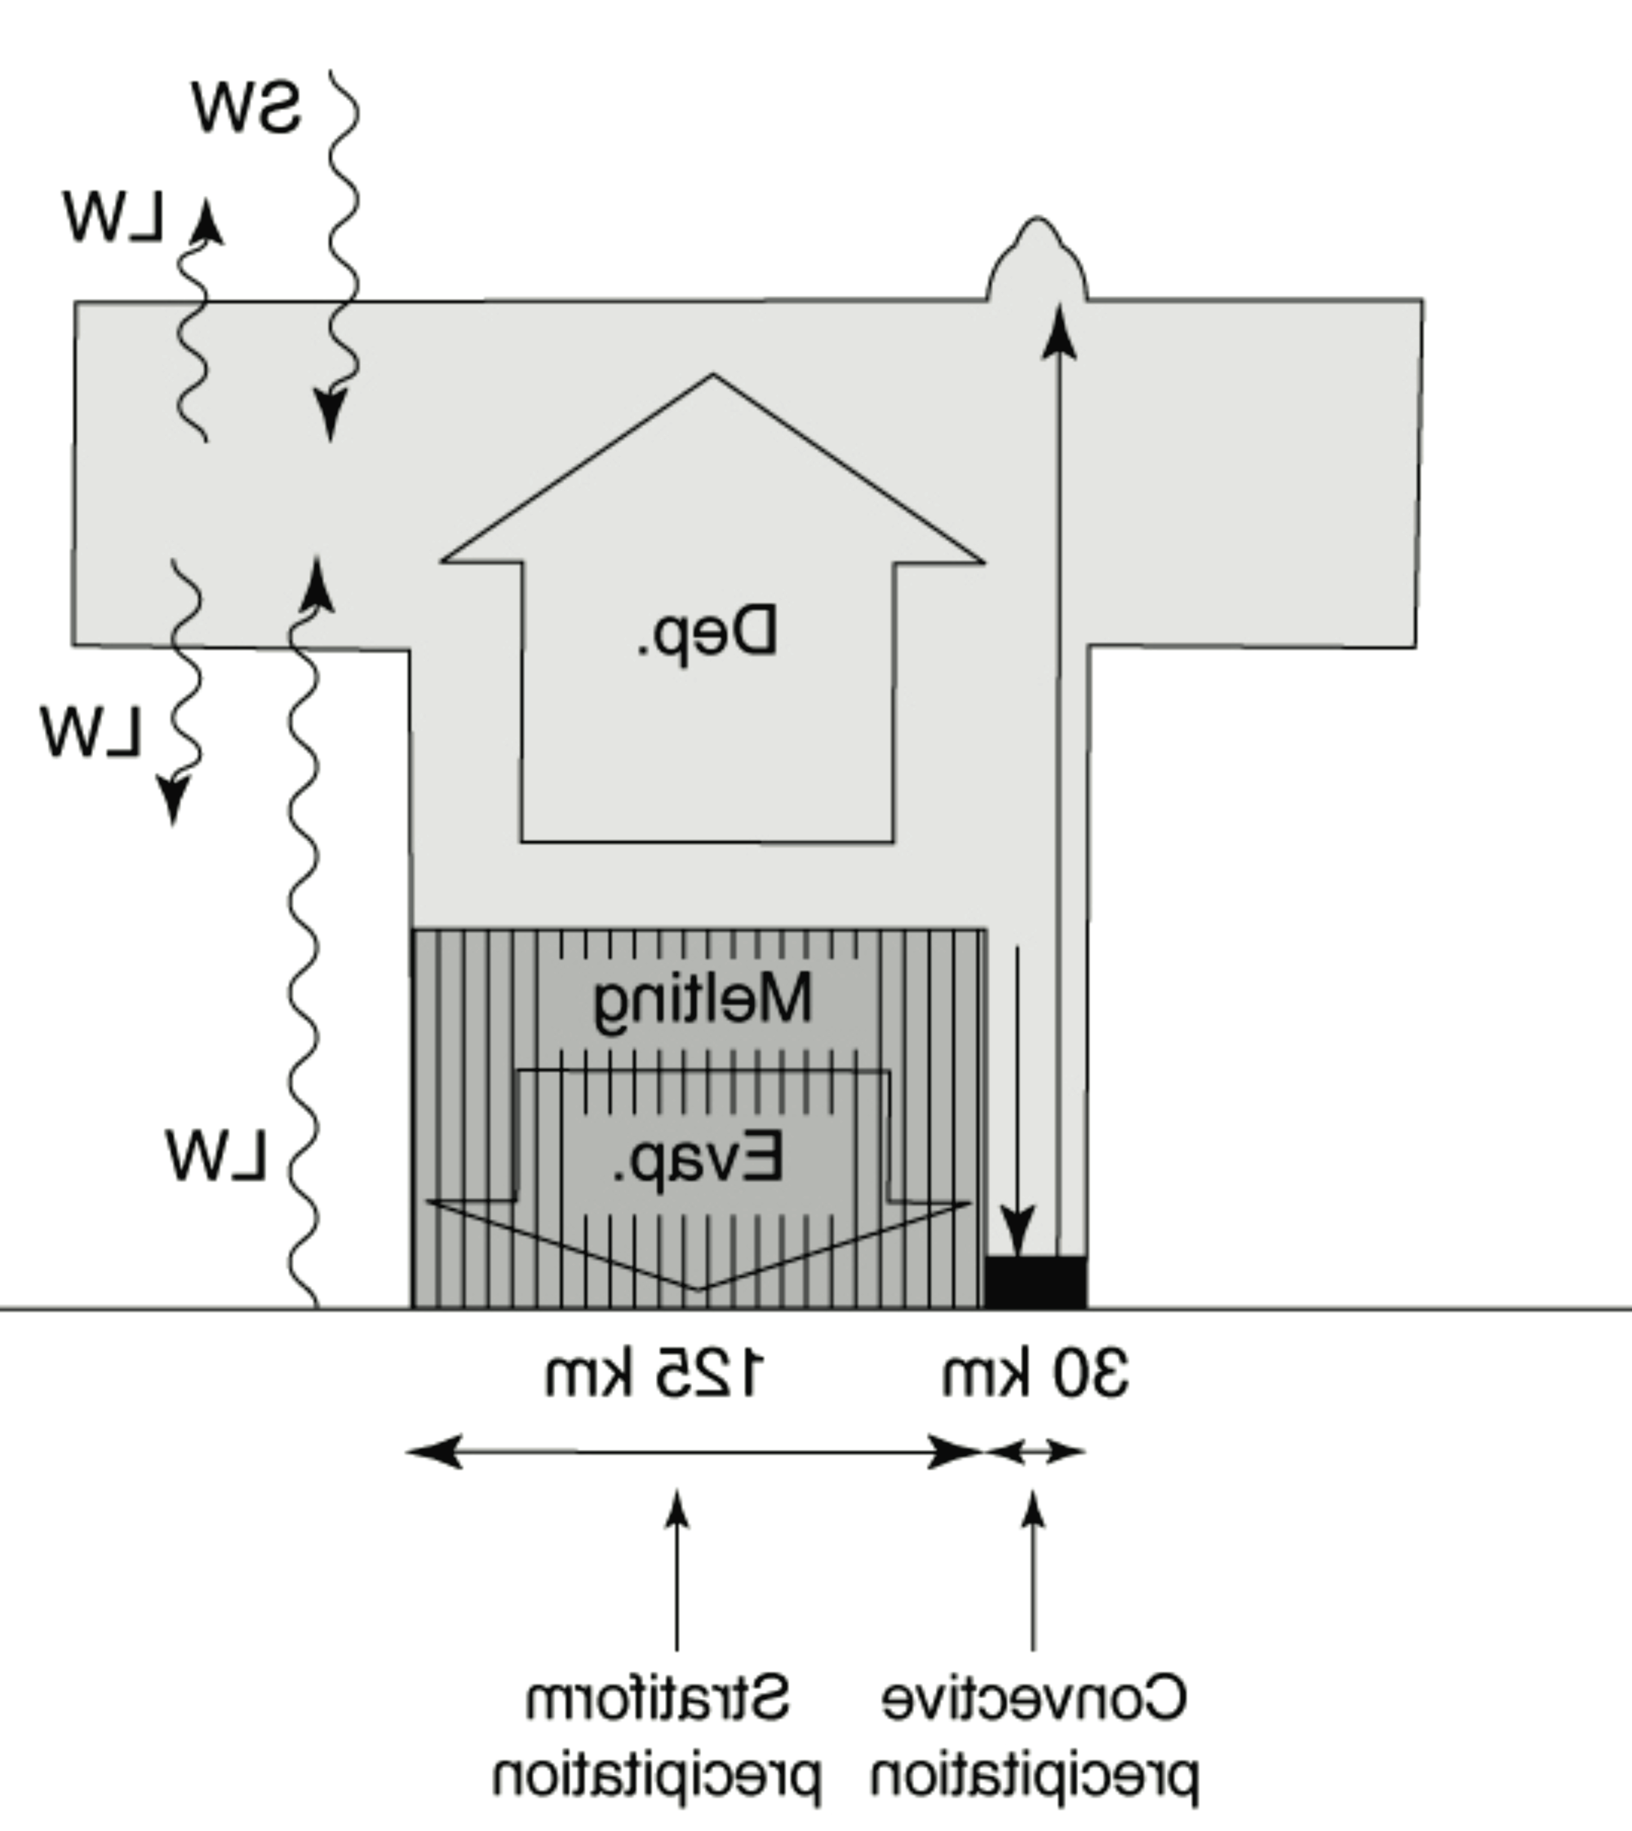
Heating & Cooling Processes in an MCS
SW
Cloud
Deposition
LW
Net heating weighted to upper troposphere
Melting
LW
Evaporation
125 km
30 km
Stratiform precipitation
Convective precipitation
Houze 1982
Houze 1982
Notes:
Radar & other data showed vertical cross section looks like this. Two types of up and down drafts. Note the distribution of heating and cooling processes.

Slide 37
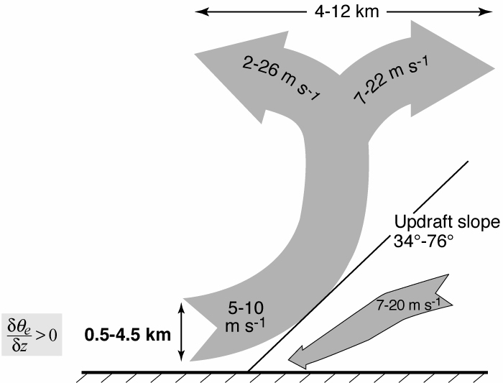
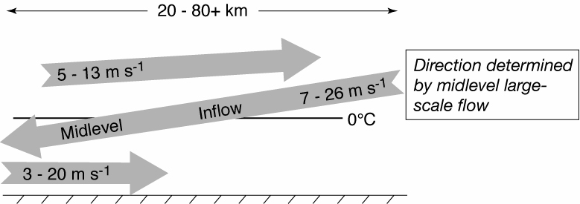
Momentum redistribution by MCS
Midlevel inflow
Layer inflow
Houze 1982
Notes:
From the distributin of heating and cooling in the sf region we expect mid level convergence.

Slide 38
Interaction with the humidity environment

Slide 39
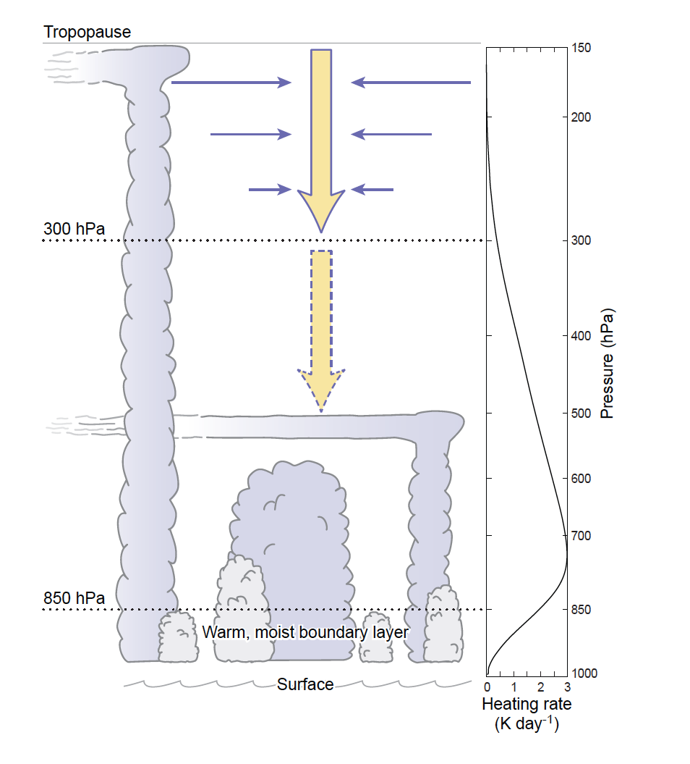
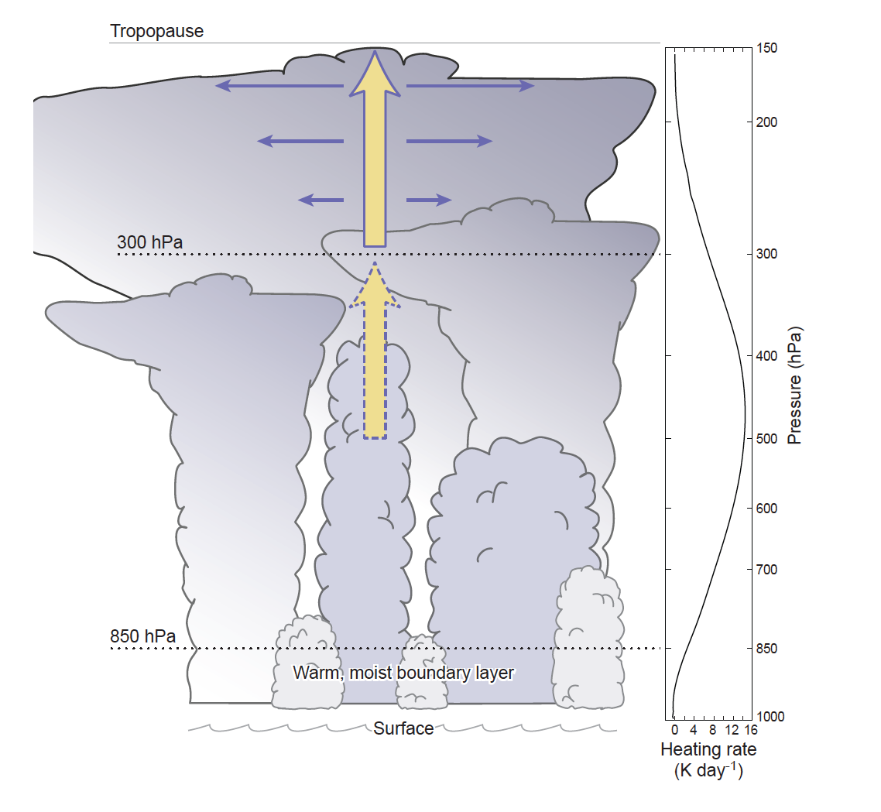
Hypothesized humidification by clouds in the MJO
Suppressed phase of MJO
Active phase of MJO
Powell and Houze 2014

Slide 40
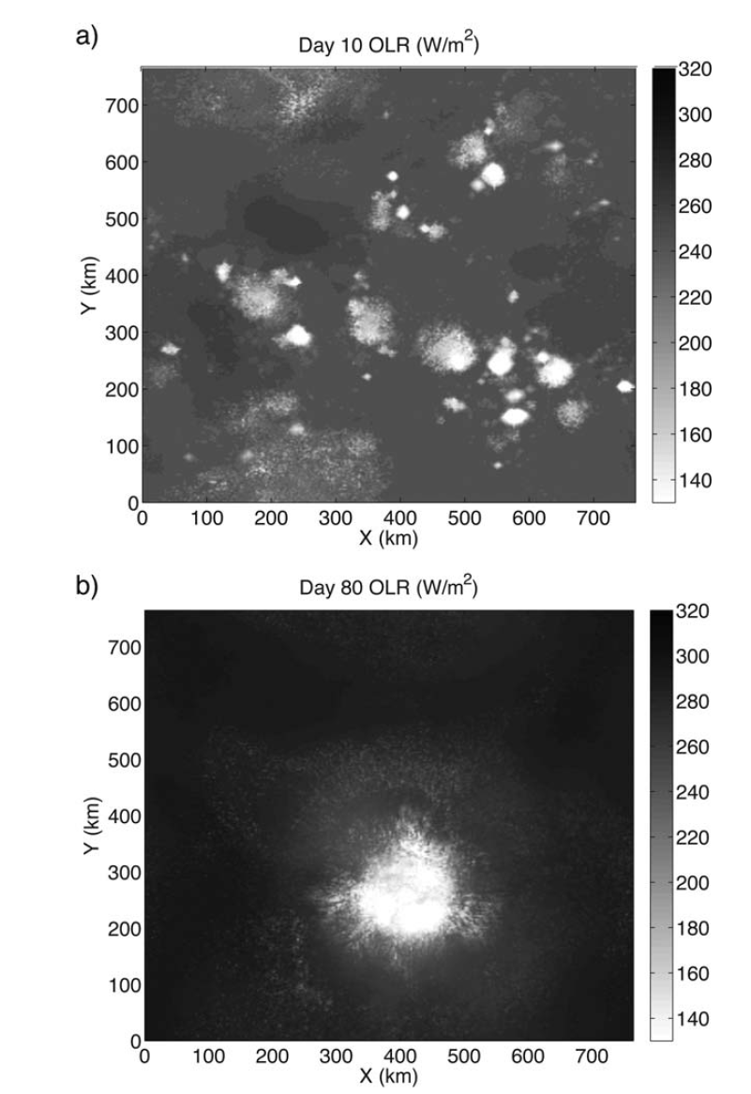
“Self Aggregation”
Wing and Emanuel 2014

Slide 41
Cloud Populations

Slide 42
A Convective Cloud Population
Houze et al. (1980)

Slide 43
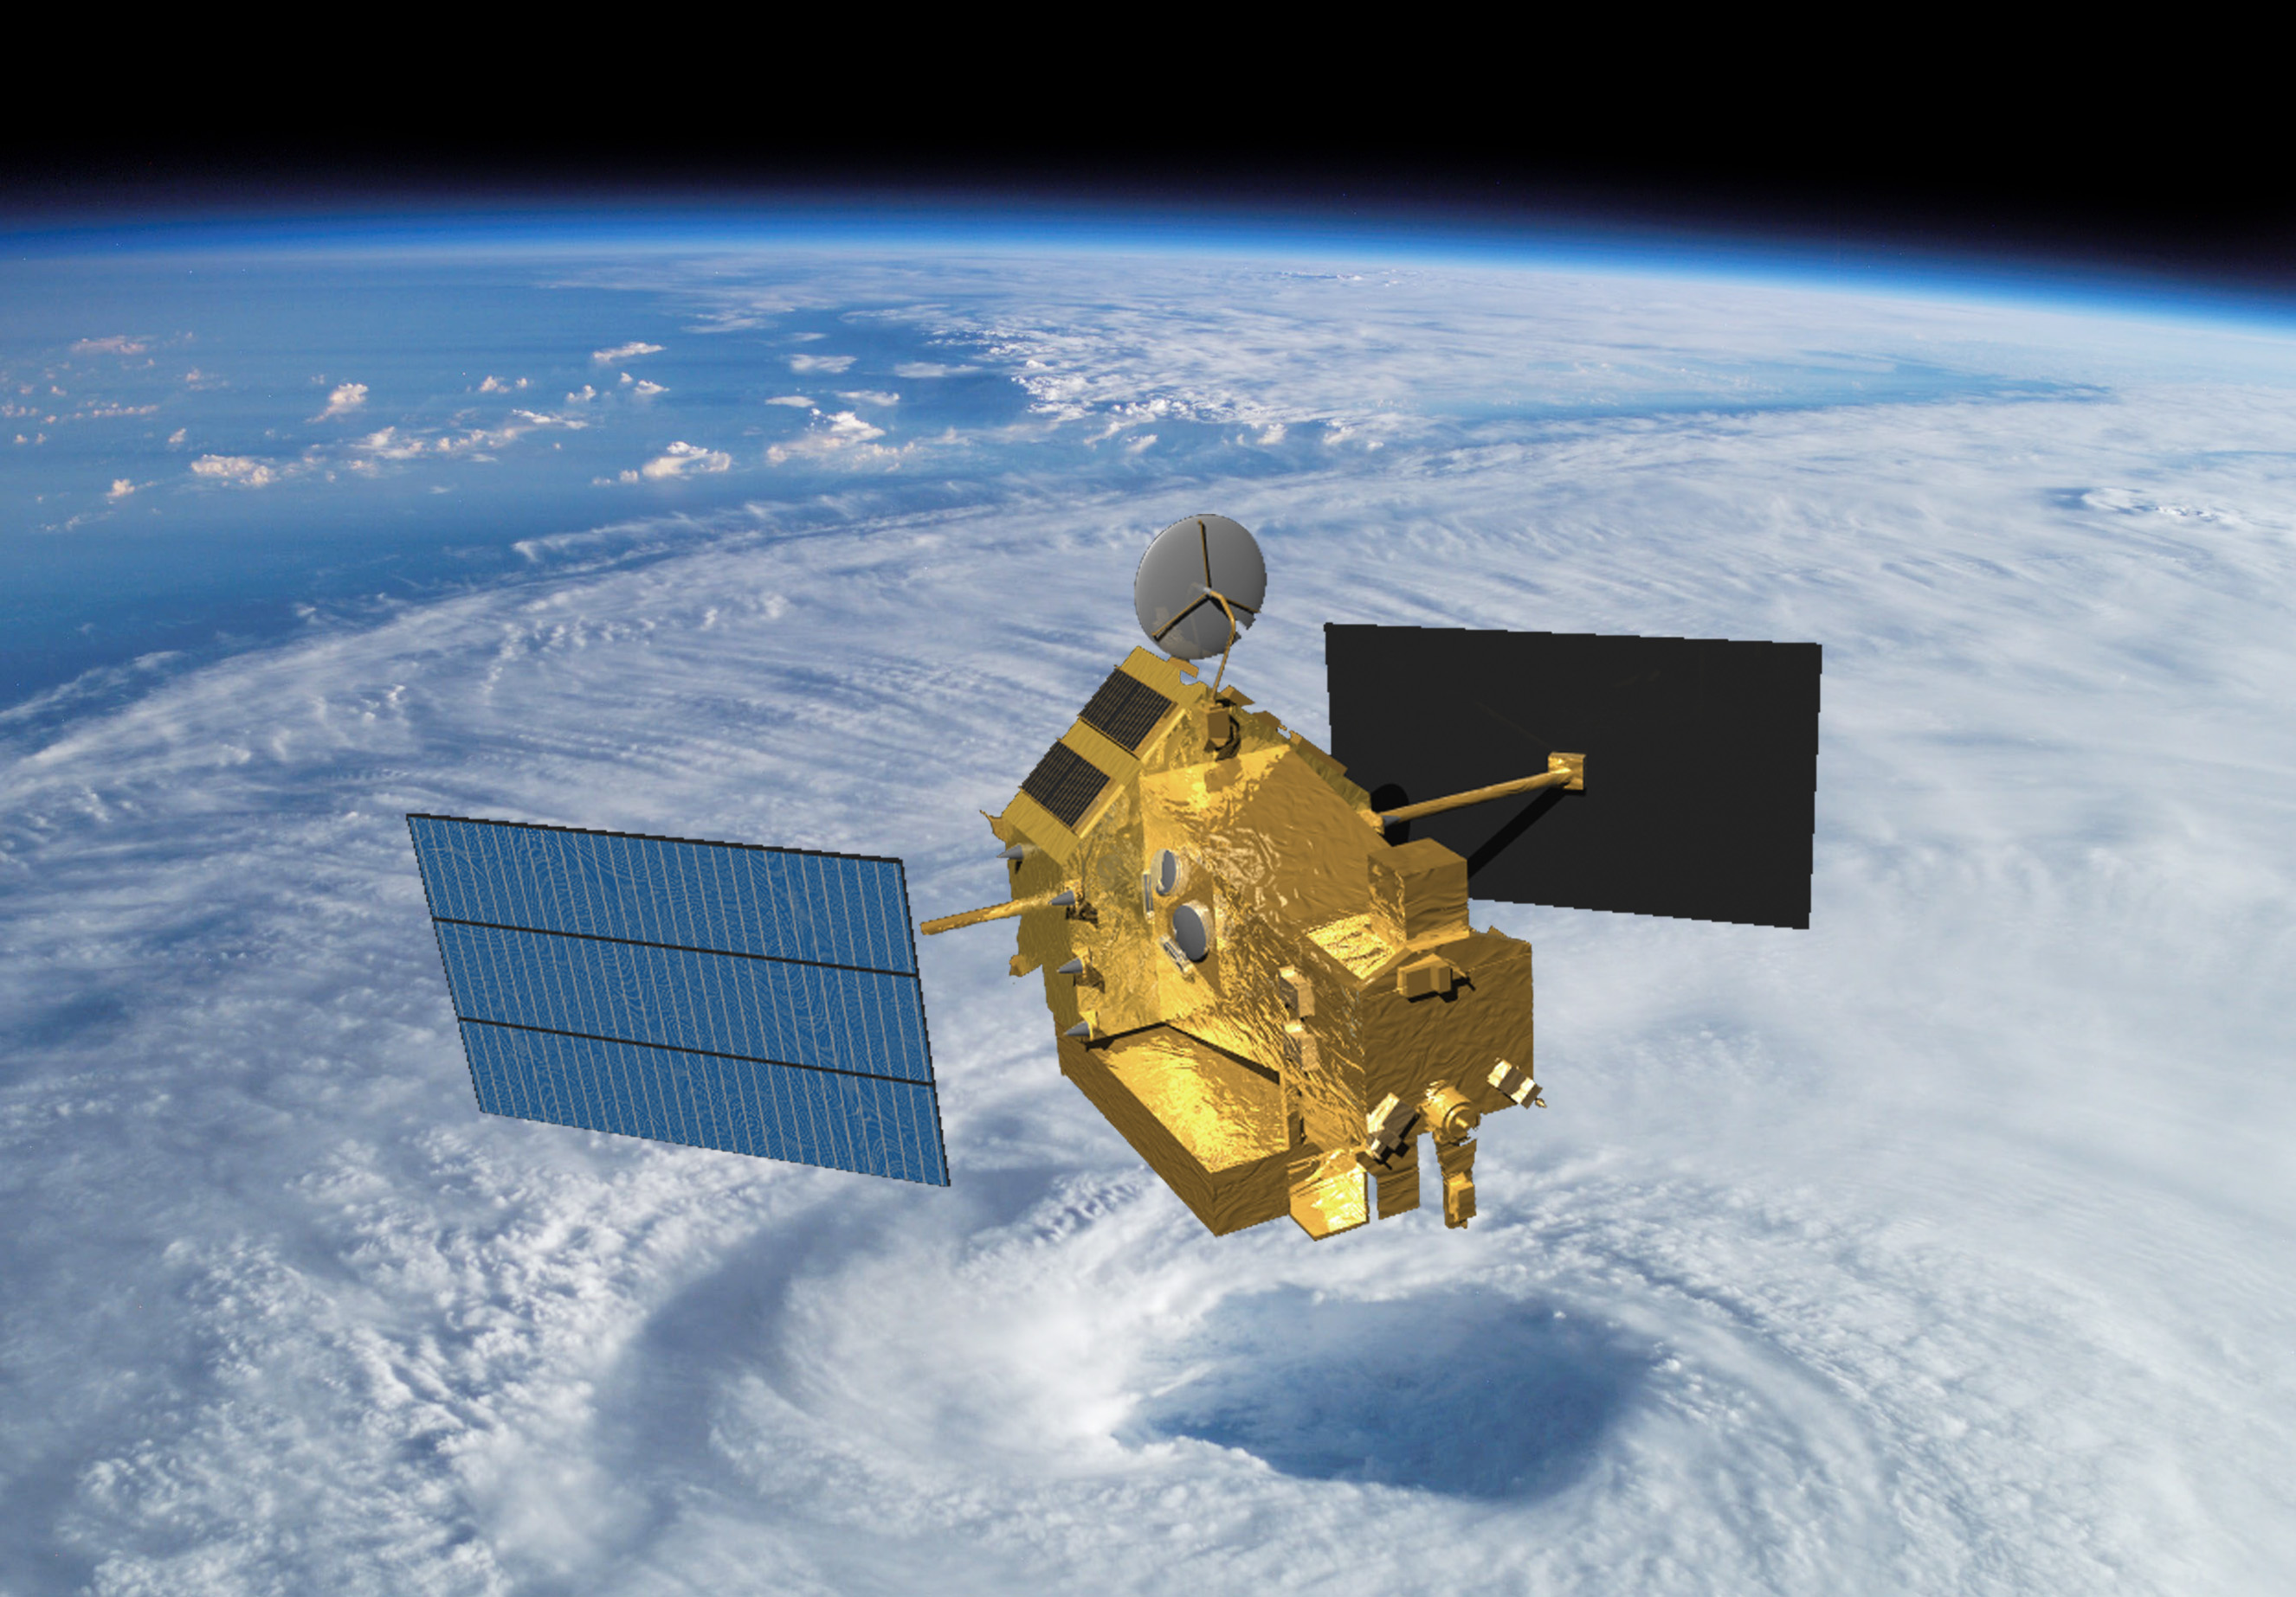
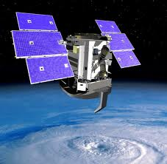
Radars in Space
TRMM
1997-
CloudSat
2006-
(A-Train)
Notes:
CloudSat: W-band, 94 GHz, 3 mm
TRMM: Ka-band, 13.8 GHz, 2.17 cm

Slide 44
TRMM Radar Observations of the MJO over the Indian Ocean
Active Phase
Suppressed Phase
Deep Convective Cores
Broad Stratiform Rain Areas
Phase 7
Barnes & Houze 2013

Slide 45
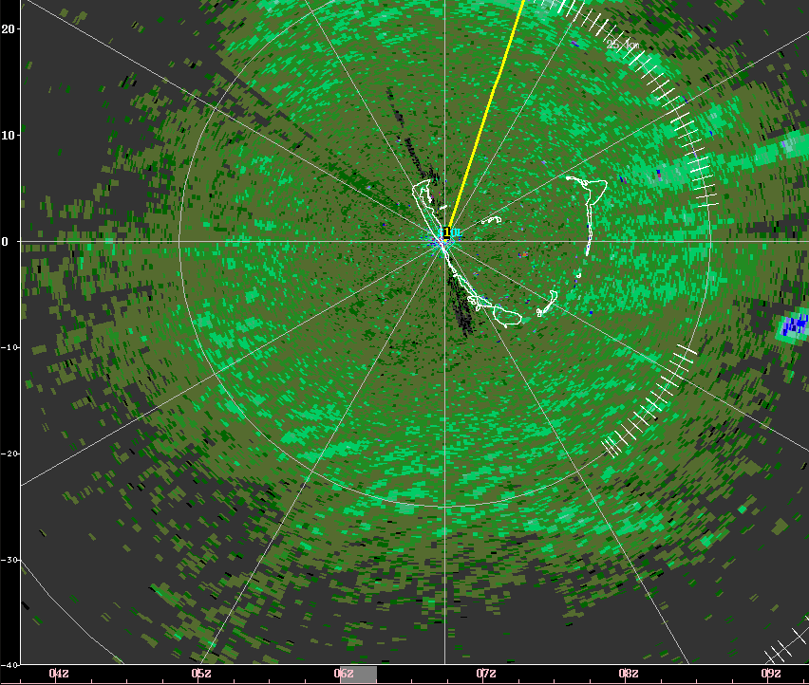
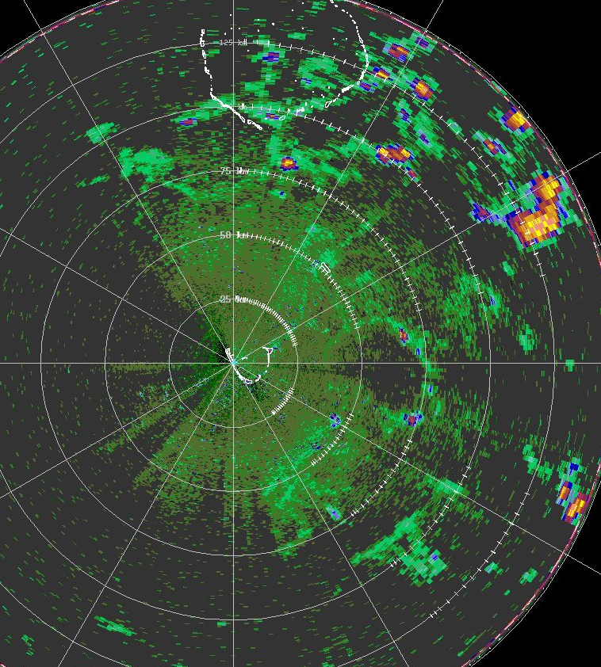
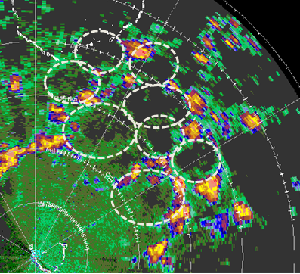
Cold Pools
Early:
Lines of cumulus parallel to wind
Later:
Cold pools
Later:
Intersecting pools

Slide 46
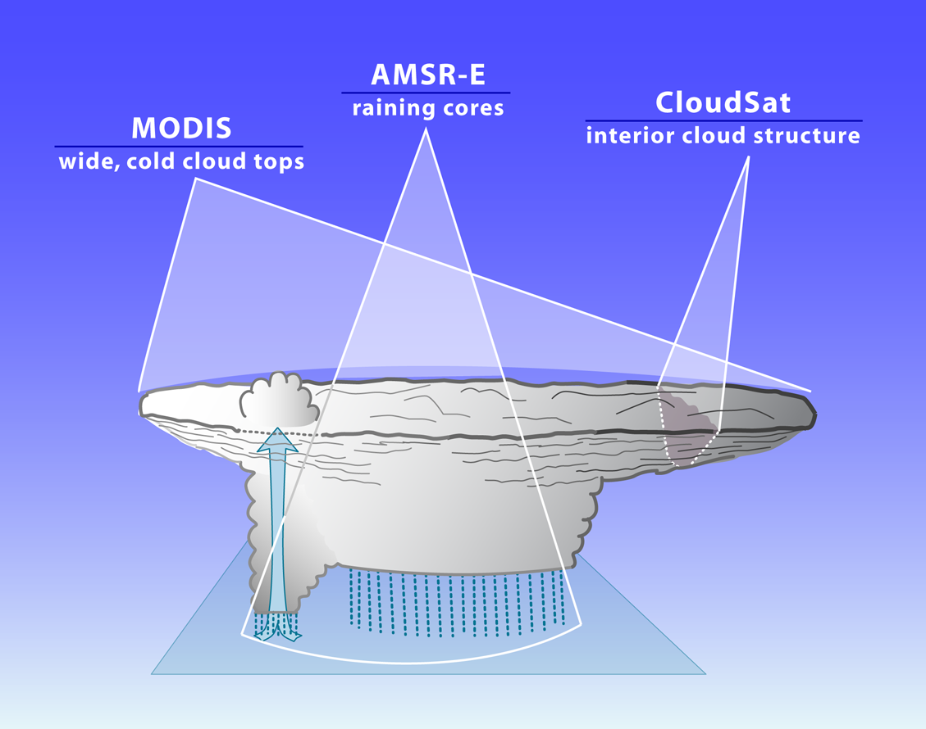
A-Train sees the whole MCS
2
3
1
Notes:
A-Train offers the ability to see all 3 characteristics simultaneously. We take advantage of this ability.

Slide 47
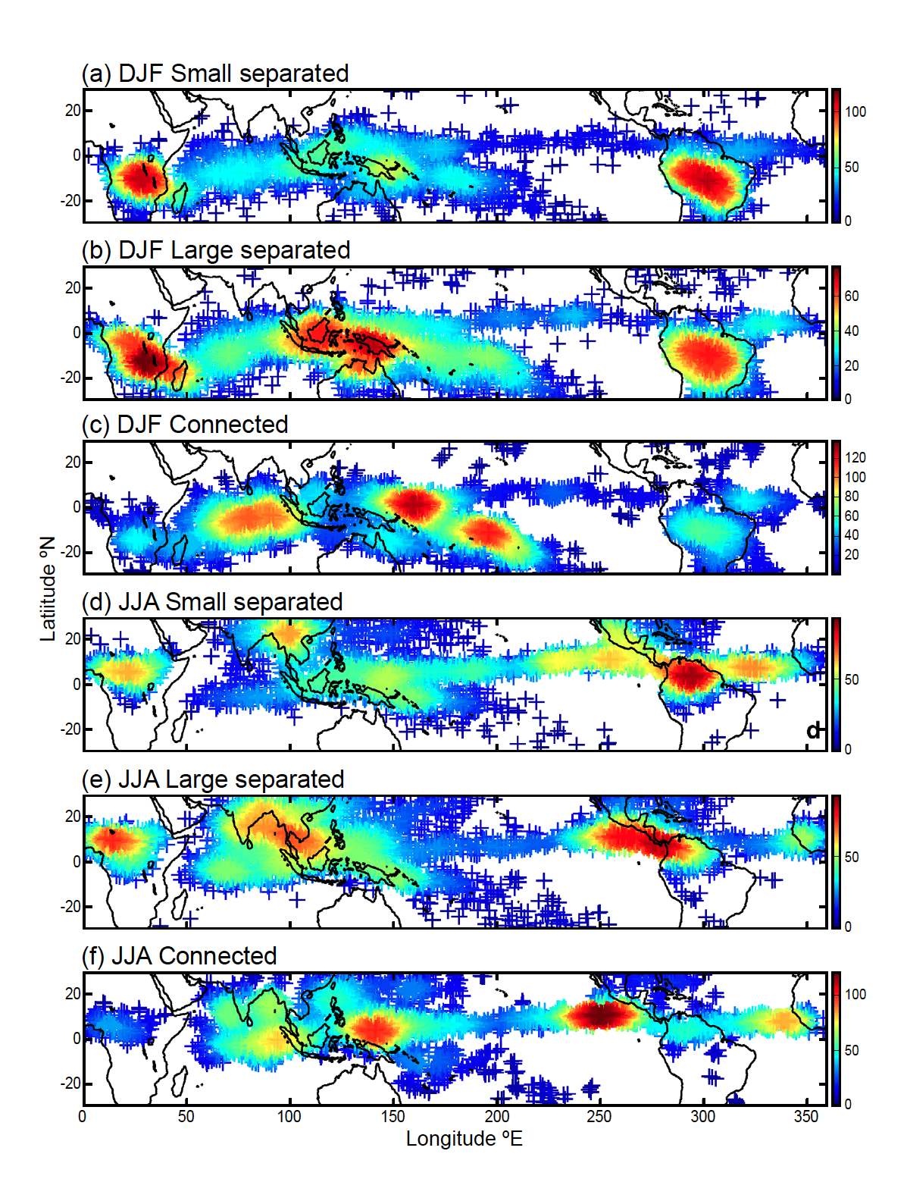
MCSs Over the Whole Tropics (DJF)
Smallest 25% (<12,000 km²)
Largest 25% (>40,000 km²)
“Superclusters”
Yuan and Houze 2010
Yuan and Houze 2010
Notes:
Size of MCS is size of cold cloud top. To qualify as MCS, must have large cold cloud top, large rain area, and some heavy rain. This figure shows spatial distribution of active MCSs. Color of each point shows the number of active MCSs found within a circular area with radius of five degrees centered on that point. (a) Small separated MCSs (<12,000km2; i.e., the smallest 25%) in DJF, (b) large separated MCS (>40,000km2; i.e., the largest 25%) in DJF, (c) connected MCS in DJF, (d)-(f) same as (a)-(c) except for JJA.

Slide 48
So…what are the big problems?

Slide 49
What a few people had to say
Kerry Emanuel
Ed Zipser
Dick Johnson
Chidong Zhang
Shuyi Chen
Paul Markowski
Courtney Schumacher
Bjorn Stevens
Steve Ghan
David Romps
Sue van den Heever
Robert Houze
Notes:
CloudSat: W-band, 94 GHz, 3 mm
TRMM: Ka-band, 13.8 GHz, 2.17 cm

Slide 50
Kerry Emanuel
    Environment humidity, esp. at upper levels
    Self-aggregation of convection—relates to radiative forcing
Ed Zipser
    Vertical velocity, especially intense updrafts
Dick Johnson
  Entrainment
  Diurnal cycle
  Sensitivity and effect on midlevel moisture
  Relation to SST and gradients of SST
  Transformations: clear-cloud, cloud-precip., MCS-waves, waves-TCs
  Lower stratosphere humidification
  Momentum transports
  Role of cirrus anvils
  Roles of different scales in Walker Circ., Hadley Cell, MJO, Monsoons, ENSO
Chidong Zhang & Shuyi Chen
    Microphysics, to get convective effects right in GCMs and climate models
    Interactions of dynamics & microphysics in CRMs
Paul Markowski
  Microphysics in supercells—effect cold pools, vorticity generation, tornadoes
  3D thermo obs. (~1-2 min, 100-300 m) to match wind obs. In rapidly evolving severe storms
  Surface effects: drag, heat & moisture fluxes, & complex terrain
Robert Houze
Upscale growth of convection
Population characteristics
Water budget of MCSs
Notes:
CloudSat: W-band, 94 GHz, 3 mm
TRMM: Ka-band, 13.8 GHz, 2.17 cm

Slide 51
Courtney Schumacher
    Internal dynamics
    Sensitivity to environment humidity & temperature
    Role of different varieties of convection
    How systems organize upscale
    Is aggregation important for climate
Bjorn Stevens
    Coupling to lower tropospheric humidity
    Surface fluxes in relation to wind speed
    How convection organizes upscale
    Radiative interaction
    Temporal dimension…crucial for understanding processes
David Romps
    High time resolution (< 1 min)
    Vertical velocity…mass flux distribution
    Buoyancy…thermal properties
Sue van den Heever
    Vertical velocity, for model verification
    Ice processes--dynamic feedbacks
    Cold pools
    Self aggregation
    Interaction with large-scale
Notes:
CloudSat: W-band, 94 GHz, 3 mm
TRMM: Ka-band, 13.8 GHz, 2.17 cm

Slide 52
Basic in-cloud properties poorly known
-vertical velocity, microphysics, & temperature
Interaction with humidity environment
-lower & upper troposphere
Combined thermal and shear environment
-isolated cumulonimbus & MCSs
Surface conditions and diurnal forcing
-all forms of convection
Upscale growth of convection
-self aggregation
-adjustment to environmental shear & thermo
Convective populations
-MJO, etc.
Aerosol environment effects (??)
-isolated vs. mesoscale
Cold pools
-small to large
Time resolution
-processes on scales < 1 min
Summary
Notes:
CloudSat: W-band, 94 GHz, 3 mm
TRMM: Ka-band, 13.8 GHz, 2.17 cm

Slide 53
  End
This research was supported by
NASA grants NNX13AQ37G, NNX12AJ82G, & NNX13AG71G
DOE grants DE-SC0008452 & PNNL 228238
Notes:
CloudSat: W-band, 94 GHz, 3 mm
TRMM: Ka-band, 13.8 GHz, 2.17 cm

Slide 54

Coming in September 2014
Notes:
CloudSat: W-band, 94 GHz, 3 mm
TRMM: Ka-band, 13.8 GHz, 2.17 cm

