Slide 1
The story of MJO convection in the Indian Ocean as told by the S-PolKa radar
Angela Rowe and Robert Houze, Jr.
University of Washington
PNNL Seminar
27 May 2014

Slide 2
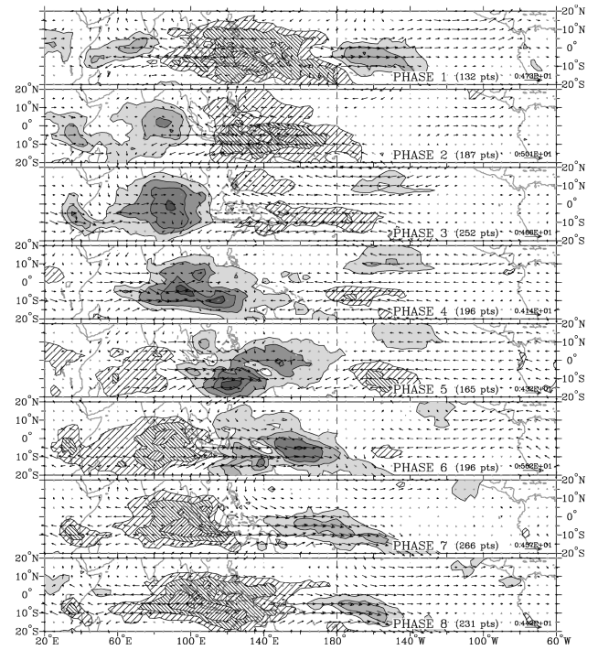
Madden-Julian Oscillation
PHASE 2
OLR anomalies
  Wheeler and Hendon (2004)
Phases 2 and 3 (“active”) for Indian Ocean
PHASE 3

Slide 3
Broad Stratiform (Barnes and Houze 2013)
%

Slide 4
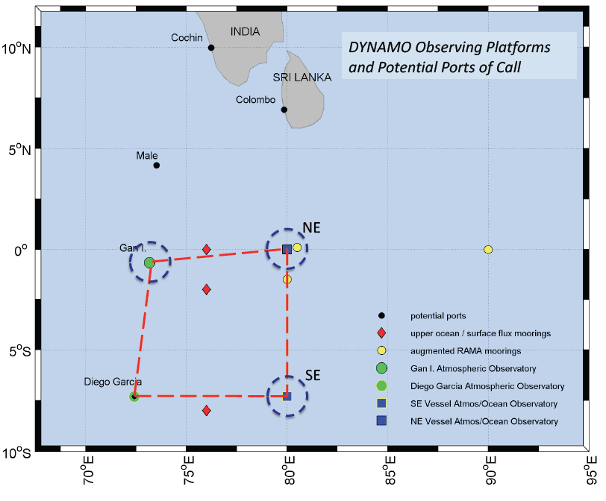
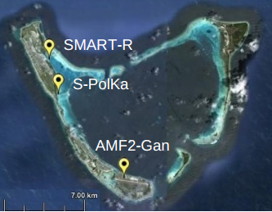
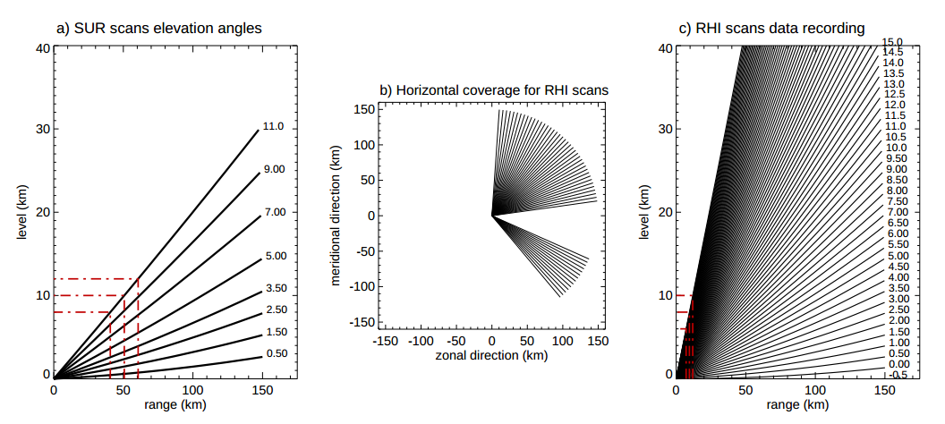
DYNAMO/AMIE
Zuluaga and Houze (2013)

Slide 5
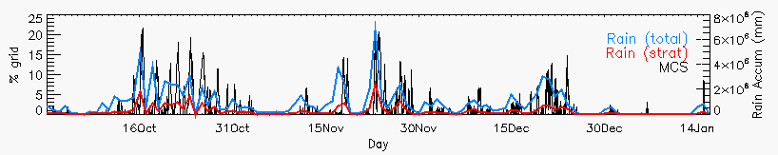
S-PolKa
Active periods: Increased rainfall/organization
Suppressed periods: Reduced rainfall, shallower convection, dry mid-levels
Objective 1: Describe the evolution of non-precipitating clouds to deeper convection during suppressed conditions

Slide 6
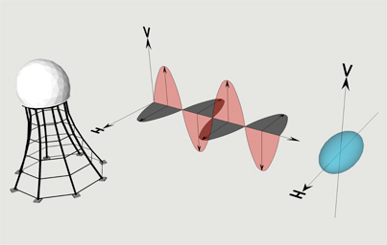

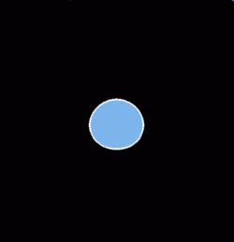



Dual-polarization
UCAR
Polarimetric variables
  Differential reflectivity (Z_{DR})
  Linear depolarization ratio (L_{DR})
  Correlation coefficient (ρ_{HV})
  Specific differential phase (K_{DP})
Particle identification
  Combination of variables (+T)
  Drizzle, rain, hail, graupel/rimed aggregates, dry/wet aggregates, ice crystals (including oriented)
CHILL

Slide 7
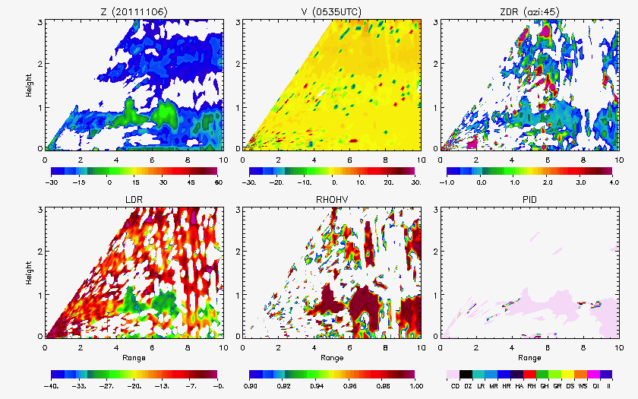
Non-precipitating echo
0-5 dBZ
No particular orientation
Homogeneous collection of scatterers
Cloud droplets

Slide 8
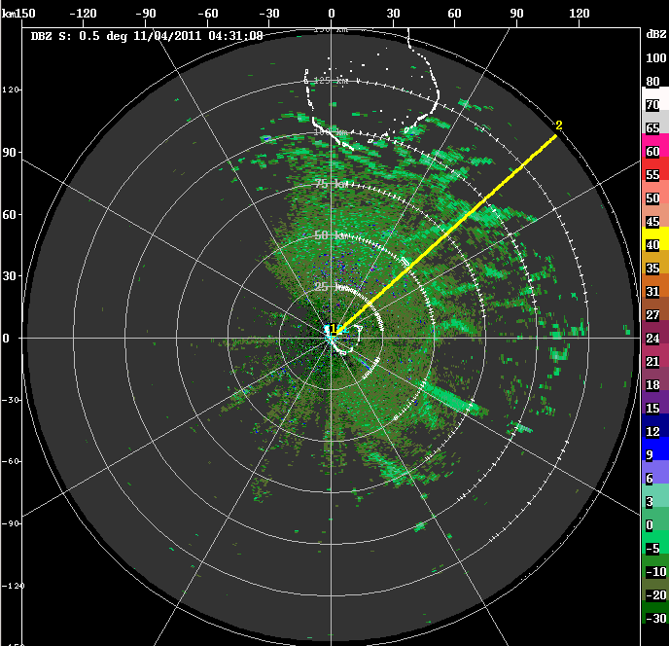
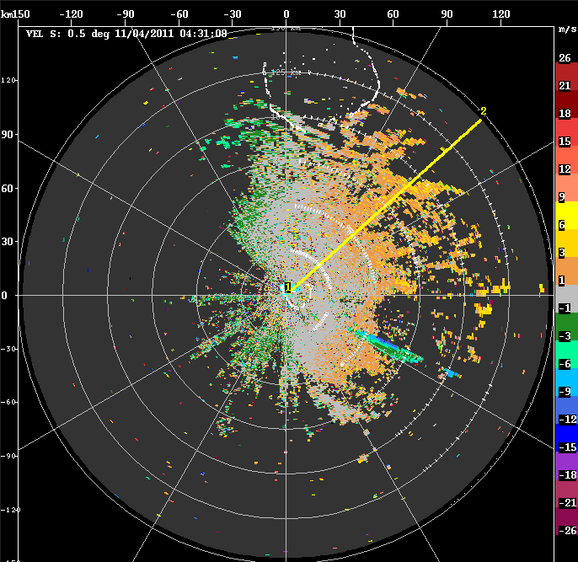
Cloud lines (6 Nov)
Z
V

Slide 9
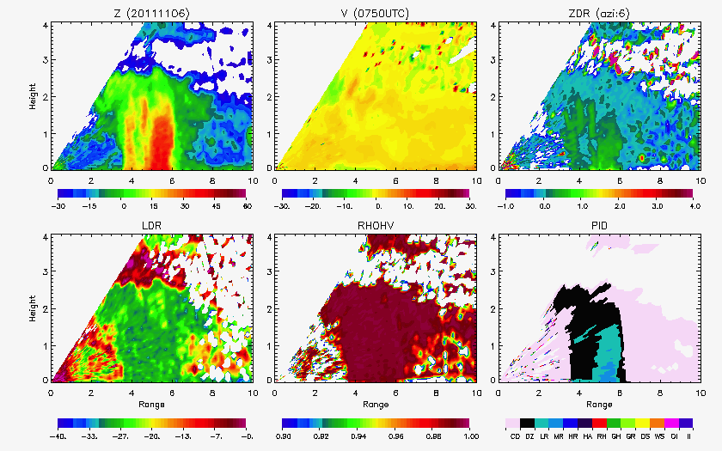
Shallow convection
3 km
Moderate rain

Slide 10
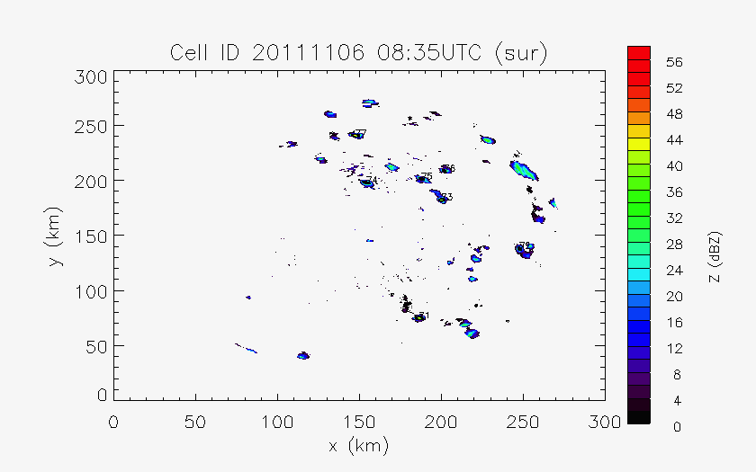
Cell tracking (> 35 dBZ)

Slide 11
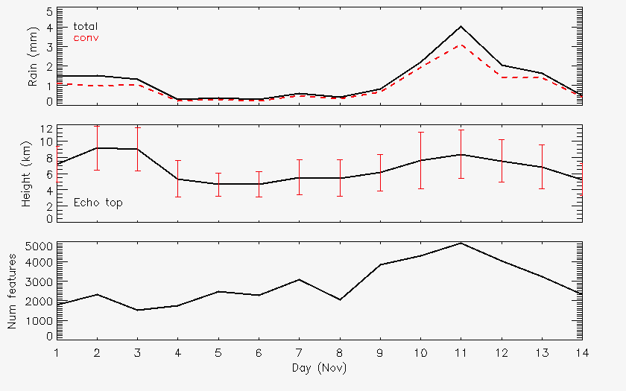
November
Rain
Rain
Echo-top heights
Echo-top heights
Number cells
Number cells

Slide 12
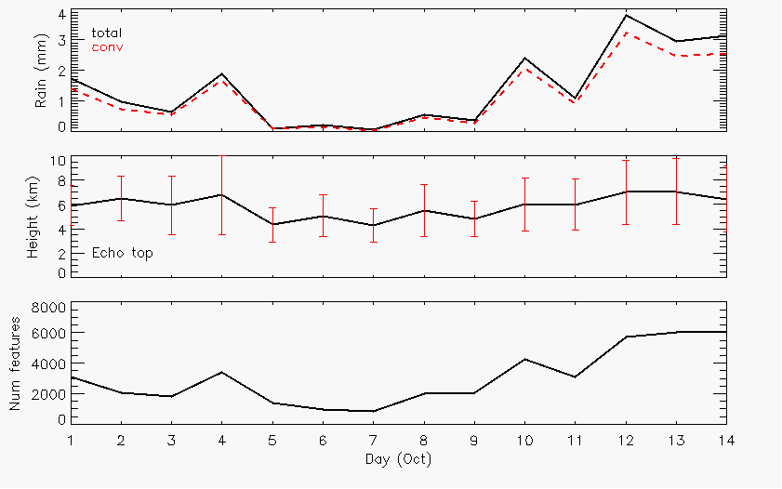
October
Rain
Echo-top heights
Number cells

Slide 13
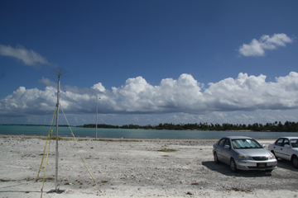
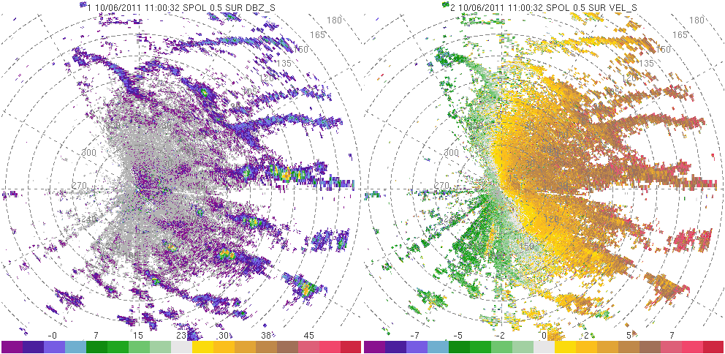
6 October
Photo: Bob Houze

Slide 14
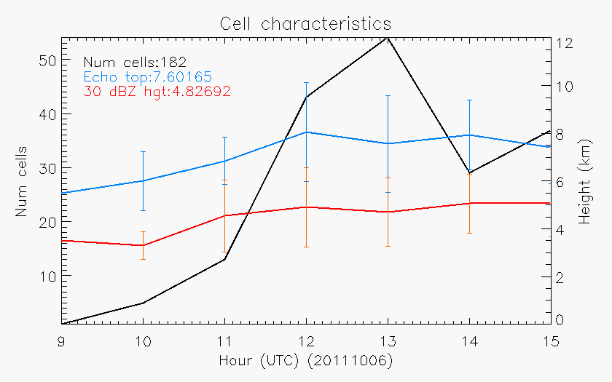
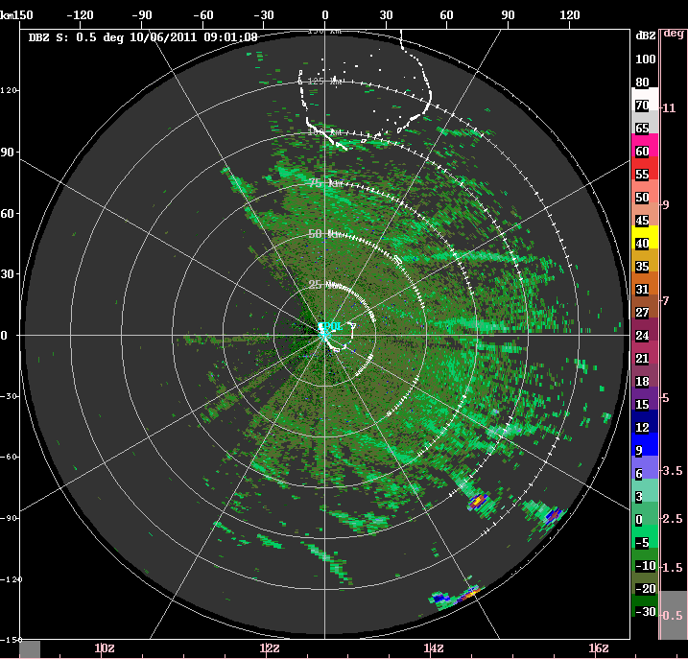
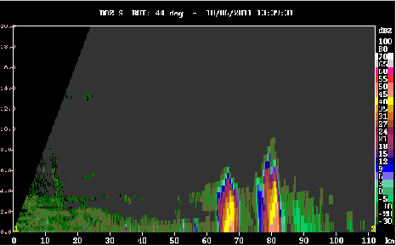
6 October
8 km

Slide 15
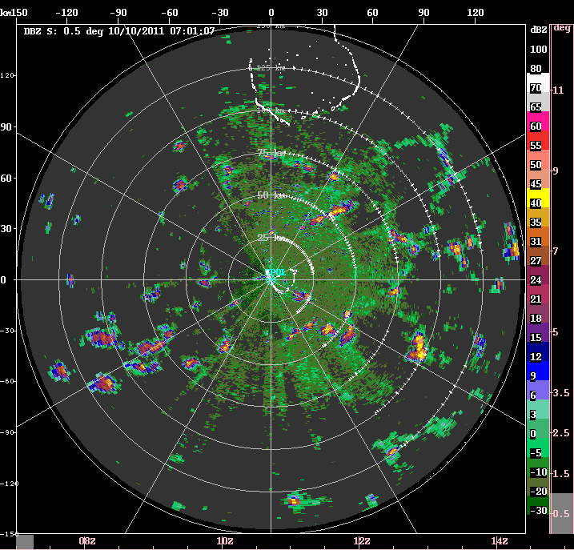
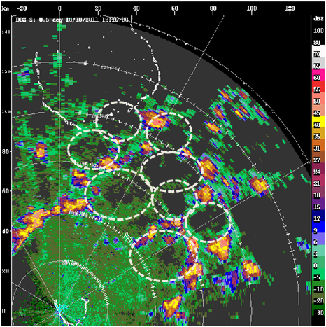
10 October
20-30 km diameters

Slide 16
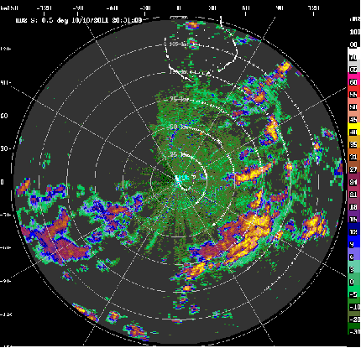
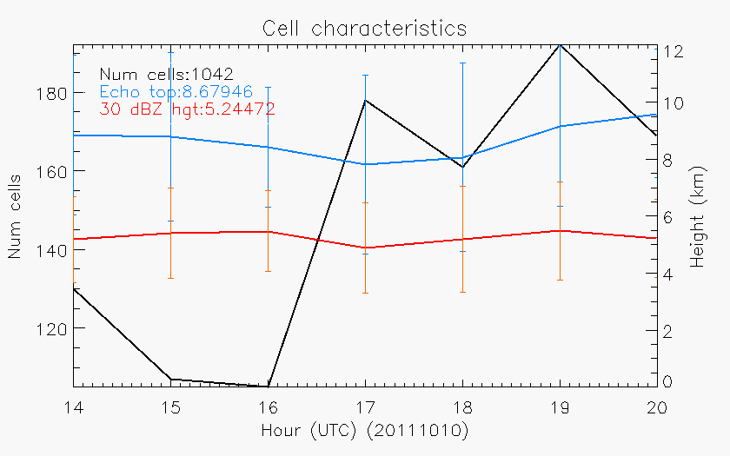
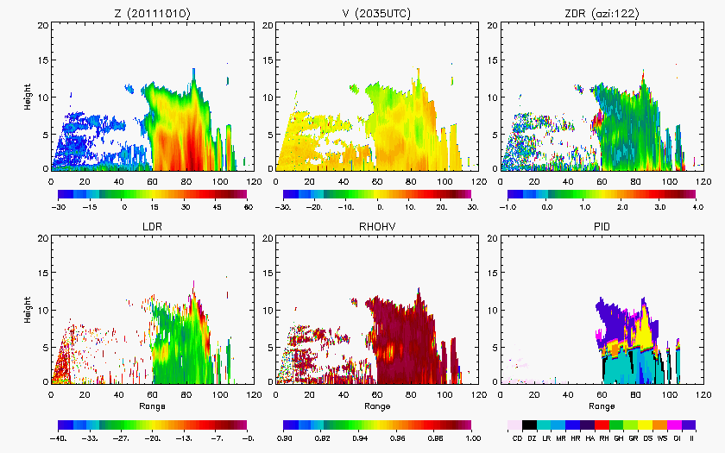
12 km

Slide 17
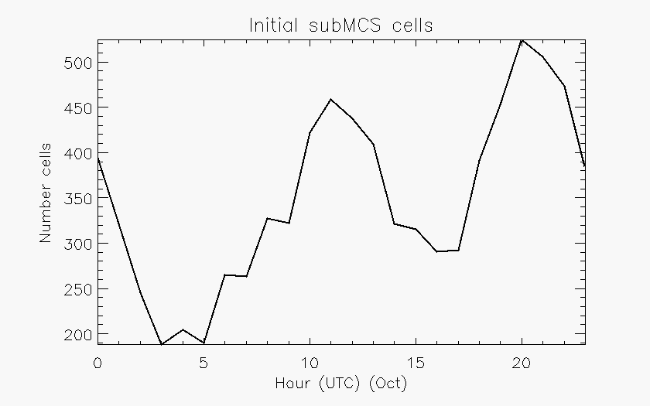
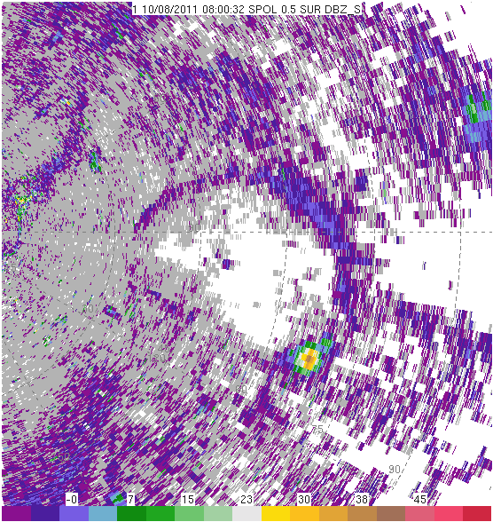
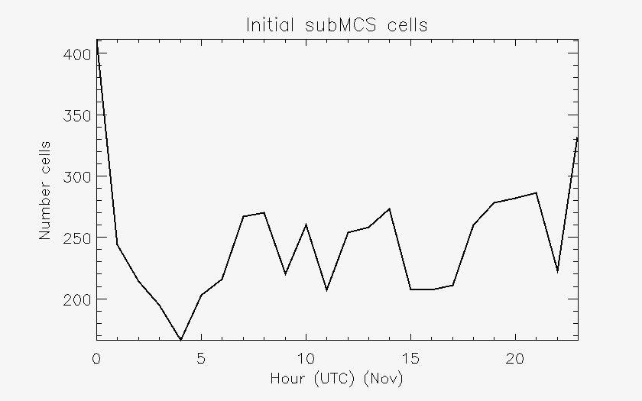
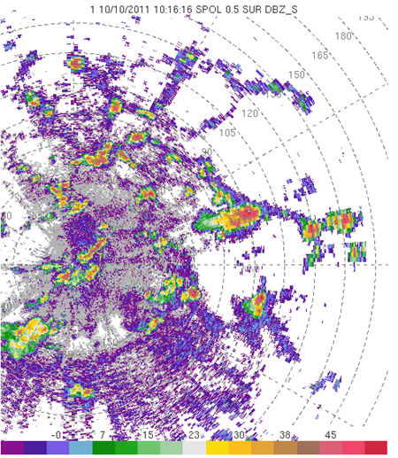

Slide 18
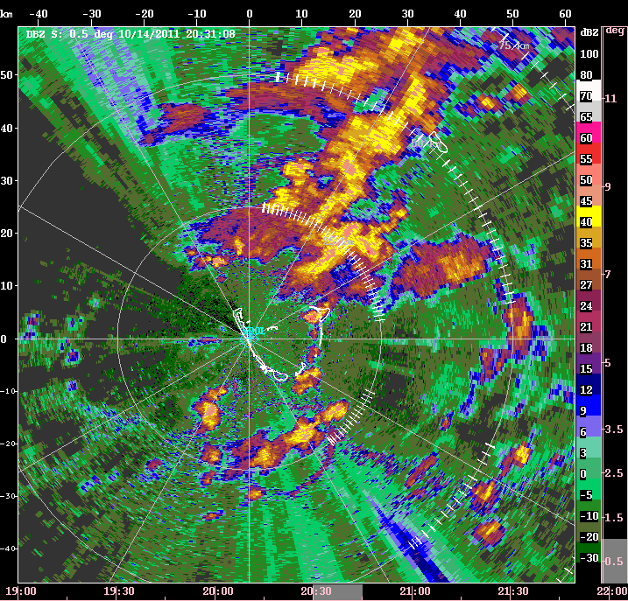

Slide 19
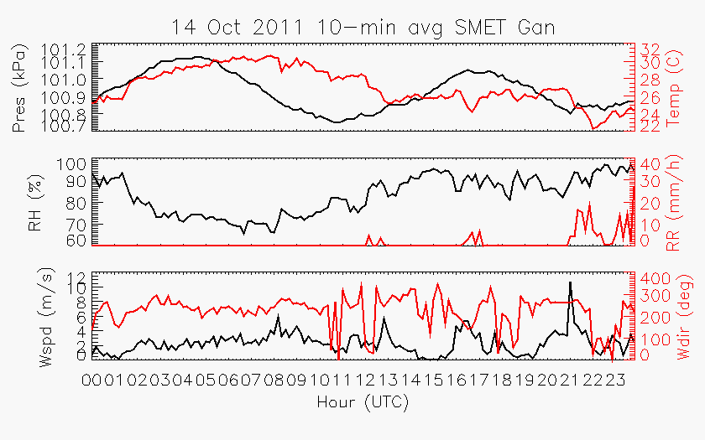

Slide 20
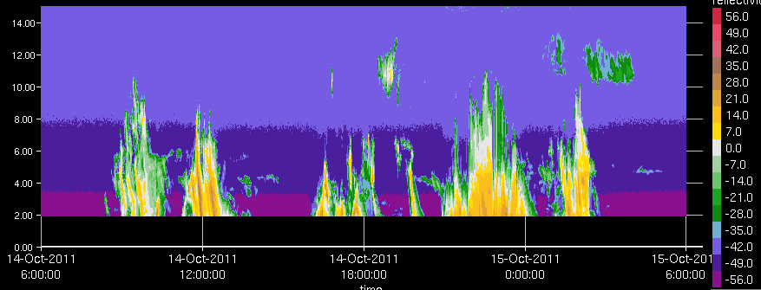
KAZR

Slide 21
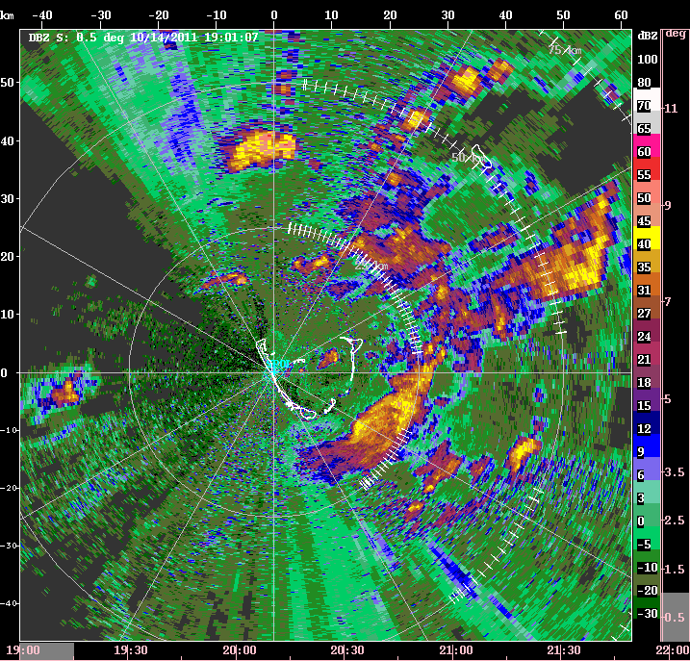

Slide 22
S-PolKa
Active periods: Increased rainfall/organization
Suppressed periods: Reduced rainfall, shallower convection, dry mid-levels
Objective 2: Describe the evolution and microphysical characteristics of precipitating systems during active periods

Slide 23
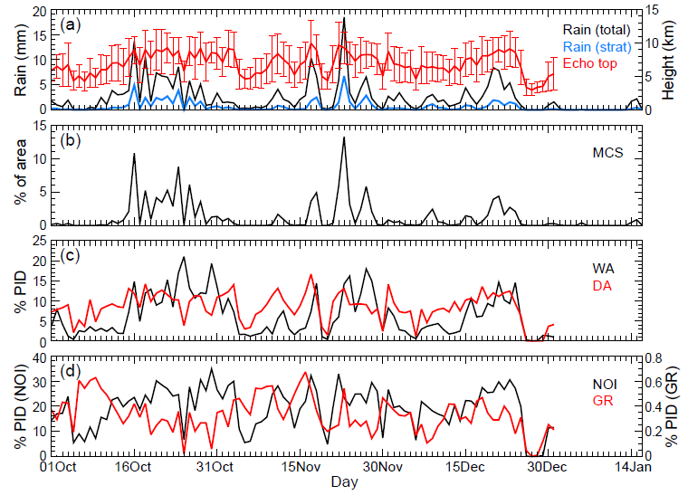
6
7
8
1
2
4
5
3
6
7
8
1
2
3
4
5
4
5
6

Slide 24
Objectives
How are hydrometeors vertically distributed in convective systems during active phases?
  Compared to suppressed?
Are the hydrometeor characteristics similar for each active MJO period?
What differences exist between the convective and stratiform components of these systems?

Slide 25
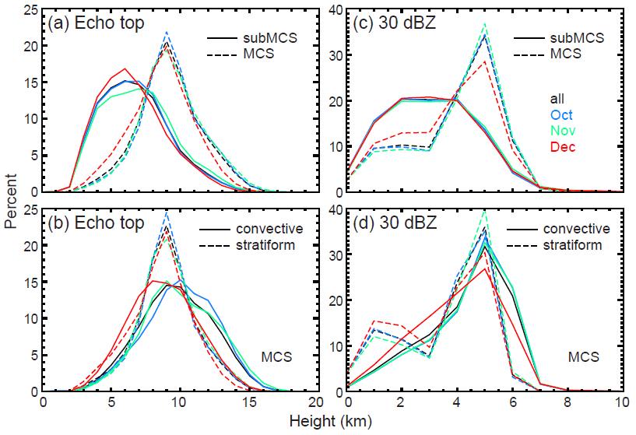
Echo distributions

Slide 26
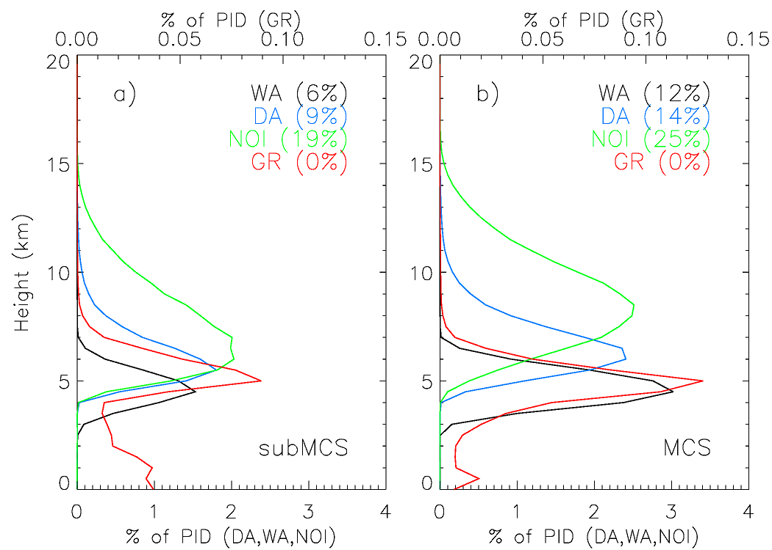
Vertical profiles
Ice crystals
Ice crystals
Dry Agg
Dry Agg
Graupel
Graupel
Wet Agg
Wet Agg

Slide 27
Hydrometeor profiles

Slide 28
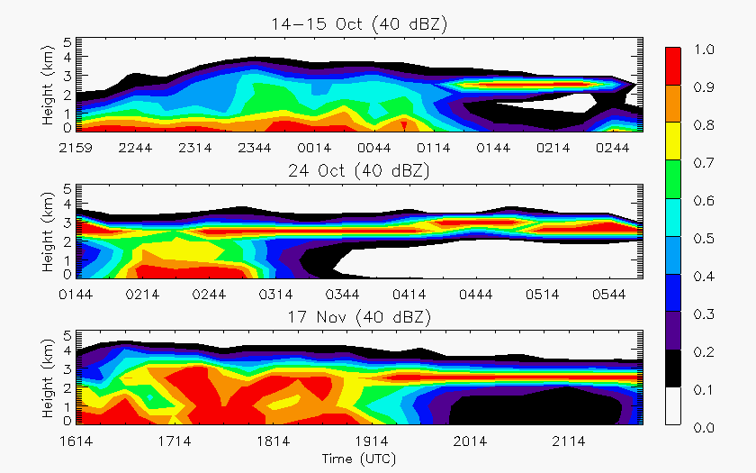
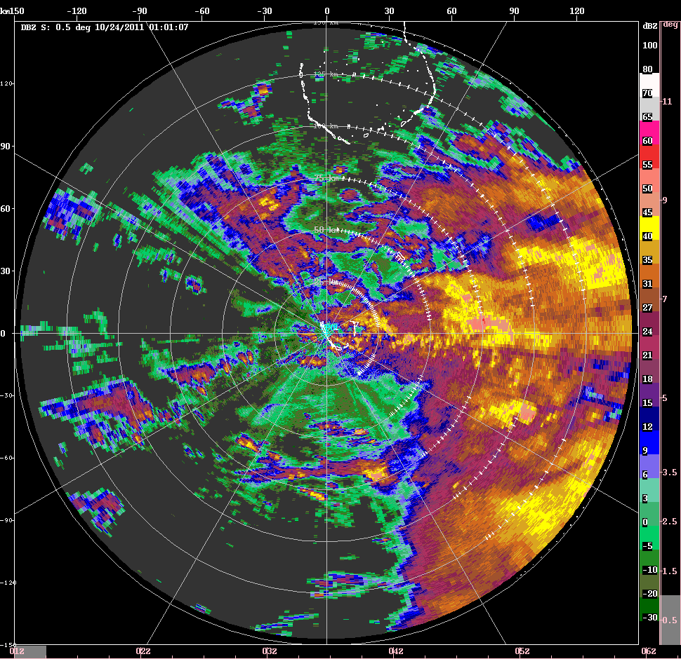
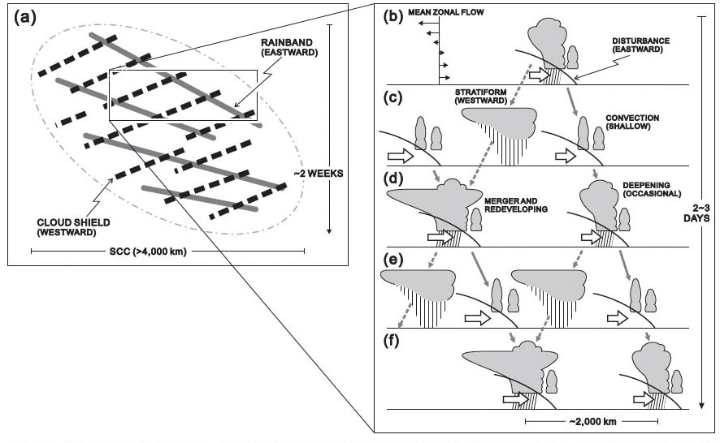
Oct, Nov
Yamada et al. (2010)
MISMO

Slide 29
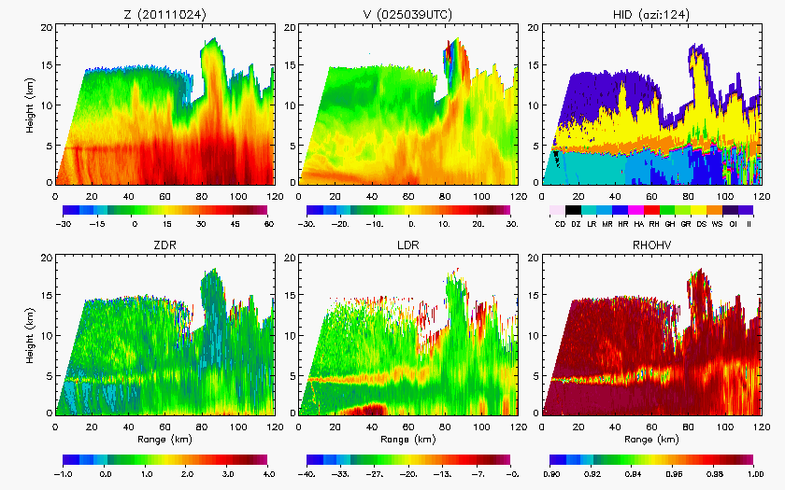
0250 UTC 24 Oct 2011

Slide 30
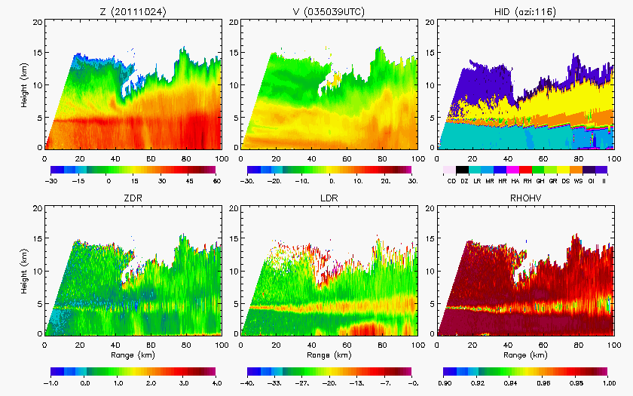
0350 UTC 24 Oct 2011

Slide 31
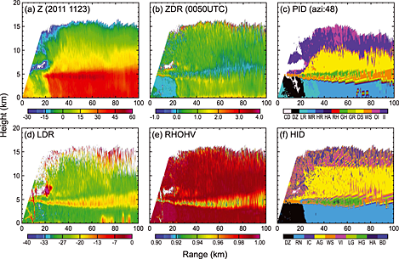
0050 UTC 23 Nov 2011

Slide 32
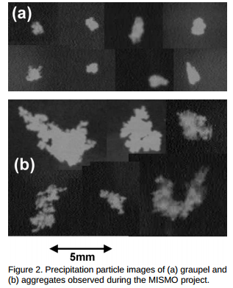
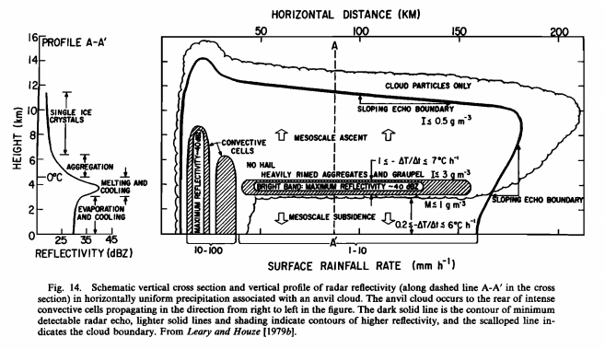
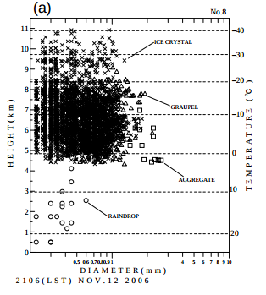
GATE: Rimed aggregates and hexagonal graupel probable ice particle types just above melting level (Houze and Betts 1981)
MISMO: Videosonde showed ice crystals, graupel, and aggregates near and above freezing level (Suzuki et al. 2008)
1979
Ice Crystals
Graupel
Aggregates
Rain

Slide 33
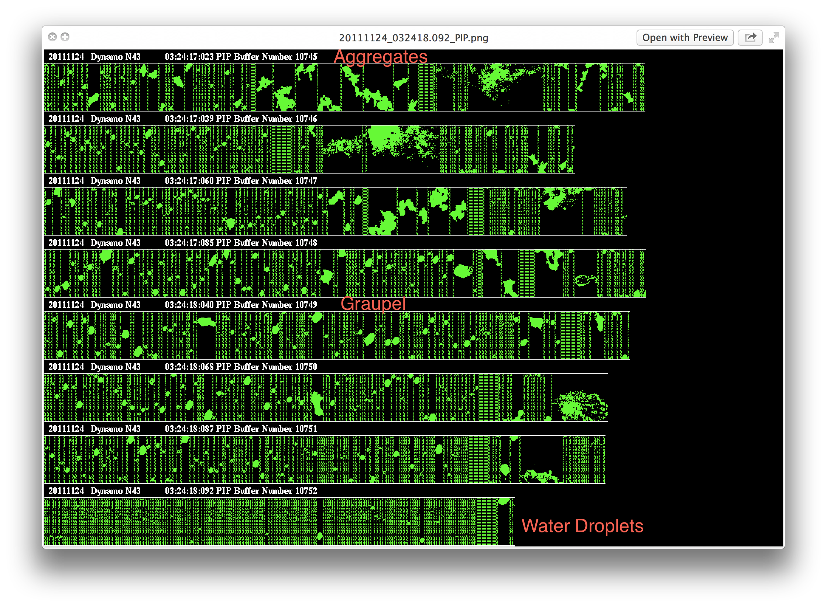
DYNAMO: NOAA P-3 flight log noted graupel and, on 24 Nov, showed both aggregates and graupel as descended through melting layer

Slide 34
What’s different about December?

Slide 35
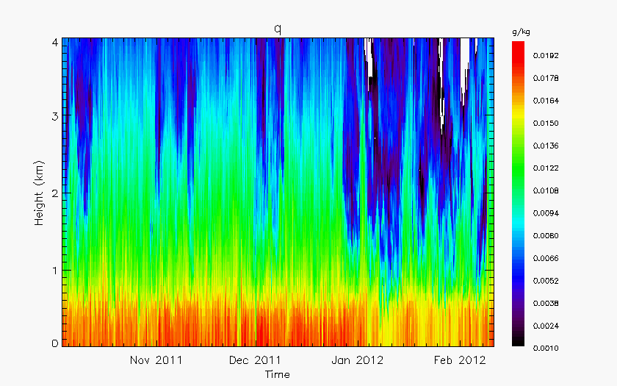
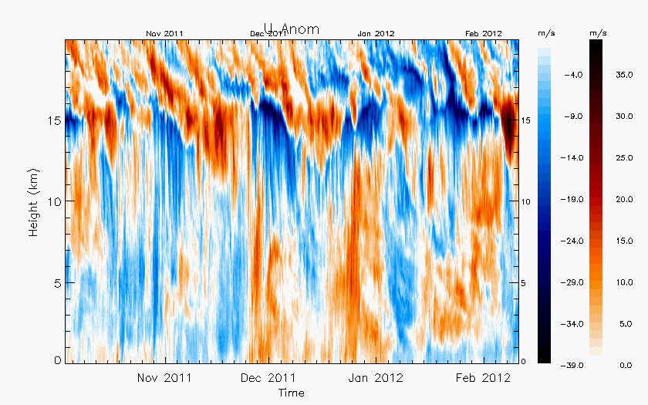
Sounding data
Zonal wind anomaly
Specific humidity

Slide 36
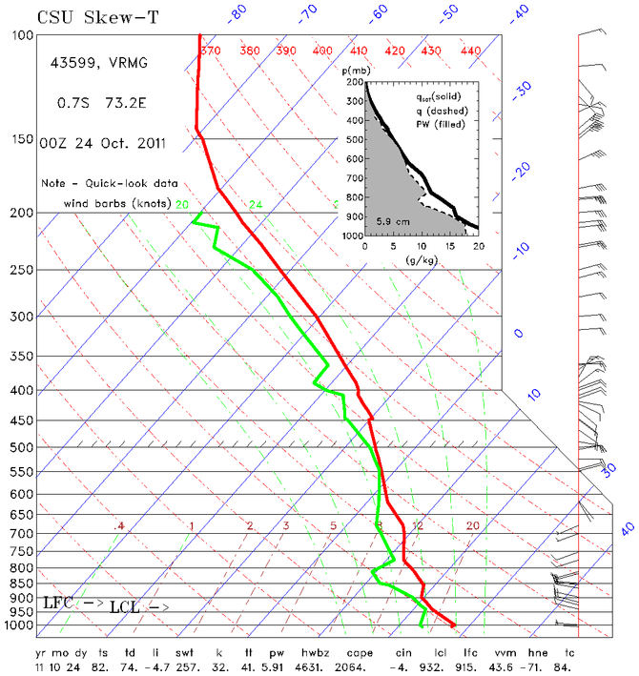
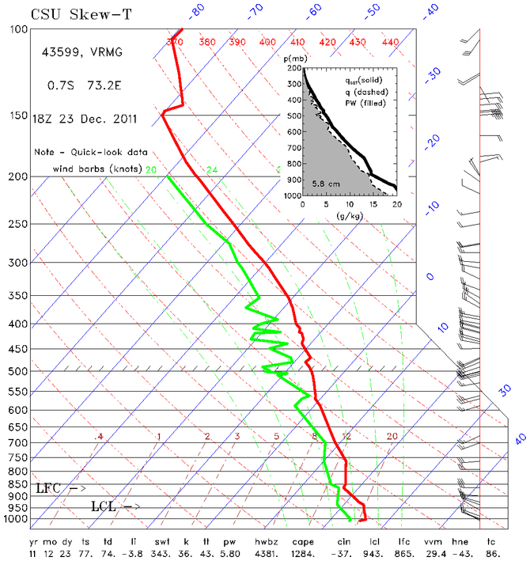
Oct
Dec

Slide 37
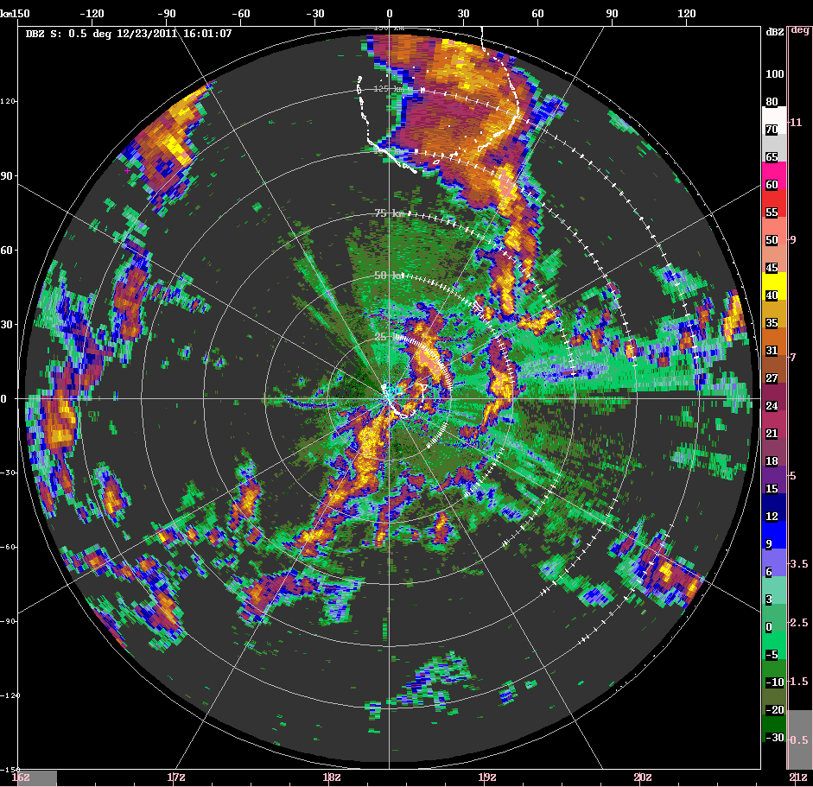
23 December

Slide 38

23 December

Slide 39


TOGA COARE
Houze et al. (2000)
Downward transport of westerly momentum (Houze et al. 2000)
  Positive feedback

Slide 40



End of active phases

Slide 41

31 October

Slide 42
MCSs
Group 1: Embedded convection decaying in widespread stratiform, easterlies over westerlies, conv/strat move in opposite directions (14-15 Oct, 24 Oct, 17 Nov)
Group 2: Transition, increased westerlies at end of active phase, drier mid-levels, weaker stratiform (31 Oct, 1-3 Dec)
Group 3: Deep, strong westerlies, fast-moving squall-lines (December active)

Slide 43

Group comparison

Slide 44

Group comparison

Slide 45


Group comparison
Kennedy et al. (2011)

Slide 46
Summary (suppressed)
Convection forming along boundary layer features (rolls, cloud lines) in the morning
  Non-precipitating clouds have distinct polarimetric signatures
Precipitating clouds produce cold pools late morning/afternoon
  New initiation focused along gust front
  More numerous and deeper convection when gust fronts collide
As near active period, increased rain, deeper echo, more cells, interacting cold pools
Cold pools initiate and enhance convection as it organizes nearing active period

Slide 47
Summary (active)
Similar hydrometeor profiles with low relative occurrence of graupel and enhanced wet aggregation during active periods as deep convection transitions to stratiform echo
Oct/Nov active phase MCSs contained deep embedded convection in weakly sheared environment with widespread stratiform (similar to MISMO)
December active period characterized by shallower convection, less robust stratiform, fast-moving squall lines with descending rear inflow (westerly momentum transport similar to TOGA COARE)
Increased westerlies (and drier mid-levels) generally resulted in shallower convection, less widespread stratiform, fast moving systems as active phases transitioned back to suppressed conditions

Slide 48

Thank you!
Funded by NSF Grant # AGS-1355567 & AGS-1059611 and DOE Grant # DE-SC0008452

