Slide 1
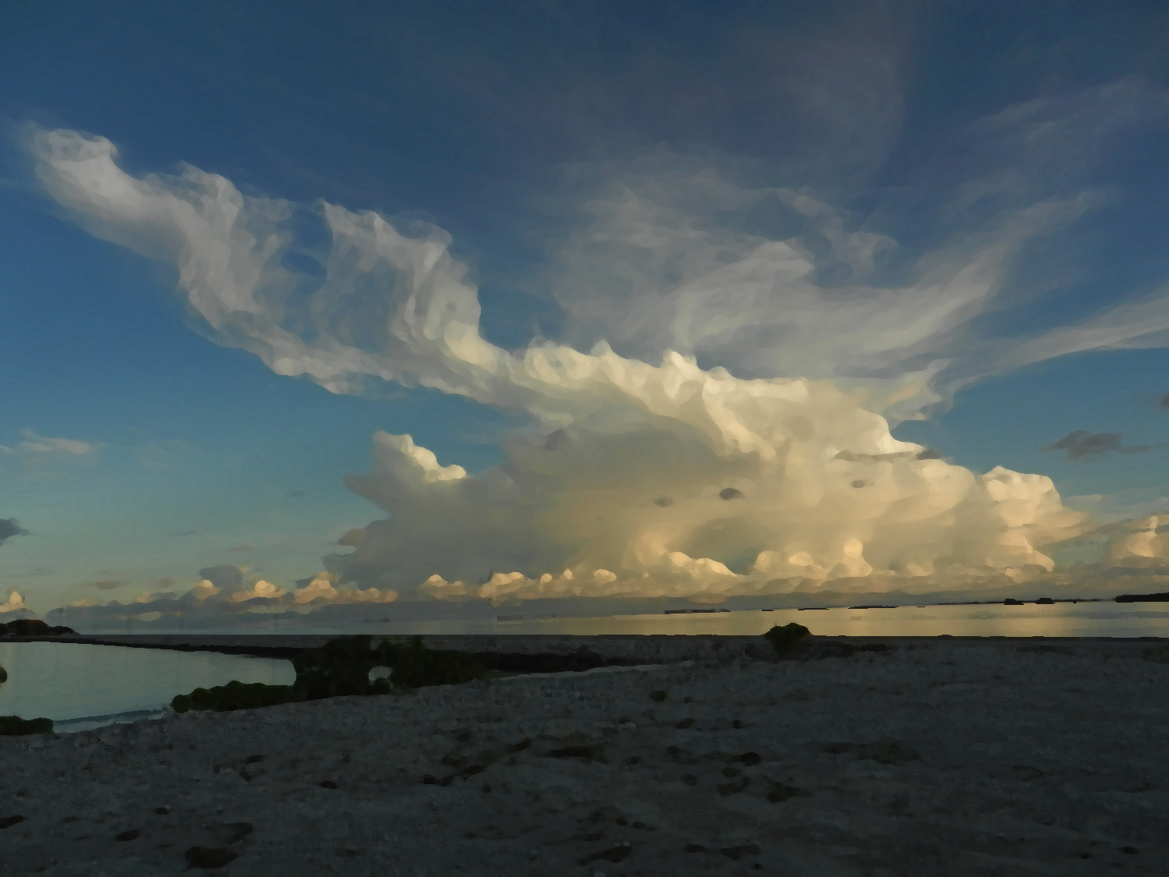
The Hydrometeor Structure of
Mesoscale Convective Systems during the Active Stage of the MJO
Funded by NSF Grants AGS-1059611 & AGS-1355567 and DOE Grant DE-SC0008452
Notes:
Begin to see systematic organization and see gap in understanding of structure. Important to fill gap so can more vigruously valid microphysical structure and latent heating of MCS

Slide 2
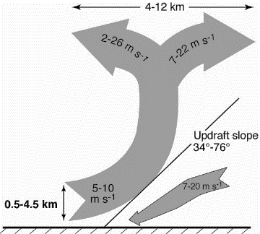
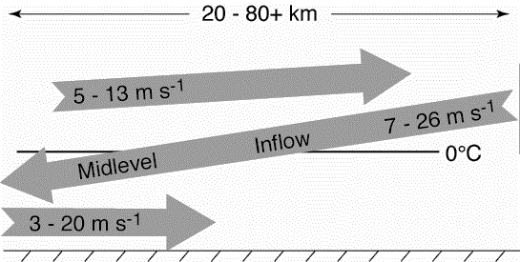
Objective
Characterize hydrometeor structure in MCSs
Composite with respect to kinematic structure
Convective
Stratiform
Kingsmill and Houze 1999a
Notes:
Thus, the primary objective of this study is to characterize the hydrometeor structure of MCSs. This will done by compositing the location of different types of hydrometeors with respect to the airflow through the convective and stratiform portions of MCSs.
MOTIVATION!!!!!

Slide 3
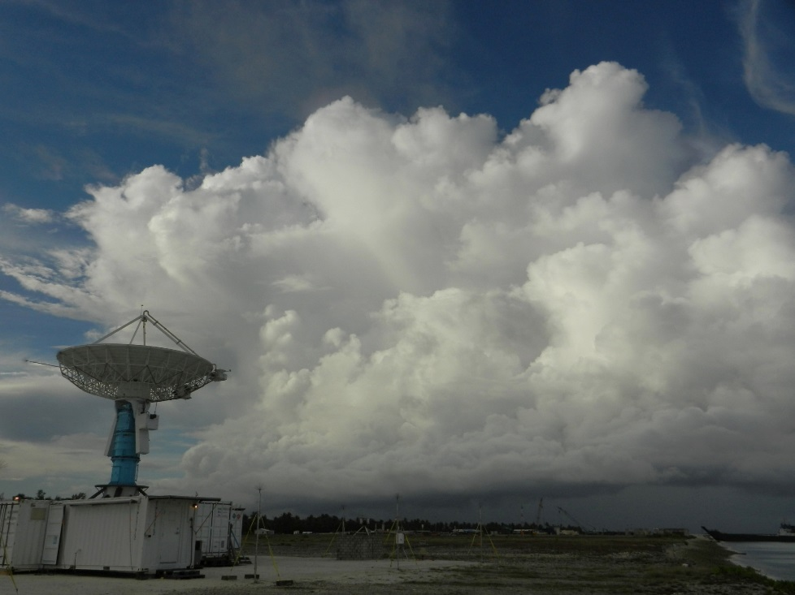
Outline
Introduction & Motivation
Mesoscale convective systems
Dual polarimetric radar
Particle identification algorithm
Compositing methodology
Results
Convective inflow
Stratiform mid-level inflow
Conclusions
Future Work
Notes:
Thus, the primary objective of this study is to characterize the hydrometeor structure of MCSs. This will done by compositing the location of different types of hydrometeors with respect to the airflow through the convective and stratiform portions of MCSs.

Slide 4
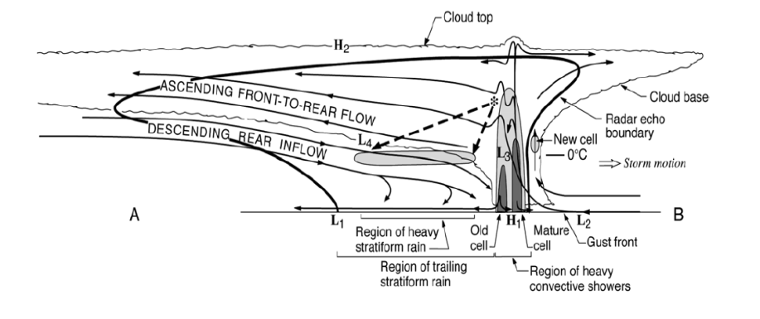
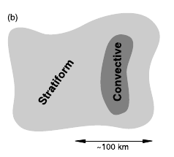
Mesoscale Convective Systems (MCSs)
Contiguous precipitation over 100 km
~ 60% of tropical precipitation
Most common during MJO active stage
Stratiform Region
Convective Region
Y
X
Houze 1997, 1989, 2004

Slide 5
Kinematic Structure of Mesoscale Convective Systems (MCSs)
Moncrieff (1992): Layer airflow
Kingsmill and Houze (1999a): 3D structure
Convective
Stratiform
Kingsmill and Houze 1999a
Notes:
Brief introduction to MCS structure
Emphasize that TOGA COARE added to that picture by confirming that layered airflow structures described by Moncrieff (1992)
Convective regions characterized by steeply sloping convergent zones with a divergence signature aloft
Stratiform often characterized by mid-level inflow that starts below the anvil and slowly descends into the precipitating stratiform region. The mid-level inflow may or may not reach the surface.
DYNAMO is opportunity to add another layer of knowledge of the structure of MCS through microphysics

Slide 6
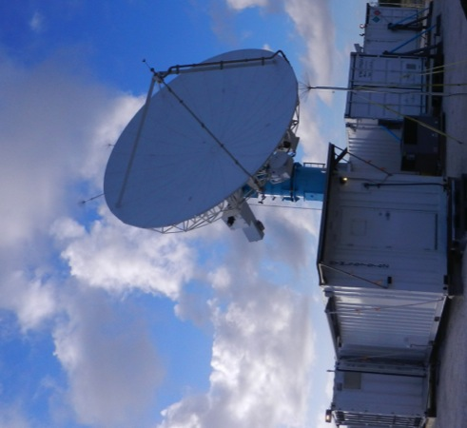
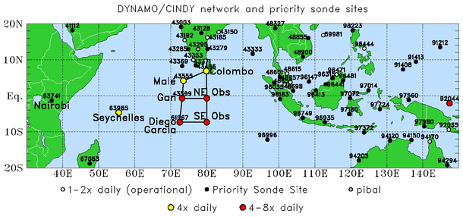
NCAR SPolKa Radar
DYNAMO (Oct 2011 – Jan 2012)
Addu Atoll, Maldives
S-Band
RHI sector and within 100 km
Single Doppler
Dual-polarimetric
Particle Identification Algorithm (Vivekanandan et al., 1999a)
Y
X
Notes:
Briefly introduce SPolKa
Doppler capabilities allow us to identify the kinematic structures of Kingsmill and Houze (similar to TOGA COARE)
Dual-polarimetric capabilities new for DYNAMO and allow to identify different types of hydrometeors.
PID algorithm developed by Vivekanadan et al. 1999 was APPLIED to the SPolKa data
In two regions the SPolKa radar did a series of high resolution RHI scans, which enabled us to obtain a detailed vertical picture of the hydrometeor structure within MCSs

Slide 7
Dual Polarimetric Radar
Height
Z
Emit and receive vertical and horizontal pulses
Variables tell about hydrometeors
ZDR – Size, shape, phase
K_{DP} – Size, water content
ρ_{HV} – Phase, diversity
LDR – Phase, orientation, diversity
range
Height
Height
ZDR
ρ_{HV}
range
range
Height
Height
KDP
LDR
range
range
Notes:
COMPLICATED SO EXPLAIN MORE
Briefly introduce SPolKa
Doppler capabilities allow us to identify the kinematic structures of Kingsmill and Houze (similar to TOGA COARE)
Dual-polarimetric capabilities new for DYNAMO and allow to identify different types of hydrometeors.
PID algorithm developed by Vivekanadan et al. 1999 was APPLIED to the SPolKa data
In two regions the SPolKa radar did a series of high resolution RHI scans, which enabled us to obtain a detailed vertical picture of the hydrometeor structure within MCSs

Slide 8
Particle Identification Algorithm (PID)
Mimics radar expert
Identifies most likely dominant hydrometeor
Based on theory, observations, experience
Polarimetric Data
Z, Z_{DR}, K_{DP}, LDR, ρ_{HV}, Temp
PID Algorithm
Characterize how well categories represented by data
Fuzzy logic based
Interest value
Hydrometeor Classification
Max interest value

Slide 9
Hydrometeor Types
Heavy Rain
Moderate Rain
Light Rain
Graupel/Rimed Aggregates
Wet Aggregates
Dry Aggregates
Small Ice Crystals
Horizontally-Oriented Ice
Rain
Mixed Phase
Frozen

Slide 10
Distribution of Convective Polarimetric Variables
Reflectivity
Linear Depolarization Ratio
GA HR MR LR WA DA SI HI
GA HR MR LR WA DA SI HI
Correlation Coefficient
Differential Reflectivity
Differential Reflectivity
GA HR MR LR WA DA SI HI
GA HR MR LR WA DA SI HI
Specific Differential Phase
Temperature
GA HR MR LR WA DA SI HI
GA HR MR LR WA DA SI HI

Slide 11
Particle Identification Algorithm (PID)
Height
Height
SI
HI
WA
DA
G/R
GA
H/R
H
HR
MR
LR
Z
PID
Mimics radar expert
Identifies most likely dominant hydrometeor
Based on theory, observations, experience
range
range
Height
Height
ZDR
ρ_{HV}
range
range
Height
Height
KDP
LDR
range
range
Notes:
Briefly introduce SPolKa
Doppler capabilities allow us to identify the kinematic structures of Kingsmill and Houze (similar to TOGA COARE)
Dual-polarimetric capabilities new for DYNAMO and allow to identify different types of hydrometeors.
PID algorithm developed by Vivekanadan et al. 1999 was APPLIED to the SPolKa data
In two regions the SPolKa radar did a series of high resolution RHI scans, which enabled us to obtain a detailed vertical picture of the hydrometeor structure within MCSs

Slide 12
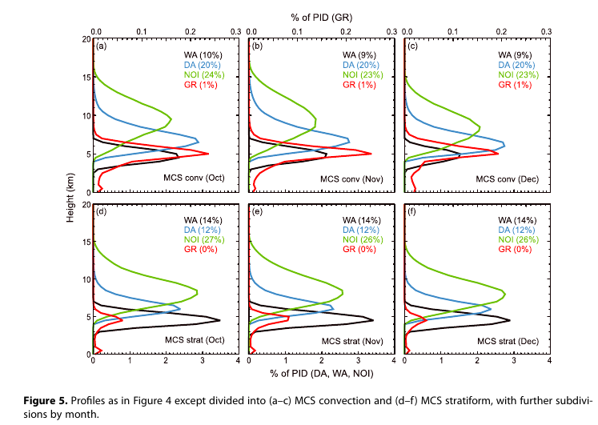
Particle Identification Algorithm (PID)
Convective
Stratiform
Rowe and Houze (2014)
Profiles within MCSs have little variability between different active events
How are hydrometeors spatially organized? Is there consistency?
Notes:
MORE EXPLINATION!!!!!
Briefly introduce SPolKa
Doppler capabilities allow us to identify the kinematic structures of Kingsmill and Houze (similar to TOGA COARE)
Dual-polarimetric capabilities new for DYNAMO and allow to identify different types of hydrometeors.
PID algorithm developed by Vivekanadan et al. 1999 was APPLIED to the SPolKa data
In two regions the SPolKa radar did a series of high resolution RHI scans, which enabled us to obtain a detailed vertical picture of the hydrometeor structure within MCSs

Slide 13
Methodology

Slide 14
Methodology: Case Selection
Convective: 24 Oct 2011
Latitude
Z
Height
V_{r} profile
SPolKa data during active phases
Subjectively identify RHIs
SPolKa radial velocity
Layer lifting
One per storm
25 Convective RHIs
37 Stratiform RHIs
Longitude
range
Stratiform: 23 December 2011
Latitude
Z
Height
V_{r} profile
Longitude
range
Notes:
Explain that focusing on the 11 top rain events during DYNAMO, which all occurred during the active phase.
Rain events selected on the 24 hr running mean time series. Consider 24 hours before and after the 11 maxima identified in that timeseries
Explain composite method
Explain basic process of selecting cases (the bottom figure highlights the region where I look for these features)
Subjective
Create map of hydrometeors in each case by hand
Enables to reduce noise and artifacts
Composite.
Done by scaling so that all cases have the same slope, height, and range.
The slope, height, and range used for compositing are the average values of all the events
____________EXTRA INFORMATION ____________
Number of events in each composite
Convective – 27
Mid-Level Inflow – 38
Trailing Stratiform – 7
Non-Trailing Stratiform – 29

Slide 15
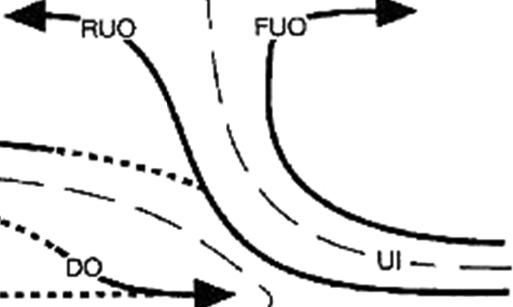
Methodology: Compositing
1.) Map kinematics and hydrometeors using radial velocity and PID
2.) Composite around layer lifting model
Radar Data
Composite Structure
X Scale Factor
Z Scale Factor

Slide 16
Methodology: Composite Results
Wet Aggregates
Height
Range
Notes:
WET AGGREGATES ONLY FIRST
Red line is the convergent updraft.
Colors shows how often that type of hydrometeor is located at a given location. The scales in each figure or different in order to show their distribution most clearly.
Top row shows the rain categories, the middle row shows the categories with graupel (there was no hail), and the bottom line shows the snow and ice categories.
Structure is systematic
Few features to emphasize
Heavy rain just downwind of updraft
Moderate rain within updraft core
Graupel just downwind updraft in a narrow vertical column
Dry aggregates extend from the melting level to the base of the divergence signature
Non-oriented ice surround dry aggregates

Slide 17
Convective Updraft
Composites
Graupel
Rimed Aggregates
Heavy Rain
Moderate Rain
Light Rain
Height
Range
Wet Aggregates
Dry Aggregates
Small Ice Crystals
Horz. Oriented Ice
Height
Range
Notes:
WET AGGREGATES ONLY FIRST
Red line is the convergent updraft.
Colors shows how often that type of hydrometeor is located at a given location. The scales in each figure or different in order to show their distribution most clearly.
Top row shows the rain categories, the middle row shows the categories with graupel (there was no hail), and the bottom line shows the snow and ice categories.
Structure is systematic
Few features to emphasize
Heavy rain just downwind of updraft
Moderate rain within updraft core
Graupel just downwind updraft in a narrow vertical column
Dry aggregates extend from the melting level to the base of the divergence signature
Non-oriented ice surround dry aggregates

Slide 18
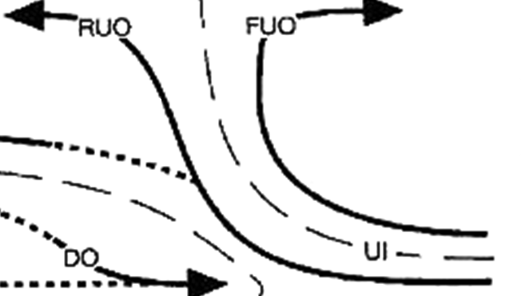
Hydrometeor Organization in Convective Updrafts
Small Ice Crystals
Dry Aggregates
Graupel/Rimed Aggregates
Light Rain
Heavy Rain
Z
Wet Aggregates
Moderate Rain
X
Notes:
Based on those results we have developed this conceptual diagram for the hydrometeor structure of convective updrafts.

Slide 19
Stratiform

Slide 20
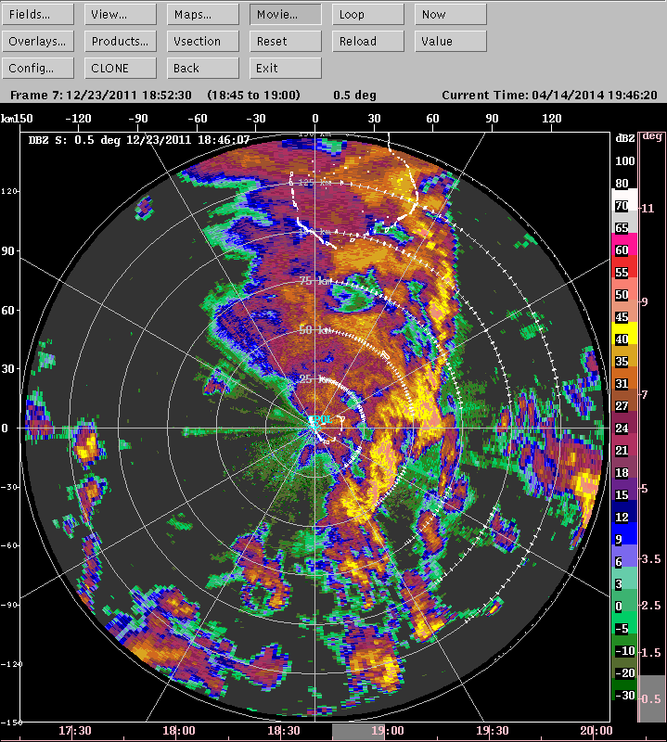
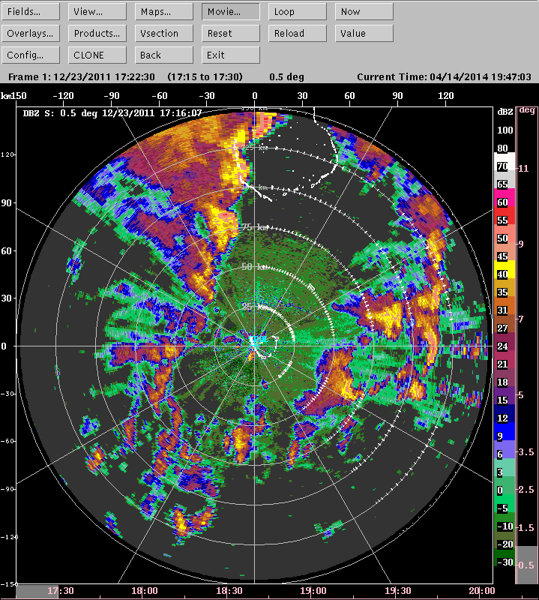
Stratiform Morphology
Stratiform with leading line
Hodograph
23 December 2011

Slide 21
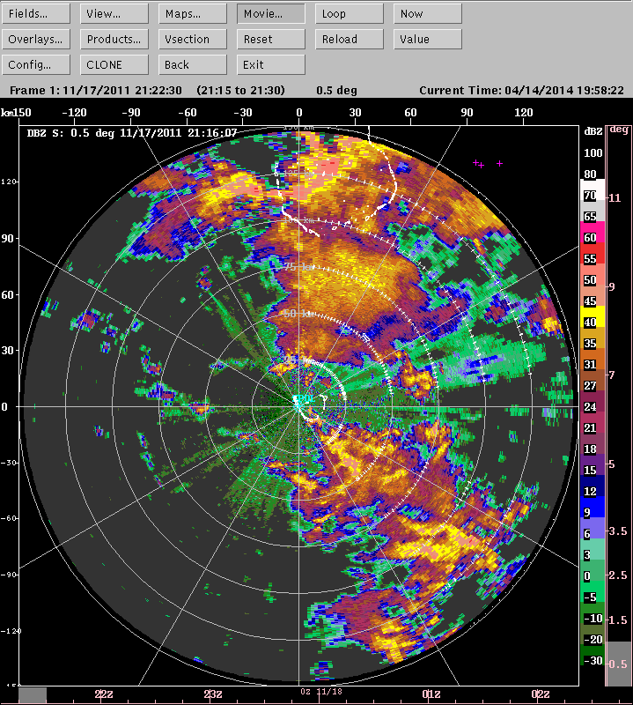
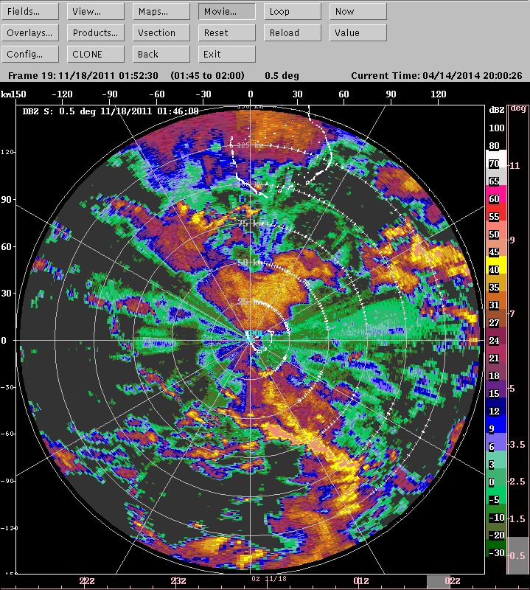
Stratiform Morphology
Stratiform without leading line
Hodograph
18 November 2011

Slide 22
Stratiform without Leading Line
Composites
Graupel
Rimed Aggregates
Heavy Rain
Moderate Rain
Light Rain
Height
Range
Wet Aggregates
Dry Aggregates
Small Ice Crystals
Horz. Oriented Ice
Notes:
- More cases in this composite so images not as fragmented but the overall hydrometeor structure is the virtually the same.

Slide 23
18 November 2011, 0150 UTC
Height
Height
Z
ρ_{HV}
Height
PID
range
Height
Height
range
range
Horz. Ice Crystals
ZDR
LDR
Height
V_{R}
range
range
range

Slide 24
Stratiform without Leading Line
Composites
Graupel
Rimed Aggregates
Heavy Rain
Moderate Rain
Light Rain
Height
Range
Wet Aggregates
Dry Aggregates
Small Ice Crystals
Horz. Oriented Ice
Notes:
- More cases in this composite so images not as fragmented but the overall hydrometeor structure is the virtually the same.

Slide 25
18 November 2011, 0150 UTC
Height
Height
Z
PID
PID
range
Graupel/Rimed Agg.
Height
range
Height
ZDR
V_{R}
range
range

Slide 26
Differences in Graupel/Rimed Aggregates and Wet Aggregates in Mid-Level Inflow Cases
Graupel/Rimed Aggregates
Wet Aggregates Only
Height
Height
Height
Height

Slide 27
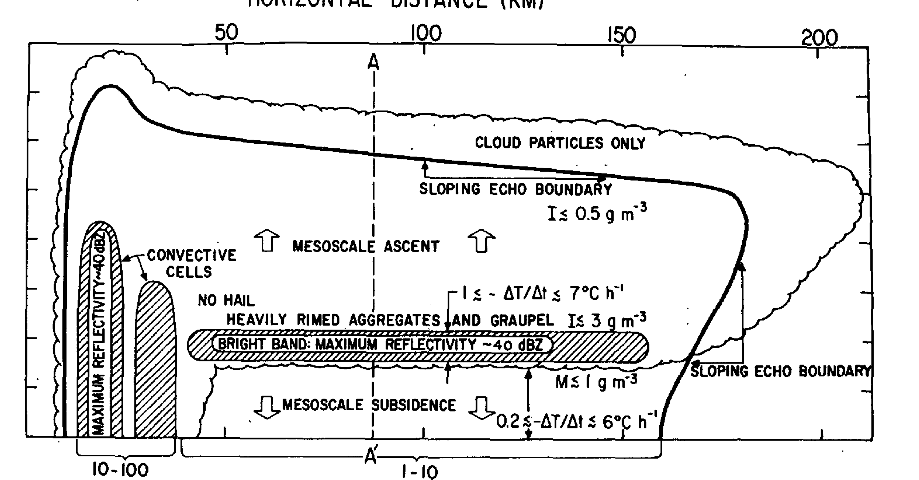
Theoretical Support of Graupel in Stratiform
Leary and Houze, 1979

Slide 28
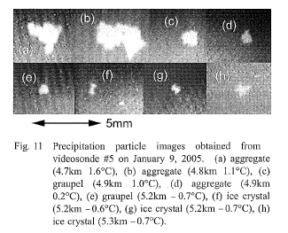
Videosonde Observations of Graupel in Stratiform
9 January 2005: Thick stratiform, gentle rain, bright band
Aggregate
4.8 km
1.1°C
Aggregate
4.9 km
0.2°C
Graupel
5.2 km
0.7°C
Suzuki et al., 2006

Slide 29
Stratiform without Leading Line
Composites
Graupel
Rimed Aggregates
Heavy Rain
Moderate Rain
Light Rain
Height
Range
Wet Aggregates
Dry Aggregates
Small Ice Crystals
Horz. Oriented Ice
Notes:
- More cases in this composite so images not as fragmented but the overall hydrometeor structure is the virtually the same.

Slide 30
Stratiform with Leading Line
Composites
Graupel
Rimed Aggregates
Heavy Rain
Moderate Rain
Light Rain
Height
Range
Wet Aggregates
Dry Aggregates
Small Ice Crystals
Horz. Oriented Ice
Notes:
Red line shows mid-level inflow that was composited around. This composite mid-level inflow can be thought of starting on the right side of each figure under the anvil and ending on the left side of the figure with stratiform precipitation
Structure again is very systematic.
As move out towards the anvil the rain intensity systematically weakens.
Snow and ice are highly layered
Wet aggregates at the melting level, then dry aggregates and non-oriented ice respectively layered above
The wet aggregate layer becomes more fragmented near the anvil
Sometimes a thin layer of graupel was found within the upper portion of the wet aggregate layer.
Especially when brightband strong
Surprised to see but do not think this is an artifact
large aggregates and graupel have been found during MISMO which was another campaign in the central Indian ocean in 2006
Videosondes (rawinsondes outfitted with video camera
Released in stratiform regions, saw aggregates and graupel near and above the melting level
Now I am going to turn to the non-leading line MCSs and I want you watch very carefully as I change the slide since the hydrometeor structure is virtually the same.

Slide 31
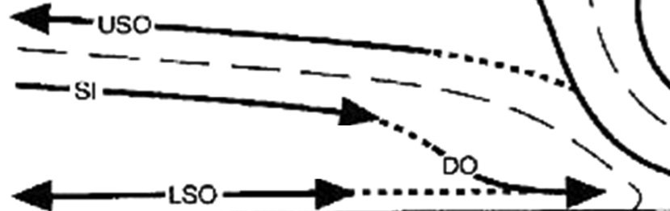
Hydrometeor Organization in Stratiform
Horizontally Oriented Ice
Small Ice Crystals
Dry Aggregates
0˚C
Light Rain
Heavy Rain
Graupel / Rimed Aggregates
Z
Moderate Rain
Wet Aggregates
X
Notes:
Using these results we have created this conceptual diagram of the hydrometeor structure for regions characterized by a mid-level inflow.
Key features
Heavy rain from events when mid-level inflow reached surface, otherwise very rare
Rain intensity decrease with distance from center of storm
Snow and ice crystals are layered
Wet aggregate layer becomes fragmented as move towards anvil

Slide 32
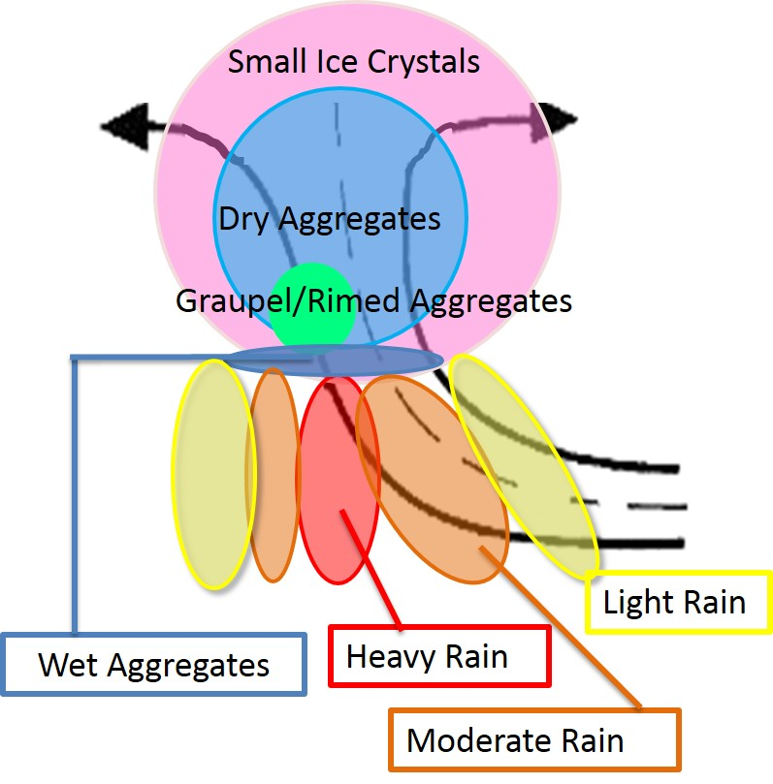
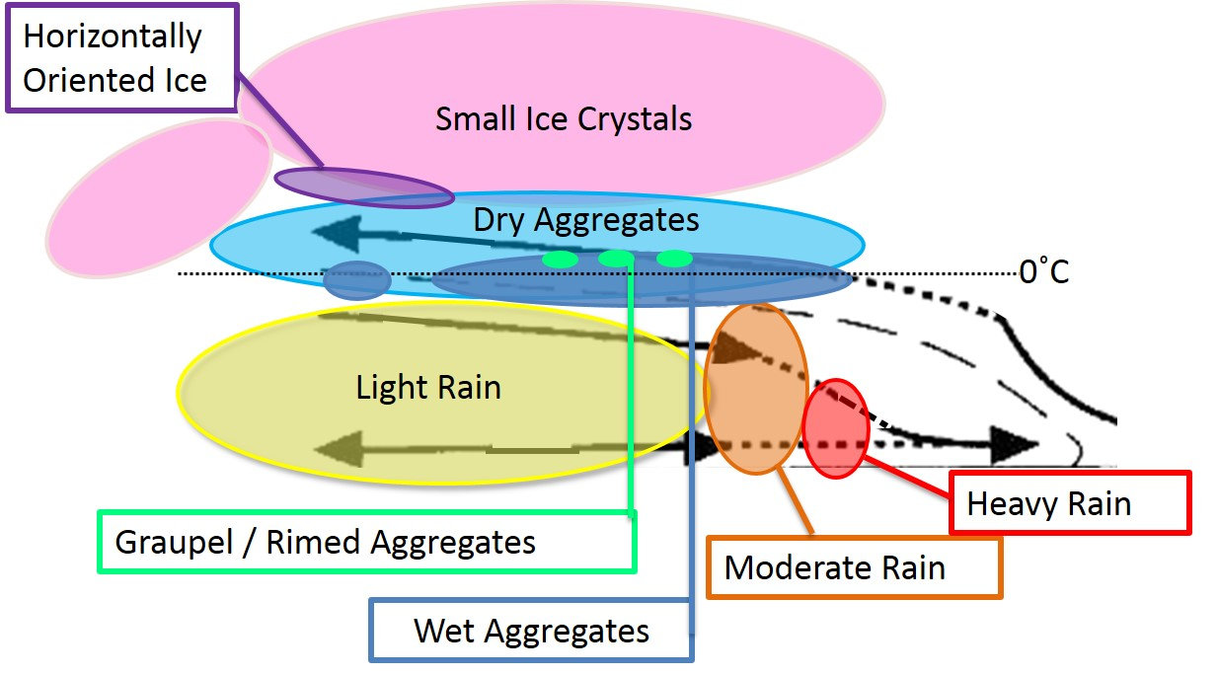
Conclusions
Convective
Stratiform
Hydrometeor organization systematic across MCS types
Heating similar with and without leading line
Interpretation of microphysical processes
Comparison of model output and radar observations
Notes:
The two previous conceptual diagrams are combined and summarized
Differences between convective updrafts and mid-level inflow
Graupel: narrow and vertical in convective updraft, but shallow and flat in mid-level inflow
More dry aggregates than non-oriented ice in convective updrafts but more non-oriented ice than dry aggregates in mid-level inflows
Two reasons why results are exciting
These hydrometeor structures are very robust. For example saw very little difference between leading line and embedded convection.
Suggests the structure of MCSs are not different because of differences in their hydrometeor structure
Emphasizes a need to further explore why MCSs take on different structures.
Can use to more directly compare model output with radar observations

Slide 33
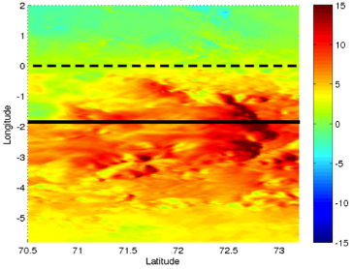
Mesoscale Modeling of Squall Line
Zonal Wind
WRF 3.4.1
Resolution: Outer – 9km, Inner – 3km
Cu Param: Outer – KF, Inner – None
MP Param: Both - Goddard
PBL Param: Both – UW
Forcing: ERAi
00 UTC 23 Dec – 00 UTC 25 Dec
Reflectivity
Notes:
dbZ > 0

Slide 34
Distribution of Hydrometeor Mixing Ratio
Zonal Wind(shading) and Reflectivity (dashed)
Cloud Mixing Ratio (blue)
Rain Mixing Ratio (blue)
Graupel Mixing Ratio (blue)
Snow Mixing Ratio (blue)
Ice Mixing Ratio (blue)
Reflectivity: 0 – 50 dBZ Mixing ratios: 10⁻⁴ – 10⁻³ kg/kg
Notes:
1e-4 – 1e-3 kg/kg

Slide 35
Mesoscale Modeling of Squall Line
Zonal Wind
PNNL WRF 3.4.1
Resolution: Outer – 9km, Inner – 3km
Cu Param: Outer – KF, Inner – None
MP Param: Both - Goddard
PBL Param: Both – UW
Forcing: ERAi
00 UTC 23 Dec – 00 UTC 25 Dec
Reflectivity
Notes:
dbZ > 0

Slide 36
Distribution of Hydrometeor Mixing Ratio
Zonal Wind(shading) and Reflectivity (dashed)
Cloud Mixing Ratio (blue)
Rain Mixing Ratio (blue)
Graupel Mixing Ratio (blue)
Snow Mixing Ratio (blue)
Ice Mixing Ratio (blue)
Reflectivity: 0 – 50 dBZ Mixing ratios: 10⁻⁴ – 10⁻³ kg/kg
Notes:
1e-4 – 1e-3 kg/kg

Slide 37

Questions ?

Slide 38
Frequency of Occurrence
 | Convective Updraft Inflow | Stratiform with Leading Line | Stratiform without Leading Line
Graupel/Rimed Aggregates | 88% | 66% | 64%
Heavy Rain | 92% | 11% | 14%
Moderate Rain | 100% | 55% | 60%
Light Rain | 72% | 100% | 100%
Wet Aggregates | 92% | 100% | 100%
Dry Aggregates | 100% | 100% | 100%
Small Ice Crystals | 92% | 100% | 89%
Horizontally-Oriented Ice Crystals | 20% | 44% | 53%

Slide 39
Areal Coverage
 | Convective Updraft Inflow | Stratiform with Leading Line | Stratiform without Leading Line
Graupel/Rimed Aggregates | 2% | 0.3% | 0.5%
Heavy Rain | 12% | 4% | 1%
Moderate Rain | 16% | 5% | 6%
Light Rain | 13% | 28% | 31%
Wet Aggregates | 3% | 1% | 4%
Dry Aggregates | 22% | 12% | 18%
Small Ice Crystals | 12% | 26% | 18%
Horizontally-Oriented Ice Crystals | - | 2% | 2%

Slide 40
Ranges for Hydrometeor Types
 | Z_{H} (dBZ) | ZDR (dB) | LDR (dB) | K_{DP} (° km⁻¹) | ρ_{HV} | T (°C)
Graupel/Rimed Aggregates | 30 - 50 | -0.1 - 0.76 | -25 - -20.17 | 0.08 - 1.65 | 0.89 – 0.96 | -50 - 0
Heavy Rain | 45 - 55 | 0.34 - 4.35 | -31 - -24.5 | 0.09 – 1.55 | 0.97 - 0.99 | 1 - 40
Moderate Rain | 35- 45 | 0.01 - 3.04 | -31 - -24.85 | -0.01 – 2.99 | 0.97 – 0.99 | 1 - 40
Light Rain | 10 - 35 | 0- 1.8 | -33- -27 | -0.02 – 0.26 | 0.97 – 0.99 | 1 - 40
Wet Aggregates | 7 - 45 | 0.5 - 3 | -25.5 - -17.2 | 0.1 - 1 | 0.75 – 0.98 | -4 – 10
Dry Aggregates | 15 - 33 | 0 - 1.1 | -26 - -17.2 | 0 – 0.168 | 0.97 - -0.98 | -50 - -1
Small Ice Crystals | 0 - 15 | 0 - 0.7 | -31 - -23.4 | 0 – 0.1 | 0.97 – 0.98 | -50 - -1
Horizontally Oriented Ice Crystals | 0 - 15 | 1 - 6 | -31 – -23.4 | 0.08 – 0.6 | 0.97 – 0.98 | -50 - -1

Slide 41
Confidence of PID
Convective Updraft
Stratiform Mid-level Inflow
1st PID
1st PID
PID interest value
Likelihood of particle type
Highest interest value chosen
PID confidence
Difference of 1st and 2nd largest interest values
Larger difference = more confidence
2nd PID
2nd PID
Interest Value Difference
Interest Value Difference

Slide 42
Distribution of Mid-Level Polarimetric Variables
Reflectivity
Linear Differential Reflectivity
GA HR MR LR WA DA SI HI
GA HR MR LR WA DA SI HI
Differential Reflectivity
Correlation Coefficient
GA HR MR LR WA DA SI HI
GA HR MR LR WA DA SI HI
Temperature
Specific Differential Phase
GA HR MR LR WA DA SI HI
GA HR MR LR WA DA SI HI

Slide 43
Ranges for Hydrometeor Types
Differential Reflectivity
Differential Reflectivity
GA HR MR LR WA DA SI HI
GA HR MR LR WA DA SI HI

